Slide 1
Chemistry
Inorganic
Mike Clark, M.D.,M.B.A.,M.S.

Slide 2
Chemistry – scientific study of matter
Matter – anything that has mass and occupies space
There is a difference between mass and weight
Mass – quantity of particles – when quantitate the number of particles per some unit volume- that is Density

Slide 3
Weight – need some pulling force on the particles – on the earth it is termed gravity
Gravity exerts a linear acceleration on each particle – thus the more particles the heavier is the object

Slide 4
Elements
Building blocks of matter
Simplest pure chemical substance that cannot be broken down by ordinary chemical means
92 naturally occurring elements
In order to make synthetic elements – must bombard a natural occurring element and change it – but the new element must exist long enough to measure its properties in order to be listed on Periodic Chart

Slide 5
Fields of Chemistry
Inorganic Organic
All molecules in organic chemistry must contain carbon – in an organified manner – which basically says you need some hydrogens- thus organic chemistry is a “Hydrocarbon” chemistry
CO2 contains carbon – but since it does not contain hydrogen – it is inorganic

Slide 6
Organic Chemistry
(Life Based Chemistry)
Biochemistry Polymer Chem. Geological
Organic Chemistry is a study of matter of life-based entities
Biochemistry studies organisms living now. The other fields of Organic Chemistry studies remnants of life – like oil, for example.

Slide 7
Biochemistry
Animal Plant
Human Other Animals
Since our focus is on human biochemistry – we can discuss 26 elements rather than all of the naturally occurring 92

Slide 8
Human Body Elements
96 % Carbon, Hydrogen, Oxygen, Nitrogen
3 % Phosphorous, Potassium, Iodine, Sulfur, Calcium, Iron, Magnesium
1 % termed “trace elements” Boron, chromium, manganese, nickel, tin, vanadium, molybdenum, arsenic, lithium, aluminium, strontium, cesium and silicon

Slide 9
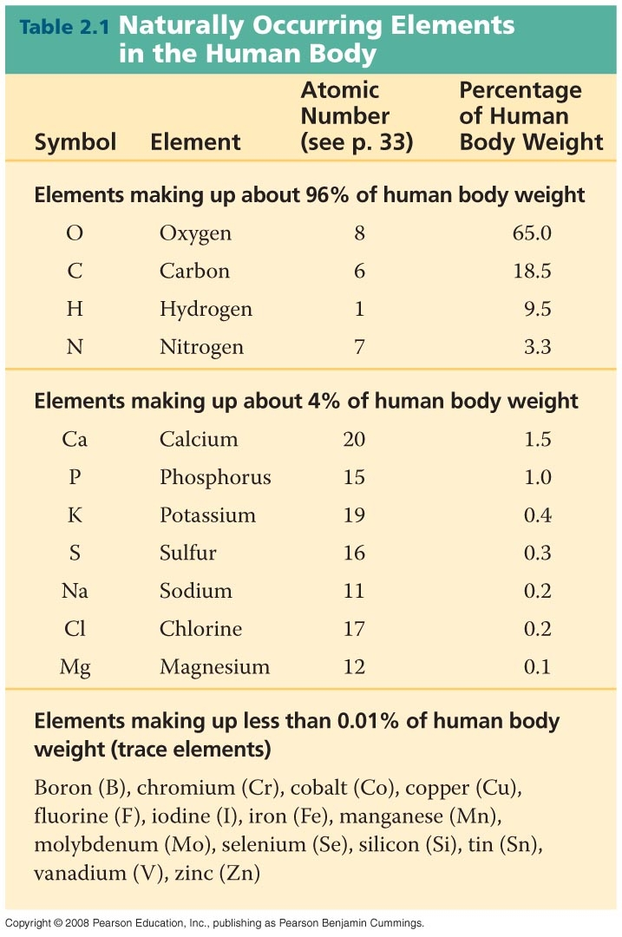

Slide 10
Atom
Smallest intact unit of matter that can enter into a chemical reaction
On the Periodic Chart each element is represented by one atom of the element
On the Periodic Chart an atom is in its best form (the charge is neutral)
The atom is made up of sub-atomic particles
neutrons, protons and electrons
Currently chemist even have described sub-sub atomic particles – leptons, bosons and others

Slide 11

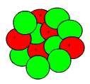
Sub-Atomic Particles
Particle Mass in Grams Charge
Neutron 1.678 x 10 ⁻²⁴ Neutral
Proton 1.672 x 10 ⁻²⁴ Positive
Electron 9.108 x 10 ⁻²⁸ Negative

Slide 12
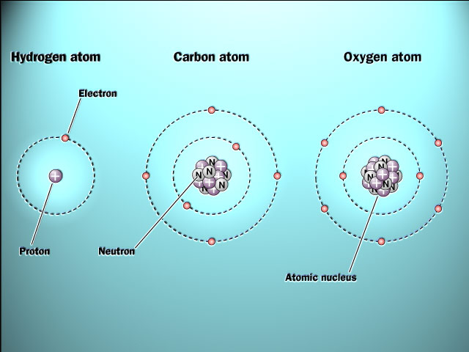

Slide 13
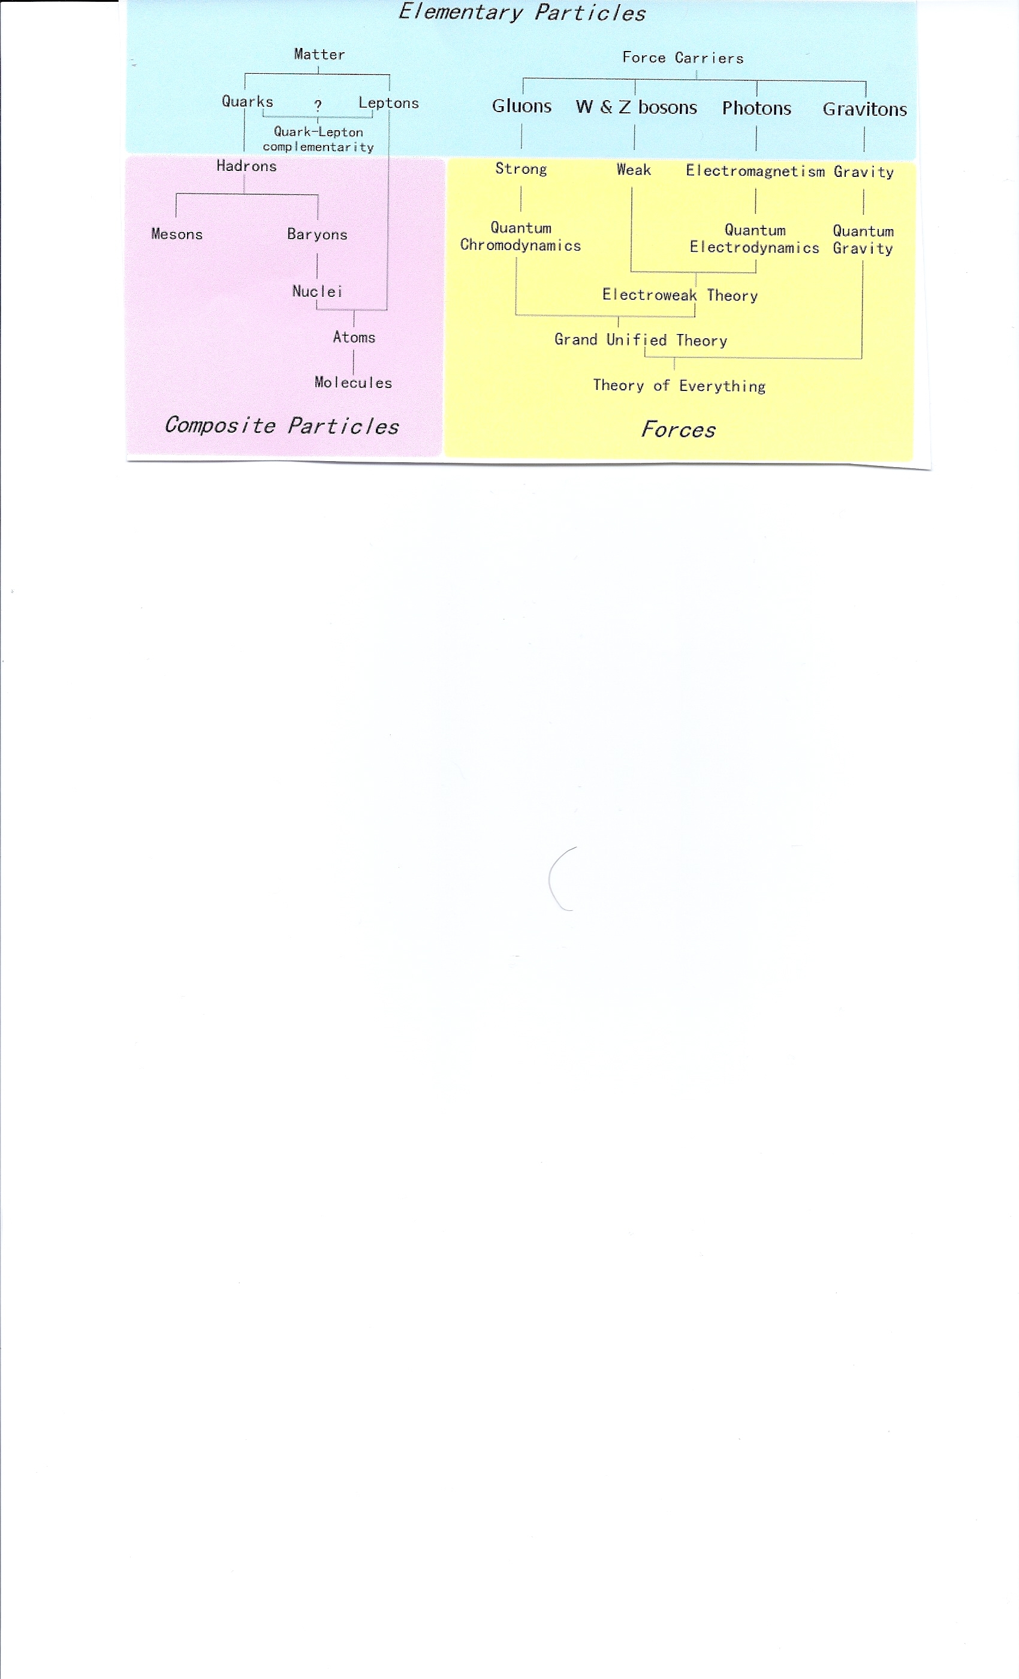

Slide 14
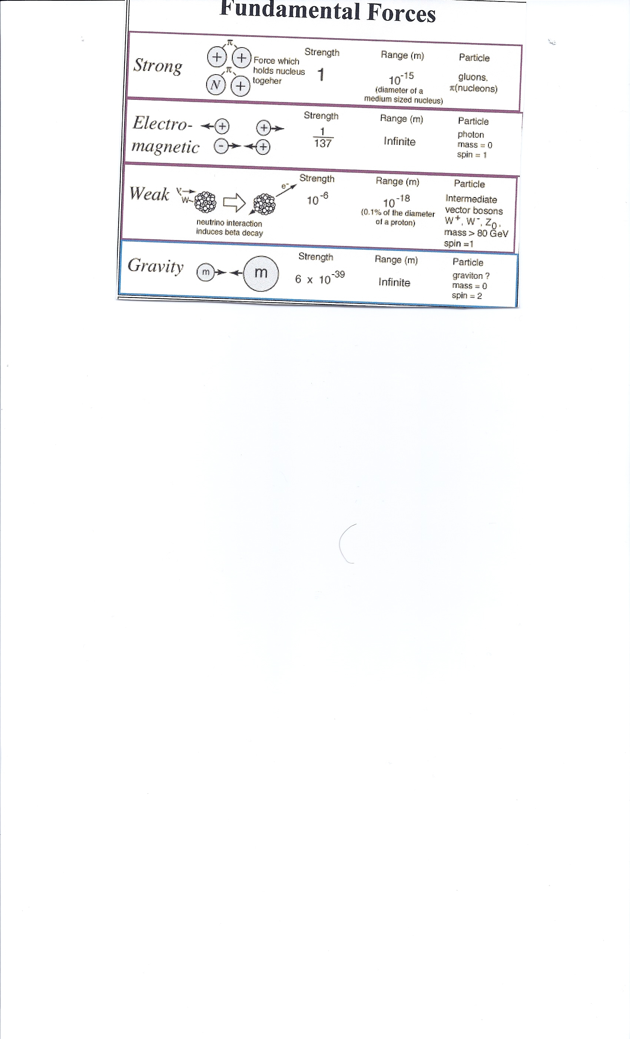

Slide 15
How Big is an Atom
The average width of the atomic nucleus is
10⁻³ picometers
The Average width of the entire atom is
10² picometers
What is a picometer?

Slide 16
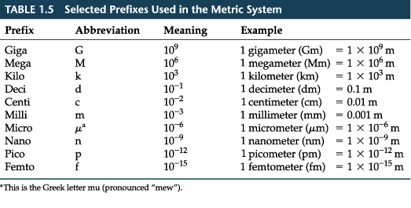
Metric System Lengths

Slide 17
Atomic Descriptors
Atomic Number – main descriptor – the number of protons
Atomic Mass ( can be given as an approximate value or Complete Atomic Mass)
Approximate – number of neutrons plus protons-since the electrons are so much smaller
Complete Atomic Mass – “Atomic Mass Units” or Daltons (this includes the electrons)

Slide 18
Atomic Mass Units
History
The chemist John Dalton was the first to suggest the mass of one atom of hydrogen as the atomic mass unit. Francis Aston, inventor of the mass spectrometer, later used ¹⁄₁₆ of the mass of one atom of oxygen-16 as his unit.
Before 1961, the physical atomic mass unit (amu) was defined as ¹⁄₁₆ of the mass of one atom of oxygen-16, while the chemical atomic mass unit (amu) was defined as ¹⁄₁₆ of the average mass of an oxygen atom (taking the natural abundance of the different oxygen isotopes into account). Both units are slightly smaller than the unified atomic mass unit, which was adopted by the International Union of Pure and Applied Physics in 1960 and by the International Union of Pure and Applied Chemistry in 1961. Hence, before 1961 physicists as well as chemists used the symbol amu for their respective (and slightly different) atomic mass units. One still sometimes finds this usage in the scientific literature today. However, the accepted standard is now the unified atomic mass unit (symbol u), with: 1 u = 1.000 317 9 amu (physical scale) = 1.000 043 amu (chemical scale). Since 1961, by definition the unified atomic mass unit is equal to one-twelfth of the mass of a carbon-12 atom.

Slide 19
Calculate the AMU in Grams
1/12th the Mass of Carbon -12
Carbon has an atomic number of 6 – thus 6 protons
It has an atomic mass rounded off to 12 – thus 6 protons and 6 neutrons
An atom on the periodic chart is neutrally charged – thus if 6 protons then 6 electrons

Slide 20
Calculate the total mass of Carbon -12 then divide by 12 to get 1/12th the mass
6 x 1.674 x 10 ⁻²⁴ (for number of neutrons) + 6 x 1.672 x 10⁻²⁴ (for number of protons) + 6 x 9.108 x 10⁻²⁸ (for number of electrons) = 20.0142 x 10⁻²⁴ (total mass of Carbon -12)
Then divide by 12 = 1.66 x 10⁻²⁴ thus 1 AMU in grams is 1.66 x 10⁻²⁴ grams

Slide 21
Deviations of Atom from Pure Form
Isotope – an alteration of the atom’s neutron number and in some cases its proton number– thus changes the atomic mass and the atom
Radioactive decay is the process in which an unstable atomic nucleus spontaneously loses energy by emitting ionizing particles and radiation. This decay, or loss of energy, results in an atom of one type, called the parent nuclide transforming to an atom of a different type, named the daughter nuclide. For example: a carbon-14 atom (the "parent") emits radiation and transforms to a nitrogen-14 atom (the "daughter"). This is a random process on the atomic level, in that it is impossible to predict when a given atom will decay, but given a large number of similar atoms the decay rate, on average, is predictable.

Slide 22
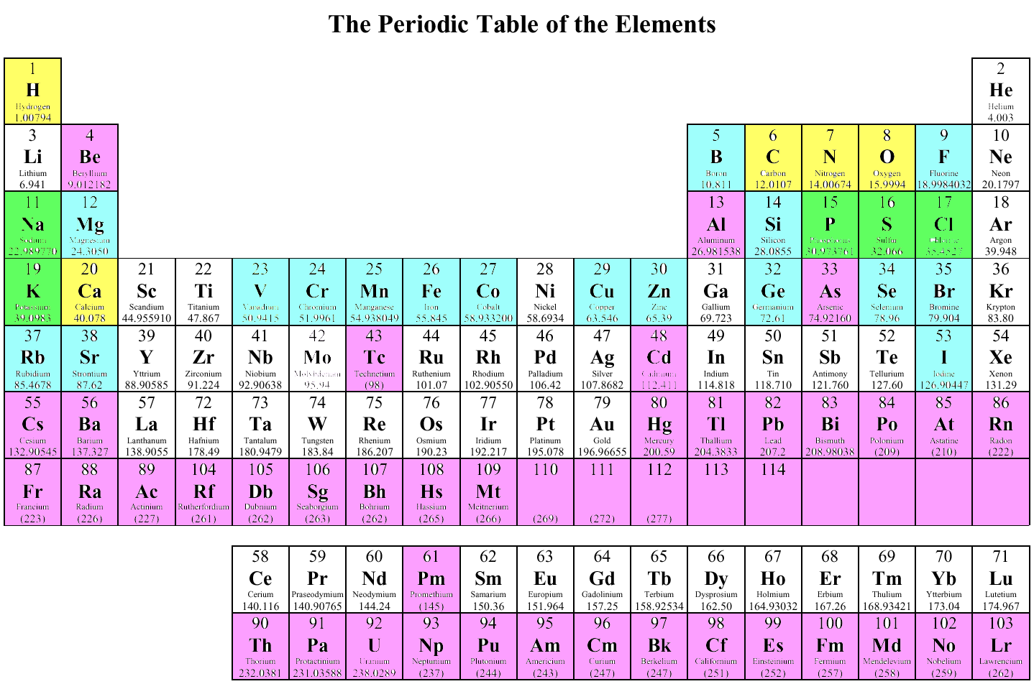

Slide 23
Isotope (Continued)
Remember that the neutrons and protons are traveling fast inside the nucleus of the atom which is a 10⁻³ picometer space
If more neutrons are added to this small space the likelihood of collisions will occur – which sets up the main basis of radiation
Isotopes of Carbon
Carbon 12, Carbon 13 and Carbon 14
Which one is more likely to be radioactive?

Slide 24
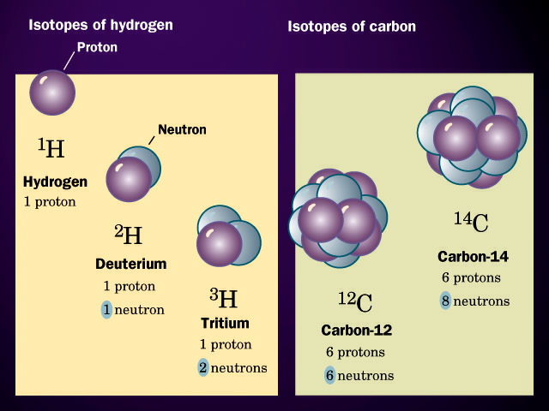

Slide 25
Alpha particles (named after and denoted by the first letter in the Greek alphabet, α) consist of two protons and two neutrons bound together into a particle identical to a helium nucleus; hence, it can be written as He²⁺ or ⁴₂He²⁺. They have a net spin of zero, and normally a total energy of about 5 MeV. They are a highly ionizing form of particle radiation, and have low penetration.
When an atom emits an alpha particle, the atom's mass number decreases by four due to the loss of the four nucleons in the alpha particle. The atomic number of the atom goes down by exactly two, as a result of the loss of two protons – the atom becomes a new element. Examples of this are when uranium becomes thorium, or radium becomes radon gas due to alpha decay.

Slide 26
Beta Particle
An unstable atomic nucleus with an excess of neutrons may undergo β⁻ decay, where a neutron is converted into a proton, an electron and an electron-type antineutrino (the antiparticle of the neutrino):
n → p + e⁻ + ν_{e}
Of the three common types of radiation given off by radioactive materials, alpha, beta and gamma, beta has the medium penetrating power and the medium ionising power. Although the beta particles given off by different radioactive materials vary in energy, most beta particles can be stopped by a few millimeters of aluminum. Being composed of charged particles, beta radiation is more strongly ionising than gamma radiation.

Slide 27
Gamma rays (denoted as γ) are electromagnetic radiation of high energy. They are produced by sub-atomic particle interactions, such as electron-positron annihilation, neutral pion decay, radioactive decay, fusion, fission or inverse Compton scattering in astrophysical processes. Gamma rays typically have frequencies above 10¹⁹ Hz and therefore energies above 100 keV and wavelength less than 10 picometers, often smaller than an atom. Gamma radioactive decay photons commonly have energies of a few hundred KeV, and are almost always less than 10 MeV in energy.

Slide 28
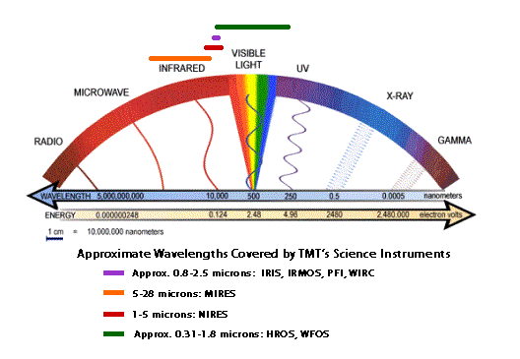

Slide 29
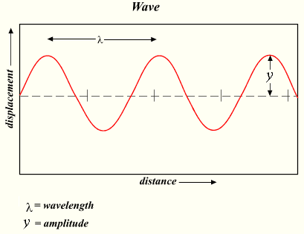
Wave Descriptions

Slide 30
ION (page 6)
Charged atom as a result of a deviation in the atoms electron number
If extra electrons are added to an atom – the atom will have a net negative charge in that there will be more electrons than protons – the term for this is an “anion” – added to this is the valency term – for example a divalent anion means it has two net negative charges
If one or more electrons are removed – the atom will have a net positive charge “cation”
Ions can be called electrolytes
The term ‘electrolyte’ is frequently used to denote a substance that, when dissolved in a specified solvent, usually water, dissociates into ions to produce an electrically conducting medium.

Slide 31
Electron Placement (page 6)
Electrons travel around the nucleus in probable space
Electrons are placed into Energy Levels
Electrons are then placed into orbitals
Electrons like to travel in pairs
The outermost energy level is termed the Valence Energy Level

Slide 32
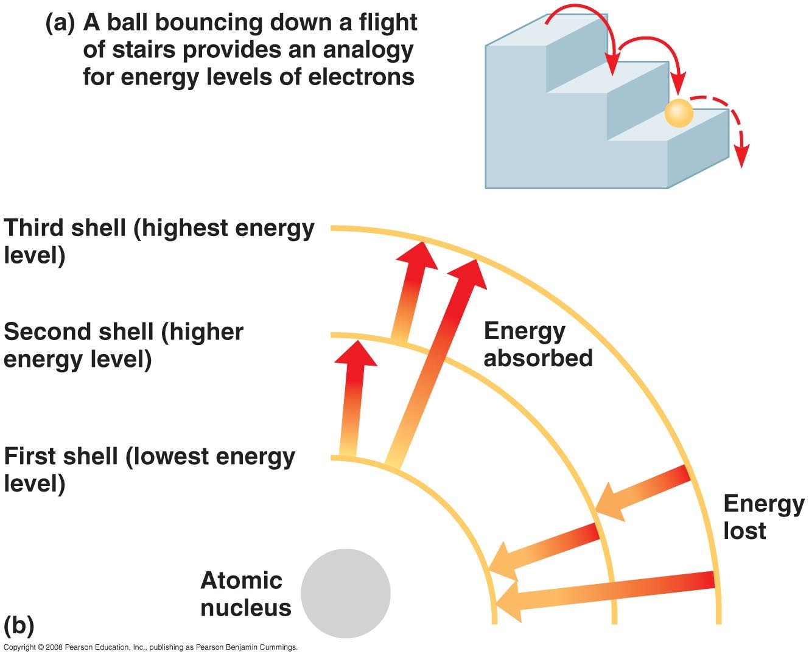

Slide 33
Energy (see page 10 of handout)
Capability to do work
Work = Force x Distance (thus in order to do work in physics something has to move)
Move now – Kinetic
Move later but can do it – Potential
Energy cannot be created or destroyed but changed in form or location
Some forms are thermal, gravitational, sound, light, elastic, and electromagnetic energy. The forms of energy are often named after a related force.

Slide 34
Any form of energy can be transformed into another form, but the total energy always remains the same. This principle, the conservation of energy, was first postulated in the early 19th century, and applies to any isolated system. According to Noether's theorem, the conservation of energy is a consequence of the fact that the laws of physics do not change over time.
Although the total energy of a system does not change with time, its value may depend on the frame of reference. For example, a seated passenger in a moving airplane has zero kinetic energy relative to the airplane, but non-zero kinetic energy relative to the Earth.
Kinetic Energy = ½ mass x Velocity ²

Slide 35
Electron Placement (Cont.)
Place electrons in lowest energy level first (conservation of energy)
Lowest energy levels are closest to the nucleus
Maximum number of electrons in each energy level
Energy Level one can hold up to 2 electrons
Energy level two can hold up to 8 electrons
Energy level three can hold up 8 – 18 electrons ( but in the main elements of the human body – only 8
For our biochemistry purposes – let’s assume the energy levels can only hold 8 electrons after energy level one.

Slide 36
Examples
Helium – has two electrons – they both are in the first energy level
Carbon has 6 electrons – two in the first energy level and 4 in the second.
Potassium (K) has 19 electrons – 2 in the first energy level – 8 in the second energy level, 8 in the third energy level, and one electron in the last energy level

Slide 37
Valence Energy Level
The outermost energy level is termed the “valence energy level”
It has important properties particularly related to atoms bonding together to form molecules
Valence Numbers
+ Valence number – how many electrons are in the outermost (valence) energy level
- Valence number – how many does it take to fill the outermost energy level

Slide 38
Periodic Chart as it relates to Electron Placement
Mendeleev and Meyer working independently found ways to arrange elements in order of increasing atomic masses and in order of similar chemical properties
A row on the chart is termed a “period”
A column is termed a “group or family”
A family has similar chemical properties (all the elements in a family have the same valence number)

Slide 39
Using the Chart to Determine Valence Number
Each row adds another energy level
Each column has a similar valence number

Slide 40
Hydrogen (one valence electron in first energy level)
Magnesium has 12 electrons (two in EL I and 8 in EL two and 2 in EL three)

Slide 41
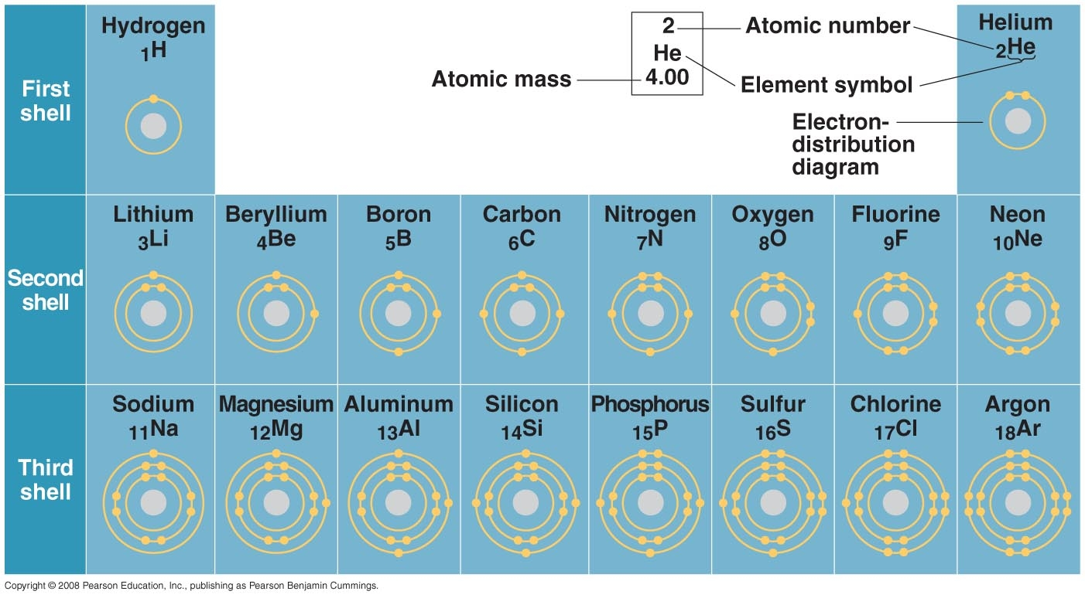

Slide 42
Why Do Atoms Combine to Make Molecules? (page 11)
Substances can combine physically or chemically
If combine physically (mixture) – each of the individual substances maintain their original chemical properties – it is more of an association than a marriage – does not require as much criteria to come together
If combine chemically (form a molecule) each of the individual atoms lose their original properties- requires more combining criteria

Slide 43
Mixture
There are three basic types of mixtures
1. Solution
2. Sol/Gel – Colloid
3. Suspension

Slide 44
Solution
Always homogenous (equally mixed or dispersed)
Requires the most criteria of the mixture group ( the mixing substance must have an affinity –like- for one another
There is a solvent and solute
The solvent is the part of the mixture in the highest quantity and solute is in the lowest quantity
The solvent dissolves the solute
The particles of the solute must not only be attracted to the solvent but they must also be small
Examples – Glucose in water or salt in water (our body has a lot of solutions)

Slide 45
Sol-Gel (Colloid)
A colloid is a type of chemical mixture in which one substance is dispersed evenly throughout another. The particles of the dispersed substance are only suspended in the mixture, unlike in a solution, in which they are completely dissolved. This occurs because the particles in a colloid are larger than in a solution - small enough to be dispersed evenly and maintain a homogeneous appearance, but large enough to scatter light and not dissolve. Because of this dispersal, some colloids have the appearance of solutions.
Thus, colloid suspensions are intermediate between homogeneous and heterogeneous mixtures. They are sometimes classified as either "homogeneous" or "heterogeneous" based upon their appearance.
Some colloids are translucent because of the Tyndall effect, which is the scattering of light by particles in the colloid. Other colloids may be opaque or have a slight color.

Slide 46
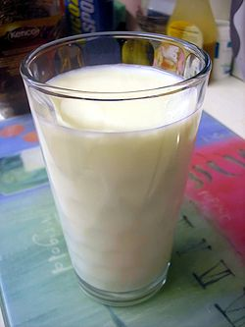
Milk is an emulsified colloid of liquid butterfat globules dispersed within a water-based fluid.

Slide 47
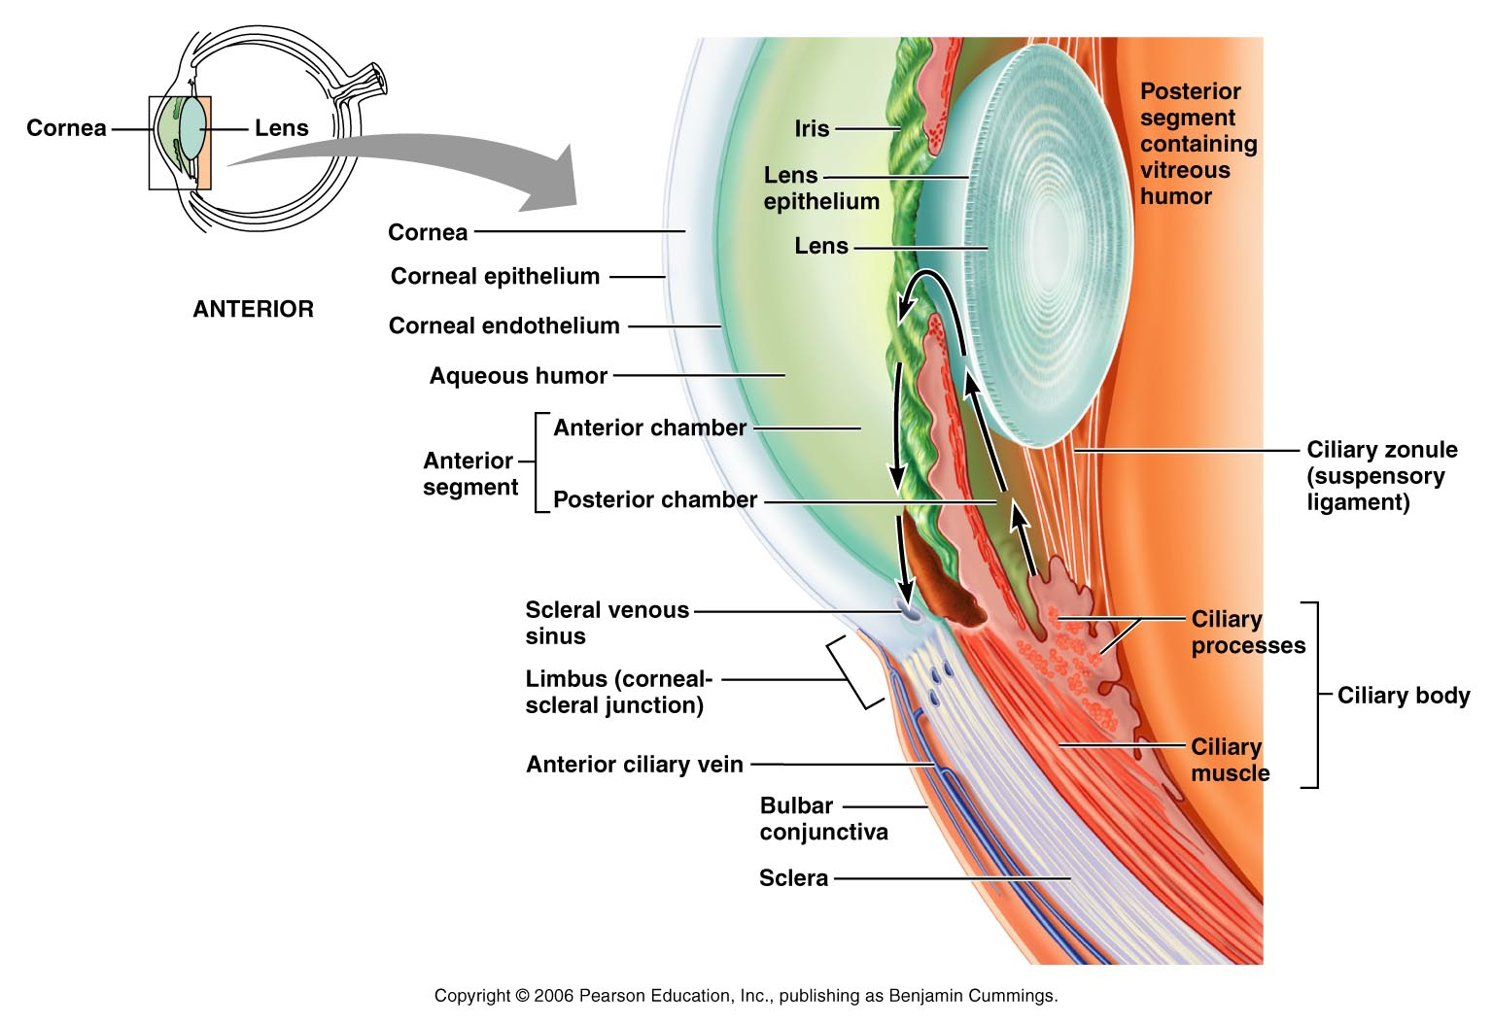
Colloid (Sol-Gel)
A colloid is a non-homogenous mixture which appears to be homogenous – but is not – like Jello.
If shine polarized light (light that travels in only one direction) through the Colloid it will deflect when it hits the non-homogenous particles that are too small for the eye to see. This is termed the Tyndall Effect.
The fluid in the back of the eye (Vitreous Humor) is a colloid

Slide 48
Suspension
The particles in a suspension do not even appear to be homogenous. The particles are simply suspended in position – because the particles are constantly being stirred (moved) by outside forces. For example stirring sand in water – if you stop stirring the sand drops to the bottom.
In our body a good example of a suspension is the whole blood. If the heart did not keep pushing (pumping) the blood – our blood cells would fall out of the fluid portion of the blood.

Slide 49
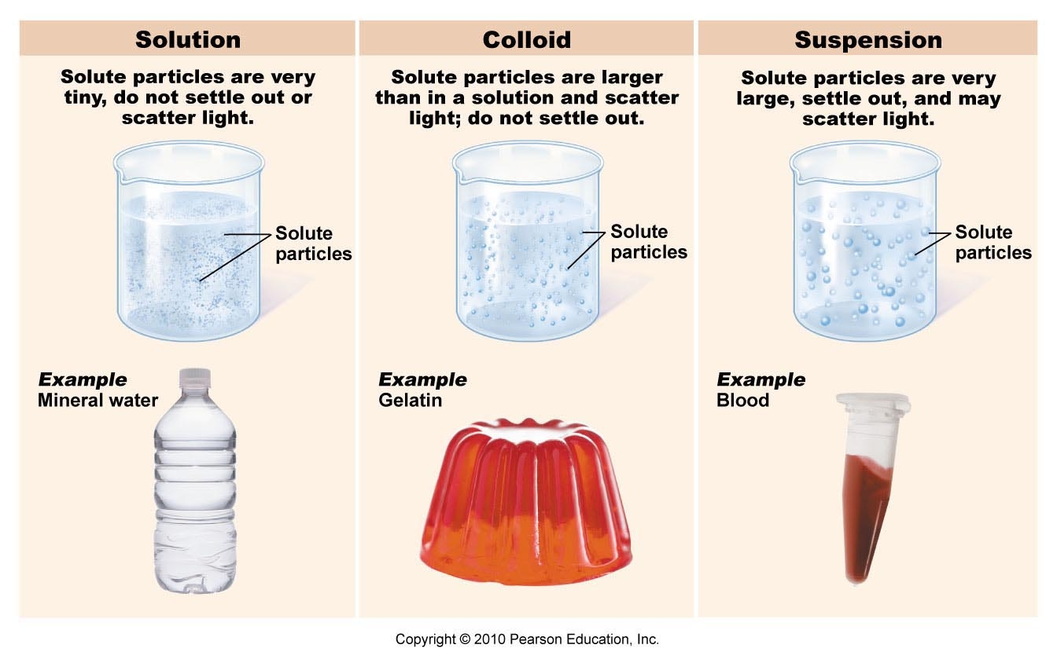

Slide 50
Adding Atoms Chemically
When atoms are put together chemically they form a molecule
In order for molecules to combine chemically – each atom must satisfy the stringent criteria to form a “chemical bond”
If the molecule has all of the atoms the same – like carbon bonded to carbon – we call it a simple molecule
If the molecule has different type elements bonded together – we call it a compound molecule – like water (H₂O)

Slide 51
What are the main criteria atoms have in order to form a chemical bond?
1. Fill the outermost energy level (valence energy level)
Remain stable or increase 3 dimensional stability
In order to do this atoms expend two main energies
1. Electronegativity 2. Ionization Energy

Slide 52
Electron Affinity versus Electronegativity
Electron affinity relates to individual atoms pulling on electrons
Electronegativity relates to atoms already combined in a covalent bond pulling on the electrons of the bonded atoms

Slide 53
Electronegativity, symbol χ, is a chemical property that describes the ability of an atom (or, more rarely, a functional group) to attract electrons (or electron density) towards itself in a covalent bond. An atom's electronegativity is affected by both its atomic weight and the distance that its valence electrons reside from the charged nucleus. The higher the associated electronegativity number, the more an element or compound attracts electrons towards it. First proposed by Linus Pauling in 1932 as a development of valence bond theory it has been shown to correlate with a number of other chemical properties. Electronegativity cannot be directly measured and must be calculated from other atomic or molecular properties. Several methods of calculation have been proposed and, although there may be small differences in the numerical values of the electronegativity, all methods show the same periodic trends between elements.

Slide 54
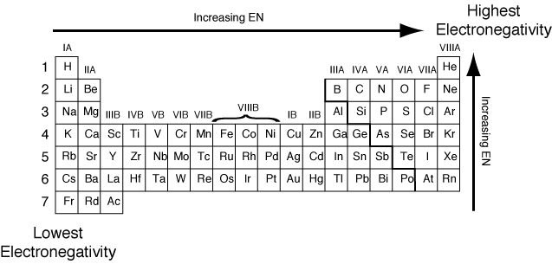
Electronegativity Chart (page 13)

Slide 55
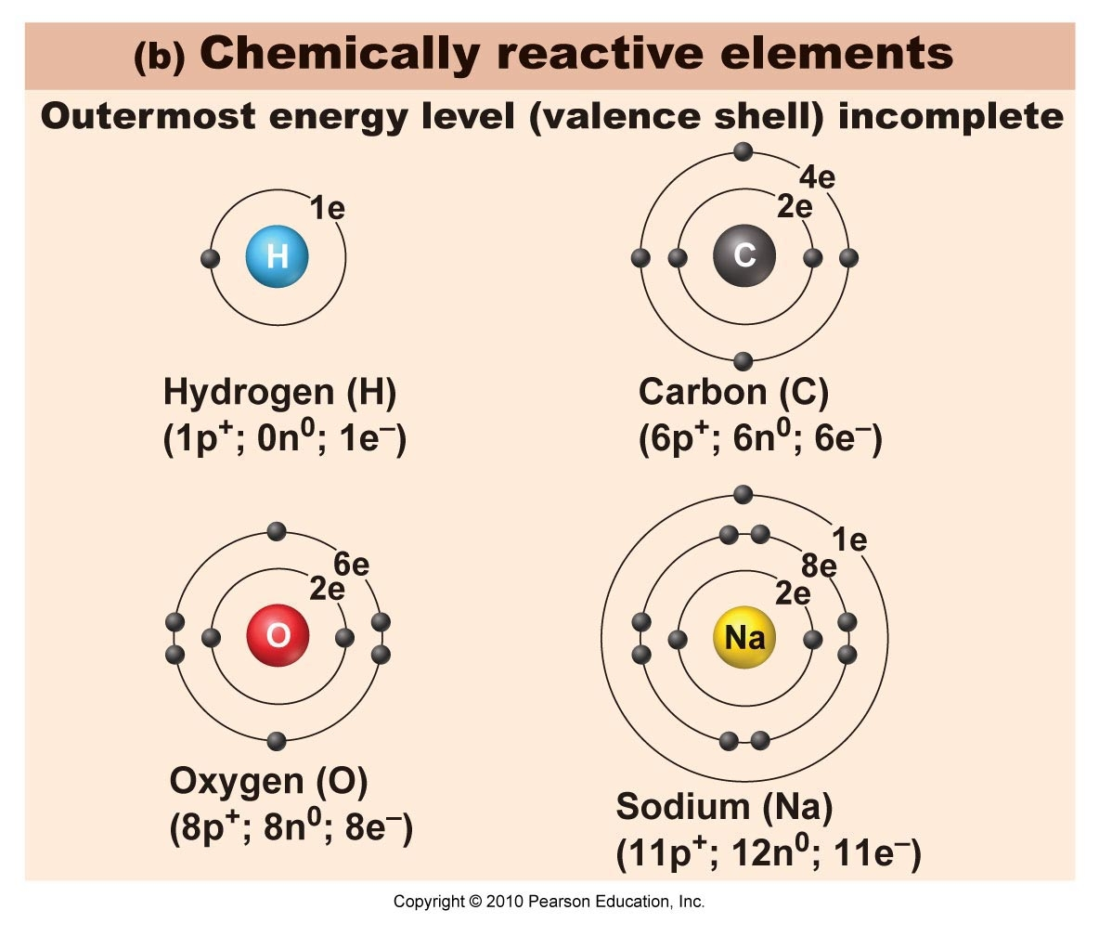
Valence Shell (Energy Level) Incomplete

Slide 56
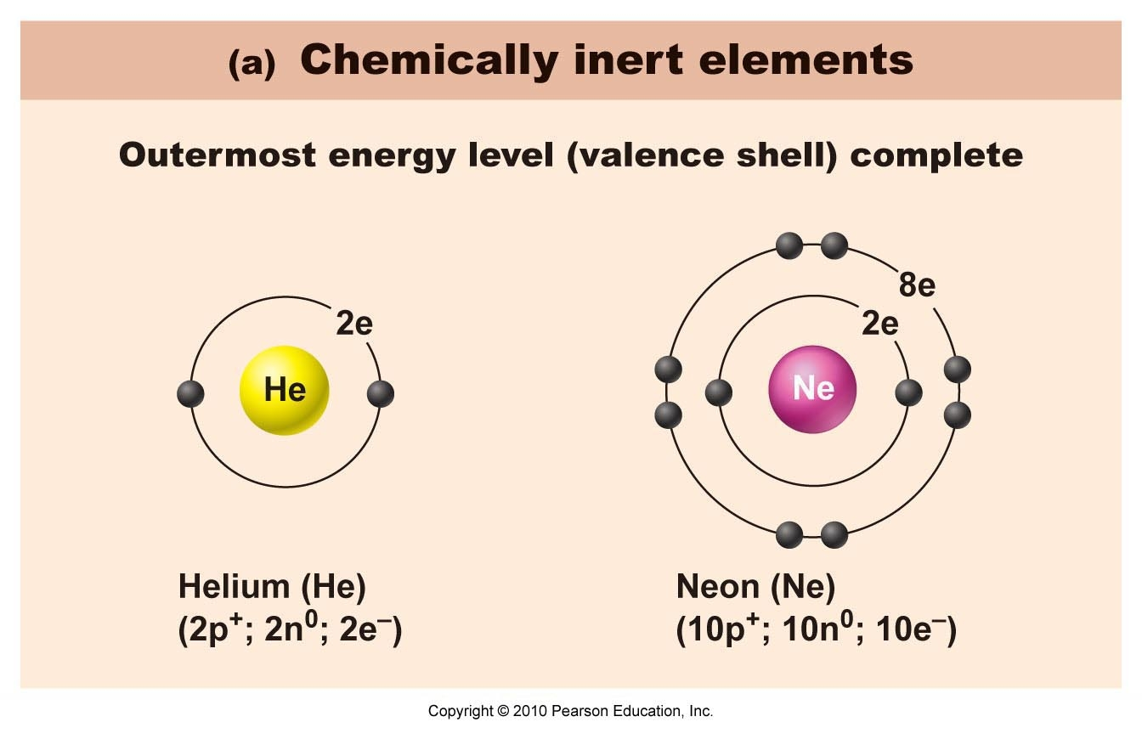
Inert Elements in Last Column

Slide 57
Ionization Energy
The term ionization energy (E_{I}) (of an atom or molecule) is most commonly used to refer to the work required to remove (to infinity) the topmost electron in the atom or molecule when the gas atom or molecule is isolated in free space and is in its ground electronic state. This quantity was formerly called ionization potential, and was at one stage measured in volts. The name "ionization energy" is now strongly preferred.

Slide 58
Chemical Bonds in Molecules
Ionic (very charged molecule) – one or more atoms in the molecule grab the electrons from other atoms
Covalent (sharing of electrons in the valence energy level)
Non-Polar Covalent (not charged)
Polar Covalent (moderately charged)
Hydrogen Bond
Van-der Walls Forces

Slide 59
Ionic Bond (page 14 & 15)
When one highly atom with high electron affinity atom happens to collide (collision theory) with another atom (or atoms) of considerably lower electron affinity and the atom (or atoms) of lower electron affinity have enough electrons to fill the higher electron affinity atom’s outer energy level an
“Ionic Bond” is formed.
The atom of considerably higher electron affinity literally steals the electron(s) from the other atoms – thus one side of the molecule has a complete positive charge and the other a complete negative charge (highly charged molecule).

Slide 60
Example of Ionic Bond
Table Salt
Chlorine (Cl) is highly more electronegative than Sodium (Na)
Chlorine steals an electron from Sodium – thus Chlorine becomes a negatively charged ion (anion) – it’s name changes to Chloride (Cl⁻) and Sodium having loss an electron becomes positively charged (Na⁺)
Resultant Na⁺ Cl⁻

Slide 61
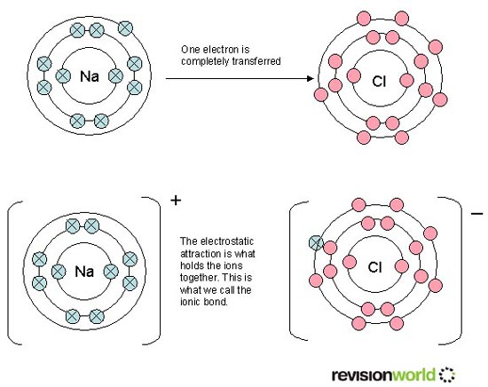

Slide 62
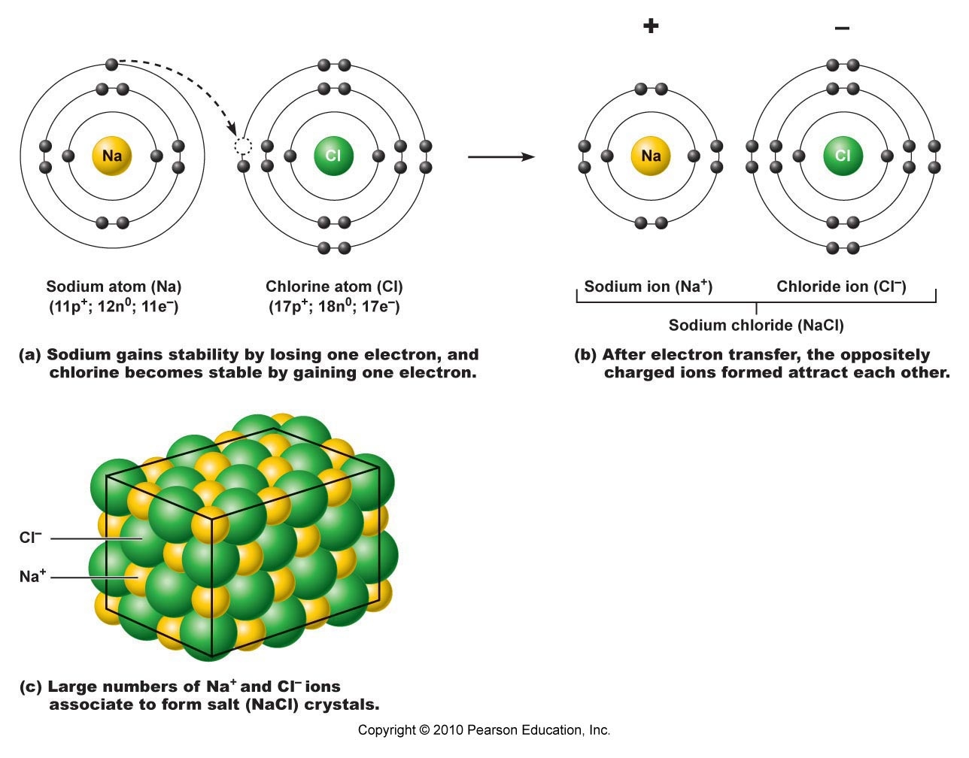

Slide 63
Main Criteria for Ionic Bond
1. One or more atoms must have much higher electron affinity than the other atoms (must completely steal the electron)
2. Must remain or improve stability in 3 dimensional space

Slide 64
Covalent Bond (page 15 & 16)
A bond in which there is sharing of electrons in the molecule in that – no atom or atoms in the molecule possess a much higher electron affinity than the others – thus the electrons must be shared.
The molecule formed after the sharing must remain or improve stability in 3 dimensional space

Slide 65
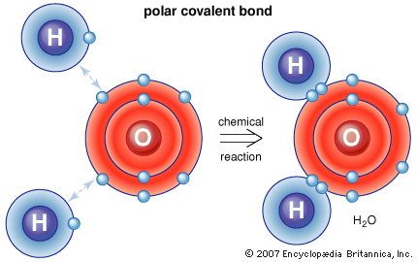
Covalent Bond
In a covalent bond – the atoms share pairs of electrons (electrons always try to travel in pairs in their orbitals) each atom in the bond contributes one electron – thus the pair consists of one electron from one atom and the other electron from the other atom. Can have a single, double or triple covalent bond depending on how many electrons are needed to fill the outermost energy level.

Slide 66
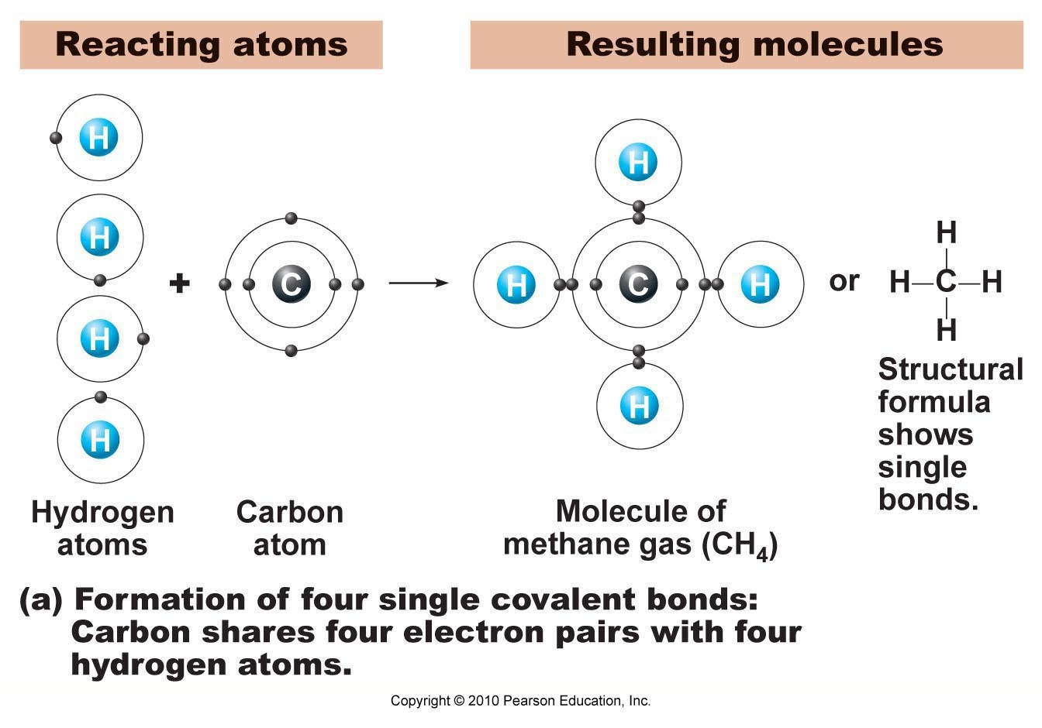
Single Covalent Bond

Slide 67
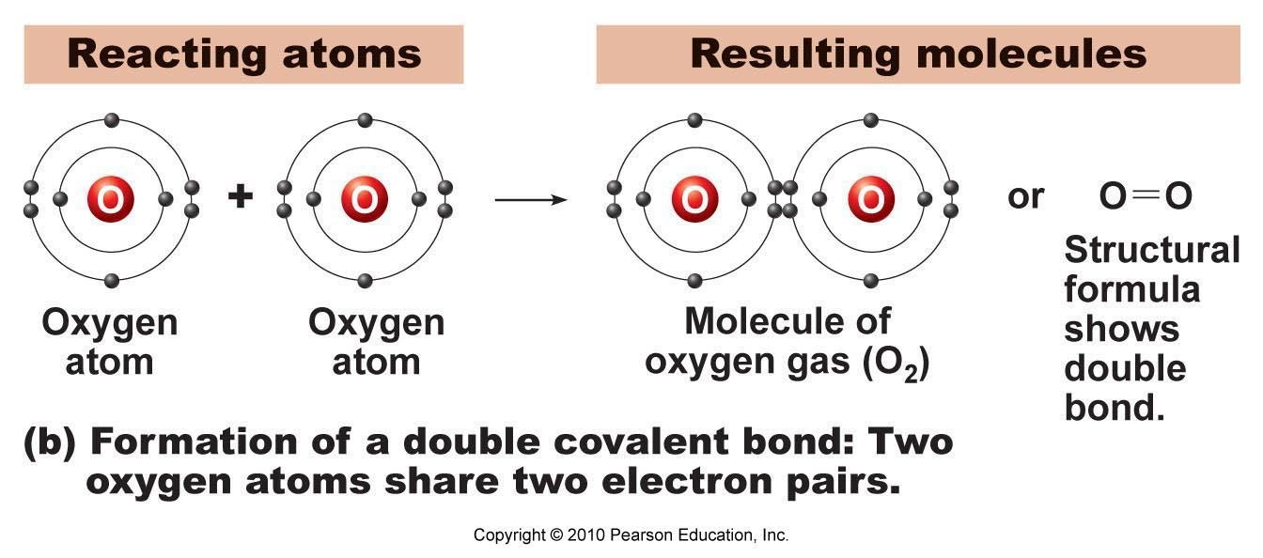
Double Covalent Bond

Slide 68
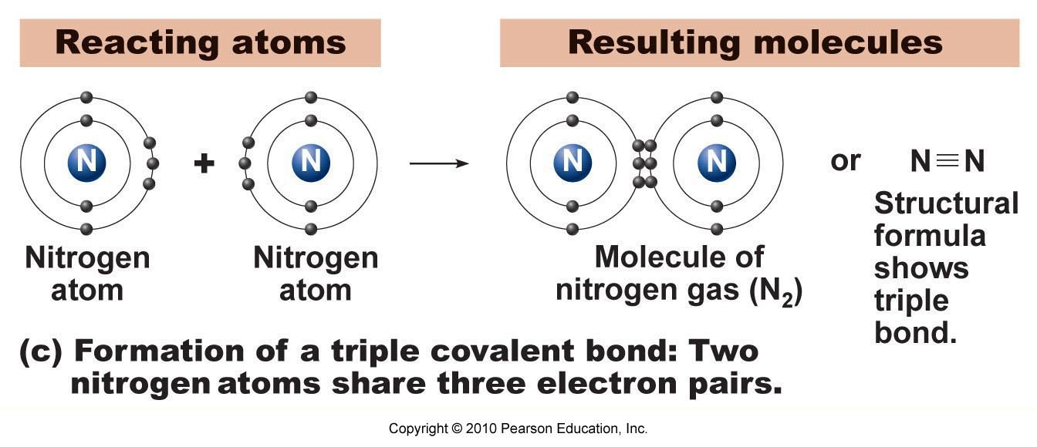
Triple Covalent Bond

Slide 69
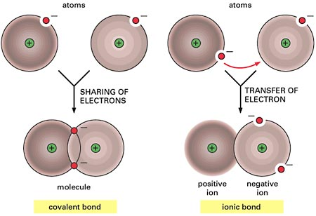
Comparison of Ionic Bond to Covalent Bond

Slide 70
Types of Covalent Bonds
Non-Polar Covalent Bond - all the atoms share pairs of electrons – but the atoms all have the same electron affinity values (example hydrogen covalently bonding to hydrogen) – the molecule is not charged- like most of the fats
Polar Covalent Bond – none of the atoms have a considerable higher electron affinity than the others – but there are slight differences- thus one or more atoms hold the electrons longer in time and closer to their nuclei. The molecule has a slight charge like water.

Slide 71
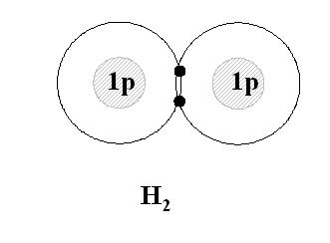
Non-Polar Covalent Bond

Slide 72
Polar Covalent Bond
For example in water H2O -- Oxygen has more electron affinity than hydrogen – but not enough to completely remove the electron from hydrogen – thus it must share – but the sharing is unequal with Oxygen holding the electrons more often in the sharing relationship (one shares a house for a year but one person keeps it 11 months and the other 1 month)
How is the sharing time measured ?
Dipole Moment
Dipole moment refers to the quality of a system to behave like a dipole. Dipole moment is the measured polarity of a polar covalent bond.

Slide 73
Polar Covalent Molecule
A Polar Covalent Molecule is charged. The amount of charge depends on the dipole moment – which depends on the individual atoms electronegativity. Water is charged.
A molecule with a large dipole moment is very charged – but not as charged as an ionically bonded molecule – which does not at all share electrons – thus one side always has a positive charge and other side always has a negative charge – whereas the polar covalent molecule sometimes has this charge separation (positive and negative poles)

Slide 74
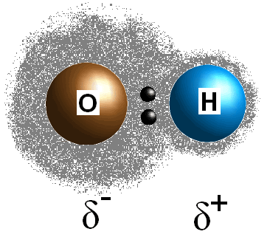
Polar Covalent Molecule
The greek symbols delta represent a partial separation in charge.
Oxygen is more highly electronegative – thus it holds the electrons more often -thus creating a more negative molecular environment (a Dipole).

Slide 75
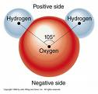
Water Molecule

Slide 76
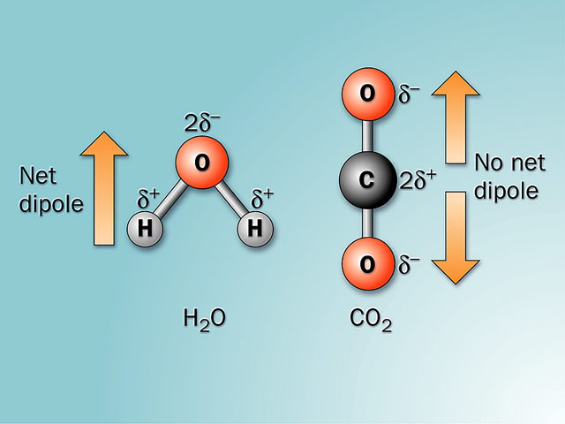

Slide 77
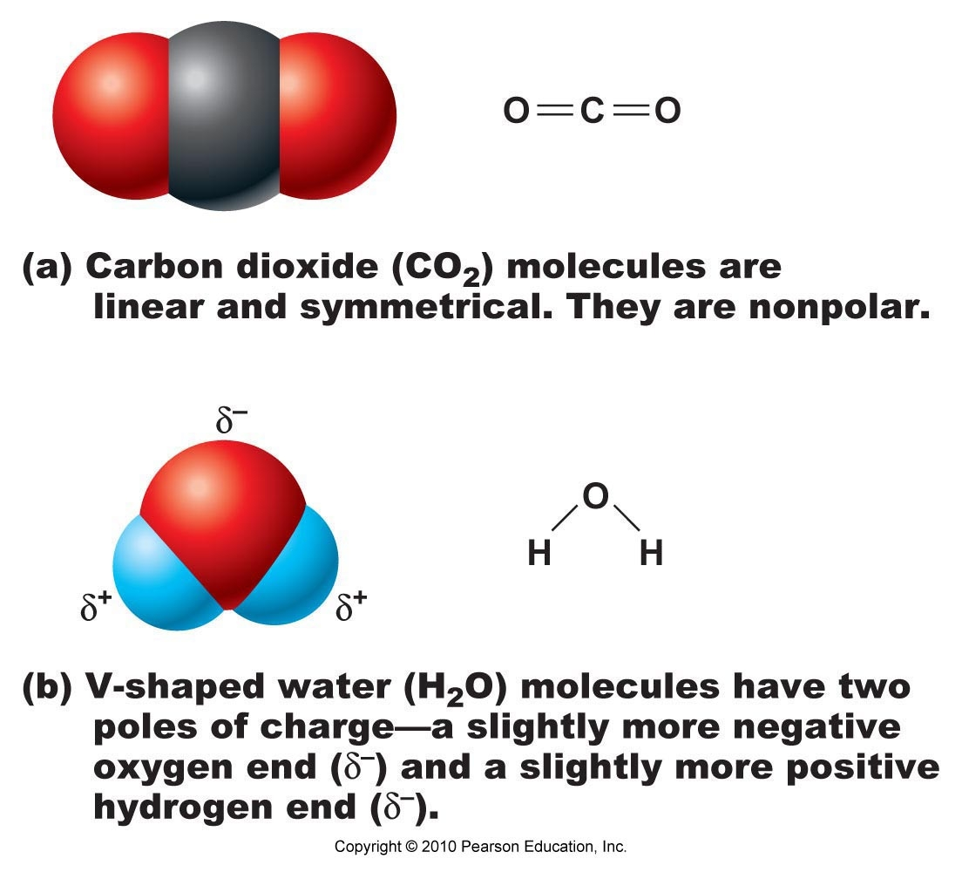

Slide 78
Review of Covalent and Ionic Bonds
Ionic Bond
1. One or more atoms must have much higher electron affinity than the other atoms (must completely steal the electron)
2. Must remain or improve stability in 3 dimensional space
Covalent Bond
A bond in which there is sharing of electrons in the molecule in that – no atom or atoms in the molecule possess a much higher electron affinity than the others – thus the electrons must be shared.

Slide 79
Review of Polar versus Non-Polar Covalent Bonds
Non-Polar Covalent Bond - all the atoms share pairs of electrons – but the atoms all have the same electron affinity values (example hydrogen covalently bonding to hydrogen) – the molecule is not charged – like the fats
Polar Covalent Bond – none of the atoms have a considerable higher electron affinity than the others – but there are slight differences- thus one or more atoms hold the electrons longer in time and closer to their nuclei. The molecule has a slight charge like water.

Slide 80
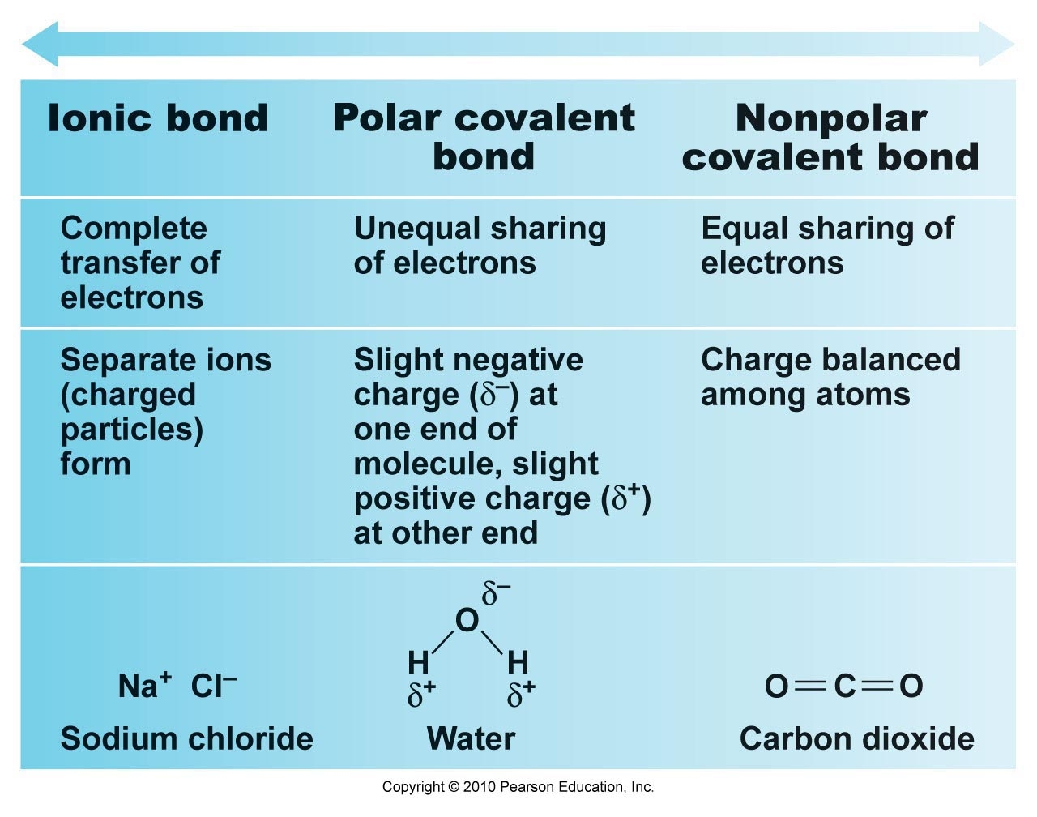

Slide 81
Hydrogen Bond
A hydrogen covalently bonded to one highly electronegative atom but having an affinity for another highly electronegative atom
The hydrogen is married to one highly electronegative atom but tries to grab onto another highly electronegative atom in its close vicinity.

Slide 82
Hydrogen Bond
1/20th the strength of a covalent bond
The intramolecular (within the water molecule) bond in water is polar covalent
The intermolecular (between water molecules) bond is a hydrogen bond
The hydrogen bond is what makes water stick to water

Slide 83
Properties of hydrogen bonds.
How are they formed? a hydrogen bond is formed when a charged part of a molecule having polar covalent bonds forms an electrostatic (charge, as in positive attracted to negative) interaction with a substance of opposite charge. Molecules that have nonpolar covalent bonds do not form hydrogen bonds.
Strength. Hydrogen bonds are classified as weak bonds because they are easily and rapidly formed and broken under normal biological conditions.
What classes of compounds can form hydrogen bonds? Under the right environmental conditions, any compound that has polar covalent bonds can form hydrogen bonds.

Slide 84
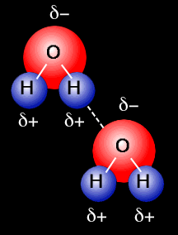
Hydrogen Bond

Slide 85
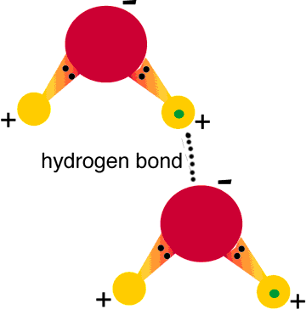
Hydrogen Bond

Slide 86
Van der Waals
It is also sometimes used loosely as a synonym for the totality of intermolecular forces. Van der Waals forces are relatively weak compared to normal chemical bonds, but play a fundamental role in fields as diverse as supramolecular chemistry, structural biology, polymer science, nanotechnology, surface science, and condensed matter physics. Van der Waals forces define the chemical character of many organic compounds. They also define the solubility of organic substances in polar and non-polar media. In low molecular weight alcohols, the properties of the polar hydroxyl group dominate the weak intermolecular forces of van der Waals. In higher molecular weight alcohols, the properties of the nonpolar hydrocarbon chain(s) dominate and define the solubility. Van der Waals forces grow with the length of the nonpolar part of the substance.

Slide 87
Hydrophobic versus Hydrophilic Interactions
(page 18)
Hydrophobic (water fearing) substances will group together when placed in water in such a manner it will look like they are bonding together – but the substances are simply trying to avoid the water
Hydrophilic substances – dissolve in water – forming solutions with water – like salt in water

Slide 88
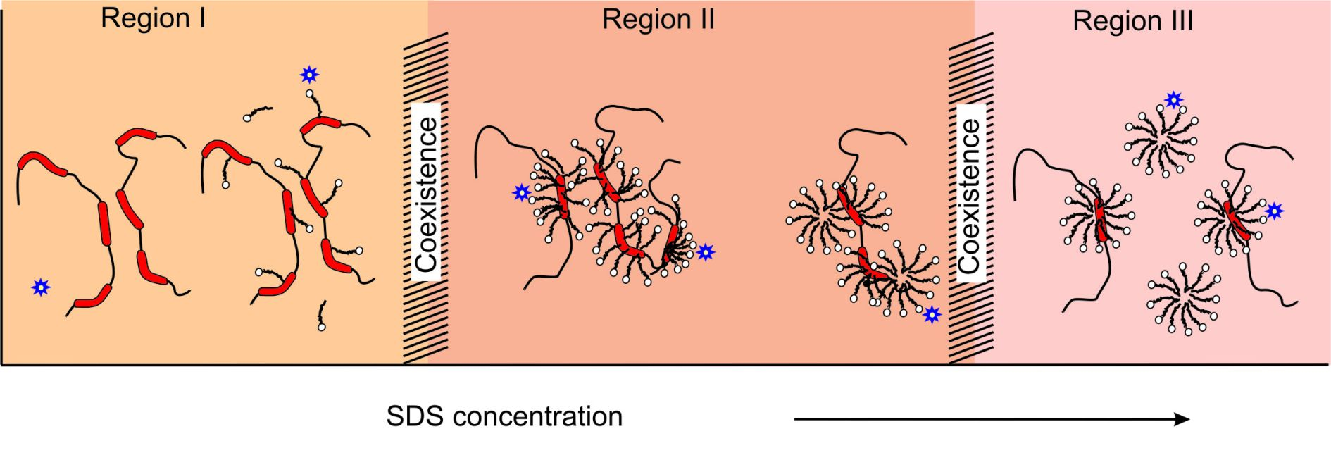
Hydrophobic Interactions
The particles may not like one another but they hate water more so they bond together

Slide 89
Collision Theory
How Atoms Come Together (page 18)
Atoms come together by chance. Atoms bounce entropically (randomly) – termed Brownian motion.
If the atoms that bounce into one another have the right bonding criteria – they will form a chemical bond – if they don’t they will bounce away.
In order to increase the likelihood of bouncing into the right atoms can (1) increase temperature (2) increase concentration or (3) add a catalyst.

Slide 90
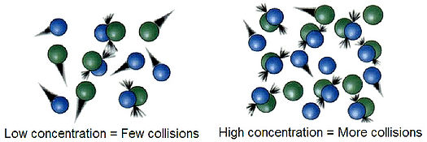

Slide 91
The Collision theory, proposed by Max Trautzand William Lewis in 1916 and 1918, qualitatively explains how chemical reactions occur and why reaction rates differ for different reactions. This theory is based on the idea that reactant particles must collide for a reaction to occur, but only a certain fraction of the total collisions have the energy to connect effectively and cause the reactants to transform into products. This is because only a portion of the molecules have enough energy and the right orientation (or "angle") at the moment of impact to break any existing bonds and form new ones. The minimal amount of energy needed for this to occur is known as activation energy. As temperature increases, the average kinetic energy and speed of the molecules increases but this only slightly increases the number of collisions. The rate of the reaction increases with temperature increase because a higher fraction of the collisions overcome the activation energy.

Slide 92
Collision Theory Tenets
1. Atoms must find one another
2. Atoms must collide in the proper orientation
3. Atoms must have the proper velocity (energy) on impact
4. Atoms must come together in the right chemical environment (right pH, right temperature, right pressure)

Slide 93
Types of Generic Chemical Reactions (page 19)
1. Building Reactions (synthesis, anabolic)
2. Breaking Down Reactions (decomposition, catabolic)
3. Exchange Reactions
4. Reversible Reactions

Slide 94
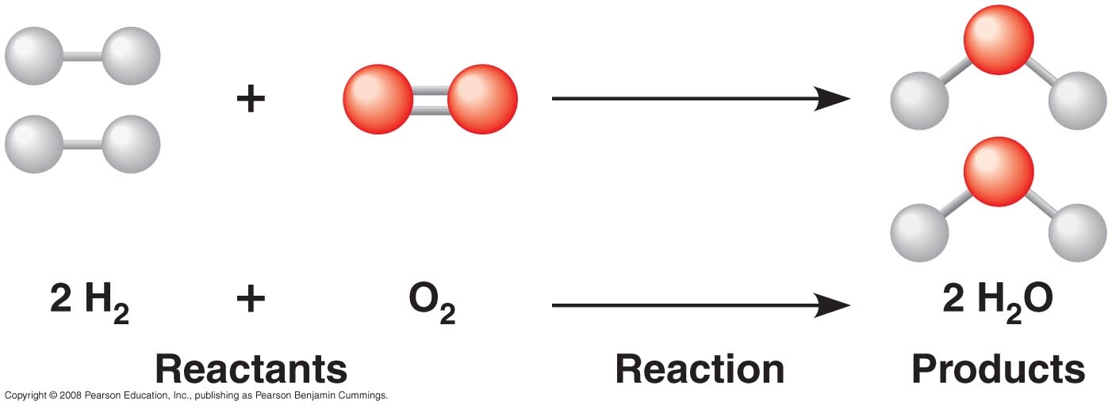
A + B AB

Slide 95
Building Reaction
Termed a synthesis reaction – in biochemistry can be termed an anabolic reaction
A + B AB
Na + Cl NaCl

Slide 96
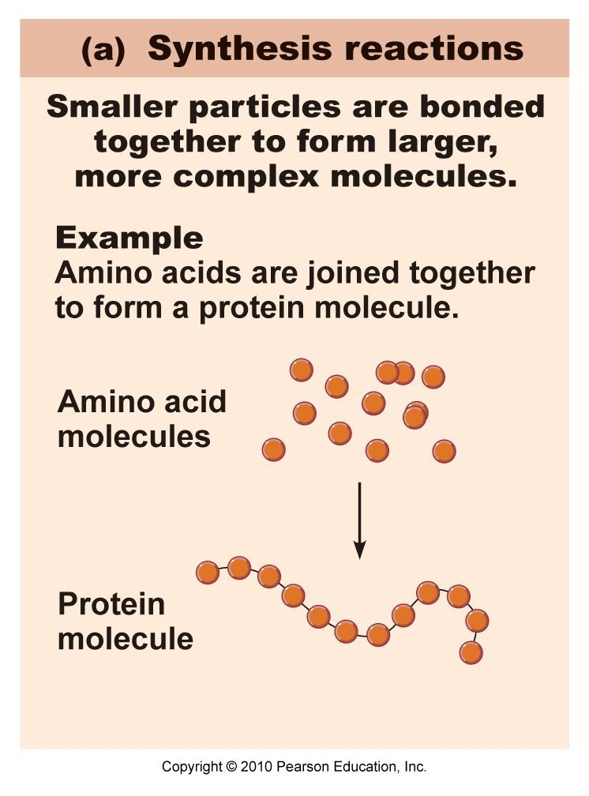
Building Reaction (Anabolic)

Slide 97
Breaking Down Reaction
Termed a decomposition reaction – in biochemistry can be termed a catabolic reaction
AB A + B
NaCl Na + Cl

Slide 98
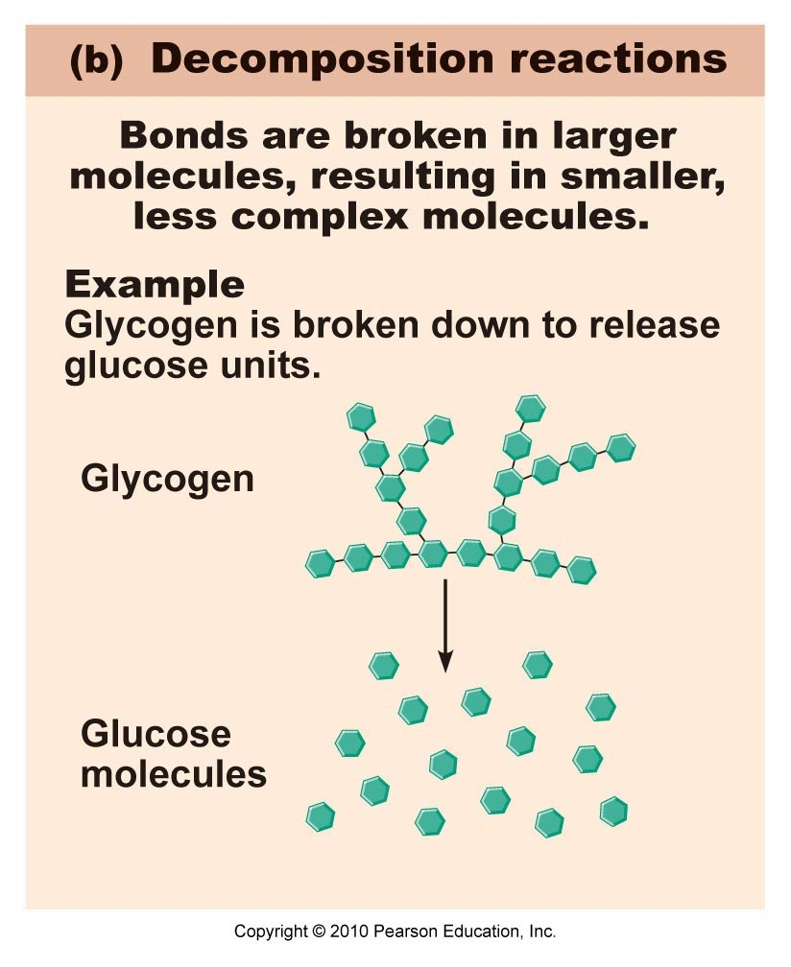
Decomposition (Catabolic) Reaction

Slide 99
Exchange Reaction
Can be termed a displacement reaction
AB + CD AC + BD
NaOH + HCl NaCl + H2O

Slide 100
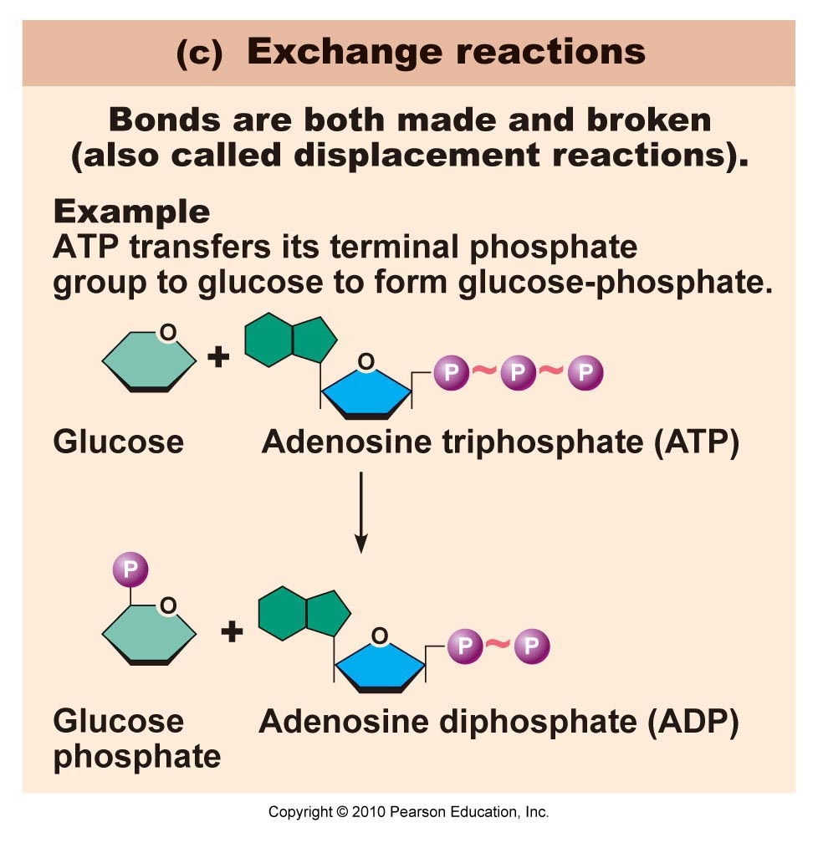
Exchange Reaction

Slide 101
Reversible Reaction
[A] + [B] [AB]
Note: Brackets around a chemical means the concentration of a chemical
A reversible chemical reaction proceeds in one direction first – then when a certain concentration is reached it starts back in the reverse direction. At that time though the reaction is still proceeding in the forward direction – thus proceeding in both directions at the same time

Slide 102
Reversible Reaction state of Equilibrium
Reaction starts when a certain concentration of substance A is mixed with a certain concentration of substance B. The reaction begins – making AB. When a certain concentration of AB is reached at a said temperature and pressure – the reaction proceed in the reverse direction. When the rate of reaction in the forward direction is equal to the rate in the reverse direction in the reverse direction – the state of equilibrium is reached.
The state of equilibrium does not mean that the concentration of both sides are equal.

Slide 103
Reversible Reaction
[A] + [B] [AB]
Keq (Equilibrium Constant) = [AB] / [A] x [B]
When a reversible reaction reaches the state of equilibrium- the concentrations will not change- thus can calculate an equilibrium constant. The only way the equilibrium concentration changes is if the outside temperature changes or the outside pressure changes or there are extra reactants added or subtracted.

Slide 104
Counting the number of Atoms and Molecules
One must be able to count the number of atoms and molecules in order to accurately determine concentrations
The problem is that atoms and molecules are too small to count directly
Avogadro got involved in this problem and came up with his Avogadro's number

Slide 105
Mole
In order to understand the Avogadro concept – one must first understand what a mole is
However – Avogadro’s work predated the Mole concept – The Avogadro constant is named after the early nineteenth century Italian scientist Amedeo Avogadro, who, in 1811 first proposed the concept. The name "mole" was coined in German (as Mol) by Wilhelm Ostwald in 1893. The name is assumed to be derived from the word Molekül (molecule).
The current definition of the mole was approved during the 1960s – formerly combining the two concepts

Slide 106
What technically is a mole?
The mole is defined as the amount of substance of a system that contains as many "elemental entities" (e.g., atoms, molecules, ions, electrons) as there are atoms in 12 g of carbon-12 (¹²C) Do you remember the basis of the AMU (Dalton). Hence:
one mole of iron contains the same number of atoms as one mole of gold;
one mole of benzene contains the same number of molecules as one mole of water;
the number of atoms in one mole of iron is equal to the number of molecules in one mole of water.

Slide 107
Mole
A mole is the gram-molecular mass or gram-atomic mass of a substance
A mole of anything contains Avogadro’s number of particles 6.02 x 10²³

Slide 108
Getting One mole of table salt
1. Know the molecular formula (NaCl)
2. Calculate the molecular mass (wt.)
Na = 23 AMU
Cl = 35 AMU
3. Obtain Total Mass which is 58 AMU
58 AMU is the total mass of one molecule of table salt
To get one mole of table salt – weigh out 58 grams of table salt
How many molecules of table salt are in 58 grams of table salt? - 6.02 x 10²³
Is 58 grams the same as 58 AMUs? – absolutely not
Then how did you convert 58 AMUs into 58 grams – explanation later

Slide 109
Getting One mole of Water
1. Know the molecular formula (H2O)
2. Calculate the molecular mass (wt.)
H = 1 AMU – but there are two of them so 2 AMUs
O = 16 AMUs
3. Obtain Total Mass which is 18 AMU
18 AMU is the total mass of one molecule of water
To get one mole of water– weigh out 18 grams of water
How many molecules of water are in 18 grams of water? - 6.02 x 10²³
Is 18 grams the same as 18 AMUs? – absolutely not
Then how did you convert 18 AMUs into 18 grams – explanation later

Slide 110
Always think in terms of Moles to count atoms and molecules
One mole of anything contains
Avogadro’s number of particles 6.02 x 10²³

Slide 111
How did I get AMUs to turn into Grams (page 21)
Mass in grams of one AMU = 1.66 x 10⁻²⁴ grams/AMU
Previously discussed – see page 4
Avogadro’s number is 6.02 x 10²³ Particles/mole
1.66 x 10⁻²⁴ x 6.02 x 10²³ = 9.9932 x 10⁻¹
Rounding off 9.9932 to 10 then gives 10 x 10⁻¹ = 1
So 1 AMU in grams multiplied times Avogadro’s number = 1
X AMU/molecule(or atom) x grams/AMU x particles per mole = grams/mole
Since multiplying X AMU/molecule x 1 = same number in grams per mole
So 58 AMU/molecule of table salt x 1 = 58 grams of table salt per mole

Slide 112
Using a Mole to make concentrations of solutions (pages 21 -23)
Molarity – mole(s) of solute per liter of total solution
Molality – mole(s) per kilogram (liter) of solvent

Slide 113
Making a 1 molar solution of table salt in water (page 21-22)
Remember - Molarity is mole(s) per liter of total solution
1. Know what is the solute and the solvent
Table salt is the solute and water is the solvent
2. Know the molecular formula of the solute (NaCl)
3. Determine the molecular mass (wt.) of the solute Na (23 AMU) + Cl (35 AMU) = 58 AMU – change to grams – one then has one mole of salt
4. Weigh out 58 grams of NaCl and put in a beaker – then add enough water to make one liter – one now has one liter of a 1 molar solution of table salt in water

Slide 114
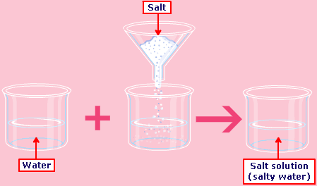

Slide 115
The Count
How many molecules of table salt is in a 1 molar solution of table salt in water?

Slide 116
How many molecules of table salt is in a 1 molar solution of table salt in water?
Answer: Avogadro’s number of particles 6.02 x 10²³
Question: How many molecules of water are in a 1 molar solution of table salt in water?

Slide 117
Question: How many molecules of water are in a 1 molar solution of table salt in water?
Answer: Don’t Know – took time to measure out the salt – but simply poured enough water to reach a liter- thus in molarity you carefully (actively) measure the solute but you passively pour in the solvent till 1 liter is reached
This sets the stage for Molality

Slide 118
Making a 1 molal solution of table salt in water (page 22)
Remember - Molality is mole(s) per kilogram (liter) of solvent
1. Know what is the solute and the solvent
Table salt is the solute and water is the solvent
2. Know the molecular formula of the solute (NaCl)
3. Determine the molecular mass (wt.) of the solute Na (23 AMU) + Cl (35 AMU) = 58 AMU – change to grams – one then has one mole of salt
4. Weigh out 58 grams of NaCl and put in a beaker – then add 1 kilogram (liter) of water– one now has over one liter of a 1 molal solution of table salt in water

Slide 119
The Count
How many molecules of table salt is in a 1 molal solution of table salt in water?

Slide 120
How many molecules of table salt is in a 1 molal solution of table salt in water?
Answer: Avogadro’s number of particles 6.02 x 10²³
Question: How many molecules of water are in a 1 molal solution of table salt in water?

Slide 121
Question: How many molecules of water are in a 1 molal solution of table salt in water?
Answer: One knows you have 1 kilogram of water in the solution. One Kg is 1,000 grams.
18 grams of water is 1 mole of water
1 mole of water contains Avogadro’s number of particles 6.02 x 10²³
1,000 grams / 18 grams/mole = 55.55 moles
55.55 moles x 6.02 x 10²³ molecules/mole = 334.44 x 10 ²³ molecules of water
The main fact is that when one uses the molal solution – one quantitates both the solute and solvent. Since it is equally important to know the solute and water amount in human body solutions – molality is mainly used.

Slide 122
Questions
1. How would one make a ½ molar solution of table salt in water?
2. How many molecules of table salt would be in a ½ molar solution of table salt in water?
3. How would one make a ½ molal solution of table salt in water?
4. How many molecules of table salt is in a ½ molal solution of table salt in water?
5. How much water is in a ½ molal solution of table salt in water?

Slide 123
Questions
1. How would one make a ½ molar solution of table salt in water?
Determine the molecular mass (wt.) of the solute Na (23 AMU) + Cl (35 AMU) = 58 AMU – change to grams – one then has one mole of salt – thus 29 grams is ½ mole
Weigh out 29 grams of NaCl and put in a beaker – then add enough water to make one liter of total solution one now has one liter of a 1/2 molar solution of table salt in water
Question: If one were to put 29 grams of table salt into a beaker and then add enough water to make ½ liter of solution – what would have? A half liter of a one molar solution

Slide 124
Questions
2. How many molecules of table salt would be in a ½ molar solution of table salt in water?
½ Avogadro’s number = ½ of 6.02 x 10²³
3.01 x 10²³

Slide 125
How would one make a ½ molal solution of table salt in water?
Determine the molecular mass (wt.) of the solute Na (23 AMU) + Cl (35 AMU) = 58 AMU – change to grams – one then has one mole of salt – thus 29 grams is ½ mole
Weigh out 29 grams of NaCl and put in a beaker – then add 1 kilogram (liter) of water– one now has over one liter of a 1/2 molal solution of table salt in water

Slide 126
How many molecules of table salt are in a ½ molal solution of table salt in water?
½ Avogadro’s number = ½ of 6.02 x 10²³
3.01 x 10²³

Slide 127
How much water is in a ½ molal solution of table salt in water?
Answer: One knows you have 1 kilogram of water in the solution. One Kg is 1,000 grams.
18 grams of water is 1 mole of water
1 mole of water contains Avogadro’s number of particles 6.02 x 10²³
1,000 grams / 18 grams/mole = 55.55 moles
55.55 moles x 6.02 x 10²³ molecules/mole = 334.44 x 10 ²³ molecules of water

Slide 128
Your Job
Determine how to make varying concentrations of molar and molal solutions – for example a 2 molar and 2 molal solution of table salt in water.
Be able to know how many molecules of salt are in the solutions and how much water.

Slide 129
If You Have a Molar Solution or Molal solution – how many atoms of solute do you have?
Let’s say you have a 1 molar solution of table salt in water-
Hopefully you now know that you have 6.02 x 10²³ molecules of table salt in the solution
The key now is to determine how many atoms are present – in order to do that you must know how many atoms are in each molecule
Table salt NaCl has two atoms per molecule – 1 sodium molecule and 1 Chloride molecule
Thus if you have 6.02 x 10²³ molecules of table salt in the solution and each molecule has two atoms then you have 2 x 6.02 x 10²³ atoms or 12.04 x 10²³

Slide 130
How Many Atoms of Solute would you have in a 1 molar solution of Calcium Chloride in water?
Molecular formula is CaCl2
Ca – ( 40 AMU) + 2 x Cl (2 x 35 AMU) = 110 AMU
Thus 110 AMU is the mass of one molecule of Calcium Chloride – Change to grams to get a mole
Put 110 grams of Calcium Chloride in a beaker – then add enough water to make 1 liter- you now have a 1 molar solution of Calcium Chloride in water
You should know now that the solution has 6.02 x 10²³ molecules of Calcium Chloride ( a mole of anything has that number of particles)
Since each molecule of Calcium Chloride has 3 Atoms
1 Calcium plus 2 Chlorides – the amount of atoms of solute in the solution is 3 x 6.02 x 10²³ = 18.06 x 10²³ atoms

Slide 131
What is Heat?
Heat is a form of energy
Heat is randomized motion of particles termed entropy
The universe likes entropy
Thus heat is the most abundant form of energy in the universe
Heat is the total kinetic motion of particles in an entity
For example if one adds up all the kinetic motion of all particles in a glass of water – you have determined that waters heat content
What is temperature? It is the average of the motion of particles in an entity

Slide 132
Discussion of Heat and Temperature (page 23-24)
There is a fundamental difference between temperature and heat. The SI units for heat are Joules. Heat is the total amount of energy in a system (body). The amount that molecules are vibrating, rotating or moving is a direct function of the heat content. Energy is transported by conduction as molecules vibrate, rotate and/or collide into each other. Heat is moved along similar to dominos knocking down their neighbors in a chain reaction. When higher energy molecules are mixed with lower energy molecules the molecular motion will come into equilibrium over time. The faster moving molecules will slow down and the slow moving molecules will speed up.
Temperature is the MEASURE of the AVERAGE molecular motions in a system and simply has units of (degrees F, degrees C, or K). Notice that one primary difference between heat and temperature is that heat has units of Joules and temperature has units of (degrees F, degrees C, or K). Another primary difference is that energy can be transported without the temperature of a substance changing (e.g. latent heat, ice water remains at the freezing point even as energy is brought into the ice water to melt more ice). But, as a general statement (ignoring latent heat), as heat energy increases, the temperature will increase. If molecules increase in vibration, rotation or forward motion and pass that energy to neighboring molecules, the measured temperature of the system will increase.

Slide 133
Temperature Formulas
Fahrenheit To Centigrade:
5/9 * (Fahrenheit - 32); note: .55555 = 5/9
Centigrade To Fahrenheit:
(1.8 * Centigrade) + 32; note: 1.8 = 9/5
Centigrade To Kelvin:
Centigrade + 273;
Kelvin To Centigrade:
Kelvin - 273;
Fahrenheit To Kelvin:
(5/9 * (Fahrenheit - 32) + 273 ); note: .55555 = 5/9
Kelvin To Fahrenheit:
((Kelvin - 273) * 1.8 ) + 32; note: 1.8 = 9/5

Slide 134
Relative Measurements of Heat
Heat Capacity – the amount of heat required to be gained or loss to change the temperature of a substance 1 degree Celsius (Centigrade)
Specific Heat – the amount of heat that must be gained or loss to change the temperature of one gram of a substance 1 degree Centigrade
calorie – the amount of heat necessary to raise the temperature of 1 gram of water 1 degree centigrade
Calorie (capital C means kilocalorie) – the amount of heat necessary to raise the temperature of 1 kilogram of water 1 degree Centigrade

Slide 135
Bomb Calorimetry ( Equating Calories to a Food)
To measure calories, a known amount (1 gram) of a substance is combusted in a bomb calorimeter and a determination of temperature change is made. The bomb is pressurized with oxygen to ensure complete combustion, and sealed to prevent escape of the combustion products. The compound is ignited by passing a current through a fuse wire within the bomb. Heat loss to the surroundings can be prevented by use of a jacket around the calorimeter, maintained at the same temperature as the calorimeter itself; the reaction is then adiabatic.

Slide 136
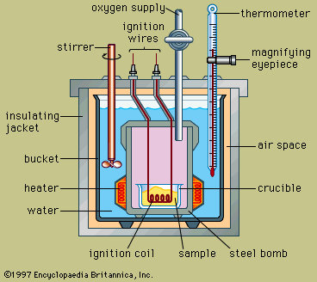
Bomb Calorimeter

Slide 137
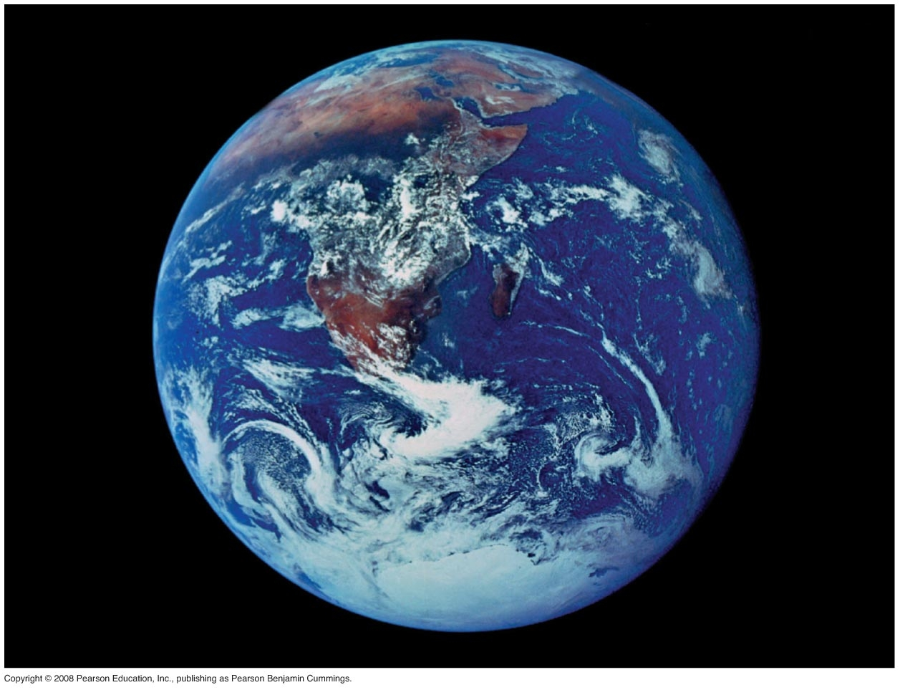
Properties of Water (page 24 – 27)
Our bodies are approximately 55% - 60% water (60% water in adult males and 55% in adult female). 70.8% of the earth is water. Blood contains 95% water, body fat contains 14% water and bone has 43% water. Skin also contains much water.

Slide 138
These good properties are mainly attributed to 1. Water’s intramolecular bond being Polar Covalent!!

Slide 139
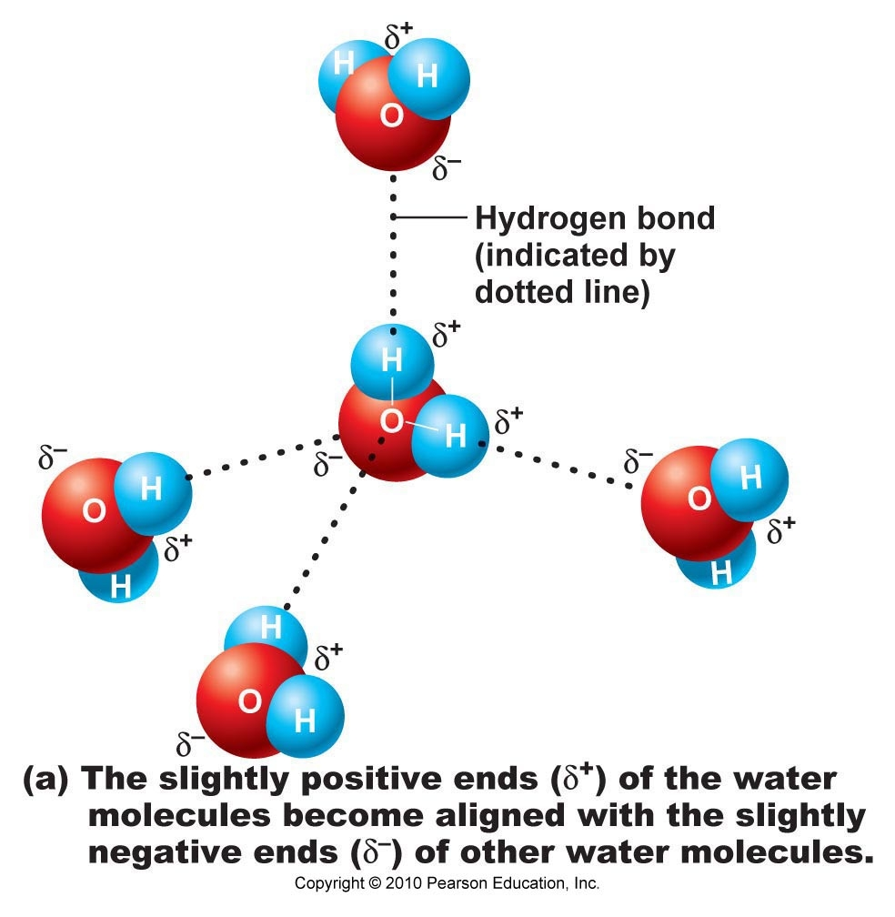
Water’s intermolecular Bond being hydrogen bonds

Slide 140
Properties of Water (page 24 – 27)
Water is a good solvent.
2. Water participates in biochemical reactions.
3. Water absorbs and releases heat very slowly.
4. Water requires a large amount of heat to change from a liquid to a gas.
5. Water has a cohesive nature.
6. Water exerts a surface tension.
7. Water serves as a good lubricant.

Slide 141
Water is a Good Solvent
Water is not a universal solvent – would not want that in that there would be no container to hold it
Water dissolves atoms or molecules that show an exposed charge – WHY?
Because water is charged (Polar Covalent) – thus like a magnet it attracts other substances that are charged

Slide 142
What Does Water Like to Dissolve Best
In decreasing order of like
1. Individual ions (charged atoms as a result of a change in the electron amount)
2. Molecules that are bonded ionically – (they show a 100% separation in charge – like Na⁺Cl⁻
3. Molecules that are polar covalent (like water). The more polar covalent (measure dipole moment) – the more water likes to dissolve them
What does water not want to dissolve? Molecules that show no charge exposure (non-polar covalent) – like the oils and fats

Slide 143
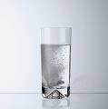
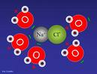



Slide 144
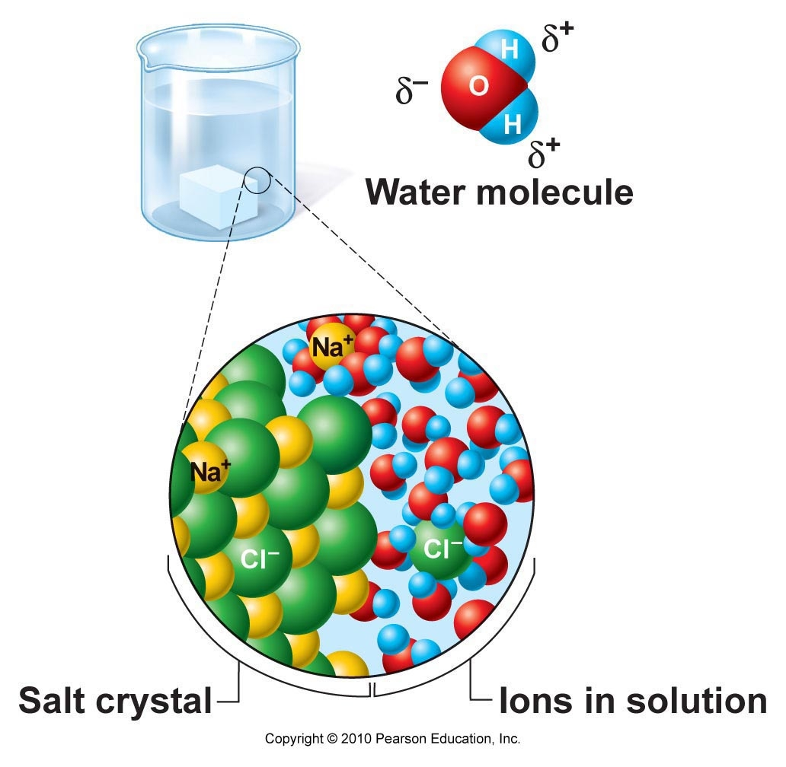

Slide 145
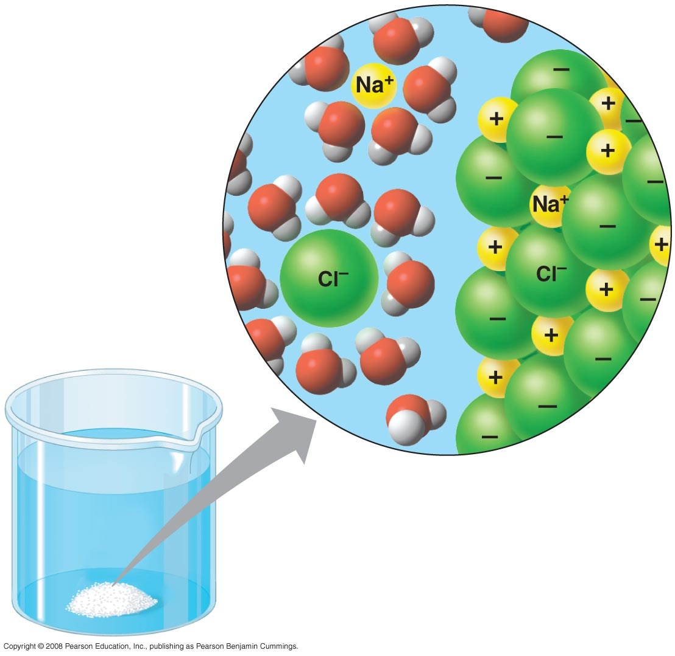

Slide 146
Water Participates in Biochemical Reactions
We will discuss this more in the organic chemistry section – but a molecule of water being introduced or taken away from a biochemical reaction can cause certain biochemical molecules to split apart (catabolism) or join together (anabolism) respectively

Slide 147
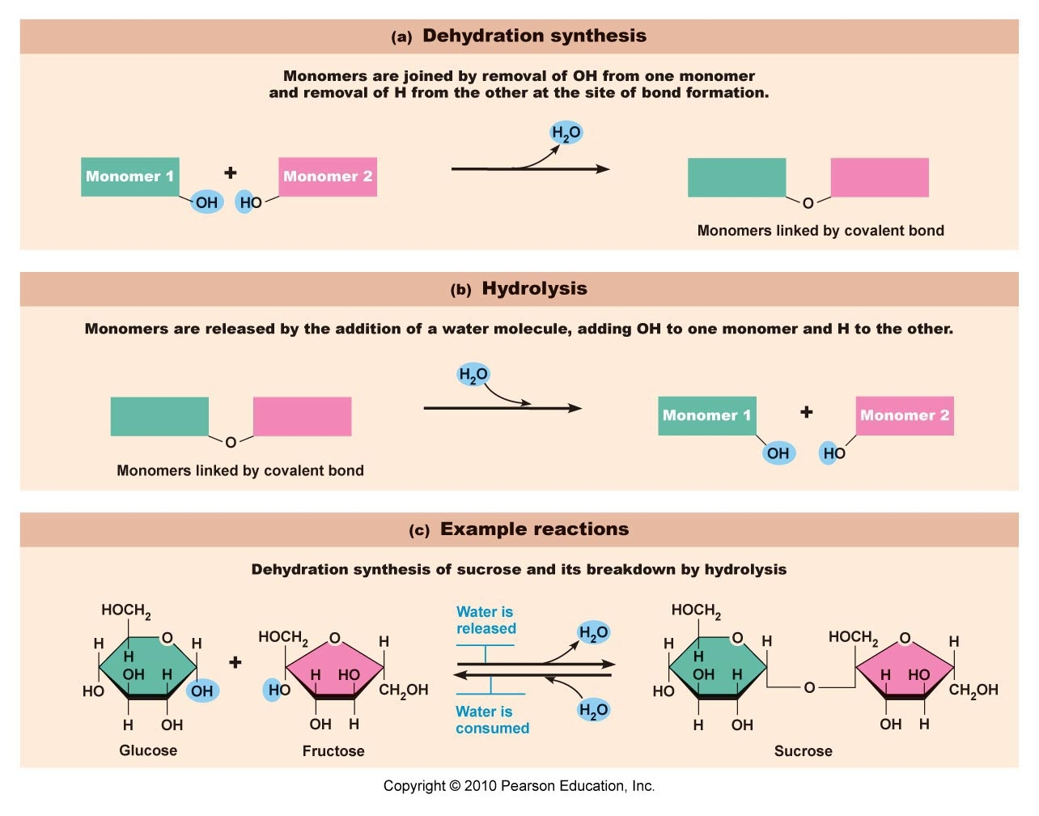
Water participates in Biochemical Reactions

Slide 148
Water absorbs and releases heat very slowly
Water has a high specific heat. It takes a lot of heat to speed up the molecules of water – in that they are being held tightly together by their numerous hydrogen bonds (intermolecular bonds).
It is because of this that water buffers our outside temperature changes – we would be a lot colder in cold weather – and a lot hotter in hot weather if water was not absorbing and releasing the heat
Galveston has less temperature fluctuations than Houston

Slide 149
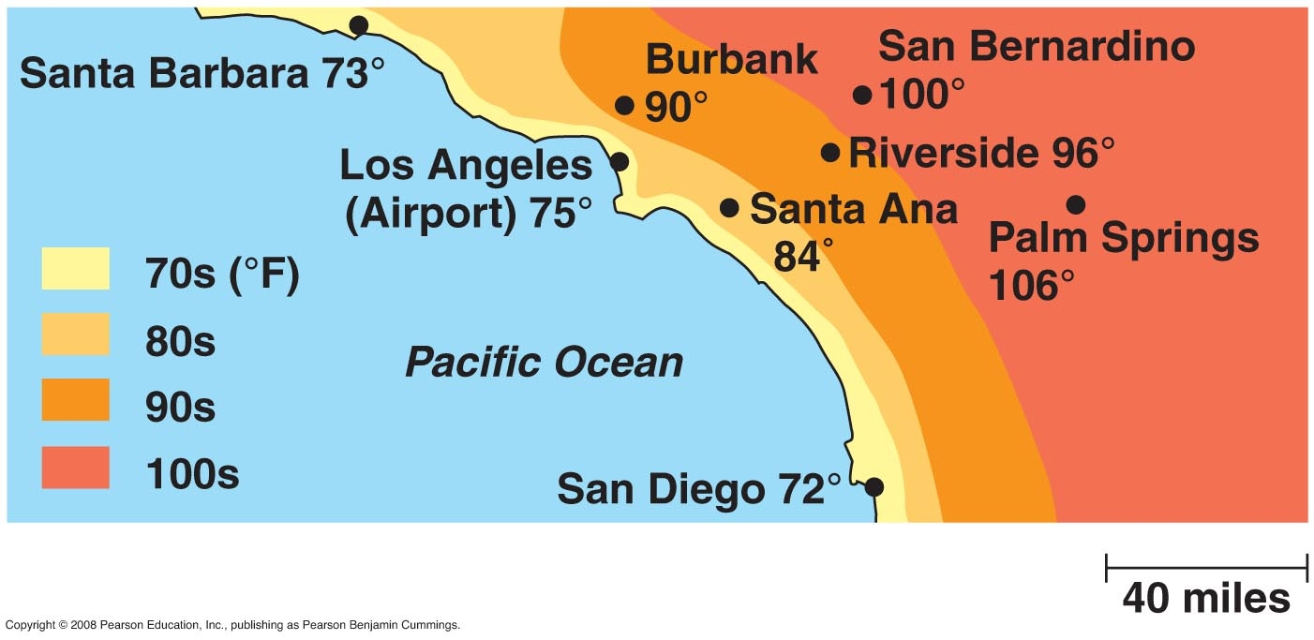

Slide 150
In order to increase temperature of water – the water molecules must increase their kinetic motions – in order to do that each water molecule must break apart from another - so that they can move independently – thus the trillions and trillions of hydrogen bonds must be broken

Slide 151
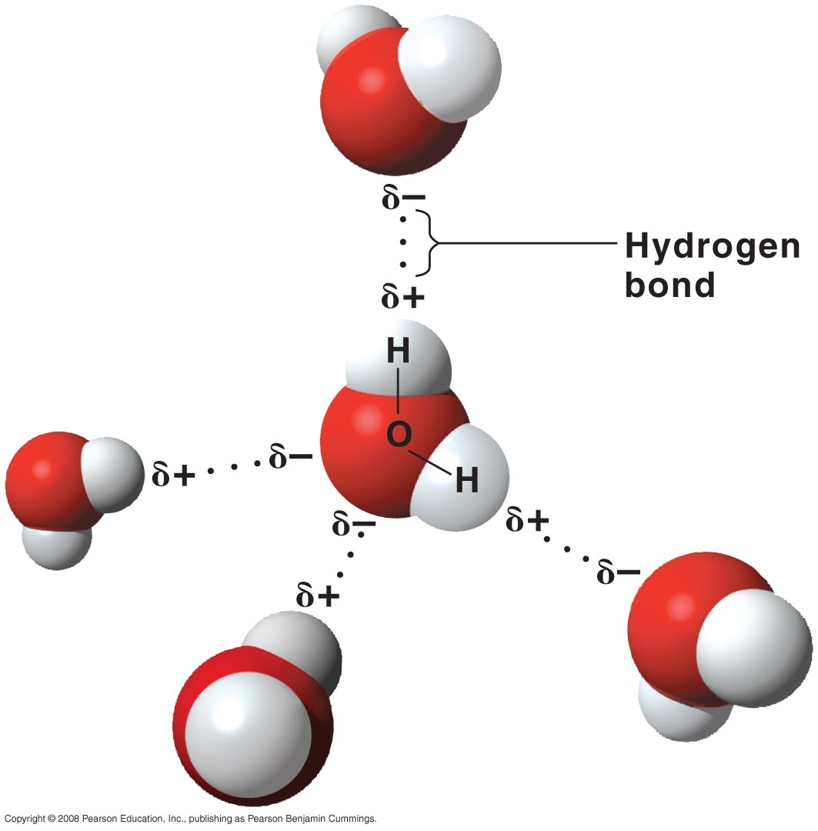

Slide 152
A glass of water is general 8 ounces of water.
8 ounces of water in the metric system is 227.3 grams. (0.500 pounds weight).
A mole of water is 18 grams – thus a glass of water is 12.62 moles (227.3/18) of water.
One mole contains 6.02 x 10²³ molecules of water.
Each water molecule can form two hydrogen bonds to other surrounding water molecules- thus in a glass of water is 2 x 6.02 x 10²³ (12.04 x 10²³) hydrogen bonds.
Even though hydrogen bonds are 1/20th the strength of covalent bonds there are a lots of them even in a glass of water.

Slide 153
Water requires a large amount of heat to change from a liquid to a gas
Water has a high heat of vaporization
It takes a lot of outside heat to raise the temperature of water 1 degree (Note: Hydrogen bond issue) – thus it takes a lot of heat to get it to boil (water boils at 100 degrees centigrade and 212 degrees Fahrenheit)
Going from a solid to a gas without passing through the liquid state is termed “sublimation” – dry ice does it all the time solid CO2

Slide 154


Slide 155
Water has a cohesive nature
Water sticks to water as a result of its Hydrogen Bonds – the intermolecular bonds
This cohesive nature of water allows it to have a strong “Surface Tension”

Slide 156

Cohesive Nature of Water

Slide 157
Water exerts a surface tension
Surface tension is the expression of intermolecular attraction at the surface of a liquid, in contact with air or another gas, a solid, or another immiscible liquid, tending to pull the liquid inward from its surface.
Water sticks to water and the top of its surface is very, very tight – all of this due to its trillions and trillions of hydrogen bonds – holding the water molecules tightly together.

Slide 158




Slide 159

Surface Tension

Slide 160
Water serves as a good lubricant
This is somewhat difficult to explain and there are different opinions.
The difficulty lies in fact that water exerts a tight surface (surface tension) yet it lets items easily slide along its surface
In my opinion two concepts must be understood in order to explain the lubrication ability of (1) floatation in water and (2) spontaneous evaporation of water

Slide 161
Floatation in Water
Whether an item will float in water has to do with a property called density. Density (amount of particles per unit volume) can relate to the weight of items that are of a specific size. Things that have a lower density than water will float in water. This is because the item weighs less than the water that it displaces. Because the water is being pulled (by gravity) towards the earth with more force than the item it is floating (not as heavy)- the water pushes the item is floating away – in such a way that the water remains underneath. The key is to shape objects in such a way that they are less dense – like the construct of a sailing ship.

Slide 162
Spontaneous Evaporation of Water
The temperature of water is not uniform from bottom to top. Water on the top is hotter (heat rises because density is less – particles not as close together).
The water on top is almost in the vapor state (almost ready to evaporate) – having absorbed heat over time from the surrounding environment
Thus an object sitting (floating) on the top of water is in some sense sitting on a vapor – which makes that object easier to slide across its surface

Slide 163
Because of
Because water is a good solvent it forms excellent solutions in the human body – dissolves our electrolytes for example
Because water absorbs and releases heat slowly it buffers our bodies from extremes outside highs and lows in temperature
Our lung surfaces must stay wet otherwise they would dry out and degenerate but unfortunately since water has a surface tension it can cause our lungs to collapse when we exhale – but our lungs have a chemical called surfactant which breaks some of the surface tension
Because water is a good lubricant is keeps things sliding over some of our body surfaces – like the serous membranes (pleura, pericardium and peritoneum)

Slide 164
Oxidation – Reduction Reactions page 27-28
Oxidation is the cause of rusting of metal
Oxidation reactions clean clothes “Oxydol”
Oxidation reactions in body are one of the major mechanisms by which we acquire energy – make ATP
Oxidation – unfortunately causes the formation of “free radicals” in the body

Slide 165
Oxidation
The term initially came from adding oxygen – there was a time that it was thought that to perform oxidation – oxygen must be added – this is not the case we know now
Oxidation is the removal of electrons (either totally or partially) – since electrons have a negative charge sometimes positively charged hydrogens come along also
The atom with the highest electron affinity pulls the electrons away (ionic) or closer to it (Polar Covalent)

Slide 166
Reduction
The adding of electrons to a substance

Slide 167
The Reactions are Coupled (Redox)
A substance is oxidized when it loses electrons
A substance is reduced when it gains electrons
Na Na⁺ + e⁻ the Na has been oxidized by losing an electron
Cl + e⁻ Cl⁻ the Cl has been reduced by gaining an electron
The two reactions are coupled together (Redox Reactions)
Because Na caused Cl to become reduced – it is the reducing agent
Because Cl caused Na to become oxidized – it is the oxidizing agent

Slide 168


Slide 169
In the molecules are ionically bonded there is a complete removal and gain of an electron – thus complete oxidation and reduction
In some cases – like polar covalent bonds – there is a partial removal and gain of electrons – this is a partial reduction and oxidation

Slide 170
Free Radical
An atom or polyatomic complex possessing high electron affinity with an unpaired electron
The high electron affinity makes it a savage scavenger ready to pull on electrons of other atoms or molecules – no matter if they need them or not
Since electrons travel in pairs – and one member of the pair is missing – this scavenger is searching for electrons with a vengeance – It is radical in behavior and on the loose (free)
It is causing oxidation – so called an oxidant – need to get rid of it with an antioxidant

Slide 171
Antioxidants
Oxidants in our body are bad and good
Some of our white blood cells use oxidants to kill microorganisms that invade our bodies
Most oxidants in our body are harmful – unfortunately 2% of the oxygen we breath does not create energy for us (ATP) but becomes free radicals
Certain environmental pollutants and certain foods increase our amount of free radicals -
We have some antioxidants our body makes such as Superoxide Dismutase and Glutathione Peroxidase. They are natural antioxidants in our human body
Due to all of the pollutants and types of foods we eat - we need some antioxidants from the outside such as certain vitamins and other substances

Slide 172
How Does an Antioxidant Work?
If it is an enzyme – like Superoxide Dismutase and Glutathione Peroxidase– it breaks the free radical apart
Superoxide Dismutase catalyze the breakdown of superoxide into oxygen and hydrogen peroxide – two relatively harmless chemicals
The biochemical function of glutathione peroxidase is to reduce lipid hydroperoxides to their corresponding alcohols and to reduce free hydrogen peroxide to water. Glutathione Peroxidase
If it is an outside antioxidant – it donates an electron to the free radical – making it happy- the outside antioxidant is OK with or without the electron it donated

Slide 173
How Does Oxidation Create Energy in the Body?
We breath oxygen (respiration) in order to burn (oxidize) the foods we ingested and absorbed
The food is absorbed, chemically broken down, and enters our cells
In a certain structure in our cells the chemically broken down food meets with oxygen and the oxygen (high electron affinity) pulls electrons and hydrogens from the food – remember when something moves – energy is liberated

Slide 174
Thermodynamics page 28 - 31
Thermodynamics is the study of energy and its transfer– primarily looking at heat since it is the most abundant form of energy
Thermodynamics determines the direction and rate of chemical reactions

Slide 175
Thermodynamics is based on laws of nature
Thermodynamic Law One: Energy cannot be created or destroyed but changed in form and/or location. Extrapolated from this law is that the energy of the universe is constant
Thermodynamic Law Two: The universe tends towards a state of entropy (randomness of motion). Extrapolated from this law is that since heat is energy is randomness of motion – it is the most abundant form of energy

Slide 176
Gibbs Free Energy
In order truly understand Thermodynamics – one must study and understand Free Energy
One of the major contributors to the field of Thermodynamics is Willard Gibbs
It is as a result of his contribution that free energy is termed Gibbs free energy – symbolized by ΔG
The major equation used to determine free energy is ΔG = ΔH – TΔS
where G is Gibbs free energy, H is enthalpy and ΔH is the change in enthalpy as a reaction proceeds , T is temperature in Kelvin and S in entropy with ΔS being the change in entropy as the reaction proceeds
Enthalpy is defined as the heat of reaction or the bond energy the energy needed to break a bond

Slide 177
Personal Simplification
I wish to simplify this by using my own terms
Consider the generic reaction A + B AB
In this reaction A & B are the reactants and AB is the product produced by the chemical reaction
Instead of using the G symbol I am going to use E for energy
EA is the energy possessed by atom A
EB is the energy possessed by atom B
EAB is the energy possessed by the molecule AB
How do I know that the atoms and the molecule possess energy ? Because the atoms and molecule are themselves moving and their respective sub-atomic particles are moving (remember when something moves it has energy)

Slide 178
Factors that must be understood in order to understand Thermodynamics are
(1) What is a system in physics and chemistry
(2) What is an open versus closed system
(3) Does energy flow into or out of a reaction

Slide 179

Open and Closed Systems
In physics a system is the amount of matter and energy under investigation- anything not in the system is in the surroundings. The surroundings includes all of the universe.

Slide 180
Energy Flow Discussion
Assume A, B, AB are particles in the system along with their associated energies
Assume the system is open
If the EA + EB (reactant energies) are less than the EAB (product energy) then the reaction needs additional energy from the surroundings to proceed – an uphill process
If the EA + EB (reactant energies) are greater than the EAB (product energy) – the reaction can give off energy – a downhill process

Slide 181

When a reaction requires energy from the surroundings to proceed (must borrow from the surroundings) it is termed an Endergonic Reaction.
Since Endergonic reactions must borrow energy from the surroundings – the reaction cannot proceed by itself – thus it is non-spontaneous

Slide 182

When a reaction, as it proceeds, gives off energy to the surroundings it is termed an Exergonic Reaction.
Since Exergonic reactions give off energy to the surroundings – the reaction can proceed by itself – thus it is spontaneous
The energy given to the surroundings is used to increase the randomness of motion (entropy) – thus the universe favors this reaction

Slide 183
If a reaction gives off heat as it proceeds – it is termed an Exothermic Reaction. When this occurs the surroundings get hotter. An example if adding a concentrated acid to water.
If a reaction takes in heat from the surroundings – it termed Endothermic. The surroundings start to get colder. Examples are dissolving ammonium chloride in water and mixing water and ammonium nitrate.
As confusing as it may seem an Exothermic Reaction does not have to be Exergonic and an Endothermic reaction does not have to be Endergonic. In order to explain this we would have to take time explaining the formula ΔG = ΔH – TΔS . Thus just take it for fact in that it is beyond the scope of this course.

Slide 184
In order for a endergonic reaction to proceed it must acquire energy from some exergonic reaction occurring at the same time or from some stored energy in a potential energy source.
The universe never donates energy directly.
When an exergonic reaction takes place – some of the energy always goes away as heat no matter what the immediate need is. Thus some energy is harnessed for the endergonic need and some goes into the universe as heat.
The Efficiency rating determines how much goes into work versus heat. The higher the efficiency rating the more energy that went into work.

Slide 185

Endergonic Reactions need a coupling to Exergonic Reactions

Slide 186
Summary of Major Thermodynamic Points
Exergonic reactions give energy to the surroundings – the universe likes that – making them “Spontaneous Reactions”
Endergonic reactions must borrow energy from exergonic reactions or from stored (potential) energy sources – they are not spontaneous
If a reaction gives off heat it is exothermic
If a reaction takes on heat it is endothermic

Slide 187
Acid-Base Actions
(page 31-36)
The wrong Acid/ Base balance can cause certain biochemical molecules (Proteins) to not work properly by bending out of shape
The wrong/acid base balance can cause seizures or vascular collapse

Slide 188
Brønsted-Lowry defines
an acid as a Proton Donor H⁺
a base as a Proton Acceptor H⁺
A proton is symbolized as H⁺ because hydrogen has a atomic number of 1 (thus one proton) and a rounded off atomic mass of 1 (thus no neutrons). On the periodic chart the element (atom) is neutral – thus it has one electron. If Hydrogen loses an electron it is composed of one proton which is positively charged (cation) H⁺.

Slide 189
The concept of acid and base was derived from the spontaneous dissociation of water.
Water is bonded to water by hydrogen bonds.
A hydrogen bond is a hydrogen covalently bonded to one highly electronegative atom but having an affinity for another highly electronegative atom. So in pure water an hydrogen atom is married to one oxygen but is being attracted to another oxygen atom in another water molecule. Oftentimes the hydrogen atom switches partners and marries (covalently bonds) to the other oxygen atom. However at the same time one of the hydrogens of the other water molecule also switches partners – thus all the oxygen atoms still have two hydrogens – but just different ones.

Slide 191
Sometimes mistakes (1 out of 554,000,00 molecules of water at 25 ° C) are made and a hydrogen marries (covalently) bonds to an oxygen atom before that oxygen atom has loss one of its hydrogens. The hydrogens always leave their electron with the old partner – so it comes as a proton H⁺
The molecule of water with the extra proton is termed the hydronium ion H₃O⁺. If there is only water in beaker then somewhere there is a OH⁻, (hydroxide) not having the proton. Thus the H₃O⁺ wants to give off a proton – an acid. The OH⁻ wants to get a proton – a base. Since there is the same amount of acid and base- water is neutral.

Slide 192


Slide 193
pH Derivation (powers of H⁺)
The pH scale was derived in order to make acid base easier to discuss in a quantitative manner for the general public
Experimentation on water at 25 ° C shows that the concentration of [H₃O⁺] is .0000001 molar – thus 1 x 10⁻⁷ molar and the concentration of OH⁻ is also 1 x 10⁻⁷ molar
Most people do not like to think in terms of exponents – particularly negative exponents – so a pH calculation is created

Slide 194
The pH calculation is born out of certain factors of algebra – Logarithms
There are two Logarithms in math- one is the common Log (Log) and the other is the natural logarithm (Ln)
We are using the common logarithm (Log)
Definition of Log: Log X^{n} = n
By using the common log one can convert an exponent to a regular number

Slide 195
Let’s now apply the Log concept to the concentration of [H₃O⁺] which is 1 x 10⁻⁷ molar
We can just talk about the proton H⁺ in the [H₃O⁺] molecule its concentration being 1 x 10⁻⁷
In order for convenience we then take the Log of 10⁻⁷ which = -7 if we are going that far – we may as well get rid of the minus sign by multiplying everything by a -1 thus pH = -1 x [H⁺]
Thus the pH = - Log [H⁺]

Slide 196

pH Scale
The pH scale goes from 0 – 14 with 7 being neutral and 0 up to 7 being acidic – and above 7 to 14 being basic (alkaline)

Slide 197


Slide 198
Acid-Base Balance
Normal pH of body fluids
  Blood pH range 7.35 – 7.45
  Arterial blood is 7.4
  Venous blood and interstitial fluid is 7.35
  Intracellular fluid is 7.0
Alkalosis or alkalemia – arterial blood pH rises above 7.45
Acidosis or acidemia – arterial pH drops below 7.35 (physiological acidosis)

Slide 199
As mentioned earlier – when the pH of body fluids gets out of range – body chemistry suffers
There are many internal metabolic reactions that would drive the pH of body fluids out of range – not to mention outside substances we eat or drink that can drive our pH out of range
What keeps the body fluid pH correct even though certain metabolic and ingestive substances try to drive it out of range
pH Buffers

Slide 200
What is a pH Buffer?
A pH buffer resists a change in pH
A pH buffer is chemically comprised of a weak acid in association with its conjugate base

Slide 201
Strength of Acids
(1) H₃A H₃A
(2) H₃A H₂A⁻ + H⁺
(3) H₃A HA⁻² + 2H⁺
(4) H₃A A⁻³ + 3H⁺
Are all the substances above acids?

Slide 202
Strength of Acids (One)
(1) H₃A H₃A Not an acid
(2) H₃A H₂A⁻ + H⁺
H₃A HA⁻² + 2H⁺ Weak Acids
H₃A A⁻³ + 3H⁺ Strong Acid
One factor that determines the strength of an acid depends how many H⁺ will liberated – how much dissociation will occur - the more free H⁺– the more can be added to the H⁺ concentration – thus a change in pH
pH = - Log [H⁺]

Slide 203
Strength of Acids (Two)
Composition: A weak acid in equilibrium with its conjugate base
[H3A] [H₂A⁻] + [H⁺]
A base wants a proton (proton acceptor) - a conjugate base is a base formed as a result of the dissociation of an acid. if a base wants a proton – and a conjugate base was formed because an acid gave up a proton – why does the resultant base want it back? If it wants it back why did it give it up in the first place? THERMODYNAMICS

Slide 204
Strength of Acids (Two)
Composition: A weak acid in equilibrium with its conjugate base
[H3A] [H₂A⁻] + [H⁺]
Non-dissociated acid dissociated acid remnants
Notice that at equilibrium (rate same not concentrations) the concentration of the non-dissociated acid (weak acid) is much greater than the dissociated acid – thus not as much free H⁺ liberated – thus a minimal change in pH

Slide 205
Two factors make an acid weak – (1) not liberating all of its hydrogen in the acid molecule if the molecule contains more than one hydrogen and
H₃A H₂A⁻ + H⁺
(2) keeping most of the acid non-dissociated during the time of equilibrium.
[H3A] [H₂A⁻] + [H⁺]

Slide 206
pH Buffer
Weak Acid Conjugate Base
[H3A] [H₂A⁻] + [H⁺]
Add outside acid to buffer it combines with the base H₂A⁻ to make more weak acid (re-shift of the equilibrium)– add base it combines with the acid H⁺ to make more weak acid – again re-shift of the equilibrium – resulting in no to minimal change in pH
LeChatelier’s Principle – an equilibrium system, when stressed, will shift its equilibrium to relieve the stress.

