Slide 1
Chemistry
Organic
Mike Clark, M.D.,M.B.A.,M.S.

Slide 2
Fields of Chemistry
Inorganic Organic
All molecules in organic chemistry must contain carbon – in an organified manner – which basically says you need some hydrogens- thus organic chemistry is a “Hydrocarbon” chemistry
CO2 contains carbon – but since it does not contain hydrogen – it is inorganic

Slide 3
Organic Chemistry
(Life Based Chemistry)
Biochemistry Polymer Chem. Geological
Organic Chemistry is a study of matter of life-based entities
Biochemistry studies organisms living now. The other fields of Organic Chemistry studies remnants of life – like oil, for example.

Slide 4
Biochemistry
Animal Plant
Human Other Animals
Since our focus is on human biochemistry – we will discuss the major biochemical molecules
carbohydrates, lipids, proteins and nucleic acids

Slide 5
The Carbohydrates, Lipids, Nucleic Acids and Proteins have two main commonalities
(1) a monomer to polymer relationship
(2) Interaction of Water into the chemical reactions
Organic Chemistry is a covalently bonded chemistry – thus all the chemical bonds joining monomers are covalent bonds

Slide 6
Monomer to Polymer Relationship
A monomer is as individual unit capable of repeat
The individual unit is a molecule itself
The monomers chemically bond together to form “polymers” – the repeated unit
Monomer of carbohydrate is termed a monosaccharide (glucose is an example)
Monomer Chemical Bond
Polymer

Slide 7
Interaction (Insertion) of Water into the chemical reactions
H HO
H20 Inserted -- result water molecule splits and one molecule gets the H and other the OH
If a molecule of water is introduced into the chemical bond it will split it apart (hydration decomposition or hydrolysis decomposition)

Slide 8
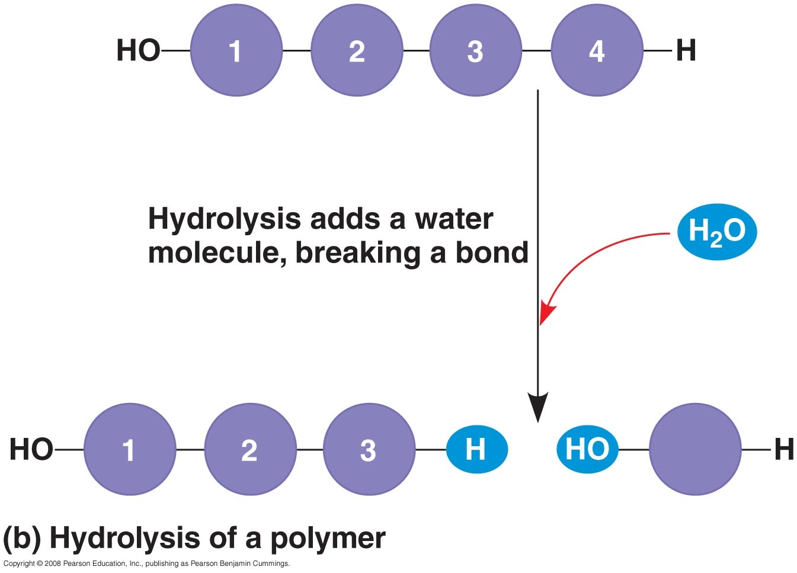

Slide 9
Interaction (Removal) of Water into the chemical reactions
H HO
result H20 removed
-- result water molecule reformed and chemical bond reformed between the monomers. This is called dehydration (remove water) synthesis (anabolic process)

Slide 10
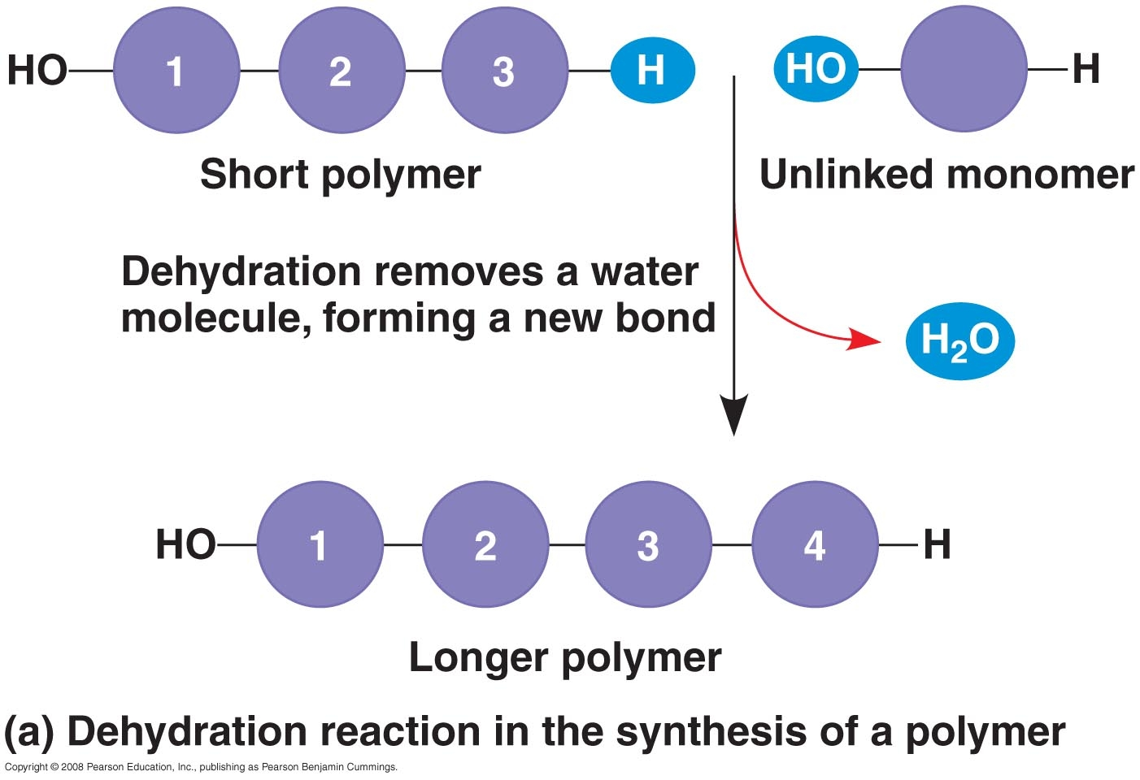

Slide 11
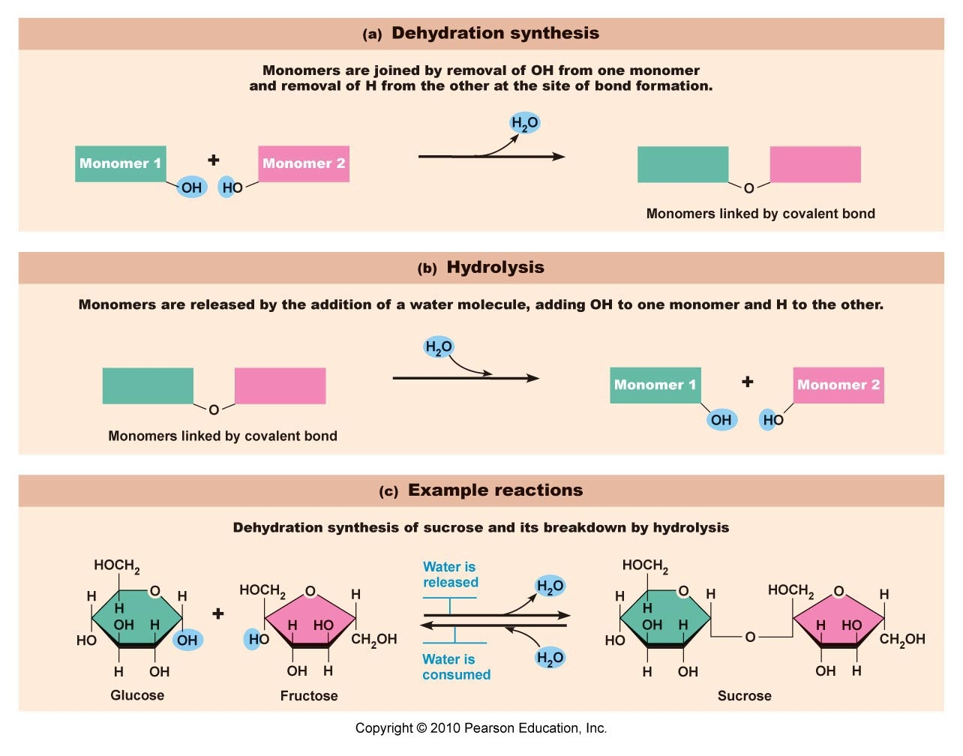

Slide 12
Chemical Formulas
Empirical Formula – name atoms by symbols but only give relative number of atoms in molecule
Molecular Formula – name atoms by symbols but give exact number of atoms in molecule
Structural Formula – on a 2 –Dimensional surface (like paper) – try to draw the shape of a molecule
Models – to truly see 3-D must make a model

Slide 13
Glucose Formula Example
Subscript number – number of atoms of preceding element. Full number in front of molecule means that number of molecules like 2H2O – means two molecules of H2O
Glucose is C6H12O6
Empirical Formula –relative number of atoms in molecule (CH2O)
Molecular Formula –give exact number of atoms in molecule (C6H12O6)
Structural Formula – on a 2 –Dimensional surface (like paper) – try to draw the shape of a molecule
Models – to truly see 3-D must make a model

Slide 14
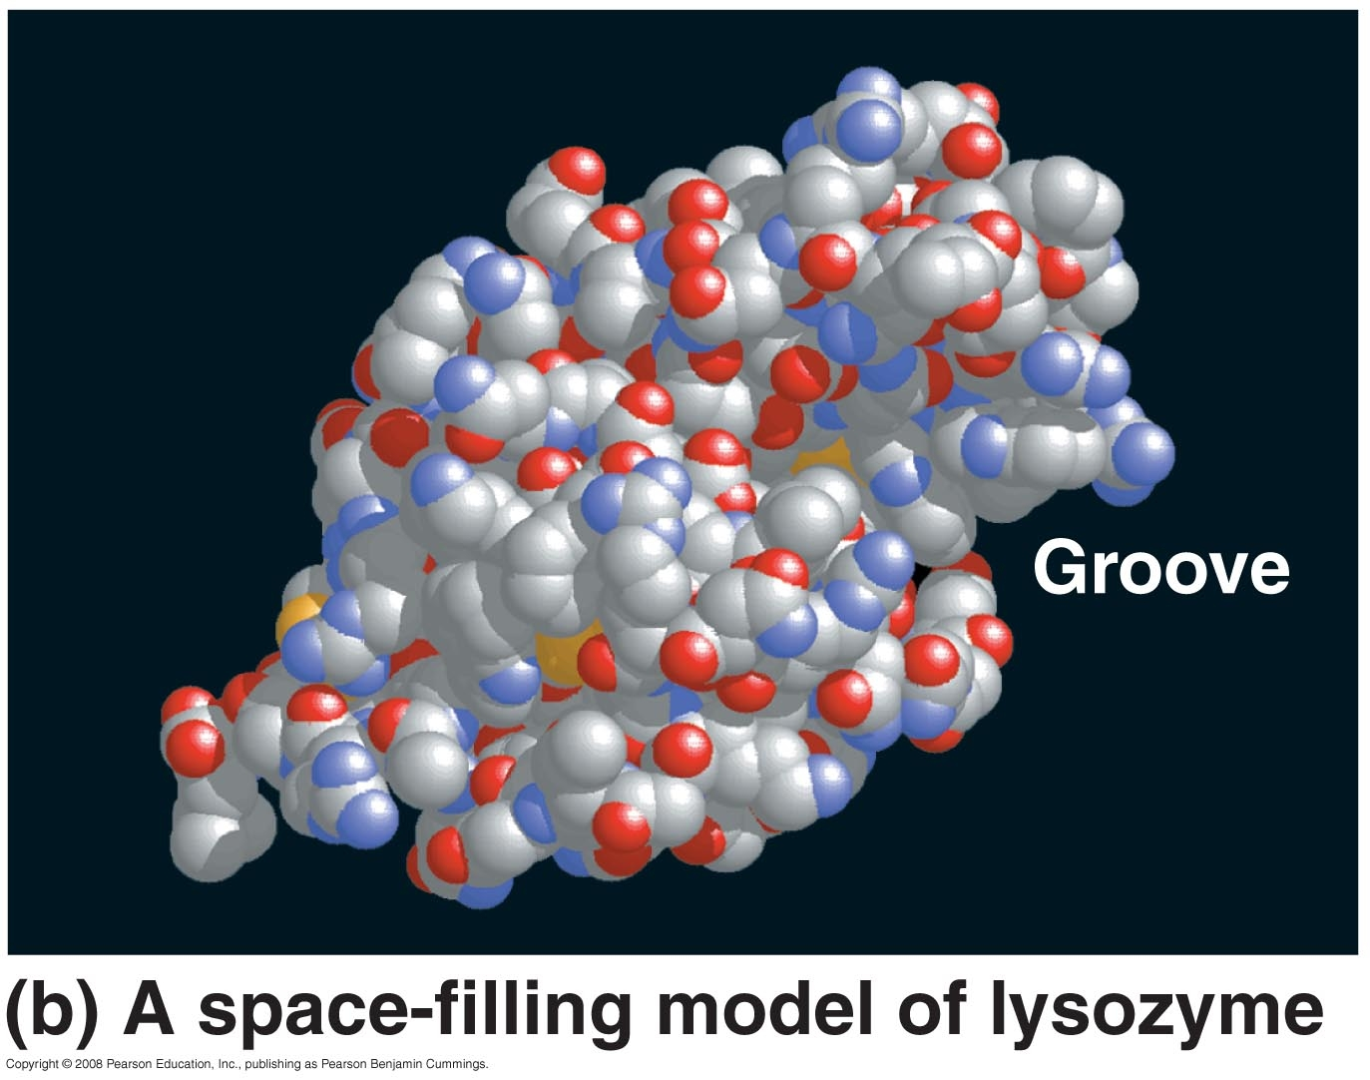
Models

Slide 15
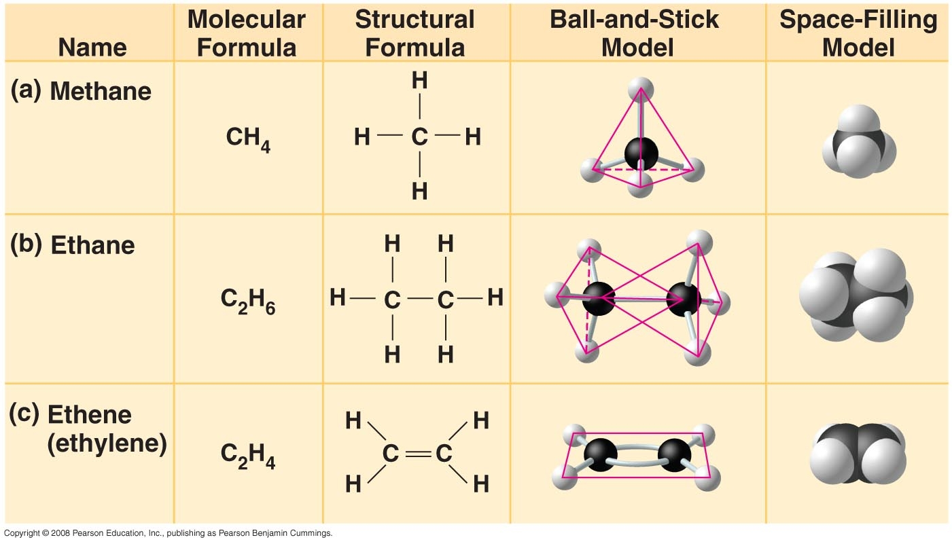

Slide 16
Carbon – Why for life?
Carbon has an atomic number of 6 – with 4 electrons in is outer energy level – thus it needs four more electrons. Carbon can combine covalently with 4 atoms to give it its 4 electrons. The fact that one carbon atom can combine with so many atoms – gives it tremendous diversity – thus the basis of life on this planet. x2
x1 C x3
x4

Slide 17
Carbon likes to bond to Carbon
Carbon Backbone
Though carbon can bond to 4 different atoms – it generally likes to bond to itself forming a “carbon backbone”
C C C C C C

Slide 18
Functional Groups
A group of always associated (grouped) atoms attached to the carbon backbone (previously discussed) – this group always chemically behaves the same no matter what carbon backbone it is attached to.
Groups to be discussed
Hydroxyl
Carbonyl
Carboxyl
Amino
Sulfhydryl
Phosphate
Methyl

Slide 19
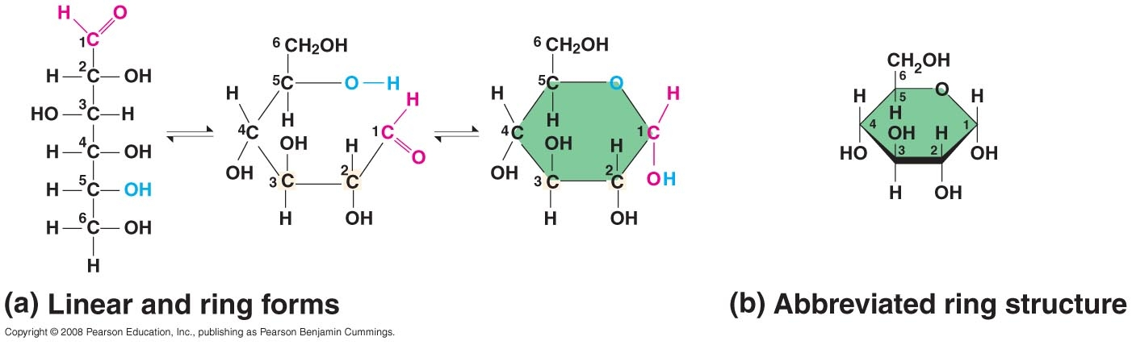
When I quickly draw a ring structure – the corners always mean carbon unless I put some other atom there.

Slide 20
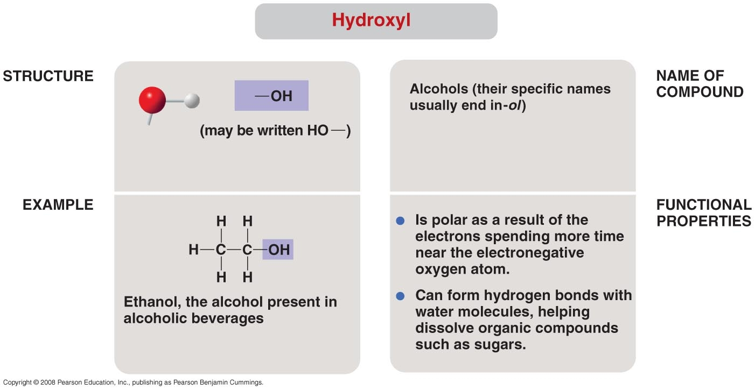

Slide 21
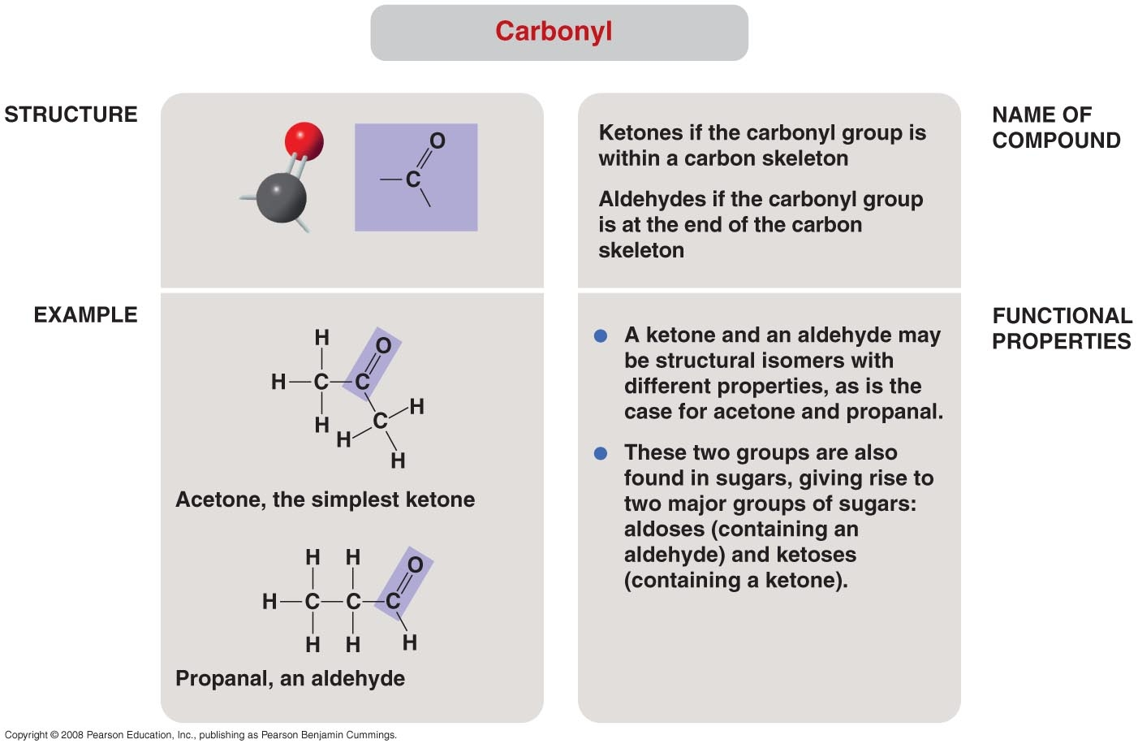

Slide 22
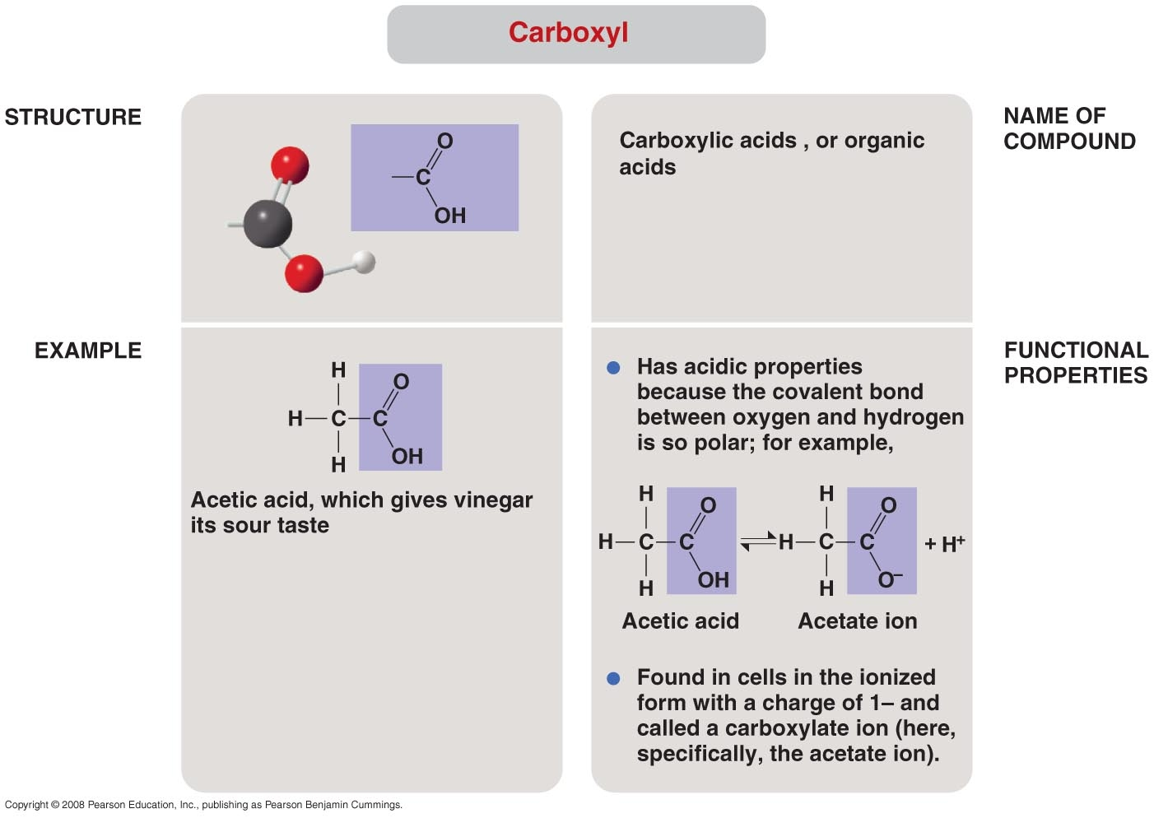

Slide 23
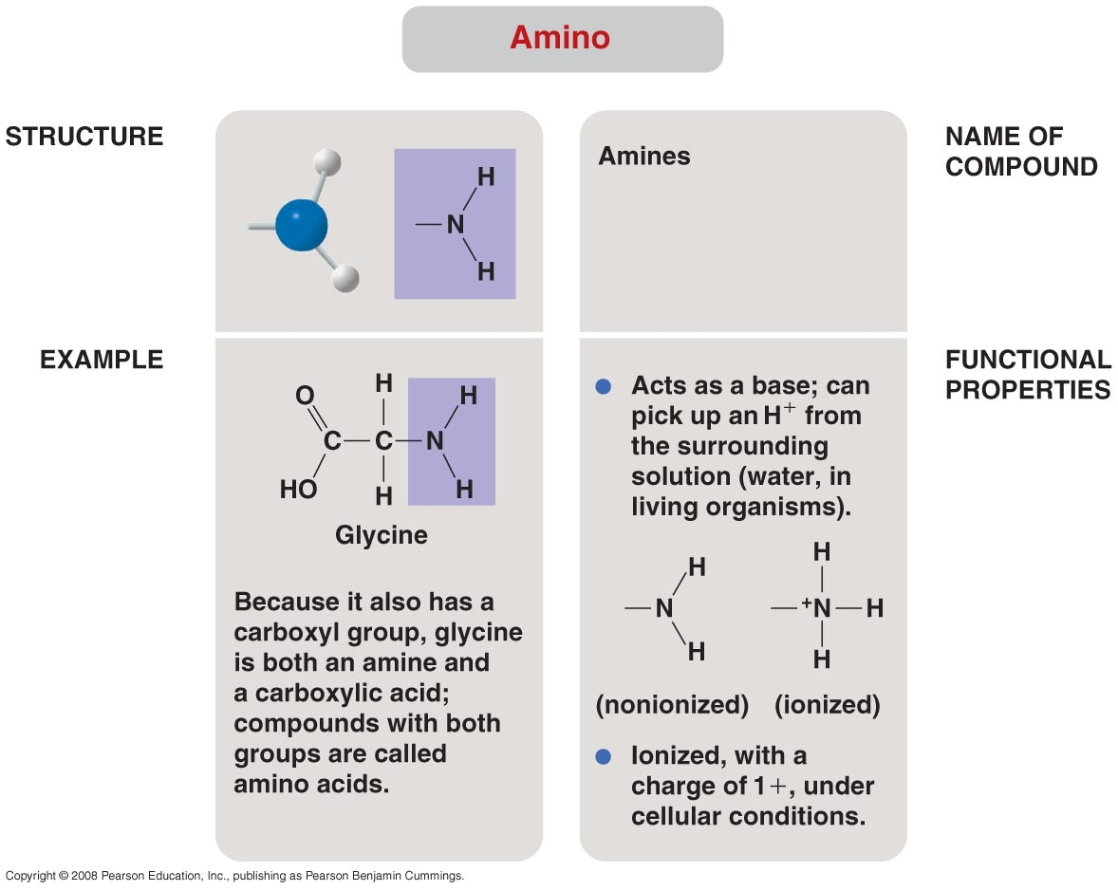

Slide 24
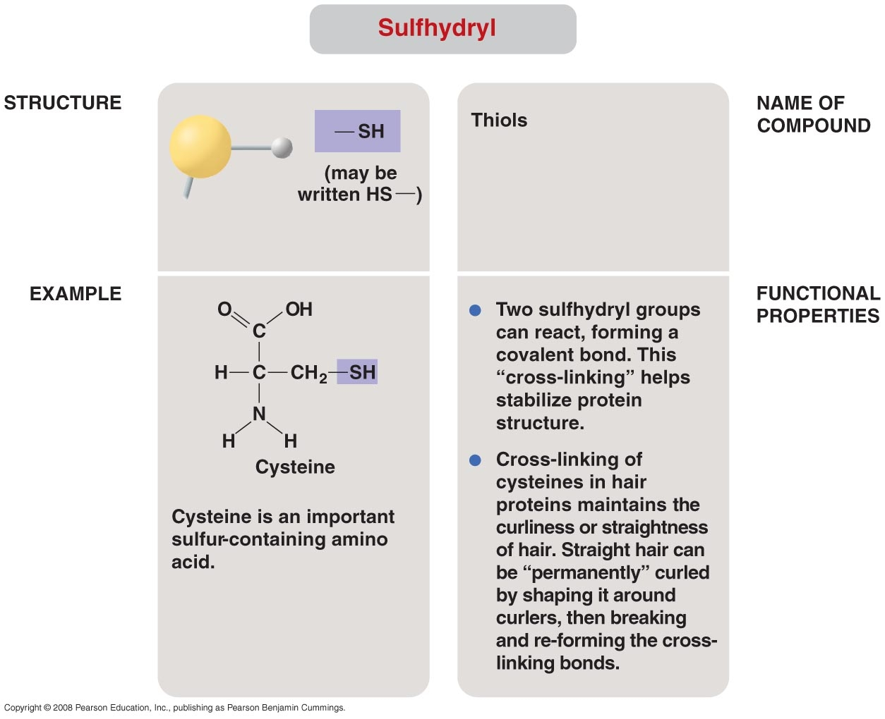

Slide 25
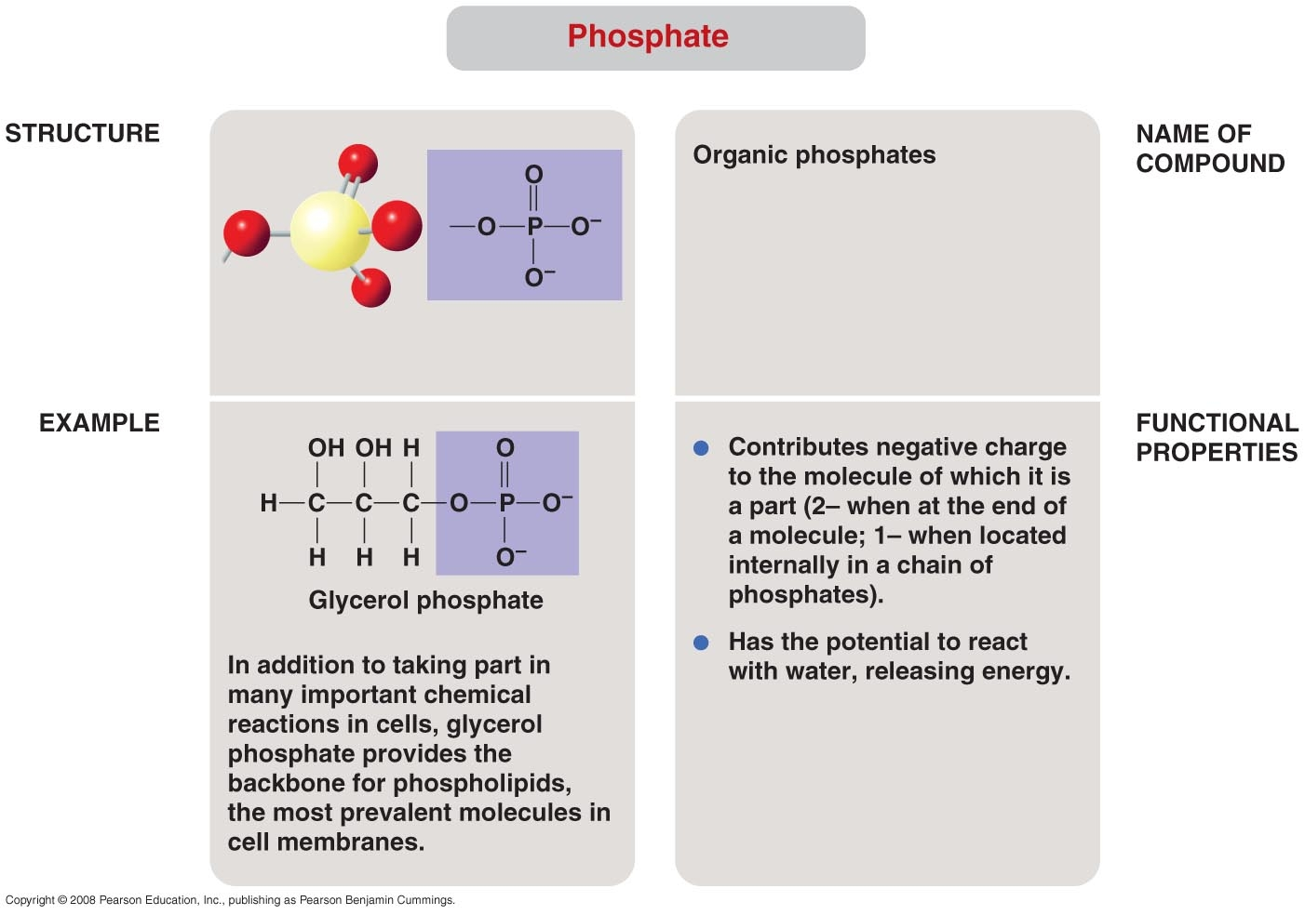

Slide 26
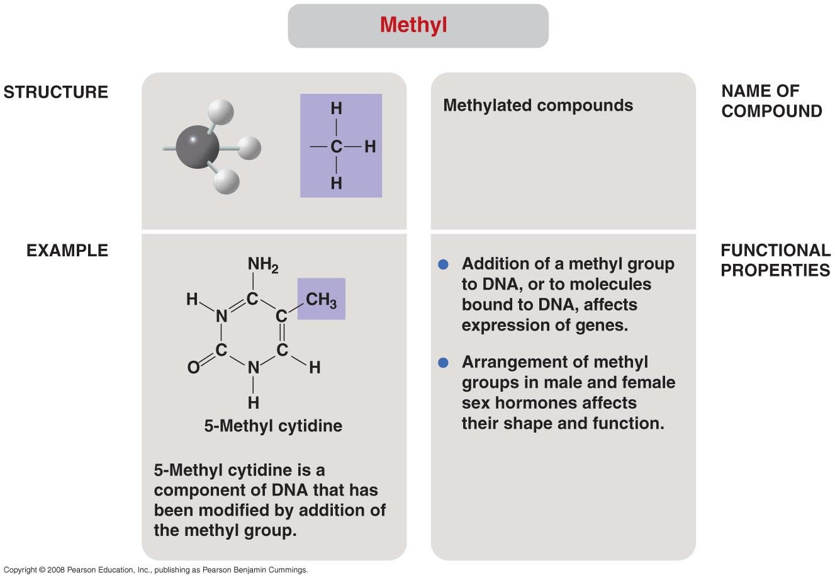

Slide 27
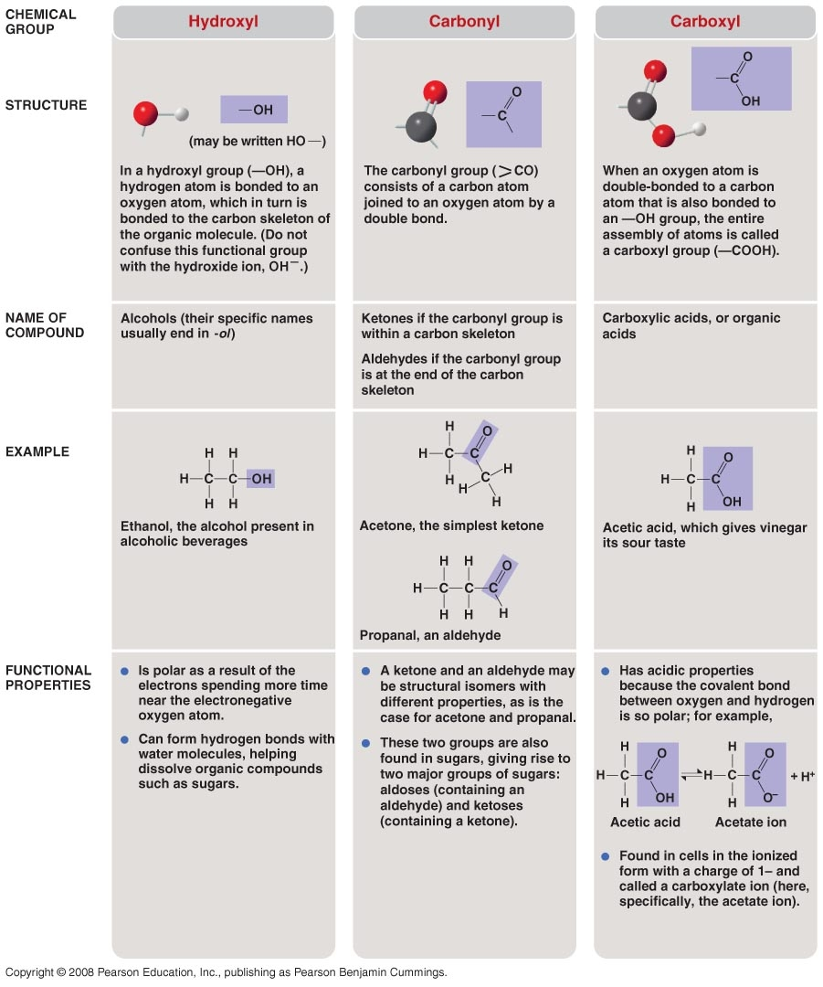

Slide 28
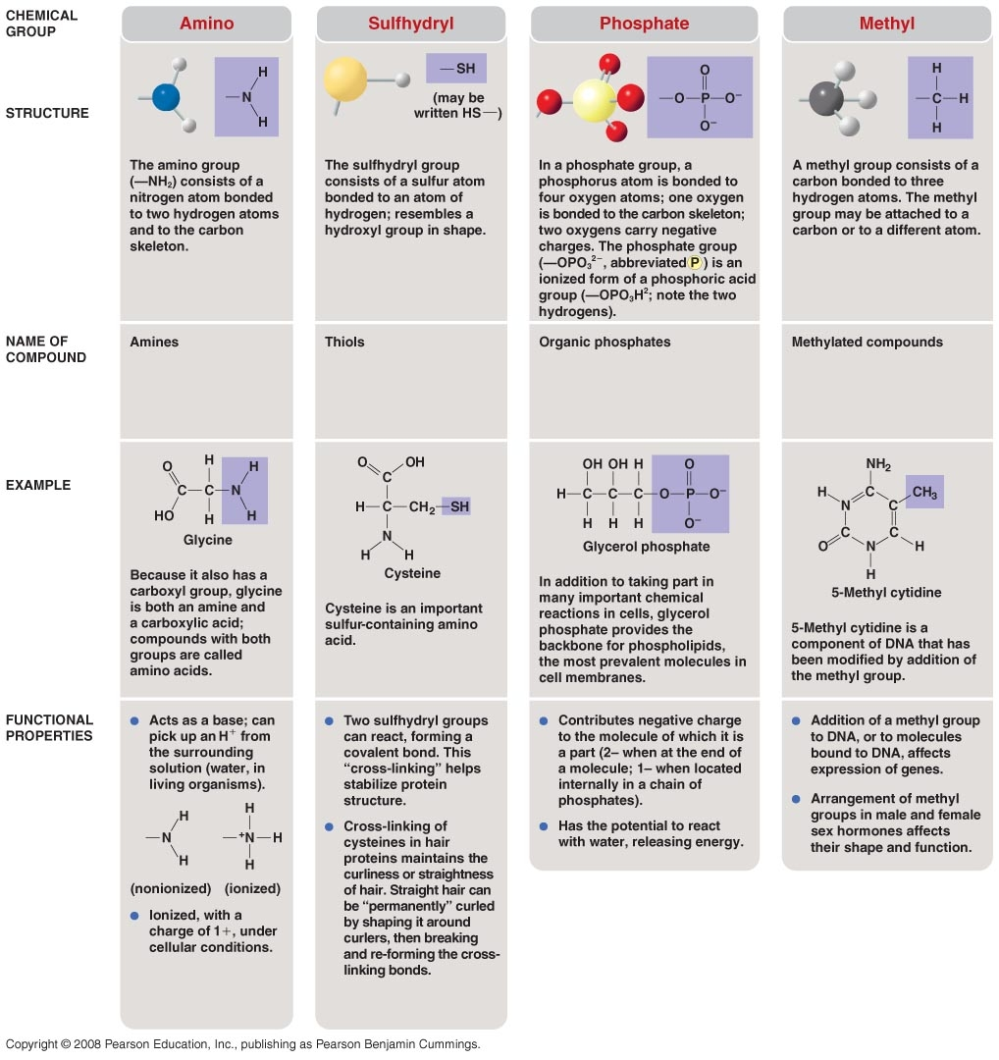

Slide 29
Nomenclature Naming of Organic Compounds
In an organic chemistry course this subject would be, in detail, discussed – but it is beyond the scope of this course.
Just for example
How many carbons? Prefix - meth 1 eth 2 prop 3 but 4 pent 5 hex 6
Do you have double covalent bonds present in the molecule? Suffix – ane if no double bonds, ene if double bonds
C C C versus C C C
Propane Propene

Slide 30

Numbering of Carbons in the Carbon Backbone
In organic chemistry it is important to be able to number the carbons correctly. However, this is beyond the scope of this course – so will have to accept my numbering.
For example – the backbone is the longest chain thus Rules- (1) find longest chain (2) number from end that produces lowest numbers for side groups
3 –ethyl-2 methylhexane

Slide 31
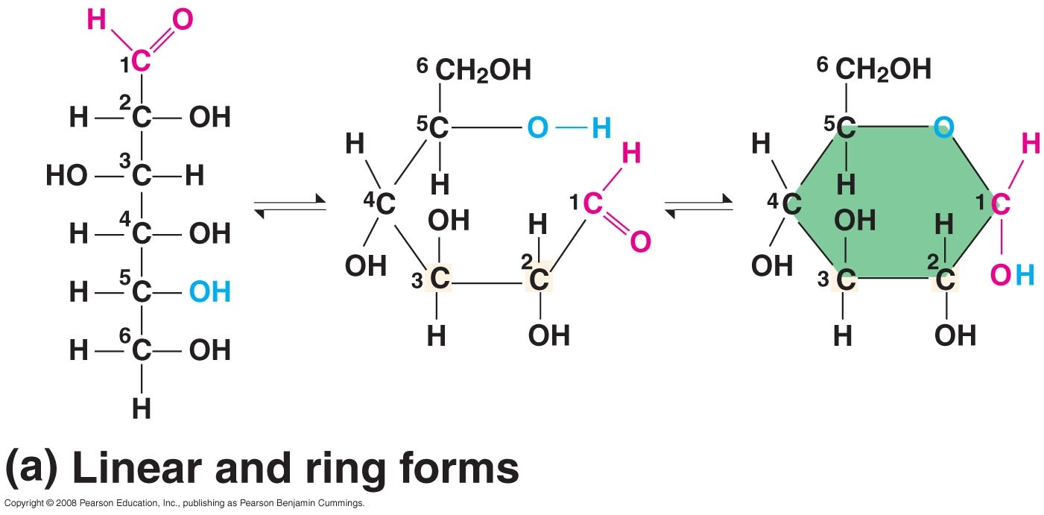

Slide 32
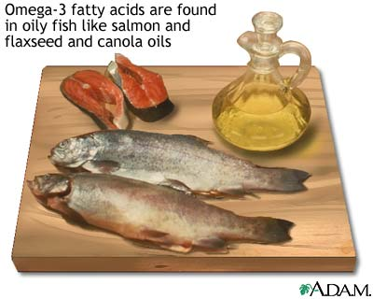
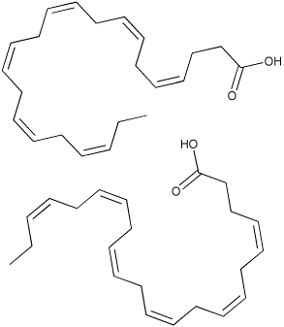
Omega 3 Fatty Acid
"Omega" means that you start counting double bonds from the tail-end of the fatty acid. An omega-3 fatty acid, in this case, has a double bond on the third carbon from the end. The double bond extends from this carbon to the fourth from the end. "Omega" is the last Greek letter and it means "End."
The "delta" letters also indicate double bonds. It works the same way, but you start counting from the actual carbon number one. Carbon one, according to IUPAC rules, is the carbon on the carboxy end of the fatty acid. Therefore, delta-9 means that there is a double bond between carbons 9 and 10, delta-12 means that there is a double bond between carbons 12 and 13, and so on.

Slide 33
Isomers
Molecules with the same molecular formula but a change in structural formula
C6H12O6 is the formula for glucose, fructose and galactose – the atoms are arranged differently in 3 –D space for each of those molecules
Just like in our large world – shape makes a difference – so is the case in the molecular world – the arrangement of atoms in 3 –D space defines the molecule – switch the atoms around in the molecule and you form a new molecule

Slide 34
Types of Isomers
Structural Isomers
Geometric Isomers (Cis-Trans)
Optical Isomers

Slide 35
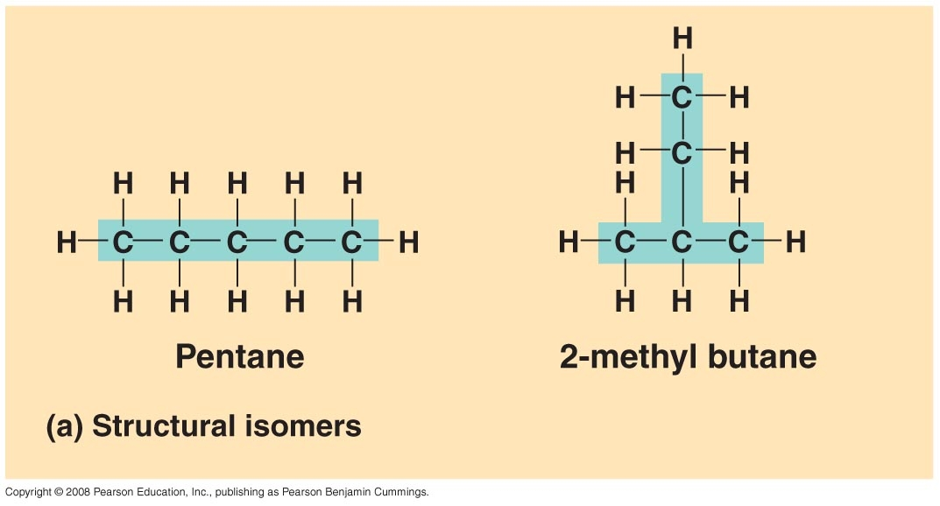

Slide 36
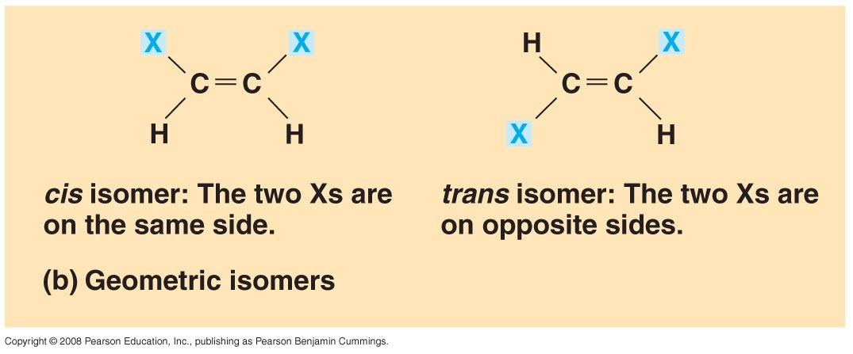

Slide 37
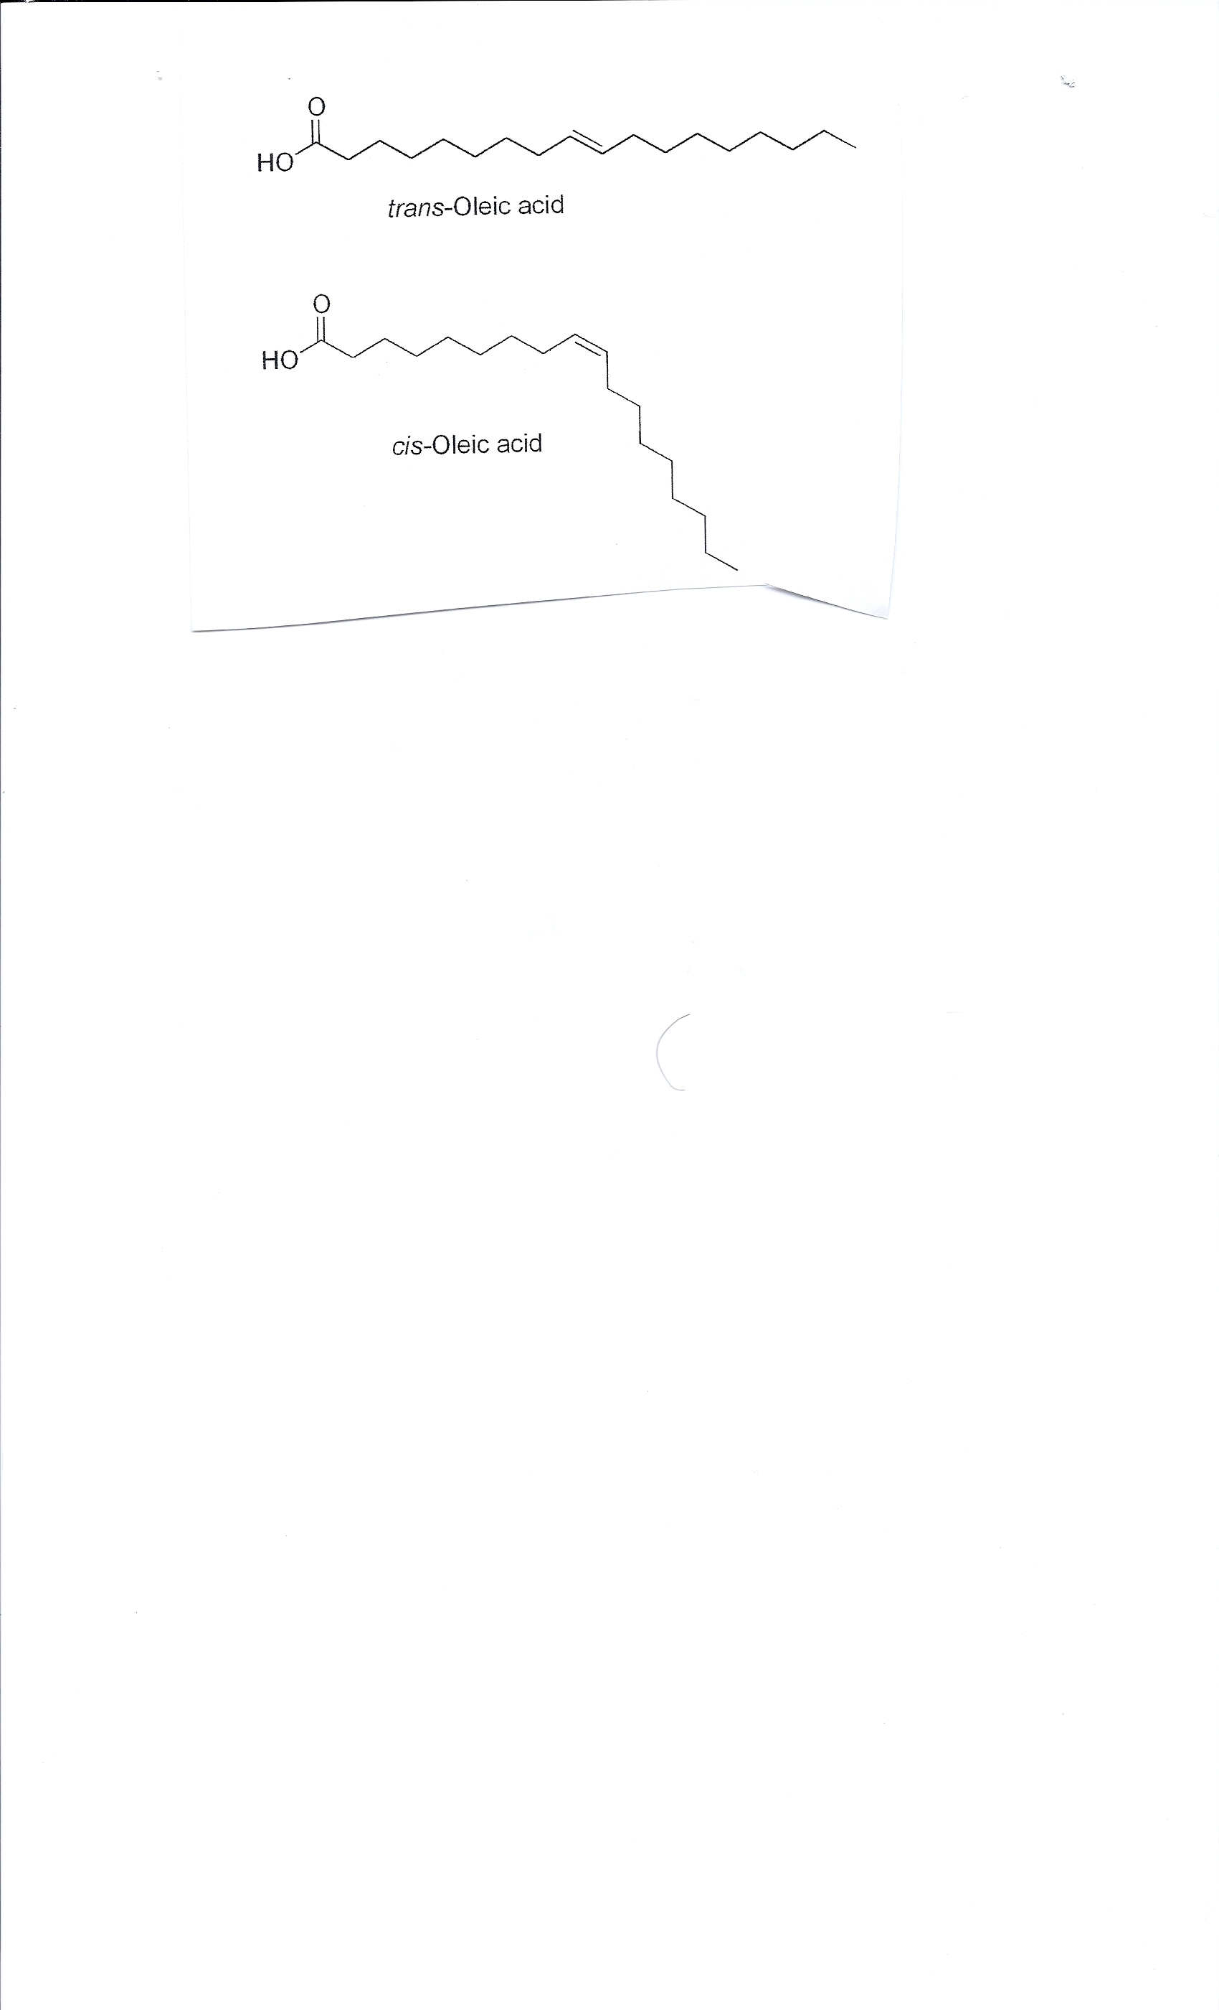

Slide 38
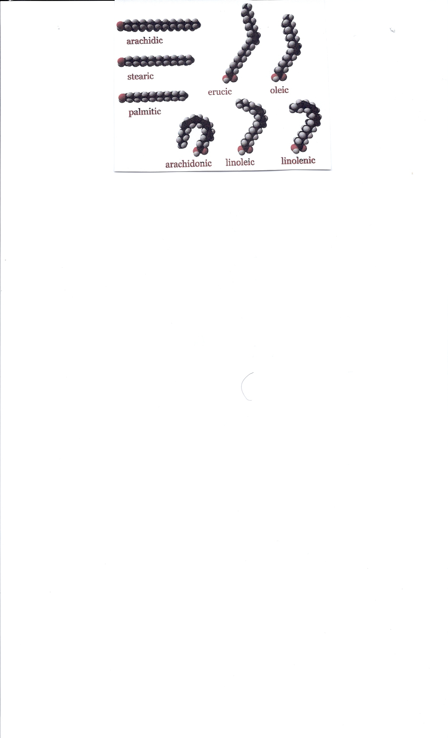

Slide 39
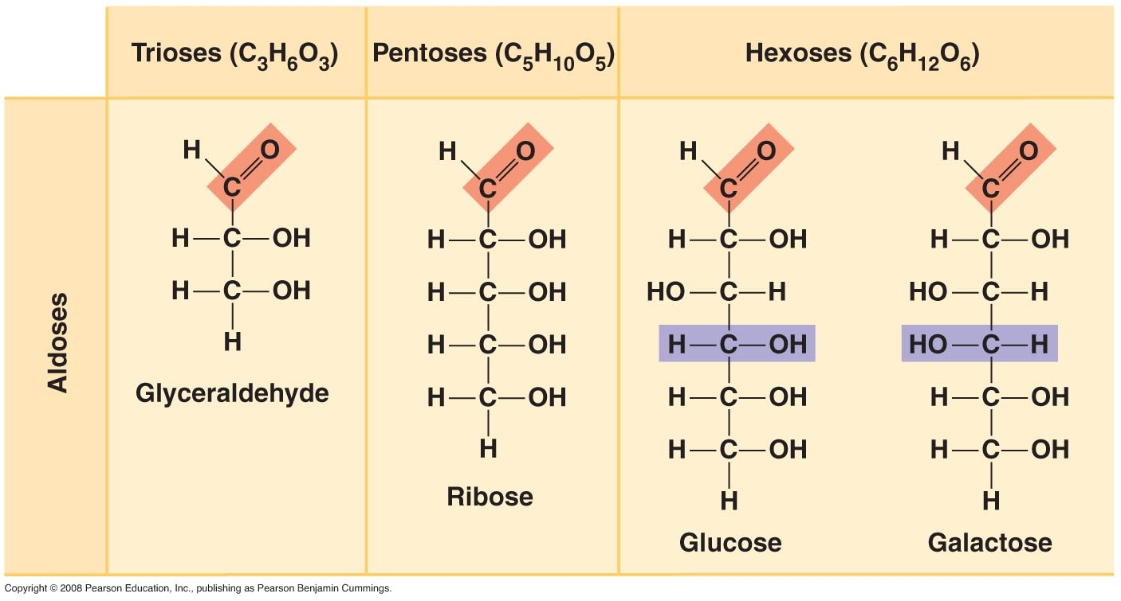

Slide 40
Optical Isomers
How does the molecule rotate polarized light?
A polarimeter is a laboratory instrument used to determine the angle of optical rotation of plane-polarized light passing through a sample of material.
A typical polarimeter consists of a light source, a polarizer, a sample holder, and some form of viewer. The optical rotation of many materials depends on both wavelength and temperature, so polarimeters often have ways to control these.

Slide 41
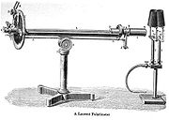
Polarimeter
If turn to right – D (Dextrotatory) or Left (levorotatory)

Slide 42
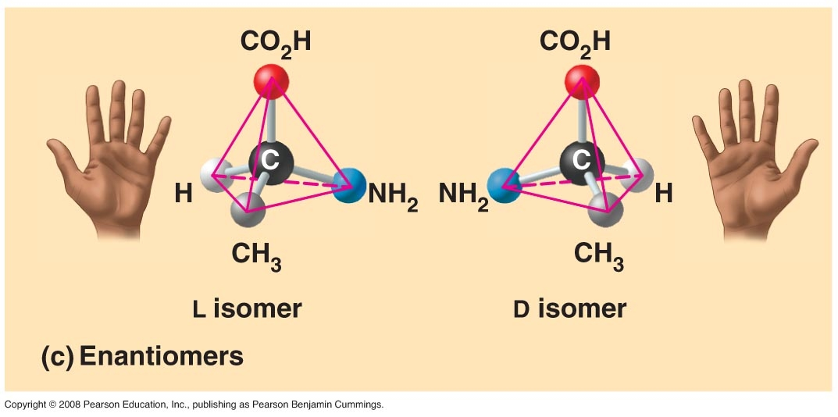

Slide 43
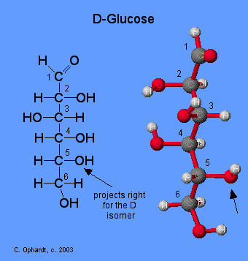
Glucose has two optical forms depending how it rotates polarized light the D- form for Dextrorotatory and L-form for Levorotatory.

Slide 44
D-Glucose versus L-Glucose
Two stereoisomers of the aldohexose sugars are known as glucose, only one of which (D-glucose) is biologically active. This form (D-glucose) is often referred to as dextrose monohydrate, or, especially in the food industry, simply dextrose (from dextrorotatory The mirror-image of the molecule, L-glucose, cannot be metabolized by cells in the biochemical process known as glycolysis.

Slide 45
L-Glucose
L-Glucose is an enantiomer of the more common D-glucose: its molecular structure is the mirror image of the more common form of glucose. It does not naturally in higher living organisms, but can be synthesized in the laboratory. L-Glucose cannot be broken down by living organisms to release energy.
Since L-glucose is sweet (albeit less sweet than D-glucose), but cannot be used as a source of energy, it had been proposed as a low-calorie sweetener. L-glucose was also found to be a laxative, and proposed as a colon-cleansing agent.

Slide 46
Carbohydrates
Empirical Formula (CXH2XOX) for the monomer
Thus it looks like each carbon is watered – hydrated carbon (carbohydrate)
Since some carbohydrates are sweet to taste they can be called the “sugars” – some others can be called the “starches”
The value x in the above formula can assume a value of 3 – 7 in nature – thus Triose carbs, tetrose carbs, pentose carbs, hexose carbs, and heptose carbs (most abundant the 3 & 5) 3 found in metabolic pathways and 5 in DNA and RNA
The carbohydrates make up about 1 -4% of cell mass

Slide 47
Monosaccharide
The monomer (individual molecule capable of repeat) of a carbohydrate is termed a
“Monosaccharide”
Its empirical formula is CH2O
The most notable monosaccharides glyceraldehyde (3-carbon carbohydrate), ribose and deoxyribose (5-carbon carbohydrate, glucose, galactose and fructose (6-carbon carbohydrate)

Slide 48
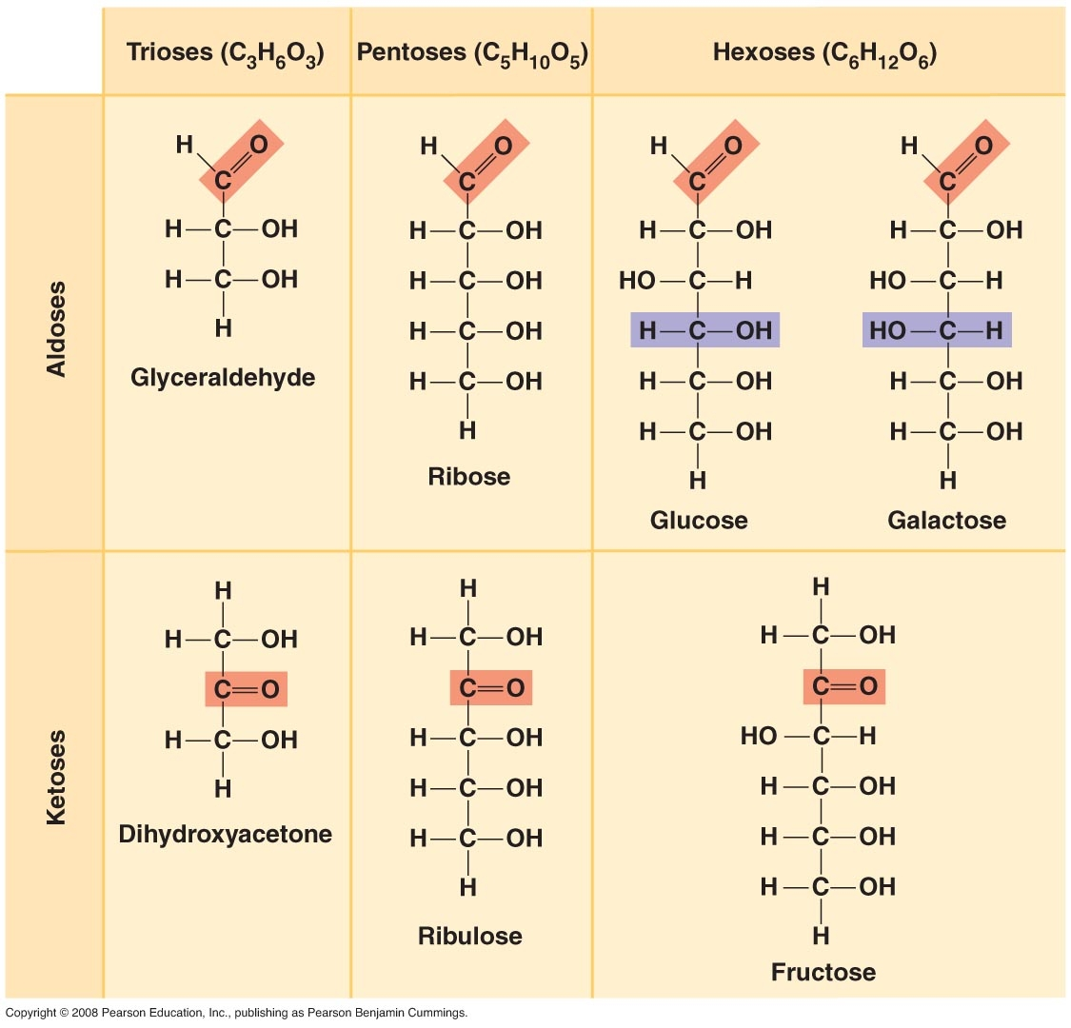

Slide 49
Monosaccharides can exist in the linear form or ring form – but most of the times they exist in the ring form – Why? More thermodynamically stable

Slide 50
Bonding Carbohydrate monomers together
Monosaccharides bond together by the removal of a water molecule (dehydration synthesis) to form a covalent bond between the two monosaccharides known as a “glycosidic bond”
When bond two monosaccharides together termed a disaccharide, when join 3 – 10 together termed an Oligosaccharide – more than 10 together – termed a polysaccharide

Slide 51
When properly identifying glycosidic bonding- one needs to delineate the (1) carbon numbers where the bond is attached – and the (2) shape of the bond.
There are two shapes of glycosidic bonds – the alpha shape and the Beta shape
Alpha 1,2 for sucrose
Alpha 1,4 for maltose
Beta 1, 4 for Lactose

Slide 52
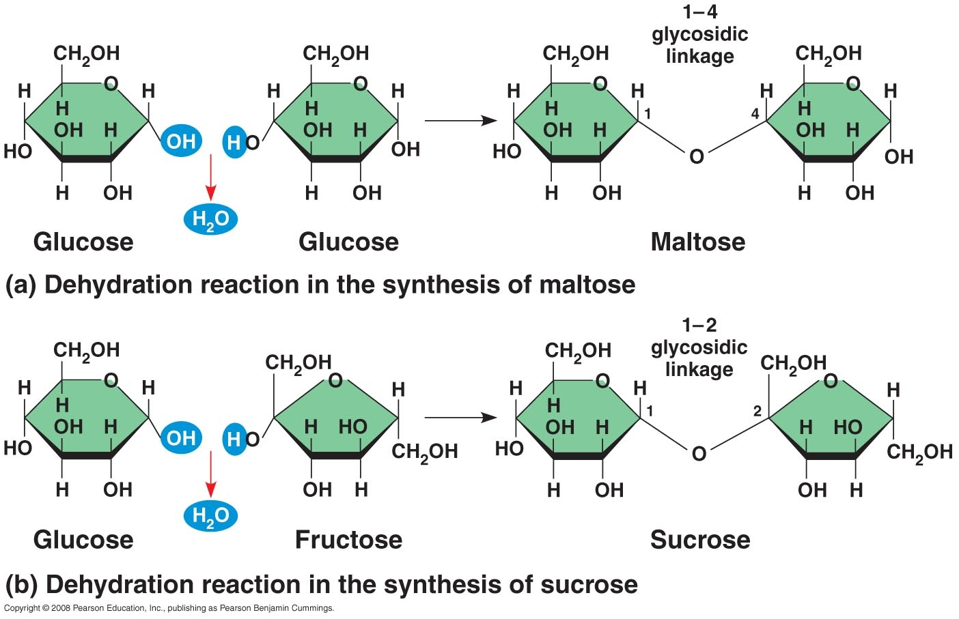

Slide 53
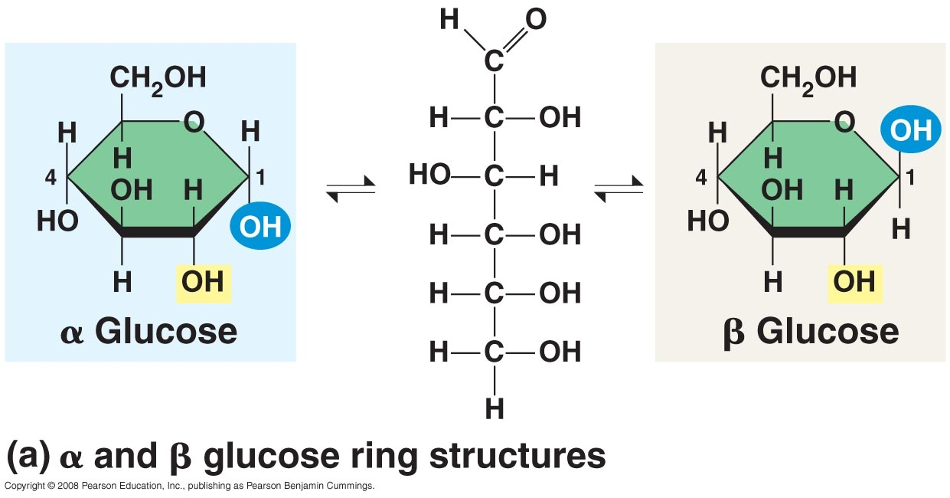
Glucose also has a alpha and Beta form.

Slide 54
Common Disaccharides
Sucrose – table sugar (glucose alpha 1,2 to fructose)
Maltose – in beer (glucose alpha 1,4 to glucose)
Lactose – in milk (galactose beta 1, 4 to glucose)

Slide 55
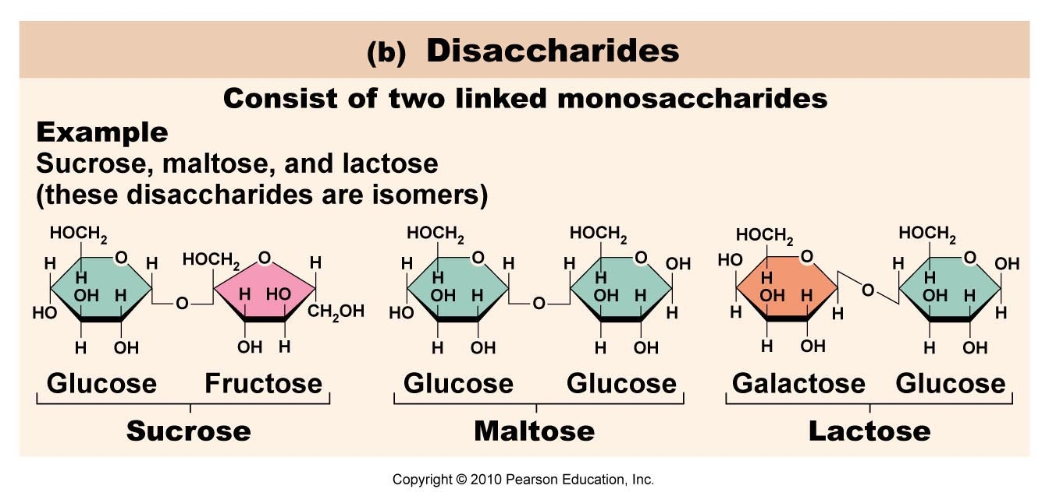

Slide 56
Oligosaccharides
Carbohydrates with 3 – 10 monosaccharides bonded together
They are generally found either O- or N-linked to compatible amino acid side chains in proteins or to lipid moieties (see glycans).
Oligosaccharides are often found as a component of glycoproteins or glycolipids and as such are often used as chemical markers, often for cell recognition.
An example is ABO blood type specificity. A and B blood types have two different oligosaccharide glycolipids embedded in the cell membranes of the red blood cells, AB-type blood has both, while O blood type has neither.

Slide 57
Polysaccharides
Carbohydrates consisting of greater than 10 monosaccharides bonded together
Food wise some are termed the “starches” and one is termed “fiber”
Their purposes are either for
(1) Storage of energy (glycogen, amylose, amylopectin) or
(2) Structure (Cellulose, chitin)

Slide 58
Amylose and Amylopectin
Amylose is a linear polymer of glucose linked mainly by α(1→4) bonds. It can be made of several thousand glucose units. It is one of the two components of starch, the other being amylopectin.
Amylose starch is less readily digested than amylopectin; however, it takes up less space so is preferred for storage in plants. It makes-up about 30% of the stored starch in plants, though the specific percentage varies by species. The digestive enzyme amylase breaks down the starch molecule into maltotriose and maltose.

Slide 59
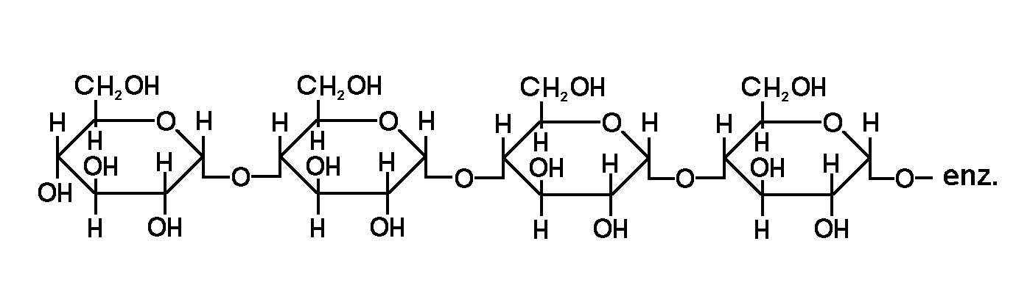
Amylose
Alpha 1,4 Linkages (Linear)

Slide 60
Amylopectin
Amylopectin is a polysaccharide and highly branched polymer of glucose found in plants. It is one of the two components of starch, the other being amylose.
Glucose units are linked in a linear way with α(1→4) glycosidic bonds. Branching takes place with α(1→6) bonds occurring every 24 to 30 glucose units
Its counterpart in animals is glycogen which has the same composition and structure, but with more extensive branching that occurs every 8 to 12 glucose units.

Slide 61
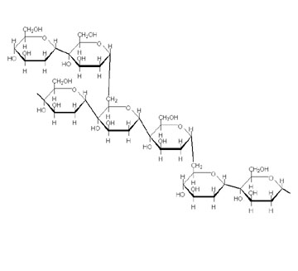
Amylopectin
Alpha 1,4 and Alpha 1,6 (Branching)

Slide 62
Glycogen
Glycogen is the molecule that functions as the secondary short-term energy storage in animal cells. It is made primarily by the liver and the muscles, but can also be made by glycogenesis within the brain and stomach. Glycogen is the analogue of starch, a less branched glucose polymer in plants, and is commonly referred to as animal starch, having a similar structure to amylopectin.

Slide 63
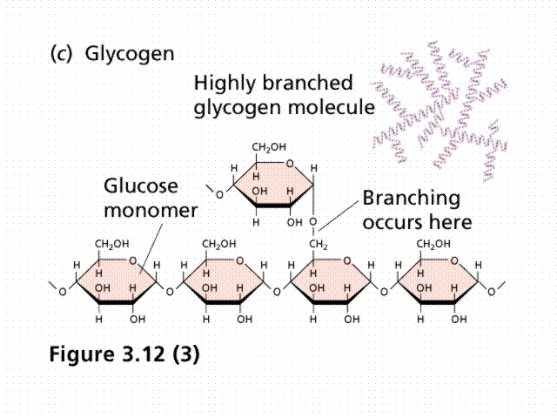
Alpha 1,4 and many Alpha 1,6

Slide 64
Cellulose (Fiber)
Cellulose is an organic compound with the formula (C₆H₁₂O₆)_{n}, a polysaccharide consisting of a linear chain of several hundred to over ten thousand β(1→4) linked D-glucose units.
Cellulose is the structural component of the primary cell wall of green plants, and many forms of algae. Some species of bacteria secrete it to form biofilms. Cellulose is the most common organic compound on Earth. About 33 percent of all plant matter is cellulose (the cellulose content of cotton is 90 percent and that of wood is 50 percent).

Slide 65
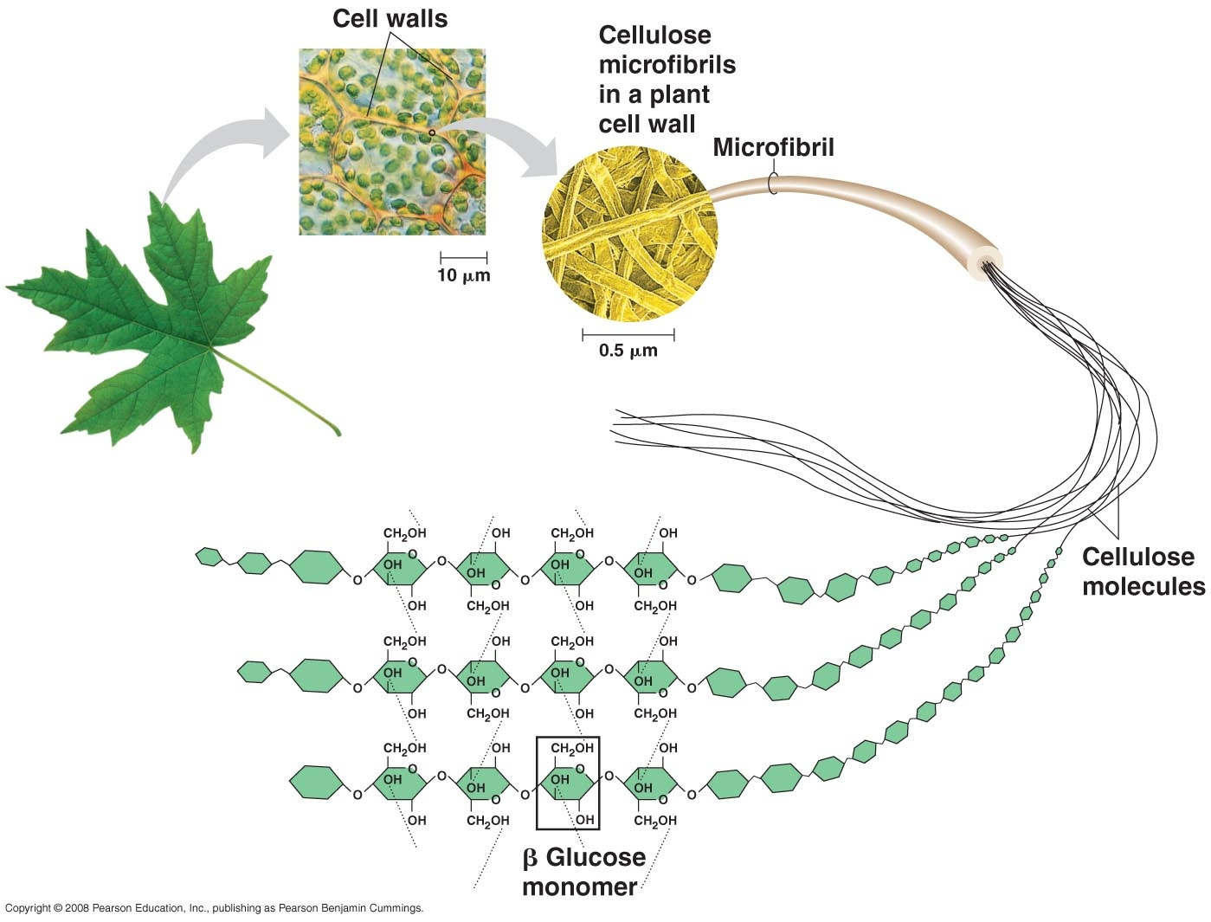
Humans Cannot Break the Beta Bond in Cellulose (Fiber) so it adds bulk to the diet

Slide 66
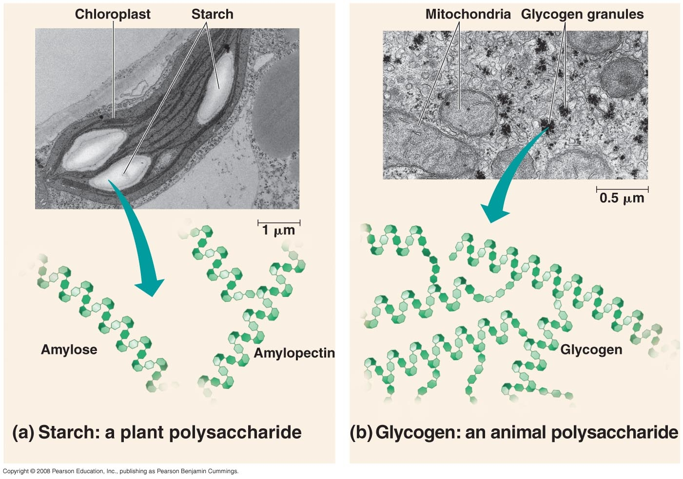

Slide 67
Chitin
Chitin (C₈H₁₃O₅N)_{n} is a long-chain polymer of a N-acetylglucosamine, a derivative of glucose, and is found in many places throughout the natural world. It is the main component of the cell walls of fungi, the exoskeletons of arthropods, such as crustaceans (e.g. crabs, lobsters and shrimps) and insects, including ants, beetles and butterflies, the radula of mollusks and the beaks of cephalopods, including squid and octopuses. Chitin has also proven useful for several medical and industrial purposes – particularly in the making of suture.

Slide 68
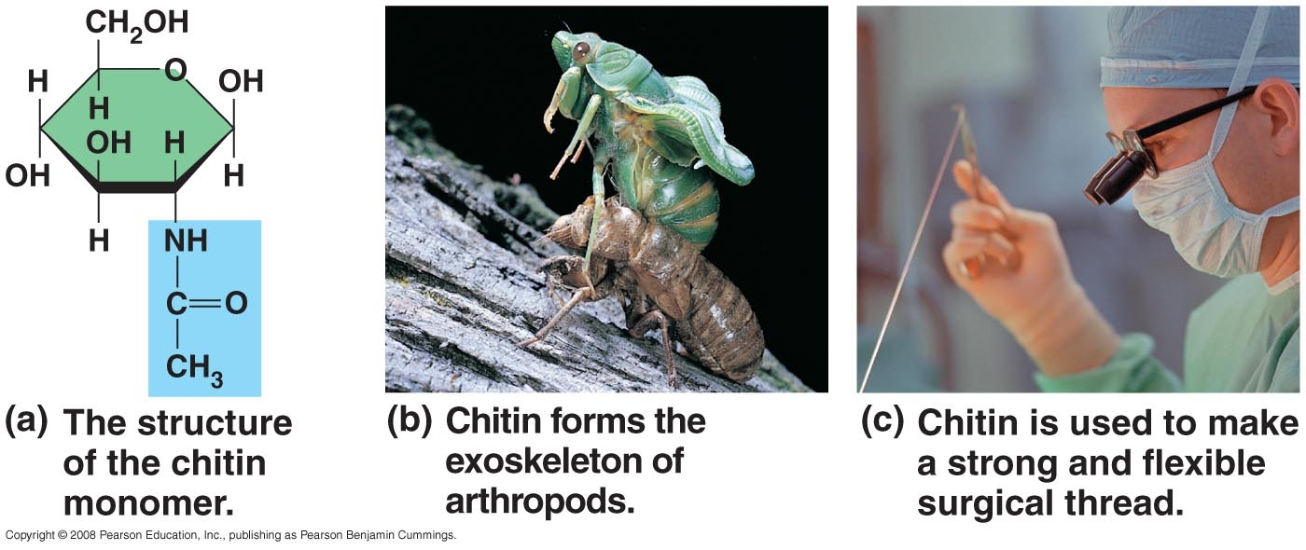
Chitin

Slide 69
Lipids
Substances that are totally or partially insoluble in water – the human body is approximately 18% – 24% Lipid
Fatty Acids
Triglycerides
Phospholipids
Sphingolipids
Carotenoids
Steroids
Eicosanoids
Fat Soluble Vitamins

Slide 70
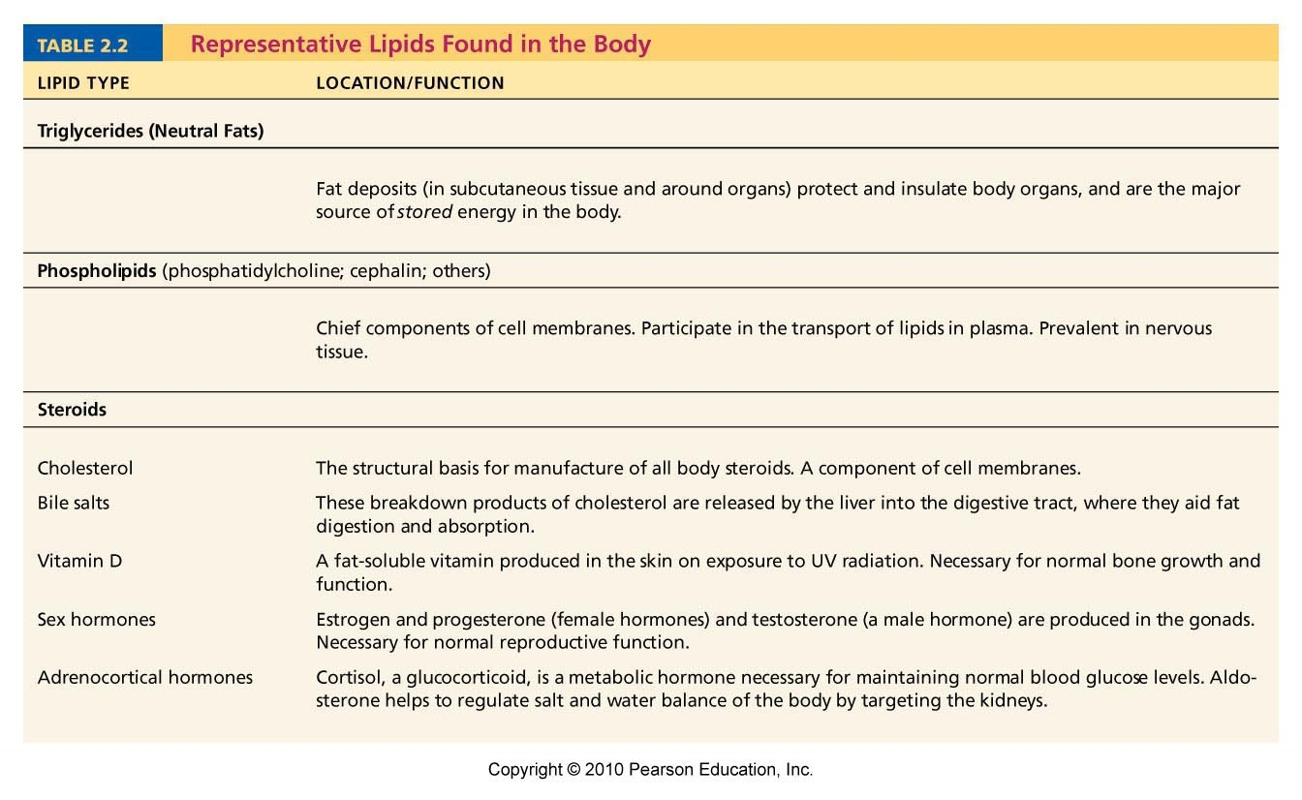

Slide 71
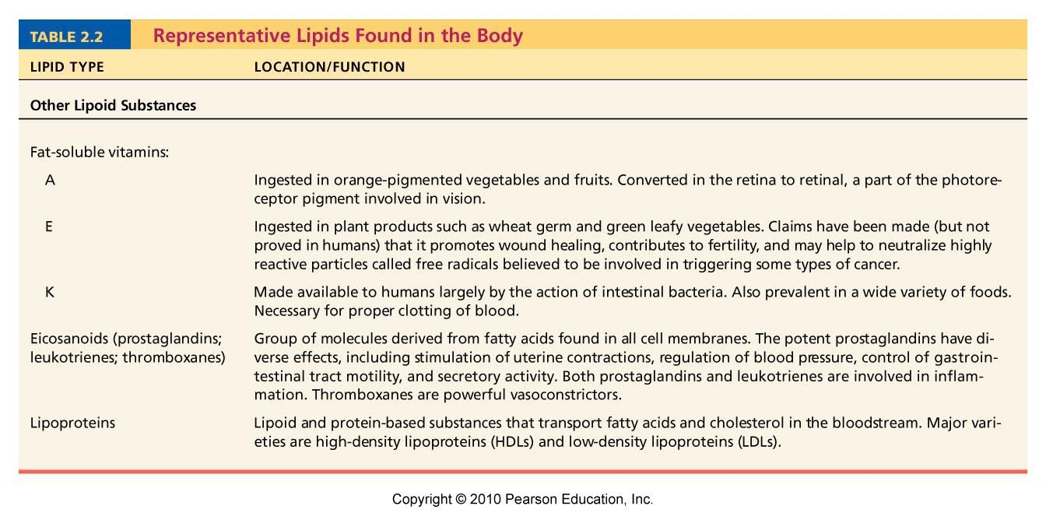

Slide 72
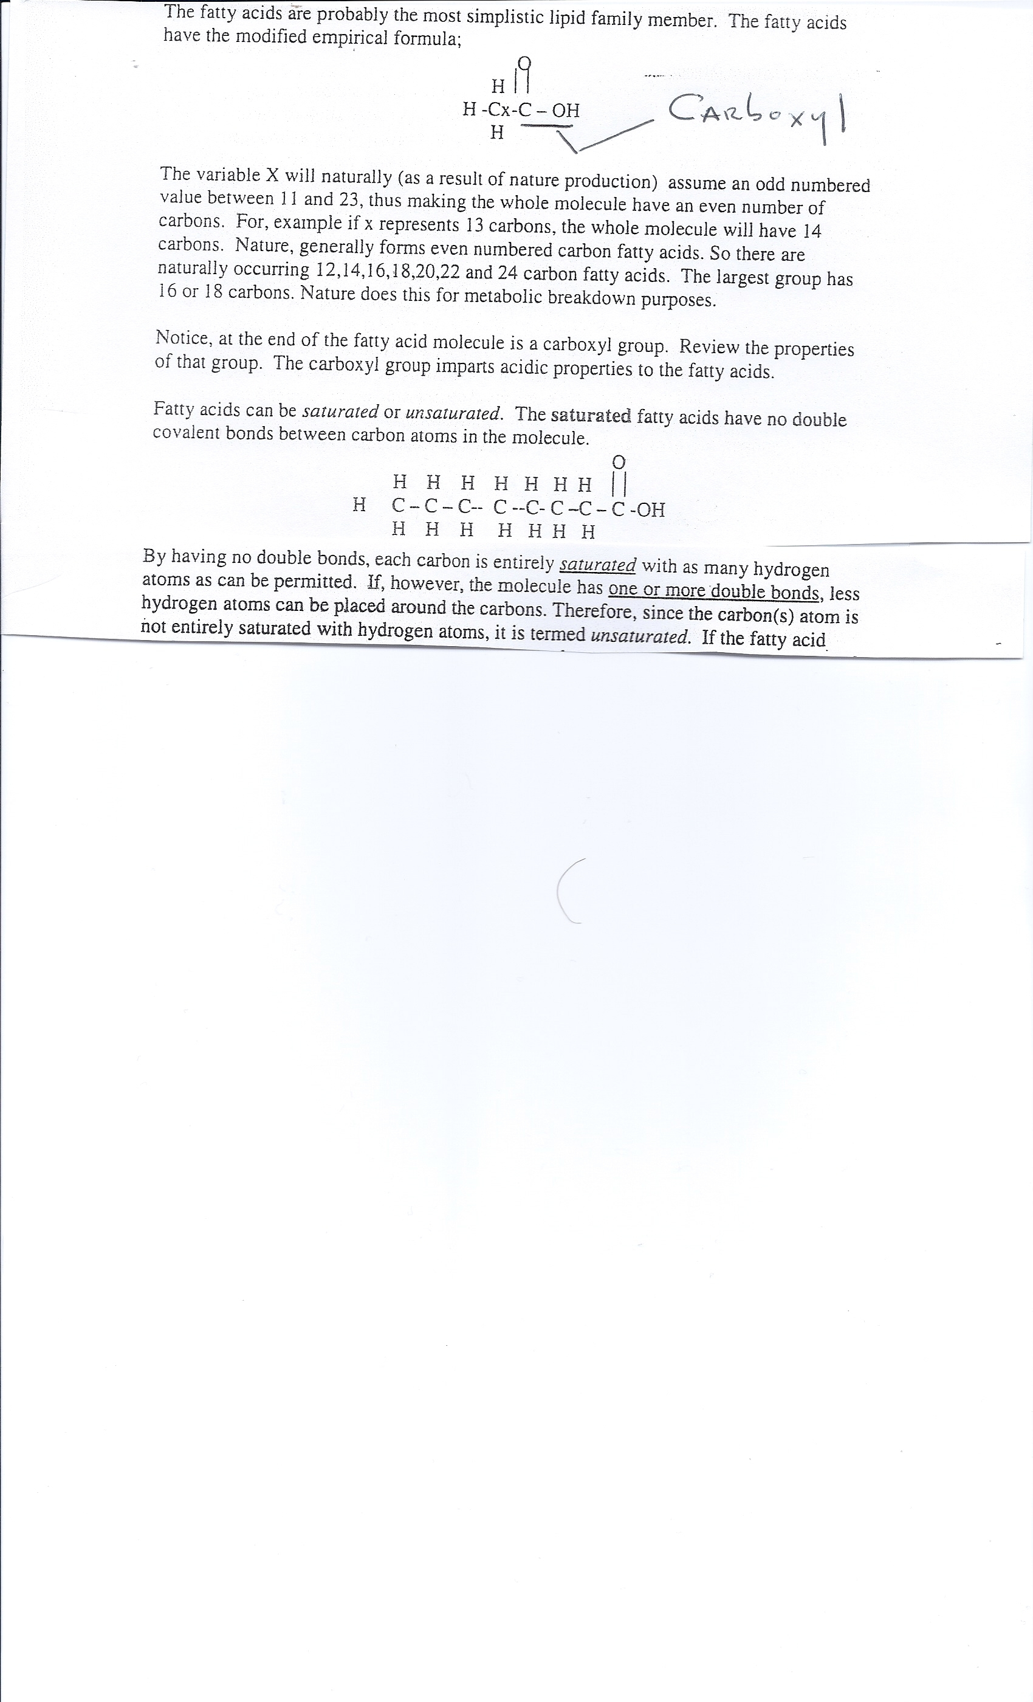
Fatty Acids (Page 14)

Slide 73
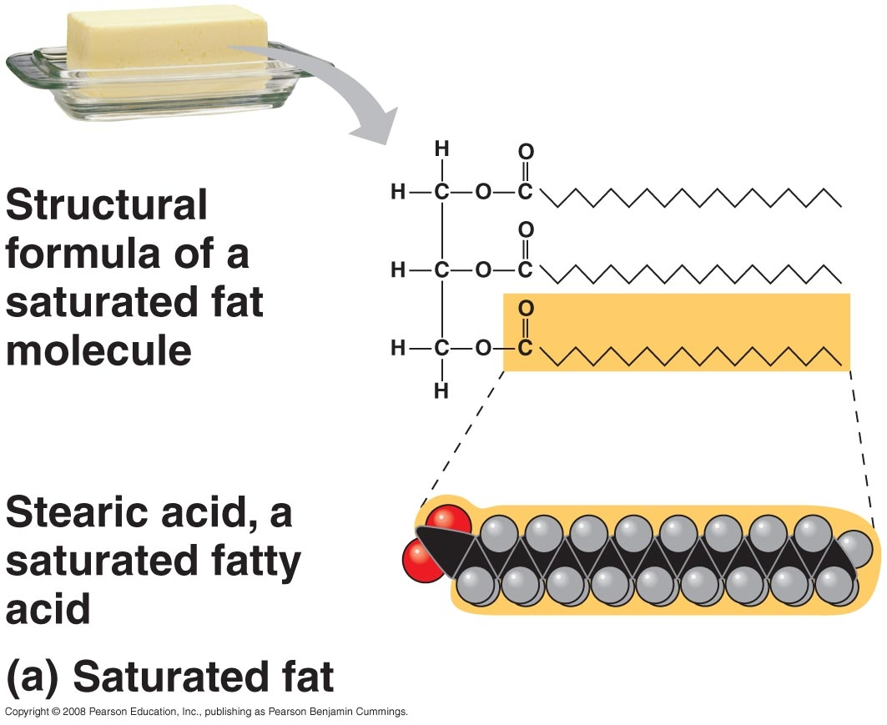

Slide 74
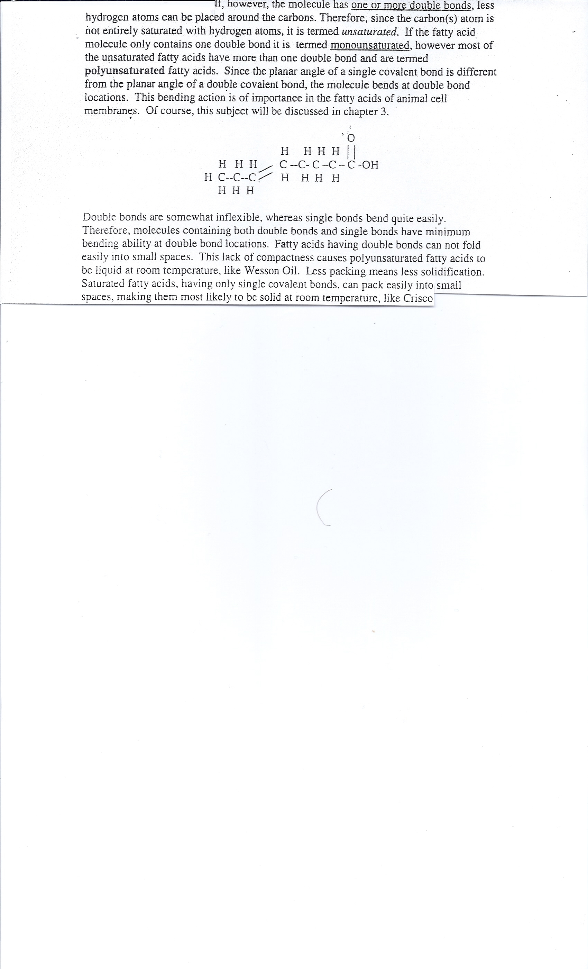
Unsaturated Fatty Acids (p.15)

Slide 75
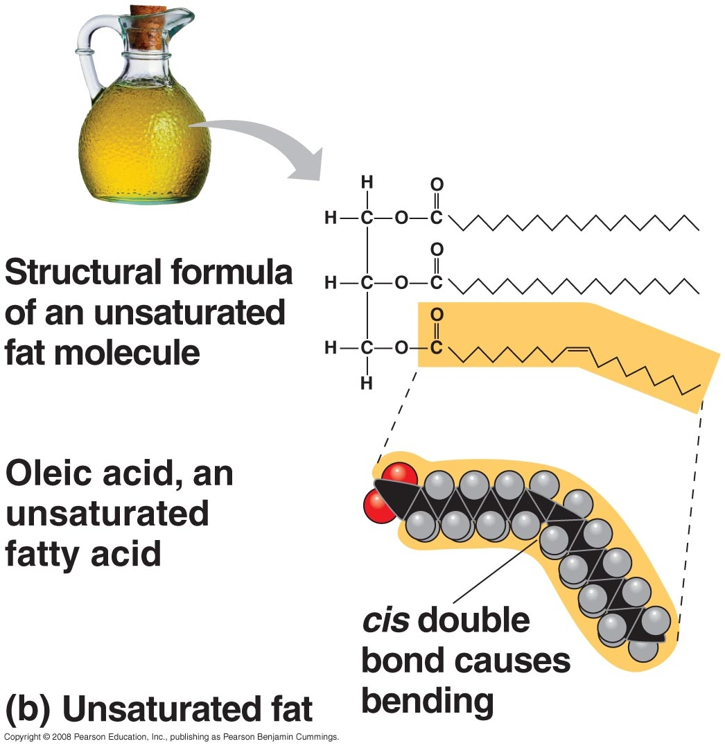
Unsaturated Fat

Slide 76
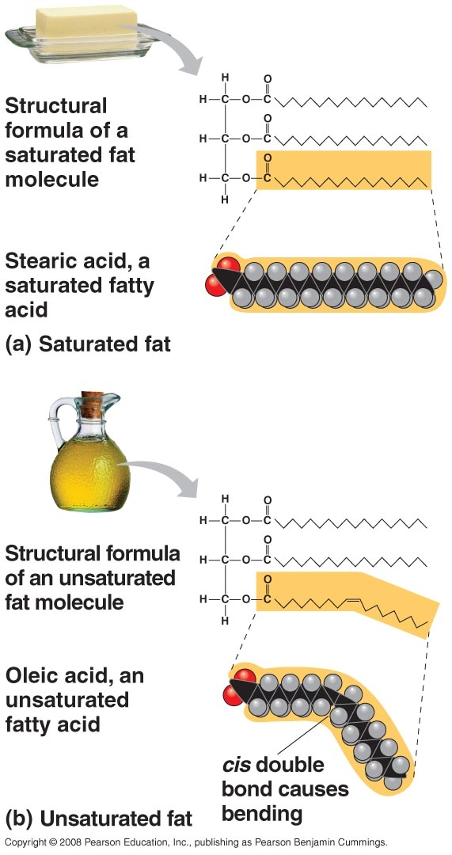
Solid Fat versus Liquid Fat at Room Temperature

Slide 77
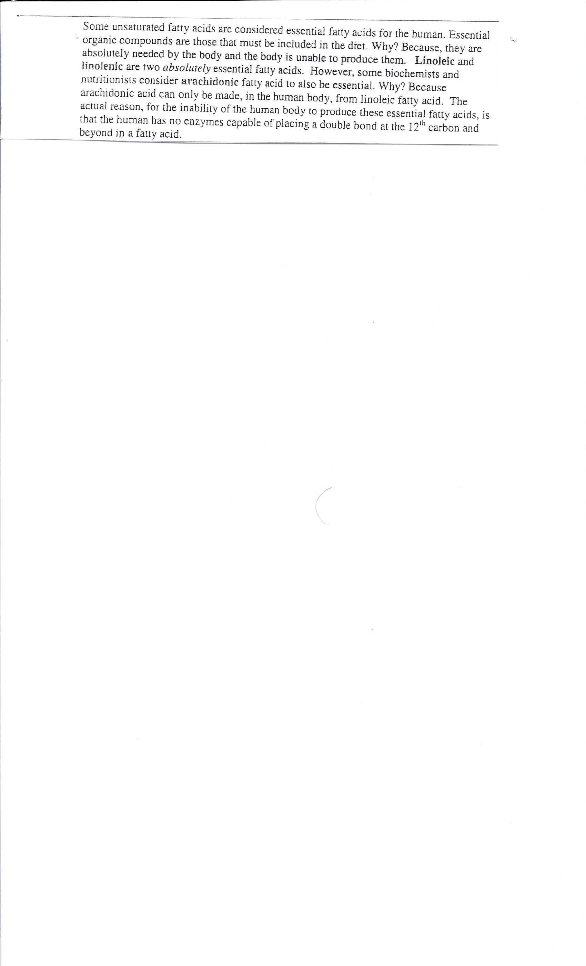
Essential Fatty Acids (p.15)

Slide 78
Essential fatty acids, or EFAs, are fatty acids that cannot be constructed within an organism (generally all references are to humans) from other components by any known chemical pathways, and therefore must be obtained from the diet. These two fatty acids cannot be synthesized by humans, as humans lack the desaturase enzymes required for their production.
There are two families of EFAs: ω-3 (or omega-3 or n−3) and ω-6 (omega-6, n−6). Fats from each of these families are essential, as the body can convert one omega-3 to another omega-3, for example, but cannot create an omega-3 from omega-6 or saturated fats. Humans can make omega -9.

Slide 79
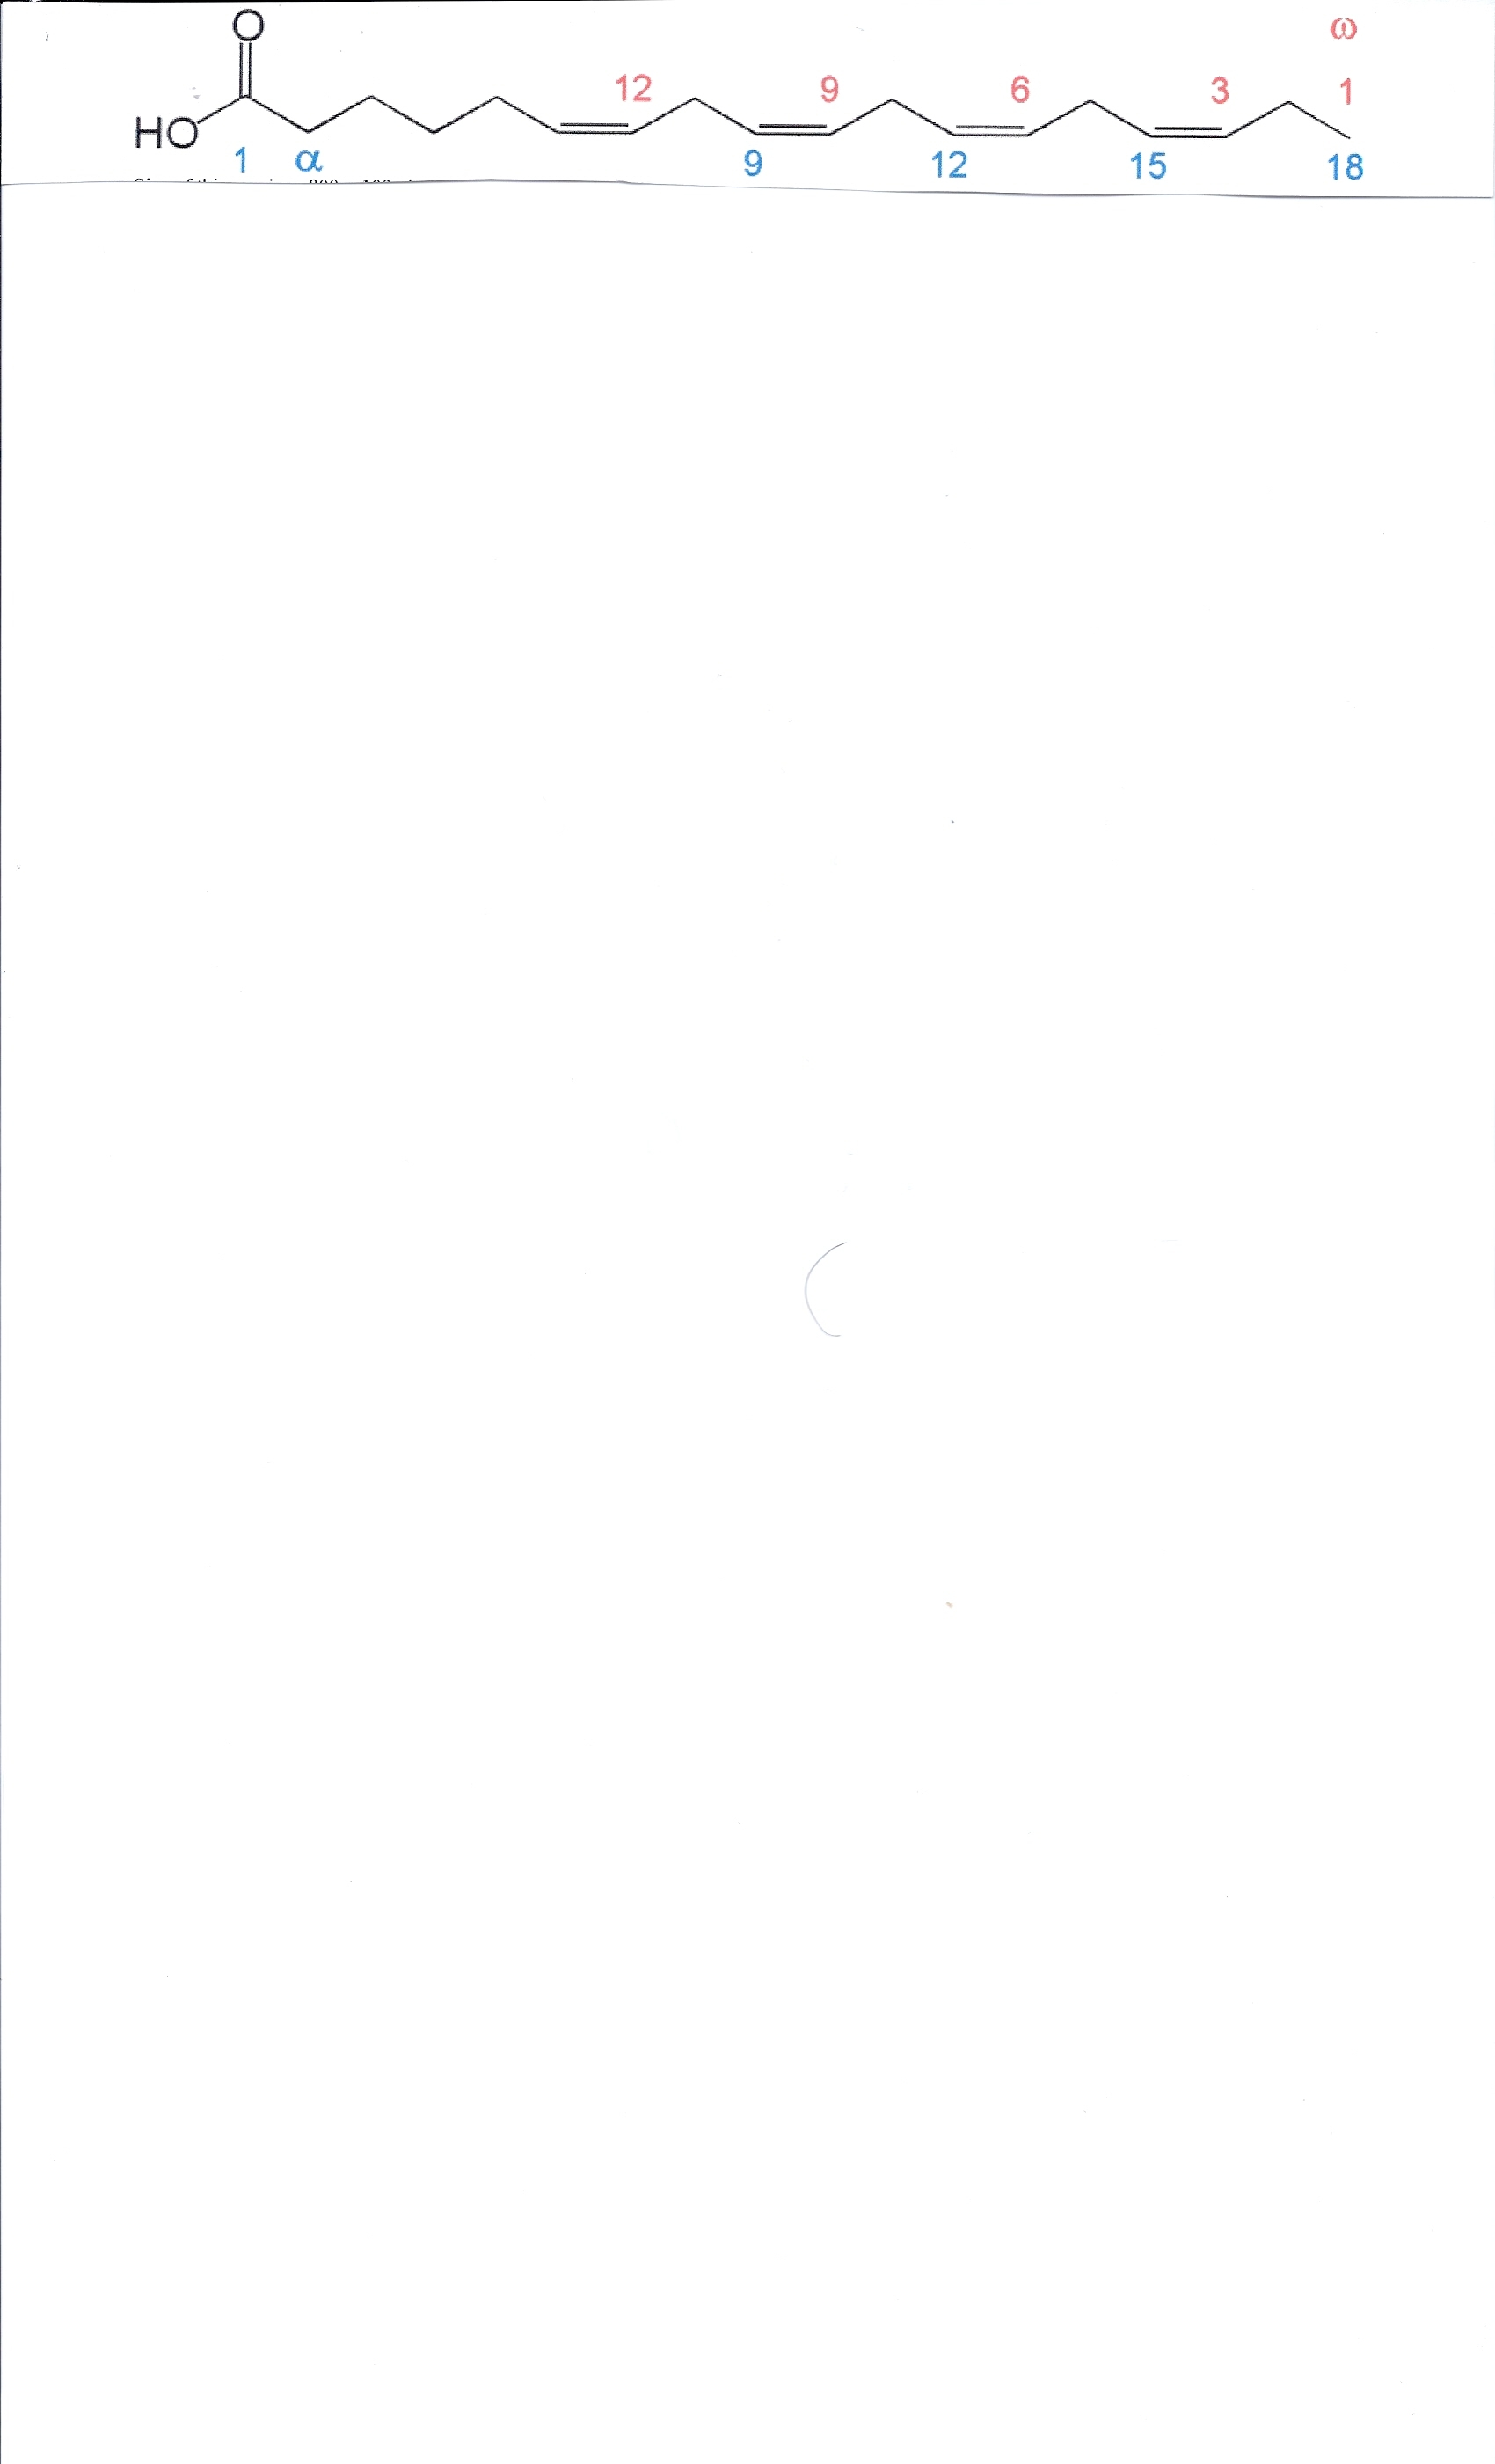
Omega numbering
Count carbons starting from free end and find first double bond

Slide 80
n−3 fatty acids (popularly referred to as omega-3 fatty acids) are a family of unsaturated fatty acids that have in common a final carbon–carbon double bond in the n−3 position; that is, the third bond from the methyl end of the fatty acid.
Important nutritionally essential n−3 fatty acids are: α-linolenic acid
n−6 fatty acids (popularly referred to as ω−6 fatty acids or omega-6 fatty acids) are a family of unsaturated fatty acids which have in common a final carbon–carbon double bond in the n−6 position; example linoleic
The biological effects of the n−6 fatty acids are largely mediated by their conversion to n-6 eicosanoids that bind to diverse receptors found in every tissue of the body. The conversion of tissue arachidonic acid (20:4n-6) to n-6 prostaglandin

Slide 81
Omegas of importance
Omega 3 (Linolenic) – Soy bean oils
Omega 6 (Linoleic and Arachidonic) – Sunflower, Corn Oils
Omega 9 (Oleic) – not essential but good for you – Olive oil, Canola Oil
“ Cardiovascular Protection”

Slide 82
Polyunsaturated
The two subjects below only involve the fatty acids having double bonds (unsaturated)
Cis versus Trans Fatty Acids
Omega Fatty Acids (already discussed)

Slide 83
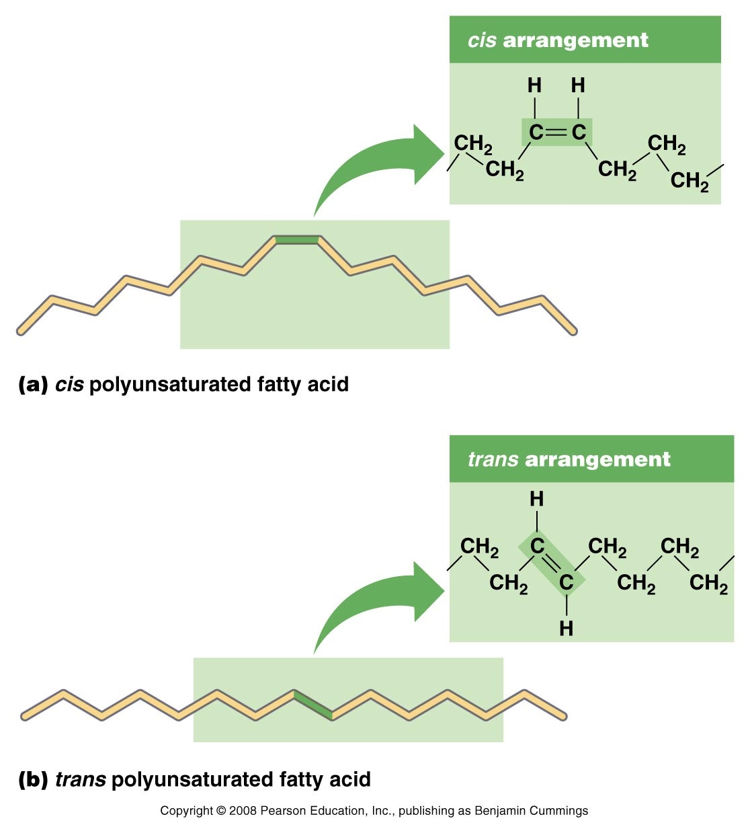
Cis versus Trans Fatty Acids

Slide 84
Trans fat is the common name for a type of unsaturated fat with trans-isomer fatty acid(s). Trans fats may be monounsaturated or polyunsaturated.
The process of hydrogenation adds hydrogen atoms to cis-unsaturated fats, eliminating a double bond and making them more saturated. These saturated fats have a higher meltin point, which makes them attractive for baking and extends shelf-life. However, the process frequently has a side effect that turns some cis-isomers into trans-unsaturated fats instead of hydrogenating them completely.
Unlike other dietary fats, trans fats are not essential, and they do not promote good health The consumption of trans fats increases one's risk of coronary heart disease by raising levels of "bad" LDL cholesterol and lowering levels of "good" HDL cholesterol.[

Slide 85
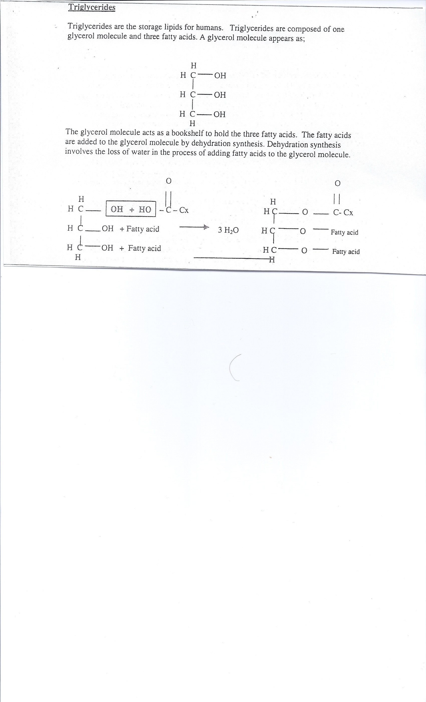

Slide 86
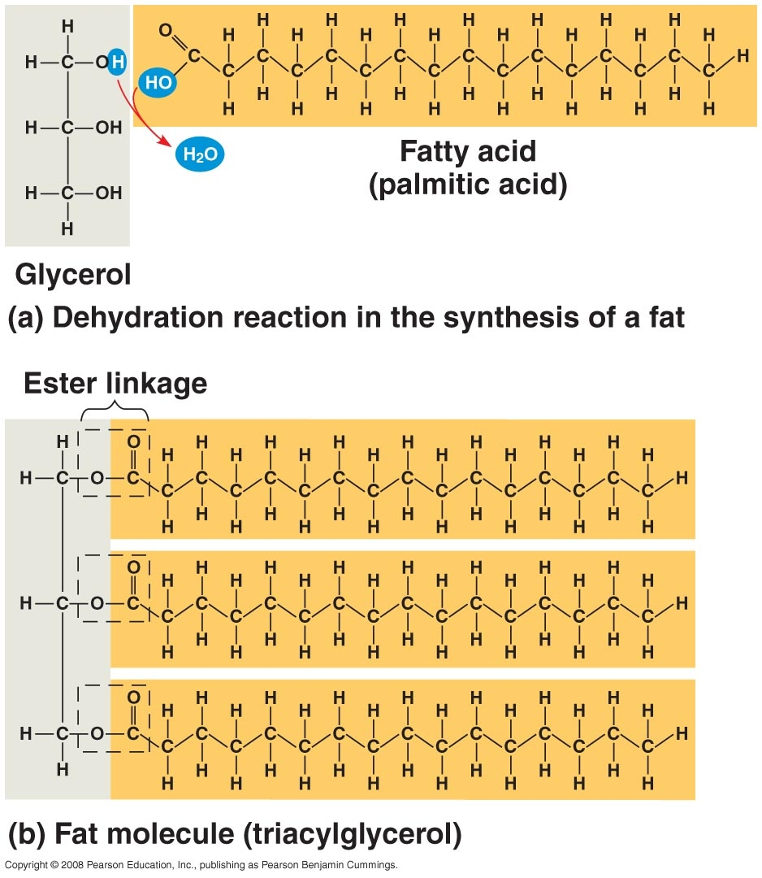
Triglyceride Formation

Slide 87
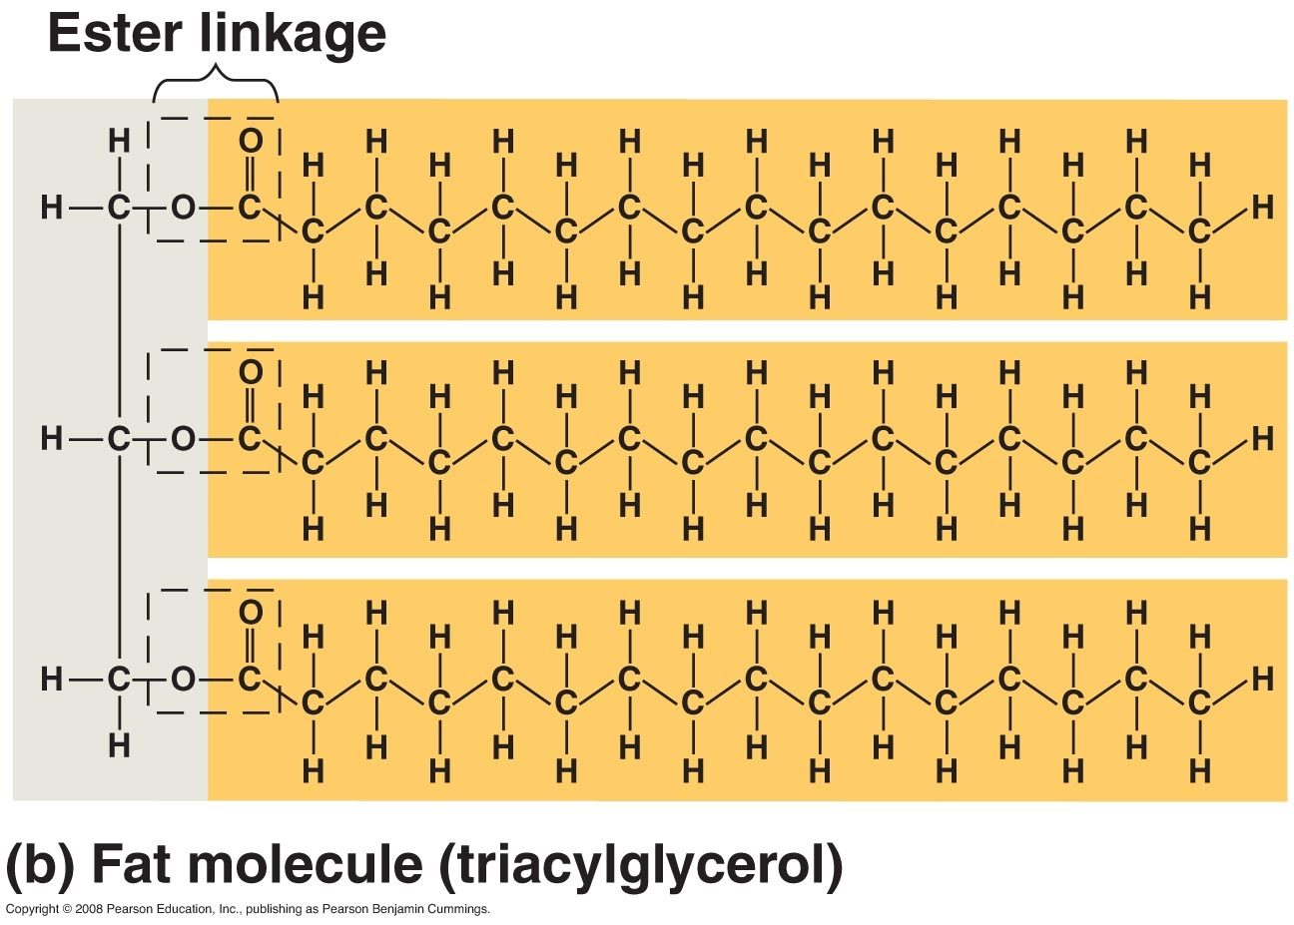
Triglyceride

Slide 88
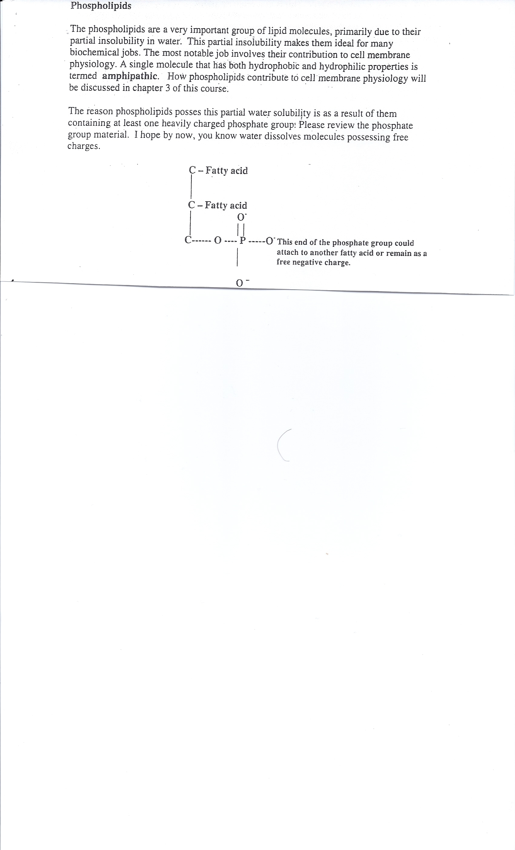

Slide 89

Phospholipid

Slide 90


Slide 91


Slide 92

Charged Region giving Polarity (thus Partially soluble in water)

Slide 93
Sphingolipids
Sphingolipids are a class of lipids derived from the aliphatic amino alcohol sphingosine. These compounds play important roles in signal transmission and cell recognition. Sphingolipidoses, or disorders of sphingolipid metabolism, have particular impact on neural tissue.

Slide 94


Ceramide is the fundamental structural unit common to all sphingolipids. They consist simply of a fatty acid chain attached through an amide linkage to sphingosine.

Slide 95
Functions of mammalian sphingolipids
Sphingolipids are commonly believed to protect the cell surface against harmful environmental factors by forming a mechanically stable and chemically resistant outer leaflet of the plasma membrane lipid bilayer. Certain complex glycosphingolipids were found to be involved in specific functions, such as cell recognition and signaling.
Recently, relatively simple sphingolipid metabolites, such as ceramide and sphingosine-1-phosphate, have been shown to be important mediators in the signaling cascades involved in apoptosis, proliferation, and stress responses.
Ceramide-based lipids self-aggregate in cell membranes and form separate phases less fluid than the bulk phospholipids. These sphingolipid-based microdomains, or "lipid rafts" were originally proposed to sort membrane proteins along the cellular pathways of membrane transport. At present, most research focuses on the organizing function during signal transduction.
Sphingolipids are synthesized in a pathway that begins in the ER and is completed in the Golgi apparatus, but these lipids are enriched in the plasma membrane and in endosomes, where they perform many of their functions. Transport occurs via vesicles and monomeric transport in the cytosol. Sphingolipids are virtually absent from mitochondria and the ER, but constitute a 20-35 molar fraction of plasma membrane lipids

Slide 96
There are three main types of sphingolipids, differing in their head groups:
Sphingomyelins have a phosphorylcholine or phosphoroethanolamine molecule with an ether linkage to the 1-hydroxy group of a ceramide.
Glycosphingolipids, which differ in the substituents on their head group (see image). Glycosphingolipids are ceramides with one or more sugar residues joined in a β-glycosidic linkage at the 1-hydroxyl position.
  Cerebrosides have a single glucose or galactose at the 1-hydroxy position.
    Sulfatides are sulfated cerebrosides.
Gangliosides have at least three sugars, one of which must be sialic acid.

Slide 97

Sphingomyelins have a phosphorylcholine or phosphoroethanolamine molecule with an ether linkage to the 1-hydroxy group of a ceramide

Slide 98
Carotenoids are organic pigments that are naturally occurring in the chloroplasts and chromoplasts of plants and some other photosynthetic organisms like algae, some types of fungus and some bacteria.
There are over 600 known carotenoids; they are split into two classes, xanthophylls (which contain oxygen) and carotenes (which are purely hydrocarbons, and contain no oxygen).
People consuming diets rich in carotenoids from natural foods, such as fruits and vegetables, are healthier and have lower mortality from a number of chronic illnesses

Slide 99


Slide 100
Function of Cholesterol and other Steroids
Cholesterol is required to build and maintain cell membranes; it regulates membrane fluidity over the range of physiological temperatures. Discussed in Chapter 3.
Within the cell membrane, cholesterol also functions in intracellular transport, cell signalling and nerve conduction. Discussed Later
Recently, cholesterol has also been implicated in cell signaling processes, assisting in the formation of lipid rafts in the plasma membrane. In many neurons a myelin sheath, rich in cholesterol since it is derived from compacted layers of lipid. Discussed Later
Cholesterol is an important precursor molecule for the synthesis of Vitamin D and the steroid hormones, including the adrenal gland hormones cortisol and aldosterone as well as the sex hormones progesterone, estrogens, and testosterone and their derivatives.

Slide 101

Cholesterol Structure
Cholesterol is a sterol type steroid - are also known as steroid alcohol. When a steroid has an OH (hydroxyl) group at the 3-position of the A-ring – it is termed a sterol.

Slide 102

Cholesterol

Slide 103


Slide 104


Slide 105
Synthesis
About 20–25% of total daily cholesterol production occurs in the liver; other sites of high synthesis rates include the intestines, adrenal glands and reproductive organs.
Synthesis within the body starts with one molecule of acetyl CoA and one molecule of acetoacetyl. HMG-CoA reductase is an important enzyme in Cholesterol Production – this is the enzyme targeted by the Statin (HMG-CoA Reductase Inhibitors) drugs.

Slide 106


Slide 107

Eicosanoids

Slide 108


Slide 109


Slide 110


Slide 111
Vitamins
In 1905, the first scientist to determine that if special factors (vitamins) were removed from food disease occurred, was Englishmen, William Fletcher. Doctor Fletcher was researching the causes of the disease Beriberi when he discovered that eating unpolished rice prevented Beriberi and eating polished rice did not. William Fletcher believed that there were special nutrients contained in the husk of the rice – later found to be Thiamine.
In 1906, English biochemist Sir Frederick Gowland Hopkins also discovered that certain food factors were important to health. In 1912, Polish scientist Cashmir Funk named the special nutritional parts of food as a "vitamine" after "vita" meaning life and "amine" from compounds found in the thiamine he isolated from rice husks. Vitamine was later shortened to vitamin. Together, Hopkins and Funk formulated the vitamin hypothesis of deficiency disease - that a lack of vitamins could make you sick.

Slide 112
Vitamin
  A vitamin is an organic compound required as a nutrient in tiny amounts by an organism. A compound is called a vitamin when it cannot be synthesized in sufficient quantities by an organism, and must be obtained from the diet.
  There are two divisions of vitamins in human physiology based on solubility – the water soluble and the fat soluble.
  Water soluble – B complex and C
  Fat soluble – A, D, E, K (in order to absorb these vitamins one must be able to adequately absorb fat

Slide 113
Protein
The word PROTEIN comes from Greek language (prota) which means "of primary importance". This name was introduced by Jons Jakob Berzelius in 1838 for large organic compounds with almost equivalent empirical formulas. This name was used because the studied organic compounds were primitive but seems to be very important for animal nutrition.
A Protein is a polymer made up of monomers termed “amino acids”

Slide 114
The functions of proteins are-
Contractile (in muscle Actin and myosin)
Regulatory (Tropomyosin in muscle and others)
Enzymes – discussed later
Structural (collagen and others)
Transport (LDL, HDL and others)
Hormones (Insulin and others)
Immune (Antibodies)
Shock Proteins - a class of functionally related proteins whose expression is increased when cells are exposed to elevated temperatures or other stress. HSPs are found in virtually all living organisms, from bacteria to humans.

Slide 115

Proteins are made-up of monomers called “amino acids. There 20 naturally occurring amino acids.

Slide 116
All of the 20 naturally occurring amino acids has the characteristic amine ( basic) group and carboxyl (acid) group. Thus – what is the difference between the amino acids? The structure of the variable (R) region. Not only does this R region independently identify the various amino acids – its design also dictates if the amino acid will be non-polar (glycine), polar (serine) charged acidic (Glutamic Acid) or charged basic (Lysine).

Slide 117


Slide 118

20 Naturally Occurring Amino Acids listed according to chemical Properties

Slide 119


Slide 120

It is non-polar because of the non-polar R Group

Slide 121

All of the non-polar AAs have non-polar R Groups

Slide 122

Polar Amino Acids with Hydroxyl Group

Slide 123

All of the polar AAs have polar R Groups (hydroxyl, sulfhydryl or carbonyl)

Slide 124


Slide 125

Carboxyl R Group
Charged Acidic

Slide 126

All of the charged acidic AAs have Carboxyl (acidic) R Groups

Slide 127

Charged Basic Amino Acid – Amine R Group

Slide 128
All of the charged basic AAs have amine (basic) R Groups

Slide 129

Sulfhydryl Group is important in forming disulfide bridges in certain protein molecules. These give strength to the protein – like keratin as well as some polarity.

Slide 130

Figure 2.16

Slide 131
Polypeptides and Proteins
Amino Acids join together to make polypeptides or proteins
Amino acids join together by performing dehydration synthesis
A covalent bond hooks amino acids together – the bond is termed a “peptide bond”
Once a polypeptide or protein forms is bends into a certain important shape.
(Shape is Paramount) Polypeptides and Proteins must maintain their shape or they will no longer function properly
When a polypeptide or protein bend out of shape it is termed “Denaturation”

Slide 132
Polypeptide versus Protein
Use of good Terminology
When 100 or less amino acids are joined together – the more proper term for that is a “polypeptide”
When more than 100 amino acids are joined together – the more proper term is “Protein”
Going further – some books even describe the number of amino acids like
2 amino acids bonded – dipeptide or 3 bonded tri-peptide and so forth
Note: not all individuals use the proper terminology – so don’t get confused in you see a book or article state that the 8 amino acid protein does some function

Slide 133

Amino acids join together by performing dehydration synthesis
Figure 2.17

Slide 134
Once a polypeptide or protein is formed the acidic end (carboxyl) and basic end (amine) of each amino acid are neutralized (loss of acid and base) in that the groups combine to form a molecule of water. However, the R- groups of the amino acids are not combined thus they hang free . Remember these are the groups that determine the chemical properties of the AA. So even in a polypeptide or protein the individual amino acids still retain their unique chemical properties.
Once a polypeptide or protein is formed- no matter how long it is (50 AA versus 1000) – one end will be the carboxy end (terminus) and the other will be the amine end (terminus).

Slide 135

R group still free

Slide 136


Slide 137
Once a polypeptide or protein forms it bends into a certain important shape
Polypeptides and proteins bend into specifically described shapes – the shapes are formed in an hierarchical manner
Primary Structure – linear sequence of Amino Acids
Secondary Structure – does the Polypeptide or protein have repeating regions (alpha helix or beta pleated sheet)
Tertiary Structure – describe the 3-D fold of the single stranded Polypeptide or protein
Quaternary structure – if the protein is made-up of more than one polypeptide chain (strand) – the quaternary structure is the shape of the entire protein (inclusive of all its strands)

Slide 138

Primary Structure – linear sequence of Amino Acids (the only thing DNA codes for directly)

Slide 139

Secondary Structure – does the Polypeptide or protein have repeating regions (alpha helix or beta pleated sheet). Secondary structuring is held together by hydrogen bonds

Slide 140

Tertiary Structure – describe the 3-D fold of the single stranded Polypeptide or Protein (held together by different types of chemical bonds depending on location and AA

Slide 141

Quaternary structure – if the protein is made-up of more than one polypeptide chain (strand) – the quaternary structure is the shape of the entire protein (inclusive of all its strands)

Slide 142


Slide 143
What helps a protein fold into its shape? (p 50 of textbook)
Protein chaperones assist in the folding process.
chaperones are proteins that assist the non-covalent folding/unfolding and the assembly/disassembly of other macromolecular structures, but do not occur in these structures when the latter are performing their normal biological functions. The common perception that chaperones are primarily concerned with protein folding is incorrect. The first protein to be called a chaperone assists the assembly of nucleosomes from folded histones and DNA and such assembly chaperones, especially in the nucleus are concerned with the assembly of folded subunits into oligomeric structures.

Slide 144
Chaperones
Many chaperones are heat shock proteins, that is, proteins expressed in response to elevated temperatures or other cellular stresses. The reason for this behavior is that protein folding is severely affected by heat and, therefore, some chaperones act to repair the potential damage caused by misfolding.
Other chaperones are involved in folding newly made proteins as they are extruded from the ribosome. Although most newly synthesized proteins can fold in absence of chaperones, a minority strictly requires them.
Chaperones are found in, for example, the endoplasmic reticulum (ER), since protein synthesis often occur in this area.

Slide 145
Denaturation
(Shape is Paramount To Polypeptides and Proteins)
Polypeptides and Proteins must maintain their shape or they will no longer function properly
When a polypeptide or protein bends out of shape it is termed “Denaturation”
What bends it out of shape?
Wrong pH, wrong temperature and/or wrong osmotic pressure –
THUS NEED
“HOMEOSTASIS”

Slide 146


Slide 147

Generally the more alpha helix’s the more fibrous
Table 2.3.1

Slide 148

Generally the more Beta pleated sheets the more globular
Table 2.3.2

Slide 149


Slide 150
Enzymes
(a Biologic catalyst)
A catalyst is a chemical additive that accelerates a chemical reaction without itself being consumed in the reaction.
By the catalyst not being consumed in the chemical reaction – it is capable on working over-and-over again on several reactions of the same kind
An enzyme is a biologic catalyst- thus it is a biochemical additive that accelerates a biochemical reaction without itself being consumed in the reaction

Slide 151
There are six major classes of enzymes: Oxidoreductases, Transferases, Hydrolases, Lyases, Isomerases, and Ligases
Oxidoreductases - general name for enzymes that catalyze reactions in which one molecule is oxidized while the other is reduced. Enzymes of this type are often called oxidases, reductases, and dehydrogenases.
Transferases - remove groups (not including H) from substrates and transfer them to acceptor molecules (not including water)

Slide 152
Hydrolases - general term for enzymes that catalyze a hydrolytic cleavage reaction.
Lyases - add or remove of groups to form double bonds (not by hydrolysis).
Isomerases - catalyze the rearrangement of bonds within a single molecule.
Ligases - ligate (put together) two substrates at the expense of ATP hydrolysis.

Slide 153
Other Types
Kinases – (sub-type of transferase) catalyze the addition of phosphate groups to molecules. Protein kinases are an important group of kinases that attach phosphate groups to proteins.
Phosphatases - (sub-type of transferase) catalyze the hydrolytic removal of a phosphate group from a molecule.
Polymerases – (type of ligase) catalyze polymerization reactions such as the synthesis of DNA and RNA.
Proteases – (type of hydrolase) break down proteins by hydrolyzing bonds between amino acids.
Nucleases - (type of hydrolase) break down nucleic acids by hydrolyzing bonds between nucleotides.
ATPases - (type of hydrolase) hydrolyze ATP. Many proteins with a wide range of roles have an energy-harnessing ATPase activity

Slide 154
Enzymes are Proteins
New exception
Nearly all known enzymes are proteins. However, certain RNA molecules can be effective biocatalysts too. These RNA molecules have come to be known as ribozymes
Enzymes govern the direction of almost all biochemical reactions – taking the reaction down the path of least resistance
An enzyme's name is often derived from its substrate or the chemical reaction it catalyzes, with the word ending in -ase. Examples are lactase, alcohol dehydrogenase and DNA polymerase

Slide 155
Enzyme History
As early as the late 1700s and early 1800s, the digestion of meat by stomach secretions and the conversion of starch to sugars by plant extracts and saliva were known. However, the mechanism by which this occurred had not been identified.
In the 19th century, when studying the fermentation of sugar to alcohol by yeast, Louis Pasteur came to the conclusion that this fermentation was catalyzed by a vital force contained within the yeast cells called "ferments", which were thought to function only within living organisms. He wrote that "alcoholic fermentation is an act correlated with the life and organization of the yeast cells, not with the death or putrefaction of the cells.”
In 1878, German physiologist Wilhelm Kühne (1837–1900) first used the term enzyme, which comes from Greek ενζυμον, "in leaven“ or “in yeast”, to describe this process.

Slide 156

What slows down a chemical reaction –even if it is exergonic (spontaneous)?
The “energy of activation”
A energy hump that all reactions must go over in order to proceed.

Slide 157

Even if a reaction is non-spontaneous it also has an energy of activation!
The energy of activation is not the main problem disallowing a non-spontaneous endergonic reaction to proceed – it needs the energy deficit to get the reactants uphill.

Slide 158
What energies make-up the energy of activation?
The energies that comprise the energy of activation are the energies involved in the collision theory.
1. Atoms must find one another
2. Atoms must collide in the proper orientation
3. Atoms must have the proper velocity (energy) on impact
4. Atoms must come together in the right chemical environment (right pH, right temperature, right pressure)

Slide 159
What does an enzyme do to the energy of activation?
It lowers the energy of activation
Key issue: An enzyme lowers the energy of reaction – but it in no way donates any energy to the reaction.
If an enzyme donated energy to a reaction – it would slowly but surely become consumed in the reaction - REMEMBER THE DEFINITION
a biochemical additive that accelerates a biochemical reaction without itself being consumed in the reaction

Slide 160

An enzyme lowers the energy of activation
Figure 2.20

Slide 161
How does an enzyme lower the energy of activation?
In order to explain this we must examine the construct of an enzyme
An enzyme is generally a long chain of amino acids arranged in a globular fold – containing two main portions an active site (where the catalysis is performed) and the rest of the protein molecule that supports the active site – sometimes called the structural unit
However – some enzymes also contain sites that bind cofactors or coenzymes, which are needed for catalysis.

Slide 162

Enzyme Structure
Though this picture makes it look like an enzyme is a solid structure – it really is a long folded string of amino acids. I drew it solid to make it easier to visualize.

Slide 163

Enzyme Proteins are folded strings of Amino Acids

Slide 164
Enzyme Active Site
In enzymatic reactions, the molecules at the beginning of the process are called substrates, and the enzyme converts them into different molecules, called the products
The enzyme active site is where the enzyme works on the substrates in order to convert them into products
The enzyme active site has affinity for the substrates - a form of magnetic power on the substrates pulling them into the active site
The enzyme active site has specificity for the substrates – this specificity is in accordance with the molecular shape of the substrates

Slide 165


Slide 166
The enzyme active site has affinity for the substrates - a form of magnetic power on the substrates pulling them into the active site
What causes this action? The type and location of the R – groups of the amino acids in the active site.
Remember the active site is comprised of amino acids just like the rest of the enzyme protein and each amino acid possesses an R-group.

Slide 167

Active Site R- Groups
The substrates are moving by entropic motion around the region
of the active site of the enzyme. The active site R-groups will pull
the right substrates in like a magnet.

Slide 168
Collision Theory Eliminators
Lowering of Energy of Activation
1. Atoms must find one another
2. Atoms must collide in the proper orientation
The active site R-groups pull the substrates in by magnetism – thus causing the substrates to find one another. That eliminated the first tenet of the collision theory which was one of the energies of the collision theory - thus somewhat lowering the energy of activation.
The arrangement of the R-groups in the active site also force the substrates to sit in the proper orientation – thus eliminating tenet two of the collision Theory.

Slide 169
The enzyme active site has specificity for the substrates – this specificity is in accordance with the molecular shape of the substrates
The shape of the active site is almost a congruent fit for the molecular shape of the substrates
There are two active site shape models – Lock and Key & Induced Fit

Slide 170
Lock and Key
Enzymes are very specific, and it was suggested by Emil Fischer in 1894 that this was because both the enzyme and the substrate possess specific complementary geometric shapes that fit exactly into one another. This is often referred to as "the lock and key" model. However, while this model explains enzyme specificity, it fails to explain the stabilization of the transition state that enzymes achieve. The "lock and key" model has proven inaccurate, and the induced fit model is the most currently accepted enzyme-substrate-coenzyme figure

Slide 171
Induced Fit Model
In 1958, Daniel Koshland suggested a modification to the lock and key model: since enzymes are rather flexible structures, the active site is continually reshaped by interactions with the substrate as the substrate interacts with the enzyme. As a result, the substrate does not simply bind to a rigid active site; the amino acid side chains which make up the active site are molded into the precise positions that enable the enzyme to perform its catalytic function. In some cases, such as glycosidases, the substrate molecule also changes shape slightly as it enters the active site. The active site continues to change until the substrate is completely bound, at which point the final shape and charge is determined.

Slide 172

Induced Fit Model
The force of closure of the enzyme active site in the induced fit model provides the necessary impact to give the velocity needed to lock the chemical bond into place. This eliminates another tenet of the collision theory. Generally when the induced fit
Occurs a lip of the enzyme temporarily closes over the substrates to create the necessary internal molecular environment (pH, etc.) to facilitate the chemical bonding process (last tenet of collision theory).

Slide 173
Energy of activation lowered and the reaction proceeds
The Peak Energy state Energy of Activation is also termed the
Transition state.
Figure 2.20

Slide 174

Energy of Activation Lowered with Enzyme

Slide 175
Thermodynamics and Enzymes
In a reversible biochemical reaction, enzymes act like any catalyst in that it does not alter the position of the chemical equilibrium of the reaction. Usually, in the presence of an enzyme, the reaction runs in the same direction as it would without the enzyme, just more quickly. However, in the absence of the enzyme, other possible un-catalyzed, "spontaneous" reactions might lead to different products, because in those conditions this different product is formed faster.
Furthermore, enzymes can couple two or more reactions, so that a thermodynamically favorable reaction can be used to "drive" a thermodynamically unfavorable one. For example, the hydrolysis of ATP is often used to drive other chemical reactions.
Enzymes catalyze the forward and backward reactions equally. They do not alter the equilibrium itself, but only the speed at which it is reached.
If however if in a reversible reaction the equilibrium is greatly displaced in one direction, it is a very exergonic reaction in one direction, the reaction is effectively irreversible. Under these conditions the enzyme will, in fact, only catalyze the reaction in the thermodynamically allowed direction.

Slide 176
The enzyme is Carbonic Anhydrase
CO2 + H2O H2CO3
The reactant substrates are Carbon Dioxide and Water making the product Carbonic Acid. The reaction is reversible and the enzyme Carbonic Anhydrase can catalyze in both directions.

Slide 178
Ability to Release Product
If the R-groups pulled in the substrates like a magnet and held them in place – how is the finished product able to escape (be released)?
Remember that when a chemical bond is formed between atoms – it changes most if not all of the chemical properties of the atom – thus atoms that had an affinity (attached to) for the R-groups before don’t do so after combining into a molecule – they no longer have their original chemical properties.

Slide 179
A Technical Explanation of How Enzymes Work
Enzymes can act in several ways, all of which lower ΔG‡ ⁻Energy of Activation
Lowering the activation energy by creating an environment in which the transition state is stabilized (e.g. straining the shape of a substrate—by binding the transition-state conformation of the substrate/product molecules, the enzyme distorts the bound substrate(s) into their transition state form, thereby reducing the amount of energy required to complete the transition).
Lowering the energy of the transition state, but without distorting the substrate, by creating an environment with the opposite charge distribution to that of the transition state.
Providing an alternative pathway. For example, temporarily reacting with the substrate to form an intermediate ES complex, which would be impossible in the absence of the enzyme.
Reducing the reaction entropy change by bringing substrates together in the correct orientation to react. Considering ΔH‡ alone overlooks this effect.

Slide 180


Slide 181

Enzymes never bind covalently
Enzyme closes around substrate

Slide 182
Cofactors and Coenzymes
Some enzymes require additional chemicals to bind to them in order for them to catalytically convert their reactant substrates into products
If an enzyme has sites for these additionally required substances to bind – they must bind in order for the enzyme to properly work
Terminology – If an enzyme is one that requires these additional chemicals to bind in order to work properly – when the enzyme lacks the additional chemical it is termed an “apoenzyme” – when the additional substance binds it is termed a “holoenzyme”

Slide 183
Cofactors and Coenzymes
New Terminology (different from my handout)
The additional substances are termed cofactors.
Cofactors can be either inorganic (e.g., metal ions and iron-sulfur clusters) or organic compounds (e.g., flavin and heme). Organic cofactors can be either prosthetic groups, which are tightly bound to an enzyme, or coenzymes, which are released from the enzyme's active site during the reaction.

Slide 184
Cofactors
Inorganic Cofactor Organic Cofactor Coenzyme
Inorganic molecule Non-protein organic molecule Non-protein organic molecule
metal ions permanently attached to enzyme * transiently attached
iron sulfur clusters prosthetic group transport chemical groups to
(main role of trace for example (1) the heme of the enzyme
elements) hemoglobin or (2) the flavin Generally the vitamins
of flavin adenine dinucleotide
*Note: the coenzyme detaches as the reaction proceeds

Slide 185
Organic Cofactors
Organic cofactors are small organic molecules (typically a molecular mass less than 1000 Da) that can be either loosely or tightly bound to the enzyme and directly participate in the reaction. In the latter case, when it is difficult to remove without denaturing the enzyme, it can be called a prosthetic group. If an organic cofactor is loosely bound and removed during the reaction it is generally called a coenzyme.

Slide 186
Inorganic Cofactors
Metal ions are common cofactors. In nutrition, the list of essential elements and trace elements reflect their roles as cofactors. In humans this list commonly includes iron, manganese, cobalt, copper, zinc, selenium, and molybdenum. Although chromium deficiency causes impaired glucose tolerance, no human enzyme that uses this metal as a cofactor has been identified.

Slide 187
Coenzymes
coenzymes are organic molecules that are required by certain enzymes to carry out catalysis.
They bind to the active site of the enzyme and participate in catalysis but are not considered substrates of the reaction. They generally exit after the reaction is completed – thus behave like substrates (but are not substrates in that they do not become products).
coenzymes often function as intermediate carriers of electrons, specific atoms or functional groups that are transferred in the overall reaction. An example of this would be the role of NAD in the transfer of electrons in certain coupled oxidation reduction reactions.

Slide 188
The Imposters
What are the inhibitors?
Enzyme inhibitors are molecules that bind to enzymes and decrease their activity (slow down the reaction).
The imposter (inhibitor) molecule has a shape similar to the real substrate or similar to the certain cofactor(s)- remember in the induced fit model -the active site does not exactly fit the substrates – like in the old Lock and Key model – thus look-alike imposters could enter the active site

Slide 189
Enzyme inhibitors can be bad – like taking a poison
Enzyme inhibitors can be good – for example some of the antibiotics – they block a vitally needed enzyme in the pathogen’s biochemistry – but we don’t have the same enzyme -so it kills the pathogen but does not bother us.
They are also used as herbicides and pesticides. Kill the bugs but not us – but some unfortunately do affect us. Always be careful and properly use a bug killer.

Slide 190
Types of Inhibitors
Competitive (attached to the active site)
Reversible (transiently attaches to AS)
Non-reversible (permanently attaches to AS)
Non-competitive (Attaches to other sites on
the enzyme)

Slide 191
Reversible Inhibition
The inhibitor jumps into the active site and jumps out!!!
Though the inhibitor jumps into and out of the active site -it still slows down the catalytic process – because while the inhibitor is in the active the real substrate cannot enter
Reversible inhibitors bind to enzymes with weak non-covalent interactions such as hydrogen bonds, hydrophobic interactions and ionic bonds.

Slide 192
Competitive Inhibition (Reversible)
In competitive reversible inhibition, the inhibitor binds loosely to the enzyme active site – temporarily denying access of the proper substrate to the enzyme’s active site. This usually results from the inhibitor having an affinity for the active site of an enzyme where the substrate also binds; the substrate and inhibitor compete for access to the enzyme's active site. This type of inhibition can be overcome by sufficiently high concentrations of substrate, i.e., by out-competing the inhibitor. Competitive inhibitors are often similar in structure to the real substrate.

Slide 193

Competitive Inhibition

Slide 194
Competitive Inhibition (Non-reversible)
The inhibitor jumps into the active site and permanently attaches by a covalent bond – thus the enzyme molecule is totally taken out of operation

Slide 195

Non-reversible (Irreversible) Inhibition
Note how the irreversible inhibitor locks on
by strong covalent bonding.

Slide 196
Non-Competitive Inhibition
The inhibitor binds to another site – but not the active site
It could block the sites for cofactors
Non-competitive inhibition is a form of mixed inhibition where the binding of the inhibitor to the enzyme reduces its activity but does not affect the binding of substrate. As a result, the extent of inhibition depends only on the concentration of the inhibitor and not the concentration of substrate (not competing with substrate).

Slide 197

Non-competitive Inhibition
Substrate
Active Site
Allosteric site where
Non-competitive
Inhibitor binds

Slide 198
Other less common inhibitions
In uncompetitive inhibition, the inhibitor binds only to the substrate-enzyme complex, it should not be confused with non-competitive inhibitors.
In mixed inhibition, the inhibitor can bind to the enzyme at the same time as the enzyme's substrate. However, the binding of the inhibitor affects the binding of the substrate, and vice versa. This type of inhibition can be reduced, but not overcome by increasing concentrations of substrate. Although it is possible for mixed-type inhibitors to bind in the active site, this type of inhibition generally results from an allosteric effect where the inhibitor binds to a different site on an enzyme. Inhibitor binding to this allosteric site changes the conformation (i.e., tertiary structure or three-dimensional shape) of the enzyme so that the affinity of the substrate for the active site is reduced.

Slide 199
The reaction with the enzyme is faster. But since there is a limitation of enzyme molecules the reaction reaches a plateau phase when all the enzyme molecules are working on substrate.
Plateau phase
Fast Rate
With Enzyme
No Enzyme
Slow rate
Low Concentration High Concentration
Substrate Concentration
Rate of
Reaction

Slide 200
Rates of biochemical reactions after competitive reversible and
Competitive non-reversible inhibitors are added.
The non-reversible goes at non-enzyme rate
Fast Rate
With Enzyme
Competitive Reversible Inhibitor
Non-Reversible
No Enzyme
Slow rate
Low Concentration High Concentration
Substrate Concentration
Rate of
Reaction

Slide 201
Enzymes determine the direction of biochemical reactions by taking the reaction down the path of least resistance. They govern all of our biochemical reactions.
A
No enzyme to take A to B
so very little A goes to B B C
D E F G
Enzyme present to take C to F but not to take C to G so very little G
made but lots of F is made.
Enzyme Present to take A to C

Slide 203
Homeostasis and enzyme activity
One mechanism that enzymes use to assist homeostasis is “by properly governing the direction of biochemical reactions.”
The other mechanism is to use competitive reversible inhibition to control the concentrations of some of the biochemicals we produce in our bodies.

Slide 204
Reversible inhibition to control the concentrations of some of the biochemicals produced In our bodies
[A]
Enzyme 1
[B]
Enzyme 2
[C]
Enzyme 3 Substance D acts as a reversible inhibitor
on enzyme 3 to maintain
the Proper production
concentration of
substance D
[D]
This reversible enzyme activity is a normal physiologic process that keeps substance D produced in the proper concentrations.

Slide 205
Enzyme Involvement in Disease
Since the tight control of enzyme activity is essential for homeostasis, in that enzymes govern the direction of our biochemical reactions. Any malfunction (mutation, overproduction, underproduction or deletion) of a single critical enzyme can lead to a genetic disease. The importance of enzymes is shown by the fact that a lethal illness can be caused by the malfunction of just one type of enzyme out of the thousands of types present in our bodies.
One example is the most common type of phenylketonuria. A mutation of a single amino acid in the enzyme phenylalanine hydroxylase, which catalyzes the first step in the degradation of phenylalanine, results in build-up of phenylalanine and related products. This can lead to mental retardation if the disease is untreated.
Another example is when germline mutations in genes coding for DNA repair enzymes cause hereditary cancer syndromes such as xeroderma pigmentosum. Defects in these enzymes cause cancer since the body is less able to repair mutations in the genome. This causes a slow accumulation of mutations and results in the development of many types of cancer in the sufferer.

Slide 206
Isoenzymes
(Discussed by me later)
Same enzyme active site but amino acid sequence of the structural unit slightly different
Can identify which cell the enzyme comes from as a result of analysis of differences in the composition of the structural unit
Acts as good markers (identifiers) in clinical medicine

Slide 207
The Nucleic Acids (DNA and RNA)
DNA is a polymer and is our genetic material
RNA is a polymer and assists our genetic material

Slide 208
History of DNA
DNA was first isolated by the Swiss physician Friedrich Miescher who, in 1869, discovered a microscopic substance in the pus of discarded surgical bandages. As it resided in the nuclei of cells, he called it "nuclein". In 1919, Phoebus Levene identified the base, sugar and phosphate nucleotide unit.
In 1928, Frederick Griffith discovered that traits of the "smooth" form of the Pneumococcus could be transferred to the "rough" form of the same bacteria by mixing killed "smooth" bacteria with the live "rough" form. DNA's role in heredity was confirmed in 1952, when Alfred Hershey and Martha Chase in the Hershey-Chase experiment showed that DNA is the genetic material of the T2 phage (a virus that infects bacteria).
In 1953 James D. Watson and Francis Crick suggested what is now accepted as the first correct double-helix model of DNA structure in the journal Nature. In an influential presentation in 1957, Crick laid out the "Central Dogma" of molecular biology, which foretold the relationship between DNA, RNA, and proteins, and articulated the "adaptor hypothesis".

Slide 209
If DNA and RNA are the polymers – what is the monomer?
A nucleotide is the monomer unit
A nucleotide is composed of a nitrogenous base, a sugar (ribose or deoxyribose) and a phosphate group

Slide 210

Fig. 5-27c-1
Each nucleotide contains one of
these 5 NBs!
Nitrogenous bases
Pyrimidines
Cytosine (C)
Thymine (T, in DNA)
Uracil (U, in RNA)
RNA has cytosine , adenine, guanine
and uracil (RNA has no thymine)
DNA has cytosine , adenine, guanine
and thymine (DNA has no uracil)
Purines
Adenine (A)
Guanine (G)
(c) Nucleoside components: nitrogenous bases

Slide 211

Fig. 5-27c-2
A nucleotide has one of these two sugars – in DNA the nucleotide
contains Deoxyribose as the sugar ( thus Deoxyribonucleic acid )
and in RNA the nucleotide contains ribose
(thus Ribonucleic Acid)
Sugars
Deoxyribose (in DNA)
Ribose (in RNA)
(c) Nucleoside components: sugars
Ribose has a oxygen at the second carbon and
Deoxyribose does not – thus deoxy

Slide 212

Fig. 5-27
5′ end
Nitrogenous bases
Pyrimidines
5′C
3′C
Nucleoside
Nitrogenous
base
Cytosine (C)
Thymine (T, in DNA)
Uracil (U, in RNA)
Purines
Phosphate
group
5′C
Sugar
(pentose)
Adenine (A)
Guanine (G)
3′C
(b) Nucleotide
Sugars
3′ end
(a) Polynucleotide, or nucleic acid
The third component of the nucleotide is
the phosphate group
Deoxyribose (in DNA)
Ribose (in RNA)
(c) Nucleoside components: sugars

Slide 213
Let’s now polymerize
The bond that hooks nucleotides together to make the polymer of DNA or RNA is termed a phosphodiester bond – the bond forms as a result of the loss of water (dehydration synthesis)
The link is through the attachment of the phosphate group to the 3rd carbon of one sugar and 5th carbon of the other – thus termed an 3,5 phosphodiester bond
The phosphate group is the liaison

Slide 214


Slide 215

3rd Carbon of this sugar hooked
To the phosphate group – then the
Phosphate group is hooked to the
5th carbon of the sugar below – thus
A 3 to 5 linkage

Slide 216
Single Strand Design of Nucleic Acid
Design
Nitrogenous Base
Sugar
Phosphate group
Nitrogenous Base

Slide 217

Fig. 5-27ab
5' end
5'C
3'C
Nucleoside
Nitrogenous
base
5'C
Phosphate
group
3'C
Sugar
(pentose)
5'C
3'C
(b) Nucleotide
3' end
(a) Polynucleotide, or nucleic acid

Slide 218

Fig. 5-UN6

Slide 219

DNA is Double Stranded
Double Strand (DNA) Design
It has two sides – looks like a ladder

Slide 220
DNA Special Bonding of Nitrogenous Bases
The DNA code (Chargaff’s rule) a purine on one side hydrogen bonds to a pyrimidine on the other side
More specifically if Adenine is on one side it will hydrogen bond to Thymine on the other side
If Cytosine is on one side it will hydrogen bond to Guanine on the other side - so
A T
G C

Slide 221

Figure 2.22a, b

Slide 222

Figure 2.22a

Slide 223

Fig. 5-UN8

Slide 224

Fig. 5-UN7

Slide 225
DNA
The two strands of DNA are anti-parallel
If one strand is in the 3 5 direction – the other side is in the 5 3 direction
Human DNA folds into a right handed alpha helix twist

Slide 226


Slide 227


Slide 228

Figure 2.22b, c

Slide 229
DNA Recap
DNA’s only direct job is to code for the primary sequence of a polypeptide/protein
DNA is made-up of nucleotides
The nitrogenous bases are adenine, cytosine, guanine and thymine (no uracil it is in RNA)
The sugar is Deoxyribose
DNA is double stranded – the two strands are attached by hydrogen bonds
Specific Bonding pattern – adenine always bonds to thymine and cytosine always bonds to guanine
Human DNA is twisted into an alpha helix

Slide 230
RNA
RNA is single stranded
RNA generally assists DNA
There are three types of RNA – messenger, transfer and ribosomal (to be discussed later)
The nitrogenous bases in RNA are cytosine, guanine, adenine and uracil (no thymine it is in DNA)
The sugar is ribose

Slide 231
Adenosine Triphosphate (ATP)
ATP is our energy battery
We do not use food energy directly – food energy recharges our energy battery (ATP) – then we use the ATPs energy to drive energy needing (endergonic) reactions
The energy of ATP is located in the chemical bonds of the phosphates
Once the bond is broken using an enzyme – the ATPase enzyme the exergonic energy is released and this energy drives some endergonic reaction in our body such as muscle contraction

Slide 232

Fig. 8-8
Notice the negative charges of the Oxygen atoms next to one another. They want to repel and fly apart.
Adenine
Phosphate groups
Ribose
The chemical bonds holding the phosphate groups are too strong so the bonds won’t let the oxygen atoms push apart. An enzyme could encase the ATP molecule– and its induced fit twist could give enough torsion on the bond to break – one of the phosphate group flies away.

Slide 233


Slide 234


Slide 235

The ejected phosphate group acts like a bullet hitting the Endergonic atom or molecule imparting its energy to that atom or molecule.

Slide 236

ATP Hydrolysis

Slide 237

Fig. 8-12
ATP
+
H₂O
Energy from
catabolism (exergonic,
energy-releasing
processes)
Energy for cellular
work (endergonic,
energy-consuming
processes)
ADP
+
P
i

Slide 238
The ATPase enzyme lowers the energy of activation
ATP
Energy 7.3 kilocalories of energy
is released per mole of ATP
ADP

Slide 239
Enzymes that digest the food along with other enzymes inside a cell
Food
In order to get energy from food - the
food must be digested, absorbed and oxidized (respiration)
Foods exergonic action reenergizes ATP - thus its energy forces the P back onto ADP
After food is metabolized the final waste products are
CO2 and H2O

Slide 240
Reaction A + B going to product AB is endergonic – it needs the exergonic ATP to release energy to drive the reaction
ATP
AB
Energy
A+ B ADP

Slide 241
FOOD ATP Drive Endergonic Rxn
Food gives off energy to restore our energy battery ATP from its ADP state
ATP donates Energy to an Endergonic Reaction
The endergonic reaction can now proceed

Slide 242

Cyclic 3, 5 AMP
This chemical, though using the same component molecules as DNA, RNA And ATP – functions nothing like any of those molecules. It acts with hormones as something
called a secondary messenger. This will be discussed later.

Slide 243
Combination Organic Molecules
We have discussed individual types of molecules – the carbohydrates as separate molecules from the lipids and these separate from the proteins. However- many of the molecules in our bodies are combination molecules like;
Glycolipid – one molecule part carbohydrate and part lipid
Glycoprotein – one molecule part carbohydrate and part protein
Lipoprotein – one molecule part lipid and part protein

