Slide 1
4
Histology
Mike Clark,M.D.

Slide 2
Tissues - the study of is termed “Histology”
A group of cells of similar embryonic origin sometimes with some intercellular substances – all dedicated to a common function.
We have 210 different cell types but only 4 different tissue types
  Epithelial tissue – lines or covers
  Connective tissue – most abundant in body
  Muscle tissue - contractile
  Nerve tissue

Slide 3
Examination of Tissue definition
A group of cells of similar embryonic origin sometimes with some intercellular substances – all dedicated to a common function.
Of the four tissue types – 3 types of tissue cells are not attached to one another – thus they have room to have some substances in between the cells (intercellular substances) – these tissues are connective, muscle, and nerve
Epithelial tissue cells are attached to one another – thus no room between the cells

Slide 4
Examination of Tissue definition
A group of cells of similar embryonic origin sometimes with some intercellular substances – all dedicated to a common function.
The similar embryonic origin refers to the formation of the “germ layers” short for the “germination layers”
The germination layers are the initial embryonic cell layers that all cells, tissues and organs arise from
These layers are termed endoderm, mesoderm and ectoderm

Slide 5
Embryology
Human embryology is a full college or medical school course to itself
However, I will say that all of embryology involves two main actions – migration and differentiation

Slide 6
Embryonic cells move throughout the embryonic body – seeking their adult positions and as they move – they are differentiating into the mature cells they are to become
For example - an endodermal embryonic cell that is intended to be an intestinal epithelial cell would initially be formed in one part of the embryo but would break free and migrate to its intended position and while doing so differentiate into the intestinal epithelial cell

Slide 7
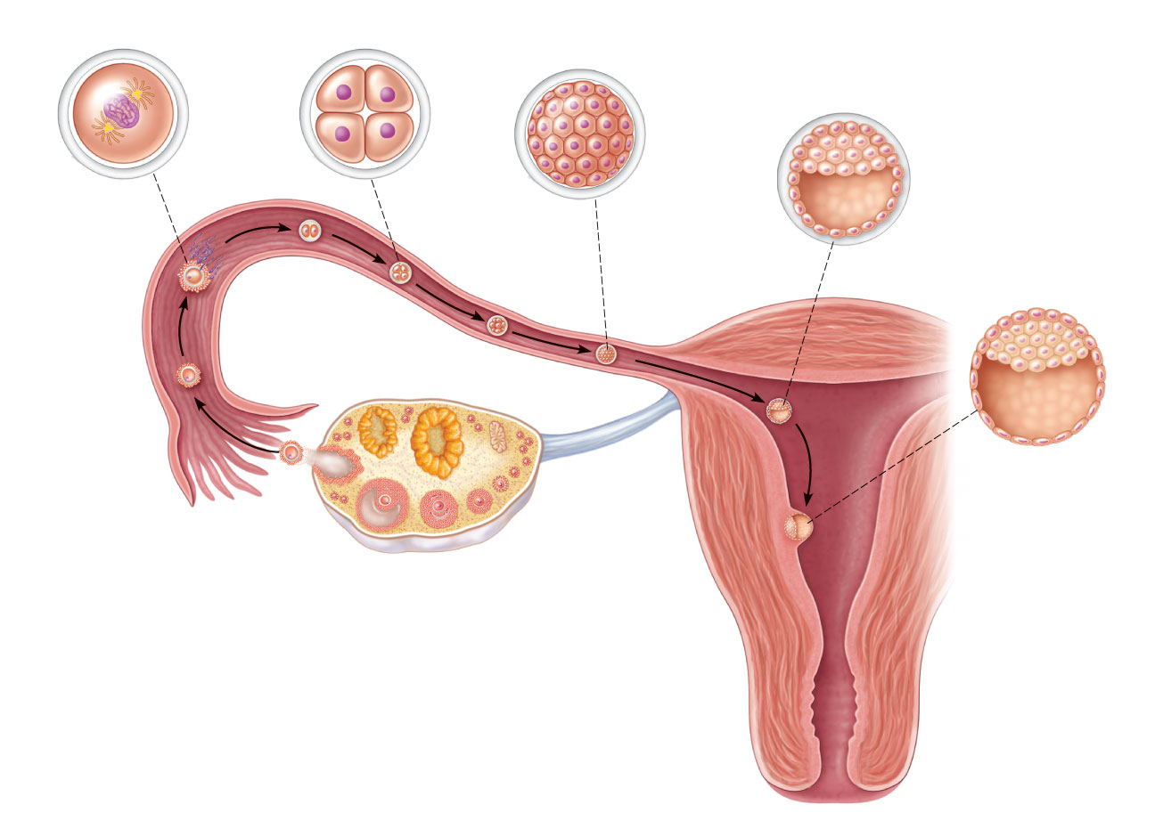
(a) Zygote
(fertilized egg)
(b) 4-cell stage
2 days
(c) Morula (a solid ball
of blastomeres).
3 days
(d) Early blastocyst (Morula
hollows out, fills with fluid,
and “hatches” from the
zona pellucida). 4 days
Zona
pellucida
Degenerating
zona
pellucida
(e) Implanting
blastocyst
(Consists of a
sphere of tropho-
blast cells and an
eccentric cell clus-
ter called the inner
cell mass). 7 days
Sperm
Blastocyst
cavity
Uterine
tube
Fertilization
(sperm
meets and
enters egg)
Oocyte
(egg)
Ovary
Ovulation
Uterus
Blastocyst
cavity
Endometrium
Trophoblast
Inner
cell
mass
Cavity of
uterus
Figure 28.4

Slide 8
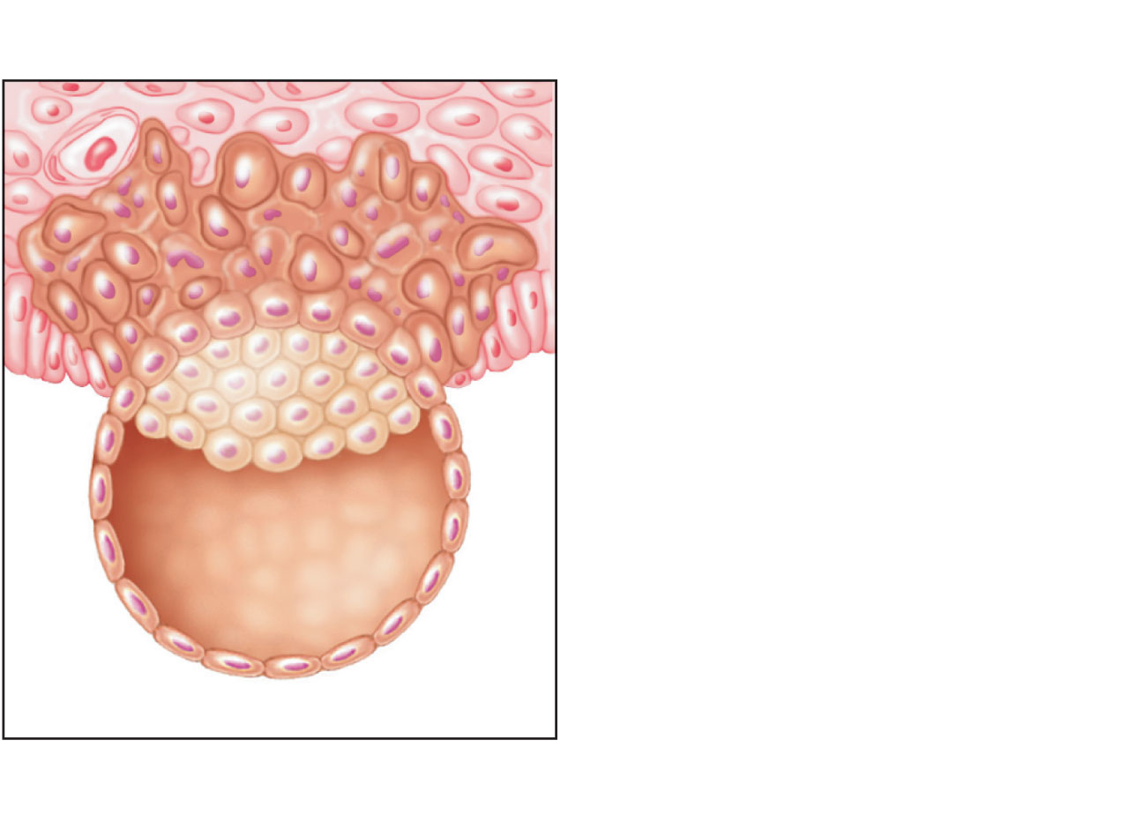
Endometrial stroma
with blood vessels
and glands
Syncytiotrophoblast
Cytotrophoblast
Inner cell mass
(future embryo)
Lumen of uterus
(c)
Figure 28.5c

Slide 9
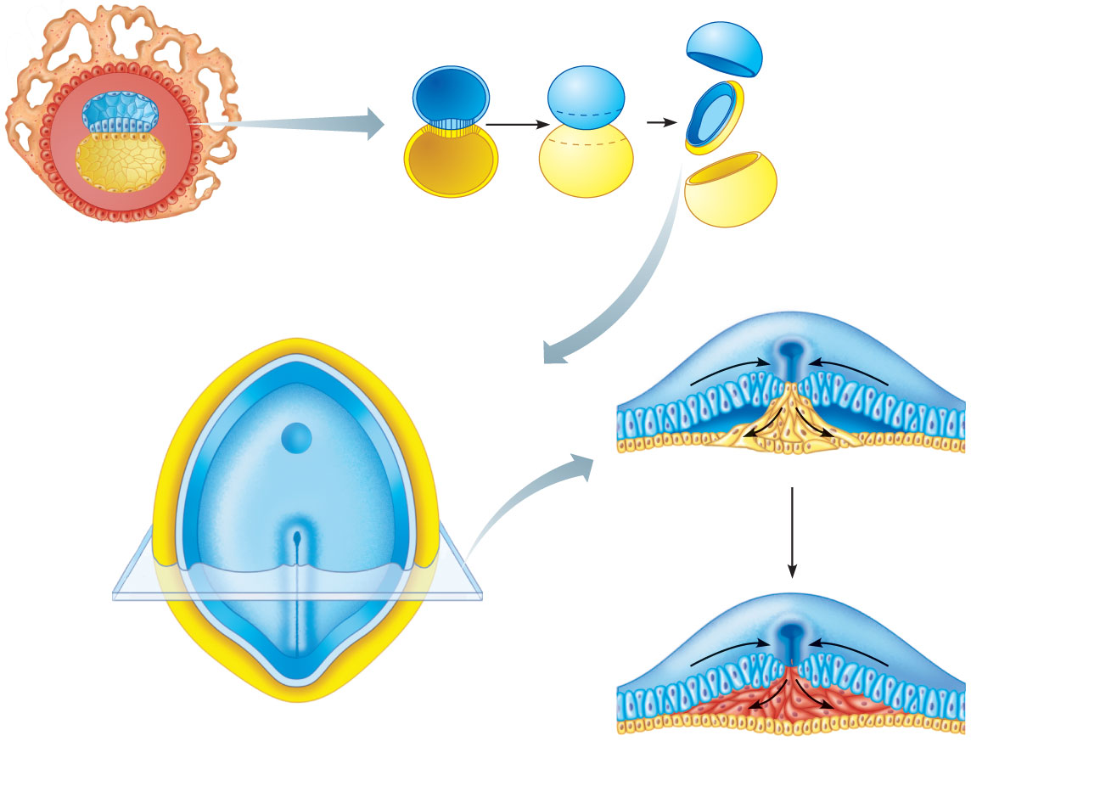
Amnion
Bilayered
embryonic
disc
Head end of bilayered
embryonic disc
Yolk sac
(b) Frontal
section
(c) 3-D
view
(a)
(d) Section
view in (e)
Primitive streak
Head end
Cut edge
of amnion
Yolk sac
(cut edge)
Epiblast
(f) 14-15 days
Endoderm
Hypoblast
Right
Left
Ectoderm
Primitive
streak
Tail end
(e) Bilayered embryonic disc,
superior view
Mesoderm
Endoderm
(g) 16 days
Figure 28.9

Slide 10
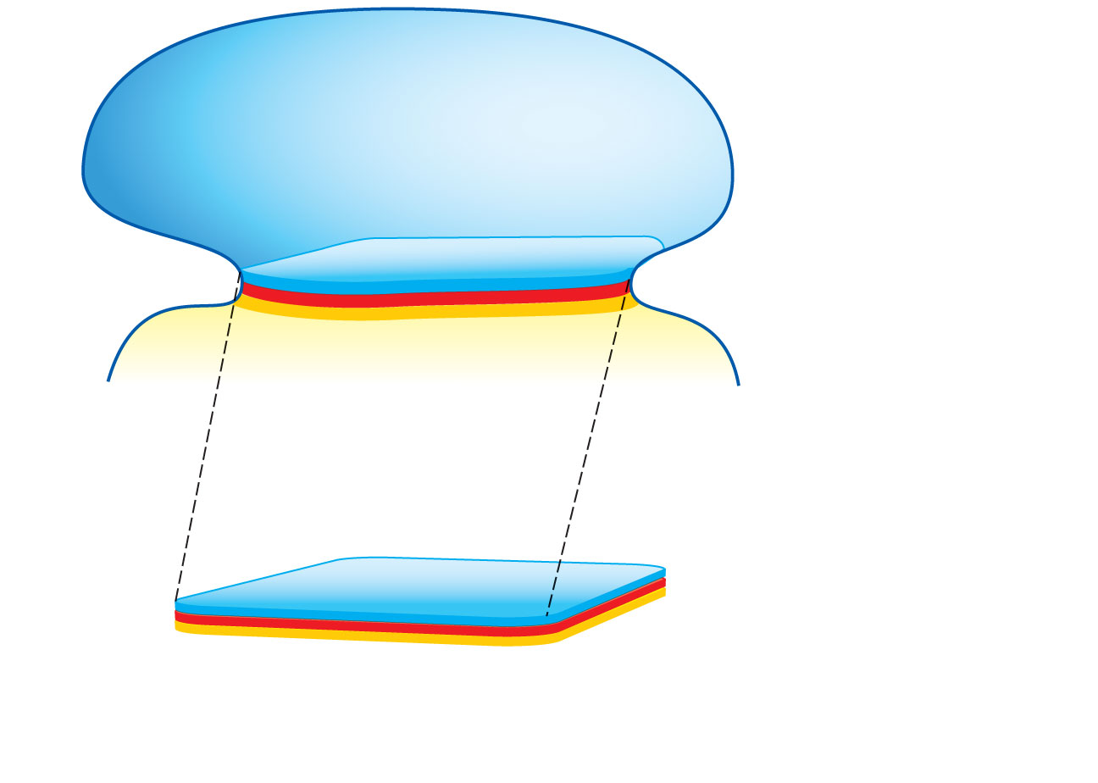
Tail
Head
Amnion
Yolk sac
(a)
Ectoderm
Mesoderm
Trilaminar
embryonic disc
Endoderm
Figure 28.11a

Slide 11
Tissues
We have 210 different cell types but only 4 different tissue types
  Epithelial tissue – lines or covers
  Connective tissue – most abundant in body
  Muscle tissue - contractile
  Nerve tissue

Slide 12
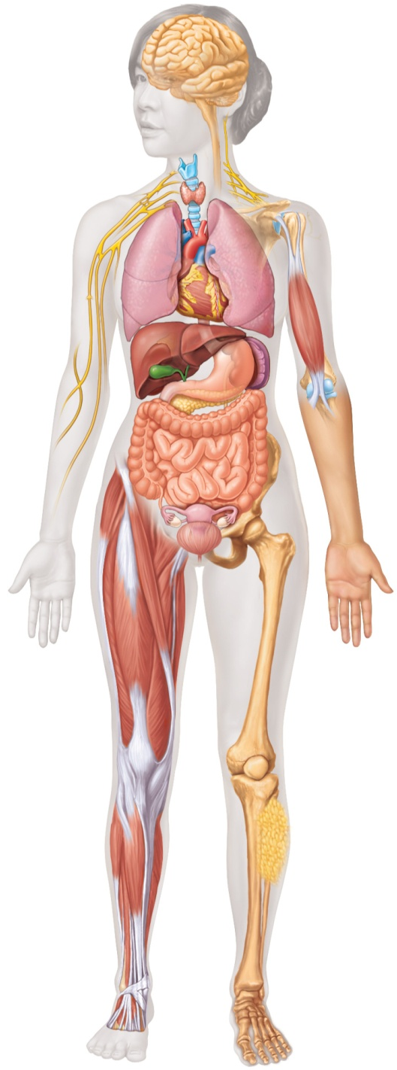
Nervous tissue: Internal communication
• Brain, spinal cord, and nerves
Muscle tissue: Contracts to cause movement
• Muscles attached to bones (skeletal)
• Muscles of heart (cardiac)
• Muscles of walls of hollow organs (smooth)
Epithelial tissue: Forms boundaries between different
environments, protects, secretes, absorbs, filters
• Skin surface (epidermis)
• Lining of GI tract organs and other hollow organs
Connective tissue: Supports, protects, binds
other tissues together
• Bones
• Tendons
• Fat and other soft padding tissue
Figure 4.1

Slide 13
Tissue Origins
Epithelial tissue originates from all three germ layers
Inside lining of blood vessels (endothelium) originates from mesoderm
Inside lining of the gastrointestinal tract originates from endoderm
The epidermis of the skin originates from ectoderm
Connective tissue originates from mesoderm
Muscle tissue originates from mesoderm
Nervous tissue originates from ectoderm

Slide 14
Epithelial Tissue (Epithelium)
The prefix epi means above – thus epithelial tissue always is at the free surface of an organ. Inasmuch as it is at the free surface it lines a hollow organ or structure like the inside of the intestines or it covers a flat surface like the skin.
However, in addition to epithelial tissue’s lining and/or covering function it also is responsible for forming the Exocrine and Endocrine Glands.

Slide 15
Characteristics of Epithelial Tissue
Cells have polarity—they have a defined top and bottom. The top can be called the apical (upper, free) surface and the bottom the basal (lower, attached) surface
  Some epithelial tops (Apical surfaces) have microvilli (e.g., brush border of intestinal lining) or cilia (e.g., lining of trachea)

Slide 16
Characteristics of Epithelial Tissue
Epithelial cells are connected to one another by intercellular junctions.
  Continuous sheets held together by tight junctions and desmosomes

Slide 17
Membrane Junctions
Three classes of junctions – depending on function :
  Anchoring Junctions – these junctions hold cells in their relative positions – some authors state there are two types (Adherens junction and Desmosome)
  Tight junction – (also termed occludens junctions) the tight junction keeps most water soluble substances from passing between the cells – but they can be leaky
  Gap junction (also termed nexus junctions) – allows water soluble substances to pass from one cell to another

Slide 18
Anchoring Junctions – hold cells in relative position
Macula or Zonula Adherens
An adherens junction is defined as a cell junction whose cytoplasmic face is linked to the actin cytoskeleton. They can appear as bands encircling the cell (zonula adherens) or as spots of attachment to the extracellular matrix (macula adherens).
Adherens junctions may serve as a regulatory module to maintain the actin contractile ring with which it is associated in microscopic studies.

Slide 19
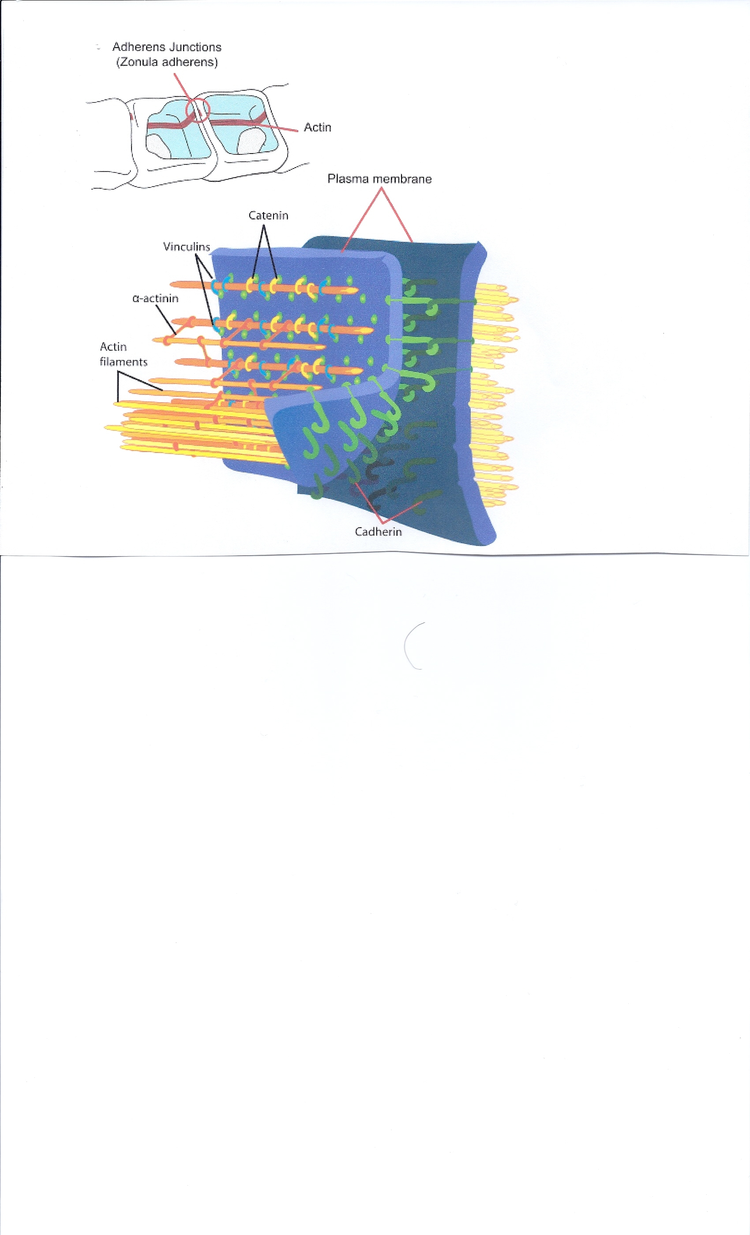
Adherens Junction
Weaker Cadheren
Weaker Filaments

Slide 20
Anchoring Junctions – hold cells in relative position
Desmosomes –stronger anchoring junction than the adherens junction
Uses Keratin and Stronger Cadherin

Slide 21
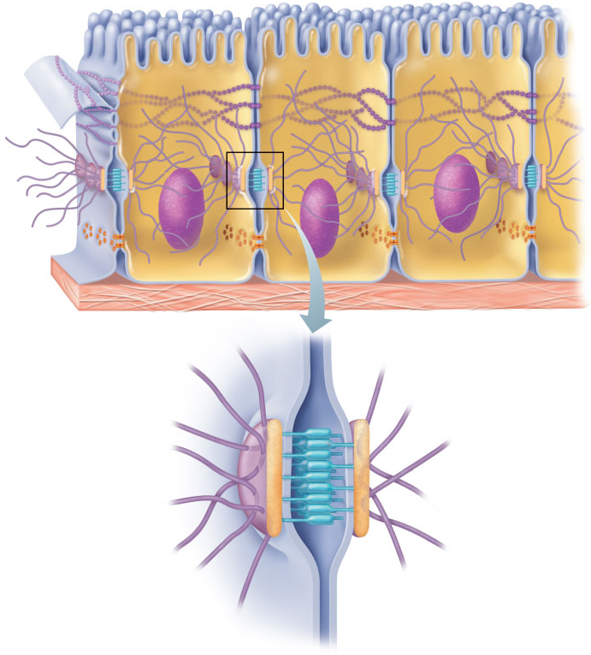
Plasma membranes
of adjacent cells
Microvilli
Intercellular
space
Basement membrane
Intercellular space
Stronger filaments
Plaque
Stronger cadherin
Intermediate
filament (keratin)
Linker glycoproteins
(cadherin)
(b) Desmosomes: Anchoring junctions bind adjacent cells together
and help form an internal tension-reducing network of fibers.
Figure 3.5b

Slide 22
Tight Junctions – Occludens Junctions
Prevent water soluble substances from passing between the cells – sometimes these junctions are leaky
For example in something known as the “Blood – Brain barrier”

Slide 23
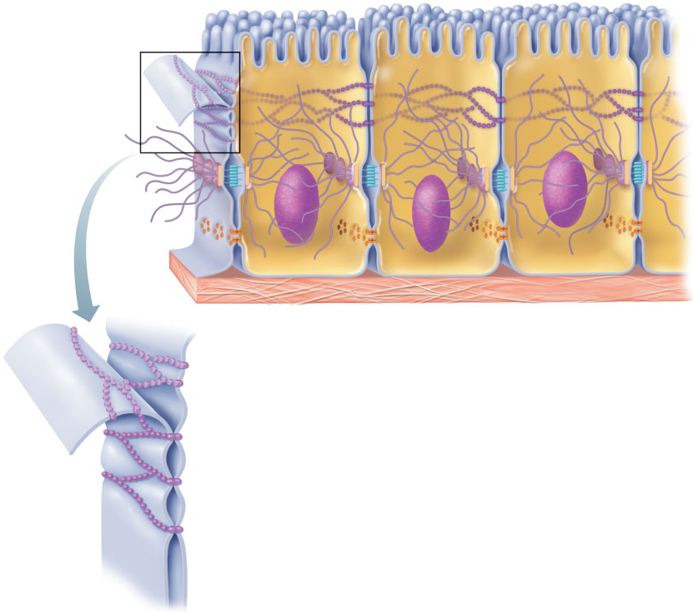
Plasma membranes
of adjacent cells
Microvilli
Intercellular
space
Basement membrane
Interlocking
junctional proteins
Intercellular
space
(a) Tight junctions: Impermeable junctions prevent water soluble molecules
from passing through the intercellular space (between the cells).
Figure 3.5a

Slide 24
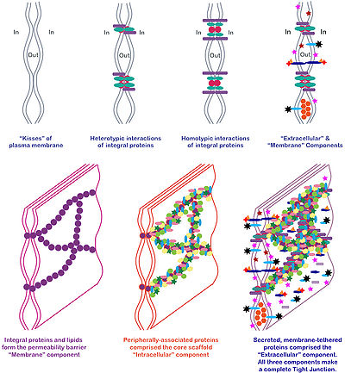
Tight Junctions (Detailed Structure)

Slide 25
Gap Junctions
A gap junction or nexus is a specialized intercellular connection between a multitude of animal cell types. It directly connects the cytoplasm of two cells, which allows various water soluble molecules and ions to pass freely between cells.

Slide 26
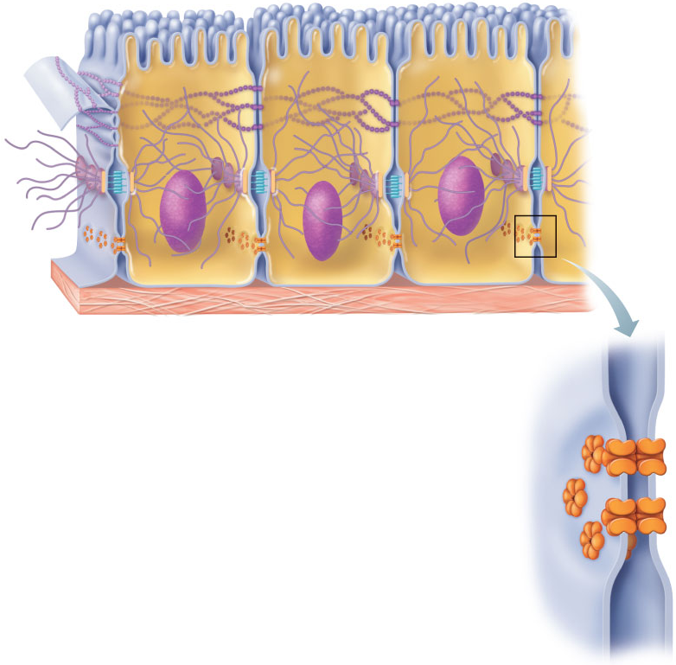
Gap junctions: Communicating junctions that allow water soluble substances (ions and small molecules) to pass from one cell to the next cell.
Basement membrane
Intercellular
space
Six transmembrane integral proteins
move (fluid mosaic) into position
on each of the two adjoining cells
to form a circle of proteins called a connexon.
The two connexons fuse to form a pore between the two cells.
Channel
between cells
(connexon)
Figure 3.5c

Slide 27
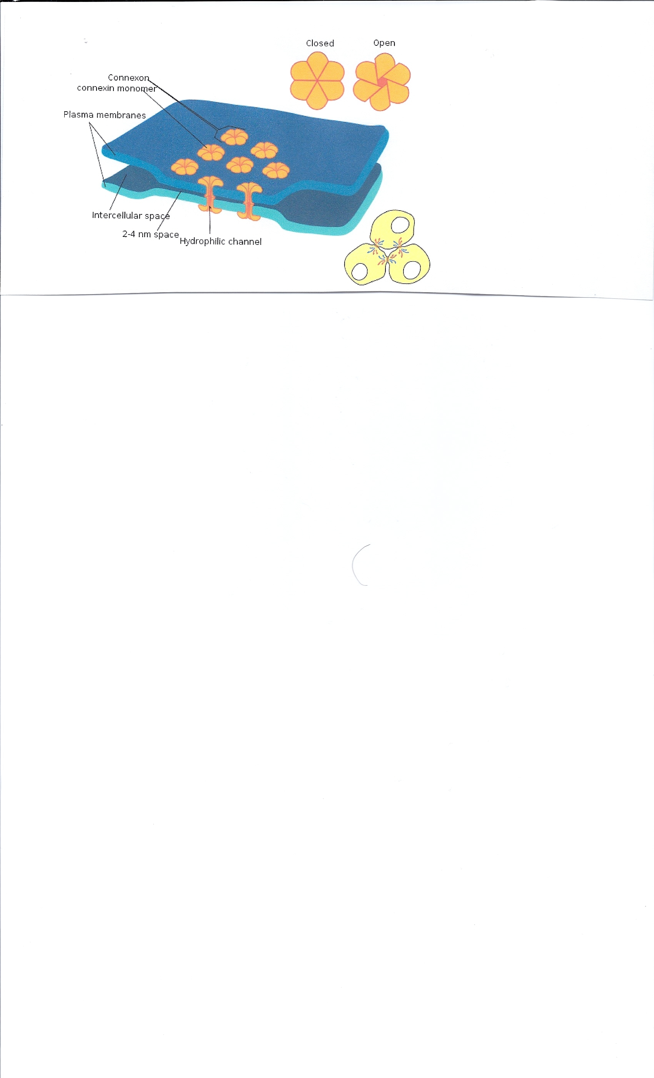
Gap Junctions

Slide 28
The rest of the characteristics of Epithelial Tissue
All epithelial tissue rests on a basal lamina or basement membrane
Avascular but innervated
High rate of regeneration

Slide 29
Basal Lamina versus a Basement Membrane
The basal lamina is a layer of extracellular matrix on which epithelium sits and which is secreted by the epithelial cells. It is often confused with the basement membrane, and sometimes used inconsistently in the literature.
The basal lamina is too thin (40-50 nanometers) to be resolved by the light microscope – a basement membrane is thicker and can be resolved by the light microscope.
A basement membrane can be formed by two basal lamina stacking on top of one another or by a basal lamina stacking on top of a reticular lamina

Slide 30
The basal lamina is secreted by the epithelial cells above it and the chemical components of the basal lamina are type IV collagen fibers; perlecan (a heparan sulfate proteoglycan) which coats these fibers, laminin, integrins, entactins, and dystroglycans).
The reticular lamina is secreted by the cells below it and the chemical components of a reticular lamina are reticular type collagen fibers (collagen type III)

Slide 31
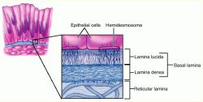
Basement membrane
Figure 3.5a

Slide 32
Review of Epithelia Characteristics
Cells have polarity
Epithelial cells are connected to one another by intercellular junctions.
All epithelial tissue rests on a basal lamina or basement membrane
Avascular but innervated
High rate of regeneration

Slide 33
Classification of Epithelia (Step One) Shape
  What is the type of epithelia according to the shape of the epithelial cell?
    Squamous – flat cells
    Cuboidal – cube shaped
    Columnar – column shaped
    taller than wide
    Transitional – can assume all the above shapes according to stretch

Slide 34
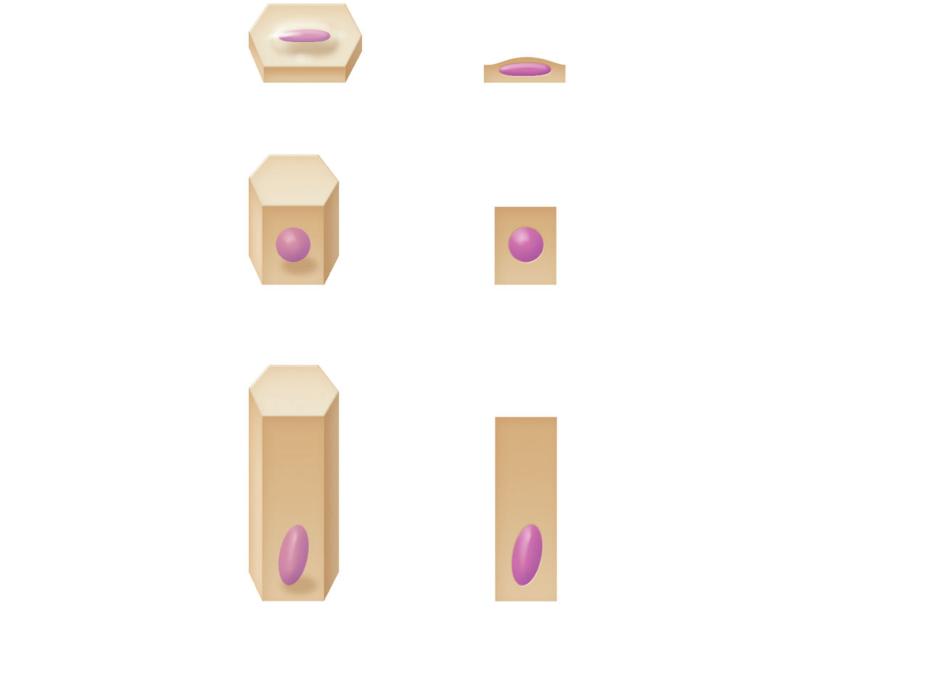
Squamous
Cuboidal
Columnar
Classification based on cell shape.
Figure 4.2b

Slide 35
Classification of Epithelia (Step Two) Stacking
Is it one layer of epithelial cells or is it more than one layer (is one layer stacked on top of another layer)?
  If it is one cell layer it is termed a “simple epithelium”
  If it is more than one cell layer (stacked) then termed a “stratified epithelium”
  If it appears that the cells are stacked (stratified) but they really are not – it is termed “pseudostratified”
  Pseudo – a prefix meaning false

Slide 36
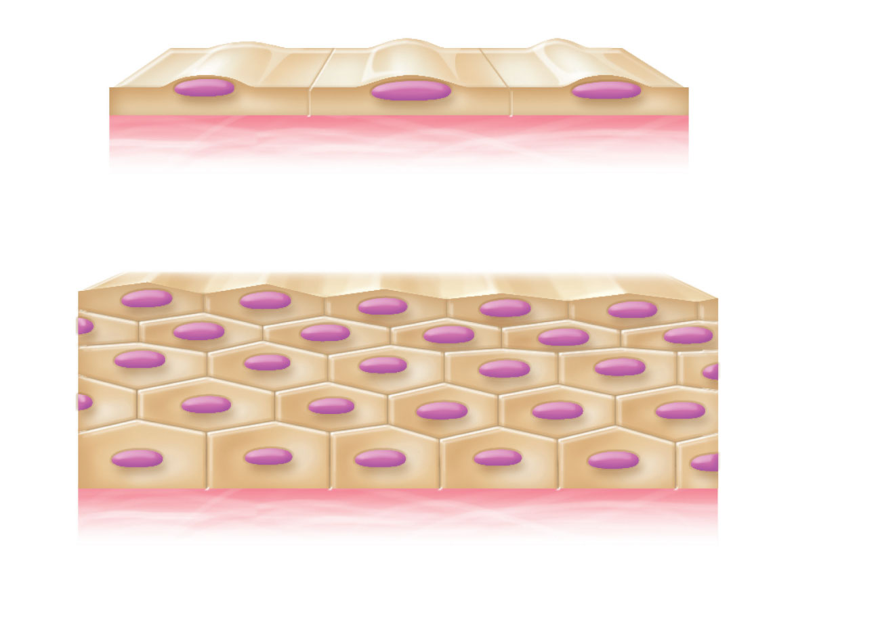
Apical surface
One cell layer
Basal surface
Simple
Apical surface
Basal surface
Stacked layers
Stratified
Classification based on number of cell layers.
Figure 4.2a

Slide 37
Apical surface
Stratified
Basal surface
When stratified – the epithelia is named in accordance with the shape of the cells in the top (apical) layer. In this case the bottom layer of cells are cuboidal – the top squamous – thus this is termed a stratified squamous.
Figure 4.2a

Slide 38
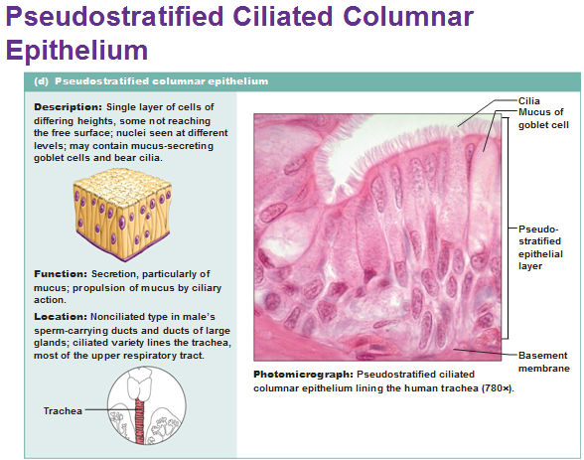

Slide 39
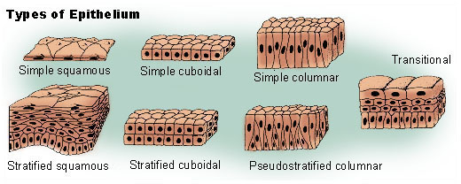

Slide 40
Functions of Epithelia
Protection - of underlying structures
Diffusion
Osmosis
Secretion – exocytosis of useful substances
Excretion- exocytosis of waste substances
Absorption
Cleaning Ciliated epithelium assists in sweeping particles

Slide 41
TYPES OF EPITHELIA

Slide 42
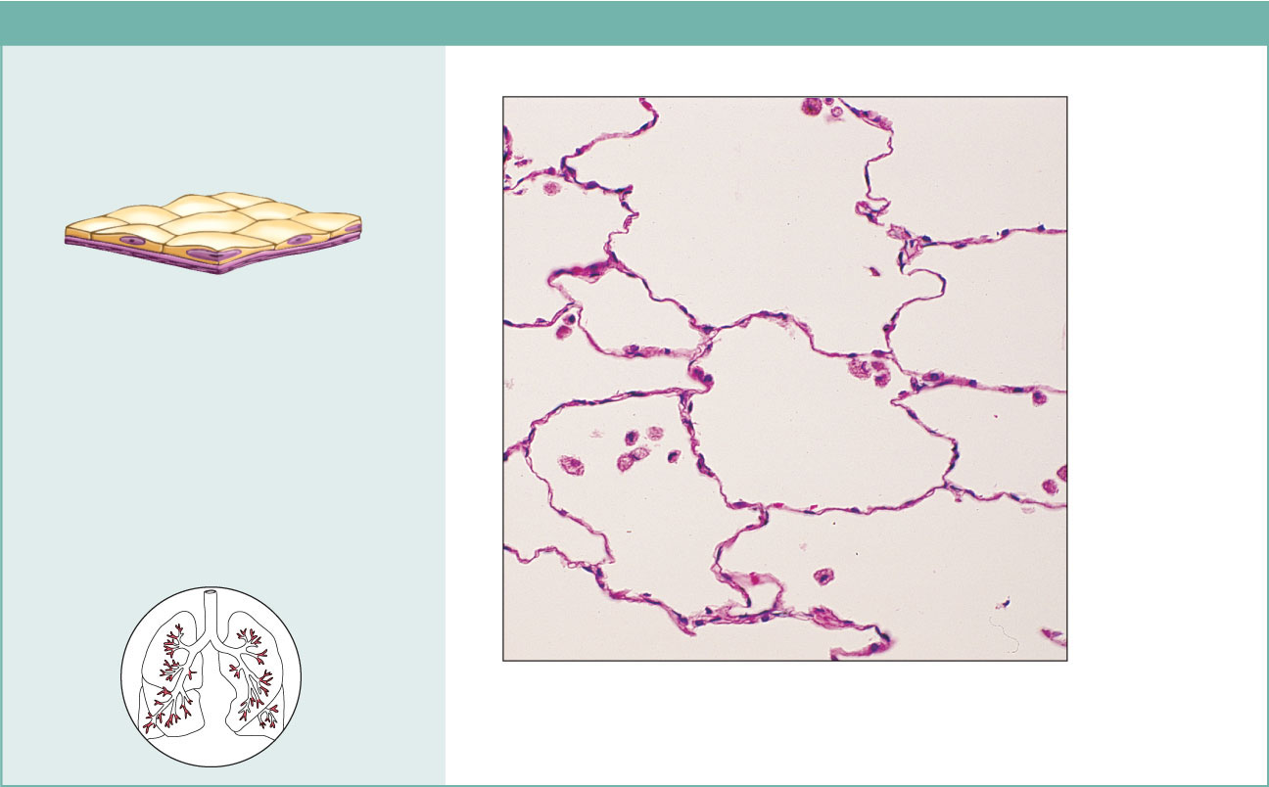
Simple Squamous Epithelium
(a) Simple squamous epithelium
Description: Single layer of flattened
cells with disc-shaped central nuclei
and sparse cytoplasm; the simplest
of the epithelia.
Air sacs of
lung tissue
Function: Allows passage of
materials by diffusion and filtration
in sites where protection is not
important; secretes lubricating
substances in serosae.
Nuclei of
squamous
epithelial
cells
Location: Kidney glomeruli; air sacs
of lungs; lining of heart, blood
vessels, and lymphatic vessels; lining
of ventral body cavity (serosae).
Photomicrograph: Simple squamous epithelium
forming part of the alveolar (air sac) walls (125x).
Figure 4.3a

Slide 43
Epithelia: Simple Squamous
Special names by location-
  Endothelium – lines blood vessels, lymphatic vessels and the inside of the heart
  Mesothelium – simple squamous epithelium lining serous membranes – pleura, pericardium and peritoneum

Slide 44
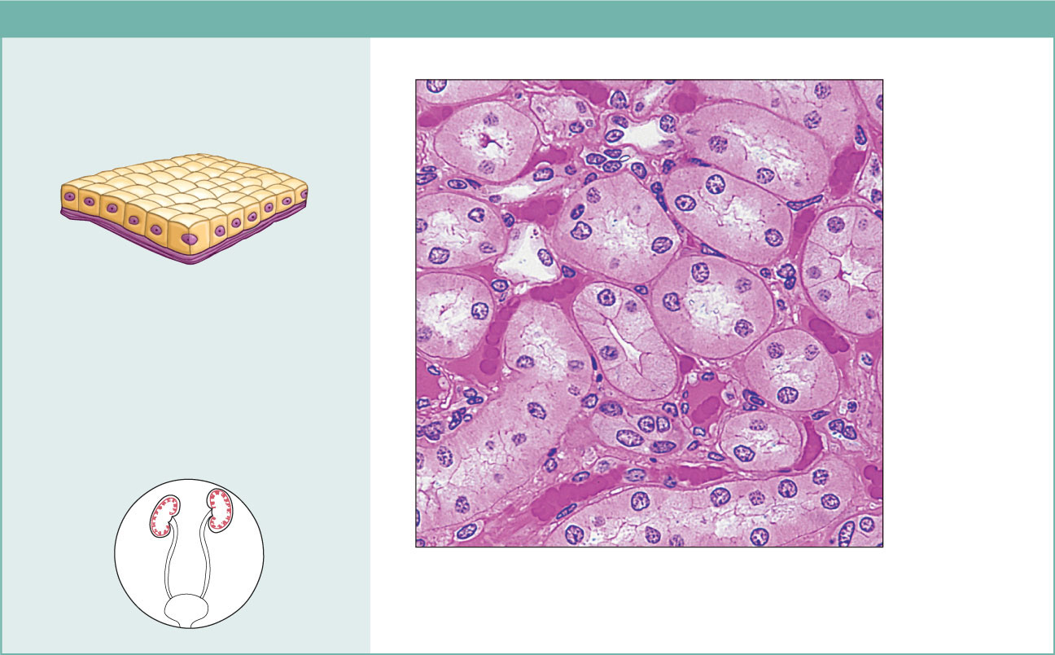
Simple Cuboidal
(b) Simple cuboidal epithelium
Description: Single layer of
cubelike cells with large,
spherical central nuclei.
Simple
cuboidal
epithelial
cells
Function: Secretion and
absorption.
Basement
membrane
Location: Kidney tubules;
ducts and secretory portions
of small glands; ovary surface.
Connective
tissue
Photomicrograph: Simple cuboidal
epithelium in kidney tubules (430x).
Figure 4.3b

Slide 45
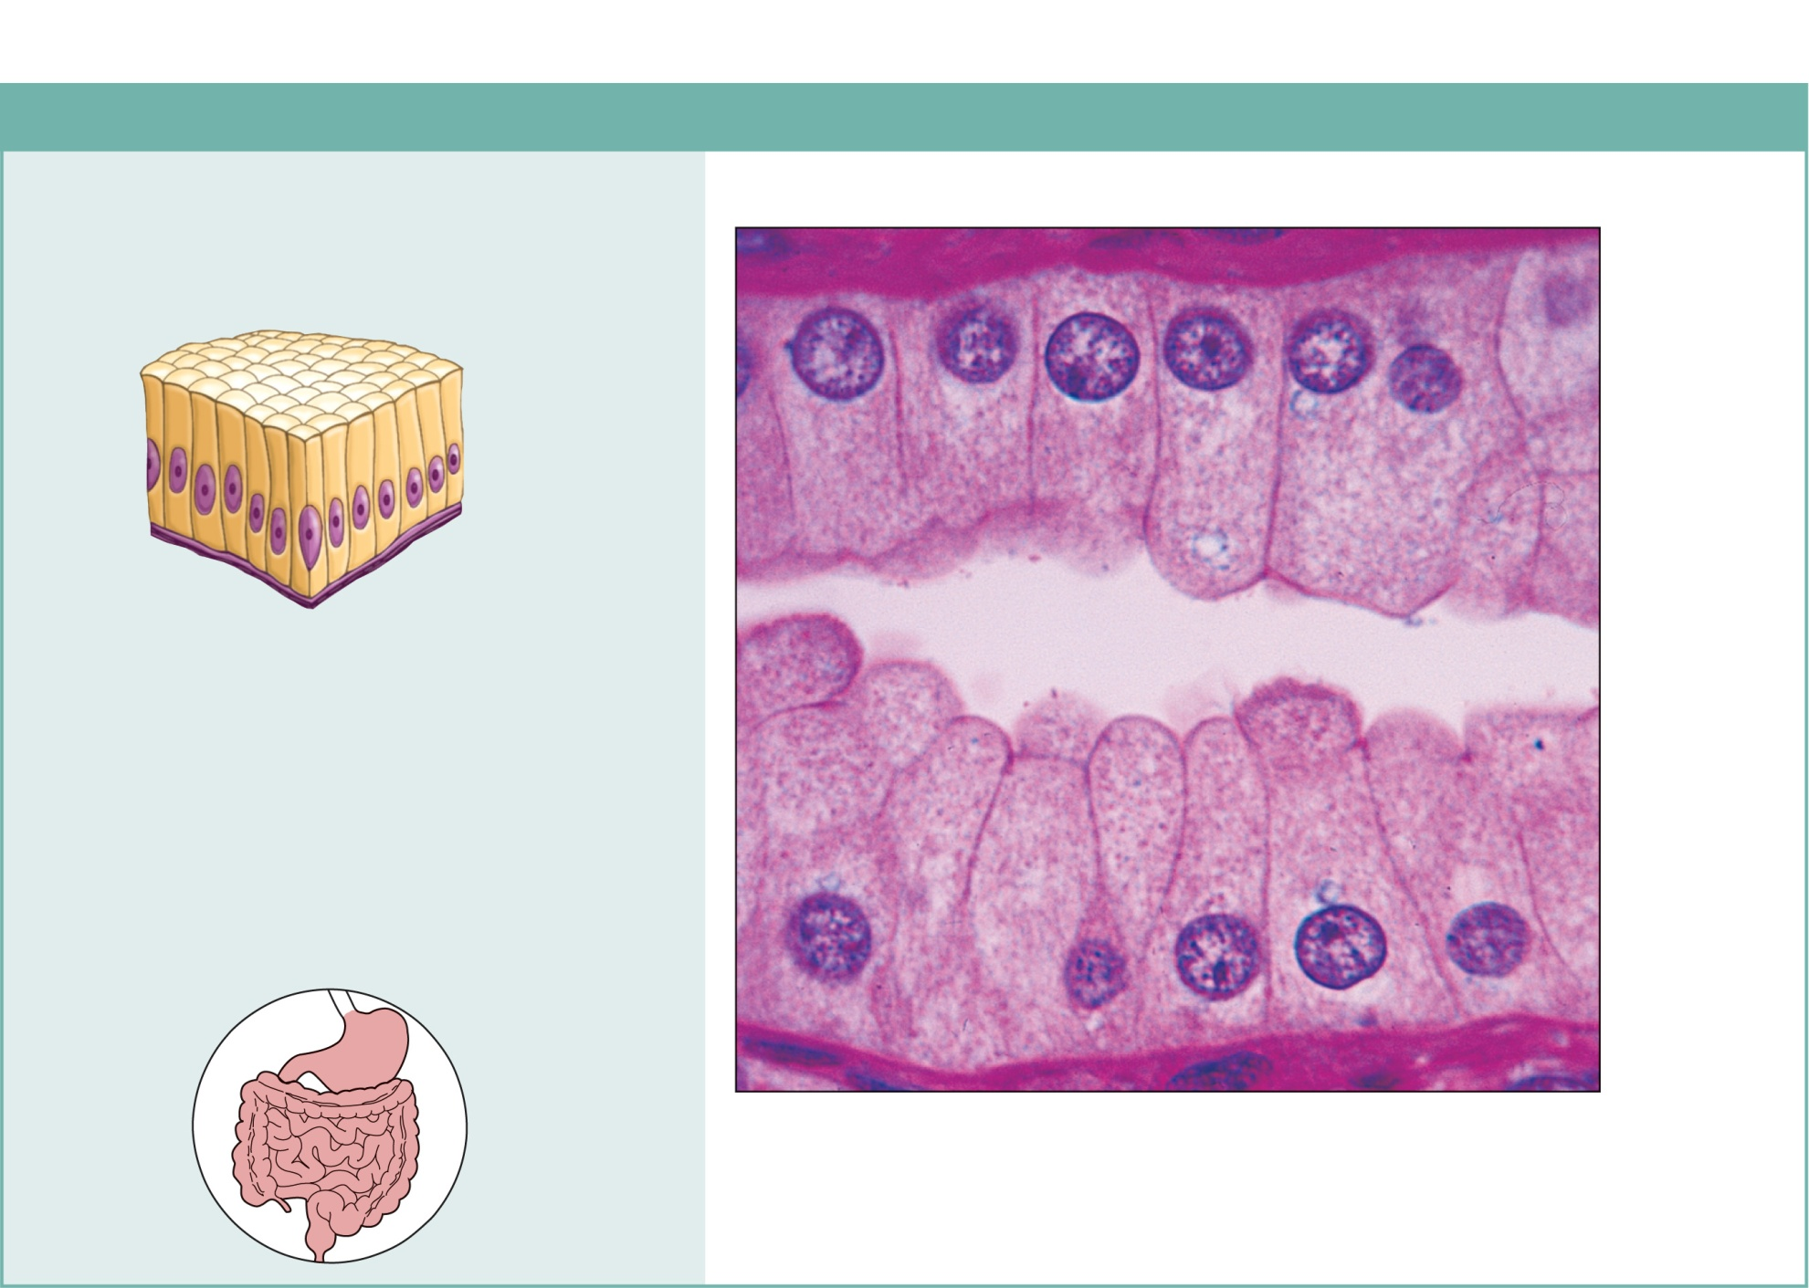
Simple Columnar
(c) Simple columnar epithelium
Description: Single layer of tall cells
with round to oval nuclei; some cells
bear cilia; layer may contain mucus-
secreting unicellular glands (goblet cells).
Simple
columnar
epithelial
cell
Function: Absorption; secretion of
mucus, enzymes, and other substances;
ciliated type propels mucus (or
reproductive cells) by ciliary action.
Location: Nonciliated type lines most of
the digestive tract (stomach to anal canal),
gallbladder, and excretory ducts of some
glands; ciliated variety lines small
bronchi, uterine tubes, and some regions
of the uterus.
Basement
membrane
Photomicrograph: Simple columnar epithelium
of the stomach mucosa (860X).
Figure 4.3c

Slide 46
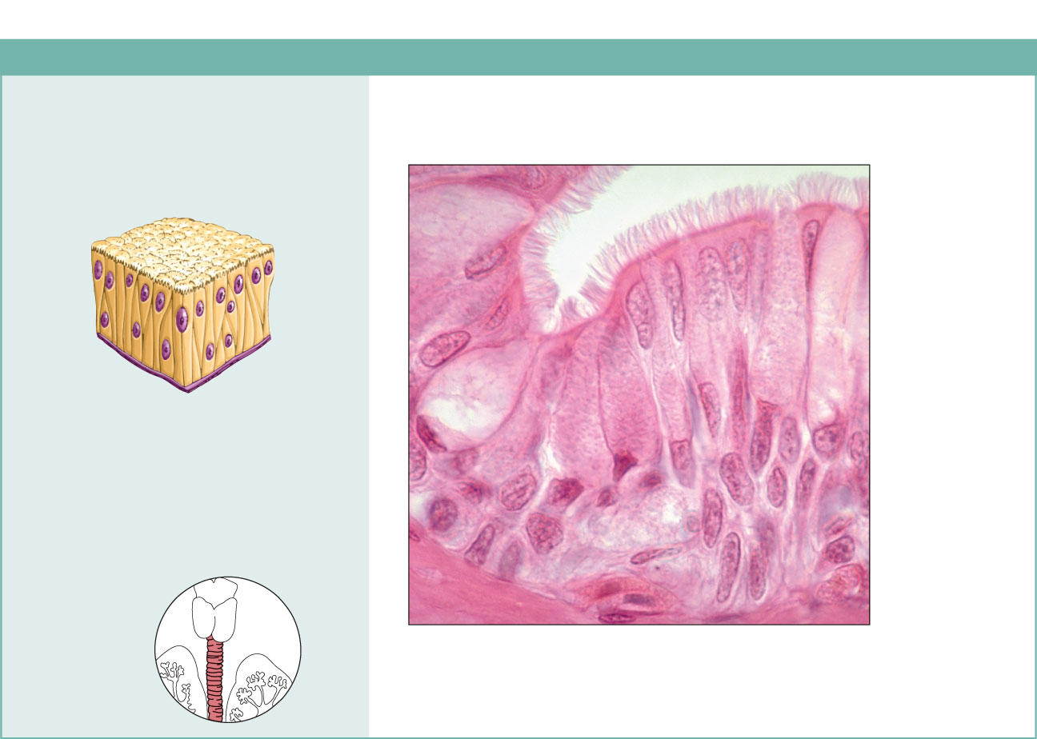
Pseudostratified Columnar
(d) Pseudostratified columnar epithelium
Description: Single layer of cells of
differing heights, some not reaching
the free surface; nuclei seen at
different levels; may contain mucus-
secreting cells and bear cilia.
Cilia
Mucus of
mucous cell
Pseudo-
stratified
epithelial
layer
Function: Secretion, particularly of
mucus; propulsion of mucus by
ciliary action.
Location: Nonciliated type in male’s
sperm-carrying ducts and ducts of
large glands; ciliated variety lines
the trachea, most of the upper
respiratory tract.
Basement
membrane
Trachea
Photomicrograph: Pseudostratified ciliated
columnar epithelium lining the human trachea (570x).
Figure 4.3d

Slide 47
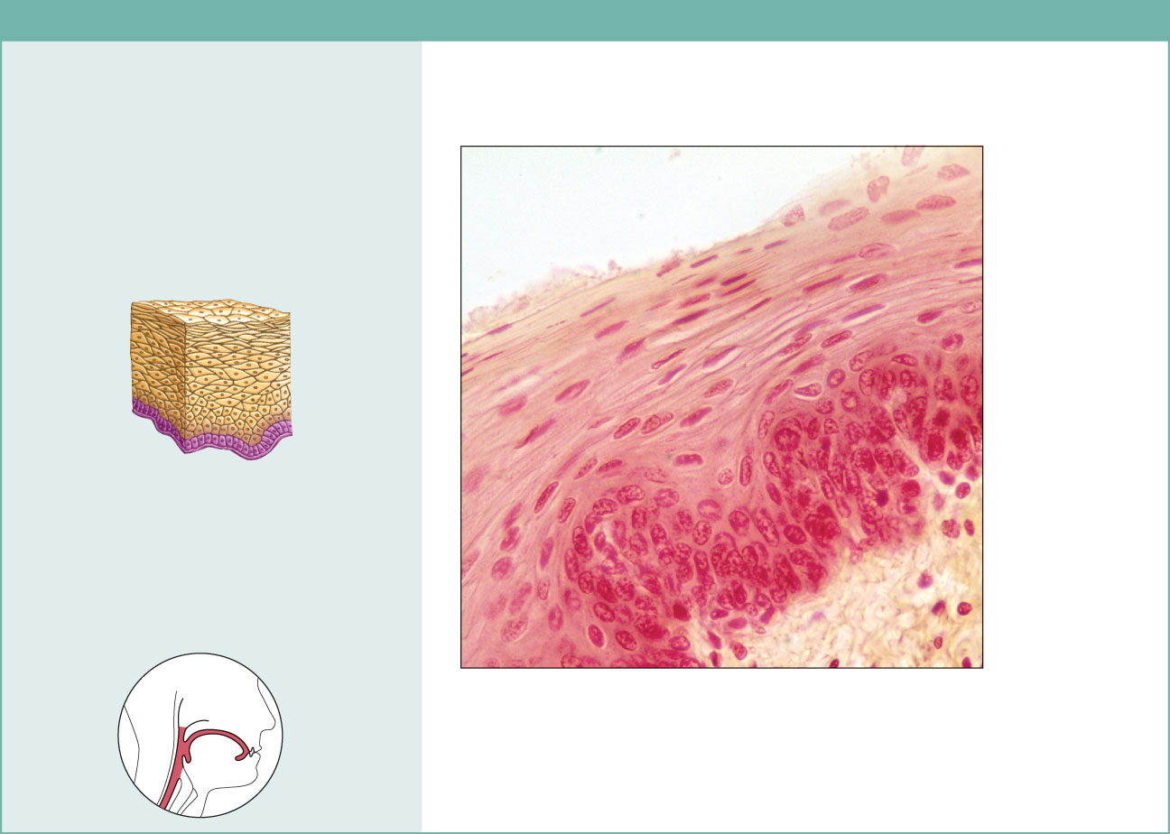
Stratified Squamous
(e) Stratified squamous epithelium
Description: Thick membrane
composed of several cell layers;
basal cells are cuboidal or columnar
and metabolically active; surface
cells are flattened (squamous); in the
keratinized type, the surface cells are
full of keratin and dead; basal cells
are active in mitosis and produce the
cells of the more superficial layers.
Stratified
squamous
epithelium
Function: Protects underlying
tissues in areas subjected to abrasion.
Nuclei
Location: Nonkeratinized type forms
the moist linings of the esophagus,
mouth, and vagina; keratinized variety
forms the epidermis of the skin, a dry
membrane.
Basement
membrane
Connective
tissue
Photomicrograph: Stratified squamous epithelium
lining the esophagus (285x).
Figure 4.3e

Slide 48
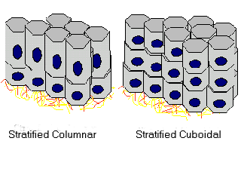
Epithelia: Stratified Cuboidal
Quite rare in body
They protect areas such as ducts of sweat glands, mammary glands and the male urethra.

Slide 49
Epithelia: Stratified Columnar
Limited distribution in body
Small amounts in pharynx, male urethra, and lining some glandular ducts
Also occurs at transition areas between two other types of epithelia

Slide 50
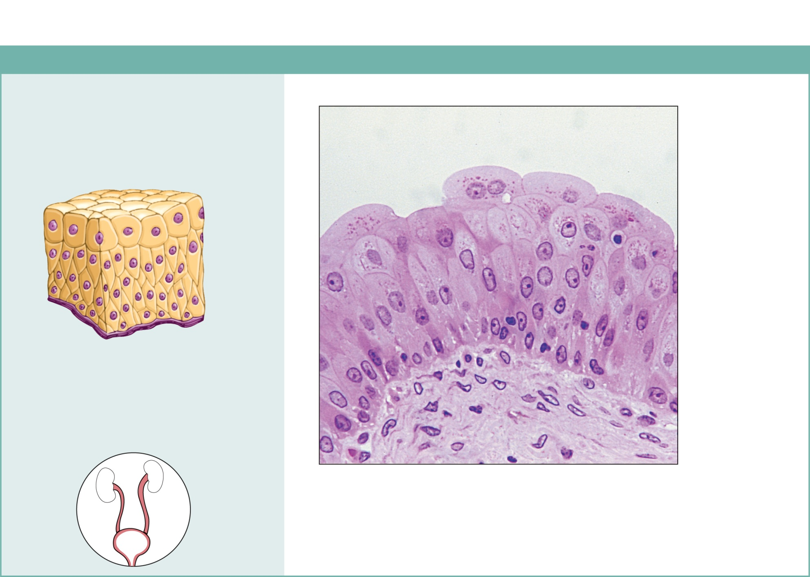
(f) Transitional epithelium
Description: Resembles both
stratified squamous and stratified
cuboidal; basal cells cuboidal or
columnar; surface cells dome
shaped or squamouslike, depending
on degree of organ stretch.
Transitional
epithelium
Function: Stretches readily and
permits distension of urinary organ
by contained urine.
Location: Lines the ureters, urinary
bladder, and part of the urethra.
Basement
membrane
Connective
tissue
Photomicrograph: Transitional epithelium lining the urinary
bladder, relaxed state (360X); note the bulbous, or rounded,
appearance of the cells at the surface; these cells flatten and
become elongated when the bladder is filled with urine.
Figure 4.3f

Slide 51
Review

Slide 52
The Glands are formed from Epithelia
A gland is one or more cells that makes and secretes an aqueous fluid
Secretion – exocytosis of a useful product
Two major types of Glands
Exocrine Glands– secretes it product through a duct and onto a surface (examples are sweat glands and oil glands)
Endocrine Glands (ductless glands) secretes it product (termed a hormone) into the bloodstream
  Site of product release—endocrine or exocrine
  Relative number of cells forming the gland—unicellular (e.g., goblet cells) or multicellular

Slide 53
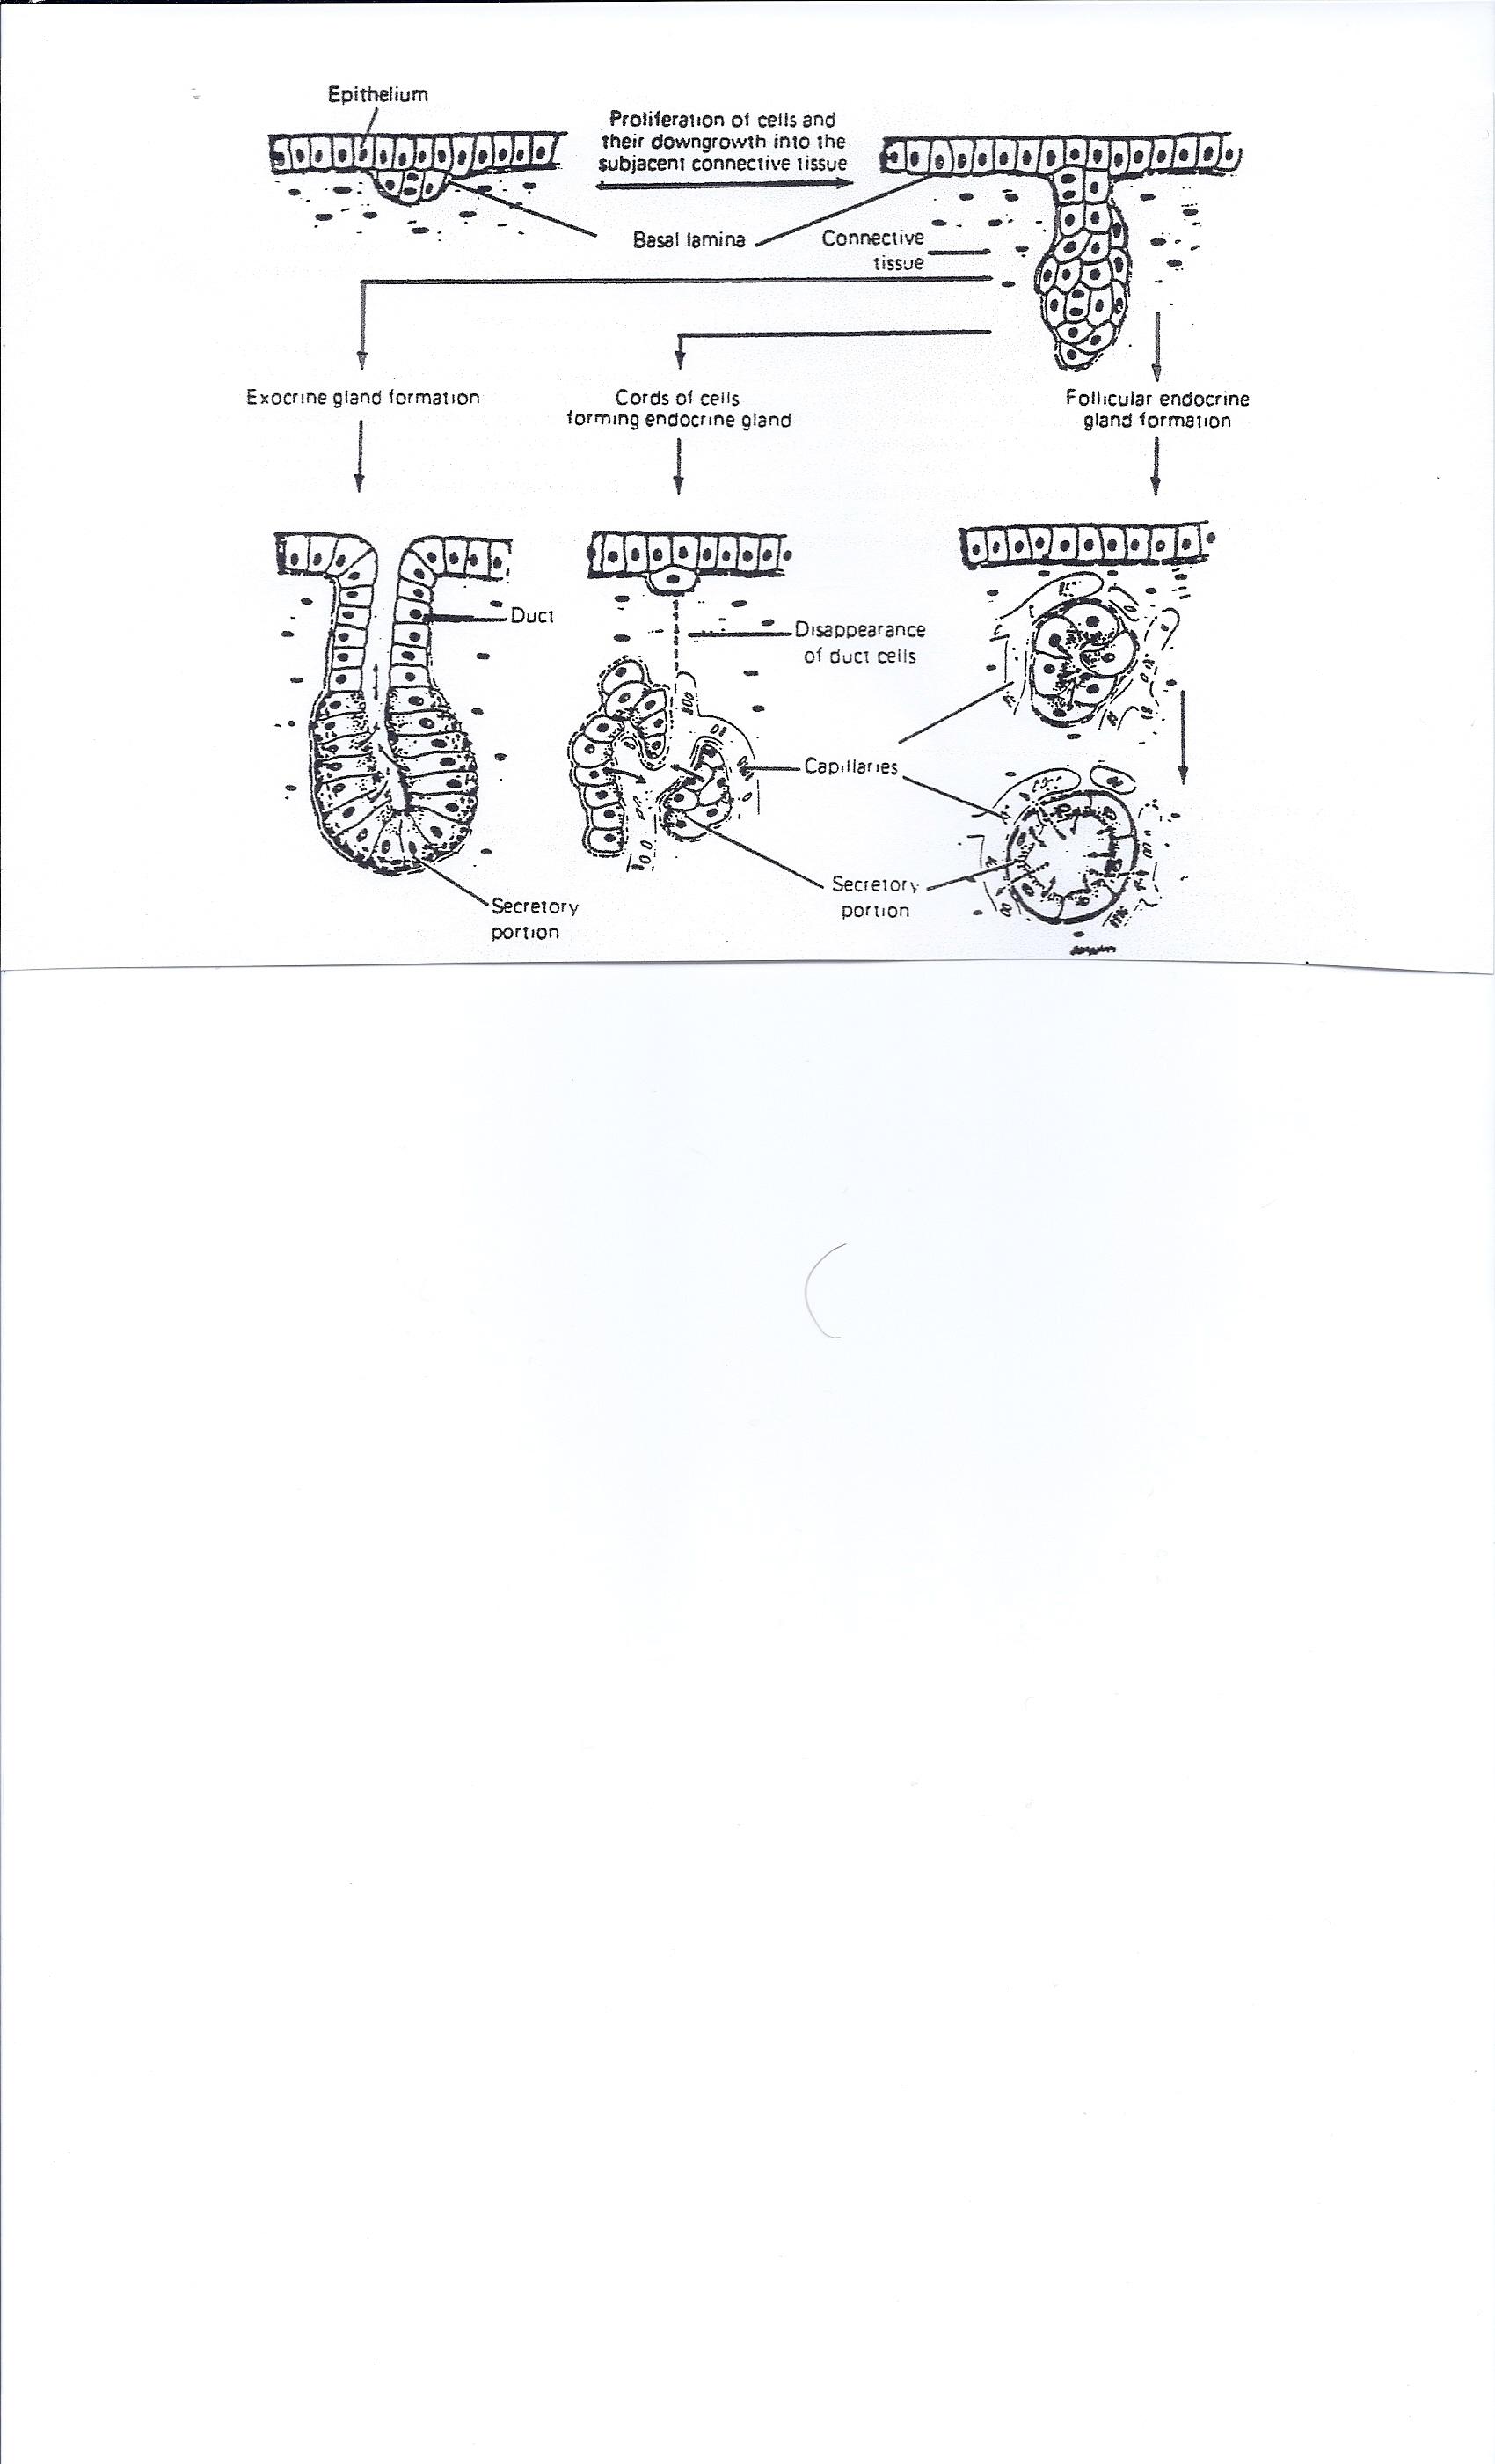
Gland Formation
Exocrine Gland
Formation
Endocrine
Gland
Formation

Slide 54
Endocrine Glands
Ductless glands
Secrete hormones that travel through lymph or blood to target organs

Slide 55
Exocrine Glands
More numerous than endocrine glands
Secrete products into ducts
Secretions released onto body surfaces (skin) or into body cavities
Examples include mucous, sweat, oil, and salivary glands

Slide 56
How to Classify an Exocrine Gland
Is the exocrine gland unicellular or multicellular?
Does the exocrine gland duct branch?
What is the shape of the gland portion of the exocrine gland?
How do the gland cells behave when they discharge their product?

Slide 57
Is the exocrine gland unicellular or multicellular?
The only unicellular gland in the human body is the Goblet Cell.
Goblet cells are glandular simple columnar epithelial cells whose sole function is to secrete mucin. Mucins are a family of high molecular weight, heavily glycosylated proteins (glycoconjugates) produced by many epithelial tissues in vertebrates.
Mucin plus water gives mucus – the viscosity mainly depends on the amount of water.

Slide 58
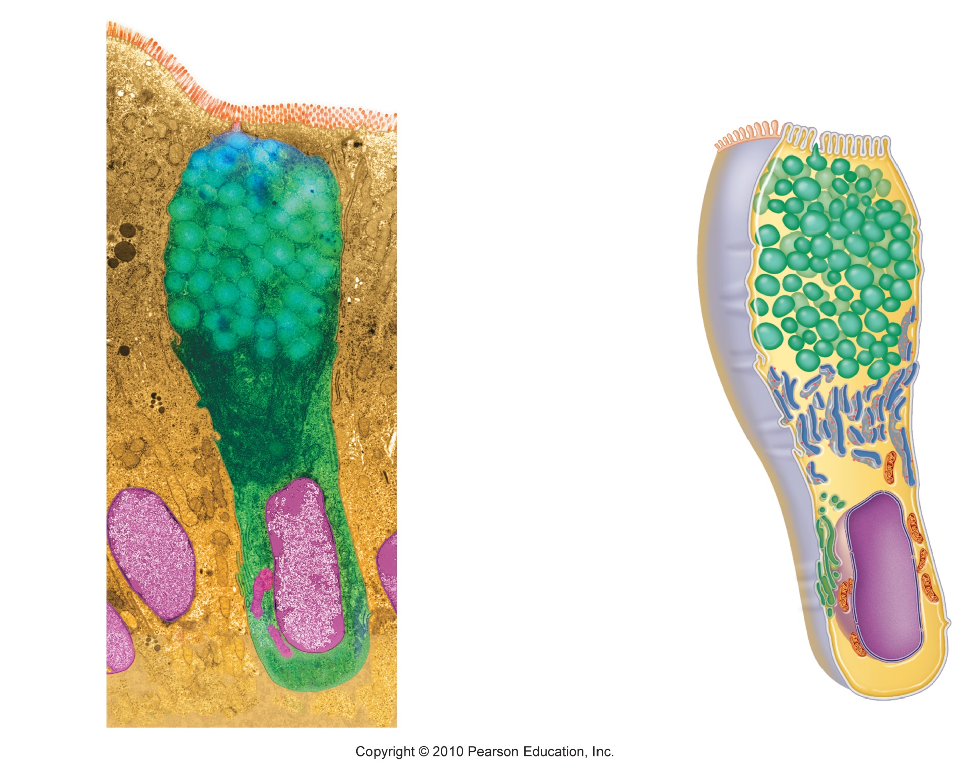
Goblet Cell
Microvilli
Secretory
vesicles
containing
mucin
Rough ER
Golgi
apparatus
Nucleus
(a)
(b)
Figure 4.4

Slide 59
Multicellular Exocrine Glands
Multicellular exocrine glands are composed of a duct portion and a secretory portion
Does the exocrine gland duct branch?
  If the duct does not branch – it is termed a simple duct
  If the duct branches it is termed a compound duct

Slide 60
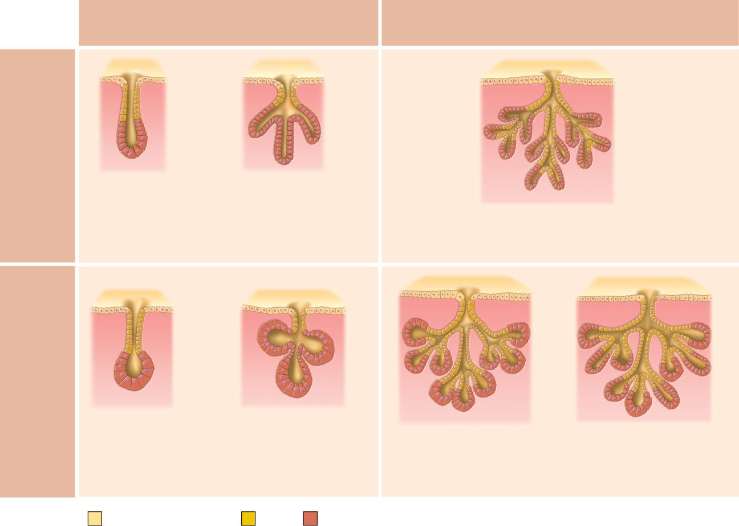
Simple duct structure
(duct does not branch)
Compound duct structure
(duct branches)
Tubular
secretory
structure
Simple tubular
Simple branched
tubular
Example
Intestinal glands
Example
Stomach (gastric)
glands
Compound tubular
Example
Duodenal glands of small intestine
Alveolar
secretory
structure
Simple
alveolar
Simple branched
alveolar
Compound alveolar
Compound
tubuloalveolar
Example
No important
example in humans
Example
Sebaceous (oil)
glands
Example
Mammary glands
Example
Salivary glands
Surface epithelium
Duct
Secretory epithelium
Figure 4.5

Slide 61
What is the shape of the gland portion of the exocrine gland?
Does it resemble a tube – tubular
Does it resemble a coiled tube – coiled tubular
Is it a round shape – Alveolar or Acinar

Slide 62
Simple duct structure
(duct does not branch)
Compound duct structure
(duct branches)
Tubular
secretory
structure
Simple tubular
Simple branched
tubular
Example
Intestinal glands
Example
Stomach (gastric)
glands
Compound tubular
Example
Duodenal glands of small intestine
Alveolar
secretory
structure
Simple
alveolar
Simple branched
alveolar
Compound alveolar
Compound
tubuloalveolar
Example
No important
example in humans
Example
Sebaceous (oil)
glands
Example
Mammary glands
Example
Salivary glands
Surface epithelium
Duct
Secretory epithelium
Figure 4.5

Slide 63
How do the gland cells behave when they discharge their product?
Does the cell merely use exocytosis to discharge the product – and not destroy any of the cell – Merocrine secretion or Eccrine
Does the gland cell load all its vesicles in the apical (top) of the cell – then break off the tip and liberate it into the duct – Apocrine secretion
Does the gland cell fill-up its entire cytoplasm with vesicles – then secrete the whole cell (the entire cell sacrifices itself) – Holocrine secretion

Slide 64
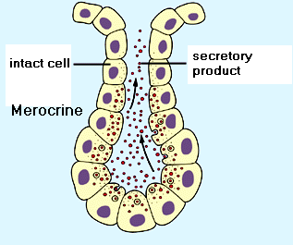
Merocrine
The cell merely use exocytosis to discharge the product – and not destroy any of the cell – Merocrine secretion
Very little chance of
clogging the duct due to
small amount of
product trying to go through
Sweat glands on most of
body

Slide 65
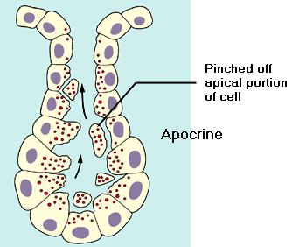
Apocrine
The gland cell loads all of its vesicles into the apical (top) portion of the cell – then the apical portion breaks off - liberating the secretory product into the gland duct – Apocrine secretion
Increased chance of
clogging the duct due to
increased amount of
product trying to
go through
Sweat Glands under
the arms and other areas
lipid component of the lactating mammary gland.
cerumen ("wax") of the outer ear

Slide 66
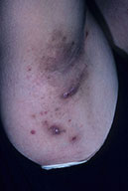
Hidradenitis suppurativa
a skin disease that affects areas bearing apocrine sweat glands and hair follicles; such as the underarms, groin and buttocks

Slide 67
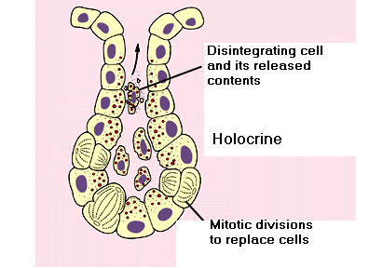
Holocrine
The gland cell fills-up its entire cytoplasm with vesicles – then the entire cell is secreted with product in vesicles inside. As the cell proceeds up the duct it disintegrates – thus releasing the product (the entire cell is sacrificed) – Holocrine secretion
Very high chance of
clogging the duct due to
the very large amount of
product trying to
go through
Oil Glands

Slide 68
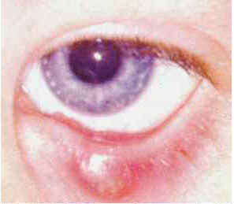
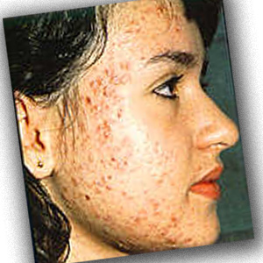
Acne and Meibomian Cysts
Examples of holocrine glands include the sebaceous glands of the skin and the meibomian glands of the eyelid. These glands can easily get clogged.

Slide 69
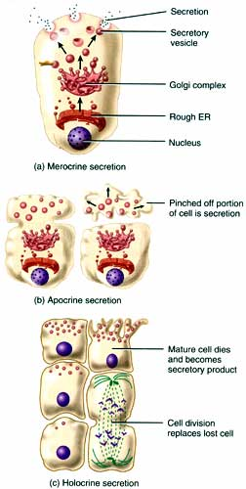
REVIEW
Cell stays intact
Tip of cell breaks off
Entire cell sacrificed

