Slide 1
1
The Human Body: An Orientation: Part B

Slide 2
Anatomical Position
Standard anatomical body position:
  Body erect
  Feet slightly apart
  Palms facing forward

Slide 3
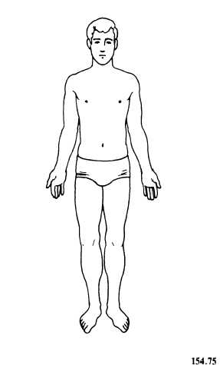
Anatomical Position

Slide 4
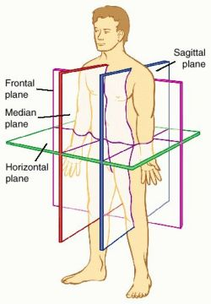
Body Planes
Plane: Flat surface along which body or structure is cut for anatomical study

Slide 5
Body Planes
Sagittal plane
  Divides body vertically into right and left parts
  Produces a sagittal section
Midsagittal (median) plane
  Lies on midline
Parasagittal plane
  Not on midline (must add numerical or anatomical qualifier) so many cm from midline; or sternal border, midclavicular, anterior axillary, etc

Slide 7
Body Planes
Frontal (coronal) plane
  Divides body vertically into anterior and posterior parts
Transverse (horizontal) plane
  Divides body horizontally into superior and inferior parts
  Produces a cross section
Oblique section
  Cuts made diagonally

Slide 9
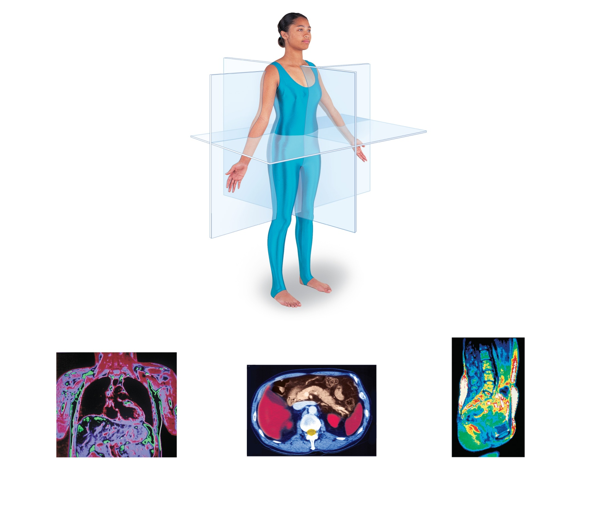
Frontal plane
Median (midsagittal) plane
Transverse plane
(a) Frontal section
(through torso)
(b) Transverse section
(through torso,
inferior view)
(c) Median section
(midsagittal)
Pancreas
Aorta
Spleen
Left and
right lungs
Liver
Heart
Spleen
Liver
Spinal cord
Rectum
Intestines
Stomach
Arm
Subcutaneous fat layer
Body wall
Vertebral
column
Figure 1.8

Slide 10
Anatomical Variability
Over 90% of all anatomical structures match textbook descriptions, but:
  Nerves or blood vessels may be somewhat out of place
  Small muscles may be missing

Slide 11
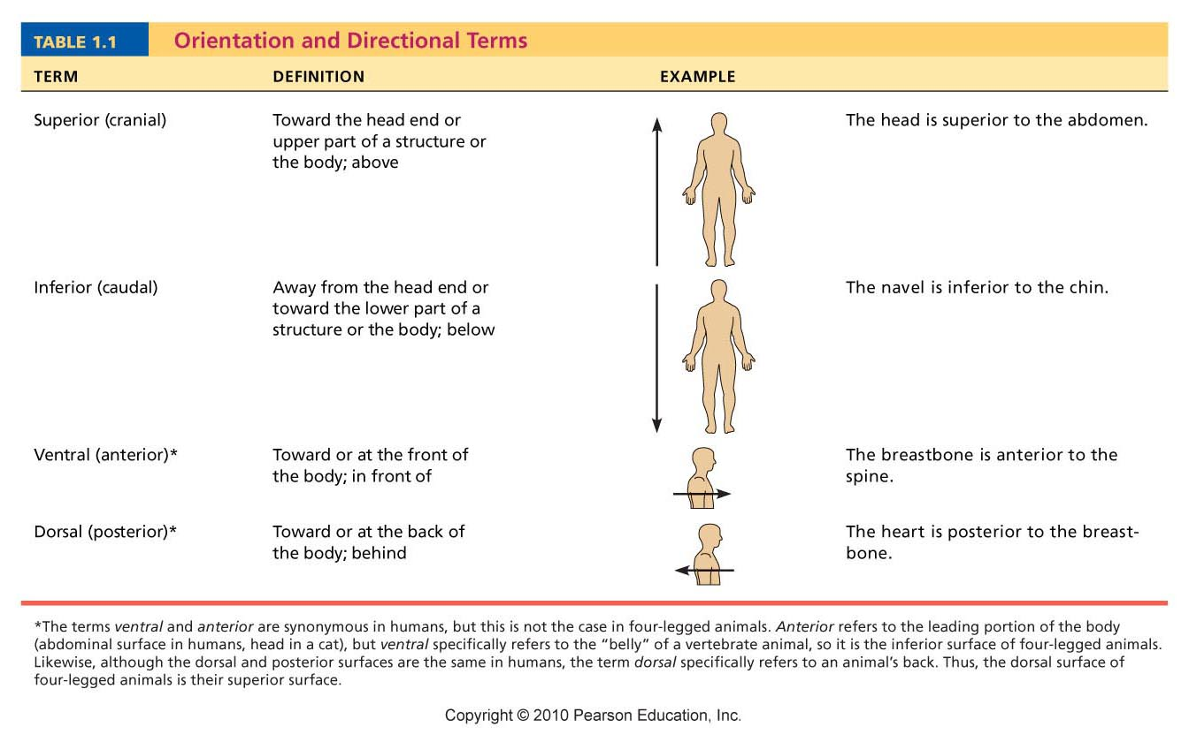
Cephalic
Table 1.1

Slide 12
Table 1.1

Slide 13
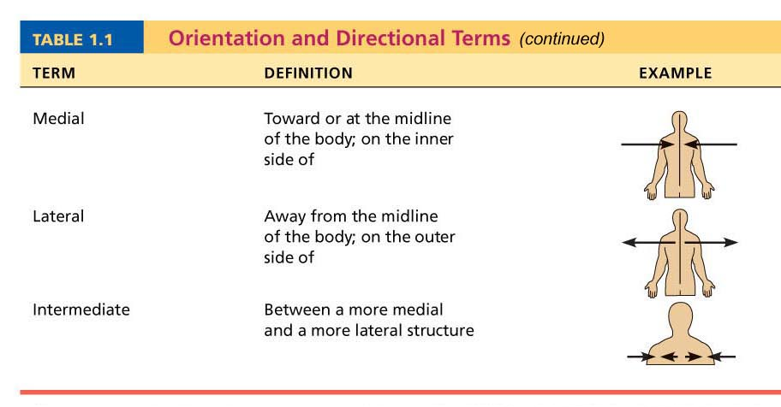
Table 1.1

Slide 14
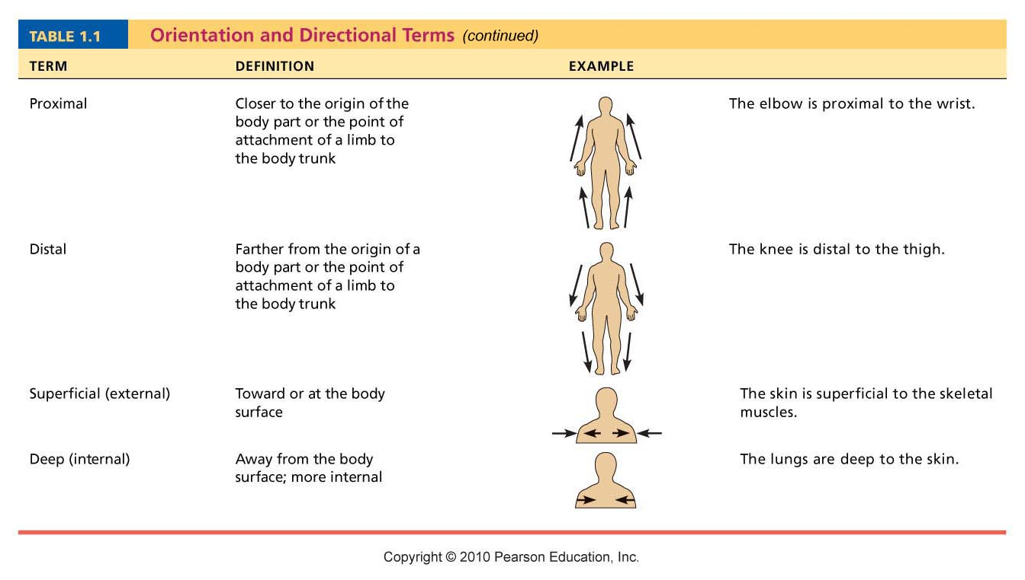
Table 1.1

Slide 15
Table 1.1

Slide 16
Additional Directional Terms
Ipsilateral – on same side of body
Contralateral – on opposite side of body

Slide 17
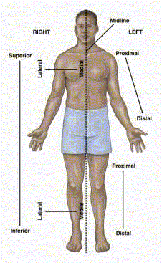

Slide 18
Non-synonymous anatomical terms
In a two-legged organism – like the human- superior, cranial, and cephalic are the same
In a two- legged organism inferior and caudal are the same
In a two-legged organism – anterior and frontal are the same and posterior and dorsal are the same
This is not true in a four-legged organism like the dog – different terms become synonymous

Slide 19
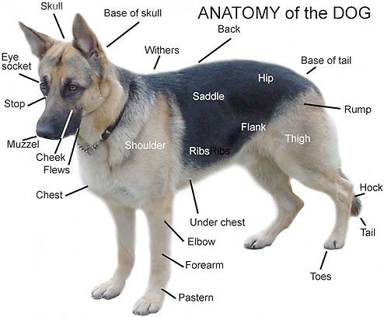
Caudal and posterior are the same
Dorsum
Anterior and
Cranial and
Cephalic are the
same
Ventrum

Slide 20
Regional Terms
Two major divisions of body:
  Axial
    Head, neck, and trunk
  Appendicular
    Limbs
Regional terms designate specific areas

Slide 21
Body Cavities
Dorsal cavity
  Protects nervous system
Two subdivisions:
  Cranial cavity
    Encases brain
  Vertebral cavity
    Encases spinal cord

Slide 22
Body Cavities
Ventral cavity
  Houses internal organs (viscera)
  Two subdivisions (separated by diaphragm):
    Thoracic cavity
    Abdominopelvic cavity

Slide 23
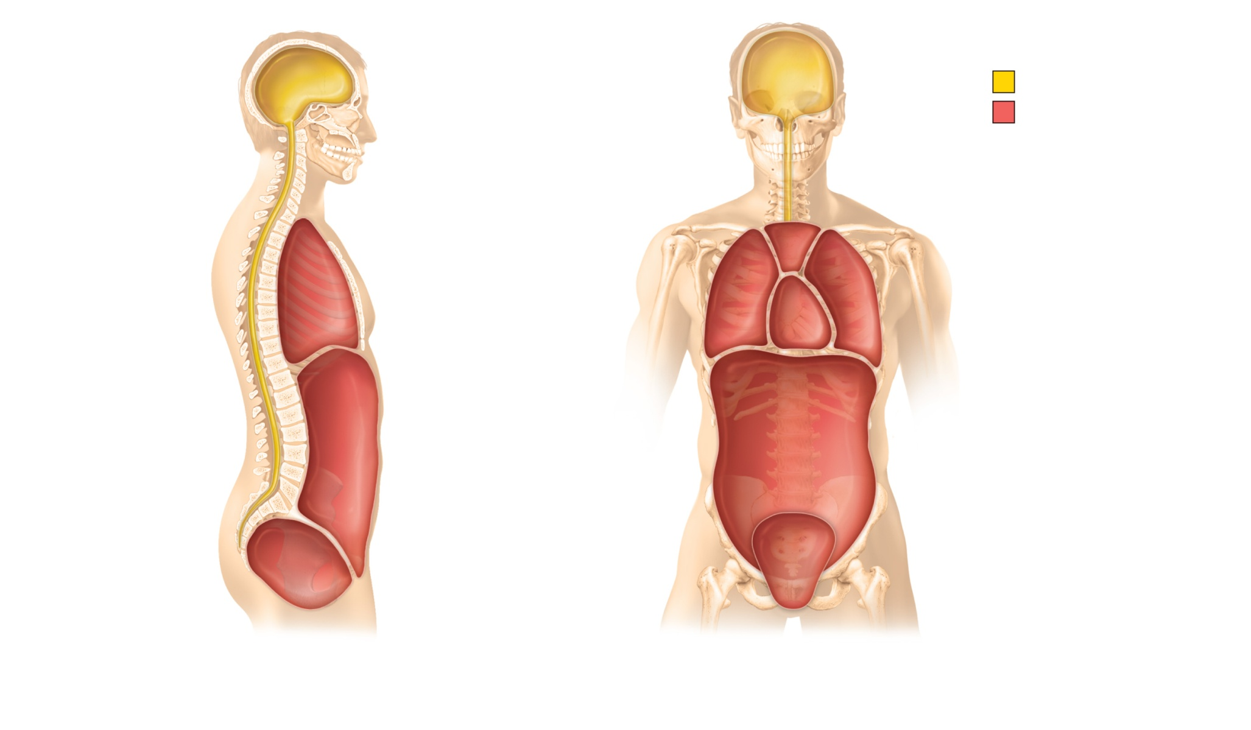
Cranial
cavity
(contains
brain)
Cranial
cavity
Dorsal body cavity
Ventral body cavity
Vertebral
cavity
Superior
mediastinum
Dorsal
body
cavity
Thoracic
cavity
(contains
heart and
lungs)
Pleural
cavity
Pericardial
cavity within
the mediastinum
Vertebral
cavity
(contains
spinal
cord)
Ventral body
cavity
(thoracic and
abdominopelvic
cavities)
Diaphragm
Abdominal cavity
(contains digestive
viscera)
Abdomino-
pelvic
cavity
Pelvic cavity
(contains urinary
bladder, reproductive
organs, and rectum)
(a) Lateral view
(b) Anterior view
Figure 1.9a-b

Slide 24
Ventral Body Cavities
Thoracic cavity subdivisions:
  Two pleural cavities
    Each houses a lung
  Mediastinum
    Contains pericardial cavity
    Surrounds thoracic organs
  Pericardial cavity
    Encloses heart

Slide 25
Ventral Body Cavities
Abdominopelvic cavity subdivisions:
  Abdominal cavity
    Contains stomach, intestines, spleen, and liver
  Pelvic cavity
    Contains urinary bladder, reproductive organs, and rectum

Slide 26
Cranial
cavity
(contains
brain)
Cranial
cavity
Dorsal body cavity
Ventral body cavity
Vertebral
cavity
Superior
mediastinum
Dorsal
body
cavity
Thoracic
cavity
(contains
heart and
lungs)
Pleural
cavity
Pericardial
cavity within
the mediastinum
Vertebral
cavity
(contains
spinal
cord)
Ventral body
cavity
(thoracic and
abdominopelvic
cavities)
Diaphragm
Abdominal cavity
(contains digestive
viscera)
Abdomino-
pelvic
cavity
Pelvic cavity
(contains urinary
bladder, reproductive
organs, and rectum)
(a) Lateral view
(b) Anterior view
Figure 1.9a-b

Slide 27
Serous Membrane (Serosa)
Thin, double-layered membrane separated by serous fluid
  Parietal serosa lines internal body walls
  Visceral serosa covers the internal organs

Slide 28
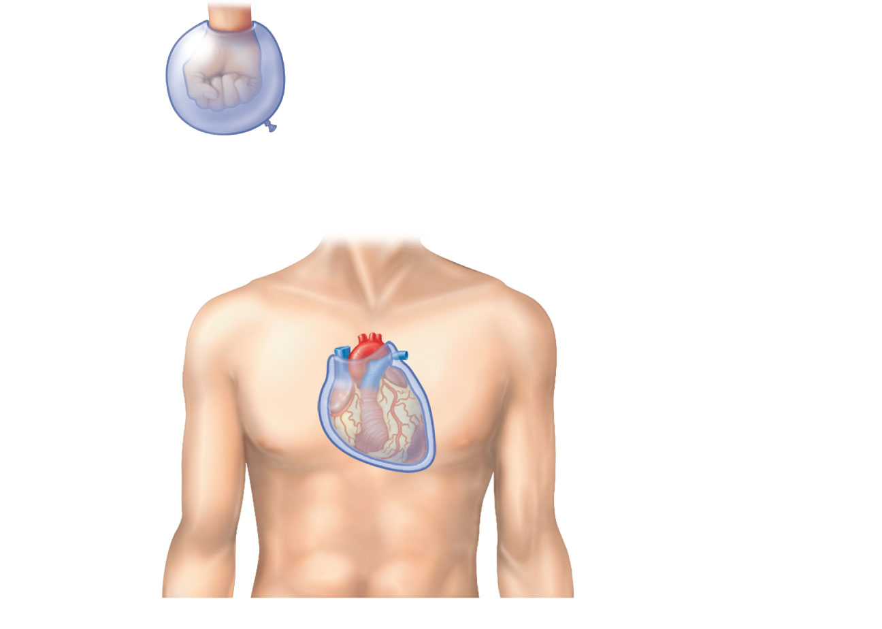
Outer balloon wall
(comparable to parietal serosa)
Air (comparable to serous cavity)
Inner balloon wall
(comparable to visceral serosa)
Heart
Parietal
pericardium
Pericardial
space with
serous fluid
Visceral
pericardium
(b) The serosae associated with the heart.
Figure 1.10a-b

Slide 29
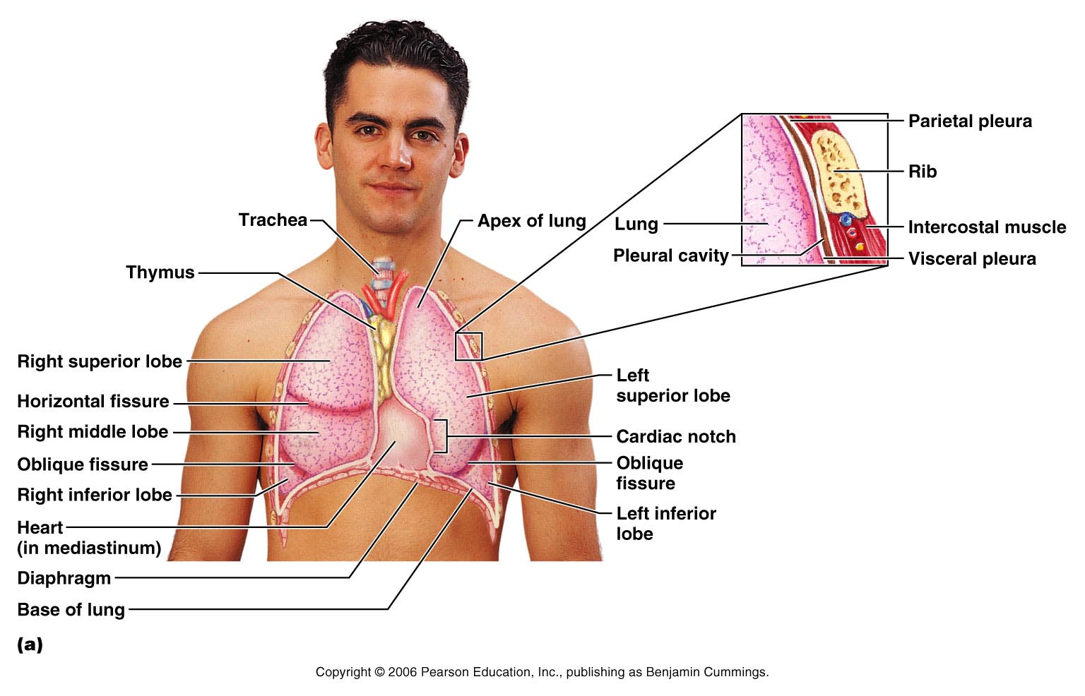
Organs in the Thoracic Cavity
Figure 22.10a

Slide 30
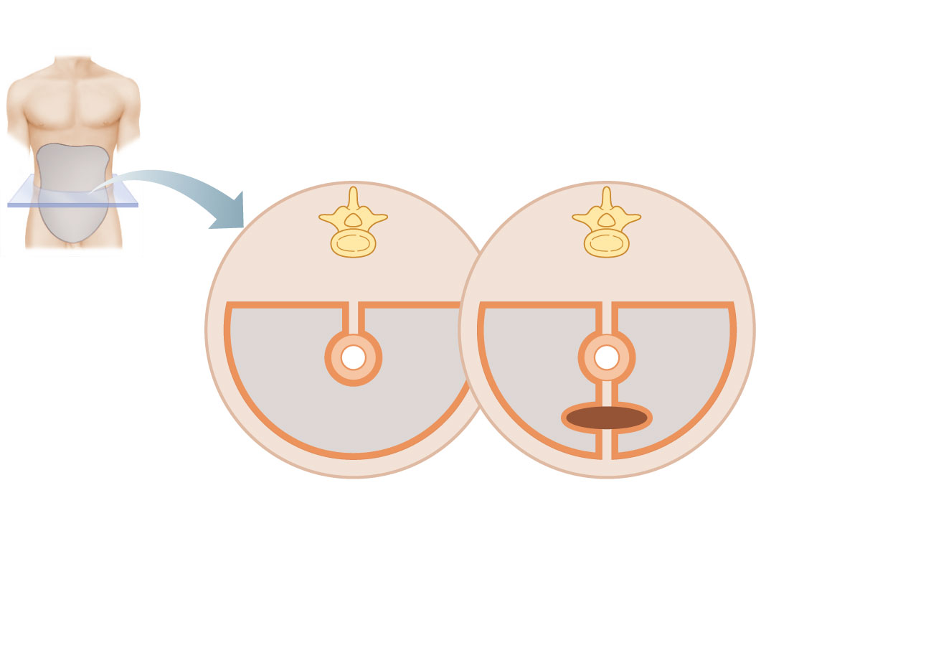
Abdominopelvic
cavity
Vertebra
Dorsal
mesentery
Parietal
peritoneum
Ventral
mesentery
Visceral
peritoneum
Peritoneal
cavity
Alimentary
canal organ
Liver
(a) Schematic cross sections of abdominal cavity
illustrate the peritoneums and mesenteries.
Figure 23.5a

Slide 31
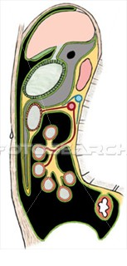

Slide 32
Abdominopelvic Regions
Nine divisions used primarily by anatomists

Slide 33
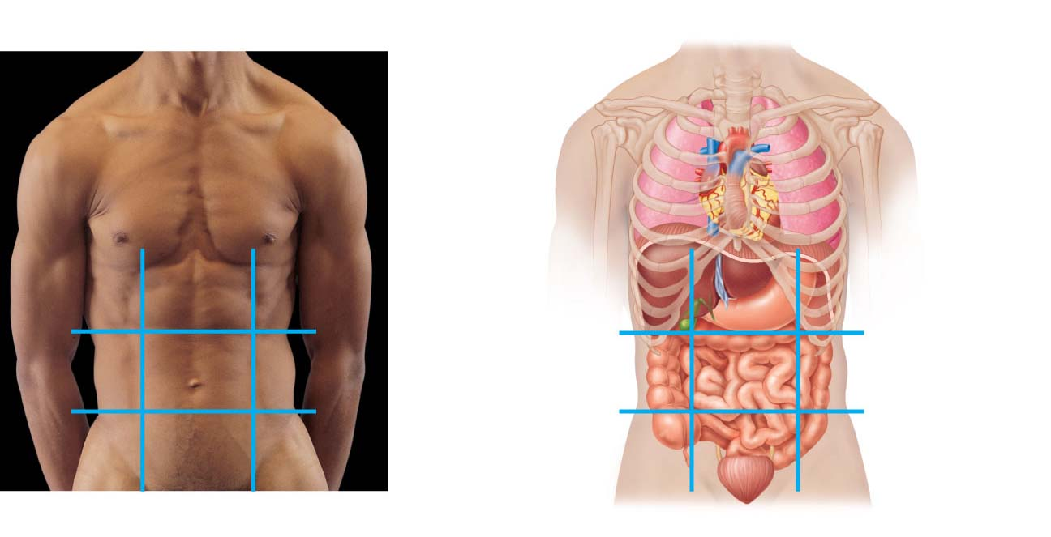
Right
hypochondriac
region
Left
hypochondriac
region
Liver
Diaphragm
Epigastric
region
Gallbladder
Stomach
Right
lumbar
region
Left
lumbar
region
Ascending colon of
large intestine
Transverse colon
of large intestine
Umbilical
region
Small intestine
Descending colon
of large intestine
Right iliac
(inguinal)
region
Hypogastric
(pubic)
region
Left iliac
(inguinal)
region
Cecum
Initial part of
sigmoid colon
Appendix
Urinary bladder
(a) Nine regions delineated by four planes
(b) Anterior view of the nine regions showing the superficial organs
Figure 1.12

Slide 34
Abdominopelvic Quadrants
Divisions used primarily by medical personnel

Slide 35
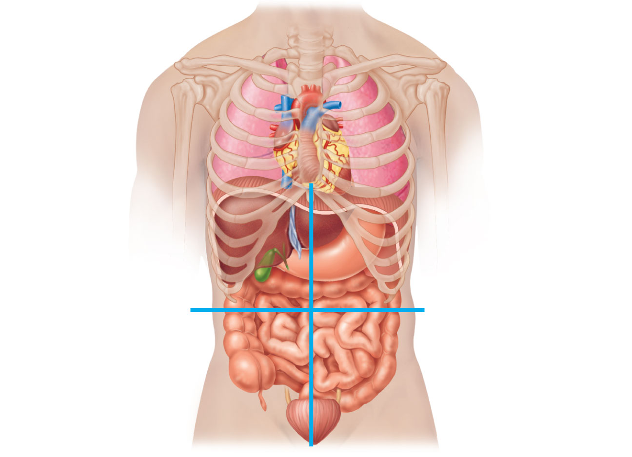
Right upper
quadrant
(RUQ)
Left upper
quadrant
(LUQ)
Right lower
quadrant
(RLQ)
Left lower
quadrant
(LLQ)
Figure 1.11

Slide 36
Other Body Cavities
Oral and digestive cavities
Nasal cavity
Orbital cavities
Middle ear cavities
Synovial cavities

