Slide 1
1
The Human Body: An Orientation: Part A

Slide 2
Anatomy & Physiology
Anatomy (from the Greek anatomia): separate, apart from, and temnein, to cut up, cut open.) is a branch of biology and medicine that is the consideration of the structure of living things.
Physiology (from Ancient Greek: physis, "nature, origin"; and –logia, “study of”) is the study of the functioning of living systems.
Though in professional programs and universities a course in anatomy can be separate from one in physiology – they both really go together

Slide 3
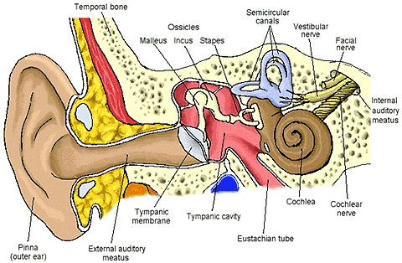

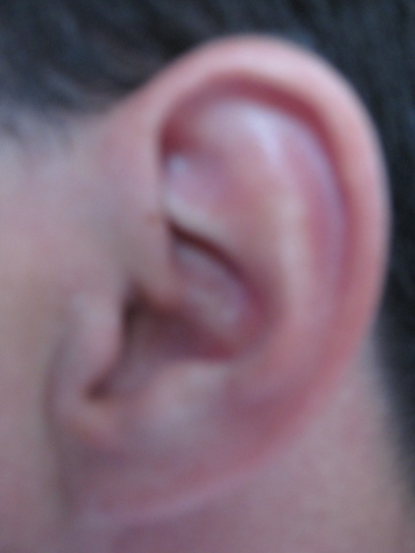
Principle of Complementarity
Anatomy and physiology are inseparable.
  Function always reflects structure
  What a structure can do depends on its specific form
  Example the Human Ear – a reverse megaphone

Slide 4
There are many ways to study anatomy!
Gross Anatomy – non-dissection
A. Topical anatomy (surface anatomy)– a study of internal structures as they relate to the overlying skin

Slide 5
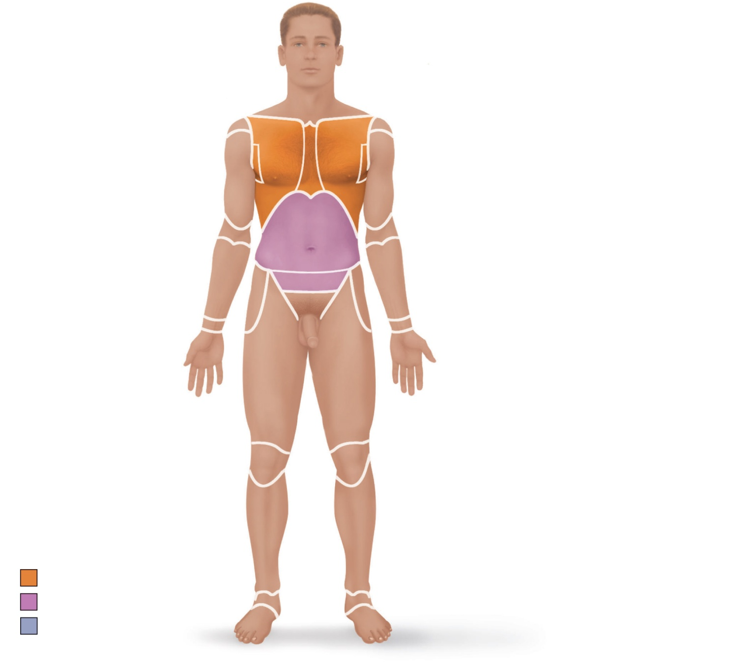
Cephalic
Upper limb
Frontal
Acromial
Orbital
Brachial (arm)
Nasal
Antecubital
Oral
Antebrachial
(forearm)
Mental
Cervical
Carpal (wrist)
Thoracic
Manus (hand)
Axillary
Palmar
Mammary
Pollex
Sternal
Digital
Abdominal
Lower limb
Umbilical
Coxal (hip)
Pelvic
Femoral (thigh)
Inguinal
(groin)
Patellar
Crural (leg)
Pubic
(genital)
Fibular or peroneal
Pedal (foot)
Thorax
Tarsal (ankle)
Abdomen
Metatarsal
Back (Dorsum)
Digital
(a) Anterior/Ventral
Hallux
Figure 1.7a

Slide 6
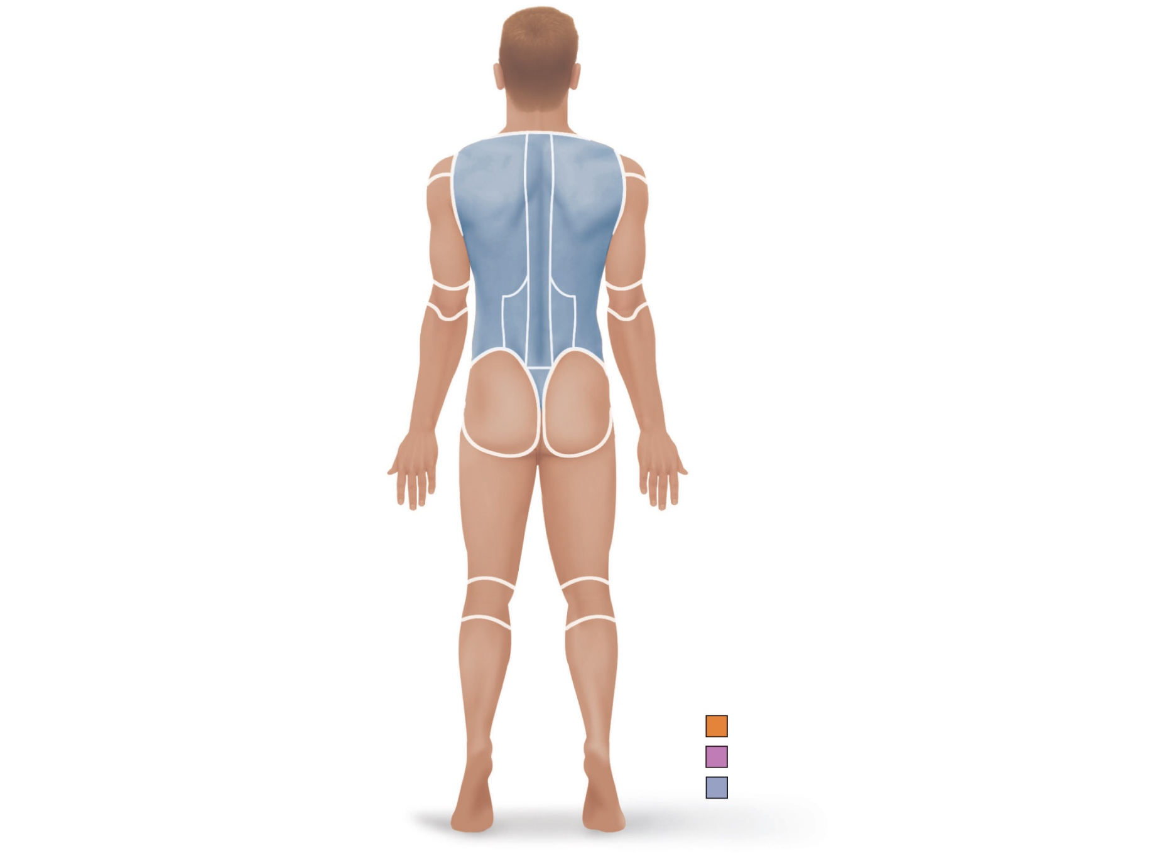
Upper limb
Cephalic
Acromial
Otic
Brachial (arm)
Occipital (back
of head)
Olecranal
Antebrachial
(forearm)
Cervical
Back (dorsal)
Manus (hand)
Scapular
Metacarpal
Vertebral
Digital
Lumbar
Lower limb
Sacral
Femoral (thigh)
Gluteal
Popliteal
Perineal (between
anus and external
genitalia)
Sural (calf)
Fibular or peroneal
Pedal (foot)
Calcaneal
Thorax
Abdomen
Back (Dorsum)
Plantar
(b) Posterior/Dorsal
Figure 1.7b

Slide 7
II. Gross Anatomy – dissection type - a macroscopic (large) study of anatomy
A. Systemic approach (dissect along the 11 organ systems)
B. Regional approach (dissect along body regions – like head and neck)
In the academic environment – most dissect according to the regional approach

Slide 8
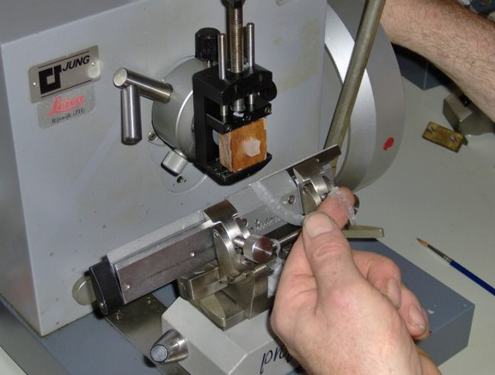
Microscopic Anatomy
Histology – the study of tissues. A tissue is a group of cells of similar embryonic origin – sometimes with some intercellular substances – all dedicated to a common function. Microtome
Four human tissue types
A. Epithelial
B. Connective
C. Muscle
D. Nerve

Slide 9
Microscopic Anatomy
Cytology – the anatomical study of the cell.
There are approximately 210 different cell types in the human body
An estimation of the number of cells in the standard human is approximately 100 trillion
The standard human for physiologic purposes is generally a male – approximately 5 foot 9 inches- late teens to early 20’s and 70 kg (154 pounds)

Slide 10
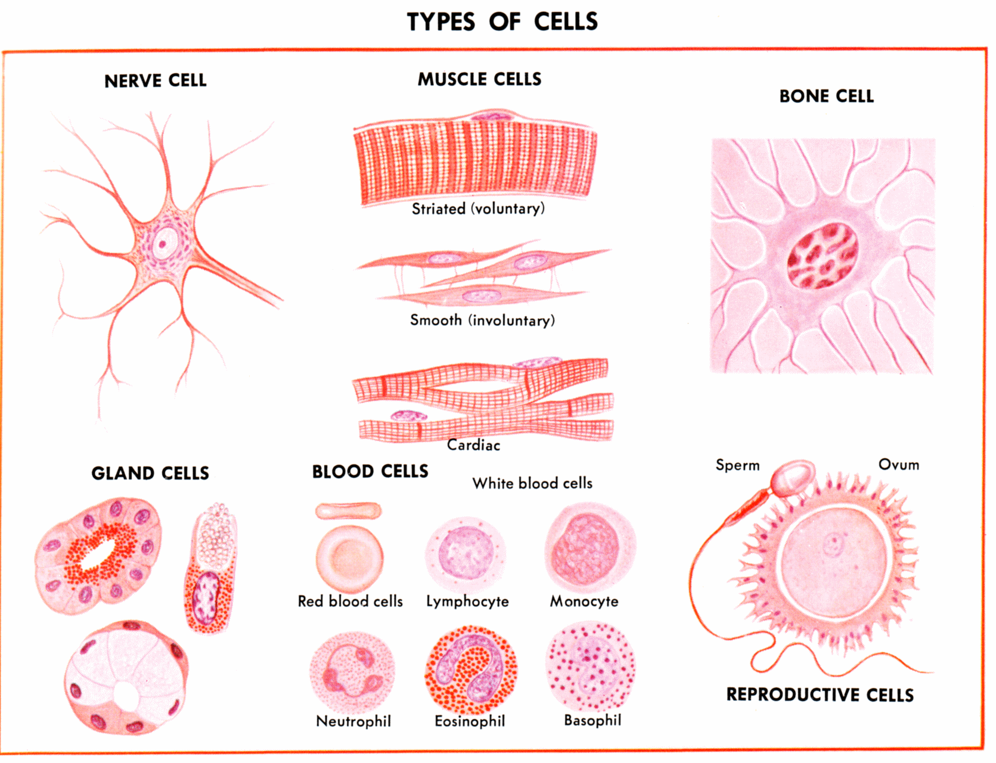
An example of a few of the 210 different cell types

Slide 11
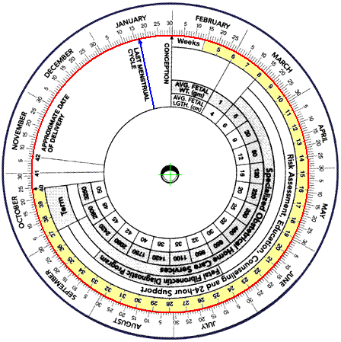
Developmental Anatomy
Pre-embryonic period – first 16 days
(cleavage, implantation, embryogenesis)
Embryo – first 8 weeks in utero (from date of conception) there is a difference between date of fertilization and LMP –which is termed gestation period
Fetus – 9 weeks till delivery
Normal pregnancy using date of conception is 36 – 40 weeks – if using gestation – 38 – 42 weeks
A pregnancy from date of fertilization is 266 days

Slide 12
Developmental Anatomy
Neonate – first 28 days after delivery
Early Childhood – ages 1 – 3
Middle Childhood – ages 3 – 6
Late Childhood – ages 6 – 12
Adolescence - ages 13 – 18
Early adulthood – ages 18 – 30
Middle adulthood – ages 30 – 65
Late adulthood – ages 65 and beyond

Slide 13
Pathology is the study of the anatomical structures involved in disease
Radiologic anatomy – studies internal structures using some radioactive or scanning source

Slide 14
There are different ways to study physiology
Physiology: The study of function at many levels
Most physiology is studied from the organ-system approach (renal, cardiovascular, digestive, etc.)
Pathophysiology – the functional study of diseases
Cell physiology – the functional study of the cell

Slide 15
Levels of Structural Organization
Chemical: atoms and molecules (Chapter 2)
Cellular: cells and their organelles (Chapter 3)
Tissue: groups of similar cells (Chapter 4)
Organ: contains two or more types of tissues
Organ system: organs that work closely together
Organismal: all organ systems

Slide 16
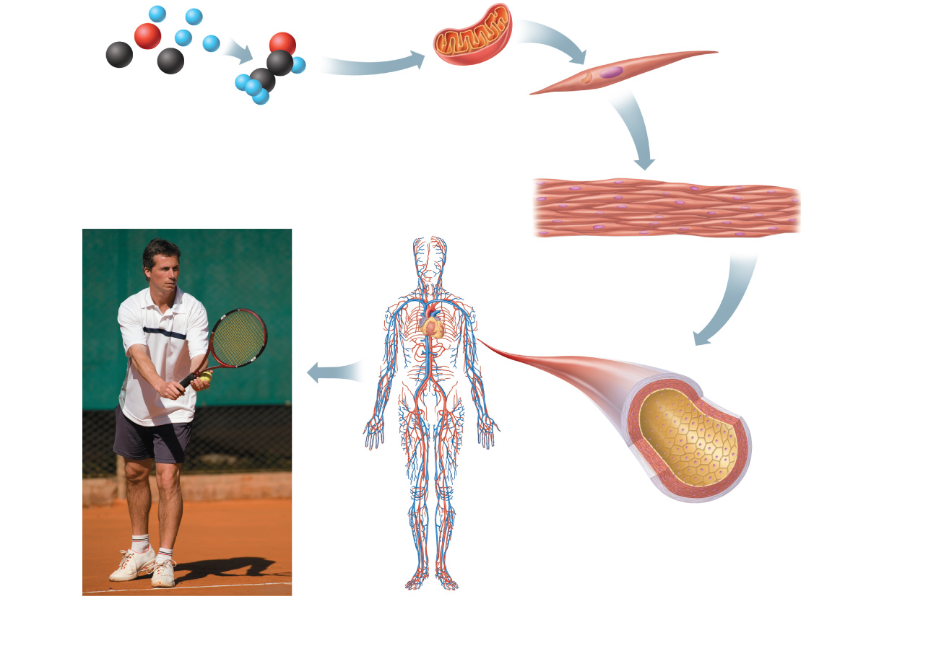
Atoms
Molecule
Organelle
Smooth muscle cell
Cellular level
Cells are made up of
molecules.
Chemical level
Atoms combine to form molecules.
2
1
Smooth muscle tissue
Cardiovascular
system
Tissue level
Tissues consist of similar
types of cells.
3
Heart
Blood
vessels
Blood vessel (organ)
Smooth muscle tissue
Connective tissue
Epithelial
tissue
Organ level
Organs are made up of different types
of tissues.
4
Organismal level
The human organism is made up
of many organ systems.
Organ system level
Organ systems consist of different
organs that work together closely.
6
5
Figure 1.1

Slide 17
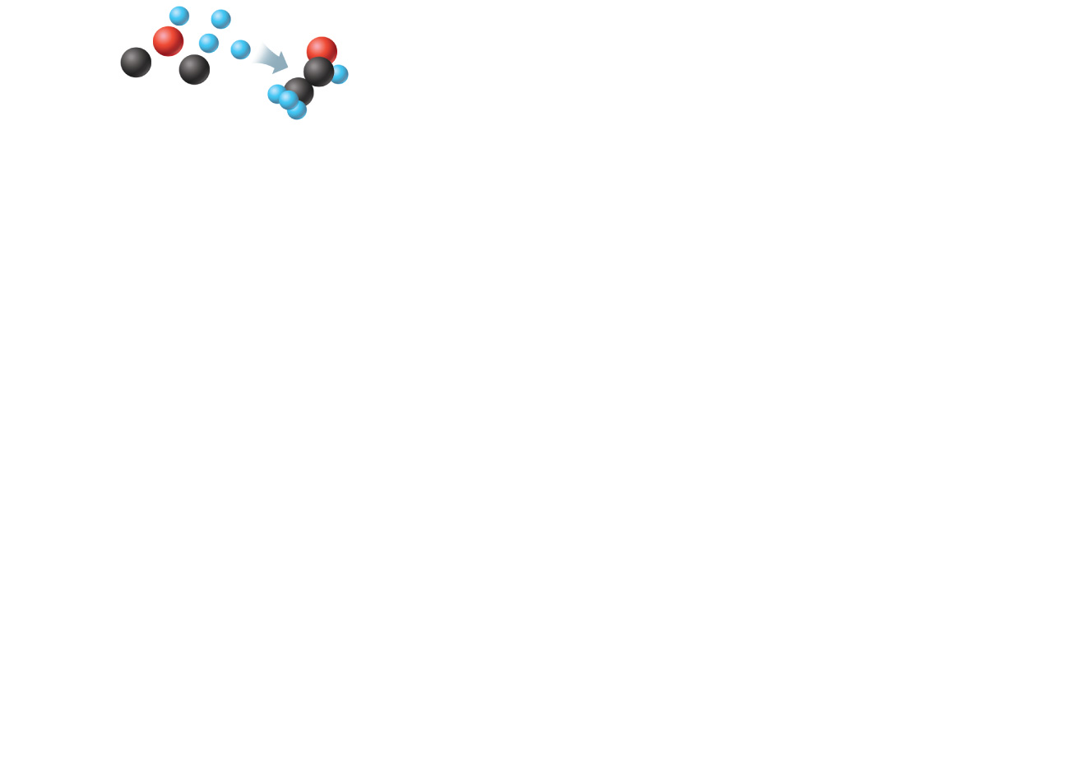
Atoms
Molecule
Chemical level
Atoms combine to form molecules.
1
Figure 1.1, step 1

Slide 18
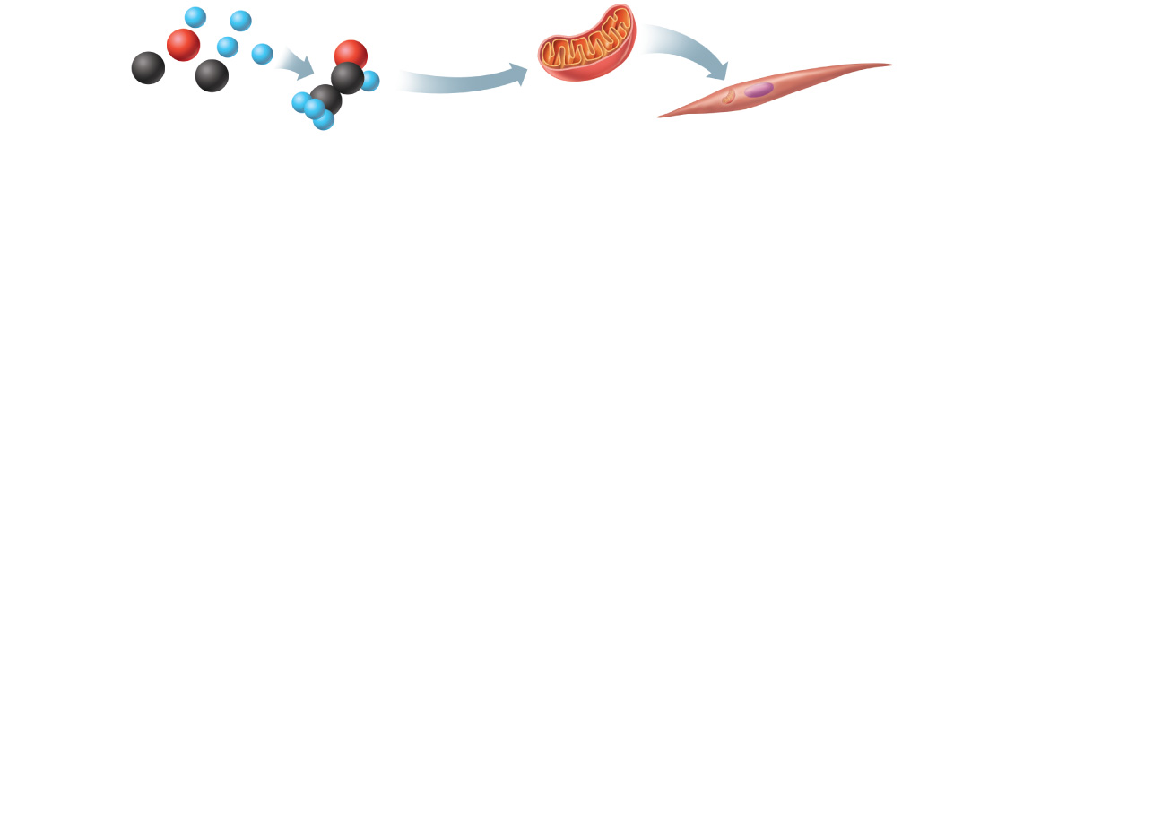
Atoms
Molecule
Organelle
Smooth muscle cell
Cellular level
Cells are made up of
molecules.
Chemical level
Atoms combine to form molecules.
2
1
Figure 1.1, step 2

Slide 19
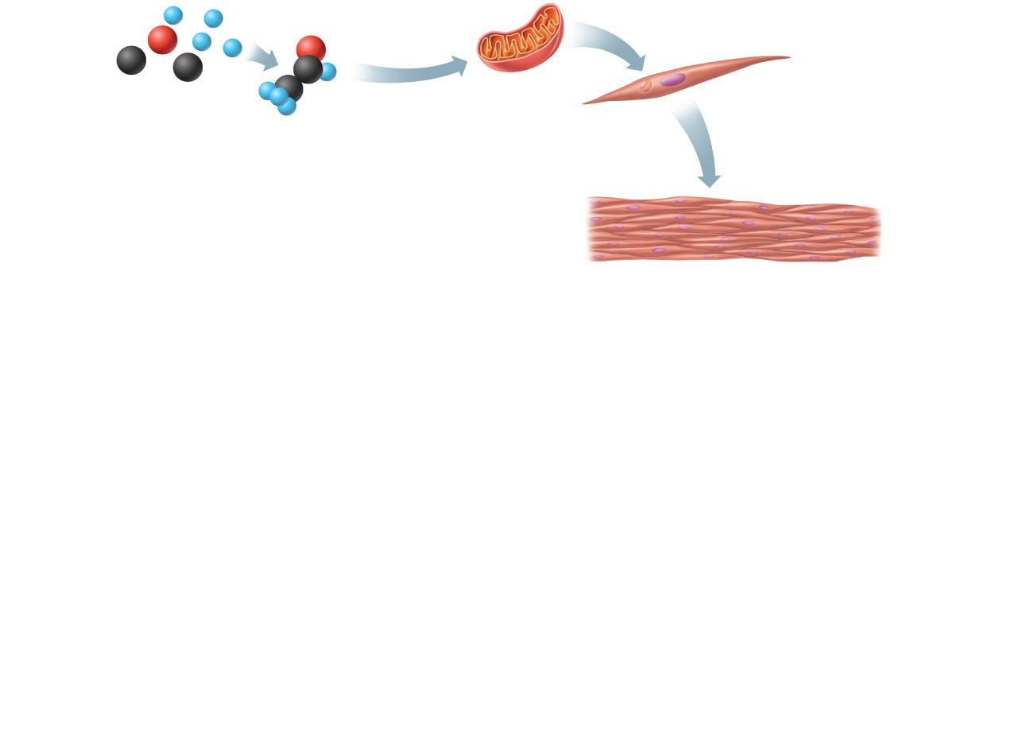
Atoms
Molecule
Organelle
Smooth muscle cell
Cellular level
Cells are made up of
molecules.
Chemical level
Atoms combine to form molecules.
2
1
Smooth muscle tissue
Tissue level
Tissues consist of similar
types of cells.
3
Figure 1.1, step 3

Slide 20
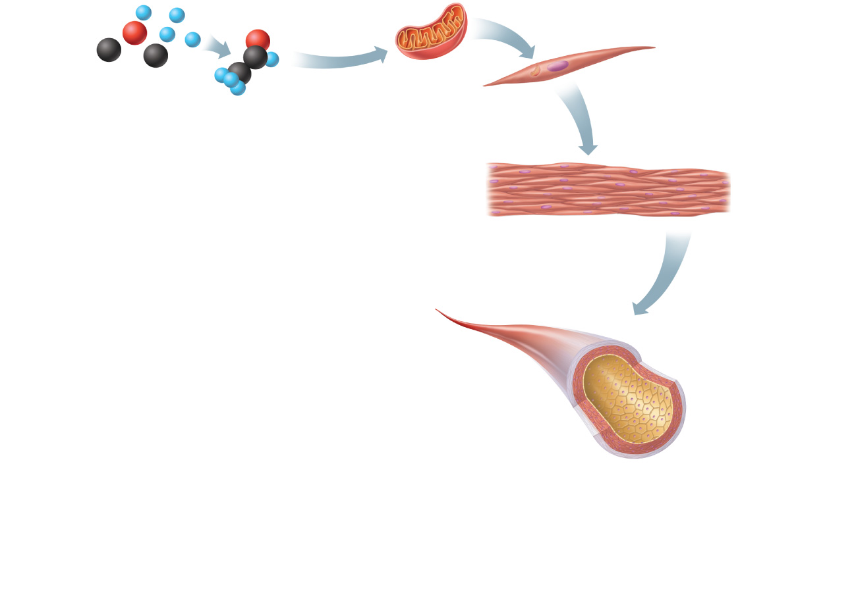
Atoms
Molecule
Organelle
Smooth muscle cell
Cellular level
Cells are made up of
molecules.
Chemical level
Atoms combine to form molecules.
2
1
Smooth muscle tissue
Tissue level
Tissues consist of similar
types of cells.
3
Blood vessel (organ)
Smooth muscle tissue
Connective tissue
Epithelial
tissue
Organ level
Organs are made up of different types
of tissues.
4
Figure 1.1, step 4

Slide 21
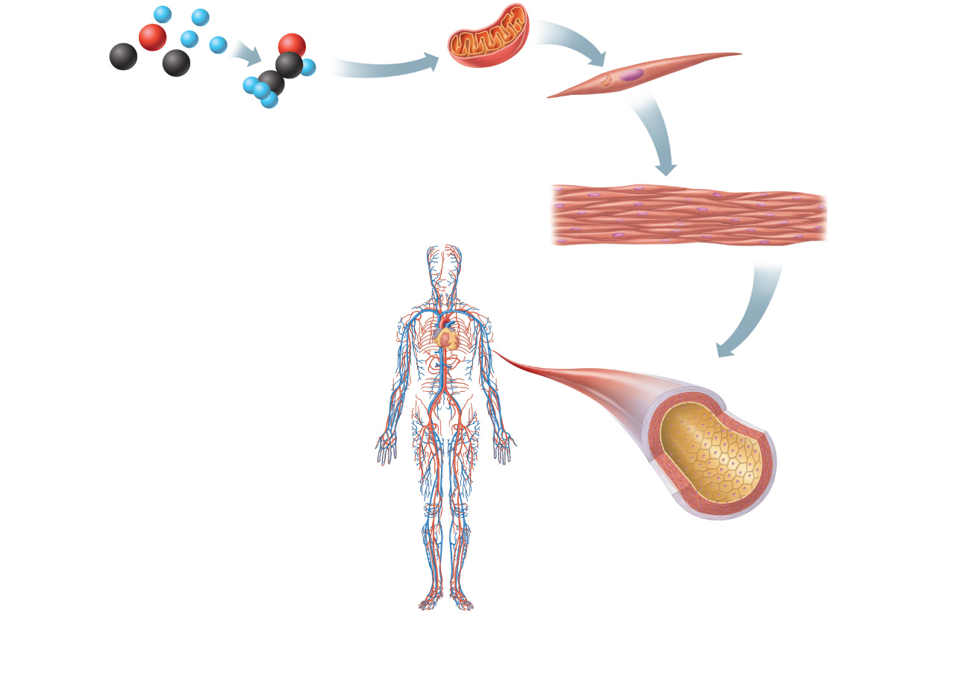
Atoms
Molecule
Organelle
Smooth muscle cell
Cellular level
Cells are made up of
molecules.
Chemical level
Atoms combine to form molecules.
2
1
Smooth muscle tissue
Cardiovascular
system
Tissue level
Tissues consist of similar
types of cells.
3
Heart
Blood
vessels
Blood vessel (organ)
Smooth muscle tissue
Connective tissue
Epithelial
tissue
Organ level
Organs are made up of different types
of tissues.
4
Organ system level
Organ systems consist of different
organs that work together closely.
5
Figure 1.1, step 5

Slide 22
Atoms
Molecule
Organelle
Smooth muscle cell
Cellular level
Cells are made up of
molecules.
Chemical level
Atoms combine to form molecules.
2
1
Smooth muscle tissue
Cardiovascular
system
Tissue level
Tissues consist of similar
types of cells.
3
Heart
Blood
vessels
Blood vessel (organ)
Smooth muscle tissue
Connective tissue
Epithelial
tissue
Organ level
Organs are made up of different types
of tissues.
4
Organismal level
The human organism is made up
of many organ systems.
Organ system level
Organ systems consist of different
organs that work together closely.
6
5
Figure 1.1, step 6

Slide 23
Let’s go further
Population – all the individuals of a species living within the bounds of a specified area
Biological Community (all the populations) – the entire array of organisms inhabiting a particular ecosystem
Ecosystem – all living and non-living entities in a localized area

Slide 24
Overview of Organ Systems
Note major organs and functions of the 11 organ systems (Fig. 1.3)

Slide 25
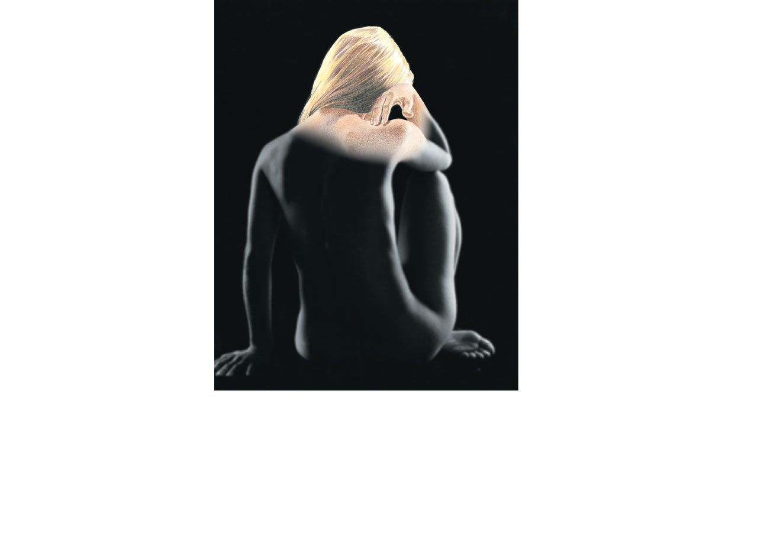
Hair
Skin
Nails
(a) Integumentary System
Forms the external body covering, and
protects deeper tissues from injury.
Synthesizes vitamin D, and houses
cutaneous (pain, pressure, etc.)
receptors and sweat and oil glands.
Figure 1.3a

Slide 26
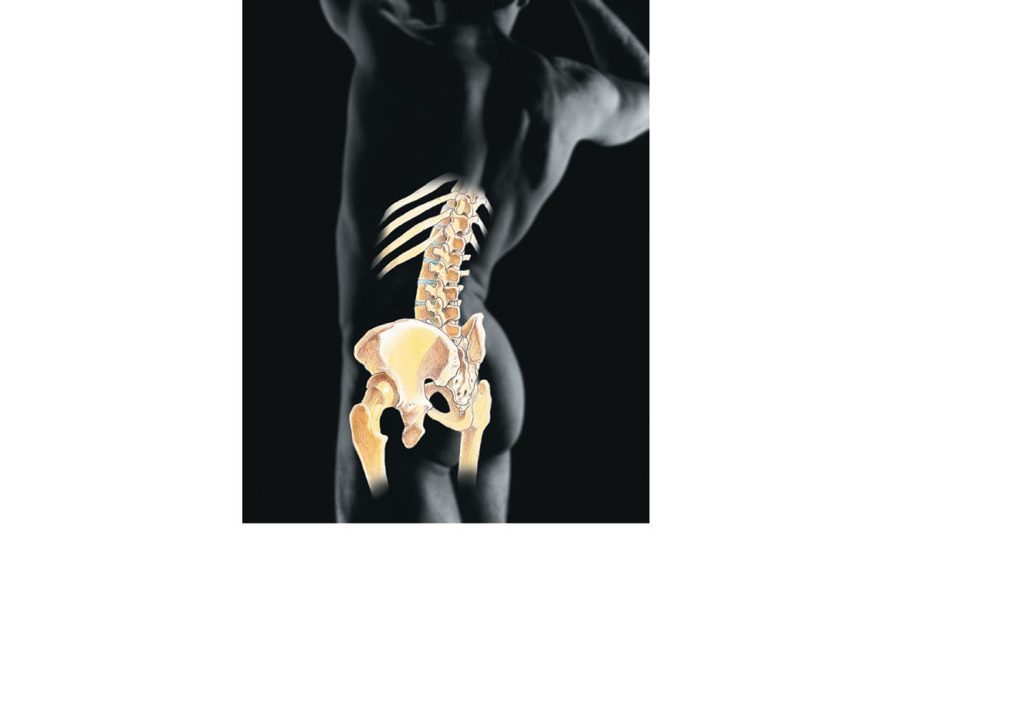
Bones
Joint
(b) Skeletal System
Protects and supports body organs,
and provides a framework the muscles
use to cause movement. Blood cells
are formed within bones. Bones store
minerals.
Figure 1.3b

Slide 27
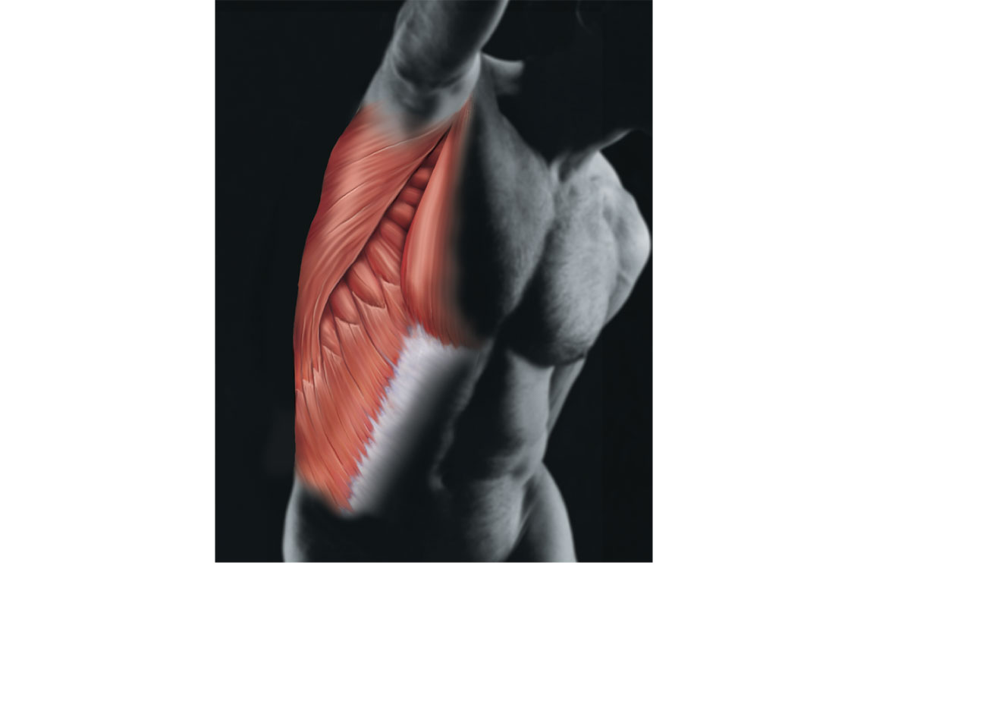
Skeletal
muscles
(c) Muscular System
Allows manipulation of the environment,
locomotion, and facial expression. Main-
tains posture, and produces heat.
Figure 1.3c

Slide 28
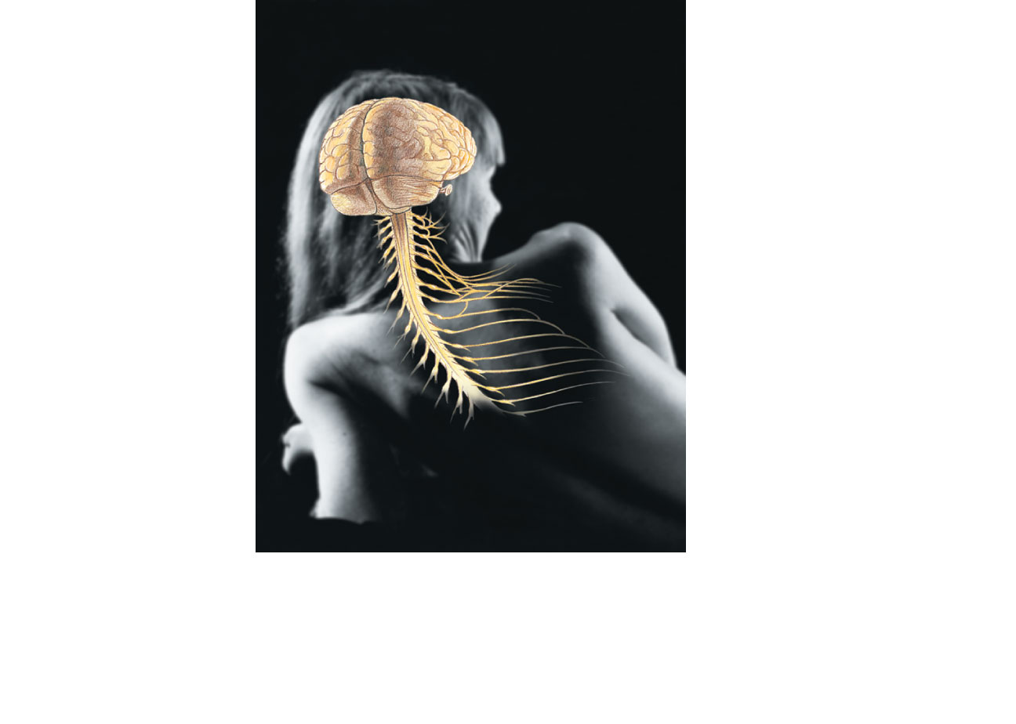
Brain
Nerves
Spinal
cord
(d) Nervous System
As the fast-acting control system of
the body, it responds to internal and
external changes by activating
appropriate muscles and glands.
Figure 1.3d

Slide 29
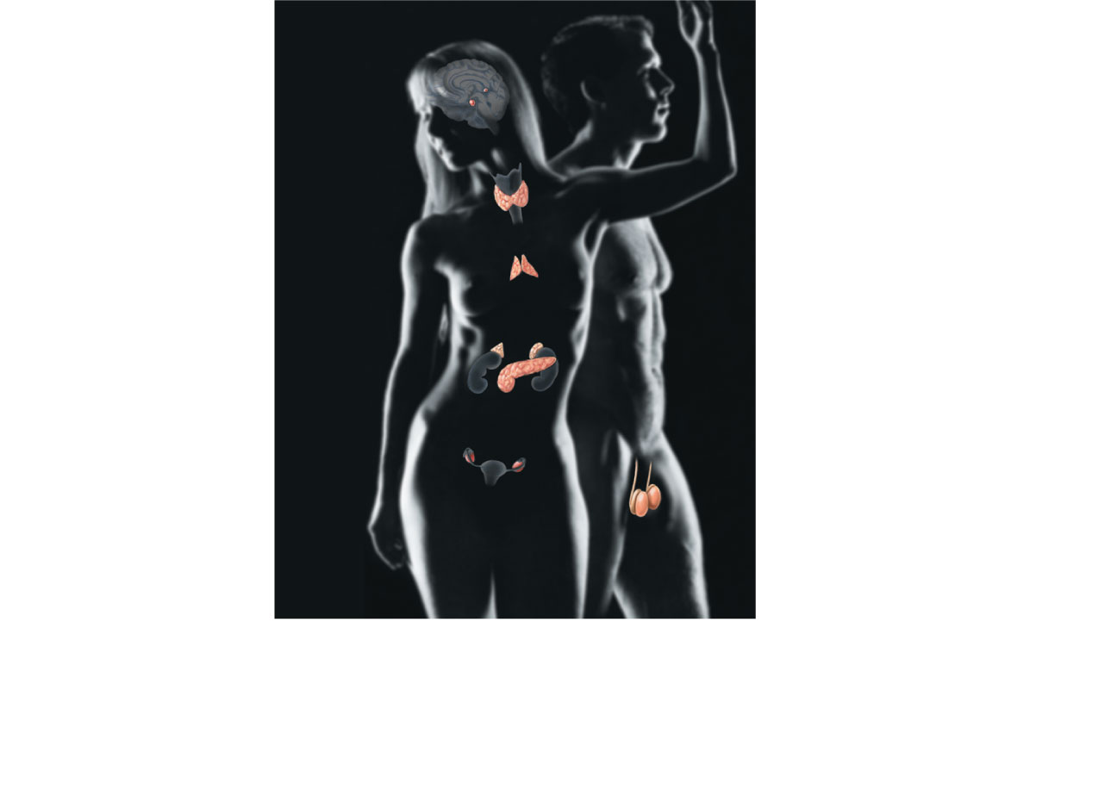
Pineal gland
Pituitary
gland
Thyroid
gland
Thymus
Adrenal
gland
Pancreas
Testis
Ovary
(e) Endocrine System
Glands secrete hormones that regulate
processes such as growth, reproduction,
and nutrient use (metabolism) by body
cells.
Figure 1.3e

Slide 30
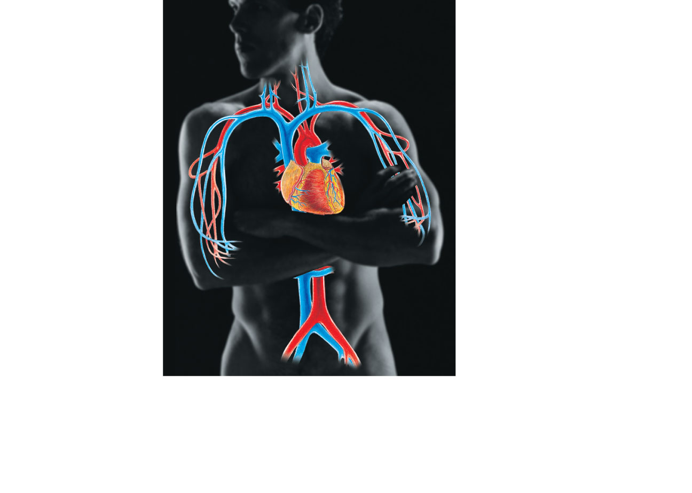
Heart
Blood
vessels
(f) Cardiovascular System
Blood vessels transport blood,
which carries oxygen, carbon
dioxide, nutrients, wastes, etc.
The heart pumps blood.
Figure 1.3f

Slide 31
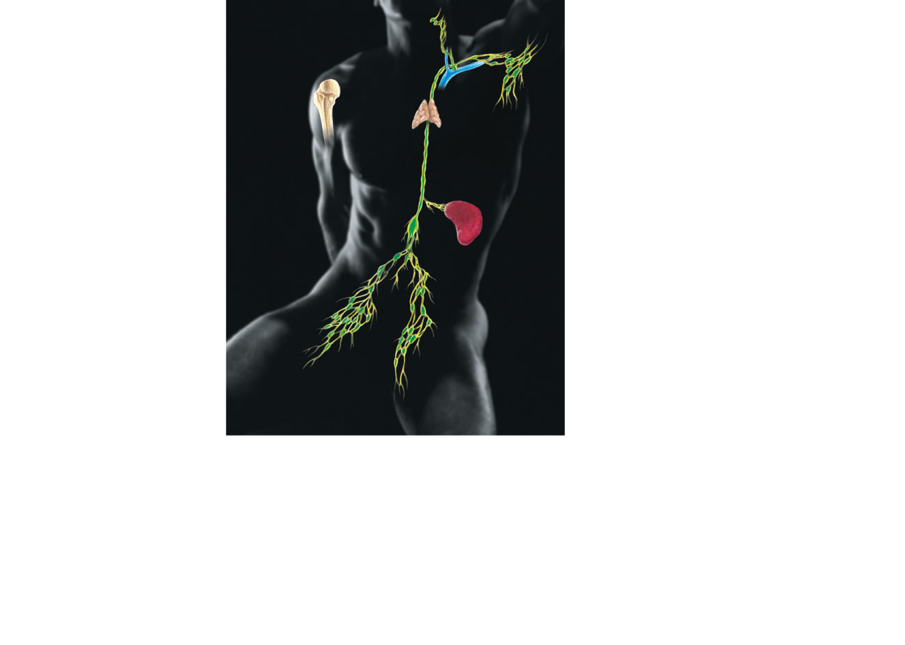
Red bone
marrow
Thymus
Lymphatic
vessels
Thoracic
duct
Spleen
Lymph
nodes
(g) Lymphatic System/Immunity
Picks up fluid leaked from blood vessels
and returns it to blood. Disposes of debris
in the lymphatic stream. Houses white
blood cells (lymphocytes) involved in
immunity. The immune response mounts
the attack against foreign substances
within the body.
Figure 1.3g

Slide 32
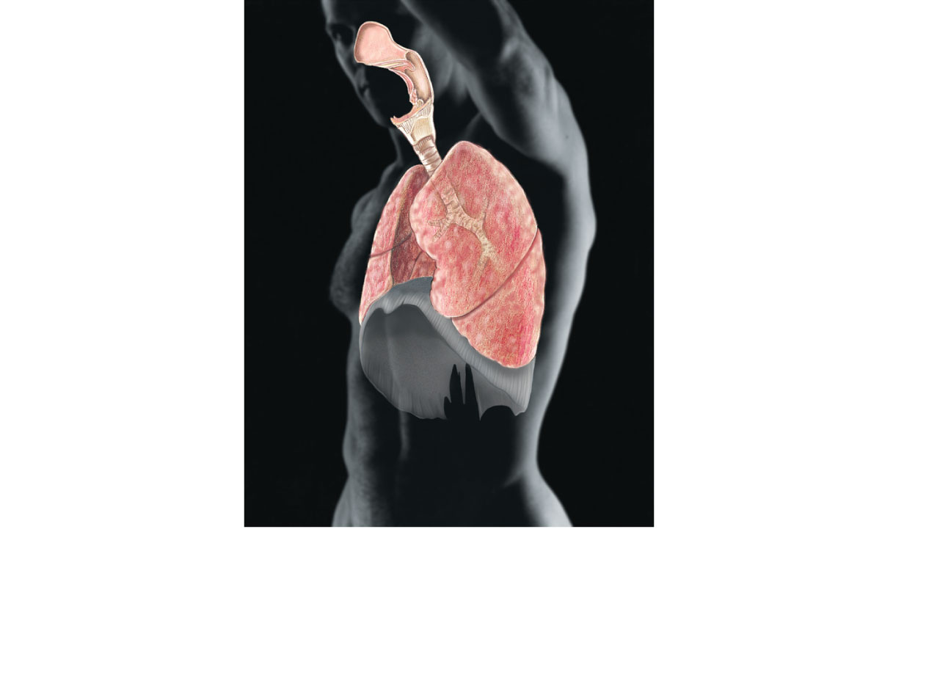
Nasal
cavity
Pharynx
Larynx
Bronchus
Trachea
Lung
(h) Respiratory System
Keeps blood constantly supplied with
oxygen and removes carbon dioxide.
The gaseous exchanges occur through
the walls of the air sacs of the lungs.
Figure 1.3h

Slide 33
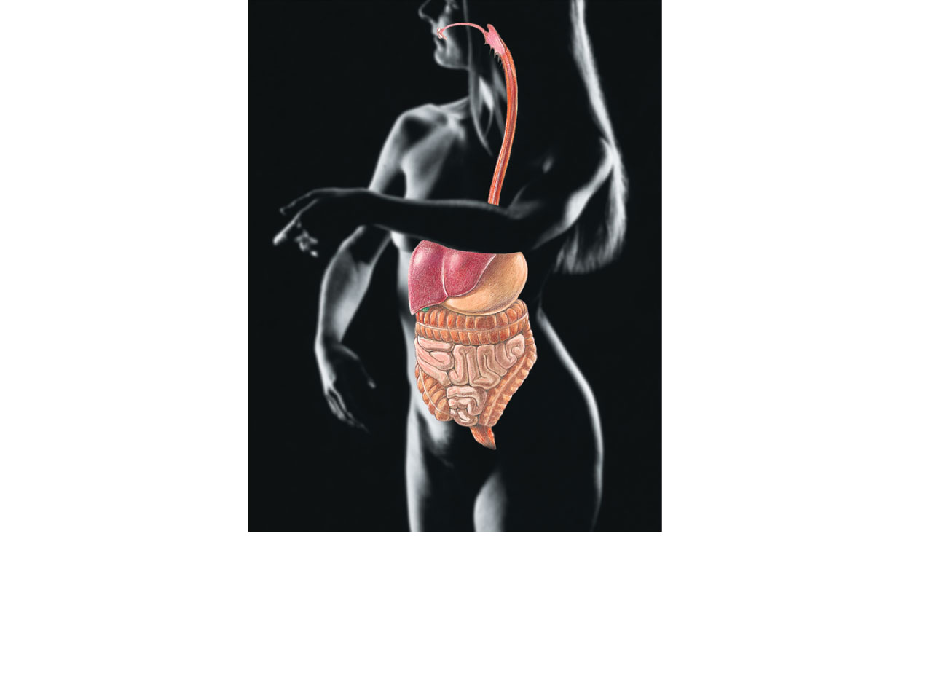
Oral cavity
Esophagus
Liver
Stomach
Small
intestine
Large
intestine
Rectum
Anus
(i) Digestive System
Breaks down food into absorbable
units that enter the blood for
distribution to body cells. Indigestible
foodstuffs are eliminated as feces.
Figure 1.3i

Slide 34
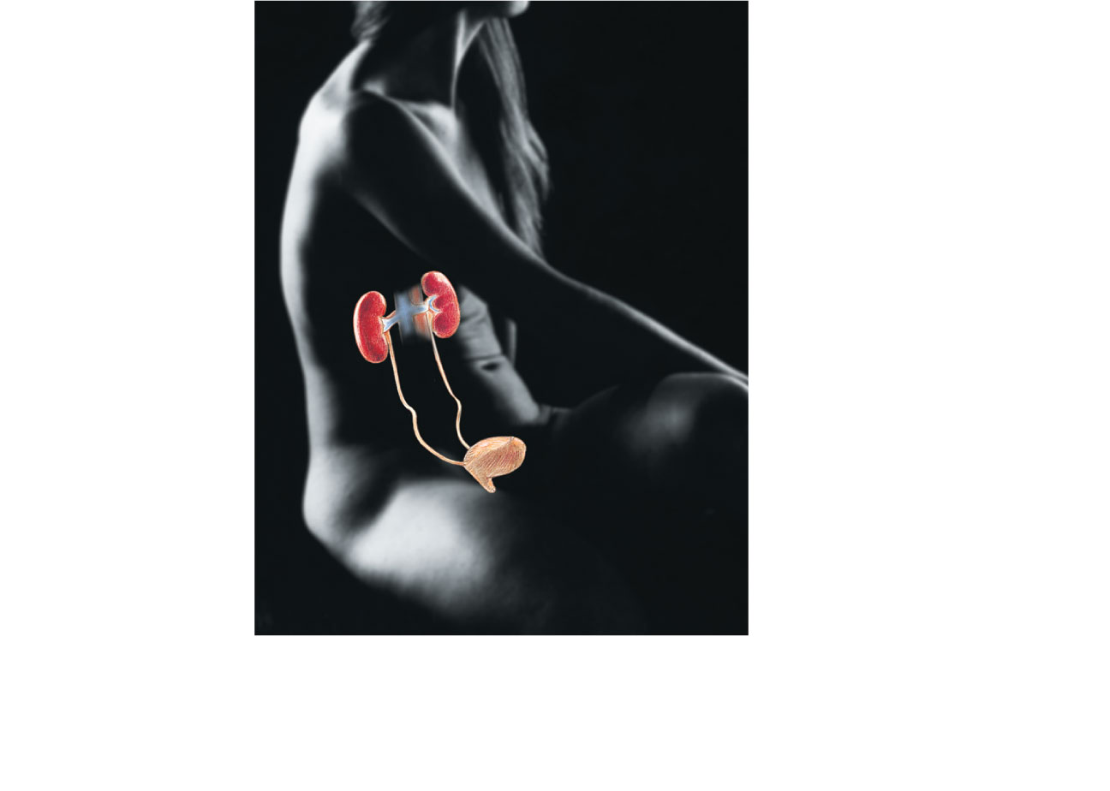
Kidney
Ureter
Urinary
bladder
Urethra
(j) Urinary System
Eliminates nitrogenous wastes from the
body. Regulates water, electrolyte and
acid-base balance of the blood.
Figure 1.3j

Slide 35
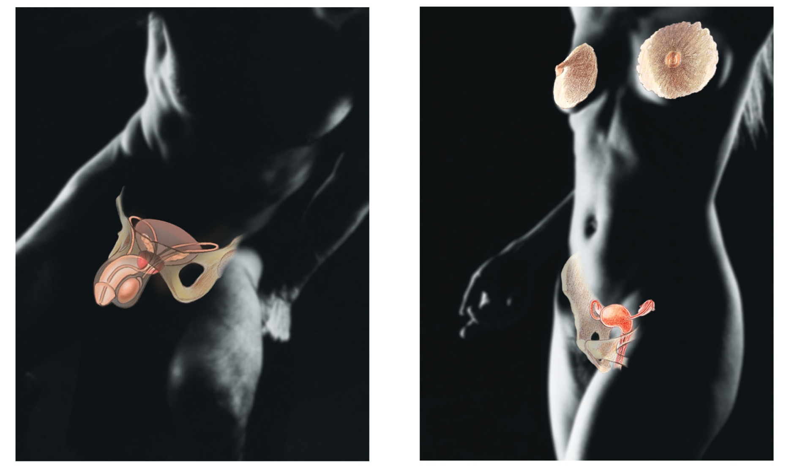
Mammary
glands (in
breasts)
Prostate
gland
Ovary
Penis
Testis
Ductus
deferens
Scrotum
Uterus
Uterine
tube
Vagina
(k) Male Reproductive System
(l) Female Reproductive System
Overall function is production of offspring. Testes produce sperm and male sex
hormone, and male ducts and glands aid in delivery of sperm to the female
reproductive tract. Ovaries produce eggs and female sex hormones. The remaining
female structures serve as sites for fertilization and development of the fetus.
Mammary glands of female breasts produce milk to nourish the newborn.
Figure 1.3k-l

Slide 36
Organ Systems Interrelationships
All cells depend on organ systems to meet their survival needs
Organ systems work cooperatively to perform necessary life functions

Slide 37
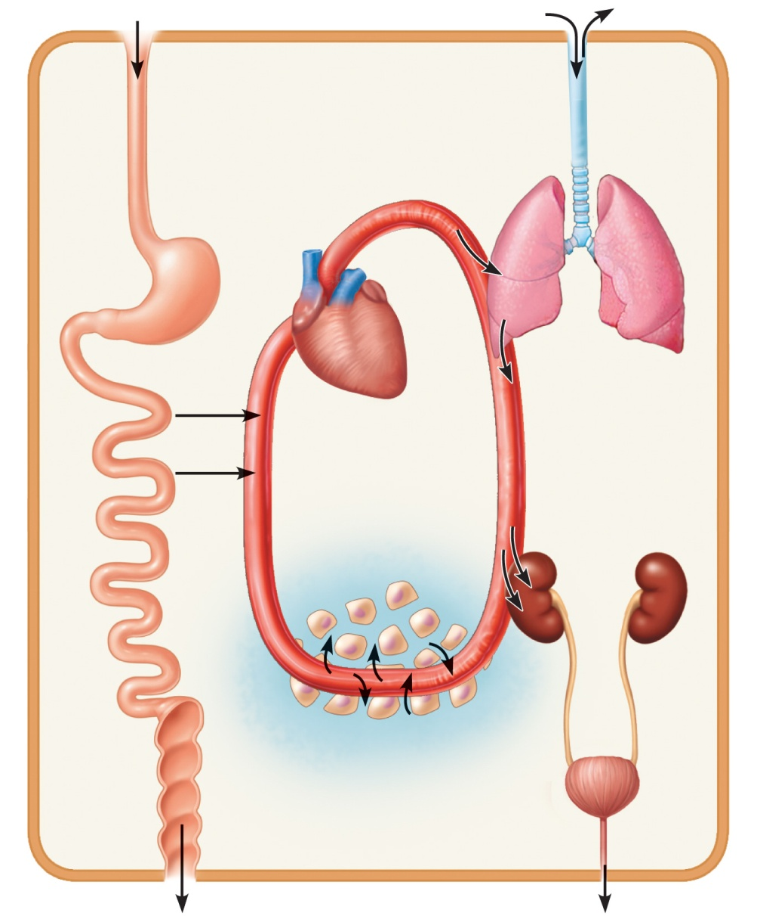
Digestive system
Takes in nutrients, breaks them
down, and eliminates unabsorbed
matter (feces)
Respiratory system
Takes in oxygen and
eliminates carbon dioxide
Food
O₂
CO₂
Cardiovascular system
Via the blood, distributes oxygen
and nutrients to all body cells and
delivers wastes and carbon
dioxide to disposal organs
Blood
CO₂
O₂
Urinary
system
Eliminates
nitrogenous
wastes and
excess ions
Heart
Nutrients
Interstitial fluid
Nutrients and wastes pass
between blood and cells
via the interstitial fluid
Integumentary system
Protects the body as a whole
from the external environment
Feces
Urine
Figure 1.2

Slide 38
Life Processes
1. Metabolism: The sum total of all chemical reactions that occur in body cells
  Catabolism and anabolism
  2. Catabolism – biologic chemical breaking down process
  3. Anabolism – biologic chemical building process (Anabolic Steroids)

Slide 39
Life Processes
4. Ingestion – taking in of food
5. Digestion – breaking down of food into simpler forms
5a. Mechanical – chewing in mouth and churning in stomach
5b. Chemical – enzymatic breakdown of food
6. Absorption – uptake of food from gut and into cells
7. Respiration – the generation of energy, usually in the presence of O2 with the release of CO2
8. Excretion – the elimination of wastes

Slide 40
Life Processes
9. Secretion – the release of useful substances from the cell
10. Differentiation – process whereby unspecialized cells become specialized
11. Excitability (responsiveness, irritability) – sensing of changes in the internal and external environment
12. Conductivity – the ability of cells to carry the effects of a stimulus from one part of a cell to another and to another cell

Slide 41
Life Processes
13. Contractility – a cell shortening against a force – seen in muscle cells
14. Assimilation - The conversion of nutrients into living tissue
14. Growth – enlargement of an organism through cellular actions
A. hypertrophy- increase in the size of a cell
B. hyperplasia – increase in the number of cells
15. Reproduction – the production of an offspring or new individuals through a sexual or asexual process

Slide 42
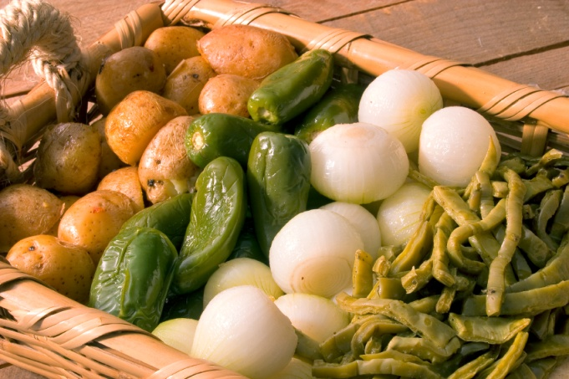
Needs of Organisms
Nutrients
  Chemicals for energy and cell building
  Carbohydrates, fats, proteins, minerals, vitamins
Oxygen
  Essential for energy release (ATP production)

Slide 43
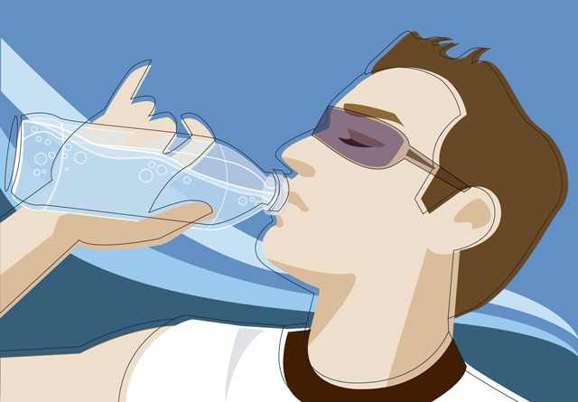
Needs of the Organism
Water
  Most abundant chemical in the body
  Site of chemical reactions
Normal body temperature
  Affects rate of chemical reactions
Appropriate atmospheric pressure
  For adequate breathing and gas exchange in the lungs

Slide 44
Homeostasis
(from Greek: homoios, "similar"; "standing still"; defined by Claude Bernard and later by Walter B. Cannon in (1929 + 1932) is the property of a system, either open or closed, that regulates its internal environment and tends to maintain a stable, constant condition. Typically used to refer to a living organism, the concept came from that of milieu interieur (the sea within us) that was created by Claude Bernard and published in 1865. Multiple dynamic equilibrium adjustment and regulation mechanisms make homeostasis possible.

Slide 45
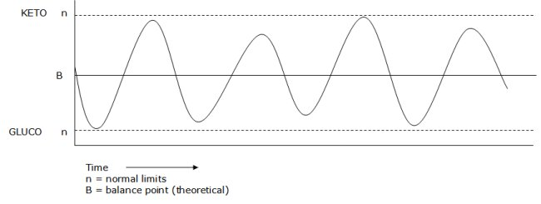
Homeostasis
Maintenance of a relatively stable internal environment in the face of a constantly changing external environment
It is a dynamic state of equilibrium
Pathology
Physiologic range
Pathology
Fasting Blood Sugar 60 mg/dl – 100 mg/dl

Slide 46
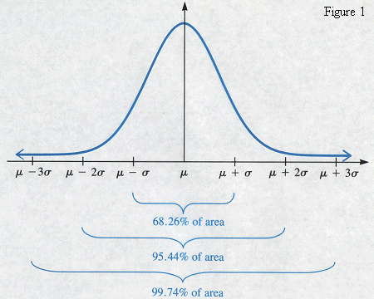
Normal Bell Shaped Curve
Median value for physiologic process – 72 BPM for heart rate or 98.6° F for oral temp
Normal range is two standard deviations – includes 95.44% of the population
Resting Heart rate range
60 -100 BPM
Oral Temp range – 97.6° F
to 99.6° F – fever at 100°F

Slide 47
What is the internal environment in homeostasis?
Maintenance of a constant environment within and around living cells, particularly with regard to pH, salt concentration, temperature, and blood sugar levels.
Cells in the body are bathed in a fluid medium – known as tissue fluid or interstitial fluid.
The concept is if the fluids around the cells are kept right – the fluid inside the cell will be kept right – and the cell can optimally survive

Slide 48
Breakdown of the Standard Human Body
55- 60% Water
2 – 4% Carbohydrates
18 – 24% Total Lipids (this includes more that the normal fat content – 8-17% male and 10 -21% female)
12 – 18% Protein
Nucleic Acids are less than 1%

Slide 49
Water Breakdown for 70 Kg male
56 – 60% water – so approximately 40 – 42 Kg(L)
Water is compartmentalized but the compartments communicate with one another
Intracellular water (inside cell) around 62.5 % or about 25 – 28 liters
Extracellular (outside cells) – 13 - 15 Liters
A. Interstitial Fluids – fluid around the cells (Homeostasis fluid) - ¾ - ⅘ of extracellular (10 -12 Liters)
B. Intravascular – fluid inside vessels – primarily the blood vessels ¼ - 1/5 (3 Liters)
Transcellular – GI fluids, CSF, Peritoneal, and others

Slide 50
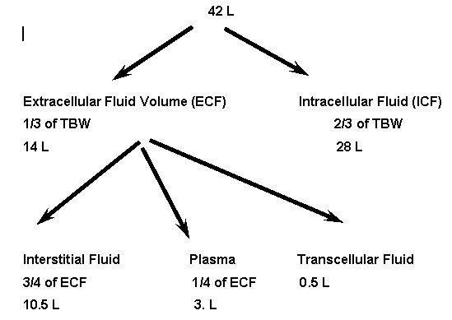

Slide 51
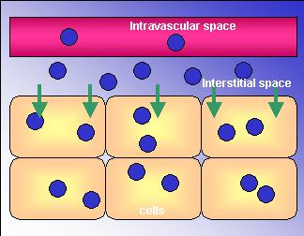
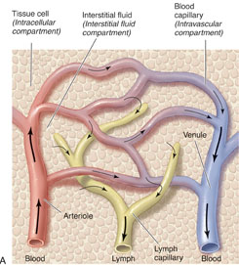

Slide 52
What process is generally used to accomplish homeostasis?
Feedback – a situation where the outcome (output) has some influence on the income (input)
A + B AB – if AB has some influence on A+ B – then there is feedback
If AB’s action on A+B enhances the amount or activity of A+ B then that is positive feedback
If AB’s action on A+B diminishes the amount or activity of A+ B then that is negative feedback

Slide 53
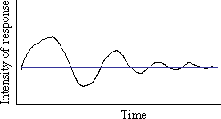
Most homeostatic mechanisms use negative feedback
If a physiologic process begins to move away from the optimal value – it is pulled back in the opposite direction – thus keeping it in range

Slide 54
Positive Feedback
Is used in homeostasis
Can take the physiologic function out of range if not controlled – thus it can lead to chaos
Only used for events that physiologically occur occasionally – like childbirth or ovulation
Need time to build something – like energy or chemical amount or proper location – then all the gradual buildup is used to perform the action – thus the levels go back to normal range

Slide 55
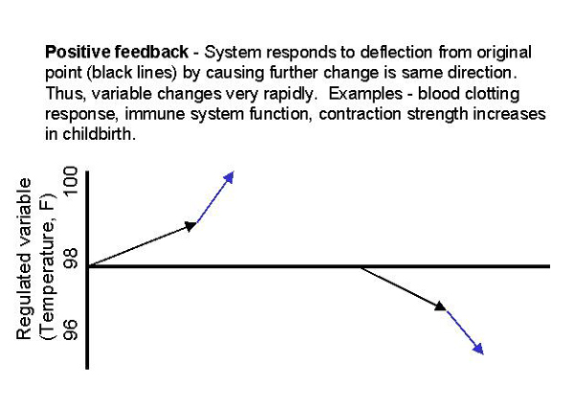

Slide 56
Positive Feedback
The response enhances or exaggerates the original stimulus
May exhibit a cascade or amplifying effect
Usually controls infrequent events e.g.:
  Enhancement of labor contractions by oxytocin (Chapter 28)
  Platelet plug formation and blood clotting

Slide 57
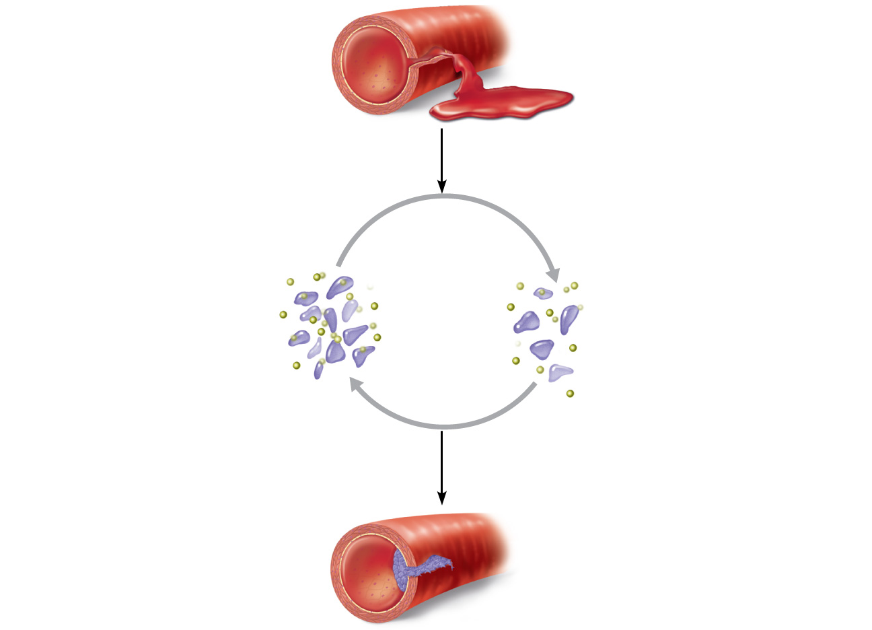
1
Break or tear
occurs in blood
vessel wall.
Positive feedback
cycle is initiated.
3
2
Released
chemicals
attract more
platelets.
Platelets
adhere to site
and release
chemicals.
Positive
feedback
loop
Feedback cycle ends
when plug is formed.
4
Platelet plug
forms.
Figure 1.6

Slide 58
Negative Feedback uses the Feedback Loop
Control Unit (has normal settings)
Afferent Limb Efferent Limb
Communication via hormones or nerves
Receptor Effector
Receives monitoring signal Acts to correct

Slide 59
Body Temp control in Homeostasis
The human body has two temperature compartments – the surface and the core
The two compartments are separated by a thermal insulator. An insulator is a poor or non-conductor of what is being insulated
The poorest conductor of heat in the human body if fat. Your fat layer is located in the hypodermis.
Thus above the hypodermis (Epidermis & Dermis) is the surface and below hypodermis is the body temp core

Slide 60
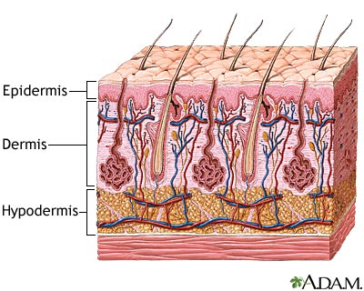
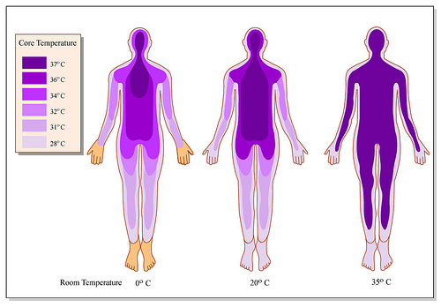

Slide 61
Body Temp control in Homeostasis
Since the vital organs are in the core – the human body protects it far more than the surface – for example if you are in the Arctics – the skin will be sacrificed (frost bite) to protect the body temp core
The human body has two sets of thermoreceptors– the surface (cutaneous thermoreceptors) and core thermoreceptors which measure blood temperature in the portion of the brain known as the hypothalamus (preoptic nucleus)

Slide 62
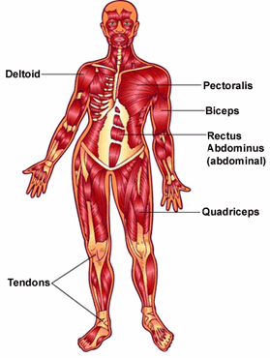
Body Temp control in Homeostasis
The control unit of the feedback loop for body temperature is in the hypothalamus.
The effectors for temperature control – are blood vessels (both surface and core), sweat glands and skeletal muscles

Slide 63
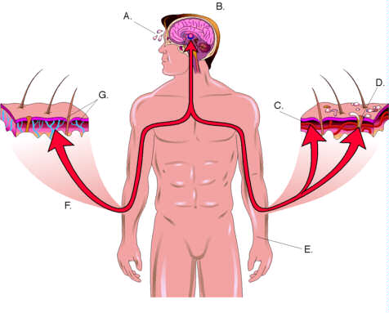

Slide 64
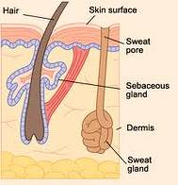
Most animals can't sweat efficiently. Cats and dogs only have sweat glands on the pads of their feet. Horses and humans are two of the few animals capable of sweating. Many animals pant rather than sweat, this is because the lungs have a large surface area and are highly vascularized.

Slide 65
Body Temp control in Homeostasis
When too cold in surroundings – surface blood vessels constrict – core blood vessels dilate– thus causing blood to circulate in the hotter core of the body – if still cold after this maneuver – may shiver (undulate skeletal muscles for heat friction)
When too hot in surroundings- surface blood vessels dilate- core blood vessels constrict – sweating may occur – and decrease skeletal muscle action may (all depending on the extent of heat

Slide 66
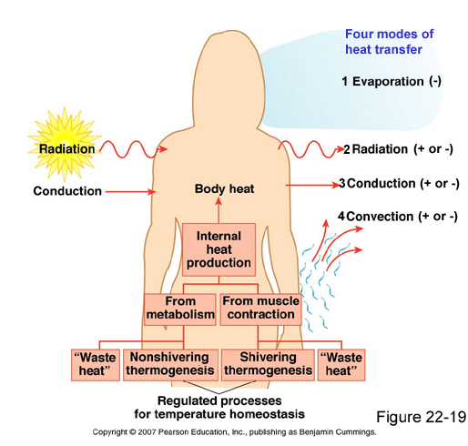

Slide 67
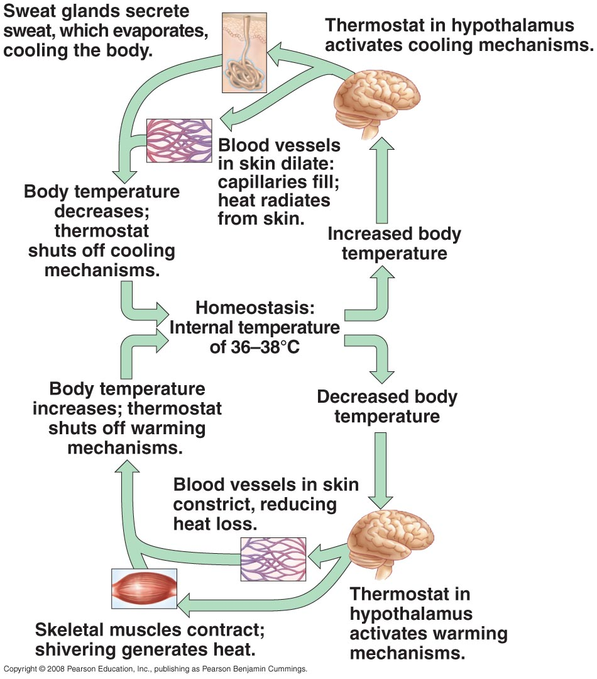

Slide 68
Fever versus Hyperthermia
A fever is caused by a pyrogen resetting the control center’s thermostat
Hyperthermia is a condition whereby a human cannot dissipate enough heat
Humans and birds are endothermic – creating heat within their bodies – more than enough heat in usual circumstances – thus this heat must be properly dissipated
Reptiles and amphibians are primarily ectothermic – needing the outside environment to keep their temperatures correct

Slide 69
Negative Feedback Another Example : Regulation of Blood Volume by ADH
Receptors sense decreased blood volume
Control center in hypothalamus stimulates pituitary gland to release antidiuretic hormone (ADH)
ADH causes the kidneys (effectors) to return more water to the blood

Slide 70
If homeostasis malfunctions or if an insult to the body occurs – then
  Increases risk of disease
  Contributes to changes associated with aging
  May allow destructive positive feedback mechanisms to take over (e.g., heart failure)
  An insult in clinical – is any action that attempts to deviate the organism from homeostatic range

