Slide 1
4
Histology II
Mike Clark, M.D.

Slide 2
Connective Tissue
Most abundant and widely distributed tissue type
Composition – Cells, Fibers and Amorphous Ground Substance
Functions
Binding and support
Protection - Immune
Insulation - Fat
Transportation (blood)

Slide 3
Connective Tissue Cells
Parenchyma – most important cell type in a tissue – for example neurons in nerve tissue and muscle cells in muscle tissue
Stroma – supporting
Fibroblast – the most important cell of soft connective tissue in that it secretes the fibers and amorphous ground substance (picture in handout)

Slide 4
Structural Elements of Connective Tissue
Cells
  Mitotically active and secretory cells = “blasts”
  Mature cells = “cytes”
    Fibroblasts in connective tissue proper
    Chondroblasts and chondrocytes in cartilage
    Osteoblasts and osteocytes in bone
    Hematopoietic stem cells in bone marrow
    Fat cells, white blood cells, mast cells, and macrophages

Slide 5
Fibers (three types)
Collagen – the most abundant protein in the human body- the strongest fiber. There are five types of collage (see handout)
Elastic Fiber – gives the property of elasticity
Reticular Fiber – thin delicate fiber

Slide 6
Structural Elements of Connective Tissue
Three types of fibers
  Collagen (white fibers) – NOTE: There are different types of collagen
    Strongest and most abundant type
    Provides high tensile strength
  Elastic
    Networks of long, thin, elastin fibers that allow for stretch
  Reticular
    Short, fine, highly branched collagenous fibers

Slide 7
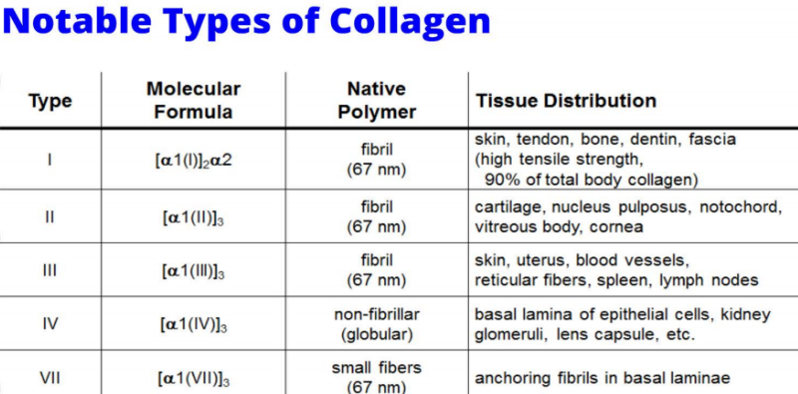

Slide 8
Amorphous Ground Substances
Amorphous (without form)– a liquid or jelly like substance that assumes the shape of the container
The amorphous ground substances are made of proteoglycans (see handout)
Proteoglycans are made of a protein core with glycosaminoglycans hanging off from the core (see handout)

Slide 9
Structural Elements of Connective Tissue
Ground substance
  Medium through which solutes diffuse between blood capillaries and cells
  Components:
    Interstitial fluid
    Adhesion proteins (“glue”)
    Proteoglycans
      Protein core + large polysaccharides (chrondroitin sulfate and hyaluronic acid)
      Trap water in varying amounts, affecting the viscosity of the ground substance

Slide 10
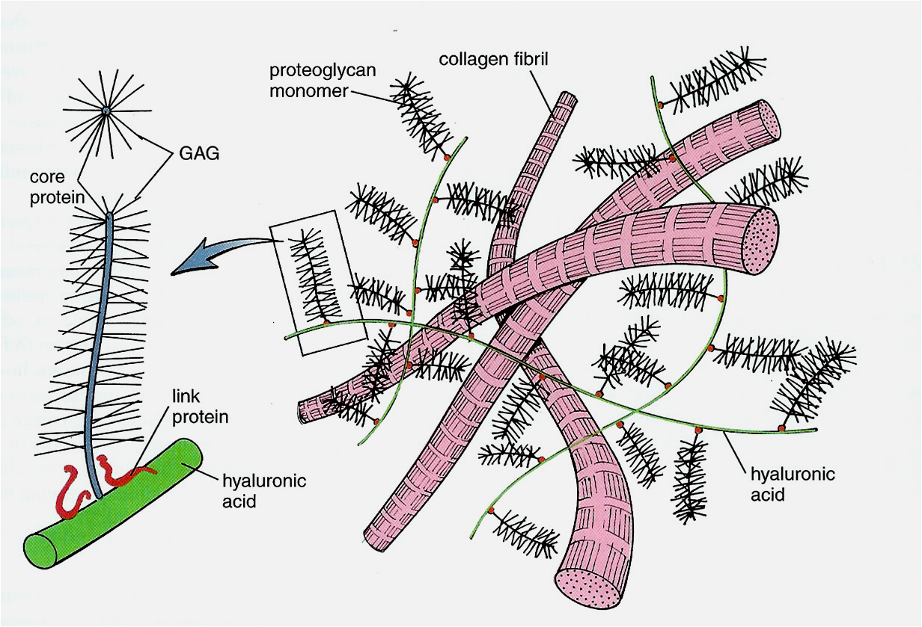
Amorphous Ground Substances
Composed of proteoglycans and cell adhesion molecules (CAMS)
Some CAMS are fibronectin, vitronectin, laminin
Proteoglycans have a protein core with glycosaminoglycans attached.
Types of Glycosaminoglycans
Chondroitin Sulfate
Dermatan Sulfate
Keratin Sulfate
Chondroitin Sulfate
Hyaluronic Acid

Slide 11
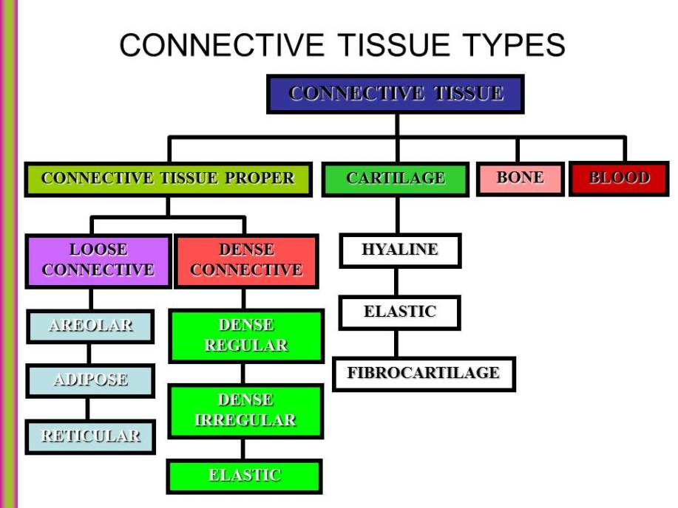
Soft Connective Tissues

Slide 12
Soft Connective Tissues
Embryonic Connective Tissue
Mesenchyme CT and Mucoid CT
Adult Connective Tissue
Loose (Areolar, adipose and reticular)
Dense (Regular, Irregular and Elastic)

Slide 13
Hard Connective Tissues
Cartilage
Elastic cartilage
Fibrocartilage
Hyaline cartilage
Bone

Slide 14
Liquid Connective Tissues
Blood
Lymph

Slide 15
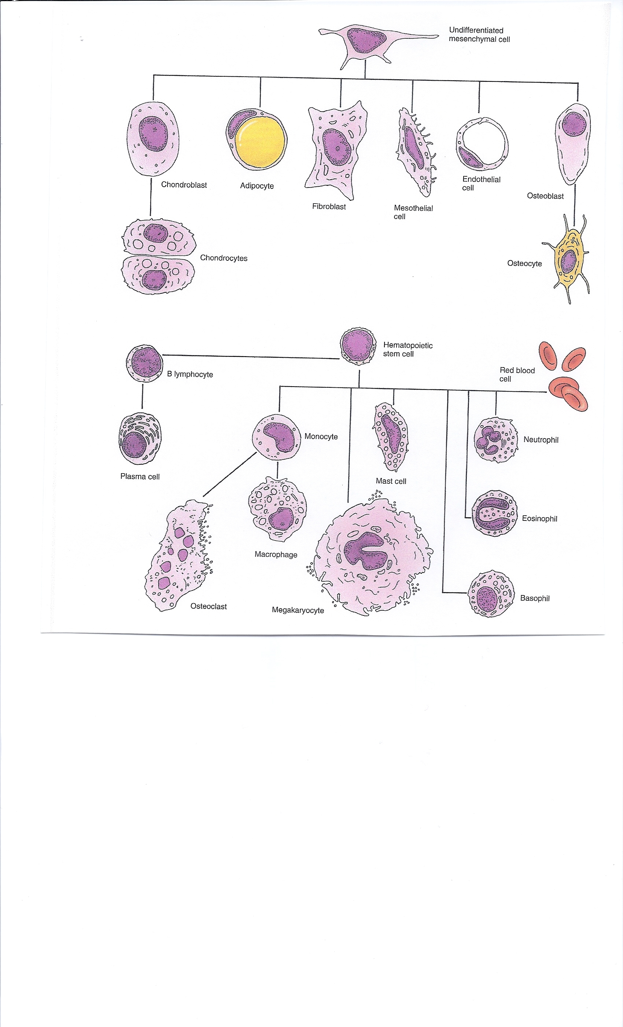

Slide 16
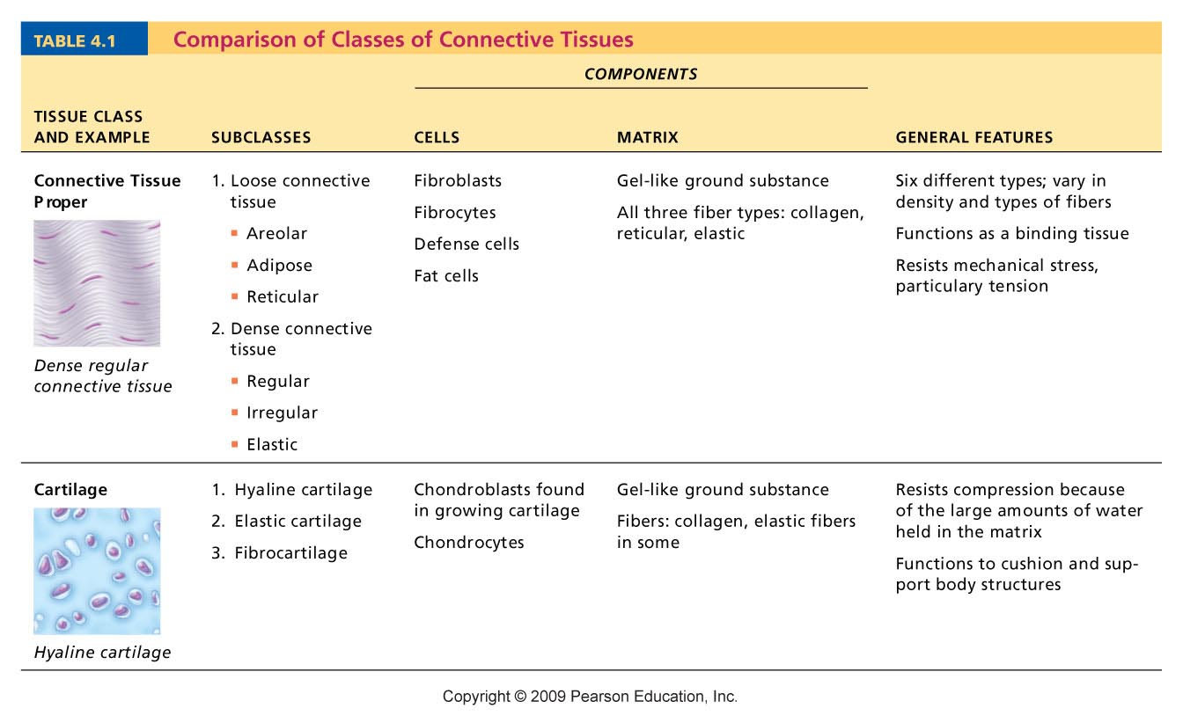
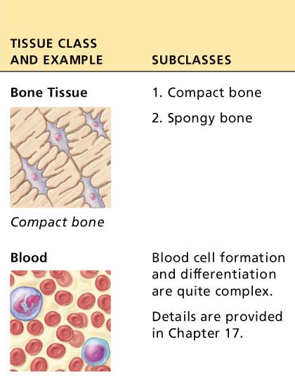
Table 4.1

Slide 17
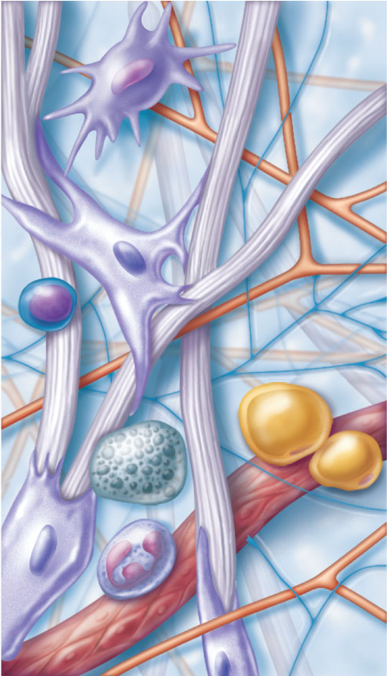
Cell types
Extracellular
matrix
Ground substance
Macrophage
Fibers
• Collagen fiber
• Elastic fiber
• Reticular fiber
Fibroblast
Lymphocyte
Fat cell
Capillary
Mast cell
Neutrophil
Figure 4.7

Slide 18
Connective Tissue: Embryonic
Mesenchyme—embryonic connective tissue
  Gives rise to all other connective tissues
  Gel-like ground substance with fibers and star-shaped mesenchymal cells
  Mucoid Connective Tissue – Wharton’s Jelly- (1) is quite similar to mesenchymal connective tissue, but with more space between the cells and fewer reticular fibres. As a result, there is a large amount of ground substance which contributes to the decreased cohesiveness of this connective tissue, accounting for its gross anatomical mucus-like morphology.

Slide 19
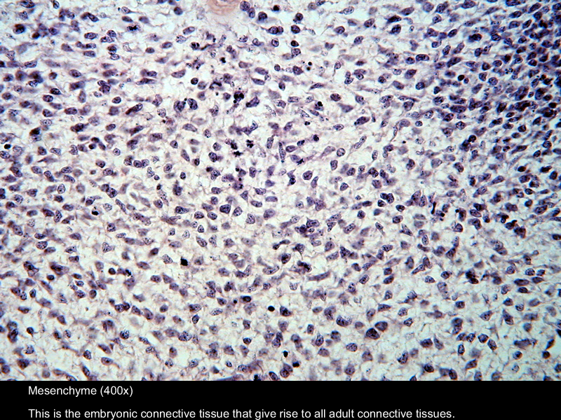
Mesenchyme

Slide 20
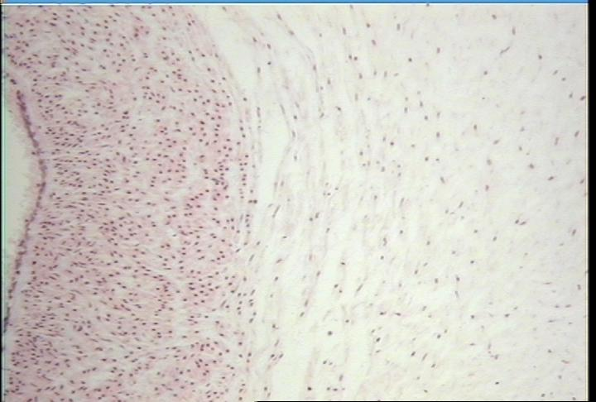
Mucoid Connective Tissue

Slide 21
Overview of Connective Tissues
For each of the following examples of connective tissue, note:
  Description
  Function
  Location

Slide 22
Connective Tissue Proper
Types:
  Loose connective tissue
    Areolar
    Adipose
    Reticular
  Dense connective tissue
    Dense regular
    Dense irregular
    Elastic

Slide 23
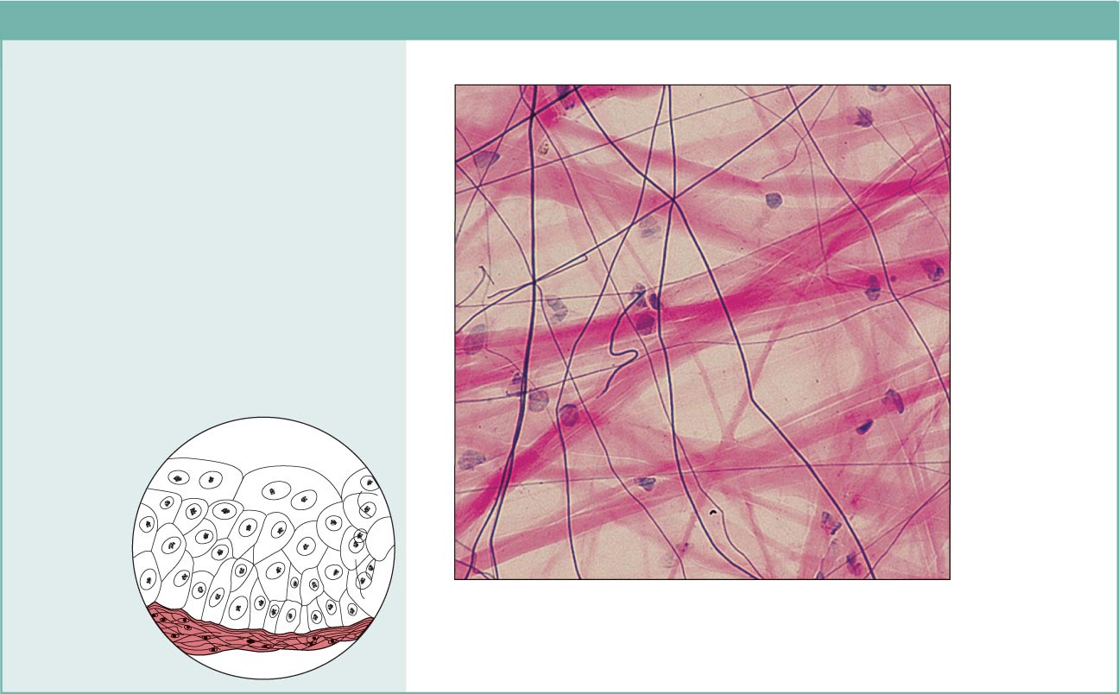
(a) Connective tissue proper: loose connective tissue, areolar
Description: Gel-like matrix with all
three fiber types; cells: fibroblasts,
macrophages, mast cells, and some
white blood cells.
Elastic
fibers
Function: Wraps and cushions
organs; its macrophages phagocytize
bacteria; plays important role in
inflammation; holds and conveys
tissue fluid.
Collagen
fibers
Location: Widely distributed under
epithelia of body, e.g., forms lamina
propria of mucous membranes;
packages organs; surrounds
capillaries.
Fibroblast
nuclei
Epithelium
Photomicrograph: Areolar connective tissue, a
soft packaging tissue of the body (300x).
Lamina
propria
Figure 4.8a

Slide 24
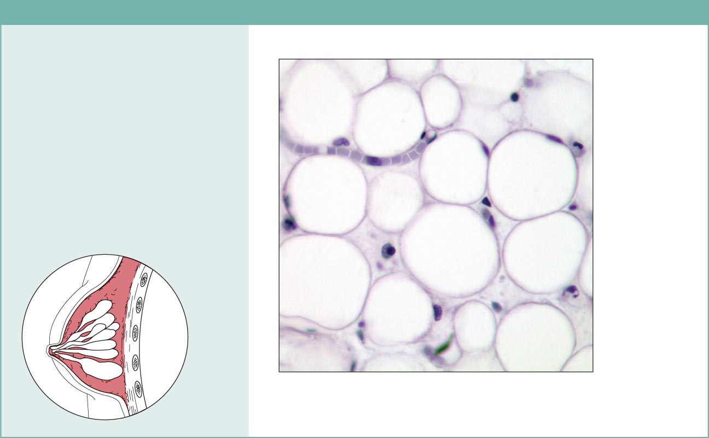
(b) Connective tissue proper: loose connective tissue, adipose
Description: Matrix as in areolar,
but very sparse; closely packed
adipocytes, or fat cells, have
nucleus pushed to the side by large
fat droplet.
Function: Provides reserve food
fuel; insulates against heat loss;
supports and protects organs.
Nucleus of
fat cell
Location: Under skin in the
hypodermis; around kidneys and
eyeballs; within abdomen; in breasts.
Adipose
tissue
Vacuole
containing
fat droplet
Photomicrograph: Adipose tissue from the
subcutaneous layer under the skin (350x).
Mammary
glands
Figure 4.8b

Slide 25
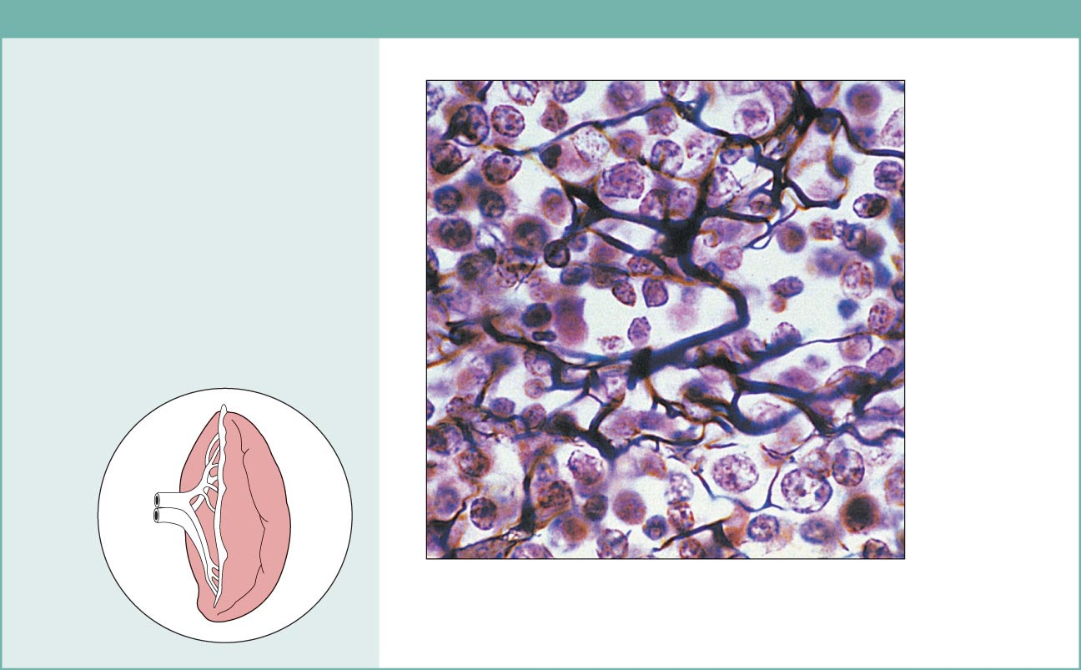
(c) Connective tissue proper: loose connective tissue, reticular
Description: Network of reticular
fibers in a typical loose ground
substance; reticular cells lie on the
network.
Function: Fibers form a soft internal
skeleton (stroma) that supports other
cell types including white blood cells,
mast cells, and macrophages.
White blood
cell
(lymphocyte)
Location: Lymphoid organs (lymph
nodes, bone marrow, and spleen).
Reticular
fibers
Spleen
Photomicrograph: Dark-staining network of reticular
connective tissue fibers forming the internal skeleton
of the spleen (350x).
Figure 4.8c

Slide 26
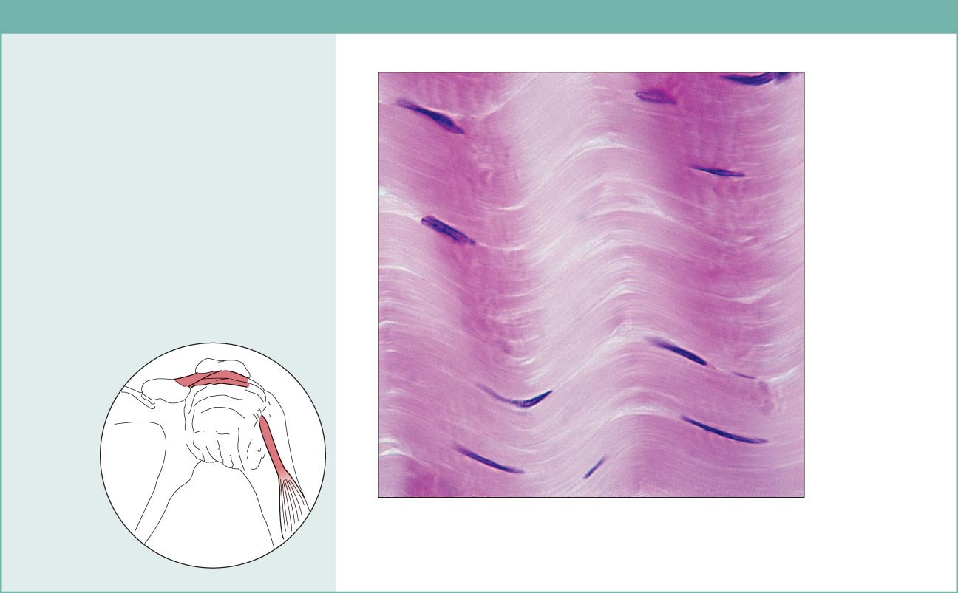
(d) Connective tissue proper: dense connective tissue, dense regular
Description: Primarily parallel
collagen fibers; a few elastic fibers;
major cell type is the fibroblast.
Collagen
fibers
Function: Attaches muscles to
bones or to muscles; attaches bones
to bones; withstands great tensile
stress when pulling force is applied
in one direction.
Location: Tendons, most
ligaments, aponeuroses.
Nuclei of
fibroblasts
Shoulder
joint
Ligament
Photomicrograph: Dense regular connective
tissue from a tendon (500x).
Tendon
Figure 4.8d

Slide 27
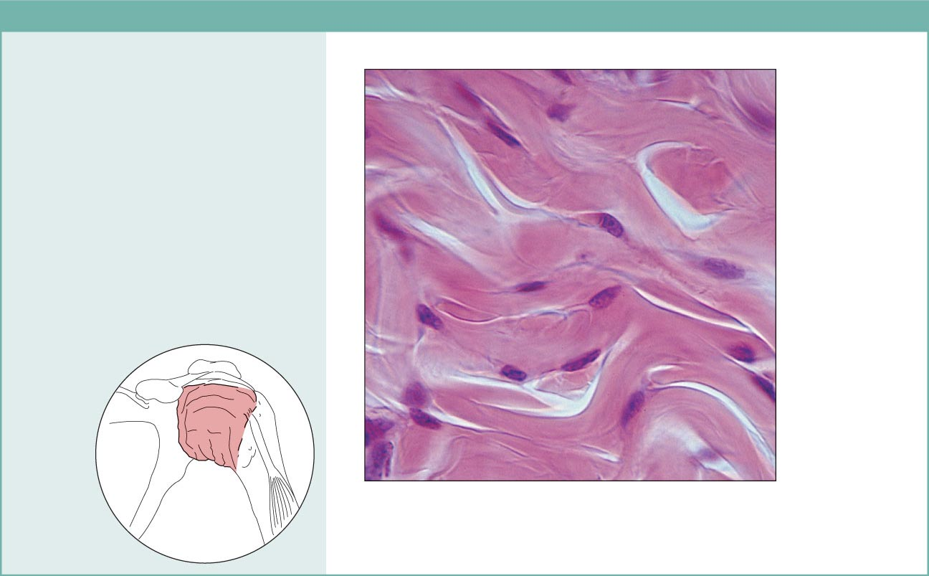
(e) Connective tissue proper: dense connective tissue, dense irregular
Description: Primarily
irregularly arranged collagen
fibers; some elastic fibers;
major cell type is the fibroblast.
Nuclei of
fibroblasts
Function: Able to withstand
tension exerted in many
directions; provides structural
strength.
Location: Fibrous capsules of
organs and of joints; dermis of
the skin; submucosa of
digestive tract.
Collagen
fibers
Fibrous
joint
capsule
Photomicrograph: Dense irregular
connective tissue from the dermis of the
skin (400x).
Figure 4.8e

Slide 28
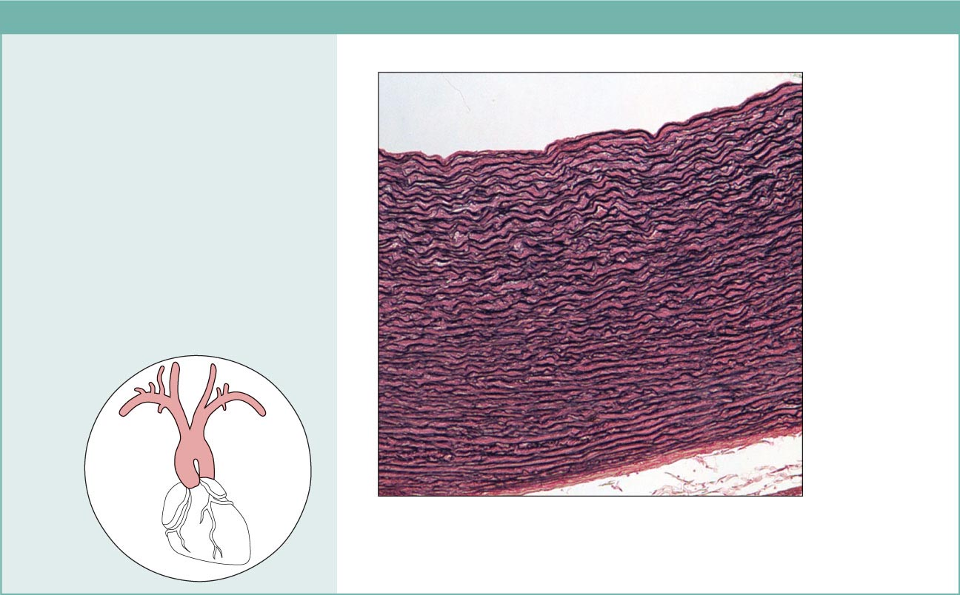
(f) Connective tissue proper: dense connective tissue, elastic
Description: Dense regular
connective tissue containing a high
proportion of elastic fibers.
Function: Allows recoil of tissue
following stretching; maintains
pulsatile flow of blood through
arteries; aids passive recoil of lungs
following inspiration.
Location: Walls of large arteries;
within certain ligaments associated
with the vertebral column; within the
walls of the bronchial tubes.
Elastic fibers
Aorta
Heart
Photomicrograph: Elastic connective tissue in
the wall of the aorta (250x).
Figure 4.8f

Slide 29
Connective Tissue: Cartilage
Three types of cartilage:
  Hyaline cartilage
  Elastic cartilage
  Fibrocartilage

Slide 30
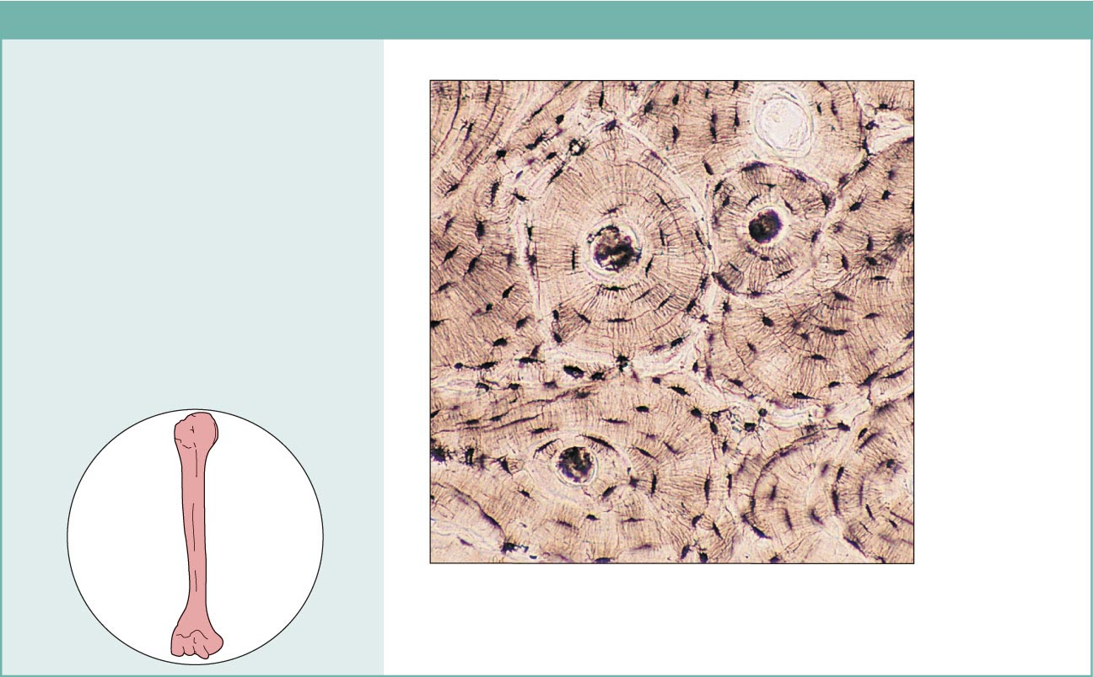
(j) Others: bone (osseous tissue)
Description: Hard, calcified
matrix containing many collagen
fibers; osteocytes lie in lacunae.
Very well vascularized.
Function: Bone supports and
protects (by enclosing);
provides levers for the muscles
to act on; stores calcium and
other minerals and fat; marrow
inside bones is the site for blood
cell formation (hematopoiesis).
Central
canal
Lacunae
Lamella
Location: Bones
Photomicrograph: Cross-sectional view
of bone (125x).
Figure 4.8j

Slide 31
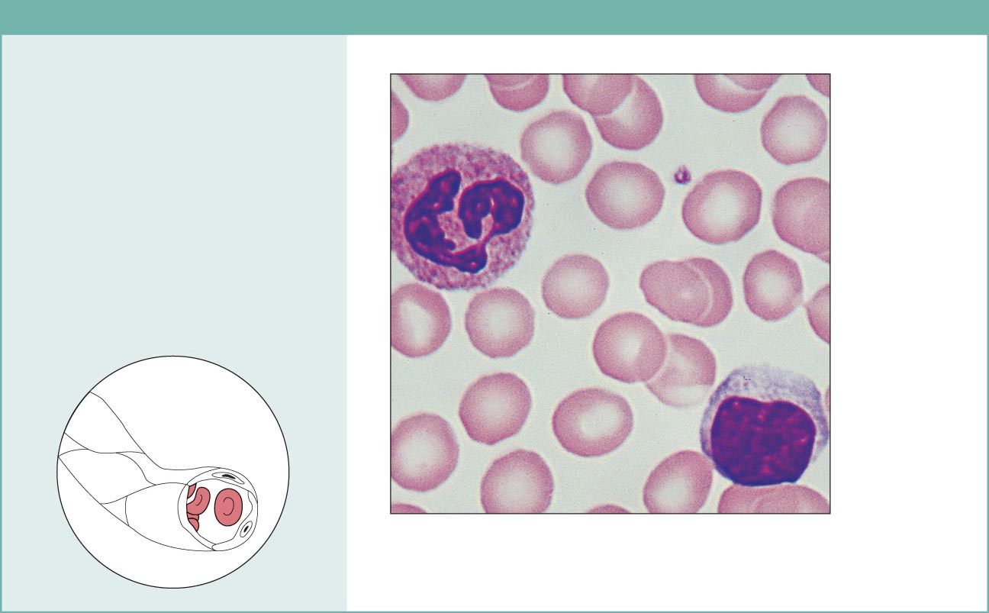
(k) Others: blood
Description: Red and white
blood cells in a fluid matrix
(plasma).
Plasma
Function: Transport of
respiratory gases, nutrients,
wastes, and other substances.
Neutrophil
Location: Contained within
blood vessels.
Red blood
cells
Lymphocyte
Photomicrograph: Smear of human blood (1860x); two
white blood cells (neutrophil in upper left and lymphocyte
in lower right) are seen surrounded by red blood cells.
Figure 4.8k

Slide 32
Muscle Tissue
Three types of muscle
Smooth
Cardiac
Skeletal

Slide 33
Nervous Tissue
Nervous system

Slide 34
Histologic Membranes
A histologic membrane (versus the cell membrane) is a composite tissue (epithelia and connective tissue) that lines or covers
Types of Histiologic Membranes are:
Cutaneous membrane (skin)
Mucous membrane
Serous membrane
Synovial membrane

Slide 35
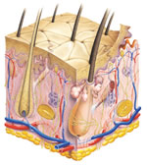
Cutaneous Membrane (Skin)
Epidermis is epithelia
Dermis is connective
Tissue

Slide 36
Mucous membranes
  Mucosae
    Line body cavities that open to the exterior (e.g., digestive and respiratory tracts)
    Sites
    Mouth
    Nose
    Anus
    Vagina
    Urethrae

Slide 37
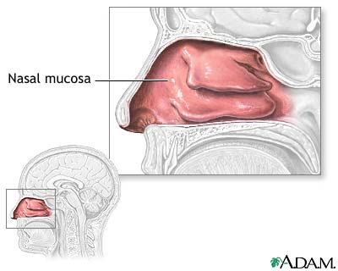
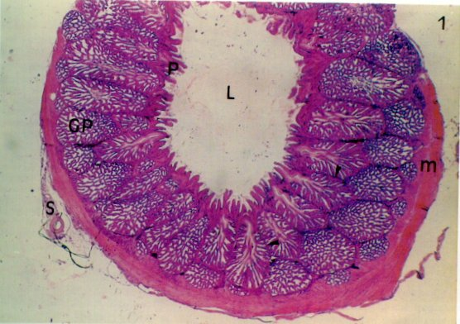
Nasal Mucosae (example of mucous membrane)
Epithelia
Connective Tissue

Slide 38
Serous Membranes (thin wet membrane)
  A very, very thin wet translucent membrane that lines hollow cavities in the body that do not open to the outside.
  The epithelial layer is a simple squamous layer known as the “mesothelium”
  This mesothelium lies on top of a thin basement membrane which has underneath an very thin layer of loose connective tissue
  The membrane always has two layers a visceral layer that covers the internal organ and a parietal layer that lines internal body walls

Slide 39
Serous Membranes
There are three serous membranes in the human body
(1) Pleura (2) Serous Pericardium and (3) Peritoneum
Each of these membranes produce and reabsorb serous fluids which are filtrates (transudates) of the blood
Purpose of serous membranes and serous fluids – reduce organ surface frictions –thus allowing organs that have considerable motion to move freely and independently
Pleura – pleural fluid Pericardium – pericardial fluid
Peritoneum – peritoneal fluid

Slide 40
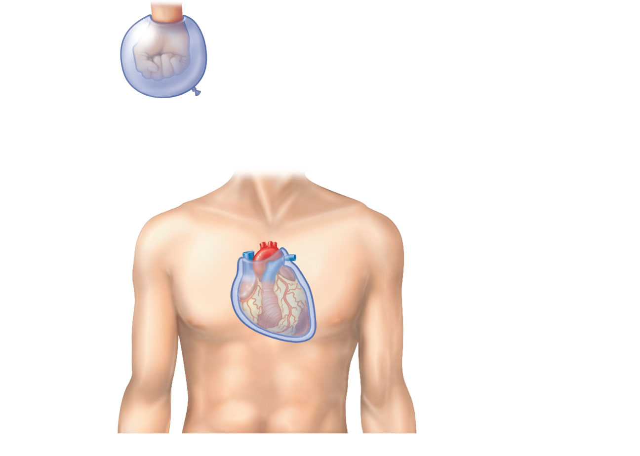
Outer balloon wall
(comparable to parietal serosa)
Air (comparable to serous cavity)
Inner balloon wall
(comparable to visceral serosa)
Heart
Parietal
pericardium
Pericardial
space with
serous fluid
Visceral
pericardium
(b) The serosae associated with the heart.
Figure 1.10a-b

Slide 41
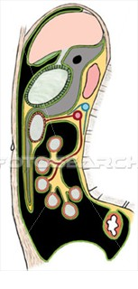

Parietal Pleura
Visceral Pleura
All the black areas are the Peritoneal cavity
Parietal Peritoneum
Stuck to inside of
Body wall
Visceral Peritoneum stuck to
Intestine surface

Slide 42
Steps in Tissue Repair
The initial step in tissue repair depends on the extent of injury to the tissues
If the injury cuts a blood vessel – then the first step is bleeding- If no blood vessel cut – the initial step is inflammation

Slide 43
If Injury Includes a Cut Blood Vessel
Bleeding
Inflammation
Migration
Proliferation
Maturation

Slide 44
Bleeding
Bleeding can be good – all of us know its bad side.
Bleeding accomplishes three tasks
It cleanses the wound as the blood rushes out
When the blood clots – some stringy looking fibers are formed called “fibrin strands.” These fibrin strands provide a scaffold like framework for cells to rest on when they migrate into the cut area to perform repair
Fibrin has lots of water mixed with it – if the wound is a skin wound – the atmospheric air will evaporate the water – the fibrin strands left behind dry and form the scab – which acts like a cover over the wound

Slide 45

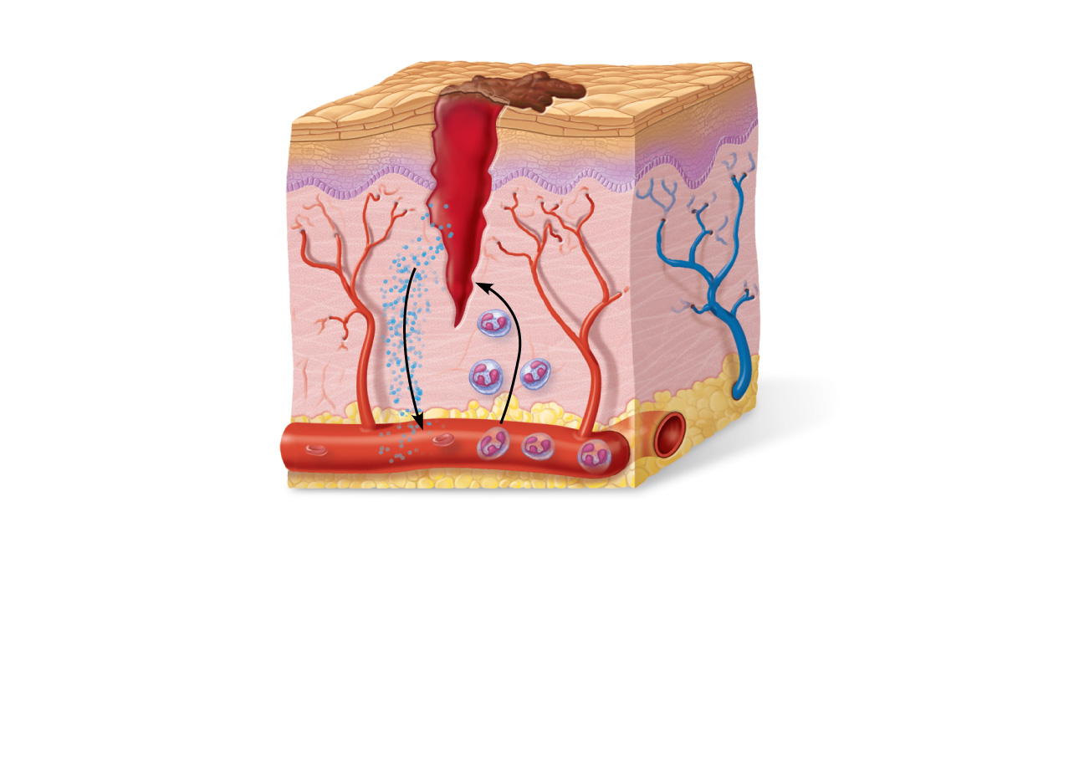
Bleeding
Scab
Blood clot in
incised wound
Figure 4.12, step 1

Slide 46
Inflammation
The inflammatory action cleans (gets rid of microorganisms) a perimeter around the wound
Inflammatory Actions
  Release of inflammatory chemicals
  Dilation of blood vessels
  Increase in vessel permeability so that white blood cells can escape the blood vessels and migrate to the site of injury

Slide 47
Scab
Epidermis
Vein
Migrating white
blood cell
Inflammatory
chemicals
Artery
Inflammation sets the stage:
• Severed blood vessels bleed and inflammatory chemicals are
released.
• Local blood vessels become more permeable, allowing white
blood cells, fluid, clotting proteins and other plasma proteins
to seep into the injured area.
•
Figure 4.12, step 1

Slide 48
Migration
Cells migrate into the inflammatory site
White Blood Cells migrate to area
Parenchymal (most important) and stromal (supportive) cells migrate to the wound site in order to initiate repair
Macrophages phagocytose wound debris

Slide 49
Proliferation
Some migrated cells perform mitosis
Some migrated cells start secreting substances to form the new tissue – for example fibroblast secrete fibers and amorphous ground substance in order to replace soft connective tissue
In order for a wound to heal it must be re-vascularized (form blood vessels). Neovascularization means forming new blood vessels. Angiogenesis is the process of forming new blood vessels. When new blood vessels begin growing into a wound – the tissue is termed Granulation Tissue.

Slide 50
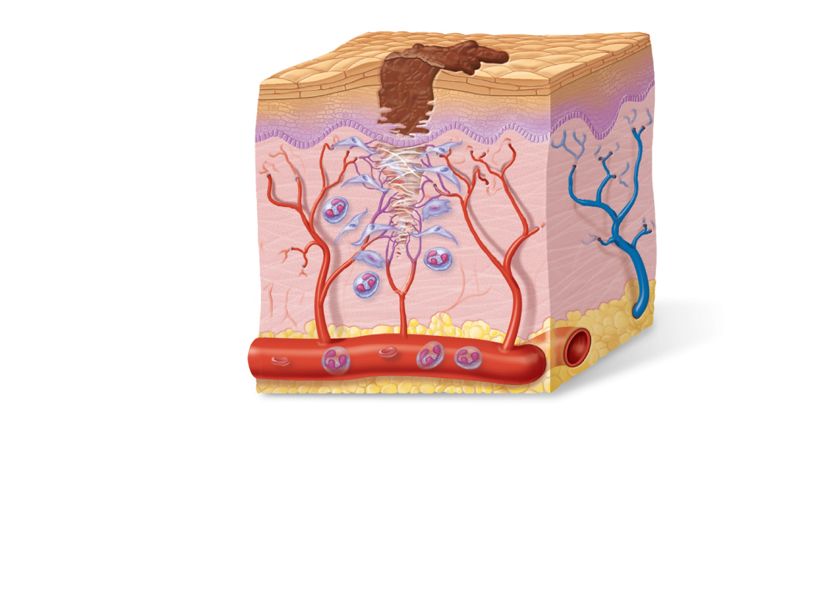
Regenerating
epithelium
Area of
granulation
tissue
ingrowth
Fibroblast
Macrophage
Organization –Migration and Proliferation
• The clot is replaced by granulation tissue, which restores
the vascular supply.
• Fibroblasts produce collagen fibers that bridge the gap.
• Macrophages phagocytize cell debris.
• Surface epithelial cells multiply and migrate over the
granulation tissue.
Figure 4.12, step 2

Slide 51
Maturation – completion of proliferation and loss of scab
Fibrosis
  The scab detaches
  Fibrous tissue matures; epithelium thickens and begins to resemble adjacent tissue
  Results in a fully regenerated epithelium with underlying scar tissue (Fibrosis)

Slide 52
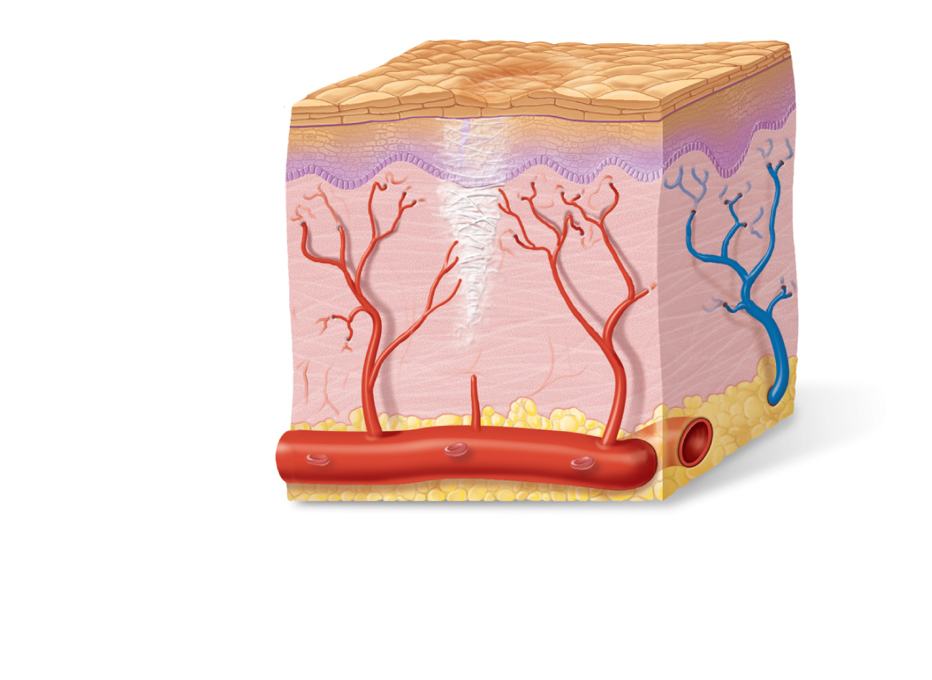
Regenerated
epithelium
Fibrosed
area
3
Regeneration and fibrosis effect permanent repair:
• The fibrosed area matures and contracts; the epithelium
thickens.
• A fully regenerated epithelium with an underlying area of
scar tissue results.
Figure 4.12, step 3

