Slide 1
5
The Integumentary System
Mike Clark, M.D.

Slide 2
Integumentary System (Organs of)
Skin
Hair
Nails
Glands
Nerves

Slide 3
Integumentary System Functions
Protection
Reservoir for Blood
Immune
Excretion
Synthesis of Vitamin D
Thermoregulation

Slide 4
Functions of the Integumentary System
Protection—three types of barriers
  Chemical
    Low pH secretions (acid mantle) ph 4 -6
    Defensins retard bacterial activity by punching holes in the bacteria
    Dermicidin in sweat
    Bacteriacidal substances in sebum
    Wounded skin releases cathelicidins that are effective in preventing infection from group A streptococcus

Slide 5
Cathelicidin
Cathelicidin antimicrobial peptide is a family of polypeptides found in lysosomes in polymorphonuclear leukocytes (PMNs).
Cathelicidins were originally found in neutrophils but have since been found in many other cells including epithelial cells and macrophages activated by bacteria, viruses, fungi, or the hormone 1,25-D.
Higher levels of human cathelicidin antimicrobial protein (hCAP18), which are regulated by vitamin D, appear to significantly reduce the risk of death from infection in dialysis patients. Patients with a high level of this protein were 3.7 times more likely to survive kidney dialysis for a year without a fatal infection

Slide 6
Dermicidin
German researchers report that human sweat contains a novel microbe-killing molecule, which they've dubbed dermicidin.
They verified their suspicion by demonstrating in test-tube experiments that dermicidin can kill four different kinds of bacteria and one fungal species.

Slide 7
Functions of the Integumentary System
  Physical/mechanical barriers
    Keratin and glycolipids block most water and water- soluble substances
    Limited penetration of skin by lipid-soluble substances, plant oleoresins (e.g., poison ivy), organic solvents, salts of heavy metals, some drugs
  Biological barriers
    Dendritic cells, macrophages and DNA

Slide 8
Chemicals that can penetrate the skin
1. Lipid soluble substances like the fat soluble vitamins (A,D,E,K), O2, CO2, steroids like estrogen.
2. Olorescins of certain plants like poison ivy and poison oak
3. Organic solvents like acetone, dry-cleaning fluid, and paint thinner which dissolve the cell lipids
4. Salts of heavy metals like lead and mercury
5. Selected drugs like nitroglycerin and nicotine
6. Drugs that help ferry other drugs through the skin like Comosperine

Slide 9
DNA as a biological skin barrier
Although melanin provides a fairly good chemical sunscreen, DNA itself is a remarkably effective biologically based sunscreen. Electrons in DNA molecules absorb UV radiation and transfer it to the atomic nuclei, which heat up and vibrate vigorously. However, since the heat dissipates to surrounding water molecules instantaneously, the DNA converts potentially destructive radiation into harmless heat.

Slide 10

Caution!!
Organic solvents (acetone, dry-cleaning fluid, and paint thinner) which dissolve the cell lipids and heavy metals (lead and mercury) are devastating to the body and can be lethal. Passage of organic substances through the skin into the blood can cause kidneys to shut down and can also cause brain damage. Absorption of lead results in anemia and neurological defects. These substances should never be handled with bare hands.

Slide 11
Functions of the Integumentary System
Body temperature regulation
  ~500 ml/day of routine insensible perspiration (at normal body temperature)
  At elevated temperature, dilation of dermal vessels and increased sweat gland activity (sensible perspirations) cool the body
Cutaneous sensations
  Temperature, touch, and pain

Slide 12
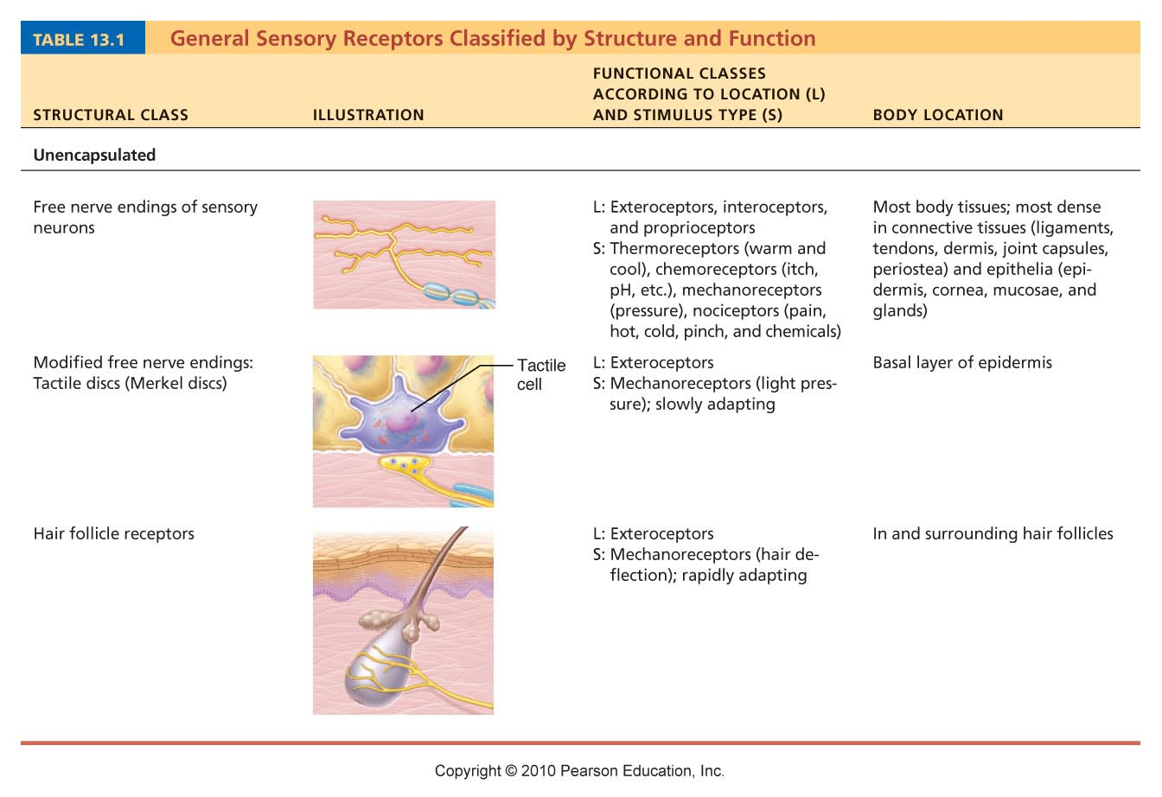
Table 13.1

Slide 13
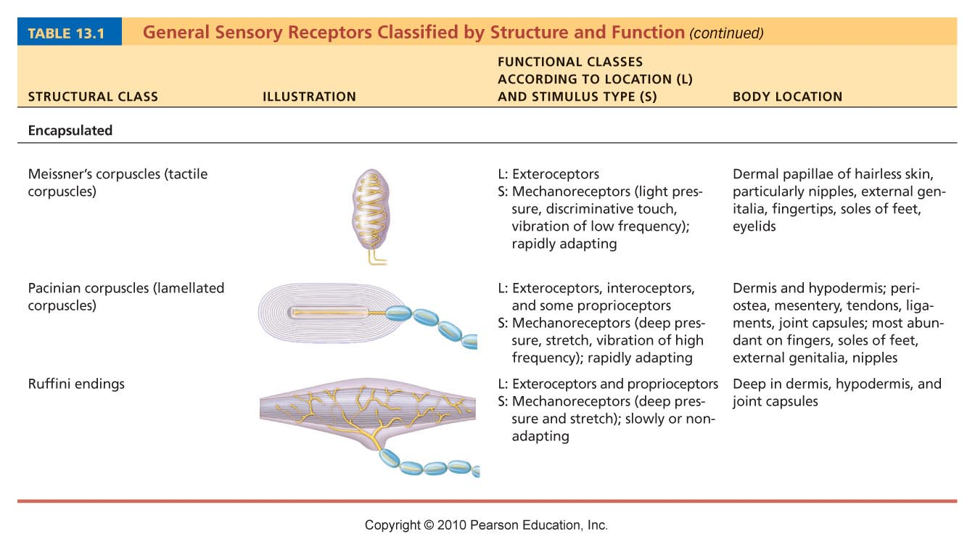
Table 13.1

Slide 14
Functions of the Integumentary System
Metabolic functions
  Synthesis of vitamin D precursor and collagenase
  Chemical conversion of carcinogens and some hormones
Blood reservoir—up to 5% of body’s blood volume
Excretion—nitrogenous wastes and salt in sweat

Slide 15
Vitamin D Synthesis
Cholesterol 7-Dehydrocholesterol (skin cells of *SB and *SS)
7 – Dehydrocholesterol Cholecalciferol (UVB light in skin) D1
Cholecalciferol 25 OH Cholecalciferol (Liver Enzyme) D2
25 OH Choecalciferol 1, 25 Dihydroxycholecalciferol D3
Kidney Enzyme
D3 is the active form of Vitamin D
*SB – Stratum Basale
*SS – Stratum Spinosum

Slide 16
Other Metabolic Functions
Keratinocytes can disarm many cancer-causing chemical that penetrate the epidermis
Activate some steroid hormones – for example cortisone applied to the irritated skin can be converted to hydrocortisone – a potent anti-inflammatory drug.
Can produce biologically important proteins such as collagenase that breaks down old collagen for new turmover production – thus eliminate wrinkles

Slide 17
Skin (the cutaneous membrane)
1.2 – 2.2 square meters surface area
4 – 5 Kg – 7% of total body weight
Composition of the Skin
Epithelial component - EPIDERMIS
Basement membrane – known as the Dermal -Epidermal junction
Connective Tissue component - Dermis

Slide 18
Skin (Integument)
  Cutaneous layer Epidermis
  Dermis
  Subcutaneous (Sub-q) Hypodermis
  The hypodermis is not part of the skin. It is termed by three names (1) Hypodermis (2) Subcutaneous layer or (3) Superficial Fascia
    The hypodermis is composed mostly of adipose tissue. It is the fat layer – the layer where most of the fat is stored as triglycerides for energy.

Slide 19
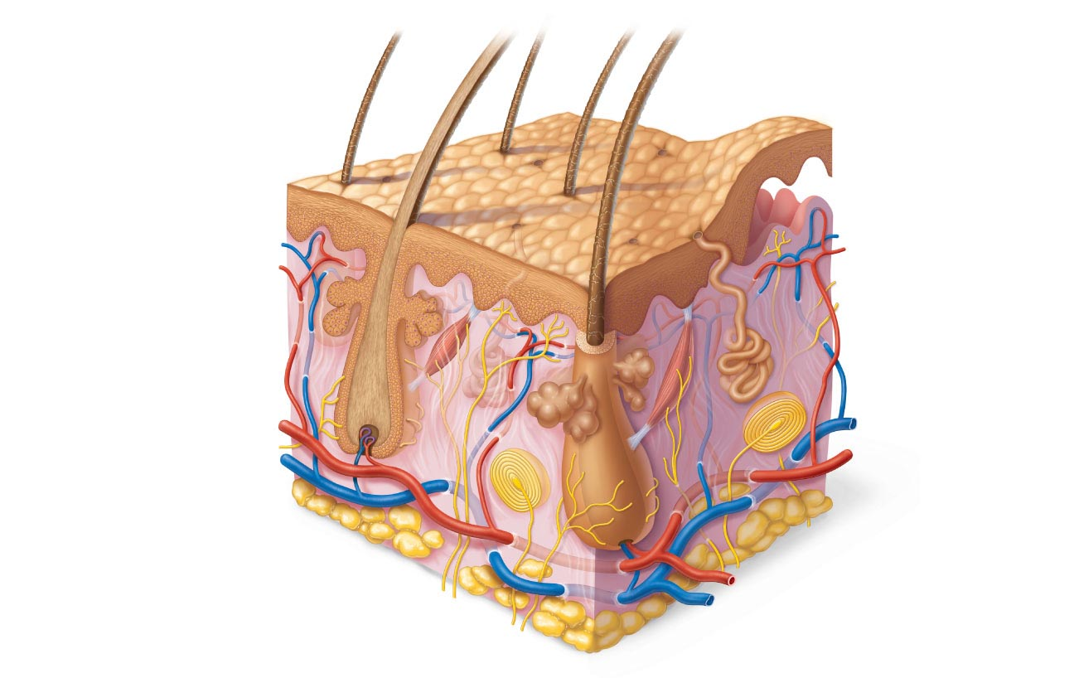
Hair shaft
Dermal papillae
Epidermis
Subpapillary
vascular plexus
Papillary
layer
Pore
Appendages
of skin
Dermis
Reticular
layer
• Eccrine sweat
gland
• Arrector pili
muscle
Hypodermis
(superficial fascia)
• Sebaceous
(oil) gland
• Hair follicle
Nervous structures
• Hair root
• Sensory nerve fiber
Cutaneous vascular
plexus
• Pacinian corpuscle
• Hair follicle receptor
(root hair plexus)
Adipose tissue
Figure 5.1

Slide 20
Epidermis
The epidermis is a Keratinized stratified squamous epithelium
The cells of epidermis are
  Keratinocytes—(most abundant) produce fibrous protein keratin
  Melanocytes
    10–25% of cells in lower epidermis
    Produce pigment melanin
  Epidermal dendritic (Langerhans) cells—macrophages that help activate immune system
  Tactile (Merkel) cells—touch receptors

Slide 21
(1) Keratinocytes
The keratinocytes are the most abundant epidermal skin cells.
The name comes from the fact these cells load themselves up with a mature keratin as they mature
If the keratinocyte stays in one position (and do not move up the layers of the epidermis) it will still undergo its changes – thus the changes in the keratinocyte are not positional changes but maturation changes
The purpose of the keratin is to waterproof the cell – so that we do not lose considerable amounts of body water through our skin – particularly since it has so much surface area.
Mature keratin is composed of (1) the intermediate filament keratin and (2) keratohyalin

Slide 22
(2) Melanocytes
Melanocytes are derived from neural crest cells – thus the melanocyte is akin to the nerve cells
The melanocytes produce a chemical substance known as melanin.
Melanin is a substance that protects us from the harmful effects of UV light
Melanin is a chemical that is enzymatically derived from the amino acid tyrosine

Slide 23
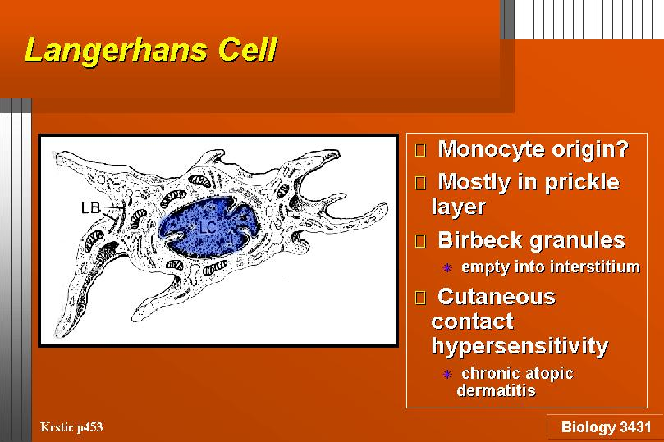
(3) Langerhan’s Cell

Slide 24
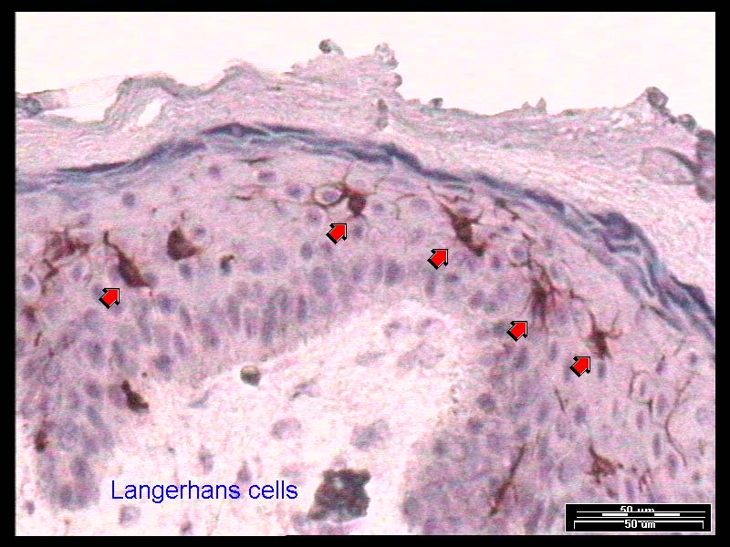
Langerhan’s Cell

Slide 25
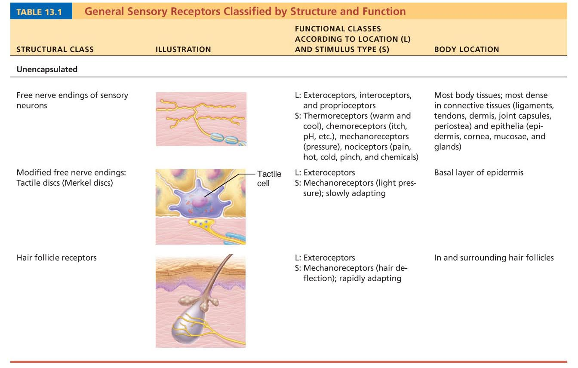
(4) Merkel’s Cell
Merkel cell (Disc)

Slide 26
Epidermal Layers
Inasmuch as the Epidermis is a stratified squamous tissue – the cells are stacked on top of one another in layers
Each layer is termed a “Stratum”
Starting from the Bottom Stratum – the layers are (1) Stratum basale
(2) Stratum spinosum
(3) Stratum granulosum
(4) Stratum lucidum – only in thick skin
(5) Stratum corneum

Slide 27
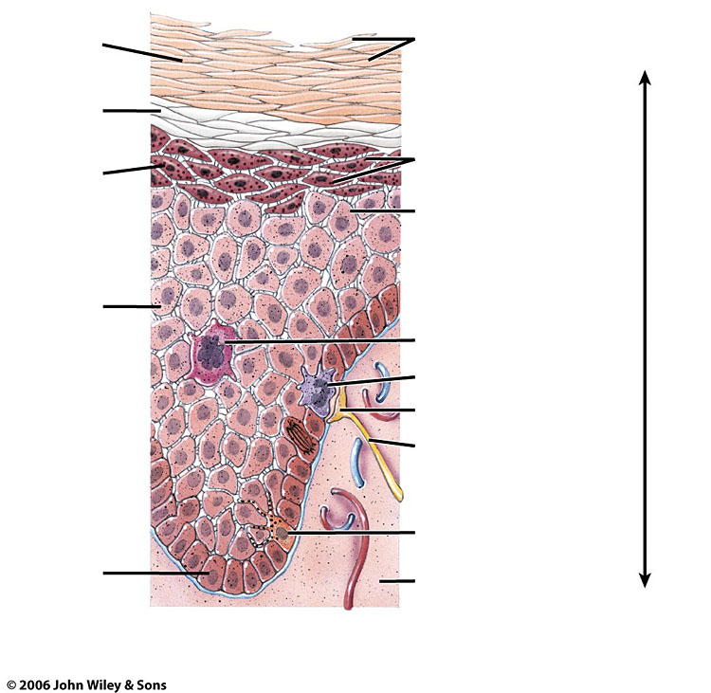
Stratum corneum
Stratum disjunctum
Stratum lucidum
Stratum granulosum
Cells with granules
Prickle Cell
Merkel’s Disc (cell)
Nerve fiber
Melanocyte
Stratum basale

Slide 28
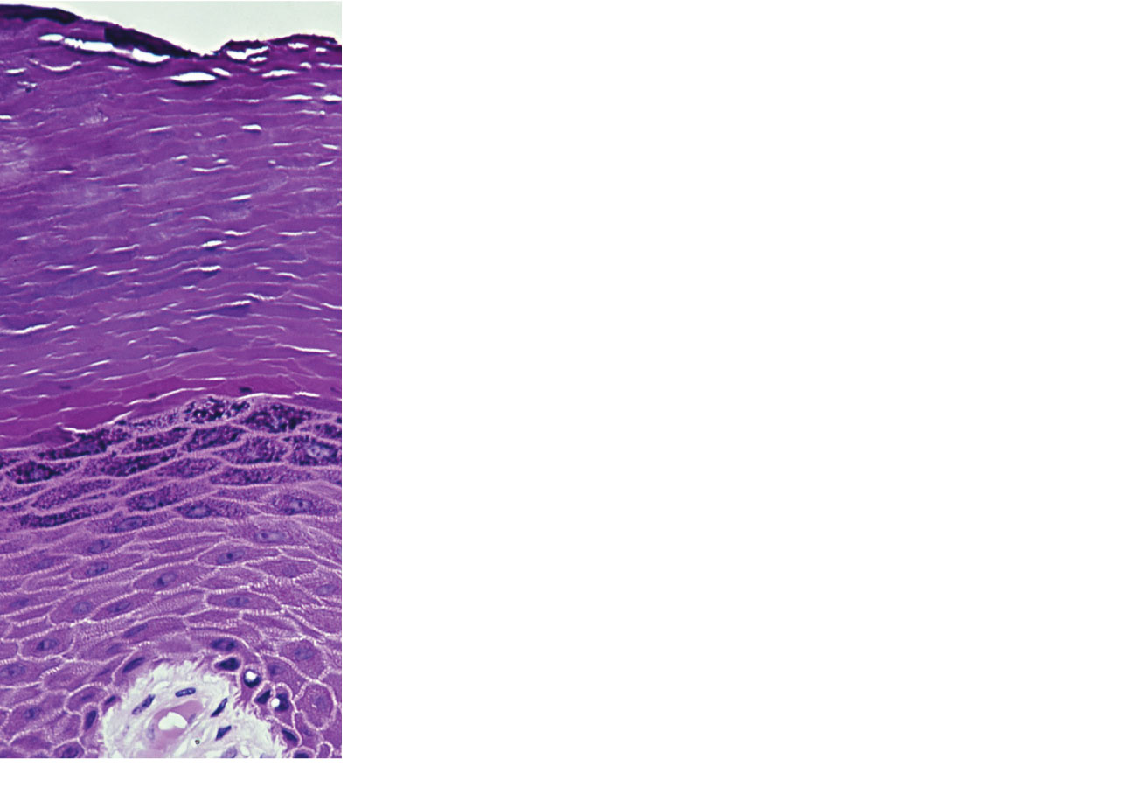
Stratum corneum
Most superficial layer; 20–30 layers of dead
cells represented only by flat membranous
sacs filled with keratin. Glycolipids in
extracellular space.
Stratum granulosum
Three to five layers of flattened cells,
organelles deteriorating; cytoplasm full of
lamellated granules (release lipids) and
keratohyaline granules.
Stratum spinosum
Several layers of keratinocytes unified by
desmosomes. Cells contain thick bundles of
intermediate filaments made of pre-keratin.
Stratum basale
Deepest epidermal layer; one row of actively
mitotic stem cells; some newly formed cells
become part of the more superficial layers.
See occasional melanocytes and epidermal
dendritic cells.
(a)
Dermis
Figure 5.2a

Slide 29
Layers of the Epidermis: Stratum Basale (Basal Layer)
Deepest epidermal layer firmly attached to Dermal-Epidermal Junction by Hemi-Desmosomes
Single row of stem cells
Along with the Stratum spinosum comprises the stratum germinativum: the two cell layers that can perform mitosis. However the cells of the Stratum basale do most of the mitosis. The cells undergo rapid division
Journey from basal layer to surface takes 25–45 days

Slide 30
Hemi-desmosomes
Hemidesmosomes (HD) are very small stud- or rivet-like structures on the inner basal surface of keratinocytes in the epidermis of skin. They are similar in form to desmosomes when visualized by electron microscopy. While desmosomes link two cells together, hemidesmosomes attach one cell to the extracellular matrix. Rather than using cadherins, hemidesmosomes use integrin cell adhesion proteins. Hemidesmosomes are asymmetrical and are found in epithelial cells connecting the basal face to other cells.

Slide 31
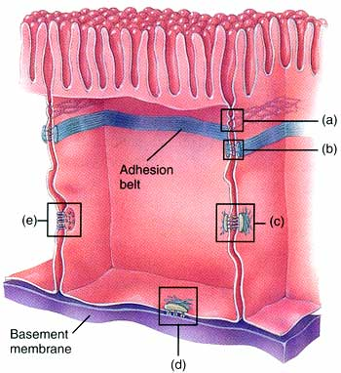
Hemi-desmosome

Slide 32
Layers of the Epidermis: Stratum Spinosum (Prickly Layer)
Cells contain a weblike system of intermediate pre-keratin filaments attached to desmosomes
The pre-keratin intermediate filaments take up a good stain which makes the cell look prickly

Slide 33
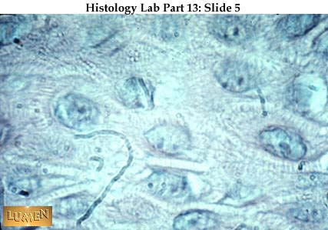

Slide 34
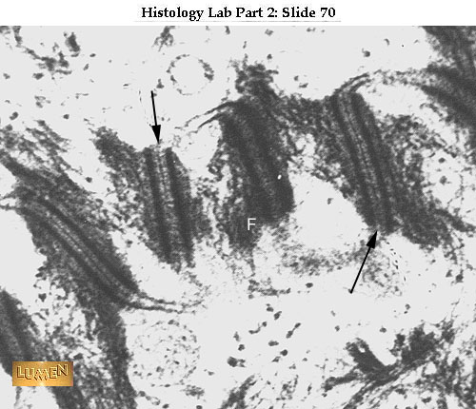
Prickle Cell Stain

Slide 35
Layers of the Epidermis: Stratum Granulosum (Granular Layer)
Thin; three to five cell layers in which the cells flatten
A granule is a stained vesicle
Keratohyaline and lamellated granules accumulate
The Keratohyalin surrounds the keratin intermediate filaments and produces the mature keratin – which waterproofs the cell
The lamellated granules also termed Odland Bodies – waterproof between the cells

Slide 36
Layers of the Epidermis: Stratum Lucidum (Clear Layer)
In thick skin (also termed Glabrous skin)
Glabrous skin is hairless skin
This is the palms and soles
Thin, transparent band superficial to the stratum granulosum
A few rows of flat, dead keratinocytes
Eleidin is a chemical in Stratum lucidum

Slide 37
Layers of the Epidermis: Stratum Corneum (Horny Layer)
20–30 rows of dead, flat, keratinized membranous sacs
Three-quarters of the epidermal thickness
Functions
  Protects from abrasion and penetration
  Waterproofs
  Barrier against biological, chemical, and physical assaults
  Stratum disjunctum – top two to three layers of SC that flake off

Slide 38
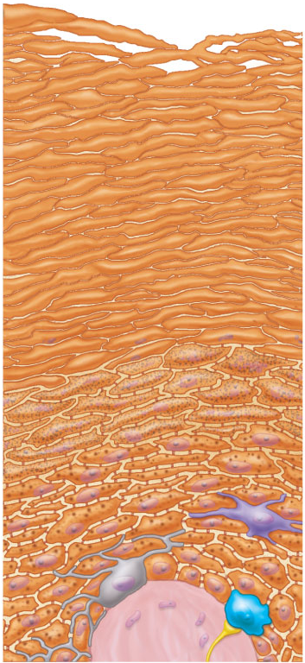
Stratum corneum
Most superficial layer; 20–30 layers of dead
cells represented only by flat membranous
sacs filled with keratin. Glycolipids in
extracellular space.
Keratinocytes
Stratum granulosum
Three to five layers of flattened cells,
organelles deteriorating; cytoplasm full of
lamellated granules (release lipids) and
keratohyaline granules.
Stratum spinosum
Several layers of keratinocytes unified by
desmosomes. Cells contain thick bundles of
intermediate filaments made of pre-keratin.
Stratum basale
Deepest epidermal layer; one row of actively
mitotic stem cells; some newly formed cells
become part of the more superficial layers. See
occasional melanocytes and epidermal
dendritic cells.
Dermis
Desmosomes
Sensory
nerve ending
Melanin granule
Epidermal
dendritic cell
Melanocyte
Tactile
(Merkel) cell
(b)
Figure 5.2b

Slide 39
Skin Color
Skin color depends on
(1) presence and color of melanin
(2) amount of carotene
(3) color of blood (red oxygenated – blue deoxygenated)

Slide 40
Melanin Production
Melanocytes are the cells that produce melanin. There are typically between 1000 and 2000 melanocytes per square millimeter of skin. Melanocytes comprise from 5% to 10% of the cells in the basal layer of epidermis. Although their size can vary, melanocytes are typically 7 micrometers in length.
Melanin is produced through enzymatic conversions from the amino acid tyrosine.
The melanocyte packages the melanin in vesicles known as melanosomes – then secretes these vesicles into neighboring keratinocytes

Slide 41
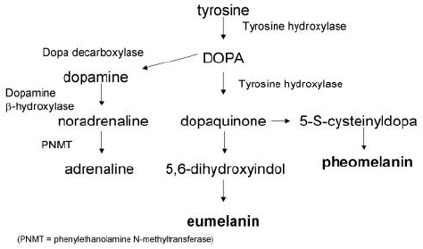

Slide 42
Melanin
Dopaquinone
E2
Tyrosine DOPA Dopamine
Norepinephrine
Epinephrine
E1
Albinos lack an enzyme called tyrosinase. Tyrosinase is required for melanocytes to produce melanin from the amino acid tyrosine.

Slide 43
Melanocortin 1 Receptor
MC1R is one of the key proteins involved in regulating mammalian skin and hair color. It is located on the plasma membrane of specialized cells known as melanocytes, which produce the pigment melanin through the process of melanogenesis. It works by controlling the type of melanin being produced, and its activation causes the melanocyte to switch from generating the yellow or red pheomelanin by default to the brown or black eumelanin in replacement.

Slide 44
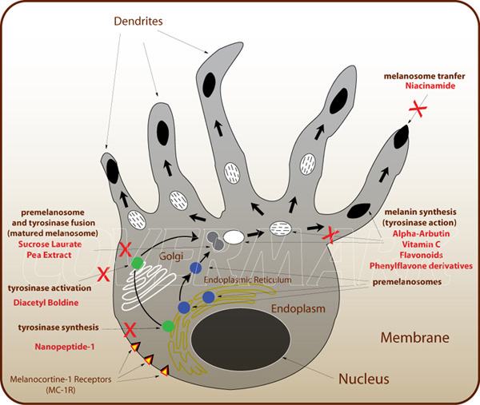
Melanin Action

Slide 45
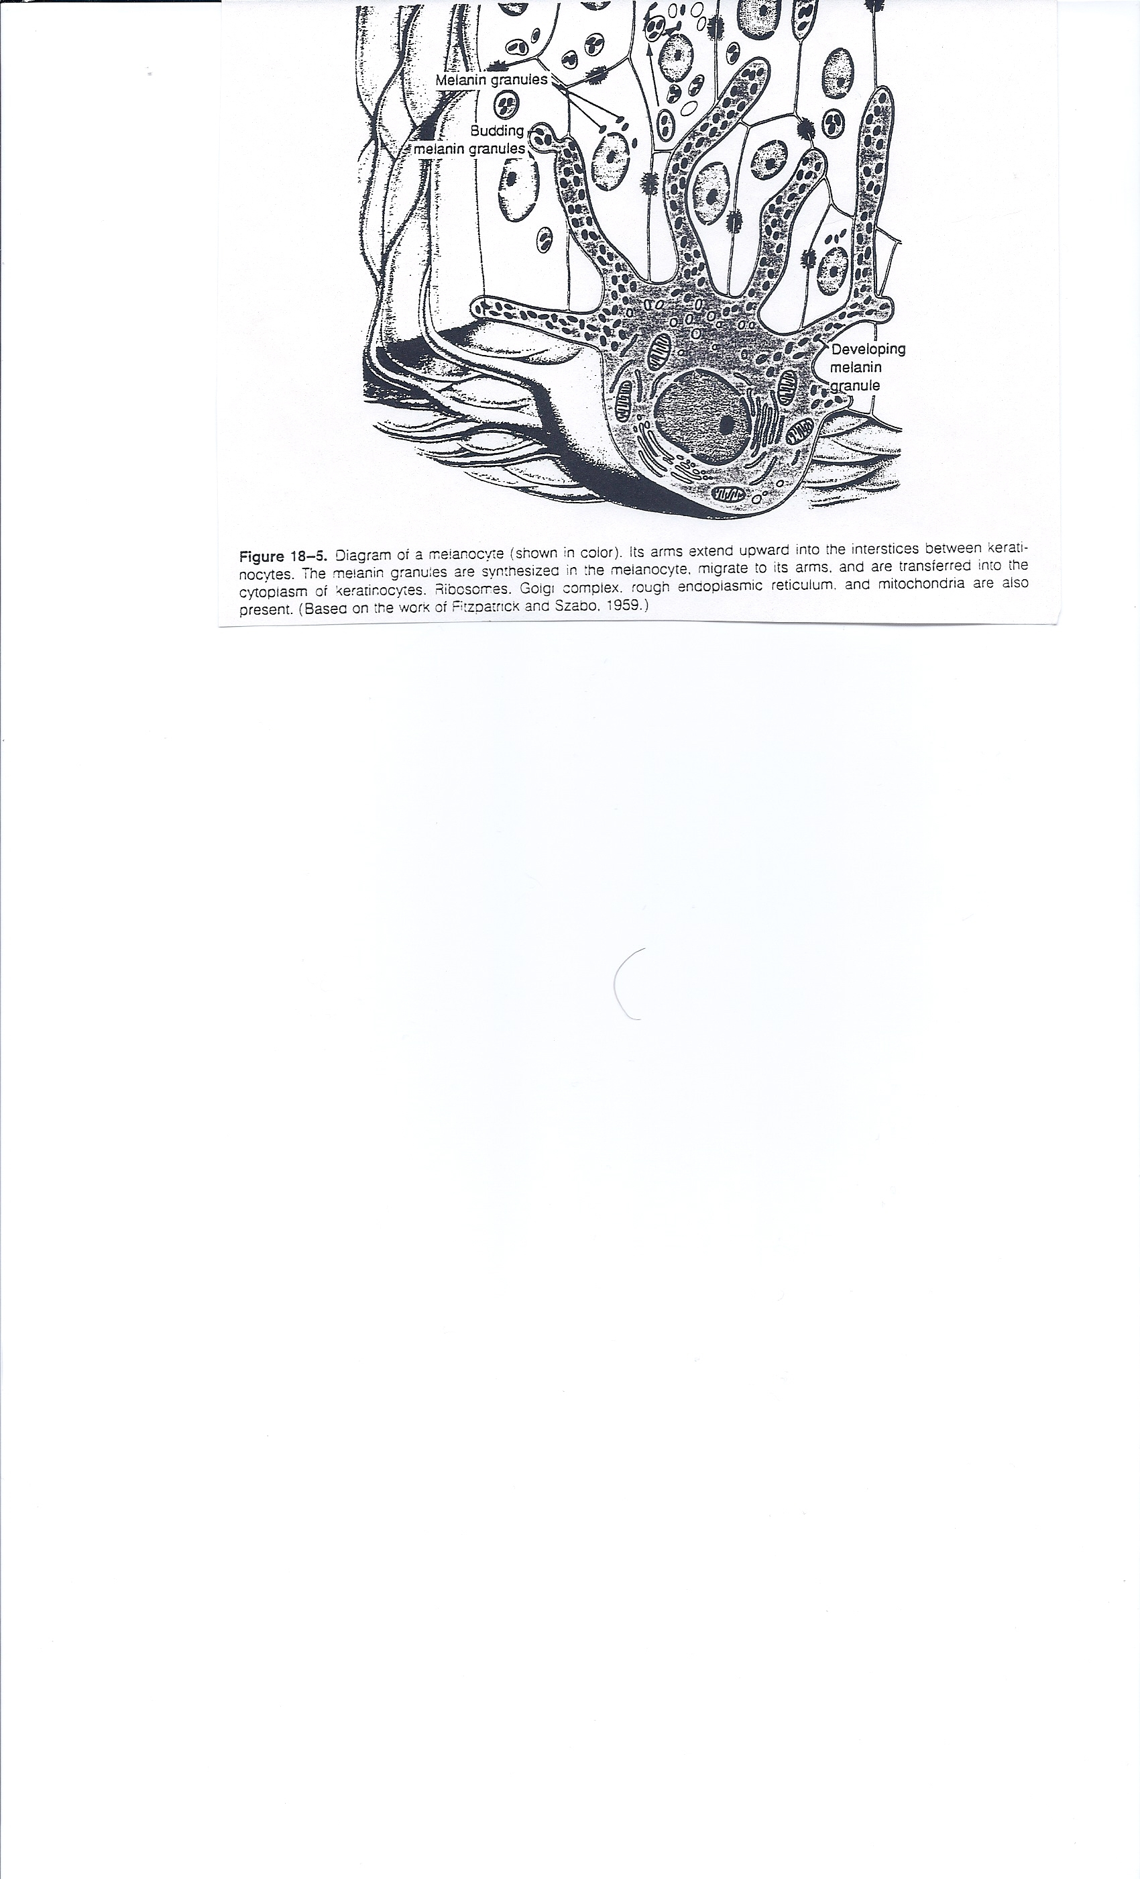
Melanin in the melanosomes is directly secreted into the neighboring
Keratinocytes in the epidermal levels of the Stratum spinosum and
S. granulosum. The melanosomes are positioned into the supranuclear region of these keratinocytes – thus protecting DNA in the nucleus.

Slide 46
Skin Color
The difference in skin color between fair people and dark people is not due to the number (quantity) of melanocytes in their skin, but to the melanocytes' level of activity (quantity and relative amounts of eumelanin and pheomelanin).

Slide 47
Stimulants of Melanin Production
1. Sunlight
2. Hormones - MSH – Melanocyte Stimulating Hormone
3. Skin irritation
4. Certain drugs like Cholera toxin, Forskolin, Vitamin D metabolites
When ultraviolet rays penetrate the skin and damage DNA, thymidine dinucleotide (pTpT) fragments from damaged DNA will trigger melanogenesis and cause the melanocyte to produce melanosomes, which are then transferred by dendrite to the top layer of keratinocytes.

Slide 48
Sunlight
The Sun emits ultraviolet radiation in the UVA, UVB, and UVC bands. The Earth's ozone layer blocks 98.7% of this UV radiation from penetrating through the atmosphere. 98.7% of the ultraviolet radiation that reaches the Earth's surface is UVA. (Some of the UVB and UVC radiation is responsible for the generation of the ozone layer.)
UVB exposure induces the production of vitamin D in the skin.

Slide 49
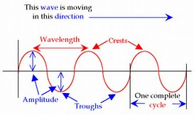
Description of Waves
The shorter the wavelength the faster the frequency. Faster frequency waves can penetrate and damage more.

Slide 50
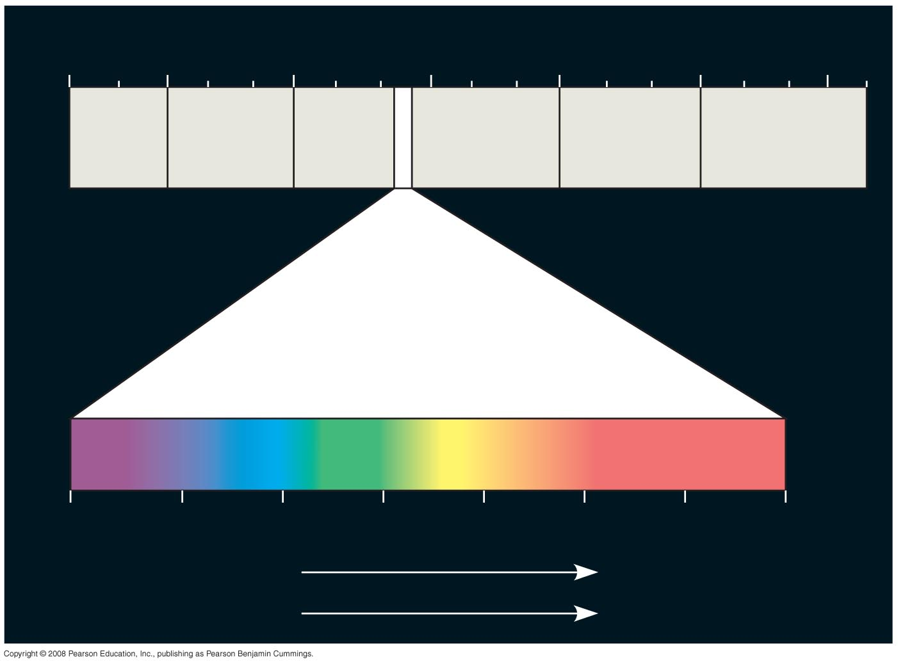
Fig. 10-6
1 m
(10⁹ nm)
10^{–5} nm
10^{–3} nm
1 nm
10³ nm
10⁶ nm
10³ m
Gamma
rays
Micro-
waves
Radio
waves
X-rays
UV
Infrared
Visible light
380
450
500
550
600
650
700
750 nm
Shorter wavelength
Longer wavelength
Higher energy
Lower energy
Notes:
Figure 10.6 The electromagnetic spectrum

Slide 51
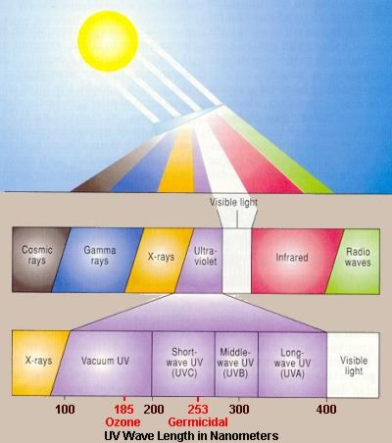

Slide 52
UVA, UVB and UVC can all damage collagen fibers and thereby accelerate aging of the skin. Both UVA and UVB destroy vitamin A in skin which may cause further damage. In the past, UVA was considered less harmful, but today it is known that it can contribute to skin cancer via indirect DNA damage (free radicals and reactive oxygen species). It penetrates deeply but it does not cause sunburn. UVA does not damage DNA directly like UVB and UVC, but it can generate highly reactive chemical intermediates, such as hydroxyl and oxygen radicals, which in turn can damage DNA.

Slide 53
Sunlight
An overexposure to UVB radiation can cause sunburn and some forms of skin cancer. In humans, prolonged exposure to solar UV radiation may result in acute and chronic health effects on the skin, eye, and immune system
UVC rays are the highest energy, most dangerous type of ultraviolet light. Little attention has been given to UVC rays in the past since they are filtered out by the atmosphere.

Slide 54
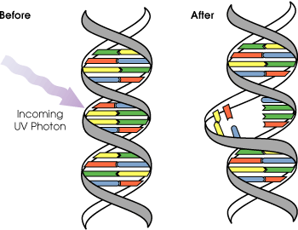
UVB light can cause direct DNA damage. The radiation excites DNA molecules in skin cells, causing aberrant covalent bonds to form between adjacent cytosine bases, producing a dimer.

Slide 55
UVA does not damage DNA directly like UVB and UVC, but it can generate highly reactive chemical intermediates, such as hydroxyl and oxygen radicals, which in turn can damage DNA. Because UVA does not cause reddening of the skin (erythema) it cannot be measured in SPF testing. There is no good clinical measurement for blockage of UVA radiation, but it is important that sunscreen block both UVA and UVB. Some scientists blame the absence of UVA filters in sunscreens for the higher melanoma-risk that was found for sunscreen users.

Slide 56
Sun Protection Formula
SPF is an acronym for Sun Protection Factor. The number you see associated with SPF represents the length of time you can stay out in the sun without burning, multiplied by the corresponding number. So a person who would normally start to burn in 10 minutes, could theoretically have 150 minutes of sun protection with a sunscreen that has an SPF of 15.

Slide 57
Review of Skin Color
Skin color depends on
(1) presence and absence of melanin – because melanin is the darkest substance it takes precedence over the other coloring agents
(2) amount of carotene – Carotene is the least common skin pigment – it results in a yellowing of skin
(3) color of hemoglobin in the red blood cells (red oxygenated – blue deoxygenated)

Slide 58
Dermal – Epidermal Junction
The basement membrane is the D-E junction
This basement membrane is composed of a basal lamina on top of a reticular lamina
The basement membrane prevents cancer of the epidermis from metastasizing in that the epidermis has no lymphatics or blood vessels
The stratum basale cells are firmly attached to the basement membrane by hemi-desmosomes – if this attachment breaks – this forms a blister

Slide 59
Dermis
Strong, flexible loose and dense connective tissues
Cells include fibroblasts, macrophages, and occasionally mast cells and white blood cells
Two layers:
  Papillary – upper 1/5th - loose connective tissue
  Reticular – bottom 4/5th – dense connective tissue

Slide 60
Hair shaft
Dermal papillae
Epidermis
Subpapillary
vascular plexus
Papillary
layer
Pore
Appendages
of skin
Dermis
Reticular
layer
• Eccrine sweat
gland
• Arrector pili
muscle
Hypodermis
(superficial fascia)
• Sebaceous
(oil) gland
• Hair follicle
Nervous structures
• Hair root
• Sensory nerve fiber
Cutaneous vascular
plexus
• Pacinian corpuscle
• Hair follicle receptor
(root hair plexus)
Adipose tissue
Figure 5.1

Slide 61
Layers of the Dermis: Papillary Layer
Papillary layer
  Loose (Areolar) connective tissue with collagen, elastic fibers and blood vessels
  Has alternating Dermal papillae and Epidermal (rete) ridges
  Dermal papillae contain:
    Capillary loops
    Meissner’s corpuscles
    Free nerve endings

Slide 62
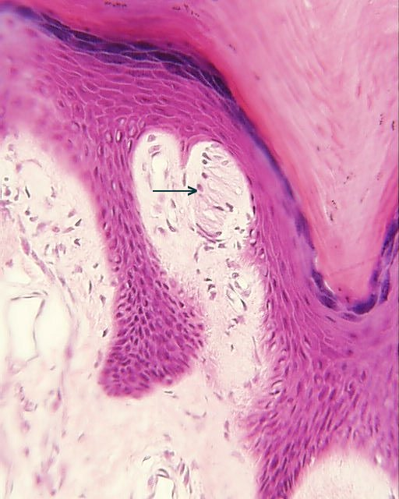
Epidermal Ridge
Dermal Papillae

Slide 63
Layers of the Dermis: Reticular Layer
Reticular layer (strength layer of the skin)
  ~80% of the thickness of dermis
  Collagen fibers provide strength and resiliency
  Elastic fibers provide stretch-recoil properties

Slide 64
Skin Markings: Finger Prints and Foot Prints
Epidermal ridges interdigitate with dermal papillary ridges to form certain ridges that give the fingerprints (Dermatoglyphics)
The purpose of the papillary ridges interdigitating with the epidermal ridges is to firmly attach the epidermis to the dermis (peg in a socket action)

Slide 65
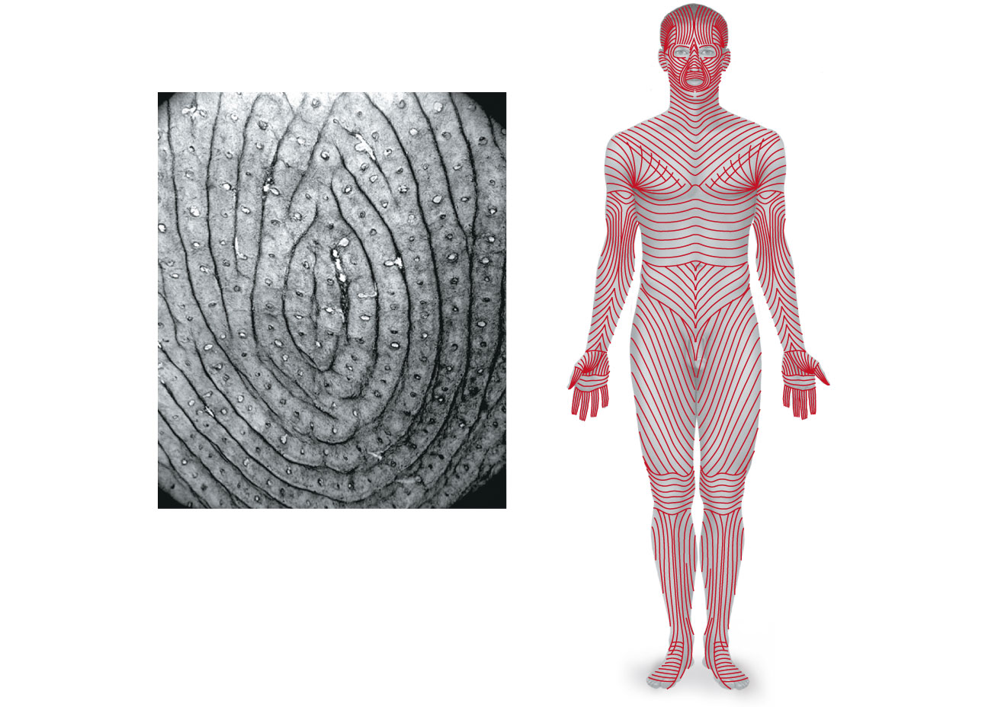
Epidermal ridges giving finger prints
Openings of sweat gland ducts
(a)
Figure 5.4a

Slide 66
Cleavage Lines (Langer’s Lines)
Collagen fibers arranged in bundles form cleavage (tension) lines
Incisions made parallel to cleavage lines heal more readily

Slide 67
(b)
Figure 5.4b

Slide 68
Appendages of the Skin
Derivatives of the epidermis
  Sweat glands
  Oil glands
  Hairs and hair follicles
  Nails

Slide 69
Sweat Glands
Two main types of sweat (sudoriferous) glands
  Eccrine (merocrine) sweat glands—present on most of body except intertriginous areas- most abundant on palms, soles, and forehead
    Sweat: 99% water, NaCl, vitamin C, antibodies, Dermcidin, metabolic wastes
    Ducts connect to pores
    Function in thermoregulation

Slide 70
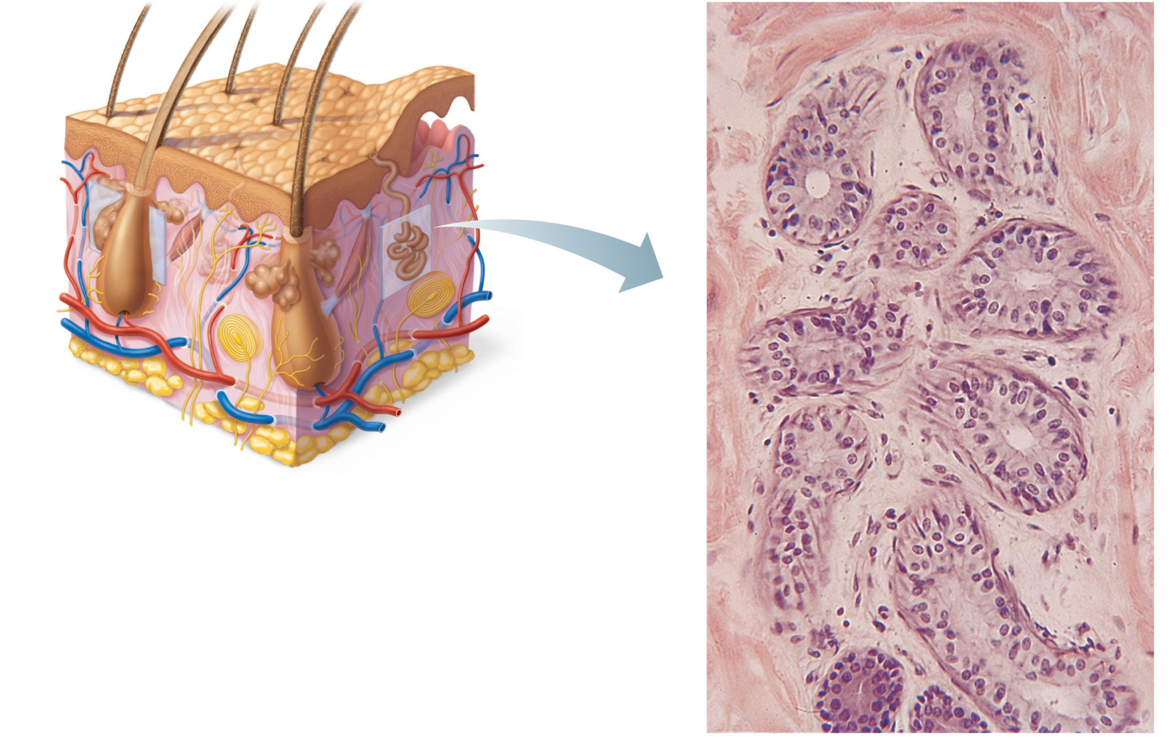
Sweat pore
Eccrine
gland
Sebaceous
gland
Duct
Dermal connective
tissue
Secretory cells
(b) Photomicrograph of a
sectioned eccrine gland (220x)
Figure 5.5b

Slide 71
Sweat Glands
  Apocrine sweat glands—confined to axillary and anogenital areas
    Sebum: sweat + fatty substances and proteins
    Ducts connect to hair follicles
    Functional from puberty onward (as sexual scent glands?)
  Specialized apocrine glands
    Ceruminous glands—in external ear canal; secrete cerumen
    Mammary glands

Slide 72
Sweat is an ultrafiltrate of the blood.
Sweating allows the body to regulate its temperature. Sweating is controlled from a center in the preoptic and anterior regions of the hypothalamus where thermosensitive neurons are located. The heat regulatory function of the hypothalamus is also affected by inputs from temperature receptors in the skin.

Slide 73
There are two situations in which our nerves will stimulate sweat glands making us sweat: during physical heat and emotional stress.
Emotionally induced sweating is generally restricted to palms, soles, and sometimes the forehead, while physical heat induced sweating occurs throughout the body.

Slide 74
Sweat Composition
Sweat contains mainly water. It also contains minerals, as well as lactate and urea. Mineral composition will vary with the individual, the acclimatization to heat, exercise and sweating, the particular stress source (exercise, sauna, etc.), the duration of sweating, and the composition of minerals in the body.
sodium 0.9 gram/liter, potassium 0.2 gram/liter, calcium 0.015 gram/liter, magnesium 0.0013 gram/liter. Also many other trace elements are excreted in sweat.
In humans sweat is hypoosmotic relative to plasma

Slide 75
Sebaceous (Oil) Glands
Widely distributed
Most develop from hair follicles
Become active at puberty (due to sudden increase in androgen production)
Sebum
  Oily holocrine secretion
  Bactericidal
  Softens hair and skin

Slide 76
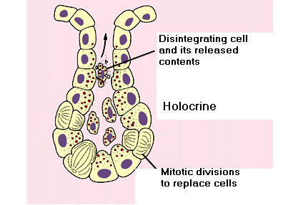
Holocrine Secretion
Increased Chance of clogging up duct - Acne

Slide 77
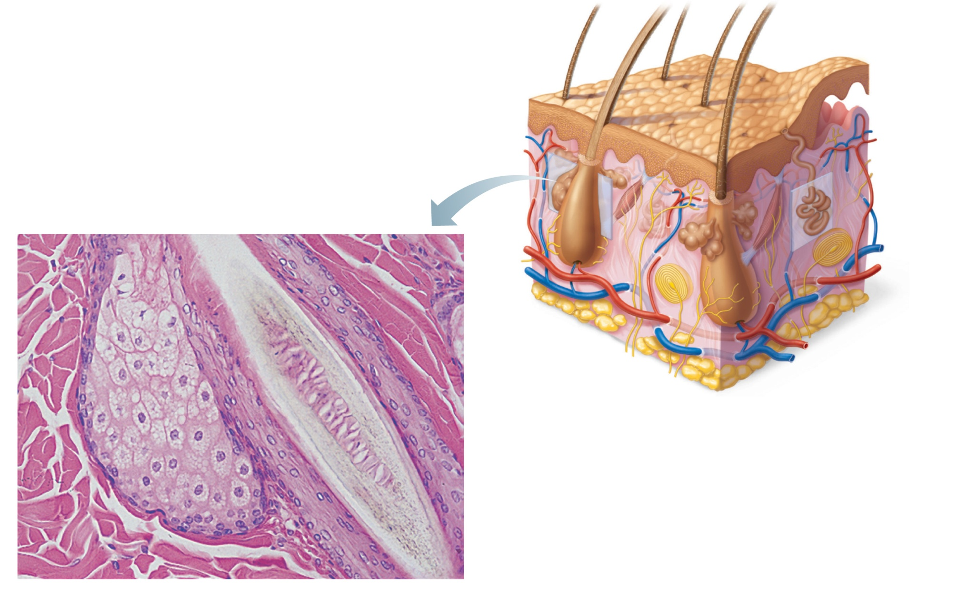
Sweat
pore
Sebaceous
gland
Dermal
connective
tissue
Sebaceous
gland duct
Eccrine
gland
Hair in
hair follicle
Secretory cells
(a) Photomicrograph of a sectioned
sebaceous gland (220x)
Figure 5.5a

Slide 78
Acne
Acne is a common skin condition, caused by changes in pilosebaceous units, skin structures consisting of a hair follicle and its associated sebaceous gland, via androgen stimulation. It is characterized by noninflammatory follicular papules or comedones and by inflammatory papules, pustules, and nodules in its more severe forms. Acne affects the areas of skin with the densest population of sebaceous follicles; these areas include the face, the upper part of the chest, and the back.

Slide 79
Severe acne is inflammatory, but acne can also manifest in noninflammatory forms
Acne is most common during adolescence, affecting more than 89% of teenagers, and frequently continues into adulthood. The cause in adolescence is generally an increase in male sex hormones, which people of both genders accrue during puberty. For most people, acne diminishes over time and tends to disappear—or at the very least decrease—after one reaches one's early twenties.

Slide 80
General Treatments
Opening the pore to prevent blockage
killing Propionibacterium acnes
anti-inflammatory effects
hormonal manipulation

Slide 81
Benzoyl Peroxide
benzoyl peroxide may be used in mild to moderate acne. In addition to its therapeutic effect as a keratolytic (a chemical that dissolves the keratin plugging the pores) benzoyl peroxide also prevents new lesions by killing P. acnes.

Slide 82
Antibiotics
Topical antibiotics
Externally applied antibiotics such as erythromycin, clindamycin or tetracycline kill the bacteria that are harbored in the blocked follicles. While topical use of antibiotics is equally as effective as oral use, this method avoids possible side effects including upset stomach and drug interactions.
Oral antibiotics
Oral antibiotics used to treat acne include erythromycin or one of the tetracycline antibiotics (tetracycline, the better absorbed oxytetracycline, or one of the once daily doxycycline, minocycline, or lymecycline). Trimethoprim is also sometimes used.

Slide 83
Retin- A
Retin-A brings acne plugs (blockages) to the surface causing blackheads to be dislocated. The blackheads are then discarded from the skin during cleansing. Retin-A can help control acne breakouts as well.
It is believed that isotretinoin works primarily by reducing the secretion of oils from the glands, however some studies suggest that it affects other acne-related factors as well. Isotretinoin has been shown to be very effective in treating severe acne and can either improve or clear well over 80% of patients.

Slide 84
Hair
Functions
  Alerting the body to presence of insects on the skin
  Guarding the scalp against physical trauma, heat loss, and sunlight
Distribution
  Entire surface except palms, soles, lips, nipples, and portions of external genitalia

Slide 85
Hair Formation in Embryo
Initial inductive events
The first signal is probably from the dermis, telling the epidermis to "make an appendage." Regions of epidermal cells proliferate and form local thickenings (placodes) of the epidermis. The signal here may be TGF-b molecules. The epidermis thickens in these regions and expresses particular adhesion molecules such as NCAM. These adhesion molecules are thought to separate the presumptive follicle cells from the remainder of the epidermis.

Slide 86
The epidermal placodes then respond by sending a message into the mesenchyme, telling the mesenchyme cells to "aggregate beneath the epidermal placodes." This signal appears to be a series of paracrine factors including fibroblast growth factors, sonic hedgehog, and BMP2.
Once aggregated, these mesenchyme cells now form the dermal papilla. The papilla sends a second message to the epidermis: "make a hair placode."

Slide 87
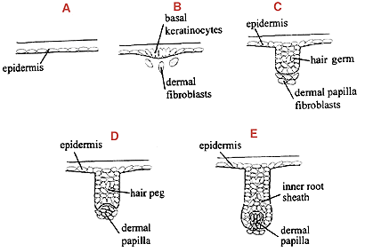
The stratum basale epidermal cells migrate downward into
the dermis towards a blood vessel. As the stratum basale
cells migrate downward they differentiate into hair matrix cells.

Slide 88
Hair
Consists of dead keratinized cells
Contains hard keratin; more durable than soft keratin of skin – lots more cysteine – thus disulfide bridges

Slide 89
Hair Color
Hair pigments: melanins (yellow, rust brown, black)
Red hair has an iron containing pigment trichosiderin
  With age the melanocytes associated with hair color lose their ability to produce tyrosinase thus the hair no longer is stained and thus turns Gray/white hair: remember cells without a stain are clear

Slide 90
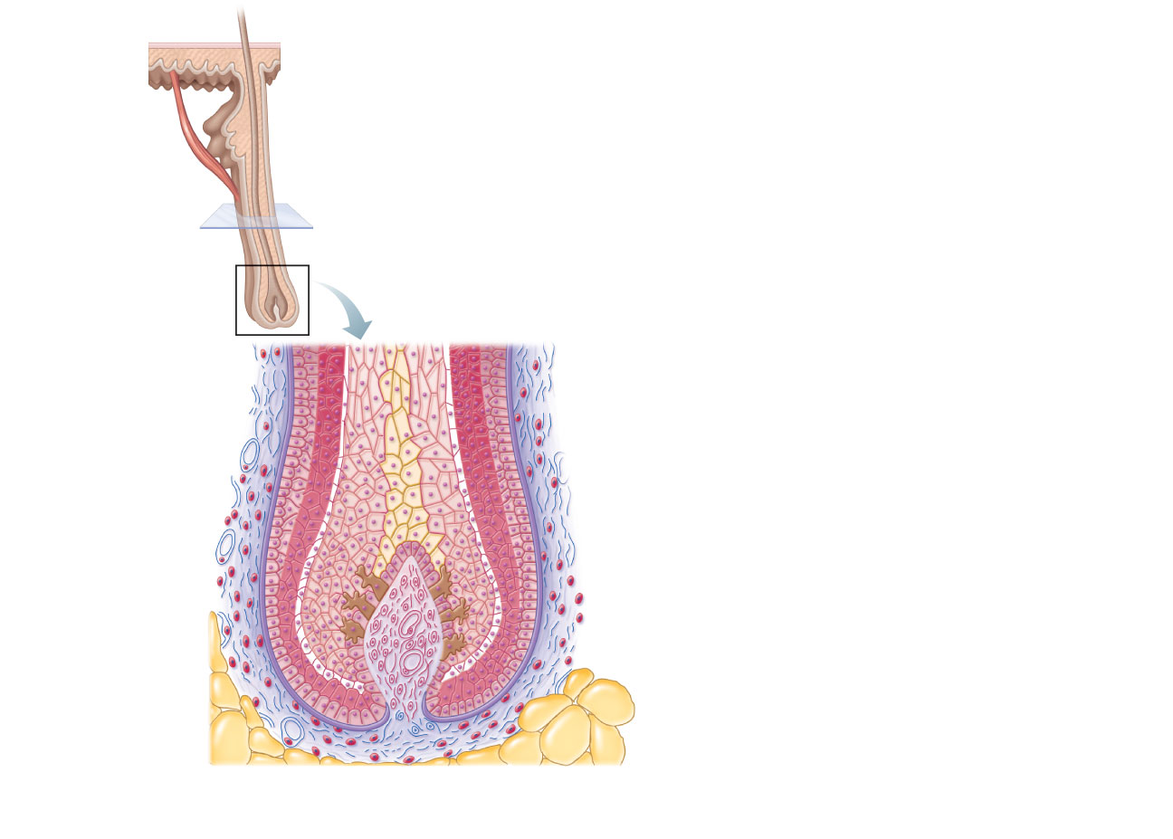
Hair shaft
Arrector
pili
Sebaceous
gland
Hair root
Follicle wall
Hair bulb
• Connective tissue root sheath
• Glassy membrane
• External epithelial root sheath
• Internal epithelial root sheath
Hair root
• Cuticle
• Cortex
• Medulla
Hair matrix
Hair papilla
Melanocyte
Subcutaneous adipose tissue
(c)
Diagram of a longitudinal view of the expanded hair
bulb of the follicle, which encloses the matrix
Figure 5.6c

Slide 91
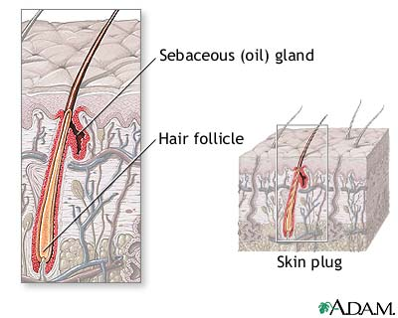
Hair Follicle (one complete hair including base)
Extends from the epidermal surface into dermis
Two-layered wall: outer connective tissue root sheath, inner epithelial root sheath
Hair bulb: expanded deep end

Slide 92
Hair Follicle
Hair follicle receptor (root hair plexus)
  Sensory nerve endings around each hair bulb
    Stimulated by bending a hair
Arrector pili
  Smooth muscle attached to follicle
  Responsible for “goose bumps”

Slide 93
Hair shaft
Arrector
pili
Sebaceous
gland
Hair root
Follicle wall
Hair bulb
• Connective tissue root sheath
• Glassy membrane
• External epithelial root sheath
• Internal epithelial root sheath
Hair root
• Cuticle
• Cortex
• Medulla
Hair matrix
Hair papilla
Melanocyte
Subcutaneous adipose tissue
(c)
Diagram of a longitudinal view of the expanded hair
bulb of the follicle, which encloses the matrix
Figure 5.6c

Slide 94
Layers of Hair Root (From outside to inside)
1. Dermal Root Sheath – bend down of Dermis
2. Glassy Membrane – the bend down of the Basement Membrane
3. External Root Sheath – Bend down of Stratum Basale
4. Internal Root Sheath – formed from hair matrix cells – composed of (a) Henley’s layer (b) Huxley’s Layer and (3) the cuticle layer of the internal root sheath
5 Cuticle Layer of Hair Shaft
6. Cortex of hair shaft
7. Medulla of hair shaft

Slide 95
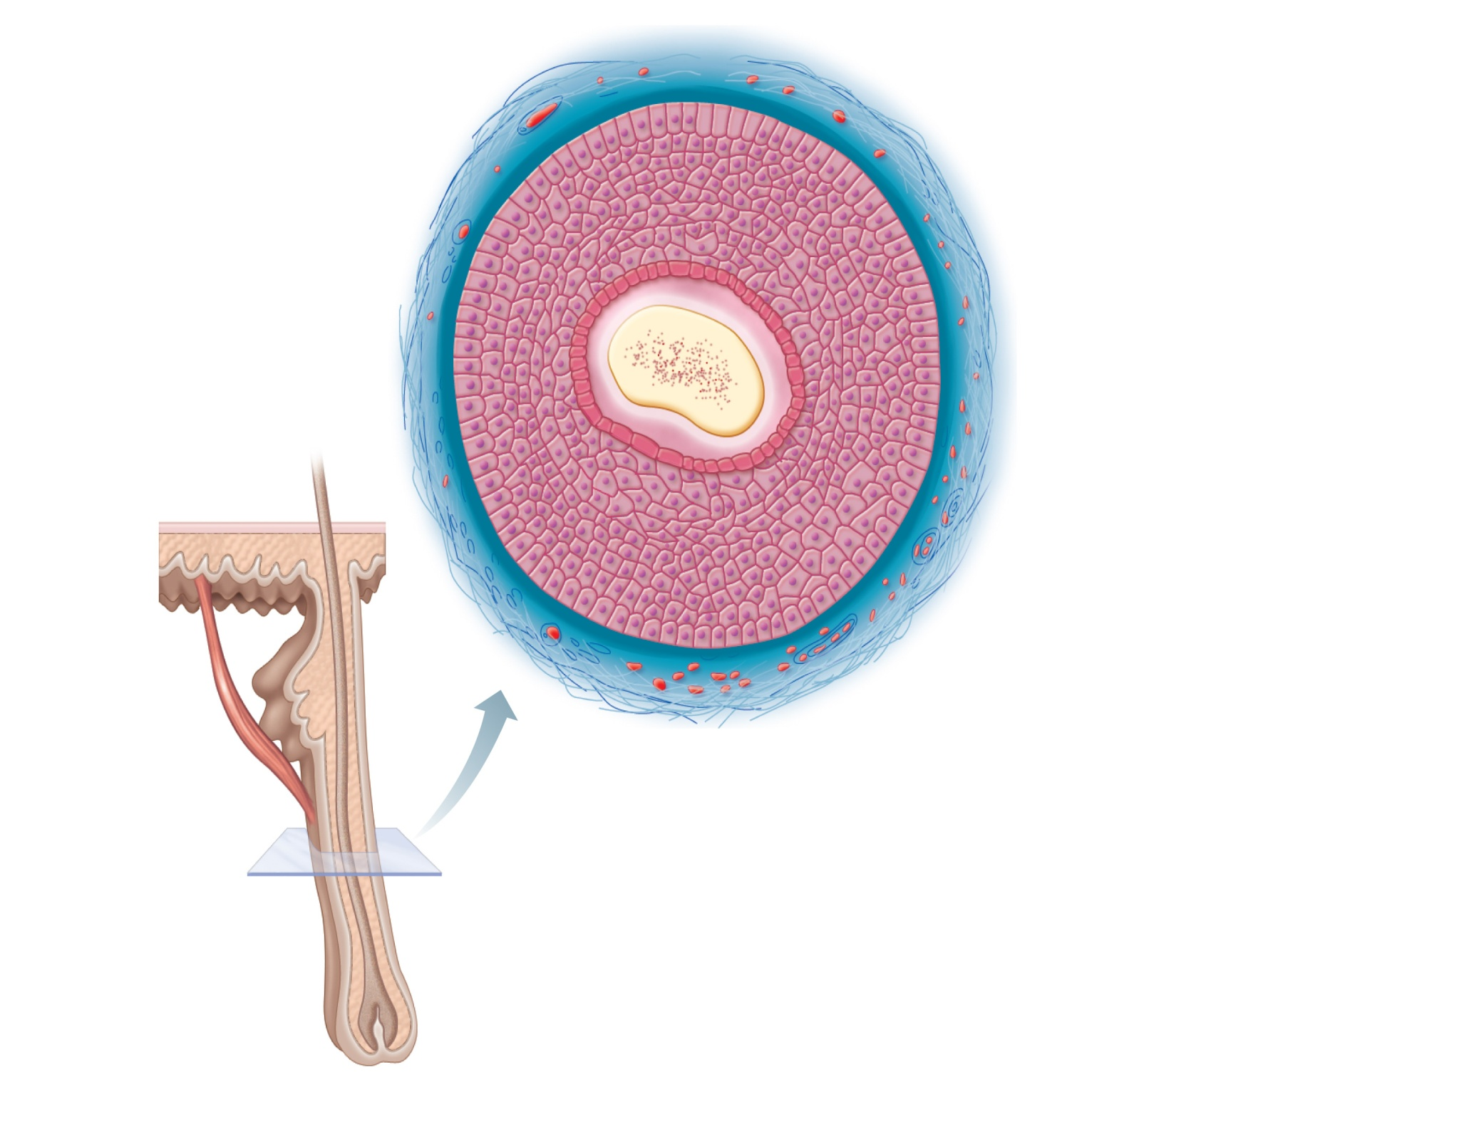
Follicle wall
• Connective tissue
root sheath
• Glassy membrane
• External epithelial
root sheath
• Internal epithelial
root sheath
Hair shaft
Hair
• Cuticle
• Cortex
• Medulla
Arrector
pili
(a) Diagram of a cross section of
a hair within its follicle
Sebaceous
gland
Hair root
Hair bulb
Figure 5.6a

Slide 96
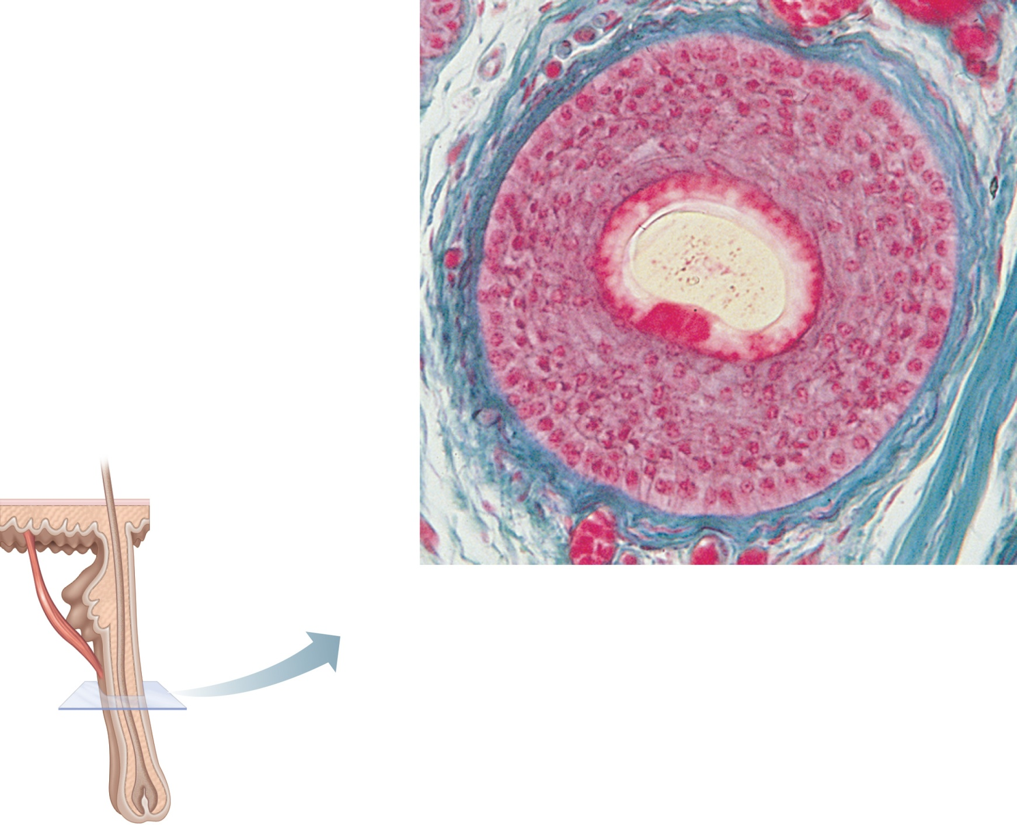
Follicle wall
• Connective tissue
root sheath
• Glassy membrane
• External epithelial
root sheath
• Internal epithelial
root sheath
Hair
• Cuticle
• Cortex
Hair shaft
• Medulla
Arrector
pili
(b) Photomicrograph of a cross
section of a hair and hair
follicle (250x)
Sebaceous
gland
Hair root
Hair bulb
Figure 5.6b

Slide 97
Hair shaft
Arrector
pili
Sebaceous
gland
Hair root
Follicle wall
Hair bulb
• Connective tissue root sheath
• Glassy membrane
• External epithelial root sheath
• Internal epithelial root sheath
Hair root
• Cuticle
• Cortex
• Medulla
Hair matrix
Hair papilla
Melanocyte
Subcutaneous adipose tissue
(c)
Diagram of a longitudinal view of the expanded hair
bulb of the follicle, which encloses the matrix
Figure 5.6c

Slide 98
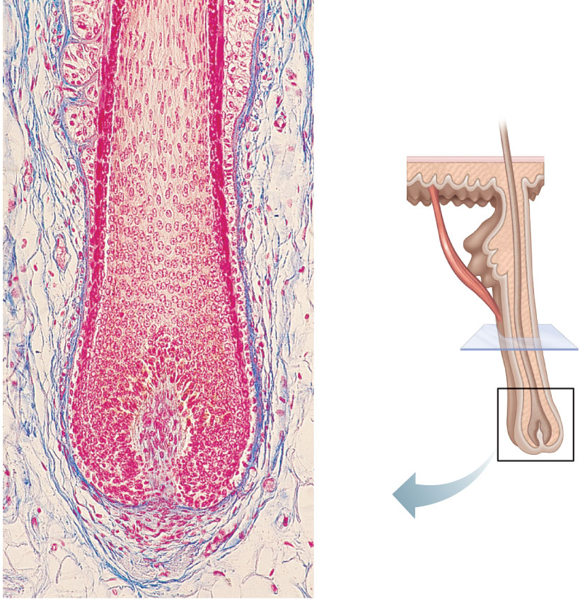
Follicle wall
• Connective
tissue root sheath
Hair shaft
• Glassy membrane
• External epithelial
root sheath
• Internal epithelial
root sheath
Hair root
Arrector
pili
• Cuticle
Sebaceous
gland
• Cortex
• Medulla
Hair root
Hair matrix
Hair bulb
Hair papilla
Subcutaneous
adipose tissue
(d) Photomicrograph of longitudinal view
of the hair bulb in the follicle (160x)
Figure 5.6d

Slide 99
Types of Hair
Vellus—pale, fine body hair of children and adult females and adult males
Terminal—coarse, long hair of eyebrows, scalp, axillary, and pubic regions (and face and neck of males)
Lanugo grows on fetuses as a normal part of gestation, but is usually shed and replaced by vellus hair at about 33 to 36 weeks of gestational age. The presence of lanugo in newborns is a sign of premature birth.
Lanugo in grown humans is also a possible sign of starvation, as the body attempts to insulate itself when body fat is lost.

Slide 100
Hair Growth Cycle
Hair grows in cycles of various phases: anagen is the growth phase; catagen is the involuting or regressing phase; and telogen, the resting or quiescent phase. Normally up to 90% of the hair follicles are in anagen phase while, 10–14% are in telogen and 1–2% in catagen.

Slide 101
Anagen phase (Growth Phase)
Anagen is the active growth phase of hair follicles. The cells in the root of the hair are dividing rapidly, adding to the hair shaft. During this phase the hair grows about 1 cm (2.5 mm per week) every 28 days. Scalp hair stays in this active phase of growth for 2-7 years. The amount of time the hair follicle stays in the anagen phase is genetically determined. At the end of the anagen phase an unknown signal causes the follicle to go into the catagen phase.

Slide 102
Hair Bulge – origination of hair matrix cells
The cells that compose the hair matrix, or actively dividing area of the hair bulb that produces the hair, originate in a region called the hair bulge located a fraction of a millimeter above the hair bulb.
When chemical signals (growth factors) diffusing from the blood vessels in the hair papilla reach the hair bulge, some of the hair bulge cells migrate downward towards the hair matrix cells and take up position there- performing mitosis and forming a new hair.

Slide 103
Hair Bulge Area
Hair shaft
Hair root
Arrector
pili
Sebaceous
gland
Hair root
Hair matrix
Hair bulb
Hair papilla
Figure 5.6d

Slide 104
Catagen Phase
The catagen phase is a short transition stage that occurs at the end of the anagen phase. It signals the end of the active growth of a hair. This phase lasts for about 2–3 weeks while a club hair is formed.
The hair shaft is still present – but it is not growing
A club hair is formed during the catagen phase. A club hair is a hair shaft with its swollen root attached – thus it looks like a club.
When a club hair is completely formed, about a 2 week process, the hair follicle enters the telogen phase and the hair follicle is shed.

Slide 105
Telogen phase
The telogen phase is the resting phase of the hair follicle. The club hair is the final product of a hair follicle in the telogen stage, and is a dead, fully keratinized hair. Fifty to one-hundred club hairs are shed daily from a normal scalp.

Slide 106
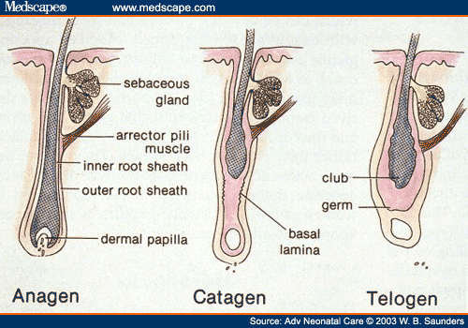

Slide 107
Hair growth cycle times
Scalp: The time these phases last varies from person to person. Different hair color and follicle shape affects the timings of these phases.
  anagen phase, 2–3 years (occasionally much longer)
  catagen phase, 2–3 weeks
  telogen phase, around 3 months
Eyebrows etc:
  anagen phase, 4–7 months
  catagen phase, 3–4 weeks
  telogen phase, about 9 months

Slide 108
Hair Thinning and Baldness
Hair grows fastest during the teen years to the 40s.
Alopecia—hair thinning in both sexes after age 40
True (frank) baldness
  Genetically determined and sex-influenced condition
  Male pattern baldness is caused by follicular response to DHT. A delayed action gene causes this action.
  Minoxidil and Finasteride
  Telogen Effluvium
  Alopecia areata

Slide 109
Structure of a Nail
Protect the ends of the digits
Assist in grasping
Used in scratching
Nails have a tougher form of keratin than hair

Slide 110
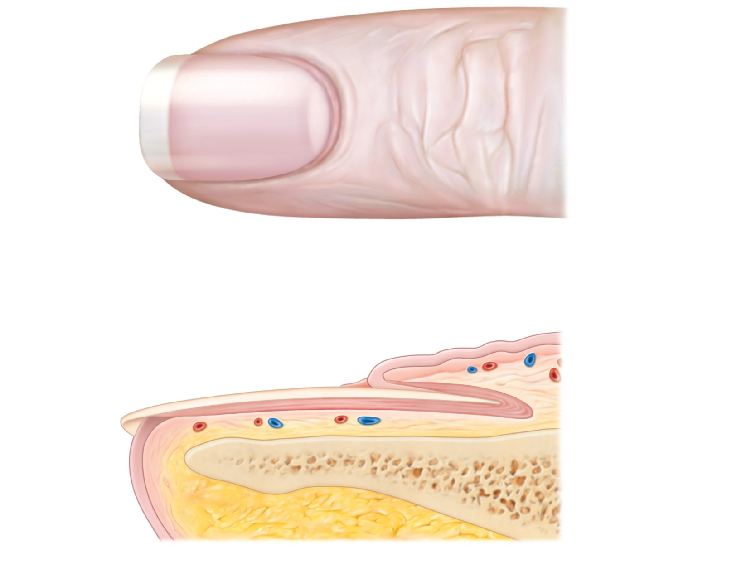
Lateral
nail fold
Lunule
(a)
Free edge
of nail
Body
of nail
Eponychium
(cuticle)
Proximal
nail fold
Nail bed
Root of nail
Nail
matrix
(b)
Hyponychium
Phalanx (bone of fingertip)
Figure 5.7

Slide 111
Skin Cancer
Most skin tumors are benign (do not metastasize)
Risk factors
  Overexposure to UV radiation
  Frequent irritation of the skin
Some skin lotions contain enzymes in liposomes that can fix damaged DNA

Slide 112
Skin Cancer
Three major types:
  Basal cell carcinoma
    Least malignant, most common
  Squamous cell carcinoma
    Second most common
  Melanoma
    Most dangerous

Slide 113
Basal Cell Carcinoma
Stratum basale cells proliferate and slowly invade dermis and hypodermis
Cured by surgical excision in 99% of cases

Slide 114
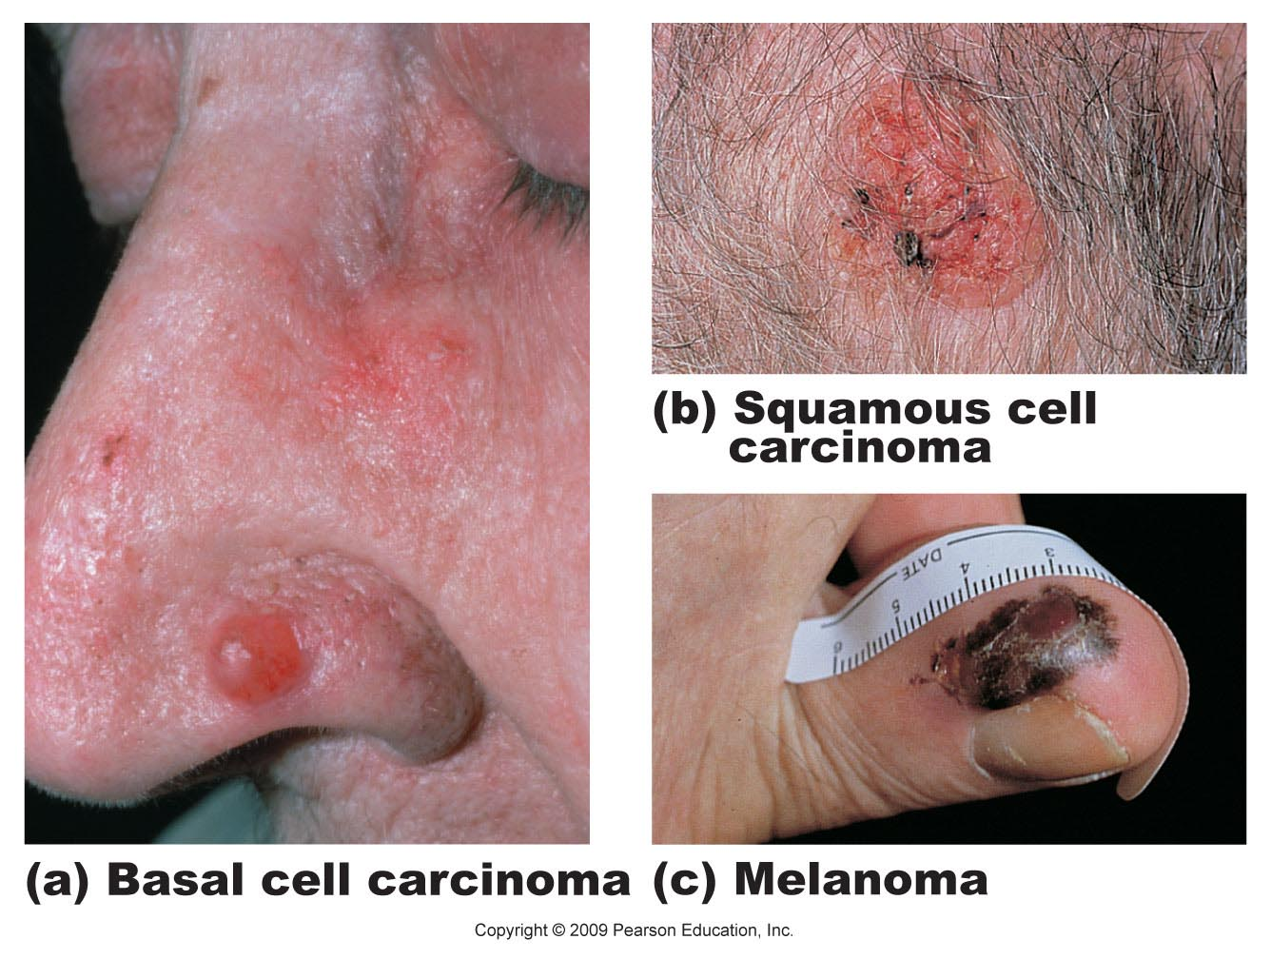
Figure 5.8a

Slide 115
Squamous Cell Carcinoma
Involves keratinocytes of stratum spinosum
Most common on scalp, ears, lower lip, and hands
Good prognosis if treated by radiation therapy or removed surgically

Slide 116
Figure 5.8b

Slide 117
Melanoma
Involves melanocytes
Highly metastatic and resistant to chemotherapy
Treated by wide surgical excision accompanied by immunotherapy

Slide 118
Melanoma
Characteristics (ABCD rule)
  A: Asymmetry; the two sides of the pigmented area do not match
  B: Border exhibits indentations
  C: Color is black, brown, tan, and sometimes red or blue
  D: Diameter is larger than 6 mm (size of a pencil eraser)

Slide 119
Figure 5.8c

Slide 120
Burns
Heat, electricity, radiation, certain chemicals
↓
Burn
(tissue damage, denatured protein, cell death)
Immediate threat:
  Dehydration and electrolyte imbalance, leading to renal shutdown and circulatory shock

Slide 121
Rule of Nines
Used to estimate the volume of fluid loss from burns
There are other classification systems also.

Slide 122
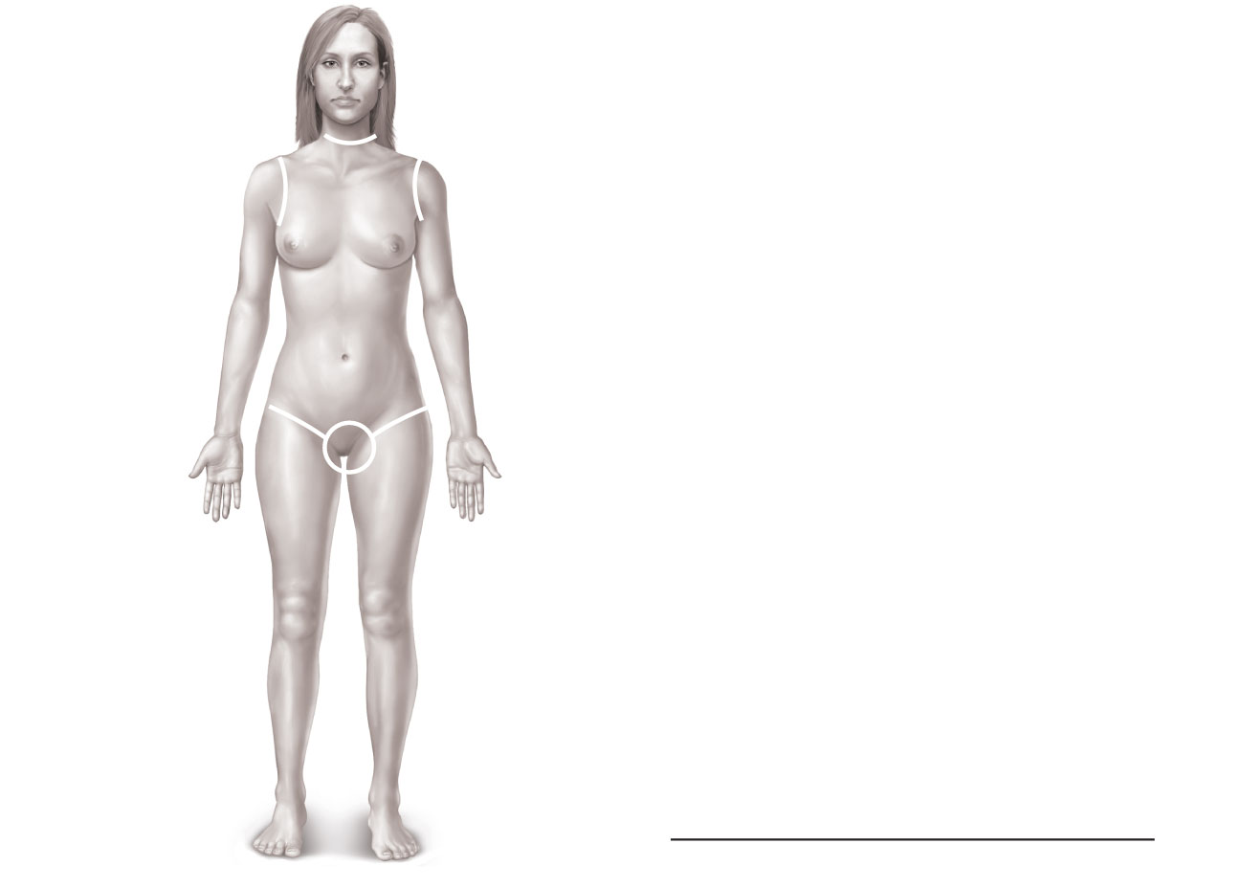
4
1
/
%
Totals
2
Anterior and posterior
head and neck, 9%
Anterior and posterior
upper limbs, 18%
Anterior
trunk,
18%
4
1
/
2
%
4
1
/
2
%
Anterior and posterior
trunk, 36%
9%
9%
(Perineum, 1%)
Anterior and posterior
lower limbs, 36%
100%
Figure 5.9

Slide 123
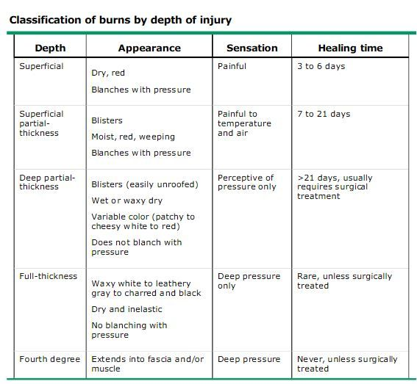

Slide 124
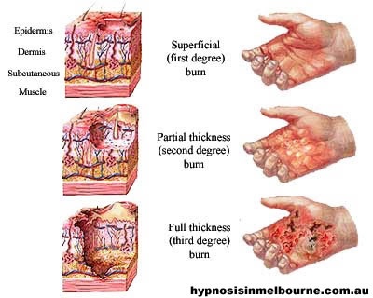

Slide 125
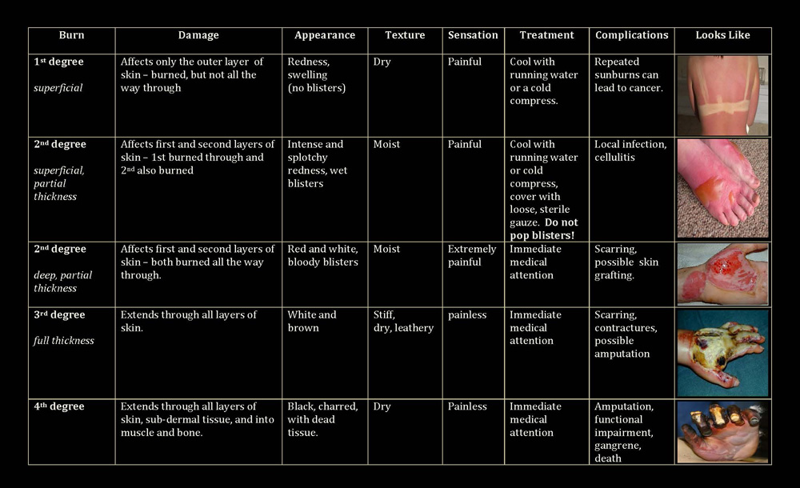

Slide 126
Partial-Thickness Burns
First degree
  Epidermal damage only
    Localized redness, edema (swelling), and pain
Second degree
  Epidermal and upper dermal damage
    Blisters appear

Slide 127
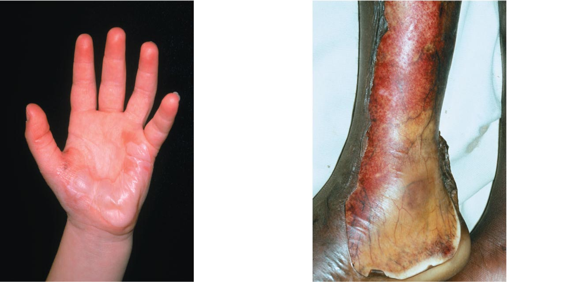
1st degree
burn
2nd degree
burn
(a)
Skin bearing partial
thickness burn (1st and
2nd degree burns)
Figure 5.10a

Slide 128
Full-Thickness Burns
Third degree
  Entire thickness of skin damaged
    Gray-white, cherry red, or black
    No initial edema or pain (nerve endings destroyed)
    Skin grafting usually necessary

Slide 129
3rd
degree
burn
(b)
Skin bearing full
thickness burn
(3rd degree burn)
Figure 5.10b

Slide 130
Severity of Burns
Critical if:
  >25% of the body has second-degree burns
  >10% of the body has third-degree burns
  Face, hands, or feet bear third-degree burns

Slide 131
Severe Burns Treatment
Fluid and Electrolyte Loss – IV Fluids Given
Infection – IV antibiotics and some topical
Scarring – surgical removal of scar tissue
Nutritional Support
Pain Management

Slide 132
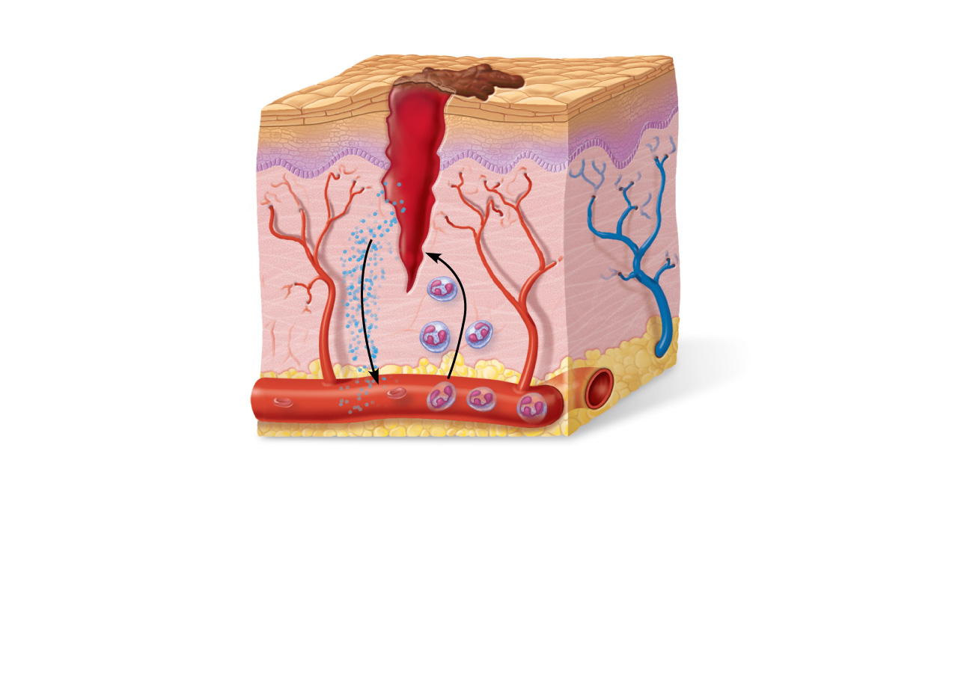
Scab
Epidermis
Vein
Migrating white
blood cell
Inflammatory
chemicals
Artery
Wound Healing
Figure 4.12, step 1

Slide 133
Skin Healing Issues
Hematoma – blood pocket
Seroma – clear fluid pocket
Fibrosis - scarring
Hypertropic Scar – routine scar
Keloid – terrible scar
Granulation tissue – when angiogenesis (new blood vessels) occurs in the wound

Slide 134
Wound Closure
Primary, Secondary, and Tertiary Intention
Primary Intention:
When wound edges are directly next to one another
Little tissue loss
Minimal scarring occurs
Most surgical wounds heal by first intention healing
Wound closure is performed with sutures, staples, or adhesive at the time of initial evaluation
example: well repaired lacerations, well reduced bone fractures, healing after flap surgery.

Slide 135
Sutures (1)
Sutures are normally classified into two types, absorbable and non-absorbable sutures. They can also be classified based on their construction, either mono-filament or multi-filament and also whether they are made from natural or synthetic materials. Sutures can also be classified according to their usage e.g. cardiovascular sutures, ophthalmic sutures, general sutures, orthopaedic sutures etc.

Slide 136
Sutures (2)
Absorbable sutures break down harmlessly in the body over time without intervention, and those which are non-absorbable and must be manually removed if they are not left indefinitely.
Sutures to be placed internally would require re-opening if they were to be removed. Sutures which lie on the exterior of the body can be removed within minutes, and without re-opening the wound. As a result, absorbable sutures are often used internally; non-absorbable externally.

Slide 137
Suture (3) Absorbable
Plain catgut – purified collagen taken from bovine intestines – lasts at least 7 days
Chromic catgut – purified collagen from bovine treated with chromic acid salts – last 10 -14 days
Polyglycolide (Vicryl, Dexon) – braided synthetic absorbable suture made from polyglycolic acid and coated with L-laurin and L-lysine (82% at least 2 weeks and 23% at least 4 weeks)
Polydioxane (PDS)– synthetic monofilament that lasts 2 to 4 weeks

Slide 138
Sutures (4) Non-absorbable
Non-absorbable sutures are made of special silk or the synthetics polypropylene, polyester or nylon.
Ethibond - A nonabsorbable, braided, sterile, surgical suture composed of Poly (ethylene, terephthalate).
PROLENE Suture is indicated for use in general soft tissue approximation and/or ligation, including use in cardiovascular, ophthalmic and neurological procedures.
ETHILON -A nonabsorbable, sterile, surgical, monofilament suture composed of the long-chain, aliphatic polymers Nylon 6 and Nylon 6.6.
Surgical Stainless Steel Suture -A nonabsorbable, sterile surgical suture composed of 316L stainless steel. Indicated for use in abdominal wound closure, hernia repair, sternal closure and orthopaedic procedures including cerclage and tendon repair.

Slide 139
Sutures (5)
Removal
Whereas some sutures are intended to be permanent, and others in specialized cases may be kept in place for an extended period of many weeks, as a rule sutures are a short term device to allow healing of a trauma or wound.
Different parts of the body heal at different speed. Common time to remove stitches will vary: facial wounds 3–5 days; scalp wound 7–10 days; limbs 10–14 days; joints 14 days; trunk of the body 7–10 days.

Slide 140
Secondary Intention:
The wound is allowed to granulate
Surgeon may pack the wound with a gauze or use a drainage system
Granulation results in a broader scar
Healing process can be slow due to presence of drainage from infection
Wound care must be performed daily to encourage wound debris removal to allow for granulation tissue formation
examples: gingivectomy, gingivoplasty, tooth extraction sockets, poorly reduced fractures.

Slide 141
Tertiary Intention (Delayed primary closure)
The wound is initially cleaned, debrided and observed, typically 4 or 5 days before closure.
The wound is purposely left open
example: healing of wounds by use of tissue grafts.

Slide 142
Developmental Aspects: Fetal
Ectoderm → epidermis
Mesoderm → dermis and hypodermis
Lanugo coat: covering of delicate hairs in 5th and 6th month
Vernix caseosa: sebaceous gland secretion; protects skin of fetus

Slide 143
Developmental Aspects: Adolescent to Adult
Sebaceous gland activity increases
Effects of cumulative environmental assaults show after age 30
Scaling and dermatitis become more common

Slide 144
Developmental Aspects: Old Age
Epidermal replacement slows, skin becomes thin, dry, and itchy
Subcutaneous fat and elasticity decrease, leading to cold intolerance and wrinkles
Increased risk of cancer due to decreased numbers of melanocytes and dendritic cells

