Slide 1
8
Joints: Part A

Slide 2
Joints (Articulations)
Articulation—site where two or more bones meet
Functions of joints:
  Give skeleton mobility
  Hold skeleton together

Slide 3
Functional Classification of Joints
Based on amount of movement allowed by the joint
Three functional classifications:
  Synarthroses—immovable
  Amphiarthroses—slightly movable
  Diarthroses—freely movable

Slide 4
Structural Classification of Joints
Based on material binding bones together and whether or not a joint cavity is present
Three structural classifications:
  Fibrous
  Cartilaginous
  Synovial

Slide 5
Fibrous Joints
Bones joined by dense fibrous connective tissue
No joint cavity
Most are synarthrotic (immovable)
Three types:
  Sutures
  Syndesmoses
  Gomphoses

Slide 6
Fibrous Joints: Sutures
Rigid, interlocking joints containing short connective tissue fibers
Allow for growth during youth
In middle age, sutures ossify and are called synostoses

Slide 7
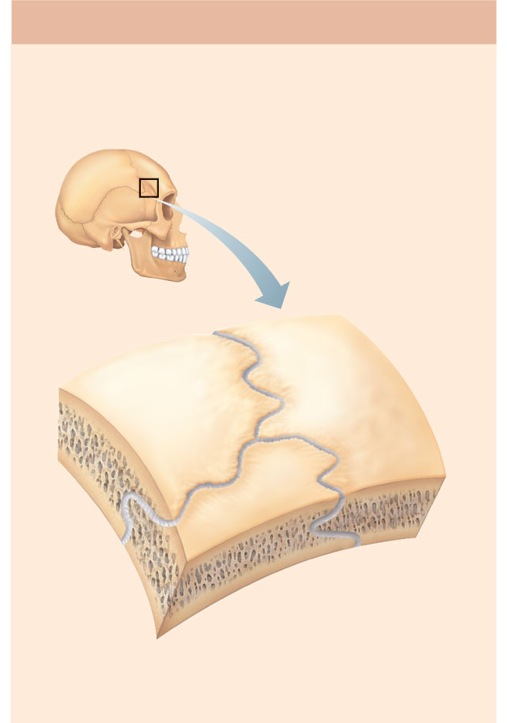
(a) Suture
Joint held together with very short,
interconnecting fibers, and bone edges
interlock. Found only in the skull.
Suture
line
Dense
fibrous
connective
tissue
Figure 8.1a

Slide 8
Fibrous Joints: Syndesmoses
Bones connected by ligaments (bands of fibrous tissue)
Movement varies from immovable to slightly movable
Examples:
  Synarthrotic distal tibiofibular joint
  Diarthrotic interosseous connection between radius and ulna

Slide 9
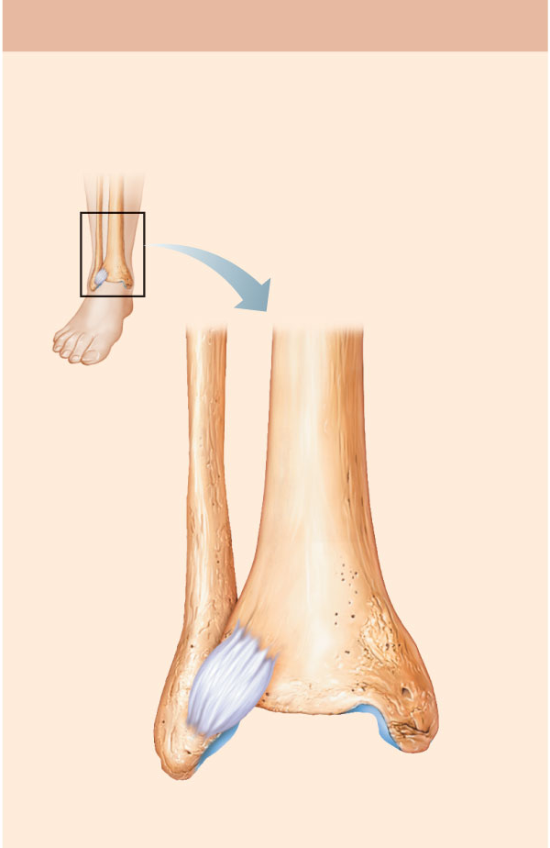
(b) Syndesmosis
Joint held together by a ligament.
Fibrous tissue can vary in length, but
is longer than in sutures.
Fibula
Tibia
Ligament
Figure 8.1b

Slide 10
Fibrous Joints: Gomphoses
Peg-in-socket joints of teeth in alveolar sockets
Fibrous connection is the periodontal ligament

Slide 11
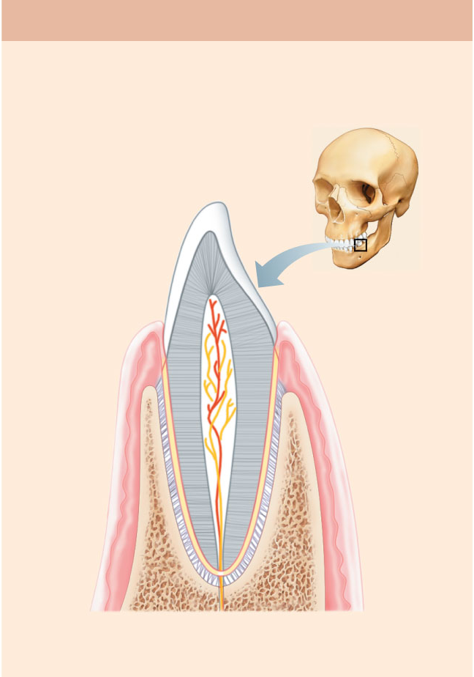
(c) Gomphosis
“Peg in socket” fibrous joint. Periodontal
ligament holds tooth in socket.
Socket of
alveolar
process
Root of
tooth
Periodontal
ligament
Figure 8.1c

Slide 12
Cartilaginous Joints
Bones united by cartilage
No joint cavity
Two types:
  Synchondroses
  Symphyses

Slide 13
Cartilaginous Joints: Synchondroses
A bar or plate of hyaline cartilage unites the bones
All are synarthrotic

Slide 14
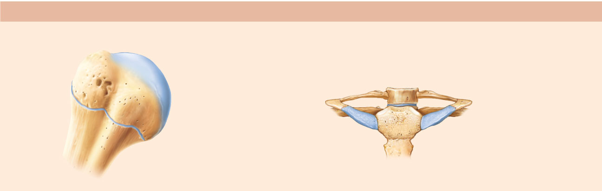
(a) Synchondroses
Bones united by hyaline cartilage
Sternum
(manubrium)
Epiphyseal
plate (temporary
hyaline cartilage
joint)
Joint between
first rib and
sternum
(immovable)
Figure 8.2a

Slide 15
Cartilaginous Joints: Symphyses
Hyaline cartilage covers the articulating surfaces and is fused to an intervening pad of fibrocartilage
Strong, flexible amphiarthroses

Slide 16
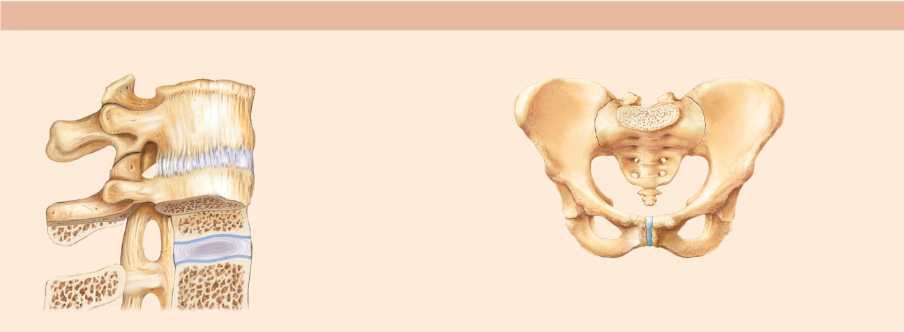
(b) Symphyses
Bones united by fibrocartilage
Body of vertebra
Fibrocartilaginous
intervertebral
disc
Hyaline cartilage
Pubic symphysis
Figure 8.2b

Slide 17
Synovial Joints
All are diarthrotic
Include all limb joints; most joints of the body

Slide 18
Synovial Joints
Distinguishing features:
Articular cartilage: hyaline cartilage
Joint (synovial) cavity: small potential space

Slide 19
Synovial Joints
Distinguishing features:
3. Articular (joint) capsule:
  Outer fibrous capsule of dense irregular connective tissue
  Inner synovial membrane of loose connective tissue

Slide 20
Synovial Joints
Distinguishing features:
4. Synovial fluid:
  Viscous slippery filtrate of plasma + hyaluronic acid
  Lubricates and nourishes articular cartilage

Slide 21
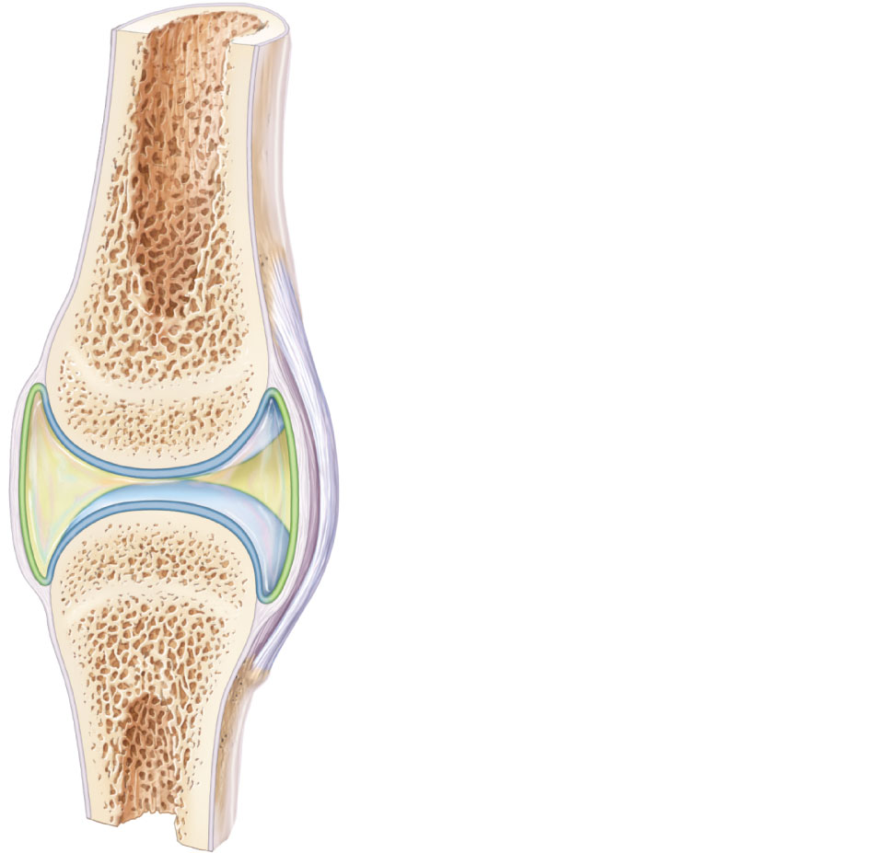
Ligament
Joint cavity
(contains
synovial fluid)
Articular (hyaline)
cartilage
Fibrous
capsule
Articular
capsule
Synovial
membrane
Periosteum
Figure 8.3

Slide 22
Synovial Joints
Distinguishing features:
5. Three possible types of reinforcing ligaments:
  Capsular (intrinsic)—part of the fibrous capsule
  Extracapsular—outside the capsule
  Intracapsular—deep to capsule; covered by synovial membrane

Slide 23
Synovial Joints
Distinguishing features:
6. Rich nerve and blood vessel supply:
  Nerve fibers detect pain, monitor joint position and stretch
  Capillary beds produce filtrate for synovial fluid

Slide 24
Synovial Joints: Friction-Reducing Structures
Bursae:
  Flattened, fibrous sacs lined with synovial membranes
  Contain synovial fluid
  Commonly act as “ball bearings” where ligaments, muscles, skin, tendons, or bones rub together

Slide 25
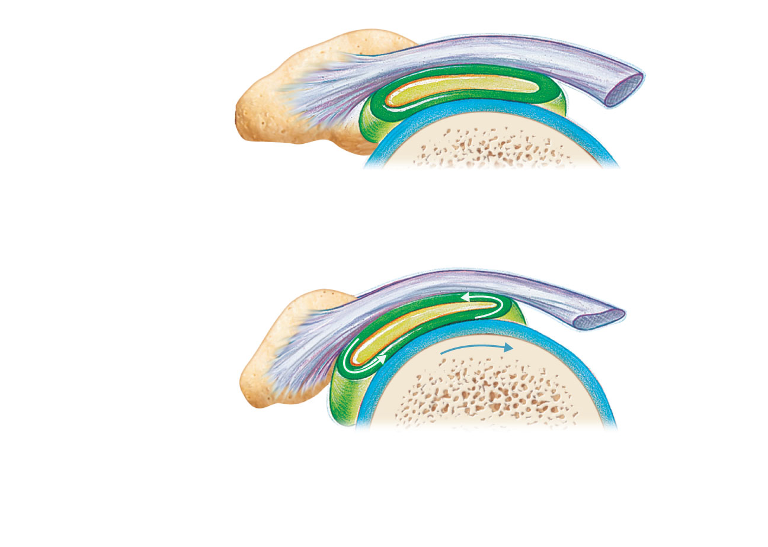
Coracoacromial
ligament
Subacromial
bursa
Humerus
resting
Cavity in
bursa containing
synovial fluid
Bursa rolls
and lessens
friction.
Humerus head
rolls medially as
arm abducts.
Humerus
moving
(b) Enlargement of (a), showing how a bursa
eliminates friction where a ligament (or other
structure) would rub against a bone
Figure 8.4b

Slide 26
Synovial Joints: Friction-Reducing Structures
Tendon sheath:
  Elongated bursa that wraps completely around a tendon

Slide 27
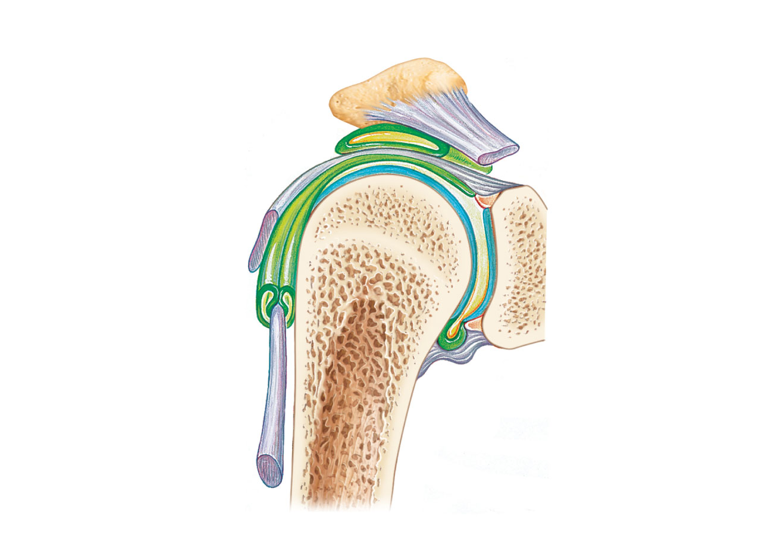
Acromion
of scapula
Coracoacromial
ligament
Joint cavity
containing
synovial fluid
Subacromial
bursa
Fibrous
articular capsule
Hyaline
cartilage
Tendon
sheath
Synovial
membrane
Tendon of
long head
of biceps
brachii muscle
Fibrous
capsule
Humerus
(a) Frontal section through the right shoulder joint
Figure 8.4a

Slide 28
Stabilizing Factors at Synovial Joints
Shapes of articular surfaces (minor role)
Ligament number and location (limited role)
Muscle tone, which keeps tendons that cross the joint taut
  Extremely important in reinforcing shoulder and knee joints and arches of the foot

Slide 29
Synovial Joints: Movement
Muscle attachments across a joint:
  Origin—attachment to the immovable bone
  Insertion—attachment to the movable bone
Muscle contraction causes the insertion to move toward the origin
Movements occur along transverse, frontal, or sagittal planes

Slide 30
Synovial Joints: Range of Motion
Nonaxial—slipping movements only
Uniaxial—movement in one plane
Biaxial—movement in two planes
Multiaxial—movement in or around all three planes

Slide 31
Movements at Synovial Joints
Gliding
Angular movements:
  Flexion, extension, hyperextension
  Abduction, adduction
  Circumduction
Rotation
  Medial and lateral rotation

Slide 32
Movements at Synovial Joints
4. Special movements
  Supination, pronation
  Dorsiflexion, plantar flexion of the foot
  Inversion, eversion
  Protraction, retraction
  Elevation, depression
  Opposition

Slide 33
Gliding Movements
One flat bone surface glides or slips over another similar surface
Examples:
  Intercarpal joints
  Intertarsal joints
  Between articular processes of vertebrae

Slide 34
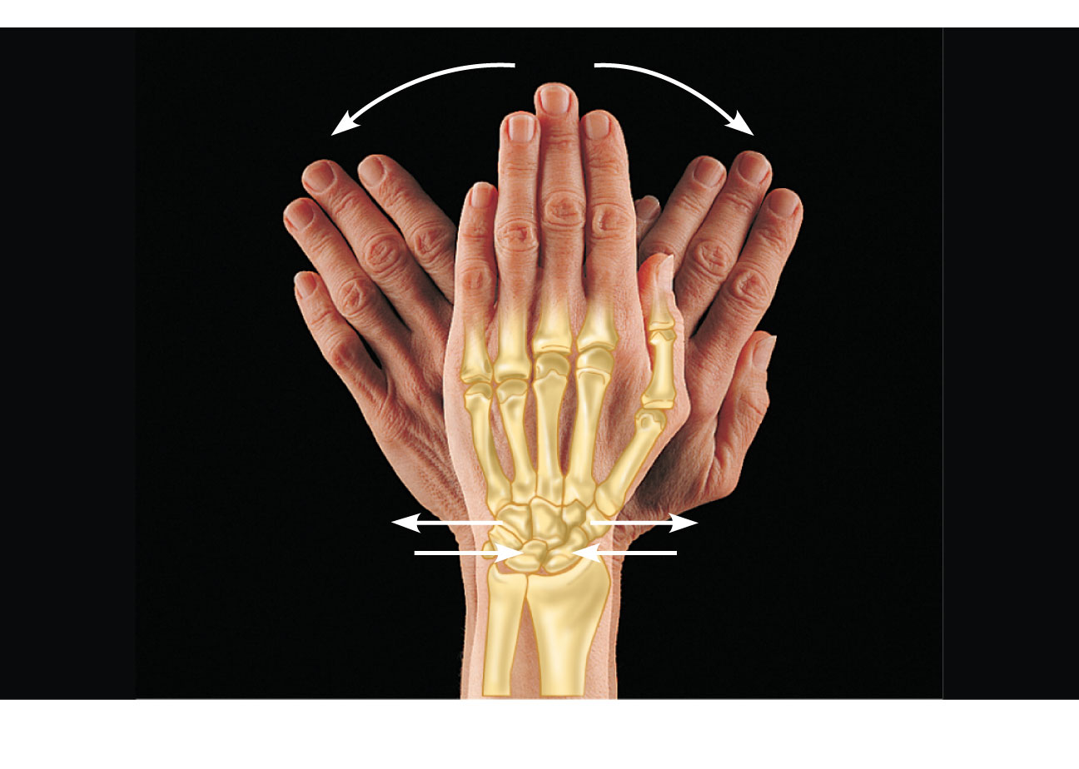
Gliding
(a) Gliding movements at the wrist
Figure 8.5a

Slide 35
Angular Movements
Movements that occur along the sagittal plane:
Flexion—decreases the angle of the joint
Extension— increases the angle of the joint
Hyperextension—excessive extension beyond normal range of motion

Slide 36
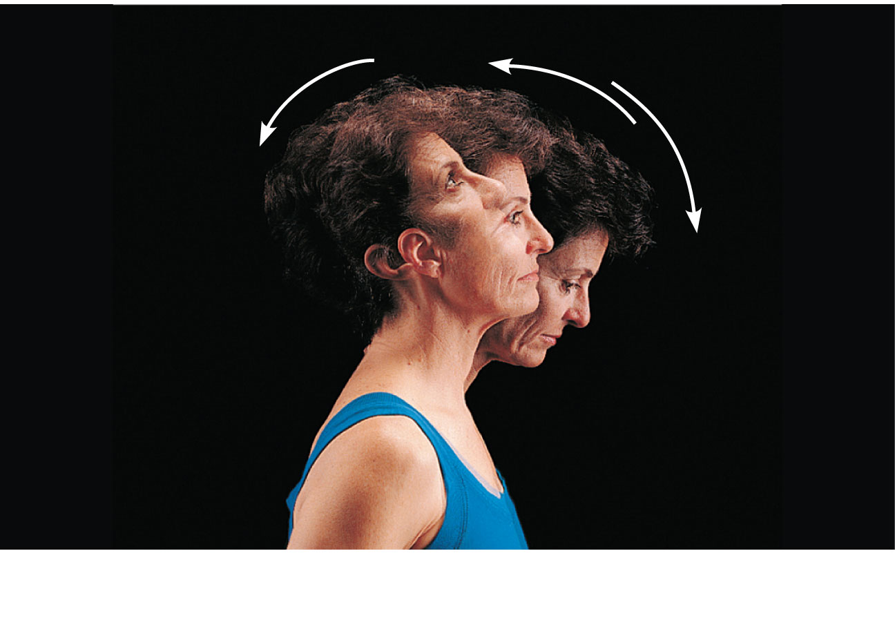
Hyperextension
Extension
Flexion
(b) Angular movements: flexion, extension, and
hyperextension of the neck
Figure 8.5b

Slide 37
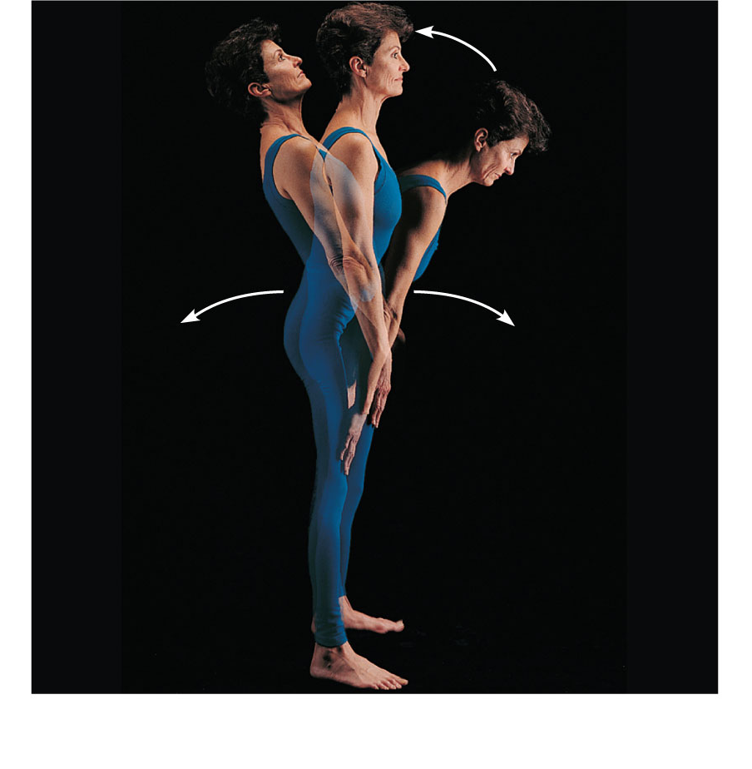
Extension
Hyperextension
Flexion
(c) Angular movements: flexion, extension, and
hyperextension of the vertebral column
Figure 8.5c

Slide 38
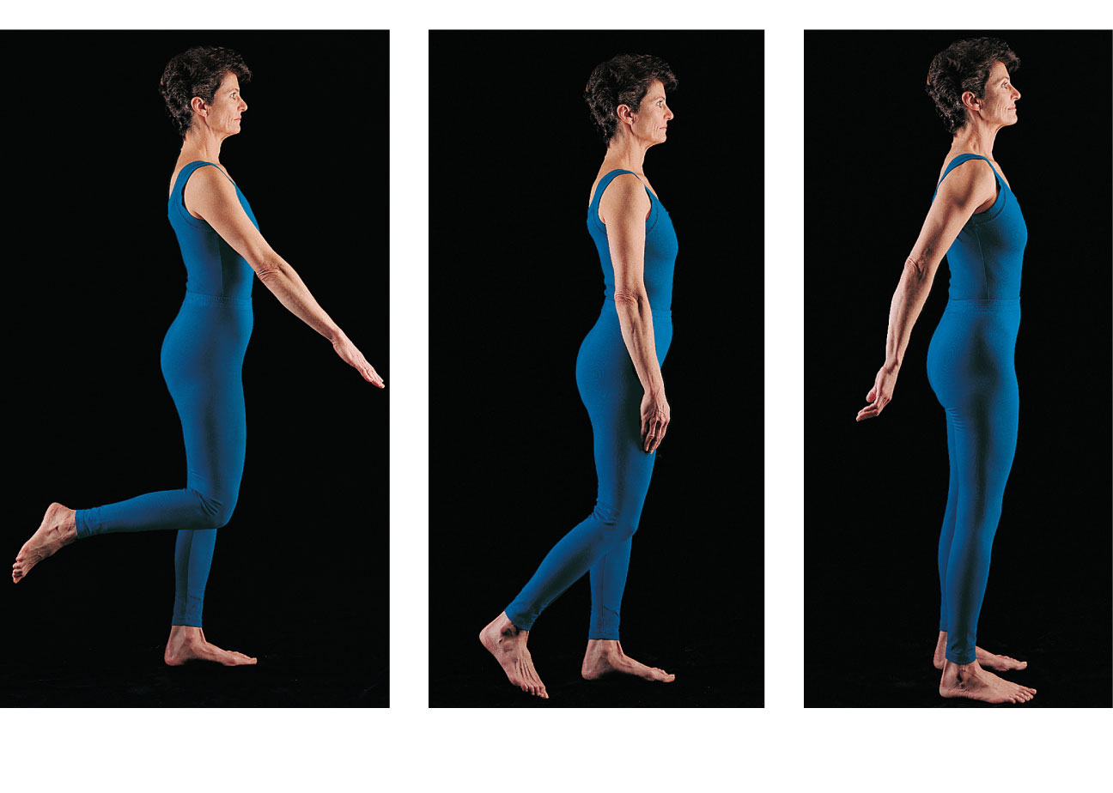
Flexion
Extension
Flexion
Extension
(d) Angular movements: flexion and extension at the
shoulder and knee
Figure 8.5d

Slide 39
Angular Movements
Movements that occur along the frontal plane:
Abduction—movement away from the midline
Adduction—movement toward the midline
Circumduction—flexion + abduction + extension + adduction of a limb so as to describe a cone in space

Slide 40
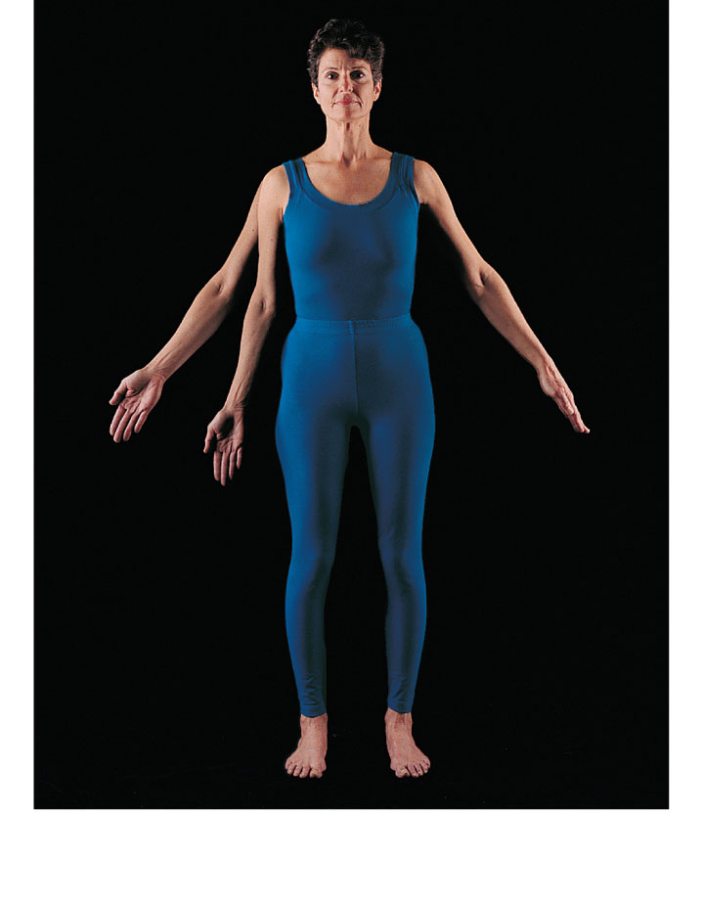
Abduction
Adduction
Circumduction
(e) Angular movements: abduction, adduction, and
circumduction of the upper limb at the shoulder
Figure 8.5e

Slide 41
Rotation
The turning of a bone around its own long axis
Examples:
  Between C₁ and C₂ vertebrae
  Rotation of humerus and femur

Slide 42
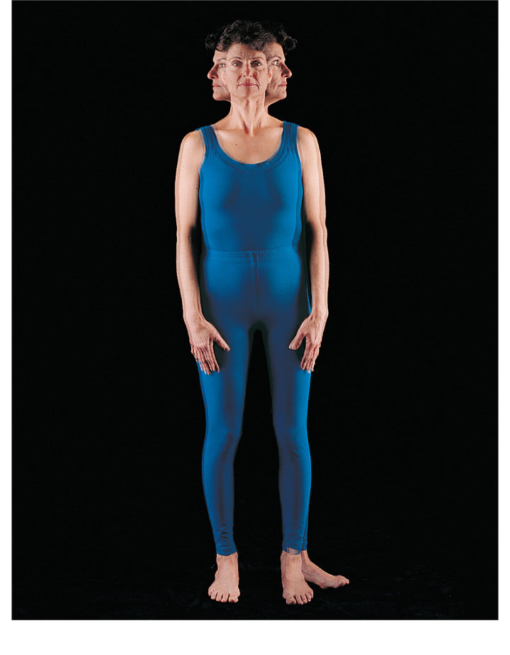
Rotation
Lateral
rotation
Medial
rotation
(f) Rotation of the head, neck, and lower limb
Figure 8.5f

Slide 43
Special Movements
Movements of radius around ulna:
  Supination (turning hand backward)
  Pronation (turning hand forward)

Slide 44
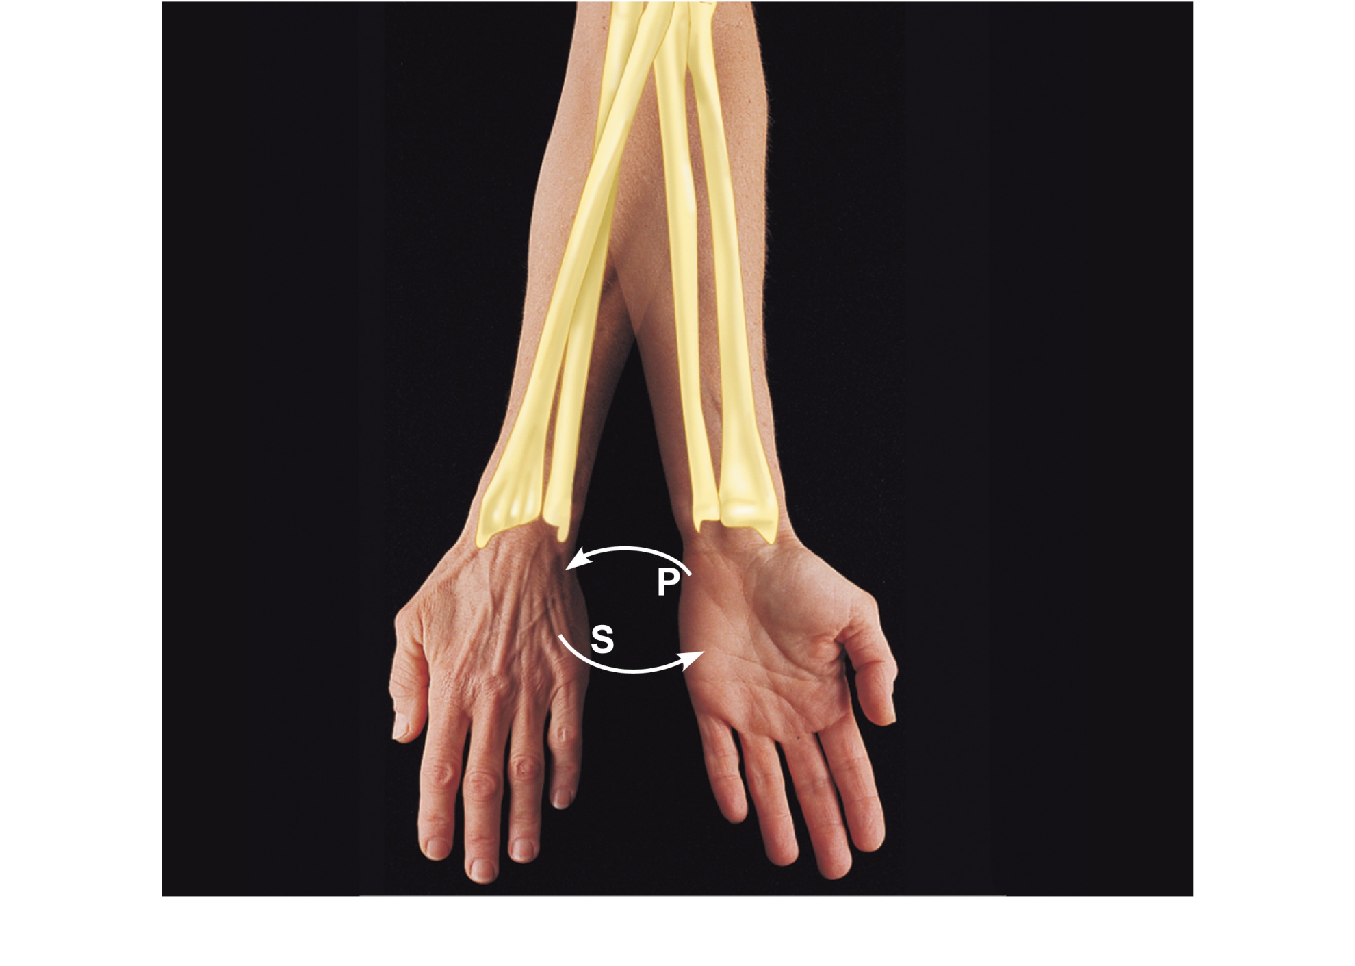
Pronation
(radius
rotates
over ulna)
Supination
(radius and
ulna are
parallel)
(a) Pronation (P) and supination (S)
Figure 8.6a

Slide 45
Special Movements
Movements of the foot:
  Dorsiflexion (upward movement)
  Plantar flexion (downward movement)

Slide 46
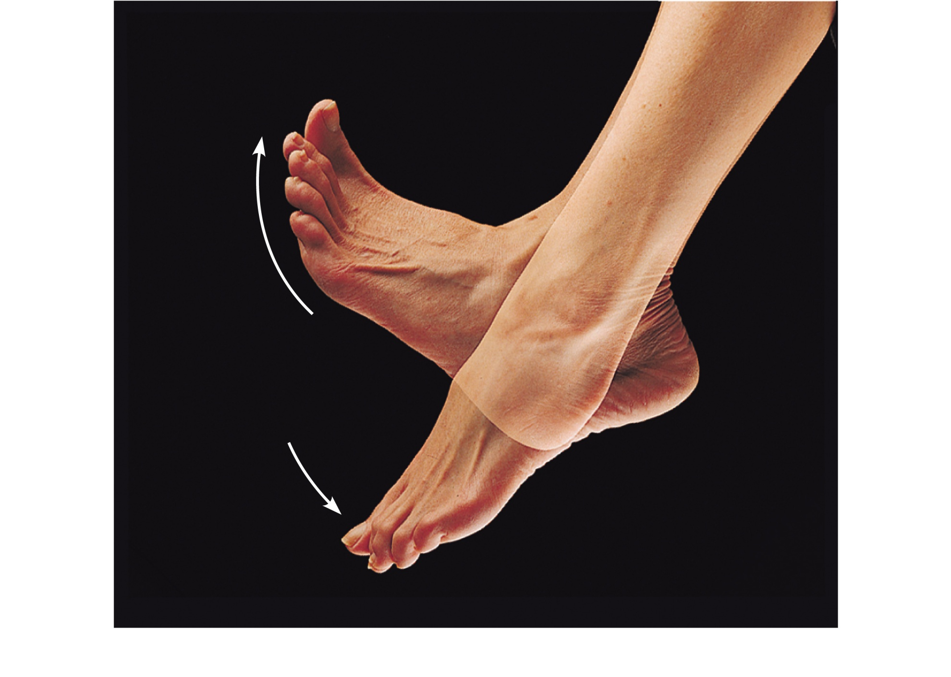
Dorsiflexion
Dorsiflexion
Plantar flexion
Plantar flexion
(b) Dorsiflexion and plantar flexion
Figure 8.6b

Slide 47
Special Movements
Movements of the foot:
  Inversion (turn sole medially)
  Eversion (turn sole laterally)

Slide 48
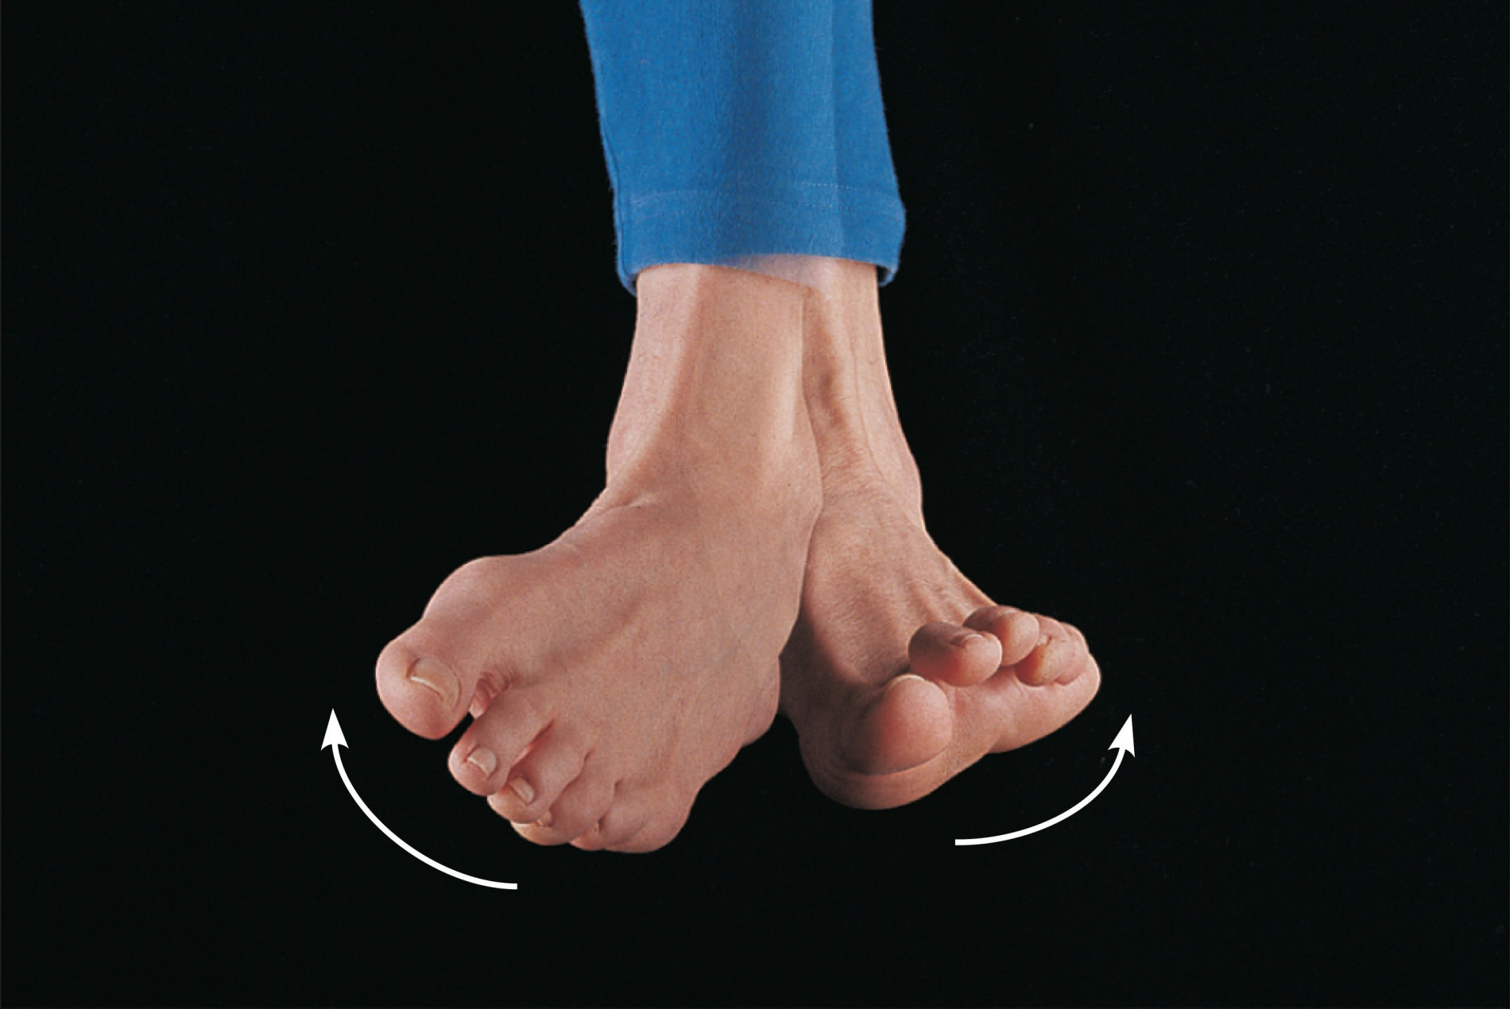
Inversion
Eversion
(c) Inversion and eversion
Figure 8.6c

Slide 49
Special Movements
Movements in a transverse plane:
  Protraction (anterior movement)
  Retraction (posterior movement)

Slide 50
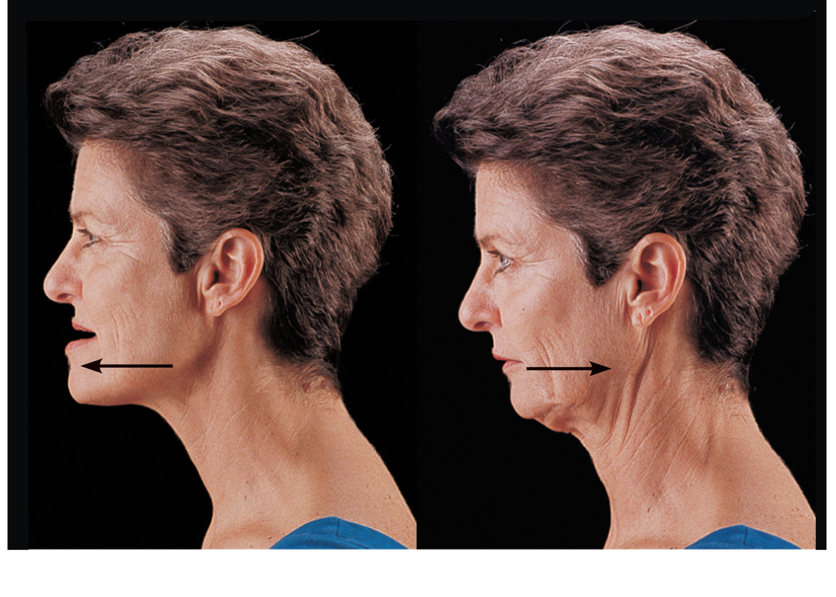
Protraction
of mandible
Retraction
of mandible
(d) Protraction and retraction
Figure 8.6d

Slide 51
Special Movements
Elevation (lifting a body part superiorly)
Depression (moving a body part inferiorly)

Slide 52
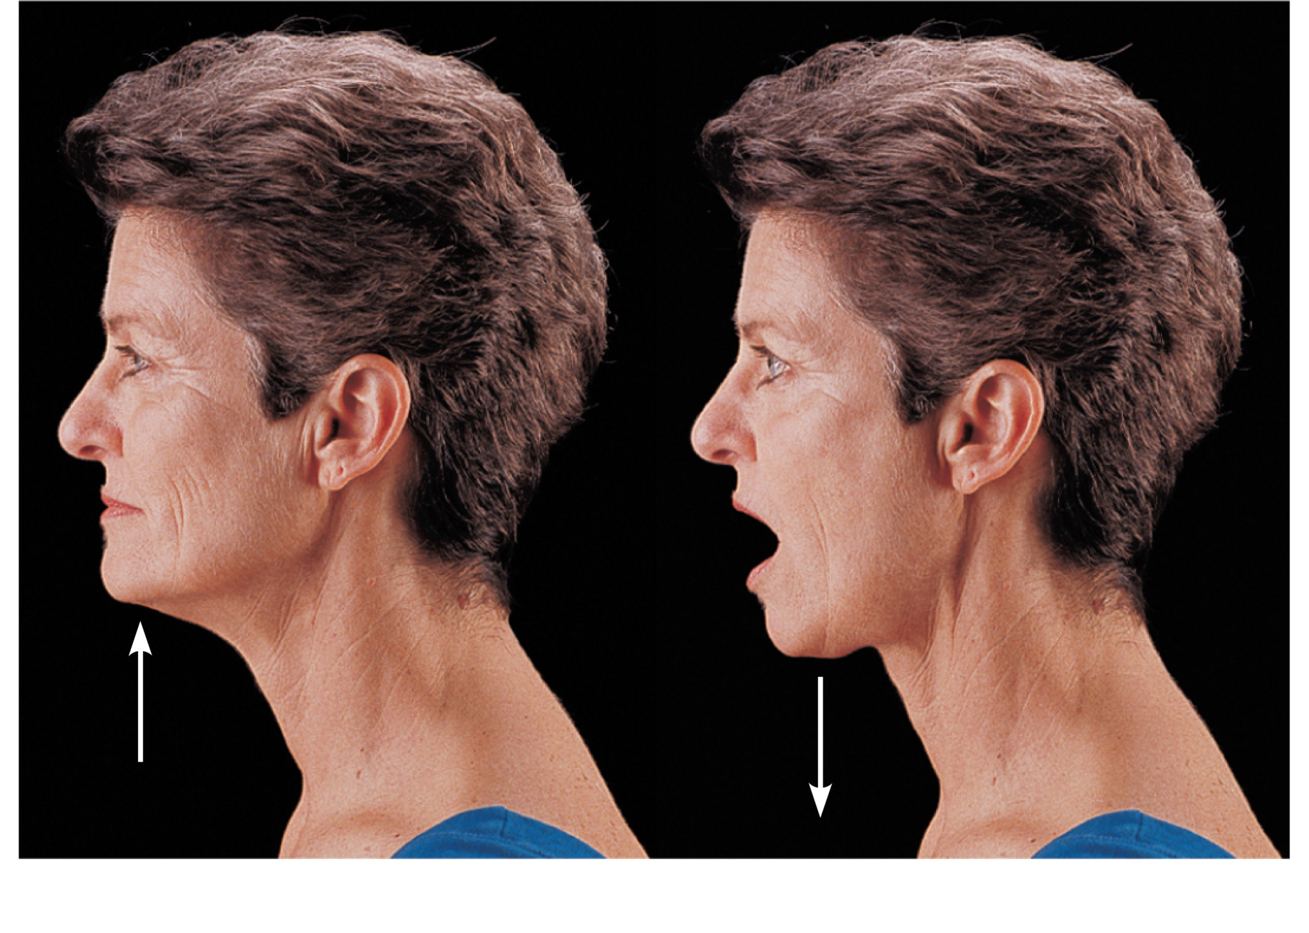
Elevation
of mandible
Depression
of mandible
(e) Elevation and depression
Figure 8.6e

Slide 53
Special Movements
Opposition of the thumb
  Movement in the saddle joint so that the thumb touches the tips of the other fingers

Slide 54
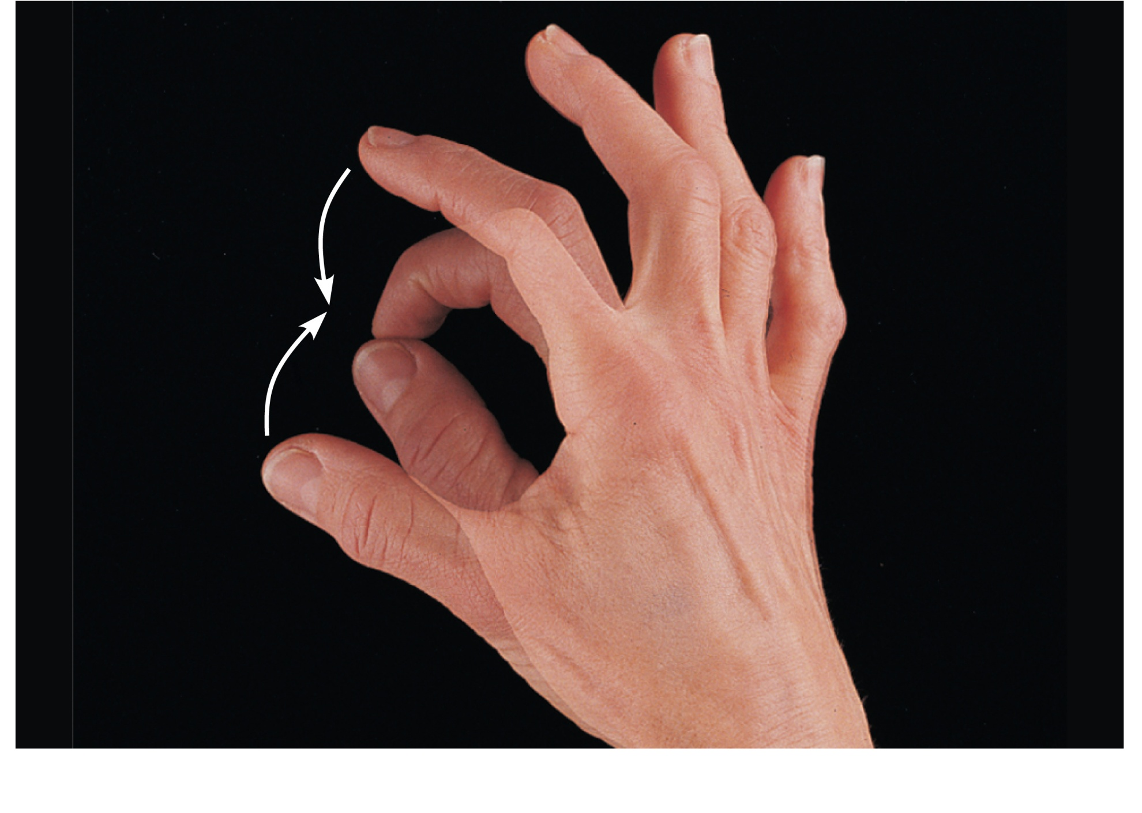
Opposition
(f) Opposition
Figure 8.6f

