Slide 1
7
The Skeleton: Part B

Slide 2
Vertebral Column
Transmits weight of trunk to lower limbs
Surrounds and protects spinal cord
Flexible curved structure containing 26 irregular bones (vertebrae)
  Cervical vertebrae (7)—vertebrae of the neck
  Thoracic vertebrae (12)—vertebrae of the thoracic cage
  Lumbar vertebrae (5)—vertebra of the lower back
  Sacrum—bone inferior to the lumbar vertebrae
  Coccyx—terminus of vertebral column

Slide 3
Vertebral Column: Curvatures
Increase the resilience and flexibility of the spine
  Two posteriorly concave curvatures
    Cervical and lumbar
  Two posteriorly convex curvatures
    Thoracic and sacral
Abnormal spine curvatures
  Scoliosis (abnormal lateral curve)
  Kyphosis (hunchback)
  Lordosis (swayback)

Slide 4
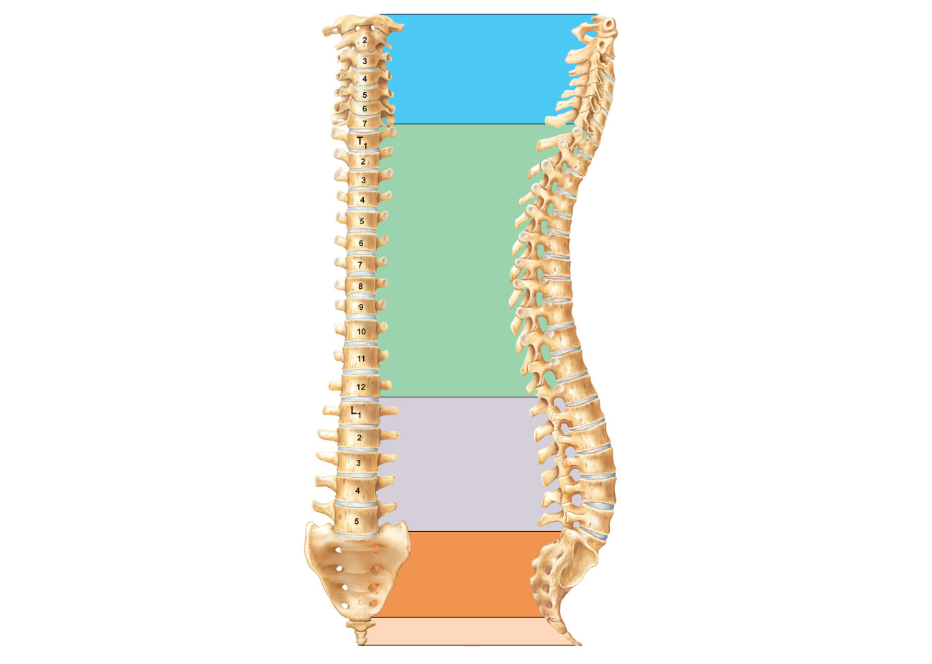
C₁
Cervical curvature
(concave)
7 vertebrae, C₁–C₇
Spinous
process
Transverse
processes
Thoracic
curvature
(convex)
12 vertebrae,
T₁–T₁₂
Intervertebral
discs
Intervertebral
foramen
Lumbar curvature
(concave)
5 vertebrae, L₁–L₅
Sacral curvature
(convex)
5 fused vertebrae
sacrum
Coccyx
4 fused vertebrae
Anterior view
Right lateral view
Figure 7.16

Slide 5
Ligaments
Anterior and posterior longitudinal ligaments
  From neck to sacrum
Ligamentum flavum
  Connects adjacent vertebrae
Short ligaments
  Connect each vertebra to those above and below

Slide 6
Intervertebral Discs
Cushionlike pad composed of two parts
  Nucleus pulposus
    Inner gelatinous nucleus that gives the disc its elasticity and compressibility
  Anulus fibrosus
    Outer collar composed of collagen and fibrocartilage

Slide 7
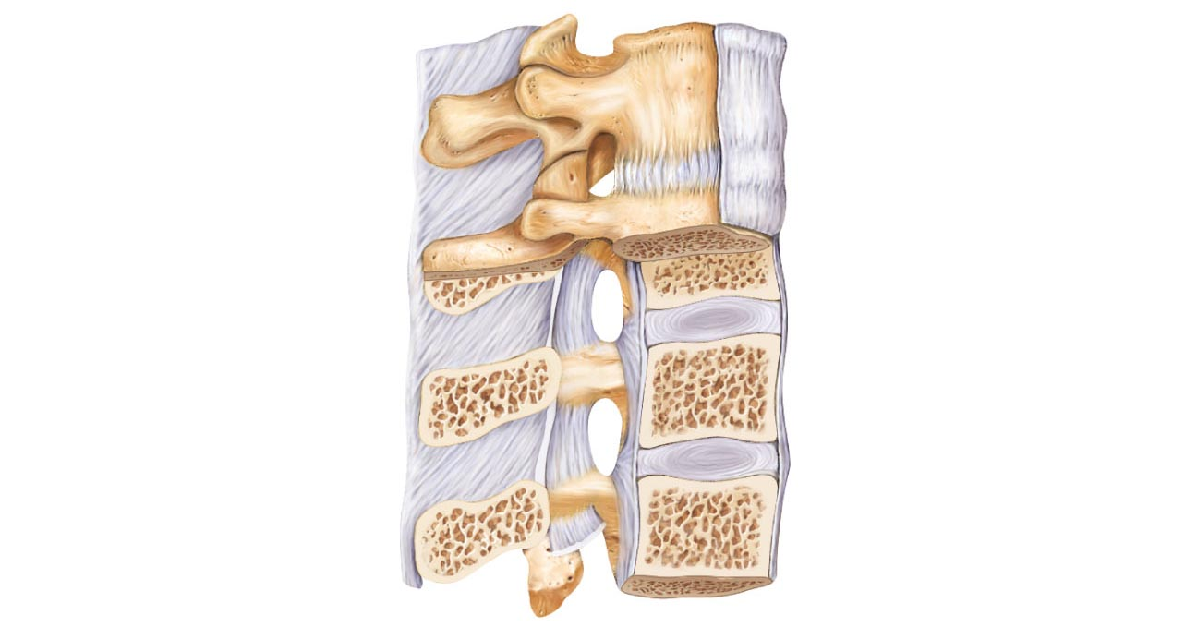
Intervertebral
disc
Supraspinous ligament
Transverse process
Anterior
longitudinal
ligament
Sectioned
spinous process
Intervertebral foramen
Ligamentum flavum
Posterior longitudinal
ligament
Interspinous
ligament
Anulus fibrosus
Nucleus pulposus
Inferior articular process
Sectioned body
of vertebra
Median section of three vertebrae, illustrating the composition
of the discs and the ligaments
Figure 7.17a

Slide 8
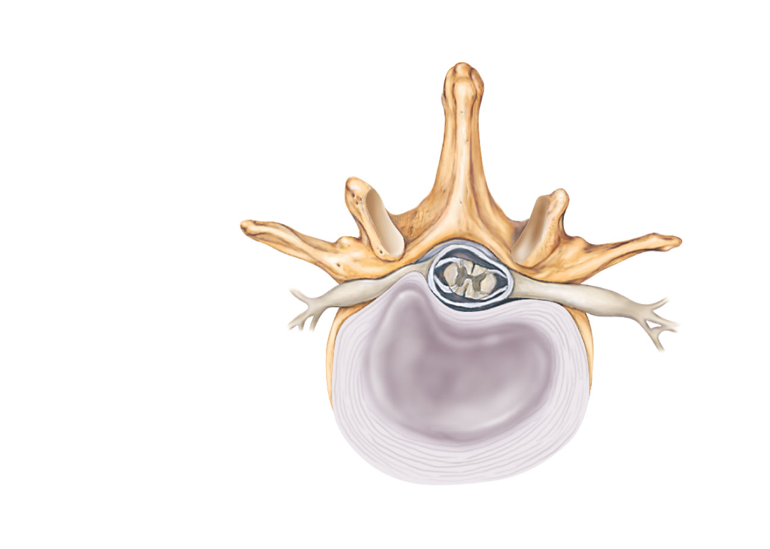
Vertebral spinous process
(posterior aspect of vertebra)
Spinal cord
Spinal nerve root
Transverse
process
Herniated portion
of disc
Anulus fibrosus
of disc
Nucleus
pulposus
of disc
(c) Superior view of a herniated intervertebral disc
Figure 7.17c

Slide 9
General Structure of Vertebrae
Body or centrum
  Anterior weight-bearing region
Vertebral arch
  Composed of pedicles and laminae that, along with centrum, enclose vertebral foramen
Vertebral foramina
  Together make up vertebral canal for spinal cord
Intervertebral foramina
  Lateral openings between adjacent vertebrae for spinal nerves

Slide 10
General Structure of Vertebrae
Seven processes per vertebra:
  Spinous process—projects posteriorly
  Transverse processes (2)—project laterally
  Superior articular processes (2)—protrude superiorly inferiorly
  Inferior articular processes (2)—protrude inferiorly
PLAY
Animation: Rotatable Spine (horizontal)
PLAY
Animation: Rotatable Spine (vertical)

Slide 11
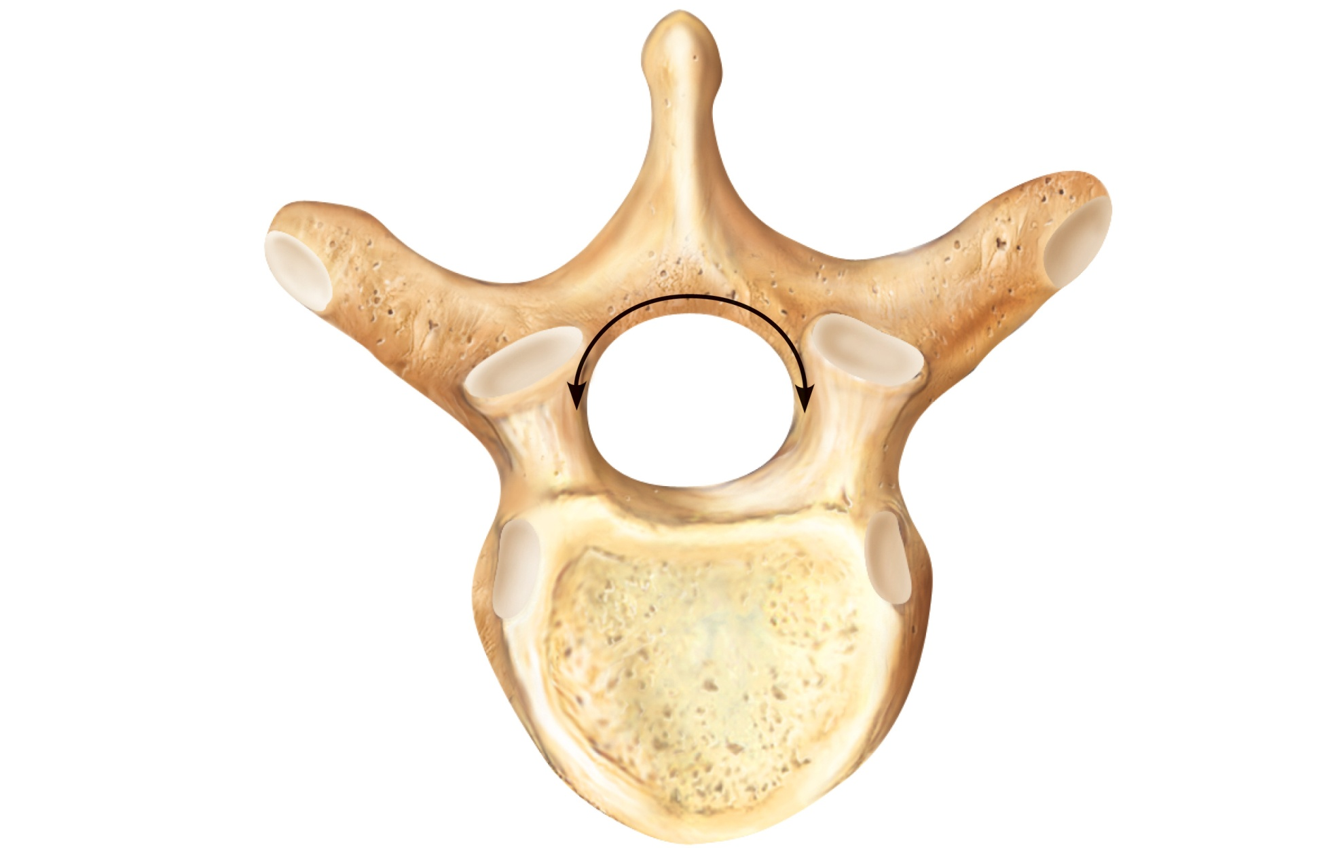
Posterior
Lamina
Vertebral
arch
Spinous
process
Transverse
process
Superior
articular
process
and
facet
Vertebral
foramen
Pedicle
Body
(centrum)
Anterior
Figure 7.18

Slide 12
Cervical Vertebrae
C₁ to C₇: smallest, lightest vertebrae
C₃ to C₇ share the following features
  Oval body
  Spinous processes are bifid (except C₇)
  Large, triangular vertebral foramen
  Transverse foramen in each transverse process

Slide 13
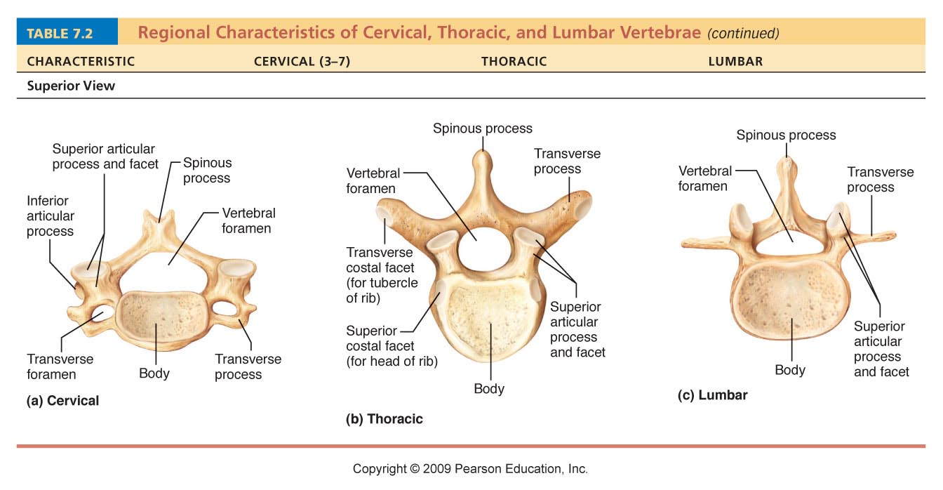
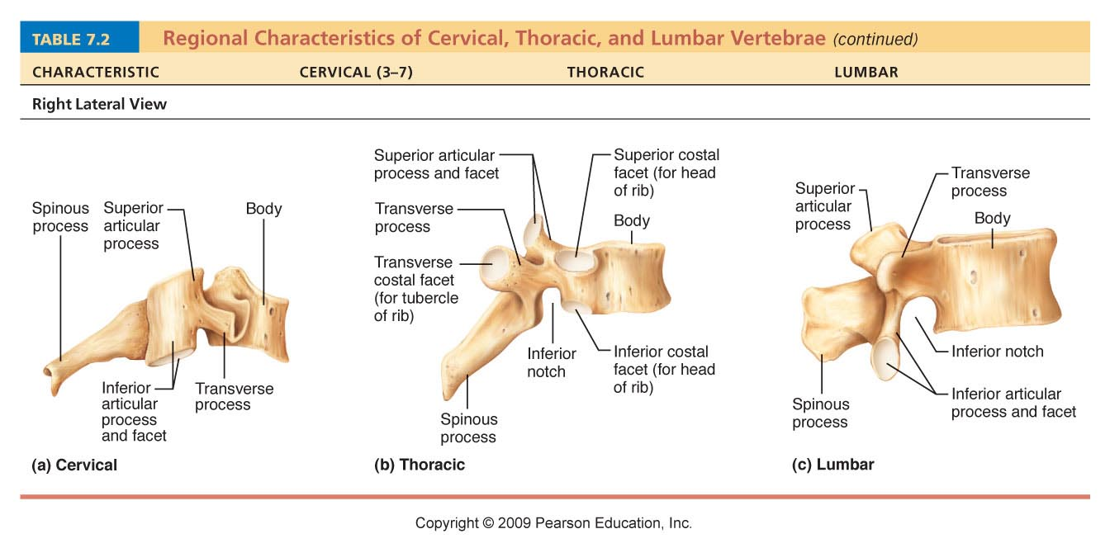
Table 7.2

Slide 14
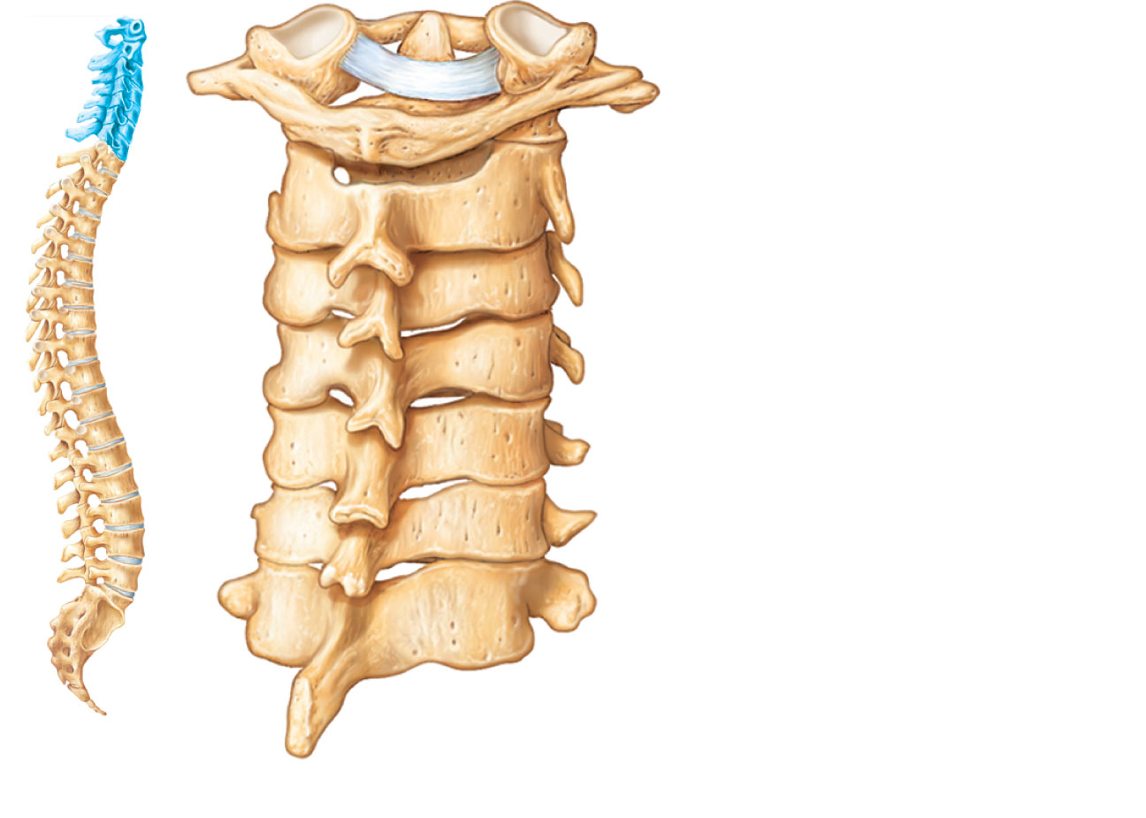
Dens of axis
Transverse ligament
of atlas
C₁ (atlas)
C₂ (axis)
C₃
Inferior articular
process
Bifid spinous
process
Transverse processes
C₇ (vertebra
prominens)
(a) Cervical vertebrae
Figure 7.20a

Slide 15
Cervical Vertebrae
C₁ (atlas) and C₂ (axis) have unique features
Atlas (C₁)
  No body or spinous process
  Consists of anterior and posterior arches, and two lateral masses
  Superior surfaces of lateral masses articulate with the occipital condyles

Slide 16
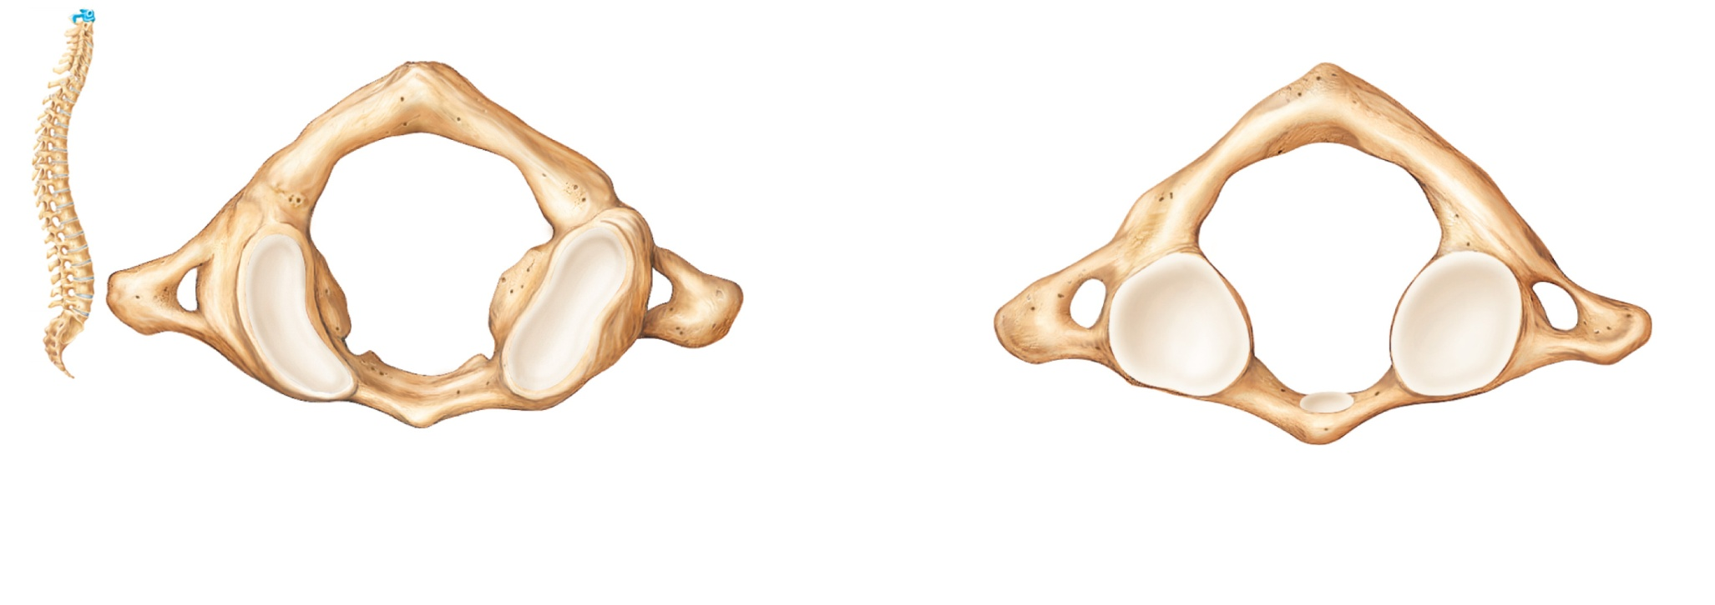
C₁
Posterior
Posterior
Posterior
tubercle
Posterior
tubercle
Posterior arch
Posterior arch
Inferior
articular
facet
Lateral
masses
Transverse
process
Lateral
masses
Transverse
foramen
Superior
articular
facet
Transverse
foramen
Anterior
arch
Anterior arch
Anterior
tubercle
Facet for dens
Anterior tubercle
(a) Superior view of atlas (C₁)
(b) Inferior view of atlas (C₁)
Figure 7.19a-b

Slide 17
Cervical Vertebrae
Axis (C₂)
  Dens projects superiorly into the anterior arch of the atlas
  Dens is a pivot for the rotation of the atlas

Slide 18
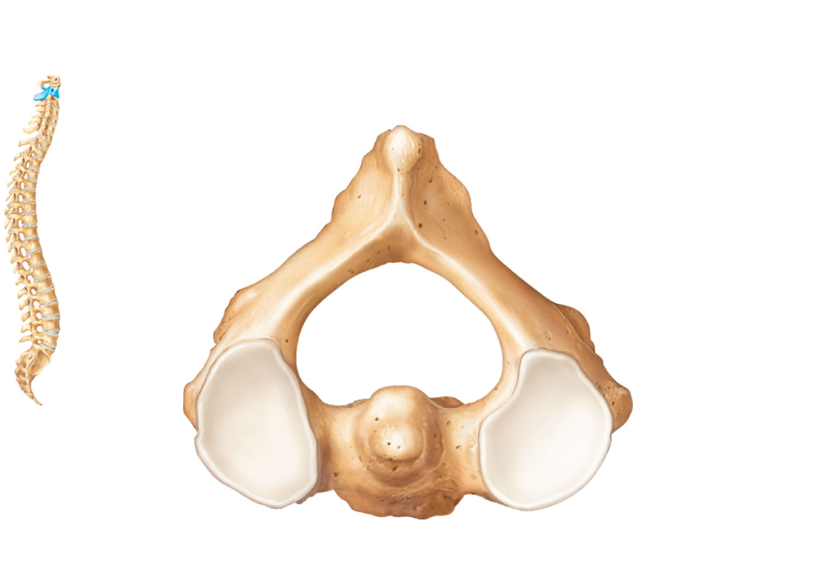
Posterior
C₂
Spinous process
Inferior
articular
process
Lamina
Pedicle
Superior
articular
facet
Transverse
process
Dens
Body
(c) Superior view of axis (C₂)
Figure 7.19c

Slide 19
Thoracic Vertebrae
T₁ to T₁₂
All articulate with ribs at facets and demifacets
Long spinous process
Location of articular facets allows rotation of this area of spine

Slide 20
Table 7.2

Slide 21
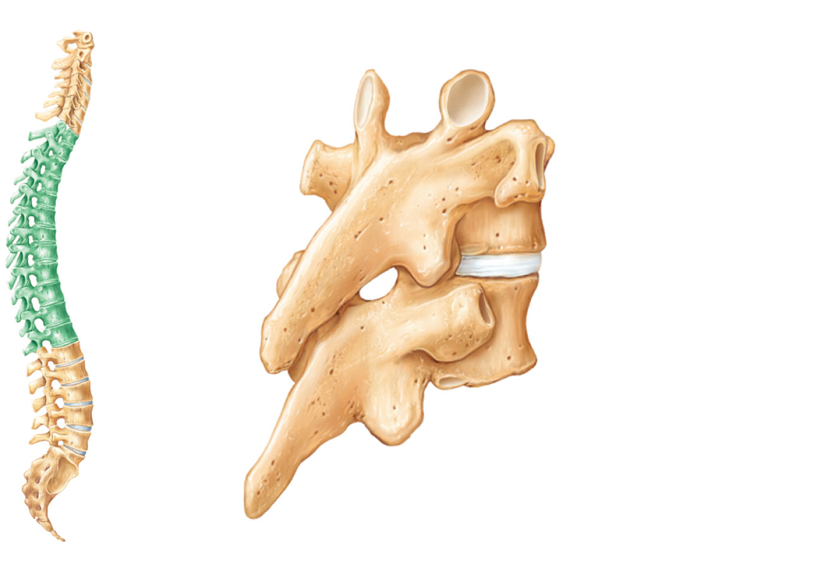
Superior articular
process
Transverse
process
Transverse
costal facet (for
tubercle of rib)
Intervertebral
disc
Body
Inferior costal
facet (for head
of rib)
Spinous
process
Inferior articular
process
(b) Thoracic vertebrae
Figure 7.20b

Slide 22
Lumbar Vertebrae
L₁ to L₅
Short, thick pedicles and laminae
Flat hatchet-shaped spinous processes
Orientation of articular facets locks lumbar vertebrae together so as to prevent rotation

Slide 23
Table 7.2

Slide 24
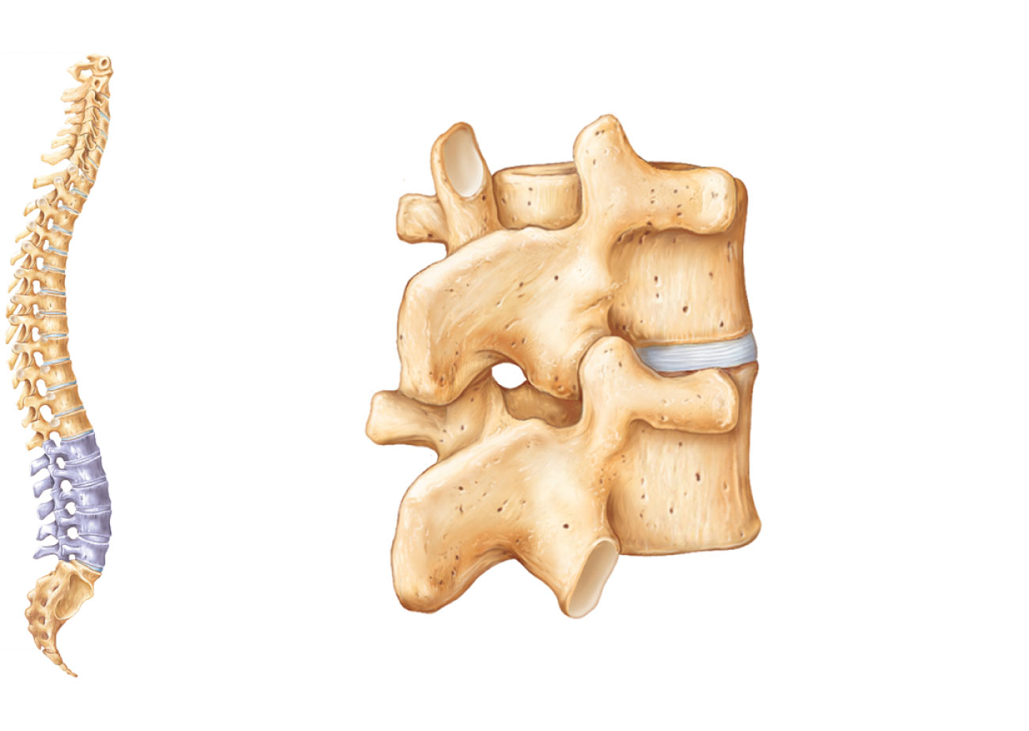
Superior
articular
process
Transverse
process
Body
Intervertebral
disc
Inferior
articular
process
Spinous
process
(c) Lumbar vertebrae
Figure 7.20c

Slide 25
Sacrum and Coccyx
Sacrum
  5 fused vertebrae (S₁–S₅)
  Forms posterior wall of pelvis
  Articulates with L₅ superiorly, and with auricular surfaces of the hip bones laterally
Coccyx
  Tailbone
  3–5 fused vertebrae
  Articulates superiorly with sacrum

Slide 26
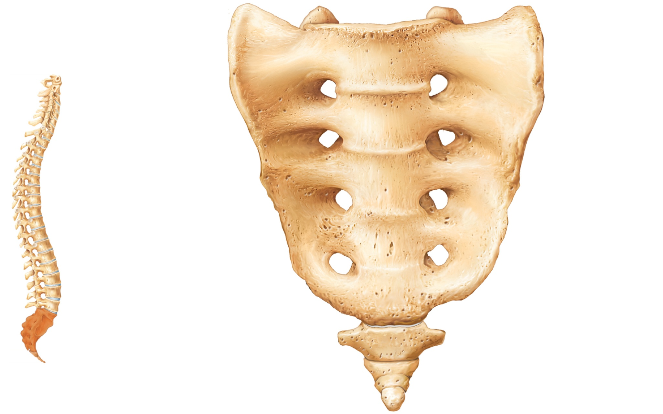
Sacral promontory
Ala
Body of
first
sacral
vertebra
Transverse
ridges (sites
of vertebral
fusion)
Anterior
sacral
foramina
Apex
Coccyx
(a) Anterior view
Figure 7.21a

Slide 27
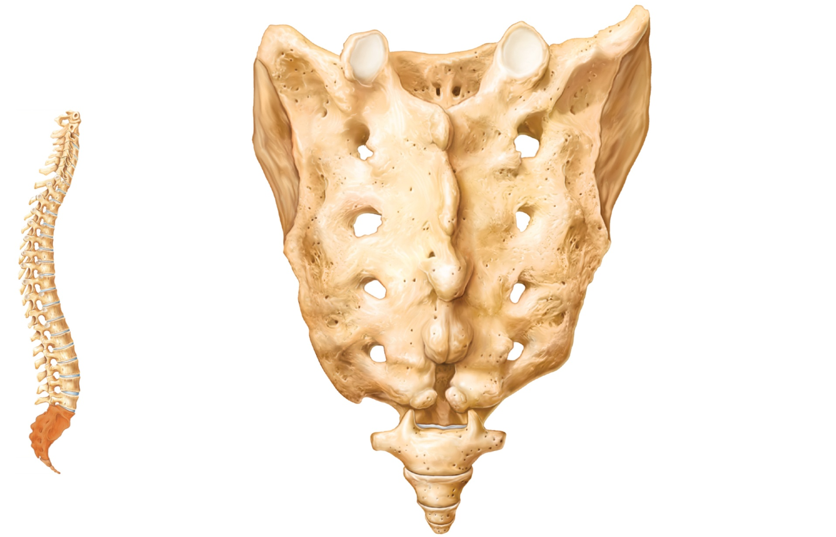
Sacral
canal
Body
Facet of
superior
articular
process
Ala
Auricular
surface
Median
sacral
crest
Lateral
sacral
crest
Posterior
sacral
foramina
Sacral
hiatus
Coccyx
(b) Posterior view
Figure 7.21b

Slide 28
Thoracic Cage
Composed of
  Thoracic vertebrae
  Sternum
  Ribs and their costal cartilages
Functions
  Protects vital organs of thoracic cavity
  Supports shoulder girdle and upper limbs
  Provides attachment sites for many muscles, including intercostal muscles used during breathing

Slide 29
Sternum (Breastbone)
Three fused bones
  Manubrium
    Articulates with clavicles and ribs 1 and 2
  Body
    Articulates with costal cartilages of ribs 2 through 7
  Xiphoid process
    Site of muscle attachment
    Not ossified until ~ age 40

Slide 30
Ribs and Their Attachments
12 pairs
All attach posteriorly to thoracic vertebrae
Pairs 1 through 7
  True (vertebrosternal) ribs
  Attach directly to the sternum by individual costal cartilages

Slide 31
Ribs and Their Attachments
Pairs 8 through12
  False ribs
  Pairs 8–10 also called vertebrochondral ribs
    Attach indirectly to sternum by joining costal cartilage of rib above
  Pairs 11–12 also called vertebral (floating) ribs
    No attachment to sternum

Slide 32
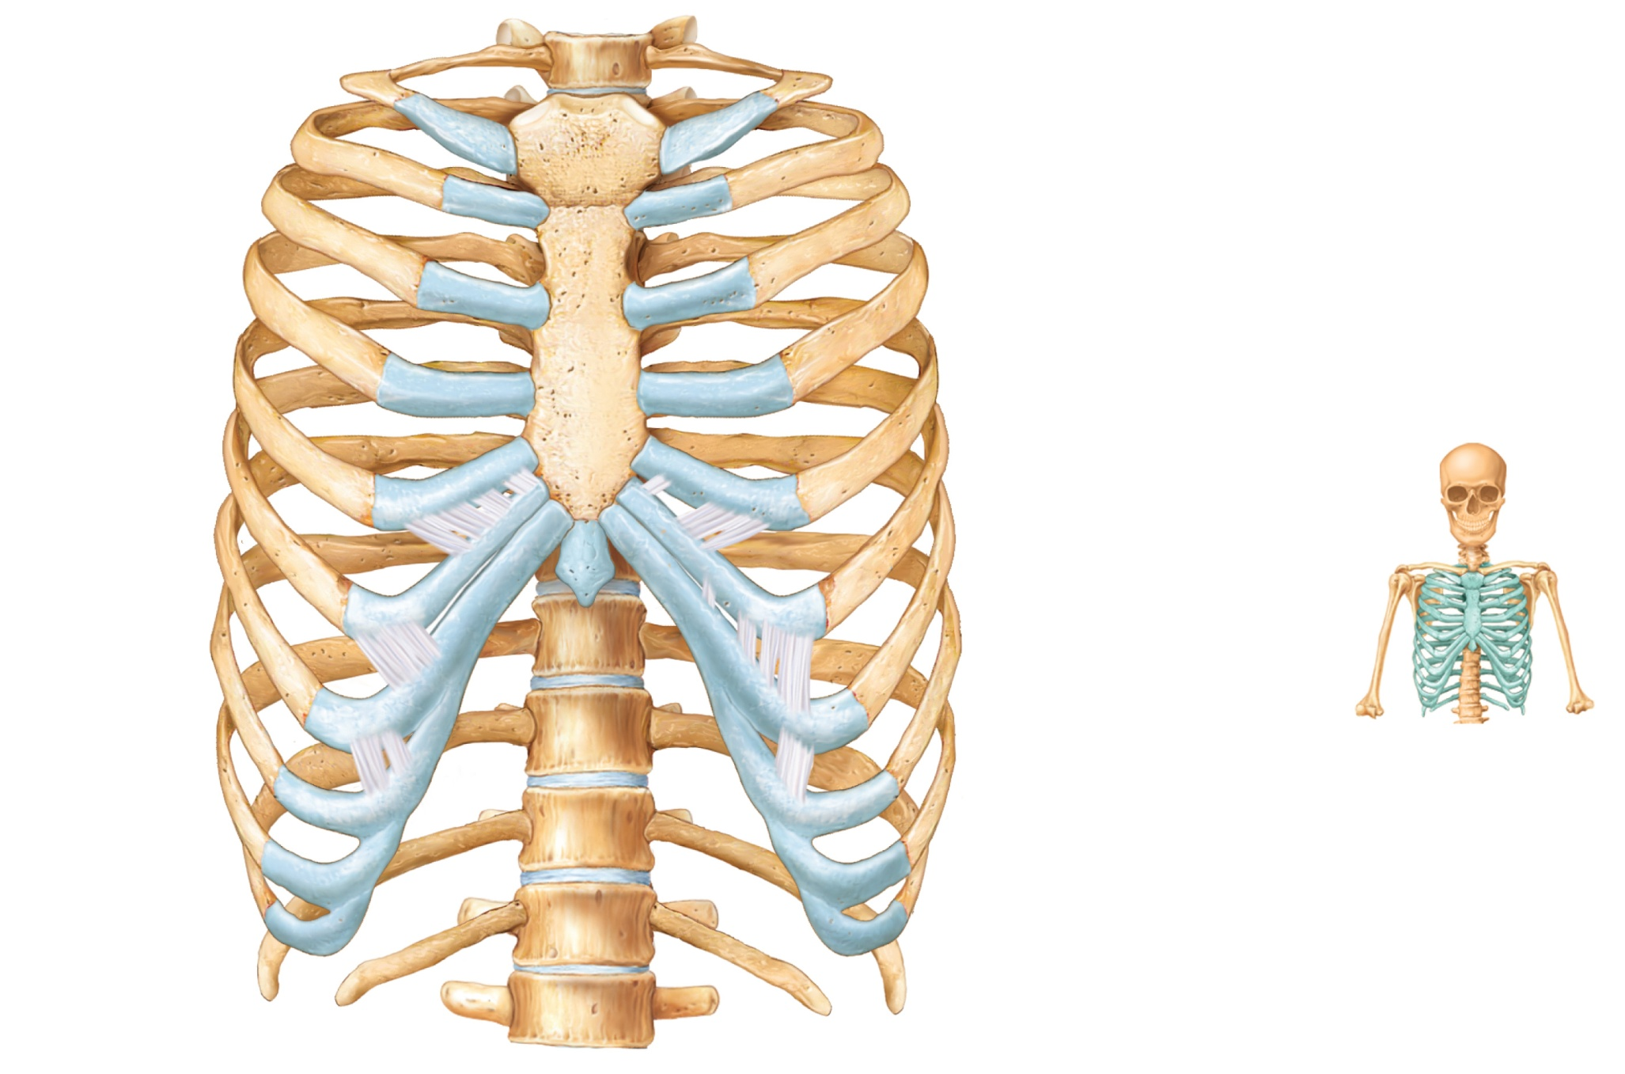
Jugular notch
Clavicular notch
Manubrium
Sternal angle
Body
Sternum
True
ribs
(1–7)
Xiphisternal
joint
Xiphoid
process
False
ribs
(8–12)
Intercostal spaces
Costal cartilage
Costal margin
L₁
Vertebra
Floating ribs (11, 12)
(a) Skeleton of the thoracic cage, anterior view
Figure 7.22a

Slide 33
Structure of a Typical Rib
Main parts:
  Head
    Articulates posteriorly with facets (demifacets) on bodies of two adjacent vertebrae
  Neck
  Tubercle
    Articulates posteriorly with transverse costal facet of same-numbered thoracic vertebra
  Shaft

Slide 34
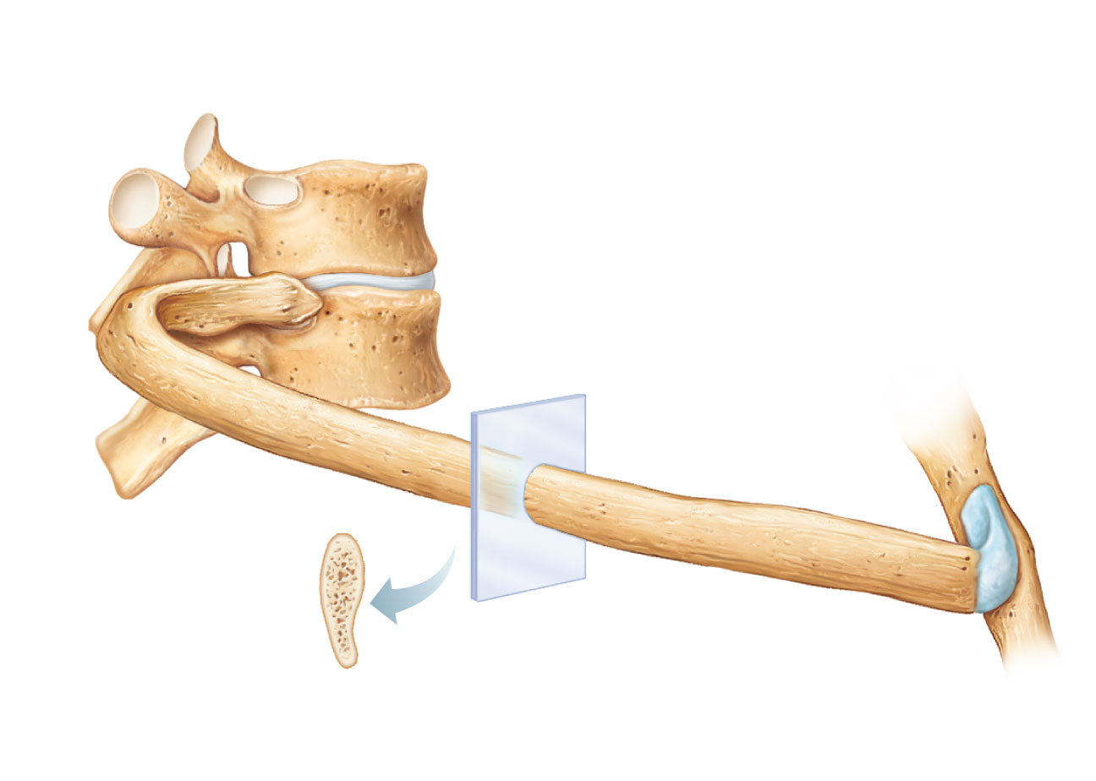
Transverse costal facet
(for tubercle of rib)
Superior costal facet
(for head of rib)
Angle
of rib
Body of vertebra
Head of rib
Intervertebral disc
Neck of rib
Tubercle of rib
Shaft
Sternum
Cross-
section
of rib
Costal groove
Costal cartilage
(a) Vertebral and sternal articulations of a
typical true rib
Figure 7.23a

Slide 35
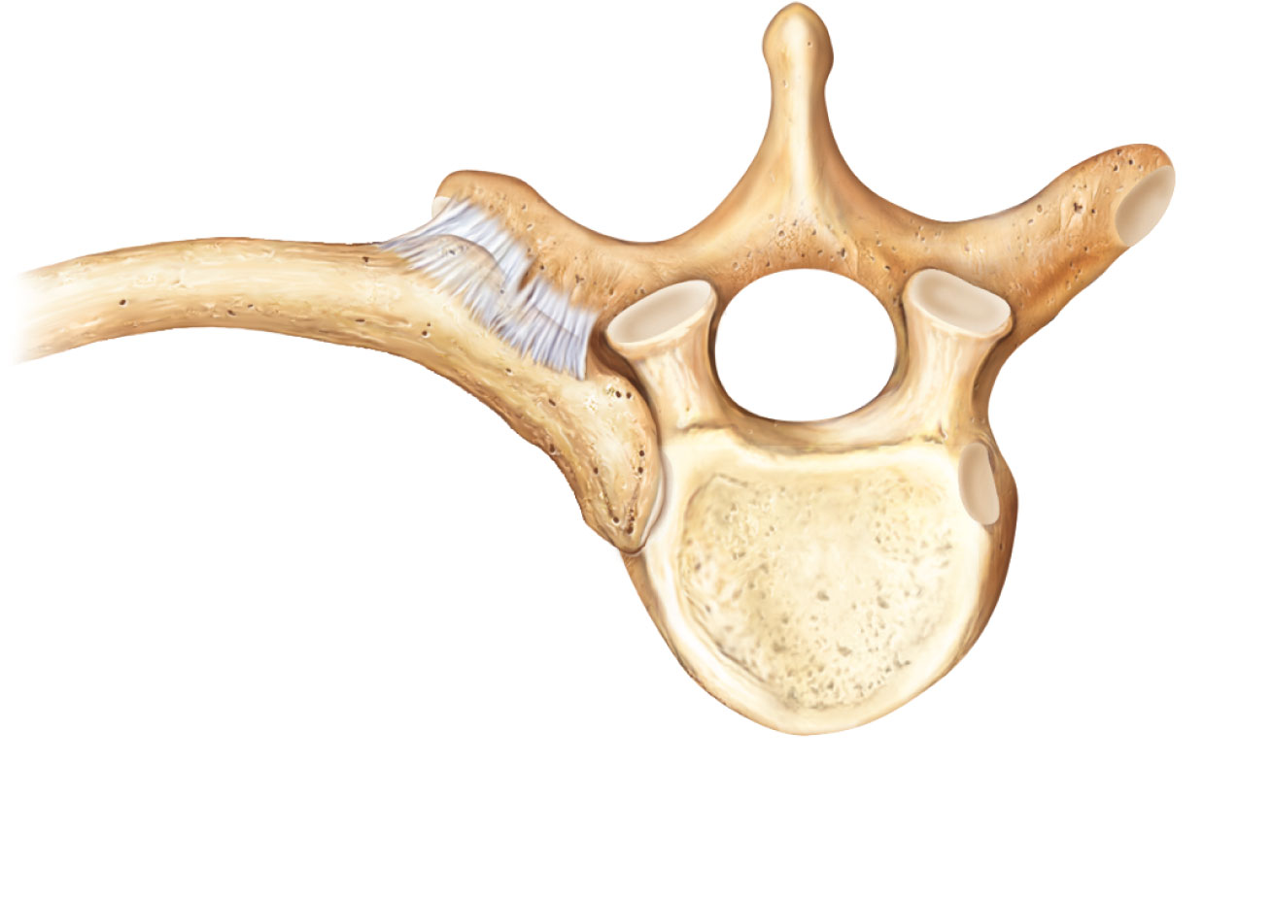
Articular facet
on tubercle of rib
Spinous process
Shaft
Transverse
costal facet
(for tubercle
of rib)
Ligaments
Neck of rib
Body of
thoracic
vertebra
Head of rib
Superior costal facet
(for head of rib)
(b) Superior view of the articulation between a
rib and a thoracic vertebra
Figure 7.23b

