Slide 1
DNA in a Cell and how is it arranged!
Mike Clark, M.D.

Slide 2
Amount of Genetic Material in a Cell
Before we discuss mitosis or meiosis – let’s examine how much genetic material is in a cell.
There are two divisions of cells in the human body- somatic cells and gametes (sex cells)
Somatic cells have twice the amount of genetic material of the gametes

Slide 3
Somatic Cells
Somatic cells are all the human body cells except the gametes
Somatic cells have 46 pieces of genetic material (46 DNA pieces) – organized into 23 pairs
23 pieces (one set) of the genetic material was given to your cells by your mother and the other 23 pieces (the other set) was given to you by your father

Slide 4
How do we identify a set of Genetic Material
Most authors say that we have 46 chromosomes – which is true – but if you notice I use the term genetic material rather than chromosome because remember that a chromosome is a certain folding pattern of the DNA – thus not always is the DNA folded into the chromosome fold – as a matter of fact most of the time it is not folded into the chromosome fold.

Slide 5
DNA Folding in a Cell
The average human cell nucleus has a diameter of approximately 5 micrometers (5 x 10 ⁻⁶ meter or 5 millionths of a meter)
If we stretch out the DNA in a somatic cell in the human – it is approximately 2 meters in length – so you can see we need a heck of a good folding system for the DNA. The DNA must be folded good so it can be read properly.

Slide 6
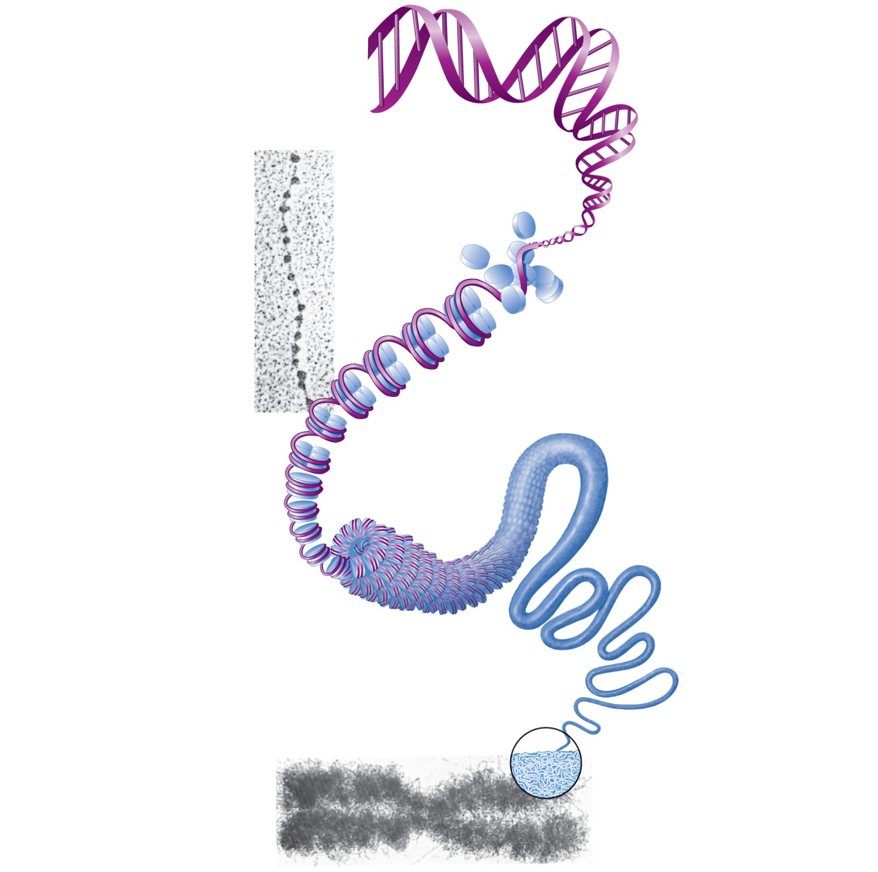
1
DNA double
helix (2-nm diameter)
2
Histones
Chromatin
(“beads on a
string”) structure
with nucleosomes
Linker DNA
Nucleosome (10-nm diameter; eight
histone proteins wrapped by two
winds of the DNA double helix)
(a)
3
Tight helical fiber
(30-nm diameter)
4
Looped domain
structure (300-nm
diameter)
5
Chromatid
(700-nm diameter)
Metaphase
chromosome
(at midpoint
of cell division)
(b)
Figure 3.30

Slide 7
Examination of Genetic Material
The chromosome is thick enough to be seen using the light microscope
The genetic material (DNA) is folded into the chromosome fold during the M-phase (mitosis or meiosis) of the cell divisional cycle.
The genetic material folds from the loop domain fold (too thin to be seen under light microscope) to the chromosome fold during the phases of prophase and metaphase – which are subdivisions of the cell’s M-phase
These prophase and metaphase stages will be discussed in the lecture on mitosis

Slide 8
How are the different chromosomes distinguished?
Human chromosomes must be determined one from another because each chromosome carries a different set of vital genes – lose a chromosome and lose those genes – thus lose the ability to make those necessary proteins
Scientist have assigned the various chromosomes certain numbers
Chromosomes are numbered 1 – 23
The 23rd chromosomes are the sex chromosomes (X versus Y) – the first 22 chromosomes are termed “autosomes”

Slide 9
Sets of Chromosomes in Human Cells
A karyotype is an ordered display of the pairs of chromosomes from a cell
The two chromosomes in each pair are called homologous chromosomes, or homologs – non-identical are termed “heterologous pairs”
Chromosomes in a homologous pair are the same length and carry genes controlling the same inherited characters
A different chromosomes are identified and classified in accordance with their individual (1) lengths (2) centromere positions and (3) unique staining patterns

Slide 10
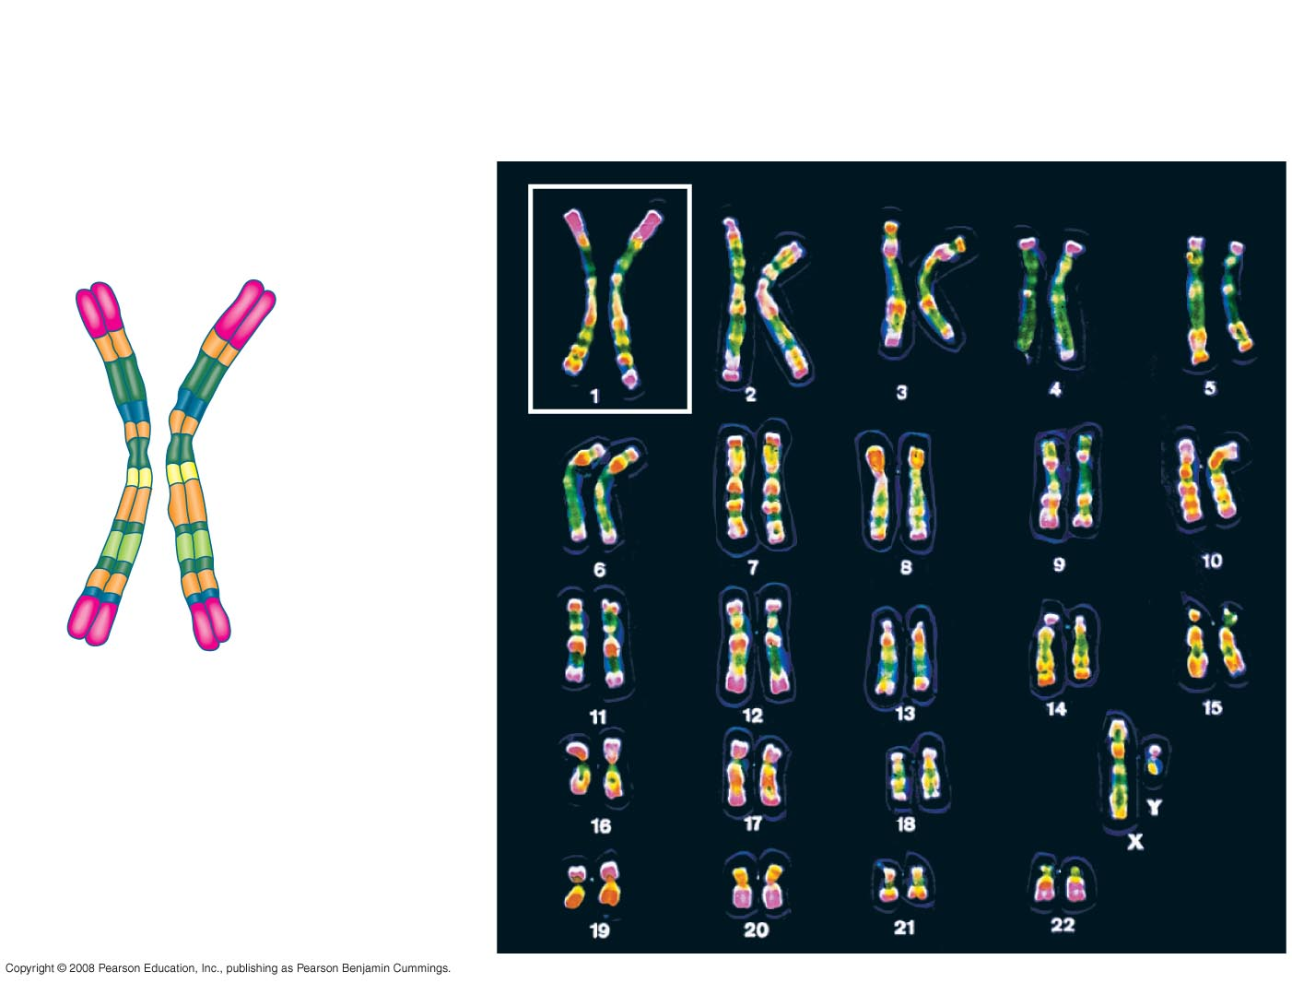
Fig. 13-3b
TECHNIQUE
5 µm
Pair of homologous
replicated chromosomes
Centromere
Sister
chromatids
Metaphase
chromosome
Notes:
Figure 13.3 Preparing a karyotype

Slide 11
Ploidy
Ploidy refers to a full set of chromosomes – a full set can also be represented by the letter n
Thus one ploidy would relate to one complete set of chromosomes (23) with one representative chromosome from each of the 23 different types – a representative from chromosome one, a representative from chromosome two – as so on till a representative from all 23.
A somatic cell is diploid (2n) with two full sets of genetic material (one set from dad and one from mom)
A gamete has ½ the amount of genetic material as a somatic cell – it is termed haploid (1n)

Slide 12
Karyotype
A karyotype is an ordered display of the pairs of chromosomes from a cell
The two chromosomes in each pair are called homologous chromosomes, or homologs

Slide 13
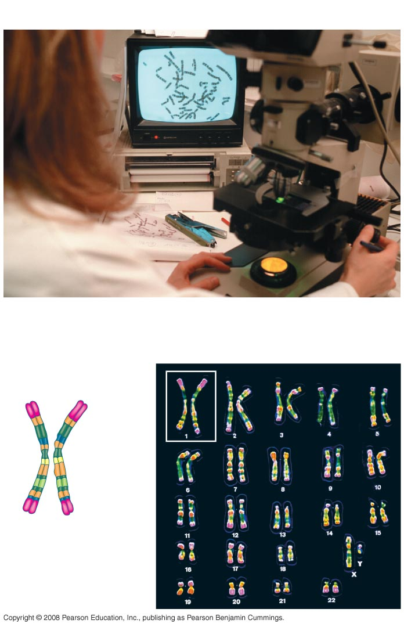
Fig. 13-3
APPLICATION
A Karyotype pictorially displaying
all of the chromosomes in a somatic cell.
TECHNIQUE
5 µm
Pair of homologous
replicated chromosomes
Centromere
Sister
chromatids
Metaphase
chromosome
Notes:
Figure 13.3 Preparing a karyotype

Slide 14
Fig. 13-3b
TECHNIQUE
5 µm
Pair of homologous
replicated chromosomes
Centromere
Sister
chromatids
Metaphase
chromosome
Notes:
Figure 13.3 Preparing a karyotype

Slide 15
Discussion of a Chromosome/Chromatid
There are two forms of a chromosome
The singlet non-attached type chromosome
The doublet (attached) type –the chromosome/chromatid form
Both forms are termed a chromosome

Slide 16
The doublet type – a chromosome/chromatid
During the S-phase in the cell divisional cycle –DNA is duplicated (as previously discussed)
Immediately after the S-phase (Synthesis phase) in the cell divisional cycle – there is twice as much DNA – each chromosome is duplicated
The new duplicate and the original stay temporarily attached to one another–thus two pieces of DNA remain temporarily attached
Each attached piece of DNA is termed a “chromatid” more especially “sister chromatids”
The two attached chromatids are termed one chromosome

Slide 17
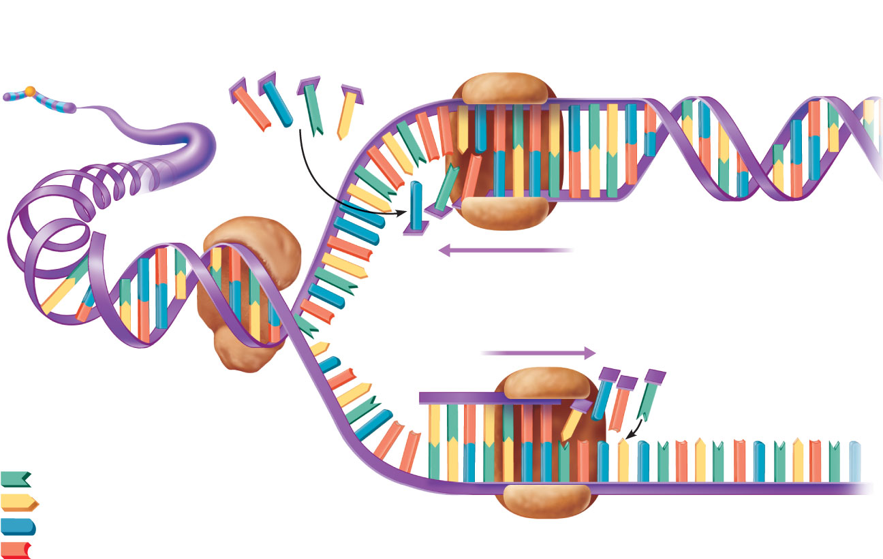
DNA replication is a semi-conservative process. When DNA replicates the two half ladder strands of DNA separate into two strands and the enzyme DNA polymerase assists to build a new complimentary half DNA to the original strand of DNA.
Free nucleotides
DNA polymerase
Old strand acts as a template for synthesis of new strand
Chromosome
Leading strand
Two new strands (leading and lagging)
synthesized in opposite directions
Old DNA
Lagging
strand
Helicase unwinds
the double helix and
exposes the bases
Replication
fork
Adenine
Thymine
Cytosine
DNA polymerase
Old (template) strand
Guanine
Thus when DNA is synthesized – there really is no completely new chromosome because each chromosome is made-up of half of the old chromosome.

Slide 18
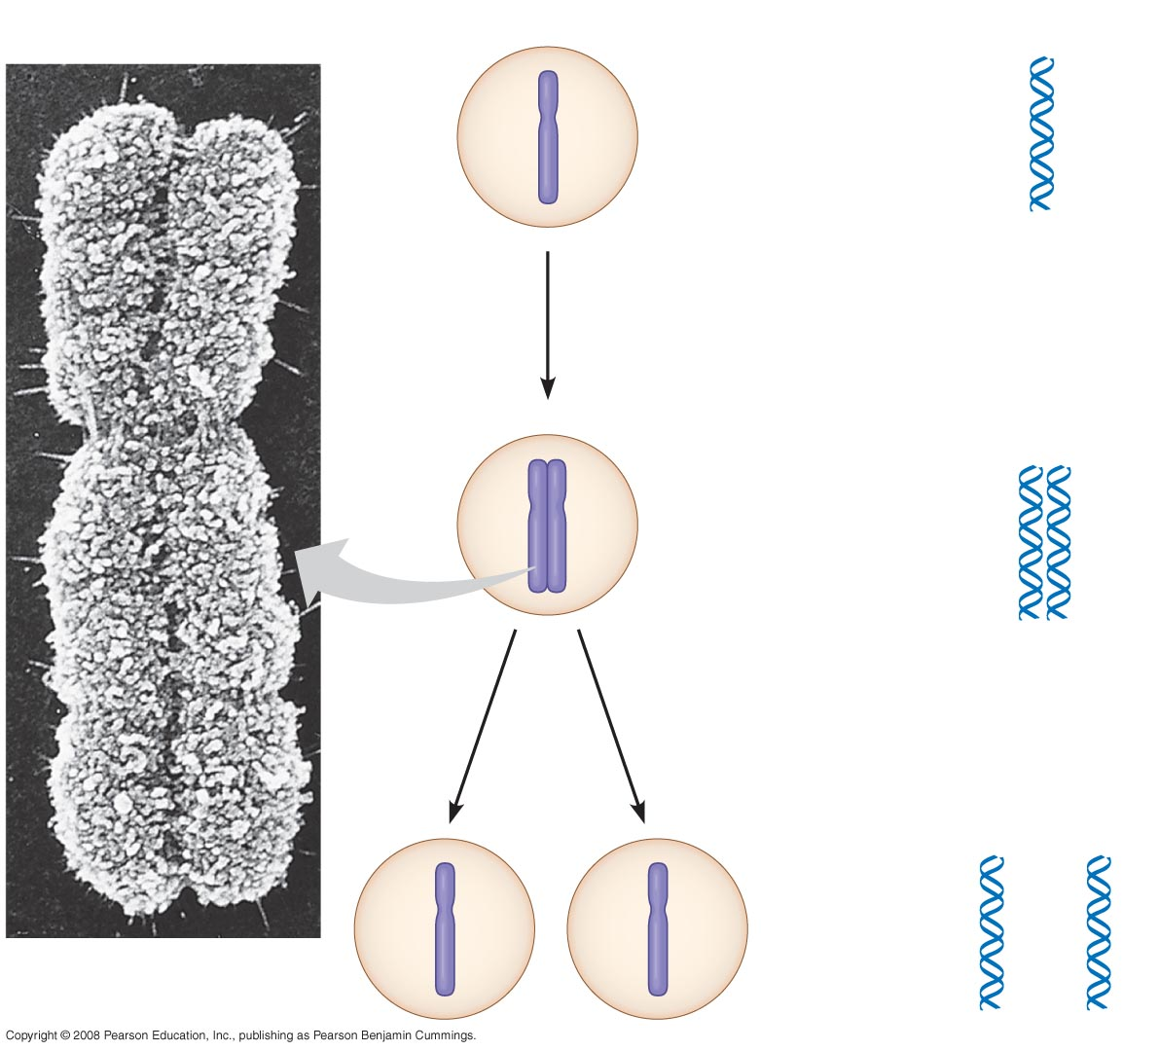
Fig. 12-4
0.5 µm
Chromosomes
DNA molecules
Chromo-
some arm
Duplicated DNA is attached- each is termed a chromatid
Chromosome
duplication
(including DNA
synthesis)
Centromere
Sister
chromatids
Separation of
sister chromatids
Centromere
Sister chromatids
Notes:
Figure 12.4 Chromosome duplication and distribution during cell division

Slide 19
Each attached piece of DNA is termed a “chromatid” more especially “ a sister chromatid” – this is the doublet form of DNA
The two attached chromatids are termed one chromosome
When the two doublets break apart (separate) each of the now split doublets are termed a chromosome – but a singlet version
Thus the term chromatid/chromosome and the term chromosome are a matter of semantics

Slide 20
Fig. 12-4
0.5 µm
Chromosomes
DNA molecules
Centromere holding chromatids
Together.
Duplicates are now separated
each separate piece is also termed a chromosome.
Separation of
sister chromatids by the breaking of the
centromere.
Notes:
Figure 12.4 Chromosome duplication and distribution during cell division

