Slide 1
Mitosis (Exact Cell Duplication)
Mike Clark, M.D.

Slide 2
Mitosis technically is the process that duplicates a cell’s nucleus. The process of mitosis is conventionally divided into four phases:
  Prophase
  Metaphase
  Anaphase
  Telophase
Some researchers divide prophase into an early and late phase and some researchers instead of using a late prophase add another complete phase termed Prometaphase – a phase preceding metaphase that encompasses the actions of late prophase
Cytokinesis is technically the process that divides the cell cytoplasm. A cell can perform mitosis without cytokineses. The cell then becomes multinucleated.
Copyright © 2008 Pearson Education, Inc., publishing as Pearson Benjamin Cummings
Notes:
For the Cell Biology Video Myosin and Cytokinesis, go to Animation and Video Files.

Slide 3
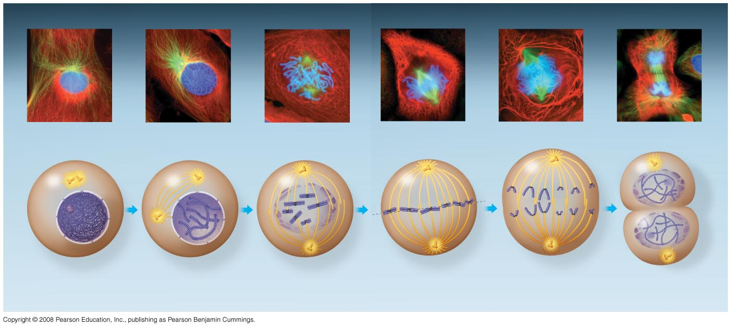
Fig. 12-6
G₂ of Interphase
Prophase
Prometaphase
Metaphase
Anaphase
Telophase and Cytokinesis
Centrosomes
(with centriole
pairs)
Chromatin
(duplicated)
Early mitotic
spindle
Aster
Centromere
Fragments
of nuclear
envelope
Nonkinetochore
microtubules
Metaphase
plate
Cleavage
furrow
Nucleolus
forming
Nucleolus
Nuclear
envelope
Plasma
membrane
Chromosome, consisting
of two sister chromatids
Kinetochore
Kinetochore
microtubule
Spindle
Centrosome at
one spindle pole
Daughter
chromosomes
Nuclear
envelope
forming
Notes:
Figure 12.6 The mitotic division of an animal cell

Slide 4
Prophase
Prophase is the stage in which the cell – a. dissolves its nuclear membrane b. coils its genetic material from the loop domain fold into the chromatid/chromosome fold and c. assembles its mitotic apparatus

Slide 5
Mitotic Apparatus
The mitotic apparatus is a structure that
(a) creates a framework forcing the separation of the genetic material – thus separating the chromatids from a doublet form chromosome into the singlet form and
(b) helps elongate the cell so that it is longer and larger for the purpose of giving each new cell a great deal of cytoplasm and organelles.
The mitotic apparatus is composed of 4 sets microtubules –termed fibers. Each set of microtubules is performing different functions.
(1) Centrioles
(2) Kinetochore Fibers (old name chromosomal fibers
(3) Polar Fibers
(4) Aster Fibers (also termed Aster rays)

Slide 6
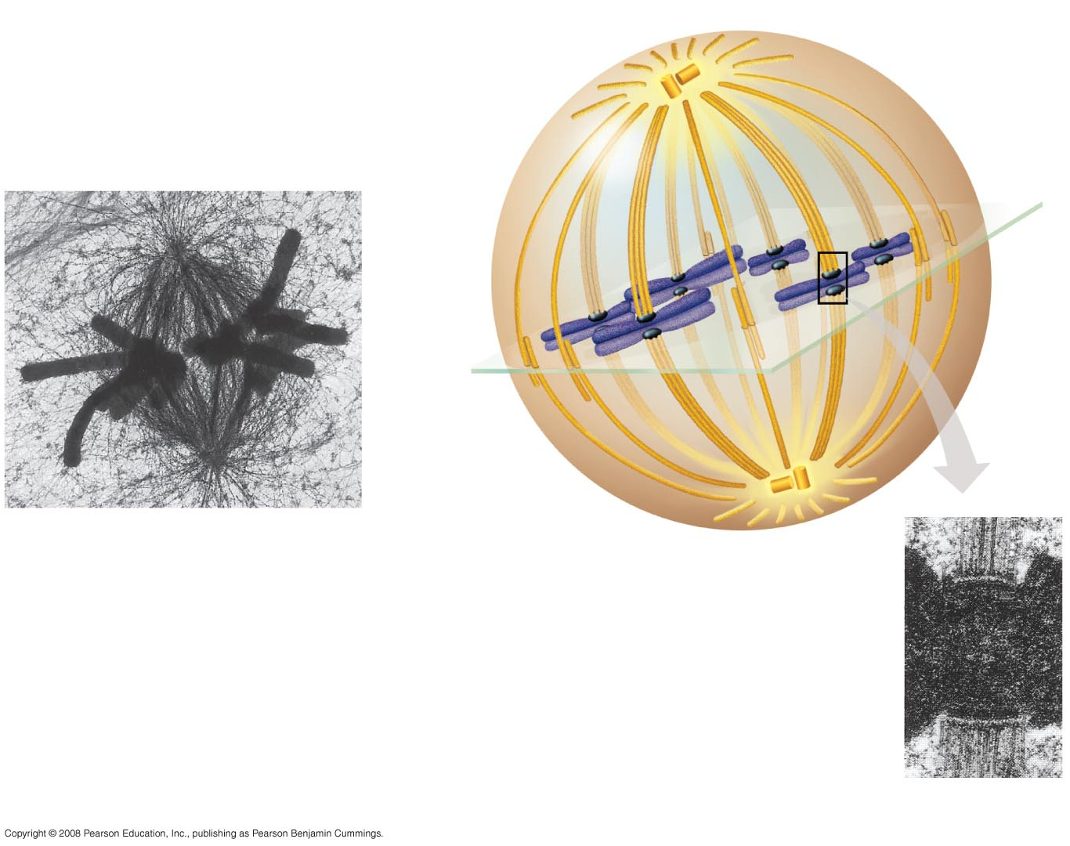
Fig. 12-7
(4) Aster
(1) centrosome
Sister
chromatids
Microtubules
Chromosomes
Metaphase
plate
Kineto-
chores
Centrosome
1 µm
(3) Overlapping polar (non-kinetochore)
microtubules
(2) Kinetochore
microtubules
0.5 µm
Notes:
Figure 12.7 The mitotic spindle at metaphase

Slide 7
Centrosome
The centrosome was discussed earlier
The centrosome (a body in the center of the cell) can be seen using the light microscope.
The centrosome is comprised of two centrioles.
The centrioles are too small and to close together to be resolved (seen by) the light microscope – but can be seen using the electron microscope – which has better resolution (previously discussed)
Furthermore using the electron microscope one can observe that the centrioles are made of microtubules arranged in a specific pattern

Slide 8
Centrosome Function
The centrosome (centrioles) are involved in the organization of the mitotic spindle and in the completion of cytokinesis
The centrosome by virtue of its centrioles are involved in organizing microtubules in the cytoplasm through formation of the Microtubule Organizing Center.
The position of the centriole determines the position of the nucleus and plays a crucial role in the spatial arrangement of cell organelles.

Slide 9
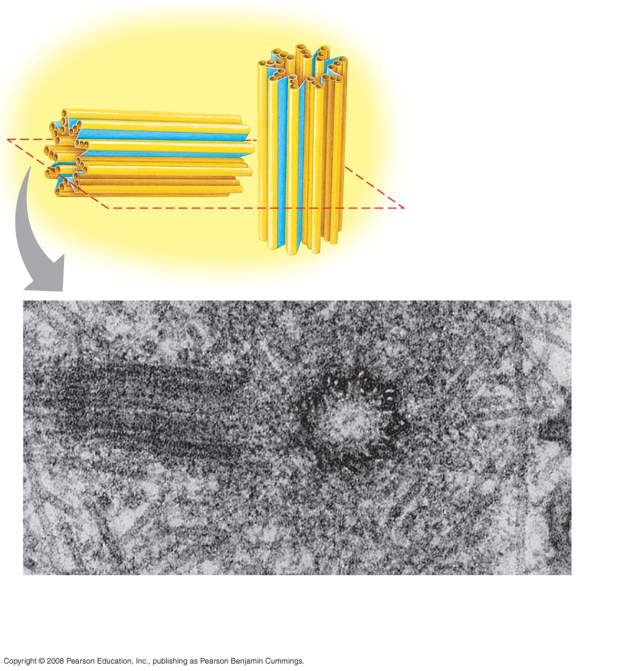
Fig. 6-22
Centrosome
Microtubule
Centrioles
0.25 µm
Longitudinal section of one centriole
Microtubules
Cross section
of the other centriole
Notes:
Figure 6.22 Centrosome containing a pair of centrioles

Slide 10

The centrosome (containing the centrioles) acts as focal point in the cell where microtubules grow out to help hold the cell shape termed the
“microtubule-organizing center”
Radiating out microtubules
Centrosome
Copyright © 2008 Pearson Education, Inc., publishing as Pearson Benjamin Cummings

Slide 11
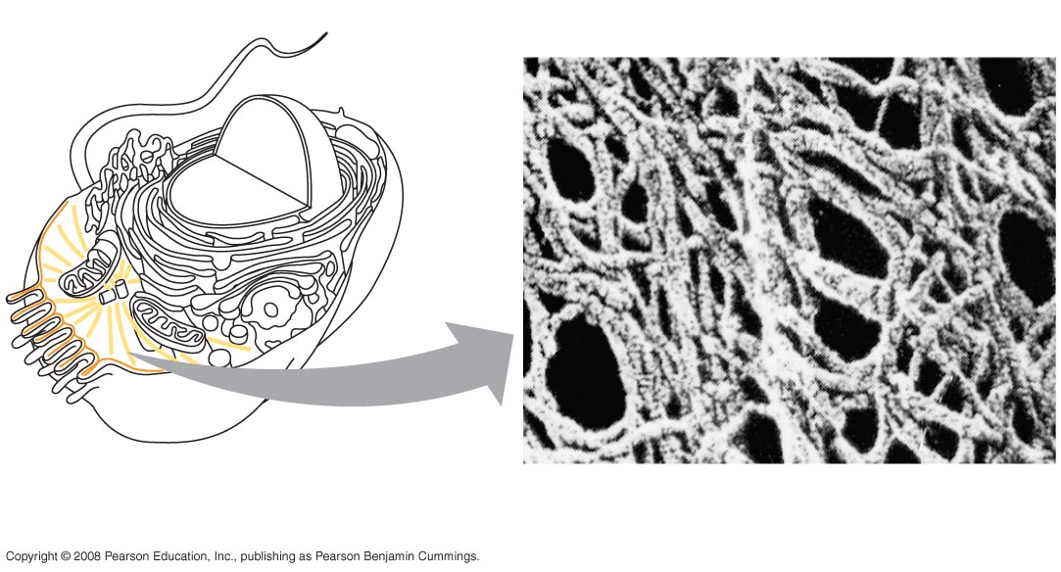
Fig. 6-20
Centrosome within a cell composed of two centrioles – forming
the microtubule organizing center
Microtubule
Microfilaments
Radiating microtubules from the MTOC – giving internal structure and support to the cell.
The cytoskeleton (microfilaments, intermediate filaments and microtubules) give structure to a cell.
Notes:
Figure 6.20 The cytoskeleton

Slide 12
Centrosome Duplication occurs in Mitosis
A cell not in mitosis generally has one centrosome containing two centrioles. The two centrioles in the centrosome are connected to each other by unidentified proteins.
Duplication of centrioles starts at the time of the G₁/S transition and ends before the onset of mitosis.
After centriole duplication, the two pairs of centrioles remain attached to each other until mitosis, when the mother and daughter centrioles separate in a manner dependent upon the enzyme separase.

Slide 13
Centrosome movement and the creation of the mitotic apparatus
Since the centrosomes organize the cell’s cytoskeleton – their movements rearrange the cell’s cytoskeletal architecture. This architectural rearrangement facilitates (helps) the formation of the mitotic apparatus.
Recent experimentation shows that though the centrosome helps in the formation of the mitotic apparatus – it is not mandatory – because even without the centrosomes – the cell will still form the mitotic apparatus – it simply takes longer to form.

Slide 14
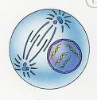
The centrosome – composed of two centrioles is separating and moving – causing the cytoskeleton to rearrange around them – thus assisting in the formation of the mitotic apparatus.

Slide 15
Fig. 12-7
Centrosome
Microtubules
Centrosome
1 µm
0.5 µm
Notes:
Figure 12.7 The mitotic spindle at metaphase

Slide 16
Kinetochore Fibers
The kinetochore fibers (microtubules) attach to a chromosome indirectly at the region of the chromosome’s centromere (the portion of the chromosome that holds the chromosome to its sister chromatid) – this segment of a chromosome does to code for any protein – thus termed heterochromatin (earlier discussed).
As stated above the kinetochore fibers attach indirectly – the kinetochore fibers actually attach. to a protein complex ( proteins clustered together) termed the kinetochore proteins
The kinetochore is physically bonded to the centromere – thus the kinetochore fibers indirectly bond to the chromosomal centromere – since the kinetochore is attached to the chromosomal centromere.

Slide 17
Function of Kinetochore Fibers
The kinetochore fibers become eaten away by motor proteins – these motor proteins break the kinetochore fiber microtubules down to their elementary molecules – tubulin molecules.
The tension created by the eating away of kinetochore fibers creates a pull on the chromosomal centromere – thus breaking it and separating the sister chromatids from one another – each now becomes a singlet chromosome

Slide 18
Sister
chromatids
Kineto-
chores
Centrosome
1 µm
Kinetochore
Kinetochore Fibers
Kinetochore
microtubules
Kinetochore fibers attached to the kinetochore proteins.
The kinetochore proteins attached to the chromosomal
centromere.
0.5 µm
Notes:
Figure 12.7 The mitotic spindle at metaphase

Slide 19
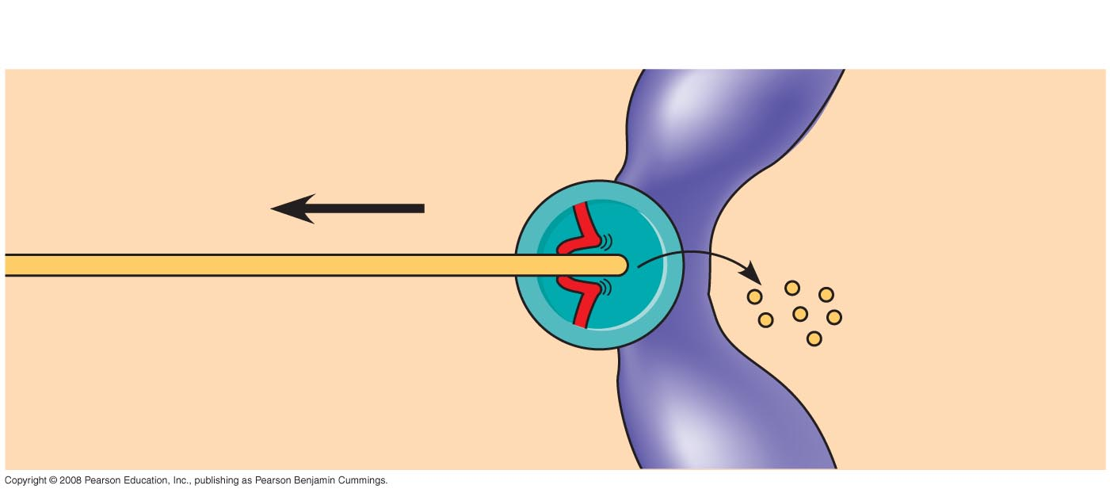
Fig. 12-8b
Kinetochore Fiber attached to
Kinetochore
Kinetochore
Microtubule
Chromosome
Notes:
Figure 12.8 At which end do kinetochore microtubules shorten during anaphase?

Slide 20
Polar Fibers
Polar fibers are another component of the mitotic apparatus. These fibers are microtubules that originate at a cell pole - but transverse across the cell towards the other cell pole. Thus one set from one pole overlaps a set coming from the opposite pole.
The function of the polar fibers is to elongate the cell during mitosis. This elongation is important in that it enlarges the cell – thus giving enough cytoplasmic room to later create two new cells.

Slide 21
Fig. 12-7
Aster
Centrosome
Metaphase
plate
Kineto-
chores
Kinetochore
microtubules
0.5 µm
Notes:
Figure 12.7 The mitotic spindle at metaphase

Slide 22
During cell division the cell creates poles
Metaphase
plate
Kineto-
chores
It also creates a section in the middle termed the equatorial region or some term it the metaphase plate.
Overlapping
nonkinetochore
microtubules
These are the polar fibers
also termed the non-Kinetochore
Proteins
0.5 µm
Notes:
Figure 12.7 The mitotic spindle at metaphase

Slide 23
Aster (Aster Rays)
The Aster rays are another component of the mitotic apparatus. There are located at the poles.
Aster rays hold onto the other end non-kinetochore end of the kinetochore fibers
There function is to hold in place the kinetochore fibers as they are broken down at the other end (kinetochore end) by the motor proteins
If the kinetochore fibers slip the pulling process on the centromere will be compromised and the sister chromatids will fail to separate

Slide 24
Fig. 12-7
Aster
Microtubules
Chromosomes
Centrosome
1 µm
Asters
0.5 µm
Notes:
Figure 12.7 The mitotic spindle at metaphase

Slide 25
Prophase
Prophase is the stage in which the cell – a. dissolves its nuclear membrane b. coils its genetic material from the loop domain fold into the chromatid/chromosome fold and c. assembles its mitotic apparatus
Early Prophase is when the above events begin
Late Prophase is when the events above are in the process of being completed

Slide 26
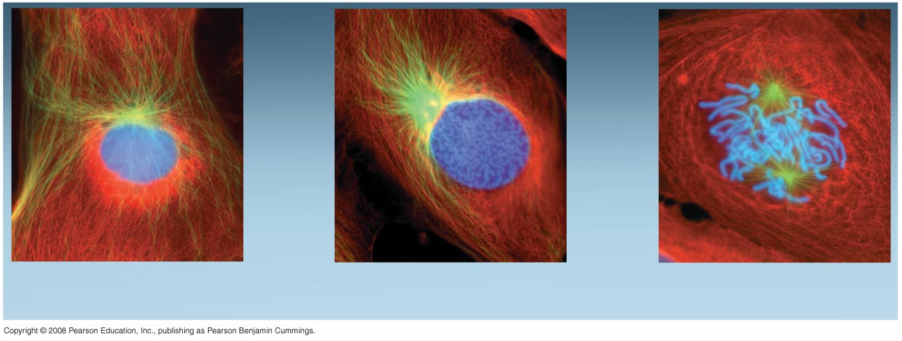
In Interphase cannot
see the genetic material using the light microscope.
During early prophase the
genetic material starts coiling
Into the light microscope visible
form (chromatid/chromosome)
G₂ of Interphase
Early Prophase
Late Prophase
During late prophase the genetic
material is coiled into the worm looking light microscope visible chromatid/chromosomes.
Notes:
Figure 12.6 The mitotic division of an animal cell

Slide 27
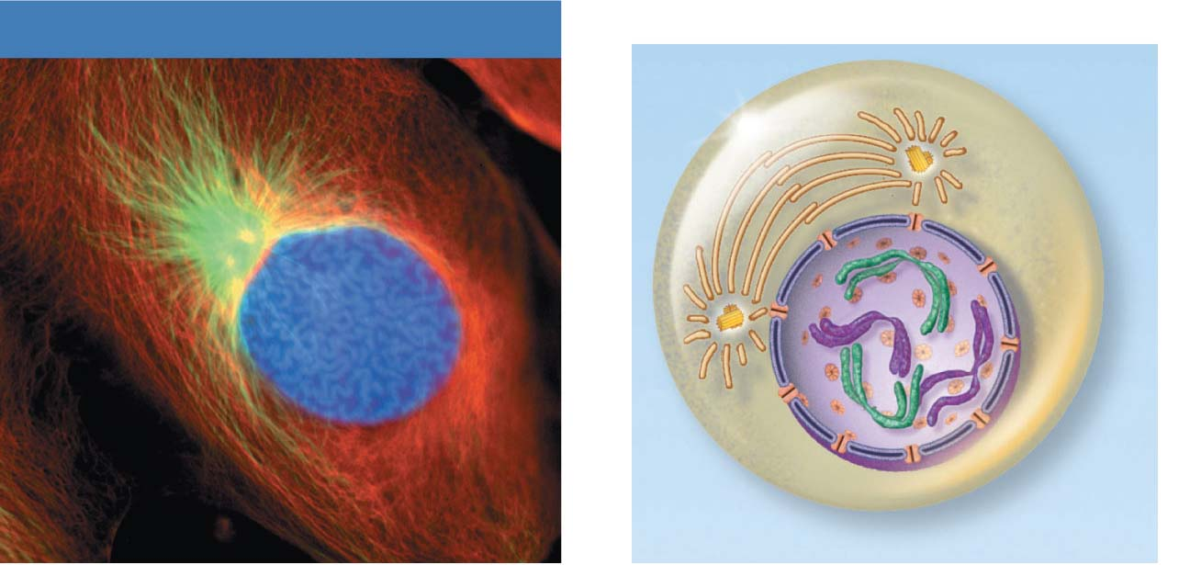
Mitotic Apparatus forming
Early mitotic
spindle
Early Prophase
Aster
Chromosome
consisting of two
sister chromatids
Centromere
Early Prophase
Figure 3.33

Slide 28
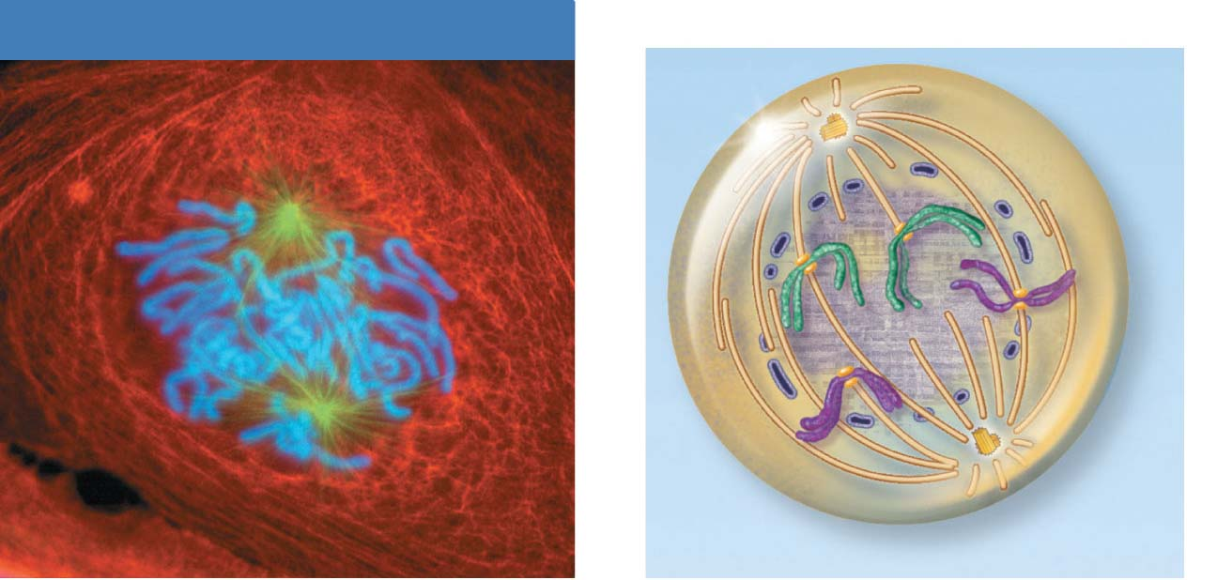
Nuclear membrane has dissolved – see only fragments. Once
the nuclear membrane dissolves the entire cell becomes the
nucleus.
Polar microtubule
Late Prophase
Spindle pole
Fragments
of nuclear
envelope
Kinetochore
Kinetochore
microtubule
Late Prophase
Figure 3.33

Slide 29
Metaphase
The longest phase in mitosis lasting approximately 20 minutes (all of mitosis is 1 hour)
Centromeres have moved to opposite poles of the cell.
These centromeres have formed the mitotic apparatus which is guiding the genetic material (chromatids/chromosomes) into the equatorial region of the cell and ultimately pushing it to the equatorial plate, also termed the metaphase plate

Slide 30
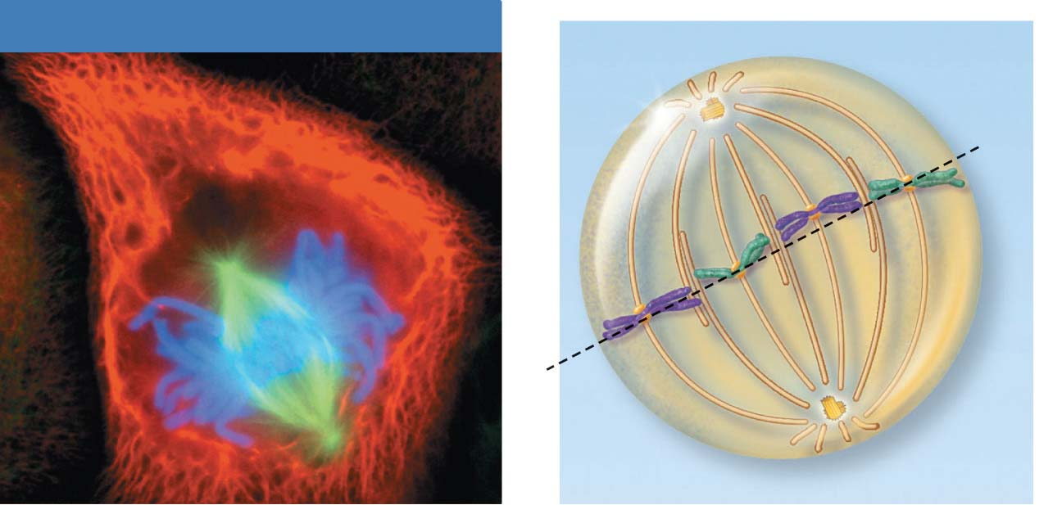
Metaphase
Spindle
Metaphase
plate
Metaphase
Figure 3.33

Slide 31
Anaphase
Shortest phase in mitosis
Centromeres of chromosomes generally split simultaneously (but if not when the first centromere breaks that starts anaphase) —each chromatid now becomes a chromosome
Chromosomes (V shaped) are pulled toward poles by motor proteins of kinetochores
Polar microtubules continue forcing the poles apart

Slide 32
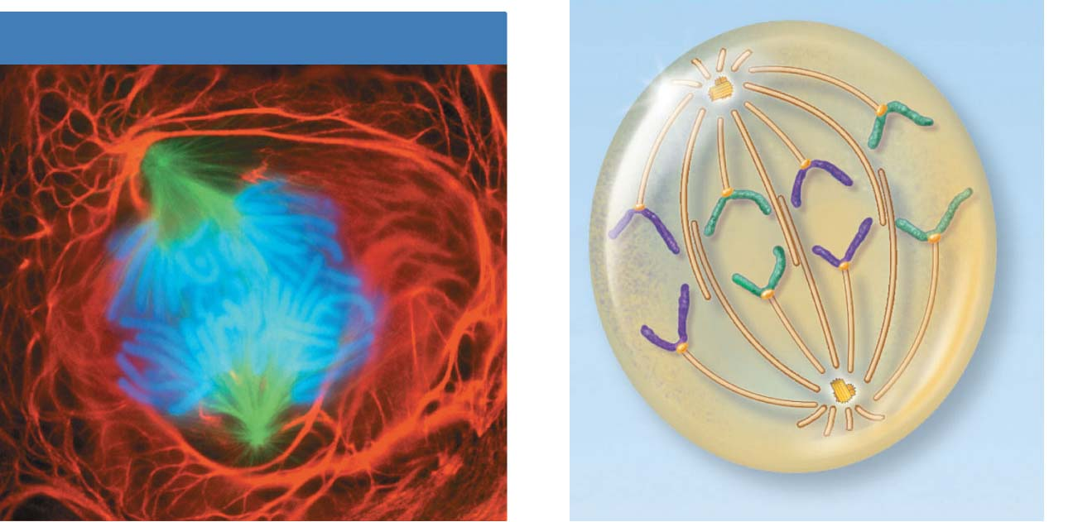
Polar (non-kinetochore) fibers are elongating the cell.
Anaphase
Daughter
chromosomes
Anaphase
Kinetochore fibers are pulling the recently
split chromosomes towards their respective
poles.
Figure 3.33

Slide 33
Telophase
Reverse of actions in prophase in that
(a) the genetic material uncoils from the chromosome stage to the loop domain stage – it starts again to become not visible with the light microscope
(b) the mitotic apparatus begins to disappear
(c) the nuclear membrane begins to reappear – but this time for the two new nuclei.
(d) the nucleoli begin to reappear

Slide 34
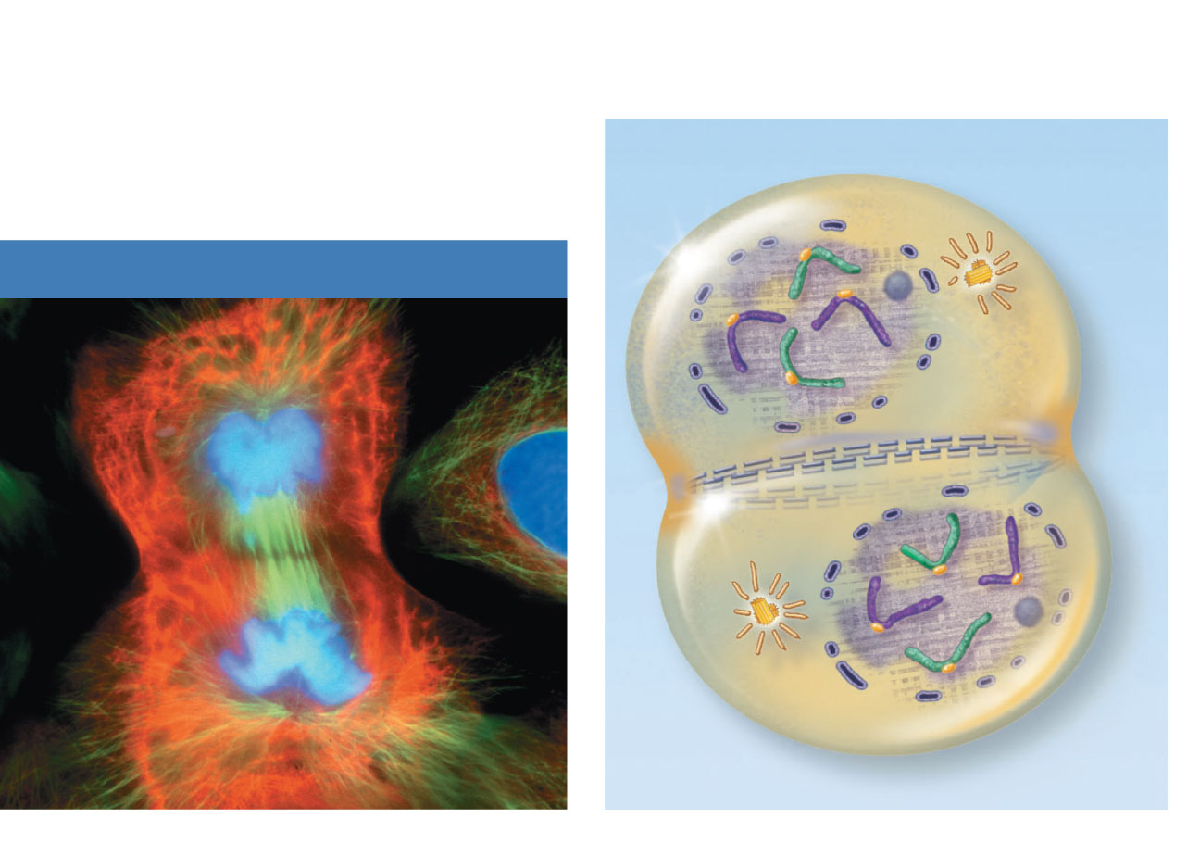
Nuclear
envelope
forming
Nucleolus
forming
Contractile
ring at
cleavage
furrow
Telophase and Cytokinesis
Telophase
Figure 3.33

Slide 35
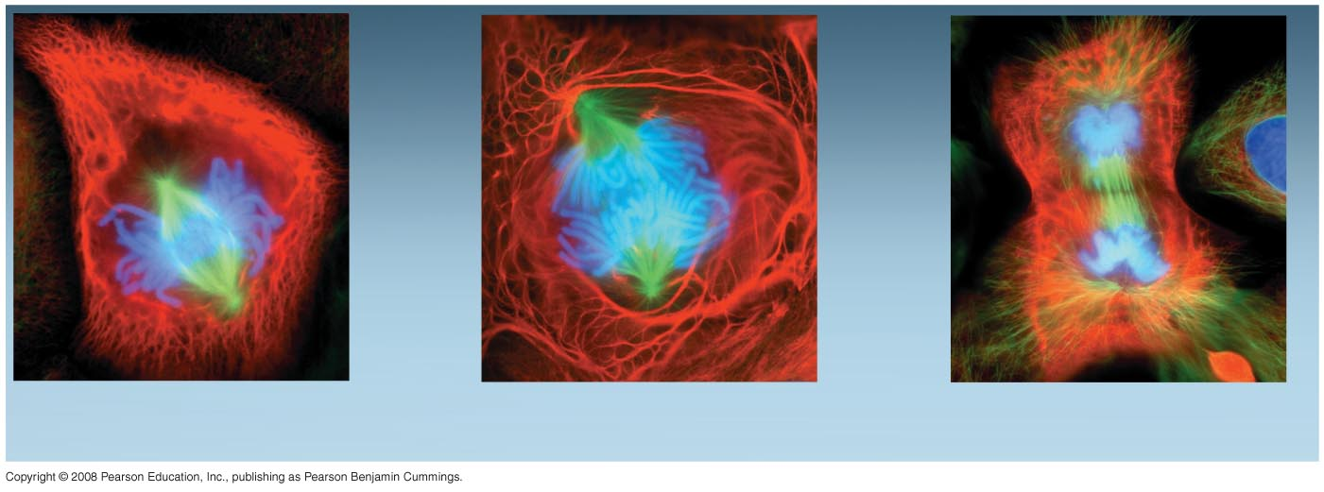
Fig. 12-6c
Metaphase
Anaphase
Telophase and Cytokinesis
Notes:
Figure 12.6 The mitotic division of an animal cell

Slide 36
Cytokinesis
Division of the cytoplasm
If Cytokinesis is to occur its action begins during late anaphase and continues beyond telophase.
Actin and myosin microfilaments form a contractile ring around the middle of the elongated cell – this contractile ring causes a cleavage furrow to form– the furrow deepens due to further contraction of the actin interacting with the myosin.
The furrow deepens to the point that it pinches the cytoplasm to the point it splits into two new cells
The original cell is termed the parent cell and the two newly formed cells are termed daughter cells
If cytokinesis does not occur then the cell becomes multi-nucleated.

Slide 37
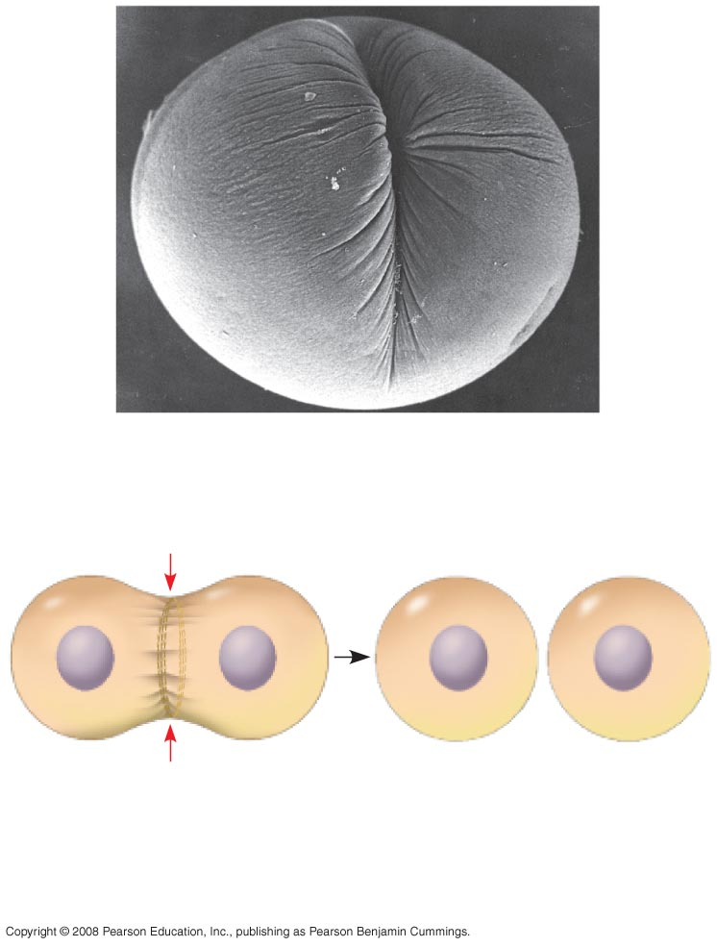
Fig. 12-9a
100 µm
Cleavage furrow
Contractile ring of
microfilaments
Daughter cells
(a) Cleavage of an animal cell (SEM)
Notes:
Figure 12.9a Cytokinesis in animal and plant cells

Slide 38
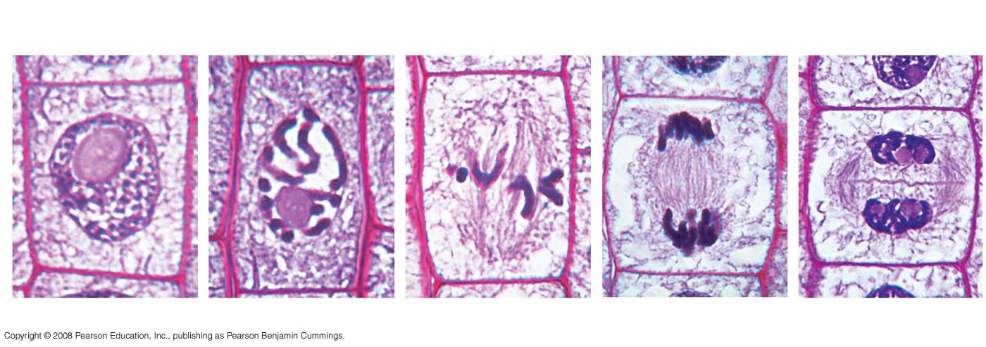
Fig. 12-10
Nucleus
Chromatin
condensing
10 µm
Nucleolus
Chromosomes
Cell plate
1
Prophase
2
Late Prophase
3
Metaphase
4
Anaphase
5
Telophase
Notes:
Figure 12.10 Mitosis in a plant cell

Slide 39
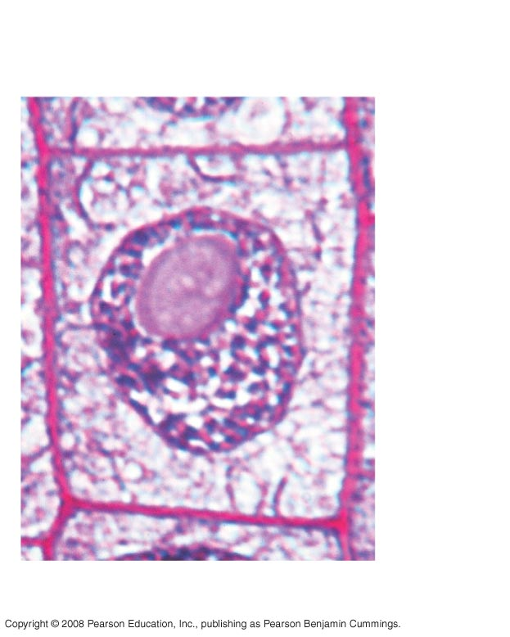
Fig. 12-10a
Nucleus
Chromatin
condensing
Nucleolus
1
Prophase
Notes:
Figure 12.10 Mitosis in a plant cell

Slide 40
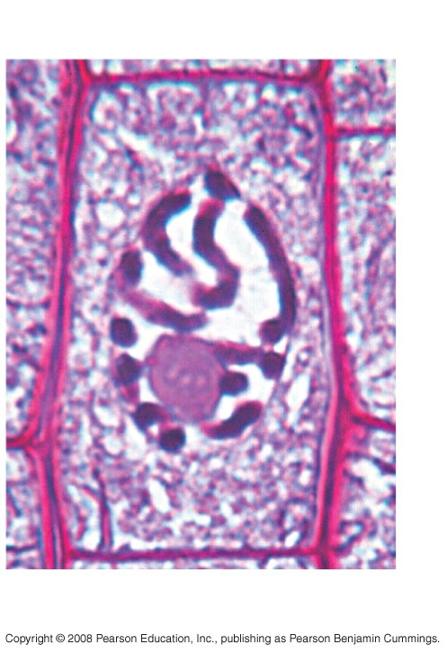
Fig. 12-10b
Chromosomes
2
Late Prophase
Notes:
Figure 12.10 Mitosis in a plant cell

Slide 41
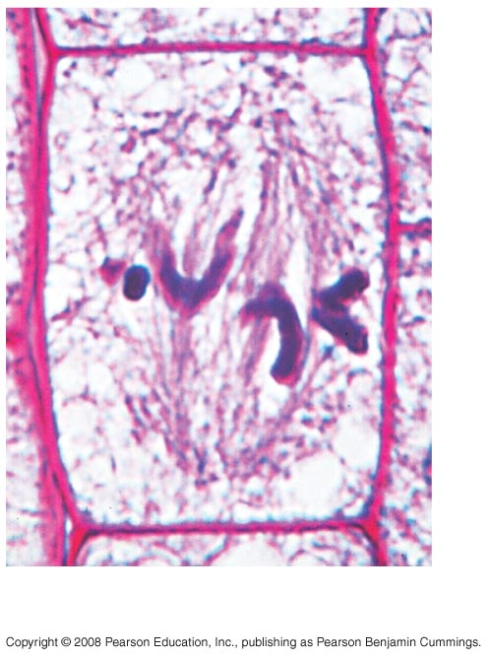
Fig. 12-10c
3
Metaphase
Notes:
Figure 12.10 Mitosis in a plant cell

Slide 42
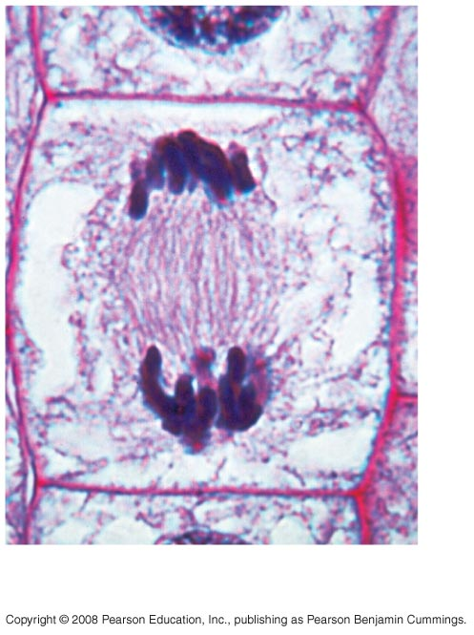
Fig. 12-10d
4
Anaphase
Notes:
Figure 12.10 Mitosis in a plant cell

Slide 43
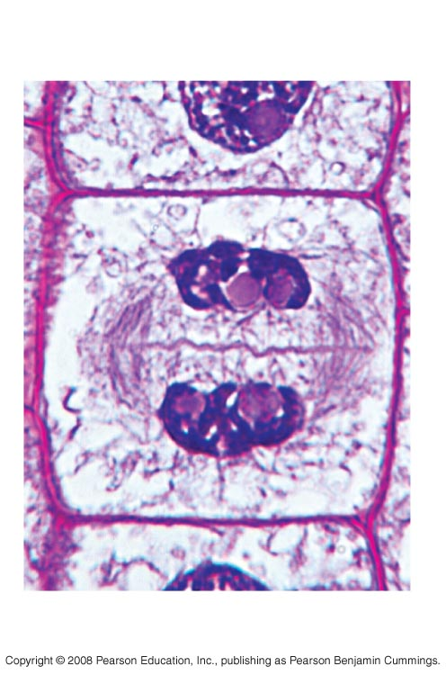
Fig. 12-10e
10 µm
Cell plate
5
Telophase
Notes:
Figure 12.10 Mitosis in a plant cell

