Slide 1
9
Muscle 1
Mike Clark, M.D.

Slide 2
Three Types of Muscle Tissue
Skeletal muscle tissue:
  Attached to bones and skin
  Striated
  Voluntary (i.e., conscious control)
  Powerful
  Primary topic of this chapter

Slide 3
Three Types of Muscle Tissue
Cardiac muscle tissue:
  Only in the heart
  Striated
  Involuntary
  More details in Chapter 18

Slide 4
Three Types of Muscle Tissue
Smooth muscle tissue:
  In the walls of hollow organs, e.g., stomach, urinary bladder, and airways
  Not striated
  Involuntary
  More details later in this chapter

Slide 5
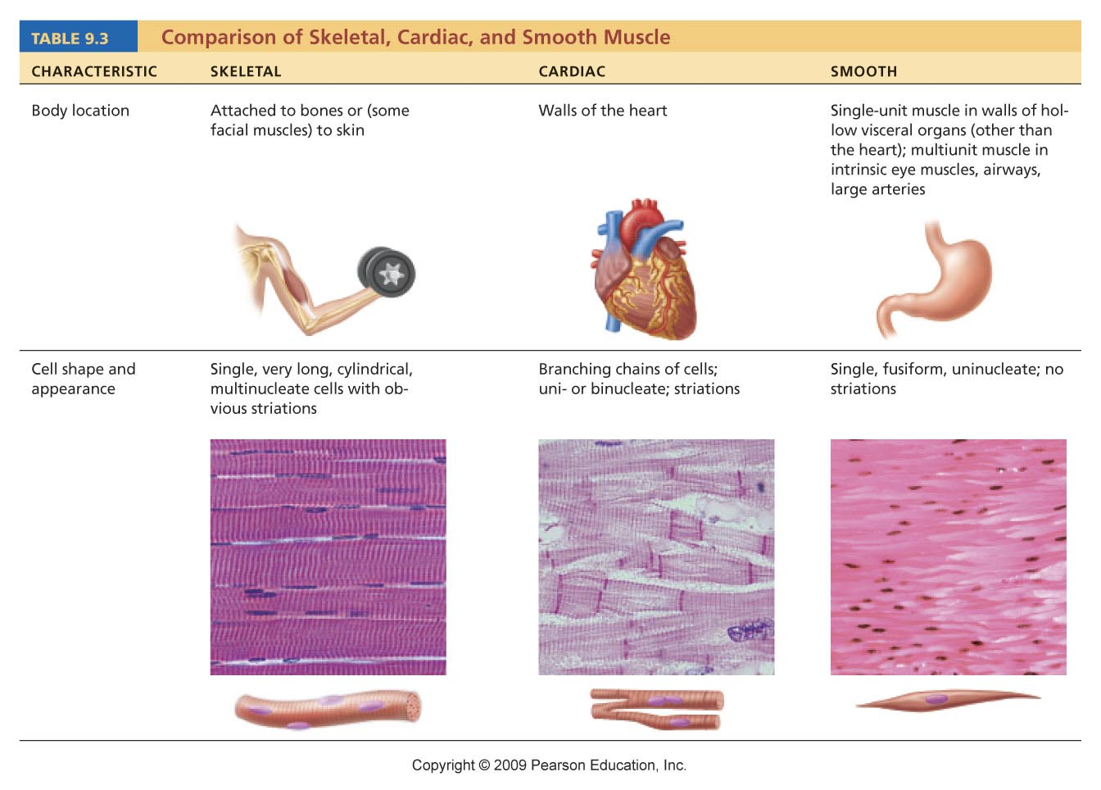
Table 9.3

Slide 6
Special Characteristics of Muscle Tissue
Excitability (responsiveness or irritability): ability to receive and respond to stimuli
Contractility: ability to shorten when stimulated
Extensibility: ability to be stretched
Elasticity: ability to recoil to resting length
Conductivity

Slide 7
Muscle Functions
Movement of bones or fluids (e.g., blood)
Maintaining posture and body position
Stabilizing joints
Heat generation (especially skeletal muscle)

Slide 8
Skeletal Muscle
Each muscle is served by one artery, one nerve, and one or more veins

Slide 9
Skeletal Muscle
Connective tissue sheaths of skeletal muscle:
  Epimysium: dense regular connective tissue surrounding entire muscle
  Perimysium: fibrous connective tissue surrounding fascicles (groups of muscle fibers)
  Endomysium: fine areolar connective tissue surrounding each muscle fiber

Slide 10
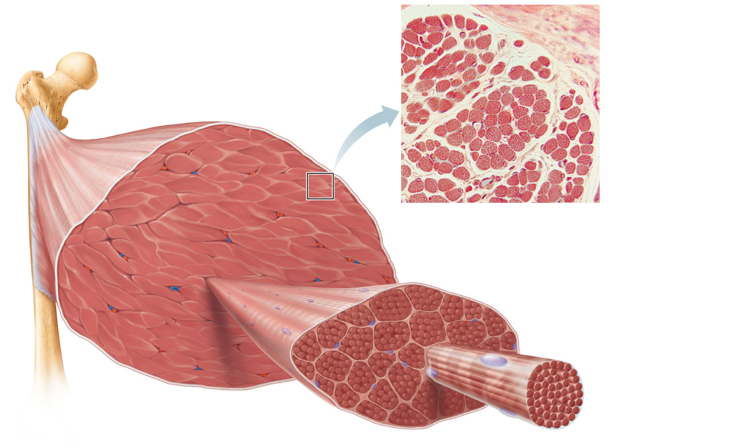
Epimysium
Bone
Epimysium
Perimysium
Tendon
Endomysium
Muscle fiber
in middle of
a fascicle
(b)
Blood vessel
Fascicle
(wrapped by perimysium)
Endomysium
(between individual
muscle fibers)
Perimysium
Fascicle
Muscle fiber
(a)
Figure 9.1

Slide 11
Skeletal Muscle: Attachments
Muscles attach:
  Directly—epimysium of muscle is fused to the periosteum of bone or perichondrium of cartilage
  Indirectly—connective tissue wrappings extend beyond the muscle as a ropelike tendon or sheetlike aponeurosis

Slide 12
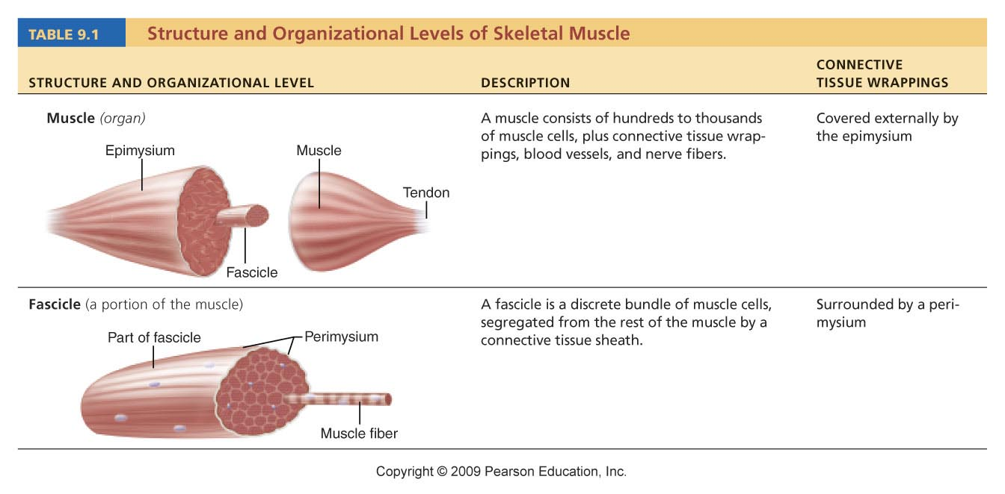
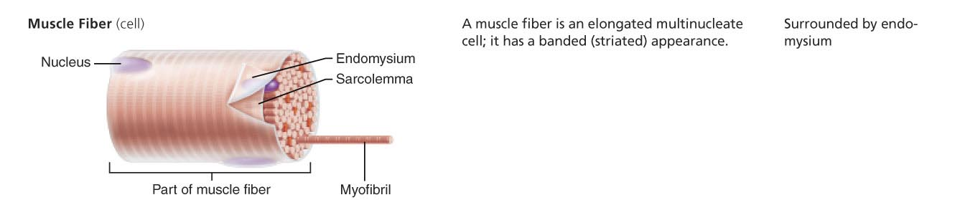
Table 9.1

Slide 13
Microscopic Anatomy of a Skeletal Muscle Fiber
Cylindrical cell 10 to 100 μm in diameter, up to 30 cm long
Multiple peripheral nuclei
Many mitochondria
Glycosomes for glycogen storage, myoglobin for O₂ storage
Also contain myofibrils, sarcoplasmic reticulum, and T tubules

Slide 14
Myofibrils
Densely packed, rodlike elements
~80% of cell volume
Exhibit striations: perfectly aligned repeating series of dark A bands and light I bands

Slide 15
Table 9.1

Slide 16
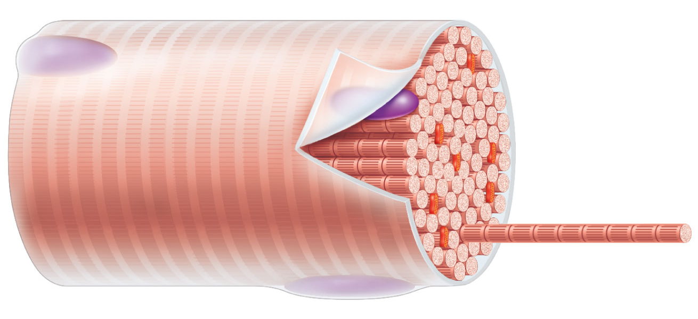
Sarcolemma
Mitochondrion
Myofibril
Dark A band
Light I band
Nucleus
(b) Diagram of part of a muscle fiber showing the myofibrils. One
myofibril is extended afrom the cut end of the fiber.

Slide 17
Sarcomere
Smallest contractile unit (functional unit) of a muscle fiber
The region of a myofibril between two successive Z discs
Composed of thick and thin myofilaments made of contractile proteins

Slide 18
Features of a Sarcomere
Thick filaments: run the entire length of an A band
Thin filaments: run the length of the I band and partway into the A band
Z disc: coin-shaped sheet of proteins that anchors the thin filaments and connects myofibrils to one another
H zone: lighter midregion where filaments do not overlap
M line: line of protein myomesin that holds adjacent thick filaments together

Slide 19
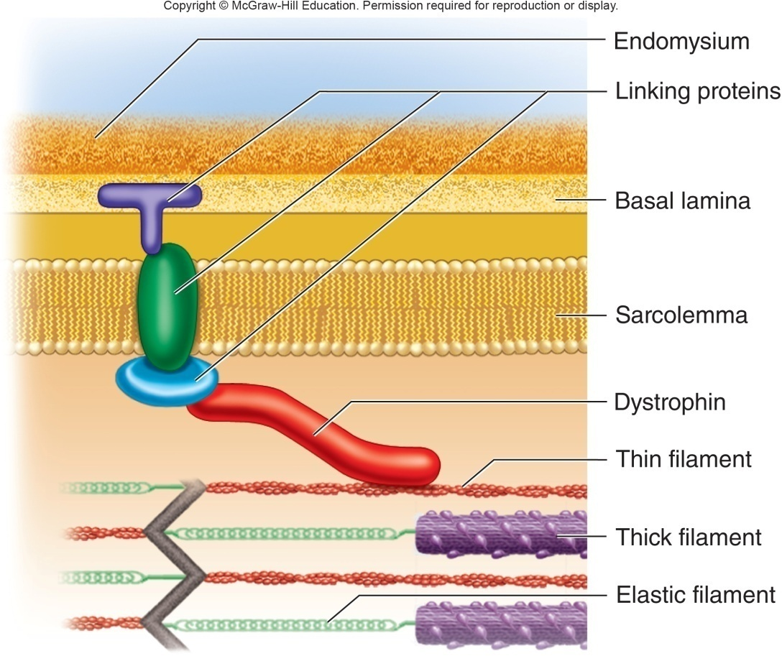
Dystrophin
Figure 11.4

Slide 20
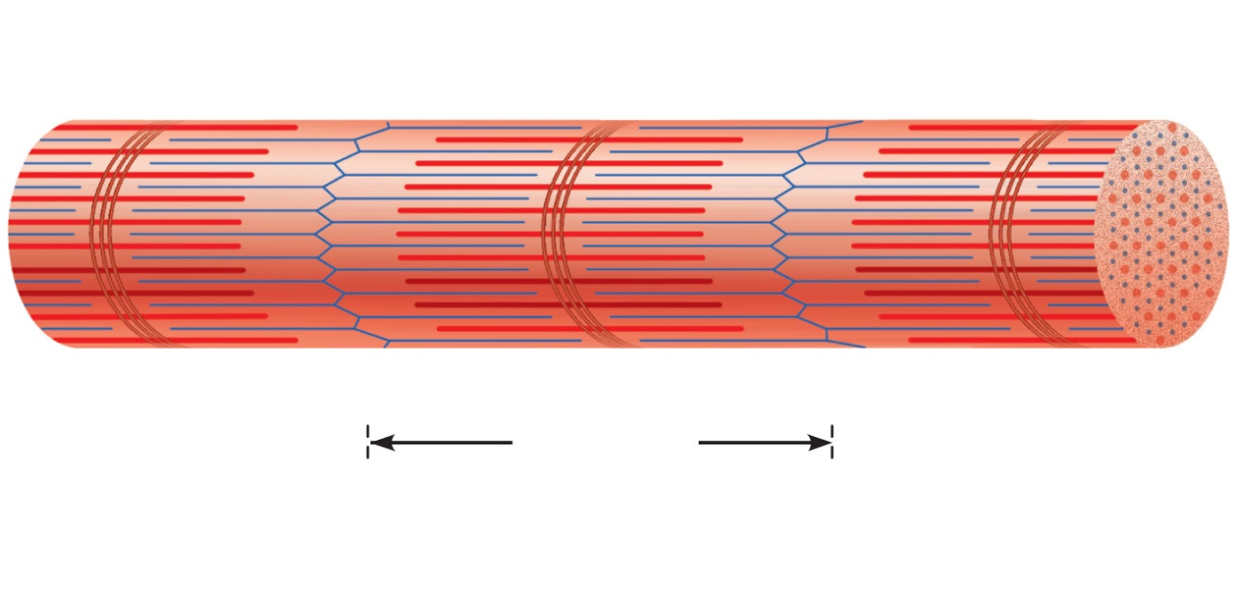
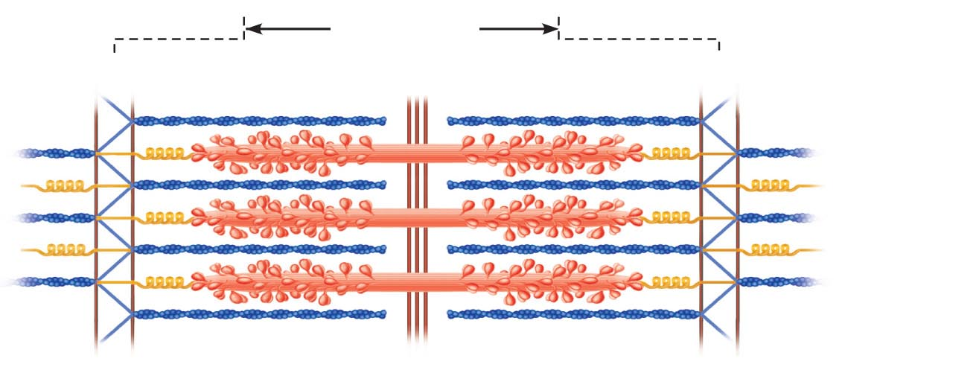
Thin (actin)
filament
Z disc
H zone
Z disc
Thick (myosin)
filament
I band
A band
Sarcomere
I band
M line
(c)
Small part of one myofibril enlarged to show the myofilaments
responsible for the banding pattern. Each sarcomere extends from
one Z disc to the next.
Alpha Actinin
Sarcomere
Z disc
M line
Z disc
Thin (actin)
filament
Elastic (titin)
filaments
Thick
(myosin)
filament
(d)
Enlargement of one sarcomere (sectioned lengthwise). Notice the
myosin heads on the thick filaments.
Figure 9.2c, d

Slide 21
Ultrastructure of Thick Filament
Composed of the protein myosin
  Myosin tails contain:
    2 interwoven, heavy polypeptide chains
  Myosin heads contain:
    2 smaller, light polypeptide chains that act as cross bridges during contraction
    Binding sites for actin of thin filaments
    Binding sites for ATP
    ATPase enzymes

Slide 22
Ultrastructure of Thin Filament
Twisted double strand of fibrous protein F actin
F actin consists of G (globular) actin subunits
G actin bears active sites for myosin head attachment during contraction
Tropomyosin and troponin: regulatory proteins bound to actin

Slide 23
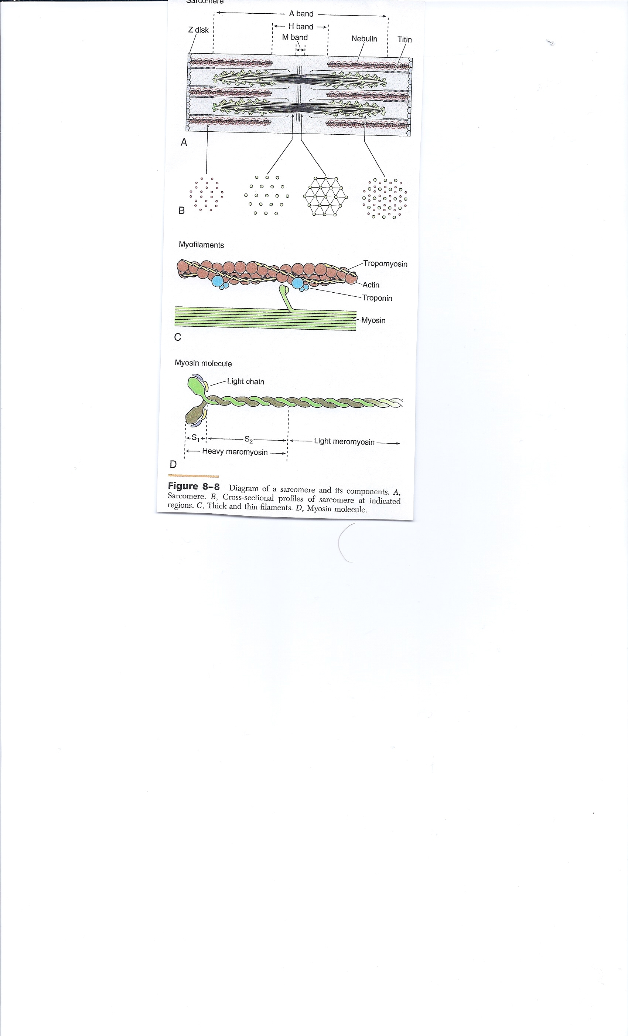

Slide 24
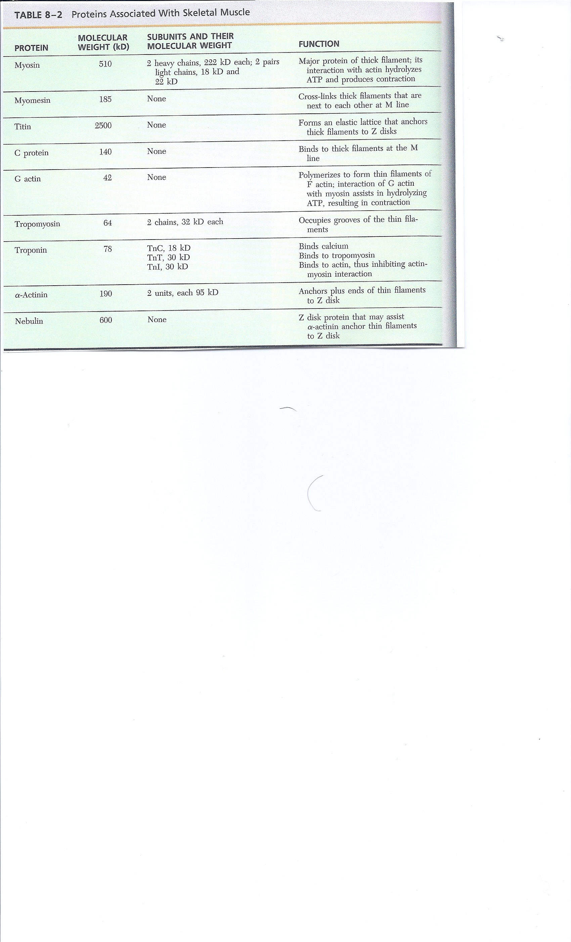

Slide 25
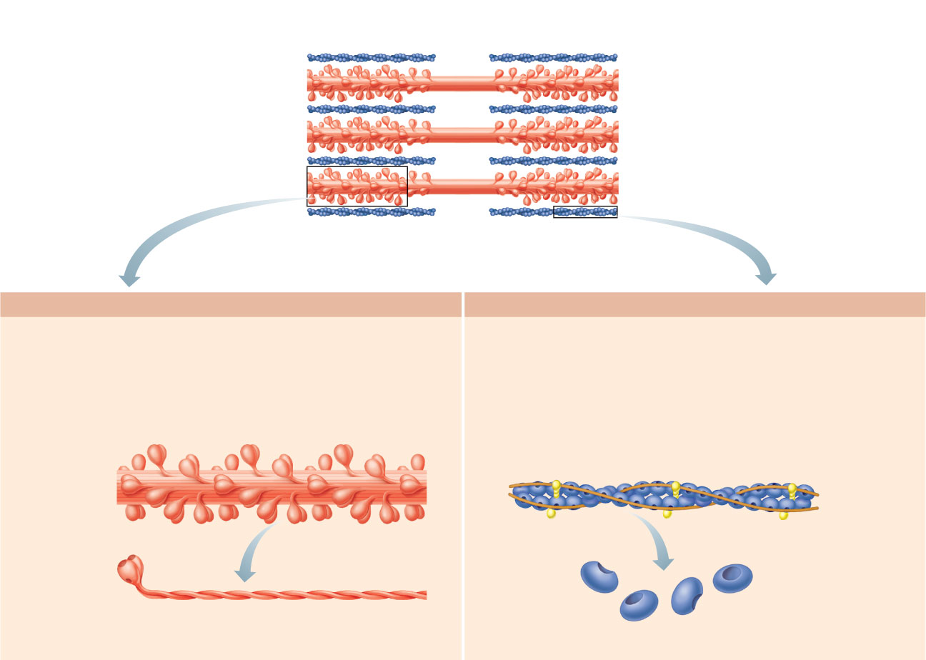
Longitudinal section of filaments
within one sarcomere of a myofibril
Thick filament
Thin filament
In the center of the sarcomere, the thick
filaments lack myosin heads. Myosin heads
are present only in areas of myosin-actin overlap.
Thick filament
Thin filament
Each thick filament consists of many
myosin molecules whose heads protrude
at opposite ends of the filament.
A thin filament consists of two strands
of actin subunits twisted into a helix
plus two types of regulatory proteins
(troponin and tropomyosin).
Portion of a thick filament
Myosin head
Portion of a thin filament
Tropomyosin
Troponin
Actin
Actin-binding sites
Heads
Tail
Active sites
for myosin
attachment
ATP-
binding
site
Actin
subunits
Flexible hinge region
Myosin molecule
Actin subunits
Figure 9.3

Slide 26
Sarcoplasmic Reticulum (SR)
Network of smooth endoplasmic reticulum surrounding each myofibril
Pairs of terminal cisternae form perpendicular cross channels
Functions in the regulation of intracellular Ca²⁺ levels

Slide 27
T Tubules
Continuous with the sarcolemma
Penetrate the cell’s interior at each A band–I band junction
Associate with the paired terminal cisternae to form triads that encircle each sarcomere

Slide 28
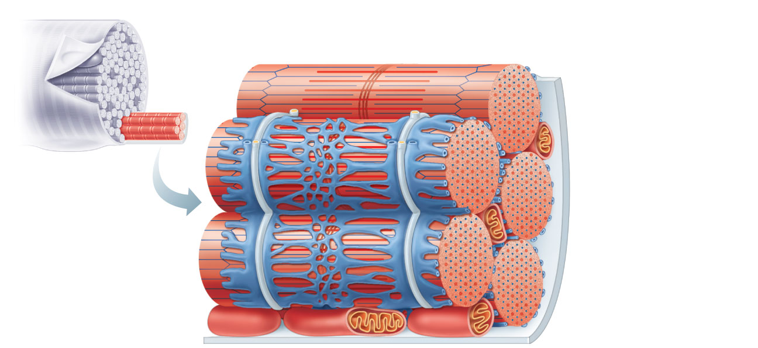
Part of a skeletal
muscle fiber (cell)
I band
A band
I band
Z disc
H zone
Z disc
Myofibril
M line
Sarcolemma
Triad:
•
T tubule
•
Terminal
cisternae
of the SR (2)
Sarcolemma
Tubules of
the SR
Myofibrils
Mitochondria
Figure 9.5

Slide 29
Triad Relationships
T tubules conduct impulses deep into muscle fiber
Integral proteins protrude into the intermembrane space from T tubule and SR cisternae membranes
T tubule proteins: voltage sensors
SR foot proteins: gated channels that regulate Ca²⁺ release from the SR cisternae

Slide 30
Contraction
The generation of force
Does not necessarily cause shortening of the fiber
Shortening occurs when tension generated by cross bridges on the thin filaments exceeds forces opposing shortening

Slide 31
Sliding Filament Model of Contraction
In the relaxed state, thin and thick filaments overlap only slightly
During contraction, myosin heads bind to actin, detach, and bind again, to propel the thin filaments toward the M line
As H zones shorten and disappear, sarcomeres shorten, muscle cells shorten, and the whole muscle shortens

Slide 32
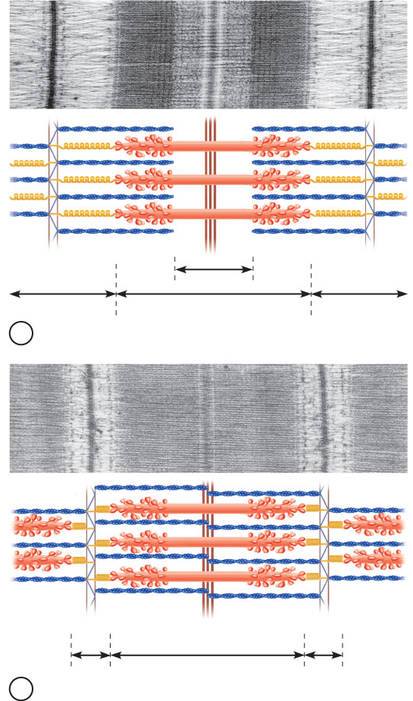
Z
H
Z
I
A
I
1
Fully relaxed sarcomere of a muscle fiber
Z
Z
I
A
I
2
Fully contracted sarcomere of a muscle fiber
Figure 9.6

Slide 33
Requirements for Skeletal Muscle Contraction
Activation: neural stimulation at a
neuromuscular junction
Excitation-contraction coupling:
  Generation and propagation of an action potential along the sarcolemma
  Final trigger: a brief rise in intracellular Ca²⁺ levels

Slide 34
Events at the Neuromuscular Junction
Skeletal muscles are stimulated by somatic motor neurons
Axons of motor neurons travel from the central nervous system via nerves to skeletal muscles
Each axon forms several branches as it enters a muscle
Each axon ending forms a neuromuscular junction with a single muscle fiber

Slide 35
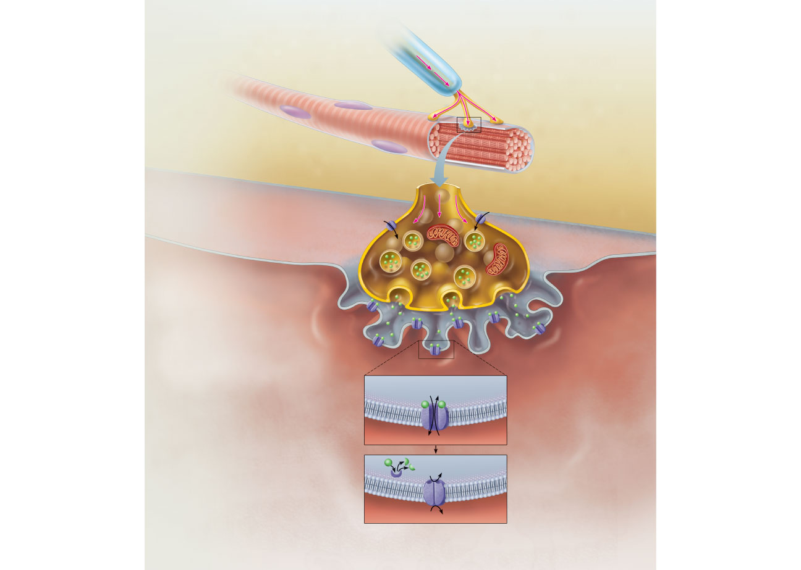
Action
potential (AP)
Myelinated axon
of motor neuron
Nucleus
Axon terminal of
neuromuscular
junction
Sarcolemma of
the muscle fiber
1
Action potential arrives at
axon terminal of motor neuron.
Ca²⁺
Ca²⁺
Synaptic vesicle
containing ACh
2
Voltage-gated Ca²⁺ channels
open and Ca²⁺ enters the axon
terminal.
Mitochondrion
Synaptic
cleft
Axon terminal
of motor neuron
Fusing synaptic
vesicles
Figure 9.8
Figure 9.8

Slide 36
Neuromuscular Junction
Situated midway along the length of a muscle fiber
Axon terminal and muscle fiber are separated by a gel-filled space called the synaptic cleft
Synaptic vesicles of axon terminal contain the neurotransmitter acetylcholine (ACh)
Junctional folds of the sarcolemma contain ACh receptors

Slide 37
Events at the Neuromuscular Junction
Nerve impulse arrives at axon terminal
ACh is released and binds with receptors on the sarcolemma
Electrical events lead to the generation of an action potential
PLAY
A&P Flix™: Events at the Neuromuscular Junction

Slide 38
Action
potential (AP)
Myelinated axon
of motor neuron
Nucleus
Axon terminal of
neuromuscular
junction
Sarcolemma of
the muscle fiber
1
Action potential arrives at
axon terminal of motor neuron.
Ca²⁺
Ca²⁺
Synaptic vesicle
containing ACh
2
Voltage-gated Ca²⁺ channels
open and Ca²⁺ enters the axon
terminal.
Mitochondrion
Synaptic
cleft
Axon terminal
of motor neuron
3
Ca²⁺ entry causes some
synaptic vesicles to release
their contents (acetylcholine)
by exocytosis.
Fusing synaptic
vesicles
Junctional
folds of
sarcolemma
ACh
4
Acetylcholine, a
neurotransmitter, diffuses across
the synaptic cleft and binds to
receptors in the sarcolemma.
Sarcoplasm of
muscle fiber
5
Postsynaptic membrane
ion channel opens;
ions pass.
ACh binding opens ion
channels that allow simultaneous
passage of Na⁺ into the muscle
fiber and K⁺ out of the muscle
fiber.
Na⁺
K⁺
6
Degraded ACh
ACh effects are terminated
by its enzymatic breakdown in
the synaptic cleft by
acetylcholinesterase.
Ach–
Na⁺
Postsynaptic membrane
ion channel closed;
ions cannot pass.
Acetyl-
cholinesterase
K⁺
Figure 9.8

Slide 39
Destruction of Acetylcholine
ACh effects are quickly terminated by the enzyme acetylcholinesterase
Prevents continued muscle fiber contraction in the absence of additional stimulation

Slide 40
Events in Generation of an Action Potential
Local depolarization (end plate potential):
  ACh binding opens chemically (ligand) gated ion channels
  Simultaneous diffusion of Na⁺ (inward) and K⁺ (outward)
  More Na⁺ diffuses, so the interior of the sarcolemma becomes less negative
  Local depolarization – end plate potential

Slide 41
Events in Generation of an Action Potential
Generation and propagation of an action potential:
  End plate potential spreads to adjacent membrane areas
  Voltage-gated Na⁺ channels open
  Na⁺ influx decreases the membrane voltage toward a critical threshold
  If threshold is reached, an action potential is generated

Slide 42
Events in Generation of an Action Potential
Local depolarization wave continues to spread, changing the permeability of the sarcolemma
Voltage-regulated Na⁺ channels open in the adjacent patch, causing it to depolarize to threshold

Slide 43
Events in Generation of an Action Potential
Repolarization:
Na⁺ channels close and voltage-gated K⁺ channels open
K⁺ efflux rapidly restores the resting polarity
Fiber cannot be stimulated and is in a refractory period until repolarization is complete
Ionic conditions of the resting state are restored by the Na⁺-K⁺ pump

Slide 44
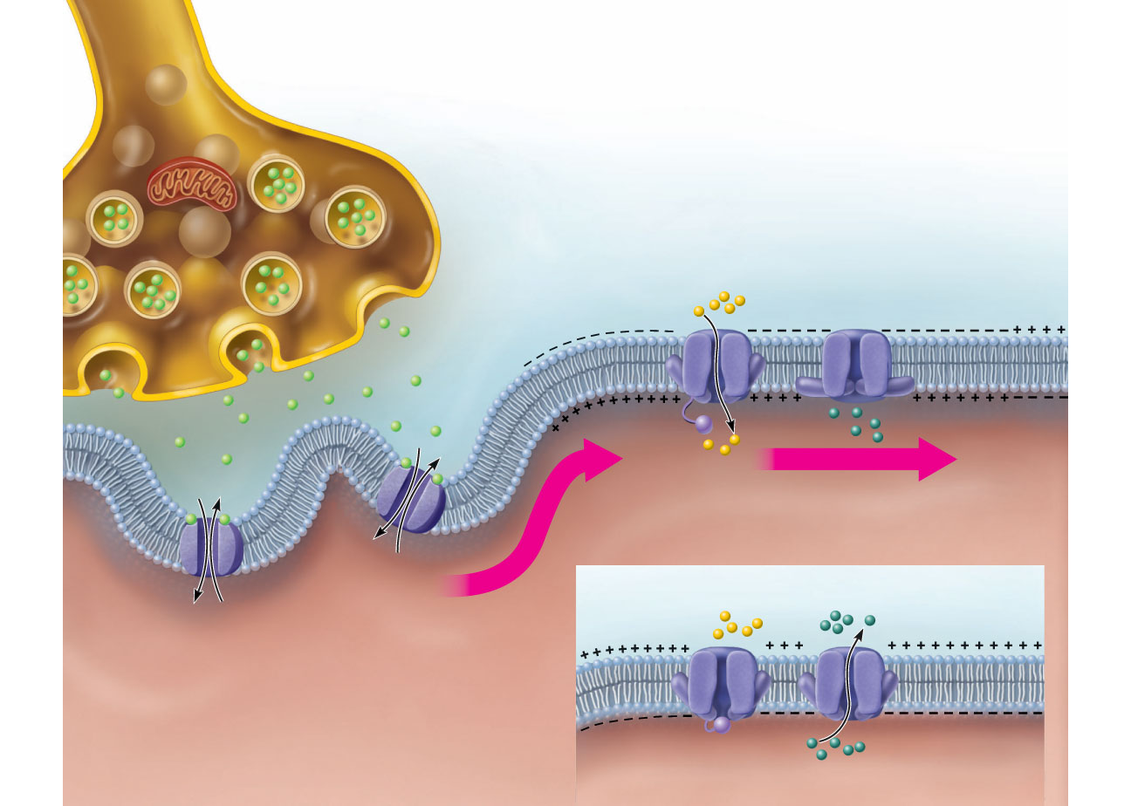
Axon terminal
Open Na⁺
Channel
Closed K⁺
Channel
Synaptic
cleft
Na⁺
ACh
Na⁺
K⁺
K⁺
ACh
+
+
+
+
+
n
+
+
+
Action potential
+
+
o
+
+
Na⁺
K⁺
a
t
i
2
z
Generation and propagation of
the action potential (AP)
i
r
a
l
o
p
e
o
f
d
W
a
v
e
Closed Na⁺
Channel
Open K⁺
Channel
1
Local depolarization:
generation of the end
plate potential on the
sarcolemma
Na⁺
3
K⁺
Sarcoplasm of muscle fiber
Repolarization
Figure 9.9

Slide 45
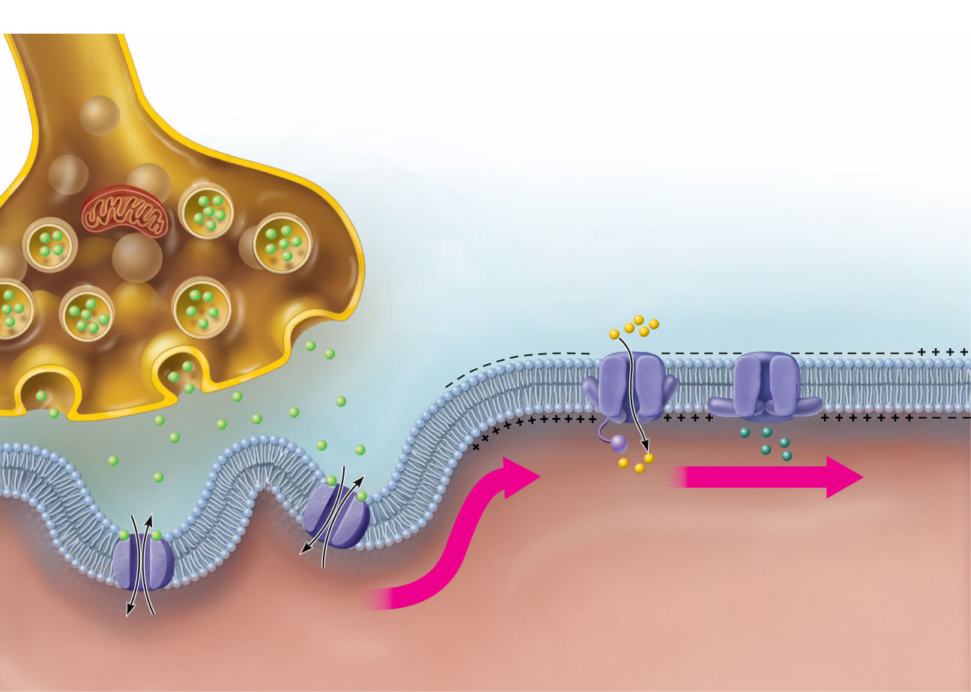
Axon terminal
Open Na⁺
Channel
Closed K⁺
Channel
Synaptic
cleft
Na⁺
ACh
K⁺
ACh
Na⁺
K⁺
+
+
+
+
+
+
+
n
+
+
Action potential
+
Na⁺
K⁺
t
i
o
+
+
z
a
i
r
a
l
o
p
e
f
d
a
v
e
o
W
1
1
Local depolarization: generation of the
end plate potential on the sarcolemma
Sarcoplasm of muscle fiber
Figure 9.9, step 1

Slide 46
Axon terminal
Open Na⁺
Channel
Closed K⁺
Channel
Synaptic
cleft
Na⁺
ACh
K⁺
ACh
Na⁺
K⁺
+
+
+
+
+
+
+
n
+
+
Action potential
+
Na⁺
K⁺
t
i
o
+
+
z
a
2
i
r
Generation and propagation of the
action potential (AP)
a
l
o
p
e
f
d
a
v
e
o
W
1
1
Local depolarization: generation of the
end plate potential on the sarcolemma
Sarcoplasm of muscle fiber
Figure 9.9, step 2

Slide 47
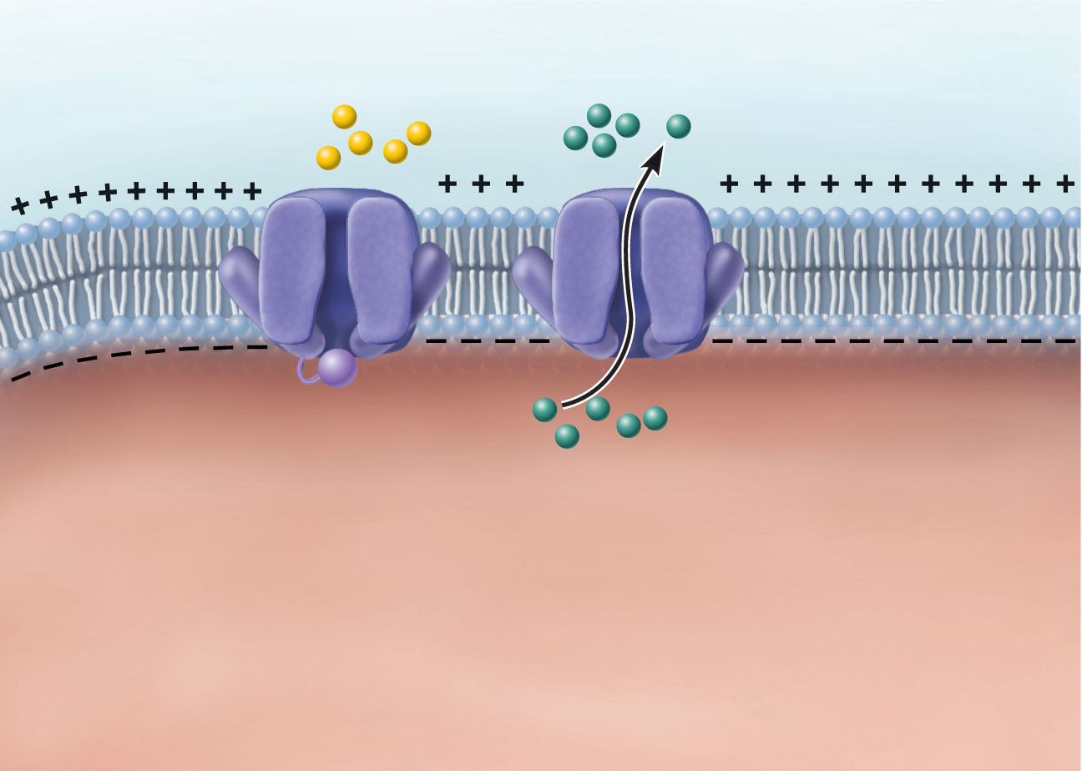
Closed Na⁺
Channel
Open K⁺
Channel
Na⁺
K⁺
3
Repolarization
Figure 9.9, step 3

Slide 48
Axon terminal
Open Na⁺
Channel
Closed K⁺
Channel
Synaptic
cleft
Na⁺
ACh
Na⁺
K⁺
K⁺
ACh
+
+
+
+
+
n
+
+
+
Action potential
+
+
o
+
+
Na⁺
K⁺
a
t
i
2
z
Generation and propagation of
the action potential (AP)
i
r
a
l
o
p
e
o
f
d
W
a
v
e
Closed Na⁺
Channel
Open K⁺
Channel
1
Local depolarization:
generation of the end
plate potential on the
sarcolemma
Na⁺
3
K⁺
Sarcoplasm of muscle fiber
Repolarization
Figure 9.9

Slide 49
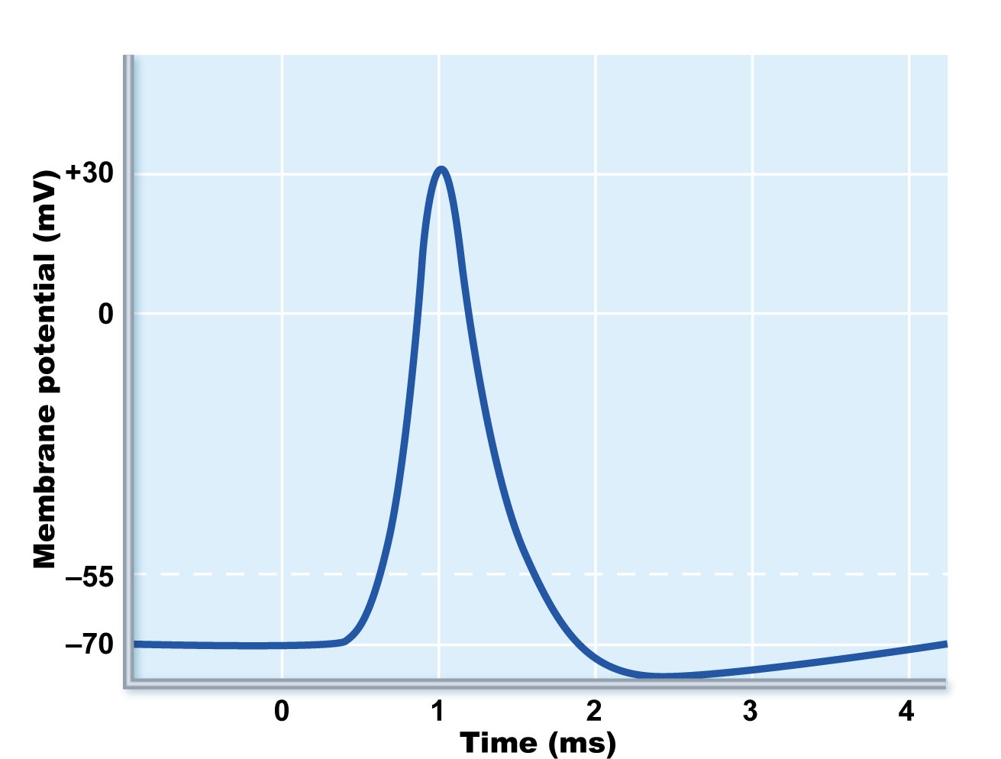
Na⁺ channels
close, K⁺ channels
open
Depolarization
due to Na+ entry
Repolarization
due to K⁺ exit
Na⁺
channels
open
Threshold
K⁺ channels
close
Figure 9.10

Slide 50
Excitation-Contraction (E-C) Coupling
Sequence of events by which transmission of an AP along the sarcolemma leads to sliding of the myofilaments
Latent period:
  Time when E-C coupling events occur
  Time between AP initiation and the beginning of contraction

Slide 51
Events of Excitation-Contraction (E-C) Coupling
AP is propagated along sarcomere to T tubules
Voltage-sensitive proteins stimulate Ca²⁺ release from SR
  Ca²⁺ is necessary for contraction

Slide 52
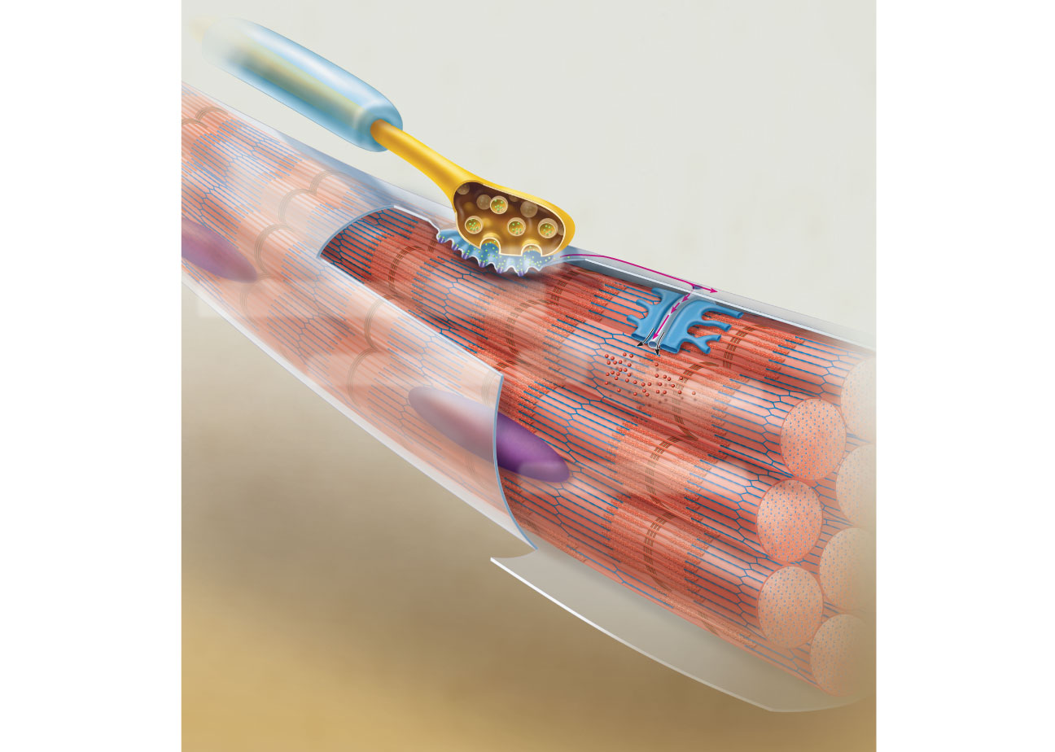
Setting the stage
Axon terminal
of motor neuron
Synaptic cleft
Action potential
is generated
ACh
Sarcolemma
Terminal cisterna of SR
Muscle fiber
Ca²⁺
Triad
One sarcomere
Figure 9.11, step 1

Slide 53
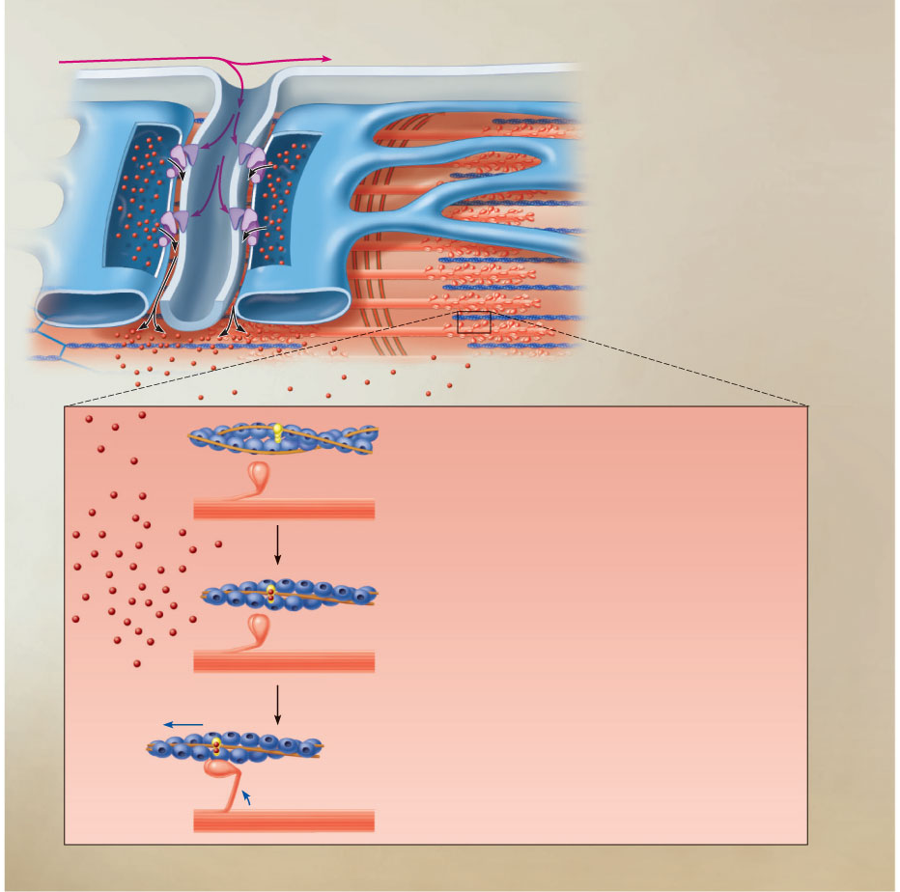
Steps in E-C Coupling:
Sarcolemma
Voltage-sensitive
tubule protein
T tubule
Action potential is propagated along
the sarcolemma and down the T tubules.
1
Ca²⁺
release
channel
2
Terminal
cisterna
of SR
Calcium ions are released.
Ca²⁺
Actin
Ca²⁺
Troponin
Tropomyosin
blocking active sites
Myosin
3
Calcium binds to troponin and
removes the blocking action of
tropomyosin.
Active sites exposed and
ready for myosin binding
4
Contraction begins
Myosin
cross
bridge
The aftermath
Figure 9.11, step 2

Slide 54
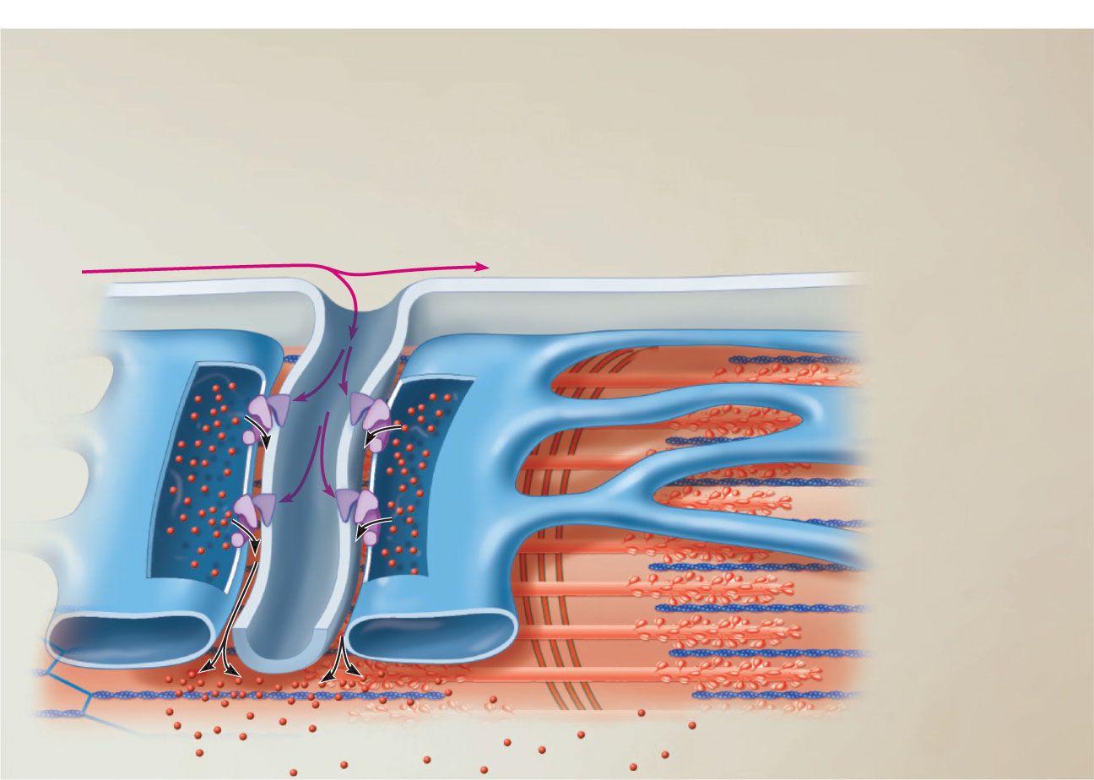
1
Action potential is
propagated along the
sarcolemma and down
the T tubules.
Steps in
E-C Coupling:
Sarcolemma
Voltage-sensitive
tubule protein
T tubule
Ca²⁺
release
channel
Terminal
cisterna
of SR
Ca²⁺
Figure 9.11, step 3

Slide 55
1
Action potential is
propagated along the
sarcolemma and down
the T tubules.
Steps in
E-C Coupling:
Sarcolemma
Voltage-sensitive
tubule protein
T tubule
Ca²⁺
release
channel
2
Calcium
ions are
released.
Terminal
cisterna
of SR
Ca²⁺
Figure 9.11, step 4

Slide 56
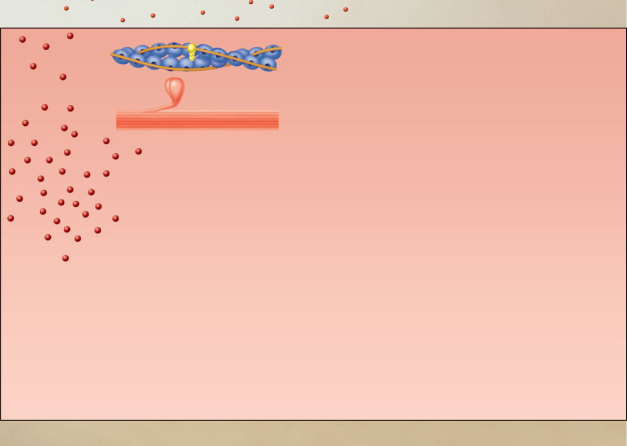
Actin
Troponin
Tropomyosin
blocking active sites
Ca²⁺
Myosin
The aftermath
Figure 9.11, step 5

Slide 57
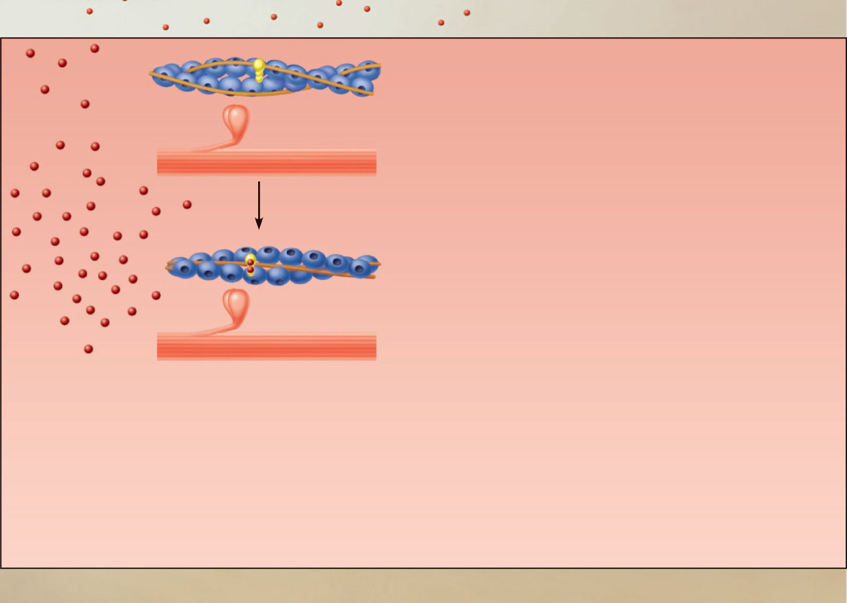
Actin
Troponin
Tropomyosin
blocking active sites
Ca²⁺
Myosin
3
Calcium binds to
troponin and removes
the blocking action of
tropomyosin.
Active sites exposed and
ready for myosin binding
The aftermath
Figure 9.11, step 6

Slide 58
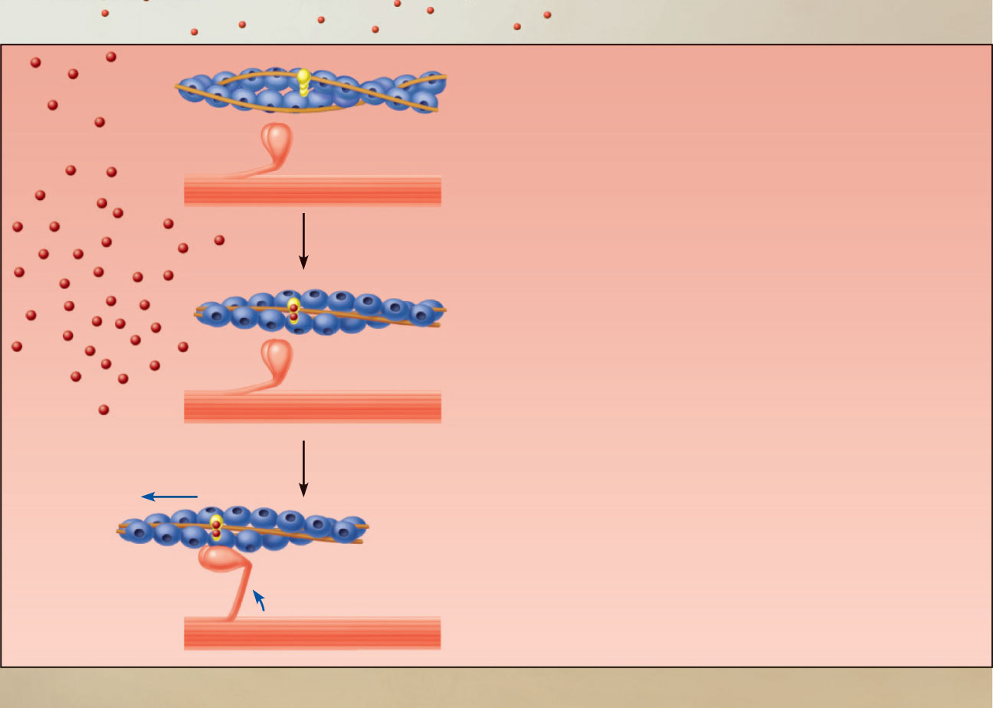
Actin
Troponin
Tropomyosin
blocking active sites
Ca²⁺
Myosin
3
Calcium binds to
troponin and removes
the blocking action of
tropomyosin.
Active sites exposed and
ready for myosin binding
Contraction begins
4
Myosin
cross
bridge
The aftermath
Figure 9.11, step 7

Slide 59
Steps in E-C Coupling:
Sarcolemma
Voltage-sensitive
tubule protein
T tubule
Action potential is propagated along
the sarcolemma and down the T tubules.
1
Ca²⁺
release
channel
2
Terminal
cisterna
of SR
Calcium ions are released.
Ca²⁺
Actin
Ca²⁺
Troponin
Tropomyosin
blocking active sites
Myosin
3
Calcium binds to troponin and
removes the blocking action of
tropomyosin.
Active sites exposed and
ready for myosin binding
4
Contraction begins
Myosin
cross
bridge
The aftermath
Figure 9.11, step 8

Slide 60
Actin
Troponin
Tropomyosin
blocking active sites
Ca²⁺
Myosin
3
Calcium binds to
troponin and removes
the blocking action of
tropomyosin.
Active sites exposed and
ready for myosin binding
Contraction begins
4
Myosin
cross
bridge
The aftermath
Figure 9.11, step 7

Slide 61
Role of Calcium (Ca²⁺) in Contraction
At low intracellular Ca²⁺ concentration:
  Tropomyosin blocks the active sites on actin
  Myosin heads cannot attach to actin
  Muscle fiber relaxes

Slide 62
Role of Calcium (Ca²⁺) in Contraction
At higher intracellular Ca²⁺ concentrations:
  Ca²⁺ binds to troponin
  Troponin changes shape and moves tropomyosin away from active sites
  Events of the cross bridge cycle occur
  When nervous stimulation ceases, Ca²⁺ is pumped back into the SR and contraction ends

Slide 63
Cross Bridge Cycle
Continues as long as the Ca2+ signal and adequate ATP are present
Cross bridge formation—high-energy myosin head attaches to thin filament
Working (power) stroke—myosin head pivots and pulls thin filament toward M line

Slide 64
Cross Bridge Cycle
Cross bridge detachment—ATP attaches to myosin head and the cross bridge detaches
“Cocking” of the myosin head—energy from hydrolysis of ATP cocks the myosin head into the high-energy state

Slide 65
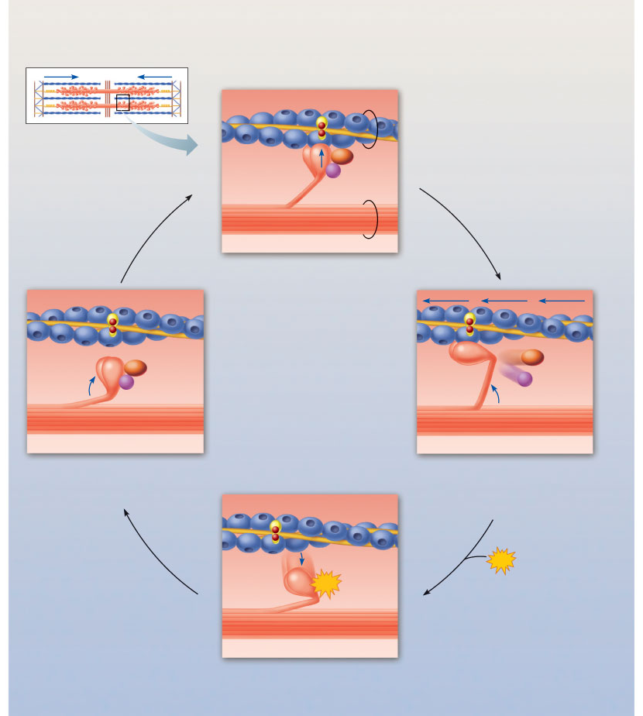
Thin filament
Actin
Ca²⁺
Myosin
cross bridge
ADP
P_{i}
Thick
filament
Myosin
1
Cross bridge formation.
ADP
ADP
P_{i}
ATP
hydrolysis
P_{i}
4
Cocking of myosin head.
2
The power (working)
stroke.
ATP
ATP
3
Cross bridge
detachment.
Figure 9.12

Slide 66
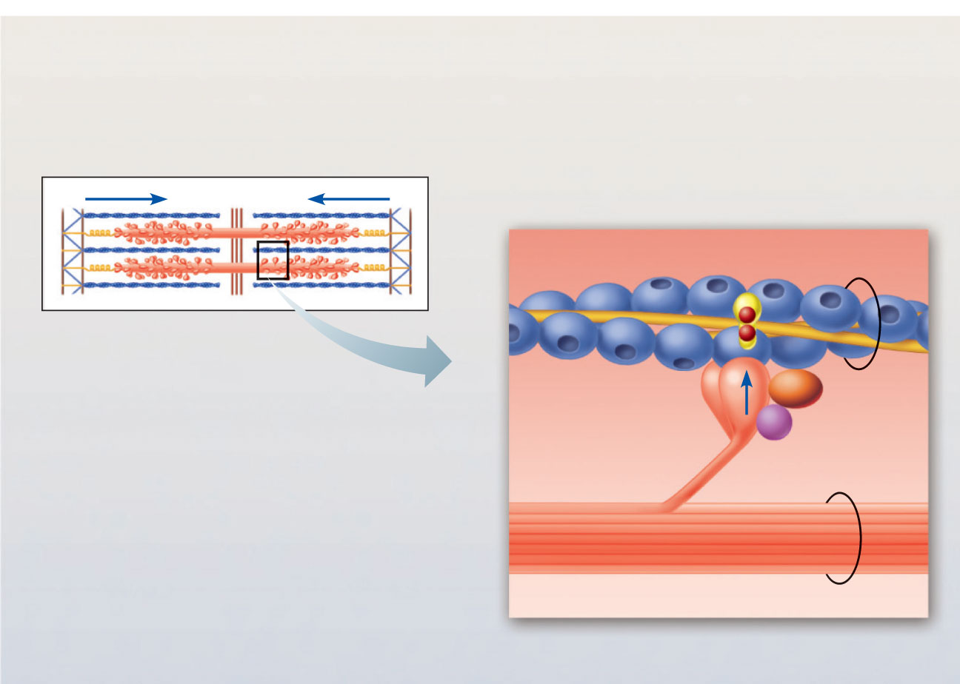
Actin
Ca²⁺
Thin filament
ADP
Myosin
cross bridge
Pi
Thick filament
Myosin
1
Cross bridge formation.
Figure 9.12, step 1

Slide 67
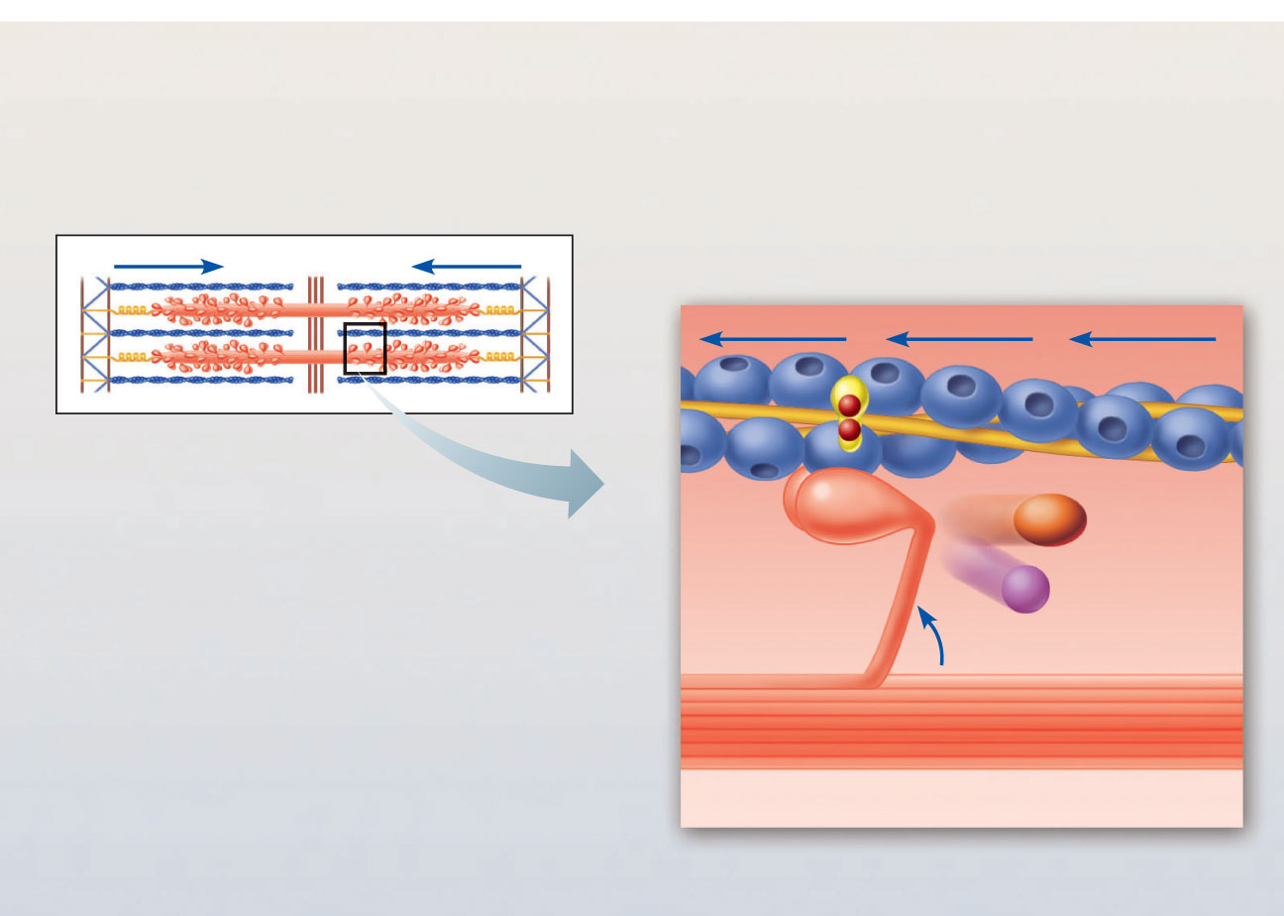
ADP
Pi
2
The power (working) stroke.
Figure 9.12, step 3

Slide 68
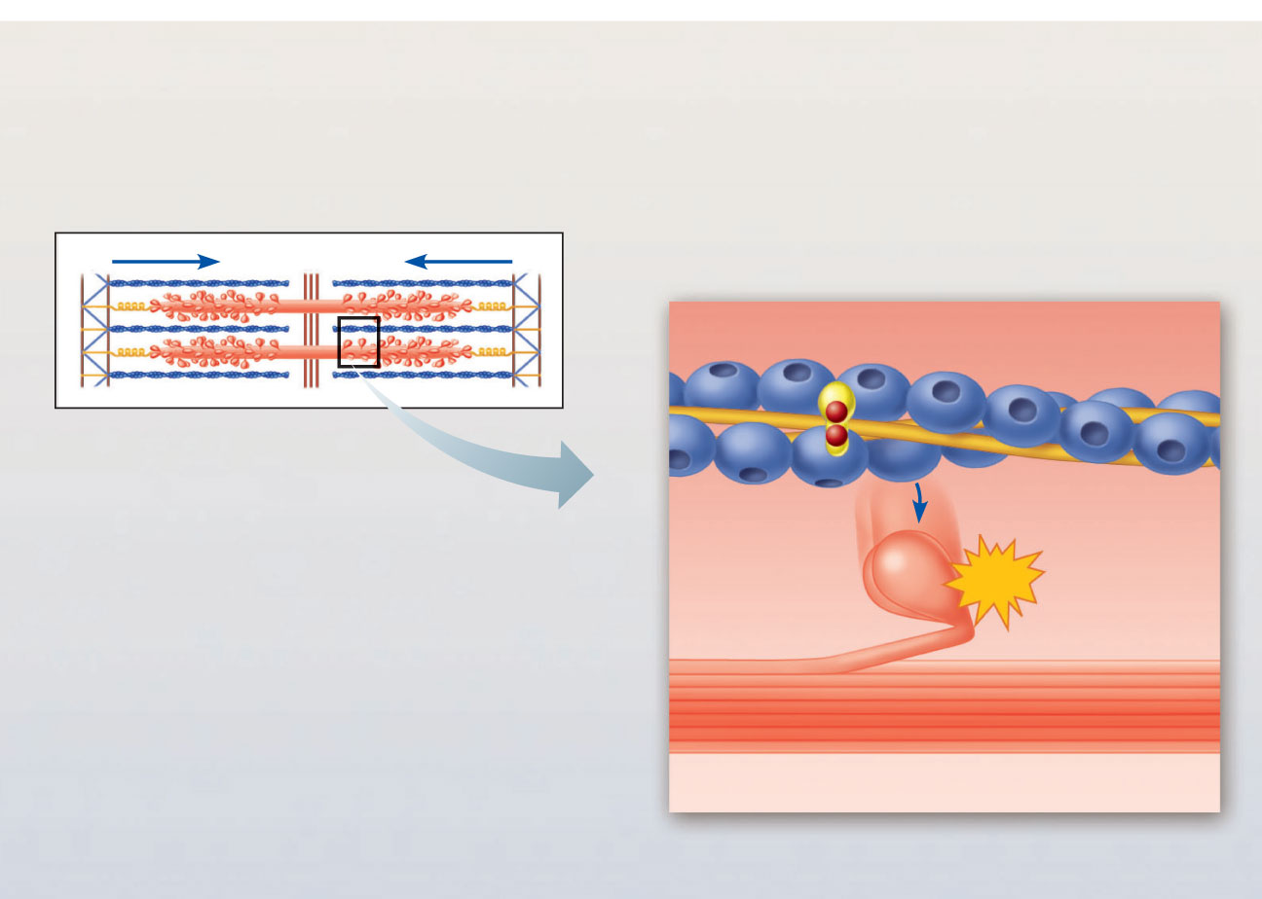
ATP
3
Cross bridge detachment.
Figure 9.12, step 4

Slide 69
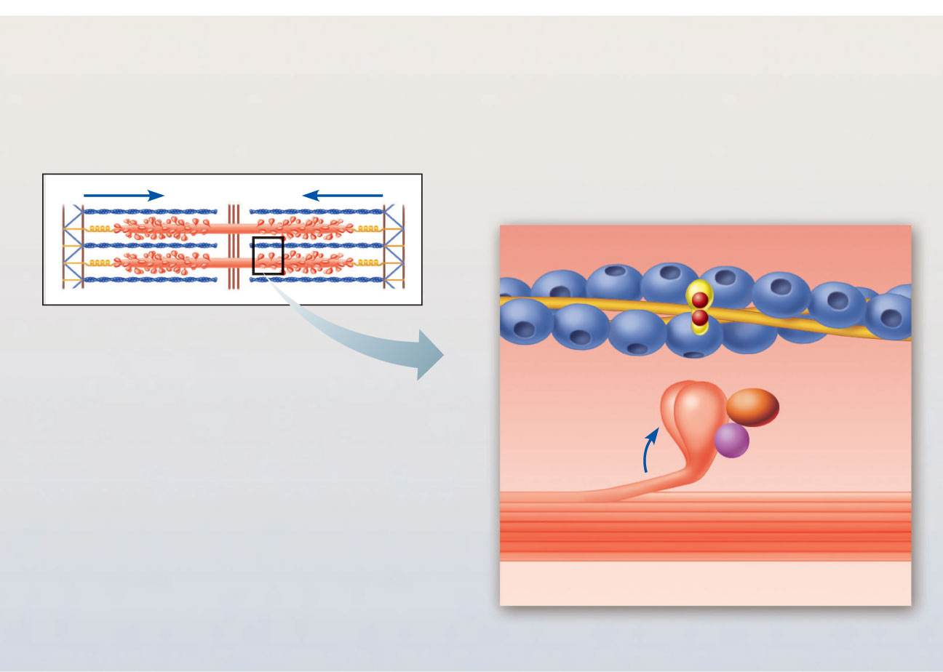
ADP
Pi
ATP
hydrolysis
4
Cocking of myosin head.
Figure 9.12, step 5

Slide 70
Thin filament
Actin
Ca²⁺
Myosin
cross bridge
ADP
P_{i}
Thick
filament
Myosin
1
Cross bridge formation.
ADP
ADP
P_{i}
ATP
hydrolysis
P_{i}
4
Cocking of myosin head.
2
The power (working)
stroke.
ATP
ATP
3
Cross bridge
detachment.
Figure 9.12

