Slide 1
9
Muscle 3
Mike Clark, M.D.

Slide 2
Force of Muscle Contraction
The force of contraction is affected by:
  Number of muscle fibers stimulated (recruitment)
  Relative size of the fibers—hypertrophy of cells increases strength

Slide 3
Force of Muscle Contraction
The force of contraction is affected by:
  Frequency of stimulation—↑ frequency allows time for more effective transfer of tension to noncontractile components
  Length-tension relationship—muscles contract most strongly when muscle fibers are 80–120% of their normal resting length

Slide 4
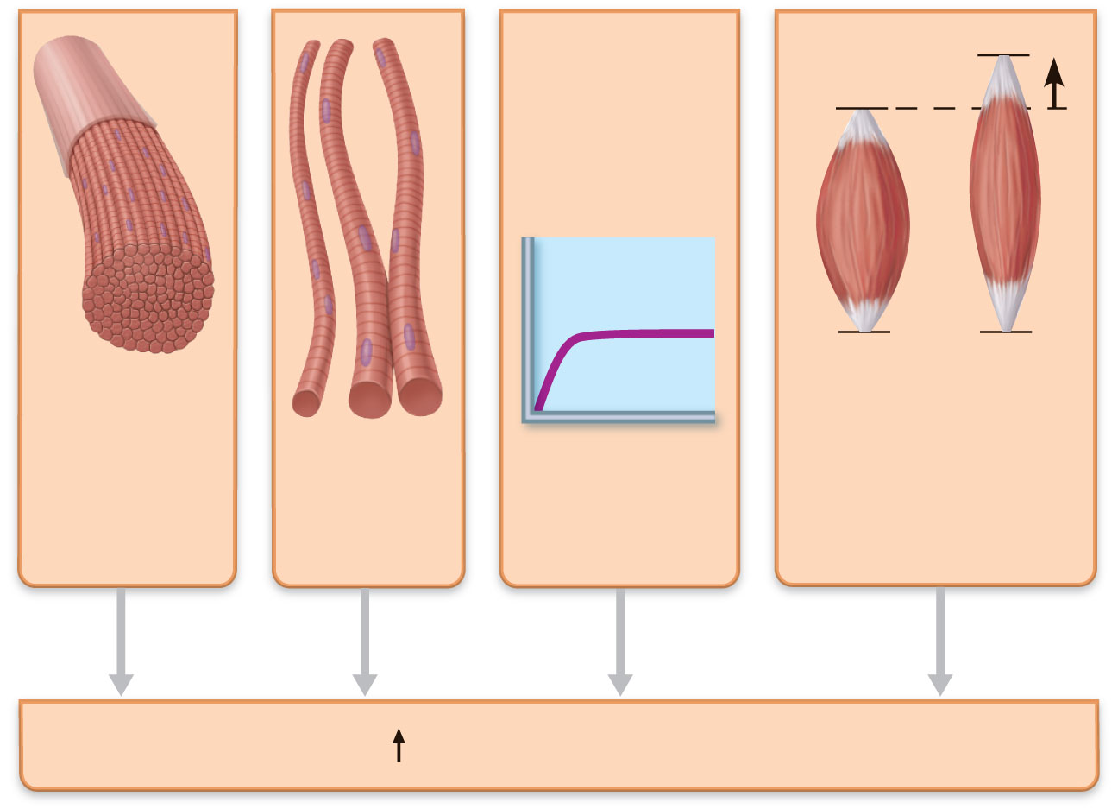
Large
number of
muscle
fibers
activated
Muscle and
sarcomere
stretched to
slightly over 100%
of resting length
Large
muscle
fibers
High
frequency of
stimulation
Contractile force
Figure 9.21

Slide 5
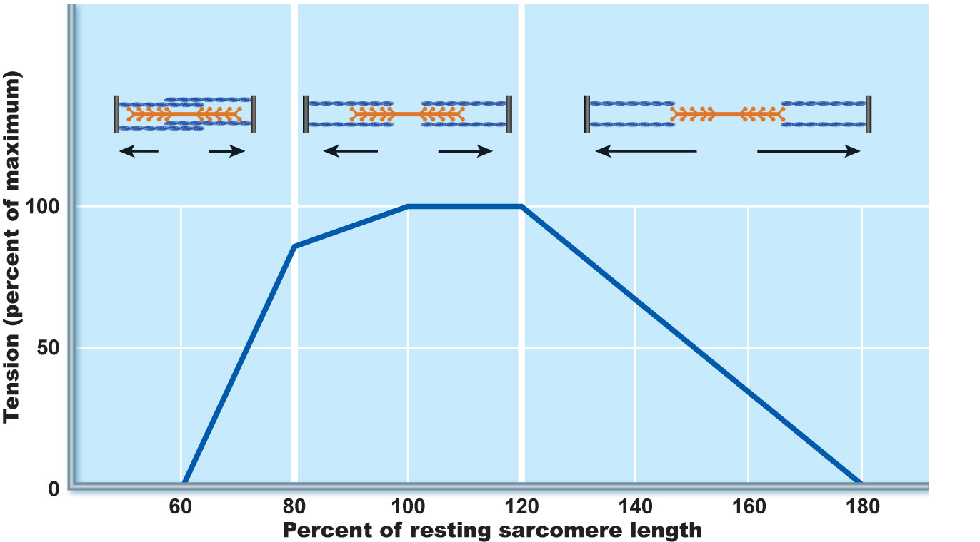
Sarcomeres
greatly
shortened
Sarcomeres at
resting length
Sarcomeres excessively
stretched
75%
100%
170%
Optimal sarcomere
operating length
(80%–120% of
resting length)
Figure 9.22

Slide 6
Velocity and Duration of Contraction
Influenced by:
  Muscle fiber type
  Load - that what the muscle is having to work against
  Recruitment

Slide 7
Muscle Fiber Type
Classified according to two characteristics:
Speed of contraction: slow or fast, according to:
  Speed at which myosin ATPases split ATP
  Pattern of electrical activity of the motor neurons

Slide 8
Muscle Fiber Type
Metabolic pathways for ATP synthesis:
  Oxidative fibers—use aerobic pathways (Krebs and Electron Transport Chain)
  Glycolytic fibers—use anaerobic glycolysis

Slide 9
Muscle Fiber Type
Three types:
  Slow oxidative fibers
  Fast oxidative fibers
  Fast glycolytic fibers

Slide 10
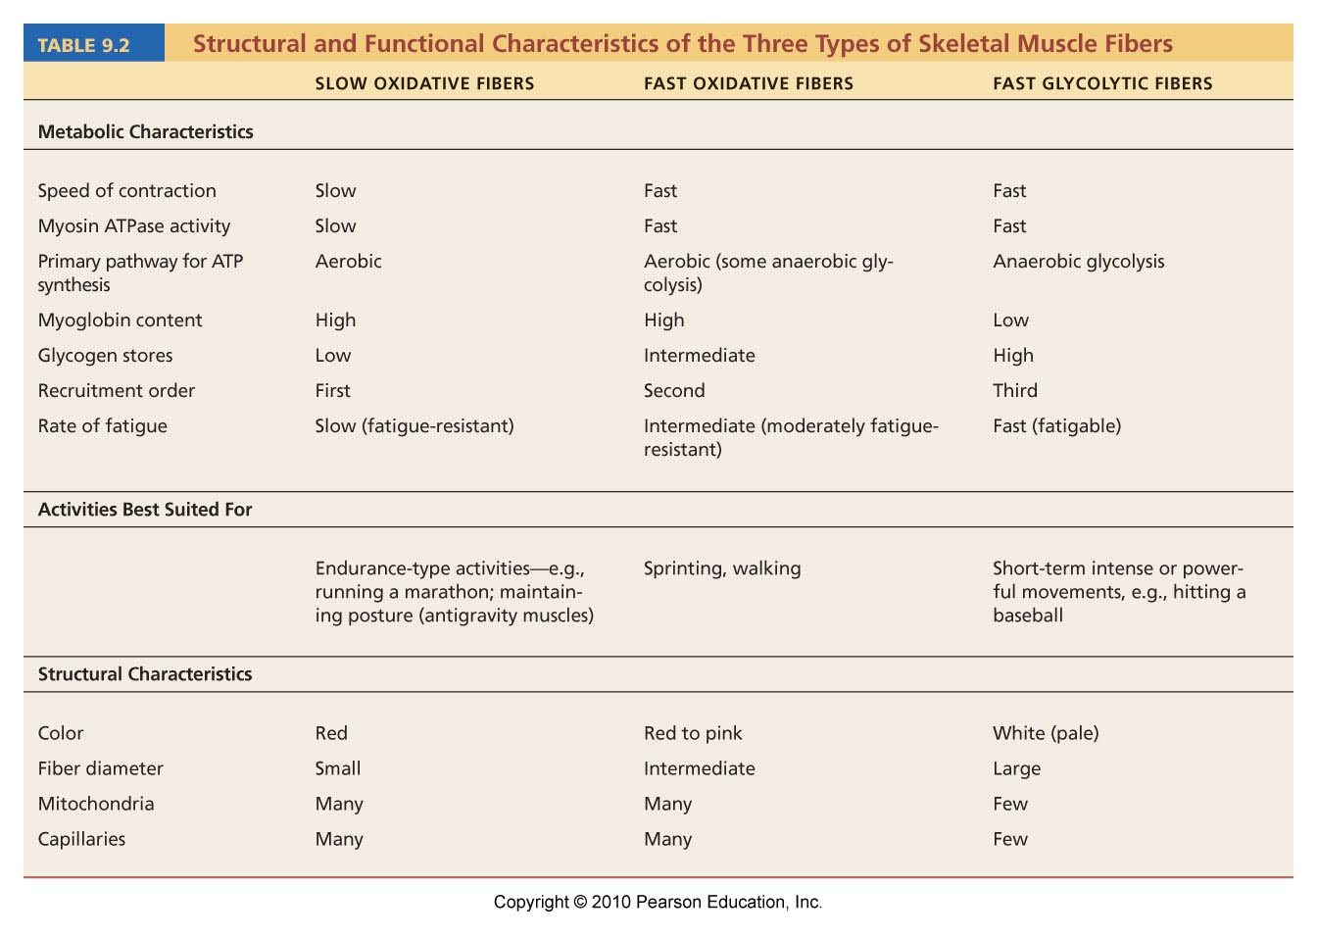
Table 9.2

Slide 11
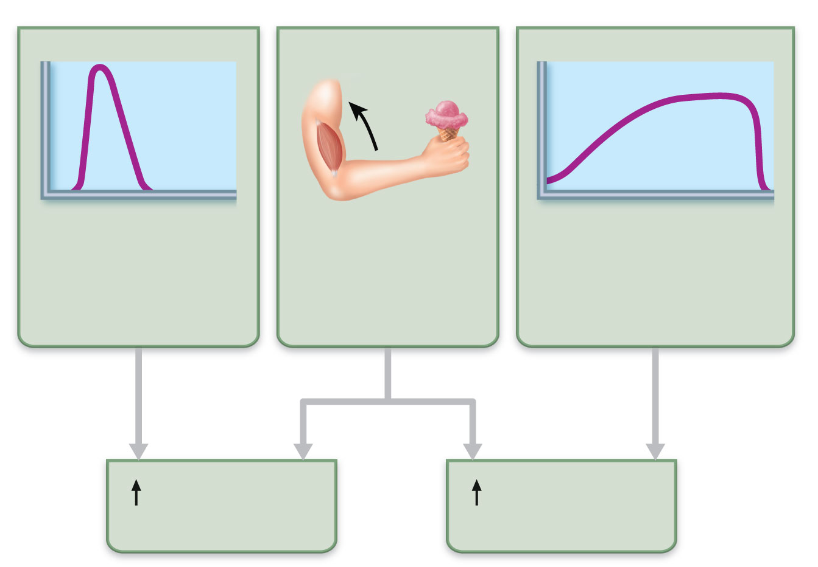
Predominance
of fast glycolytic
(fatigable) fibers
Small load
Predominance
of slow oxidative
(fatigue-resistant)
fibers
Contractile
velocity
Contractile
duration
Figure 9.23

Slide 12
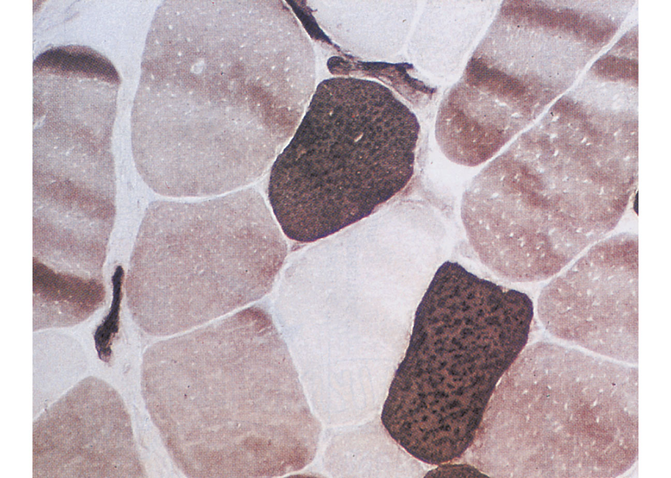
FO
SO
FG
Figure 9.24

Slide 13
Influence of Load
↑ load → ↑ latent period, ↓ contraction, and ↓ duration of contraction

Slide 14
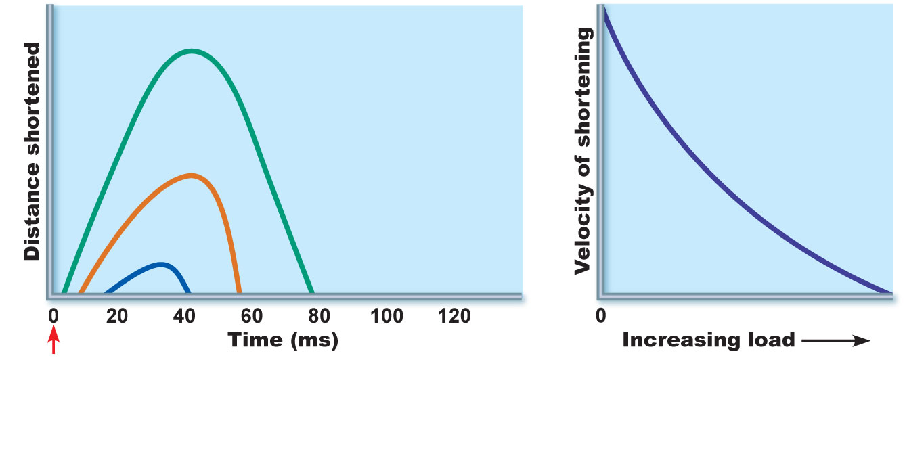
Light load
Intermediate load
Heavy load
Stimulus
(a) The greater the load, the less the muscle
shortens and the shorter the duration of
contraction
(b) The greater the load, the
slower the contraction
Figure 9.25

Slide 15
Influence of Recruitment
Recruitment → faster contraction and ↑ duration of contraction

Slide 16
Effects of Exercise
Aerobic (endurance) exercise:
Leads to increased:
  Muscle capillaries
  Number of mitochondria
  Myoglobin synthesis
Results in greater endurance, strength, and resistance to fatigue
May convert fast glycolytic fibers into fast oxidative fibers

Slide 17
Effects of Resistance Exercise
Resistance exercise (typically anaerobic) results in:
  Muscle hypertrophy (due to increase in fiber size)
  Increased mitochondria, myofilaments, glycogen stores, and connective tissue

Slide 18
The Overload Principle
Forcing a muscle to work hard promotes increased muscle strength and endurance
Muscles adapt to increased demands
Muscles must be overloaded to produce further gains

Slide 19
Smooth Muscle
Found in walls of most hollow organs
(except heart)
Usually in two layers (longitudinal and circular)

Slide 20
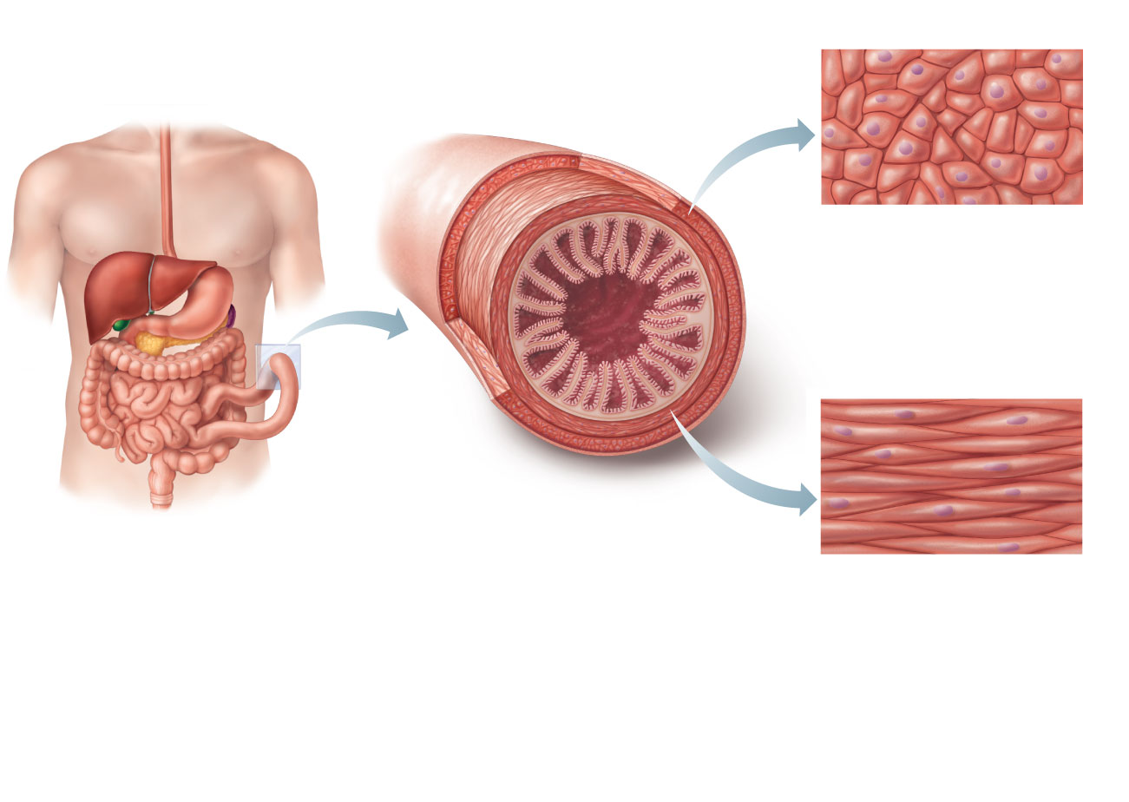
Longitudinal layer
of smooth muscle
(shows smooth
muscle fibers in
cross section)
Small
intestine
Mucosa
(a)
(b) Cross section of the
intestine showing the
smooth muscle layers
(one circular and the
other longitudinal)
running at right
angles to each other.
Circular layer of
smooth muscle
(shows longitudinal
views of smooth
muscle fibers)
Figure 9.26

Slide 21
Peristalsis
Alternating contractions and relaxations of smooth muscle layers that mix and squeeze substances through the lumen of hollow organs
  Longitudinal layer contracts; organ dilates and shortens
  Circular layer contracts; organ constricts and elongates

Slide 22
Microscopic Structure
Spindle-shaped fibers: thin and short compared with skeletal muscle fibers
Connective tissue: endomysium only
SR: less developed than in skeletal muscle
Pouchlike infoldings (caveolae) of sarcolemma sequester Ca²⁺
No sarcomeres, myofibrils, or T tubules

Slide 23
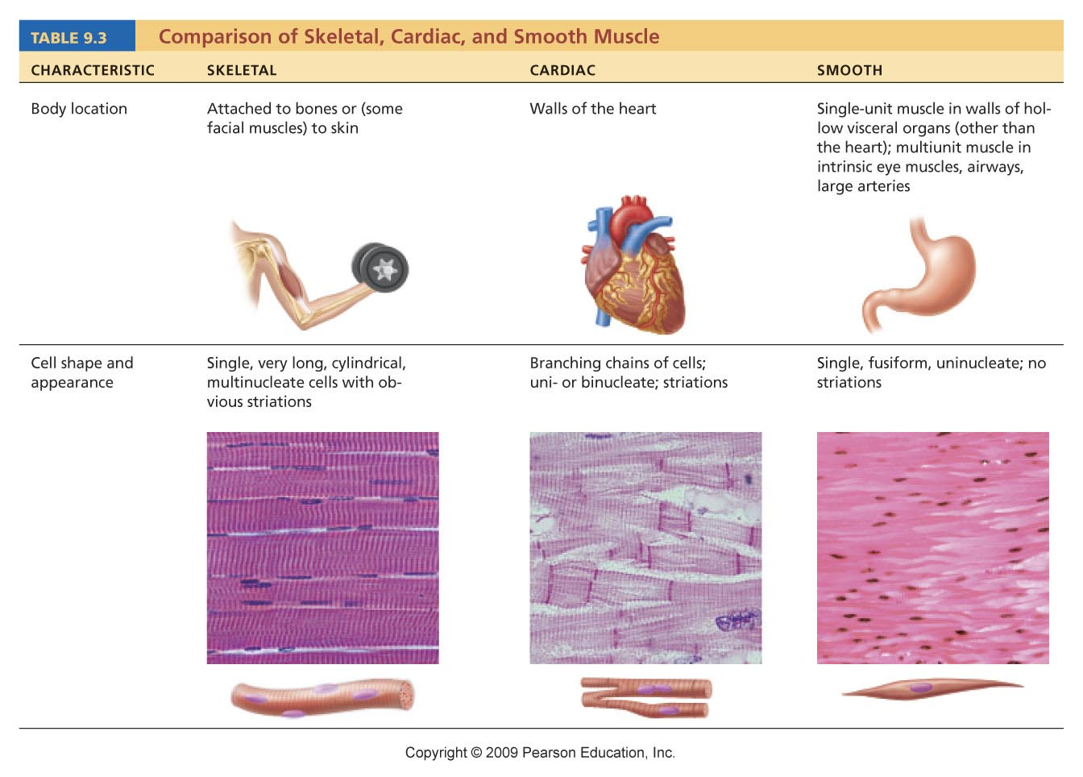
Table 9.3

Slide 24
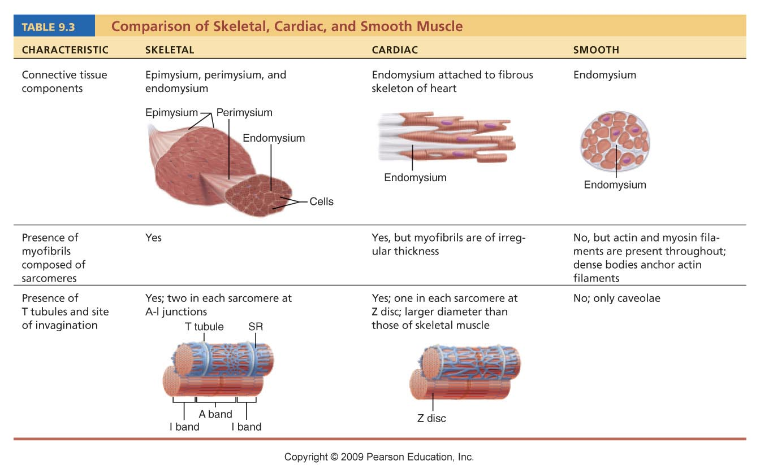
Table 9.3

Slide 25
Innervation of Smooth Muscle
Autonomic nerve fibers innervate smooth muscle at diffuse junctions
Varicosities (bulbous swellings) of nerve fibers store and release neurotransmitters

Slide 26
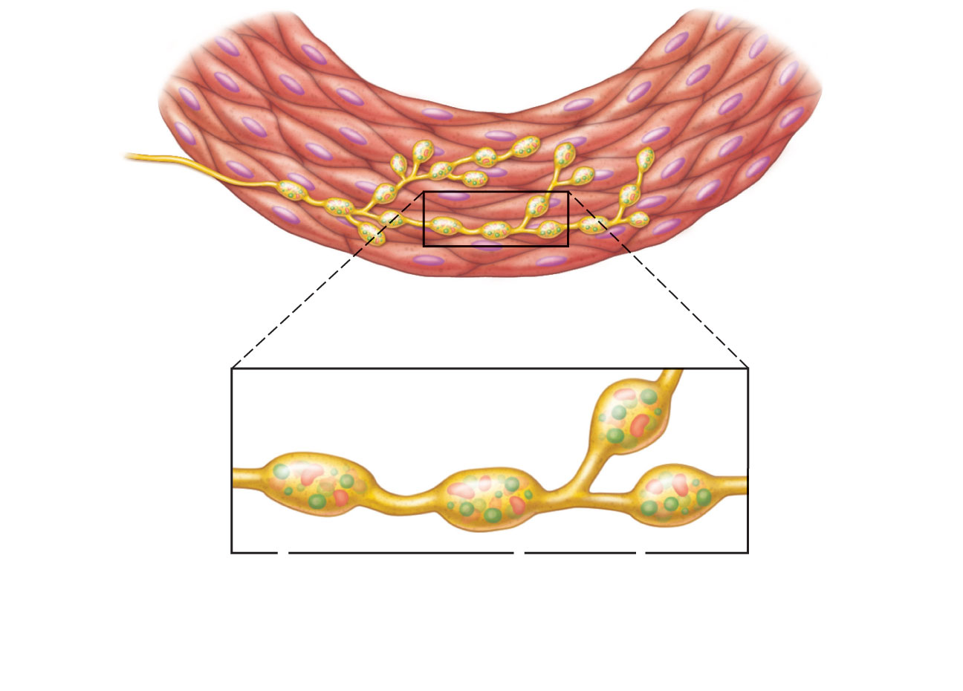
Varicosities
Autonomic
nerve fibers
innervate
most smooth
muscle fibers.
Smooth
muscle
cell
Synaptic
vesicles
Mitochondrion
Varicosities release
their neurotransmitters
into a wide synaptic
cleft (a diffuse junction).
Figure 9.27

Slide 27
Myofilaments in Smooth Muscle
Ratio of thick to thin filaments (1:13) is much lower than in skeletal muscle (1:2)
Thick filaments have heads along their entire length
No troponin complex; protein calmodulin binds Ca²⁺

Slide 28
Myofilaments in Smooth Muscle
Myofilaments are spirally arranged, causing smooth muscle to contract in a corkscrew manner
Dense bodies: proteins that anchor noncontractile intermediate filaments to sarcolemma at regular intervals – the dense bodies also attach to the Actin filaments – thus acting as a type of Z-line

Slide 29
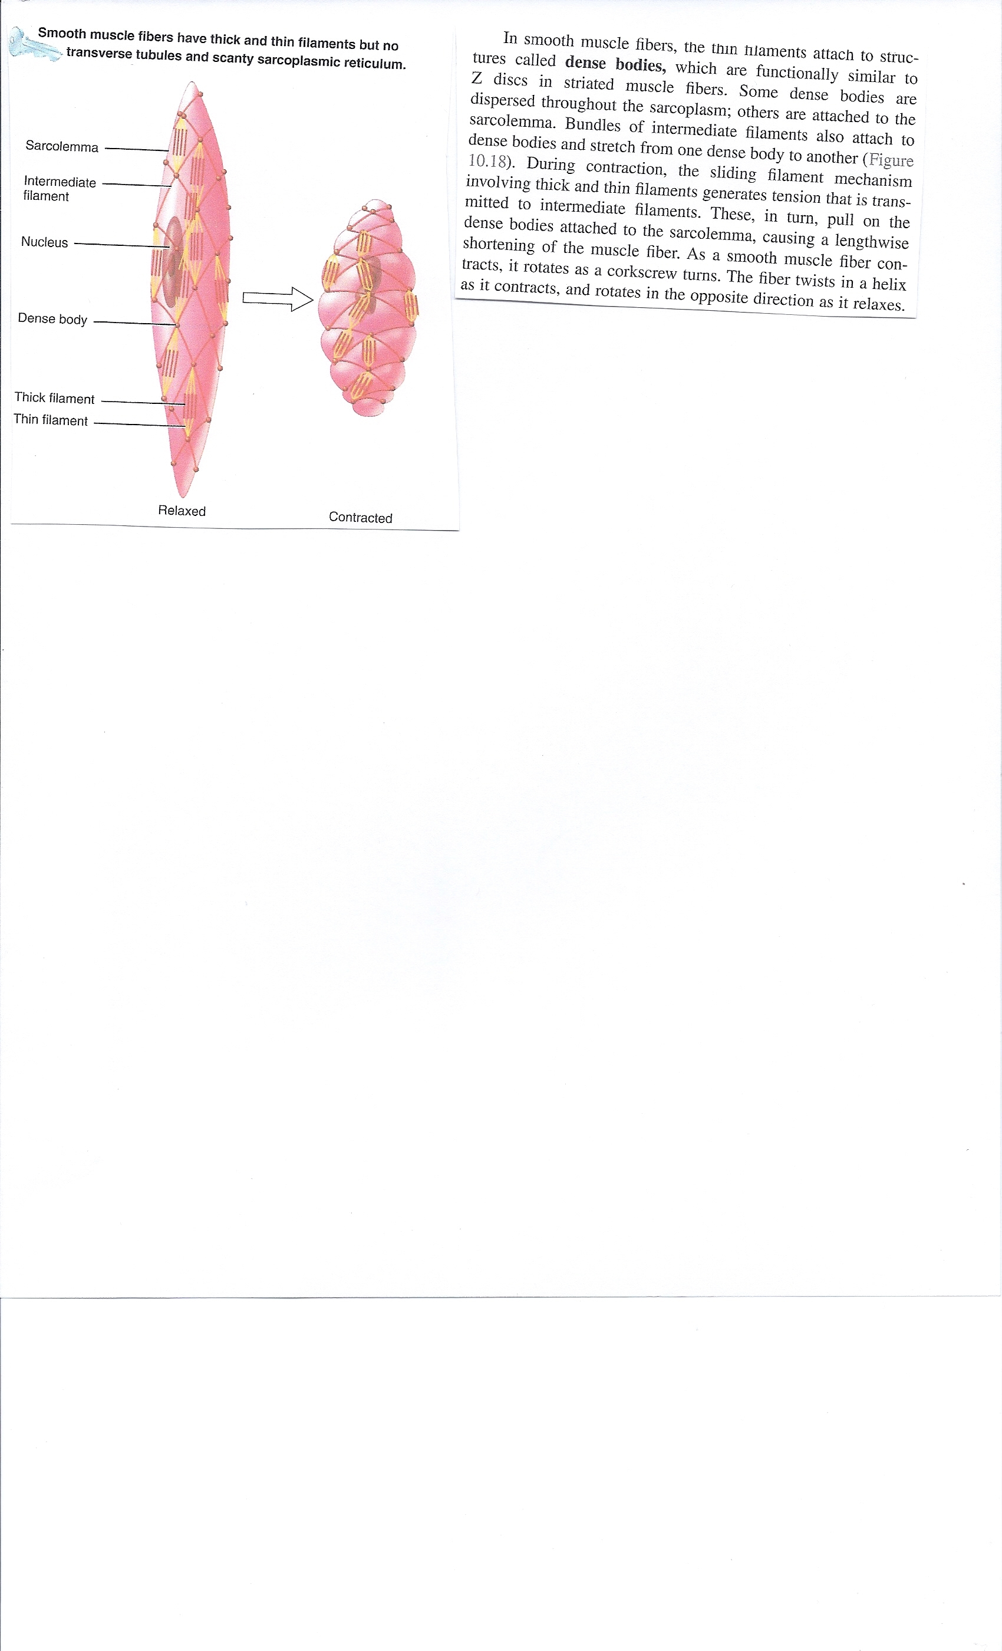

Slide 30
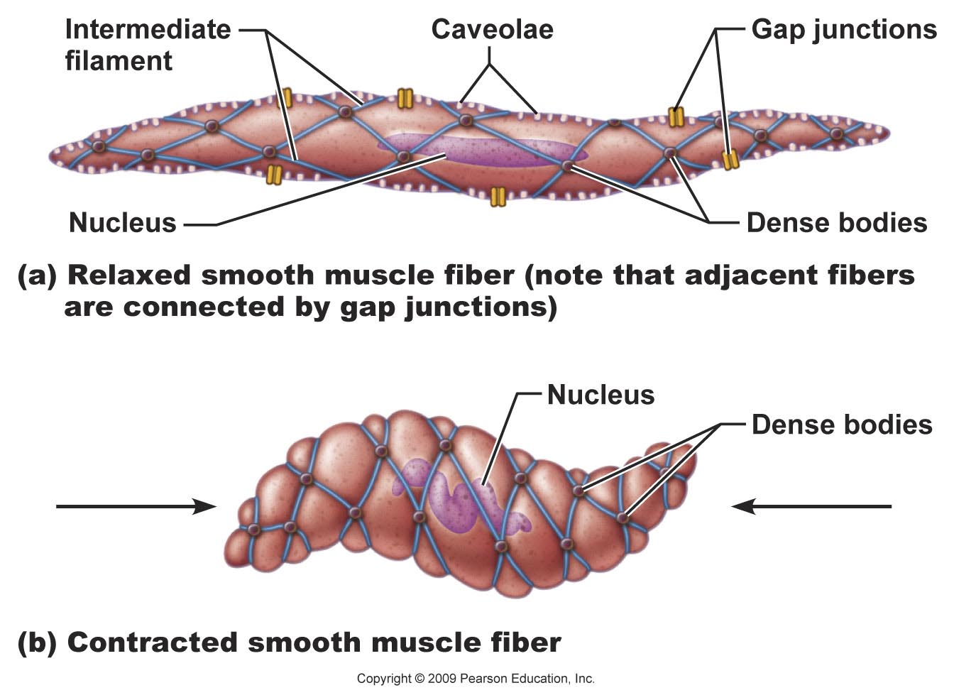
Figure 9.28a

Slide 31
Figure 9.28b

Slide 32
Contraction of Smooth Muscle
Slow, synchronized contractions
Cells are electrically coupled by gap junctions
Some cells are self-excitatory (depolarize without external stimuli); act as pacemakers for sheets of muscle
Rate and intensity of contraction may be modified by neural and chemical stimuli

Slide 33
Contraction of Smooth Muscle
Sliding filament mechanism
Final trigger is ↑ intracellular Ca²⁺
Ca²⁺ is obtained from the SR and extracellular space

Slide 34
Role of Calcium Ions
Ca²⁺ binds to and activates calmodulin
Activated calmodulin activates myosin (light chain) kinase
Activated kinase phosphorylates and activates myosin
Cross bridges interact with actin

Slide 35
Table 9.3

Slide 36
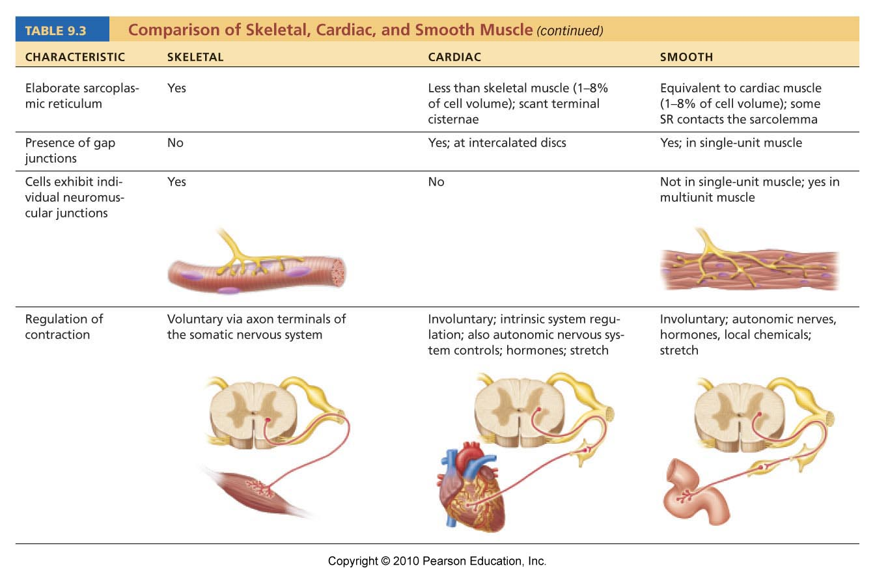
Table 9.3

Slide 37
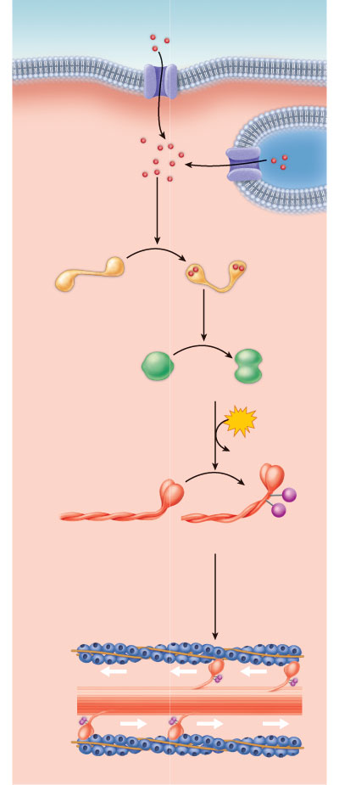
Extracellular fluid (ECF)
Ca²⁺
Plasma membrane
Cytoplasm
1
Calcium ions (Ca²⁺)
enter the cytosol from
the ECF via voltage-
dependent or voltage-
independent Ca²⁺
channels, or from
the scant SR.
Ca²⁺
2
Sarcoplasmic
reticulum
Ca²⁺ binds to and
activates calmodulin.
Ca²⁺
Inactive calmodulin
Activated calmodulin
3
Activated calmodulin
activates the myosin
light chain kinase
enzymes.
Inactive kinase
Activated kinase
4
ATP
The activated kinase enzymes
catalyze transfer of phosphate
to myosin, activating the myosin
ATPases.
ADP
Pi
Pi
Inactive
myosin molecule
Activated (phosphorylated)
myosin molecule
5
Activated myosin forms cross
bridges with actin of the thin
filaments and shortening begins.
Thin
filament
Thick
filament
Figure 9.29

Slide 38
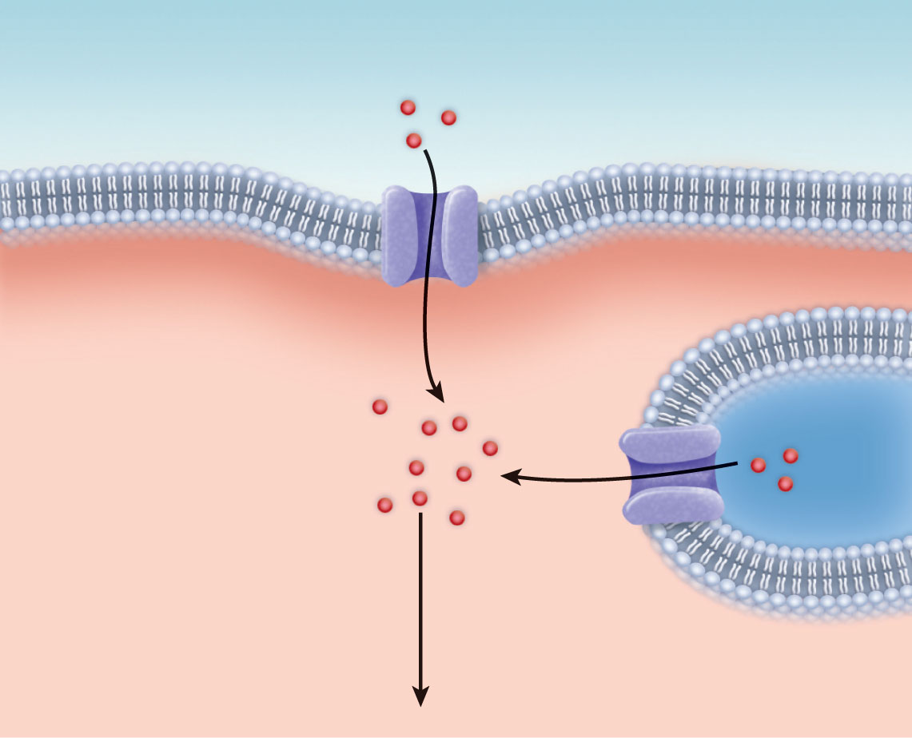
Extracellular fluid (ECF)
Ca²⁺
Plasma membrane
Cytoplasm
1
Calcium ions (Ca²⁺)
enter the cytosol from
the ECF via voltage-
dependent or voltage-
independent Ca²⁺
channels, or from
the scant SR.
Ca²⁺
Sarcoplasmic
reticulum
Figure 9.29, step 1

Slide 39
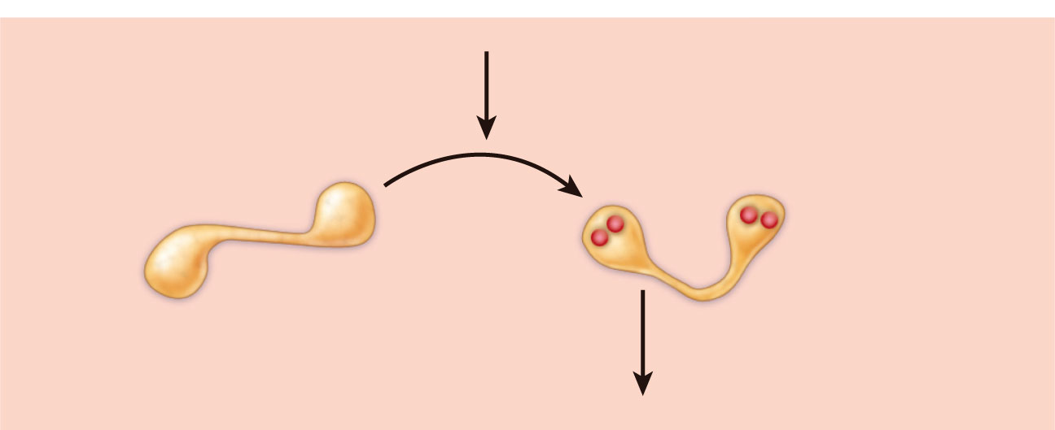
2
Ca²⁺ binds to and
activates calmodulin.
Ca²⁺
Inactive calmodulin
Activated calmodulin
Figure 9.29, step 2

Slide 40
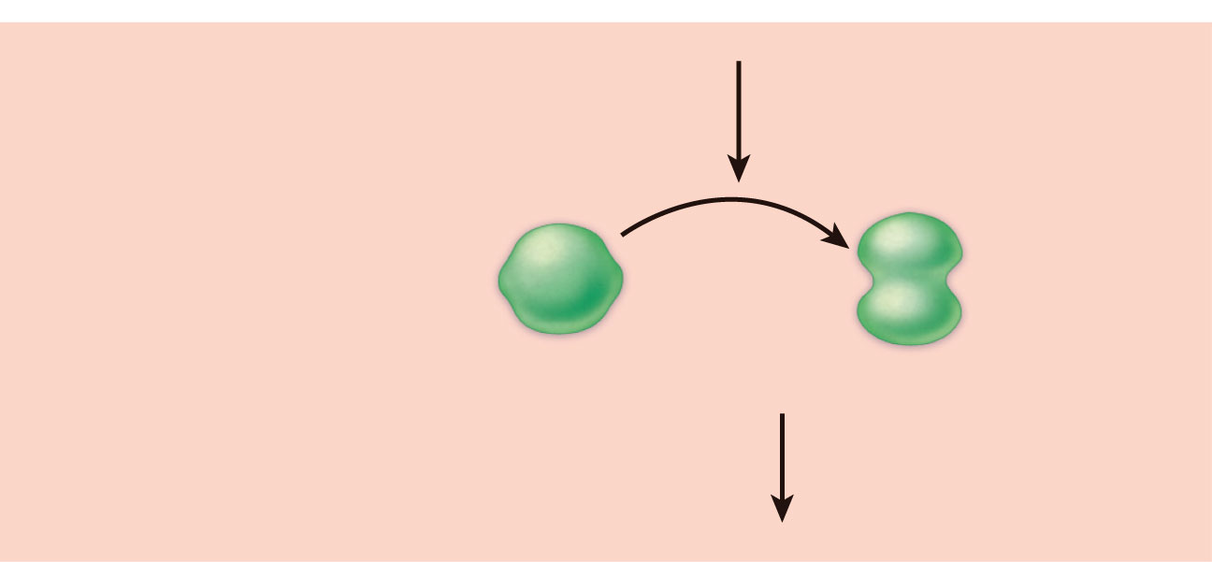
3
Activated calmodulin
activates the myosin
light chain kinase
enzymes.
Inactive kinase
Activated kinase
Figure 9.29, step 3

Slide 41
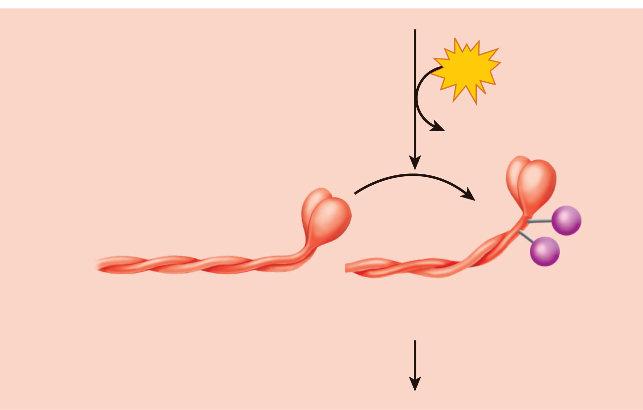
4
ATP
The activated kinase enzymes
catalyze transfer of phosphate
to myosin, activating the myosin
ATPases.
ADP
Pi
Pi
Inactive
myosin molecule
Activated (phosphorylated)
myosin molecule
Figure 9.29, step 4

Slide 42
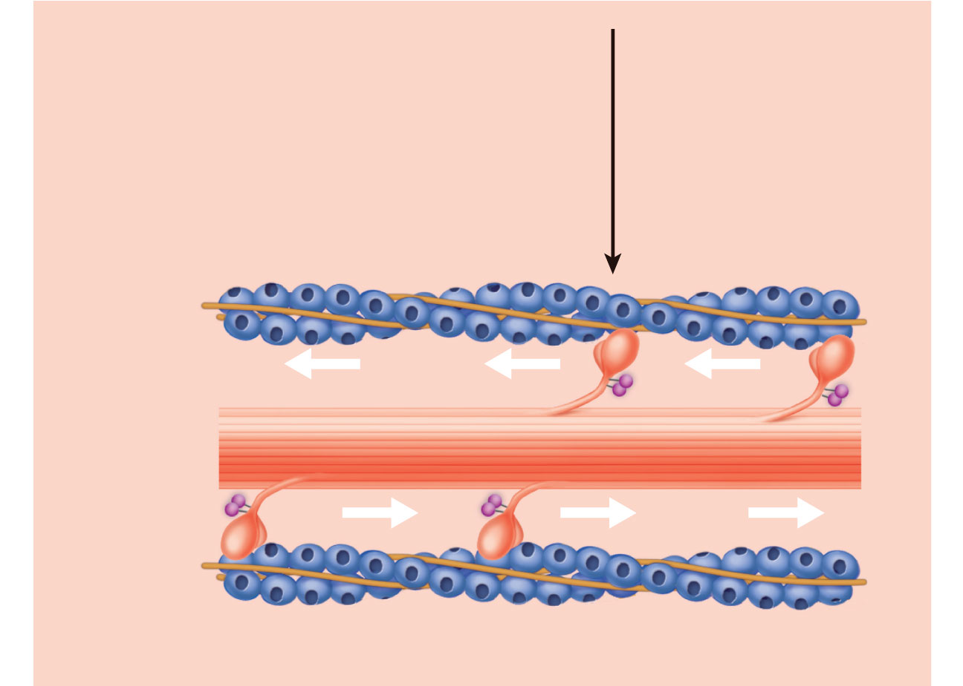
5
Activated myosin forms cross
bridges with actin of the thin
filaments and shortening begins.
Thin
filament
Thick
filament
Figure 9.29, step 5

Slide 43
Extracellular fluid (ECF)
Ca²⁺
Plasma membrane
Cytoplasm
1
Calcium ions (Ca²⁺)
enter the cytosol from
the ECF via voltage-
dependent or voltage-
independent Ca²⁺
channels, or from
the scant SR.
Ca²⁺
2
Sarcoplasmic
reticulum
Ca²⁺ binds to and
activates calmodulin.
Ca²⁺
Inactive calmodulin
Activated calmodulin
3
Activated calmodulin
activates the myosin
light chain kinase
enzymes.
Inactive kinase
Activated kinase
4
ATP
The activated kinase enzymes
catalyze transfer of phosphate
to myosin, activating the myosin
ATPases.
ADP
Pi
Pi
Inactive
myosin molecule
Activated (phosphorylated)
myosin molecule
5
Activated myosin forms cross
bridges with actin of the thin
filaments and shortening begins.
Thin
filament
Thick
filament
Figure 9.29

Slide 44
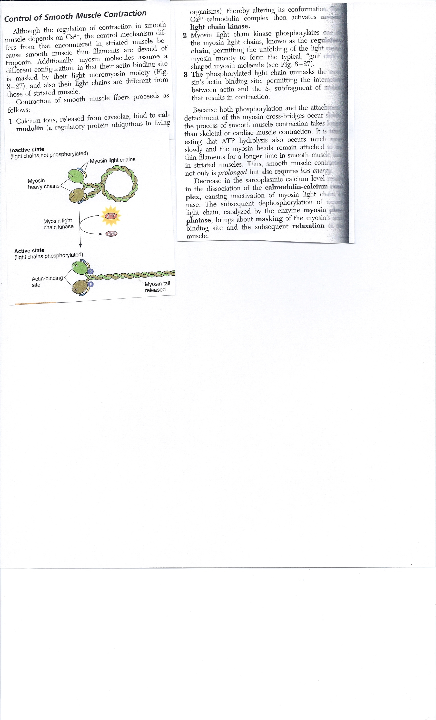

Slide 45
Contraction of Smooth Muscle
Very energy efficient (slow ATPases)
Myofilaments may maintain a latch state for prolonged contractions
Relaxation requires:
Ca²⁺ detachment from calmodulin
Active transport of Ca²⁺ into SR and ECF
Dephosphorylation of myosin to reduce myosin ATPase activity

Slide 46
Regulation of Contraction
Neural regulation:
Neurotransmitter binding → ↑ [Ca²⁺] in sarcoplasm; either graded (local) potential or action potential
Response depends on neurotransmitter released and type of receptor molecules

Slide 47
Regulation of Contraction
Hormones and local chemicals:
  May bind to G protein–linked receptors
  May either enhance or inhibit Ca²⁺ entry

Slide 48
Special Features of Smooth Muscle Contraction
Stress-relaxation response:
  Responds to stretch only briefly, then adapts to new length
  Retains ability to contract on demand
  Enables organs such as the stomach and bladder to temporarily store contents
Length and tension changes:
  Can contract when between half and twice its resting length

Slide 49
Special Features of Smooth Muscle Contraction
Hyperplasia:
  Smooth muscle cells can divide and increase their numbers
  Example:
    estrogen effects on uterus at puberty and during pregnancy

Slide 50
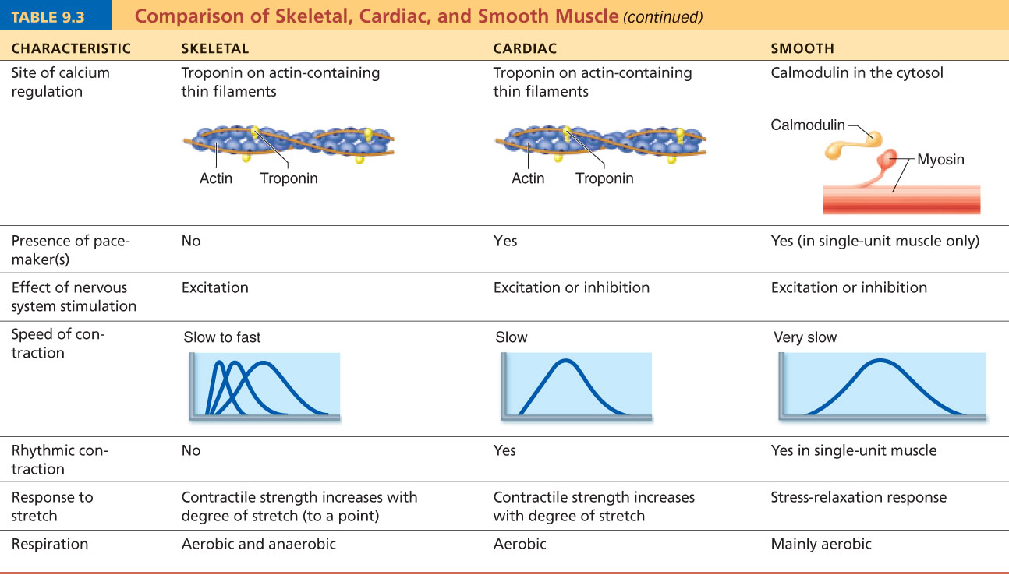
Table 9.3

Slide 51
Types of Smooth Muscle
Single-unit (visceral) smooth muscle:
  Sheets contract rhythmically as a unit (gap junctions)
  Often exhibit spontaneous action potentials
  Arranged in opposing sheets and exhibit stress-relaxation response

Slide 52
Types of Smooth Muscle: Multiunit
Multiunit smooth muscle:
  Located in large airways, large arteries, arrector pili muscles, and iris of eye
  Gap junctions are rare
  Arranged in motor units
  Graded contractions occur in response to neural stimuli

Slide 53
Developmental Aspects
All muscle tissues develop from embryonic myoblasts
Multinucleated skeletal muscle cells form by fusion
Growth factor agrin stimulates clustering of ACh receptors at neuromuscular junctions
Cardiac and smooth muscle myoblasts develop gap junctions

Slide 54
Developmental Aspects
Cardiac and skeletal muscle become amitotic, but can lengthen and thicken
Myoblast-like skeletal muscle satellite cells have limited regenerative ability
Injured heart muscle is mostly replaced by connective tissue
Smooth muscle regenerates throughout life

Slide 55
Developmental Aspects
Muscular development reflects neuromuscular coordination
Development occurs head to toe, and proximal to distal
Peak natural neural control occurs by midadolescence
Athletics and training can improve neuromuscular control

Slide 56
Developmental Aspects
Female skeletal muscle makes up 36% of body mass
Male skeletal muscle makes up 42% of body mass, primarily due to testosterone
Body strength per unit muscle mass is the same in both sexes

Slide 57
Myostatin
Myostatin (formerly known as Growth differentiation factor 8) is a growth factor that limits muscle tissue growth, i.e. higher concentrations of myostatin in the body may cause the individual to have less developed muscles. The myostatin protein is produced primarily in skeletal muscle cells, circulates in the blood and lymph and acts on muscle tissue, apparently by slowing down the development of muscle stem cells. The precise mechanism remains unknown.

Slide 58
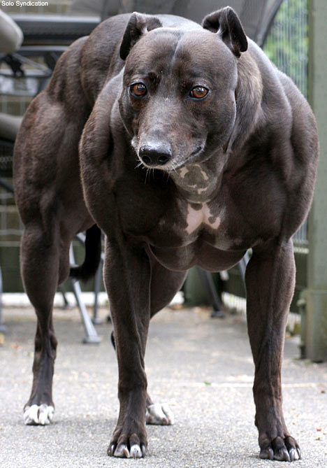
Whippet

Slide 59
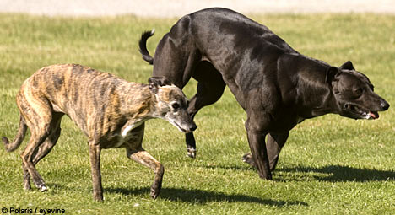
Whippets

Slide 60
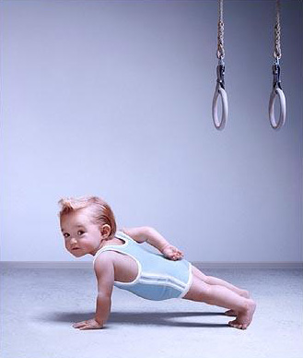
Super Baby
Before he was 5 years old, he could hold 7 lbs. weights with arms extended,

Slide 61
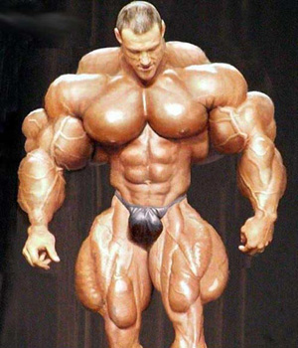
Over doing your myostatin deficiency

Slide 62
Developmental Aspects
With age, connective tissue increases and muscle fibers decrease
By age 30, loss of muscle mass (sarcopenia) begins
Regular exercise reverses sarcopenia
Atherosclerosis may block distal arteries, leading to intermittent claudication and severe pain in leg muscles

Slide 63
Muscular Dystrophy
Nine diseases including Duchenne, Becker, limb girdle, congenital, facioscapulohumeral, myotonic, oculopharyngeal, distal, and Emery-Dreifuss are always classified as muscular dystrophy but there are more than 100 diseases in total with similarities to muscular dystrophy.

Slide 64
Dystrophin
a rod-shaped cytoplasmic protein, and a vital part of a protein complex that connects the cytoskeleton of a muscle fiber to the surrounding extracellular matrix through the cell membrane.
As of 2007, dystrophin is the longest gene known, covering 2.4 megabases (0.08% of the human genome) at locus Xp21. The primary transcript measures about 2,400 kilobases and takes 16 hours to transcribe, the mature mRNA measures 14.0 kilobases. The 79 exons code for a protein of over 3500 amino acid residues.

Slide 65
Muscular Dystrophy
Group of inherited muscle-destroying diseases
Muscles enlarge due to fat and connective tissue deposits
Muscle fibers atrophy

Slide 66
Muscular Dystrophy
Duchenne muscular dystrophy (DMD):
  Most common and severe type
  Inherited, sex-linked, carried by females and expressed in males (1/3500) as lack of dystrophin
  Victims become clumsy and fall frequently; usually die of respiratory failure in their 20s
  No cure, but viral gene therapy or infusion of stem cells with correct dystrophin genes show promise

Slide 67
