Slide 1
11
Fundamentals of the Nervous System and Nervous Tissue: Part A

Slide 2
Functions of the Nervous System
Sensory input
  Information gathered by sensory receptors about internal and external changes
Integration
  Interpretation of sensory input
Motor output
  Activation of effector organs (muscles and glands) produces a response

Slide 3
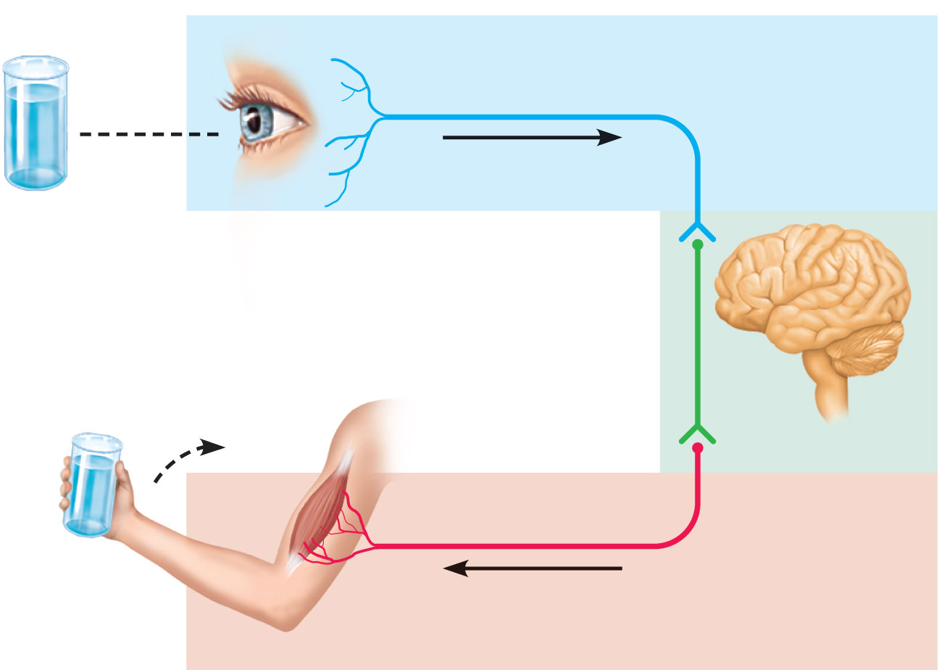
Sensory input
Integration
Motor output
Figure 11.1

Slide 4
Divisions of the Nervous System
Central nervous system (CNS)
  Brain and spinal cord
  Integration and command center
Peripheral nervous system (PNS)
  Paired spinal and cranial nerves carry messages to and from the CNS

Slide 5
Peripheral Nervous System (PNS)
Two functional divisions
  Sensory (afferent) division
    Somatic afferent fibers—convey impulses from skin, skeletal muscles, and joints
    Visceral afferent fibers—convey impulses from visceral organs
  Motor (efferent) division
    Transmits impulses from the CNS to effector organs

Slide 6
Motor Division of PNS
Somatic (voluntary) nervous system
  Conscious control of skeletal muscles

Slide 7
Motor Division of PNS
Autonomic (involuntary) nervous system (ANS)
  Visceral motor nerve fibers
  Regulates smooth muscle, cardiac muscle, and glands
  Two functional subdivisions
    Sympathetic –fear, flight and flight
    Parasympathetic – rest and recluse

Slide 8
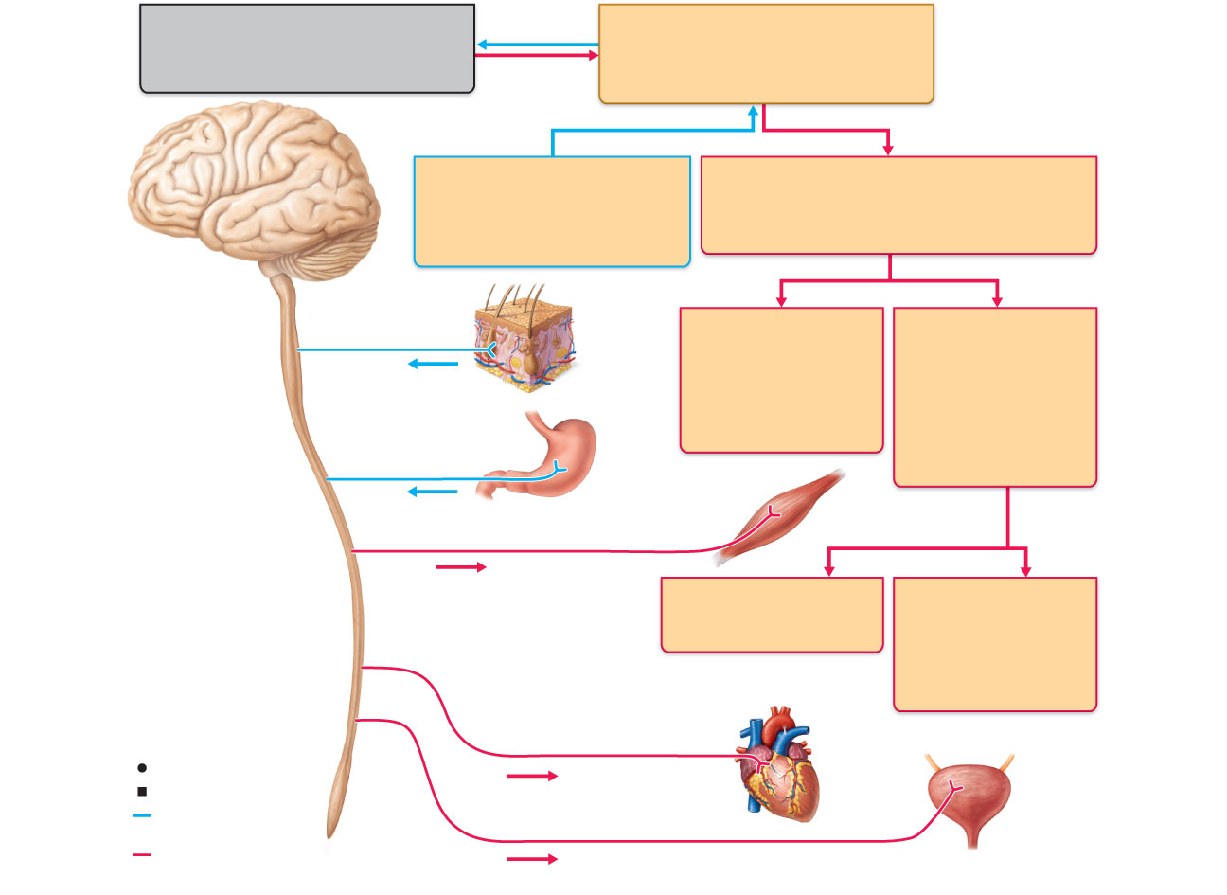
Central nervous system (CNS)
Peripheral nervous system (PNS)
Brain and spinal cord
Cranial nerves and spinal nerves
Integrative and control centers
Communication lines between the
CNS and the rest of the body
Sensory (afferent) division
Motor (efferent) division
Somatic and visceral sensory
nerve fibers
Motor nerve fibers
Conducts impulses from
receptors to the CNS
Conducts impulses from the CNS
to effectors (muscles and glands)
Somatic sensory
fiber
Somatic nervous
system
Autonomic nervous
system (ANS)
Skin
Somatic motor
(voluntary)
Visceral motor
(involuntary)
Conducts impulses
from the CNS to
skeletal muscles
Conducts impulses
from the CNS to
cardiac muscles,
smooth muscles,
and glands
Visceral sensory fiber
Stomach
Skeletal
muscle
Motor fiber of somatic nervous system
Sympathetic division
Parasympathetic
division
Mobilizes body
systems during activity
Conserves energy
Promotes house-
keeping functions
during rest
Sympathetic motor fiber of ANS
Heart
Structure
Function
Sensory (afferent)
division of PNS
Parasympathetic motor fiber of ANS
Bladder
Motor (efferent)
division of PNS
Figure 11.2

Slide 9
Histology of Nervous Tissue
Two principal cell types
  Neurons—excitable cells that transmit electrical signals – parenchymal cell – most important in nervous system

Slide 10
Histology of Nervous Tissue
Neuroglia (glial cells)—supporting cells (stromal cells):
    Astrocytes (CNS)
    Microglia (CNS)
    Ependymal cells (CNS)
    Oligodendrocytes (CNS)
    Satellite cells (PNS)
    Schwann cells (PNS)

Slide 11
Astrocytes
Most abundant, versatile, and highly branched glial cells
Cling to neurons, synaptic endings, and capillaries
Support and brace neurons

Slide 12
Astrocytes
Help determine capillary permeability
Guide migration of young neurons
Control the chemical environment
Participate in information processing in the brain

Slide 13
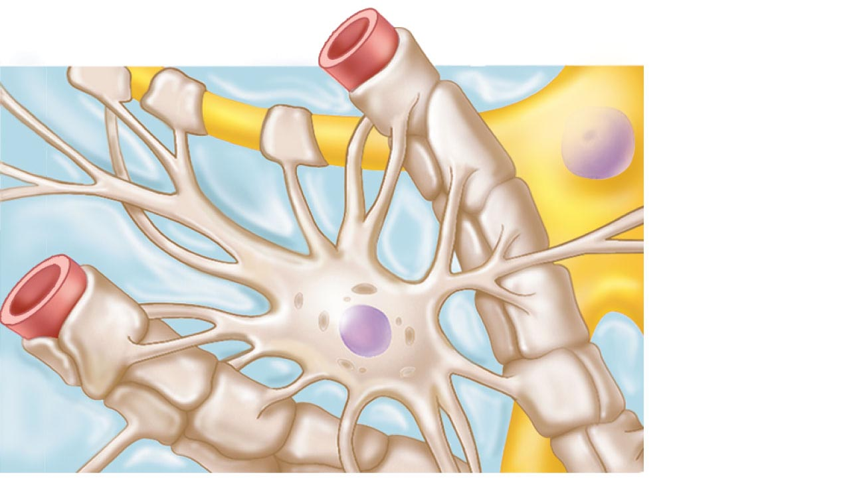
Capillary
Neuron
Astrocyte
(a) Astrocytes are the most abundant
CNS neuroglia.
Figure 11.3a

Slide 14
Microglia
Small, ovoid cells with thorny processes
Migrate toward injured neurons
Phagocytize microorganisms and neuronal debris

Slide 15
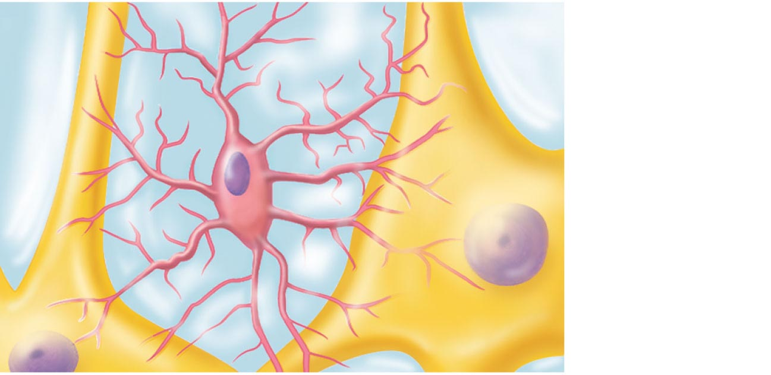
Neuron
Microglial
cell
(b) Microglial cells are defensive cells in
the CNS.
Figure 11.3b

Slide 16
Ependymal Cells
Range in shape from squamous to columnar
May be ciliated
  Line the central cavities of the brain and spinal column
  Separate the CNS interstitial fluid from the cerebrospinal fluid in the cavities

Slide 17
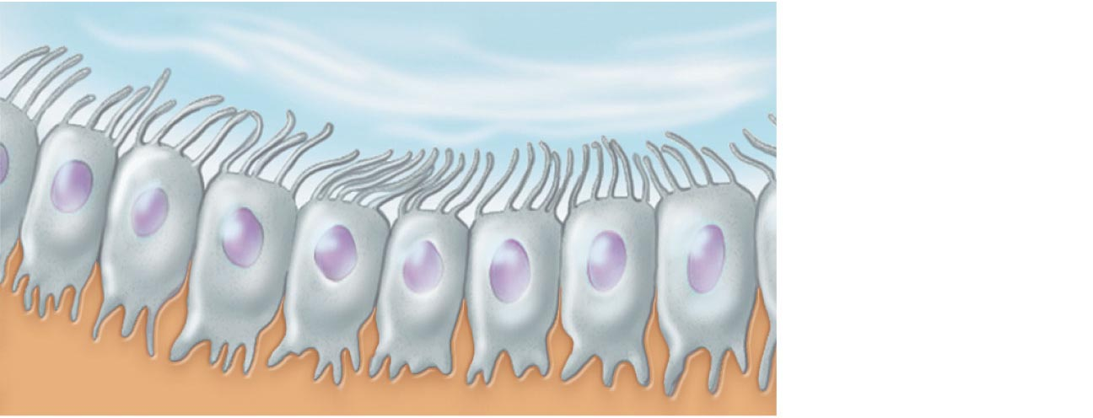
Fluid-filled cavity
Ependymal
cells
Brain or
spinal cord
tissue
(c) Ependymal cells line cerebrospinal
fluid-filled cavities.
Figure 11.3c

Slide 18
Oligodendrocytes
Branched cells
Processes wrap CNS nerve fibers, forming insulating myelin sheaths

Slide 19
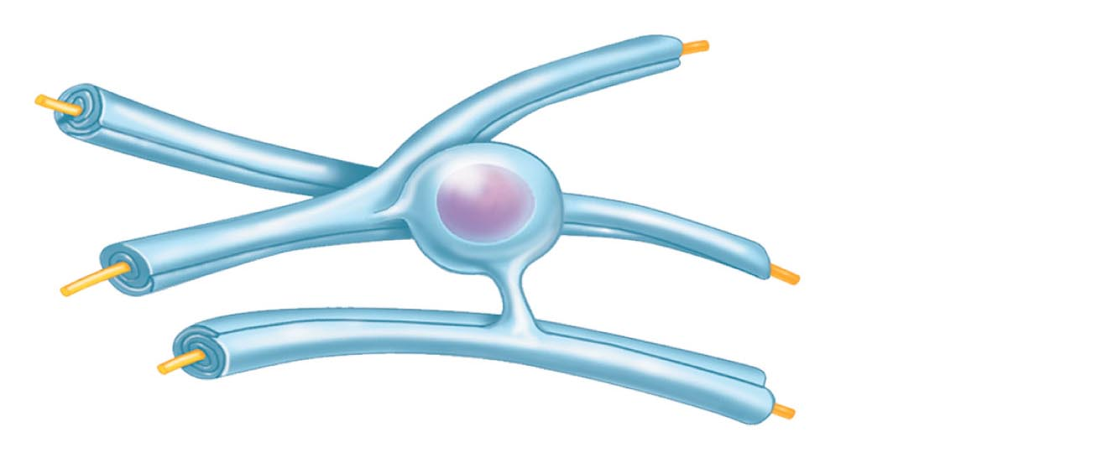
Myelin sheath
Process of
oligodendrocyte
Nerve
fibers
(d) Oligodendrocytes have processes that form
myelin sheaths around CNS nerve fibers.
Figure 11.3d

Slide 20
Satellite Cells and Schwann Cells
Satellite cells
  Surround neuron cell bodies in the PNS
Schwann cells (neurolemmocytes)
  Surround peripheral nerve fibers and form myelin sheaths
  Vital to regeneration of damaged peripheral nerve fibers

Slide 21
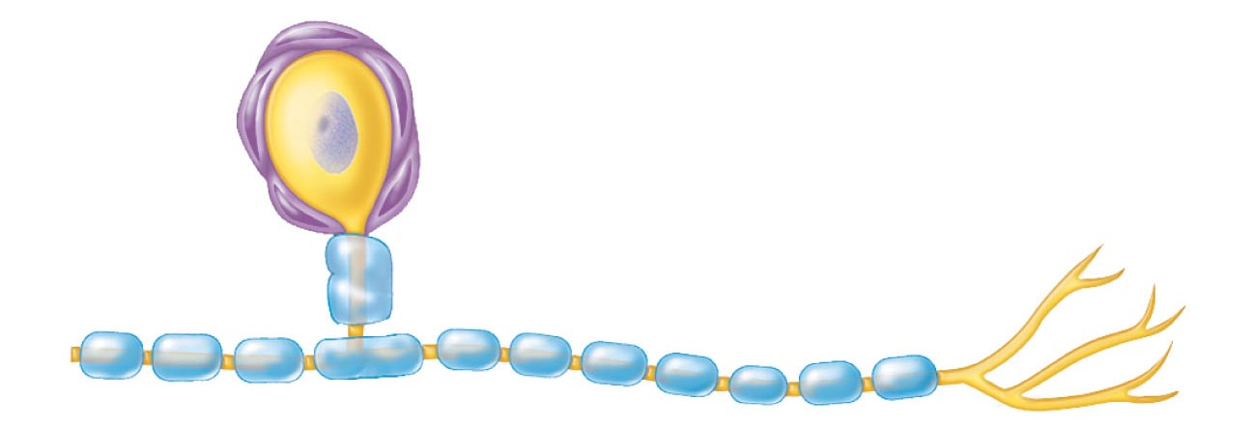
Satellite
cells
Cell body of neuron
Schwann cells
(forming myelin sheath)
Nerve fiber
(e) Satellite cells and Schwann cells (which
form myelin) surround neurons in the PNS.
Figure 11.3e

Slide 22
Neurons (Nerve Cells)
Special characteristics:
  Long-lived (→ 100 years or more)
  Amitotic—with few exceptions
  High metabolic rate—depends on continuous supply of oxygen and glucose
  Plasma membrane functions in:
    Electrical signaling
    Cell-to-cell interactions during development

Slide 23
Cell Body (Perikaryon or Soma)
Biosynthetic center of a neuron
Spherical nucleus with nucleolus
Well-developed Golgi apparatus
Rough ER called Nissl bodies (chromatophilic substance)

Slide 24
Cell Body (Perikaryon or Soma)
Network of neurofibrils (neurofilaments)
Axon hillock—cone-shaped area from which axon arises
Clusters of cell bodies are called nuclei in the CNS, ganglia in the PNS

Slide 25
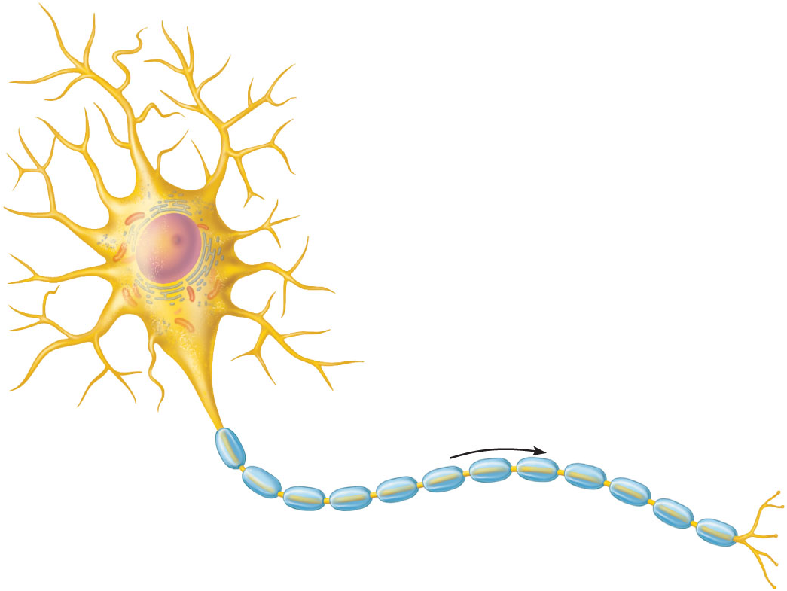
Dendrites
(receptive regions)
Cell body
(biosynthetic center
and receptive region)
Nucleolus
Axon
(impulse generating
and conducting region)
Nucleus
Impulse
direction
Nissl bodies
Node of Ranvier
Axon
terminals
(secretory
region)
Axon hillock
Schwann cell
(one inter-
node)
(b)
Neurilemma
Terminal
branches
Figure 11.4b

Slide 26
Processes
Dendrites and axons
Bundles of processes are called
  Tracts in the CNS
  Nerves in the PNS

Slide 27
Dendrites
Short, tapering, and diffusely branched
Receptive (input) region of a neuron
Convey electrical signals toward the cell body as graded potentials

Slide 28
The Axon
One axon per cell arising from the axon hillock
Long axons (nerve fibers)
Occasional branches (axon collaterals)

Slide 29
The Axon
Numerous terminal branches (telodendria)
Knoblike axon terminals (synaptic knobs or boutons)
  Secretory region of neuron
  Release neurotransmitters to excite or inhibit other cells

Slide 30
Axons: Function
Conducting region of a neuron
Generates and transmits nerve impulses (action potentials) away from the cell body

Slide 31
Axons: Function
Molecules and organelles are moved along axons by motor molecules in two directions:
  Anterograde—toward axonal terminal
    Examples: mitochondria, membrane components, enzymes
  Retrograde—toward the cell body
    Examples: organelles to be degraded, signal molecules, viruses, and bacterial toxins

Slide 32
Dendrites
(receptive regions)
Cell body
(biosynthetic center
and receptive region)
Nucleolus
Axon
(impulse generating
and conducting region)
Nucleus
Impulse
direction
Nissl bodies
Node of Ranvier
Axon
terminals
(secretory
region)
Axon hillock
Schwann cell
(one inter-
node)
(b)
Neurilemma
Terminal
branches
Figure 11.4b

Slide 33
Myelin Sheath
Segmented protein-lipoid sheath around most long or large-diameter axons
It functions to:
  Protect and electrically insulate the axon
  Increase speed of nerve impulse transmission

Slide 34
Myelin Sheaths in the PNS
Schwann cells wraps many times around the axon
  Myelin sheath—concentric layers of Schwann cell membrane
Neurilemma—peripheral bulge of Schwann cell cytoplasm

Slide 35
Myelin Sheaths in the PNS
Nodes of Ranvier
  Myelin sheath gaps between adjacent Schwann cells
  Sites where axon collaterals can emerge

Slide 36
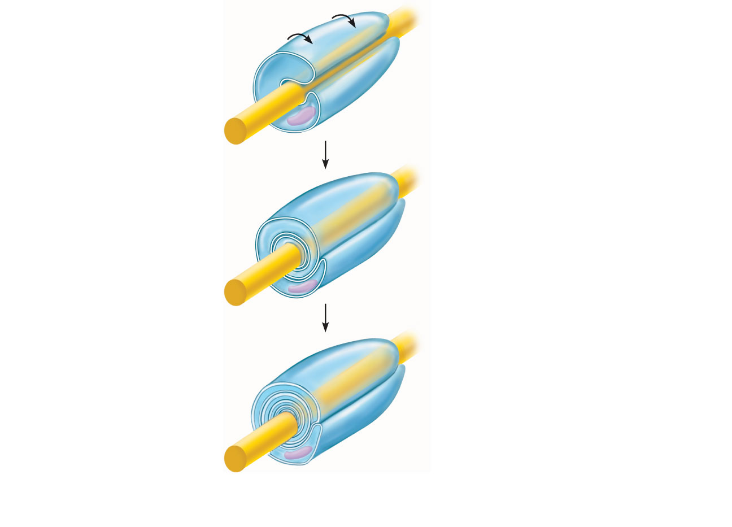
Schwann cell
plasma membrane
A Schwann cell
envelopes an axon.
Schwann cell
cytoplasm
1
Axon
Schwann cell
nucleus
2
The Schwann cell then
rotates around the axon,
wrapping its plasma
membrane loosely around
it in successive layers.
Neurilemma
The Schwann cell
cytoplasm is forced from
between the membranes.
The tight membrane
wrappings surrounding
the axon form the myelin
sheath.
3
Myelin sheath
(a) Myelination of a nerve
fiber (axon)
Figure 11.5a

Slide 37
Unmyelinated Axons
Thin nerve fibers are unmyelinated
One Schwann cell may incompletely enclose 15 or more unmyelinated axons

Slide 38
Myelin Sheaths in the CNS
Formed by processes of oligodendrocytes, not the whole cells
Nodes of Ranvier are present
No neurilemma
Thinnest fibers are unmyelinated

Slide 39
Myelin sheath
Process of
oligodendrocyte
Nerve
fibers
(d) Oligodendrocytes have processes that form
myelin sheaths around CNS nerve fibers.
Figure 11.3d

Slide 40
White Matter and Gray Matter
White matter
  Dense collections of myelinated fibers
Gray matter
  Mostly neuron cell bodies and unmyelinated fibers

Slide 41
Structural Classification of Neurons
Three types:
  Multipolar—1 axon and several dendrites
    Most abundant
    Motor neurons and interneurons
  Bipolar—1 axon and 1 dendrite
    Rare, e.g., retinal neurons

Slide 42
Structural Classification of Neurons
  Unipolar (pseudounipolar)—single, short process that has two branches:
    Peripheral process—more distal branch, often associated with a sensory receptor
    Central process—branch entering the CNS

Slide 43
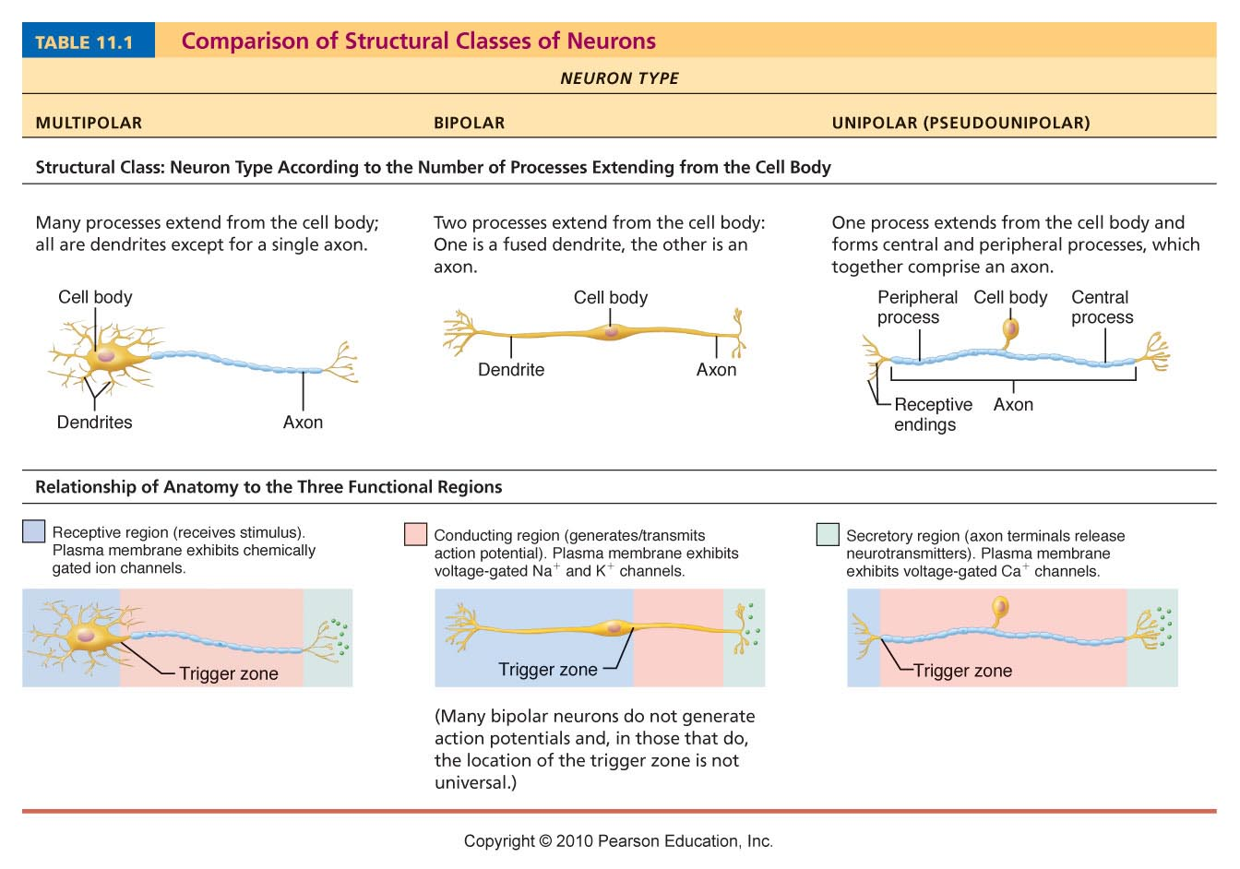
Table 11.1 (1 of 3)

Slide 44
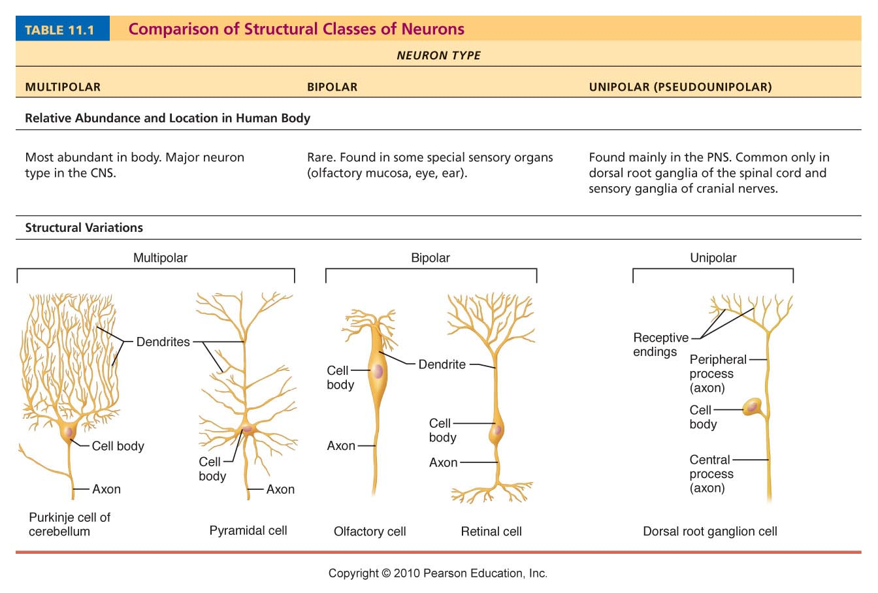
Table 11.1 (2 of 3)

Slide 45
Functional Classification of Neurons
Three types:
  Sensory (afferent)
    Transmit impulses from sensory receptors toward the CNS
  Motor (efferent)
    Carry impulses from the CNS to effectors

Slide 46
Functional Classification of Neurons
  Interneurons (association neurons)
    Shuttle signals through CNS pathways; most are entirely within the CNS

Slide 47
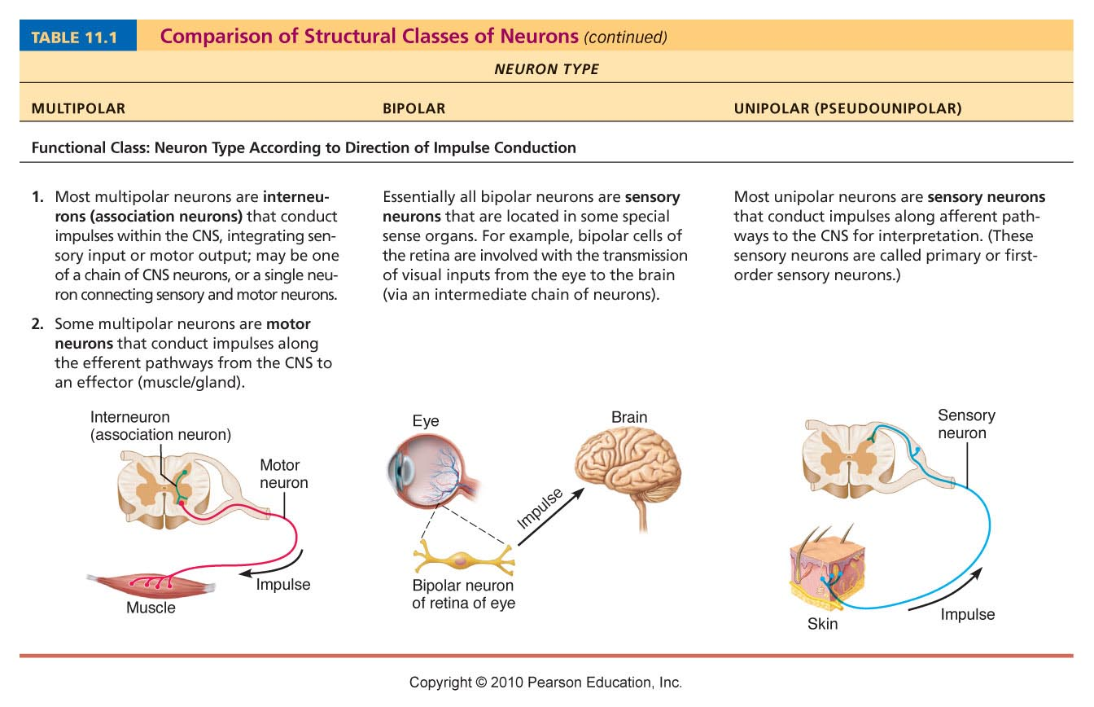
Table 11.1 (3 of 3)

