Slide 1
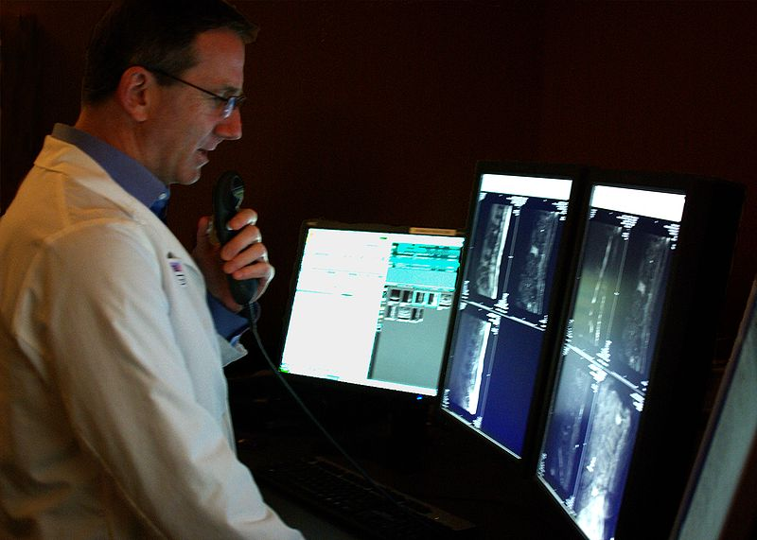
Radiology
William M. Clark, M.D.

Slide 2
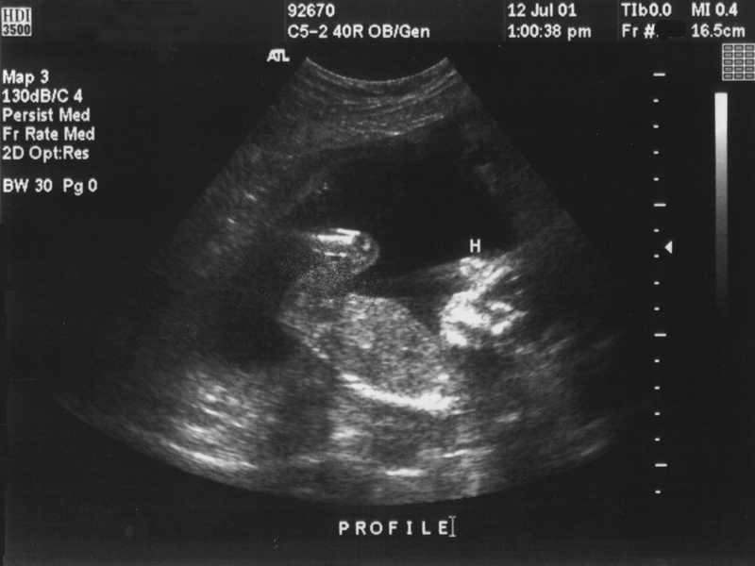
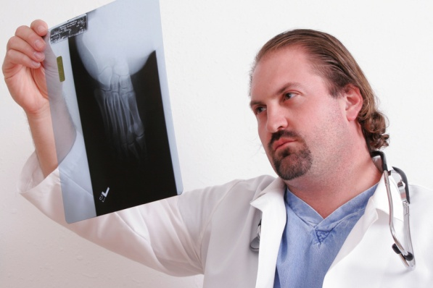
Radiologic Techniques
Standard X-ray
Enhanced X-ray (Contrast Agent)
Fluoroscopy
CT scan ( newer Xenon CT)
Magnetic Resonance Imaging (MRI) plus functional MRI
Dynamic Spatial Reconstruction
Digital Subtraction Angiography
Positive Emission Tomography
Sonography (Ultrasound)

Slide 3
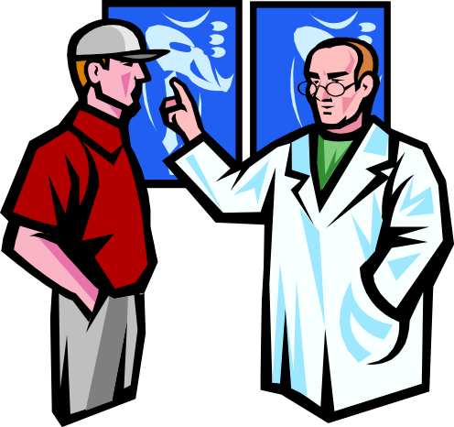
Radiology is the branch or specialty of medicine that utilizes imaging technologies like x-rays, CT scans, and MRIs to diagnose and treat diseases.

Slide 4

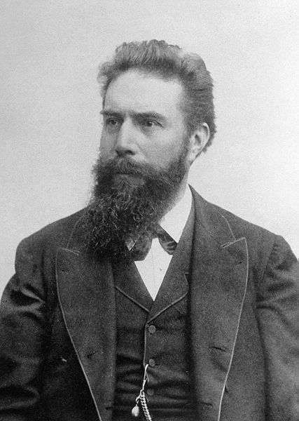
A Little History
Wilhelm Conrad Röntgen (27 March 1845 – 10 February 1923) was a German physicist, who, on 8 November 1895, produced and detected electromagnetic radiation in a wavelength range today known as x-rays or Röntgen rays, an achievement that earned him the first Nobel Prize in Physics in 1901.
For a more complete and interesting
description of the history of x-ray – please go to
my website and look at “Discovery
Goes to the Prepared Mind” – under
the section Special Topics.

Slide 5
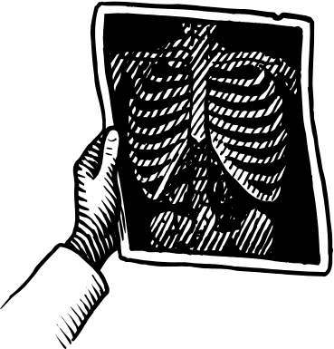
Standard Flat Plate X-ray
  Principle: use of high-energy radiation waves at lower doses to produce images to help diagnose disease
  Can penetrate through tissues at varying degrees depending on tissue density – tissues or objects (prosthesis) that cannot be penetrated (termed radiopaque) appear white on the X-ray film – while tissues that can be penetrated appear dark on the film – thus it is similar to a negative film in photography
  The range of densities, from most to least dense, is represented by metal (white, or radiopaque), bone cortex (less white), muscle and fluid (gray), fat (darker gray), and air or gas (black, or radiolucent)

Slide 6
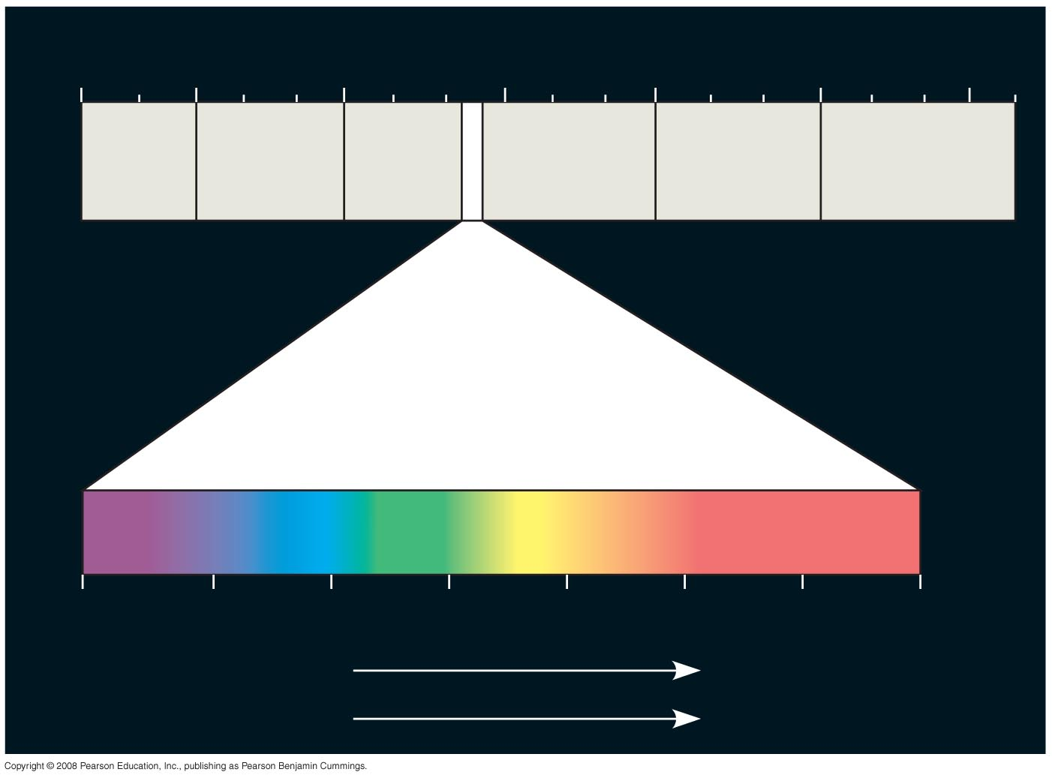
Fig. 10-6
1 m
(10⁹ nm)
10^{–5} nm
10^{–3} nm
1 nm
10³ nm
10⁶ nm
10³ m
Gamma
rays
Micro-
waves
Radio
waves
X-rays
UV
Infrared
Visible light
380
450
500
550
600
650
700
750 nm
Shorter wavelength
Longer wavelength
Higher energy
Lower energy
Notes:
Figure 10.6 The electromagnetic spectrum

Slide 7
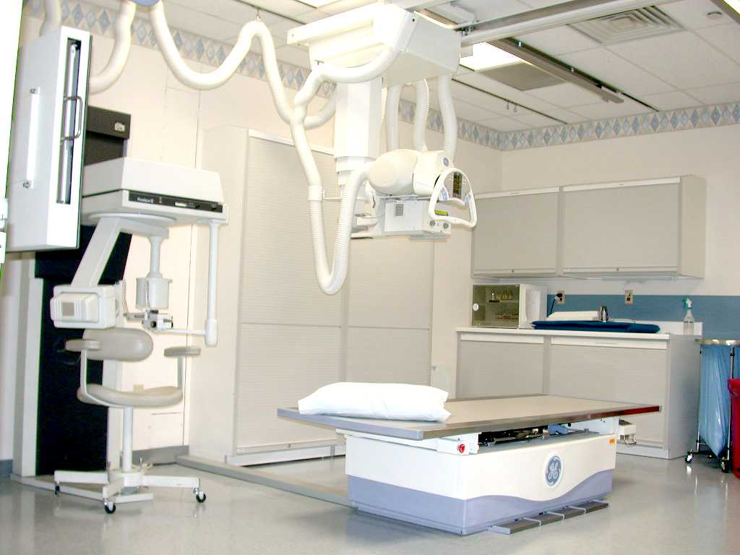
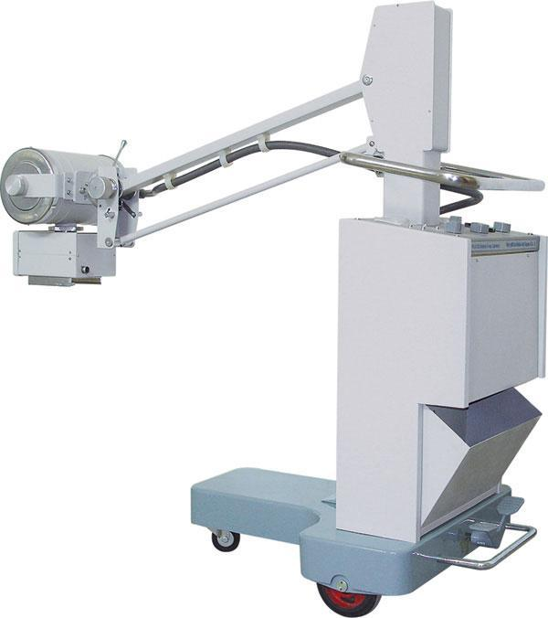
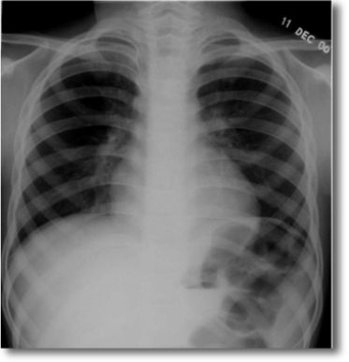
Portable X-ray

Slide 8
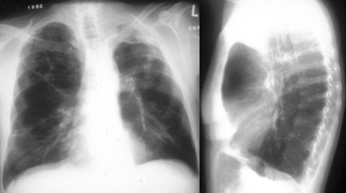
  Standard Flat Plate X-ray
  Major Problem with the flat plate X-ray is “duplication of density”- if a tissue of lower density is positioned behind a tissue of higher density – the lower density structure will not be seen
  How is the problem of duplication of density solved – turning the patient into different positions and/or introducing a contrast media

Slide 9
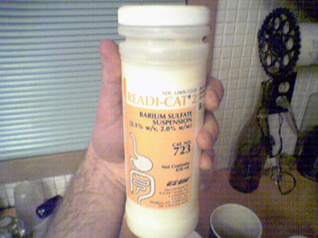
Contrast Studies
When the density of adjacent tissues is similar, a radiopaque contrast agent is often added to one tissue or structure to differentiate it from its surroundings. Structures typically requiring a contrast agent include blood vessels (for angiography) and the lumina of the GI, biliary, and GU tracts. Gas may be used to distend the lower GI tract and make it visible.

Slide 10
  Barium sulfate: intestinal tract
  Radiopaque oil: bronchogram
  Intravenous dye: intravenous pyelogram; urinary tract
  Radiopaque tablets: visualize gallstones
  Arteriogram: visualize blood flow, identify narrowing or obstruction

Slide 11
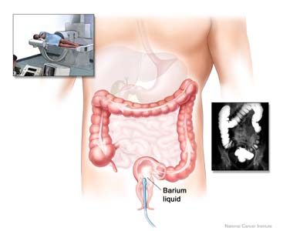
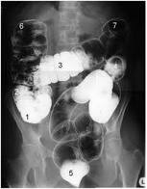

Slide 12
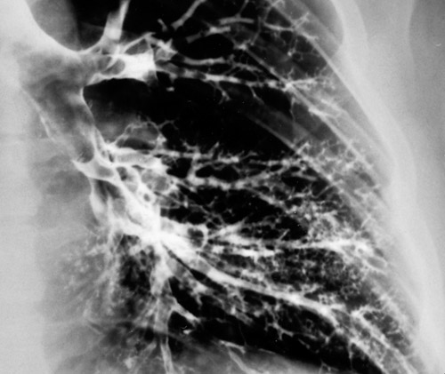
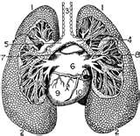
Use of radiopaque oil to highlight the bronchial tree
      Bronchogram showing normal caliber and branching of bronchi and bronchioles
© Courtesy of Leonard Crowley, M.D./University of Minnesota Medical School

Slide 13
Fluoroscopy
A continuous x-ray beam is used to produce images of moving structures or objects. Fluoroscopy is most often used with contrast agents (eg, in swallowing studies or coronary artery catheterization) or during medical procedures to guide placement of a lead, catheter.

Slide 14
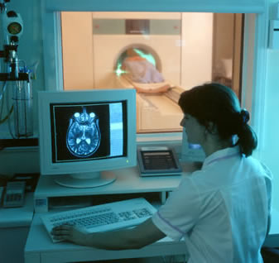
Computed tomographic (CT) scans
  Principle: radiation detectors record amount of X-rays or ionizing radiation absorbed by body and feed data into a computer that reconstructs the data into an image
  Radiopaque and radiolucent tissues appear white and dark as in a conventional x-ray
  Individual organs sharply demarcated by planes of fat that appear dark because of its low density
  Delivers higher dose of ionizing radiation than x-ray
  Just as with the standard X-ray
  the film can be enhanced with the
  introduction of a contrast agent

Slide 15
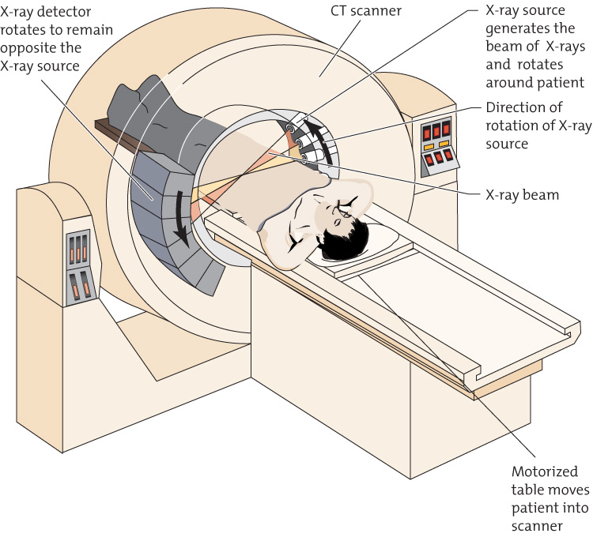
      Computed tomographic scan, CT scan
© Courtesy of Leonard Crowley, M.D./University of Minnesota Medical School

Slide 16
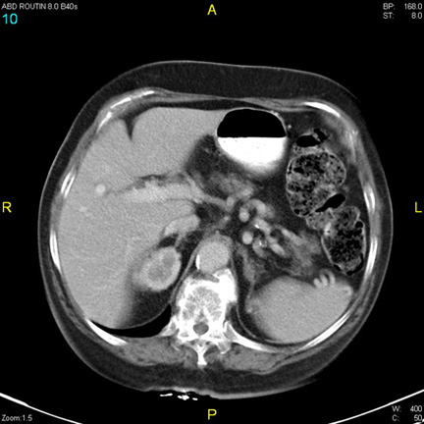
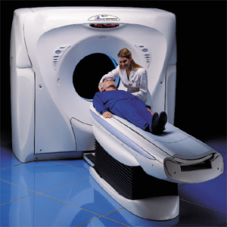
CT Scan

Slide 17
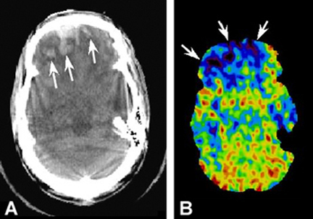
Xenon CT
A CT scan in which Xenon gas has been introduced into the patient
Xenon gas is inhaled in a 28% mixture with room air – it quickly enters the blood stream distributing to body tissues with in accordance with blood flow
Low levels of or absence of Xenon from the area being scanned signifies low
or no blood flow
The Xenon gas is stable non radioactive Xenon. It acts as a contrast agent because of its high atomic number (54), similar to Iodine (53).

Slide 18
Magnetic resonance imaging (MRI)
  Principle: computer-constructed images of body based on response of hydrogen protons in water molecules when placed in a strong magnetic field
    Protons align in the direction of the magnetic field
    Protons are temporarily dislodged and wobble when radiofrequency waves are directed at them
    Protons emit a measurable signal (resonance) that can be used to construct images
    Intensity of resonance depends on water content of tissues, strength and duration of radiofrequency pulse

Slide 19
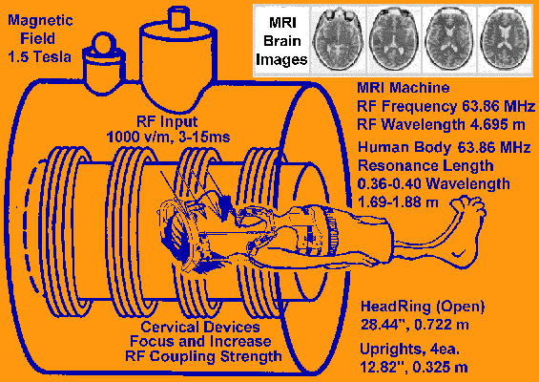
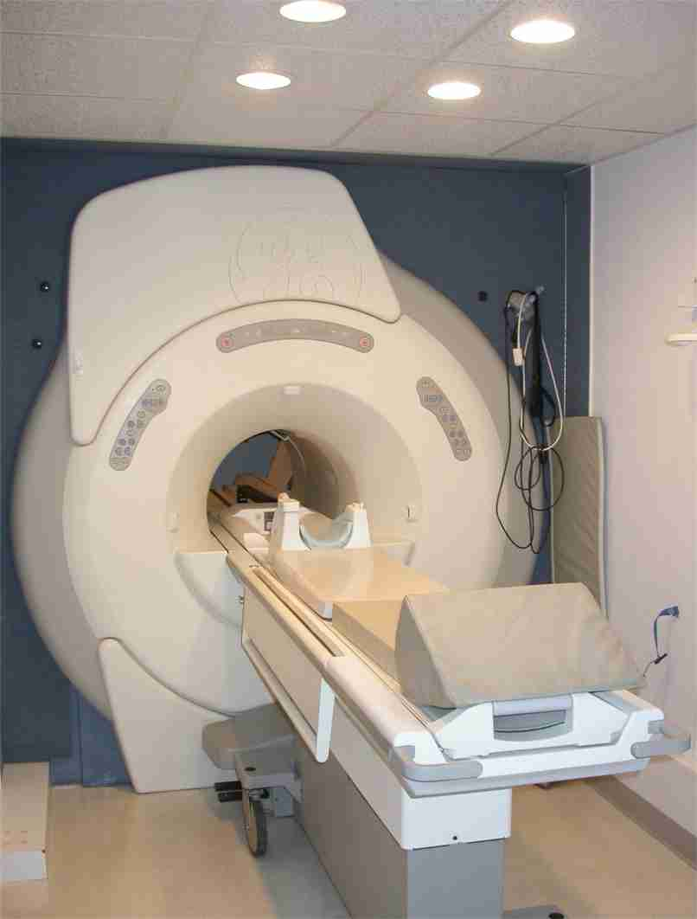
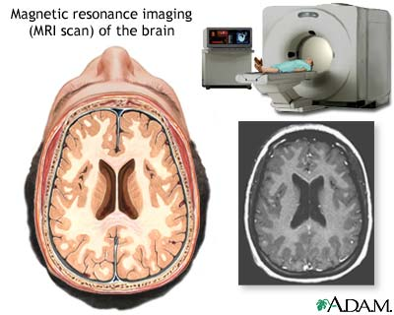
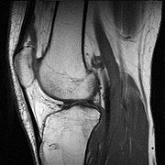

Slide 20
MRI: advantages over CT scan
  Does not use ionizing radiation
  Can detect abnormalities in tissues surrounded by bone, such as spinal cord, orbit, skull
  Bone interferes with scanning because of its density but does not produce an image in MRI because of its low water content
Uses
  Multiple sclerosis
  Superior to mammography in detecting breast cancer

Slide 21
Claustrophobia and discomfort
Due to the construction of some MRI scanners, they can be potentially unpleasant to lie in. Older models of closed bore MRI systems feature a fairly long tube or tunnel. The part of the body being imaged must lie at the center of the magnet, which is at the absolute center of the tunnel. Because scan times on these older scanners may be long (occasionally up to 40 minutes for the entire procedure), people with even mild claustrophobia are sometimes unable to tolerate an MRI scan without management. Modern scanners may have larger bores (up to 70 cm) and scan times are shorter. This means that claustrophobia is less of an issue, and many patients now find MRI an innocuous and easily tolerated procedure.

Slide 22
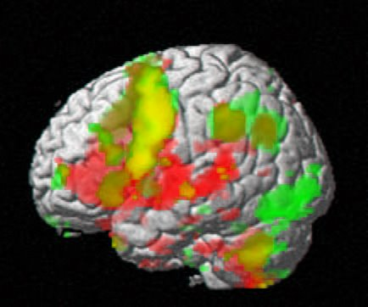
Functional MRI
a type of specialized MRI scan that measures the hemodynamic response (change in blood flow) related to neural activity in the brain or spinal cord of humans or other animals. It is one of the most recently developed forms of neuroimaging.

Slide 23
Functional MRI Principles
Blood-oxygen-level dependence (BOLD) is the MRI contrast of blood deoxyhemoglobin, first discovered in 1990 at AT&T Bell Labs
As neurons do not have internal reserves for glucose and oxygen, more neuronal activity requires more glucose and oxygen to be delivered through blood stream rapidly. Through a process called the hemodynamic response, blood releases glucose to neurons at a greater rate than in the area of inactive neurons. It results in a surplus of oxyhemoglobin in the veins of the area and distinguishable change of the local ratio of oxyhemoglobin to deoxyhemoglobin, the "marker" of BOLD for MRI
Hemoglobin is diamagnetic when oxygenated (oxyhemoglobin) but paramagnetic when deoxygenated (deoxyhemoglobin). The (MR) signal of blood is therefore slightly different depending on the level of oxygenation.
Diamagnetism is the property of an object which causes it to create a magnetic field in opposition to an externally applied magnetic field, thus causing a repulsive effect whereas in paramagnetism objects are attracted to the magnetic field.

Slide 24
Dynamic Spatial Reconstruction
Principle: uses ultrafast CT scanners to provide three-dimensional images of body organs from any angle, and scrutinize their movements and changes in internal volumes and normal speed, in slow motion, and at a specific movement.
Greatest value- visualize the heart beating and blood flowing through blood vessels
Allows clinicians to evaluate heart defects, constricted or blocked blood vessels, and status of coronary bypass grafts

Slide 25
Digital Subtraction Angiography
A technique used in interventional radiology to clearly visualize blood vessels in a bony or dense soft tissue environment. Images are produced using contrast medium by subtracting a 'pre-contrast image' or the mask from later images, once the contrast medium has been introduced into a structure. Hence the term 'digital subtraction angiography'.

Slide 26
Applications of
Digital Subtraction Angiography
used to image blood vessels. It is useful in the diagnosis and treatment of:
Arterial and venous occlusions, including carotid artery stenosis, pulmonary embolisms and acute limb ischemia
Arterial stenosis, which is particularly useful for potential renal donors in detecting renal artery stenosis
Cerebral aneurysms and arteriovenous malformations (AVM).

Slide 27
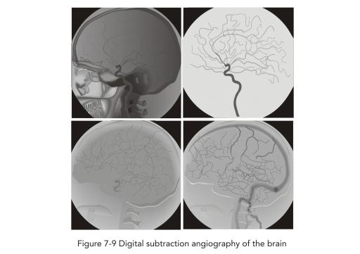
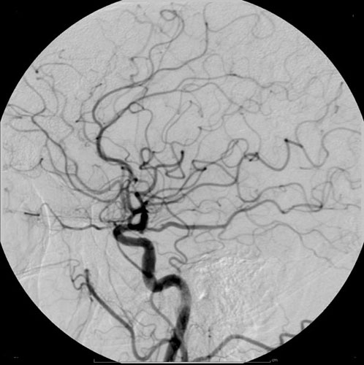

Slide 28
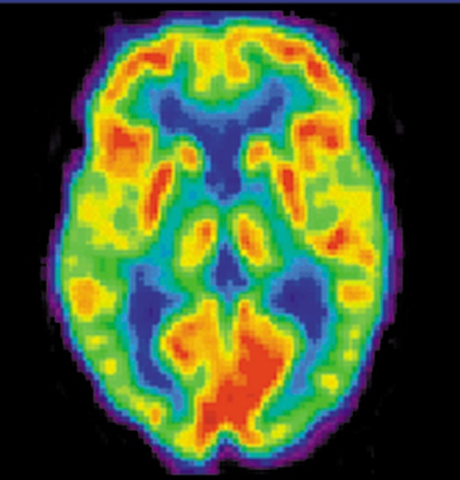
Positron Emission Tomography (PET)
Principle: Measures metabolism of biochemical compounds that are labeled with positron-emitting isotopes to measure organ function, example glucose
  Disadvantages
    Very expensive and not widely available
    Requires facilities for incorporating the isotopes into the biochemical compound

Slide 29
Uses of PET
  Assess biochemical functions in brain
  Determine metabolic activities of organ or tissue; specific site in an organ where compound is metabolized
  Evaluate changes in blood flow in heart muscle following a heart attack
  Distinguish benign from a malignant tumor (increased glucose uptake in malignant versus benign tumors)

Slide 30
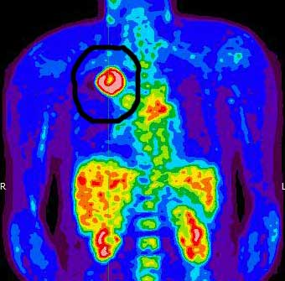
Positive Emission Tomography
Hot tumor in lungs
Tumor takes up
significant amounts
of glucose – due the
tumor’s high metabolic
rate.

Slide 31
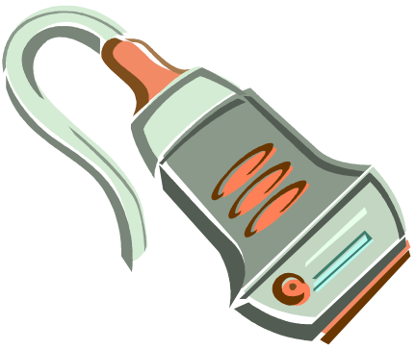

Ultrasound
an ultrasound-based diagnostic medical imaging technique used to visualize muscles, tendons, and many internal organs, to capture their size, structure and any pathological lesions with real time tomographic images.
Ultrasonic sound (frequency above human hearing) is sent into the body by a transducer - the rate that the sound echoes back into the receiver depends on tissue densities
Hertz (cycles per second) – named after the German Physicist
Heinrich Hertz
Ultrasound range 1 - 20 MHz
MHz – mega (million Hertz)
Human audible range is 20 Hz to 20 KHz (20,000 Hz)
The most common use is to view the fetus in-utero
Transducer & Receiver

Slide 32
Echoes are based on Impedance
When waves (like sound waves) pass through substances with major differences in impedances – they bounce off (echo) and do not enter the substance . This is the basis of the ultrasound
Medium Impedance
Air 0.000429
Water 1.50
Blood 1.59
Fat 1.38
Muscle 1.70
Bone 6.50

Slide 33
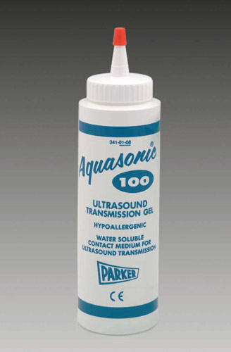
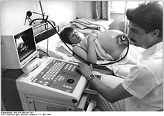
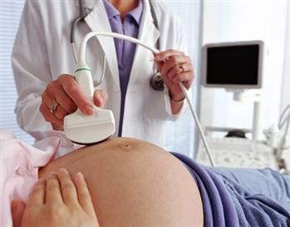

Slide 34
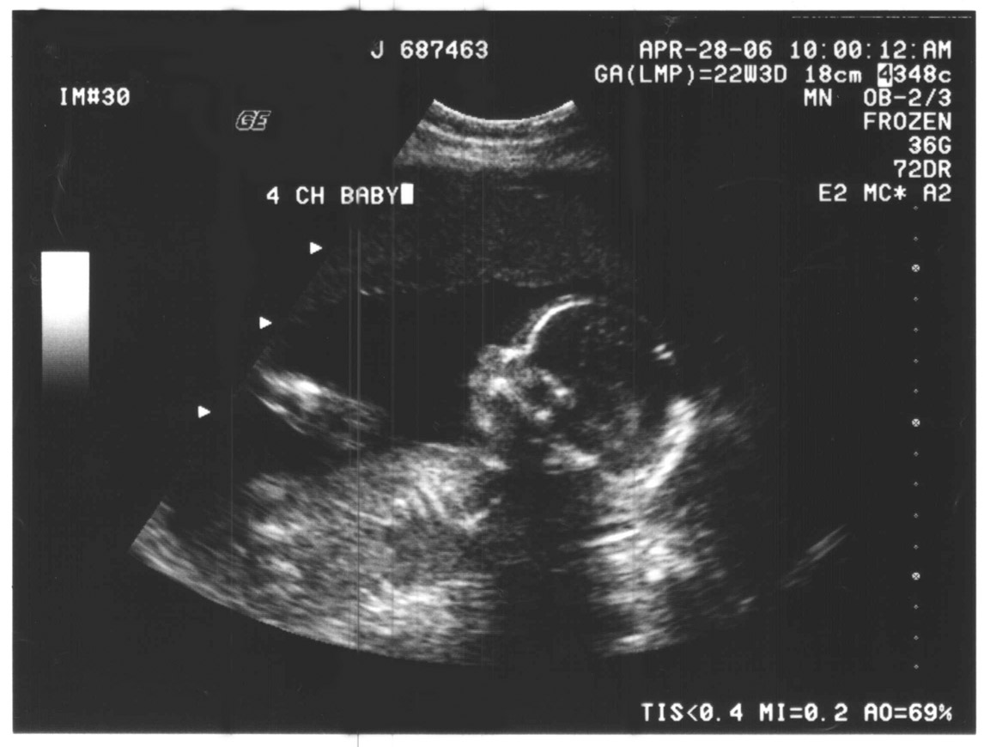
      Ultrasound examination of 22-week-old fetus
Courtesy of Belinda Thresher

Slide 35
Advantages compared with other techniques
Ultrasound examinations are non-invasive i.e. they do not require the body to be opened up, or anything to be inserted into the body.
2. Ultrasound methods are relatively inexpensive, quick and convenient, compared to techniques such as X-rays or MRI scans. The equipment can be made portable, and the images can be stored electronically.
3. No harmful effects have been detected, at the intensity levels used for examinations and imaging. This contrasts with methods based on X-rays or on radioactive isotopes, which have known risks associated
with them, and ultrasound methods are preferred whenever possible. This is particularly relevant to examination of expectant mothers.
4. Ultrasound is particularly suited to imaging soft tissues such as the eye, heart and other internal organs, and examining blood vessels.

Slide 36
Disadvantages of ultrasound compared with other techniques
1. The major disadvantage is that the resolution of images is often limited. This is being overcome as time
passes, but there are still many situations where X-rays produce a much higher resolution.
2. Ultrasound is reflected very strongly on passing from tissue to gas, or vice versa. This means that
ultrasound cannot be used for examinations of areas of the body containing gas, such as the lung and the
digestive system.
3. Ultrasound also does not pass well through bone, so that the method is of limited use in diagnosing
fractures. It is possible to obtain quite good ultrasound scans of the brain, but much greater detail is obtained by an MRI scan.

