Slide 1
14
The Autonomic Nervous System

Slide 2
Autonomic Nervous System (ANS)
The ANS consists of motor neurons that:
  Innervate smooth and cardiac muscle and glands
  Make adjustments to ensure optimal support for body activities
  Operate via subconscious control
  Sensory division – visceral afferents

Slide 3
Autonomic Nervous System (ANS)
Other names
  Involuntary nervous system
  General visceral motor system

Slide 4
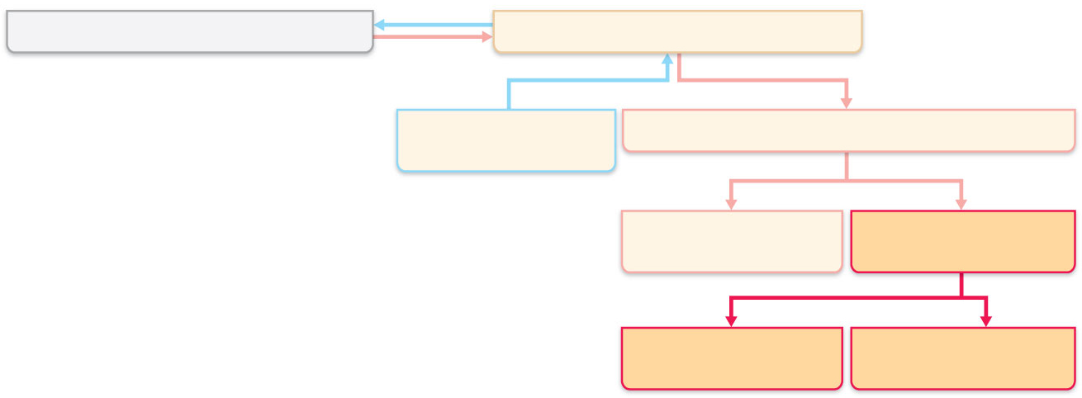
Central nervous system (CNS)
Peripheral nervous system (PNS)
Sensory (afferent)
division
Motor (efferent) division
Somatic nervous
system
Autonomic nervous
system (ANS)
Sympathetic
division
Parasympathetic
division
Figure 14.1

Slide 5
Somatic and Autonomic Nervous Systems
The two systems differ in
  Effectors
  Efferent pathways (and their neurotransmitters)
  Target organ responses to neurotransmitters

Slide 6
Effectors
Somatic nervous system
  Skeletal muscles
ANS
  Cardiac muscle
  Smooth muscle
  Glands

Slide 7
Efferent Pathways
Somatic nervous system
  A, thick, heavily myelinated somatic motor fiber makes up each pathway from the CNS to the muscle
ANS pathway is a two-neuron chain
  Preganglionic neuron (in CNS) has a thin, lightly myelinated preganglionic axon
  Ganglionic (Post ganglionic) neuron in autonomic ganglion has an unmyelinated postganglionic axon that extends to the effector organ

Slide 8
Terminology
  A nucleus is a group of cell bodies in the CNS
  A ganglion is a group of cell bodies in the PNS
  A tract is a group of axons in the CNS
  A nerve is a group of axons in the PNS

Slide 9
Neurotransmitter Effects
Somatic nervous system
  All somatic motor neurons release acetylcholine (ACh)
  Effects are always stimulatory
ANS
  Preganglionic fibers release ACh
  Postganglionic fibers release norepinephrine or ACh at effectors
  Effect is either stimulatory or inhibitory, depending on type of receptors

Slide 10
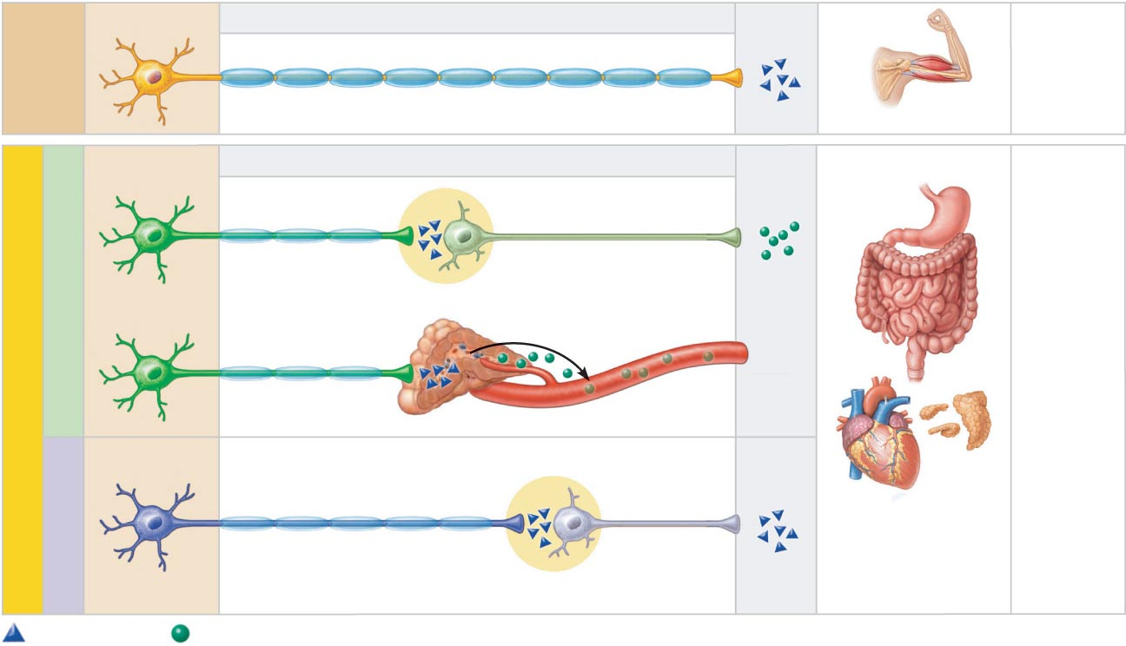
Neuro-
transmitter
at effector
Cell bodies in central
nervous system
Peripheral nervous system
Effector
organs
Effect
Single neuron from CNS to effector organs
SOMATIC
NERVOUS
SYSTEM
ACh
+
Heavily myelinated axon
Stimulatory
Skeletal muscle
Two-neuron chain from CNS to effector organs
ACh
NE
Unmyelinated
postganglionic axon
SYMPATHETIC
Lightly myelinated
preganglionic axons
Ganglion
+
Epinephrine and
norepinephrine
ACh
Stimulatory
or inhibitory,
depending
on neuro-
transmitter
and
receptors
on effector
organs
AUTONOMIC NERVOUS SYSTEM
Adrenal medulla
Blood vessel
ACh
ACh
Smooth muscle
(e.g., in gut),
glands, cardiac
muscle
PARASYMPATHETIC
Lightly myelinated
preganglionic axon
Unmyelinated
postganglionic
axon
Ganglion
Acetylcholine (ACh)
Norepinephrine (NE)
Figure 14.2

Slide 11
Divisions of the ANS
Sympathetic division
Parasympathetic division
Dual innervation
  Almost all visceral organs are served by both divisions, but they cause opposite effects

Slide 12
Role of the Parasympathetic Division
Promotes maintenance activities and conserves body energy
Its activity is illustrated in a person who relaxes, reading, after a meal
  Blood pressure, heart rate, and respiratory rates are low
  Gastrointestinal tract activity is high
  Pupils are constricted and lenses are accommodated for close vision

Slide 13
Role of the Sympathetic Division
Mobilizes the body during activity; is the “fight-or-flight” system
Promotes adjustments during exercise, or when threatened
  Blood flow is shunted to skeletal muscles and heart
  Bronchioles dilate
  Liver releases glucose

Slide 14
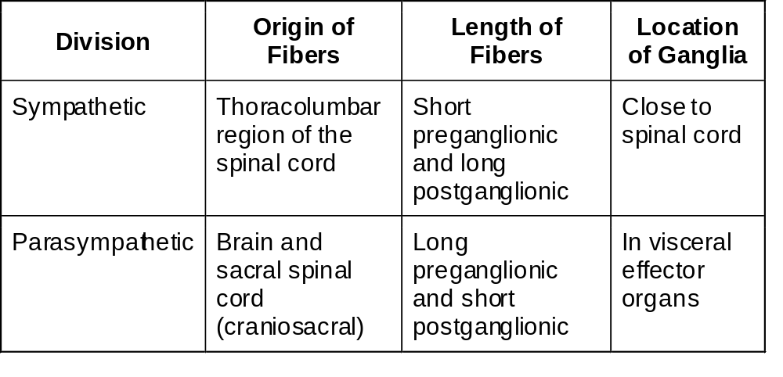
ANS Anatomy

Slide 15
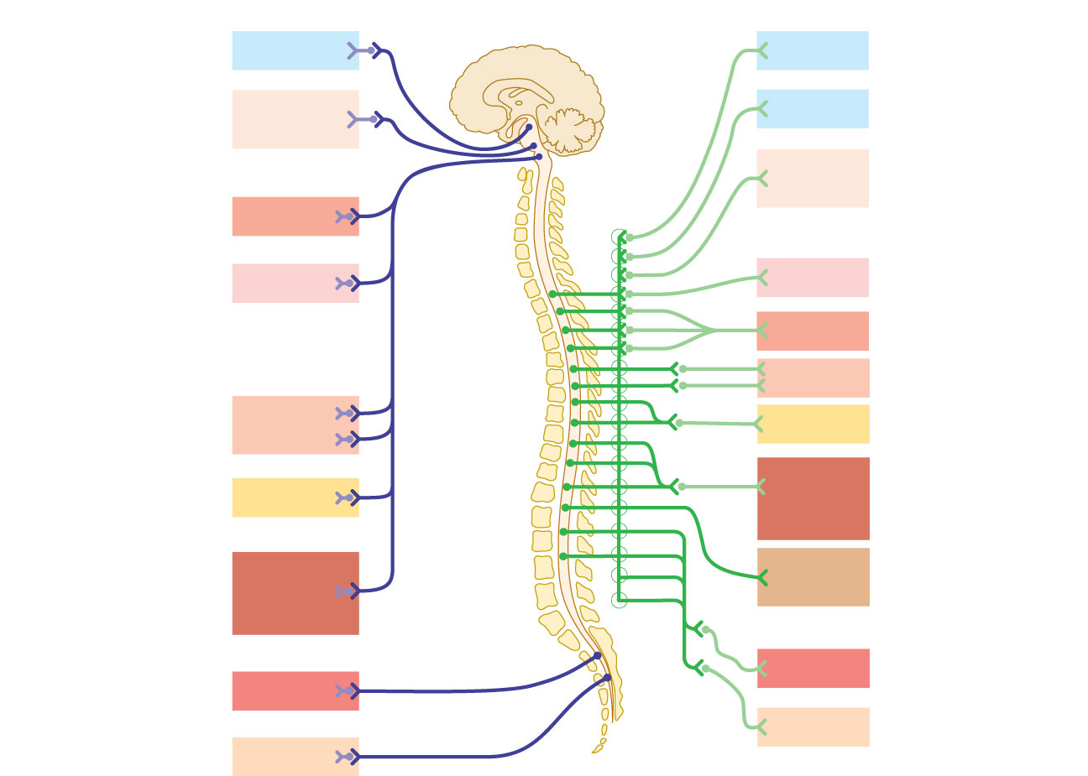
Parasympathetic
Sympathetic
Eye
Brain
stem
Eye
Salivary
glands
Skin*
Cranial
Sympathetic
ganglia
Salivary
glands
Heart
Cervical
Lungs
Lungs
T₁
Heart
Stomach
Thoracic
Stomach
Pancreas
Liver
and gall-
bladder
Pancreas
L₁
Liver and
gall-
bladder
Adrenal
gland
Lumbar
Bladder
Bladder
Genitals
Genitals
Sacral
Figure 14.3

Slide 16
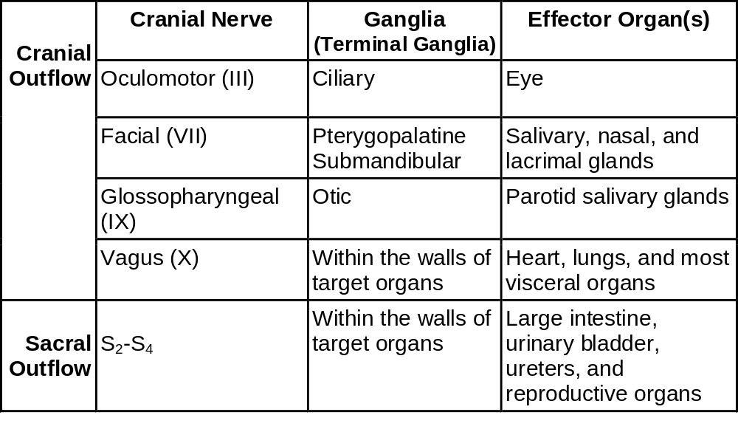
Parasympathetic (Craniosacral) Division Outflow

Slide 17
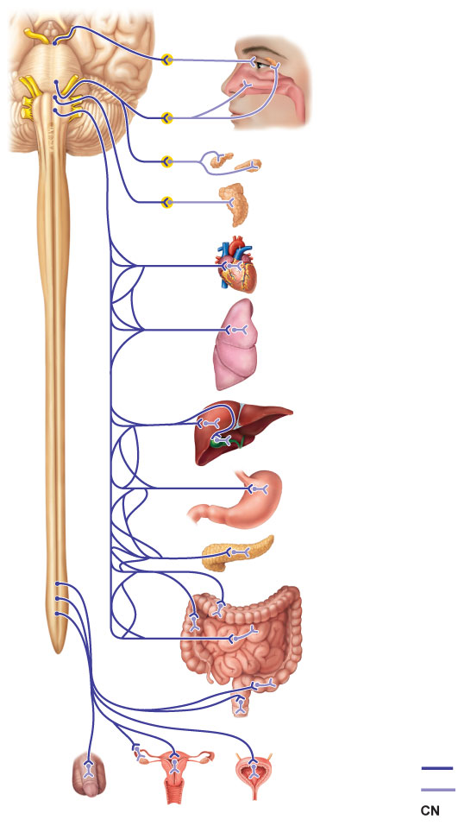
CN III
Ciliary
ganglion
Eye
Lacrimal
gland
CN VII
Pterygopalatine
ganglion
CN IX
Pterygopalatine
ganglion
Nasal
mucosa
CN X
Submandibular
ganglion
Submandibular
and sublingual
glands
Otic ganglion
Parotid gland
Heart
Cardiac and
pulmonary
plexuses
Lung
Liver and
gallbladder
Celiac
plexus
Stomach
Pancreas
S₂
Large
intestine
S₄
Pelvic
splanchnic
nerves
Small
intestine
Inferior
hypogastric
plexus
Rectum
Genitalia
(penis,
clitoris, and vagina)
Urinary
bladder
and ureters
Preganglionic
Postganglionic
Cranial nerve
Figure 14.4

Slide 18
Sympathetic (Thoracolumbar) Division
Preganglionic neurons are in spinal cord segments T₁ – L₂
Sympathetic neurons produce the lateral horns of the spinal cord
Preganglionic fibers pass through the white rami communicantes and enter sympathetic trunk (paravertebral) ganglia

Slide 19
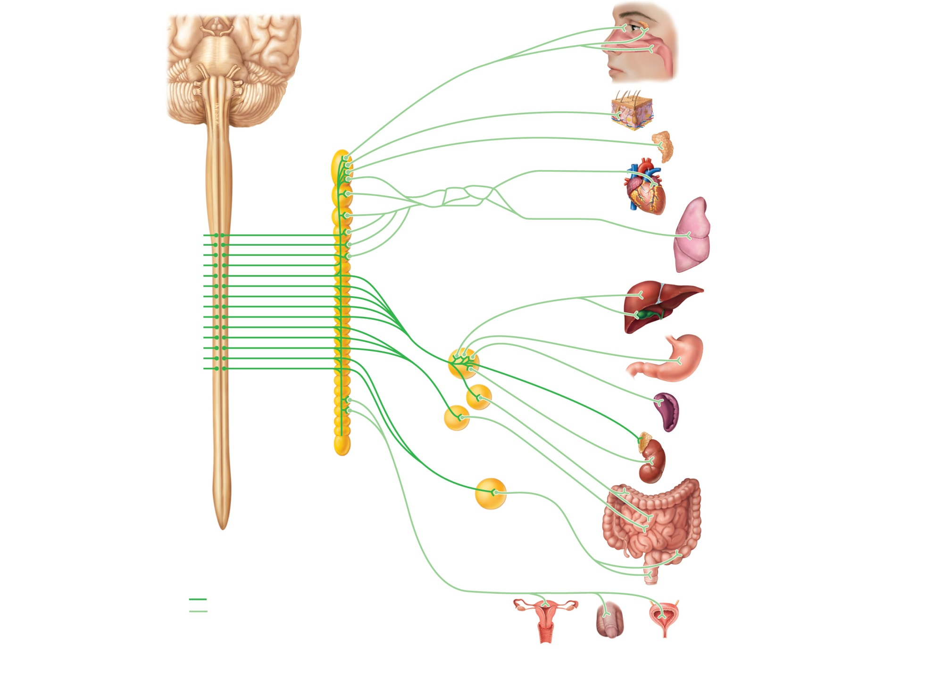
Eye
Lacrimal gland
Pons
Nasal mucosa
Sympathetic trunk
(chain) ganglia
Blood vessels;
skin (arrector pili
muscles and
sweat glands)
Superior
cervical
ganglion
Middle
cervical
ganglion
Salivary glands
Inferior
cervical
ganglion
Heart
Cardiac and
pulmonary
plexuses
Lung
T₁
Greater splanchnic nerve
Lesser splanchnic nerve
Liver and
gallbladder
Celiac ganglion
L₂
Stomach
White rami
communicantes
Superior
mesenteric
ganglion
Spleen
Adrenal medulla
Sacral
splanchnic
nerves
Kidney
Lumbar
splanchnic
nerves
Inferior
mesenteric
ganglion
Small
intestine
Large
intestine
Rectum
Preganglionic
Postganglionic
Genitalia (uterus, vagina, and
penis) and urinary bladder
Figure 14.6

Slide 20
Sympathetic Trunks and Pathways
There are 23 paravertebral ganglia in the sympathetic trunk (chain)
  3 cervical
  11 thoracic
  4 lumbar
  4 sacral
  1 coccygeal

Slide 21
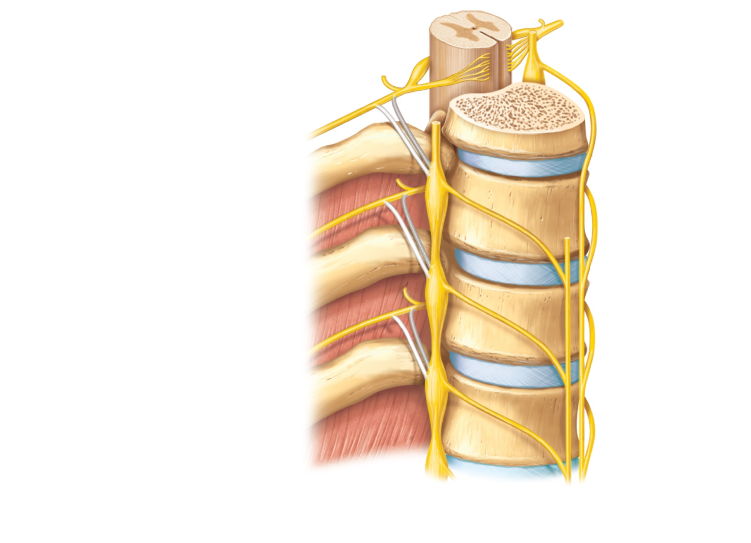
Spinal cord
Dorsal root
Ventral root
Rib
Sympathetic
trunk ganglion
Sympathetic
trunk
Ventral ramus
of spinal nerve
Gray ramus
communicans
White ramus
communicans
Thoracic
splanchnic nerves
(a) Location of the sympathetic trunk
Figure 14.5a

Slide 22
Sympathetic Trunks and Pathways
Upon entering a sympathetic trunk ganglion a preganglionic fiber may do one of the following:
  Synapse with a ganglionic neuron within the same ganglion
  Ascend or descend the sympathetic trunk to synapse in another trunk ganglion
  Pass through the trunk ganglion and emerge without synapsing

Slide 23
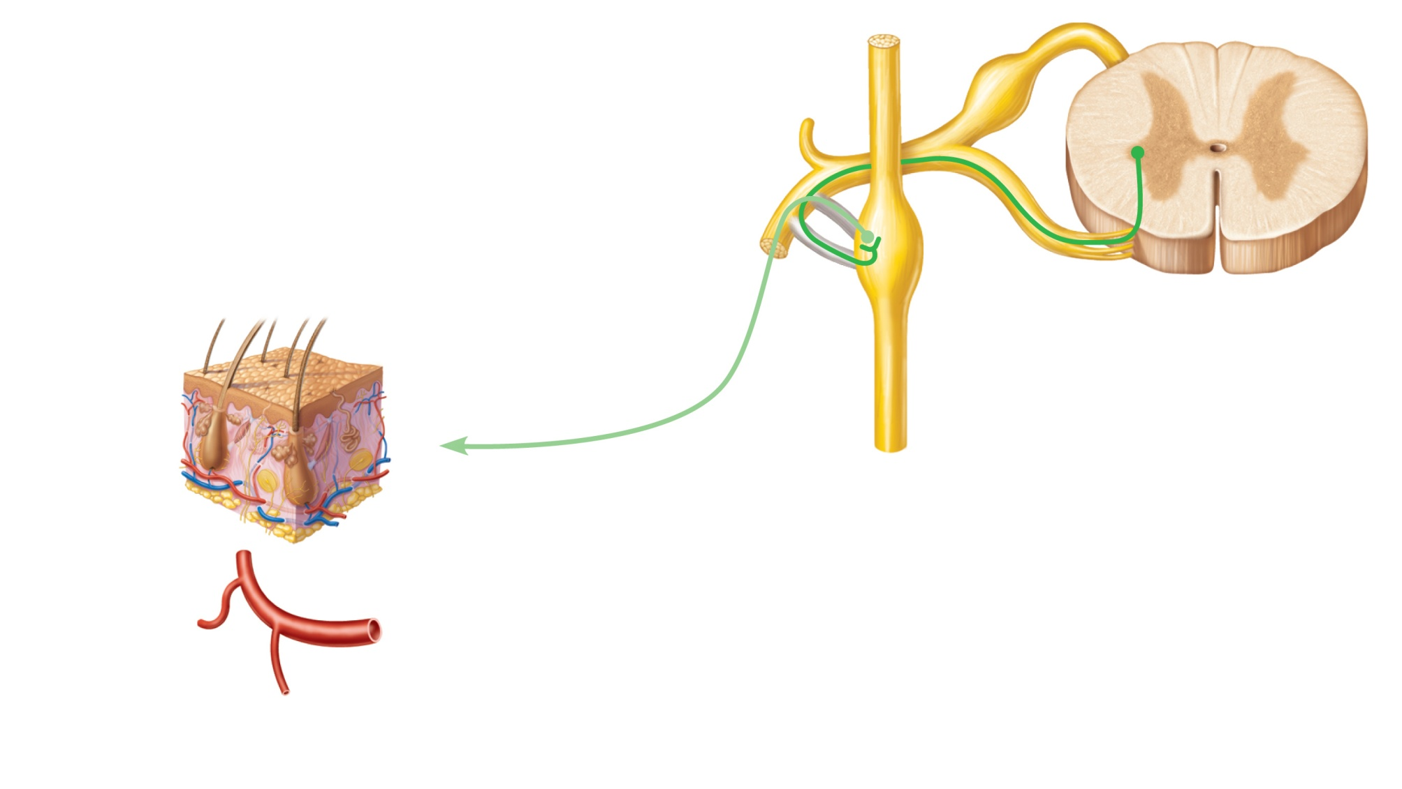
Lateral horn (visceral
motor zone)
Dorsal root
Dorsal root ganglion
Dorsal ramus of
spinal nerve
Ventral ramus of
spinal nerve
Skin (arrector
pili muscles
and sweat
glands)
Gray ramus
communicans
Ventral root
White ramus
communicans
Sympathetic
trunk ganglion
Sympathetic trunk
To effector
1
Synapse at the same level
Blood vessels
(b) Three pathways of sympathetic innervation
Figure 14.5b (1 of 3)

Slide 24
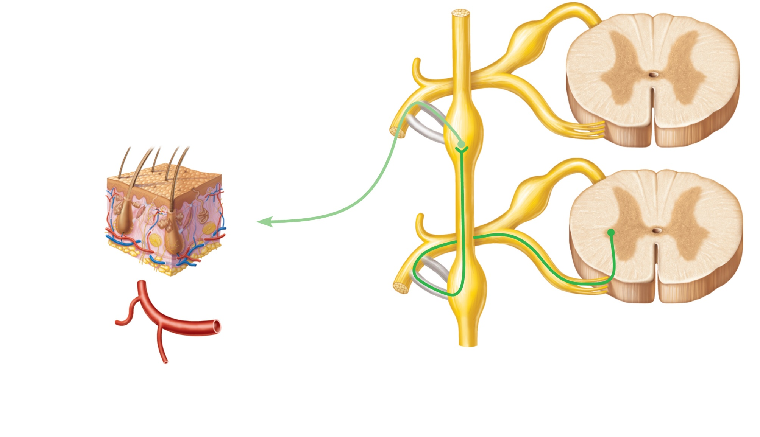
Skin (arrector
pili muscles
and sweat
glands)
To effector
Blood vessels
2
Synapse at a higher or lower level
(b) Three pathways of sympathetic innervation
Figure 14.5b (2 of 3)

Slide 25
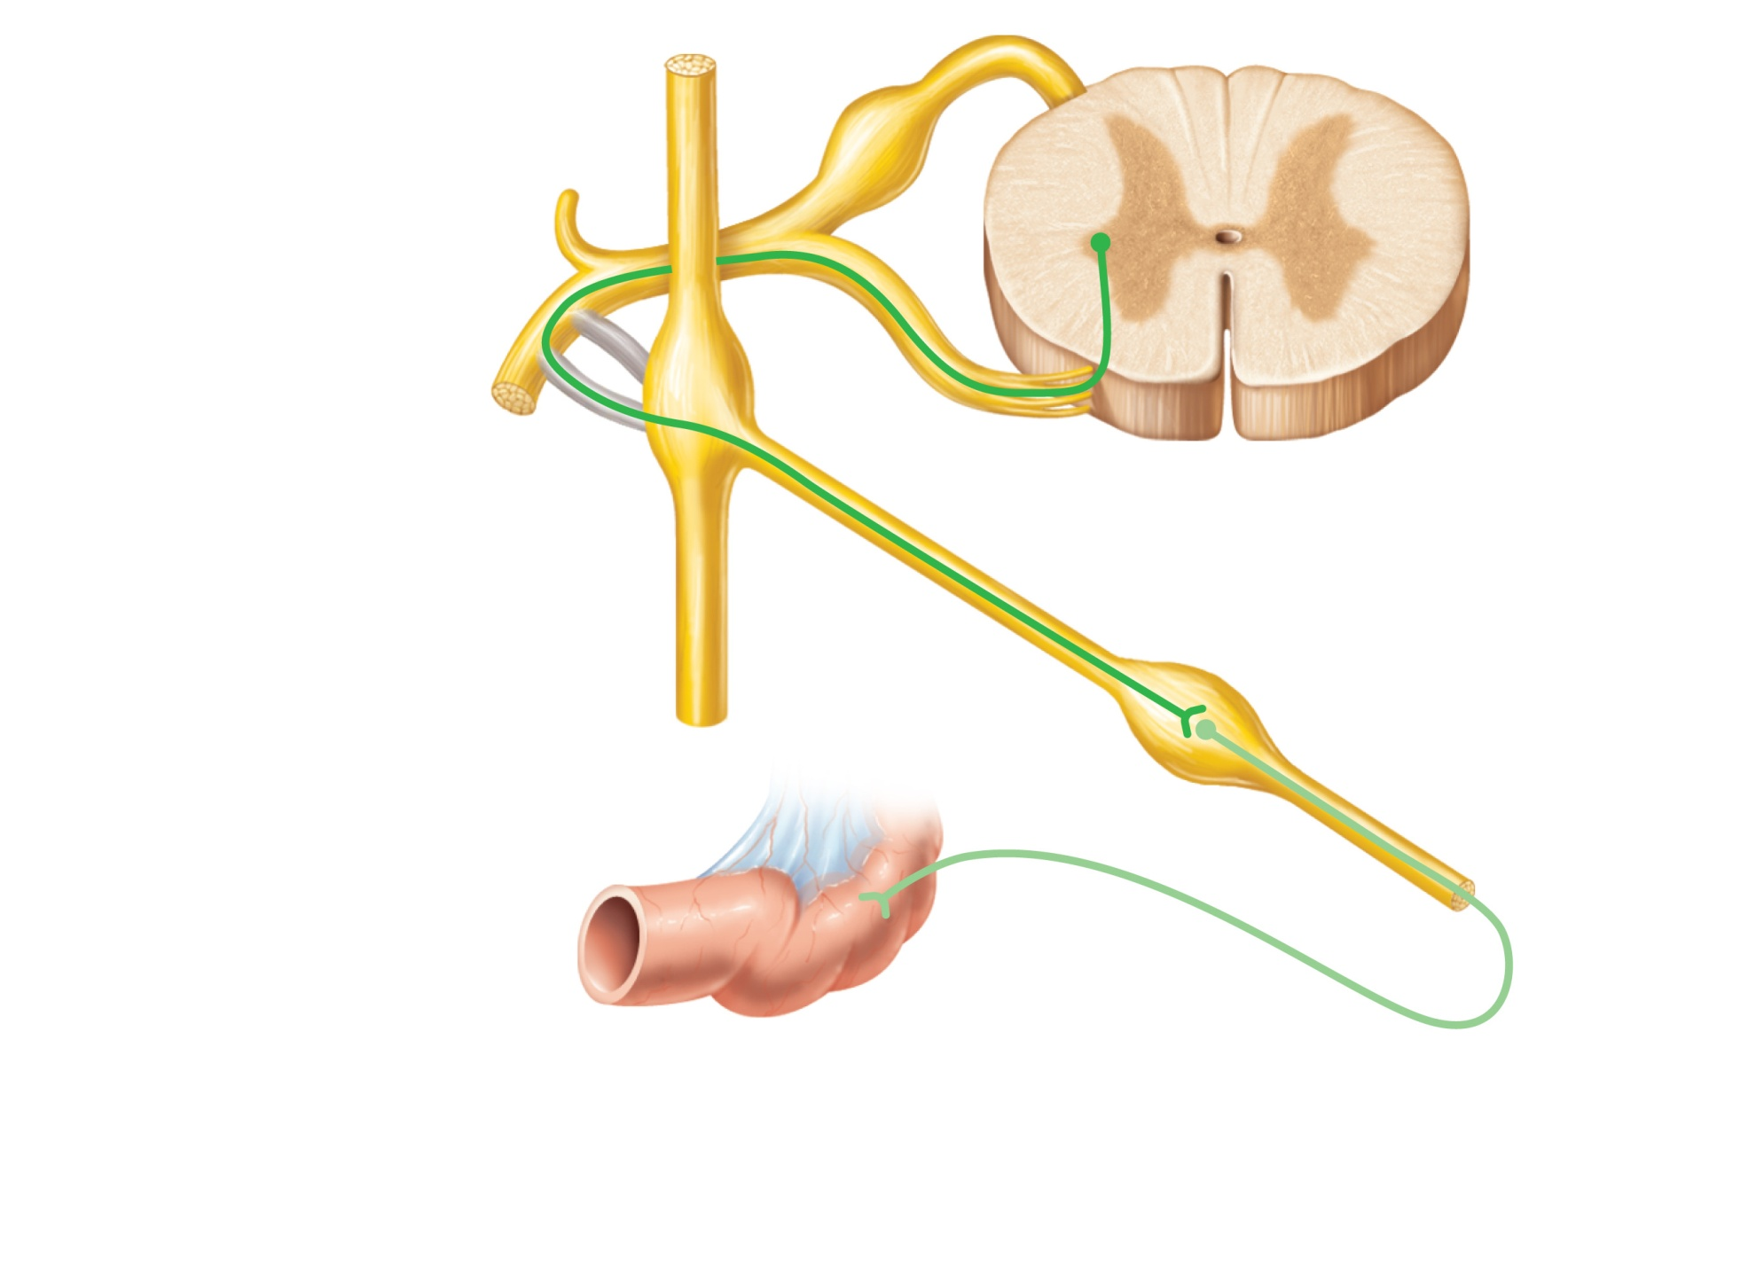
Splanchnic nerve
Collateral ganglion
(such as the celiac)
Target organ
in abdomen
(e.g., intestine)
3
Synapse in a distant collateral ganglion
anterior to the vertebral column
(b) Three pathways of sympathetic innervation
Figure 14.5b (3 of 3)

Slide 26
Pathways with Synapses in Chain Ganglia
Postganglionic axons enter the ventral rami via the gray rami communicantes
These fibers innervate
  Sweat glands
  Arrector pili muscles
  Vascular smooth muscle

Slide 27
Pathways to the Head
Fibers emerge from T₁ – T₄ and synapse in the superior cervical ganglion
These fibers
  Innervate skin and blood vessels of the head
  Stimulate dilator muscles of the iris
  Inhibit nasal and salivary glands

Slide 28
Pathways to the Thorax
Preganglionic fibers emerge from T₁ – T₆ and synapse in the cervical trunk ganglia
Postganglionic fibers emerge from the middle and inferior cervical ganglia and enter nerves C₄ – C₈
These fibers innervate:
  Heart via the cardiac plexus
  Thyroid gland and the skin
  Lungs and esophagus

Slide 29
Pathways with Synapses in Collateral Ganglia
Most fibers from T₅ – L₂ synapse in collateral ganglia
They form thoracic, lumbar, and sacral splanchnic nerves
Their ganglia include the celiac and the superior and inferior mesenteric

Slide 30
Pathways to the Abdomen
Preganglionic fibers from T₅ – L₂ travel through the thoracic splanchnic nerves
Synapses occur in the celiac and superior mesenteric ganglia
Postganglionic fibers serve the stomach, intestines, liver, spleen, and kidneys

Slide 31
Pathways to the Pelvis
Preganglionic fibers from T₁₀ – L₂ travel via the lumbar and sacral splanchnic nerves
Synapses occur in the inferior mesenteric and hypogastric ganglia
Postganglionic fibers serve the distal half of the large intestine, the urinary bladder, and the reproductive organs

Slide 32
Pathways with Synapses in the Adrenal Medulla
Some preganglionic fibers pass directly to the adrenal medulla without synapsing
Upon stimulation, medullary cells secrete norepinephrine and epinephrine into the blood

Slide 33
Visceral Reflexes
Visceral reflex arcs have the same components as somatic reflexes
Main difference: visceral reflex arc has two neurons in the motor pathway
Visceral pain afferents travel along the same pathways as somatic pain fibers, contributing to the phenomenon of referred pain

Slide 34
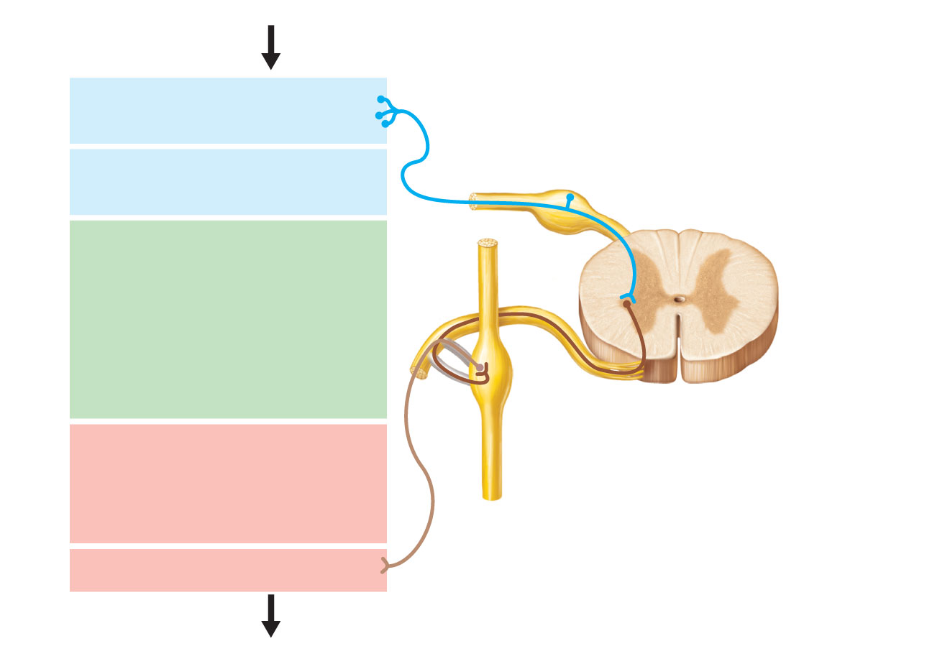
Stimulus
Sensory receptor
in viscera
Dorsal root ganglion
1
Visceral sensory
neuron
Spinal cord
2
Integration center
• May be preganglionic
neuron (as shown)
• May be a dorsal horn
interneuron
• May be within walls
of gastrointestinal tract
3
Autonomic ganglion
Efferent pathway
(two-neuron chain)
• Preganglionic neuron
• Ganglionic neuron
4
5
Visceral effector
Response
Figure 14.7

Slide 35
Referred Pain
Visceral pain afferents travel along the same pathway as somatic pain fibers
Pain stimuli arising in the viscera are perceived as somatic in origin

Slide 36
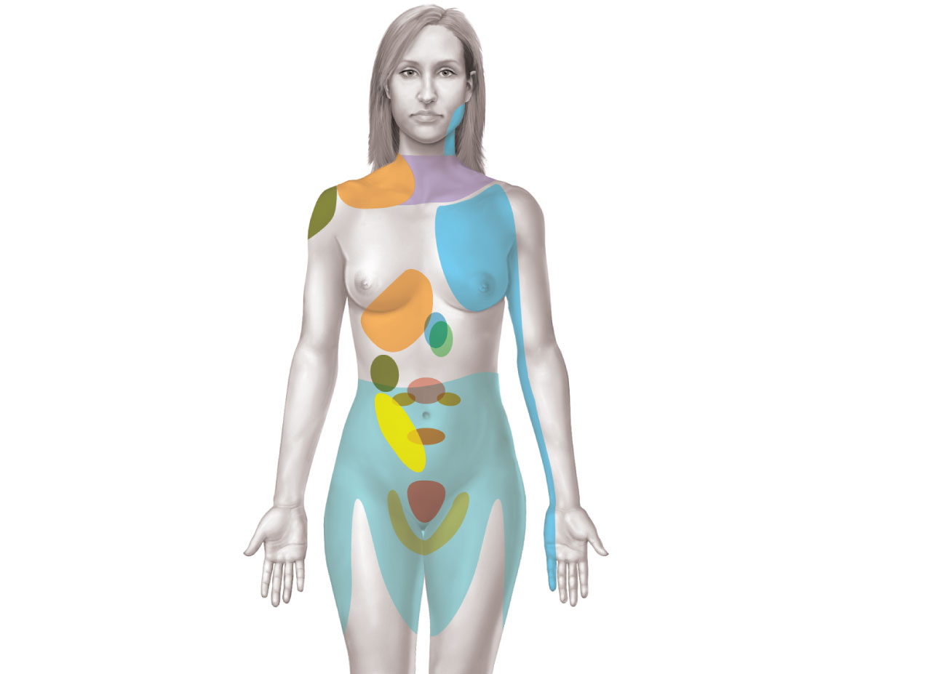
Heart
Lungs and
diaphragm
Liver
Gallbladder
Heart
Liver
Appendix
Stomach
Pancreas
Small intestine
Ovaries
Colon
Kidneys
Urinary
bladder
Ureters
Figure 14.8

Slide 37
Neurotransmitters
Cholinergic fibers release the neurotransmitter ACh
  All ANS preganglionic axons
  All parasympathetic postganglionic axons
Adrenergic fibers release the neurotransmitter NE
  Most sympathetic postganglionic axons
  Exceptions: sympathetic postganglionic fibers secrete ACh at sweat glands and some blood vessels in skeletal muscles
  Cholinergic Adrenergics

Slide 38
Two-neuron chain from CNS to effector organs
ACh
NE
Unmyelinated
postganglionic axon
SYMPATHETIC
Lightly myelinated
preganglionic axons
Ganglion
+
Epinephrine and
norepinephrine
ACh
Stimulatory
or inhibitory,
depending
on neuro-
transmitter
and
receptors
on effector
organs
AUTONOMIC NERVOUS SYSTEM
Adrenal medulla
Blood vessel
ACh
ACh
Smooth muscle
(e.g., in gut),
glands, cardiac
muscle
PARASYMPATHETIC
Lightly myelinated
preganglionic axon
Unmyelinated
postganglionic
axon
Ganglion
Acetylcholine (ACh)
Norepinephrine (NE)
Figure 14.2

Slide 39
Receptors for Neurotransmitters
Cholinergic receptors for ACh
Adrenergic receptors for NE

Slide 40
Cholinergic Receptors
Two types of receptors bind ACh
  Nicotinic
  Muscarinic
Named after drugs that bind to them and mimic ACh effects

Slide 41
Nicotinic Receptors
Found on
  Motor end plates of skeletal muscle cells (Chapter 9)
  All ganglionic neurons (sympathetic and parasympathetic)
  Hormone-producing cells of the adrenal medulla
Effect of ACh at nicotinic receptors is always stimulatory

Slide 42
Muscarinic Receptors
Found on
All effector cells stimulated by postganglionic cholinergic fibers
The effect of ACh at muscarinic receptors
  Can be either inhibitory or excitatory
  Depends on the receptor type of the target organ

Slide 43
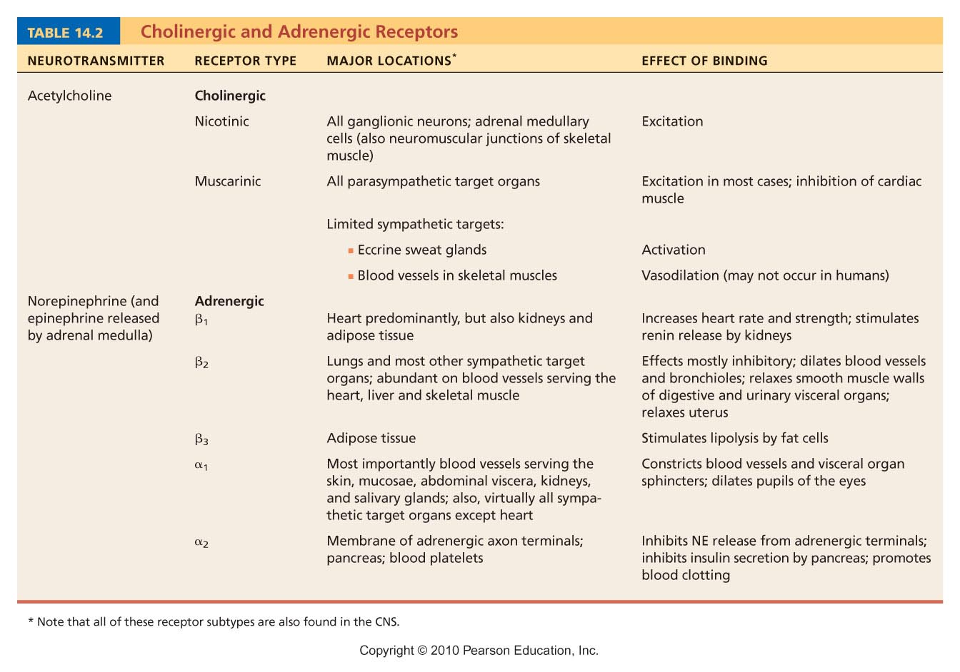
Table 14.2

Slide 44
Adrenergic Receptors
Two types
  Alpha (α) (subtypes α1, α2)
  Beta (β) (subtypes β1, β2 , β3)
Effects of NE depend on which subclass of receptor predominates on the target organ

Slide 45
Table 14.2

Slide 46
Effects of Drugs
Atropine
  Anticholinergic; blocks muscarinic receptors
  Used to prevent salivation during surgery, and to dilate the pupils for examination
Neostigmine
  Inhibits acetylcholinesterase
  Used to treat myasthenia gravis

Slide 47
Effects of Drugs
Over-the-counter drugs for colds, allergies, and nasal congestion
  Stimulate α-adrenergic receptors
Beta-blockers
  Drugs that attach to β₂ receptors to dilate lung bronchioles in asthmatics; other uses

Slide 48
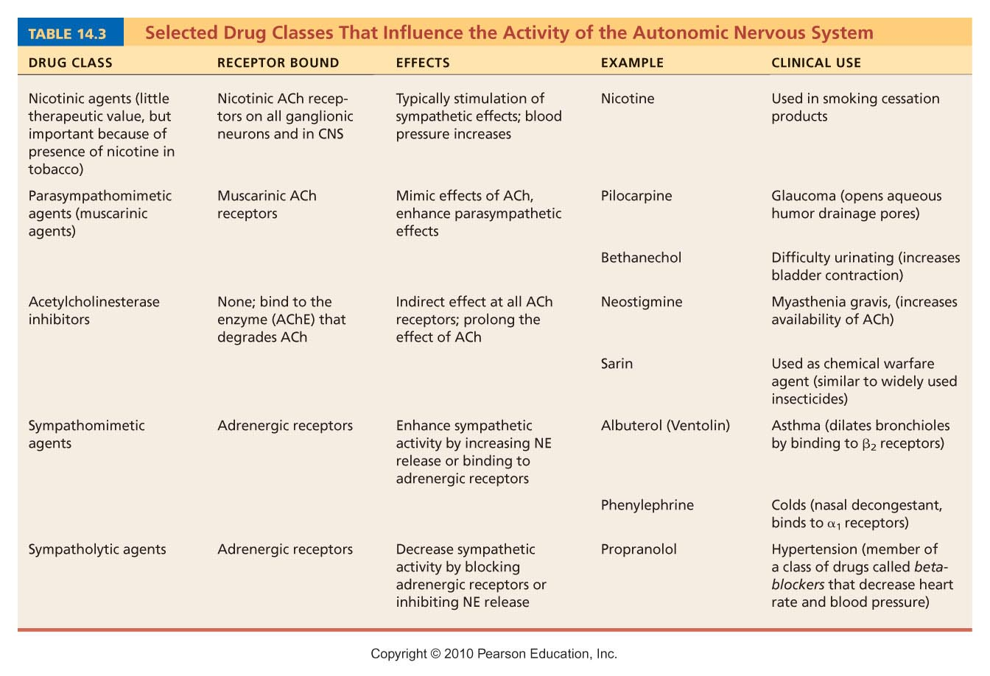
Table 14.3

Slide 49
Interactions of the Autonomic Divisions
Most visceral organs have dual innervation
Dynamic antagonism allows for precise control of visceral activity
  Sympathetic division increases heart and respiratory rates, and inhibits digestion and elimination
  Parasympathetic division decreases heart and respiratory rates, and allows for digestion and the discarding of wastes

Slide 50
Sympathetic Tone
Sympathetic division controls blood pressure, even at rest
Sympathetic tone (vasomotor tone)
  Keeps the blood vessels in a continual state of partial constriction

Slide 51
Sympathetic Tone
Sympathetic fibers fire more rapidly to constrict blood vessels and cause blood pressure to rise
Sympathetic fibers fire less rapidly to prompt vessels to dilate to decrease blood pressure
Alpha-blocker drugs interfere with vasomotor fibers and are used to treat hypertension

Slide 52
Parasympathetic Tone
Parasympathetic division normally dominates the heart and smooth muscle of digestive and urinary tract organs
  Slows the heart
  Dictates normal activity levels of the digestive and urinary tracts
The sympathetic division can override these effects during times of stress
Drugs that block parasympathetic responses increase heart rate and block fecal and urinary retention

Slide 53
Cooperative Effects
Best seen in control of the external genitalia
Parasympathetic fibers cause vasodilation; are responsible for erection of the penis or clitoris
Sympathetic fibers cause ejaculation of semen in males and reflex contraction of a female’s vagina

Slide 54
Unique Roles of the Sympathetic Division
The adrenal medulla, sweat glands, arrector pili muscles, kidneys, and most blood vessels receive only sympathetic fibers
The sympathetic division controls
  Thermoregulatory responses to heat
  Release of renin from the kidneys
  Metabolic effects
    Increases metabolic rates of cells
    Raises blood glucose levels
    Mobilizes fats for use as fuels

Slide 55
Localized Versus Diffuse Effects
Parasympathetic division: short-lived, highly localized control over effectors
Sympathetic division: long-lasting, bodywide effects

Slide 56
Effects of Sympathetic Activation
Sympathetic activation is long lasting because NE
  Is inactivated more slowly than ACh
  NE and epinephrine are released into the blood and remain there until destroyed by the liver

Slide 57
Control of ANS Functioning
Hypothalamus—main integrative center of ANS activity
Subconscious cerebral input via limbic lobe connections influences hypothalamic function
Other controls come from the cerebral cortex, the reticular formation, and the spinal cord

Slide 58
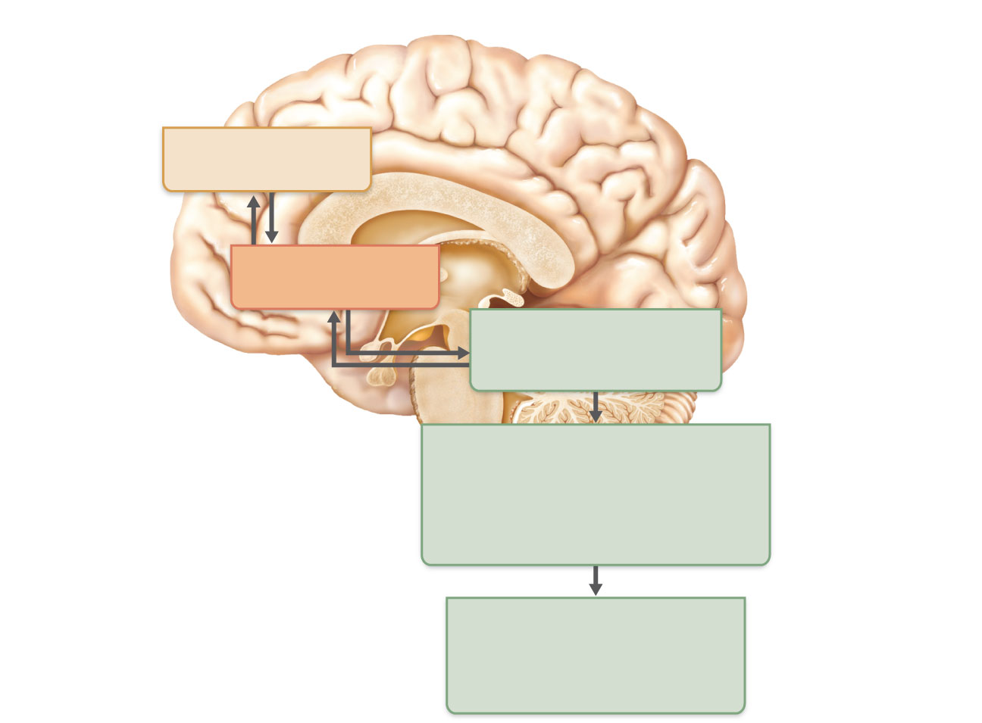
Communication at
subconscious level
Cerebral cortex
(frontal lobe)
Limbic system
(emotional input)
Hypothalamus
Overall integration
of ANS, the boss
Brain stem
(reticular formation, etc.)
Regulation of pupil size,
respiration, heart, blood
pressure, swallowing, etc.
Spinal cord
Urination, defecation,
erection, and ejaculation
reflexes
Figure 14.9

Slide 59
Hypothalamic Control
Control may be direct or indirect (through the reticular system)
Centers of the hypothalamus control
  Heart activity and blood pressure
  Body temperature, water balance, and endocrine activity
  Emotional stages (rage, pleasure) and biological drives (hunger, thirst, sex)
  Reactions to fear and the “fight-or-flight” system

Slide 60
Developmental Aspects of the ANS
During youth, ANS impairments are usually due to injury
In old age, ANS efficiency declines, partially due to structural changes at preganglionic axon terminals

Slide 61
Developmental Aspects of the ANS
Effects of age on ANS
  Constipation
  Dry eyes
  Frequent eye infections
  Orthostatic hypotension
    Low blood pressure occurs because aging pressure receptors respond less to changes in blood pressure with changes in body position and because of slowed responses by sympathetic vasoconstrictor centers

