Slide 1
12
P A R T A
  Brain – Short
  Version

Slide 2
Central Nervous System (CNS)
CNS – composed of the brain and spinal cord
Cephalization
  Elaboration of the anterior portion of the CNS
  Increase in number of neurons in the head
  Highest level is reached in the human brain

Slide 3
The Brain
Composed of an outer layer of wrinkled, pinkish gray tissue (gray matter) – that is composed of non-myelinated neurons and an inner core of whitish tissue (white matter) composed of myelinated neurons.
Surface anatomy includes cerebral hemispheres, cerebellum, and brain stem

Slide 4
Embryonic Development
During the first 26 days of development:
  Ectoderm thickens forming the neural plate
  The neural plate invaginates, forming the neural groove
  The neural groove fuses dorsally and forms the neural tube

Slide 5
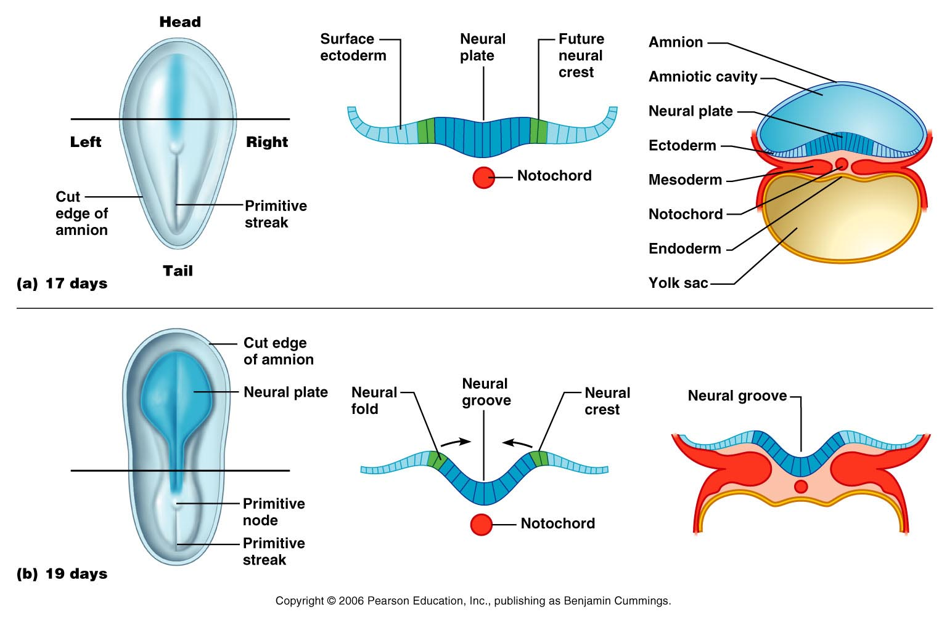
Specialization of Ectoderm: Neuralization
Figure 28.9a, b

Slide 6
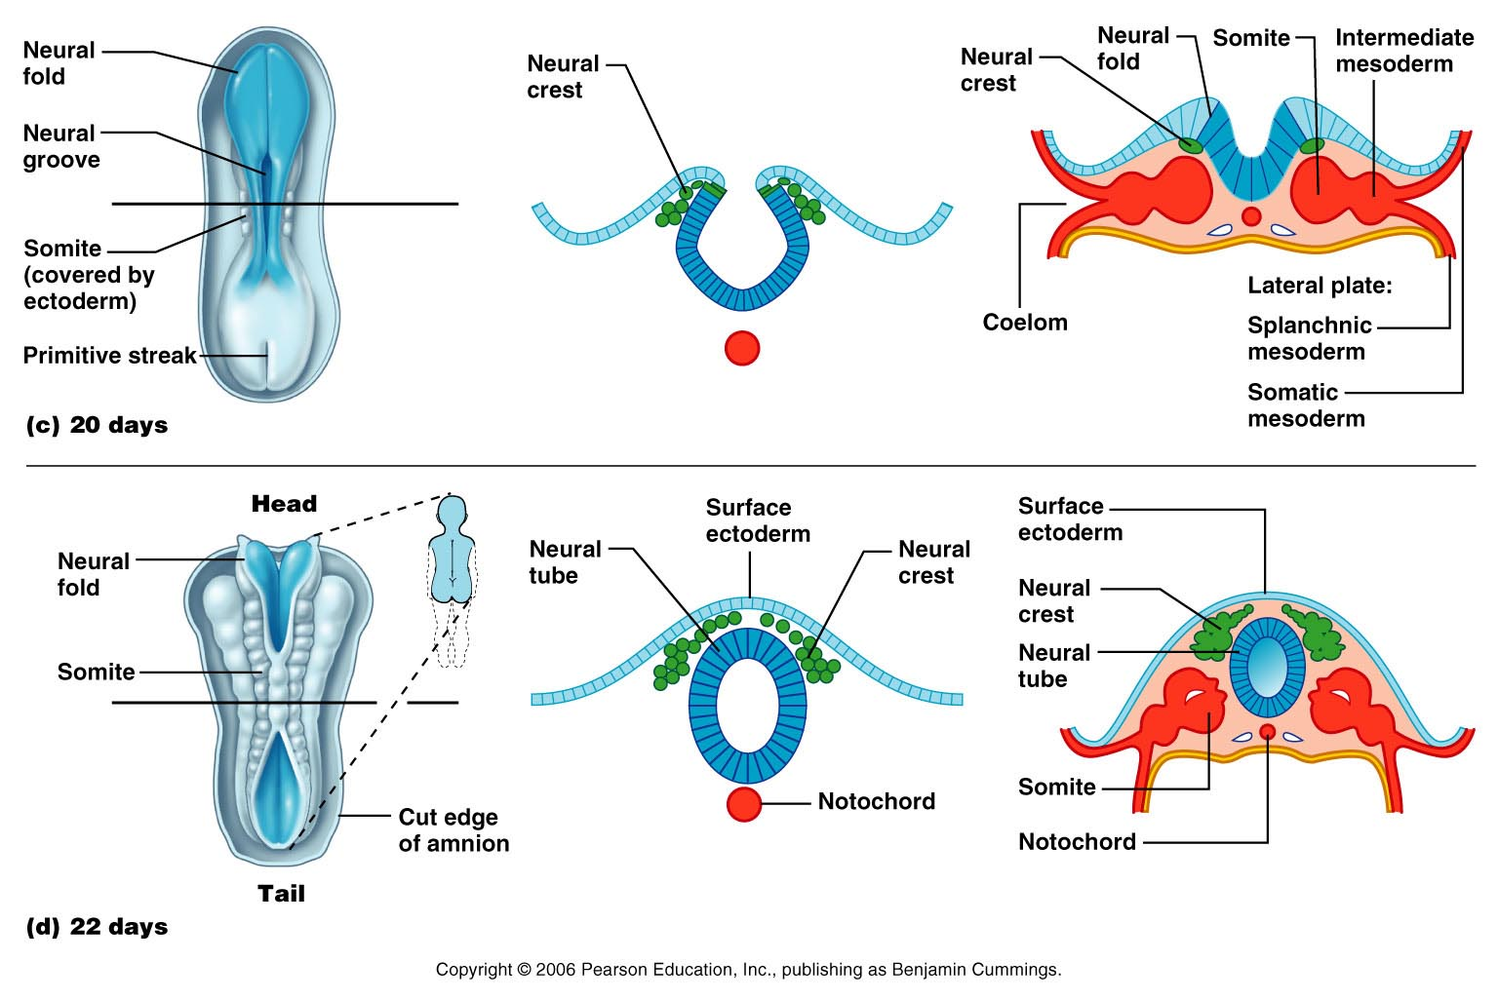
Specialization of Ectoderm: Neuralization
Figure 28.9c, d

Slide 7
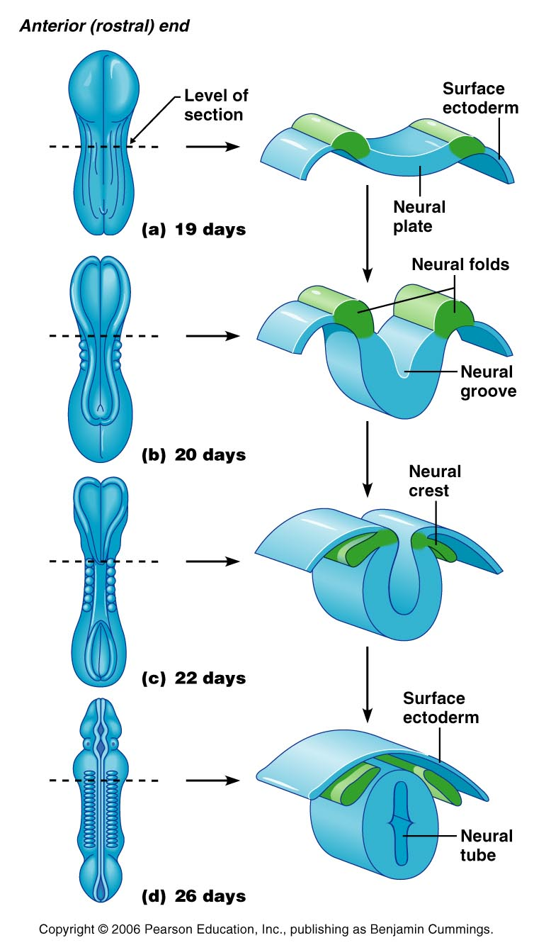
Embryonic Development
Figure 12.1

Slide 8
Primary Brain Vesicles
The anterior end of the neural tube expands and constricts to form the three primary brain vesicles
  Prosencephalon – the forebrain
  Mesencephalon – the midbrain
  Rhombencephalon – hindbrain

Slide 9
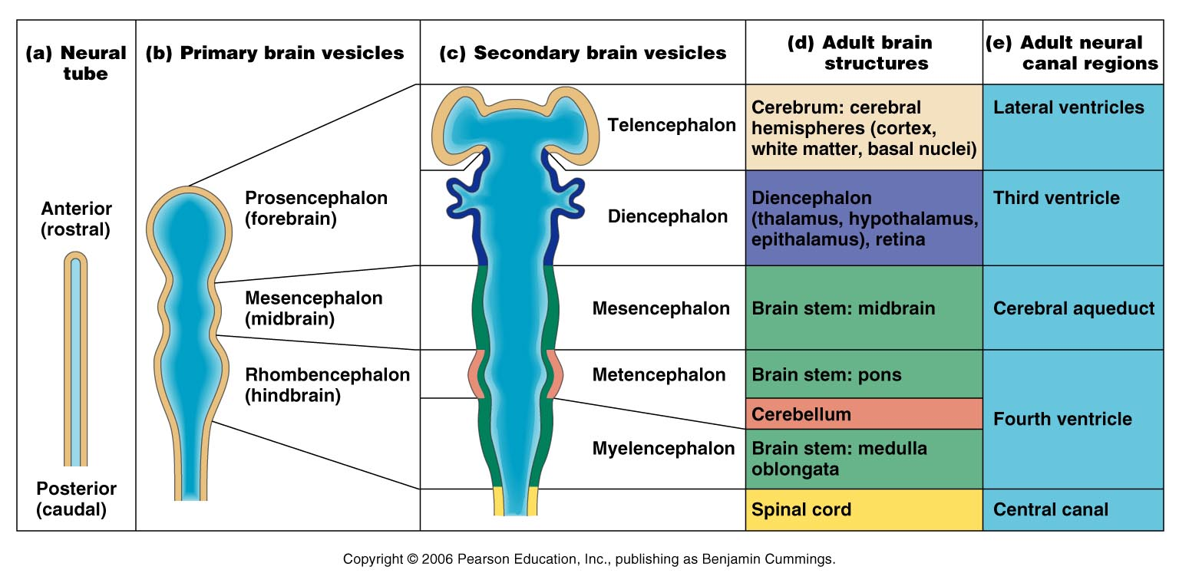
Neural Tube and Primary Brain Vesicles
Figure 12.2a, b

Slide 10
Secondary Brain Vesicles
Figure 12.2c

Slide 11
Secondary Brain Vesicles
In week 5 of embryonic development, secondary brain vesicles form
  Telencephalon and diencephalon arise from the forebrain
  Mesencephalon remains undivided
  Metencephalon and myelencephalon arise from the hindbrain

Slide 12
Adult Brain Structures
Fates of the secondary brain vesicles:
  Telencephalon – cerebrum: cortex, white matter, and basal nuclei
  Diencephalon – thalamus, hypothalamus, and epithalamus
  Mesencephalon – brain stem: midbrain
  Metencephalon – brain stem: pons
  Myelencephalon – brain stem: medulla oblongata

Slide 13
Adult Neural Canal Regions
Figure 12.2c, d

Slide 14
Adult Neural Canal Regions
Adult structures derived from the neural canal
  Telencephalon – lateral ventricles
  Diencephalon – third ventricle
  Mesencephalon – cerebral aqueduct
  Metencephalon and myelencephalon – fourth ventricle

Slide 15
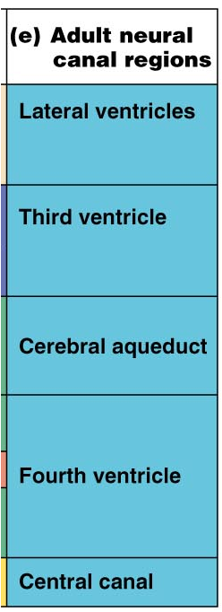
Adult Neural Canal Regions
Figure 12.2c, e

Slide 16
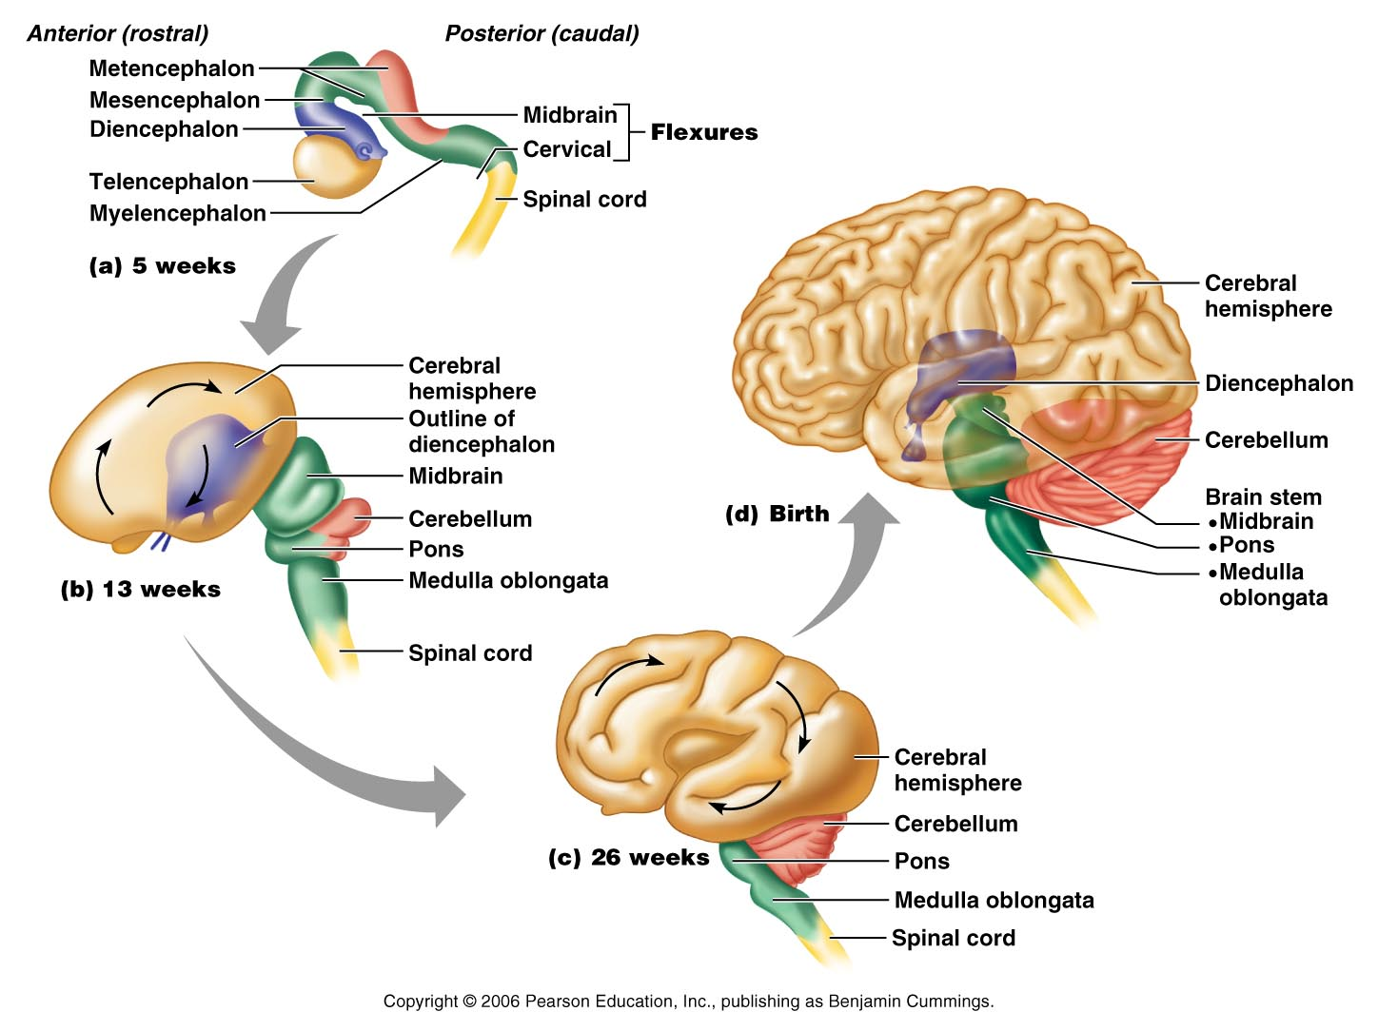
Space Restriction and Brain Development
Figure 12.3

Slide 17
Basic Pattern of the Central Nervous System
Spinal Cord (two layers – outer white matter and inner gray)
  Central cavity surrounded by a gray matter core
  External to which is white matter composed of myelinated fiber tracts
Brain (three layers outer gray – mid white then an inner area of gray matter)
  Similar to spinal cord but with additional areas of gray matter
  Cerebellum has gray matter in nuclei
  Cerebrum has nuclei and additional gray matter in the cortex

Slide 18
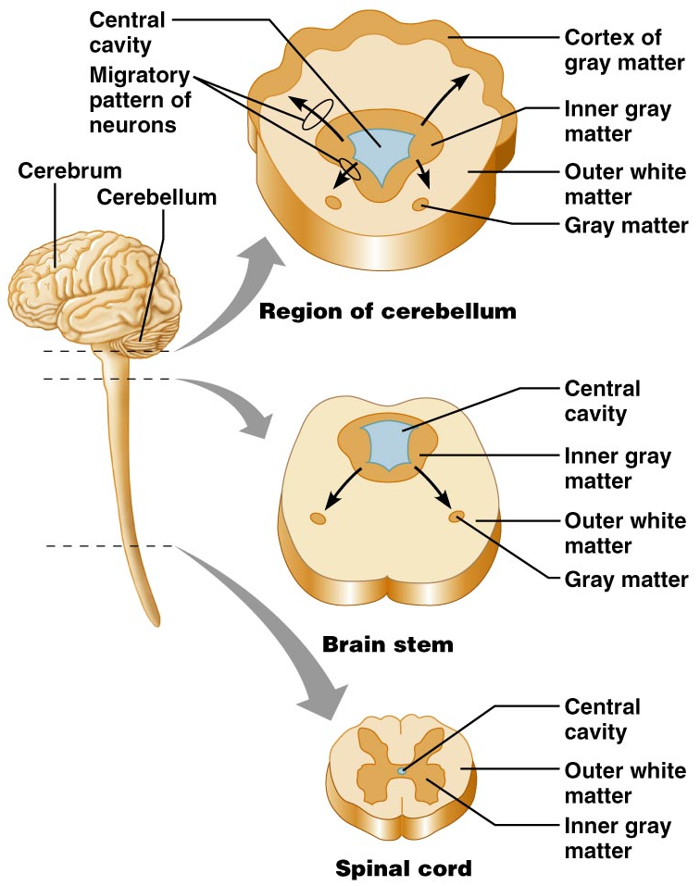
Basic Pattern of the Central Nervous System
Figure 12.4

Slide 19
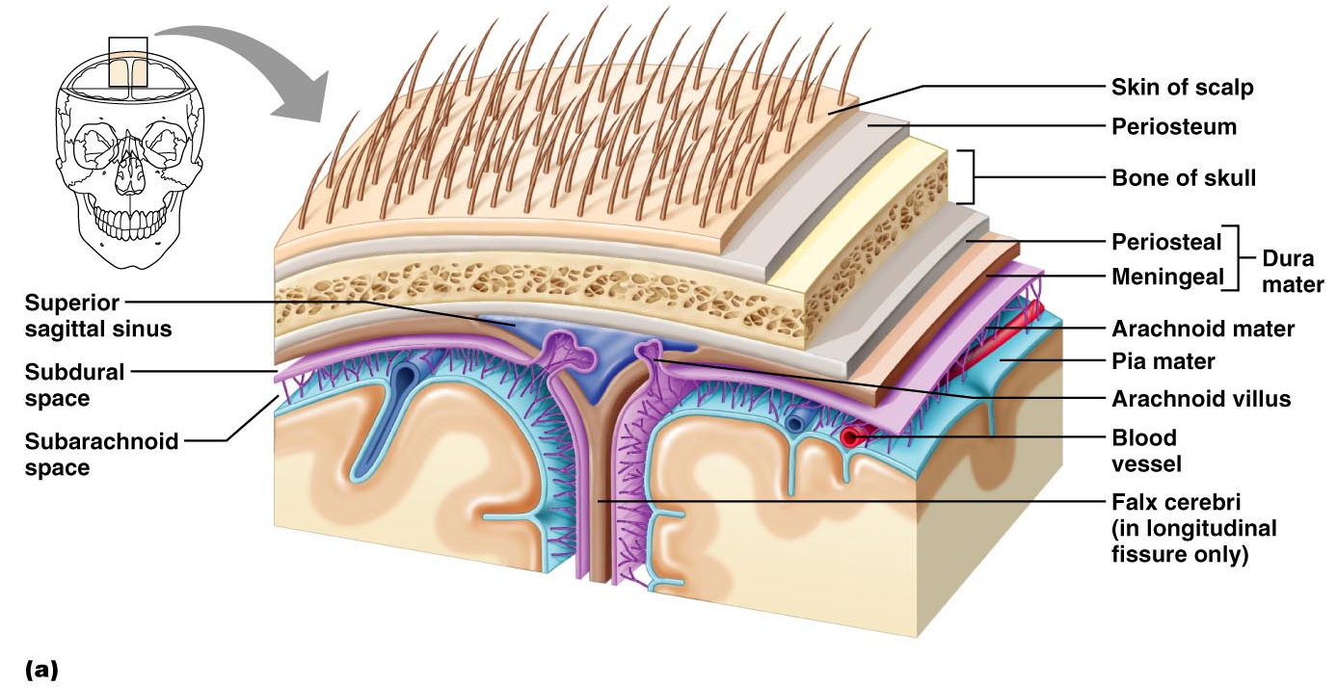
Meninges
Figure 12.24a

Slide 20
Dura Mater
Leathery, strong meninx composed of two fibrous connective tissue layers
The two layers separate in certain areas and form dural sinuses

Slide 21
Dura Mater
Three dural septa extend inward and limit excessive movement of the brain
  Falx cerebri – fold that dips into the longitudinal fissure
  Falx cerebelli – runs along the vermis of the cerebellum
  Tentorium cerebelli – horizontal dural fold extends into the transverse fissure

Slide 22
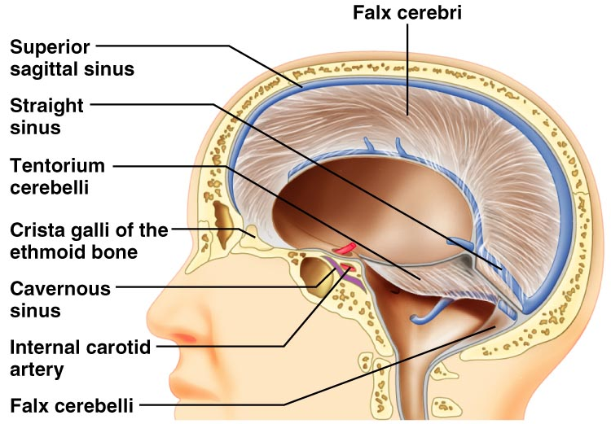
Dura Mater
Figure 12.25

Slide 23
Arachnoid Mater
The middle meninx, which forms a loose brain covering
It is separated from the dura mater by the subdural space
Beneath the arachnoid is a wide subarachnoid space filled with CSF and large blood vessels
Arachnoid villi protrude superiorly and permit CSF to be absorbed into venous blood

Slide 24
Arachnoid Mater
Figure 12.24a

Slide 25
Pia Mater
Deep meninx composed of delicate connective tissue that clings tightly to the brain

Slide 26
Ventricles of the Brain
Arise from expansion of the lumen of the neural tube
The ventricles are:
  The paired C-shaped lateral ventricles
  The third ventricle found in the diencephalon
  The fourth ventricle found in the hindbrain dorsal to the pons

Slide 27
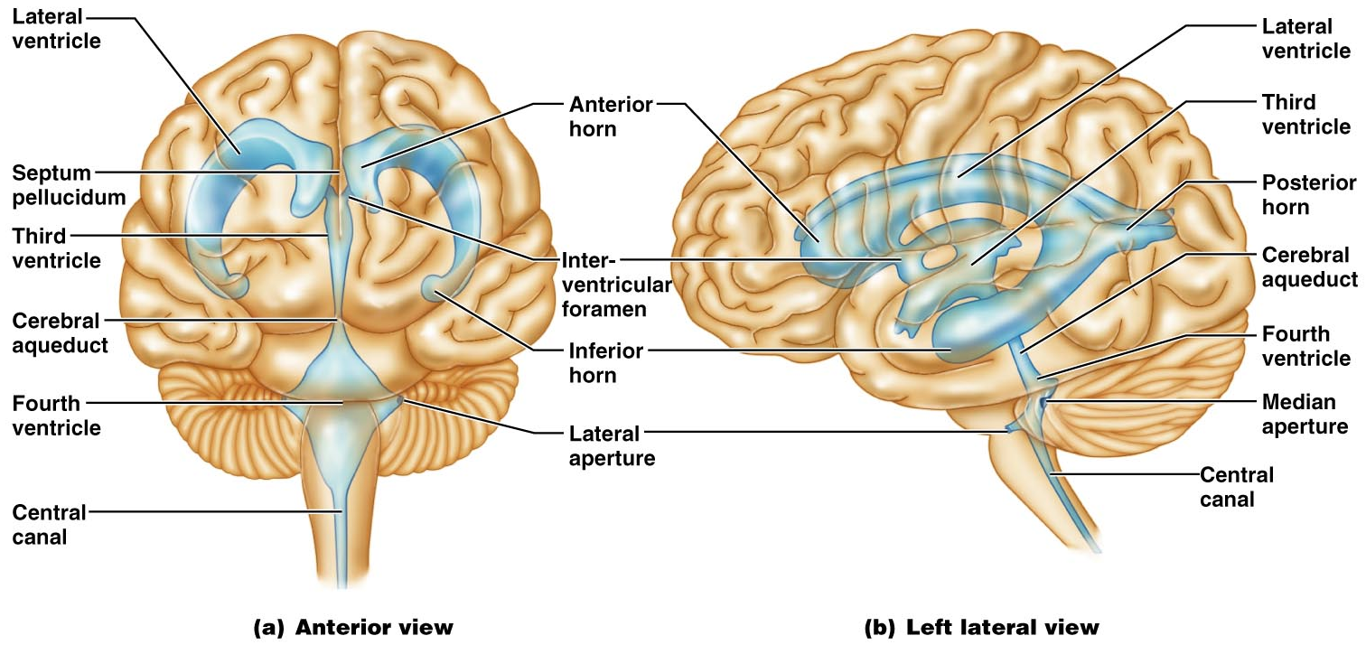
Ventricles of the Brain
Figure 12.5

Slide 28
Cerebrospinal Fluid (CSF)
Watery solution similar in composition to blood plasma
Contains less protein and different ion concentrations than plasma
Forms a liquid cushion that gives buoyancy to the CNS organs

Slide 29
Cerebrospinal Fluid (CSF)
Prevents the brain from crushing under its own weight
Protects the CNS from blows and other trauma
Nourishes the brain and carries chemical signals throughout it

Slide 30
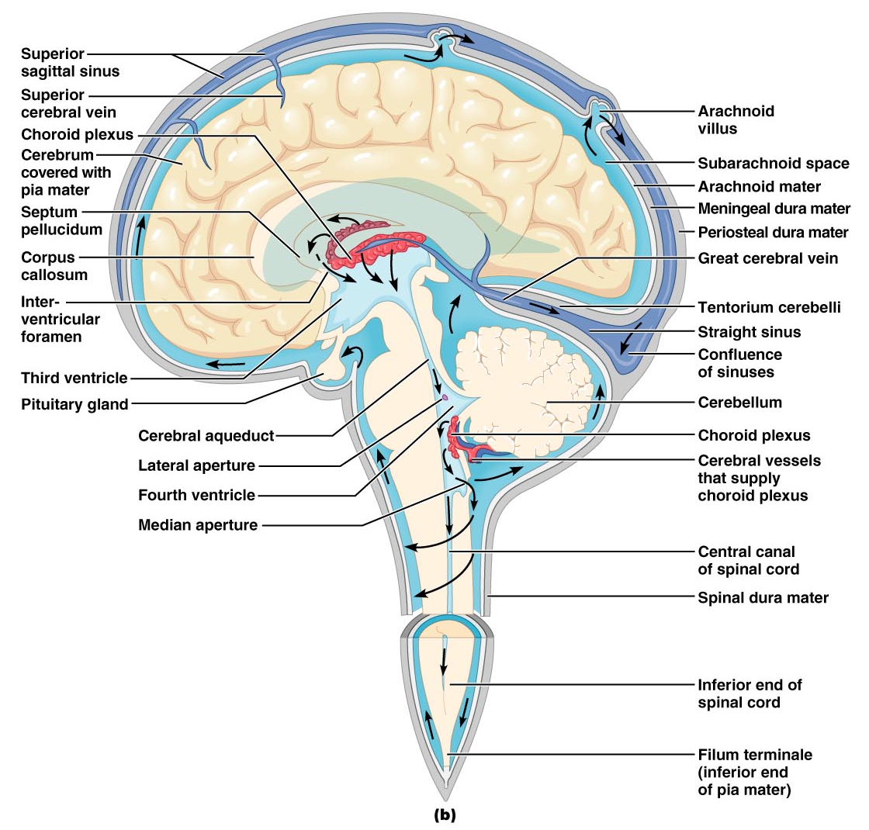
Circulation of CSF
Figure 12.26b

Slide 31
Choroid Plexuses
Clusters of capillaries that form tissue fluid filters, which hang from the roof of each ventricle
Have ion pumps that allow them to alter ion concentrations of the CSF
Help cleanse CSF by removing wastes

Slide 32
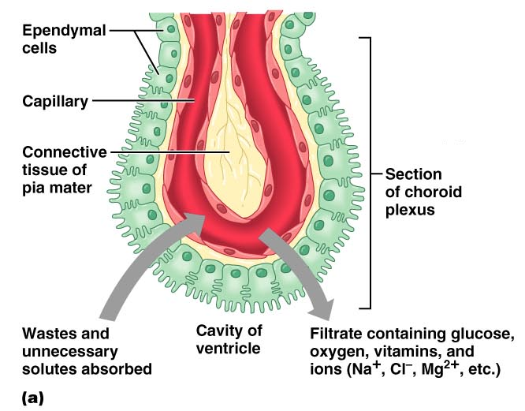
Choroid Plexuses
Figure 12.26a

Slide 33
Blood-Brain Barrier
Protective mechanism that helps maintain a stable environment for the brain
Bloodborne substances are separated from neurons by:
  Continuous endothelium of capillary walls
  Relatively thick basal lamina
  Bulbous feet of astrocytes

Slide 34
Blood-Brain Barrier: Functions
Selective barrier that allows nutrients to pass freely
Is ineffective against substances that can diffuse through plasma membranes
Absent in some areas (vomiting center and the hypothalamus), allowing these areas to monitor the chemical composition of the blood
Stress increases the ability of chemicals to pass through the blood-brain barrier

Slide 35
Cerebrum composed of the Cerebral Hemispheres
Form the superior part of the brain and make up 83% of its mass
Contain ridges (gyri) and shallow grooves (sulci)
Contain deep grooves called fissures
Are separated by the longitudinal fissure
Have three basic regions: cortex, white matter, and basal nuclei

Slide 36
Major Lobes, Gyri, and Sulci of the Cerebral Hemisphere
Deep sulci divide the hemispheres into five lobes:
  Frontal, parietal, temporal, occipital, and insula
Central sulcus – separates the frontal and parietal lobes

Slide 37
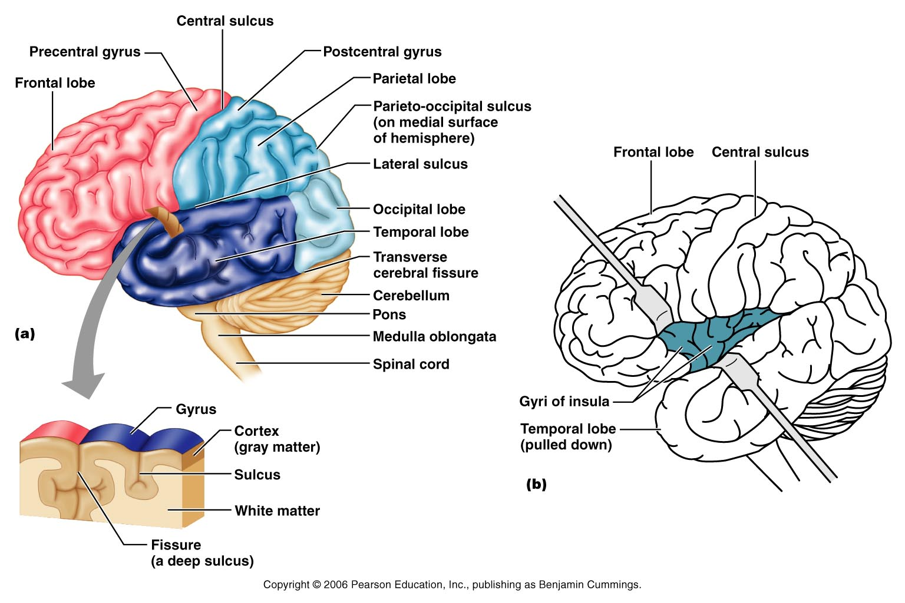
Brain Lobes
Figure 12.6a–b

Slide 38
Major Lobes, Gyri, and Sulci of the Cerebral Hemisphere
Parieto-occipital sulcus – separates the parietal and occipital lobes
Lateral sulcus – separates the parietal and temporal lobes
The precentral and postcentral gyri border the central sulcus

Slide 39
Cerebral Cortex
The cortex – superficial gray matter; accounts for 40% of the mass of the brain
It enables sensation, communication, memory, understanding, and voluntary movements
Each hemisphere acts contralaterally (controls the opposite side of the body)
Hemispheres are not equal in function (right more artistic – left more technical)
No functional area acts alone; conscious behavior involves the entire cortex

Slide 40
Functional Areas of the Cerebral Cortex
The three types of functional areas are:
  Motor areas – control voluntary movement
  Sensory areas – conscious awareness of sensation
  Association areas – integrate diverse information
  Several anatomists attempted to find physiologic (functional) areas of the – K. Broadman in 1906 was the best. He found 52 functional areas – thus numbered. However, now we no that one area of the brain functionally does it all for a function. It is a combination of several areas confluently working together.

Slide 41
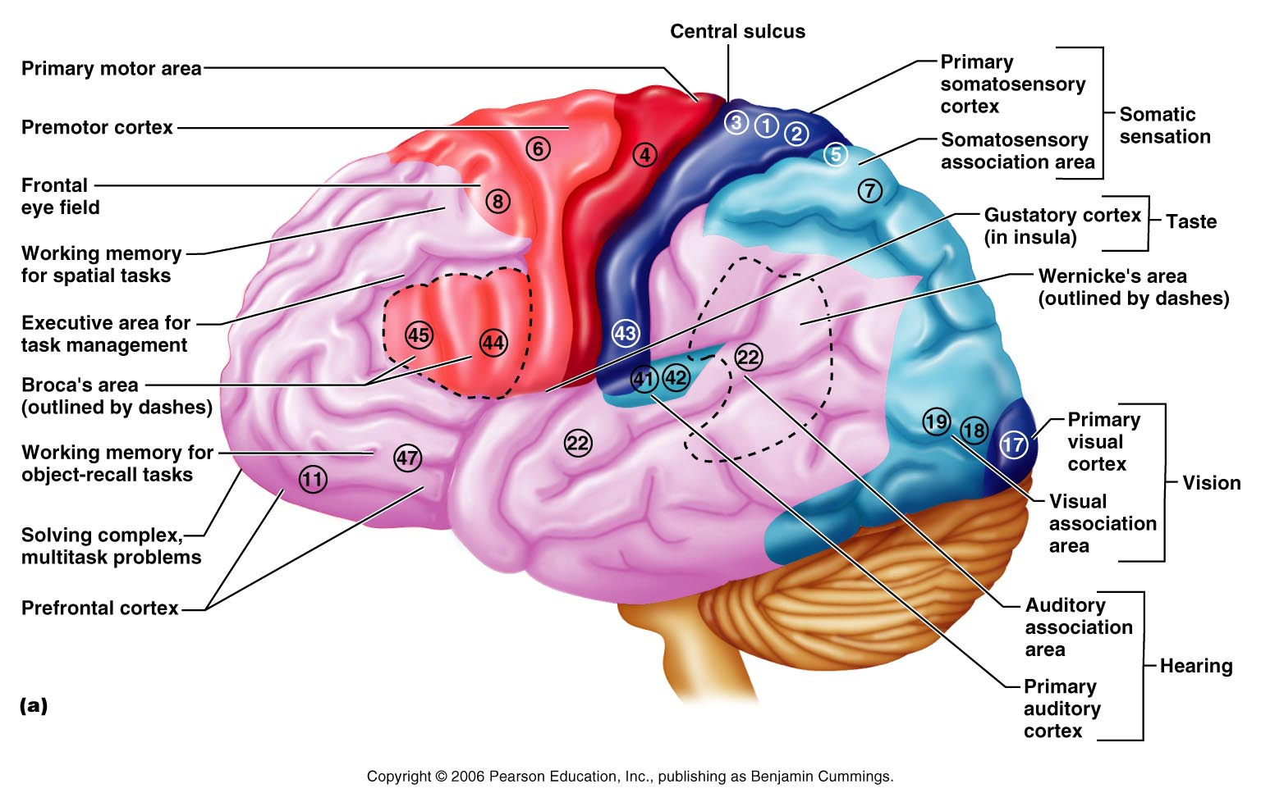
Functional Areas of the Cerebral Cortex
Figure 12.8a

Slide 42
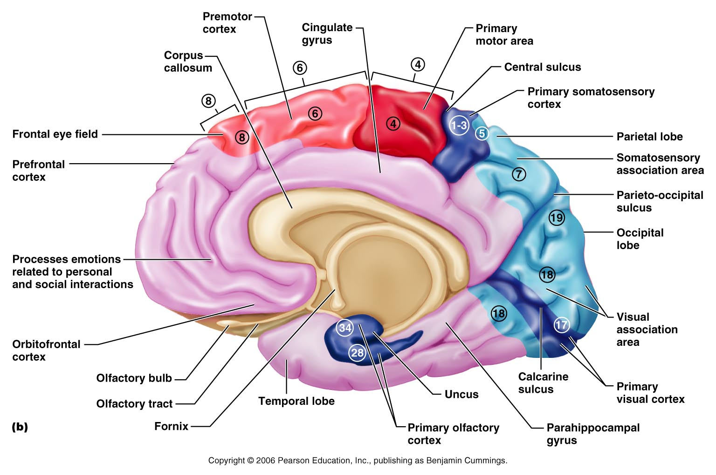
Functional Areas of the Cerebral Cortex
Figure 12.8b

Slide 43
Cerebral Cortex: Motor Areas
Primary (somatic) motor cortex (Broadman 4)
Premotor cortex (Broadman 6)
Broca’s area (Speech area) (Broadman 45 and 44)
Frontal eye field (Broadman 8)

Slide 44
Primary Motor Cortex
Located in the precentral gyrus
Pyramidal cells whose axons make up the corticospinal tracts
Allows conscious control of precise, skilled, voluntary movements

Slide 45
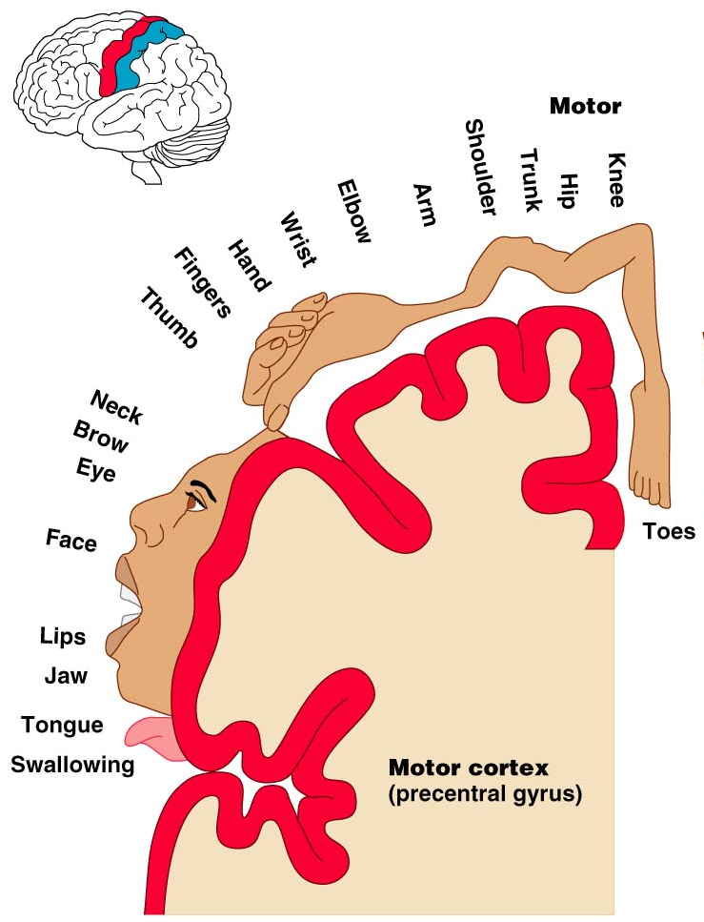
Primary Motor Cortex Homunculus
Figure 12.9.1

Slide 46
Premotor Cortex
Located anterior to the precentral gyrus (in front of the primary motor cortex)
Controls learned, repetitious, or patterned motor skills
Coordinates simultaneous or sequential actions
Involved in the planning of movements

Slide 47
Broca’s Area
Broca’s area
  Located anterior to the inferior region of the premotor area
  Present in one hemisphere (usually the left)
  A motor speech area that directs muscles of the tongue
  Is active as one prepares to speak

Slide 48
Motor Area (Broca)
Broca’s Area
Figure 12.8a

Slide 49
Frontal Eye Field
Frontal eye field
  Located anterior to the premotor cortex and superior to Broca’s area
  Controls voluntary eye movement
  Note: vision itself is in the occipital lobe

Slide 50
Motor Area (Frontal Eye Field)
Figure 12.8a

Slide 51
Sensory Areas
Primary somatosensory cortex (1, 2, 3)
Somatosensory association cortex (5, 7)
Visual (19, 18, 17) and auditory areas ( 41, 42, 22)
Olfactory Cortex (34, 28)
Gustatory Cortex (Insula)
Visceral Cortex (Insula)
Vestibular Cortex (Insula)

Slide 52
Sensory Areas
Figure 12.8a

Slide 53
Functional Areas of the Cerebral Cortex
Figure 12.8b

Slide 54
PrImary Somatosensory Cortex
Located in the postcentral gyrus, this area:
  Receives information from the skin and skeletal muscles
  Exhibits spatial discrimination

Slide 55
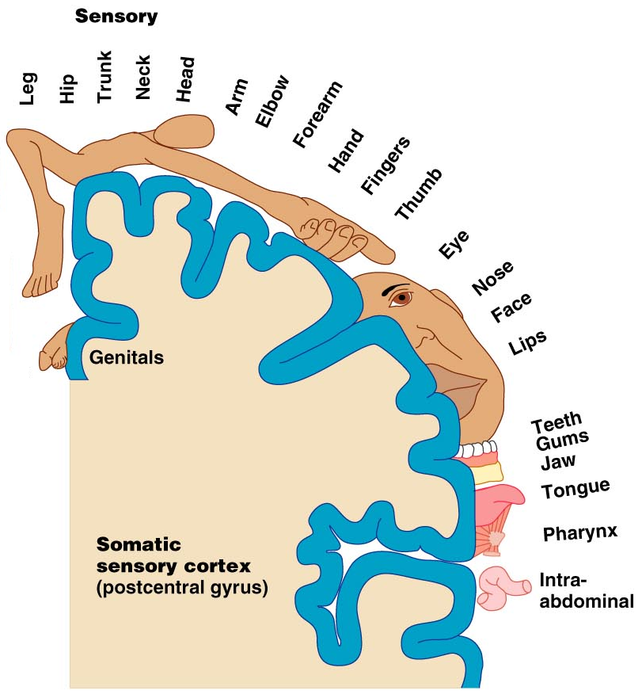
Primary Somatosensory Cortex Homunculus
Figure 12.9.2

Slide 56
Somatosensory Association Cortex
Located posterior to the primary somatosensory cortex
Integrates sensory information
Forms comprehensive understanding of the stimulus
Determines size, texture, and relationship of parts

Slide 57
Visual Areas
Primary visual (striate) cortex
  Seen on the extreme posterior tip of the occipital lobe
  Most of it is buried in the calcarine sulcus
  Receives visual information from the retinas
Visual association area
  Surrounds the primary visual cortex
  Interprets visual stimuli (e.g., color, form, and movement)

Slide 58
Auditory Areas
Primary auditory cortex
  Located at the superior margin of the temporal lobe
  Receives information related to pitch, rhythm, and loudness
Auditory association area
  Located posterior to the primary auditory cortex
  Stores memories of sounds and permits perception of sounds
  Wernicke’s area

Slide 59
Olfactory Cortex
Located on medial aspect of temporal lobe in an area termed the piriform lobe – which is dominated by the hooklike uncus
The olfactory cortex is part of the rhinencephalon
The rhinencephalon includes the orbitofrontal cortex, the uncus and associated regions of the temporal lobe, and the protruding olfactory tracts and bulbs that extend into the nose
Most of the rhinencephalon as a result of evolution has become associated with the Limbic system

Slide 60
The Insula Cortices
Gustatory Cortex is located in the insula
Visceral Sensory Area – Located in the Insula – this cortex is involved in conscious awareness of a full bladder or upset stomach, etc.
Vestibular Cortex – difficult to pin down its location – quite diffuse location but appears to be in posterior part to the insula – involved in conscious awareness of balance – head in space location

Slide 61
Multimodal Association Areas
The pure motor or pure sensory cortices and their sub-divisions are concerned with only one sensory modality (input) – but how do we put multiple inputs together to get a meaning – by sending the messages to the Multimodal Association Areas – which consist of:
Prefrontal cortex (Anterior Association Area)
Posterior Association Area
Limbic Association area

Slide 62
Association Areas
Figure 12.8a

Slide 63
Prefrontal Cortex (Anterior Association Area)
Areas 11 and 47
Located in the anterior portion of the frontal lobe
Involved with intellect, cognition, recall, and personality
Necessary for judgment, reasoning, persistence, and conscience
Closely linked to the limbic system (emotional part of the brain)

Slide 64
Association Areas
Prefrontal Cortex – where your main intelligence is stored
Figure 12.8a

Slide 65
Posterior Association Area
Takes up most of temporal, occipital and parietal cortex - IDENTIFICATION and INTERPRETATION
Involved in 1) recognition of patterns and faces
2) localizing us and our surroundings
in space
3) building different inputs into a
complete picture

Slide 66
Association Areas
Prefrontal Cortex – where your main intelligence is stored
Figure 12.8a

Slide 67
Association Areas
Posterior Association Area – takes up what is in this circle.
Prefrontal Cortex – where your main intelligence is stored
Figure 12.8a

Slide 68
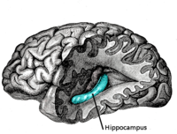
Limbic Association Cortex
Located in the Cingulate Gyrus, Hippocampus, Parahippocampal gyrus
Provides emotional sense to what inputs we have

Slide 69
Cingulate Gyrus
Parahippocampal
Figure 12.8b

Slide 70
Putting it together
Drop a bottle of acid on chemistry lab floor and it splashes on you
See it – visual cortex – then to visual association
Hear it – auditory cortex – then to auditory association
Feel it – primary sensory cortex thus locate– then to sensory association cortex to interpret
Then to multimodal association cortices

Slide 71
Lateralization of Cortical Function
Lateralization – each hemisphere has abilities not shared with its partner
Cerebral dominance – designates the hemisphere dominant for language
Left hemisphere – controls language, math, and logic
Right hemisphere – controls visual-spatial skills, emotion, and artistic skills
10% have sides reversed or use both sides equally

Slide 72
Cerebral White Matter
Consists of deep myelinated fibers and their tracts
It is responsible for communication between:
  The cerebral cortex and lower CNS center, and areas of the cerebrum

Slide 73
Cerebral White Matter
Types include:
  Commissures – connect corresponding gray areas of the two hemispheres
  Association fibers – connect different parts of the same hemisphere
  Projection fibers – enter the hemispheres from lower brain or cord centers

Slide 74
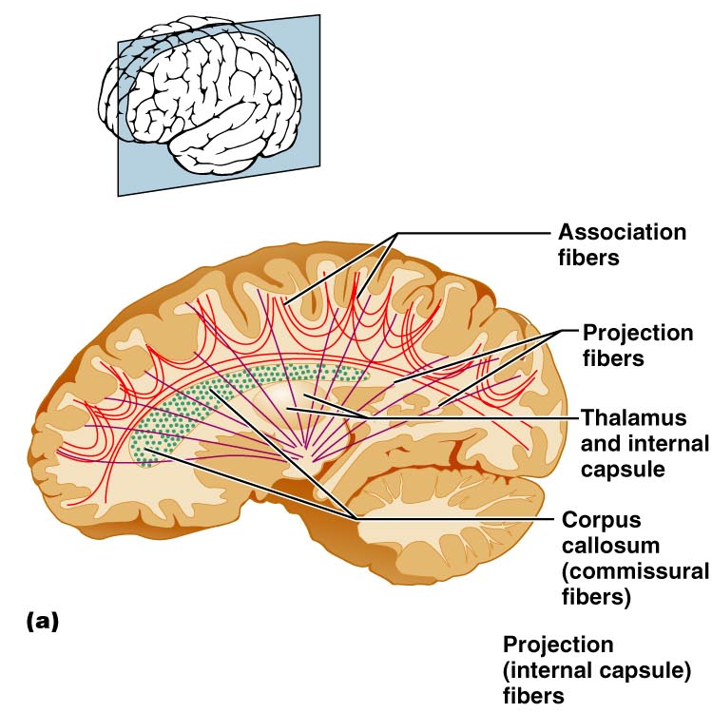
Fiber Tracts in White Matter
Figure 12.10a

Slide 75
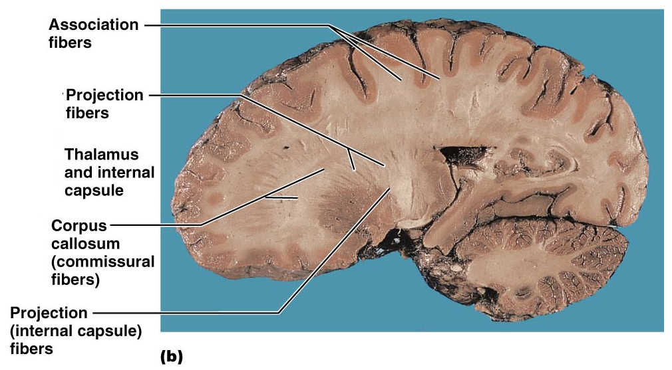
Fiber Tracts in White Matter
Figure 12.10b

Slide 76
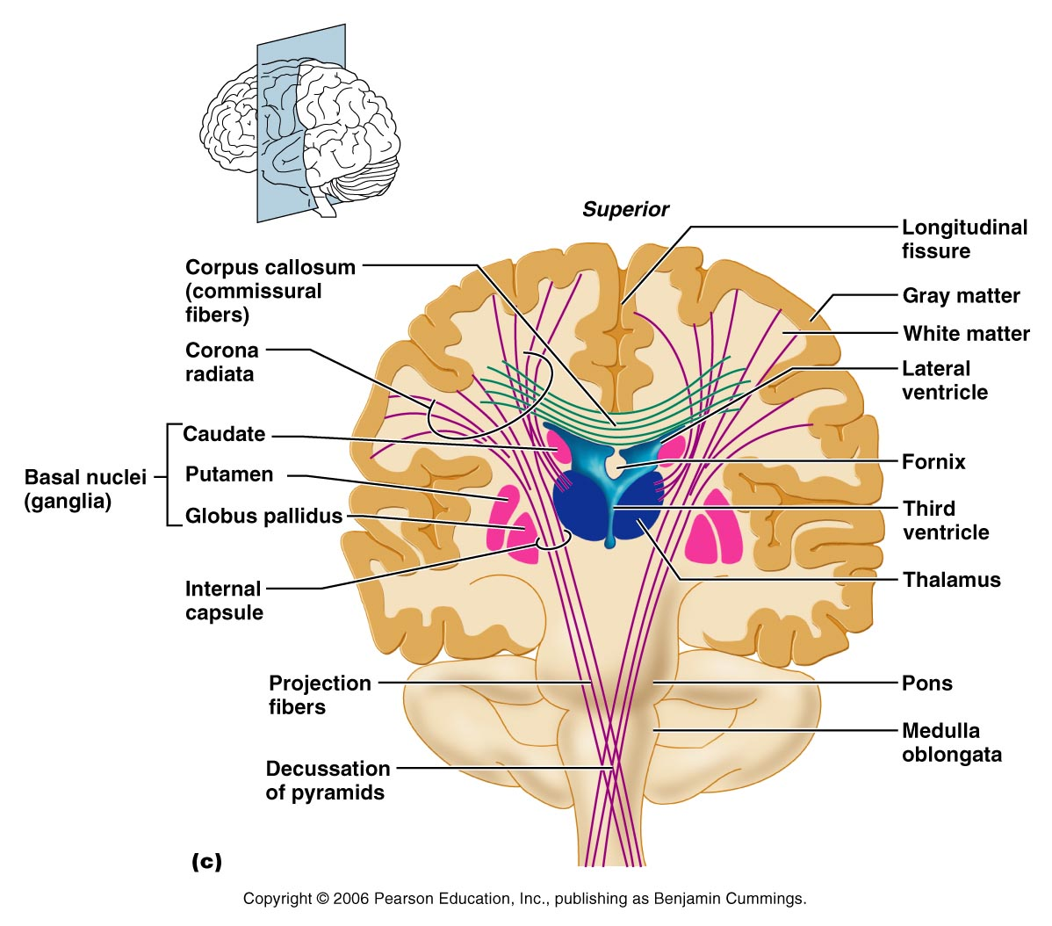
Figure 12.10c

Slide 77
Basal Nuclei (Old name Basal Ganglia)
Masses of gray matter found deep within the cortical white matter
The corpus striatum is composed of three parts
  Caudate nucleus
  Lentiform nucleus – composed of the putamen and the globus pallidus
  Fibers of internal capsule running between and through caudate and lentiform nuclei
  Functionally associated with sub-thalamic nucleus and the Substantia Nigra

Slide 78
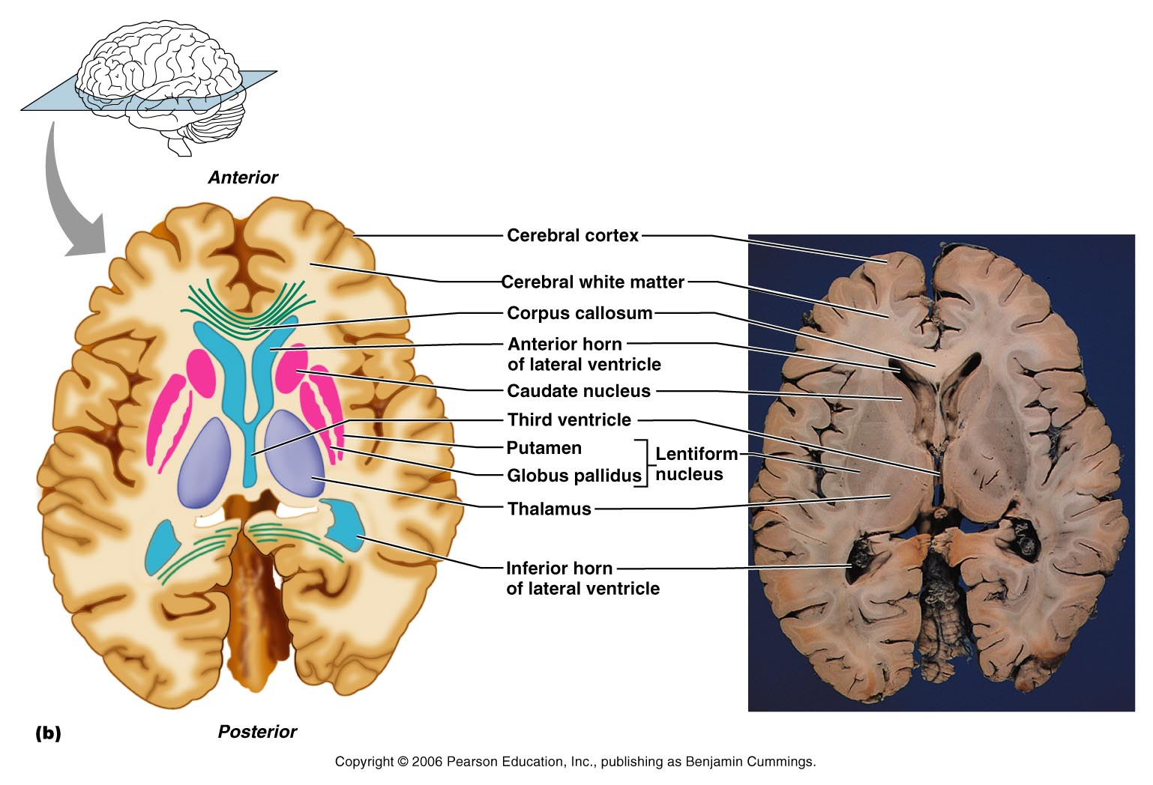
Basal Nuclei
Figure 12.11b

Slide 79
Functions of Basal Nuclei
Though somewhat elusive, the following are thought to be functions of basal nuclei – some functions regarding movement are shared with the Cerebellum
  Influence muscular activity – particularly starting and stopping movements and regulating the intensity of these movements particularly those that are slow and stereotyped like arm swinging while walking
  Regulate attention and cognition
  Inhibit antagonistic and unnecessary movement

Slide 80
Input: The Basal Nuclei receive inputs from (1) all areas of cerebral cortex (above Basal Nuclei) and from (2) subcortical nuclei and from (3) each other nuclei within the Basal Nuclei
Output: Via relays through Thalamus, Globus Pallidus and Substantia Nigra – they project to the Premotor cortex and prefrontal (anterior association area) cortices to affect motor movements of the primary motor cortex. The Basal Nuclei have no direct access to motor pathways.
Note: Premotor cortex – learned movements
Prefrontal cortex – your intelligence area

Slide 81
Problems with the Basal Nuclei could give too much involuntary movement as in Huntington’s Chorea or too little motion as in Parkinson’s Disease.

Slide 82
Diencephalon
Central core of the forebrain
Consists of three paired structures – thalamus, hypothalamus, and epithalamus
Encloses the third ventricle

Slide 83
Thalamus – the inner room
(80% of Diencephalon)
Paired, egg-shaped masses that form the superolateral walls of the third ventricle
Connected at the midline by the intermediate mass
Contains four groups of nuclei – anterior, ventral, dorsal, and posterior
Nuclei project and receive fibers from the cerebral cortex
Nuclei also receive input from sensory projections below the Thalamus and nuclei within Thalamus

Slide 84
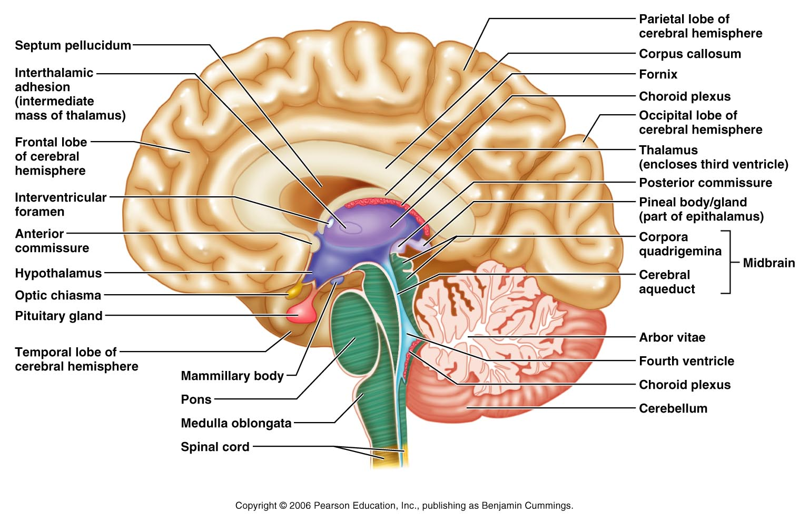
Diencephalon
Figure 12.12

Slide 85
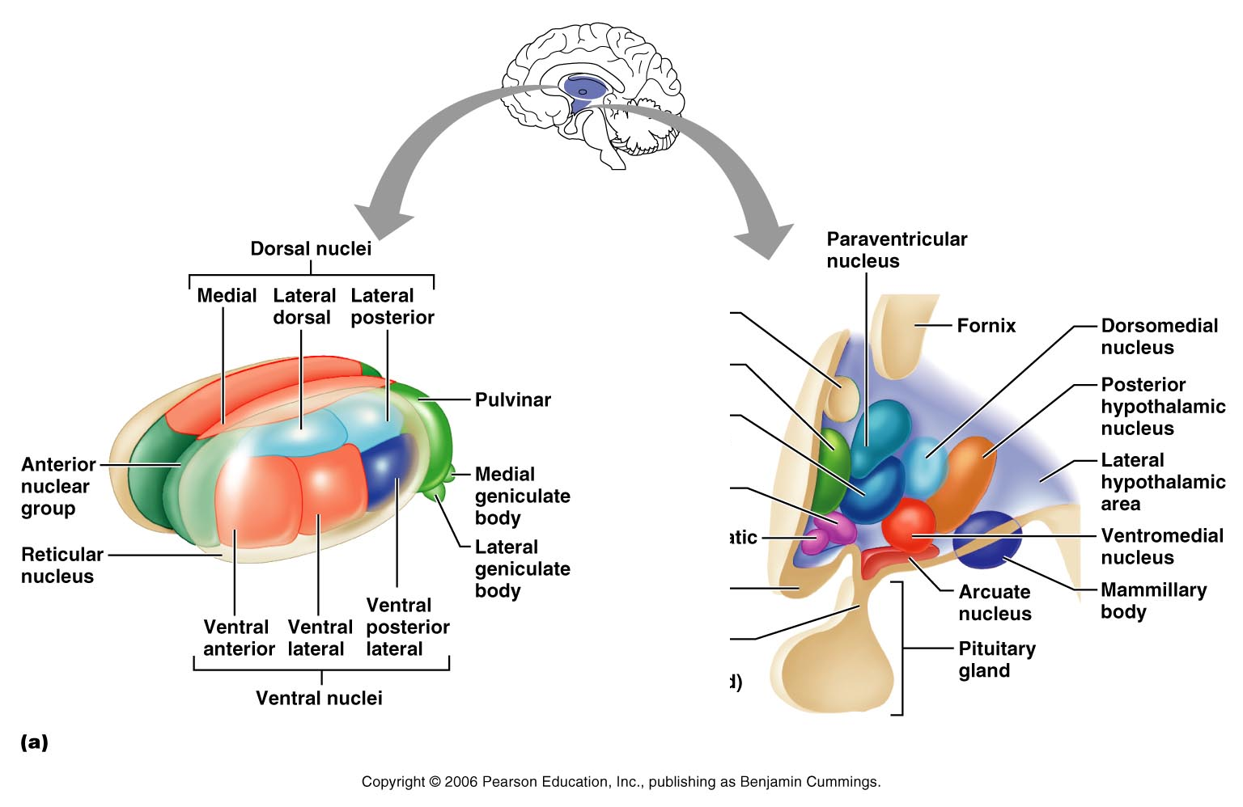
Thalamus
Since there are so many nuclei – approximately 26 – clustered in a small area neuroanatomists had to name the nuclei primarily by there relative locations to one another using the directional terms – anterior, posterior, dorsal, ventral, medial and lateral. Use the four legged animal as your landmarks.
Figure 12.13a

Slide 86
Thalamic Function
Sensory afferent impulses converge and synapse in the thalamus (all sensory to cortex must go through Thalamus)
Gives a crude sense of pleasant versus unpleasant
Impulses of similar function are sorted out, edited, and relayed as a group
All inputs ascending to the cerebral cortex pass through the thalamus
Mediates sensation, motor activities, cortical arousal, learning, and memory

Slide 87
Hypothalamus
Located below the thalamus, it caps the brainstem and forms the inferolateral walls of the third ventricle
Mammillary bodies
  Small, paired nuclei bulging anteriorly from the hypothalamus
  Relay station for olfactory pathways
Infundibulum – stalk of the hypothalamus; connects to the pituitary gland
  Main visceral control center of the body

Slide 88
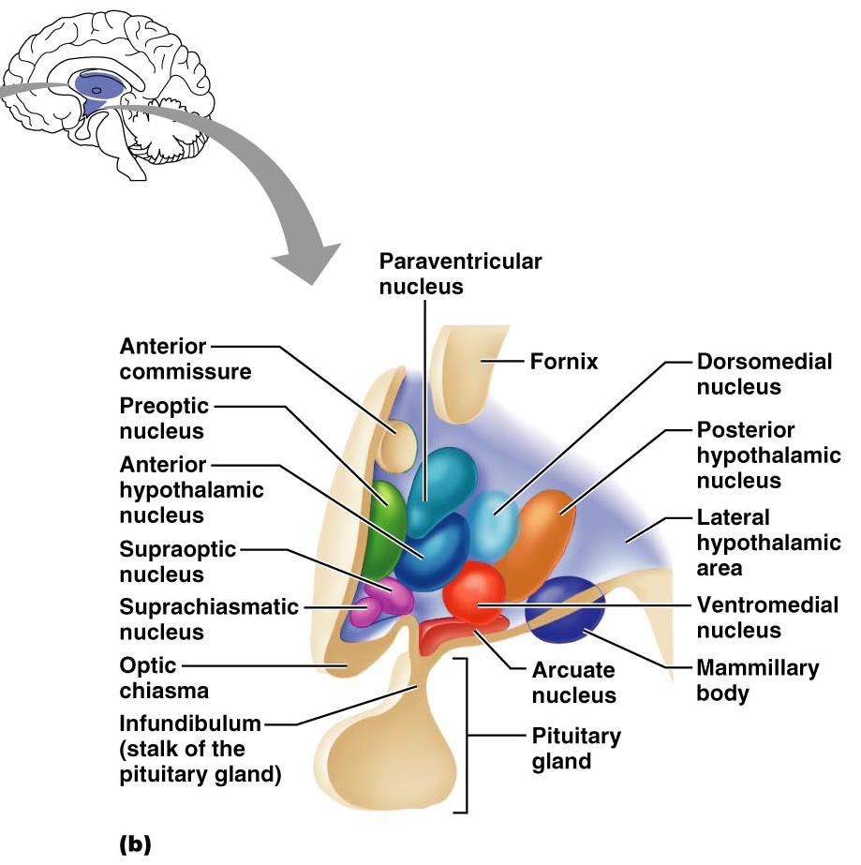
Hypothalamic Nuclei
Figure 12.13b

Slide 89
Hypothalamic Function
Regulates Autonomic Nervous system – thus assists in regulation of blood pressure, rate and force of heartbeat, digestive tract motility, rate and depth of breathing, and many other visceral activities
Regulates Anterior Pituitary Gland secretions via its releasing and inhibiting factors
Perception of pleasure, fear, and rage (major part of Limbic System)
Maintains normal body temperature
Regulates feelings of hunger and satiety
Regulates sleep and the sleep cycle
Senses Osmotic Pressure – thus regulating fluid and electrolyte balance

Slide 90
Endocrine Functions of the Hypothalamus
Releasing hormones control secretion of hormones by the anterior pituitary
The supraoptic and paraventricular nuclei produce ADH and oxytocin

Slide 91
Epithalamus
Most dorsal portion of the diencephalon; forms roof of the third ventricle
Pineal gland – extends from the posterior border and secretes melatonin
  Melatonin – a hormone involved with sleep regulation, sleep-wake cycles, and mood

Slide 92
Melatonin
Secreted primarily from the pineal gland
Controlled by the suprachiasmatic nucleus of the Hypothalamus
Secretion of melatonin occurs in darkness
It is inhibited by light – particularly blue light
Causes drowsiness and lowered body temperature
Antioxidant role
Immune System action
Dreaming

Slide 93
Epithalamus
Figure 12.12

Slide 94
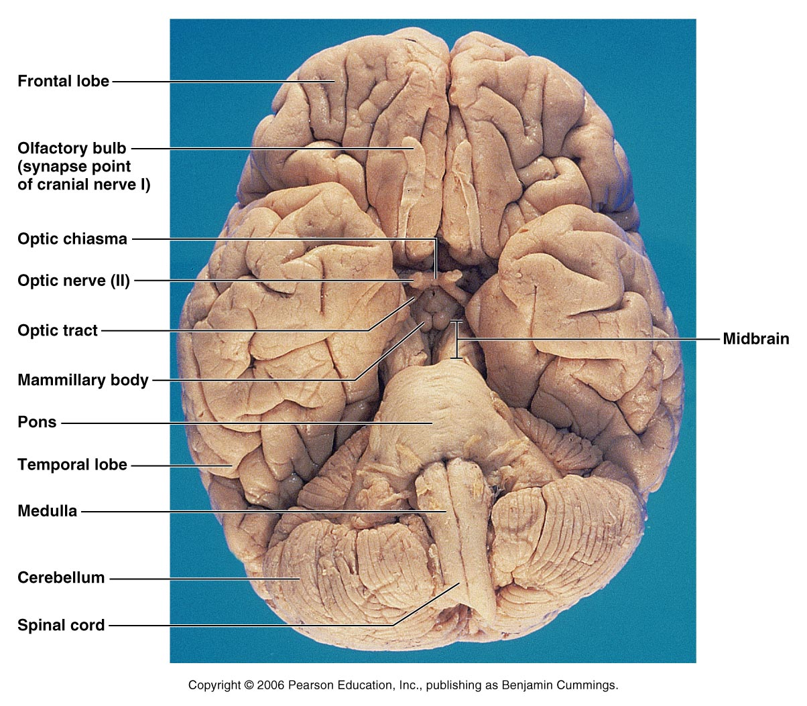
Human Brain: Ventral Aspect
Figure 12.14

Slide 95
Brain Stem
Consists of three regions – midbrain, pons, and medulla oblongata
Similar to spinal cord but contains embedded nuclei
Controls automatic behaviors necessary for survival
Provides the pathway for tracts between higher and lower brain centers
Associated with 10 of the 12 pairs of cranial nerves

Slide 96
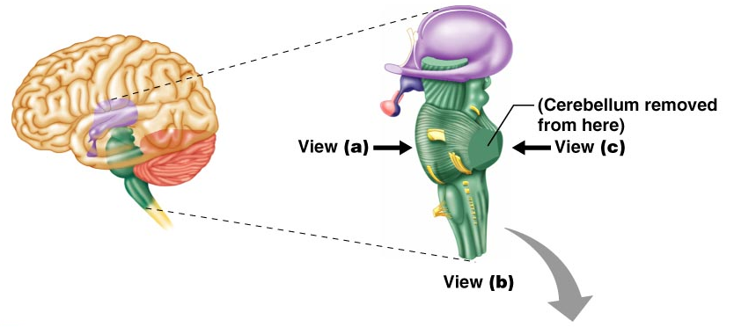
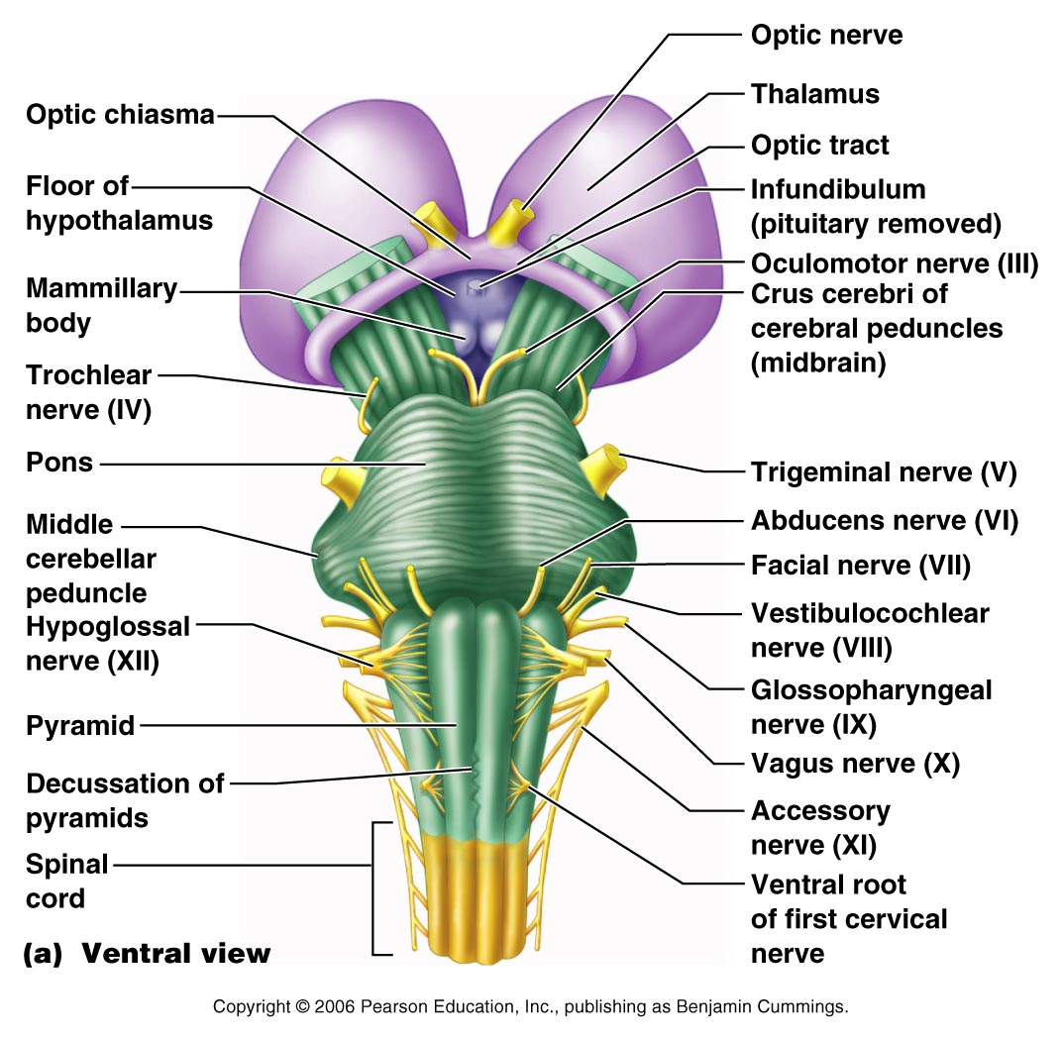
Brain Stem
Figure 12.15a

Slide 97
Midbrain
Located between the diencephalon and the pons
Midbrain structures include:
  Cerebral peduncles – two bulging structures that contain descending pyramidal motor tracts
  Cerebral aqueduct – hollow tube that connects the third and fourth ventricles
  Various nuclei

Slide 98
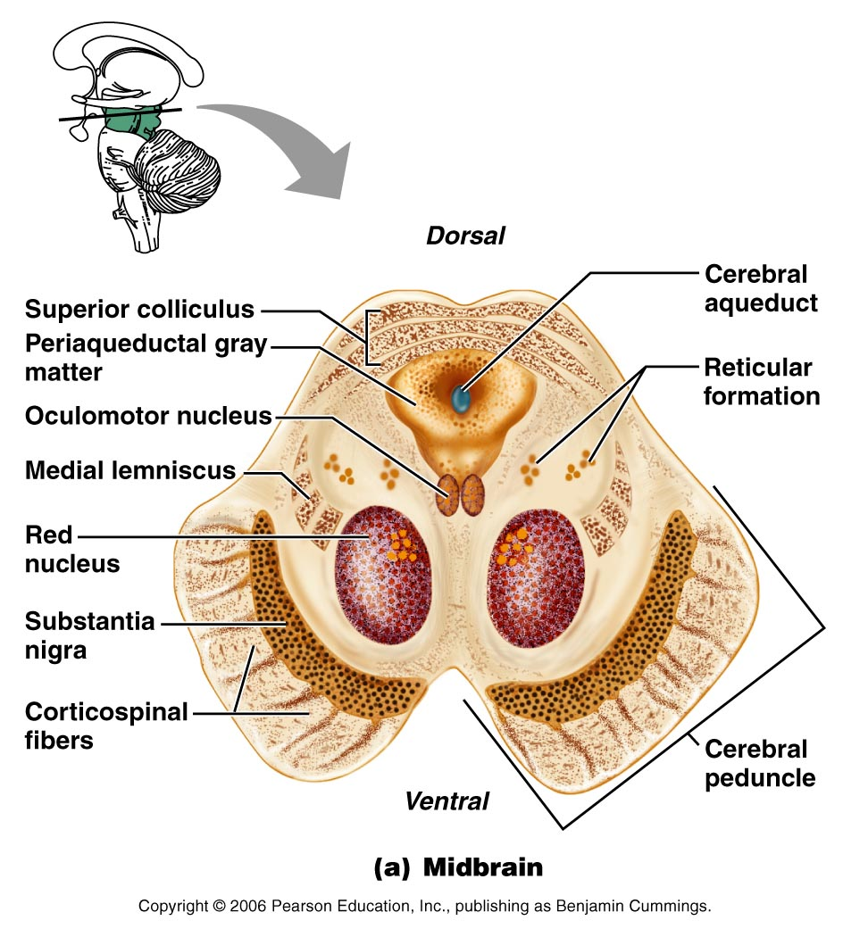
Midbrain Nuclei
Figure 12.16a

Slide 99
Midbrain Nuclei
Nuclei that control cranial nerves III (oculomotor) and IV (trochlear)
Corpora quadrigemina – four domelike protrusions of the dorsal midbrain
Superior colliculi – visual reflex centers

Slide 100
Midbrain Nuclei
Inferior colliculi – auditory relay centers
Substantia nigra – functionally linked to basal nuclei
Red nucleus – largest nucleus of the reticular formation; red nuclei are relay nuclei for some descending motor pathways

Slide 101
Midbrain Nuclei
Figure 12.16a

Slide 102
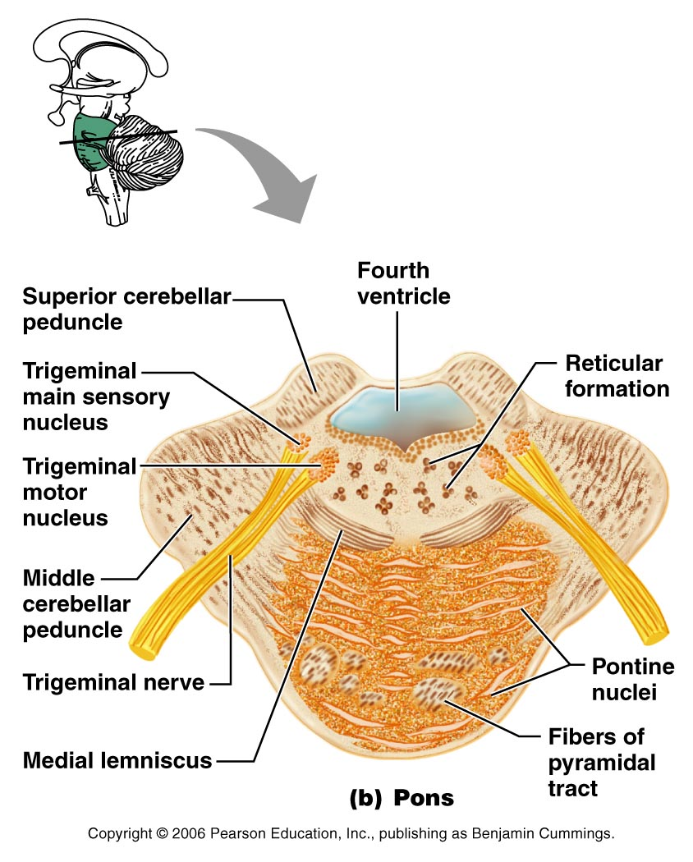
Pons
Figure 12.16b

Slide 103
Pons
Bulging brainstem region between the midbrain and the medulla oblongata
Forms part of the anterior wall of the fourth ventricle
Fibers of the pons:
  Connect higher brain centers and the spinal cord
  Relay impulses between the motor cortex and the cerebellum

Slide 104
Pons
Origin of cranial nerves V (trigeminal), VI (abducens), and VII (facial)
Contains nuclei of the reticular formation
Contains some of the breathing centers

Slide 105
Medulla Oblongata
Most inferior part of the brain stem
Along with the pons, forms the ventral wall of the fourth ventricle
Contains a choroid plexus of the fourth ventricle
Pyramids – two longitudinal ridges formed by corticospinal tracts
Decussation of the pyramids – crossover points of the corticospinal tracts

Slide 106
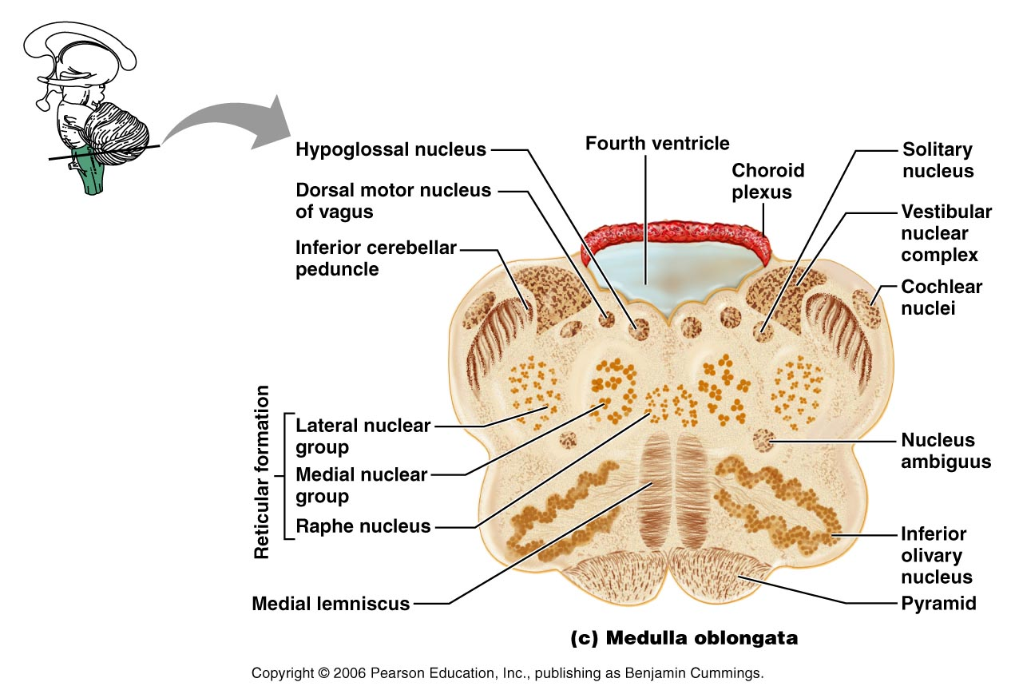
Medulla Oblongata
Figure 12.16c

Slide 107
Medulla Nuclei
Inferior olivary nuclei – gray matter that relays sensory information
Cranial nerves X, XI, and XII are associated with the medulla
Vestibular nuclear complex – synapses that mediate and maintain equilibrium
Ascending sensory tract nuclei, including nucleus cuneatus and nucleus gracilis

Slide 108
Medulla Nuclei
Cardiovascular control center – adjusts force and rate of heart contraction
Respiratory centers – control rate and depth of breathing
Additional centers – regulate vomiting, hiccuping, swallowing, coughing, and sneezing
Vasomotor Center – control of dilation and constriction of blood vessels.

Slide 109
The Cerebellum
Located dorsal to the pons and medulla
Protrudes under the occipital lobes of the cerebrum
Makes up 11% of the brain’s mass
Provides precise timing and appropriate patterns of skeletal muscle contraction
Cerebellar activity occurs subconsciously

Slide 110
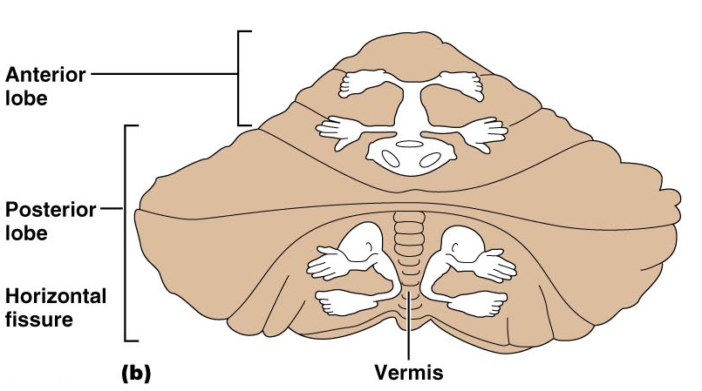
The Cerebellum
Figure 12.17b

Slide 111
Anatomy of the Cerebellum
Two bilaterally symmetrical hemispheres connected medially by the vermis
Folia – transversely oriented gyri
Each hemisphere has three lobes – anterior, posterior, and flocculonodular
Neural arrangement – gray matter cortex, internal white matter, scattered nuclei
Arbor vitae – distinctive treelike pattern of the cerebellar white matter

Slide 112
Cerebellar Peduncles
Three paired fiber tracts that connect the cerebellum to the brain stem
All fibers in the cerebellum are ipsilateral
Superior peduncles connect the cerebellum to the midbrain
Middle peduncles connect the pons to the cerebellum
Inferior peduncles connect the medulla to the cerebellum

Slide 113
Cerebellar Processing
Cerebellum receives impulses of the intent to initiate voluntary muscle contraction
Proprioceptors and visual signals “inform” the cerebellum of the body’s condition
Cerebellar cortex calculates the best way to perform a movement
A “blueprint” of coordinated movement is sent to the cerebral motor cortex

Slide 114
Cerebellar Cognitive Function
Plays a role in language and problem solving
Recognizes and predicts sequences of events

Slide 115
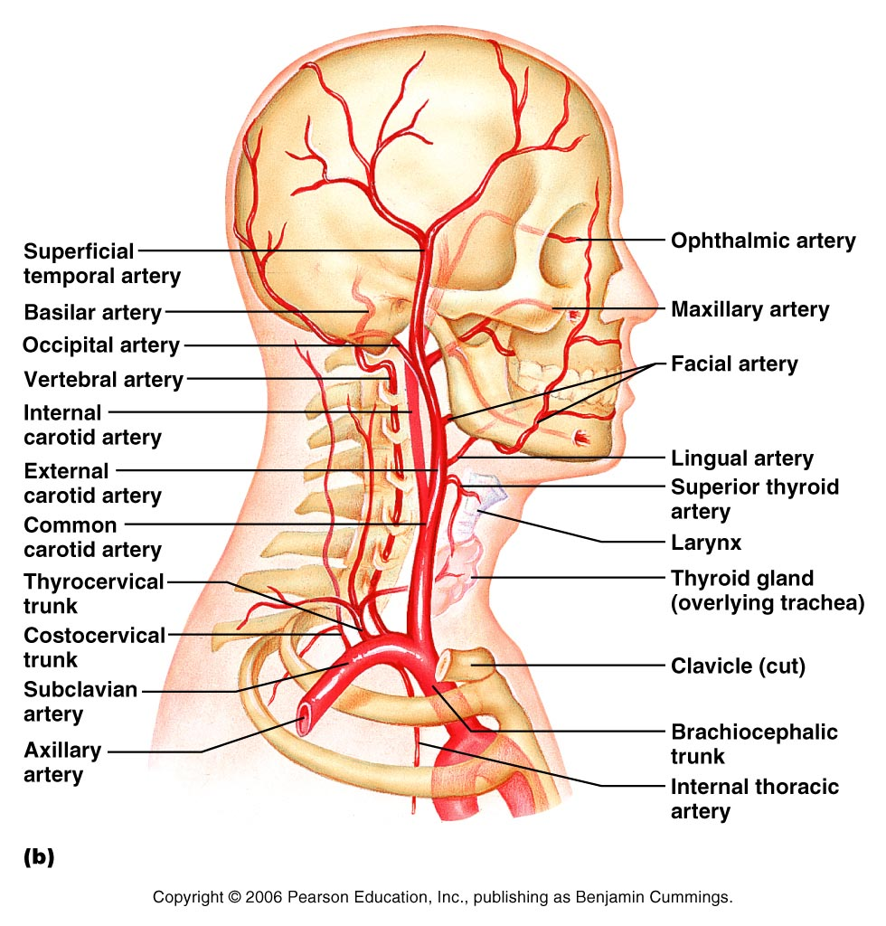

Slide 116
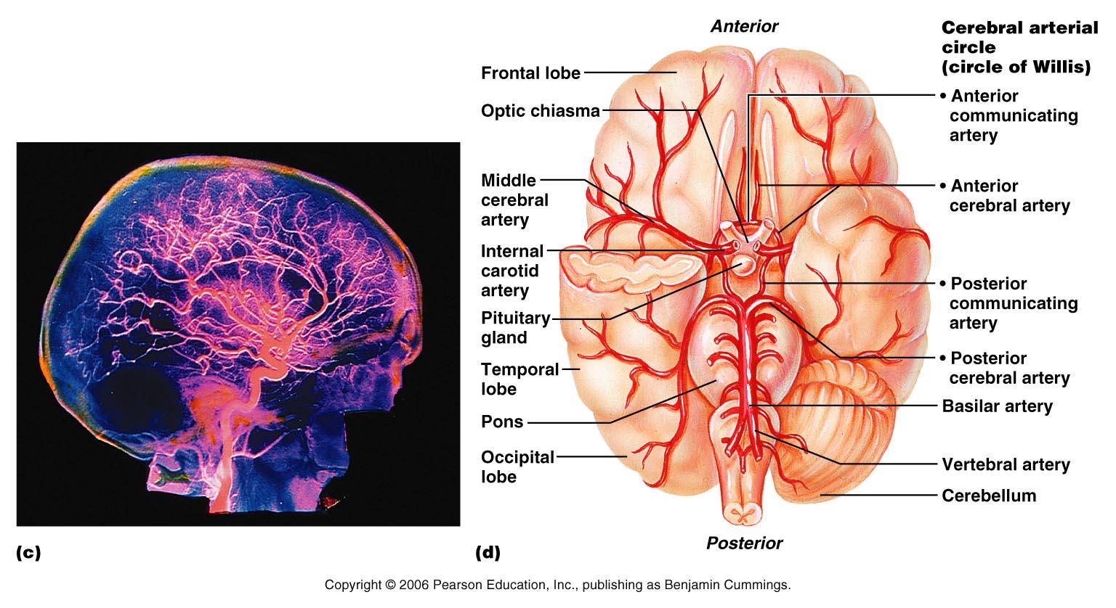

Slide 117
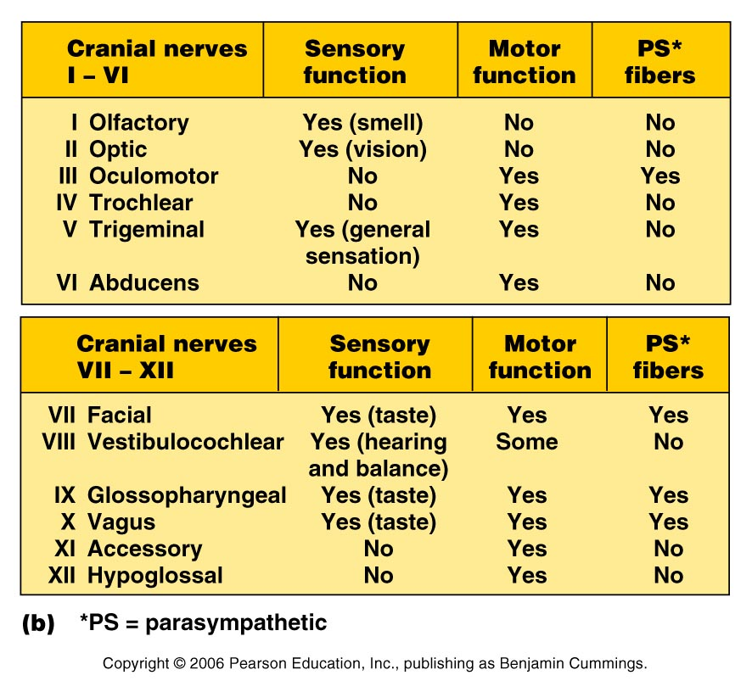

Slide 118
CN I – smell
CN II – vision
CN III –(Midbrain) Controls 4 of 6 eye muscles and Levator Palpebrae superioris - has ciliary ganglion – for pupil – Sensory for same eye muscles
CN IV – (Midbrain) Controls Superior Oblique eye muscle and sensory proprioception from that muscle

Slide 119
CN V – Trigeminal (Pons) - 3 branches ophthalmic, maxillary and mandibular – Motor to muscles of mastication NOTE – sensory of anterior tongue but not taste
CN VI – (Pons) Motor to Lateral Rectus of eye and sensory proprioception from that muscle

Slide 120
CN VII – (Pons) Motor to muscles of facial expression (five branches – temporal, zygomatic, buccal, mandibular and cervical) Autonomic (pterygopalatine ganglion – goes to lacrimal glands and nasal mucosae and submandibular ganglion- goes to submandibular and sublingual salivary glands) – Sensory – taste from anterior 2/3 of tongue

Slide 121
CN X – only cranial nerve to extend below head- most motor fibers are parasympathetic Sensory from viscera and some sensory from baroreceptors and chemoreceptors
CN XI – Formed by union of cranial root and spinal roots (C1 – C5) – Mainly motor cranial root gives motor to larynx, pharynx, and soft palate. Spinal root supplies the trapezius and sternocleidomastoid Sensory – proprioception from those muscles

Slide 122
CN XII – carries fibers to extrinsic and intrinsic tongue muscles.

Slide 123
Functional Brain System
Networks of neurons working together and spanning wide areas of the brain
The two systems are:
  Limbic system
  Reticular formation

Slide 124
Limbic System
Structures located on the medial aspects of cerebral hemispheres and diencephalon
Includes the rhinencephalon, amygdala, hypothalamus, and anterior nucleus of the thalamus

Slide 125
Limbic System
Parts especially important in emotions:
  Amygdala – deals with anger, danger, and fear responses
  Cingulate gyrus – plays a role in expressing emotions via gestures, and resolves mental conflict
Puts emotional responses to odors – e.g., skunks smell bad

Slide 126
Reticular Formation
Composed of three broad columns along the length of the brain stem
  Raphe nuclei
  Medial (large cell) group
  Lateral (small cell) group
Has far-flung axonal connections with hypothalamus, thalamus, cerebellum, and spinal cord

Slide 127
Reticular Formation
Composed of three broad columns along the length of the brain stem
  Raphe nuclei
  Medial (large cell) group
  Lateral (small cell) group
Has far-flung axonal connections with hypothalamus, thalamus, cerebellum, and spinal cord

Slide 128
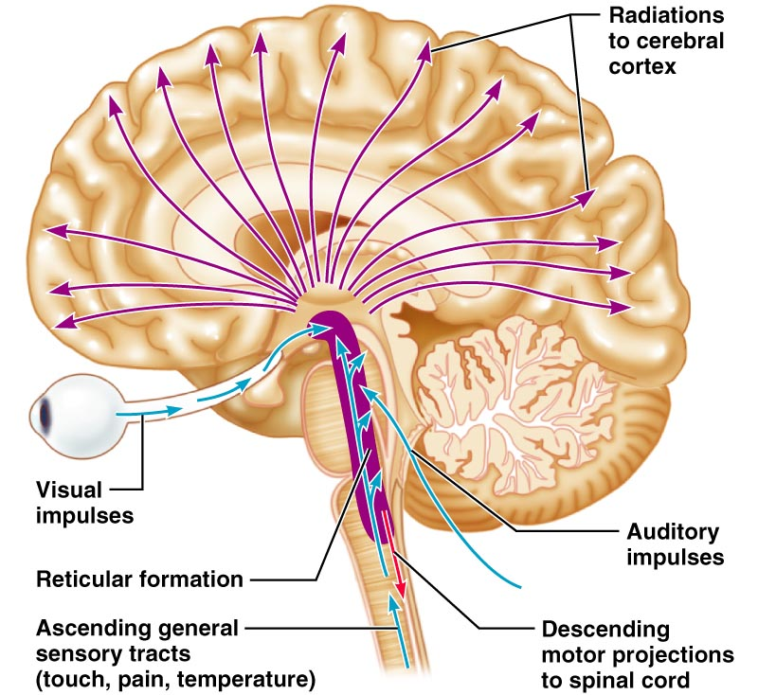
Reticular Formation
Figure 12.19

Slide 129
Reticular Formation: RAS and Motor Function
RAS – Reticular Activating System
  Sends impulses to the cerebral cortex to keep it conscious and alert
  Filters out repetitive and weak stimuli
Motor function
  Helps control coarse motor movements
  Autonomic centers regulate visceral motor
  functions – e.g., vasomotor, cardiac, and respiratory centers

Slide 130
Consciousness
Clinically defined on a continuum that grades behavior in response to stimuli
  Alertness
  Drowsiness (lethargy)
  Stupor
  Coma

Slide 131
Brain Waves
Normal brain function involves continuous electrical activity
An electroencephalogram (EEG) records this activity
Patterns of neuronal electrical activity recorded are called brain waves
Each person’s brain waves are unique
Continuous train of peaks and troughs
Wave frequency is expressed in Hertz (Hz)

Slide 132
Types of Brain Waves
Alpha waves – regular and rhythmic, low-amplitude, slow, synchronous waves indicating an “idling” brain
Beta waves – rhythmic, more irregular waves occurring during the awake and mentally alert state
Theta waves – more irregular than alpha waves; common in children but abnormal in adults
Delta waves – high-amplitude waves seen in deep sleep and when reticular activating system is damped

Slide 133
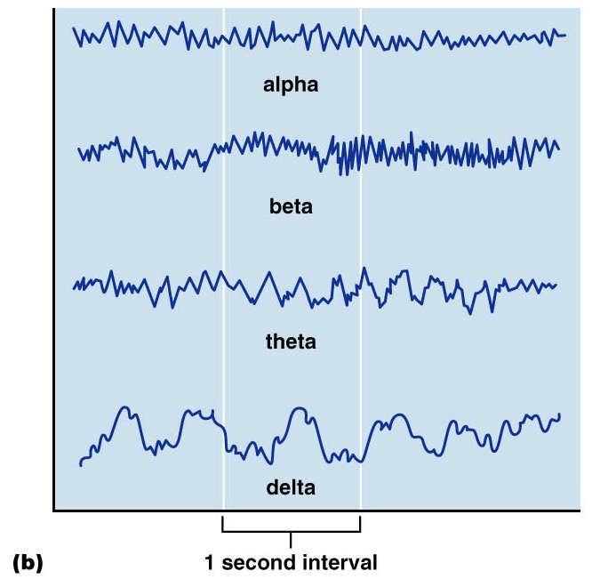
Types of Brain Waves
Figure 12.20b

Slide 134
Types of Sleep
There are two major types of sleep:
  Non-rapid eye movement (NREM)
  Rapid eye movement (REM)
One passes through four stages of NREM during the first 30-45 minutes of sleep
REM sleep occurs after the fourth NREM stage has been achieved

Slide 135
Types and Stages of Sleep: NREM
NREM stages include:
  Stage 1 – eyes are closed and relaxation begins; the EEG shows alpha waves; one can be easily aroused
  Stage 2 – EEG pattern is irregular with sleep spindles (high-voltage wave bursts); arousal is more difficult
  Stage 3 – sleep deepens; theta and delta waves appear; vital signs decline; dreaming is common
  Stage 4 – EEG pattern is dominated by delta waves; skeletal muscles are relaxed; arousal is difficult

Slide 136
Importance of Sleep
Slow-wave sleep (NREM stages 3 and 4) presumed to be restorative stage
People deprived of REM sleep become moody and depressed
REM sleep may be reverse learning process where superfluous information purged from brain
Daily sleep requirements decline with age
Stage 4 sleep declines steadily and may disappear after age 60

Slide 137
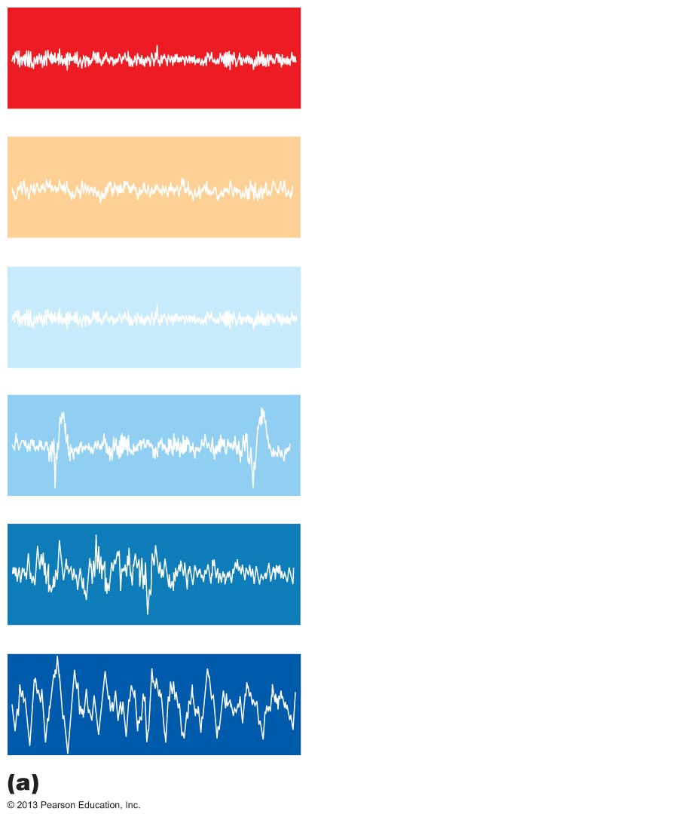
Figure 12.19a Types and stages of sleep.
Awake
REM: Skeletal muscles (except
ocular muscles and diaphragm)
are actively inhibited; most
dreaming occurs.
NREM stage 1: Relaxation
begins; EEG shows alpha waves;
arousal is easy.
NREM stage 2: Irregular EEG
with sleep spindles (short high-
amplitude bursts); arousal is more
difficult.
NREM stage 3: Sleep deepens;
theta and delta waves appear; vital
signs decline.
NREM stage 4: EEG is
dominated by delta waves;
arousal is difficult; bed-wetting,
night terrors, and sleepwalking
may occur.
Typical EEG patterns

Slide 138
Memory
Memory is the storage and retrieval of information
The three principles of memory are:
  Storage – occurs in stages and is continually changing
  Processing – accomplished by the hippocampus and surrounding structures
  Memory traces – chemical or structural changes that encode memory

Slide 139
Stages of Memory
The two stages of memory are short-term memory and long-term memory
Short-term memory (STM, or working memory) – a fleeting memory of the events that continually happen
STM lasts seconds to hours and is limited to 7 or 8 pieces of information
Long-term memory (LTM) has limitless capacity

Slide 140
Categories of Memory
The two categories of memory are fact memory and skill memory
Fact (declarative) memory:
  Entails learning explicit information
  Is related to our conscious thoughts and our language ability
  Is stored with the context in which it was learned

Slide 141
Skill Memory
Skill memory is less conscious than fact memory and involves motor activity
It is acquired through practice
Skill memories do not retain the context in which they were learned

Slide 142
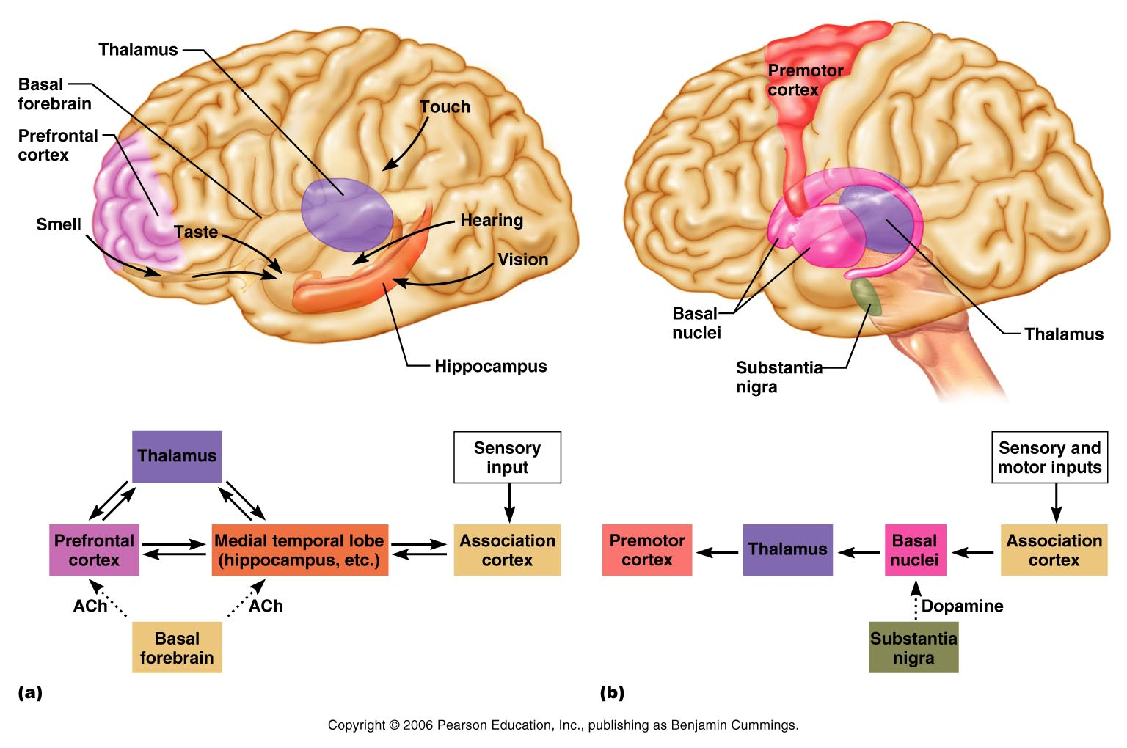
Proposed Memory Circuits
Declarative memory(Concepts)
Skill memory – like typing
Figure 12.23

