Slide 1
11
Fundamentals of the Nervous System and Nervous Tissue: Part B

Slide 2
Neuron Function
Neurons are highly irritable
Respond to adequate stimulus by generating an action potential (nerve impulse)
Impulse is always the same regardless of stimulus

Slide 3
Principles of Electricity
Opposite charges attract each other
Energy is required to separate opposite charges across a membrane
Energy is liberated when the charges move toward one another
If opposite charges are separated, the system has potential energy

Slide 4
Definitions
Voltage (V): measure of potential energy generated by separated charge
Potential difference: voltage measured between two points
Current (I): the flow of electrical charge (ions) between two points

Slide 5
Definitions
Resistance (R): hindrance to charge flow (provided by the plasma membrane)
Insulator: substance with high electrical resistance
Conductor: substance with low electrical resistance

Slide 6
Role of Membrane Ion Channels
Proteins serve as membrane ion channels
Two main types of ion channels
  Leakage (nongated) channels—always open

Slide 7
Role of Membrane Ion Channels
  Gated channels (three types):
      Chemically gated (ligand-gated) channels—open with binding of a specific neurotransmitter
      Voltage-gated channels—open and close in response to changes in membrane potential
      Mechanically gated channels—open and close in response to physical deformation of receptors

Slide 8
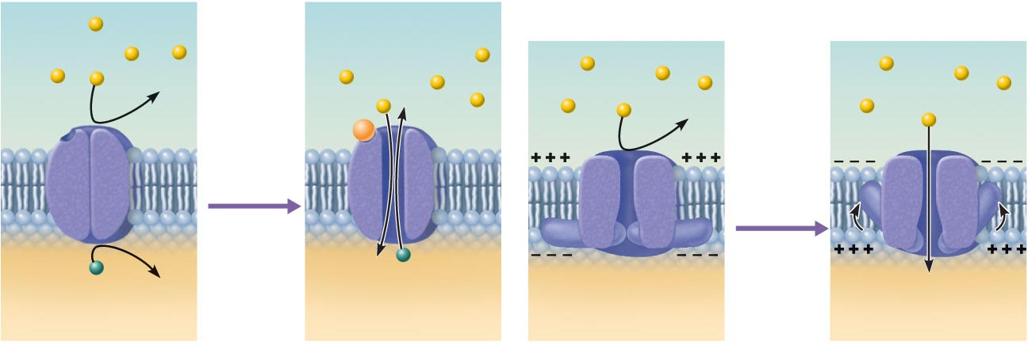
Receptor
Neurotransmitter chemical
attached to receptor
Na⁺
Na⁺
Na⁺
Na⁺
Chemical
binds
Membrane
voltage
changes
K⁺
K⁺
Closed
Open
Closed
Open
(a) Chemically (ligand) gated ion channels open when the
appropriate neurotransmitter binds to the receptor,
allowing (in this case) simultaneous movement of
Na⁺ and K⁺.
(b) Voltage-gated ion channels open and close in response
to changes in membrane voltage.
Figure 11.6

Slide 9
Gated Channels
When gated channels are open:
  Ions diffuse quickly across the membrane along their electrochemical gradients
    Along chemical concentration gradients from higher concentration to lower concentration
    Along electrical gradients toward opposite electrical charge
  Ion flow creates an electrical current and voltage changes across the membrane

Slide 10
Resting Membrane Potential (Vr)
Potential difference across the membrane of a resting cell
  Approximately –70 mV in neurons (cytoplasmic side of membrane is negatively charged relative to outside)
Generated by:
  Differences in ionic makeup of ICF and ECF
  Differential permeability of the plasma membrane

Slide 11
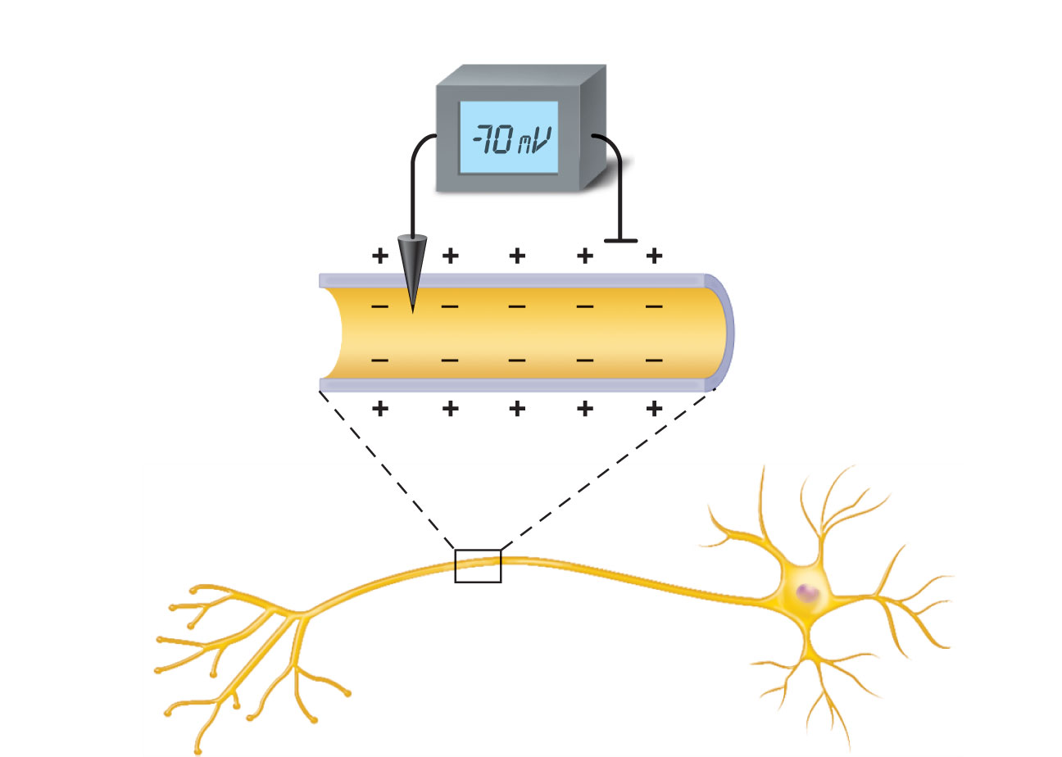
Voltmeter
Plasma
membrane
Ground electrode
outside cell
Microelectrode
inside cell
Axon
Neuron
Figure 11.7

Slide 12
Resting Membrane Potential
Differences in ionic makeup
  ICF has lower concentration of Na⁺ and Cl– than ECF
  ICF has higher concentration of K⁺ and negatively charged proteins (A–) than ECF

Slide 13
Resting Membrane Potential
Differential permeability of membrane
  Impermeable to A–
  Slightly permeable to Na⁺ (through leakage channels)
  75 times more permeable to K⁺ (more leakage channels)
  Freely permeable to Cl–

Slide 14
Resting Membrane Potential
Negative interior of the cell is due to much greater diffusion of K⁺ out of the cell than Na⁺ diffusion into the cell
Sodium-potassium pump stabilizes the resting membrane potential by maintaining the concentration gradients for Na⁺ and K⁺

Slide 15
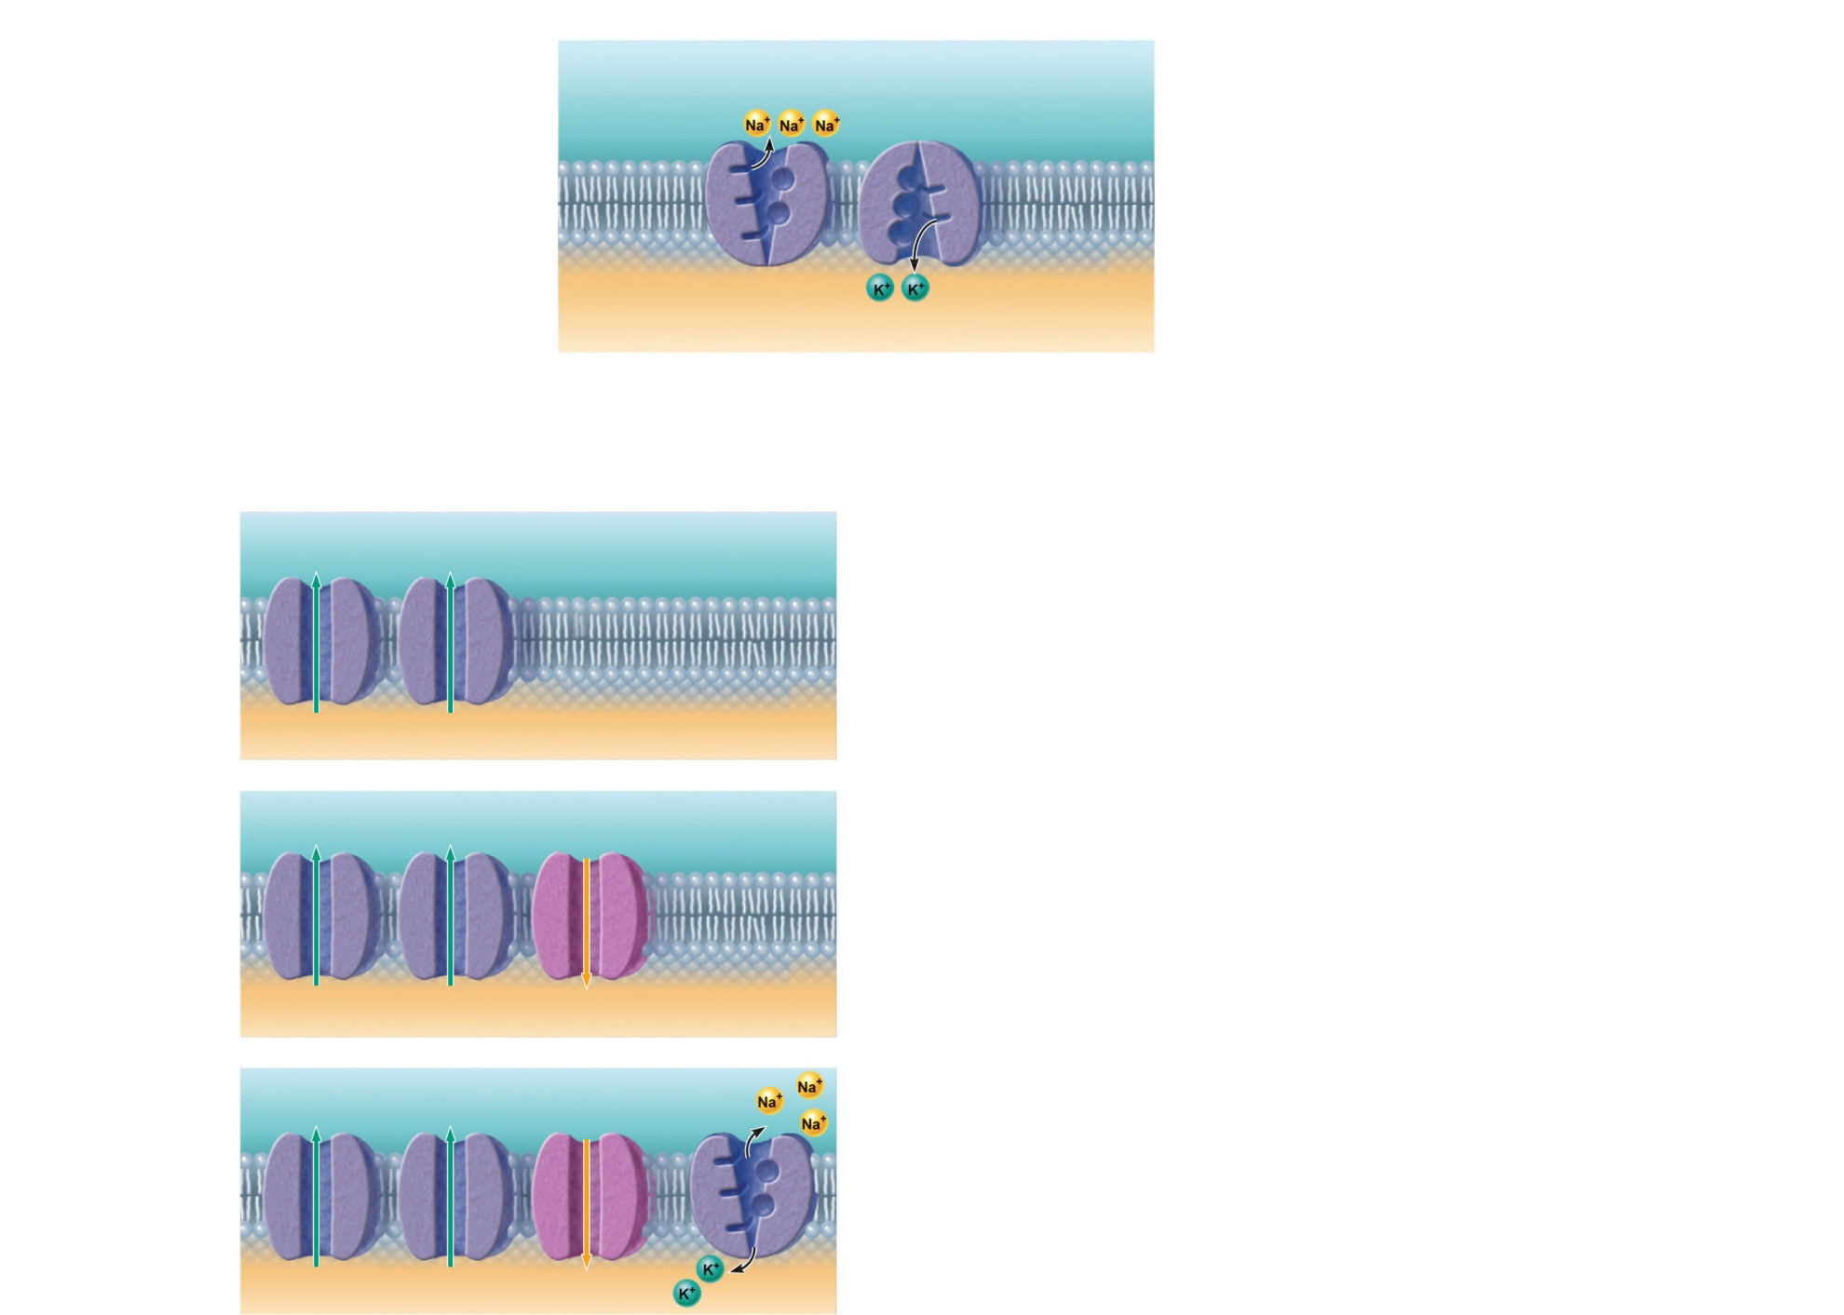
The concentrations of Na⁺ and K⁺ on each side of the membrane are different.
The Na⁺ concentration
is higher outside the
cell.
Outside cell
K⁺
(5 mM )
Na⁺
(140 mM )
The K⁺ concentration
is higher inside the
cell.
K⁺
(140 mM )
Na⁺
(15 mM )
Inside cell
Na⁺-K⁺ ATPases (pumps)
maintain the concentration
gradients of Na⁺ and K⁺
across the membrane.
The permeabilities of Na⁺ and K⁺ across the
membrane are different.
K⁺ leakage channels
Suppose a cell has only K⁺ channels...
K⁺ loss through abundant leakage
channels establishes a negative
membrane potential.
K⁺
K⁺
K⁺
K⁺
Cell interior
–90 mV
Now, let’s add some Na⁺ channels to our cell...
Na⁺ entry through leakage channels reduces
the negative membrane potential slightly.
K⁺
K⁺
Na⁺
K
K⁺
Na⁺
Cell interior
–70 mV
Na+-K+ pump
Finally, let’s add a pump to compensate
for leaking ions.
Na⁺-K⁺ ATPases (pumps) maintain the
concentration gradients, resulting in the
resting membrane potential.
K⁺
K⁺
Na⁺
K⁺
K⁺
Na⁺
Cell interior
–70 mV
Figure 11.8

Slide 16
Membrane Potentials That Act as Signals
Membrane potential changes when:
  Concentrations of ions across the membrane change
  Permeability of membrane to ions changes
Changes in membrane potential are signals used to receive, integrate and send information

Slide 17
Membrane Potentials That Act as Signals
Two types of signals
  Graded potentials
    Incoming short-distance signals
  Action potentials
    Long-distance signals of axons

Slide 18
Changes in Membrane Potential
Depolarization
  A reduction in membrane potential (toward zero)
  Inside of the membrane becomes less negative than the resting potential
  Increases the probability of producing a nerve impulse

Slide 19
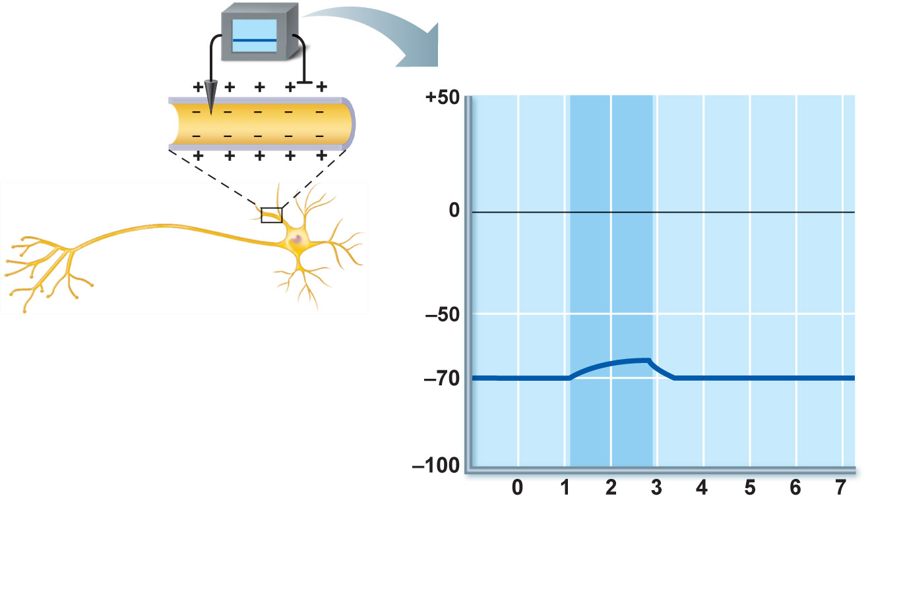
Depolarizing stimulus
Inside
positive
Inside
negative
Depolarization
Resting
potential
Time (ms)
(a) Depolarization: The membrane potential
moves toward 0 mV, the inside becoming
less negative (more positive).
Figure 11.9a

Slide 20
Changes in Membrane Potential
Hyperpolarization
  An increase in membrane potential (away from zero)
  Inside of the membrane becomes more negative than the resting potential
  Reduces the probability of producing a nerve impulse

Slide 21
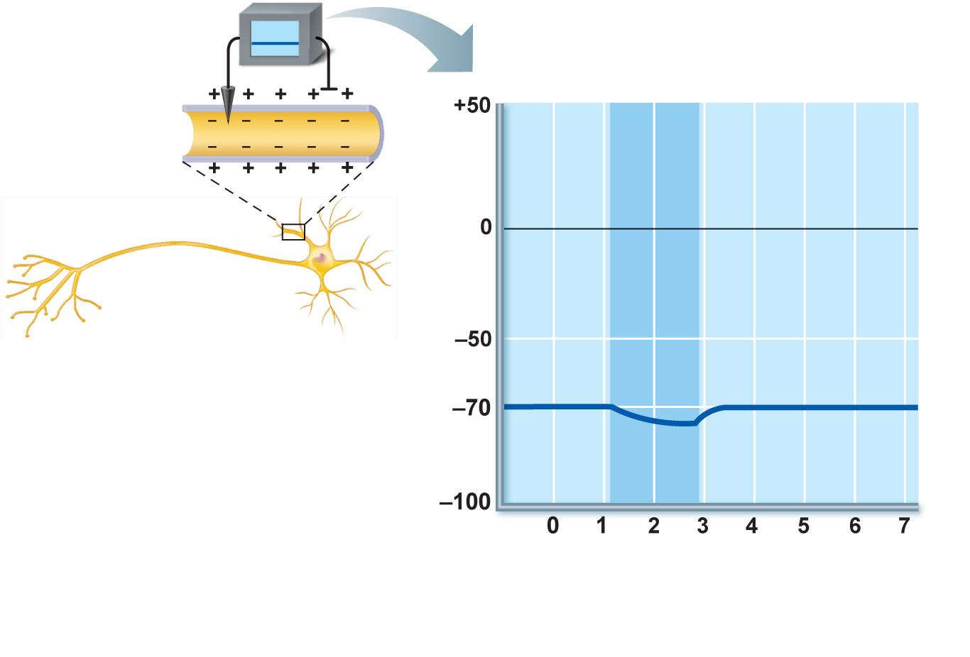
Hyperpolarizing stimulus
Resting
potential
Hyper-
polarization
Time (ms)
(b) Hyperpolarization: The membrane
potential increases, the inside becoming
more negative.
Figure 11.9b

Slide 22
Graded Potentials
Short-lived, localized changes in membrane potential
Depolarizations or hyperpolarizations
Graded potential spreads as local currents change the membrane potential of adjacent regions

Slide 23
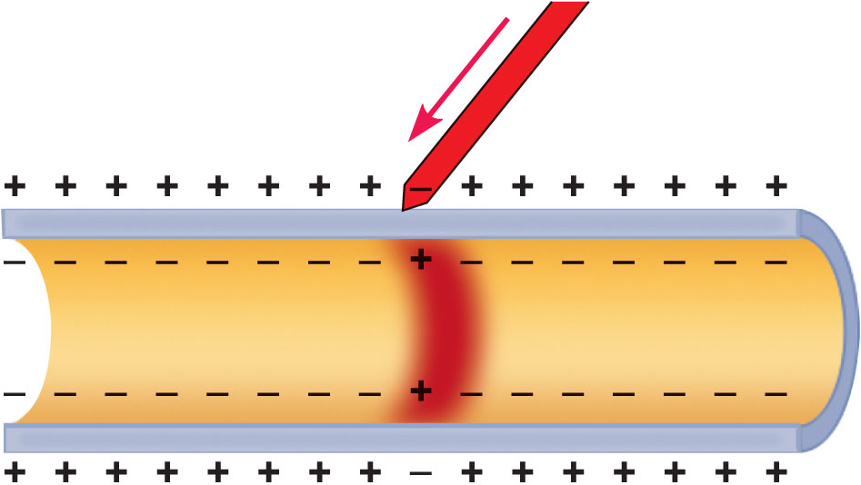
Stimulus
Depolarized region
Plasma
membrane
(a) Depolarization: A small patch of the
membrane (red area) has become depolarized.
Figure 11.10a

Slide 24
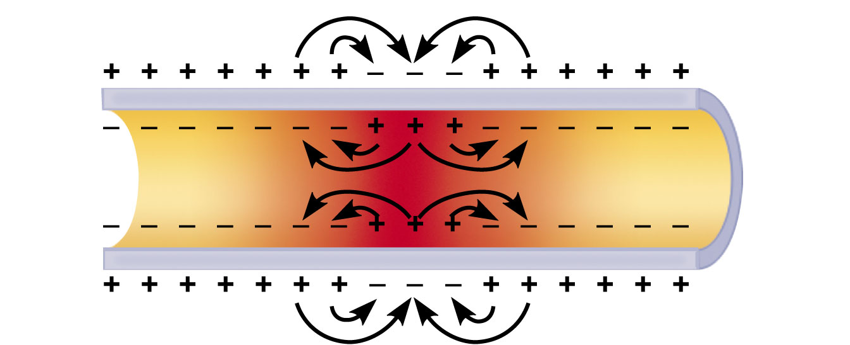
(b) Spread of depolarization: The local currents
(black arrows) that are created depolarize
adjacent membrane areas and allow the wave of
depolarization to spread.
Figure 11.10b

Slide 25
Graded Potentials
Occur when a stimulus causes gated ion channels to open
  E.g., receptor potentials, generator potentials, postsynaptic potentials
Magnitude varies directly (graded) with stimulus strength
Decrease in magnitude with distance as ions flow and diffuse through leakage channels
Short-distance signals

Slide 26
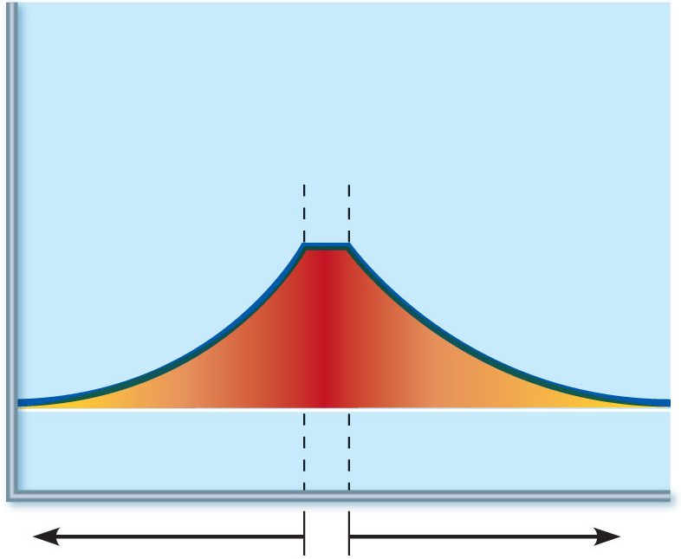
Active area
(site of initial
depolarization)
Membrane potential (mV)
–70
Resting potential
Distance (a few mm)
(c) Decay of membrane potential with distance: Because current
is lost through the “leaky” plasma membrane, the voltage declines
with distance from the stimulus (the voltage is decremental ).
Consequently, graded potentials are short-distance signals.
Figure 11.10c

Slide 27
Action Potential (AP)
Brief reversal of membrane potential with a total amplitude of ~100 mV
Occurs in muscle cells and axons of neurons
Does not decrease in magnitude over distance
Principal means of long-distance neural communication

Slide 28
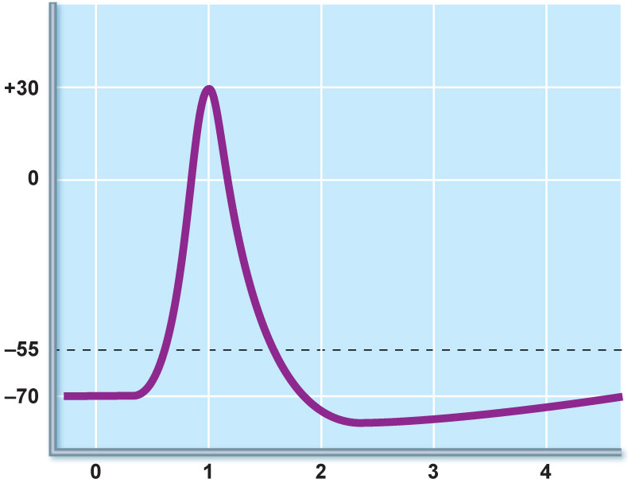
The big picture
1
Resting state
2
Depolarization
3
Repolarization
3
4
Hyperpolarization
Membrane potential (mV)
2
Action
potential
Threshold
1
1
4
Time (ms)
Figure 11.11 (1 of 5)

Slide 29
Generation of an Action Potential
Resting state
  Only leakage channels for Na⁺ and K⁺ are open
  All gated Na⁺ and K⁺ channels are closed

Slide 30
Properties of Gated Channels
Properties of gated channels
  Each Na⁺ channel has two voltage-sensitive gates
    Activation gates
      Closed at rest; open with depolarization
    Inactivation gates
      Open at rest; block channel once it is open

Slide 31
Properties of Gated Channels
Each K⁺ channel has one voltage-sensitive gate
Closed at rest
Opens slowly with depolarization

Slide 32
Depolarizing Phase
Depolarizing local currents open voltage-gated Na⁺ channels
Na⁺ influx causes more depolarization
At threshold (–55 to –50 mV) positive feedback leads to opening of all Na⁺ channels, and a reversal of membrane polarity to +30mV (spike of action potential)

Slide 33
Repolarizing Phase
Repolarizing phase
  Na⁺ channel slow inactivation gates close
  Membrane permeability to Na⁺ declines to resting levels
  Slow voltage-sensitive K⁺ gates open
  K⁺ exits the cell and internal negativity is restored

Slide 34
Hyperpolarization
Hyperpolarization
  Some K⁺ channels remain open, allowing excessive K⁺ efflux
  This causes after-hyperpolarization of the membrane (undershoot)

Slide 35
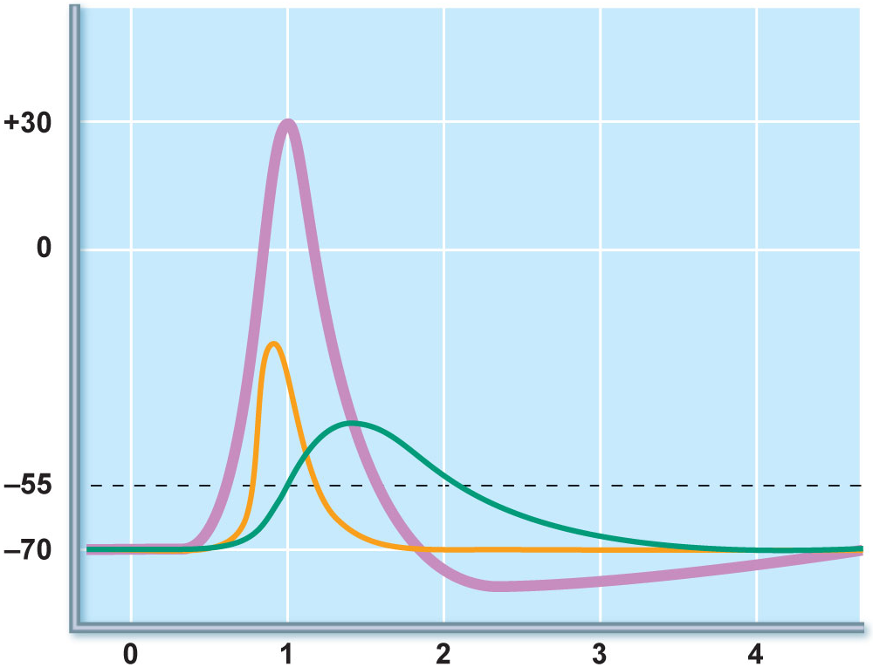
The AP is caused by permeability changes in
the plasma membrane
3
Action
potential
Membrane potential (mV)
Na⁺ permeability
2
Relative membrane permeability
K⁺ permeability
1
1
4
Time (ms)
Figure 11.11 (2 of 5)

Slide 36
Role of the Sodium-Potassium Pump
Repolarization
  Restores the resting electrical conditions of the neuron
  Does not restore the resting ionic conditions
Ionic redistribution back to resting conditions is restored by the thousands of sodium-potassium pumps

Slide 37
Propagation of an Action Potential
Na⁺ influx causes a patch of the axonal membrane to depolarize
Local currents occur
Na⁺ channels toward the point of origin are inactivated and not affected by the local currents

Slide 38
Propagation of an Action Potential
Local currents affect adjacent areas in the forward direction
Depolarization opens voltage-gated channels and triggers an AP
Repolarization wave follows the depolarization wave
(Fig. 11.12 shows the propagation process in unmyelinated axons.)

Slide 39
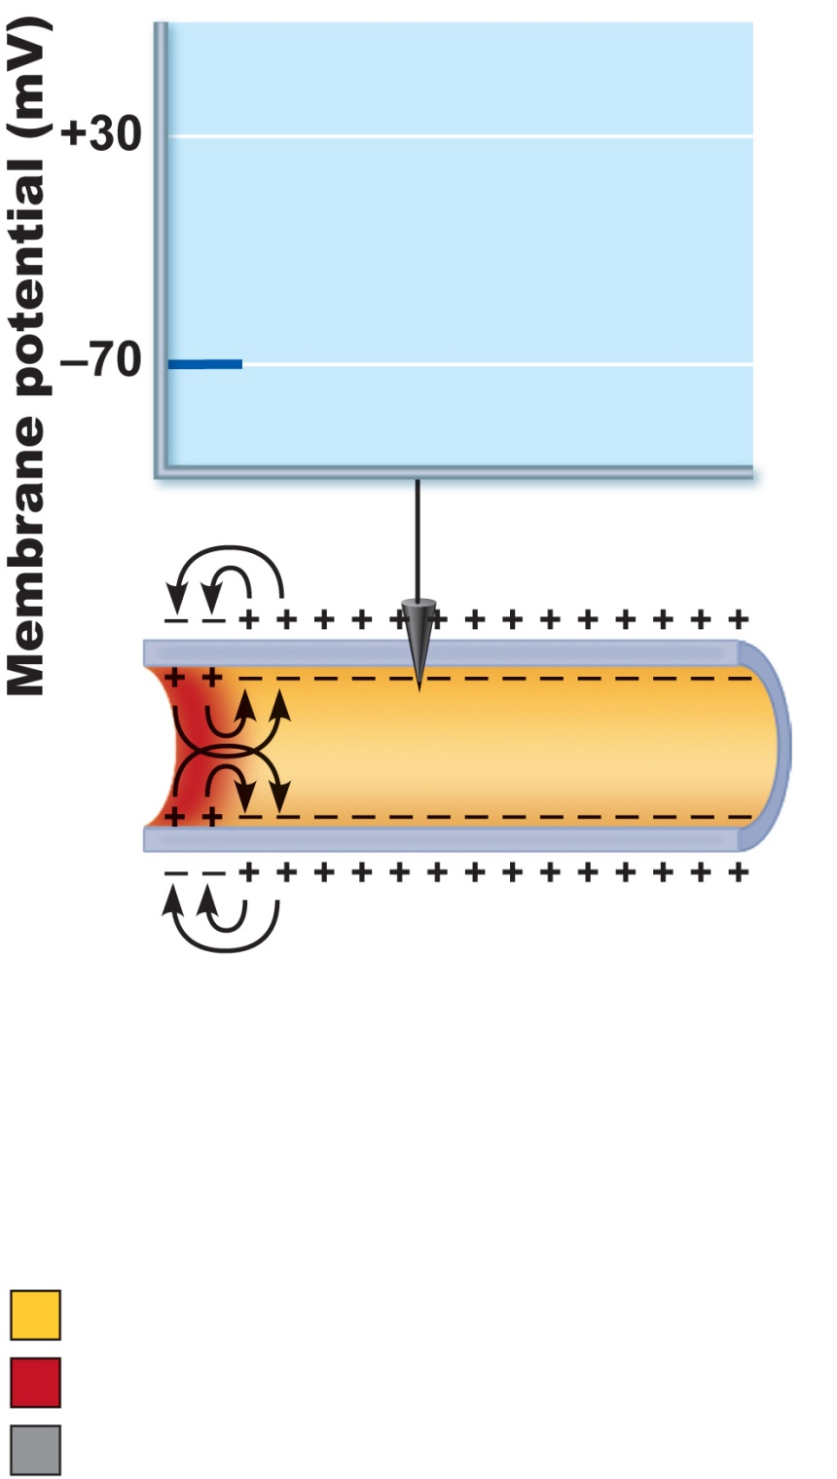
Voltage
at 0 ms
Recording
electrode
(a) Time = 0 ms. Action
potential has not yet
reached the recording
electrode.
Resting potential
Peak of action potential
Hyperpolarization
Figure 11.12a

Slide 40
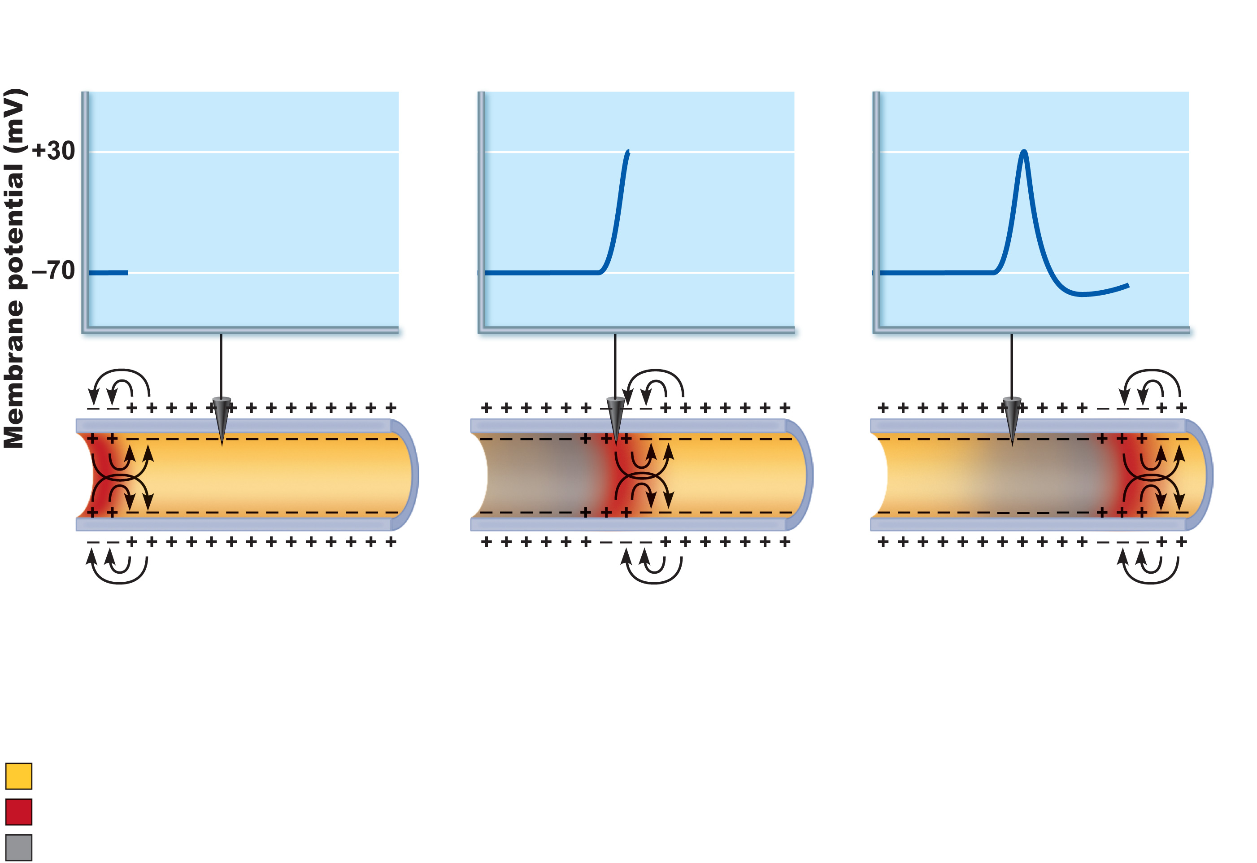
Voltage
at 2 ms
(b) Time = 2 ms. Action
potential peak is at the
recording electrode.
Figure 11.12b

Slide 41
Voltage
at 4 ms
(c) Time = 4 ms. Action
potential peak is past
the recording electrode.
Membrane at the
recording electrode is
still hyperpolarized.
Figure 11.12c

Slide 42
Threshold
At threshold:
  Membrane is depolarized by 15 to 20 mV
  Na⁺ permeability increases
  Na influx exceeds K⁺ efflux
  The positive feedback cycle begins

Slide 43
Threshold
Subthreshold stimulus—weak local depolarization that does not reach threshold
Threshold stimulus—strong enough to push the membrane potential toward and beyond threshold
AP is an all-or-none phenomenon—action potentials either happen completely, or not at all

Slide 44
Coding for Stimulus Intensity
All action potentials are alike and are independent of stimulus intensity
  How does the CNS tell the difference between a weak stimulus and a strong one?
Strong stimuli can generate action potentials more often than weaker stimuli
The CNS determines stimulus intensity by the frequency of impulses

Slide 45
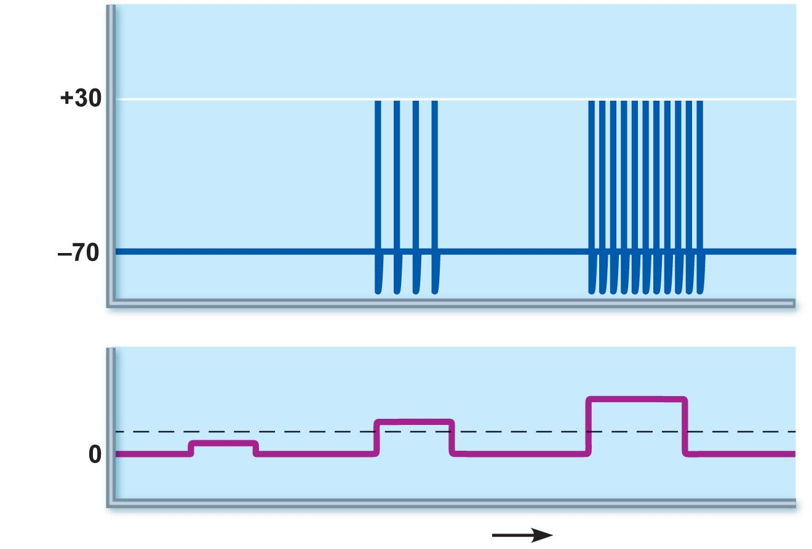
Action
potentials
Stimulus
Threshold
Time (ms)
Figure 11.13

Slide 46
Absolute Refractory Period
Time from the opening of the Na⁺ channels until the resetting of the channels
Ensures that each AP is an all-or-none event
Enforces one-way transmission of nerve impulses

Slide 47
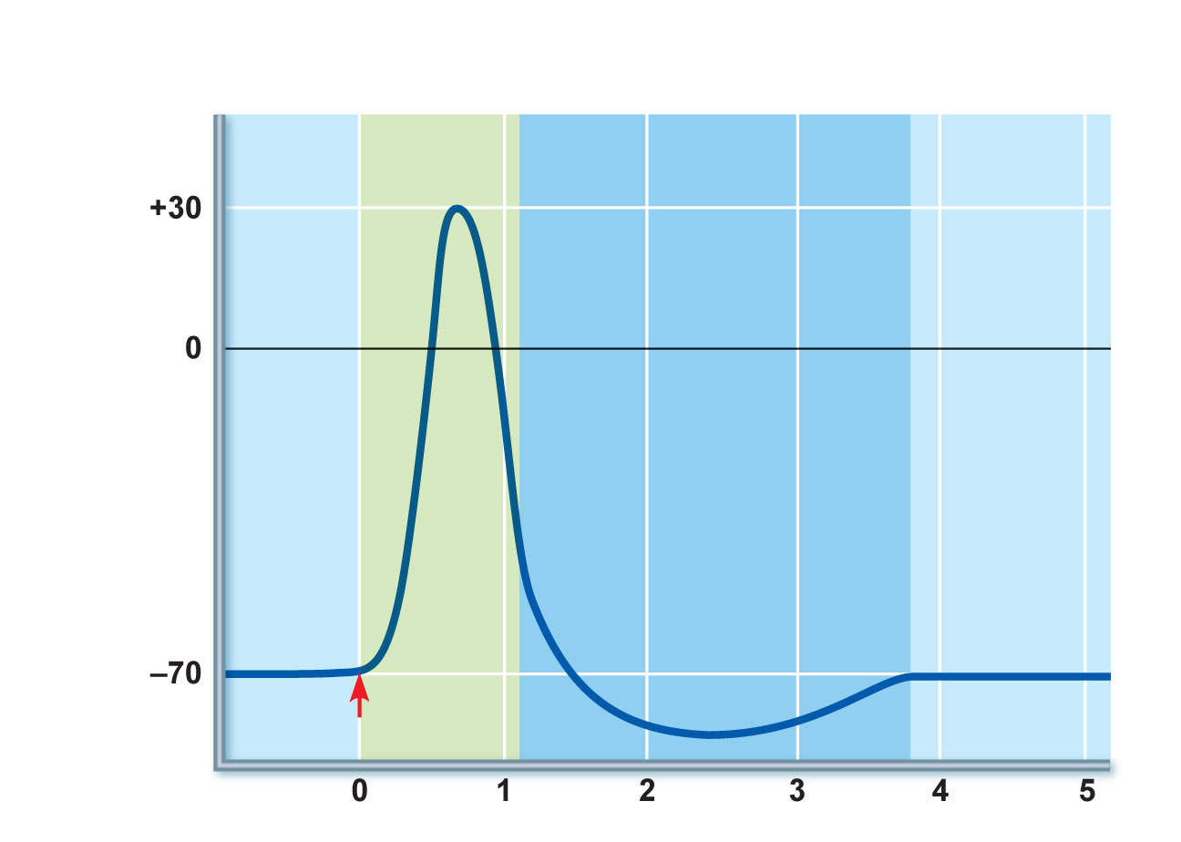
Absolute refractory
period
Relative refractory
period
Depolarization
(Na⁺ enters)
Repolarization
(K⁺ leaves)
After-hyperpolarization
Stimulus
Time (ms)
Figure 11.14

Slide 48
Relative Refractory Period
Follows the absolute refractory period
  Most Na⁺ channels have returned to their resting state
  Some K⁺ channels are still open
  Repolarization is occurring
Threshold for AP generation is elevated
Exceptionally strong stimulus may generate an AP

Slide 49
Conduction Velocity
Conduction velocities of neurons vary widely
Effect of axon diameter
  Larger diameter fibers have less resistance to local current flow and have faster impulse conduction
Effect of myelination
  Continuous conduction in unmyelinated axons is slower than saltatory conduction in myelinated axons

Slide 50
Conduction Velocity
Effects of myelination
  Myelin sheaths insulate and prevent leakage of charge
  Saltatory conduction in myelinated axons is about 30 times faster
    Voltage-gated Na⁺ channels are located at the nodes
    APs appear to jump rapidly from node to node

Slide 51
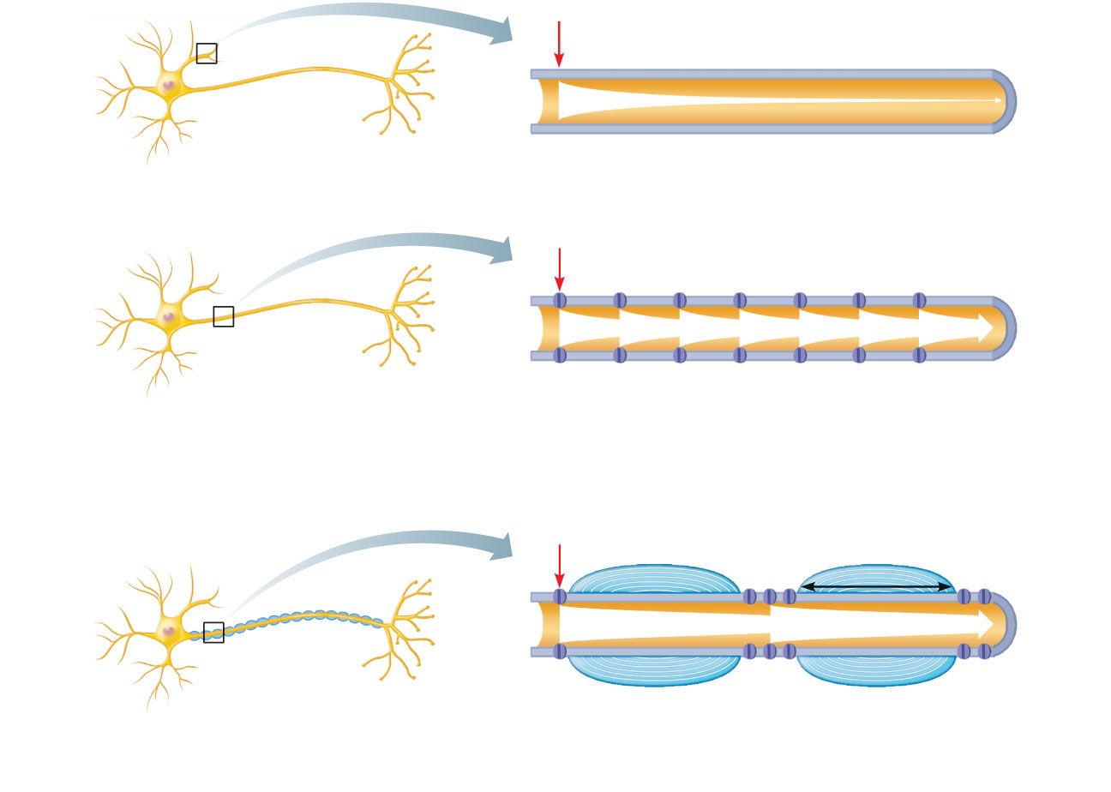
Stimulus
Size of voltage
(a) In a bare plasma membrane (without voltage-gated
channels), as on a dendrite, voltage decays because
current leaks across the membrane.
Stimulus
Voltage-gated
ion channel
(b) In an unmyelinated axon, voltage-gated Na⁺ and K⁺
channels regenerate the action potential at each point
along the axon, so voltage does not decay. Conduction
is slow because movements of ions and of the gates
of channel proteins take time and must occur before
voltage regeneration occurs.
Stimulus
Node of Ranvier
Myelin
sheath
1 mm
(c) In a myelinated axon, myelin keeps current in axons
(voltage doesn’t decay much). APs are generated only
in the nodes of Ranvier and appear to jump rapidly
from node to node.
Myelin sheath
Figure 11.15

Slide 52
Multiple Sclerosis (MS)
An autoimmune disease that mainly affects young adults
Symptoms: visual disturbances, weakness, loss of muscular control, speech disturbances, and urinary incontinence
Myelin sheaths in the CNS become nonfunctional scleroses
Shunting and short-circuiting of nerve impulses occurs
Impulse conduction slows and eventually ceases

Slide 53
Multiple Sclerosis: Treatment
Some immune system–modifying drugs, including interferons and Copazone:
  Hold symptoms at bay
  Reduce complications
  Reduce disability

Slide 54
Nerve Fiber Classification
Nerve fibers are classified according to:
  Diameter
  Degree of myelination
  Speed of conduction

Slide 55
Nerve Fiber Classification
Group A fibers
  Large diameter, myelinated somatic sensory and motor fibers
Group B fibers
  Intermediate diameter, lightly myelinated ANS fibers
Group C fibers
  Smallest diameter, unmyelinated ANS fibers

