Slide 1
11
Fundamentals of the Nervous System and Nervous Tissue: Part C

Slide 2
The Synapse
A junction that mediates information transfer from one neuron:
  To another neuron, or
  To an effector cell

Slide 3
The Synapse
Presynaptic neuron—conducts impulses toward the synapse
Postsynaptic neuron—transmits impulses away from the synapse
PLAY
Animation: Synapses

Slide 4
Types of Synapses Neuro-neuronal
Axodendritic—between the axon of one neuron and the dendrite of another
Axosomatic—between the axon of one neuron and the soma of another
Less common types:
  Axoaxonic (axon to axon)
  Dendrodendritic (dendrite to dendrite)
  Dendrosomatic (dendrite to soma)

Slide 5
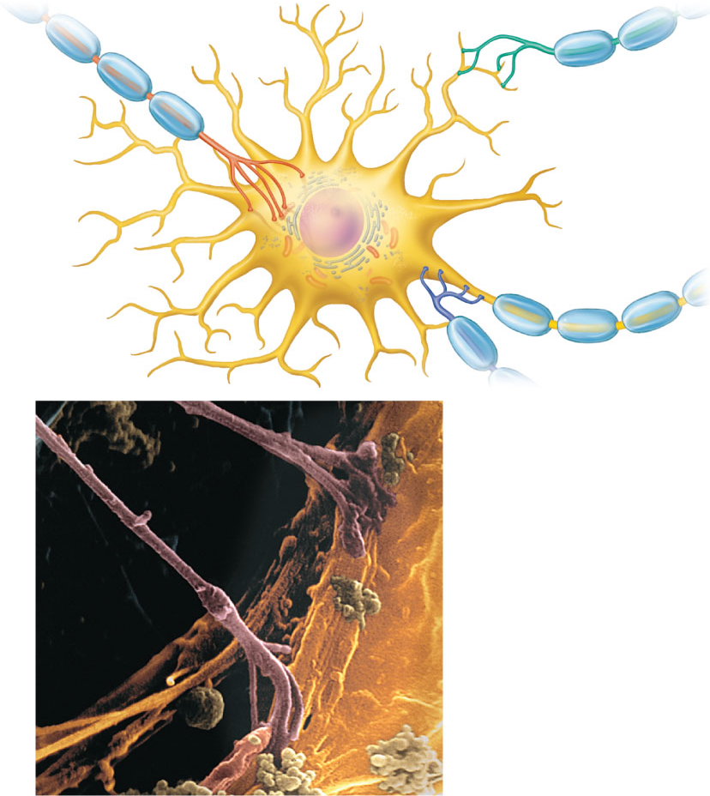
Axodendritic
synapses
Dendrites
Axosomatic
synapses
Cell body
Axoaxonic synapses
(a)
Axon
Axon
Axosomatic
synapses
Cell body (soma) of
postsynaptic neuron
(b)
Figure 11.16

Slide 6
Electrical Synapses
Less common than chemical synapses
  Neurons are electrically coupled (joined by gap junctions)
  Communication is very rapid, and may be unidirectional or bidirectional
  Are important in:
    Embryonic nervous tissue
    Some brain regions

Slide 7
Chemical Synapses
Specialized for the release and reception of neurotransmitters
Typically composed of two parts
  Axon terminal of the presynaptic neuron, which contains synaptic vesicles
  Receptor region on the postsynaptic neuron

Slide 8
Synaptic Cleft
Fluid-filled space separating the presynaptic and postsynaptic neurons
Prevents nerve impulses from directly passing from one neuron to the next

Slide 9
Synaptic Cleft
Transmission across the synaptic cleft:
  Is a chemical event (as opposed to an electrical one)
  Involves release, diffusion, and binding of neurotransmitters
  Ensures unidirectional communication between neurons
PLAY
Animation: Neurotransmitters

Slide 10
Information Transfer
AP arrives at axon terminal of the presynaptic neuron and opens voltage-gated Ca²⁺ channels
Synaptotagmin protein binds Ca²⁺ and promotes fusion of synaptic vesicles with axon membrane
Exocytosis of neurotransmitter occurs

Slide 11
Information Transfer
Neurotransmitter diffuses and binds to receptors (often chemically gated ion channels) on the postsynaptic neuron
Ion channels are opened, causing an excitatory or inhibitory event (graded potential)

Slide 12
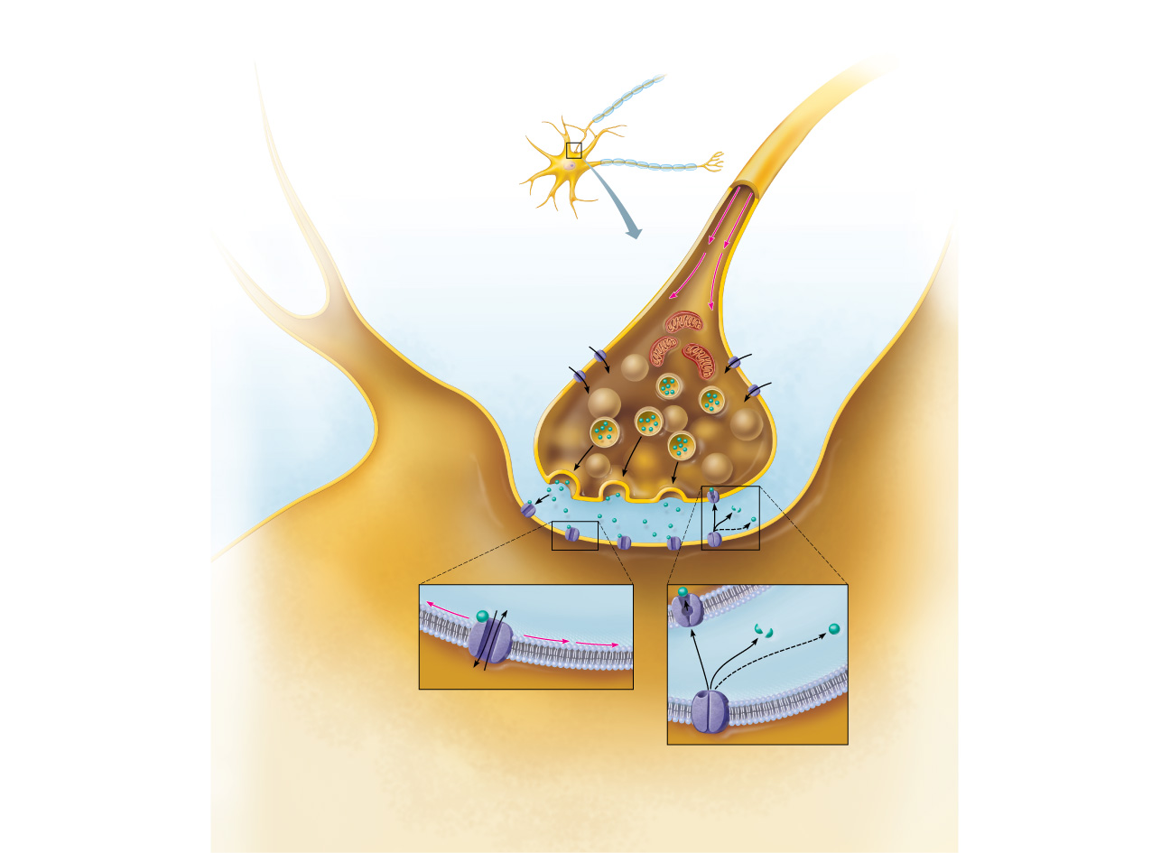
Chemical synapses
transmit signals from
one neuron to another
using neurotransmitters.
Presynaptic
neuron
Presynaptic
neuron
Postsynaptic
neuron
1
Action potential
arrives at axon terminal.
2
Voltage-gated Ca²⁺
channels open and Ca²⁺
enters the axon terminal.
Ca²⁺
Mitochondrion
Ca²⁺
Ca²⁺
Ca²⁺
3
Synaptic
cleft
Ca²⁺ entry causes
neurotransmitter-
containing synaptic
vesicles to release their
contents by exocytosis.
Axon
terminal
Synaptic
vesicles
4
Neurotransmitter
diffuses across the synaptic
cleft and binds to specific
receptors on the
postsynaptic membrane.
Postsynaptic
neuron
Ion movement
Enzymatic
degradation
Graded potential
Reuptake
Diffusion away
from synapse
5
Binding of neurotransmitter
opens ion channels, resulting in
graded potentials.
6
Neurotransmitter effects are
terminated by reuptake through
transport proteins, enzymatic
degradation, or diffusion away
from the synapse.
Figure 11.17

Slide 13
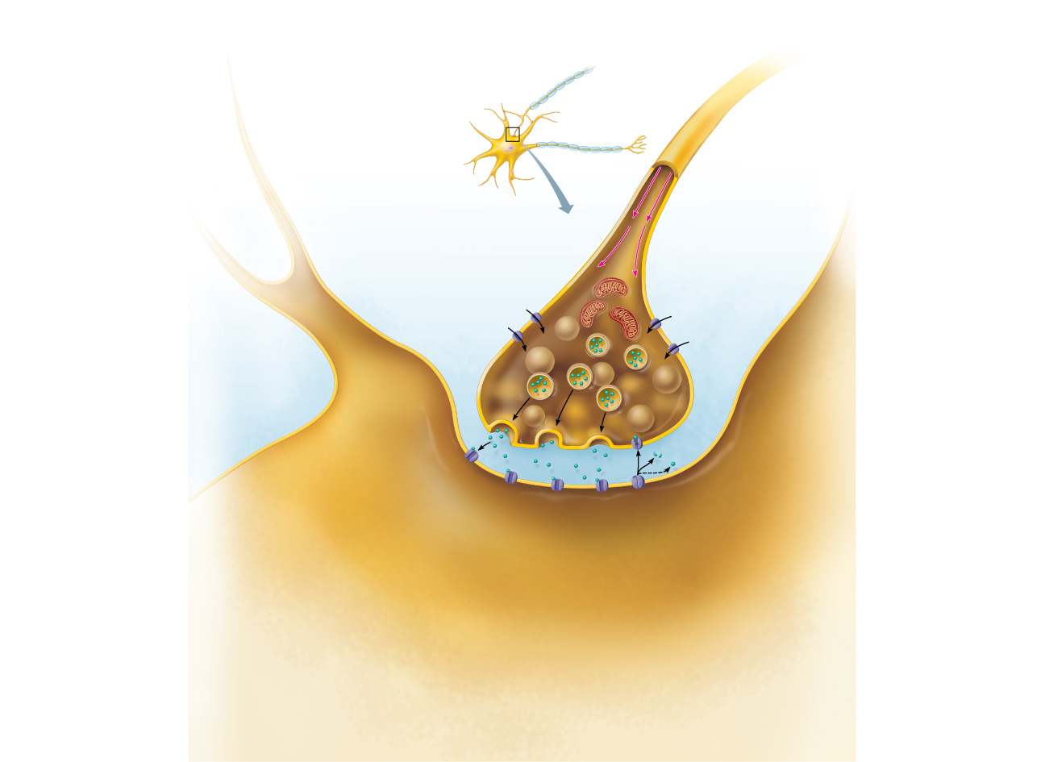
Chemical synapses
transmit signals from
one neuron to another
using neurotransmitters.
Presynaptic
neuron
Presynaptic
neuron
Postsynaptic
neuron
1
Action potential
arrives at axon terminal.
Ca²⁺
Mitochondrion
Ca²⁺
Ca²⁺
Ca²⁺
Synaptic
cleft
Axon
terminal
Synaptic
vesicles
Postsynaptic
neuron
Figure 11.17, step 1

Slide 14
Chemical synapses
transmit signals from
one neuron to another
using neurotransmitters.
Presynaptic
neuron
Presynaptic
neuron
Postsynaptic
neuron
1
Action potential
arrives at axon terminal.
2
Voltage-gated Ca²⁺
channels open and Ca²⁺
enters the axon terminal.
Ca²⁺
Mitochondrion
Ca²⁺
Ca²⁺
Ca²⁺
Synaptic
cleft
Axon
terminal
Synaptic
vesicles
Postsynaptic
neuron
Figure 11.17, step 2

Slide 15
Chemical synapses
transmit signals from
one neuron to another
using neurotransmitters.
Presynaptic
neuron
Presynaptic
neuron
Postsynaptic
neuron
1
Action potential
arrives at axon terminal.
2
Voltage-gated Ca²⁺
channels open and Ca²⁺
enters the axon terminal.
Ca²⁺
Mitochondrion
Ca²⁺
Ca²⁺
Ca²⁺
3
Synaptic
cleft
Ca²⁺ entry causes
neurotransmitter-
containing synaptic
vesicles to release their
contents by exocytosis.
Axon
terminal
Synaptic
vesicles
Postsynaptic
neuron
Figure 11.17, step 3

Slide 16
Chemical synapses
transmit signals from
one neuron to another
using neurotransmitters.
Presynaptic
neuron
Presynaptic
neuron
Postsynaptic
neuron
1
Action potential
arrives at axon terminal.
2
Voltage-gated Ca²⁺
channels open and Ca²⁺
enters the axon terminal.
Ca²⁺
Mitochondrion
Ca²⁺
Ca²⁺
Ca²⁺
3
Synaptic
cleft
Ca²⁺ entry causes
neurotransmitter-
containing synaptic
vesicles to release their
contents by exocytosis.
Axon
terminal
Synaptic
vesicles
4
Neurotransmitter
diffuses across the synaptic
cleft and binds to specific
receptors on the
postsynaptic membrane.
Postsynaptic
neuron
Figure 11.17, step 4

Slide 17
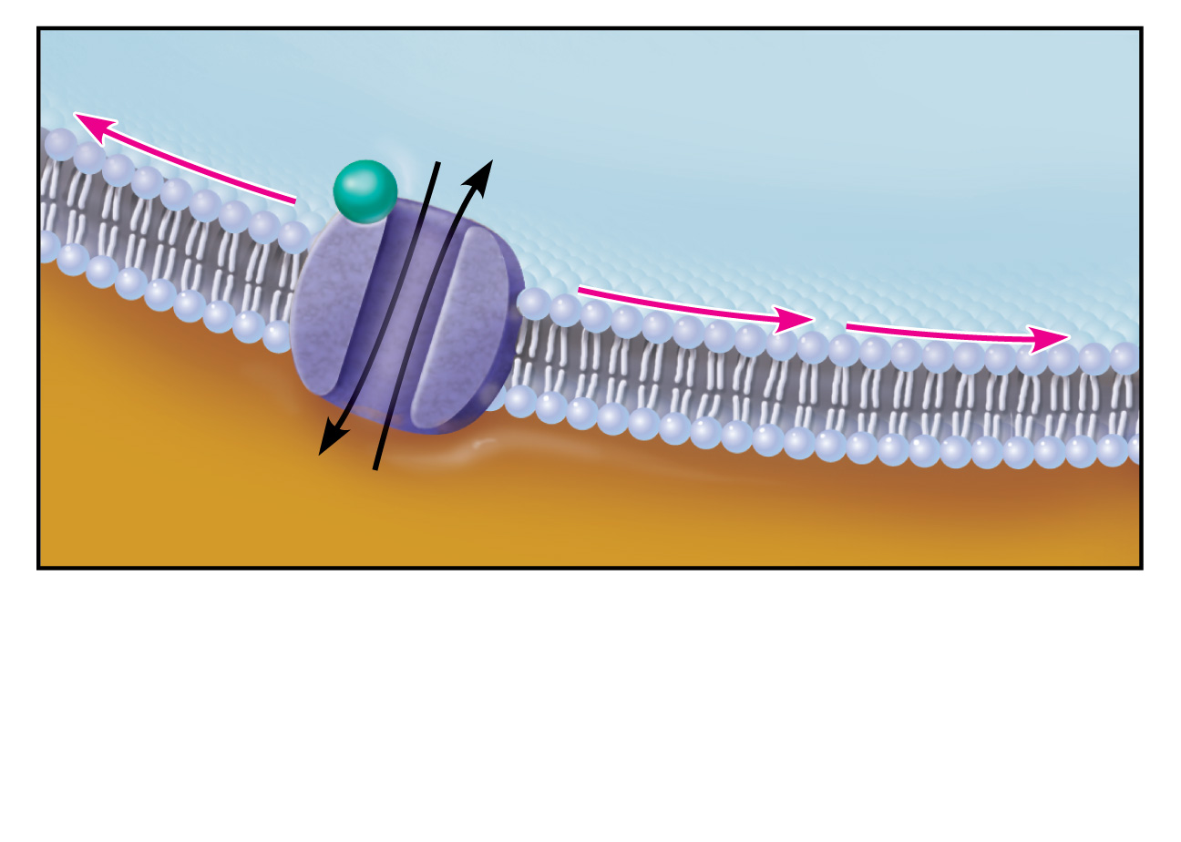
Ion movement
Graded potential
5
Binding of neurotransmitter
opens ion channels, resulting in
graded potentials.
Figure 11.17, step 5

Slide 18
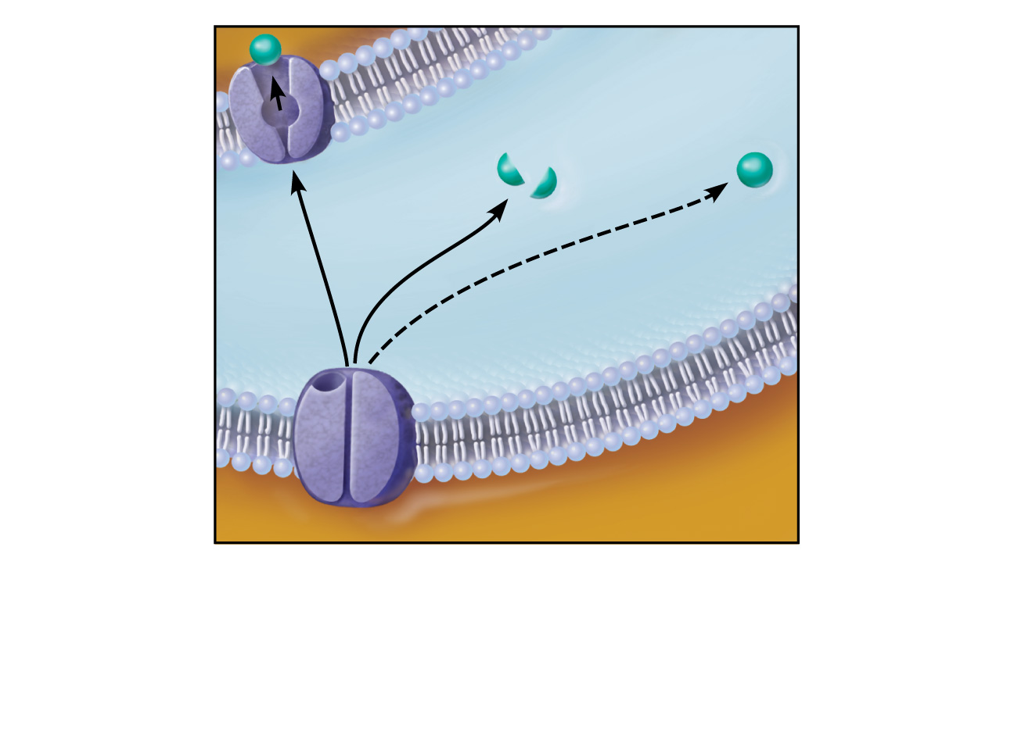
Enzymatic
degradation
Reuptake
Diffusion away
from synapse
6
Neurotransmitter effects are terminated
by reuptake through transport proteins,
enzymatic degradation, or diffusion away
from the synapse.
Figure 11.17, step 6

Slide 19
Chemical synapses
transmit signals from
one neuron to another
using neurotransmitters.
Presynaptic
neuron
Presynaptic
neuron
Postsynaptic
neuron
1
Action potential
arrives at axon terminal.
2
Voltage-gated Ca²⁺
channels open and Ca²⁺
enters the axon terminal.
Ca²⁺
Mitochondrion
Ca²⁺
Ca²⁺
Ca²⁺
3
Synaptic
cleft
Ca²⁺ entry causes
neurotransmitter-
containing synaptic
vesicles to release their
contents by exocytosis.
Axon
terminal
Synaptic
vesicles
4
Neurotransmitter
diffuses across the synaptic
cleft and binds to specific
receptors on the
postsynaptic membrane.
Postsynaptic
neuron
Ion movement
Enzymatic
degradation
Graded potential
Reuptake
Diffusion away
from synapse
5
Binding of neurotransmitter
opens ion channels, resulting in
graded potentials.
6
Neurotransmitter effects are
terminated by reuptake through
transport proteins, enzymatic
degradation, or diffusion away
from the synapse.
Figure 11.17

Slide 20
Termination of Neurotransmitter Effects
Within a few milliseconds, the neurotransmitter effect is terminated
  Degradation by enzymes
  Reuptake by astrocytes or axon terminal
  Diffusion away from the synaptic cleft

Slide 21
Synaptic Delay
Neurotransmitter must be released, diffuse across the synapse, and bind to receptors
Synaptic delay—time needed to do this (0.3–5.0 ms)
Synaptic delay is the rate-limiting step of neural transmission

Slide 22
Postsynaptic Potentials
Graded potentials
Strength determined by:
  Amount of neurotransmitter released
  Time the neurotransmitter is in the area
Types of postsynaptic potentials
  EPSP—excitatory postsynaptic potentials
  IPSP—inhibitory postsynaptic potentials

Slide 23
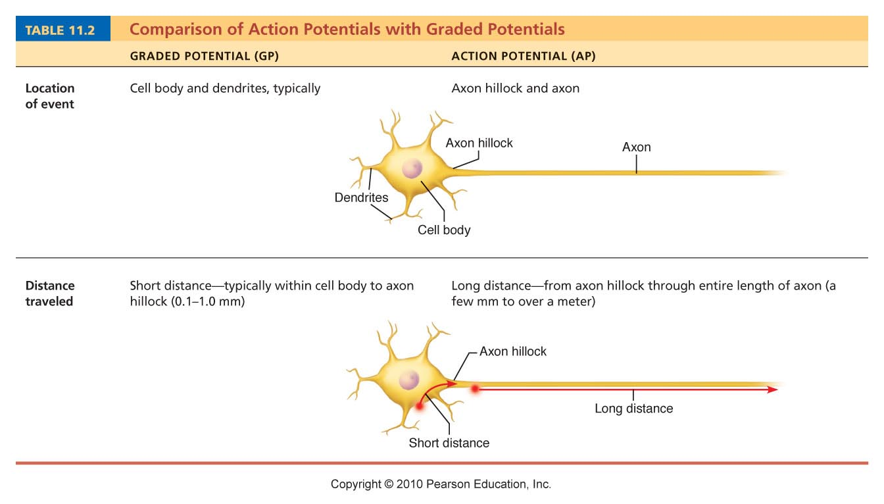
Table 11.2 (1 of 4)

Slide 24
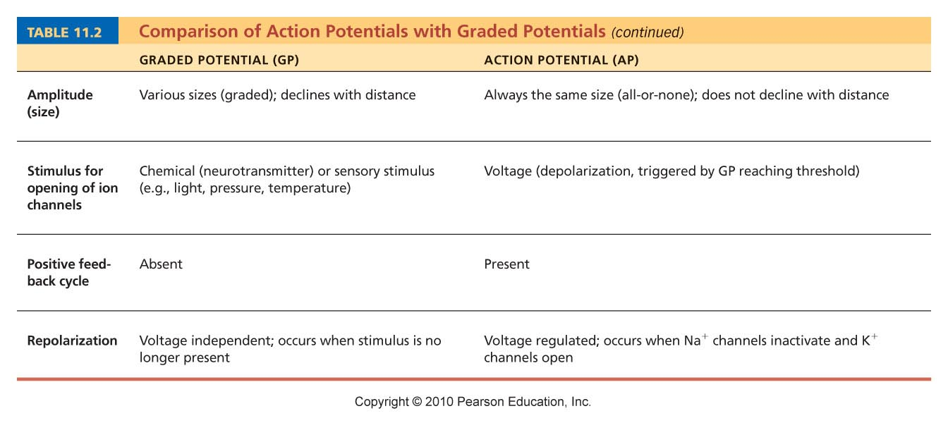
Table 11.2 (2 of 4)

Slide 25
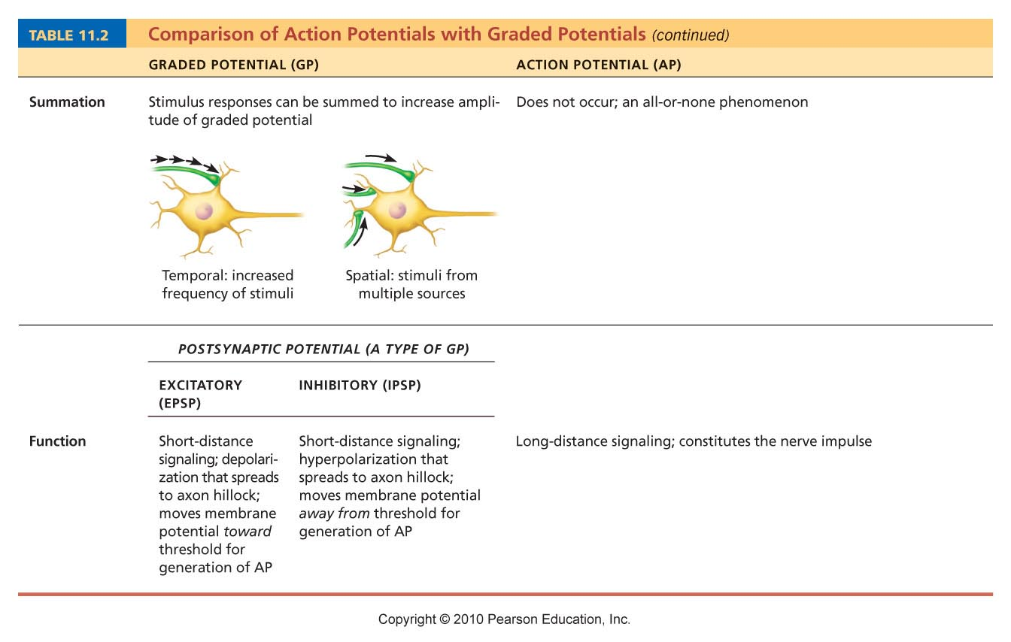
Table 11.2 (3 of 4)

Slide 26
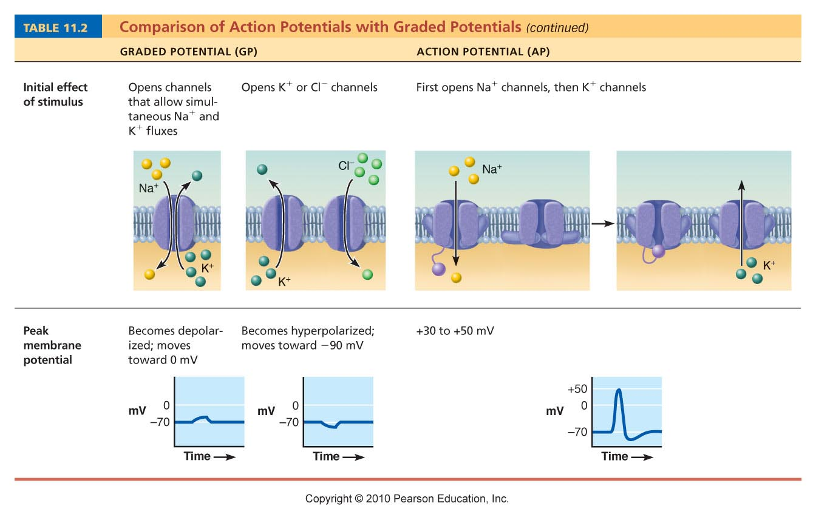
Table 11.2 (4 of 4)

Slide 27
Excitatory Synapses and EPSPs
Neurotransmitter binds to and opens chemically gated channels that allow simultaneous flow of Na⁺ and K⁺ in opposite directions
Na⁺ influx is greater that K⁺ efflux, causing a net depolarization
EPSP helps trigger AP at axon hillock if EPSP is of threshold strength and opens the voltage-gated channels

Slide 28
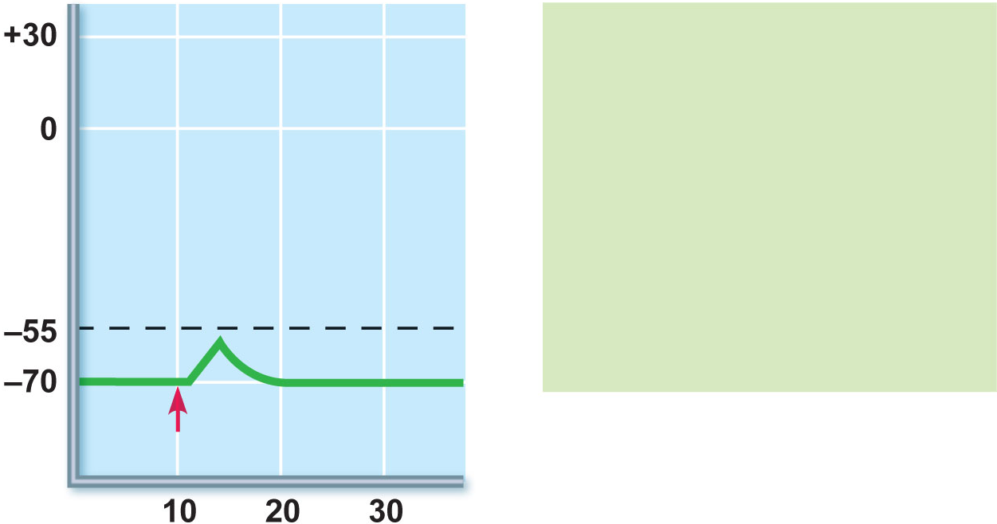
An EPSP is a local
depolarization of the
postsynaptic membrane
that brings the neuron
closer to AP threshold.
Neurotransmitter binding
opens chemically gated
ion channels, allowing
the simultaneous pas-
sage of Na⁺ and K⁺.
Membrane potential (mV)
Threshold
Stimulus
Time (ms)
(a) Excitatory postsynaptic potential (EPSP)
Figure 11.18a

Slide 29
Inhibitory Synapses and IPSPs
Neurotransmitter binds to and opens channels for K⁺ or Cl–
Causes a hyperpolarization (the inner surface of membrane becomes more negative)
Reduces the postsynaptic neuron’s ability to produce an action potential

Slide 30
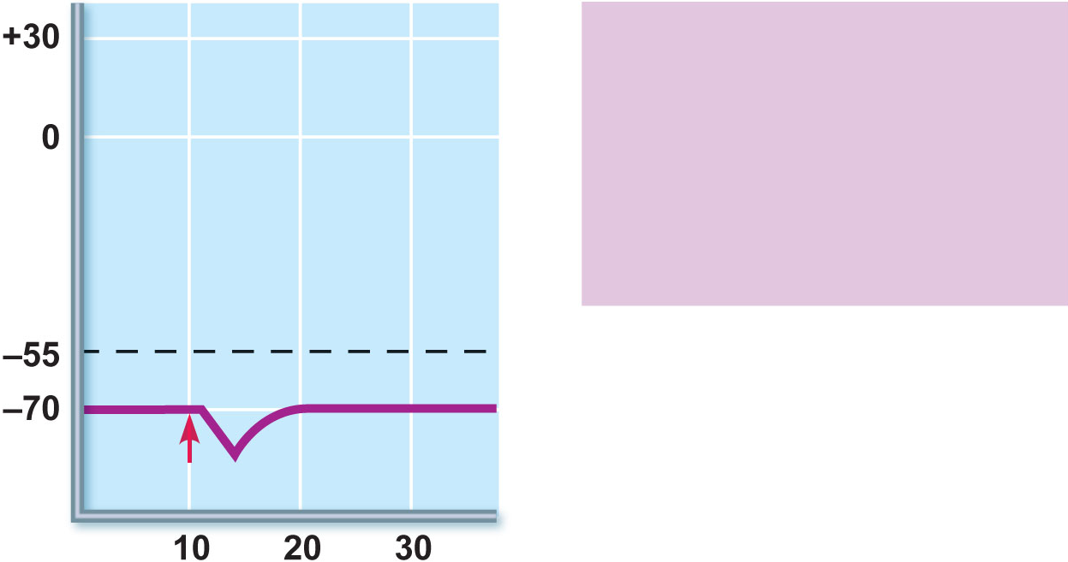
An IPSP is a local
hyperpolarization of the
postsynaptic membrane
and drives the neuron
away from AP threshold.
Neurotransmitter binding
opens K⁺ or Cl– channels.
Membrane potential (mV)
Threshold
Stimulus
Time (ms)
(b) Inhibitory postsynaptic potential (IPSP)
Figure 11.18b

Slide 31
Integration: Summation
A single EPSP cannot induce an action potential
EPSPs can summate to reach threshold
IPSPs can also summate with EPSPs, canceling each other out

Slide 32
Integration: Summation
Temporal summation
  One or more presynaptic neurons transmit impulses in rapid-fire order
Spatial summation
  Postsynaptic neuron is stimulated by a large number of terminals at the same time

Slide 33
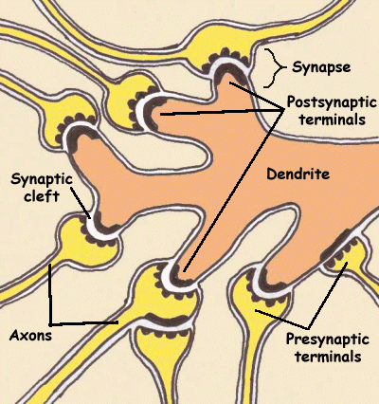
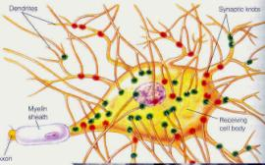
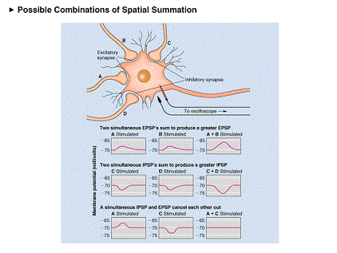
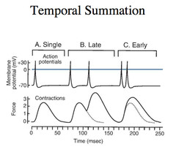
Neurons have
Multiple synapses.

Slide 34
Temporal Summation
Temporal summation involves the fact that action potentials start to finish are a little over 3 milliseconds. Where as EPSPs and IPSPs are several milliseconds. So several action potentials can occur during one single EPSP or IPSP.
Each IPSP or EPSP can accumulate its electrolyses in the cell.
Assume the axon hillock can algebraically summate.

Slide 35
Spatial Summation
Spatial summation involves the fact that all neurons have several synapses on them. Thus, the graded potentials are added up in space from all the neuron’s synapses.

Slide 36
Assume the axon hillock performs algebraic summation.
Assume to start action potentials in the axon, the axon hillock (first area to have voltage dependent gates) must get a 30 mv. charge for threshold
The dendrites and cell body do graded potentials and the synapses occur on these structures.

Slide 37
Let’s say the resting membrane potential at the axon hillock is -70 mv.
To reach threshold there, we need +30 mv charge. So the membrane needs to get to a -40mv at the axon hillock to fire action potentials.
There are several synapses on the dendrites sending EPSP signals. All there signals give us a +40 mv potential hit at the axon hillock, but we have several synapses sending IPSPs and they give us a – 40 total at the axon hillock. So the membrane potential at the axon hillock does not change.

Slide 38
Another scenario: There are several synapses on the dendrites sending EPSP signals. All there signals give us a +40 mv potential hit at the axon hillock, but we have several synapses sending IPSPs and they give us a – 20 total at the axon hillock. So the membrane potential at the axon hillock is +20 mv, bringing the axon hillock to -50 mv, but we need a -40mv to reach threshold, so we are closer but no there yet. We say the membrane has facilitation.
Closer to threshold but not there.

Slide 39
Another 4th scenario: There are several synapses on the dendrites sending EPSP signals. All there signals give us a +40 mv potential hit at the axon hillock, but we have several synapses sending IPSPs and they give us a – 50 total at the axon hillock. So the membrane potential at the axon hillock is now a -80 mv (it originally was a -70 mv). The membrane has been brought further from threshold, thus now inhibited.

Slide 40
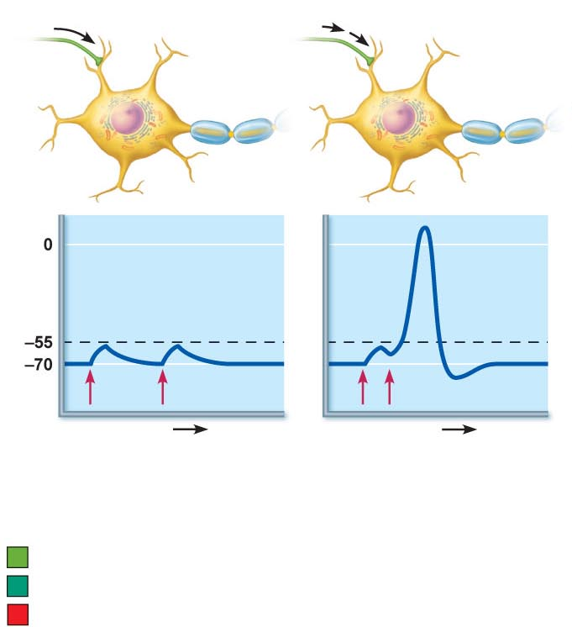
E₁
E₁
Threshold of axon of
postsynaptic neuron
Resting potential
E₁
E₁
E₁
E₁
Time
Time
(a)
No summation:
2 stimuli separated in time
cause EPSPs that do not
add together.
(b)
Temporal summation:
2 excitatory stimuli close
in time cause EPSPs
that add together.
Excitatory synapse 1 (E₁)
Excitatory synapse 2 (E₂)
Inhibitory synapse (I₁)
Figure 11.19a, b

Slide 41
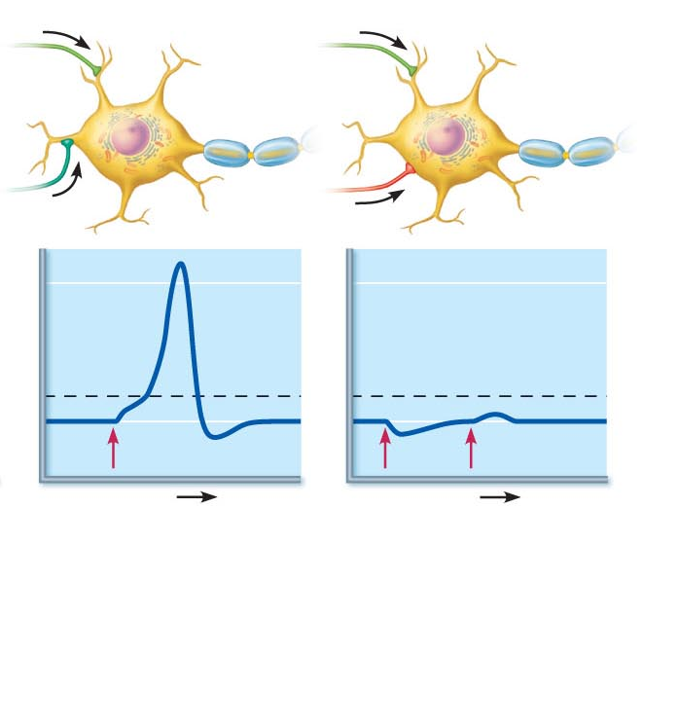
E₁
E₁
E₂
I₁
E₁ + E₂
I₁
E₁ + I₁
Time
Time
(c)
Spatial summation:
2 simultaneous stimuli at
different locations cause
EPSPs that add together.
(d)
Spatial summation of
EPSPs and IPSPs:
Changes in membane
potential can cancel each
other out.
Figure 11.19c, d

Slide 42
Integration: Synaptic Potentiation
Repeated use increases the efficiency of neurotransmission
Ca²⁺ concentration increases in pre-synaptic terminal and postsynaptic neuron
Brief high-frequency stimulation partially depolarizes the postsynaptic neuron
  Chemically gated channels (NMDA receptors) allow Ca²⁺ entry
  Ca²⁺ activates kinase enzymes that promote more effective responses to subsequent stimuli

Slide 43
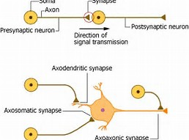
Integration: Presynaptic Inhibition
Release of excitatory neurotransmitter by one neuron may be inhibited by the activity of another neuron via an axoaxonic synapse
Less neurotransmitter is released and smaller EPSPs are formed

Slide 44
Neurotransmitters
Most neurons make two or more neurotransmitters, which are released at different stimulation frequencies
50 or more neurotransmitters have been identified
Classified by chemical structure and by function

Slide 45
Chemical Classes of Neurotransmitters
Acetylcholine (Ach)
  Released at neuromuscular junctions and some ANS neurons
  Synthesized by enzyme choline acetyltransferase
  Degraded by the enzyme acetylcholinesterase (AChE)

Slide 46
Chemical Classes of Neurotransmitters
Biogenic amines include:
    Catecholamines
      Dopamine, norepinephrine (NE), and epinephrine
    Indolamines
      Serotonin and histamine
Broadly distributed in the brain
Play roles in emotional behaviors and the biological clock

Slide 47
Chemical Classes of Neurotransmitters
Amino acids include:
    GABA—Gamma (γ)-aminobutyric acid
    Glycine
    Aspartate
    Glutamate

Slide 48
Chemical Classes of Neurotransmitters
Peptides (neuropeptides) include:
    Substance P
      Mediator of pain signals
    Endorphins
      Act as natural opiates; reduce pain perception
    Gut-brain peptides
      Somatostatin and cholecystokinin

Slide 49
Chemical Classes of Neurotransmitters
Purines such as ATP:
    Act in both the CNS and PNS
    Produce fast or slow responses
    Induce Ca²⁺ influx in astrocytes
    Provoke pain sensation

Slide 50
Chemical Classes of Neurotransmitters
Gases and lipids
  Nitric oxide (NO)
    Synthesized on demand
    Activates the intracellular receptor guanylyl cyclase to cyclic GMP
    Involved in learning and memory
  Carbon monoxide (CO) is a regulator of cGMP in the brain

Slide 51
Chemical Classes of Neurotransmitters
Gases and lipids
  Endocannabinoids
    Lipid soluble; synthesized on demand from membrane lipids
    Bind with G protein–coupled receptors in the brain
    Involved in learning and memory

Slide 52
Functional Classification of Neurotransmitters
Neurotransmitter effects may be excitatory (depolarizing) and/or inhibitory (hyperpolarizing)
  Determined by the receptor type of the postsynaptic neuron
  GABA and glycine are usually inhibitory
  Glutamate is usually excitatory
  Acetylcholine
    Excitatory at neuromuscular junctions in skeletal muscle
    Inhibitory in cardiac muscle

Slide 53
Neurotransmitter Actions
Direct action
  Neurotransmitter binds to channel-linked receptor and opens ion channels
  Promotes rapid responses
  Examples: ACh and amino acids

Slide 54
Neurotransmitter Actions
Indirect action
  Neurotransmitter binds to a G protein-linked receptor and acts through an intracellular second messenger
  Promotes long-lasting effects
  Examples: biogenic amines, neuropeptides, and dissolved gases

Slide 55
Neurotransmitter Receptors
Types
  Channel-linked receptors
  G protein-linked receptors

Slide 56
Channel-Linked (Ionotropic) Receptors
Ligand-gated ion channels
Action is immediate and brief
Excitatory receptors are channels for small cations
Na⁺ influx contributes most to depolarization
Inhibitory receptors allow Cl– influx or K⁺ efflux that causes hyperpolarization

Slide 57
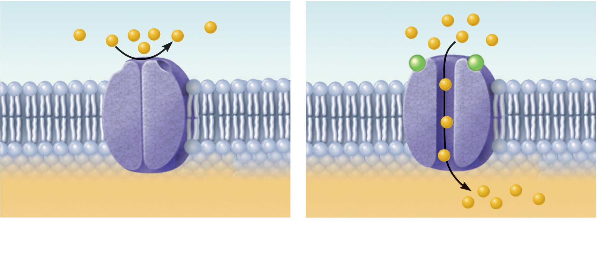
Ion flow blocked
Ions flow
Ligand
Closed ion channel
Open ion channel
(a) Channel-linked receptors open in response to binding
of ligand (ACh in this case).
Figure 11.20a

Slide 58
G Protein-Linked (Metabotropic) Receptors
Transmembrane protein complexes
Responses are indirect, slow, complex, and often prolonged and widespread
Examples: muscarinic ACh receptors and those that bind biogenic amines and neuropeptides

Slide 59
G Protein-Linked Receptors: Mechanism
Neurotransmitter binds to G protein–linked receptor
G protein is activated
Activated G protein controls production of second messengers, e.g., cyclic AMP, cyclic GMP, diacylglycerol or Ca²⁺

Slide 60
G Protein-Linked Receptors: Mechanism
Second messengers
  Open or close ion channels
  Activate kinase enzymes
  Phosphorylate channel proteins
  Activate genes and induce protein synthesis

Slide 61
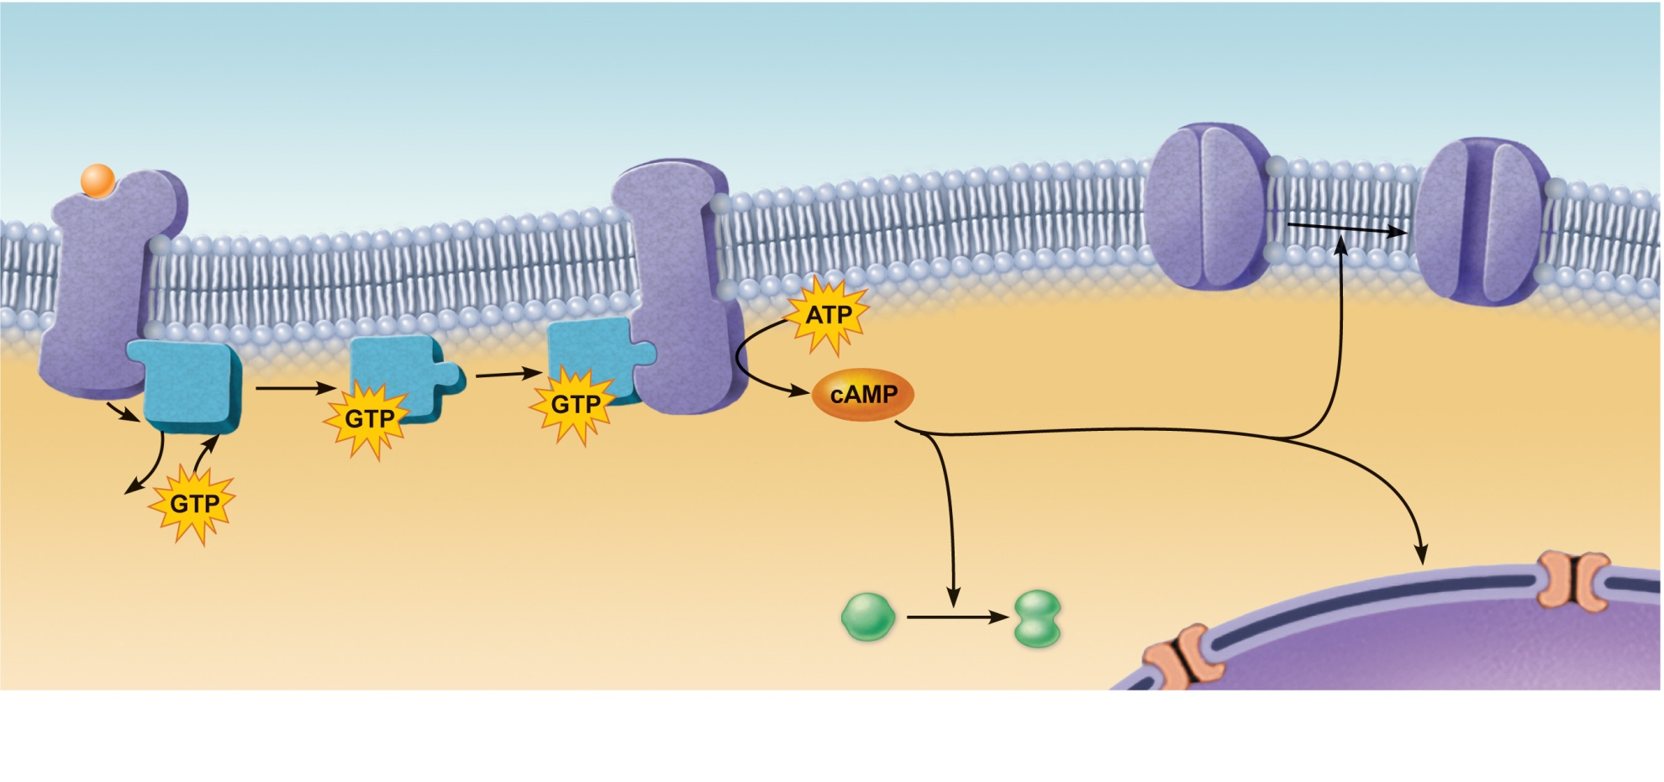
1
Closed ion
channel
Open ion
channel
Neurotransmitter
(1st messenger) binds
and activates receptor.
Adenylate cyclase
Receptor
G protein
cAMP changes
membrane permeability
by opening or closing ion
channels.
5a
cAMP activates
specific genes.
5c
GDP
5b
cAMP activates
enzymes.
2
3
4
Receptor
activates G
protein.
G protein
activates
adenylate
cyclase.
Adenylate
cyclase converts
ATP to cAMP
(2nd messenger).
Active enzyme
Nucleus
(b) G-protein linked receptors cause formation of an intracellular second messenger (cyclic
AMP in this case) that brings about the cell’s response.
Figure 11.17b

Slide 62
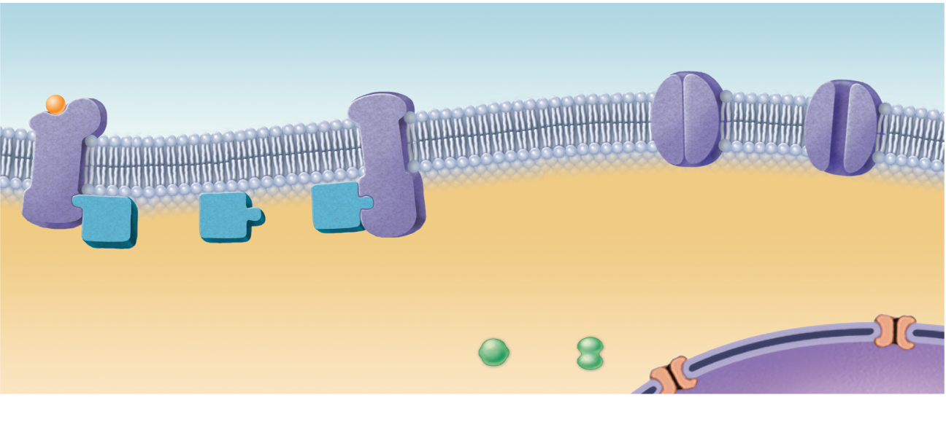
1
Neurotransmitter
(1st messenger) binds
and activates receptor.
Receptor
(b) G-protein linked receptors cause formation of an intracellular second messenger (cyclic
AMP in this case) that brings about the cell’s response.
Figure 11.17b, step 1

Slide 63
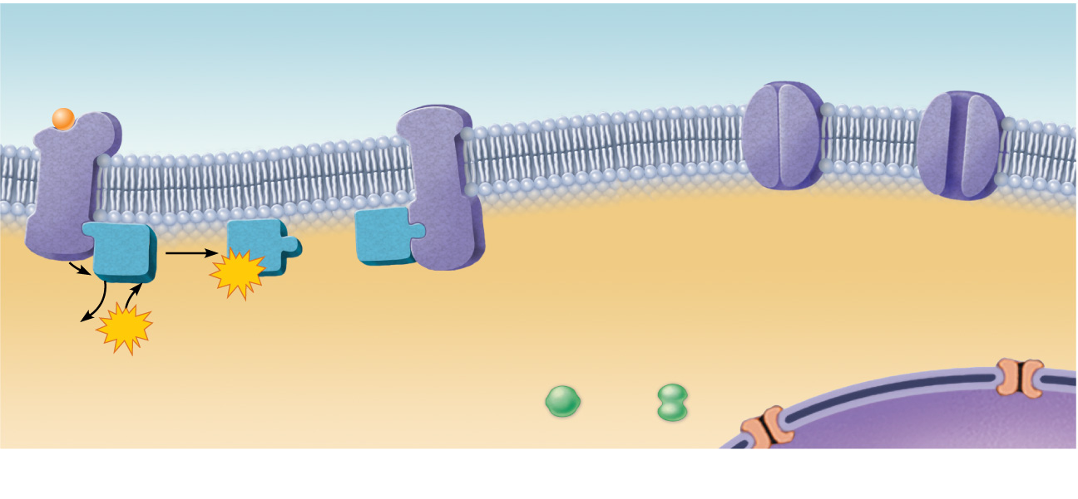
1
Neurotransmitter
(1st messenger) binds
and activates receptor.
Receptor
G protein
GTP
GDP
GTP
2
Receptor
activates G
protein.
Nucleus
(b) G-protein linked receptors cause formation of an intracellular second messenger (cyclic
AMP in this case) that brings about the cell’s response.
Figure 11.17b, step 2

Slide 64

1
Neurotransmitter
(1st messenger) binds
and activates receptor.
Adenylate cyclase
Receptor
G protein
GTP
GTP
GDP
GTP
2
3
Receptor
activates G
protein.
G protein
activates
adenylate
cyclase.
Nucleus
(b) G-protein linked receptors cause formation of an intracellular second messenger (cyclic
AMP in this case) that brings about the cell’s response.
Figure 11.17b, step 3

Slide 65
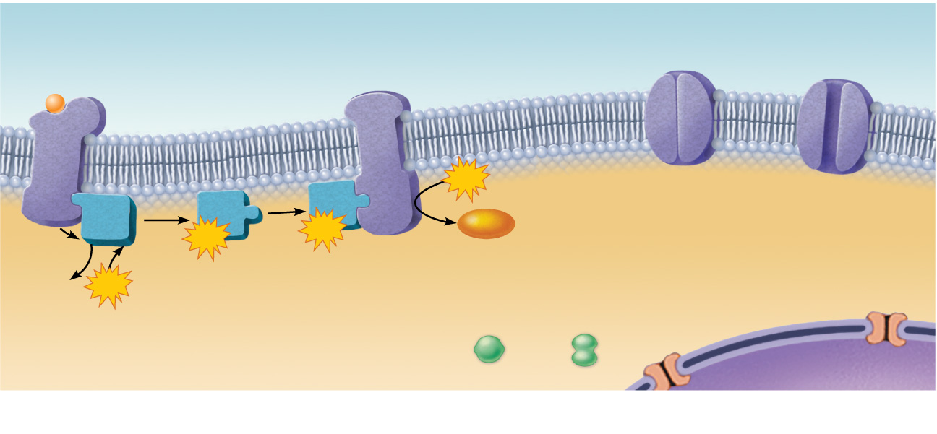
1
Neurotransmitter
(1st messenger) binds
and activates receptor.
Adenylate cyclase
Receptor
G protein
ATP
GTP
GTP
cAMP
GDP
GTP
2
3
4
Receptor
activates G
protein.
G protein
activates
adenylate
cyclase.
Adenylate
cyclase converts
ATP to cAMP
(2nd messenger).
Nucleus
(b) G-protein linked receptors cause formation of an intracellular second messenger (cyclic
AMP in this case) that brings about the cell’s response.
Figure 11.17b, step 4

Slide 66
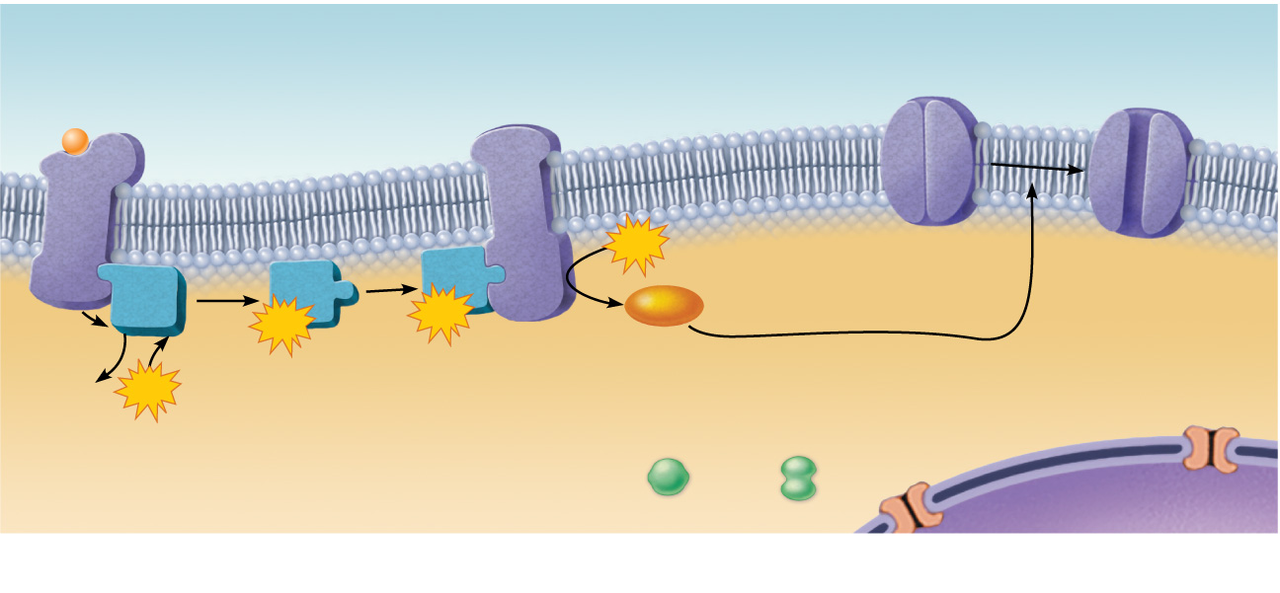
1
Neurotransmitter
(1st messenger) binds
and activates receptor.
Adenylate cyclase
Closed ion channel
Open ion channel
Receptor
G protein
ATP
5a
cAMP changes
membrane permeability by
opening and closing ion
channels.
GTP
GTP
cAMP
GDP
GTP
2
3
4
Receptor
activates G
protein.
G protein
activates
adenylate
cyclase.
Adenylate
cyclase converts
ATP to cAMP
(2nd messenger).
Nucleus
(b) G-protein linked receptors cause formation of an intracellular second messenger (cyclic
AMP in this case) that brings about the cell’s response.
Figure 11.17b, step 5a

Slide 67

1
Neurotransmitter
(1st messenger) binds
and activates receptor.
Adenylate cyclase
Closed ion channel
Open ion channel
Receptor
G protein
ATP
5a
cAMP changes
membrane permeability by
opening and closing ion
channels.
GTP
GTP
cAMP
GDP
GTP
5b
cAMP activates
enzymes.
2
3
4
Receptor
activates G
protein.
G protein
activates
adenylate
cyclase.
Adenylate
cyclase converts
ATP to cAMP
(2nd messenger).
Active enzyme
Nucleus
(b) G-protein linked receptors cause formation of an intracellular second messenger (cyclic
AMP in this case) that brings about the cell’s response.
Figure 11.17b, step 5b

Slide 68

1
Neurotransmitter
(1st messenger) binds
and activates receptor.
Adenylate cyclase
Closed ion channel
Open ion channel
Receptor
G protein
ATP
5a
cAMP changes
membrane permeability by
opening and closing ion
channels.
GTP
GTP
cAMP
5c
cAMP
activates
specific genes.
GDP
GTP
5b
cAMP activates
enzymes.
2
3
4
Receptor
activates G
protein.
G protein
activates
adenylate
cyclase.
Adenylate
cyclase converts
ATP to cAMP
(2nd messenger).
Active enzyme
Nucleus
(b) G-protein linked receptors cause formation of an intracellular second messenger (cyclic
AMP in this case) that brings about the cell’s response.
Figure 11.17b, step 5c

Slide 69
Neural Integration: Neuronal Pools
Functional groups of neurons that:
  Integrate incoming information
  Forward the processed information to other destinations

Slide 70
Neural Integration: Neuronal Pools
Simple neuronal pool
  Single presynaptic fiber branches and synapses with several neurons in the pool
  Discharge zone—neurons most closely associated with the incoming fiber
  Facilitated zone—neurons farther away from incoming fiber

Slide 71
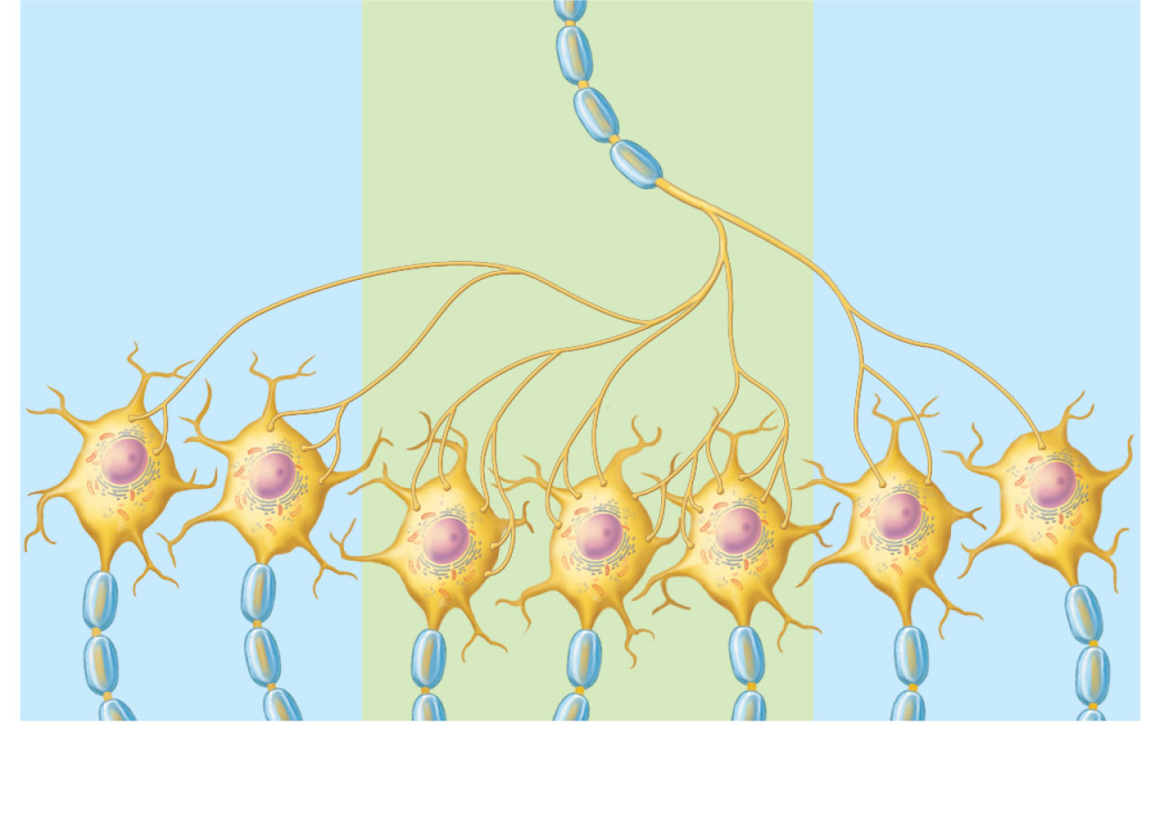
Presynaptic
(input) fiber
Facilitated zone
Discharge zone
Facilitated zone
Figure 11.21

Slide 72
Types of Circuits in Neuronal Pools
Diverging circuit
  One incoming fiber stimulates an ever-increasing number of fibers, often amplifying circuits
  May affect a single pathway or several
  Common in both sensory and motor systems

Slide 73
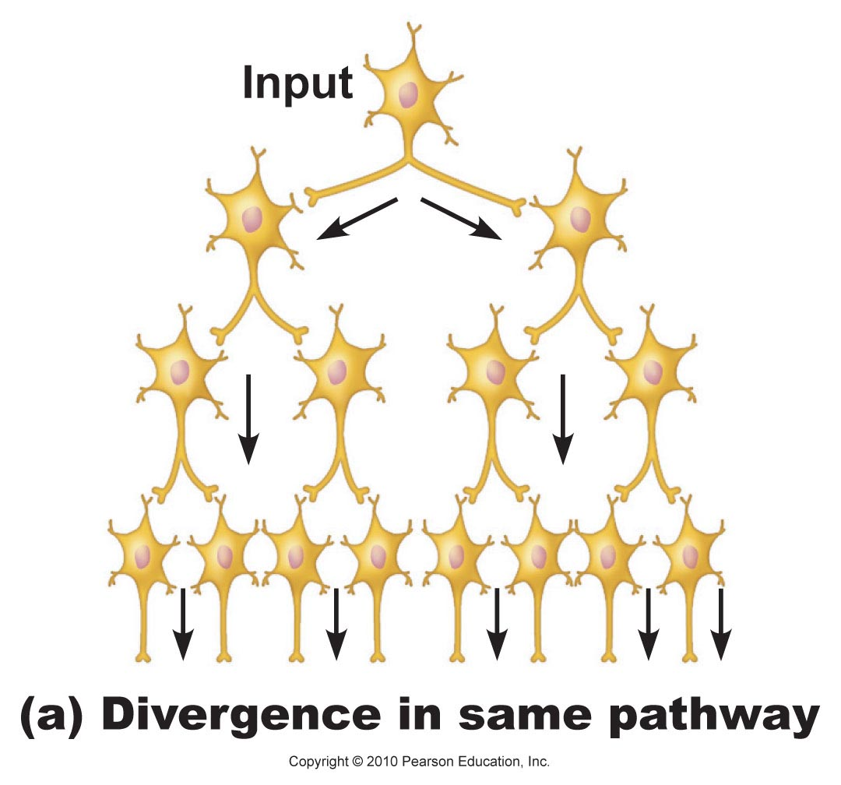
Figure 11.22a

Slide 74
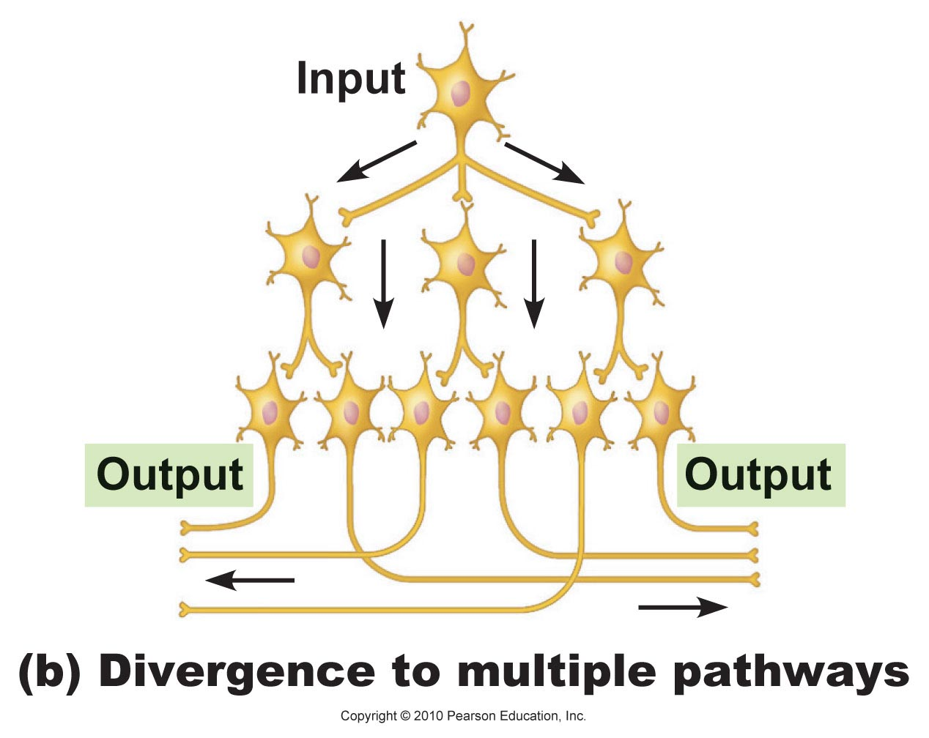
Figure 11.22b

Slide 75
Types of Circuits in Neuronal Pools
Converging circuit
  Opposite of diverging circuits, resulting in either strong stimulation or inhibition
  Also common in sensory and motor systems

Slide 76
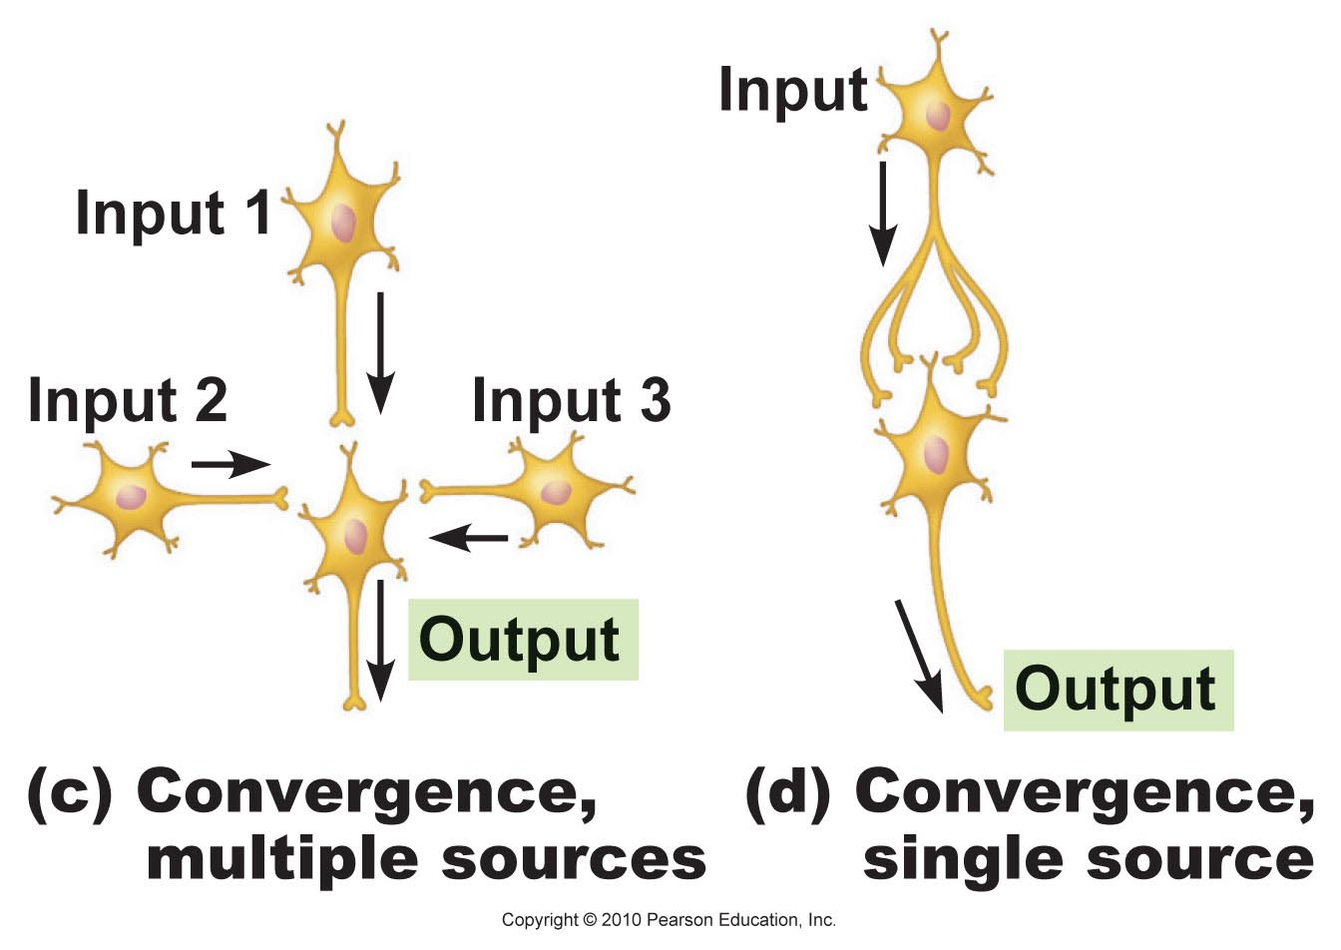
Figure 11.22c, d

Slide 77
Types of Circuits in Neuronal Pools
Reverberating (oscillating) circuit
  Chain of neurons containing collateral synapses with previous neurons in the chain

Slide 78
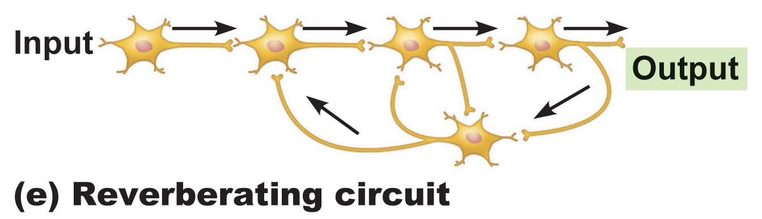
Figure 11.22e

Slide 79
Types of Circuits in Neuronal Pools
Parallel after-discharge circuit
  Incoming fiber stimulates several neurons in parallel arrays to stimulate a common output cell

Slide 80
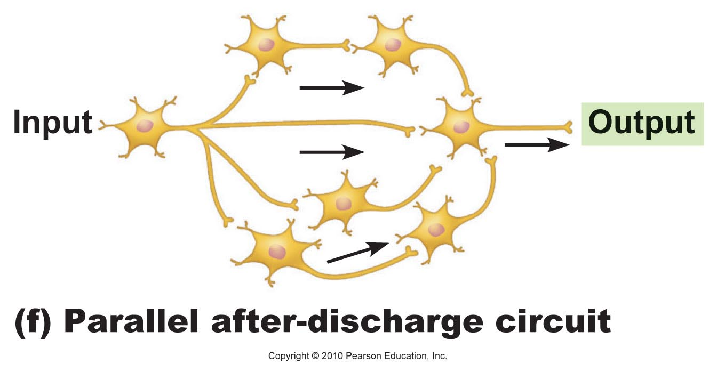
Figure 11.22f

Slide 81
Patterns of Neural Processing
Serial processing
  Input travels along one pathway to a specific destination
  Works in an all-or-none manner to produce a specific response

Slide 82
Patterns of Neural Processing
Serial processing
  Example: reflexes—rapid, automatic responses to stimuli that always cause the same response
  Reflex arcs (pathways) have five essential components: receptor, sensory neuron, CNS integration center, motor neuron, and effector

Slide 83
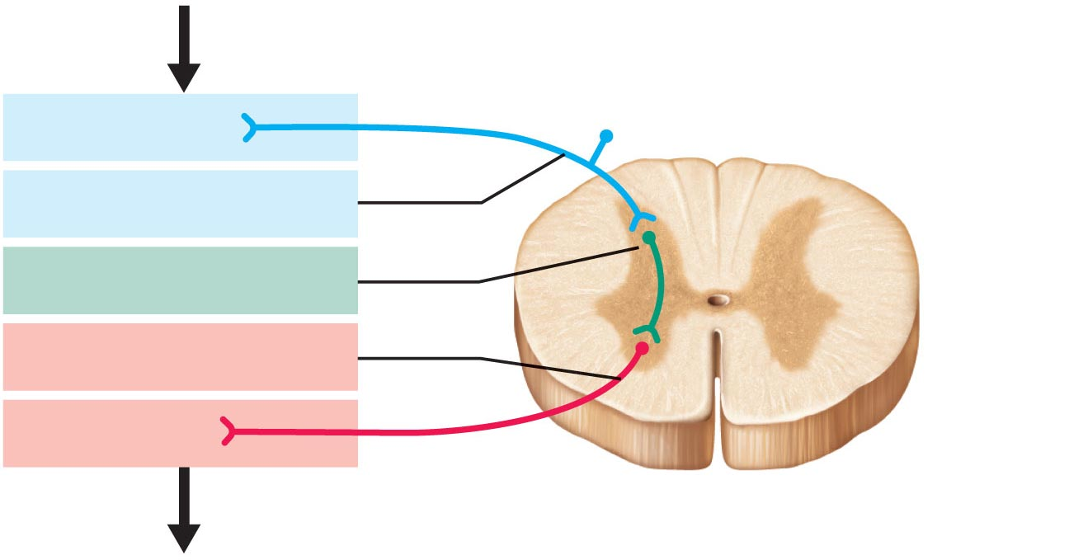
Stimulus
1
Receptor
Interneuron
2
Sensory neuron
3
Integration center
4
Motor neuron
5
Effector
Spinal cord (CNS)
Response
Figure 11.23

Slide 84
Patterns of Neural Processing
Parallel processing
  Input travels along several pathways
  One stimulus promotes numerous responses
  Important for higher-level mental functioning
Example: a smell may remind one of the odor and associated experiences

Slide 85
Developmental Aspects of Neurons
The nervous system originates from the neural tube and neural crest formed from ectoderm
The neural tube becomes the CNS
  Neuroepithelial cells of the neural tube undergo differentiation to form cells needed for development
  Cells (neuroblasts) become amitotic and migrate
  Neuroblasts sprout axons to connect with targets and become neurons

Slide 86
Axonal Growth
Growth cone at tip of axon interacts with its environment via:
  Cell surface adhesion proteins (laminin, integrin, and nerve cell adhesion molecules or N-CAMs)
  Neurotropins that attract or repel the growth cone
  Nerve growth factor (NGF), which keeps the neuroblast alive
Astrocytes provide physical support and cholesterol essential for construction of synapses

Slide 87
Cell Death
About 2/3 of neurons die before birth
  Death results in cells that fail to make functional synaptic contacts
  Many cells also die due to apoptosis (programmed cell death) during development

