Slide 1
12
The Spinal Cord
Mike Clark,MD

Slide 2
The Spinal Cord: Embryonic Development
By week 6, there are two clusters of neuroblasts
  Alar plate—will become interneurons; axons form white matter of cord
  Basal plate—will become motor neurons; axons will grow to effectors
Neural crest cells form the dorsal root ganglia sensory neurons; axons grow into the dorsal aspect of the cord

Slide 3
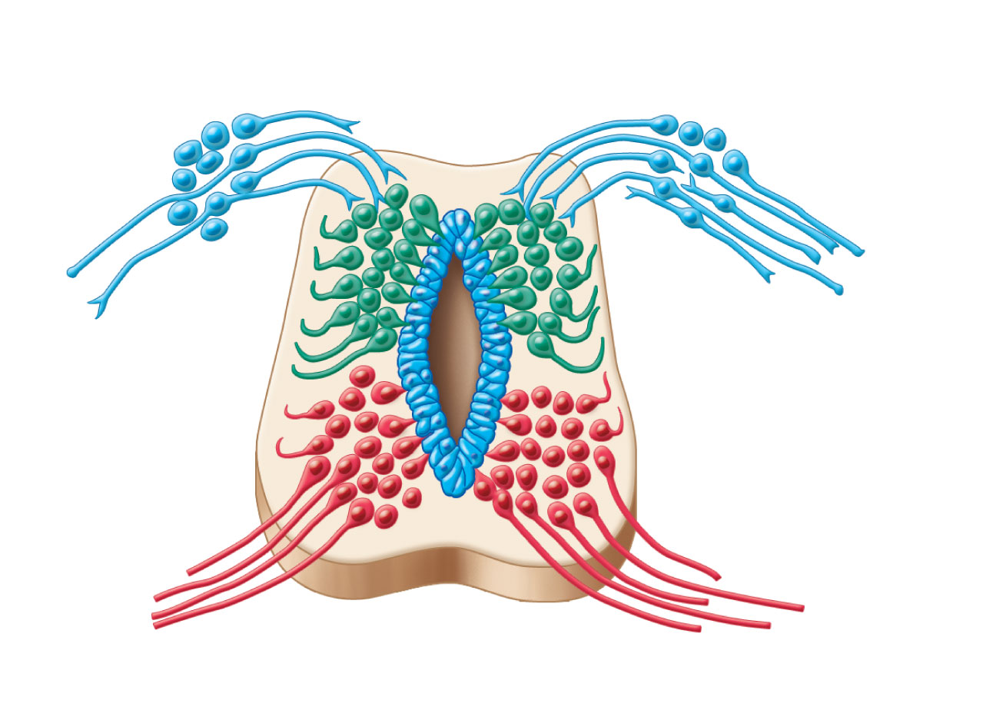
Dorsal root ganglion: sensory
neurons from neural crest
Alar plate:
interneurons
White
matter
Basal plate:
motor neurons
Neural tube
cells
Central
cavity
Figure 12.28

Slide 4
Spinal Cord
Location
  Begins at the foramen magnum
  Ends as conus medullaris at L₁ vertebra
Functions
  Provides two-way communication to and from the brain
  Contains spinal reflex centers

Slide 5
Spinal Cord: Protection
Bone, meninges, and CSF
Cushion of fat and a network of veins in the epidural space between the vertebrae and spinal dura mater
CSF in subarachnoid space

Slide 6
Spinal Cord: Protection
Denticulate ligaments: extensions of pia mater that secure cord to dura mater
Filum terminale: fibrous extension from conus medullaris; anchors the spinal cord to the coccyx

Slide 7
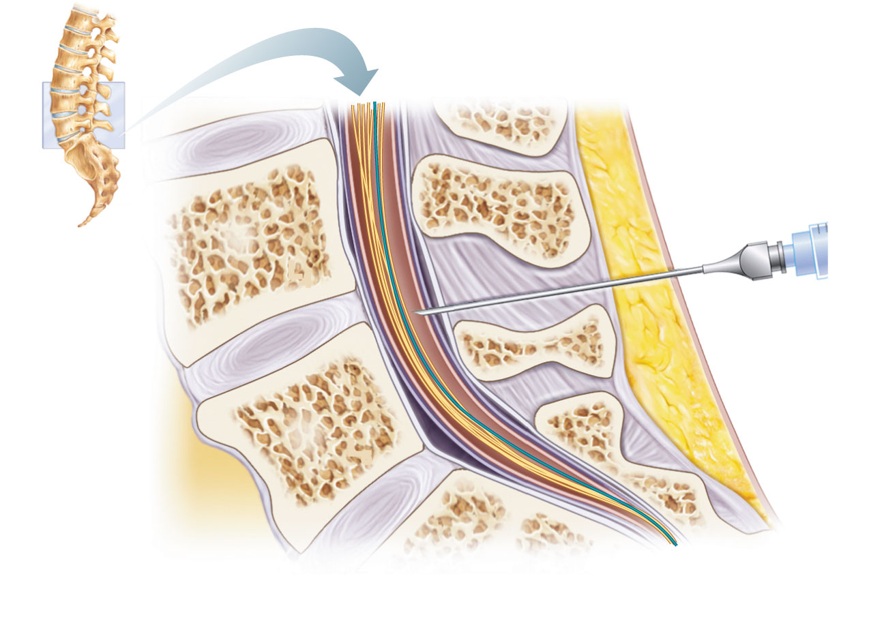
T₁₂
Ligamentum
flavum
L₅
Lumbar puncture
needle entering
subarachnoid
space
L₄
Supra-
spinous
ligament
L₅
Filum
terminale
S₁
Inter-
vertebral
disc
Cauda equina
in subarachnoid
space
Arachnoid
matter
Dura
mater
Figure 12.30

Slide 8
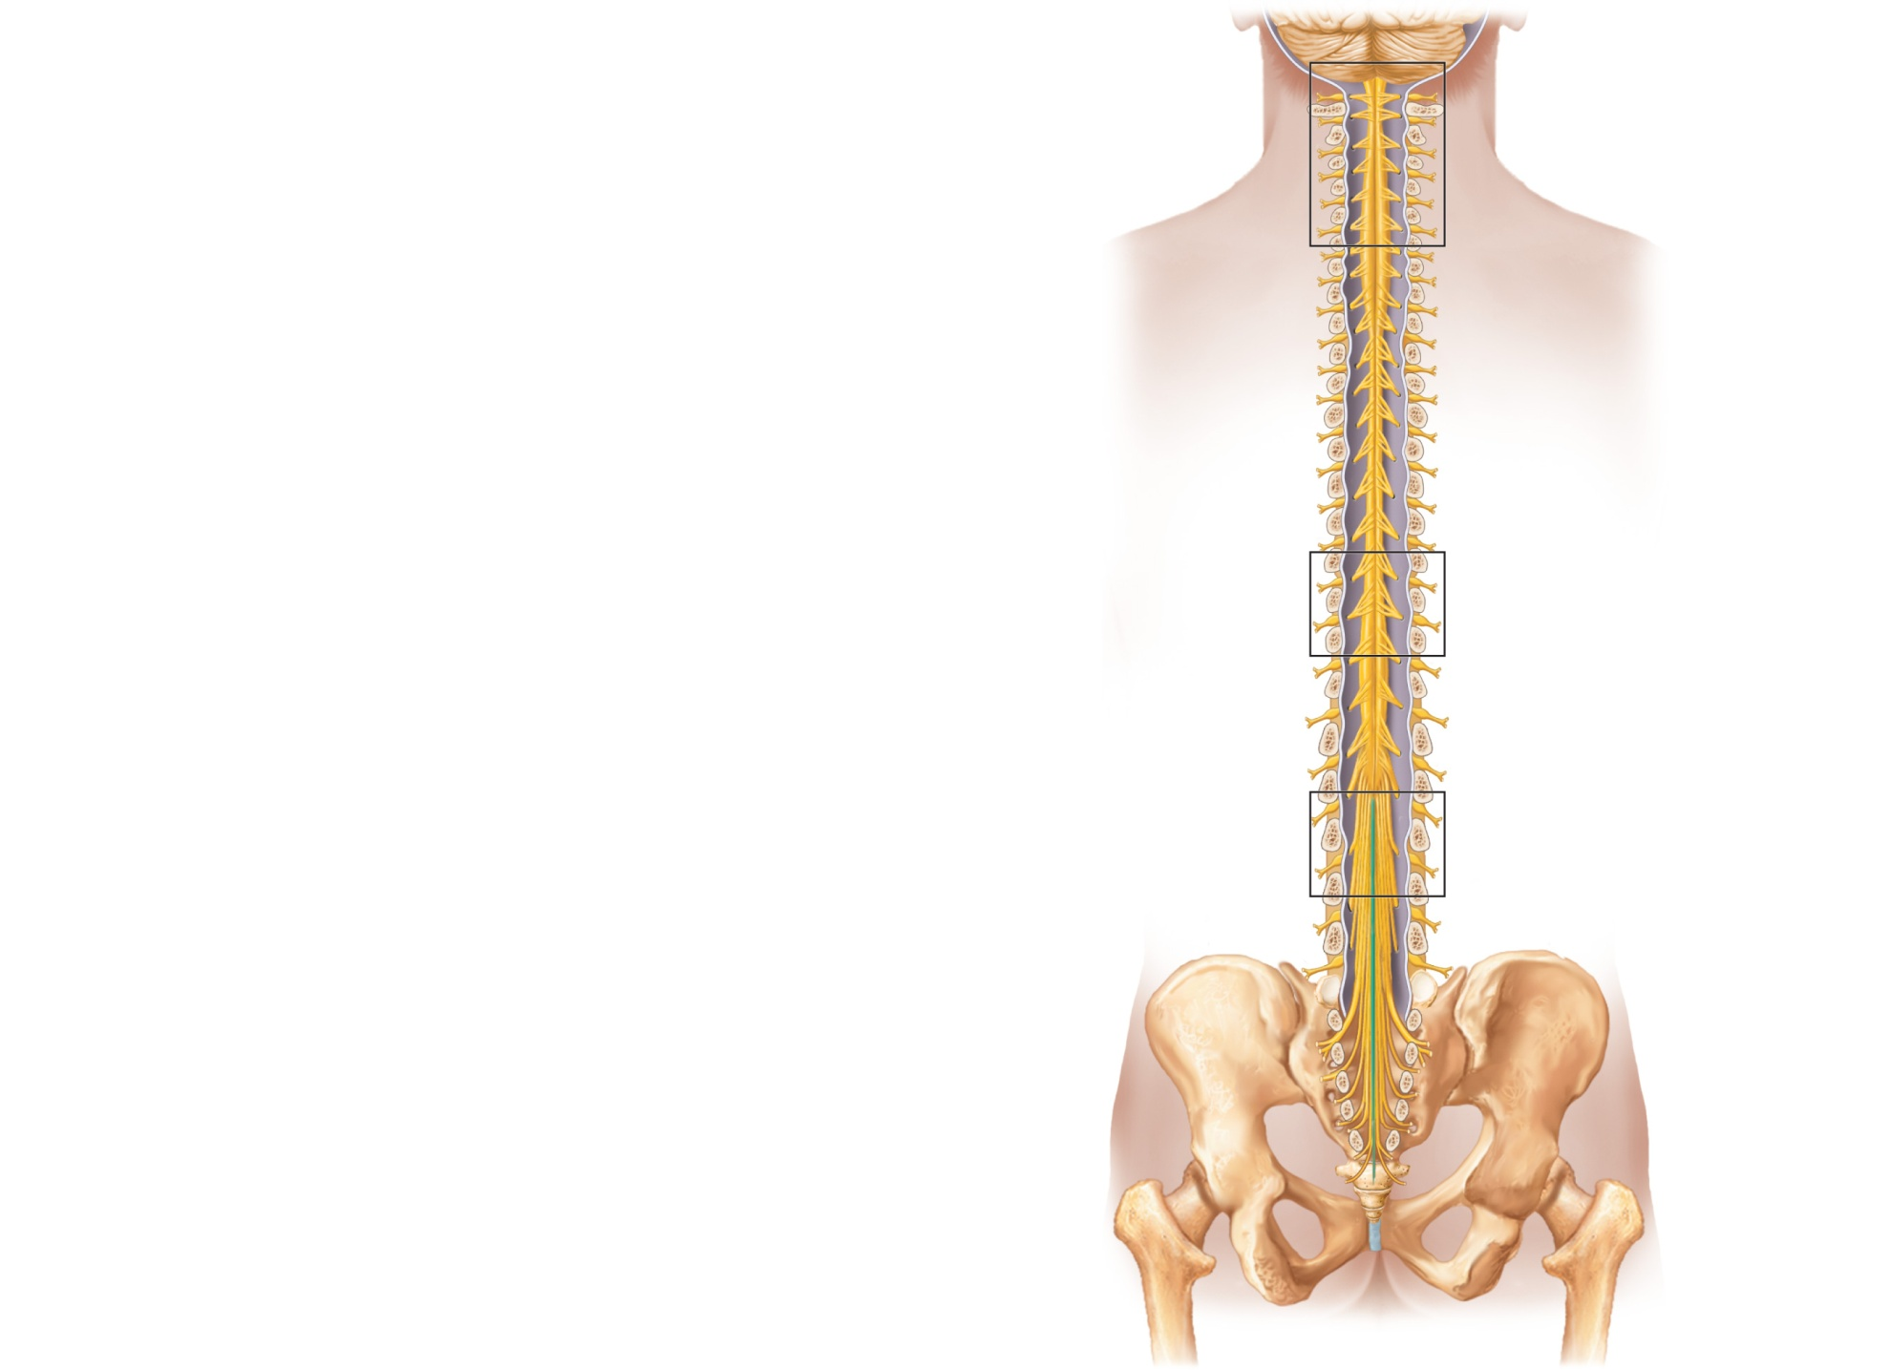
Cervical
spinal nerves
Cervical
enlargement
Dura and
arachnoid
mater
Thoracic
spinal nerves
Lumbar
enlargement
Conus
medullaris
Cauda
equina
Lumbar
spinal nerves
Filum
terminale
(a) The spinal cord and its nerve
roots, with the bony vertebral
arches removed. The dura mater
and arachnoid mater are cut
open and reflected laterally.
Sacral
spinal nerves
Figure 12.29a

Slide 9
Spinal Cord
Spinal nerves
  31 pairs
Cervical and lumbar enlargements
  The nerves serving the upper and lower limbs emerge here
Cauda equina
  The collection of nerve roots at the inferior end of the vertebral canal

Slide 10
Cross-Sectional Anatomy
Two lengthwise grooves divide cord into right and left halves
  Ventral (anterior) median fissure
  Dorsal (posterior) median sulcus
Gray commissure—connects masses of gray matter; encloses central canal

Slide 11
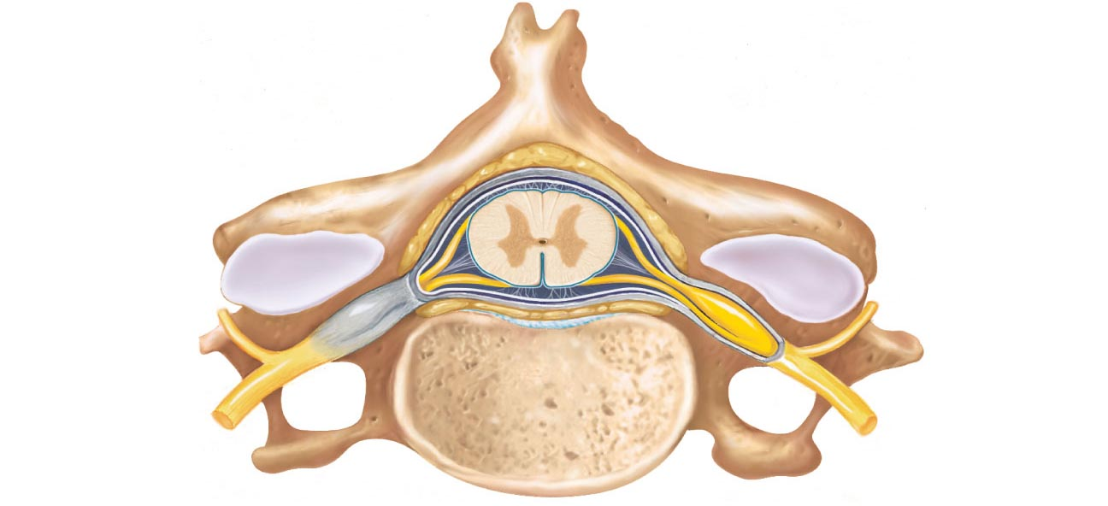
Epidural space
(contains fat)
Pia mater
Arachnoid
mater
Spinal
meninges
Subdural space
Dura mater
Subarachnoid
space
(contains CSF)
Bone of
vertebra
Dorsal root
ganglion
Body
of vertebra
(a) Cross section of spinal cord and vertebra
Figure 12.31a

Slide 12
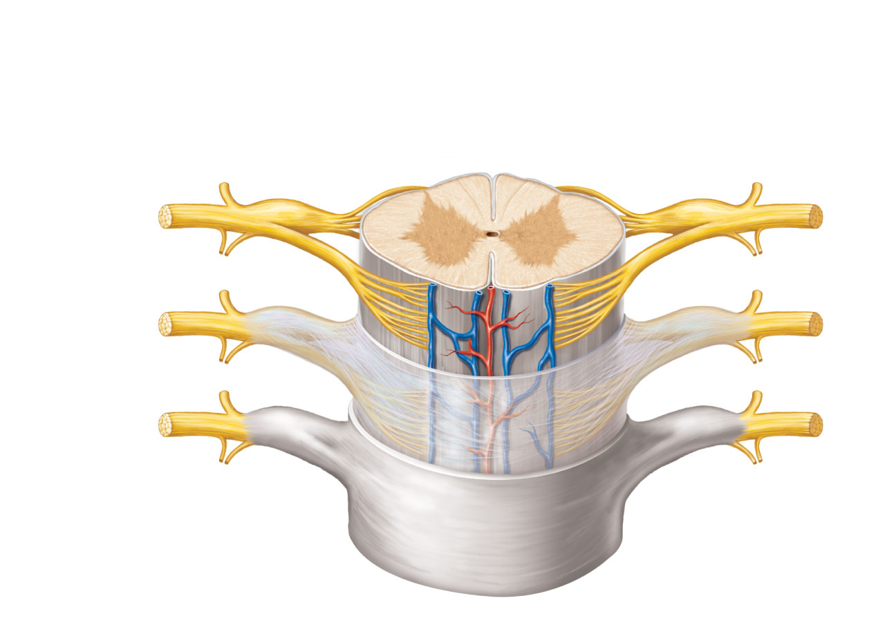
Dorsal median sulcus
Gray
commissure
Dorsal funiculus
White
columns
Ventral funiculus
Dorsal horn
Gray
matter
Ventral horn
Lateral funiculus
Lateral horn
Dorsal root
ganglion
Spinal nerve
Central canal
Dorsal root
(fans out into
dorsal rootlets)
Ventral median
fissure
Ventral root
(derived from several
ventral rootlets)
Pia mater
Arachnoid mater
Spinal dura mater
(b) The spinal cord and its meningeal coverings
Figure 12.31b

Slide 13
Gray Matter
Dorsal horns—interneurons that receive somatic and visceral sensory input
Ventral horns—somatic motor neurons whose axons exit the cord via ventral roots
Lateral horns (only in thoracic and lumbar regions) –sympathetic neurons
Dorsal root (spinal) gangia—contain cell bodies of sensory neurons

Slide 14
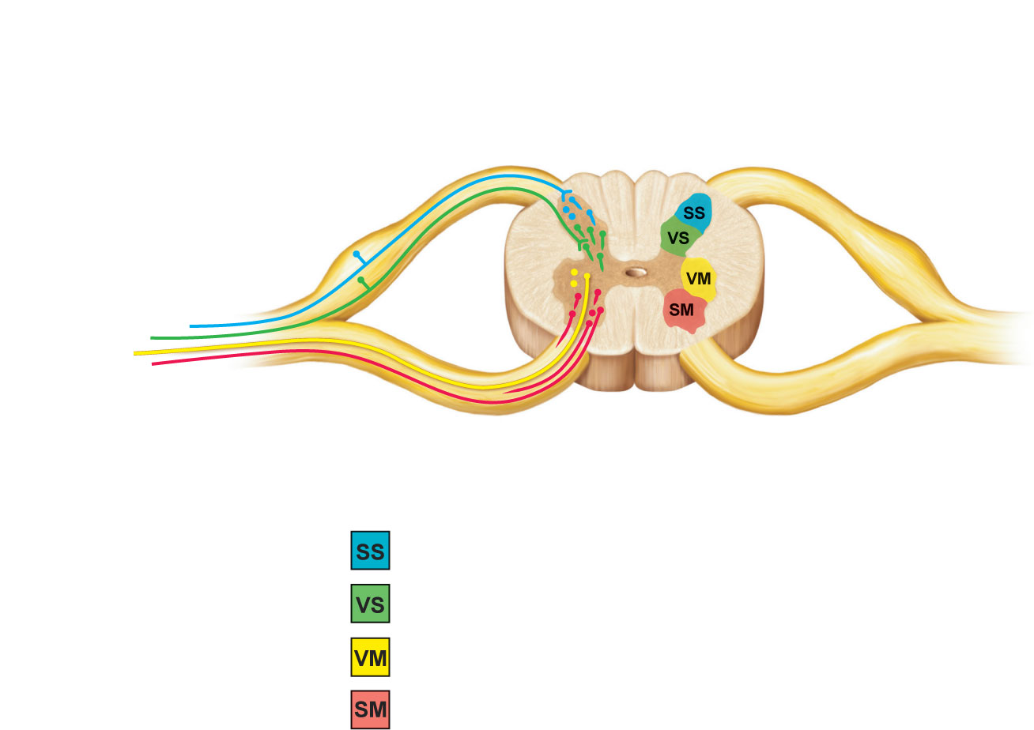
Dorsal root (sensory)
Dorsal root ganglion
Dorsal horn (interneurons)
Somatic
sensory
neuron
Visceral
sensory
neuron
Visceral
motor
neuron
Spinal nerve
Ventral horn
(motor neurons)
Ventral root
(motor)
Somatic
motor neuron
Interneurons receiving input from somatic sensory neurons
Interneurons receiving input from visceral sensory neurons
Visceral motor (autonomic) neurons
Somatic motor neurons
Figure 12.32

Slide 15
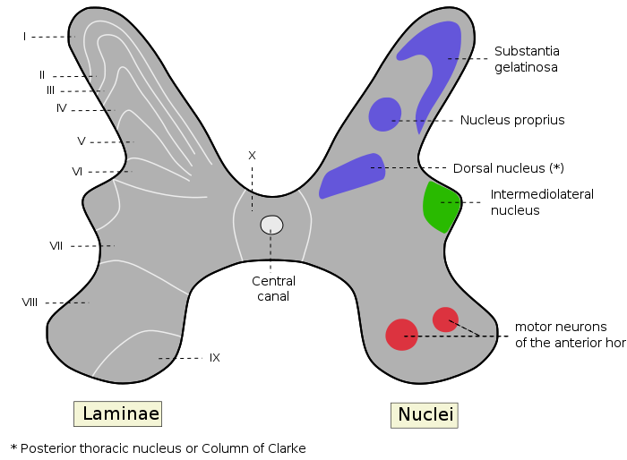

Slide 16
White Matter
Consists mostly of ascending (sensory) and descending (motor) tracts
Transverse tracts (commissural fibers) cross from one side to the other
Tracts are located in three white columns (funiculi on each side—dorsal (posterior), lateral, and ventral (anterior)
Each spinal tract is composed of axons with similar functions

Slide 17
Pathway Generalizations
Pathways decussate (cross over)
Most consist of two or three neurons (a relay)
Most exhibit somatotopy (precise spatial relationships)
Pathways are paired symmetrically (one on each side of the spinal cord or brain)

Slide 18
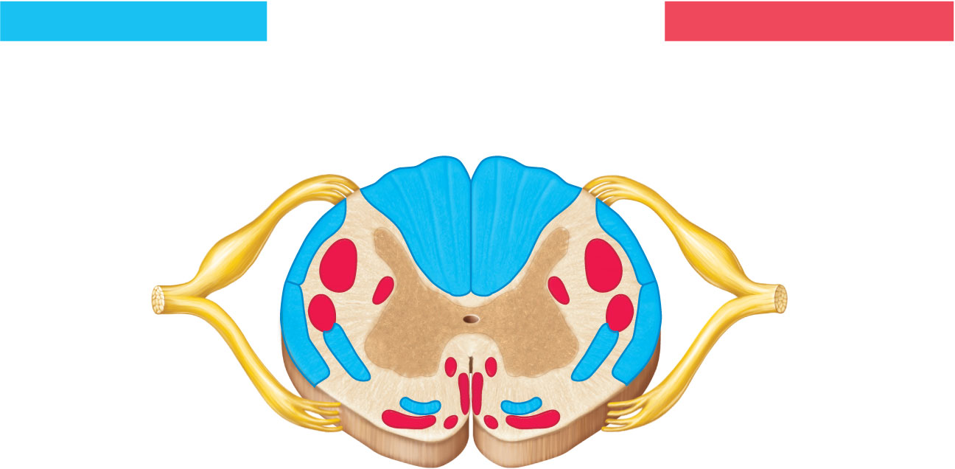
Ascending tracts
Descending tracts
Fasciculus gracilis
Ventral white
commissure
Dorsal
white
column
Fasciculus cuneatus
Lateral
reticulospinal tract
Dorsal
spinocerebellar
tract
Lateral
corticospinal tract
Rubrospinal
tract
Ventral
spinocerebellar
tract
Medial
reticulospinal
tract
Lateral
spinothalamic tract
Ventral corticospinal
tract
Ventral spinothalamic
tract
Vestibulospinal tract
Tectospinal tract
Figure 12.33

Slide 19
Ascending Pathways
Consist of three neurons
First-order neuron
  Conducts impulses from cutaneous receptors and proprioceptors
  Branches diffusely as it enters the spinal cord or medulla
  Synapses with second-order neuron

Slide 20
Ascending Pathways
Second-order neuron
  Interneuron
  Cell body in dorsal horn of spinal cord or medullary nuclei
  Axons extend to thalamus or cerebellum

Slide 21
Ascending Pathways
Third-order neuron
  Interneuron
  Cell body in thalamus
  Axon extends to somatosensory cortex

Slide 22
Ascending Pathways
Two pathways transmit somatosensory information to the sensory cortex via the thalamus
  Dorsal column-medial lemniscal pathways
  Spinothalamic pathways
Spinocerebellar tracts terminate in the cerebellum

Slide 23
Dorsal Column-Medial Lemniscal Pathways
Transmit input to the somatosensory cortex for discriminative touch and vibrations
Composed of the paired fasciculus cuneatus and fasciculus gracilis in the spinal cord and the medial lemniscus in the brain (medulla to thalamus)

Slide 24
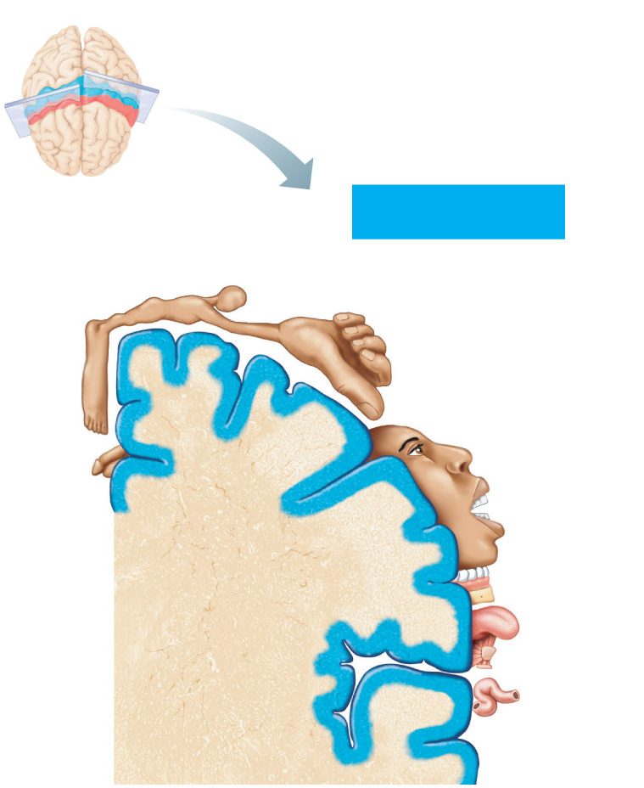
Posterior
Sensory
Anterior
Sensory map in
postcentral gyrus
Genitals
Primary somato-
sensory cortex
(postcentral gyrus)
Intra-
abdominal
Figure 12.9

Slide 25
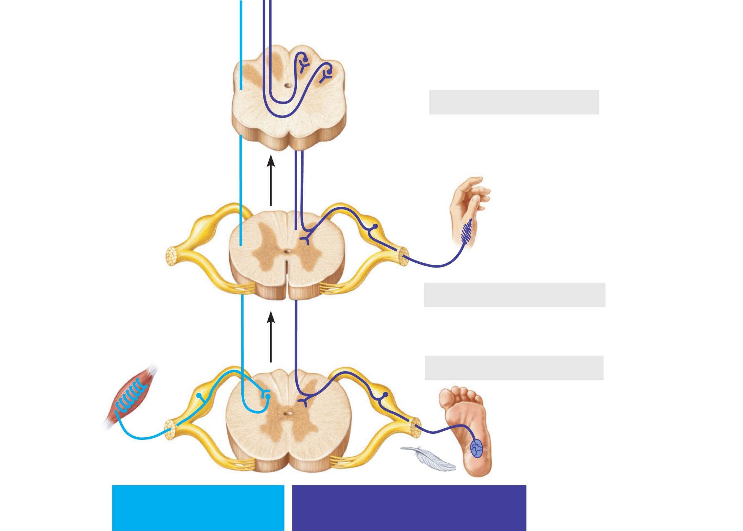
Dorsal
spinocerebellar
tract (axons of
second-order
neurons)
Medial lemniscus (tract)
(axons of second-order neurons)
Nucleus gracilis
Nucleus cuneatus
Medulla oblongata
Fasciculus cuneatus
(axon of first-order sensory neuron)
Joint stretch
receptor
(proprioceptor)
Axon of
first-order
neuron
Cervical spinal cord
Fasciculus gracilis
(axon of first-order sensory neuron)
Muscle spindle
(proprioceptor)
Lumbar spinal cord
Touch
receptor
(a)
Spinocerebellar
pathway
Dorsal column–medial
lemniscal pathway
Figure 12.34a (2 of 2)

Slide 26
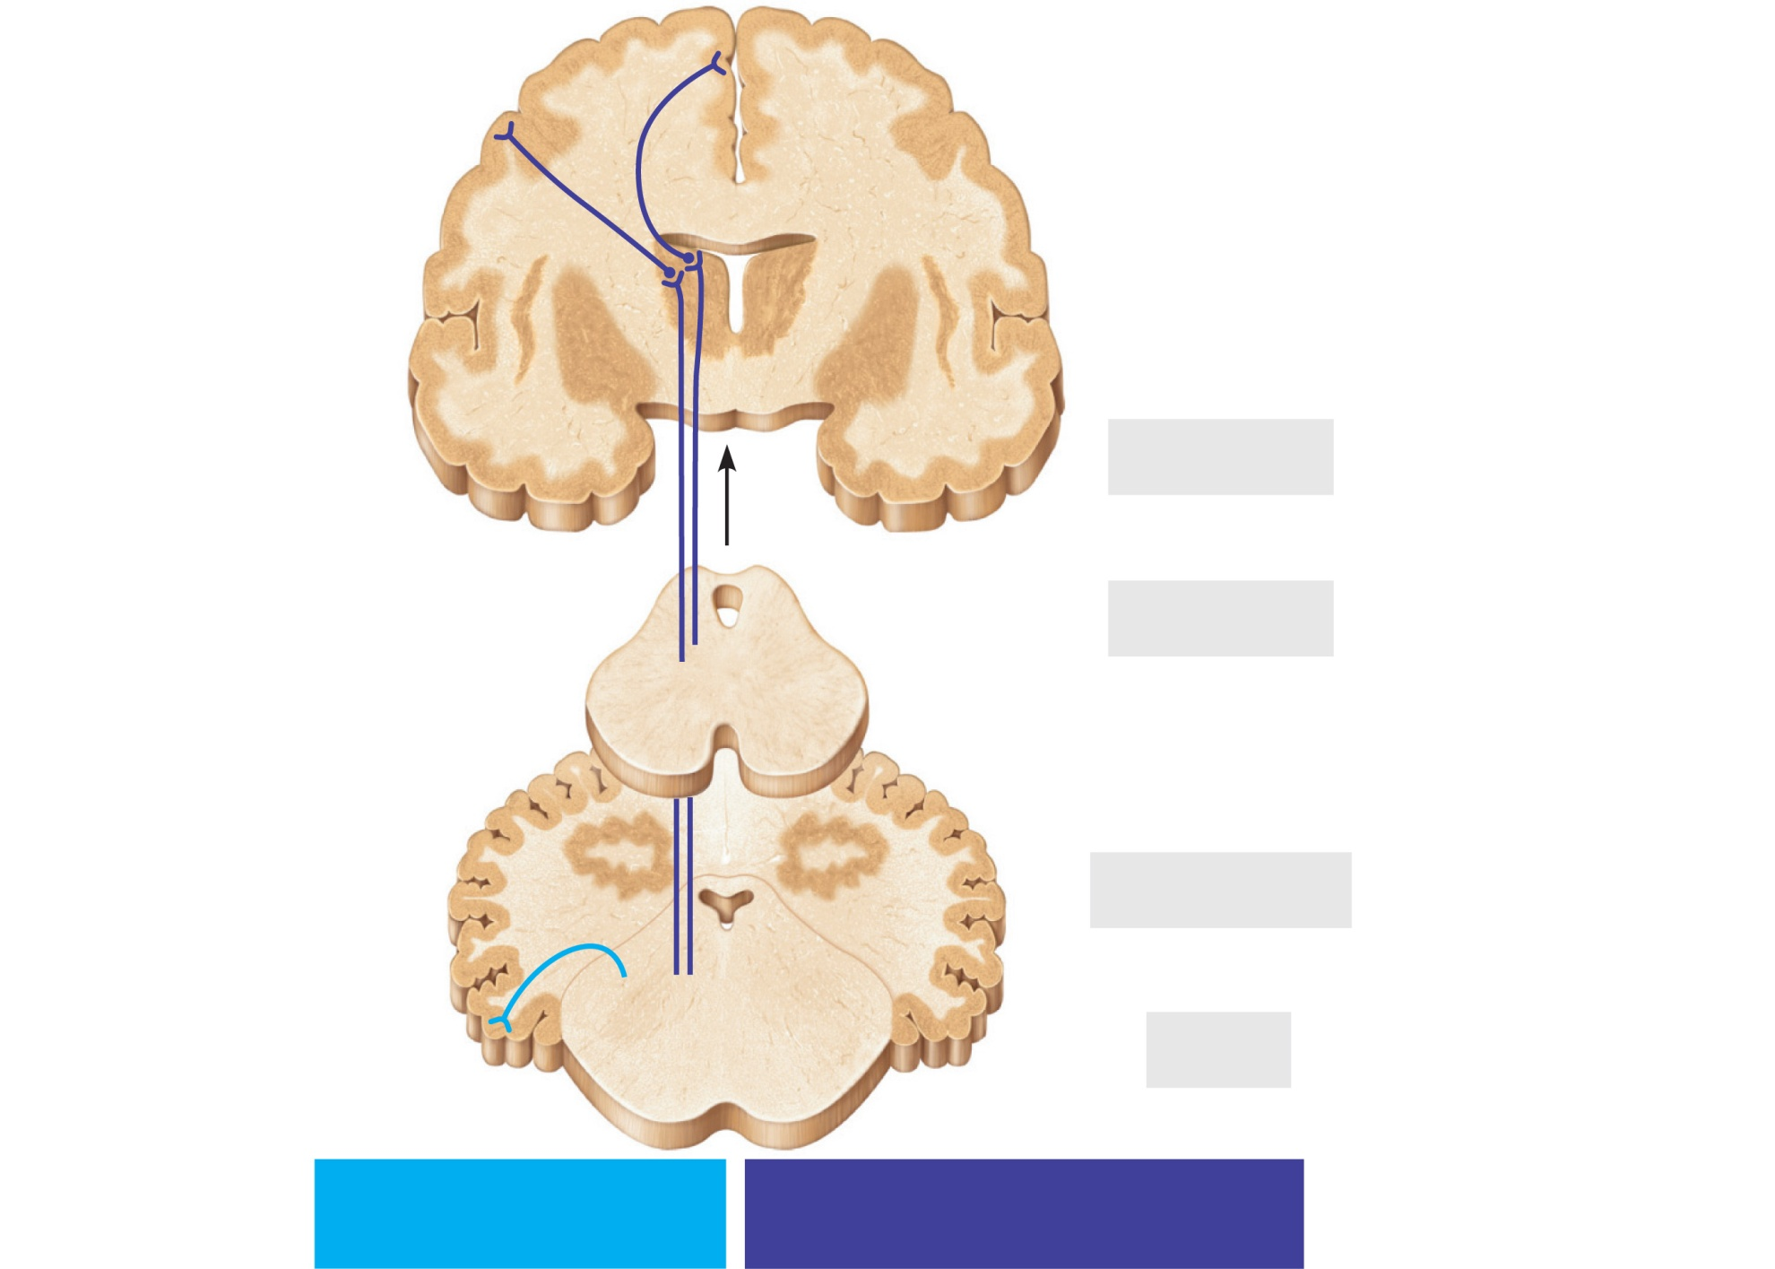
Primary
somatosensory
cortex
Axons of third-order
neurons
Thalamus
Cerebrum
Midbrain
Cerebellum
Pons
(a)
Spinocerebellar
pathway
Dorsal column–medial
lemniscal pathway
Figure 12.34a (1 of 2)

Slide 27
Anterolateral Pathways
Lateral and ventral spinothalamic tracts
Transmit pain, temperature, and coarse touch impulses within the lateral spinothalamic tract

Slide 28
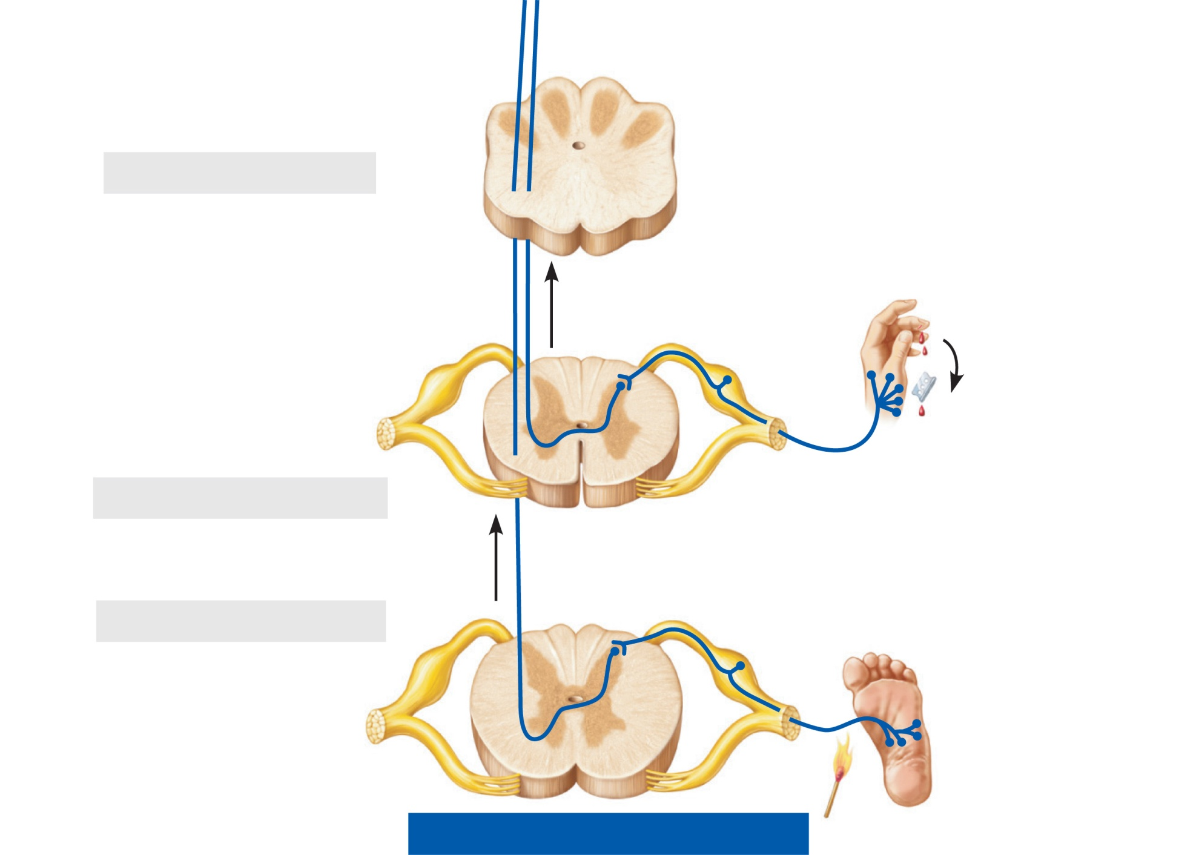
Lateral
spinothalamic
tract (axons of
second-order
neurons)
Medulla oblongata
Pain receptors
Cervical spinal cord
Axons of first-order
neurons
Temperature
receptors
Lumbar spinal cord
(b)
Spinothalamic pathway
Figure 12.34b (2 of 2)

Slide 29
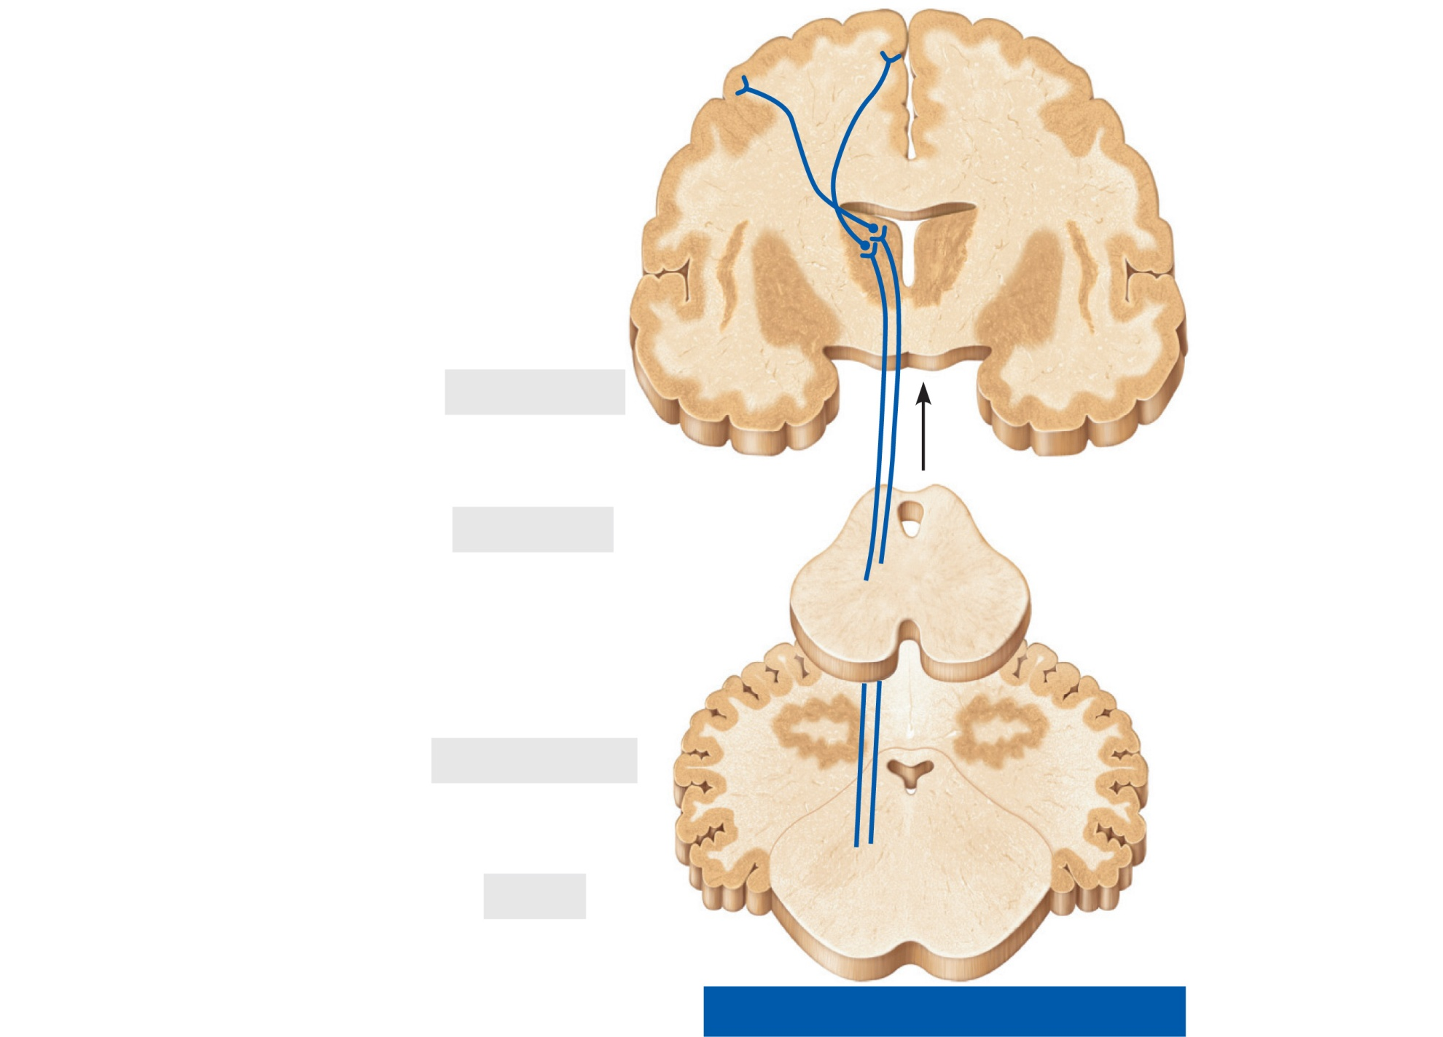
Primary
somatosensory
cortex
Axons of third-order
neurons
Thalamus
Cerebrum
Midbrain
Cerebellum
Pons
(b)
Spinothalamic pathway
Figure 12.34b (1 of 2)

Slide 30
Posterior
Sensory
Anterior
Sensory map in
postcentral gyrus
Genitals
Primary somato-
sensory cortex
(postcentral gyrus)
Intra-
abdominal
Figure 12.9

Slide 31
Spinocerebellar Tracts
Ventral and dorsal tracts
Convey information about muscle or tendon stretch to the cerebellum

Slide 32
Dorsal
spinocerebellar
tract (axons of
second-order
neurons)
Medial lemniscus (tract)
(axons of second-order neurons)
Nucleus gracilis
Nucleus cuneatus
Medulla oblongata
Fasciculus cuneatus
(axon of first-order sensory neuron)
Joint stretch
receptor
(proprioceptor)
Axon of
first-order
neuron
Cervical spinal cord
Fasciculus gracilis
(axon of first-order sensory neuron)
Muscle spindle
(proprioceptor)
Lumbar spinal cord
Touch
receptor
(a)
Spinocerebellar
pathway
Dorsal column–medial
lemniscal pathway
Figure 12.34a (2 of 2)

Slide 33
Primary
somatosensory
cortex
Axons of third-order
neurons
Thalamus
Cerebrum
Midbrain
Cerebellum
Pons
(a)
Spinocerebellar
pathway
Dorsal column–medial
lemniscal pathway
Figure 12.34a (1 of 2)

Slide 34
Posterior
Sensory
Anterior
Sensory map in
postcentral gyrus
Genitals
Primary somato-
sensory cortex
(postcentral gyrus)
Intra-
abdominal
Figure 12.9

Slide 35
Descending Pathways and Tracts
Deliver efferent impulses from the brain to the spinal cord
  Direct pathways—pyramidal tracts
  Indirect pathways—all others

Slide 36
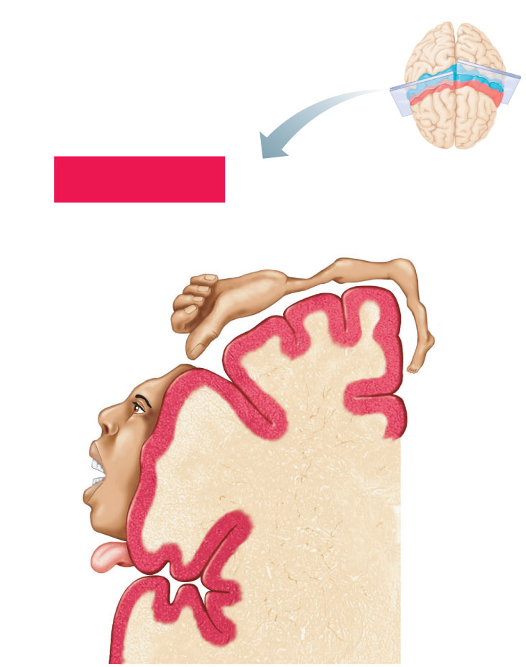
Posterior
Motor
Motor map in
precentral gyrus
Anterior
Toes
Jaw
Tongue
Primary motor
cortex
(precentral gyrus)
Swallowing
Figure 12.9

Slide 37
Descending Pathways and Tracts
Involve two neurons:
  Upper motor neurons
    Pyramidal cells in primary motor cortex
  Lower motor neurons
    Ventral horn motor neurons
    Innervate skeletal muscles

Slide 38
The Direct (Pyramidal) System
Impulses from pyramidal neurons in the precentral gyri pass through the pyramidal (corticospinal)l tracts
Axons synapse with interneurons or ventral horn motor neurons
The direct pathway regulates fast and fine (skilled) movements

Slide 39
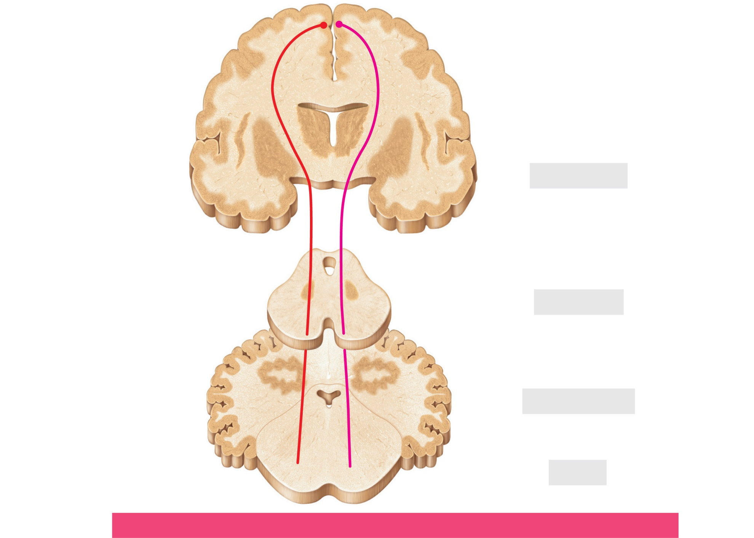
Pyramidal cells
(upper motor
neurons)
Primary motor cortex
Internal capsule
Cerebrum
Midbrain
Cerebral
peduncle
Cerebellum
Pons
(a)
Pyramidal (lateral and ventral corticospinal) pathways
Figure 12.35a (1 of 2)

Slide 40
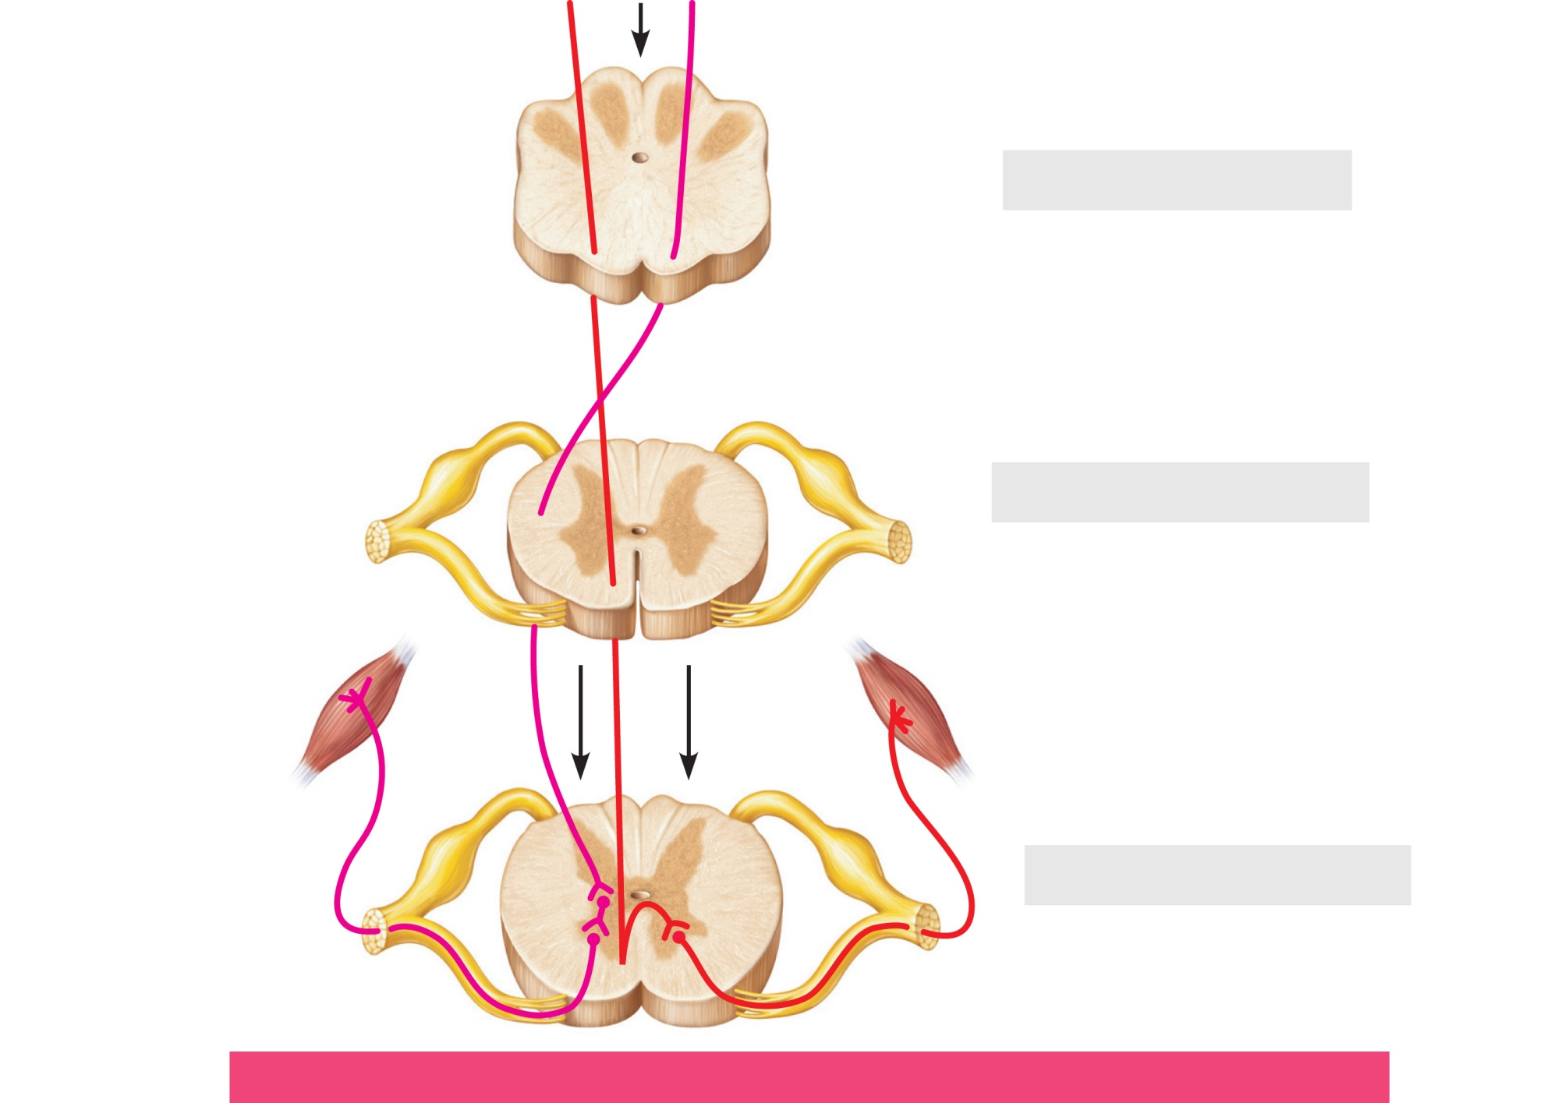
Ventral
corticospinal
tract
Medulla oblongata
Pyramids
Decussation
of pyramid
Lateral
corticospinal
tract
Cervical spinal cord
Skeletal
muscle
Lumbar spinal cord
Somatic motor neurons
(lower motor neurons)
(a)
Pyramidal (lateral and ventral corticospinal) pathways
Figure 12.35a (2 of 2)

Slide 41
Indirect (Extrapyramidal) System
Includes the brain stem motor nuclei, and all motor pathways except pyramidal pathways
Also called the multineuronal pathways

Slide 42
Indirect (Extrapyramidal) System
These pathways are complex and multisynaptic, and regulate:
  Axial muscles that maintain balance and posture
  Muscles controlling coarse movements
  Head, neck, and eye movements that follow objects

Slide 43
Indirect (Extrapyramidal) System
Reticulospinal and vestibulospinal tracts—maintain balance
Rubrospinal tracts—control flexor muscles
Superior colliculi and tectospinal tracts mediate head movements in response to visual stimuli

Slide 44
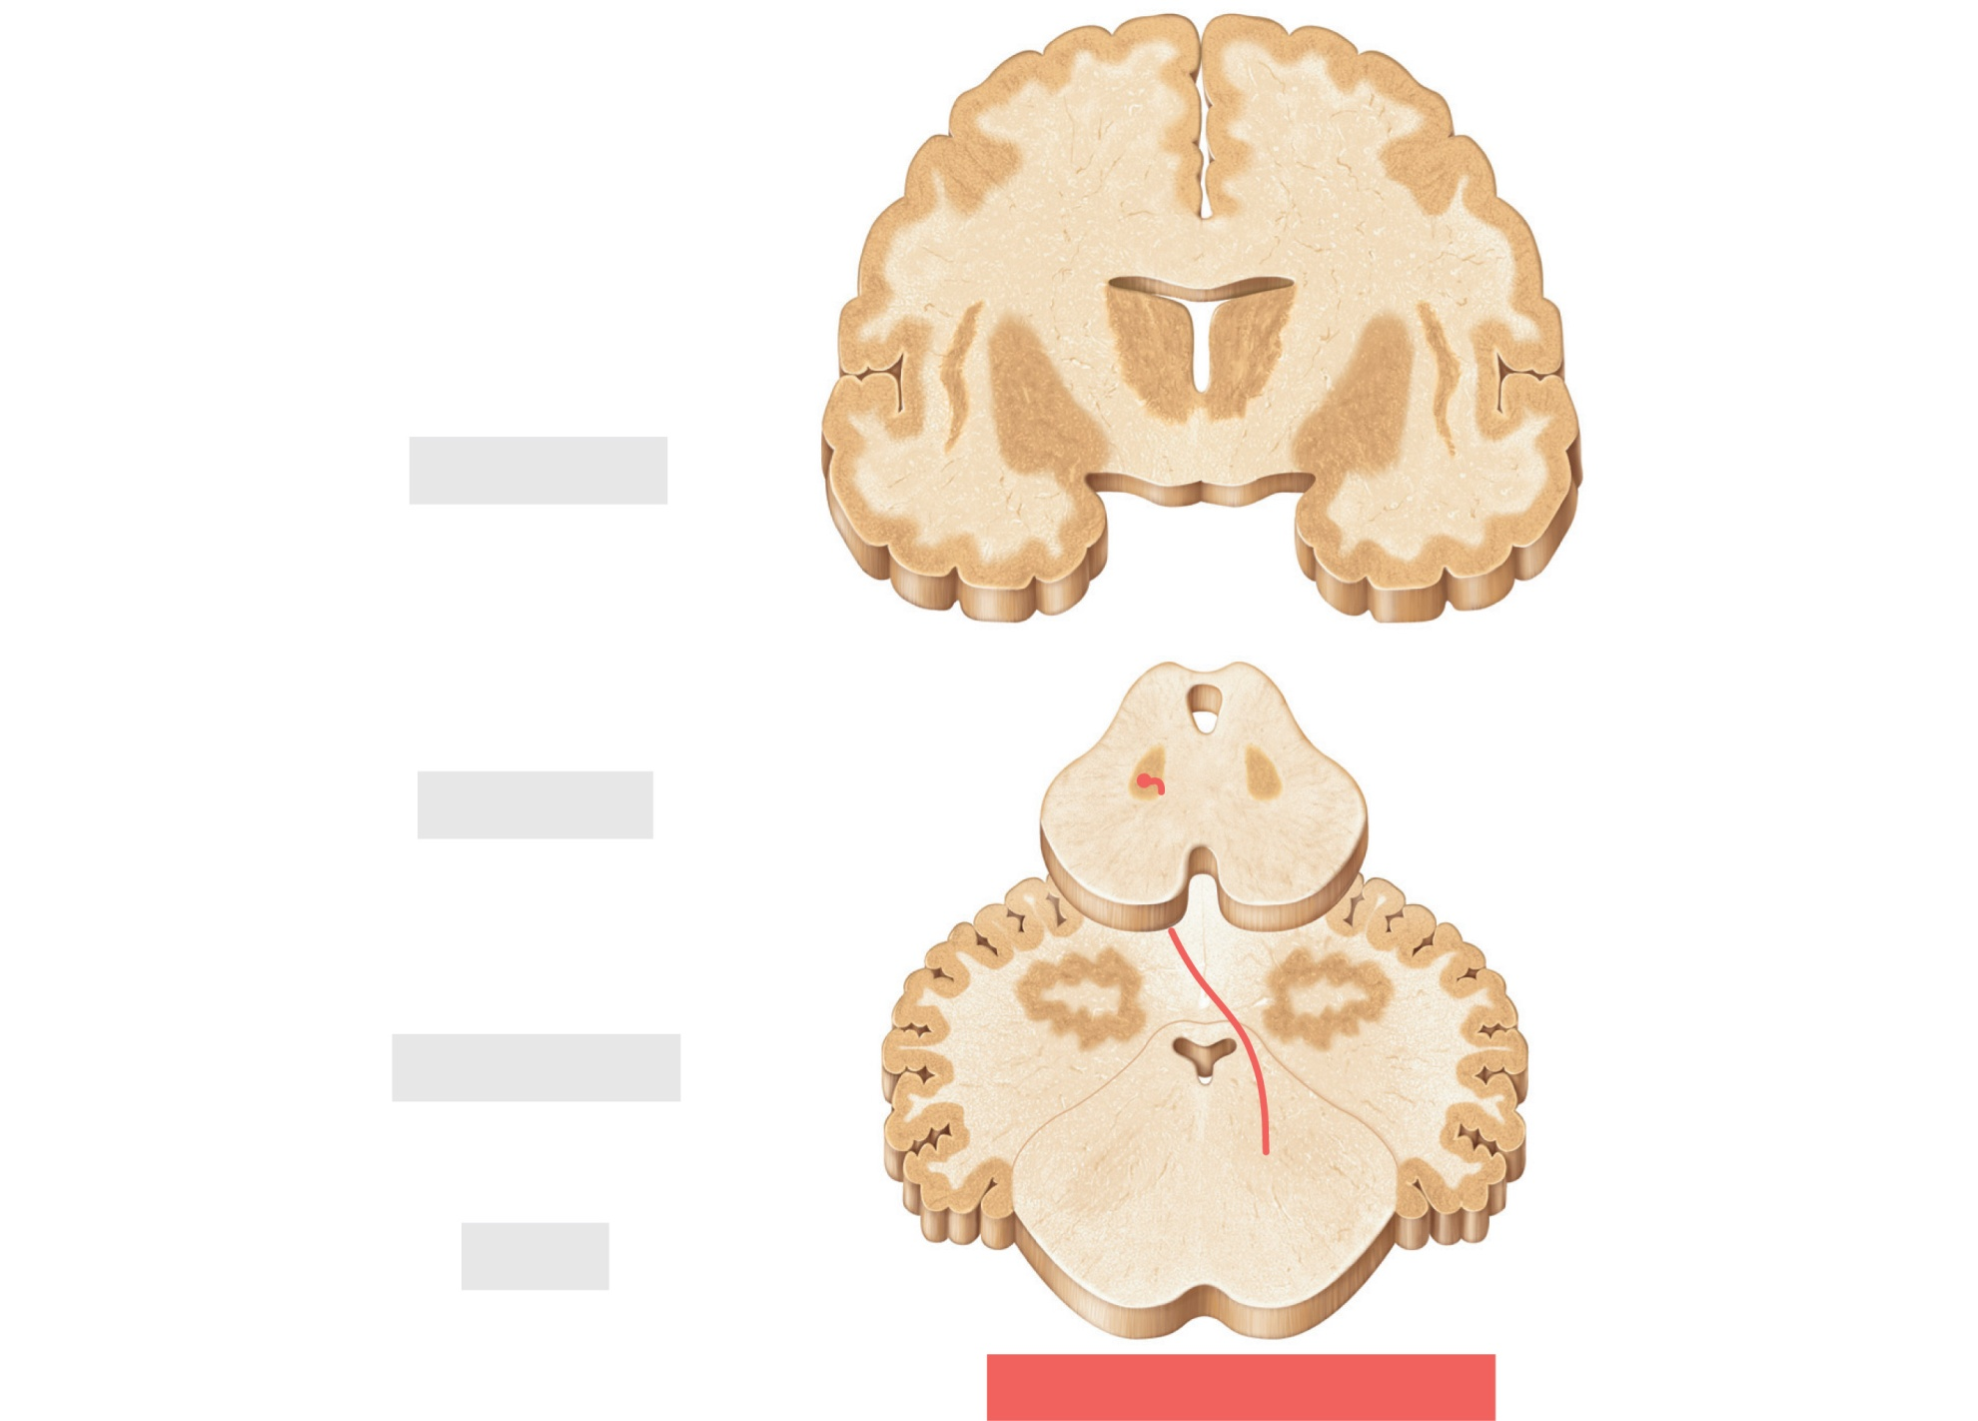
Cerebrum
Red nucleus
Midbrain
Cerebellum
Pons
(b)
Rubrospinal tract
Figure 12.35b (1 of 2)

Slide 45
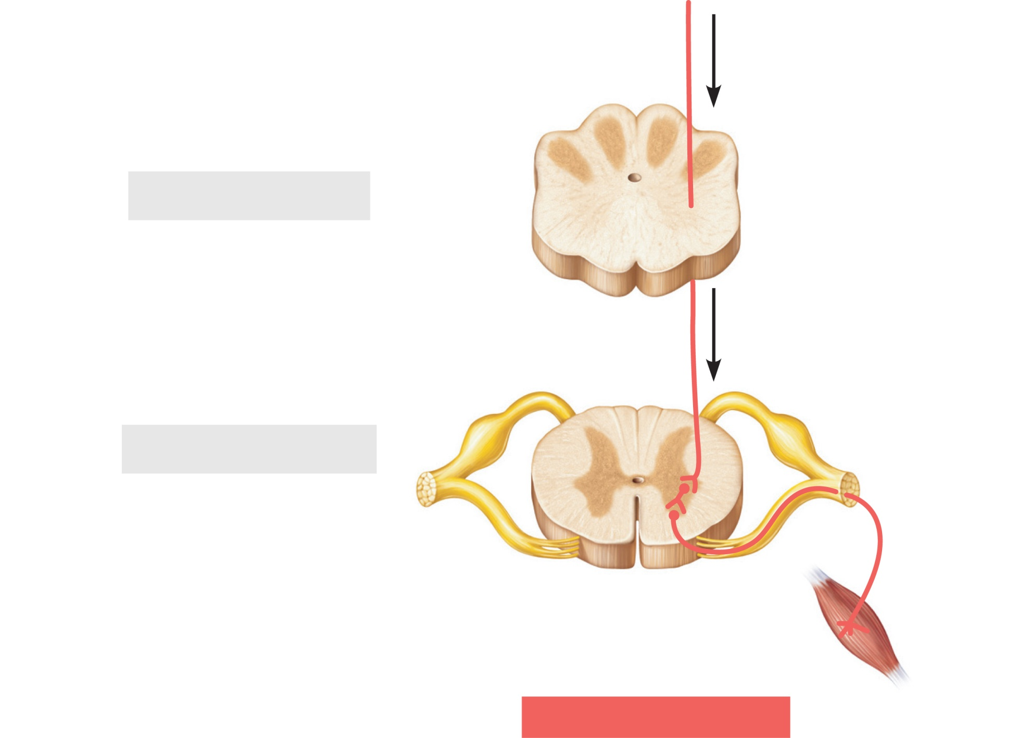
Rubrospinal tract
Medulla oblongata
Cervical spinal cord
(b)
Rubrospinal tract
Figure 12.35b (2 of 2)

Slide 46
Spinal Cord Trauma
Functional losses
  Parasthesias
    Sensory loss
  Paralysis
    Loss of motor function

Slide 47
Spinal Cord Trauma
Flaccid paralysis—severe damage to the ventral root or ventral horn cells
  Impulses do not reach muscles; there is no voluntary or involuntary control of muscles
  Muscles atrophy

Slide 48
Spinal Cord Trauma
Spastic paralysis—damage to upper motor neurons of the primary motor cortex
  Spinal neurons remain intact; muscles are stimulated by reflex activity
  No voluntary control of muscles

Slide 49
Spinal Cord Trauma
Transection
  Cross sectioning of the spinal cord at any level
  Results in total motor and sensory loss in regions inferior to the cut
  Paraplegia—transection between T₁ and L₁
  Quadriplegia—transection in the cervical region

Slide 50
Poliomyelitis
Destruction of the ventral horn motor neurons by the poliovirus
Muscles atrophy
Death may occur due to paralysis of respiratory muscles or cardiac arrest
Survivors often develop postpolio syndrome many years later, as neurons are lost

Slide 51
Amyotrophic Lateral Sclerosis (ALS)
Also called Lou Gehrig’s disease
Involves progressive destruction of ventral horn motor neurons and fibers of the pyramidal tract
Symptoms—loss of the ability to speak, swallow, and breathe
Death typically occurs within five years
Linked to glutamate excitotoxicity, attack by the immune system, or both

Slide 52
Developmental Aspects of the CNS
CNS is established during the first month of development
Gender-specific areas appear in both brain and spinal cord, depending on presence or absence of fetal testosterone
Maternal exposure to radiation, drugs (e.g., alcohol and opiates), or infection can harm the developing CNS
Smoking decreases oxygen in the blood, which can lead to neuron death and fetal brain damage

Slide 53
Developmental Aspects of the CNS
The hypothalamus is one of the last areas of the CNS to develop
Visual cortex develops slowly over the first 11 weeks
Neuromuscular coordination progresses in superior-to-inferior and proximal-to-distal directions along with myelination

Slide 54
Developmental Aspects of the CNS
Age brings some cognitive declines, but these are not significant in healthy individuals until they reach their 80s
Shrinkage of brain accelerates in old age
Excessive use of alcohol causes signs of senility unrelated to the aging process

