Slide 1
13
P A R T C
The Peripheral Nervous System (PNS)
Spinal Nerves

Slide 2
Spinal Nerves
Thirty-one pairs of mixed nerves arise from the spinal cord and supply all parts of the body except the head
They are named according to their point of issue
  8 cervical (C₁-C₈)
  12 thoracic (T₁-T₁₂)
  5 Lumbar (L₁-L₅)
  5 Sacral (S₁-S₅)
  1 Coccygeal (C₀)

Slide 3
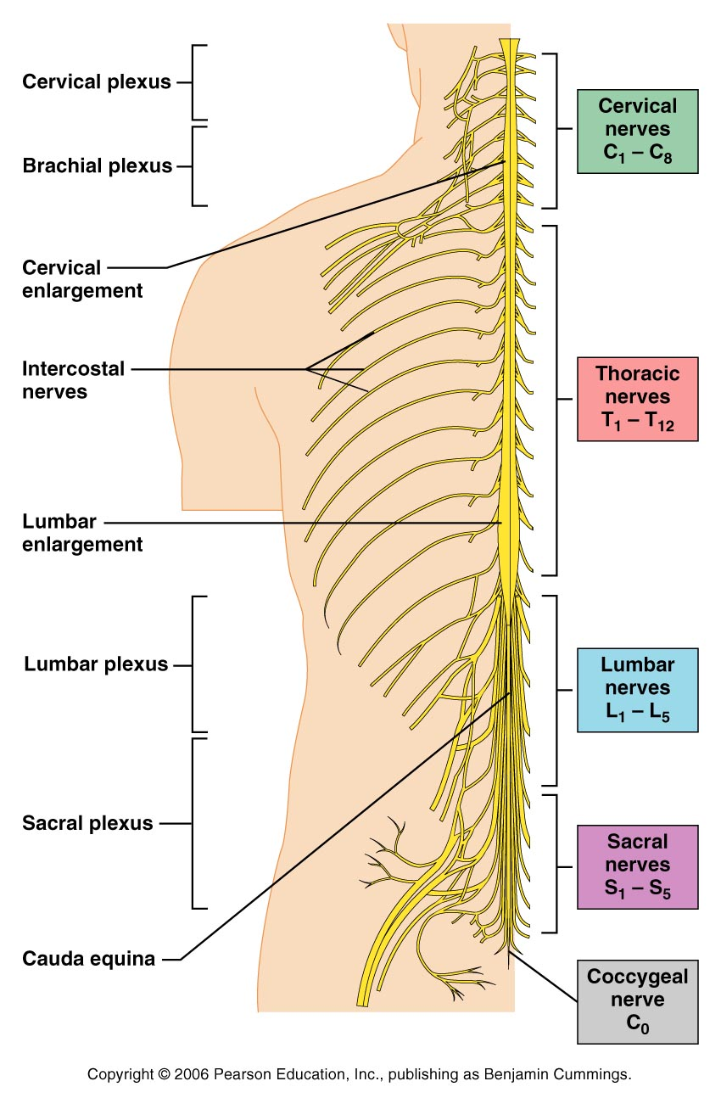
Spinal Nerves
Figure 13.6

Slide 4
Spinal Nerves: Roots
Each spinal nerve connects to the spinal cord via two medial roots
Each root forms a series of rootlets that attach to the spinal cord
Ventral roots arise from the anterior horn and contain motor (efferent) fibers
Dorsal roots arise from sensory neurons in the dorsal root ganglion and contain sensory (afferent) fibers

Slide 5
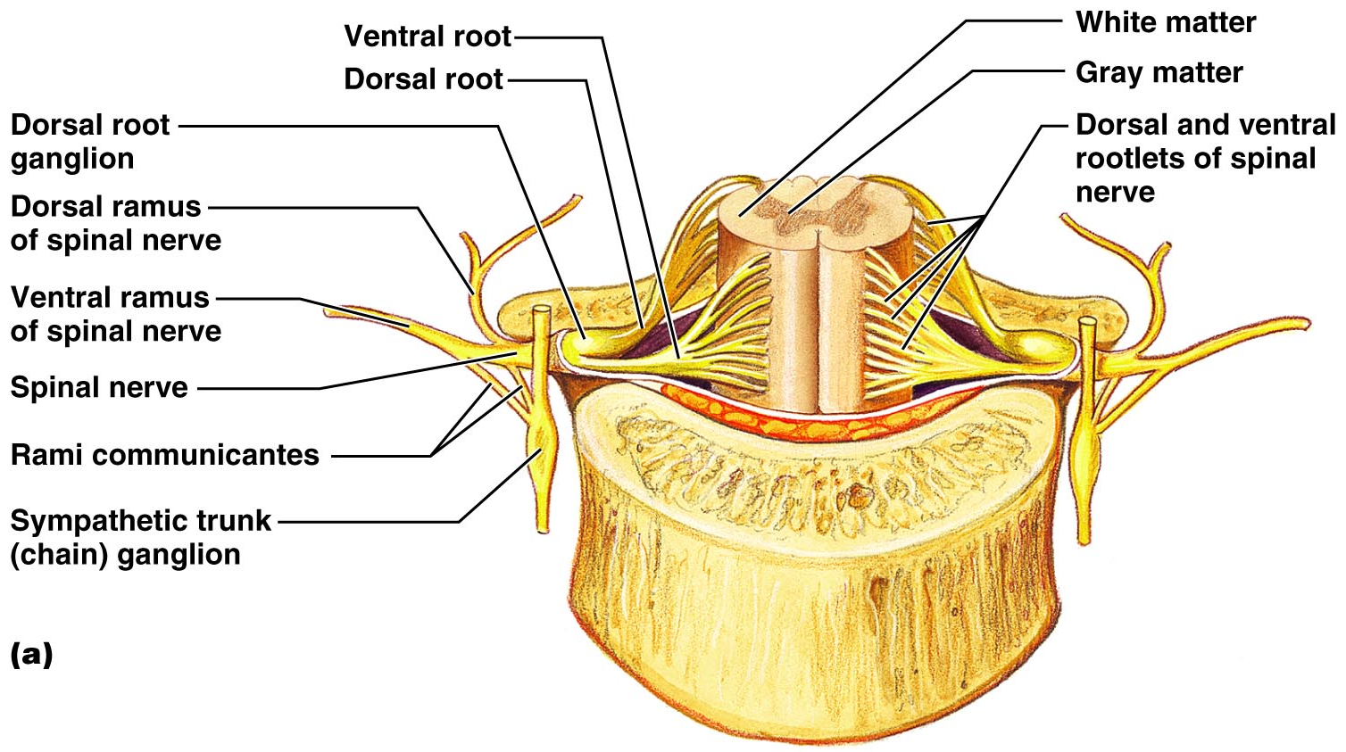
Spinal Nerves: Roots
Figure 13.7a

Slide 6
Spinal Nerves: Rami
The short spinal nerves branch into three or four mixed, distal rami
  Small dorsal ramus
  Larger ventral ramus
  Tiny meningeal branch
  Rami communicantes at the base of the ventral rami in the thoracic region

Slide 7
Nerve Plexuses
All ventral rami except T₂-T₁₂ form interlacing nerve networks called plexuses
Plexuses are found in the cervical, brachial, lumbar, and sacral regions
Each resulting branch of a plexus contains fibers from several spinal nerves

Slide 8
Nerve Plexuses
Fibers travel to the periphery via several different routes
Each muscle receives a nerve supply from more than one spinal nerve
Damage to one spinal segment cannot completely paralyze a muscle

Slide 9
Spinal Nerve Innervation: Back, Anterolateral Thorax, and Abdominal Wall
The back is innervated by dorsal rami via several branches
The thorax is innervated by ventral rami T₁-T₁₂ as intercostal nerves
Intercostal nerves supply muscles of the ribs, anterolateral thorax, and abdominal wall

Slide 10
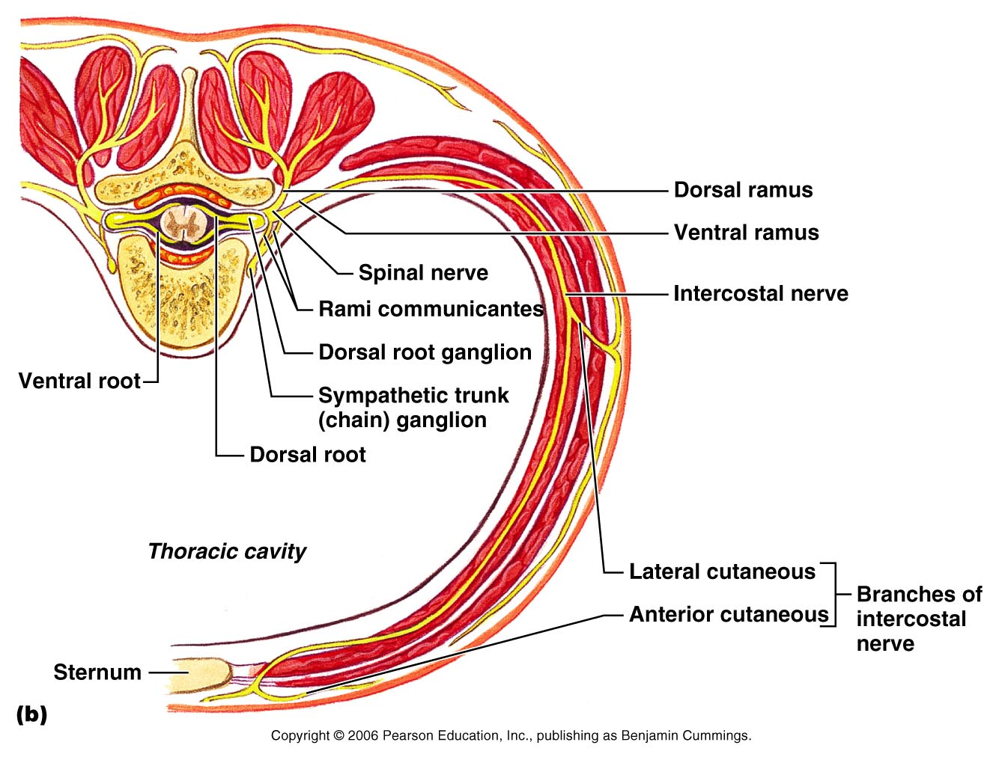
Spinal Nerve Innervation: Back, Anterolateral Thorax, and Abdominal Wall
Figure 13.7b

Slide 11
Cervical Plexus
The cervical plexus is formed by ventral rami of
C₁-C₄
Most branches are cutaneous nerves of the neck, ear, back of head, and shoulders
The most important nerve of this plexus is the phrenic nerve
The phrenic nerve is the major motor and sensory nerve of the diaphragm

Slide 12
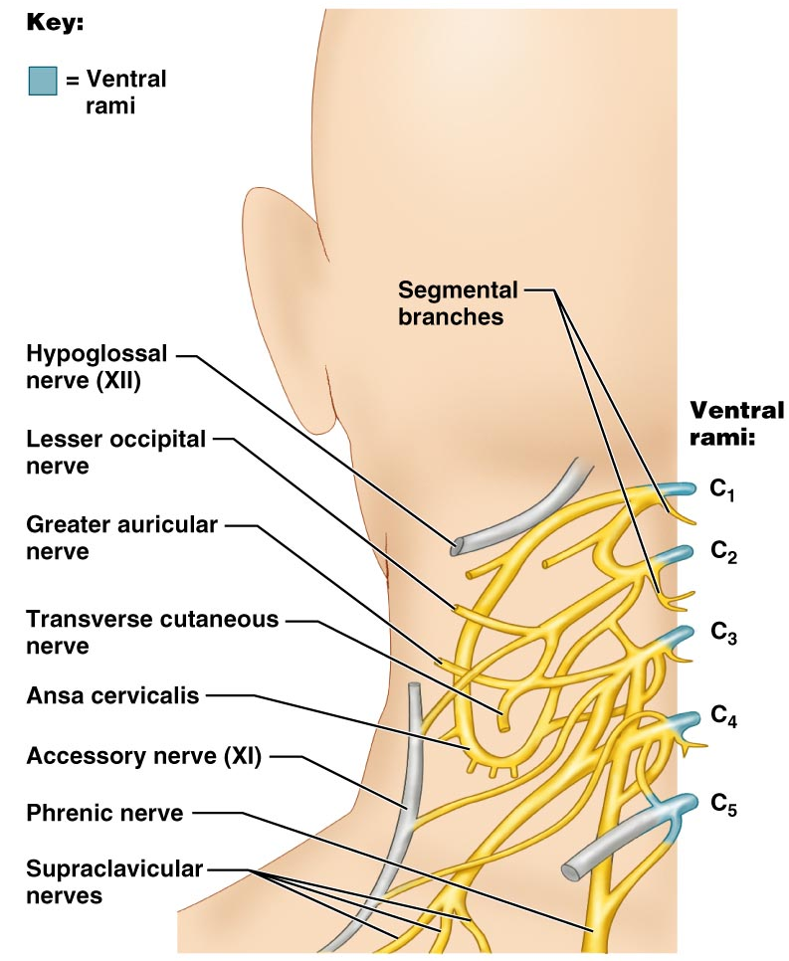
Cervical Plexus
Figure 13.8

Slide 13
Brachial Plexus
Formed by C₅-C₈ and T₁ (C₄ and T₂ may also contribute to this plexus)
It gives rise to the nerves that innervate the upper limb

Slide 14
Brachial Plexus
There are four major branches of this plexus
  Roots – five ventral rami (C₅-T₁)
  Trunks – upper, middle, and lower, which form divisions
  Divisions – anterior and posterior serve the front and back of the limb
  Cords – lateral, medial, and posterior fiber bundles

Slide 15
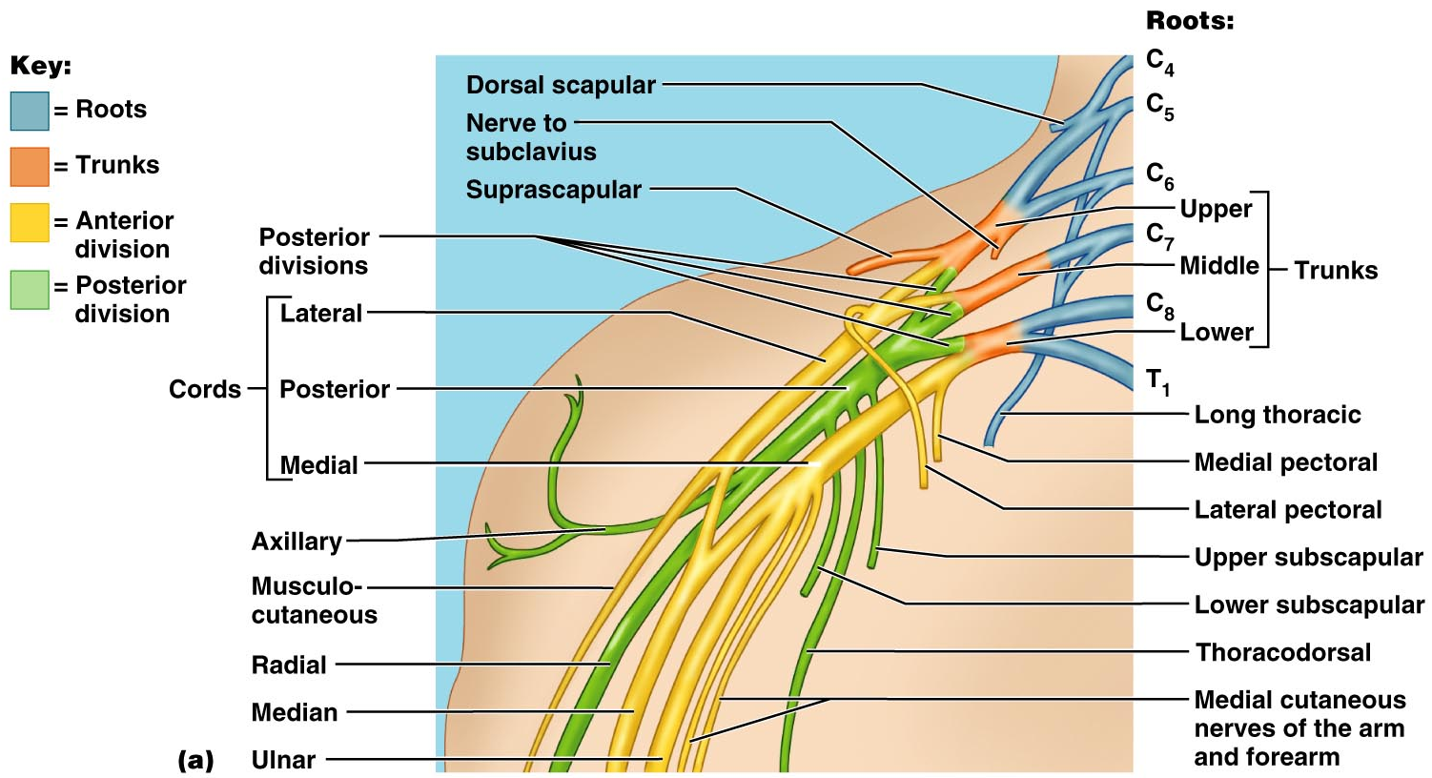
Brachial Plexus
Figure 13.9a

Slide 16
Brachial Plexus: Nerves
Axillary – innervates the deltoid and teres minor
Musculocutaneous – sends fibers to the biceps brachii and brachialis
Median – branches to most of the flexor muscles of arm
Ulnar – supplies the flexor carpi ulnaris and part of the flexor digitorum profundus
Radial – innervates essentially all extensor muscles

Slide 17
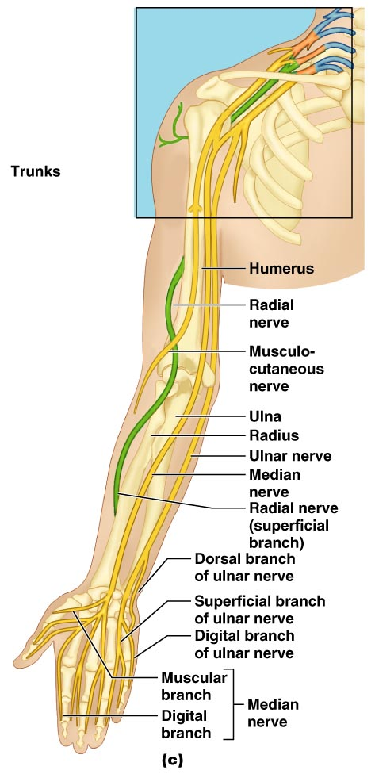
Brachial Plexus: Distribution of Nerves
Figure 13.9c

Slide 18
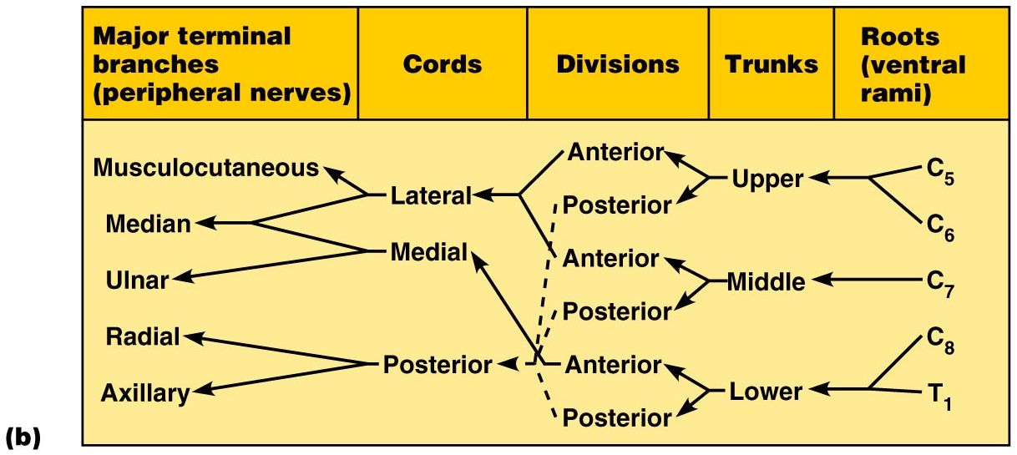
Brachial Plexus: Nerves
Figure 13.9b

Slide 19
Lumbar Plexus
Arises from L₁-L₄ and innervates the thigh, abdominal wall, and psoas muscle
The major nerves are the femoral and the obturator

Slide 20
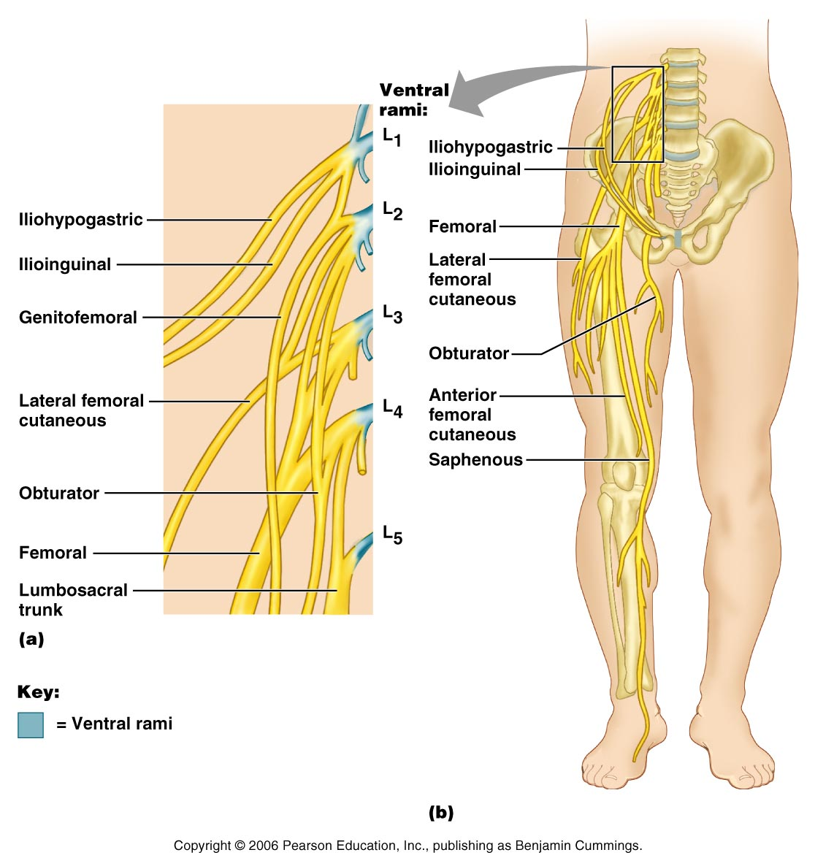
Lumbar Plexus
Figure 13.10

Slide 21
Sacral Plexus
Arises from L₄-S₄ and serves the buttock, lower limb, pelvic structures, and the perineum
The major nerve is the sciatic, the longest and thickest nerve of the body
The sciatic is actually composed of two nerves: the tibial and the common fibular (peroneal) nerves

Slide 22
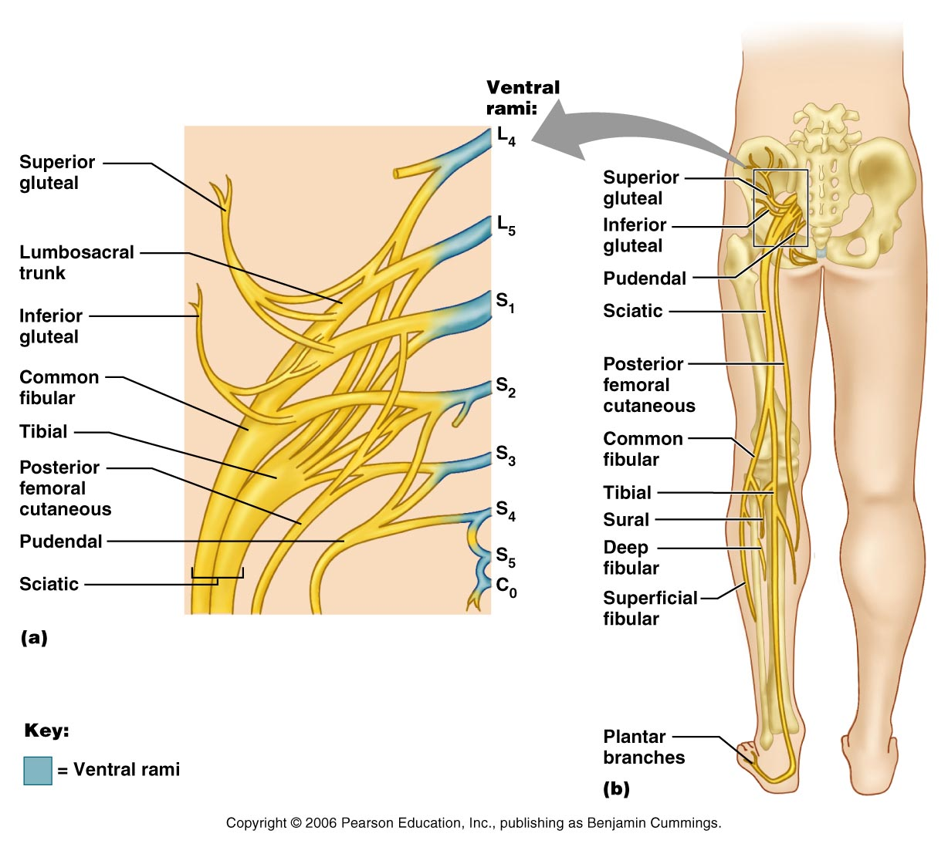
Sacral Plexus
Figure 13.11

Slide 23
Dermatomes
A dermatome is the area of skin innervated by the cutaneous branches of a single spinal nerve
All spinal nerves except C₁ participate in dermatomes

Slide 24
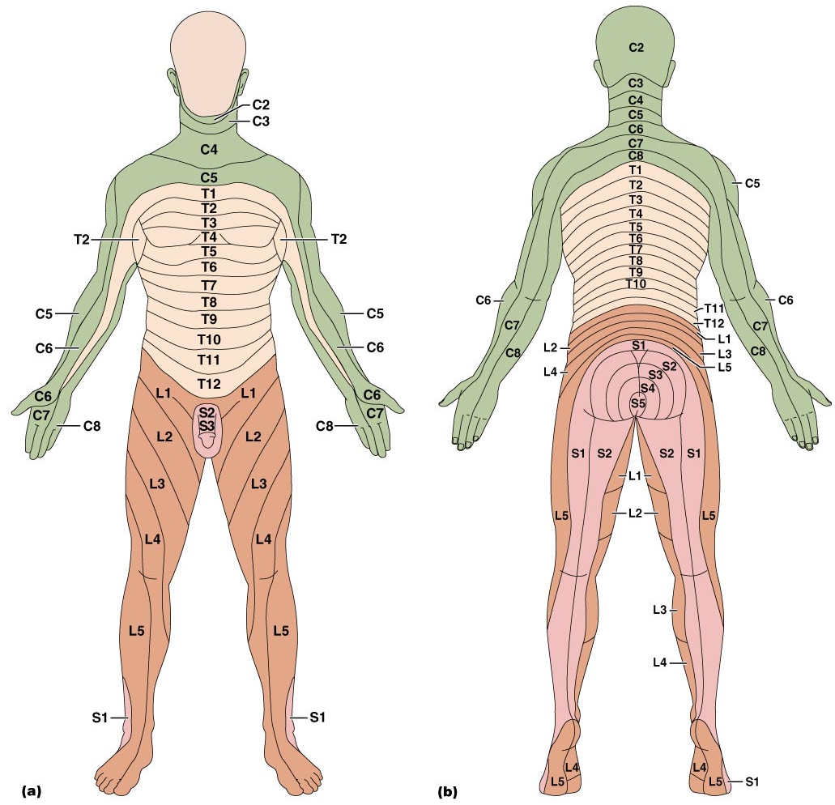
Dermatomes
Figure 13.12

