Slide 1
6
Bones and Skeletal Tissues
Mike Clark, M.D.

Slide 2
Skeletal System
The components of the skeletal system are:
Bone – 206 Bones
Cartilage
Tendons – attach muscle to bone
Ligaments – attach bone to bone
Joint structures

Slide 3
Function of the Skeletal System
Support the framework of the body
Movement – by bone being attached to muscle it acts as a lever to assist with movement
Protection – it protects the brain, spinal cord, and vital internal organs
Storage – provides storage of calcium and phosphorous- also for triglycerides
Enclosure – provides a protective enclosure for blood forming cells

Slide 4
Qualities of Bone
(1) Bone has tensile strength
Tensile strength is a strength preventing something from being pulled apart – by extensive stretching force
Bone has hardness (Compression strength)
Bone has a certain degree of elasticity
Bone is fairly lightweight particularly as it relates to its strength

Slide 5
Bone chemistry and histology
Bone is a hard connective tissue – thus it must, at least, be comprised of (1) cells (2) fibers and (3) amorphous ground substance
Bone is comprised of two matrices
Organic Matrix 35% of dry weight
(Organic matrix - 20% with water)
Bone (Inorganic matrix 37% with water)
Inorganic Matrix 65% of dry weight
Water is approximately 43% of bone

Slide 6
Organic Matrix
The organic matrix of bone is comprised of the (1) bone cells, (2) the bone fibers and the (3) amorphous ground substance (4) special glycoproteins
In histological specimen, osteoid is the un-mineralized, organic portion of the bone matrix that forms prior to the maturation of bone tissue.

Slide 7
The Bone Cells ( Part of Organic Matrix)
Osteoprogenitor cells – stem cell for bone that can differentiate into the Osteoblast
Osteoblast – the parenchymal cell of bone that secretes the fibers and amorphous ground substance and some special glycoproteins
Osteocyte – an osteoblast that is temporarily resting – thus either not any longer secreting or minimally secreting – however it can return to the active osteoblast stage and again begin secreting
Osteoclast – a special type of macrophage that has enzymes capable of phagocytosing (dissolving) bone

Slide 8
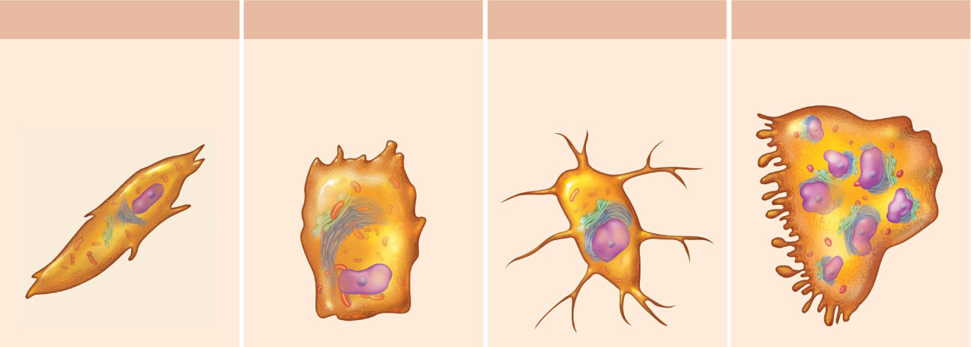
(a) Osteogenic cell
(b) Osteoblast
Stem cell
Matrix-synthesizing
cell responsible
for bone growth
Figure 6.4a-b

Slide 9
(c) Osteocyte
(d) Osteoclast
Mature bone cell
that maintains the
bone matrix
Bone-resorbing cell
Ruffled border to increase surface area of the cell.
Figure 6.4c-d

Slide 10
Osteoprogenitor Cells
Derived from mesenchyme
Can undergo mitosis
Can differentiate in a osteoblast
Under certain conditions of low oxygen – it can differentiate into chondrogenic cells

Slide 11
Osteoblasts
Derived from osteoprogenitor cells
Are responsible for synthesis of the organic components of the bone matrix, including collagen, proteoglycans, and glycoproteins.
Has receptors for Parathyroid Hormone Receptors – when parathyroid hormone binds to these receptors, it stimulates osteoblasts to secrete osteoprotegerin ligand which stimulates osteoclast into activation – it also secretes osteoclast stimulating factor (RNAKL) which does the same thing.
Osteoblast connect to one another by gap junctions

Slide 12
Osteocytes
An inactive osteoblast that forms after the osteoblast is surrounded in its lacunae by a calcified matrix
If freed from the lacunae by osteoclast – these cells can return to blast stage
Can secrete substances such as cyclic AMP, osteocalcin, and insulin- like growth factor as a result of receiving tension (weight) – these substances can stimulate osteoblast in the near vicinity to secrete more bone substances

Slide 13
Osteoclasts
Precursor originates from monocytes in the bone marrow
These cells are responsible for bone resorption

Slide 14
Mechanism of Bone Resorption (1)
Bone resorption is the process by which osteoclasts break down bone and release the minerals, resulting in a transfer of calcium from bone fluid to the blood.
The osteoclasts are multi-nucleated cells that contain numerous mitochondria and lysosomes. These are the cells responsible for the resorption of bone.

Slide 15
Bone Resorption (2)
Attachment of the osteoclast to the osteon begins the process. The osteoclast then induces an infolding of its cell membrane and secretes collagenase (Acid Phosphatase) and other enzymes important in the resorption process. There is a proton pump that pumps H⁺ and Cl⁻ follows; the HCl dissolves the inorganic matrix. High levels of calcium, magnesium, phosphate and products of collagen will be released into the extracellular fluid as the osteoclasts tunnel into the mineralized bone.

Slide 16
Bone Resorption (3)
Osteoclasts are also prominent in the tissue destruction commonly found in psoriatic arthritis and other rheumatology related disorders.
Bone resorption can also be the result of disuse and the lack of stimulus for bone maintenance. Astronauts, for instance will undergo a certain amount of bone resorption due to the lack of gravity, providing the proper stimulus for bone maintenance.
During childhood, bone formation exceeds resorption, but as the aging process occurs, resorption exceeds formation.

Slide 17
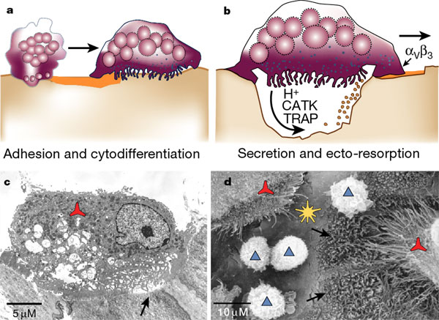
Howship’s Lacunae – where osteoclast dissolves bone
releasing minerals from the bone. The mineral portion of the matrix (called hydroxyapatite) includes calcium and phosphate ions. These ions are absorbed into small vesicles by endocytosis, which move across the cell and eventually are released into the extracellular fluid, thus increasing levels of the ions in the blood.
Howship’s Lacunae

Slide 18
Extracellular Organic Matrix
Fibers , Amorphous Ground Substance &
Special Glycoproteins
The fibers, amorphous ground substances and special glycoproteins are secretory products of the Osteoblast
Fibers: Type I Collagen fibers – makes up 90% of the protein content of bone
Amorphous Ground Substance: Chondroitin Sulfate and Keratin Sulfate
Special Glycoproteins: Osteocalcin, Osteonectin
Sialoprotein

Slide 19
Inorganic Matrix ( a calcified matrix)
Water comprises almost half of the inorganic matrix of bone
The major inorganic chemicals are Calcium, and Phosphorous
Other inorganic chemicals are bicarbonate, citrate, magnesium, sodium and potassium
Calcium and phosphorous primarily exist in a molecular form known as the “Hydroxyapatite Crystal” Ca10 (PO4)6. OH2
Some does exist has Calcium Phosphate

Slide 20
Questions about bone
(1) What is the function of the glycoproteins and the sialoprotein?
(2) What gives bone its slight amount elasticity and why does this elasticity decrease with age?
(3) Why does bone get hard unlike the other tissues of the body?

Slide 21
What is the function of the glycoproteins and the sialoprotein?
Osteocalcin – binds to hydroxyapatite
Osteopontin – binds to hydroxyapatite but has additional binding sites of *integrins present on osteobasts and osteoclasts.
Vitamin D stimulates the synthesis of glycoproteins.
Bone sialoprotein, another matrix protein, has binding sites for matrix components and integrins of osteoblasts and osteocytes, suggesting the adherence of the these cells to the bone matirx

Slide 22
What gives bone its slight amount elasticity and why does this elasticity decrease with age?
The water content in bone provides the slight elasticity. The water content decreases as the individual ages – thus the bones become more brittle.
Water is part of the inorganic matrix of bone. Bone in a young person is approximately 43% water.
The surface ions of the hydroxyapatite crystals attract H2O and form a hydration shell, which permits ion exchange with the extracellular fluid.

Slide 23
Why does bone get hard unlike the other tissues of the body? The inorganic calcified matrix makes bone hard!
Fibroblast cells secrete collagen and amorphous ground substance – which is a soft organic matrix– why when the osteoblast cells secrete a soft organic matrix does it gets hard? (see handout)
The osteoblast secrete a type I collagen along with the fore-mentioned special glycoproteins. It appears that the type of collagen and the special glycoproteins – particularly osteocalcin cause the calcium and phosphorous in the interstitial fluid to precipitate out and form the calcified matrix – particularly that of the hydroxyapatite crystal.

Slide 24
Review of Bone Qualities
(1) Bone has tensile strength – due to the type I collagen fibers
Tensile strength is a strength preventing something from being pulled apart
Bone has hardness – due to the inorganic calcified matrix
Bone has a certain degree of elasticity- due to the water content
Bone is fairly lightweight – due to its construct on the histiologic level – to be discussed shortly

Slide 25
Bone Classifications
Density Classification
(1) Compact – substantia compacta
(2) Spongy – substantia spongiosa – cancellous
Shape Classification
Flat
Long Bones
Short Bones Round (personal terminology)
Irregular Bones

Slide 26
Bone Density (Texture) Classification
Compact bone
  Dense outer layer
Spongy (cancellous) bone
  Honeycomb of trabeculae

Slide 27
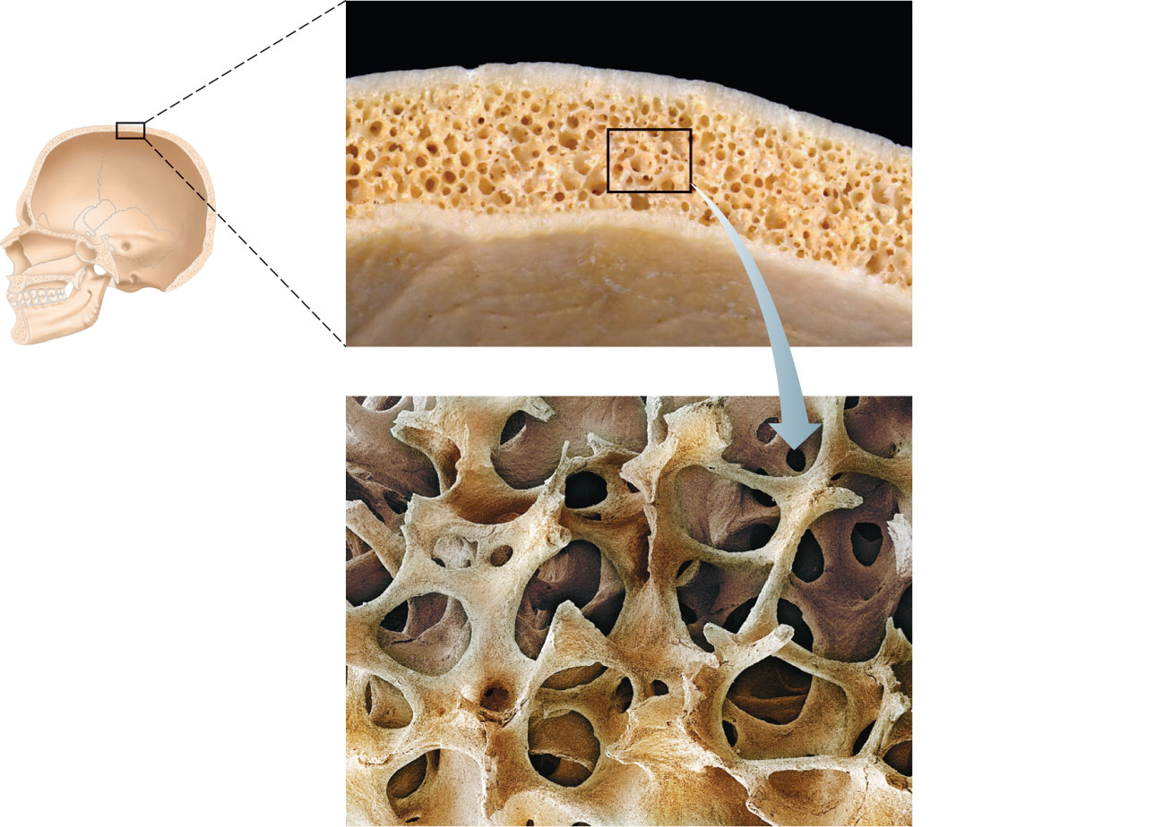
Spongy bone
(diploë)
Compact
bone
Trabeculae
Figure 6.5

Slide 28
Classification of Bones by Shape
Long bones
  Longer than they are wide
Short bones
  Cube-shaped bones (in wrist and ankle)
  Sesamoid bones (within tendons, e.g., patella)

Slide 29
Classification of Bones by Shape
Flat bones
  Thin, flat, slightly curved
Irregular bones
  Complicated shapes

Slide 30
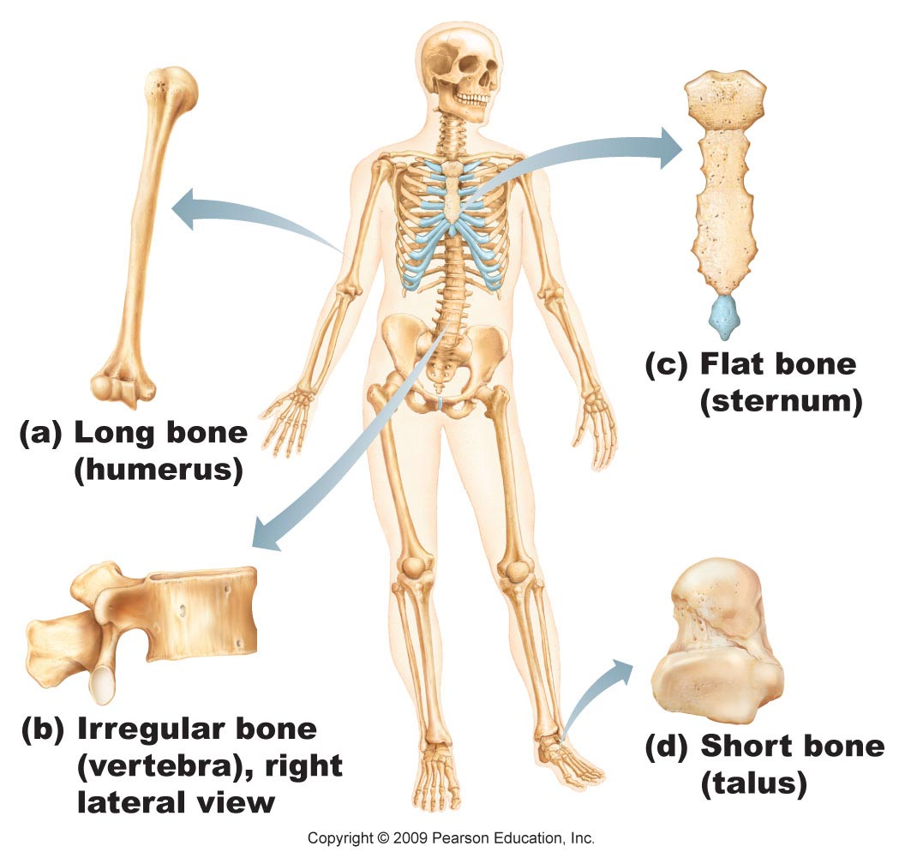
Figure 6.2

Slide 31
Structures associated with a Long Bone
Epiphysis – ends of a long bone
Diaphysis – shaft of a long bond
Metaphysis – region between epiphysis and diaphysis
Medullary Cavity – cut out region in shaft where blood is formed during early life and fat in later years
Periosteum – dense irregular connective tissue collar around diaphysis
Endosteum – layer of cells lining the rim of the medullary cavity
Articular surface – cartilage covering the surface of the epiphysis – used as a smooth surface to form a joint

Slide 32
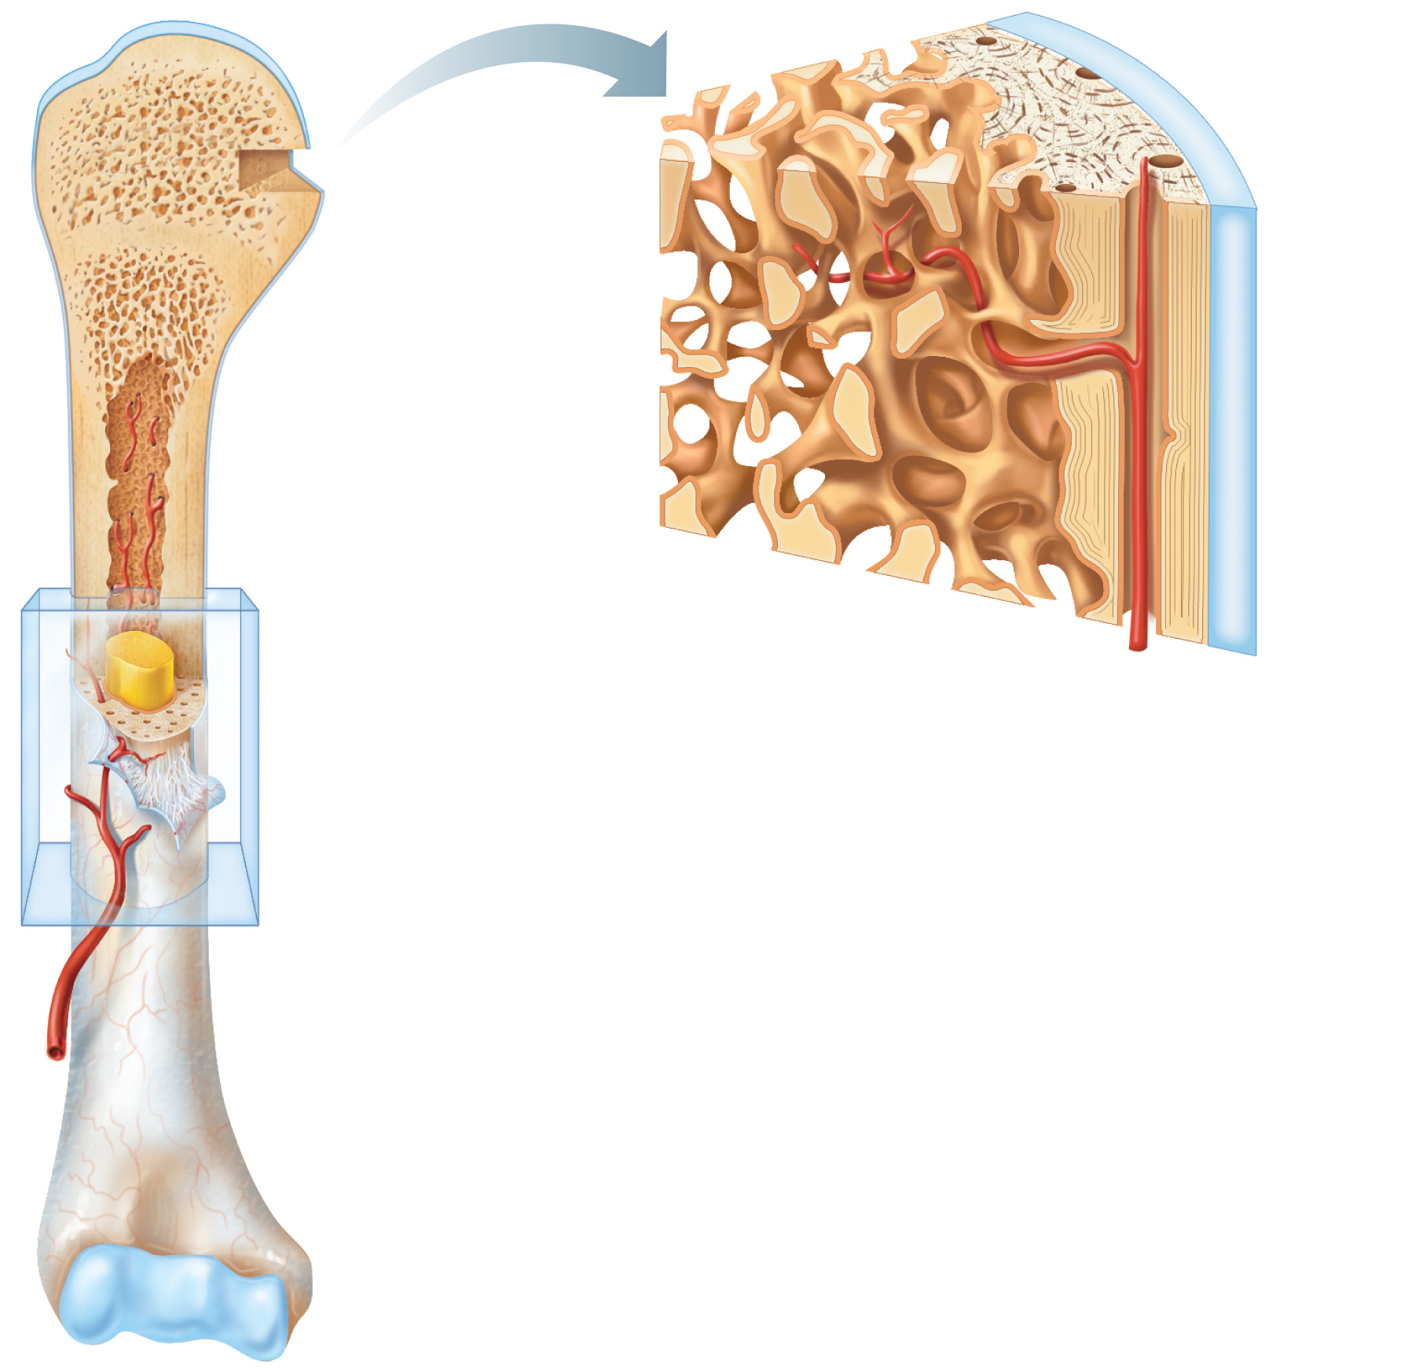
Articular
cartilage
Compact bone
Proximal
epiphysis
Spongy bone
Epiphyseal
line
Periosteum
Compact bone
Medullary
cavity (lined
by endosteum)
(b)
Diaphysis
Distal
epiphysis
(a)
Figure 6.3a-b

Slide 33
Structure of a Long Bone
Epiphyses
  Expanded ends
  Spongy bone interior
  Epiphyseal line (remnant of growth plate)
  Articular (hyaline) cartilage on joint surfaces

Slide 34
Articular
cartilage
Proximal
epiphysis
Compact bone
Spongy bone
Epiphyseal
line
Periosteum
Compact bone
Medullary
cavity (lined
by endosteum)
(b)
Diaphysis
Distal
epiphysis
(a)
Figure 6.3a-b

Slide 35
Structure of a Long Bone
Diaphysis (shaft)
  Compact bone collar surrounds medullary (marrow) cavity
  Medullary cavity in adults contains fat (yellow marrow)

Slide 36
Articular
cartilage
Compact bone
Proximal
epiphysis
Spongy bone
Epiphyseal
line
Periosteum
Compact bone
Medullary
cavity (lined
by endosteum)
(b)
Diaphysis
Distal
epiphysis
(a)
Figure 6.3a-b

Slide 37
Metaphysis
The metaphysis is the wider portion of a long bone adjacent to the epiphyseal plate. It is this part of the bone that grows during childhood; as it grows, it ossifies near the diaphysis and the epiphyses. At roughly 18 to 25 years of age, the metaphysis stops growing altogether and completely ossifies into solid bone.
Epiphyseal plates ("growth plates") are located in the metaphysis and are responsible for growth in the length of the bone.

Slide 38
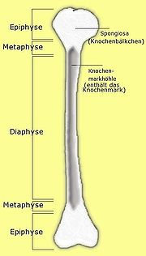
Metaphysis

Slide 39
Clinical significance of Metaphysis
Because of their rich blood supply, metaphysis of long bones are prone to hematogenous spread of Osteomyelitis in children.
Metaphyseal tumors or lesions include osteosarcoma, chondrosarcoma, fibrosarcoma, osteoblastoma, enchondroma, fibrous dysplasia, simple bone cyst, aneurysmal bone cyst, non-ossifying fibroma, and osteoid osteoma.

Slide 40
Videos on Bone Structure to View
Compact Bone Structure https://www.youtube.com/watch?v=8A0rRIpjutY
Histology of Bone https://www.youtube.com/watch?v=fMIxh4mPvQ0

Slide 41
Membranes of Bone
Periosteum
  Outer fibrous layer
  Inner osteogenic layer
    Osteoblasts (bone-forming cells)
    Osteoclasts (bone-destroying cells)
    Osteogenic cells (stem cells)
  Nerve fibers, nutrient blood vessels, and lymphatic vessels enter the bone via nutrient foramina
  Secured to underlying bone by Sharpey’s fibers

Slide 42
Membranes of Bone
Endosteum
  Delicate membrane on internal surfaces of bone
  Also contains osteoblasts and osteoclasts

Slide 43
Bone Marrow
There are two types of bone marrow: red marrow (consisting mainly of myeloid tissue) and yellow marrow (consisting mainly of fat cells). Red blood cells, platelets and most white blood cells arise in red marrow. Both types of bone marrow contain numerous blood vessels and capillaries.
At birth, all bone marrow is red. With age, more and more of it is being replaced by the yellow type. About half of adult bone marrow is red

Slide 44
Red marrow is found mainly in the flat bones, such as the hip bone, breast bone, skull, ribs, vertebrae and shoulder blades, and in the cancellous ("spongy") material at the epiphyseal ends of the long bones such as the femur and humerus. Yellow marrow is found in the hollow interior of the middle portion of long bones.
In cases of severe blood periods, the body can convert yellow marrow back to red marrow to increase blood cell production.

Slide 45
Microscopic Anatomy of Bone: Compact Bone
Haversian system,
A osteon is a structural unit
  Lamellae
    Weight-bearing
    Column-like matrix tubes
  Central (Haversian) canal
    Contains blood vessels and nerves

Slide 46
Microscopic Anatomy of Bone: Compact Bone
Perforating (Volkmann’s) canals
  At right angles to the central canal
  Connects blood vessels and nerves of the periosteum and central canal
Lacunae—small cavities that contain osteocytes
Canaliculi—hairlike canals that connect lacunae to each other and the central canal

Slide 47
Microscopic Anatomy of Bone: Compact Bone
Perforating (Volkmann’s) canals
  At right angles to the central canal
  Connects blood vessels and nerves of the periosteum and central canal
Lacunae—small cavities that contain osteocytes
Canaliculi—hairlike canals that connect lacunae to each other and the central canal

Slide 48
Articular
cartilage
Compact bone
Proximal
epiphysis
Spongy bone
Epiphyseal
line
Periosteum
Compact bone
Medullary
cavity (lined
by endosteum)
(b)
Diaphysis
Distal
epiphysis
(a)
Figure 6.3a-b

Slide 49
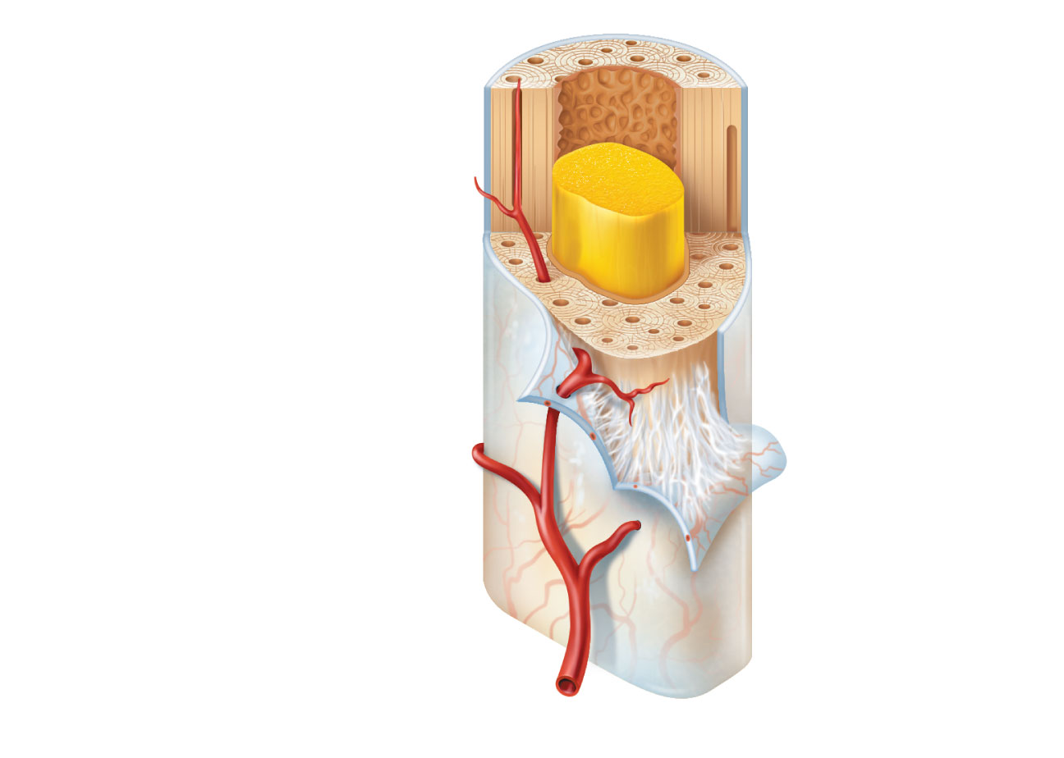
Endosteum
Yellow
bone marrow
Compact bone
Outer Fibrous Layer
Periosteum
Perforating
(Sharpey’s) fibers
Nutrient
arteries
(c)
Figure 6.3c

Slide 50
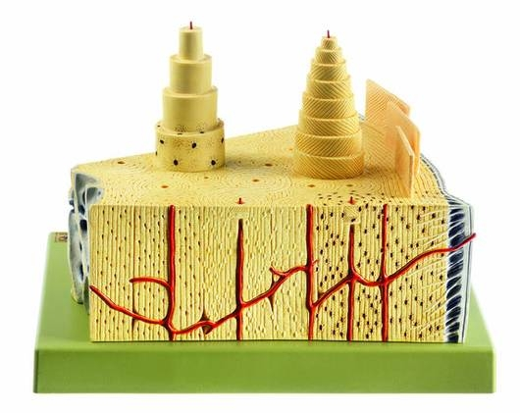
Bone Wedge – Primarily Showing Compact Bone Anatomy
Spongy bone surrounding
Medullary cavity
Osteon
Outer circumferential lamellae
Outer fibrous layer of periosteum
Nutrient foramen with artery
entering bone.
Sharpey’s fibers
Volkmann's Canal
Blood vessel in central (Haversian) canal

Slide 51
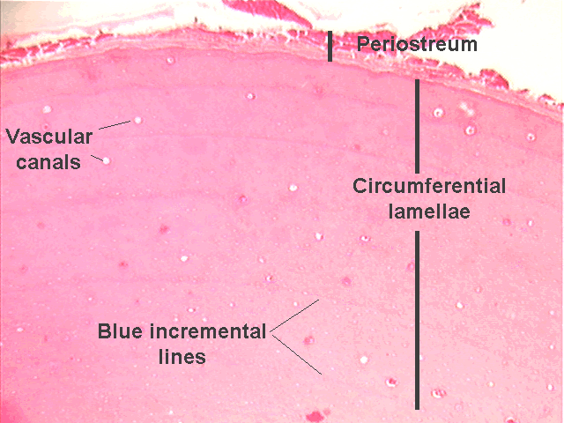
Periosteum
Outer Fibrous Layer
Inner cellular (Osteogenic
Layer

Slide 52
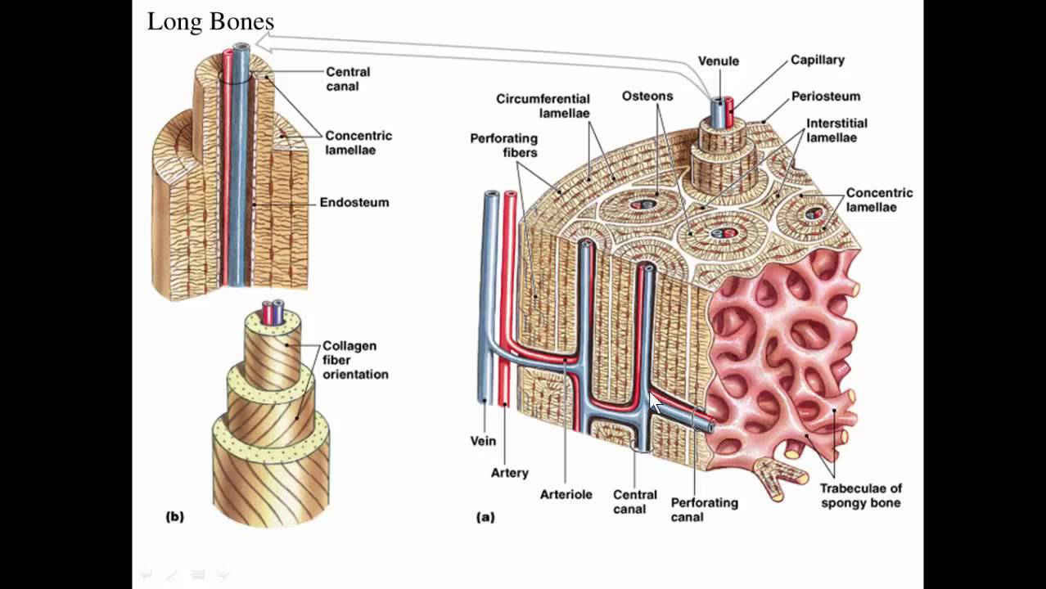

Slide 53
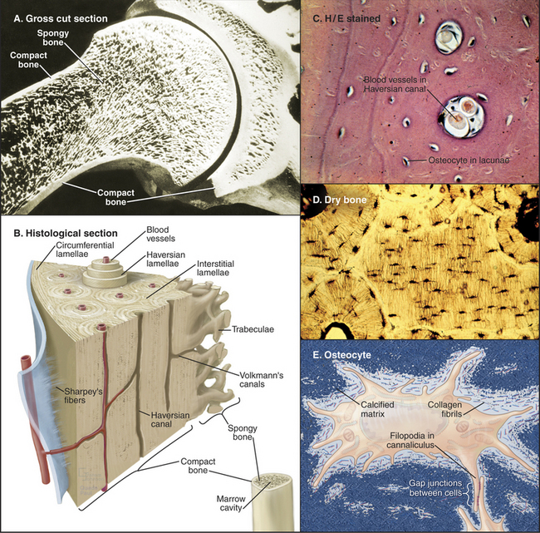

Slide 54
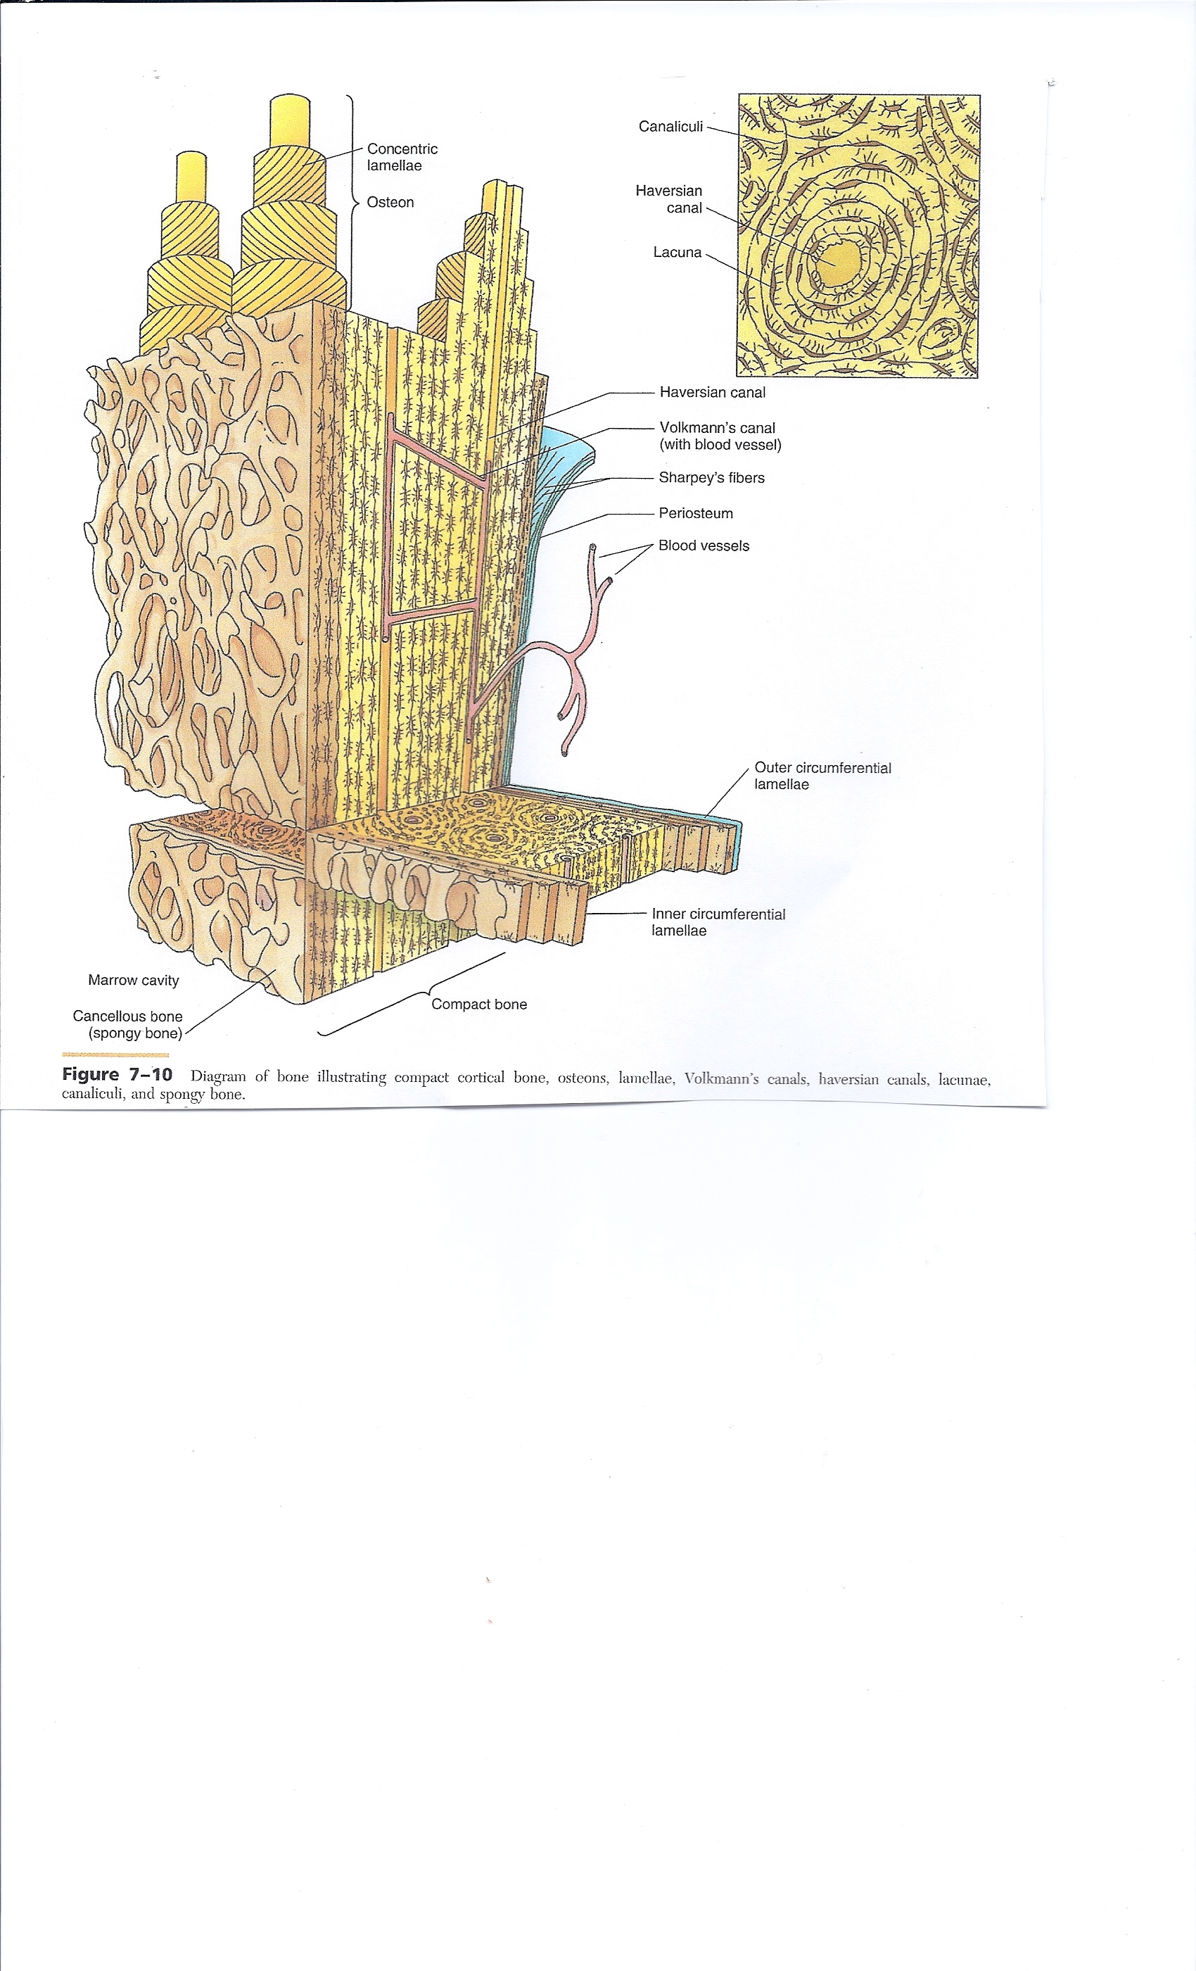

Slide 55
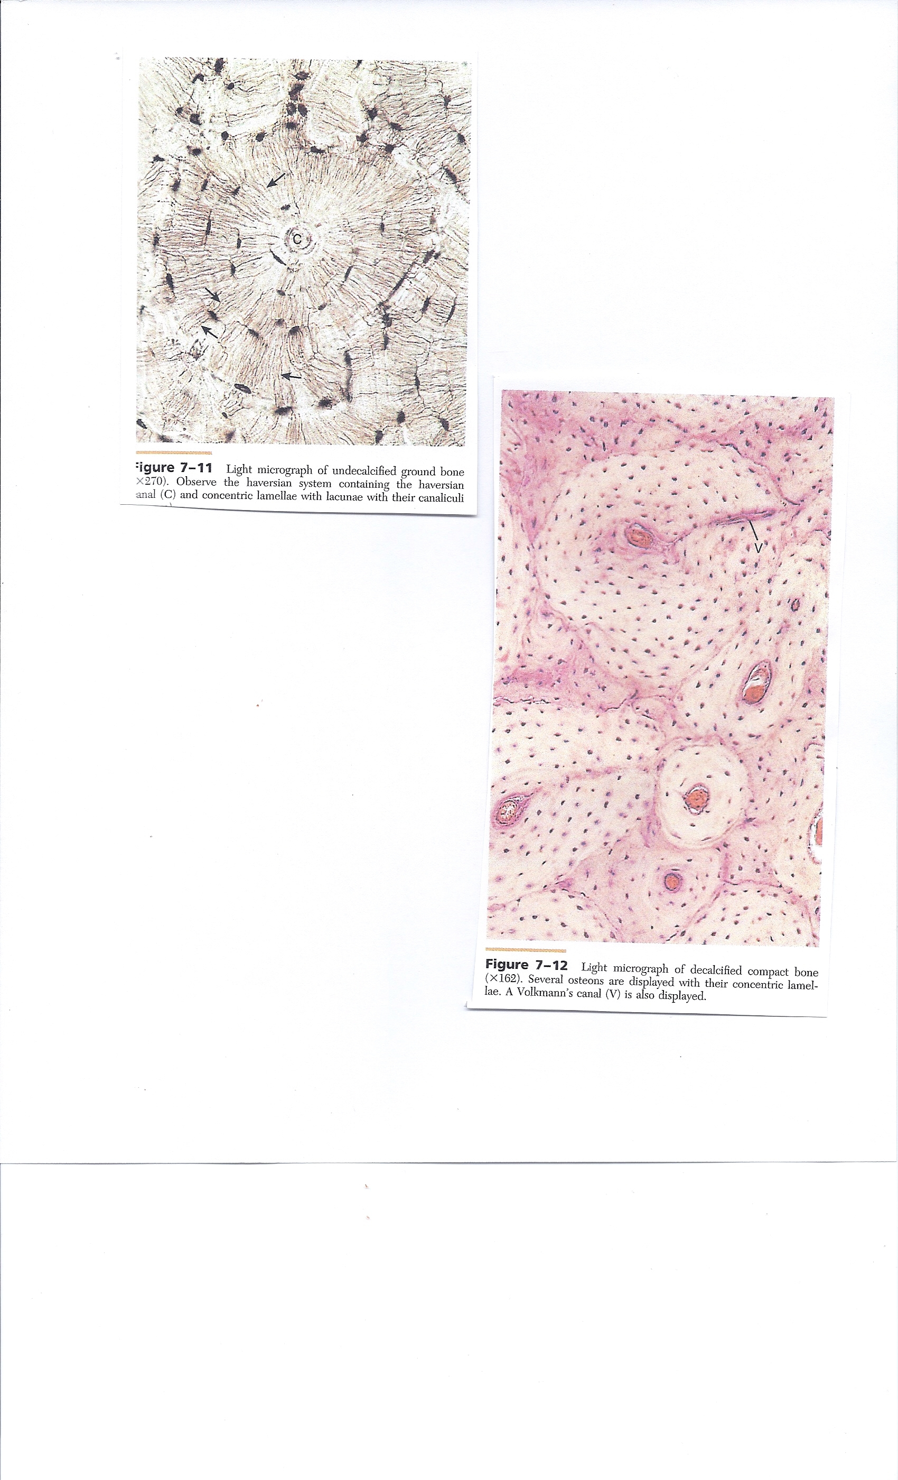

Slide 56
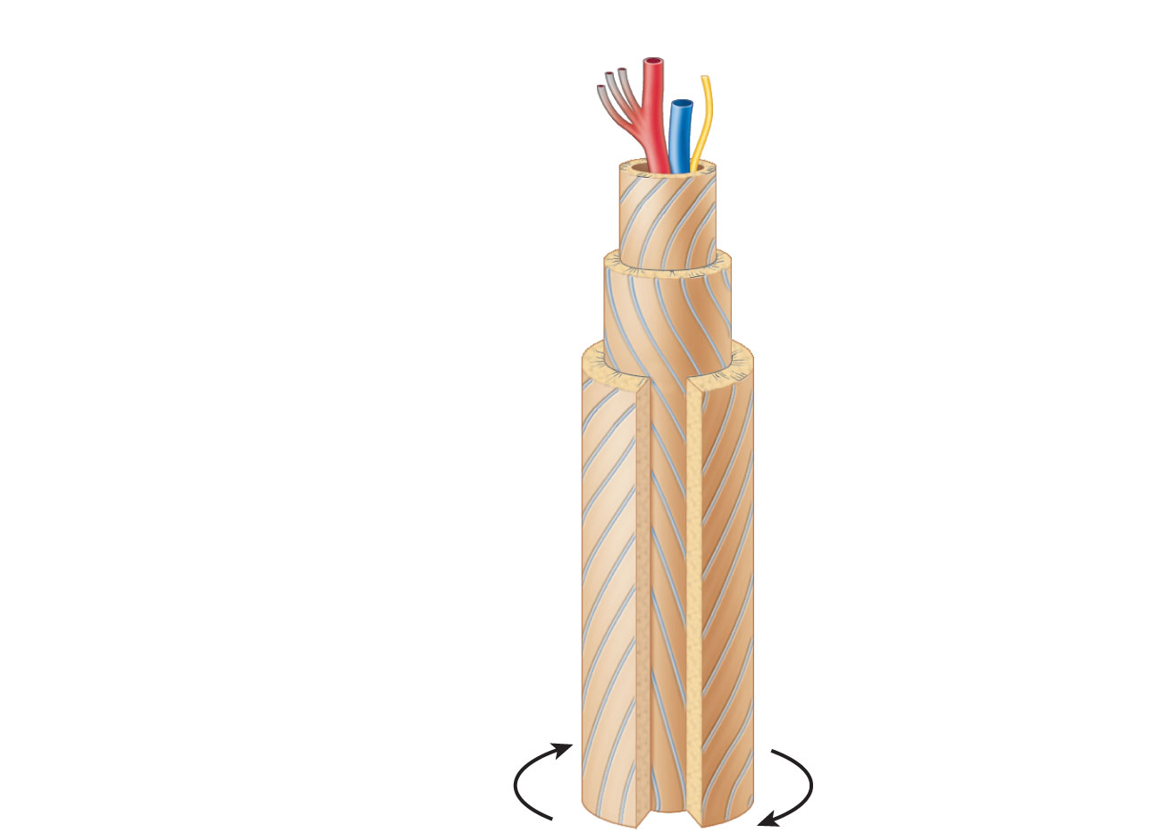
Artery with
capillaries
Structures
in the
central
canal
Vein
Nerve fiber
Lamellae
Collagen
fibers
run in
different
directions
Twisting
force
Figure 6.6

Slide 57
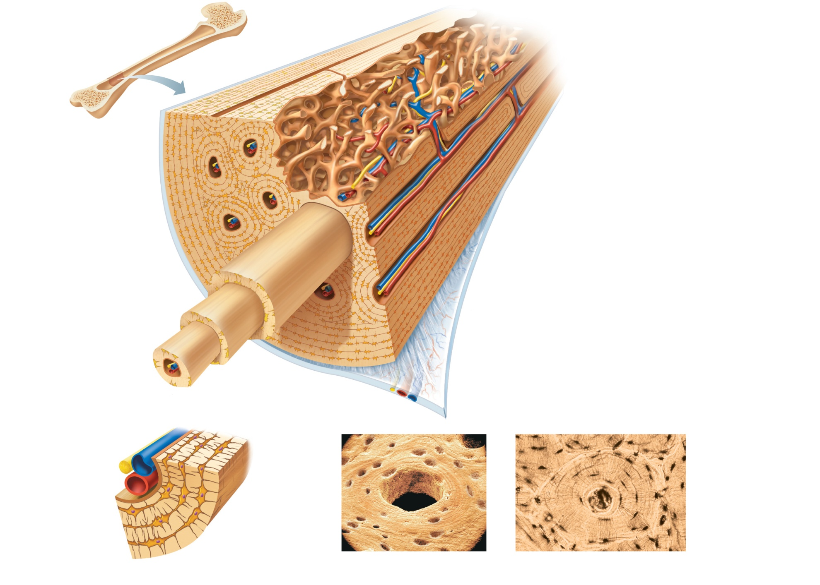
Compact
bone
Spongy bone
Central
(Haversian) canal
Perforating
(Volkmann’s) canal
Endosteum lining bony canals
and covering trabeculae
Osteon
(Haversian system)
Circumferential
lamellae
(a)
Perforating (Sharpey’s) fibers
Lamellae
Periosteal blood vessel
Periosteum
Nerve
Vein
Lamellae
Artery
Canaliculi
Central
canal
Lacuna (with
osteocyte)
Osteocyte
in a lacuna
Lacunae
(b)
(c)
Interstitial lamellae
Figure 6.7a-c

Slide 58
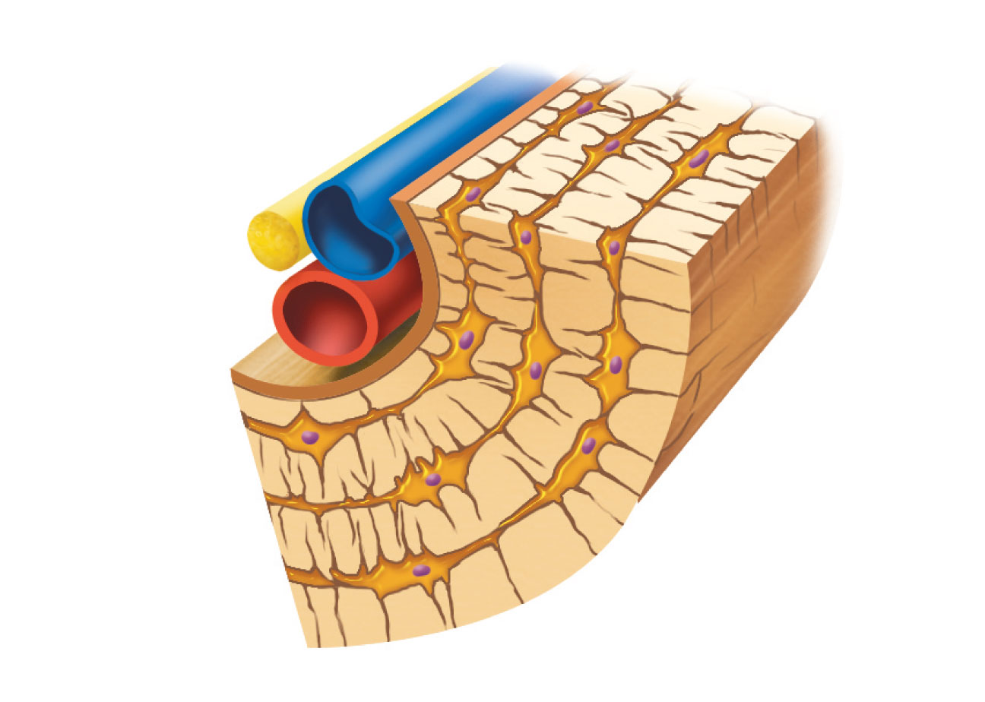
Nerve
Vein
Lamellae
Artery
Central
canal
Canaliculus
Osteocyte
in a lacuna
Lacunae
(b)
Figure 6.3b

Slide 59
Microscopic Anatomy of Bone: Spongy Bone (Pseudo-Haversian System)
Trabeculae
  Align along lines of stress
  No osteons
  Contain irregularly arranged lamellae, osteocytes, and canaliculi
  Capillaries in endosteum supply nutrients

Slide 60
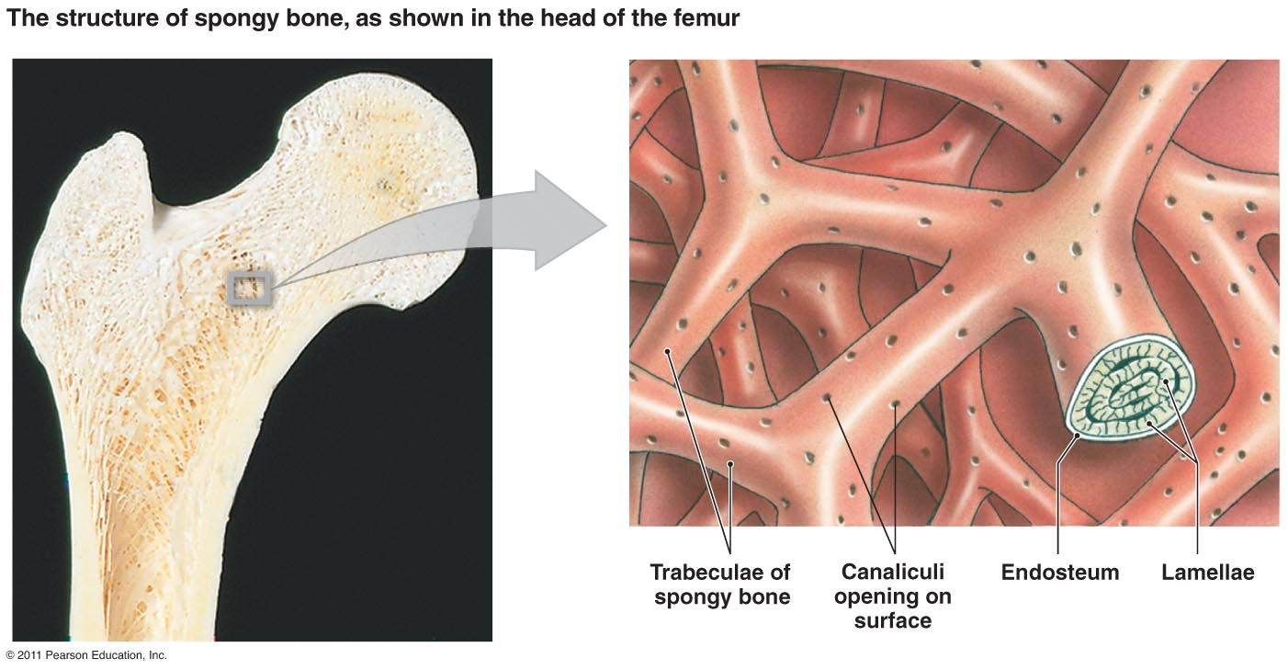
Spongy Bone

Slide 61
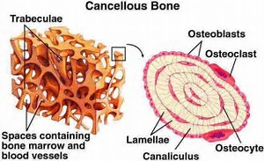
Spongy Bone

Slide 62
Videos on Bone Structure to View
Compact Bone Structure https://www.youtube.com/watch?v=8A0rRIpjutY
Histology of Bone https://www.youtube.com/watch?v=fMIxh4mPvQ0

