Slide 1
6
Bones and Skeletal Tissues: Part B

Slide 2
Bone Development
Osteogenesis (ossification)—bone tissue formation
Stages
  Bone formation—begins in the 2nd month of development
  Postnatal bone growth—until early adulthood
  Bone remodeling and repair—lifelong

Slide 3
Bone Development Timeline
3rd week – somite
4th week – mesenchyme produced
5th week – limb buds
6th week – hand plates and foot plates – with separation constriction rings – also first hyalin cartilage model
8th week – first ossification center
12th week all areas have primary ossification centers

Slide 4
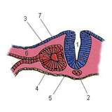
Somite

Slide 5
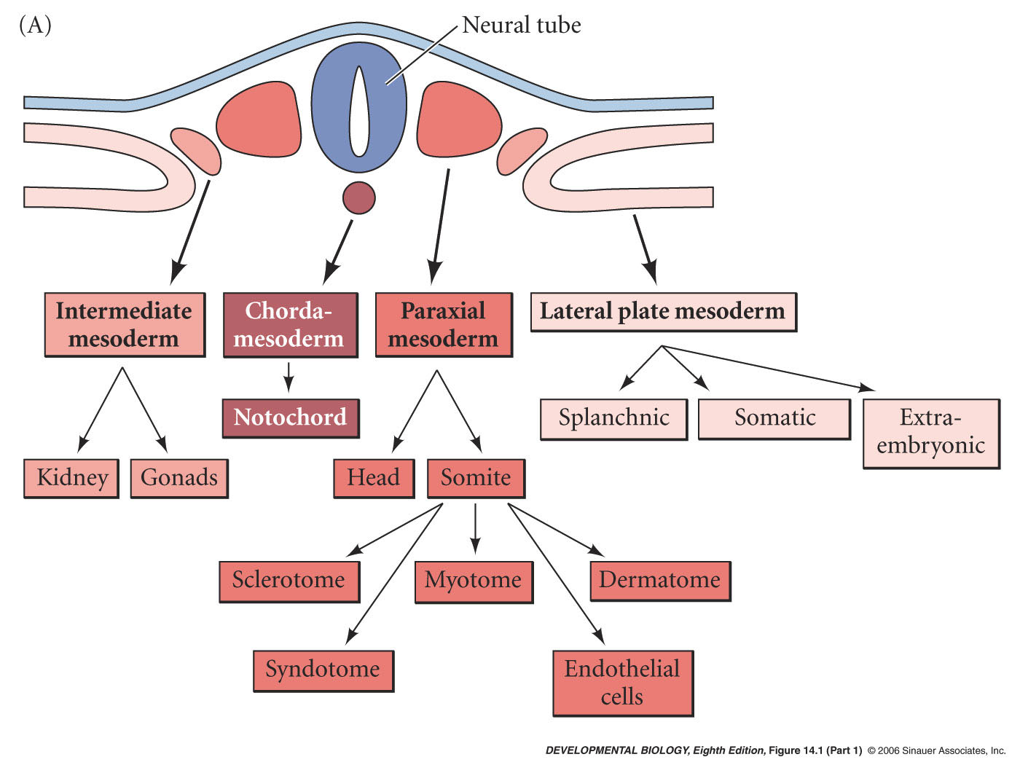
Somite
Bone Forming

Slide 6
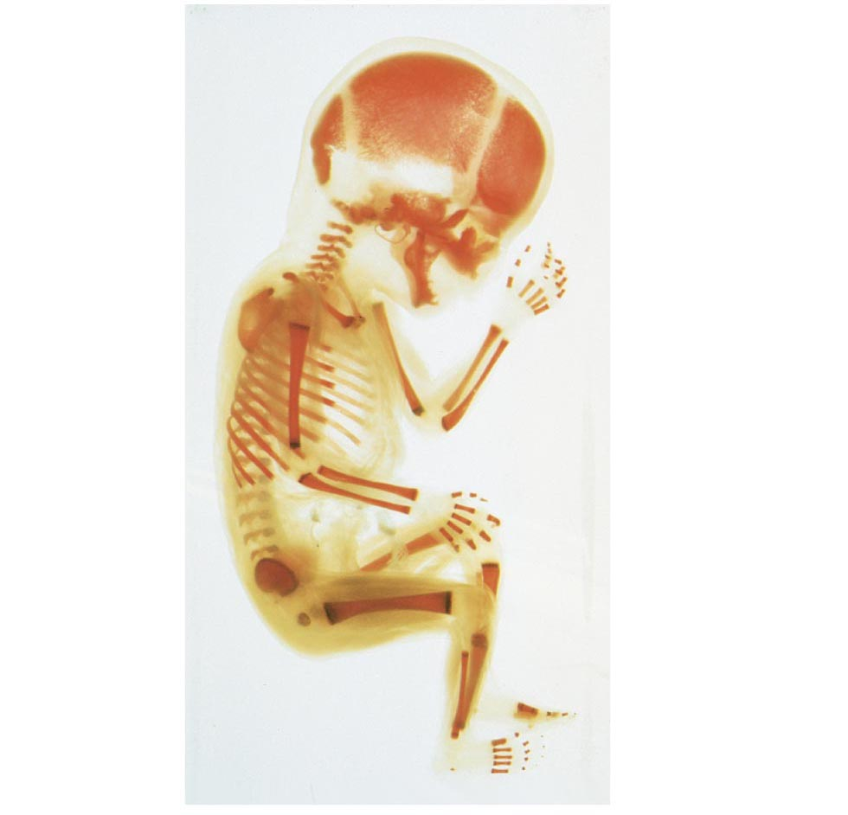
Figure 6.17 Fetal primary ossification centers at 12 weeks.

Slide 7
Developmental Aspects of Bones
Embryonic skeleton ossifies predictably so fetal age easily determined from X rays or sonograms
At birth, most long bones are well ossified (except epiphyses)

Slide 8
Developmental Aspects of Bones
Nearly all bones completely ossified by age 25
Bone mass decreases with age beginning in 4th decade
Rate of loss determined by genetics and environmental factors
In old age, bone resorption predominates

Slide 9
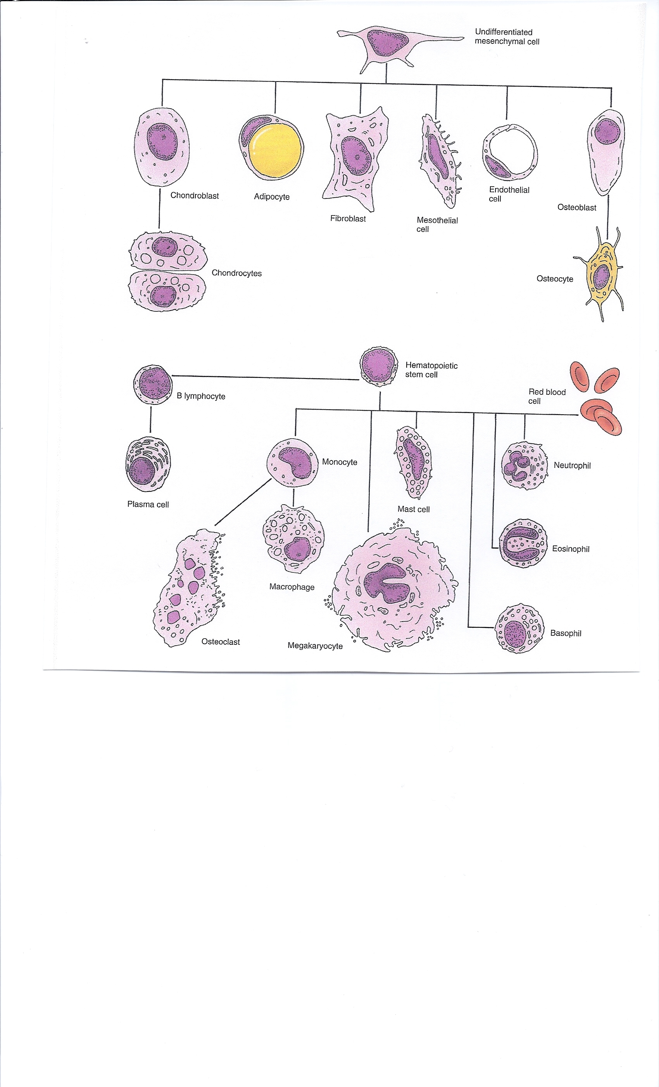

Slide 10
Bone Formation Videos To Watch
Intramembranous Bone Formation https://www.youtube.com/watch?v=gh6J2CHR_q4
Endochondral Bone Formation https://www.youtube.com/watch?v=RpV1t9ZMSxY

Slide 11
Types of Ossification https://www.youtube.com/watch?v=NM8zQLJ1ipQ
Intramembranous ossification
  Membrane bone develops from fibrous membrane
  Forms flat bones, e.g. clavicles and cranial bones
Endochondral ossification (Cartilage Model)
  Cartilage (endochondral) bone forms by replacing hyaline cartilage
  Forms most of the rest of the skeleton
3. Ectopic Bone Formation (Unusual)

Slide 12
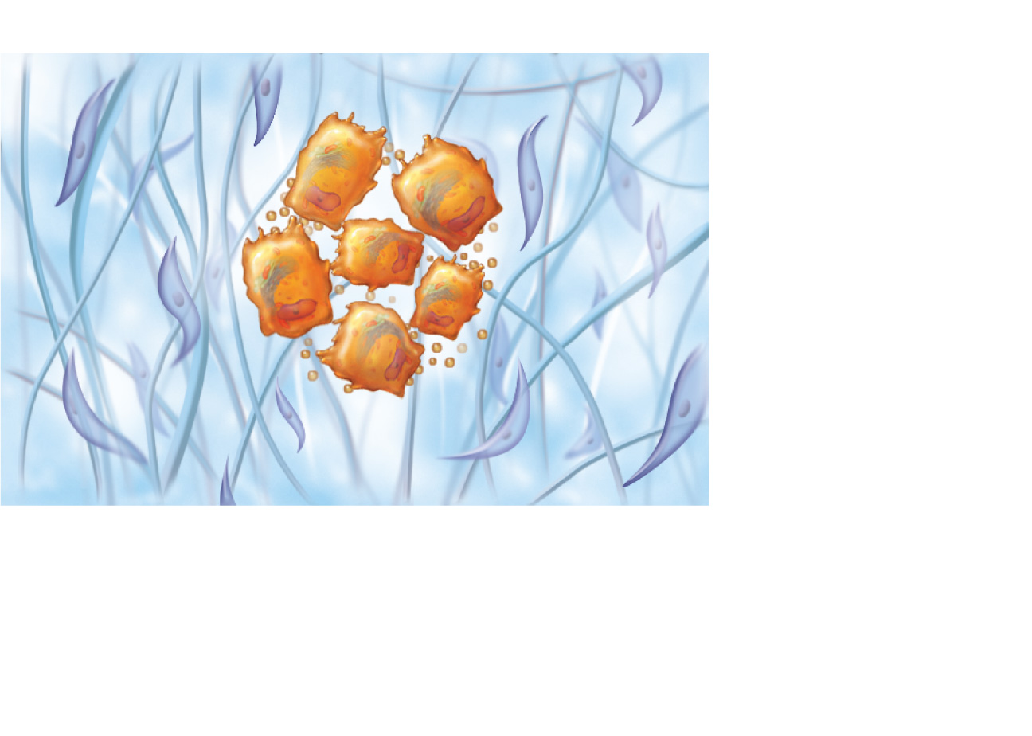
Intramembranous Bone Formation
Mesenchymal
cell
Collagen
fiber
Ossification
center
Osteoid
Osteoblast
1
Ossification centers appear in the fibrous
connective tissue membrane.
• Selected centrally located mesenchymal cells cluster
and differentiate into osteoblasts, forming an
ossification center.
Figure 6.8, (1 of 4)

Slide 13
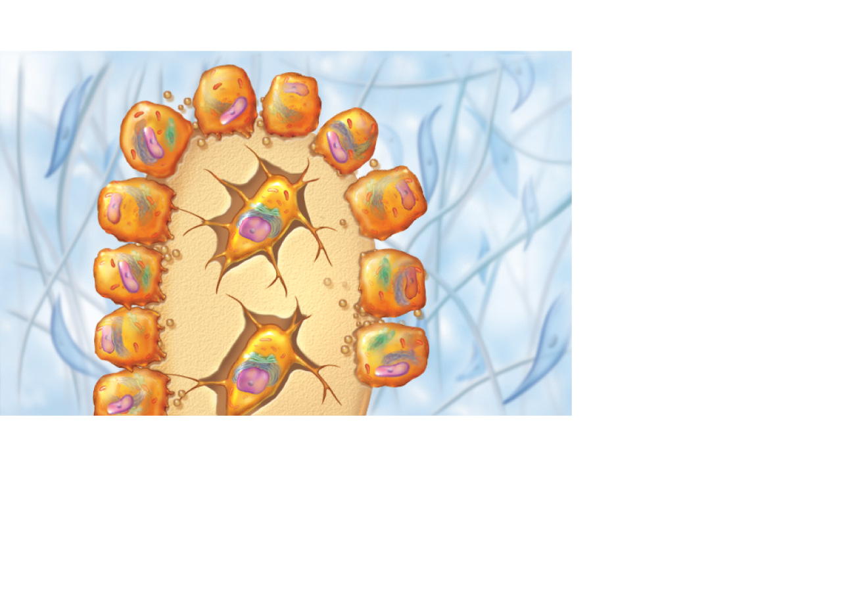
Intramembranous Bone Formation
Osteoblast
Osteoid
Osteocyte
Newly calcified
bone matrix
2
Bone matrix (osteoid) is secreted within the
fibrous membrane and calcifies.
• Osteoblasts begin to secrete osteoid, which is calcified
within a few days.
• Trapped osteoblasts become osteocytes.
Figure 6.8, (2 of 4)

Slide 14
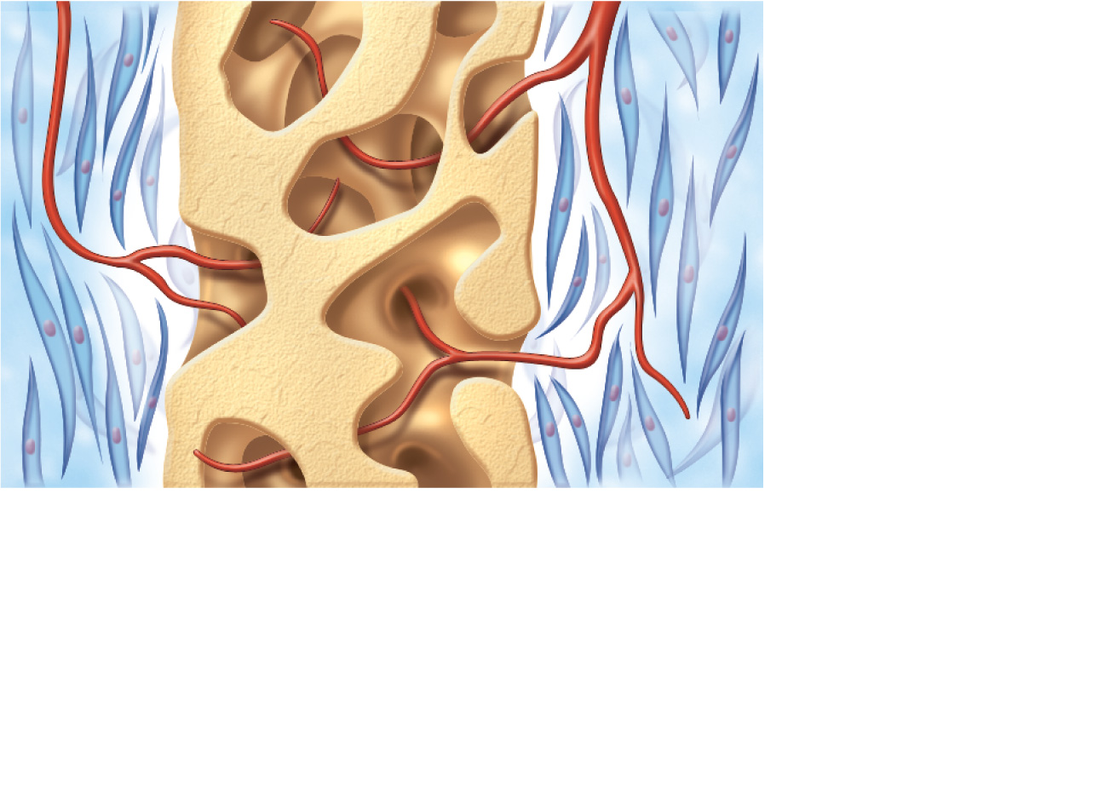
Intramembranous Bone Formation
Mesenchyme
condensing
to form the
periosteum
Trabeculae of
woven bone
Blood vessel
3
Woven bone and periosteum form.
• Accumulating osteoid is laid down between embryonic
blood vessels in a random manner. The result is a network
(instead of lamellae) of trabeculae called woven bone.
• Vascularized mesenchyme condenses on the external face
of the woven bone and becomes the periosteum.
Figure 6.8, (3 of 4)

Slide 15
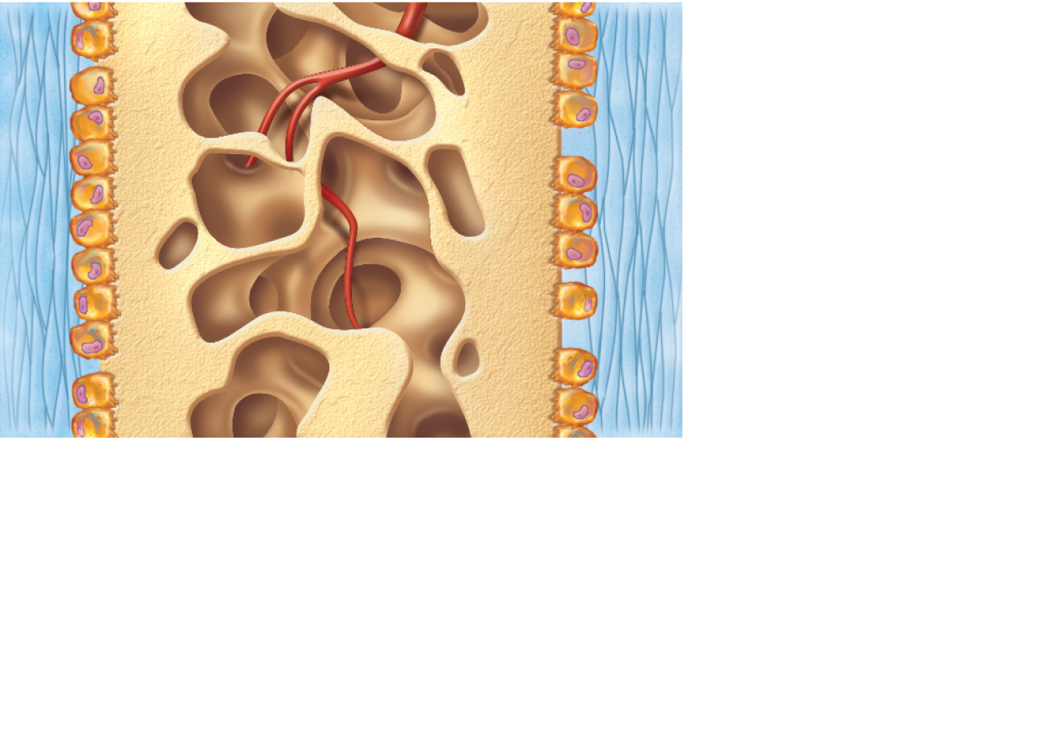
Intramembranous Bone Formation
Fibrous
periosteum
Osteoblast
Plate of
compact bone
Diploë (spongy
bone) cavities
contain red
marrow
4
Lamellar bone replaces woven bone, just deep to
the periosteum. Red marrow appears.
• Trabeculae just deep to the periosteum thicken, and are later
replaced with mature lamellar bone, forming compact bone
plates.
• Spongy bone (diploë), consisting of distinct trabeculae, per-
sists internally and its vascular tissue becomes red marrow.
Figure 6.8, (4 of 4)

Slide 16
Endochondral Bone Formation
Endochondral Bone Formation uses a cartilage model first
Let’s discuss cartilage

Slide 17
Three types of Cartilage
Hyaline cartilages
  Provide support, flexibility, and resilience
  Most abundant type
Elastic cartilages
  Similar to hyaline cartilages, but contain elastic fibers
Fibrocartilages
  Collagen fibers—have great tensile strength

Slide 18
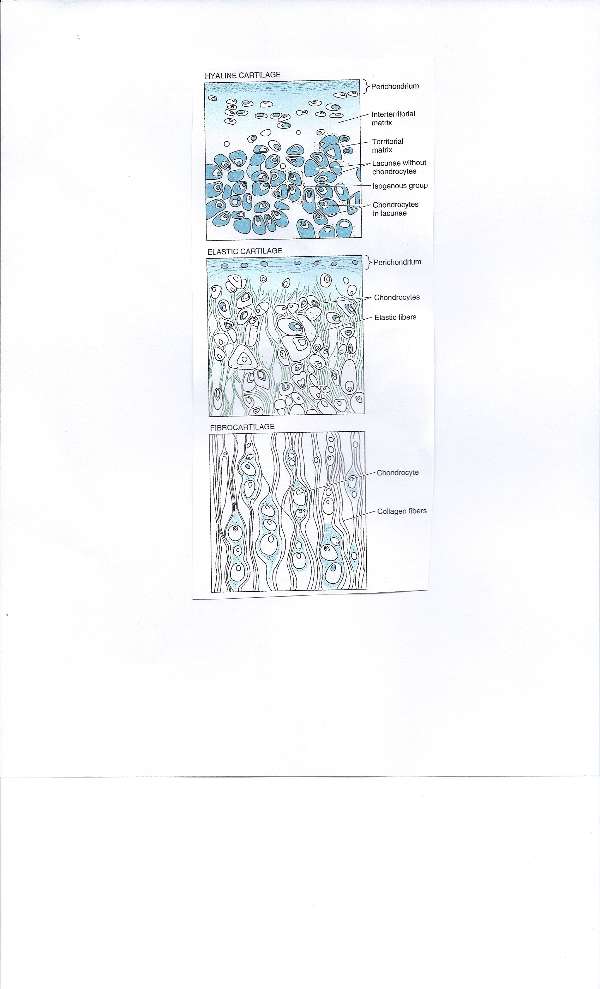

Slide 19
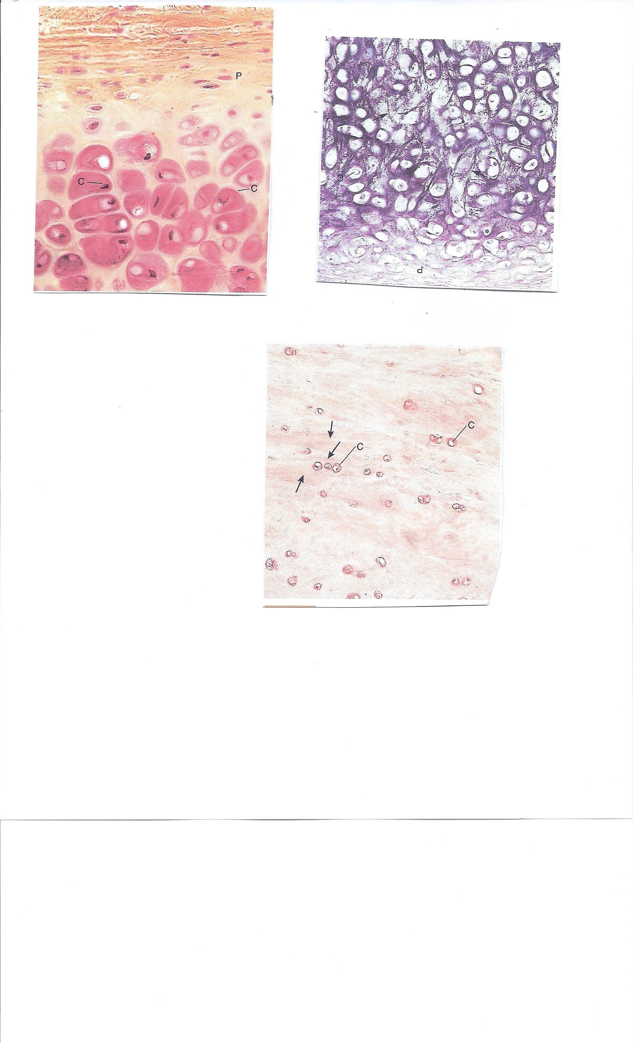
Elastic Cartilage
Hyaline Cartilage
Fibrocartilage

Slide 20
Cartilage Tissue
Contain no blood vessels or nerves
Dense connective tissue girdle of perichondrium contains blood vessels for nutrient delivery to cartilage

Slide 21
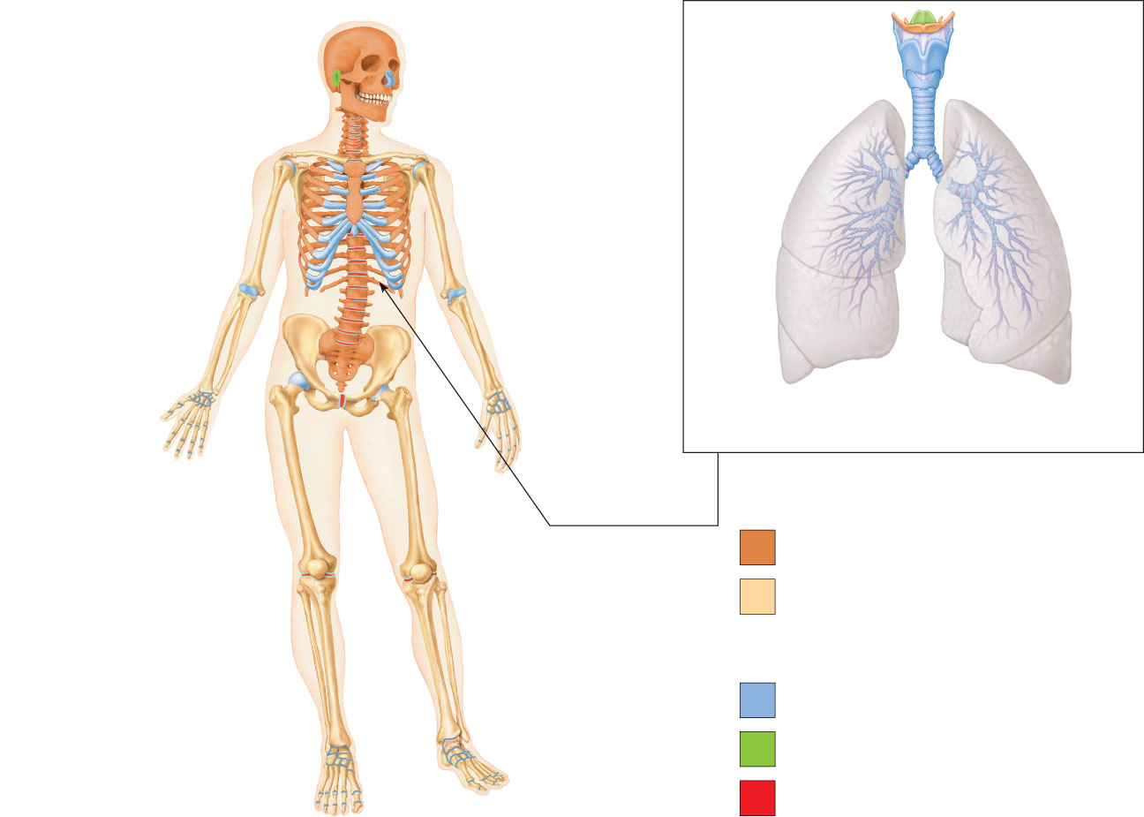
Epiglottis
Thyroid
cartilage
Larynx
Cartilage in
external ear
Cartilages in
nose
Cricoid
cartilage
Trachea
Articular
Cartilage
of a joint
Lung
Cartilage in
Intervertebral
disc
Costal
cartilage
Respiratory tube cartilages
in neck and thorax
Pubic
symphysis
Bones of skeleton
Meniscus (padlike
cartilage in
knee joint)
Axial skeleton
Appendicular skeleton
Cartilages
Articular cartilage
of a joint
Hyaline cartilages
Elastic cartilages
Fibrocartilages
Figure 6.1

Slide 22
Growth of Cartilage
Appositional
  Cells secrete matrix against the external face of existing cartilage
Interstitial
  Chondrocytes divide and secrete new matrix, expanding cartilage from within
Calcification of cartilage occurs during
  Normal bone growth
  Old age

Slide 23
Endochondral Ossification
Uses hyaline cartilage models (a cartilage prototype)
Requires breakdown of hyaline cartilage prior to ossification

Slide 24
Stages of Endochondral Bone Formation
(1) Primary Bone Formation
A. Primary Ossification (Diaphysis)
B. Secondary Ossification (Epiphysis) around the time of birth
(2) Secondary Bone Formation - Remodeling

Slide 25
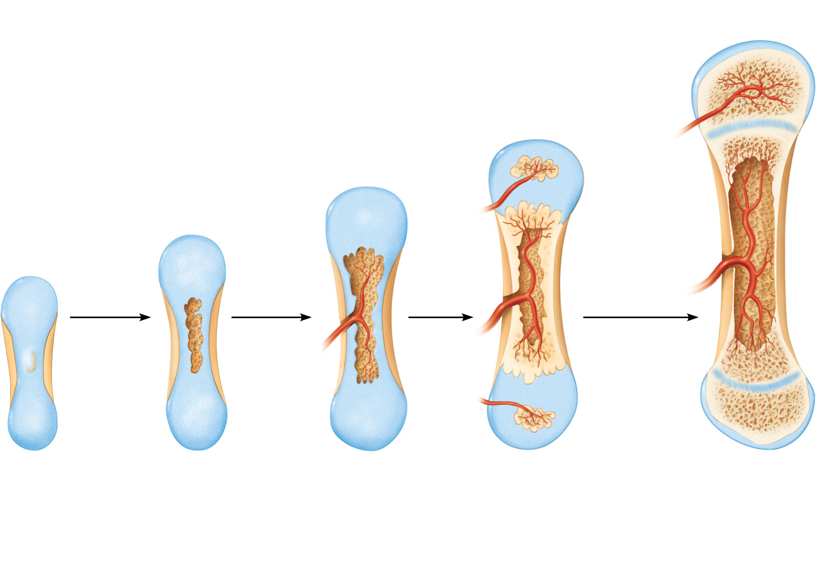
Week 9
Month 3
Birth
Childhood to
adolescence
Articular
cartilage
Secondary
ossification
center
Spongy
bone
Epiphyseal
blood vessel
Area of
deteriorating
cartilage matrix
Epiphyseal
plate
cartilage
Hyaline
cartilage
Spongy
bone
formation
Medullary
cavity
Bone
collar
Blood
vessel of
periosteal
bud
Primary
ossification
center
1
2
3
4
5
Bone collar
forms around
hyaline cartilage
model.
Cartilage in the
center of the
diaphysis calcifies
and then develops
cavities.
The periosteal
bud inavades the
internal cavities
and spongy bone
begins to form.
The diaphysis elongates
and a medullary cavity
forms as ossification
continues. Secondary
ossification centers appear
in the epiphyses in
preparation for stage 5.
The epiphyses
ossify. When
completed, hyaline
cartilage remains only
in the epiphyseal
plates and articular
cartilages.
Figure 6.9

Slide 26
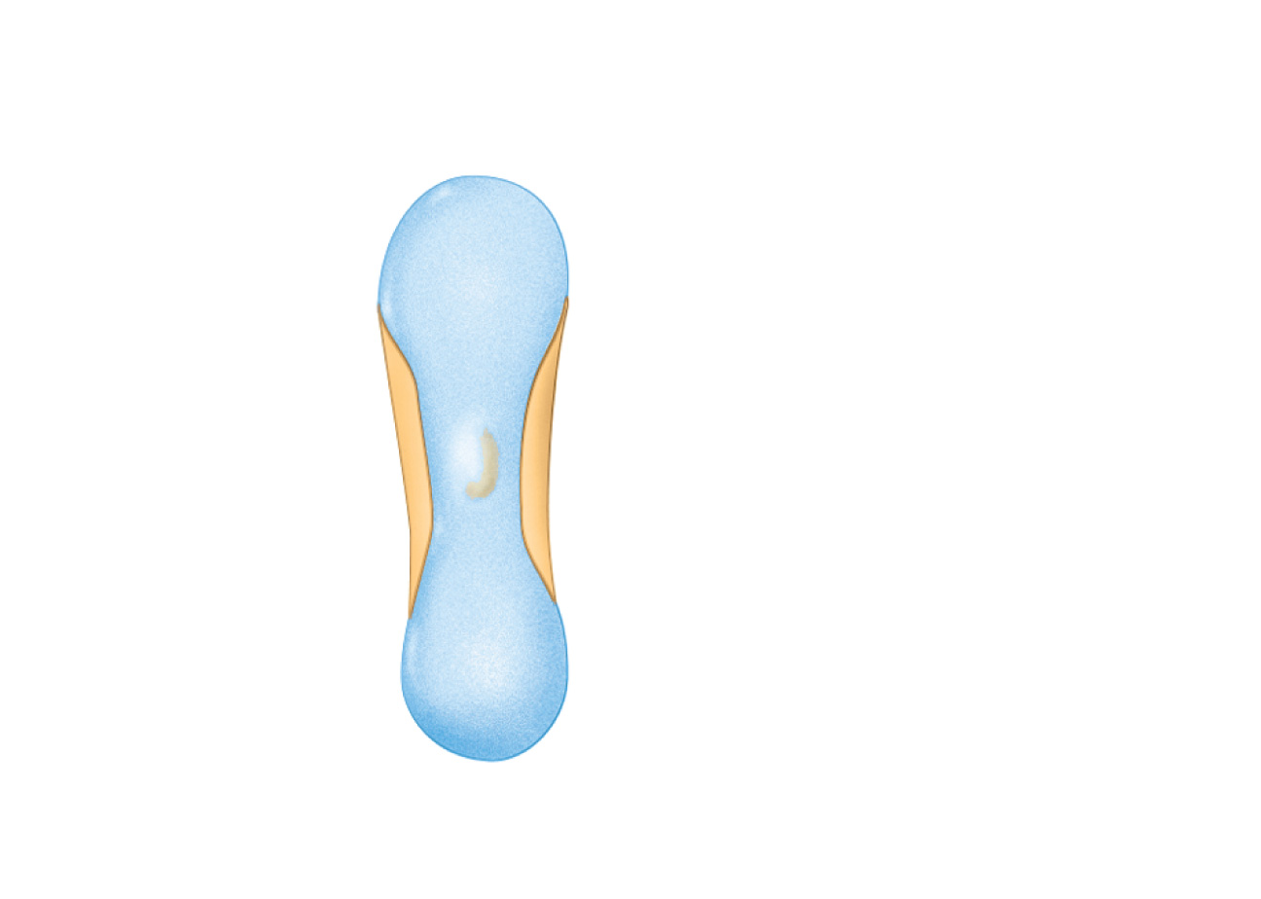
Week 9
Hyaline cartilage
Bone collar
Primary
ossification
center
1
Bone collar forms around
hyaline cartilage model.
Figure 6.9, step 1

Slide 27
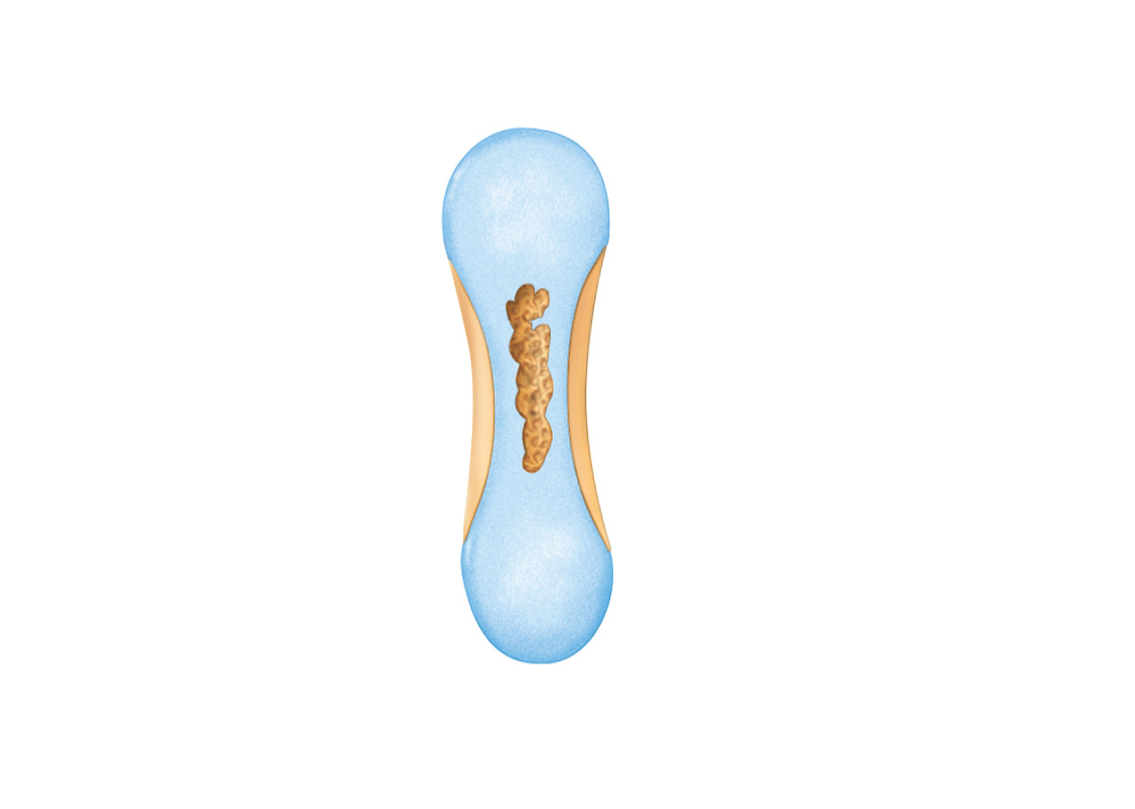
Area of deteriorating
cartilage matrix
2
Cartilage in the center
of the diaphysis calcifies
and then develops cavities.
Figure 6.9, step 2

Slide 28
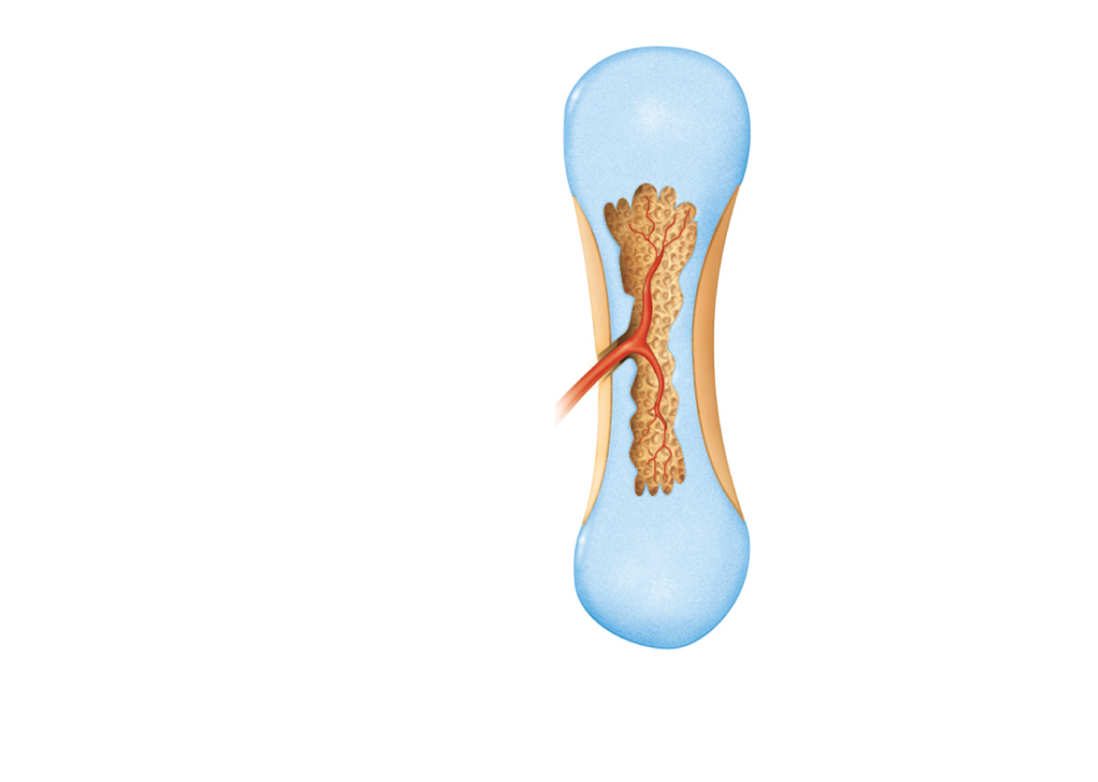
Month 3
Spongy
bone
formation
Blood
vessel of
periosteal
bud
3
The periosteal bud inavades
the internal cavities and
spongy bone begins to form.
Figure 6.9, step 3

Slide 29
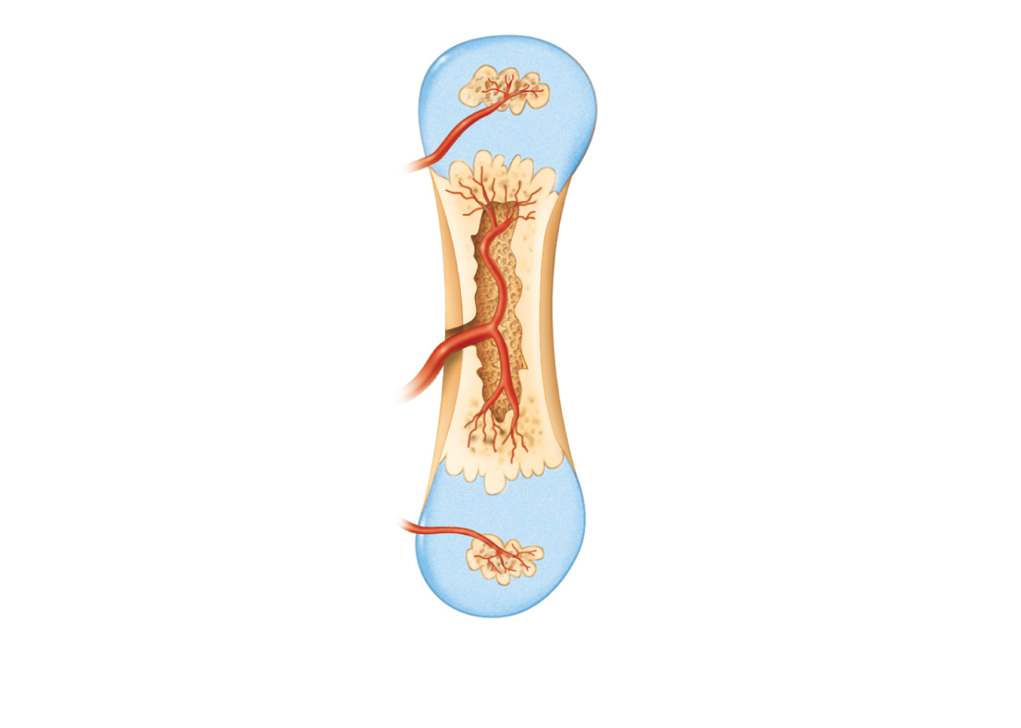
Birth
Epiphyseal
blood vessel
Secondary
ossification
center
Medullary
cavity
4
The diaphysis elongates and a medullary cavity forms
as ossification continues. Secondary ossification centers
appear in the epiphyses in preparation for stage 5.
Figure 6.9, step 4

Slide 30
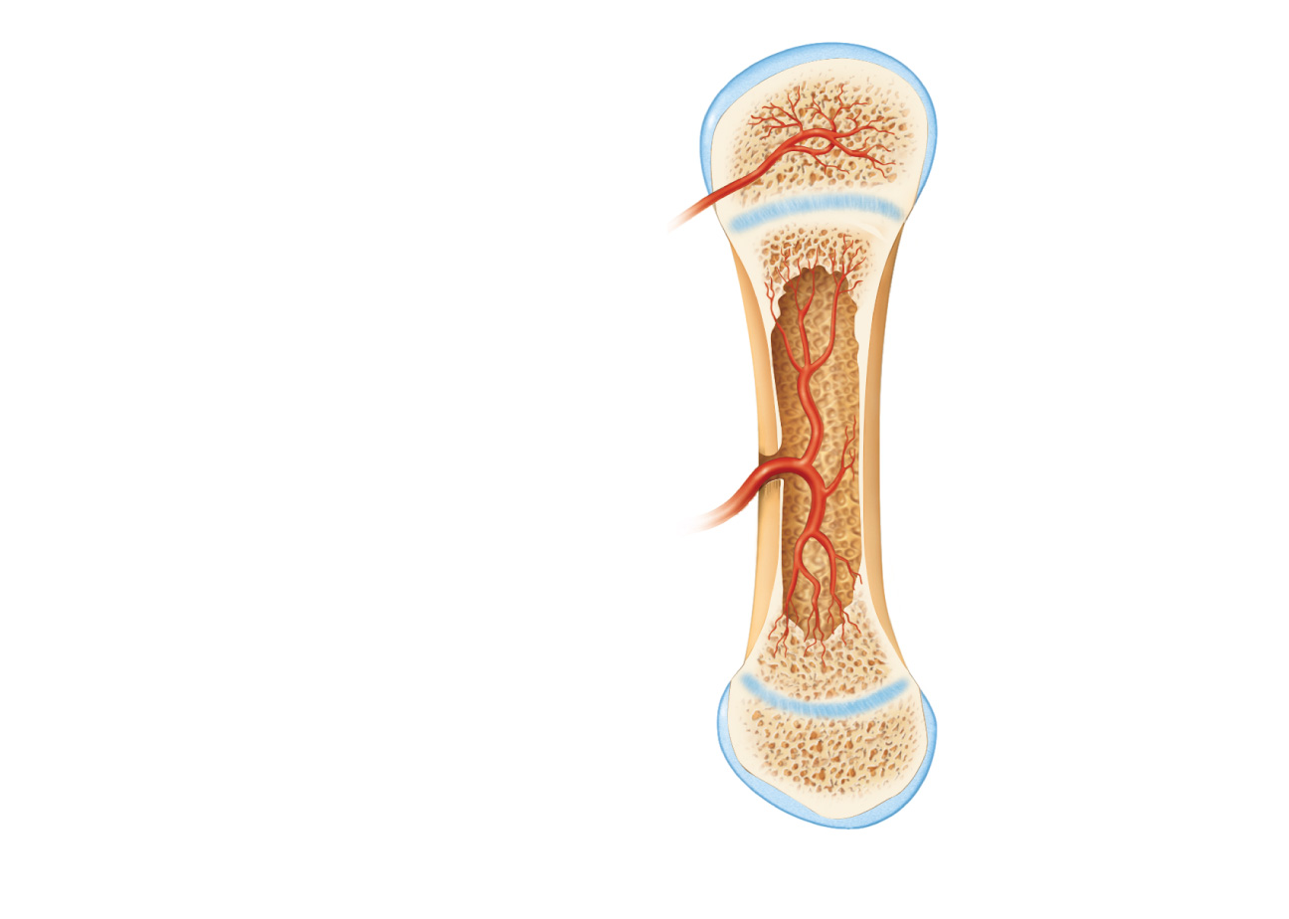
Childhood to adolescence
Articular cartilage
Spongy bone
Epiphyseal plate
cartilage
The epiphyses ossify. When completed, hyaline cartilage
remains only in the epiphyseal plates and articular cartilages.
5
Figure 6.9, step 5

Slide 31
Week 9
Month 3
Birth
Childhood to
adolescence
Articular
cartilage
Secondary
ossification
center
Spongy
bone
Epiphyseal
blood vessel
Area of
deteriorating
cartilage matrix
Epiphyseal
plate
cartilage
Hyaline
cartilage
Spongy
bone
formation
Medullary
cavity
Bone
collar
Blood
vessel of
periosteal
bud
Primary
ossification
center
1
2
3
4
5
Bone collar
forms around
hyaline cartilage
model.
Cartilage in the
center of the
diaphysis calcifies
and then develops
cavities.
The periosteal
bud inavades the
internal cavities
and spongy bone
begins to form.
The diaphysis elongates
and a medullary cavity
forms as ossification
continues. Secondary
ossification centers appear
in the epiphyses in
preparation for stage 5.
The epiphyses
ossify. When
completed, hyaline
cartilage remains only
in the epiphyseal
plates and articular
cartilages.
Figure 6.9

Slide 32
Bone Growth Video to Watch
Bone Growth https://www.youtube.com/watch?v=MI6G1amBarU

Slide 33
Postnatal Bone Growth
Interstitial growth:
  ↑ length of long bones
Appositional growth:
  ↑ thickness and remodeling of all bones by osteoblasts and osteoclasts on bone surfaces

Slide 34
Growth in Length of Long Bones
Epiphyseal plate cartilage (also known as the growth plate) organizes into various zones:
Order of Zones starting with epiphyseal side
Zone of Reserve Cartilage
Zone of Proliferation
Zone of Maturation
Zone of Hypertrophy
Zone of Provisional Calcification
Zone of Ossification

Slide 35
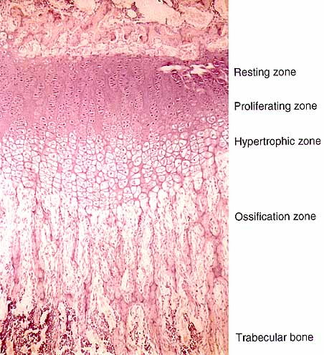
Growth Plate
Zone of Reserve Cartilage
Zone of Proliferation
Zone of Maturation
Zone of Hypertrophy
Zone of Provisional Calcification
Zone of Ossification

Slide 36
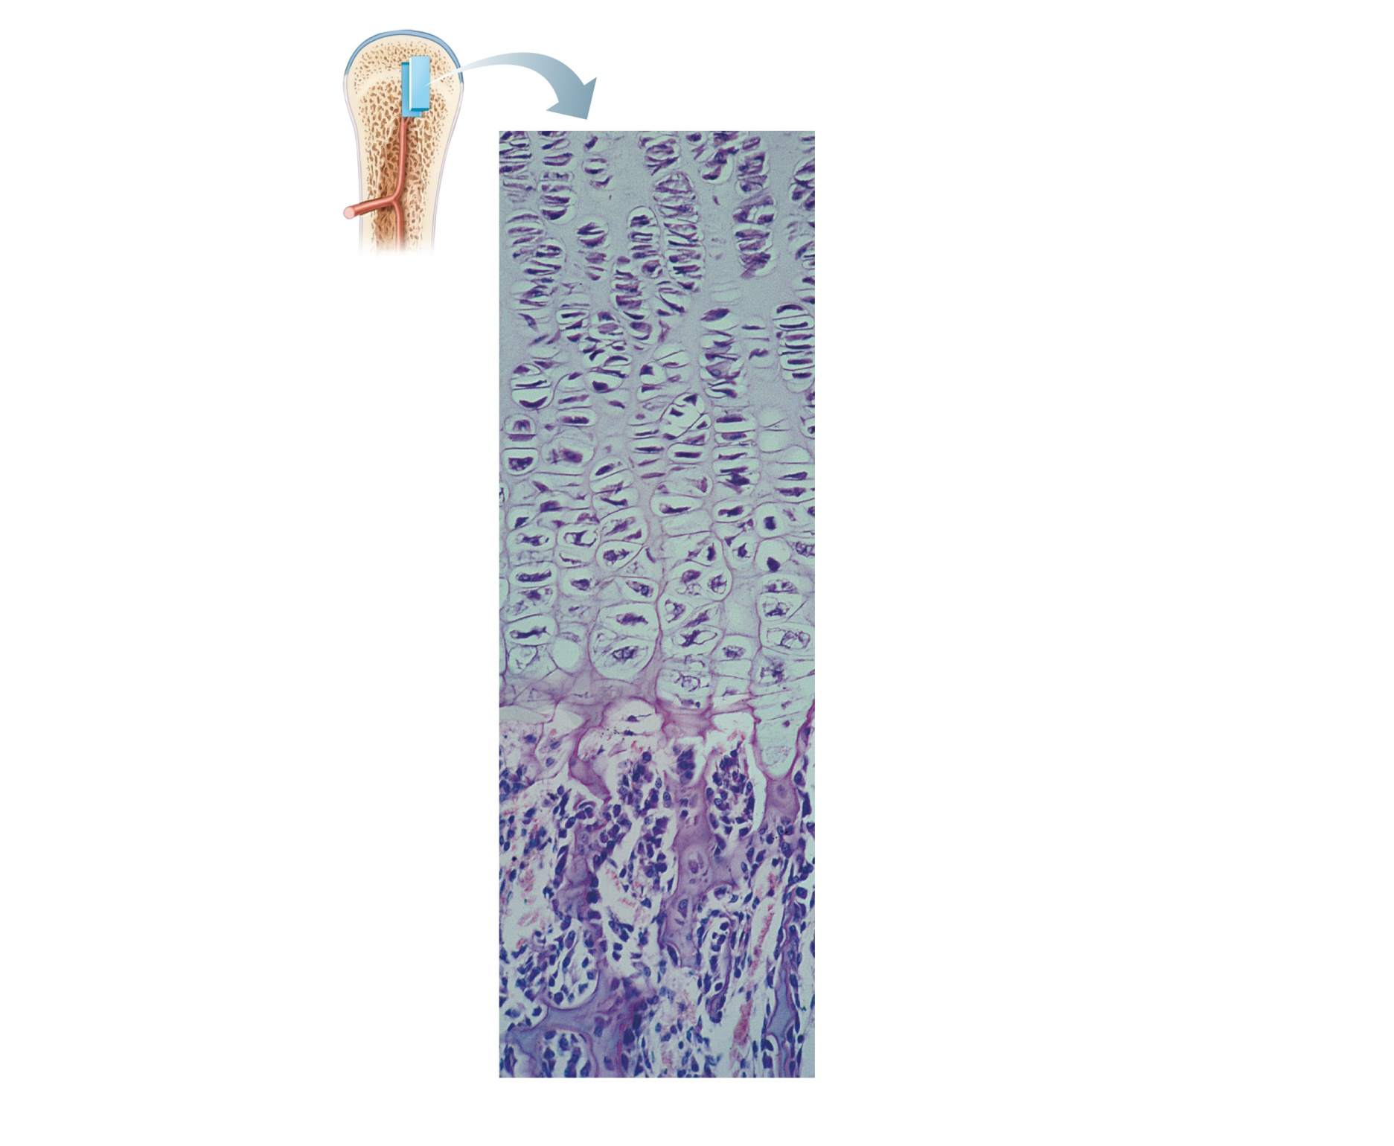
Calcified cartilage
spicule
Calcification zone
Matrix becomes calcified;
cartilage cells die; matrix
begins deteriorating.
Osteoblast depositing
bone matrix
Osseous tissue
(bone) covering
cartilage spicules
Ossification zone
New bone formation is
occurring.
Figure 6.10

Slide 37
Bone Growth in Length
The proliferation rate of the zone of proliferation needs to be as fast or faster than the rate of action in the zone of ossification.
When the rate of the zone of proliferation is faster than the rate of death of cartilage cells in the zone of ossification – the person grows in length
When the proliferation zone rate becomes less than the rate of action in the ossification zone – the ossification zones begins to move towards the proliferation zone killing cartilage cells – the growth plate is closing

Slide 38
Piezoelectric effect on Bone Growth
When a crystalline structure has pressure applied, it will generate a current.
When a crystalline structure has an electric current applied, it will generate pressure.
Bone has hydroxyapatite crystals, thus when pressure is applied to bone it will generate a small current.
The current can cause osteoblasts to start secreting the organic matrix, thus thickening the bone to handle the pressure.

Slide 39
Growth of Bone
Discuss Generic Hormones
1. Types of Hormones (Peptide, Protein. Lipid)
2. Receptors and locations
3. Secondary messengers

Slide 40
Excerpt on Hormones
Hormones are secreted from Endocrine Glands (Source Cells).
Hormones travel long distances in the bloodstream or lymphatics.
Hormones only activate cells (Target Cells) that have receptors for the particular hormone.
Hormones want to communicate with the cell nucleus of the target cell.

Slide 41
Chemistry of Hormones
Two main classes
  1. Amino acid-based hormones
    Amines, thyroxine, peptides, and proteins
  2. Steroids
    Synthesized from cholesterol
    Gonadal and adrenocortical hormones

Slide 42
Mechanisms of Hormone Action
Two mechanisms, depending on their chemical nature
  Water-soluble hormones (all amino acid–based hormones except thyroid hormone)
    Cannot enter the target cells
    Act on plasma membrane receptors
    Coupled by G proteins to intracellular second messengers that mediate the target cell’s response

Slide 43
Mechanisms of Hormone Action
  Lipid-soluble hormones (steroid and thyroid hormones)
    Act on intracellular receptors that directly activate genes

Slide 44
Interaction of Hormones at Target Cells
Multiple hormones may interact in several ways
  Permissiveness: one hormone cannot exert its effects without another hormone being present
  Synergism: more than one hormone produces the same effects on a target cell
  Antagonism: one or more hormones opposes the action of another hormone

Slide 45
Hormonal Regulation of Bone Growth
Growth hormone stimulates epiphyseal plate activity
Thyroid hormone modulates activity of growth hormone
Testosterone and estrogens (at puberty)
  Promote adolescent growth spurts
  End growth by inducing epiphyseal plate closure

Slide 46
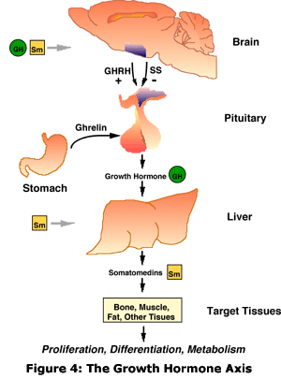

Slide 47
Leptins – central regulation of Bone Mass
Obesity appears to lower risk of osteoporosis
Leptins are known to be involved in regulation of body adiposity, leading to the idea that leptin was involved in regulation of bone
Leptins are produced by adipocytes, receptors located in hypothalamus
Leptins induce catecholamine (adrenalin) secretion from the hypothalamus
Osteoblasts express catecholamine receptors
Estrogen depletion (as with menopause) leads to increased osteoclast activity and net bone resorption

Slide 48
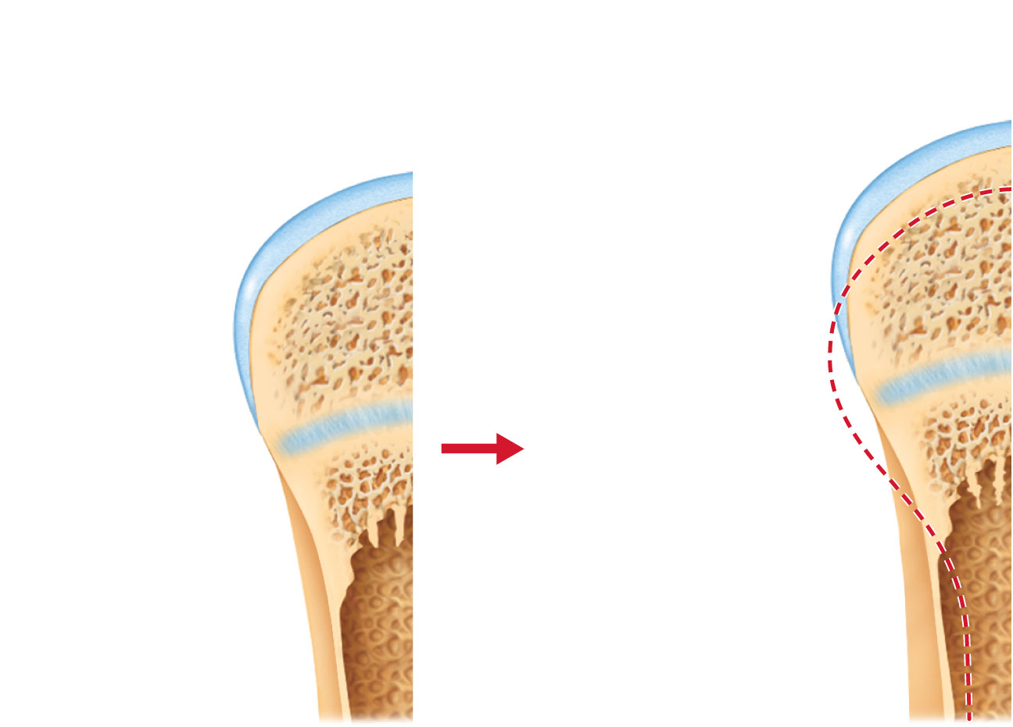
Bone growth
Bone remodeling
Articular cartilage
Cartilage
grows here.
Epiphyseal plate
Cartilage
is replaced
by bone here.
Bone is
resorbed here.
Cartilage
grows here.
Bone is added
by appositional
growth here.
Cartilage
is replaced
by bone here.
Bone is
resorbed here.
Figure 6.11

Slide 49
Bone Deposit
Occurs where bone is injured or added strength is needed
Requires a diet rich in protein; vitamins C, D, and A; calcium; phosphorus; magnesium; and manganese

Slide 50
Bone Deposit
Sites of new matrix deposit are revealed
by the
  Osteoid seam
    Unmineralized band of matrix
  Calcification front
    The abrupt transition zone between the osteoid seam and the older mineralized bone

Slide 51
Bone Resorption
Osteoclasts secrete
  Lysosomal enzymes (digest organic matrix)
  Acids (convert calcium salts into soluble forms)
Dissolved matrix is transcytosed across osteoclast, enters interstitial fluid and then blood

Slide 52
Control of Remodeling
What controls continual remodeling of bone?
  Hormonal mechanisms that maintain calcium homeostasis in the blood
  Mechanical and gravitational forces

Slide 53
PTH
PTH – Parathyroid Hormone – released from the parathyroid gland is the major controller of the blood calcium level.
Parathyroid hormone increases the blood calcium level, by causing A. increased breakdown of bone by osteoclasts B. increased reabsorption of calcium in the kidneys C. Increased absorption of calcium in the intestines.

Slide 54
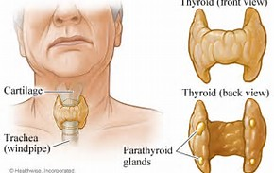
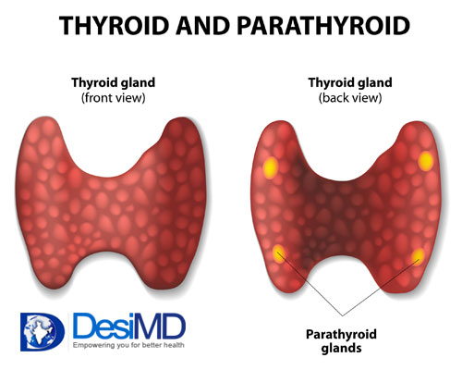

Slide 55
Calcitonin
Calcitonin is secreted by the parafollicular cells of the thyroid gland.
This hormone acts a secondary hormone (behind PTH) to lower blood calcium level.
If the PTH level falls and the blood calcium level is still too high, calcitonin is released.

Slide 56
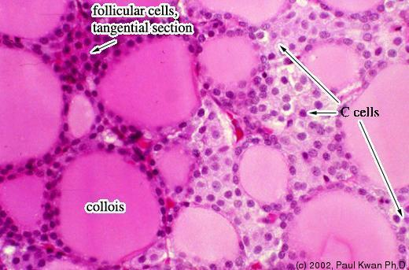

Slide 57
Hormonal Control of Blood Ca²⁺
Calcium is necessary for
  Transmission of nerve impulses
  Muscle contraction
  Blood coagulation
  Secretion by glands and nerve cells
  Cell division

Slide 58
Hormonal Control of Blood Ca²⁺
Primarily controlled by parathyroid hormone (PTH)
  ↓ Blood Ca²⁺ levels
  ↓
  Parathyroid glands release PTH
  ↓
  PTH stimulates osteoclasts to degrade bone matrix and release Ca²⁺
  ↓
  ↑ Blood Ca²⁺ levels

Slide 59
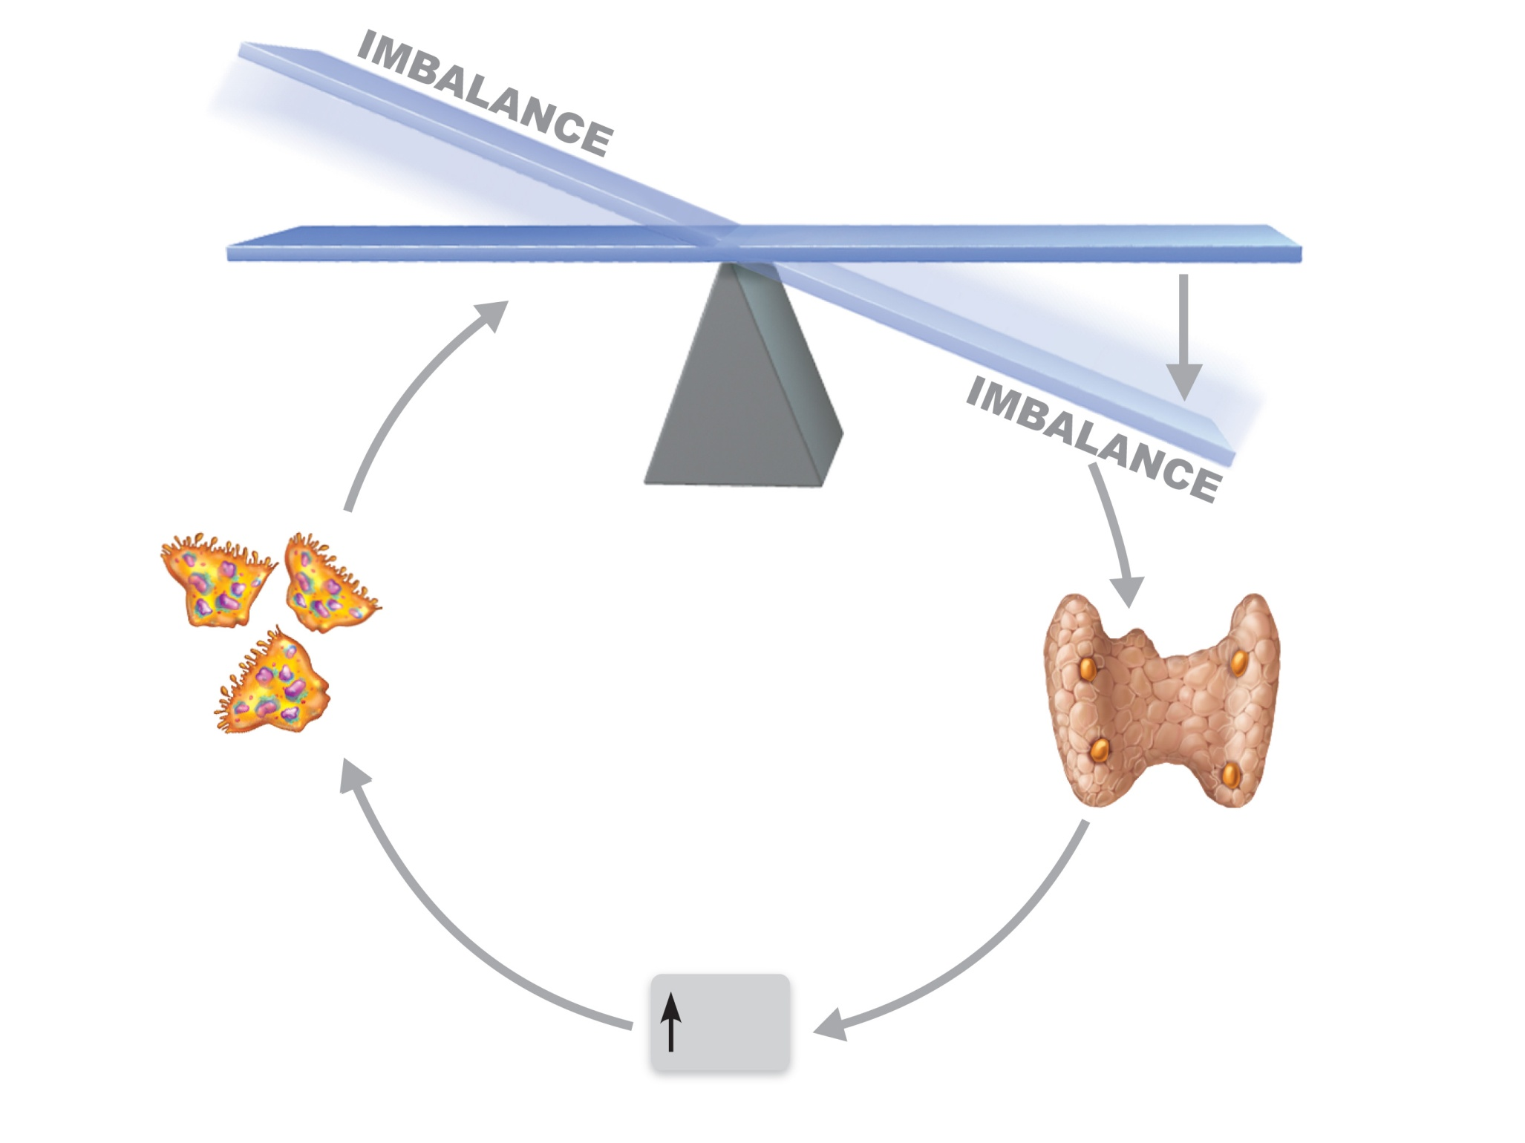
Calcium homeostasis of blood: 9–11 mg/100 ml
BALANCE
BALANCE
Stimulus
Falling blood
Ca²⁺ levels
Thyroid
gland
Osteoclasts
degrade bone
matrix and
release Ca²⁺
into blood.
Parathyroid
glands
Parathyroid
glands release
parathyroid
hormone (PTH).
PTH
Figure 6.12

Slide 60
Hormonal Control of Blood Ca²⁺
May be affected to a lesser extent by calcitonin
  ↑ Blood Ca²⁺ levels
  ↓
  Parafollicular cells of thyroid release calcitonin
  ↓
  Osteoblasts deposit calcium salts
  ↓
  ↓ Blood Ca²⁺ levels
Leptin has also been shown to influence bone density by inhibiting osteoblasts

Slide 61
Response to Mechanical Stress
Wolff’s law: A bone grows or remodels in response to forces or demands placed upon it
Observations supporting Wolff’s law:
  Handedness (right or left handed) results in bone of one upper limb being thicker and stronger
  Curved bones are thickest where they are most likely to buckle
  Trabeculae form along lines of stress
  Large, bony projections occur where heavy, active muscles attach

Slide 62
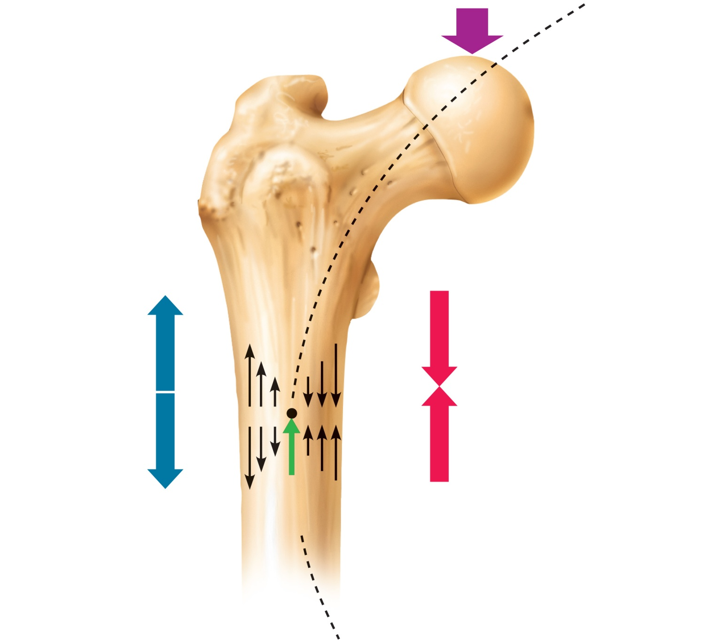
Load here (body weight)
Head of
femur
Tension
here
Compression
here
Point of
no stress
Figure 6.13

Slide 63
Classification of Bone Fractures
Bone fractures may be classified by four “either/or” classifications:
  Position of bone ends after fracture:
    Nondisplaced—ends retain normal position
    Displaced—ends out of normal alignment
  Completeness of the break
    Complete—broken all the way through
    Incomplete—not broken all the way through

Slide 64
Classification of Bone Fractures
  Orientation of the break to the long axis of the bone:
    Linear—parallel to long axis of the bone
    Transverse—perpendicular to long axis of the bone
  Whether or not the bone ends penetrate the skin:
    Compound (open)—bone ends penetrate the skin
    Simple (closed)—bone ends do not penetrate the skin

Slide 65
Common Types of Fractures
All fractures can be described in terms of
  Location
  External appearance
  Nature of the break

Slide 66
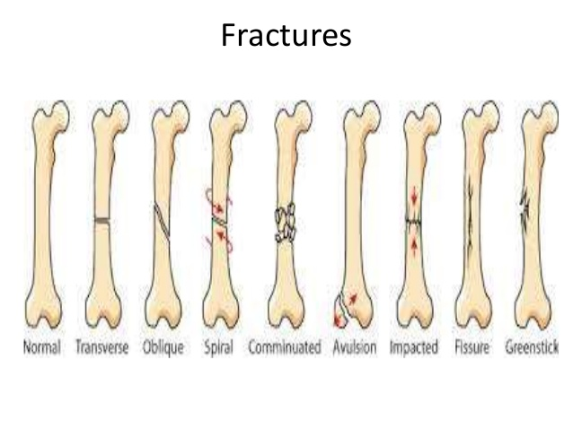

Slide 67
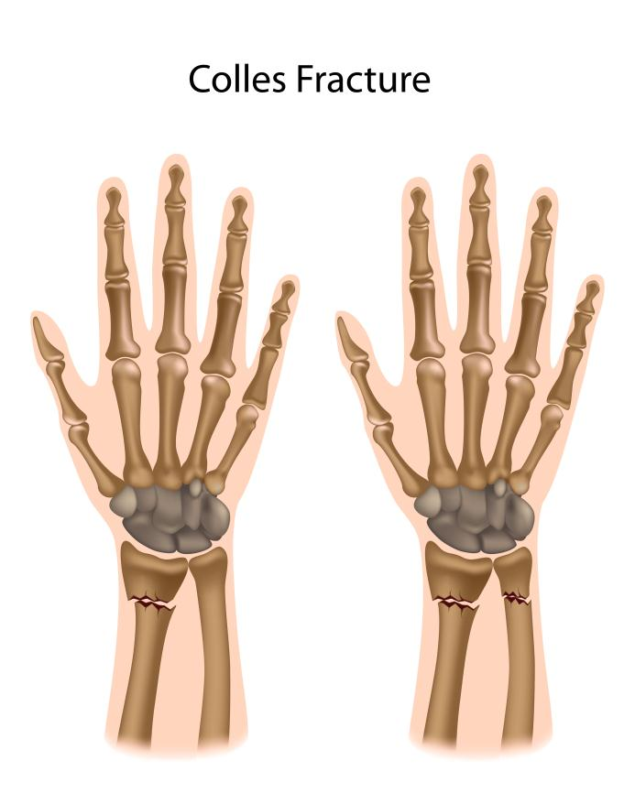
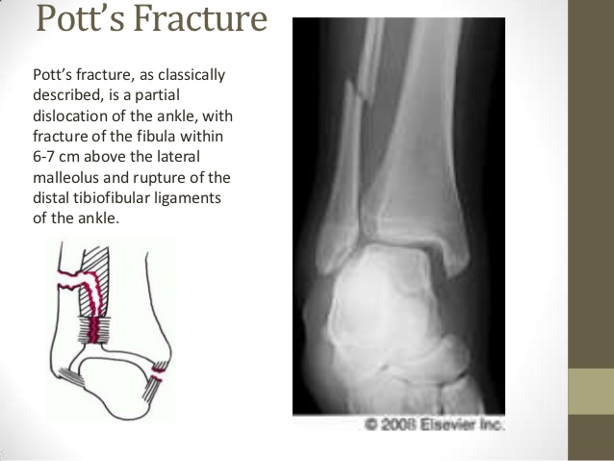

Slide 68
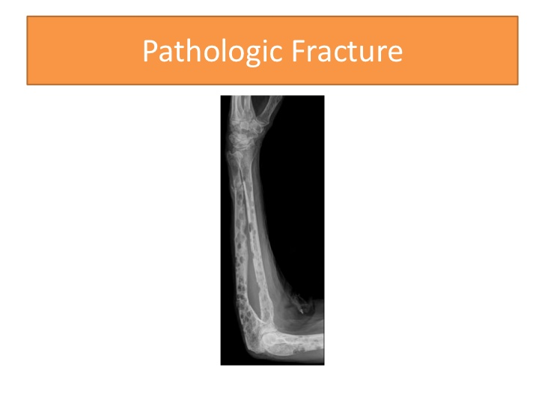

Slide 70
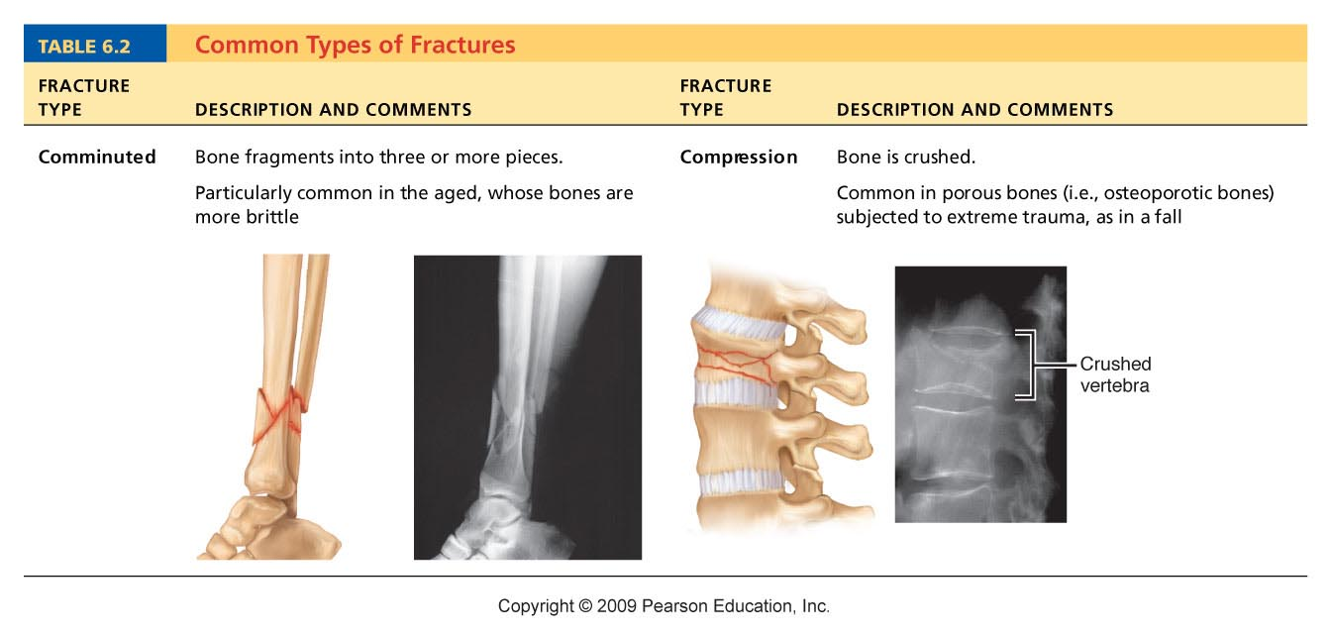
Table 6.2

Slide 71
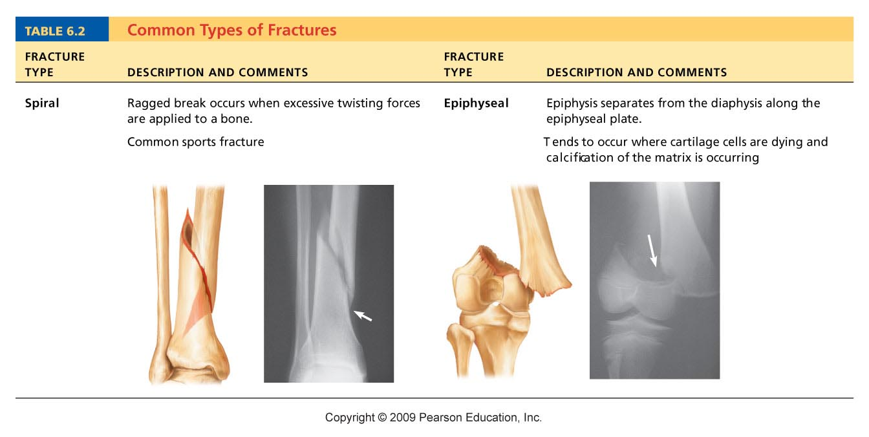
Table 6.2

Slide 72
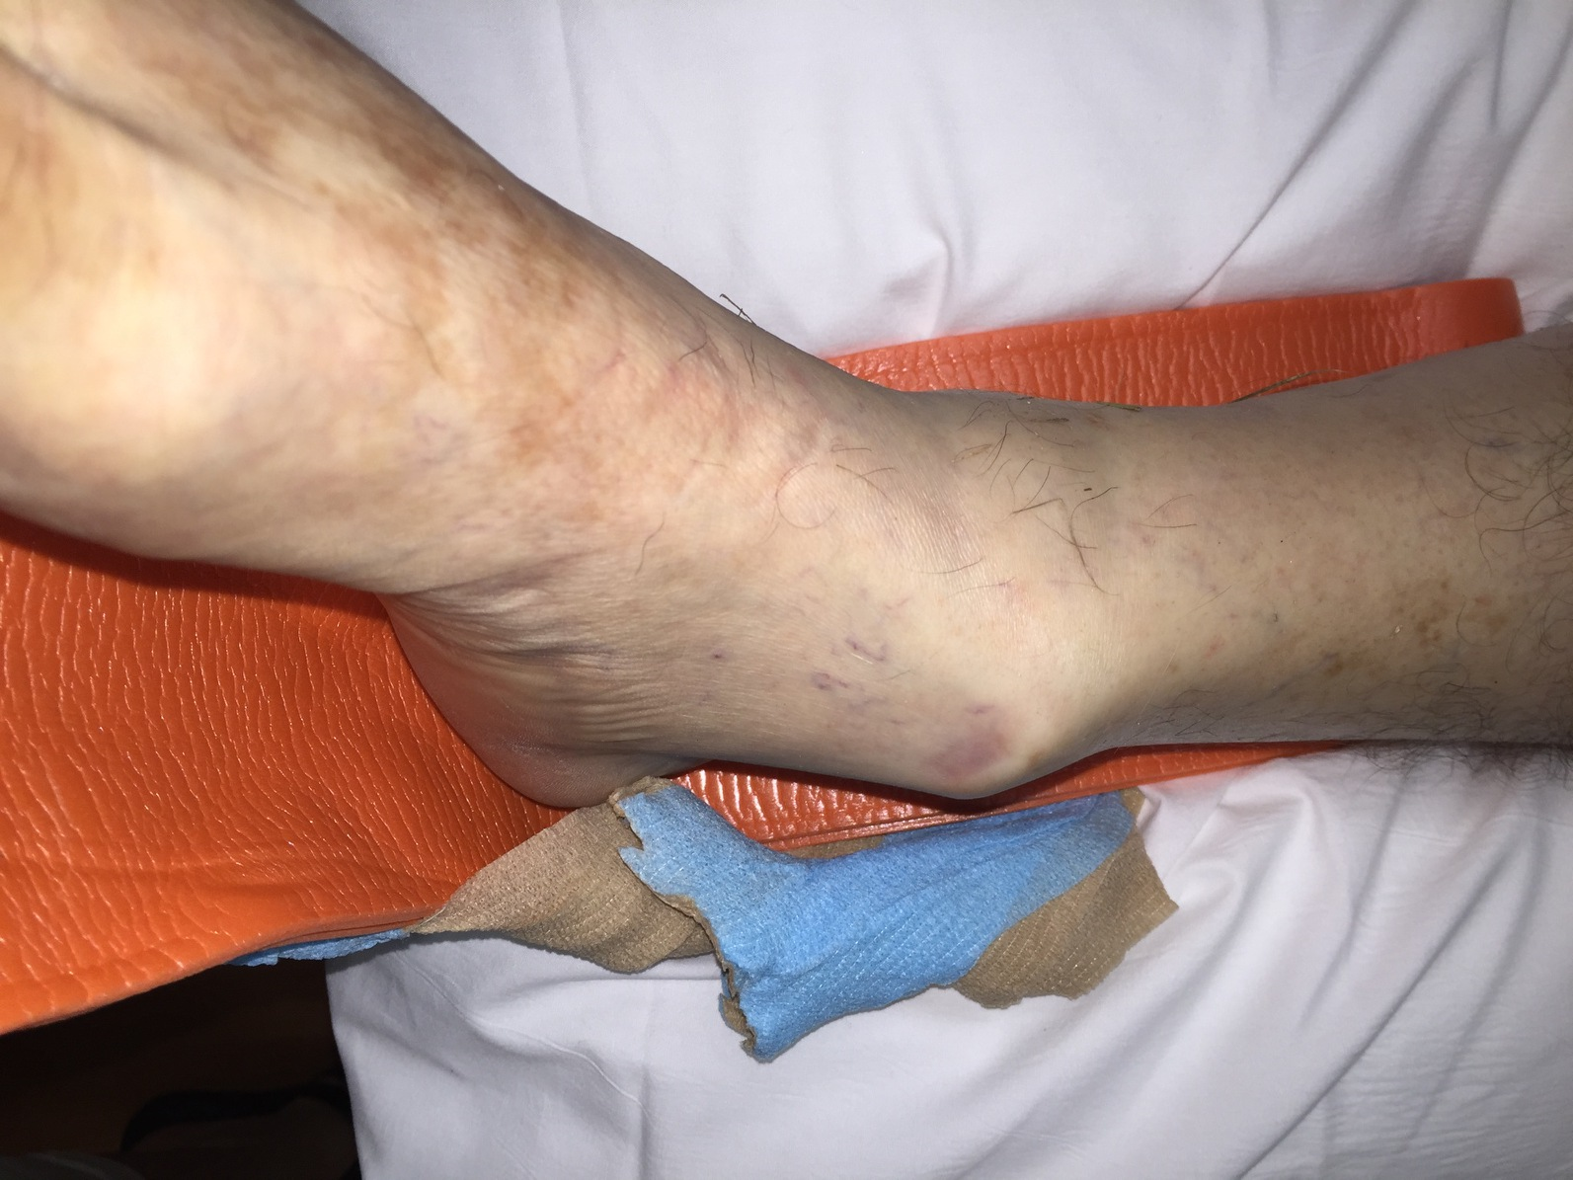
Ankle Break

Slide 73
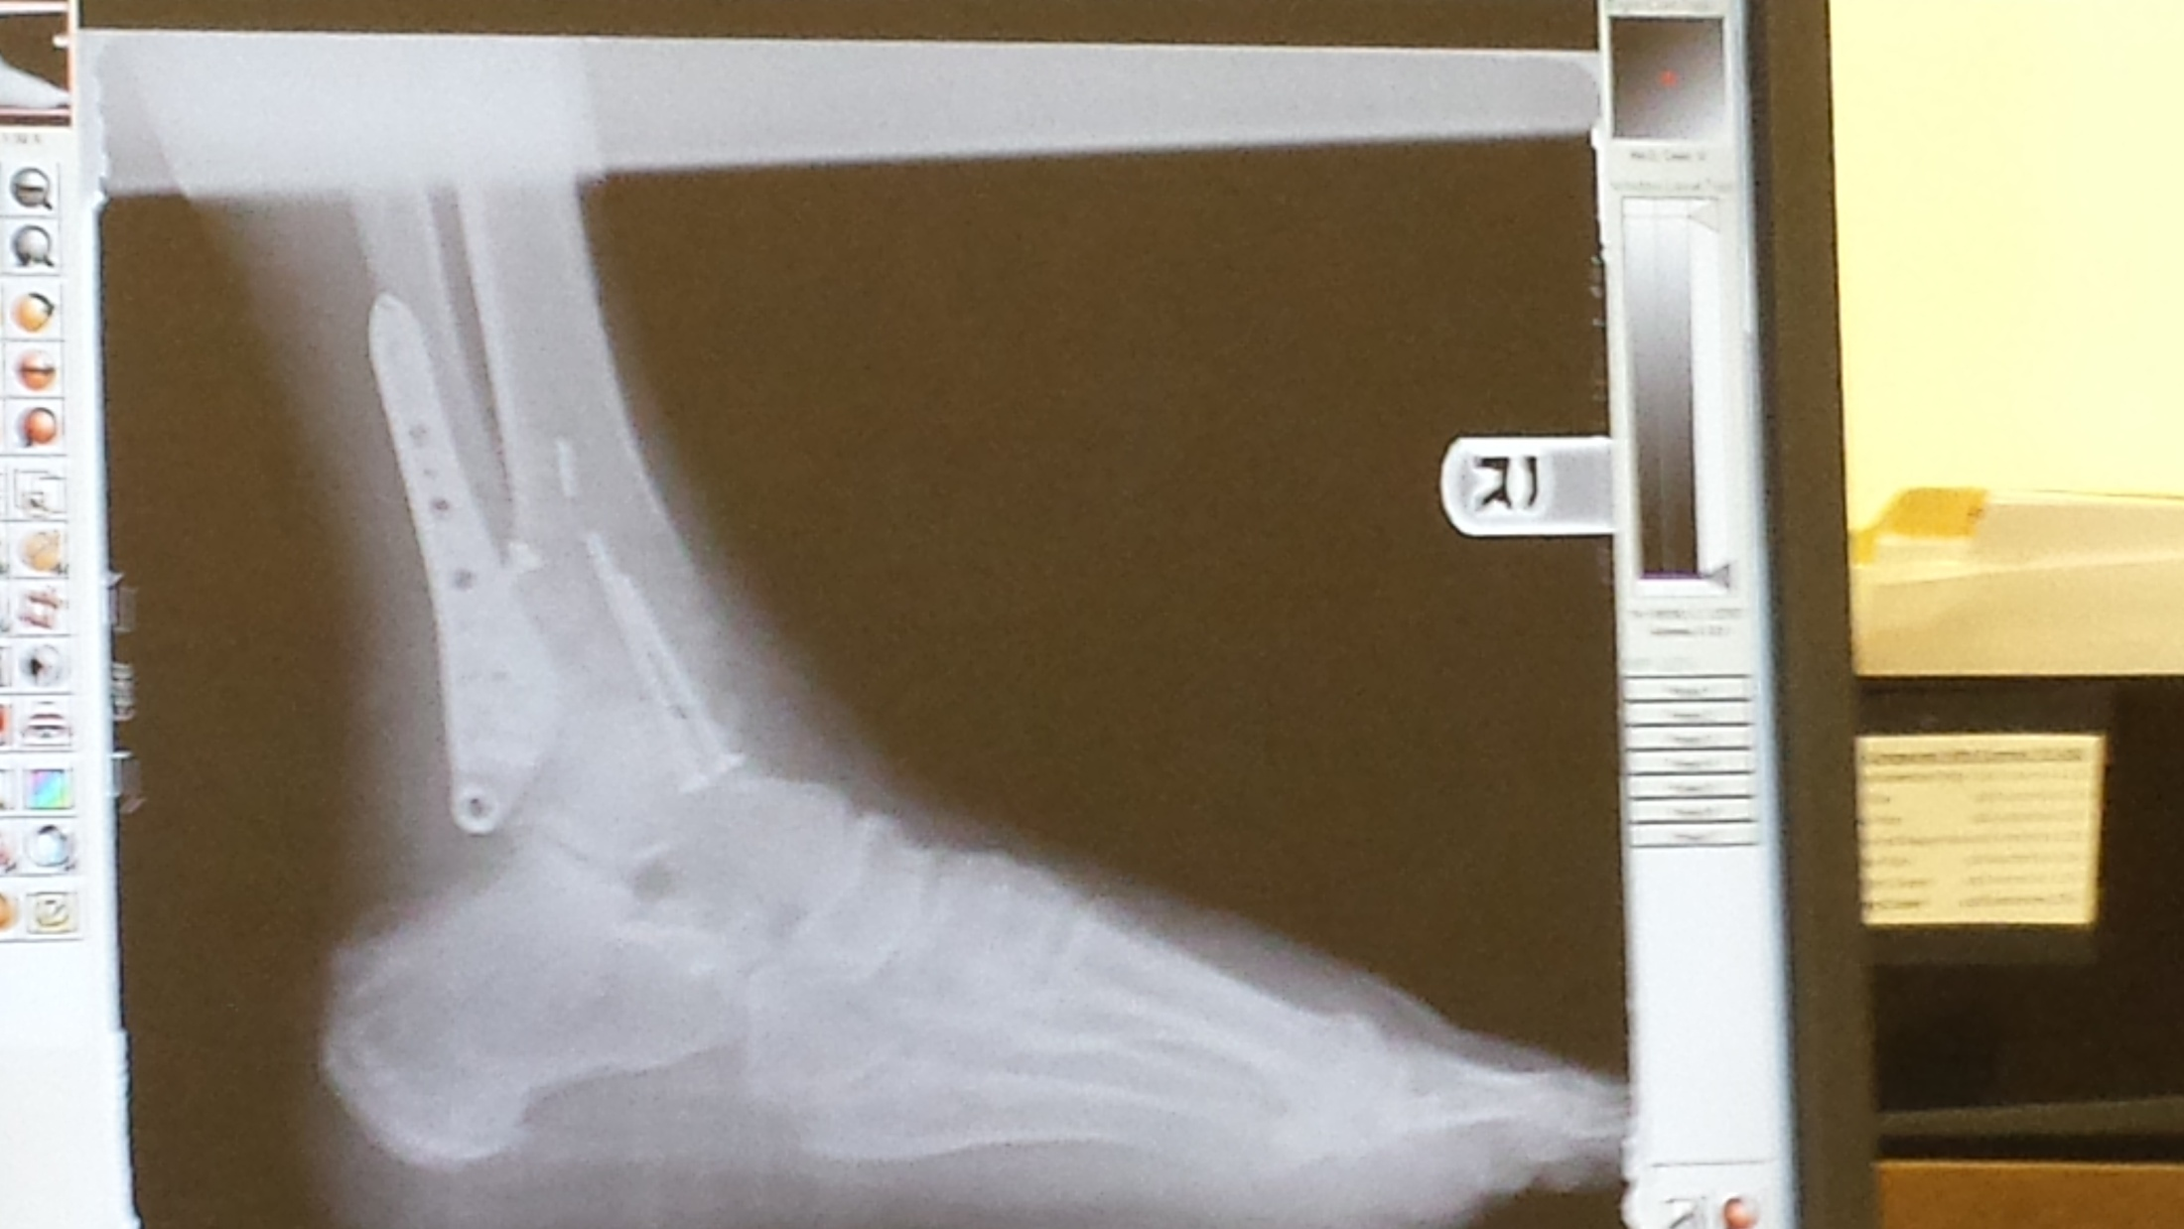
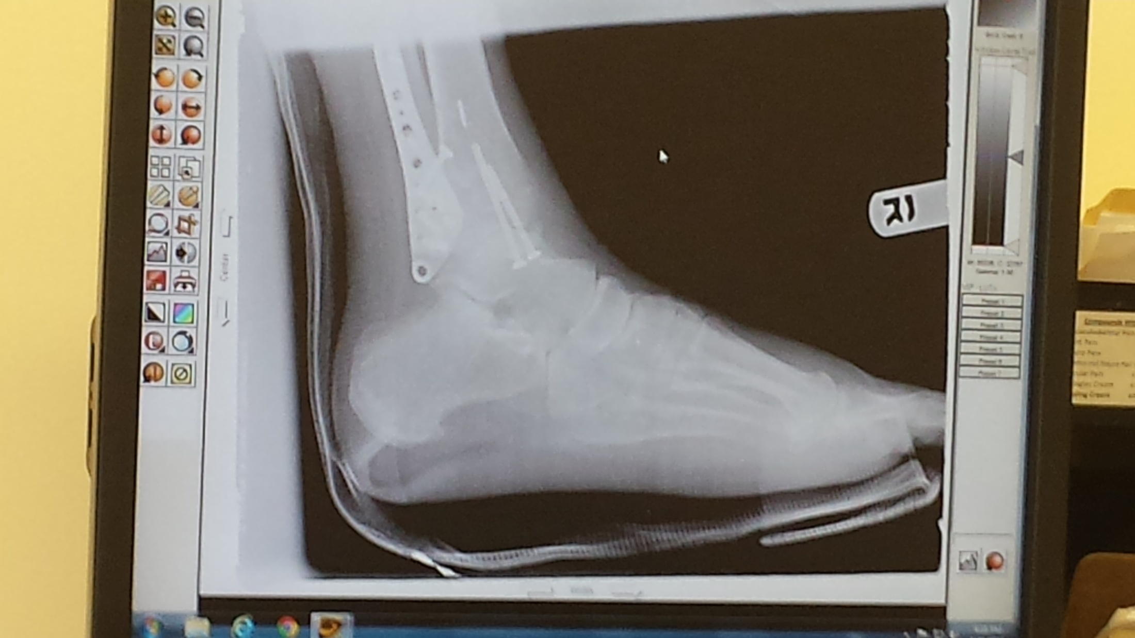
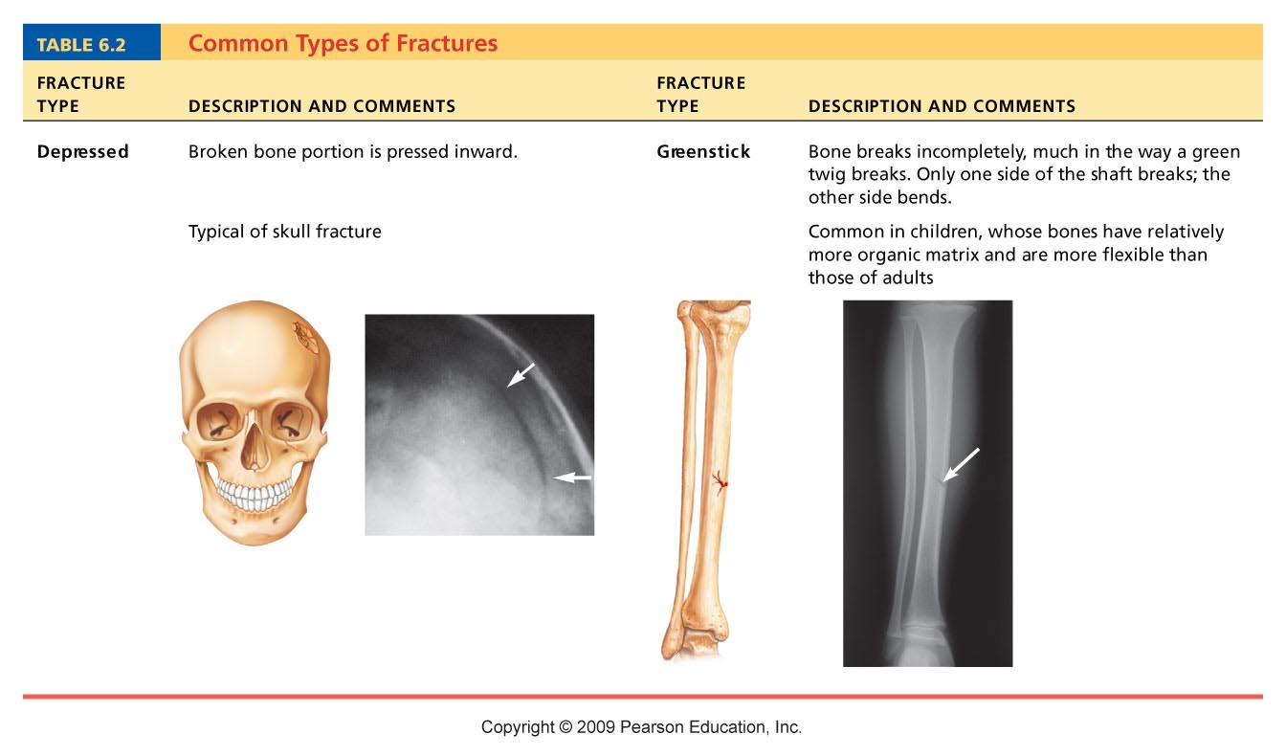
Table 6.2

Slide 74


Slide 75
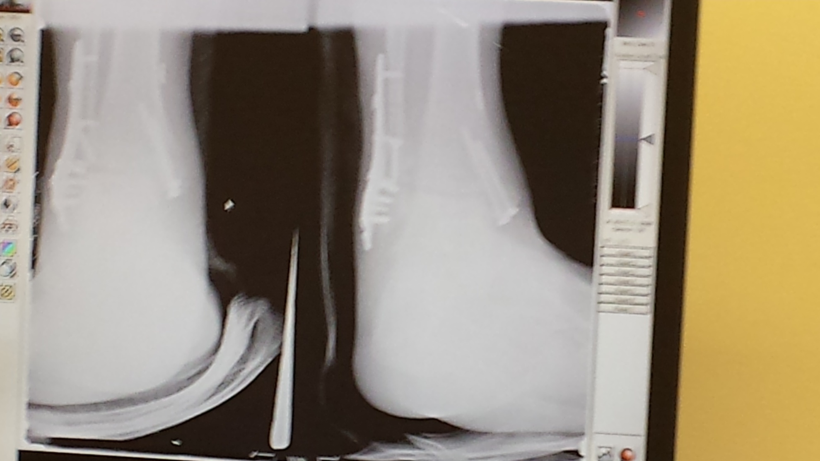

Slide 76
Stages in the Healing of a Bone Fracture
Hematoma forms
  Torn blood vessels hemorrhage
  Clot (hematoma) forms
  Site becomes swollen, painful, and inflamed

Slide 77
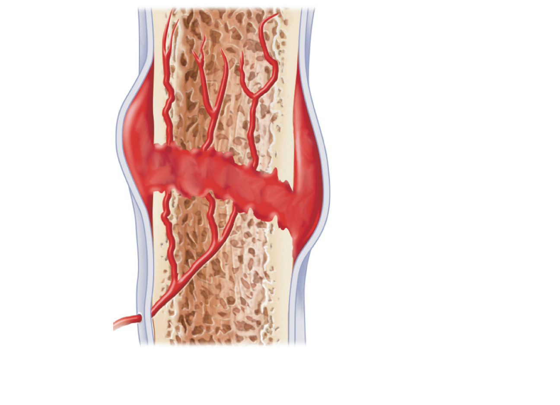
Hematoma
1
A hematoma forms.
Figure 6.15, step 1

Slide 78
Stages in the Healing of a Bone Fracture
Fibrocartilaginous callus forms
  Phagocytic cells clear debris
  Osteoblasts begin forming spongy bone within 1 week
  Fibroblasts secrete collagen fibers to connect bone ends
  Mass of repair tissue now called fibrocartilaginous callus

Slide 79
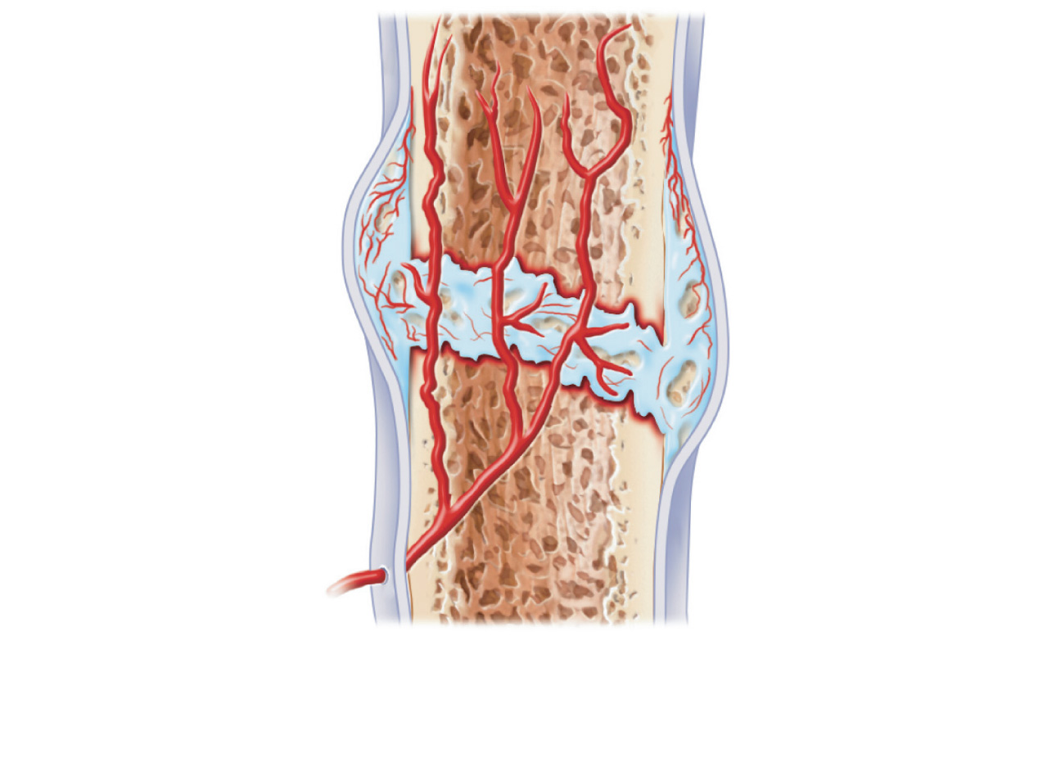
External
callus
Internal
callus
(fibrous
tissue and
cartilage)
New
blood
vessels
Spongy
bone
trabecula
2
Fibrocartilaginous
callus forms.
Figure 6.15, step 2

Slide 80
Stages in the Healing of a Bone Fracture
Bony callus formation
  New trabeculae form a bony (hard) callus
  Bony callus formation continues until firm union is formed in ~2 months

Slide 81
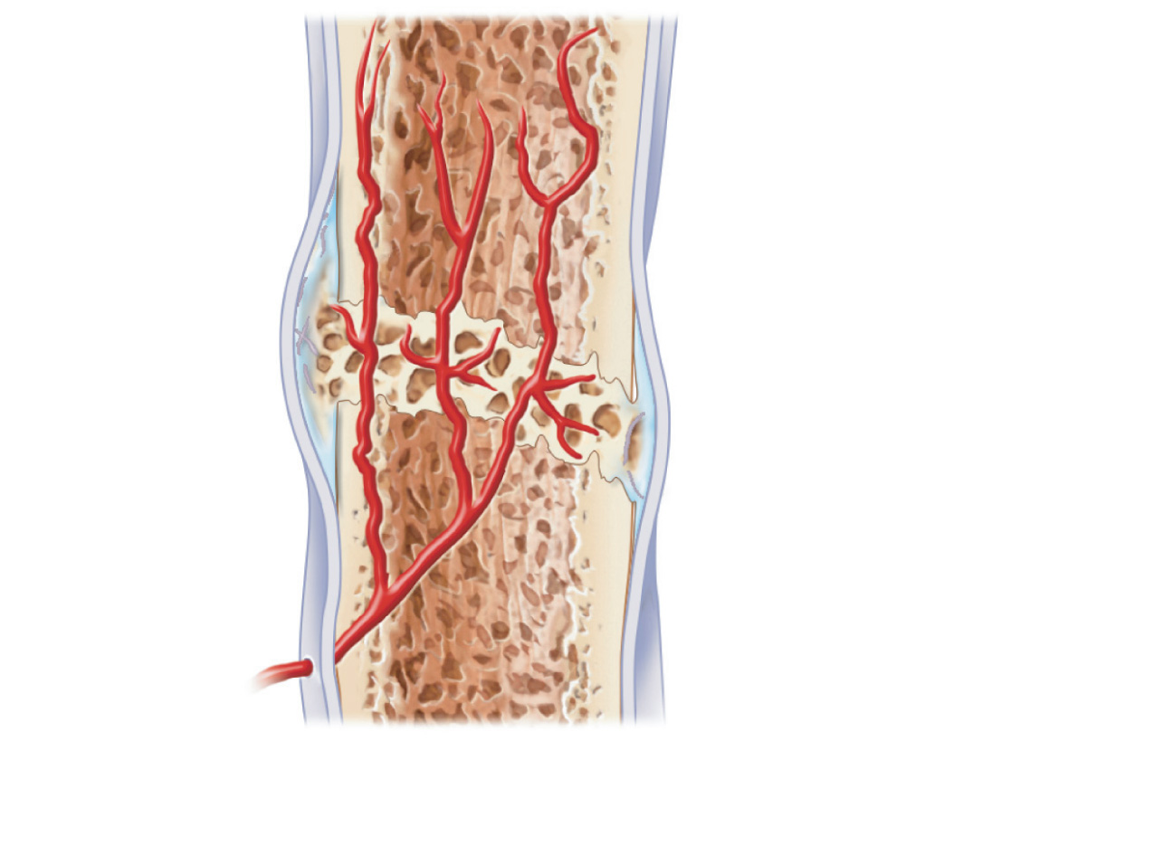
Bony
callus of
spongy
bone
3
Bony callus forms.
Figure 6.15, step 3

Slide 82
Stages in the Healing of a Bone Fracture
Bone remodeling
  In response to mechanical stressors over several months
  Final structure resembles original

Slide 83
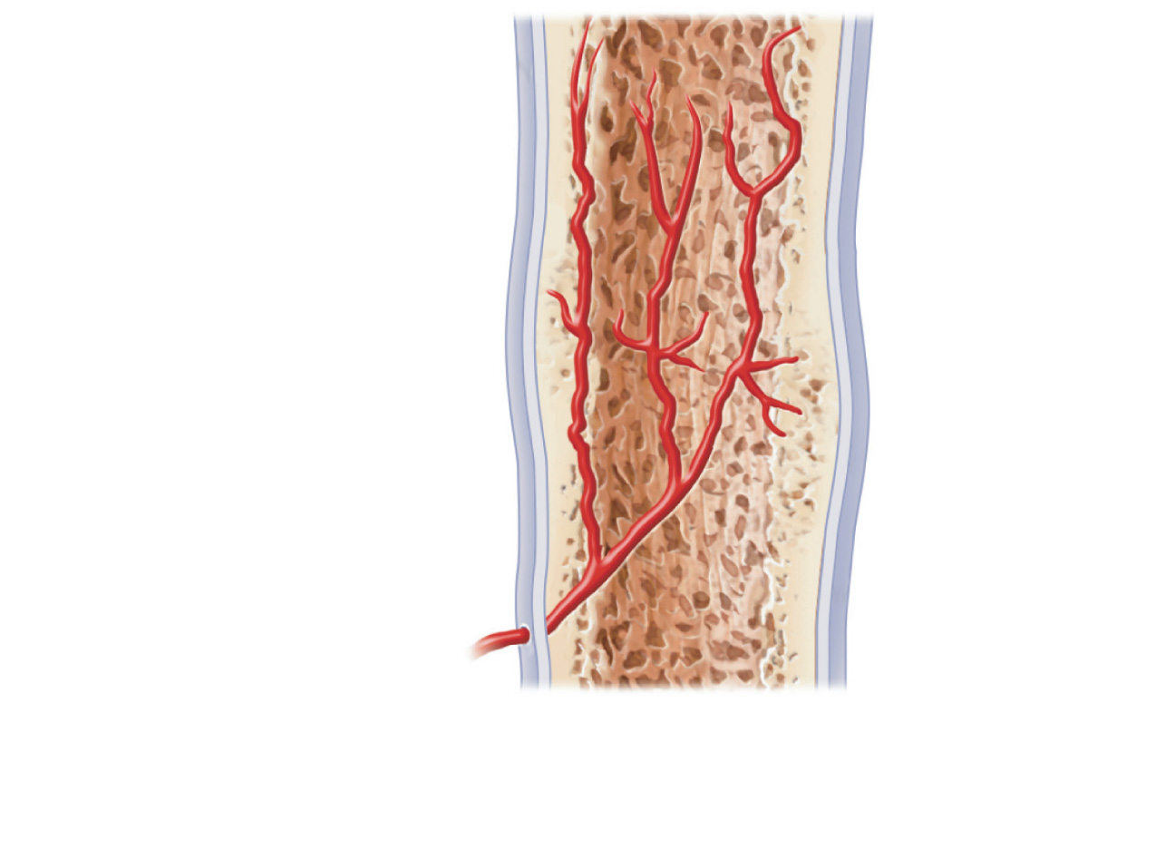
Healed
fracture
4
Bone remodeling
occurs.
Figure 6.15, step 4

Slide 84
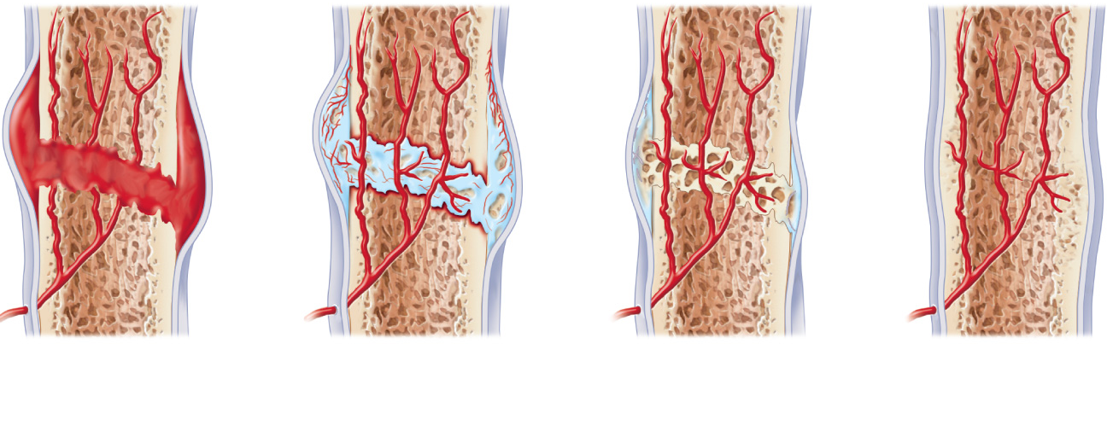
Hematoma
External
callus
Bony
callus of
spongy
bone
Internal
callus
(fibrous
tissue and
cartilage)
New
blood
vessels
Healed
fracture
Spongy
bone
trabecula
1
A hematoma forms.
2
3
4
Fibrocartilaginous
callus forms.
Bony callus forms.
Bone
remodeling
occurs.
Figure 6.15

Slide 85
Homeostatic Imbalances
Osteomalacia and rickets (bone softening)
Deficiency of adequate inorganic (calcified) matrix
  Calcium salts not deposited
  Rickets (childhood disease) causes bowed legs and other bone deformities
  Cause: vitamin D deficiency or insufficient dietary calcium

Slide 86
PTH
PTH – Parathyroid Hormone – released from the parathyroid gland is the major controller of the blood calcium level.
Parathyroid hormone increases the blood calcium level, by causing A. increased breakdown of bone by osteoclasts B. increased reabsorption of calcium in the kidneys C. Increased absorption of calcium in the intestines.

Slide 87
Vitamin D Synthesis
Cholesterol 7-Dehydrocholesterol (skin cells of *SB and *SS)
7 – Dehydrocholesterol Cholecalciferol (UVB light in skin) D1
Cholecalciferol 25 OH Cholecalciferol (Liver Enzyme) D2
25 OH Choecalciferol 1, 25 Dihydroxycholecalciferol D3
Kidney Enzyme
D3 is the active form of Vitamin D. It carries out the function of PTH, thus it acts as a hormone. It A. increased reabsorption of calcium in the kidneys B. Increased absorption of calcium in the intestines.
PTH Activates the kidney enzyme

Slide 88
Osteomalcia
Osteomalacia in the adult is most commonly found in confined, dark-skinned, or diet-in balanced subjects. Many of the effects of the disease overlap with the more common osteoporosis, but the two diseases are significantly different. Osteomalacia is specifically a defect in mineralization of the protein framework known as osteoid. This defective mineralization is mainly caused by lack in vitamin D.

Slide 89
Osteomalacia
Causes
Insufficient sunlight exposure, especially in dark-skinned subjects – blocking of UVB
Insufficient nutritional quantities or faulty metabolism of vitamin D or phosphorus
Renal tubular acidosis
Malnutrition during pregnancy
Malabsorption syndrome
Chronic renal failure
Tumor-induced osteomalacia

Slide 90
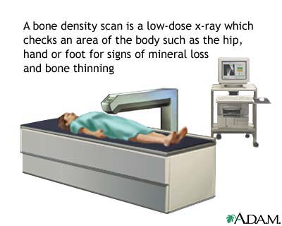
Bone Density Scan

Slide 91
Osteopenia
Osteopenia is a condition where bone mineral density is lower than normal. It is considered by many doctors to be a precursor to osteoporosis. However, not every person diagnosed with osteopenia will develop osteoporosis. More specifically, osteopenia is defined as a bone mineral density Z score between -1.0 and -2.5

Slide 92
Z-score
The Z-score is a comparison of a patient's BMD (Bone Mineral Density) to that of a healthy thirty-year-old of the same sex and ethnicity. This value is used in post-menopausal women and men over aged 50 because it better predicts risk of future fracture. The criteria of the World Health Organization are:
Normal is a Z-score of -1.0 or higher
Osteopenia is defined as less than -1.0 and greater than -2.5
Osteoporosis is defined as -2.5 or lower, meaning a bone density that is two and a half standard deviations below the mean of a thirty year old woman.

Slide 93
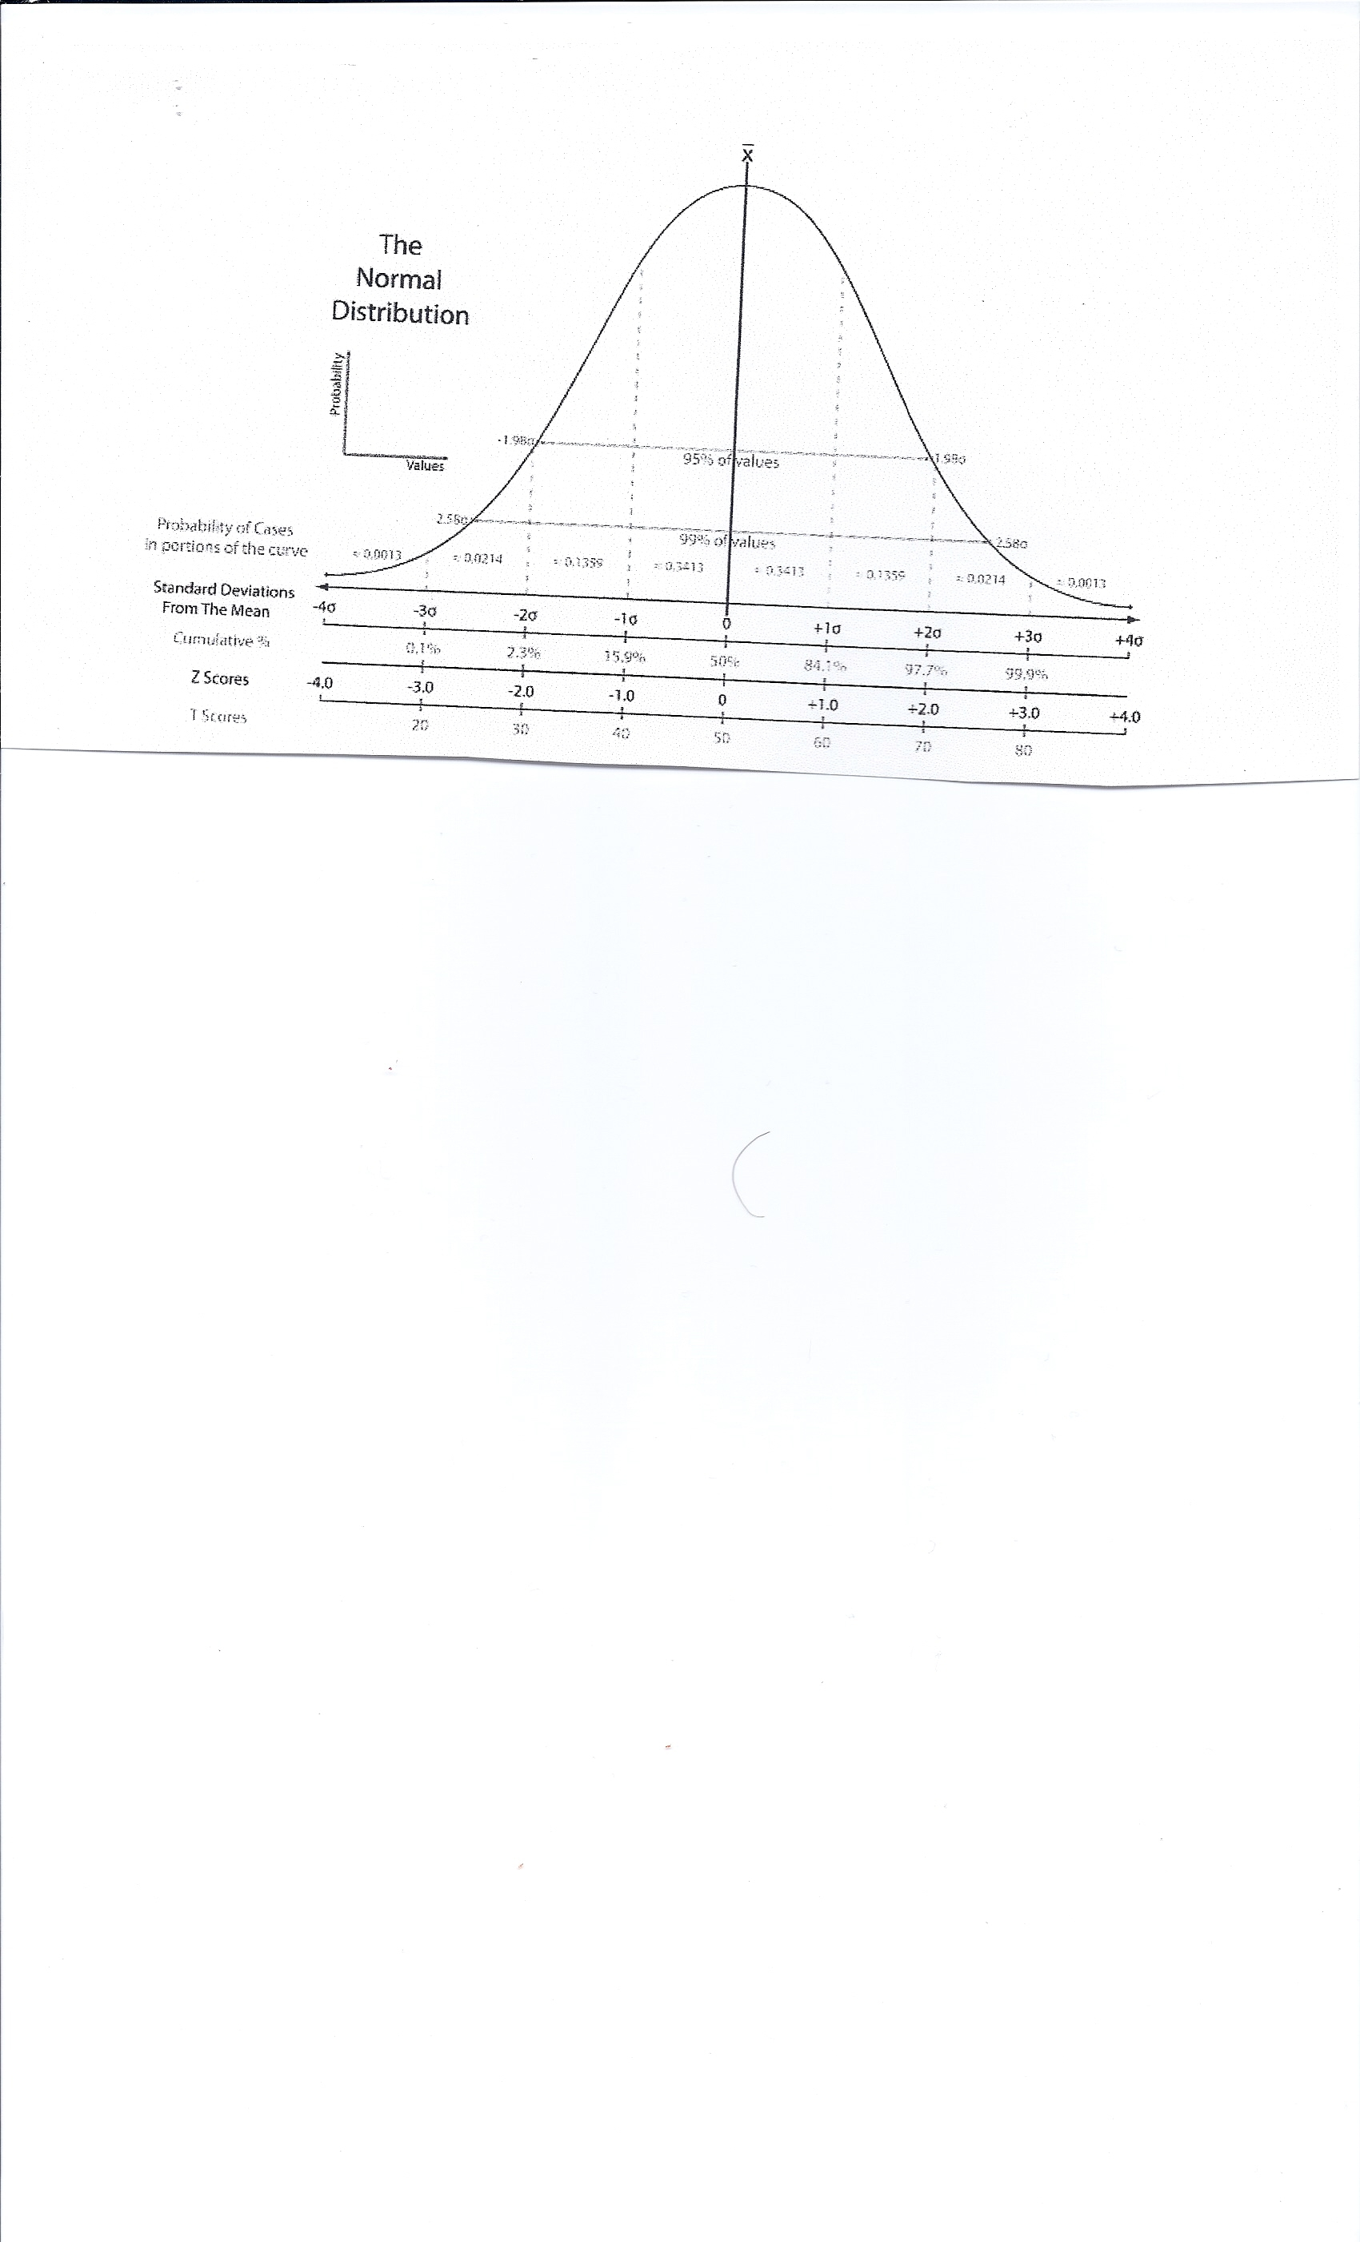

Slide 94
Homeostatic Imbalances
Osteoporosis
  Loss of bone mass—bone resorption outpaces deposit
  Spongy bone of spine and neck of femur become most susceptible to fracture
  Risk factors
    Lack of estrogen, calcium or vitamin D; petite body form; immobility; low levels of TSH; diabetes mellitus

Slide 95
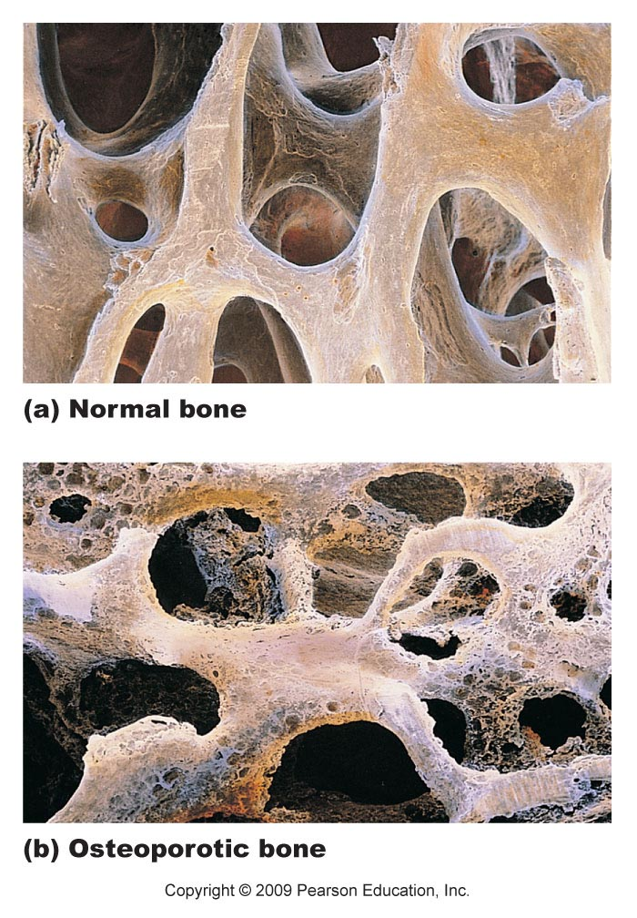
Figure 6.16

Slide 96
Osteoporosis: Treatment and Prevention
Calcium, vitamin D, and fluoride supplements
↑ Weight-bearing exercise throughout life
Hormone (estrogen) replacement therapy (HRT) slows bone loss but does not reverse it
Some drugs (Fosamax, SERMs, statins) increase bone mineral density

Slide 97
Drugs for Osteoporosis
Adrenolate (Fosamax) – decreases osteoclast activity
Selective Estrogen Receptor Modulators (SERMs) – for example Raloxifene – termed “light estrogen” because it mimics estrogen’s beneficial bone-sparing properties without targeting the uterus or breast
The statins which lower cholesterol seem to increase bone density.
Some of the phytoestrogens seem to help

Slide 98
Estrogen and Bone
Estrogen actions on bone are complex. The major physiological effect of estrogen is to inhibit bone resorption. Bone cells have two kinds of intracellular steroid receptors for estrogen. When estrogen binds to the receptors, various genes become active. Estrogen also has effects that do not depend on activating the DNA.
Estrogen effects may be mediated in part by growth factors and interleukins. For example, interleukin 6 is a potent stimulator of bone resorption, and estrogen blocks the osteoblast's synthesis of interleukin

Slide 99
Osteoclast apoptosis is regulated by estrogens. With estrogen deficiency, the osteoclasts live longer and are therefore able to resorb more bone. In response to the increased bone resorption, there is increased bone formation and a high-turnover state develops which leads to bone loss and perforation of the trabecular plates.
Estrogen has multiple other effects that relate to the skeleton. For example, enhanced intestinal calcium absorption can be beneficial to bones. Estrogen protects the bone from the resorptive effects of PTH. Estrogens may interact with mechanical forces to build bone.

Slide 100
Paget’s Disease
Excessive and haphazard bone formation and breakdown, usually in spine, pelvis, femur, or skull
Pagetic bone has very high ratio of spongy to compact bone and reduced mineralization
Unknown cause (possibly viral)
Treatment includes calcitonin and biphosphonates

Slide 101
Bone Tumors
Osteoma - An osteoma is a new piece of bone usually growing on another piece of bone, typically the skull. It is a benign tumor
Osteosarcoma is the second most common primary malignancy of bone behind multiple myeloma. Osteosarcoma accounts for 20% of primary bone malignancies. There is a preference for the metaphyseal region of tubular long bones. 50% of cases occur around the knee. It is a malignant connective (soft) tissue tumor whose neoplastic cells present osteoblastic differentiation and form tumoral bone.

Slide 102
Multiple Myeloma
Multiple myeloma) is a cancer of the white blood cells known as plasma cells, which produce antibodies.
These plasma cells, a type of B cell, are part of the immune system, formed in bone marrow, and numerous in lymphatics. Myeloma is incurable, but remissions may be induced with steroids, chemotherapy, thalidomide and stem cell transplants.

Slide 103
Chondrosarcoma
A chondrosarcoma is a type of cancer^{[1]} of the cartilage. Chondrosarcoma is a cartilage-based tumor and is in a category of cancers called sarcomas. About 25% of primary bone cancers (meaning those which start in the bone) are chondrosarcomas. This disease can affect people or animals of any age, although it is more common among older people than among children

Slide 104
Bone Metastasis (Bone is a secondary site)
Bone metastases will develop in many people with cancer at some point in the course of their disease. Bones are often a site for metastases for certain common tumors, such as breast and prostate cancers.
Metastases can occur in any bone in the body, but are most often found in bones near the center of the body. The spine is the most common site of bone metastasis. Other common sites are the pelvis (hip), upper leg bone (femur), upper arm bone (humerus), ribs, and the skull.

