Slide 1
Electrophysiology of Muscle
Skeletal & Cardiac excitation & contraction
Mike Clark, M.D.

Slide 2
NOTE
Prior to reading this PowerPoint presentation – students may want to review my PowerPoint presentation General Electrophysiology – which explains the Resting Membrane Potential and Action Potentials in general.

Slide 3
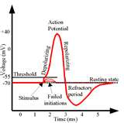
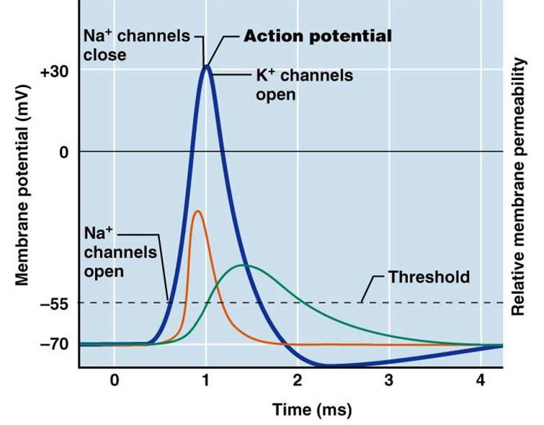
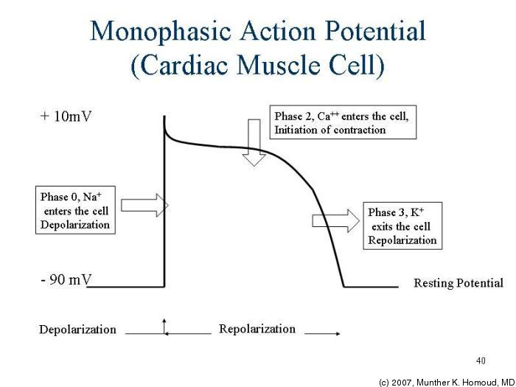
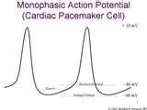
Neuron Action Potential Skeletal Muscle Action Potential

Slide 4
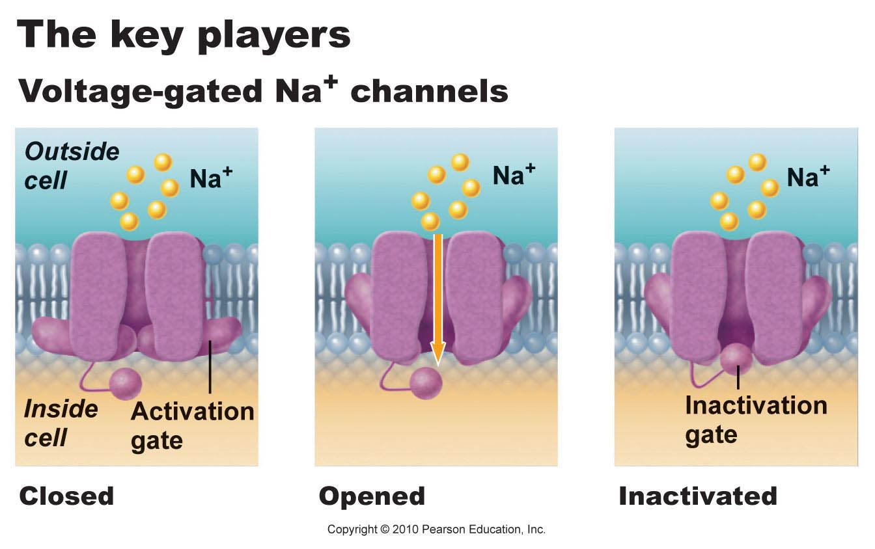
Events in Neuron Action Potential
A threshold voltage there is immediate opening of the sodium voltage dependent activation gate
At threshold there is the start of slow closure of the sodium voltage dependent inactivation gate
Result from the above two events sodium can rush into the neuron because both gates are temporarily open to sodium

Slide 5
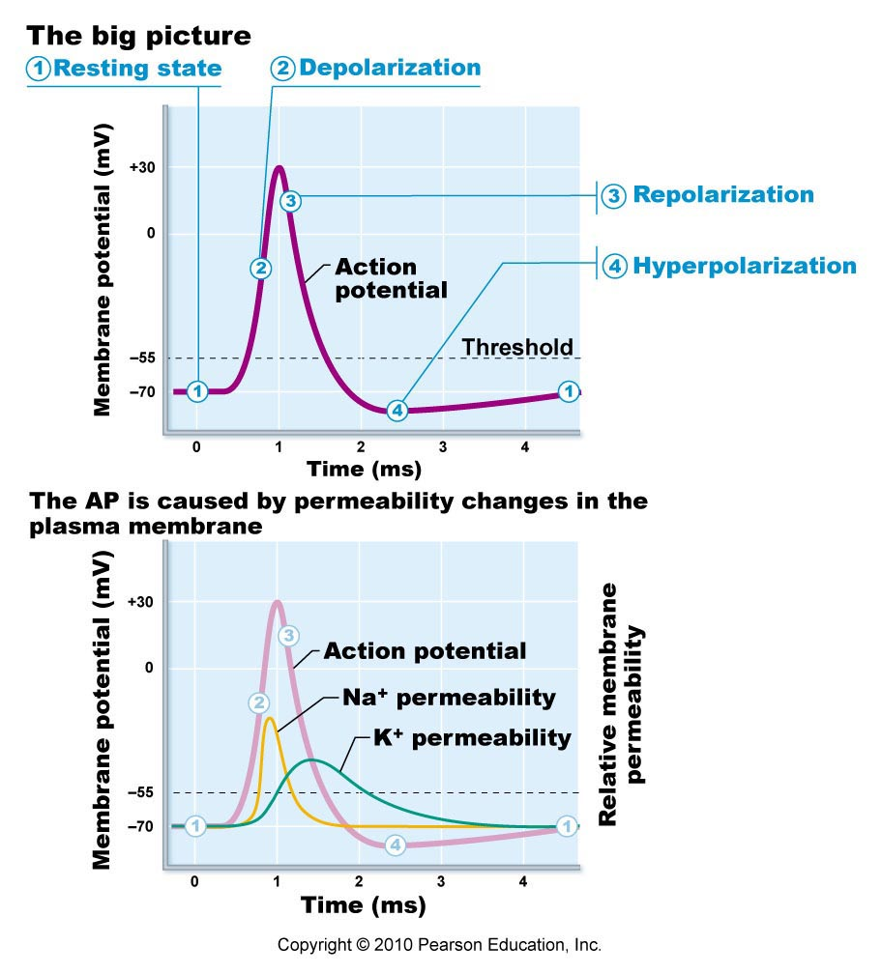
As a result of the positive sodium ions rushing in through the open gates you get step 2 depolarization of the membrane

Slide 6
When the slow sodium inactivation gate closes the positive sodium ions stop rushing in and the membrane depolarizes no further – the up-shoot stops.
The same voltage that operated the sodium gates also is the same voltage to initiate action of the potassium gates – however the potassium gates are very slow so they do not open till around the time that the sodium inactivation gate is
closing – thus since no further
sodium is rushing In and now positive potassium is rushing out the inside of the neuron again begins to become More negative – Repolarization.

Slide 7
Just like the potassium gate was slow to open it is also slow to close – thus an overshoot of potassium moves out of the cell – causing the interior of the neuron to become more negative than at the start (Resting Membrane Potential). This overshoot is termed “hyperpolarization.”
6. The neuron must again return to the Resting Membrane Potential state – this is a result of the Sodium /Potassium pump (3 Na out for 2 K in) action and the large intracellular molecular anions (discussed in the General electrophysiology PowerPoint).

Slide 8
Refractory Periods
Absolute Refractory Period – a time in which the same area of the neuron cell membrane cannot be re-excited (fire another action potential). It is time it takes for the sodium gates to fully reset.
Relative Refractory Period – a time immediately after the absolute refractory period in which the same area of the neuron cell membrane can be re-excited but requires a higher voltage higher than the usual threshold voltage. During this time the potassium channels are still open – thus positive potassium is rushing out making the interior of the neuron more negative thus harder to reach the voltage of threshold.

Slide 9
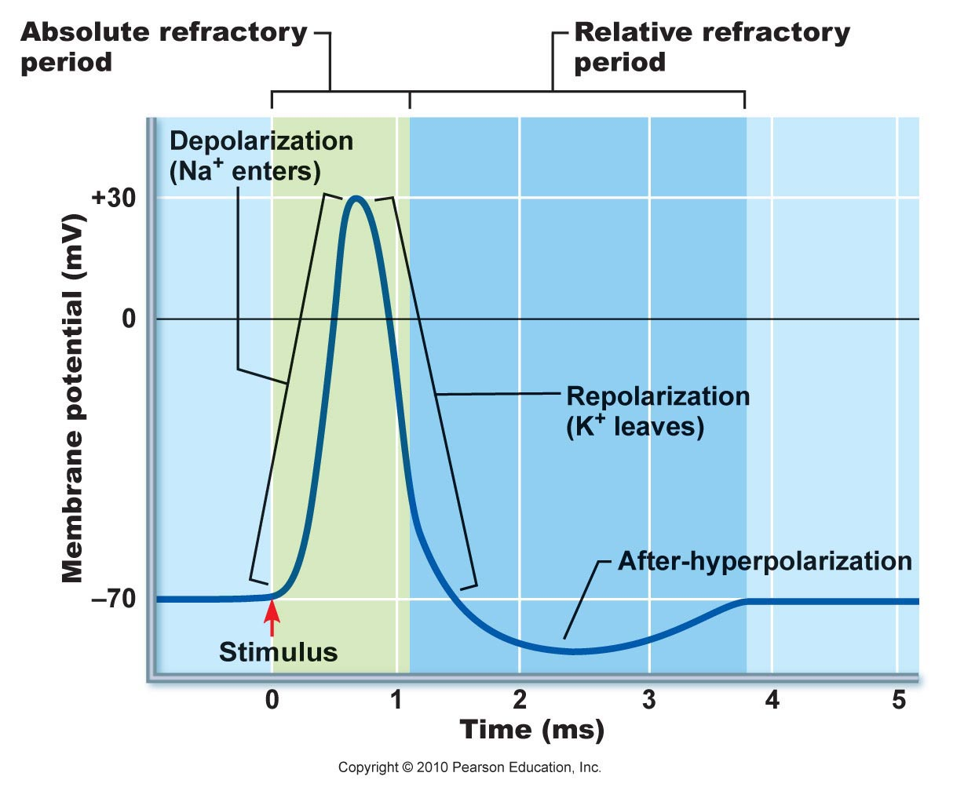

Slide 10
Events in a Skeletal Muscle Action Potential
Unlike neurons – the skeletal muscle has only one type voltage dependent sodium gate. When threshold voltage is reached it quickly opens and sodium rushes in causing the depolarization.
The sodium voltage dependent gate later closes and depolarization stops.
The same voltage
(Threshold voltage)
that causes the opening of
the Na gates is the same Voltage
that opens the potassium gates
but they are slower - opening about
the same time that the Na gates are
Closing – K rushes out causing
Repolarization
Na/K pump and larger molecular anions
Return membrane to Resting State (RMP)

Slide 11
Excitation- Contraction Coupling
Neurons can illicit conductivity (sometimes referred to as excitation)
This conductivity is in the form of action potentials
Muscle can illicit the charge activity of conductivity as well as the mechanical activity of contractility
The charge movement of conductivity (action potentials) leads to the mechanical contraction – thus the excitation must be coupled to the contraction
Since charge activity is faster than mechanical activity – the action potentials initiate first followed fairly quickly by the initiation of the mechanical activity of contraction.

Slide 12
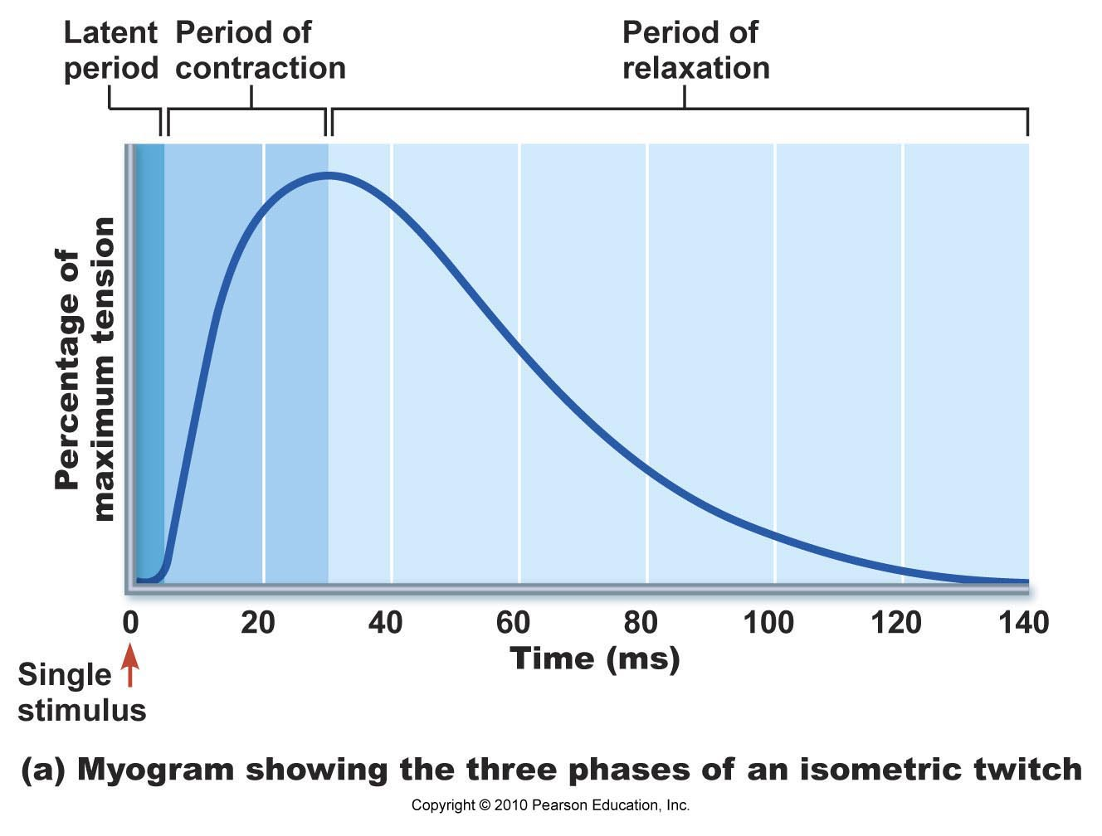
Latent Phase of Contraction
The differential in time between when the action potentials initiate and the contraction initiates is termed the latent phase of muscle contraction
Action potential
initiated

Slide 13
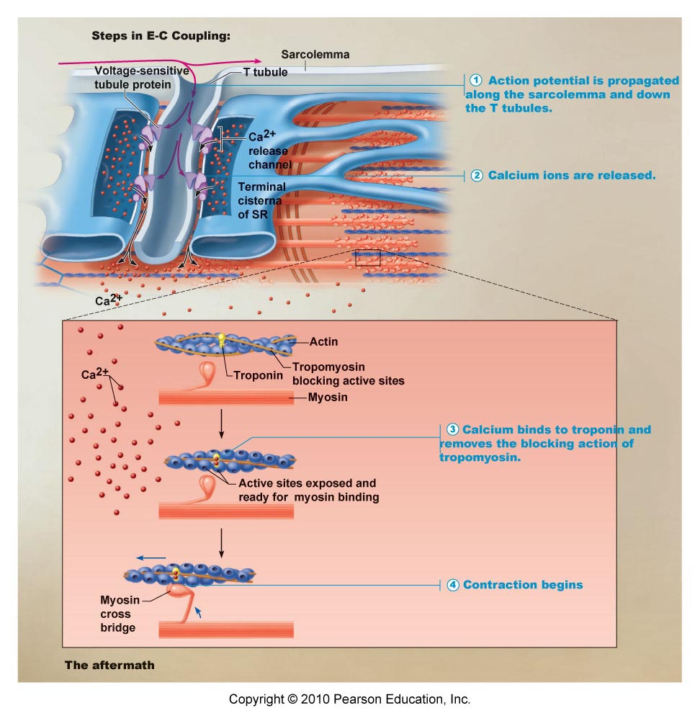
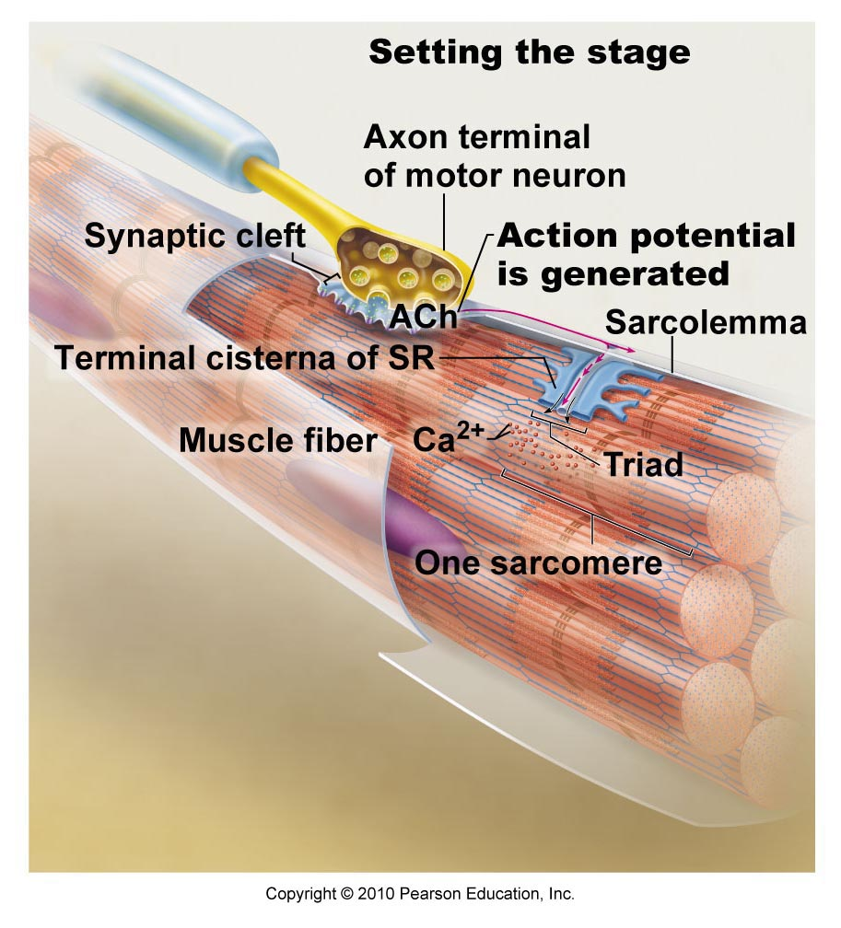
Latent Phase
The latent phase involves all the events after the action potential till the myosin drags the actin over it (sliding filament) – thus causing the initiation of the muscle contraction

Slide 14
Actual Contraction (skeletal muscle)
A contraction as a result of one action potential is termed a muscle twitch. A muscle twitch has 3 periods – latent, contraction and relaxation.
Though the action
potential only lasts
1 to 3 milliseconds
the skeletal
muscle contraction
lasts over 100 ms

Slide 15
100 milliseconds is 1/10 of a second
100 milliseconds (1/10th of a second) is not a long time at all – we could not do anything muscle wise in that time frame – thus we must add (summate) together these isolated contractions (muscle twitch) – to make a longer useful contraction. The adding together of muscle twitches is termed “tetany.”
Tetany occurs by delivering to the muscle cell- a rapid continuous set of action potentials.
The action potentials can occur fast but how close together they can occur is limited by the action potentials “absolute refractory period.”

Slide 16
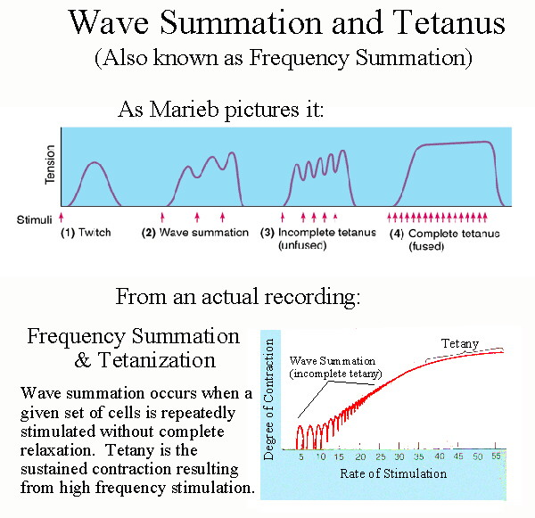

Slide 17
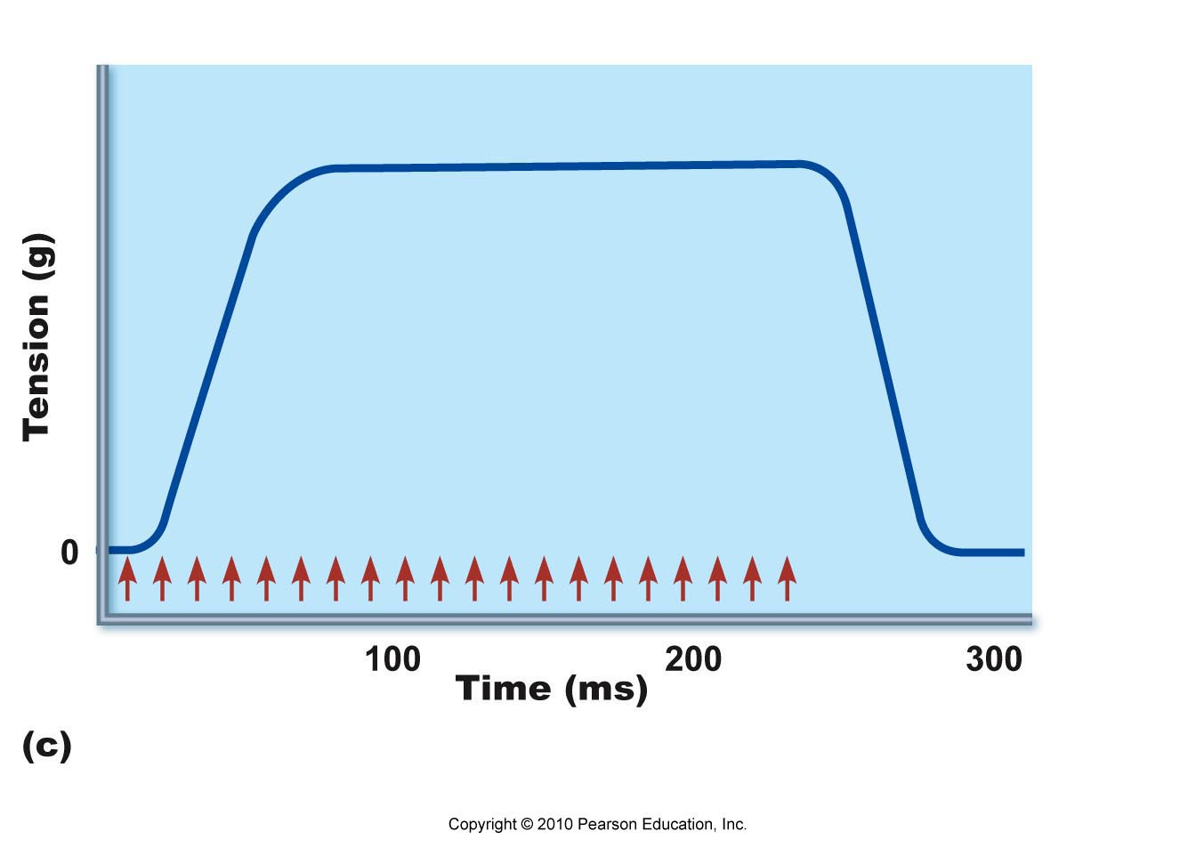
Tetany
Action potentials being delivered in rapid succession – thus maintaining a sustained skeletal muscle contraction.

Slide 18
The events causing heart muscle contraction differ slightly from those of skeletal muscle
Cardiac muscle – just as skeletal muscle- require calcium to allow actin to bind to myosin – which is the main component of the sliding filament model of muscle contraction.
All the calcium required for skeletal muscle contraction is located on the inside of the skeletal muscle cell in the sarcoplasmic reticulum – however cardiac muscle requires some calcium to enter from outside of the muscle cell.
in cardiac muscle some (10 -20%) extracellular calcium is required for contraction. This calcium enters through voltage dependent calcium channels known as L channels or sometimes referred to as slow calcium channels. release In fact the 10 -20% of calcium coming from the outside of the cell not only goes to troponin C to assist directly with contraction – but it also assists in the opening of the calcium release channels in the cardiac muscle cell sarcoplasmic reticulum for the other 80 – 90% to be released.

Slide 19
Cell Membrane Calcium Channels
In cardiac muscle cells some (10 -20%) of extracellular calcium is required for contraction. This calcium enters through voltage dependent calcium channels known as L (Long lasting) channels or sometimes referred to as slow calcium channels.
The 10 -20% of calcium coming from the outside of the cell not only goes to troponin C to assist directly with cardiac muscle contraction – but it also assists in the opening of the calcium release channels in the cardiac muscle cell sarcoplasmic reticulum for the other 80 – 90% to be released.

Slide 20
This influx of calcium from the outside of the cell occurs during the cardiac muscle action potential – part of the mechanism of the action potential – especially in the plateau phase. Thus even though the calcium enters as part of the action potential mechanism–it is also important for the contraction action.
The entering calcium is important for excitation and contraction.
Since (1) the amount of calcium available to troponin C is important to the strength of contraction in both skeletal muscle and cardiac muscle and (2) some of the calcium for cardiac muscle contraction must come from the extracellular fluid – the blood (extracellular fluid) calcium level is more important to cardiac muscle than skeletal muscle.
Since cardiac muscle has functional L calcium channels – and skeletal muscle cells do not – a calcium channel blocker drug will affect cardiac muscle and not skeletal muscle (example Verapamil) . The medication will decrease the force of contractility (inotropic effect).

Slide 21
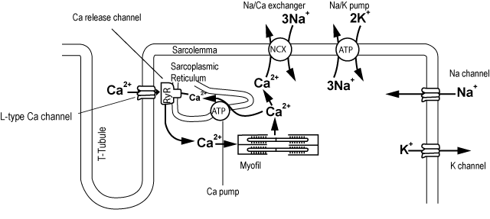
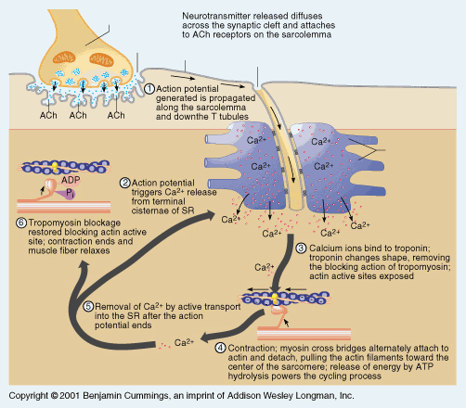
Cardiac Muscle
Skeletal Muscle

Slide 22
The Heart Action Potentials
The heart has two types of action potentials – one type that is the heart muscle action potential
and another type that is the pacemaker (SA node, AV node, etc. ) action potential

Slide 23
NO TETANY
The heart muscle should never go into tetany. A heart muscle cell should do one muscle twitch then relax for a while before it embarks on another twitch.
A heart chamber only fills with blood when it is relaxed (diastole) – thus tetany would cause a heart chamber to have a sustained contraction- not relax and be unable to fill with blood.
If the heart chamber cannot fill – it has no blood to empty into the next chamber or into the next blood vessels.
If heart muscle goes into tetany – that is what is called cardiac flutter and fibrillation. Fibrillation can lead to death.

Slide 24
Prevention of Cardiac muscle tetany
Since one initiated action potential can cause one muscle contraction (muscle twitch) – and a rapid succession of action potentials on a muscle cell can cause tetany – then make the action potentials get further apart – so they cannot summate as easily.
How can this be done?
Prolong the absolute refractory period.

Slide 25
Prolonged absolute
Refractory period.
The plateau phase of the cardiac muscle action potential – provides a longer absolute refractory period – thus disallowing cardiac muscle action potentials from coming to close together – thus disallowing cardiac muscle tetany.

Slide 26
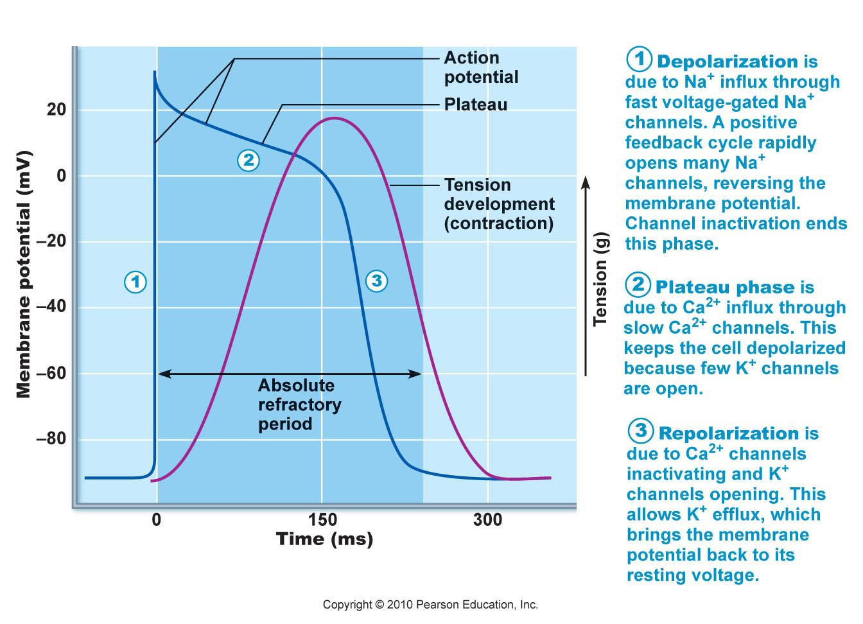
In addition to the fact that the cardiac muscle action potentials cannot come to close together there is another fact of interest – the absolute refractory period lasts over 200 msec which is almost the entire time of one cardiac muscle twitch (one contraction). Thus by the time the action potential is fully over – so is the muscle contraction – thus no tetany.
The red graph
is the contraction
curve and the
blue is the action
potential curve

Slide 27
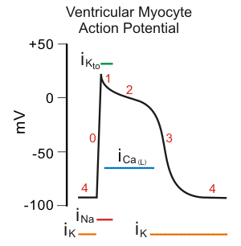
Events in the Cardiac Muscle Action Potentials

Slide 28
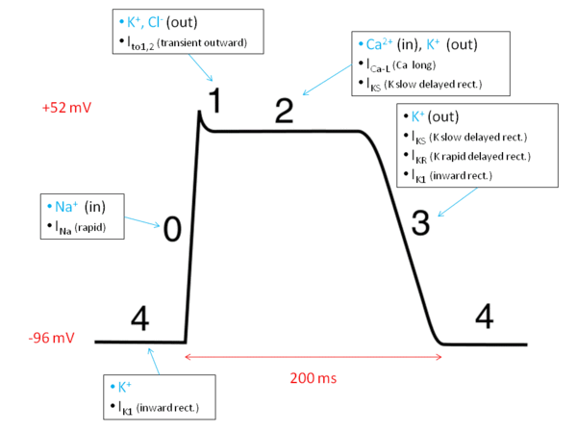
Events in the Cardiac Muscle Action Potential

Slide 29
Phase 0
Phase 0 is the rapid depolarization phase. The slope of phase 0 represents the maximum rate of depolarization of the cell. This phase is due to the opening of the fast Na⁺ channels causing a rapid increase in the membrane conductance to Na⁺ (G_{Na}) and thus a rapid influx of Na⁺ ions (I_{Na}) into the cell; a Na⁺ current.
The ability of the cell to open the fast Na⁺ channels during phase 0 is related to the membrane potential at the moment of excitation. If the membrane potential is at its baseline (about -85 mV), all the fast Na⁺ channels are closed, and excitation will open them all, causing a large influx of Na⁺ ions. If, however, the membrane potential is less negative, some of the fast Na⁺ channels will be in an inactivated state insensitive to opening, thus causing a lesser response to excitation of the cell membrane and a lower V_{max}. For this reason, if the resting membrane potential becomes too positive, the cell may not be excitable, and conduction through the heart may be delayed, increasing the risk for arrhythmias.

Slide 30
Phase 1
Phase 1 of the action potential occurs with the sudden inactivation of the fast Na⁺ channels. The small transient down-shoot (more negative) is due to the movement of K⁺ and Cl⁻ ions. K⁺ is moving out and Cl⁻ is moving into the cell – making the interior temporarily more negative. Both ions are directionally moving in accordance with their respective electrochemical gradients. They are moving through their respective passive leak channels.

Slide 31
Phase 2 – the plateau phase
The basis of the prolonged absolute refractory period!
As the voltage of the cardiac muscle cell changes – it causes the slower later opening of L- Calcium channels and also the opening of some special slow delayed rectifier potassium channels (not the usual passive leak potassium channels or the usual voltage dependent potassium channels seen in neurons and skeletal muscle cells).
This "plateau" phase of the cardiac action potential is sustained by a balance between inward movement of Ca²⁺ through L-type calcium channels and outward movement of K⁺ through the slow delayed rectifier potassium channels.

Slide 32
Phase 3
Phase 4 is the usual Resting Membrane Potential
During phase 3 (the "rapid repolarization" phase) of the action potential, the L-type Ca²⁺ channels close, while the slow delayed rectifier K⁺ channels remain open. This ensures a net outward current, corresponding to negative change in membrane potential, thus allowing more types of K⁺ channels to open. These are primarily the rapid delayed rectifier K⁺ channels.
This net outward, positive current (equal to loss of positive charge from the cell) causes the cell to repolarize. The delayed rectifier K⁺ channels close when the membrane potential is restored to about -80 to -85 mV. The Na/K pump helps restore the RMP – Phase 4.

Slide 33
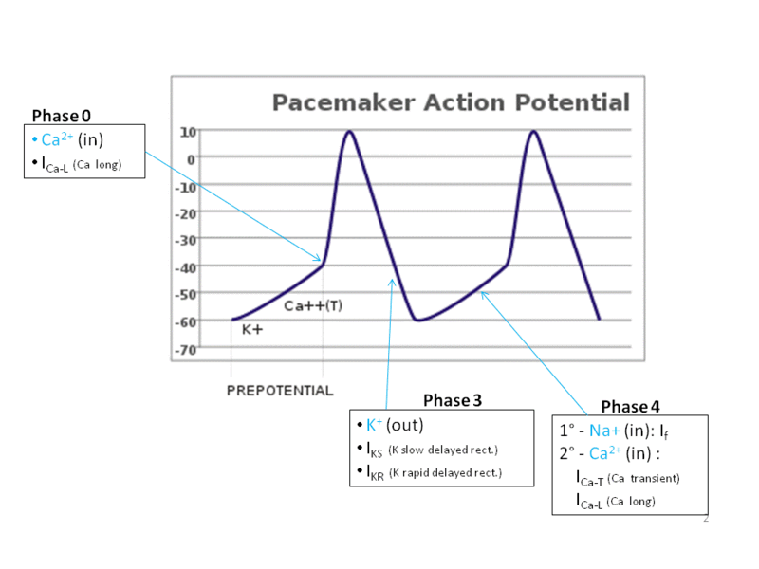
Cardiac Pacemaker Action Potential

Slide 34
Pacemaker cells
The pacemaker cells have automatic rhythm – they spontaneously in and of themselves can fire action potentials.
Each pacemaker structure has a different automatic firing rate.
SA node – 60 – 80 natural pacemaker of the heart because it has the fastest firing frequency
AV node – 40 – 60 spontaneous action potentials per minute
Bundle of HIS – 20 – 40 action potentials per minute
Bundle Branches – 10 – 20 action potentials per minute
It is the pacemaker cells that cause the adjacent cardiac muscle cells to reach threshold voltage – thus initiating the cardiac muscle cell action potential

Slide 35
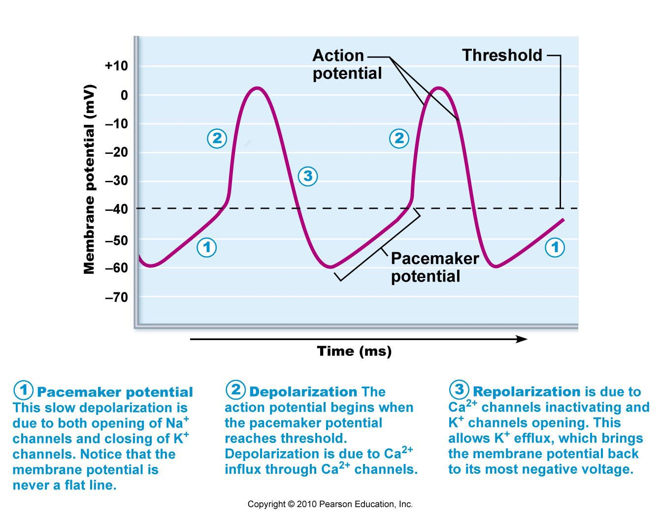
Events of the Pacemaker Action Potential
The rate at which the pacemaker potential reaches threshold is the key to understanding the differences in the rate of firing of the different pacemakers.

Slide 36
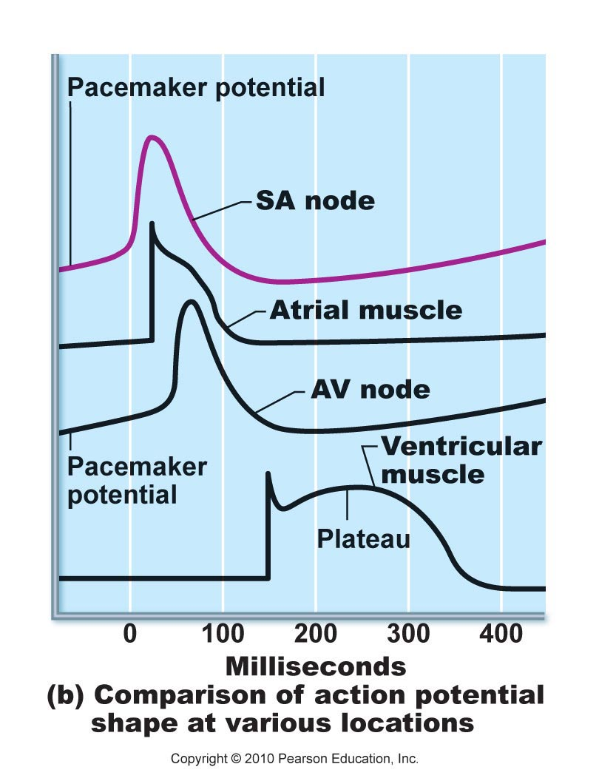
Putting it all Together

Slide 37
Threshold
Subthreshold stimulus—weak local depolarization that does not reach threshold
Threshold stimulus—strong enough to push the membrane potential toward and beyond threshold
AP is an all-or-none phenomenon—action potentials either happen completely, or not at all

