Slide 1
General Electrophysiology with emphasis on nerve action
Mike Clark, M.D.

Slide 2
Principles of Electricity
Opposite charges attract each other
Energy is required to separate opposite charges across a membrane
Energy is liberated when the charges move toward one another
If opposite charges are separated, the system has potential energy

Slide 3
Definitions
Voltage (V): measure of potential energy generated by separated charge
Potential difference: voltage measured between two points
Current (I): the flow of electrical charge (ions) between two points

Slide 4
Definitions
Resistance (R): hindrance to charge flow (provided by the plasma membrane)
Insulator: substance with high electrical resistance
Conductor: substance with low electrical resistance

Slide 5
Membrane Charges
Every living cell in the human body has a charge on its membrane – known as the “Resting Membrane Potential”
This is due to the membrane having passive leak ion channels
These channels allow ions to move in and out of the membrane according to their own energies moving down their concentration gradients and charge gradients

Slide 6
Resting Membrane Potential
Differences in ionic makeup
  ICF has lower concentration of Na⁺ and Cl– than ECF
  ICF has higher concentration of K⁺ and negatively charged proteins (A–) than ECF

Slide 7
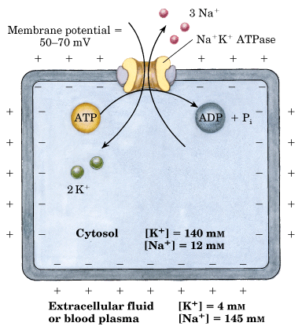
A- (Large Molecular Anions)

Slide 8
Ion Ease of Permeability
Differential permeability of membrane
  Impermeable to A–
  Slightly permeable to Na⁺ (through leakage channels)
  75 times more permeable to K⁺ (more leakage channels)
  Freely permeable to Cl–

Slide 9
Conductivity
For simplicity sake we will say that a Resting Membrane Potential is a charge on a cell membrane that sits in one position.
As alluded to earlier all living cells (some skin cells, all hair and nail cells are dead) have this resting membrane potential
Muscle and Nerve cells can move a charge along their respective membranes – this is termed conductivity
This conductivity is as a result of nerve and muscle cells being able to create action potentials
How can this occur? Nerve and muscle cells not only have passive leak channels like all other living cells – they also voltage dependent gates (channels) in their membranes.
Unlike passive leak channels which in most cases are always open – voltage dependent gates are generally closes – opening only if the cell membrane receives a certain voltage change.

Slide 10
Role of Membrane Ion Channels
Integral Proteins serve as membrane ion channels
Two main types of ion channels
  Leakage (non-gated) channels—always open – ions are constantly leaking through down their respective electrochemical gradients.
  Gated channels (three types):
      Chemically gated (ligand-gated) channels—open with binding of a specific neurotransmitter
      Voltage-gated channels—open and close in response to changes in membrane potential
      Mechanically gated channels—open and close in response to physical deformation of receptors – like pain receptors

Slide 11
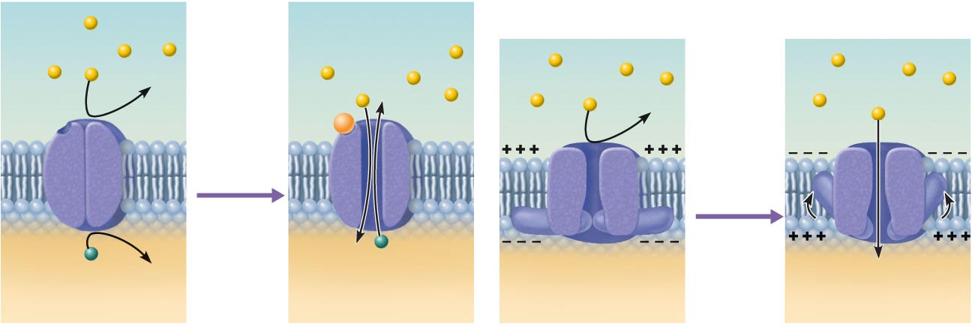
Receptor
Neurotransmitter chemical
attached to receptor
Na⁺
Na⁺
Na⁺
Na⁺
Chemical
binds
Membrane
voltage
changes
K⁺
K⁺
Closed
Open
Closed
Open
(a) Chemically (ligand) gated ion channels open when the
appropriate neurotransmitter binds to the receptor,
allowing (in this case) simultaneous movement of
Na⁺ and K⁺.
(b) Voltage-gated ion channels open and close in response
to changes in membrane voltage.
Figure 11.6

Slide 12
Gated Channels
When gated channels are open:
  Ions diffuse quickly across the membrane along their electrochemical gradients
    Along chemical concentration gradients from higher concentration to lower concentration
    Along electrical gradients toward opposite electrical charge
  Ion flow creates an electrical current and voltage changes across the membrane

Slide 13
Resting Membrane Potential
Every living cell in the body has a charge on its membrane
The membrane acts as a capacitor – an object that can hold a charge
The outside of a cell close to the membrane has a positive charge and the inside of a cell close to the membrane has a negative charge

Slide 14
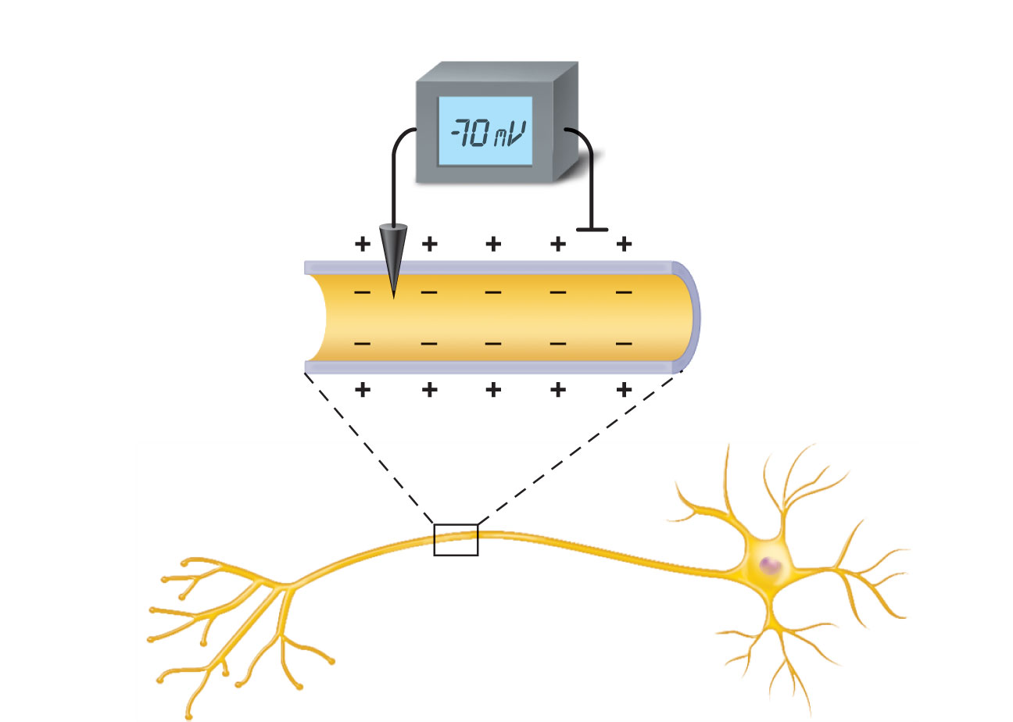
Voltmeter
Plasma
membrane
Ground electrode
outside cell
Microelectrode
inside cell
Axon
Neuron
Figure 11.7

Slide 15
Separation of Charge across the Membrane
The membrane acts as an insulator that it holds the positive and negative charges separate despite the fact that opposite charges like to move towards one another. The cell membrane capacitance determines how many charges it can hold apart.
Energy is the capability to do work- work is a force times a distance- when something moves work is done and energy is formed – when something moves that is kinetic energy- when it wants to move but is not doing it now that is potential energy
Since the charges want to move – but cannot at the time it is known as a membrane potential (potential energy)
Since the membrane is not doing action potentials (to be discussed later) – it is considered to be at rest – thus a “Resting Membrane Potential”

Slide 16
Resting Membrane Potential (Measurement)
Force in electricity if measured in volts
By placing an electrode inside a cell and one outside the cell – the magnitude of the resting membrane potential can be measured
The electrode is a glass pipette with a narrow tip – the inside of the pipette is filled with an conducting electrolyte solution- a thin wire is placed in both pipettes – thus allowing a current to move from one pipette to the other bypassing the membrane
The thin wire is hooked to a voltmeter – thus the current from move through the voltmeter before it can go to the next pipette (electrode) – this meter can then measure the force of movement in volts
By international agreement the pipette (electrode) on the inside of the cell is the measuring electrode and the outside one acts as a ground electrode.

Slide 17
Millivolts and the negative sign
The voltage across a cell is not a full volt – in fact it is in thousandths of volts
For example .070 volt is the voltage across a resting neuron membrane – if we move the decimal point over 3 places and add the prefix milli in front of the term we could say 70 millivolts
Since the inside of a cell is negative and that is where we measure – we could say a -70 mv is the magnitude of resting membrane potential across the neuron cell membrane
The resting membrane potential voltage varies with the type of cell – for example muscle cells generally have a -90 mv

Slide 18
Voltmeter
Plasma
membrane
Ground electrode
outside cell
Microelectrode
inside cell
Axon
Neuron
Figure 11.7

Slide 19
Resting Membrane Potential (Vr)
Potential difference across the membrane of a resting cell
  Approximately –70 mV in neurons (cytoplasmic side of membrane is negatively charged relative to outside)
Generated by:
  Differences in ionic makeup of ICF and ECF
  Differential permeability of the plasma membrane

Slide 20
Bulk Electro-neutrality
Bulk electro-neutrality is a law of charges that states that any macroscopic or bulk portion of a solution must contain an equal number of positive and negative charges. Certainly it is possible to separate positive and negative charges, but the law holds for bulk quantities of solution because large forces are required to separate small quantities of charge. For example, an electrical potential of 100 mV would be developed if 10⁻¹¹ moles of potassium ions were separated from 10⁻¹¹ moles of chloride ions by a distance of 1 angstrom (10⁻⁸ meters) in water.

Slide 21
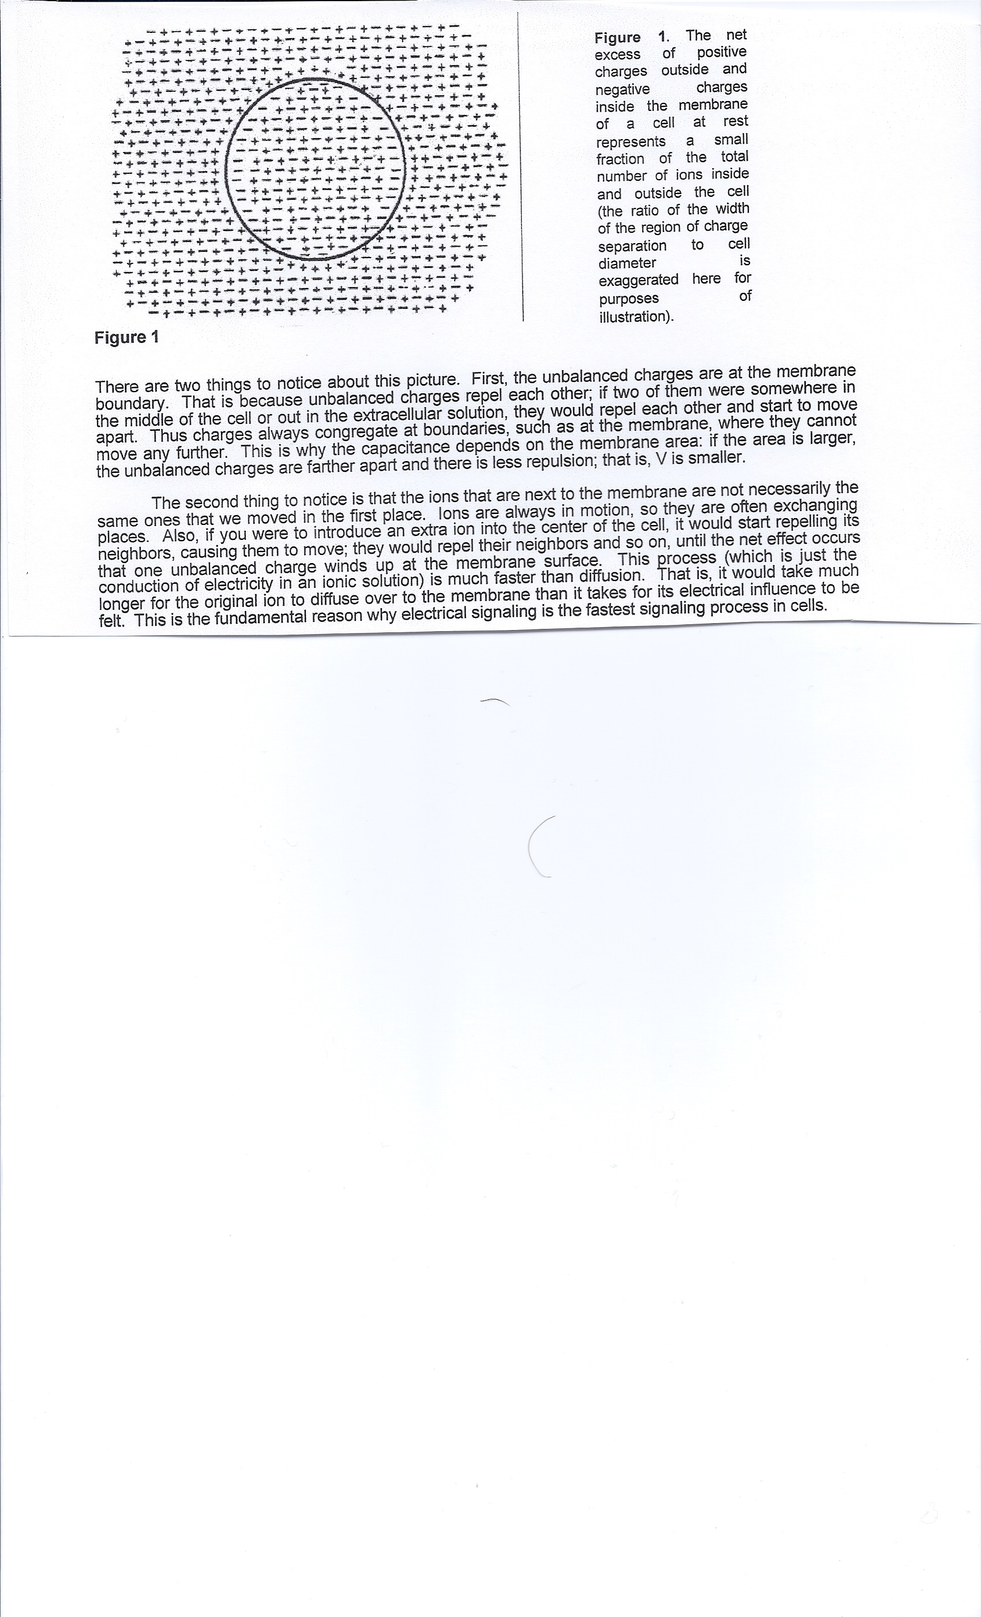

Slide 22
What Gives the Resting Membrane (and reestablishes it) Potential?
1. Na⁺ /K⁺ pump
2. The trapped large intracellular anions
3. Dragging effect
4. Maintenance of Bulk Electro-neutrality

Slide 23
Explanatory Equations
Ohms Law Current Flow
(I) = Emf/ Resistance
I is current – measured in Amperes
Emf – is measured in volts
Resistance is measured in Ohms

Slide 24
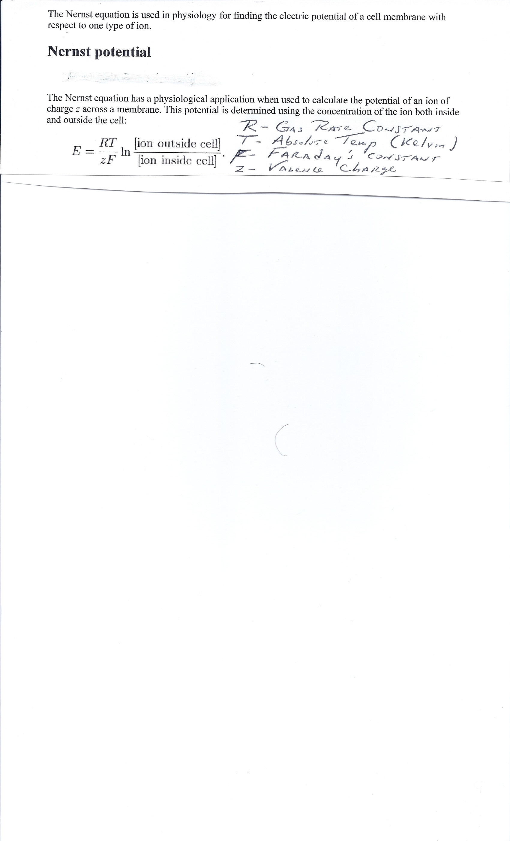
Nernst Equation
The Nernst equation gives a value to the Resting Membrane Potential – if only one ion was moving. Potassium is the ion that best approximates the Resting Membrane Potential.

Slide 25
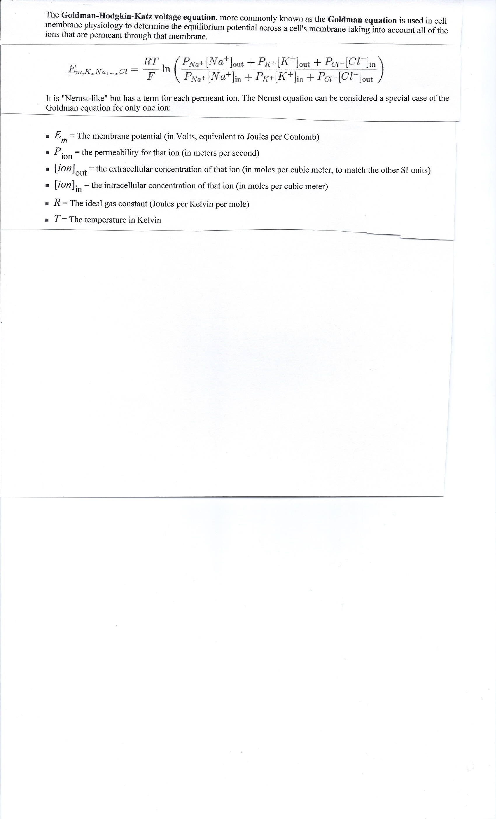
Goldmann Equation
The Goldmann equation gives a value to the Resting Membrane Potential – if all of the ions are moving. Even if all of the ions are moving - potassium continues to be the ion contributing most to the value of the Resting Membrane Potential – even compared to all of the ions together.

Slide 26
Action Potentials
Nerve and Muscle cells – along with some other cells – can generate action potentials
Why is this? Because they have voltage dependent gates in addition to their passive leak channels – that created a Resting Membrane Potential
Action Potentials provide for conductivity – the ability to propagate an impulse along the membrane

Slide 27
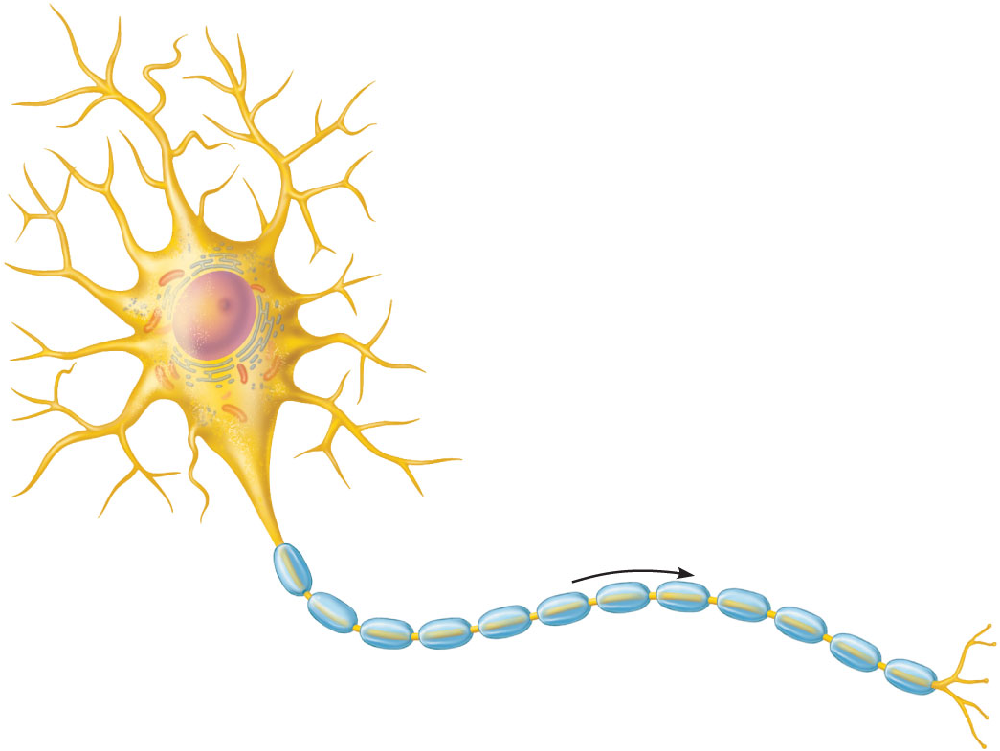
Dendrites
(receptive regions)
Cell body
(biosynthetic center
and receptive region)
Nucleolus
Axon
(impulse generating
and conducting region)
Nucleus
Impulse
direction
Nissl bodies
Node of Ranvier
Axon
terminals
(secretory
region)
Axon hillock
Schwann cell
(one inter-
node)
(b)
Neurilemma
Terminal
branches
Figure 11.4b

Slide 28
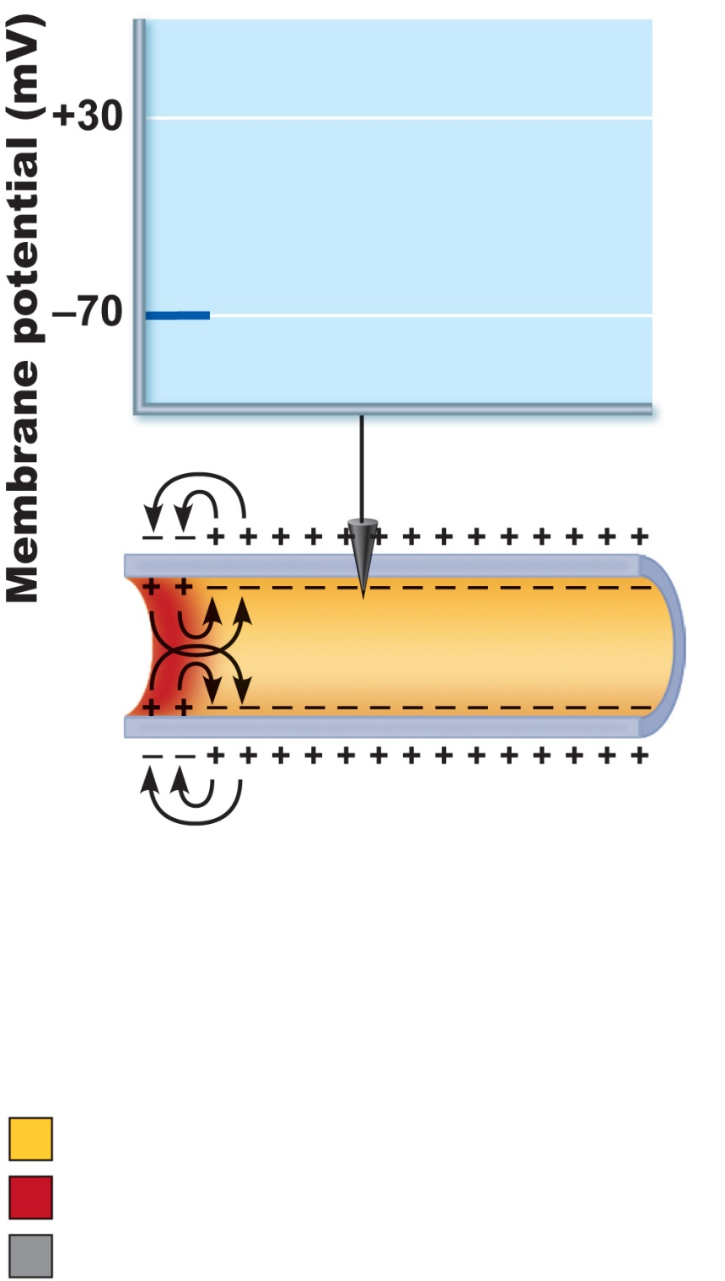
Voltage
at 0 ms
Step Up Voltage Battery hooked to membrane
Recording
electrode
(a) Time = 0 ms. Action
potential has not yet
reached the recording
electrode.
Resting potential
Peak of action potential
Hyperpolarization
Figure 11.12a

Slide 29
Action Potential (AP)
Brief reversal of membrane potential with a total amplitude of ~100 mV
Occurs in muscle cells and axons of neurons
Does not decrease in magnitude over distance
Principal means of long-distance neural communication

Slide 30
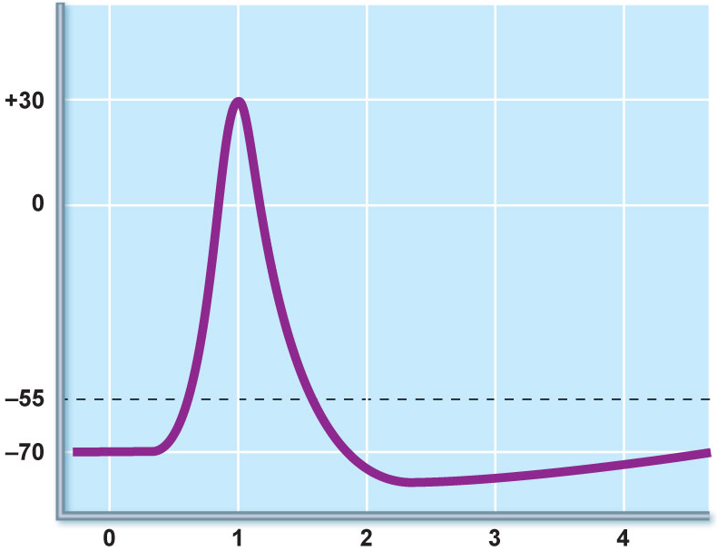
The big picture
1
Resting state
2
Depolarization
3
Repolarization
3
4
Hyperpolarization
Membrane potential (mV)
2
Action
potential
Threshold
1
1
4
Time (ms)
Figure 11.11 (1 of 5)

Slide 31
Generation of an Action Potential
Resting state
  Only leakage channels for Na⁺ and K⁺ are open
  All gated Na⁺ and K⁺ channels are closed

Slide 32
Properties of Gated Channels
Properties of gated channels (in nerve cells)
  Each Na⁺ channel has two voltage-sensitive gates
    Activation gates
      Closed at rest; open with depolarization
    Inactivation gates
      Open at rest; block channel once it is open
NOTE: Muscle cells have only one voltage dependent gate for sodium unlike nerve cells

Slide 33
Properties of Gated Channels
Each K⁺ channel has one voltage-sensitive gate
Closed at rest
Opens slowly with depolarization

Slide 34
Depolarizing Phase
Depolarizing local currents open voltage-gated Na⁺ channels
Na⁺ influx causes more depolarization
At threshold (–55 to –50 mV) positive feedback leads to opening of all Na⁺ channels, and a reversal of membrane polarity to +30mV (spike of action potential)

Slide 35
Repolarizing Phase
Repolarizing phase
  Na⁺ channel slow inactivation gates close
  Membrane permeability to Na⁺ declines to resting levels
  Slow voltage-sensitive K⁺ gates open
  K⁺ exits the cell and internal negativity is restored

Slide 36
Hyperpolarization
Hyperpolarization
  Some K⁺ channels remain open, allowing excessive K⁺ efflux
  This causes after-hyperpolarization of the membrane (undershoot)

Slide 37
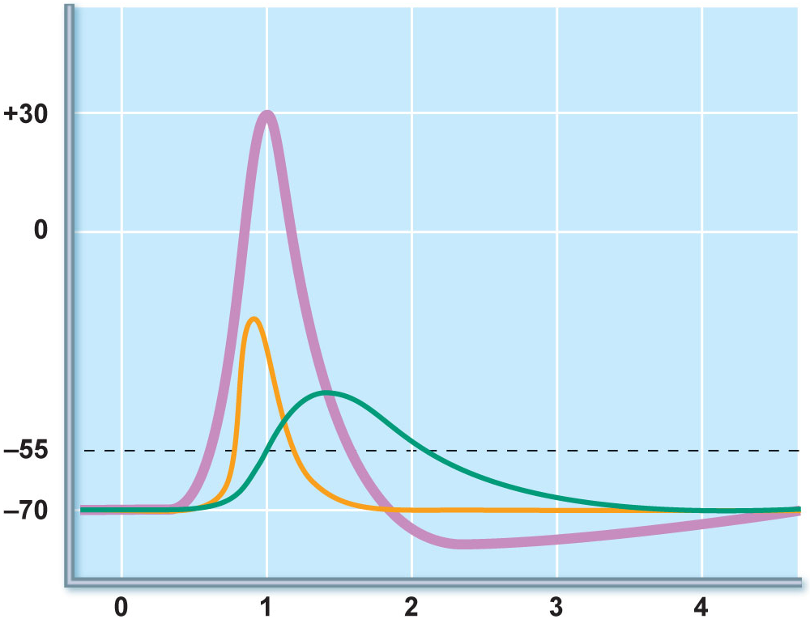
The AP is caused by permeability changes in
the plasma membrane
3
Action
potential
Membrane potential (mV)
Na⁺ permeability
2
Relative membrane permeability
K⁺ permeability
1
1
4
Time (ms)
Figure 11.11 (2 of 5)

Slide 38
Role of the Sodium-Potassium Pump
Repolarization
  Restores the resting electrical conditions of the neuron
  Does not restore the resting ionic conditions
Ionic redistribution back to resting conditions is restored by the thousands of sodium-potassium pumps – AND DUE TO PRESENCE OF NON-PERMEABLE LARGE MOLECULAR ANIONS TRAPPED INSIDE THE CELL

Slide 39
Propagation of an Action Potential
Local currents affect adjacent areas in the forward direction
Depolarization opens voltage-gated channels and triggers an AP
Repolarization wave follows the depolarization wave
(Fig. 11.12 shows the propagation process in unmyelinated axons.)

Slide 40
Voltage
at 0 ms
Recording
electrode
(a) Time = 0 ms. Action
potential has not yet
reached the recording
electrode.
Resting potential
Peak of action potential
Hyperpolarization
Figure 11.12a

Slide 41
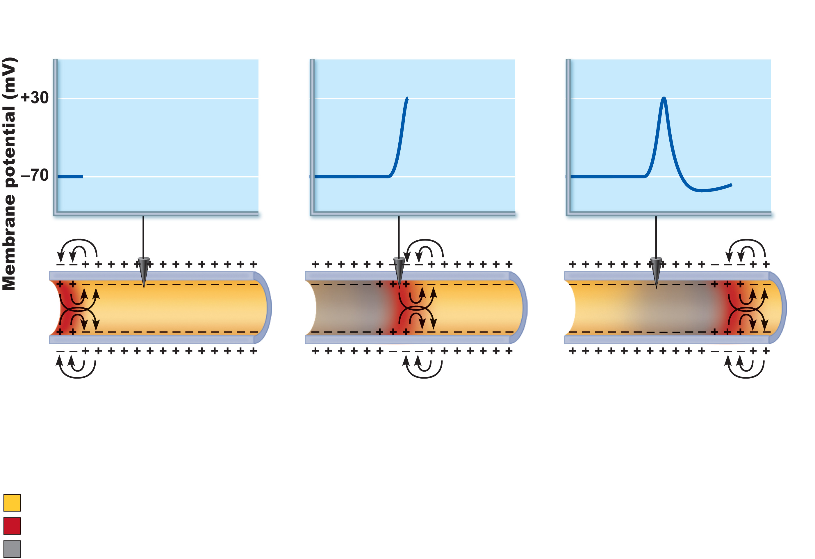
Voltage
at 2 ms
(b) Time = 2 ms. Action
potential peak is at the
recording electrode.
Figure 11.12b

Slide 42
Voltage
at 4 ms
(c) Time = 4 ms. Action
potential peak is past
the recording electrode.
Membrane at the
recording electrode is
still hyperpolarized.
Figure 11.12c

Slide 43
Threshold
At threshold:
  Membrane is depolarized by 15 to 20 mV
  Na⁺ permeability increases
  Na influx exceeds K⁺ efflux
  The positive feedback cycle begins

Slide 44
Muscle Action Potentials
Everything is the same as neuron action potentials except
1. Resting membrane potential is about -80mv to a -90mv instead of a -70mv
2. Duration of Action Potential is 1 – 5 milliseconds in skeletal muscle versus 1 millisecond in nerve cells
3. Velocity of conduction along the muscle cell membrane is about 1/13th the speed of the fastest neurons

Slide 45
Threshold
Subthreshold stimulus—weak local depolarization that does not reach threshold
Threshold stimulus—strong enough to push the membrane potential toward and beyond threshold
AP is an all-or-none phenomenon—action potentials either happen completely, or not at all

Slide 46
Coding for Stimulus Intensity
All action potentials are alike and are independent of stimulus intensity
  How does the CNS tell the difference between a weak stimulus and a strong one?
Strong stimuli can generate action potentials more often than weaker stimuli
The CNS determines stimulus intensity by the frequency of impulses

Slide 47
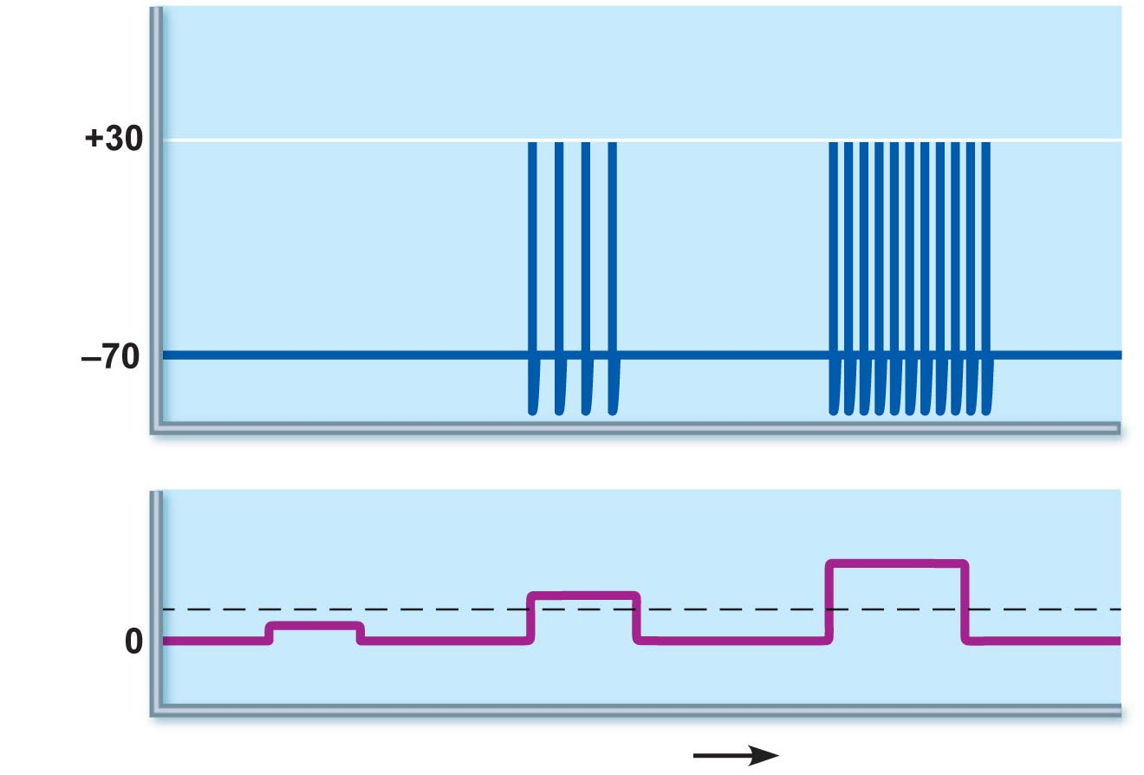
Action
potentials
Stimulus
Threshold
Time (ms)
Figure 11.13

Slide 48
Absolute Refractory Period
Time from the opening of the Na⁺ channels until the resetting of the channels
Ensures that each AP is an all-or-none event
Enforces one-way transmission of nerve impulses

Slide 49
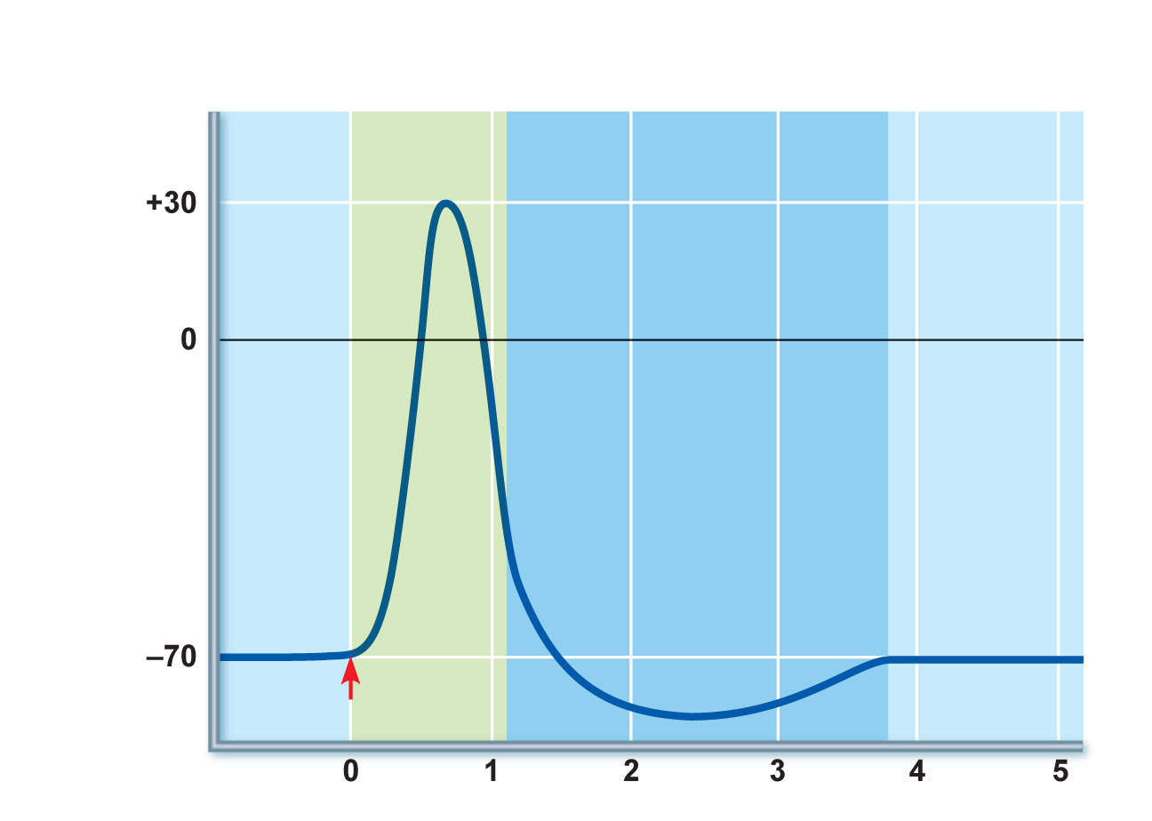
Absolute refractory
period
Relative refractory
period
Depolarization
(Na⁺ enters)
Repolarization
(K⁺ leaves)
After-hyperpolarization
Stimulus
Time (ms)
Figure 11.14

Slide 50
Relative Refractory Period
Follows the absolute refractory period
  Most Na⁺ channels have returned to their resting state
  Some K⁺ channels are still open
  Repolarization is occurring
Threshold for AP generation is elevated
Exceptionally strong stimulus may generate an AP

Slide 51
Conduction Velocity
Conduction velocities of neurons vary widely
Effect of axon diameter
  Larger diameter fibers have less resistance to local current flow and have faster impulse conduction
Effect of myelination
  Continuous conduction in unmyelinated axons is slower than saltatory conduction in myelinated axons

Slide 52
Conduction Velocity
Effects of myelination
  Myelin sheaths insulate and prevent leakage of charge
  Saltatory conduction in myelinated axons is about 30 times faster
    Voltage-gated Na⁺ channels are located at the nodes
    APs appear to jump rapidly from node to node

Slide 53
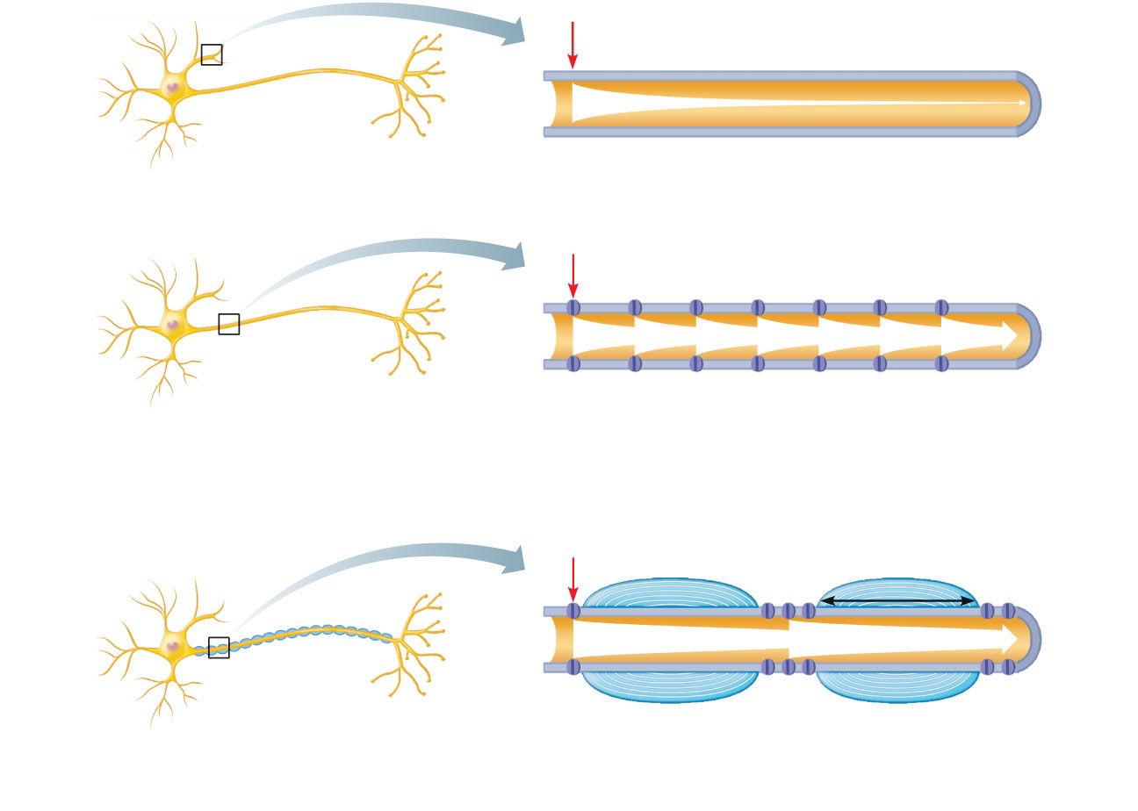
Stimulus
Size of voltage
(a) In a bare plasma membrane (without voltage-gated
channels), as on a dendrite, voltage decays because
current leaks across the membrane.
Stimulus
Voltage-gated
ion channel
(b) In an unmyelinated axon, voltage-gated Na⁺ and K⁺
channels regenerate the action potential at each point
along the axon, so voltage does not decay. Conduction
is slow because movements of ions and of the gates
of channel proteins take time and must occur before
voltage regeneration occurs.
Stimulus
Node of Ranvier
Myelin
sheath
1 mm
(c) In a myelinated axon, myelin keeps current in axons
(voltage doesn’t decay much). APs are generated only
in the nodes of Ranvier and appear to jump rapidly
from node to node.
Myelin sheath
Figure 11.15

Slide 54
Multiple Sclerosis (MS)
An autoimmune disease that mainly affects young adults
Symptoms: visual disturbances, weakness, loss of muscular control, speech disturbances, and urinary incontinence
Myelin sheaths in the CNS become nonfunctional scleroses
Shunting and short-circuiting of nerve impulses occurs
Impulse conduction slows and eventually ceases

Slide 55
Nerve Fiber Classification
Group A fibers
  Large diameter, myelinated somatic sensory and motor fibers
Group B fibers
  Intermediate diameter, lightly myelinated ANS fibers
Group C fibers
  Smallest diameter, unmyelinated ANS fibers

