Slide 1
The Cell
Mike Clark, M.D.,M.B.A.,M.S.

Slide 2
The cell is the structural and functional unit of all known living organisms.
It is the smallest unit of an organism that is classified as living, and is often called the building block of life.
Some organisms, such as most bacteria, are unicellular (consist of a single cell). Other organisms, such as humans, are multicellular.
Humans have an estimated 70 - 100 trillion cells
There are about 210 known distinct human cell types – these can be divided into two broad groups (somatic cells and gametes) Gametes are sex cells (sperm and egg) Somatic cells are the others

Slide 3
Some History
The word cell comes from the Latin cellula, meaning, a small room. The descriptive name for the smallest living biological structure was chosen by Robert Hooke in a book he published in 1665 when he compared the cork cells he saw through his microscope to the small rooms monks lived in.

Slide 4
Two Basic Cell Types
There are two types of cells: eukaryotic and prokaryotic. Prokaryotic cells are usually independent, while eukaryotic cells are often found in multicellular organisms.

Slide 5
Prokaryotic
The prokaryote cell is simpler than a eukaryote cell, lacking a nucleus and most of the other organelles of eukaryotes. There are two kinds of prokaryotes: bacteria and archaea; these share a similar overall structure.

Slide 6
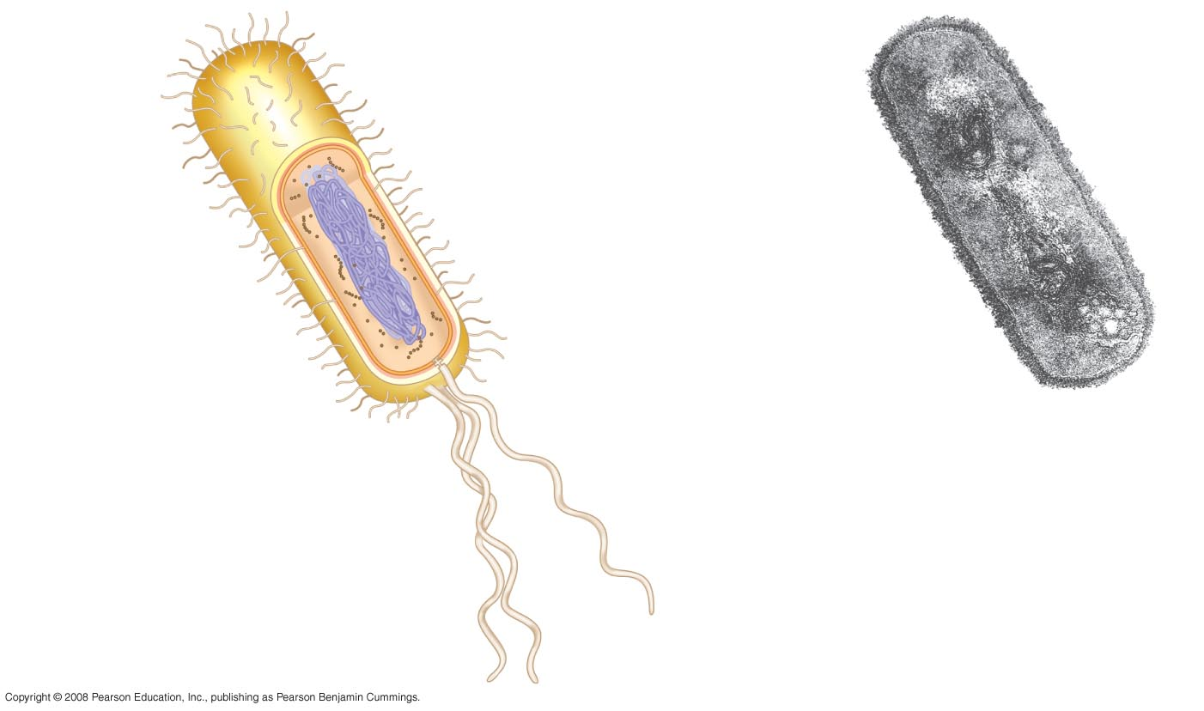
Fig. 6-6
Fimbriae
Nucleoid
Ribosomes
Plasma membrane
Bacterial
chromosome
Cell wall
Capsule
0.5 µm
(a)
A typical rod-shaped bacterium
Flagella
(b)
A thin section through the bacterium Bacillus coagulans (TEM)

Slide 7
Eukaryotic
Eukaryotic cells are about 10 times the size of a typical prokaryote and can be as much as 1000 times greater in volume.
The major difference between prokaryotes and eukaryotes is that eukaryotic cells contain membrane-bound compartments in which specific metabolic activities take place. Most important among these is the presence of a cell nucleus, a membrane-delineated compartment that houses the eukaryotic cell's DNA. It is this nucleus that gives the eukaryote its name, which means "true nucleus."

Slide 8
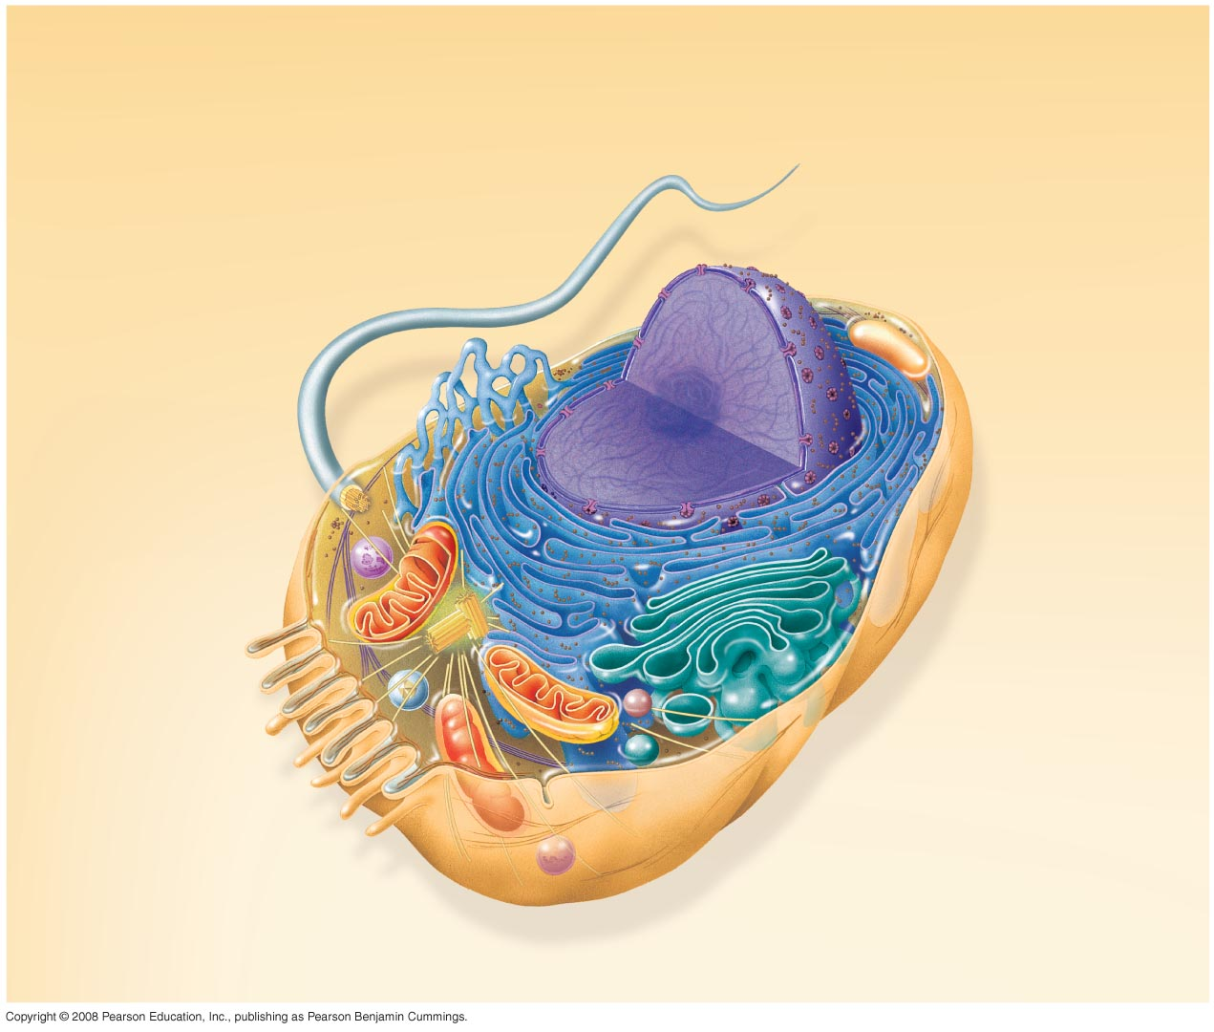
Fig. 6-9a
Nuclear
envelope
ENDOPLASMIC RETICULUM (ER)
NUCLEUS
Nucleolus
Rough ER
Smooth ER
Flagellum
Chromatin
Centrosome
Plasma membrane
CYTOSKELETON:
Microfilaments
Intermediate
filaments
Microtubules
Ribosomes
Microvilli
Golgi
apparatus
Peroxisome
Mitochondrion
Lysosome

Slide 9
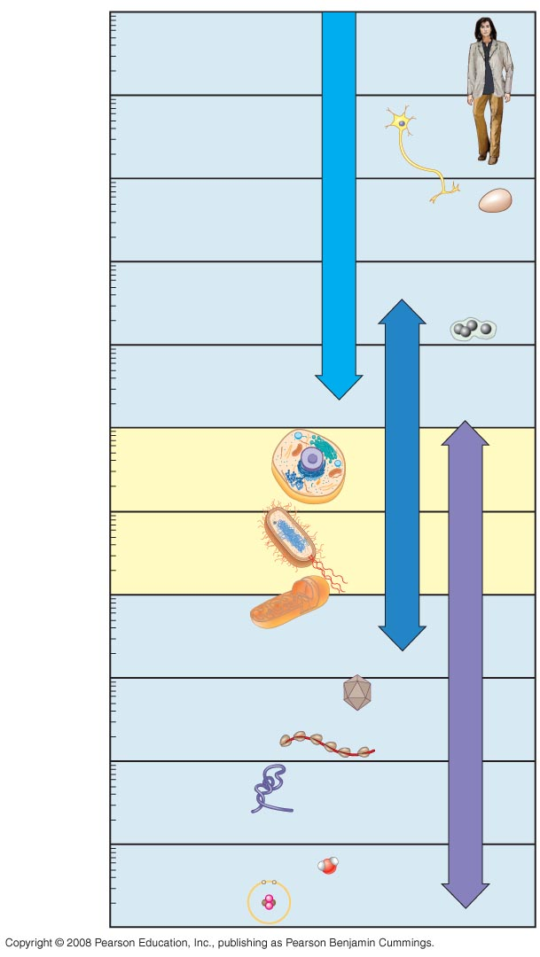
Fig. 6-2
10 m
1 m
Human height
Length of some nerve and muscle cells
0.1 m
Unaided eye
Prokaryotic
Archaea- .1 – 1 micrometers
Bacteria- 1 – 10 micrometers
Chicken egg
1 cm
1 mm
Frog egg
Eukaryotic
Animal and Plant
10 – 100 micrometers
100 µm
Most plant and animal cells
Light microscope
10 µm
Nucleus
Most bacteria
1 µm
Mitochondrion
100 nm
Smallest bacteria
Electron microscope
Viruses
10 nm
Ribosomes
Proteins
1 nm
Lipids
Small molecules
0.1 nm
Atoms

Slide 10
Microscopes
In order to see small objects in biology – an individual uses a microscope
There are two major types of microscopes- the Light Microscope and the Electron Microscope
Two important parameters in microscopy are magnification and resolving power, or resolution.

Slide 11
Magnification versus Resolution
Magnification is the ratio of an object’s image size to its real size
X versus x
Resolution is a measure of the clarity of an image; it is the minimum distance two points can be separated and still be distinguished as two points. For example, what appears to the unaided eye as one star in the sky may be resolved as twin stars with a telescope
How close can you get those two
dots and still say they are two dots
instead of one dot?

Slide 12
Microscopes (Light)
The light microscope", is a type of microscope which uses visible light and a system of lenses to magnify images of small samples. Optical microscopes are the oldest and simplest of the microscopes.
Two important parameters in microscopy are magnification and resolving power, or resolution.
In practice the best obtainable resolution is around 0.2 micrometers for a light microscope

Slide 13
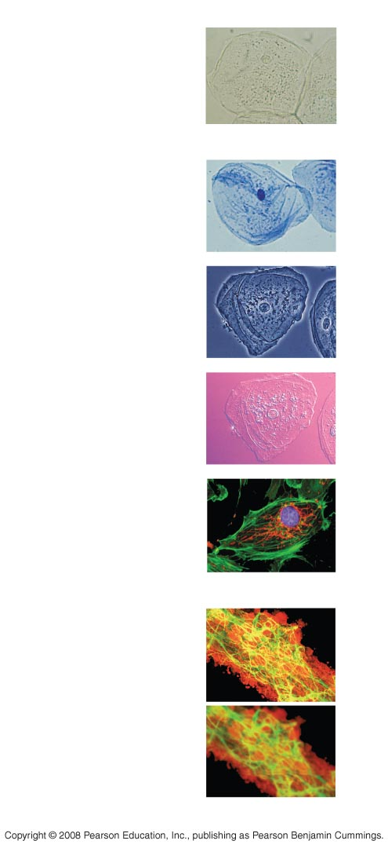
Fig. 6-3
TECHNIQUE
RESULTS
(a) Brightfield (unstained
specimen)
Types of
Light Microscopes
50 µm
(b) Brightfield (stained
specimen)
(c) Phase-contrast
(d) Differential-interference-
contrast (Nomarski)
(e) Fluorescence
50 µm
(f) Confocal
50 µm

Slide 14
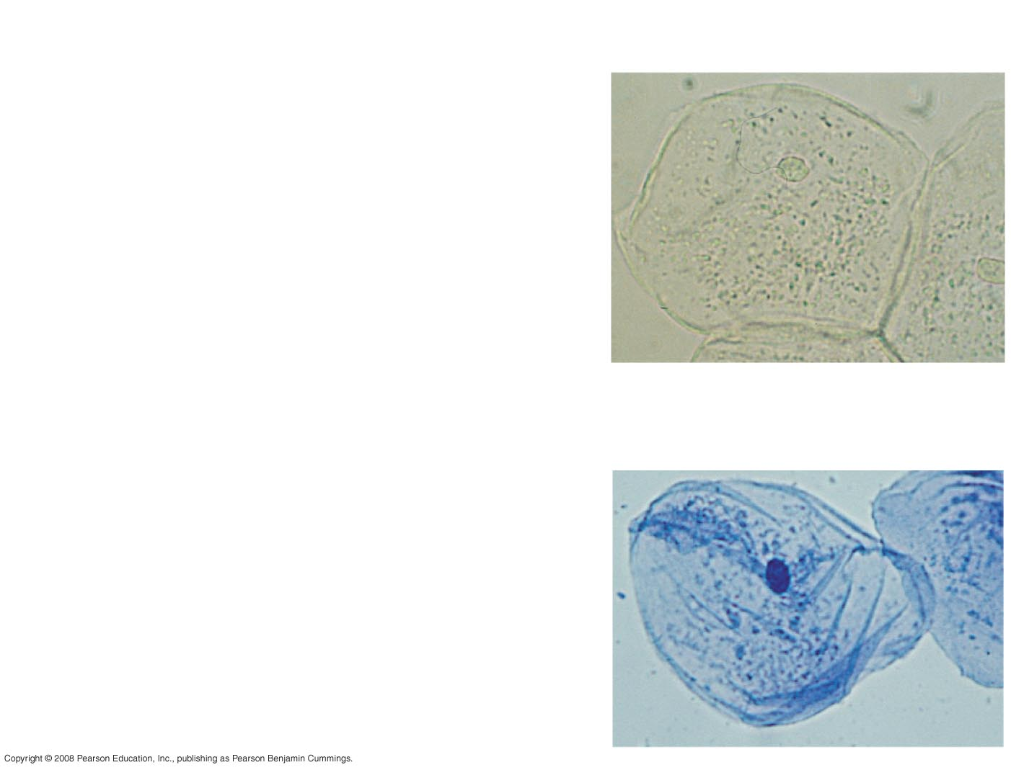
Fig. 6-3ab
TECHNIQUE
RESULTS
(a) Brightfield (unstained
specimen)
Passes light directly through
specimen. Unless cell is
naturally pigmented or artificially
stained, image has little contrast.
50 µm
(b) Brightfield (stained
specimen)
Staining with various dyes
enhances contrast. Most staining
procedures require that cells be
fixed (preserved).

Slide 15
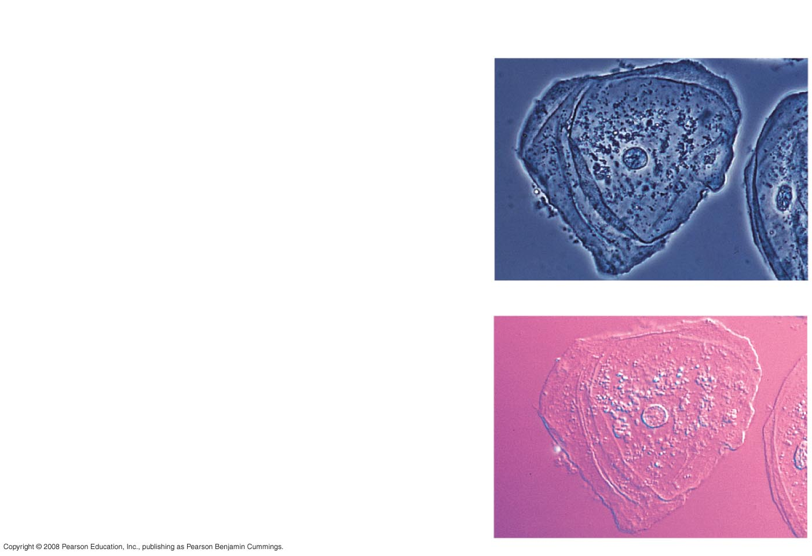
Fig. 6-3cd
TECHNIQUE
RESULTS
(c) Phase-contrast
Enhances contrast in unstained cells
by amplifying variations in density
within specimen; especially useful
for examining living unpigmented
cells.
(d) Differential-interference-
contrast (Nomarski)
Like phase-contrast microscopy, uses
Optical modifications to exaggerate
Differences in density, making the
Image appear almost 3-D.

Slide 16
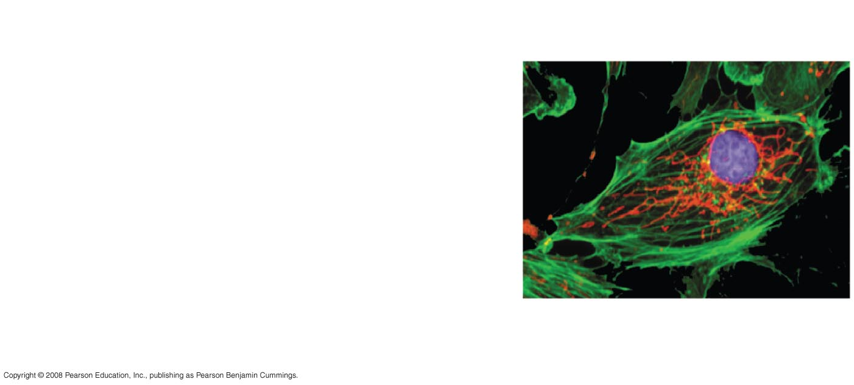
Fig. 6-3e
TECHNIQUE
RESULTS
(e) Fluorescence
Shows the locations of specific
molecules in the cell by tagging the
molecules with fluorescent dyes or
antibodies. These fluorescent
substances Absorb UV light and
emit visible light.
50 µm

Slide 17
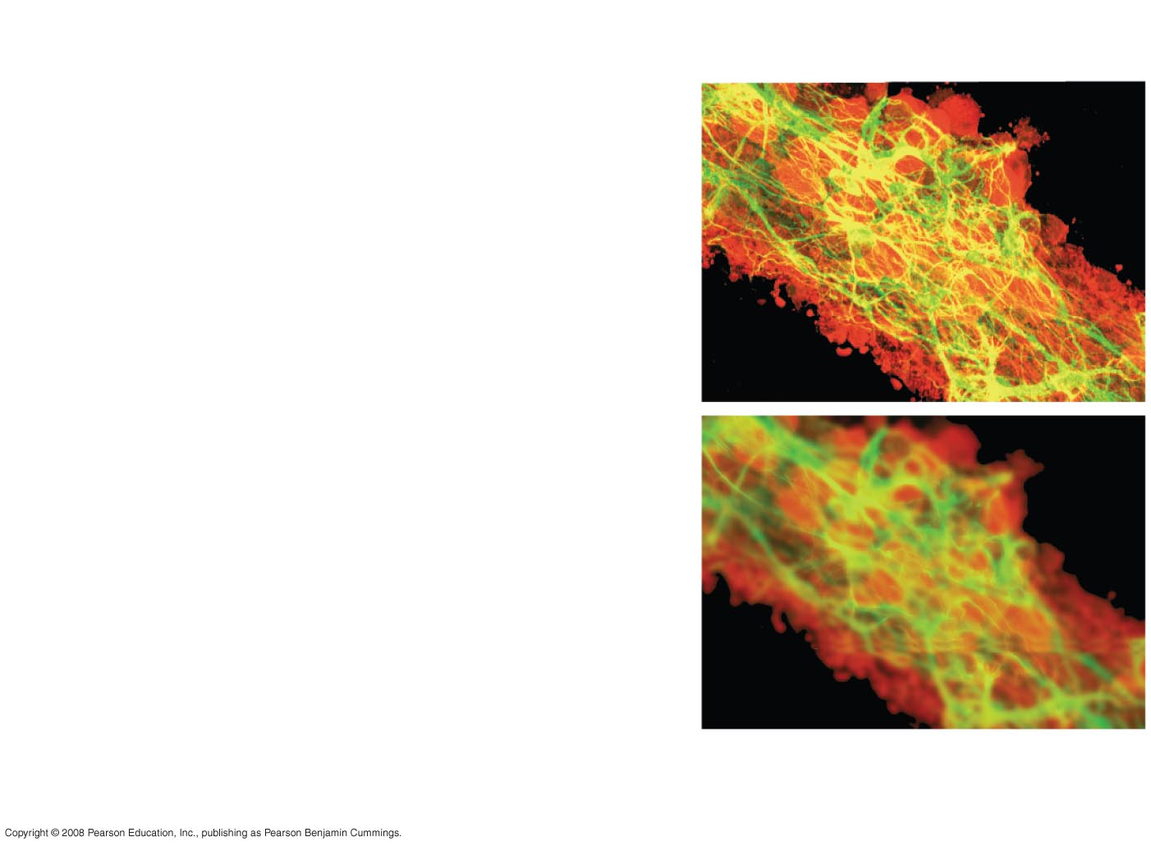
Fig. 6-3f
TECHNIQUE
RESULTS
(f) Confocal
A fluorescent “optical” sectioning
technique that uses a pinhole
aperture to eliminate out-of-focus
light from a thick sample, creating
a single plane of fluorescence in the
image. By capturing sharp images
at many different planes, a 3-D
reconstruction can be created. At the
right are confocal (top) and standard
fluorescent micrographs of stained
nervous tissue, where nerve cells
are green, support cells are red, and regions of overlap
are yellow.
50 µm

Slide 18
Electron Microscope
An electron microscope is a type of microscope that uses a particle beam of electrons to illuminate a specimen and create a highly-magnified image. Electron microscopes have much greater resolving power than light microscopes that use electromagnetic radiation and can obtain much higher magnifications. The greater resolution is 0.2 nanometers versus 0.2 micrometers for the light microscope. The greater magnification of the electron microscope is because the wavelength of an electron; is much smaller than that of a photon of visible light.

Slide 19
Two Types of Electron Microscopes
Transmission Electron Microscope – electrons pass through the specimen – show the inside of the specimen
Scanning Electron Microscope – electrons scan along the surface of specimen – shows a surface view of the specimen

Slide 20

Transmission Electron Microscope

Slide 21
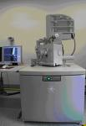
Scanning Electron Microscope

Slide 22
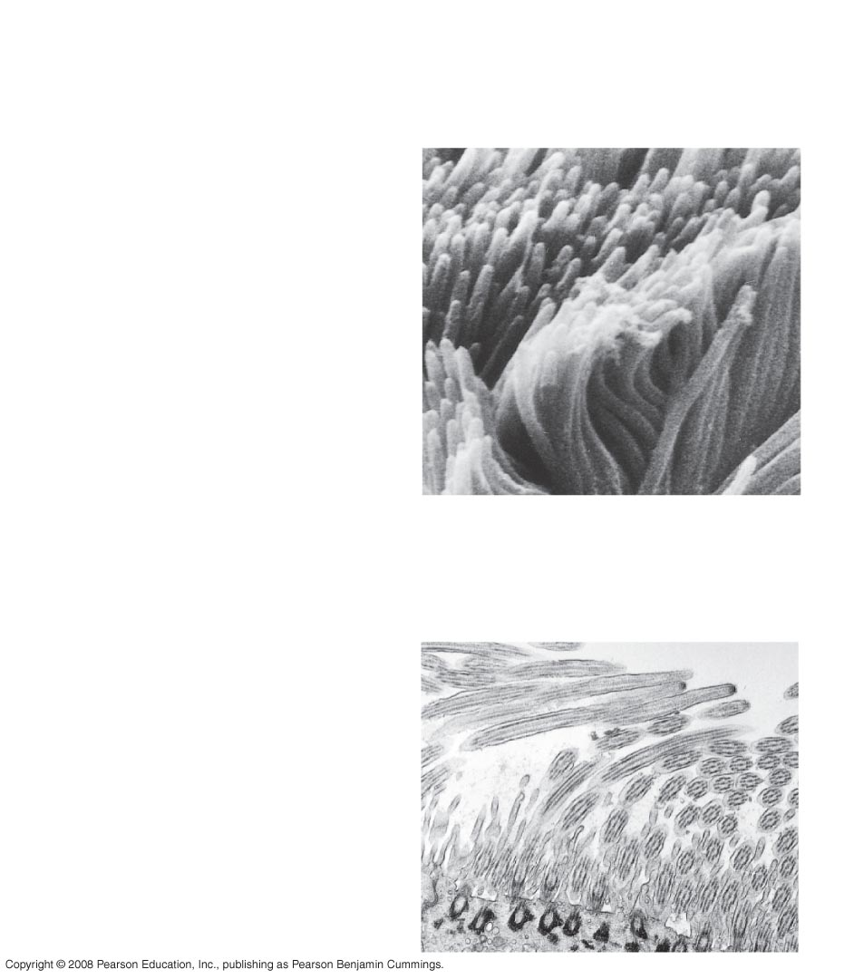
Fig. 6-4
TECHNIQUE
RESULTS
(a) Scanning electron
microscopy (SEM)
Cilia
1 µm
Micrographs taken with a
scanning electron microscope
show a 3-D image of the surface
of a specimen. A surface view
of cilia.
(b) Transmission electron
microscopy (TEM)
Longitudinal
section of
cilium
Cross section
of cilium
1 µm
A TEM profiles a thin section of
a specimen. The TEM looks
inside a specimen. This is a view inside of cilia.

Slide 23
Fig. 6-9a
Let’s look at the cell components
Nuclear
envelope
ENDOPLASMIC RETICULUM (ER)
NUCLEUS
Nucleolus
Rough ER
Smooth ER
Flagellum
Chromatin
Centrosome
Plasma membrane
CYTOSKELETON:
Microfilaments
Intermediate
filaments
Microtubules
Ribosomes
Microvilli
Golgi
apparatus
Peroxisome
Mitochondrion
Lysosome

Slide 24
Plasma (Cell) Membrane
The cell membrane separates intracellular fluids from extracellular fluids

Slide 25
Functions of the Cell Membrane
The cell membrane plays a role in providing shape to a cell, and in attaching a group cells together in the formation of tissues.
The barrier is selectively permeable and able to regulate what enters and exits the cell
Specific proteins embedded in the cell membrane can act as molecular signals (for example the enzymes that serve to make the secondary messengers like cyclic AMP) that allow cells to communicate with each other.
Some Protein receptors function to receive signals from both the environment and other cells.
Other proteins on the surface of the cell membrane serve as "markers" that identify a cell to other cells.

Slide 26
Structure of the Cell Membrane
“Fluid Mosaic Model”
Double bilayer of lipids with imbedded, dispersed proteins
Bilayer consists of phospholipids, cholesterol, and glycolipids
  Glycolipids are lipids with bound carbohydrate
  Phospholipids have hydrophobic and hydrophilic bipoles

Slide 27
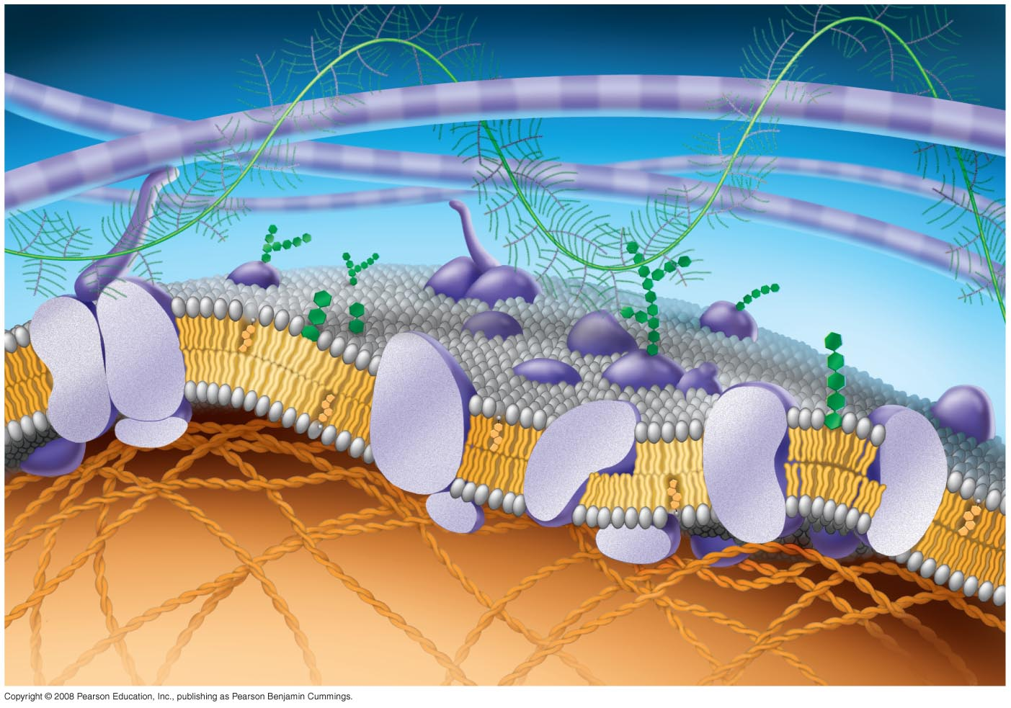
Fig. 7-7
Fibers of
extracellular
matrix (ECM)
Glyco-
protein
Carbohydrate
Glycolipid
EXTRACELLULAR
SIDE OF
MEMBRANE
Cholesterol
Microfilaments
of cytoskeleton
Peripheral
proteins
Integral
protein
CYTOPLASMIC SIDE
OF MEMBRANE

Slide 28
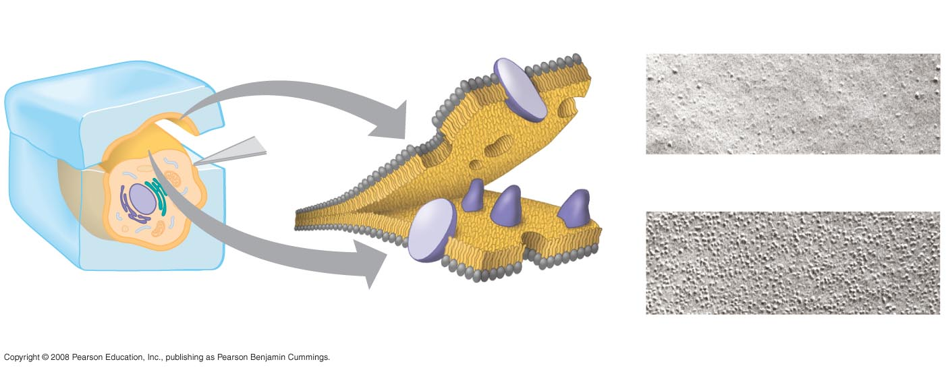
Fig. 7-4
Phospholipid Bilayer
TECHNIQUE
RESULTS
Extracellular
layer
Proteins
Inside of extracellular layer
Knife
Plasma membrane
Cytoplasmic layer
Inside of cytoplasmic layer

Slide 29
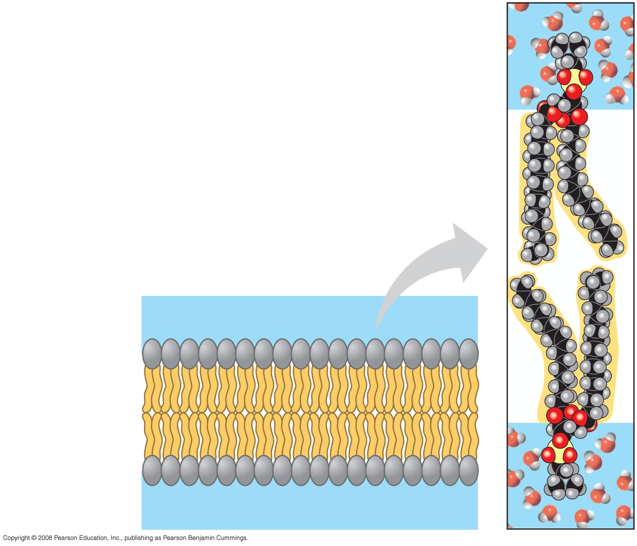
Fig. 7-2
Why Phospholipids? They are amphipathic – they like water At the polar side (phosphate group) and don’t like water the fatty Acid component. Thus water will approach the molecule at both Sides – intracellular water and extracellular water. However, the Fatty acid region (in the middle of the bilayer) will not let water or Water soluble substances pass through easily – thus keeping excess Water or water soluble substances from entering or leaving the
Cell.
WATER
Hydrophilic
head
Hydrophobic
tail
WATER

Slide 30
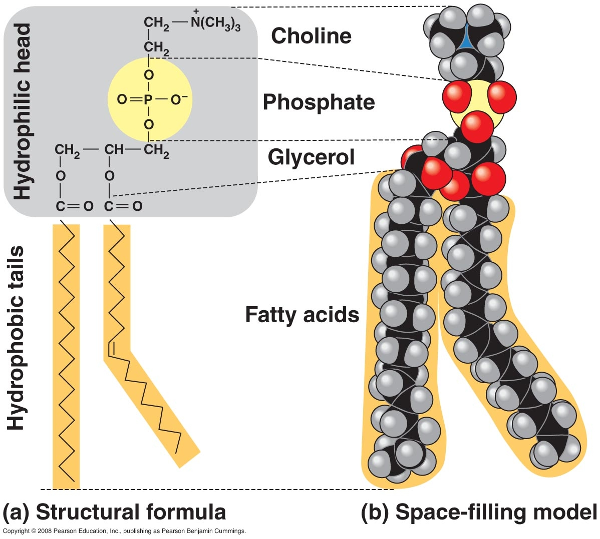
Phospholipid

Slide 31
Proteins in cell membrane
Two types in accordance to location within the membrane
Integral Proteins (transmembrane and partial transmembrane) – transmembrane proteins span the entire thickness of the membrane & partial ones go partway through the membrane
Peripheral Proteins are not embedded in the lipid bilayer at all; they are appendages loosely bound to the surface of the membrane, often to exposed parts of the integral proteins.

Slide 32
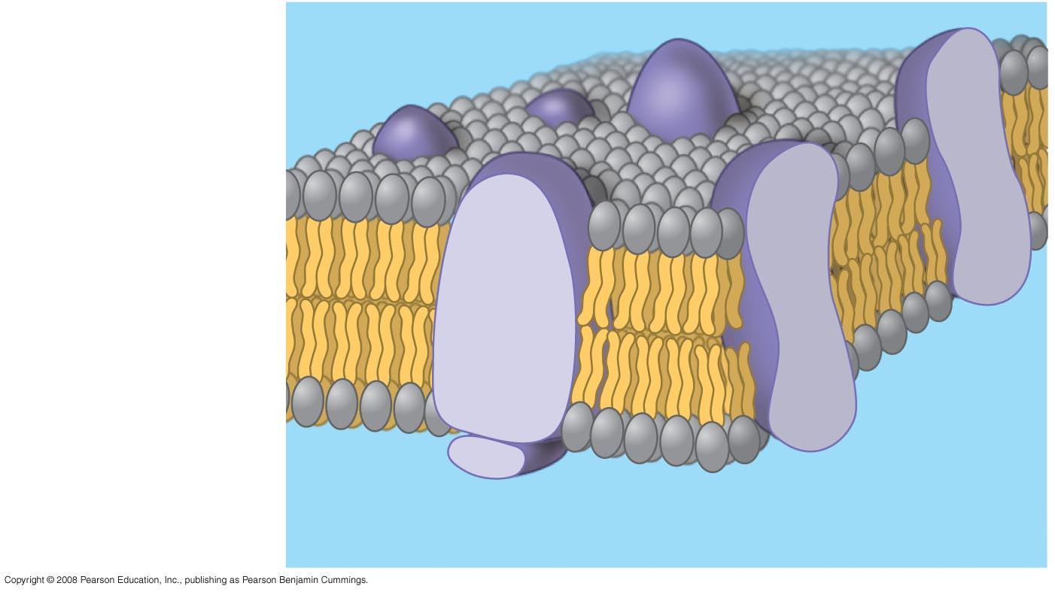
Fig. 7-3
Transmembrane Proteins
Phospholipid
bilayer
Hydrophobic regions
of protein
Hydrophilic
regions of protein
Peripheral Proteins

Slide 33
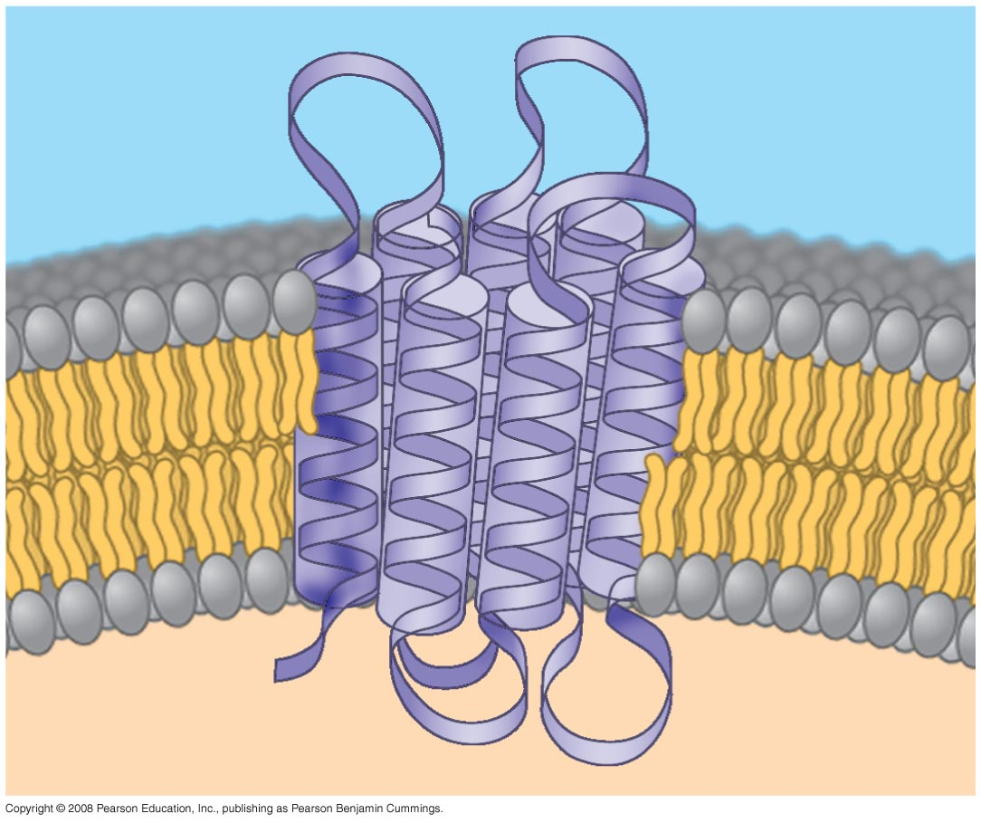
Fig. 7-8
Transmembrane
N-terminus
EXTRACELLULAR
SIDE
C-terminus
CYTOPLASMIC
SIDE
α Helix

Slide 34
Functions of Cell Membrane Proteins
Transport
Enzymatic
Signal Transduction
Cell to cell recognition
Intercellular joining
Attachment to cytoskeleton and extracellular matrix

Slide 35
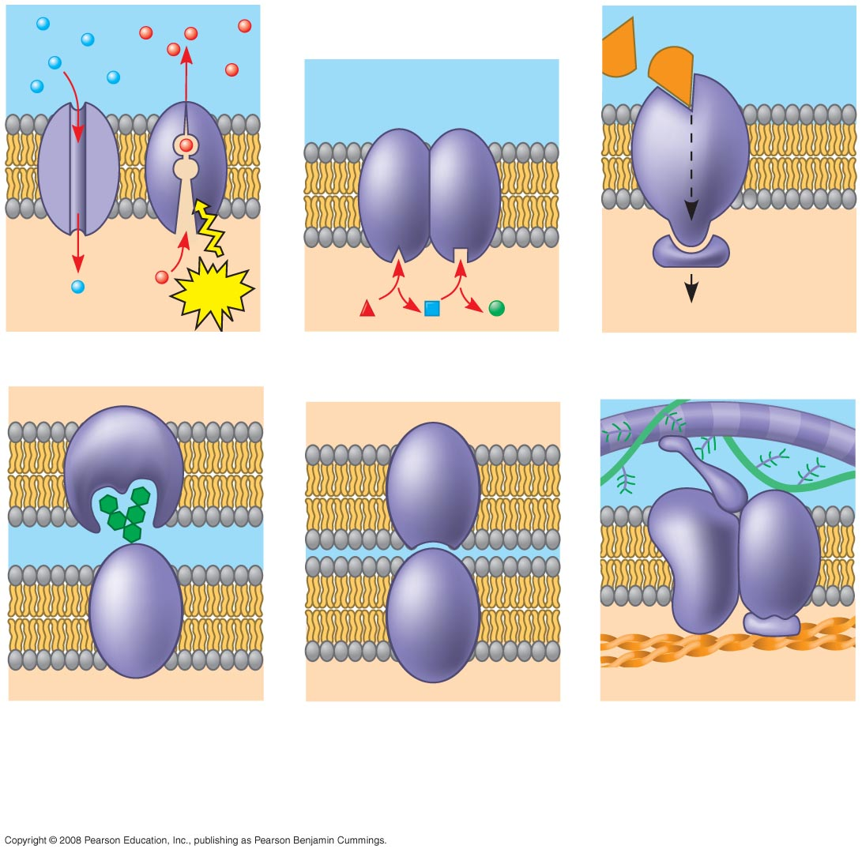
Fig. 7-9
Signaling molecule
Enzymes
Receptor
ATP
Signal transduction
(a) Transport
(b) Enzymatic activity
(c) Signal transduction
Glyco-
protein
(d) Cell-cell recognition
(e) Intercellular joining
(f) Attachment to
the cytoskeleton
and extracellular
matrix (ECM)

Slide 36
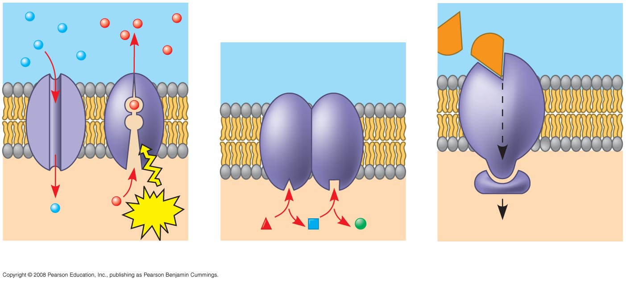
Fig. 7-9ac
Hormone Actions
Signaling molecule
Enzymes
Receptor
ATP
Signal transduction
(a) Transport
(b) Enzymatic activity
(c) Signal transduction

Slide 37
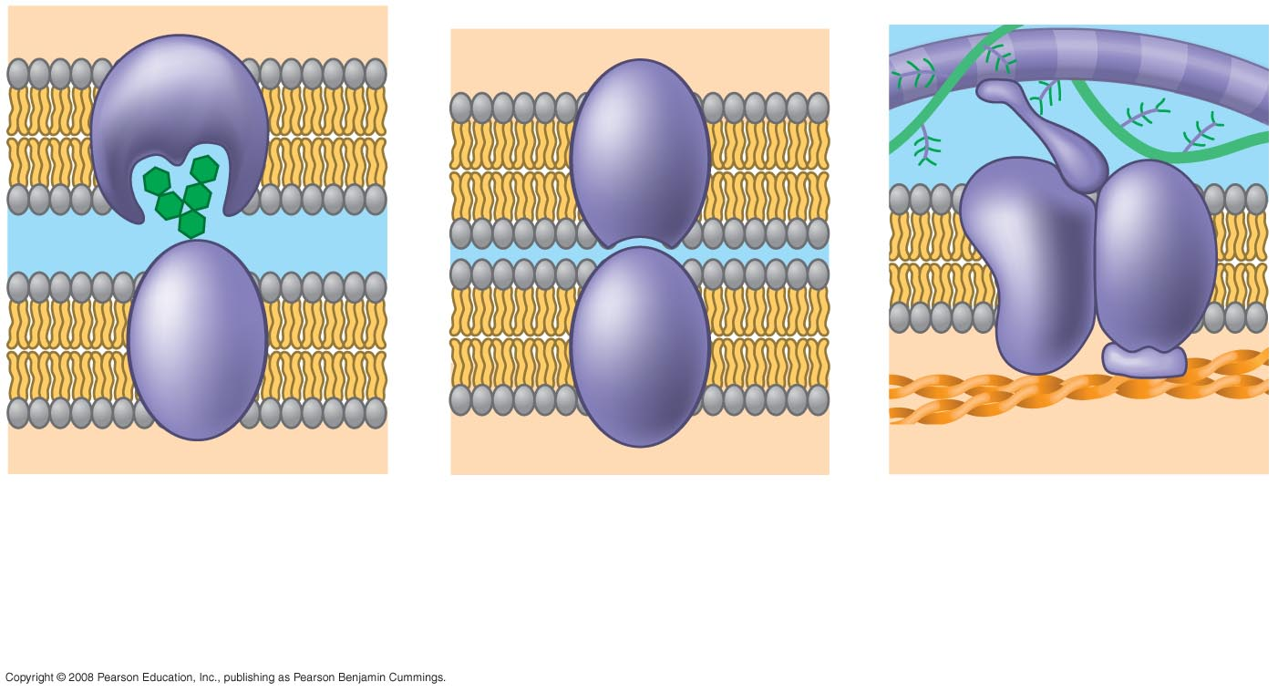
Fig. 7-9df
Glyco-
protein
(d) Cell-cell recognition
(e) Intercellular joining
(f) Attachment to
the cytoskeleton
and extracellular
matrix (ECM)
For example
white blood cell
Surveillance

Slide 38
Cell Membrane Transport
I. Passive Transport (no added particle energy)
A. Diffusion
B. Osmosis
C. Facilitated Transport
II. Active Transport (added amount of particle energy)
A. Primary Active
B. Secondary Active (Cotransport, Contra-port)
III. Large Particle Transport (cave out cell membrane)
A. Phagocytosis
B. Pinocytosis
C. Receptor Mediated Endocytosis

Slide 39
The Cell Membrane has selective permeability
The cell membrane is selective as to what it will let pass in and/or out
The major criteria for permeability
Small molecular size
Lipid soluble (uncharged particles)

Slide 40
Criteria for speed of Transport through the Cell Membrane
When particles increase in size – or have charges – the particles can move through the membrane but slower than those particles preferred (small size and uncharged)
When particles become too large and/or have significant charges- the membrane may disallow movement through the membrane unless great amounts of additional energy is added to the particles

Slide 41
Passive Transport
A type of transport in which the moving particles have their own energies. The cell does not need to add energy to the moving particles.
There are three types of passive transport;
A. Diffusion
B. Osmosis
C. Facilitated Transport

Slide 42
Diffusion
Net movement of certain particles from a region of high concentration of those certain particles to a region of low concentration of those certain particles
Particles look at their own kinds – when moving
Particles bounce around randomly by entropic (Brownian motion) – they bump into one another like people moving in a crowded room- they wish to get hit less so they tend to bounce into the less crowded room

Slide 43
AAAA (4 As) AA (2 As)
BB (2 Bs) BBBB (4 Bs)
CCCCC (5 Cs) CCC (3 Cs)
DDD (3 Ds) DD (2 Ds)
Compartment Z Compartment X
14 total Particles 11 Total Particles
Net in math means to subtract
Particles move in accordance with their own kinds (Inter-diffusion)

Slide 44
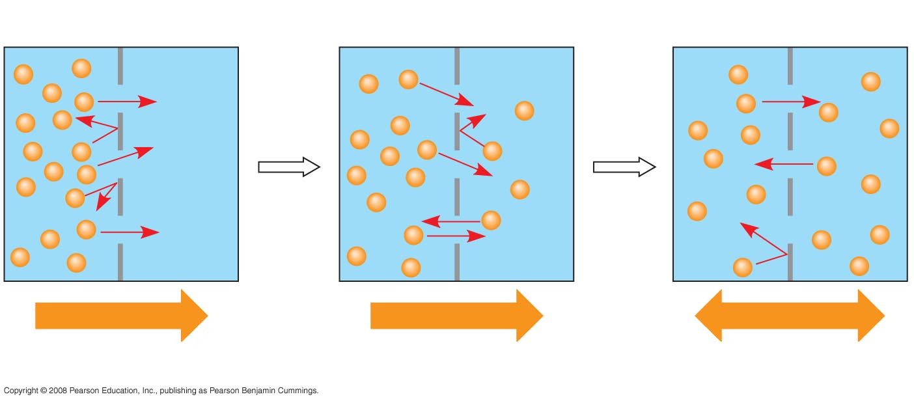
Fig. 7-11a
When the concentrations of the particles on both sides is the same such that particle movement in one direction is the same as that in the other direction – this is equilibrium in diffusion.
Molecules of dye
Membrane (cross section)
WATER
Net diffusion
Net diffusion
Equilibrium
(a) Diffusion of one solute

Slide 45
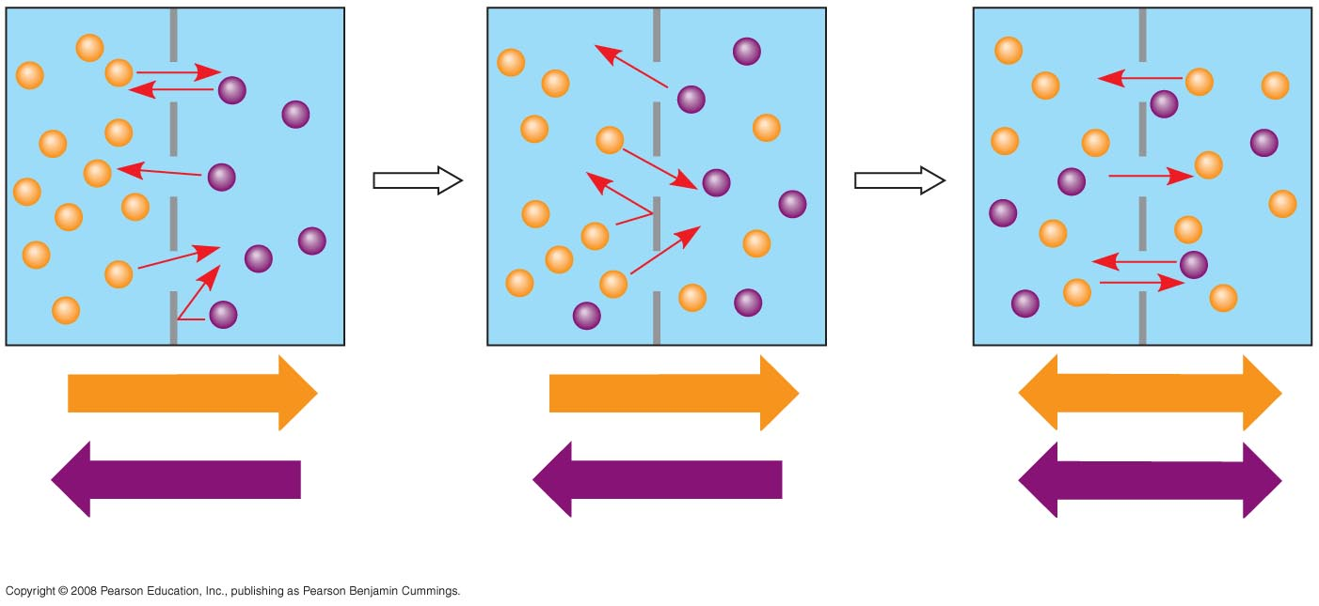
Fig. 7-11b
When the concentrations of the particles on both sides
is the same such that particle movement in one direction
is the same as that in the other direction –
this is equilibrium in diffusion.
Net diffusion
Net diffusion
Equilibrium
Net diffusion
Net diffusion
Equilibrium
(b) Diffusion of two solutes

Slide 46
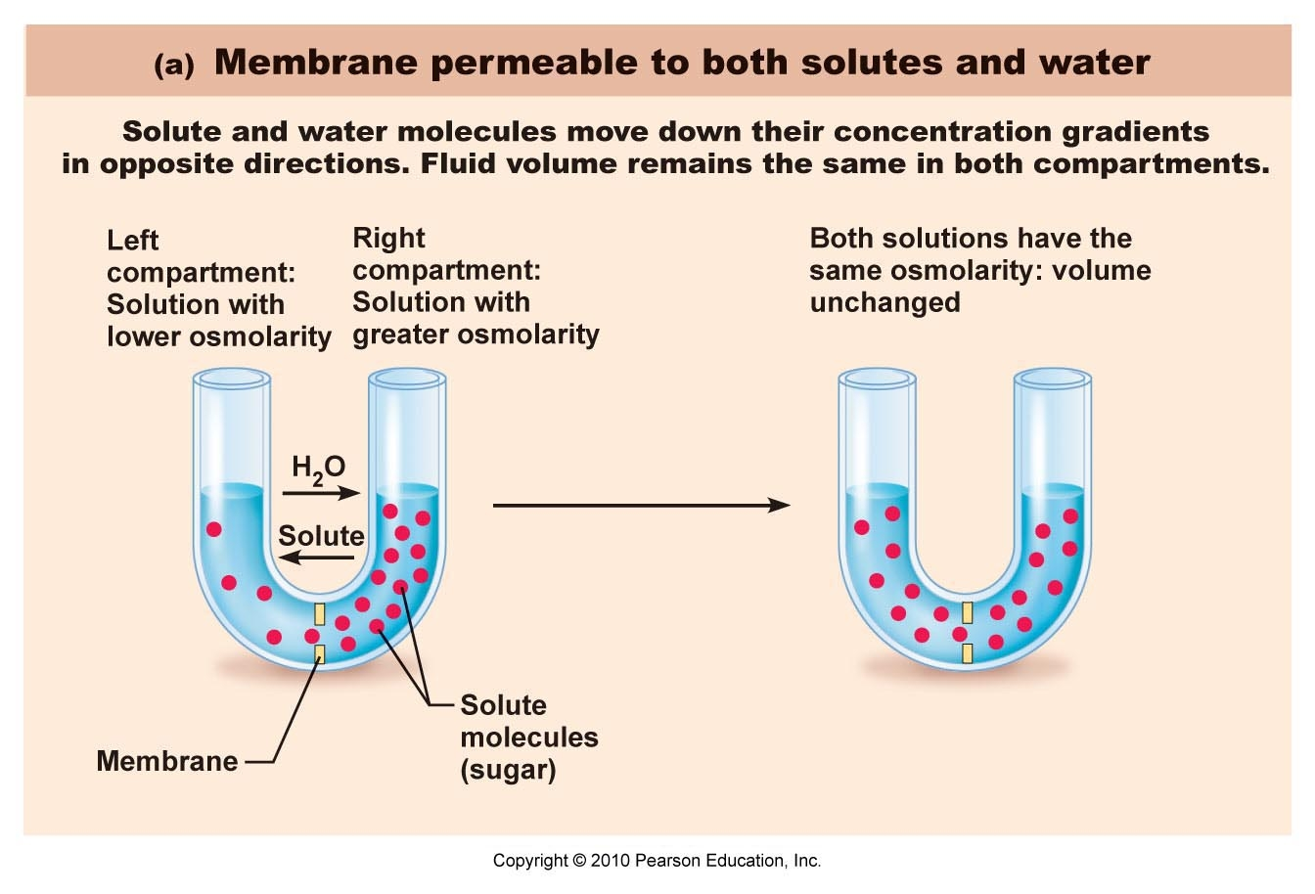
Diffusion

Slide 47
Osmosis
Net movement of certain selected particles from a region of high concentration of those certain selected particles to a region of low concentration of those certain selected particles – through a membrane primarily permeable to those certain particles.

Slide 48
AAAA (4 As) Blocked AA (2 As)
BB (2 Bs) Blocked BBBB (4 Bs)
CCCCC (5 Cs) CCC (3 Cs)
DDD (3 Ds) Blocked DD (2 Ds)
Compartment Z Compartment X
14 total Particles 11 Total Particles
Assume only the C particles can move and the others cannot (blocked) – then the C particles will move and the others will stay behind. C particles alone will achieve equilibrium – because particles move in accordance of their own kind irrespective of the other non-like particles.

Slide 49
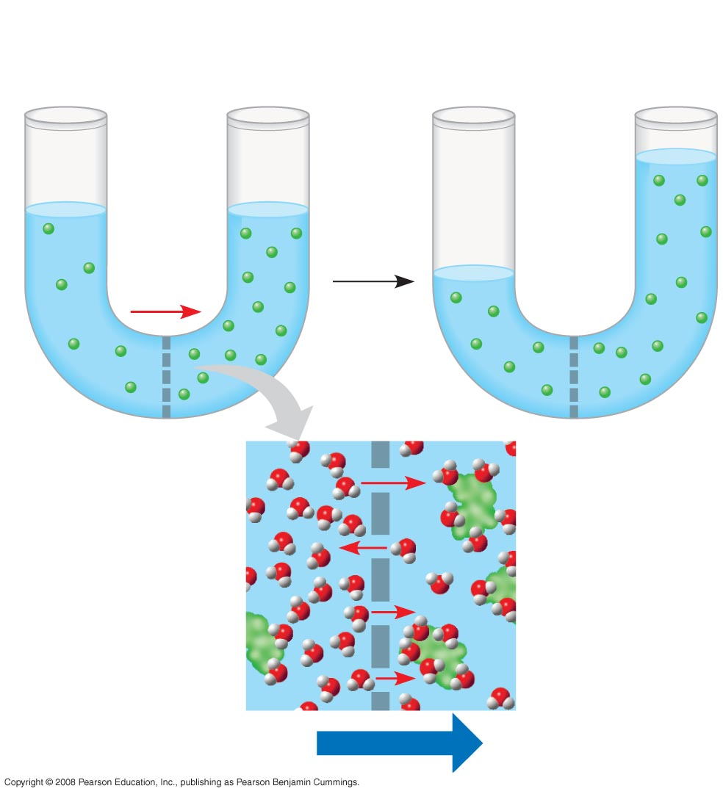
Fig. 7-12
Lower
concentration
of solute (sugar)
Higher concentration
of sugar
Same concentration
of sugar
H₂O
Selectively
permeable
membrane
Notice – the higher
water level
Osmosis

Slide 50
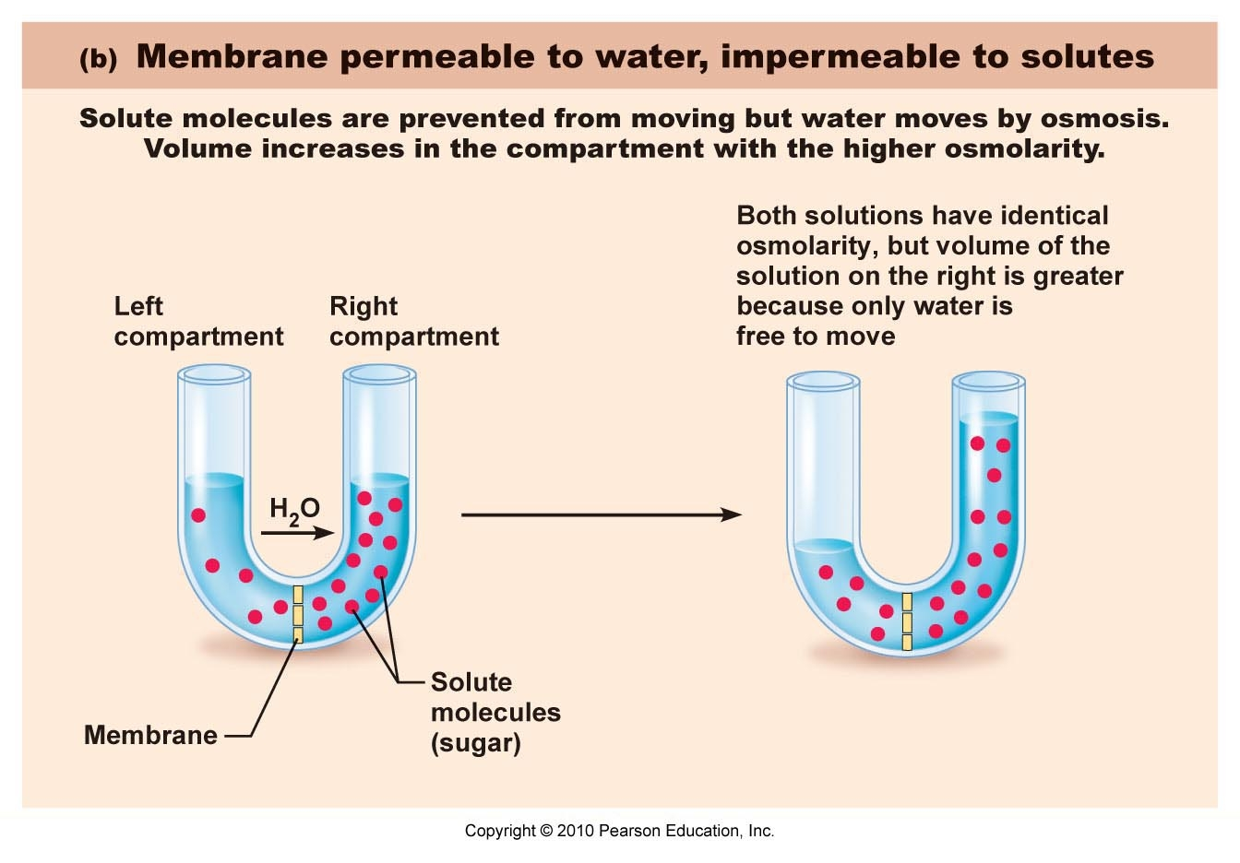
Osmosis

Slide 51
Solutions and Osmosis
Hyperosmotic – higher solute concentration as compared to another solution
Hyposmotic – lower solute concentration as compared to another solution
Isosmotic – same amount of solute concentration
Tonus –to stretch
To use the terms below the container must be able to stretch – for example a cell can stretch
Hypertonic
Hypotonic
Isotonic
A red blood cell is isotonic with a 0.9% NaCl solution

Slide 52
Examine Handout on Osmosis
Osmosis Handout for AP I

Slide 53
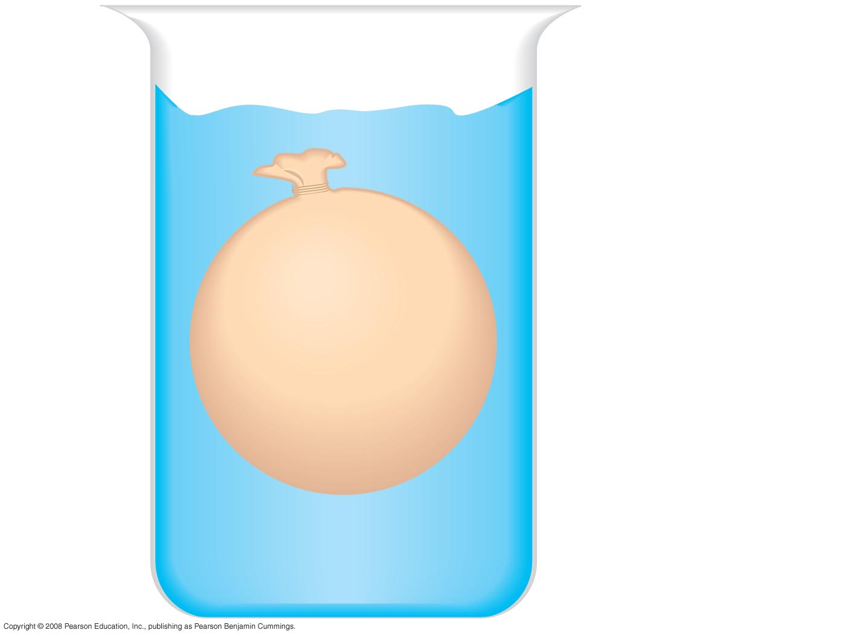
Fig. 7-UN3
Environment:
0.01 M sucrose
0.01 M glucose
0.01 M fructose
“Cell”
0.03 M sucrose
0.02 M glucose

Slide 54
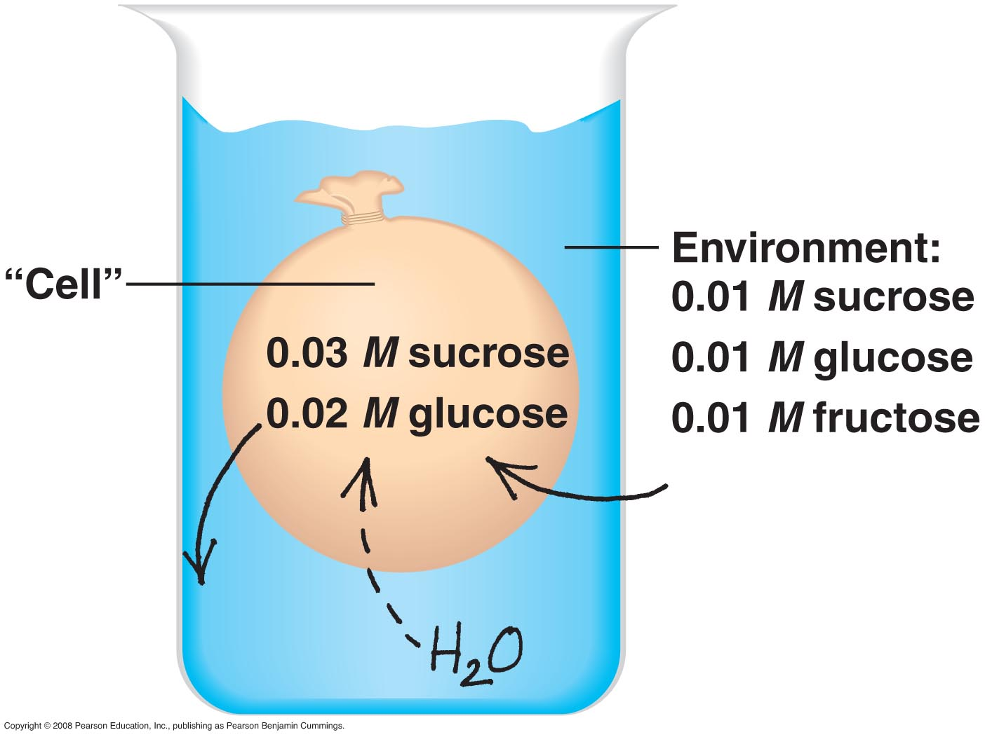
Fig. 7-UN4
Hypertonic in that it is .05 molar intracellularly compared to .03 molar of the extracellular environment – thus water moves into the cell (hypertonic is a vacuum for water).

Slide 55
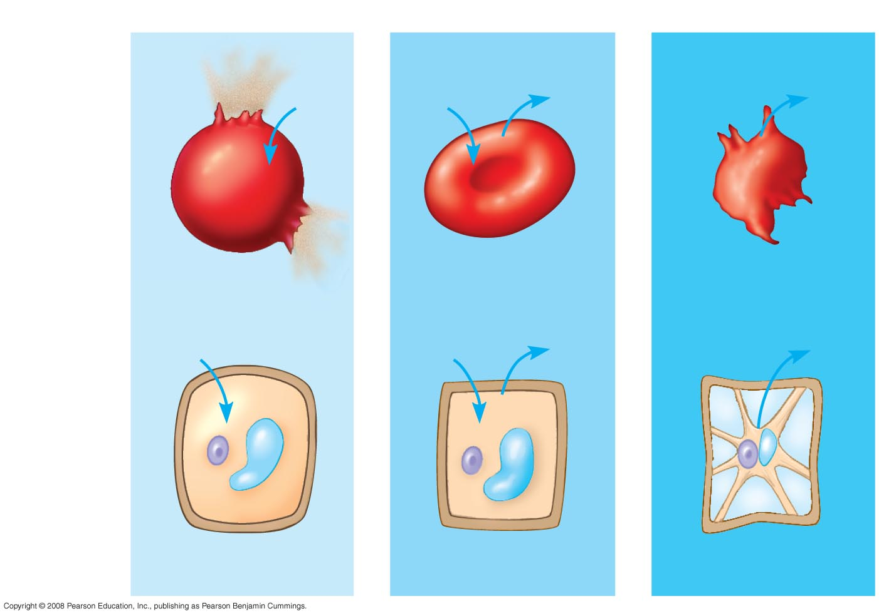
Fig. 7-13
Hypotonic solution
Isotonic solution
Hypertonic solution
H₂O
H₂O
H₂O
H₂O
(a) Animal
cell
Lysed
Normal
Shriveled
H₂O
H₂O
H₂O
H₂O
(b) Plant
cell
Turgid (normal)
Flaccid
Plasmolyzed

Slide 56
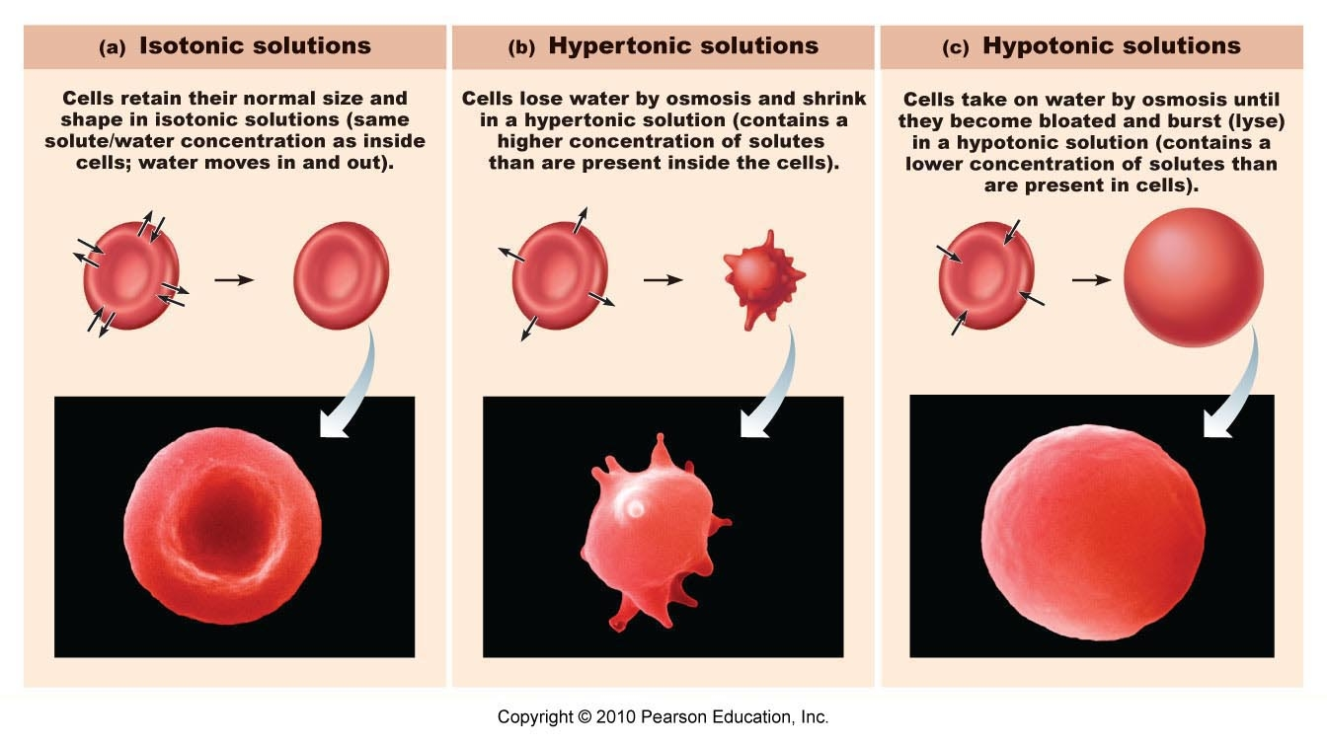

Slide 57
Facilitated Transport
In a situation in which particles do not have the optimal criteria for entrance into a cell – but the cell wants it in faster – the cell must put some special transmembrane integral proteins into the cell membrane to help (facilitate) the entrance of these particles – for example glucose entrance into a cell uses these transporters

Slide 58
Remember that the cell easily permits particles to enter or leave the cell that have small molecular sizes and are lipid soluble (uncharged particles)
When particles increase in molecular size – or have charges – the particles can move through the membrane but slower than those particles preferred (small size and uncharged)
As mentioned - In a situation in which particles do not have the optimal criteria for entrance into a cell – but the cell wants it in faster – the cell must put some special transmembrane integral proteins into the cell membrane to help (facilitate) the entrance of these particles

Slide 59
Glucose is an essential substrate for the metabolism of most cells. Because glucose is a polar molecule, transport through biological membranes requires specific transport proteins.

Slide 60
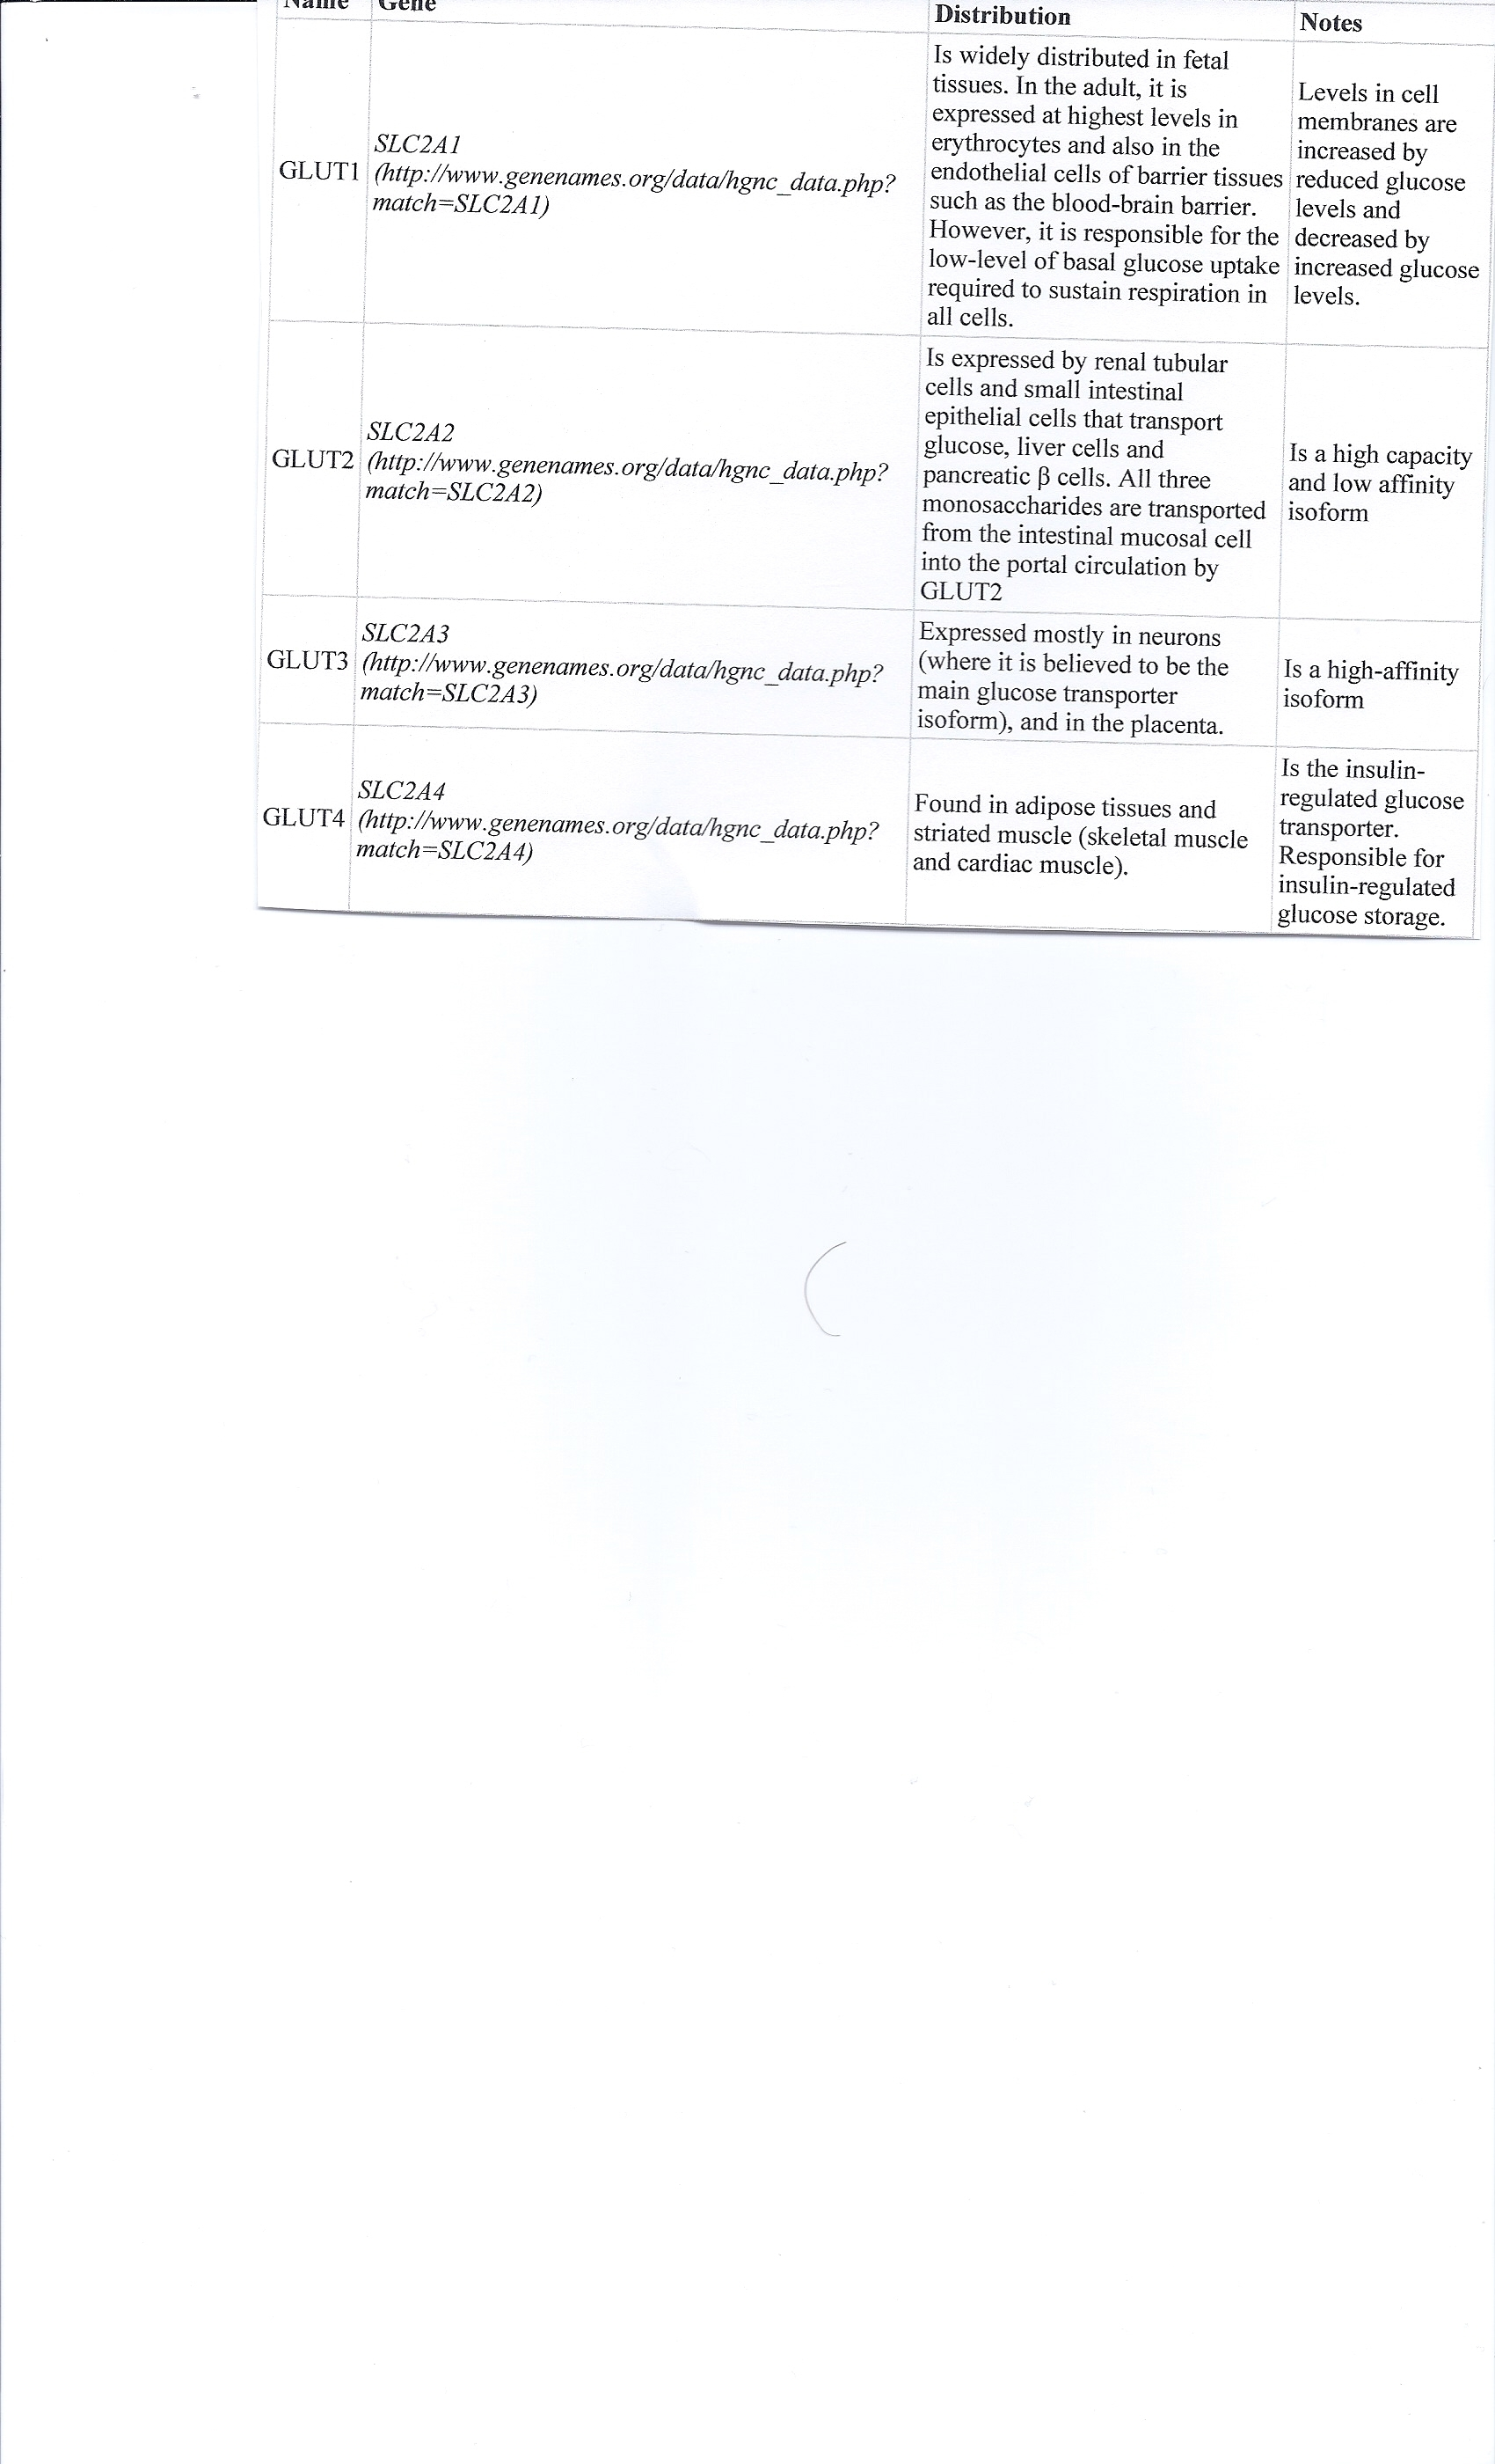

Slide 61
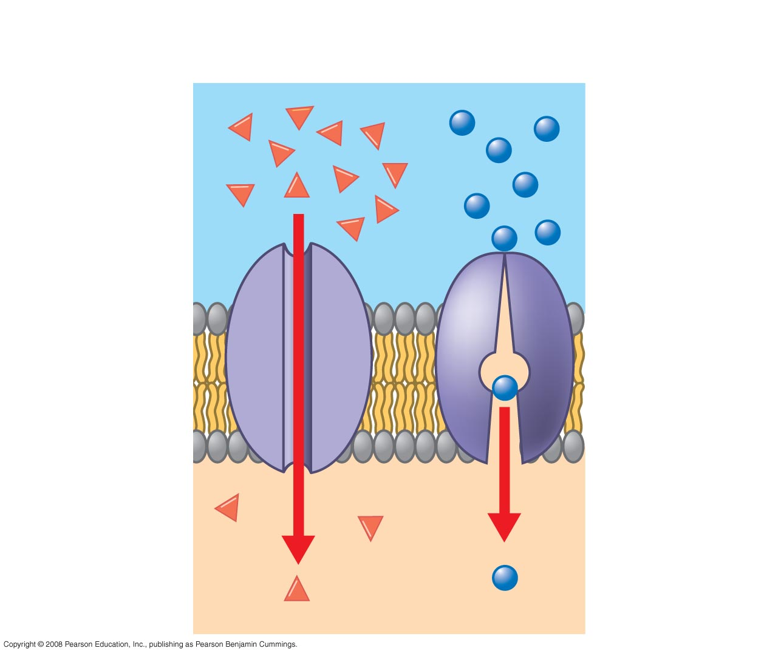
Fig. 7-UN1
Passive transport:
Facilitated diffusion
Channel
protein
Carrier
protein

Slide 62
Active Transport
Energy must be added to the moving particles- the process is endergonic – it requires liberation of energy from ATP
Primary Active Transport
The Na⁺/K⁺ pump
Secondary Active Transport
Symport – Cotransport
Antiport - Contraport

Slide 63
Primary Active Transport
The Na⁺/K⁺ pump
Every living cell in the body has thousands of copies of the ATP dependent Na⁺/K⁺ pump
The pump pushes 3 Na⁺ out of a cell and 2 K⁺ into a cell- thus it keeps the Na⁺ concentration high outside a cell and the K⁺ concentration high within a cell
This pump helps the charge on a cell membrane known as the “Resting Membrane Potential”

Slide 64
The Cell Gradients
Concentration & Charge Gradients
The Na⁺/K⁺ pump assists in the creation and maintenance of a concentration gradient and charge gradient across the cell membrane
Concentration Gradient of ions– the cation Na⁺ is high outside a cell and the anion Cl⁻ is also high outside a cell --- the cation K⁺ is high inside a cell
Charge Gradient - The inside of a cell close to the cell membrane has a net negative charge and the inside close to the membrane has a net positive charge

Slide 65
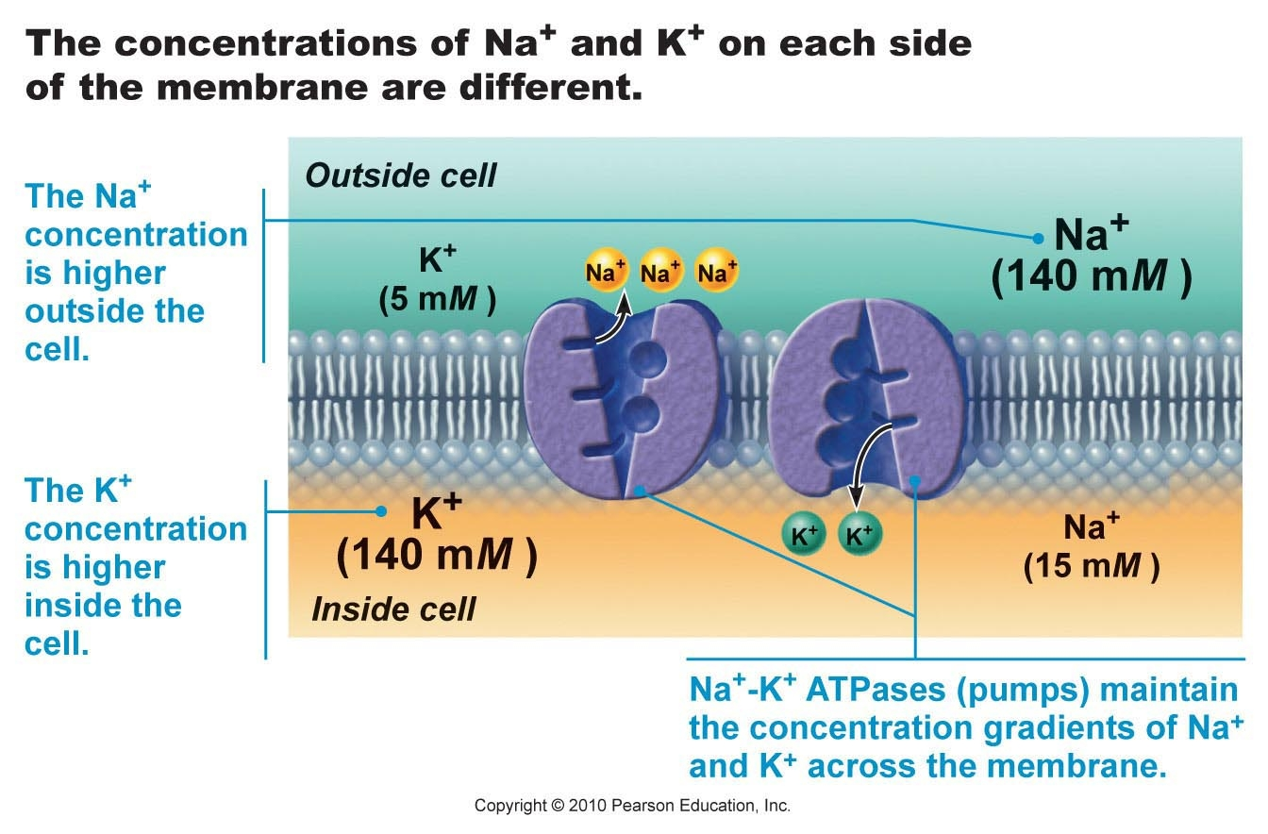
Na⁺/K⁺ pump

Slide 66
The Na⁺ role in Secondary Active Transport
The Na⁺ movement into a cell is very, very exergonic – Na⁺ wants to move into a cell by both its concentration gradient and charge gradient (remember Na⁺ has a net positive charge and the inside of the cell has a net negative charge)
The Na⁺ movement is so exergonic (having lots more energy than needed for its own movement) it can help move some other ions needing energy for their movements (endergonic) – thus creating a “Secondary Transport”
Na⁺ is not the only ion that can create secondary active transport

Slide 67
Secondary Transport
If the particles needing energy travel in the same direction as the Na⁺ movement – it is called cotransport or symport
If the particles needing energy travel in the opposite direction as the Na⁺ movement – it is called contra-port or antiport

Slide 68
Large Particle Transport
(must cave out cell membrane)
Phagocytosis ( cell eating)
B. Pinocytosis (cell drinking)
C. Receptor Mediated Endocytosis (using cell membrane receptors to select which particles that will come into the cell)
When large particles are brought into a cell it is termed “Endocytosis”
When large particles are pushed out of a cell it is termed “Exocytosis”

Slide 69
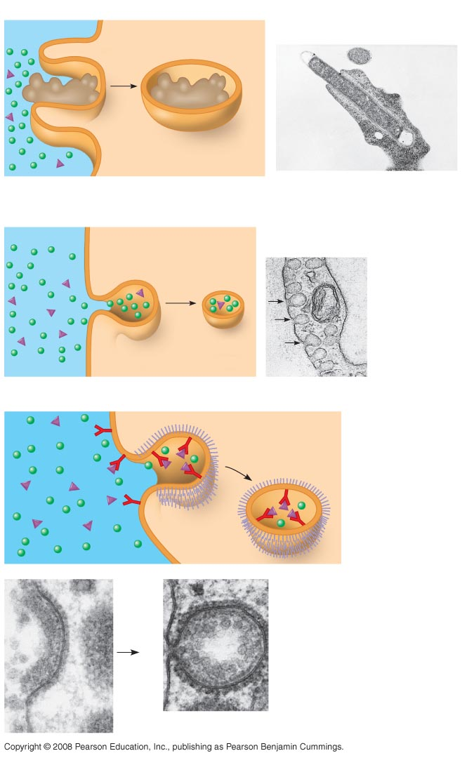
Fig. 7-20
In phagocytosis, a cell engulfs a particle by wrapping a pseudopodia around it and packaging it within a membrane
bound sac called a vesicle.
PHAGOCYTOSIS
EXTRACELLULAR
FLUID
CYTOPLASM
1 µm
Pseudopodium
Pseudopodium
of amoeba
“Food”or
other particle
Bacterium
Food
vacuole
Food vacuole
An amoeba engulfing a bacterium
via phagocytosis (TEM)
PINOCYTOSIS
Plasma
membrane
0.5 µm
Pinocytosis vesicles
forming (arrows) in
a cell lining a small
blood vessel (TEM)
Vesicle
In pinocytosis the cell gulps droplets of extracellular fluid
into tiny vesicles.
RECEPTOR-MEDIATED ENDOCYTOSIS
Receptor
Coat protein
Coated
vesicle
Coated
pit
Ligand
Coat
protein
A coated pit
and a coated
vesicle formed
during
receptor-
mediated
endocytosis
(TEMs)
Plasma
membrane
0.25 µm

Slide 70
Receptor mediated endocytosis enables the cell to acquire bulk quantities of specific substances, even though those substances may not be very concentrated in the extracellular fluid. Embedded in the membrane are proteins with specific receptor sites exposed to the extracellular fluid. The receptor proteins are usually already clustered in regions of the membrane called coated pits, which are lined on their cytoplasmic side by a fuzzy layer of coat proteins. When binding occurs, the coated pit forms a vesicle containing the ligand molecules. After the ingested material is liberated from the vesicle, the receptors are recycled to the cell membrane by the same vesicle.

Slide 71
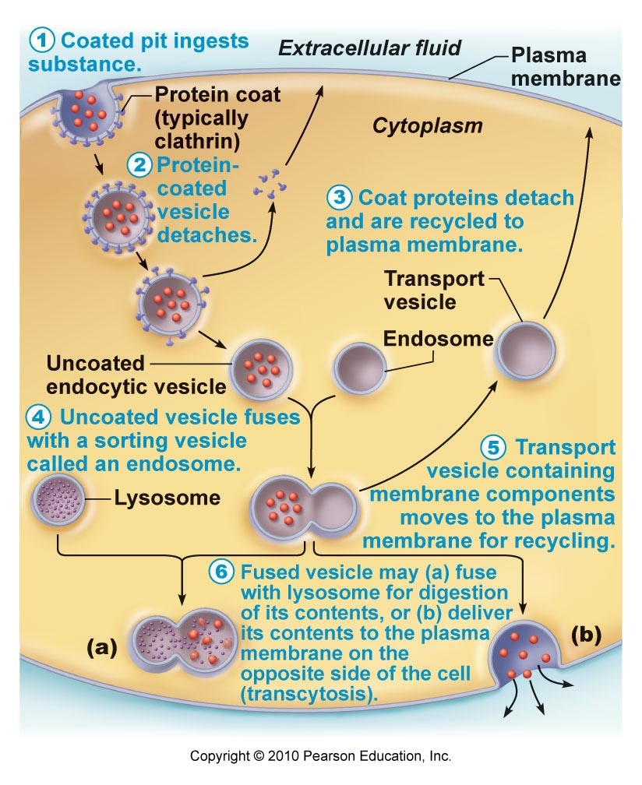
Receptor Mediated Endocytosis

Slide 72
Exocytosis
Pushing large molecules outside the cell
Examples:
  Hormone secretion
  Neurotransmitter release
  Mucus secretion
  Ejection of wastes

Slide 73
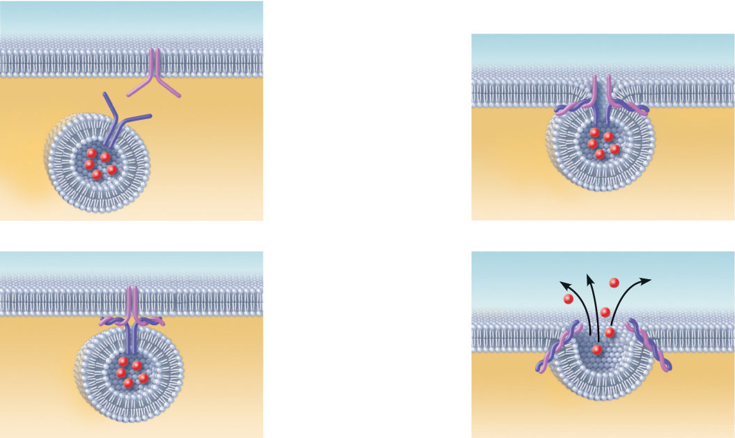
The process of exocytosis
Extracellular
fluid
Plasma membrane
SNARE (t-SNARE)
Fusion pore formed
1
Secretory
vesicle
Vesicle
SNARE
(v-SNARE)
The membrane-
bound vesicle
migrates to the
plasma membrane.
3
The vesicle
and plasma
membrane fuse
and a pore
opens up.
Molecule to
be secreted
Cytoplasm
2
There, proteins
at the vesicle
surface (v-SNAREs)
bind with t-SNAREs
(plasma membrane
proteins).
4
Vesicle
contents are
released to the
cell exterior.
Fused
v- and
t-SNAREs
Figure 3.14a

Slide 74
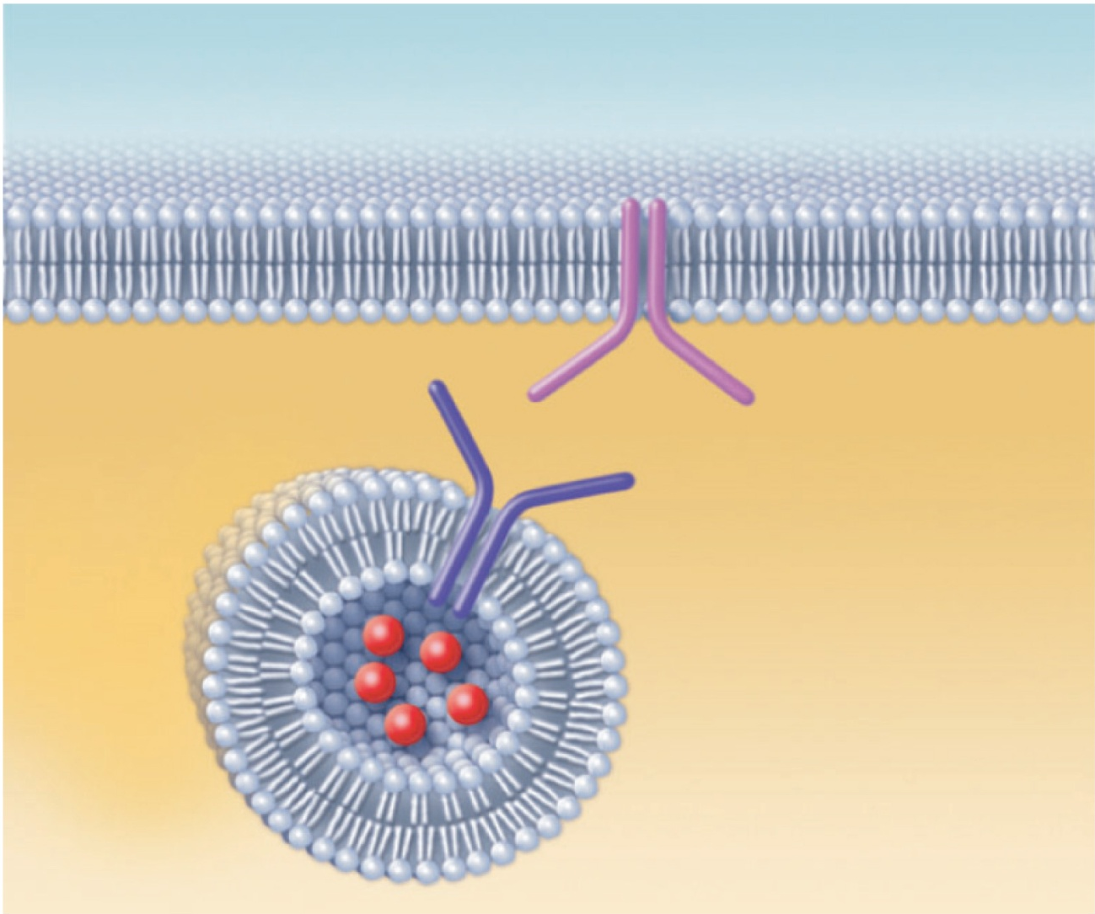
1
The membrane-bound vesicle
migrates to the plasma membrane.
Plasma membrane
SNARE (t-SNARE)
Extracellular
fluid
Secretory
vesicle
Vesicle
SNARE
(v-SNARE)
Molecule to
be secreted
Cytoplasm
(a) The process of exocytosis

Slide 75
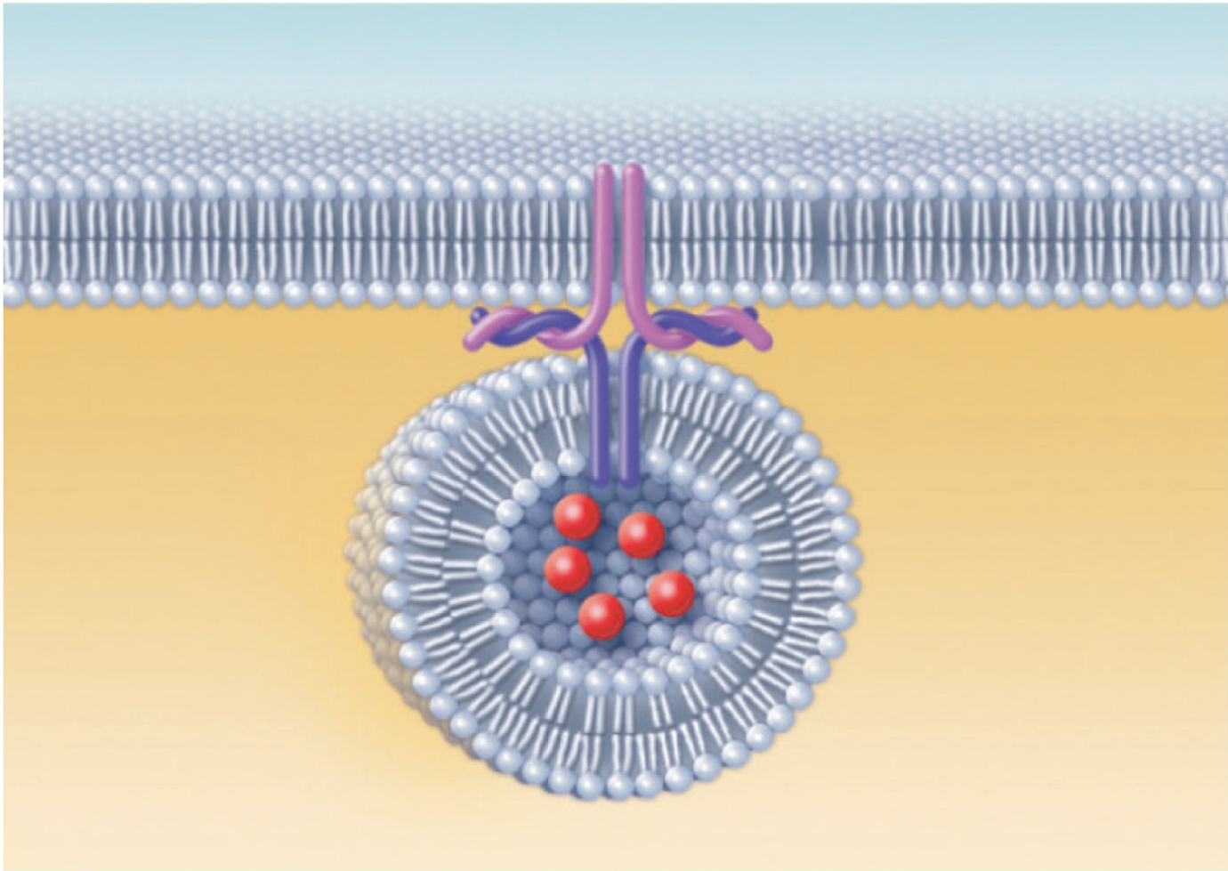
2
There, proteins at the vesicle surface
(v-SNAREs) bind with t-SNAREs
(plasma membrane proteins).
Fused
v- and
t-SNAREs
(a) The process of exocytosis

Slide 76
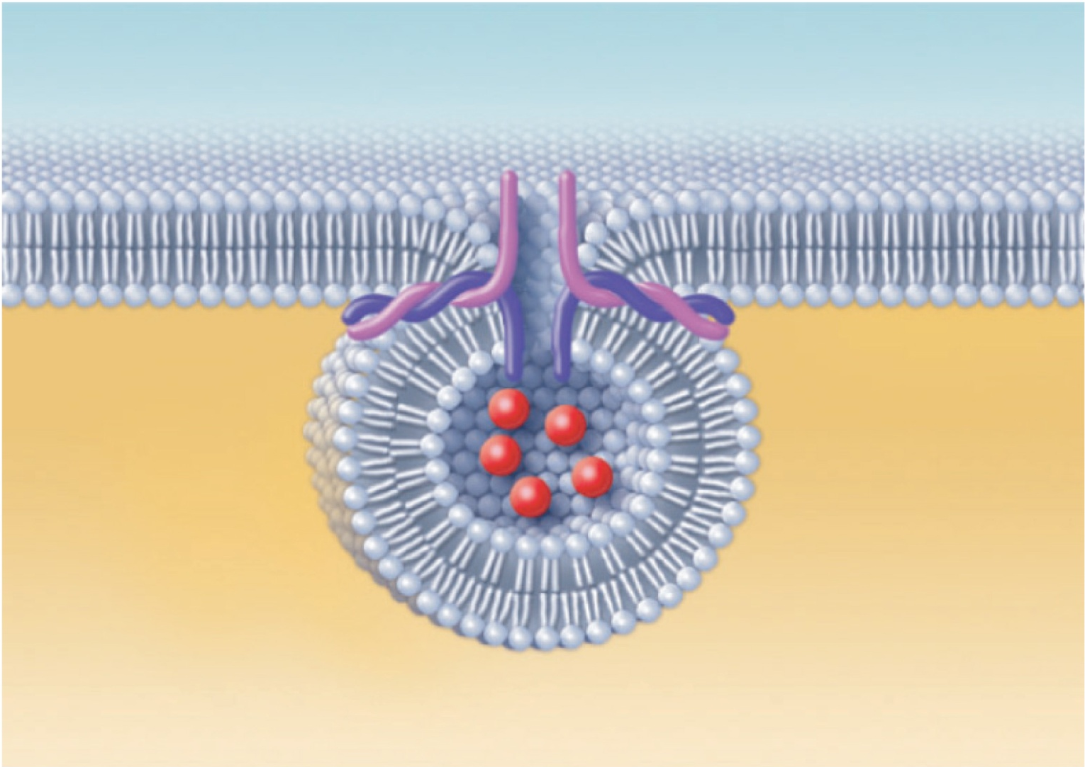
3
The vesicle and plasma membrane
fuse and a pore opens up.
Fusion pore formed
(a) The process of exocytosis

Slide 77
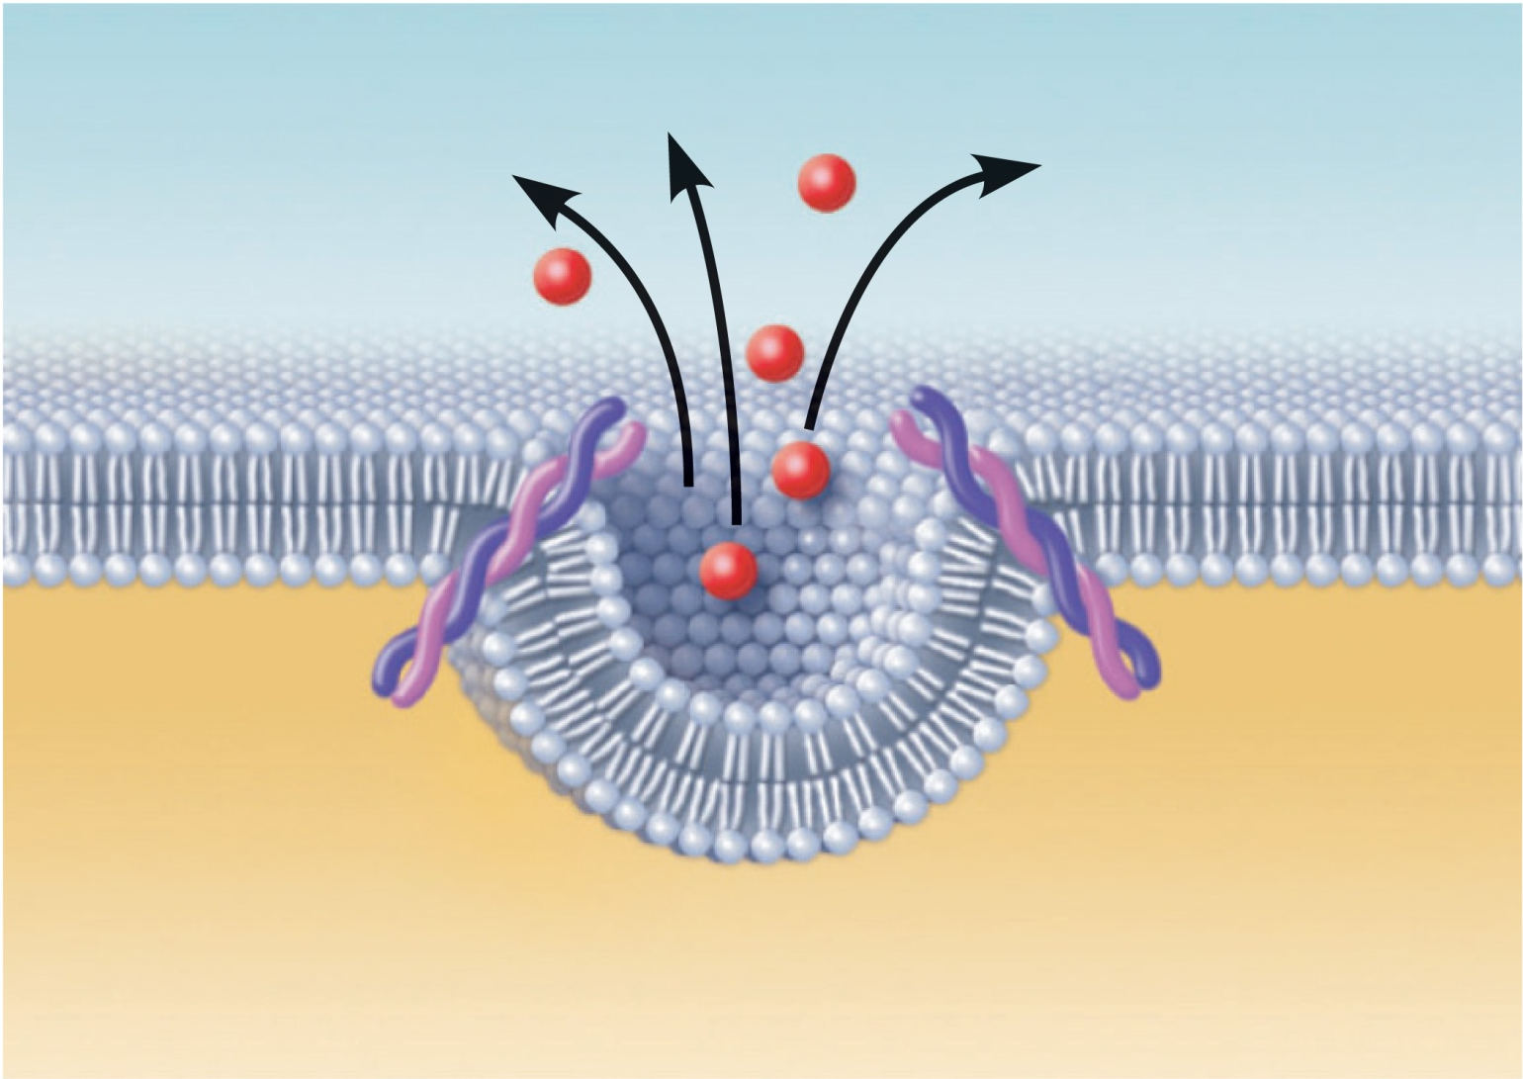
4
Vesicle contents are released
to the cell exterior.
(a) The process of exocytosis

Slide 78
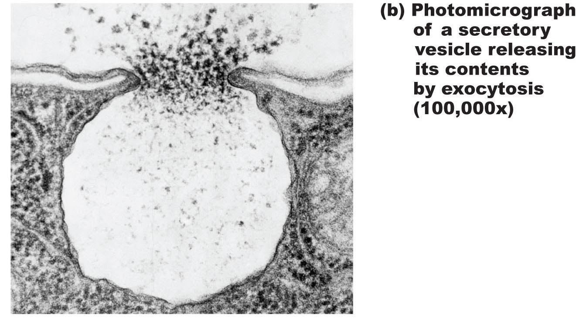
Figure 3.14b Exocytosis.

Slide 79
Cell-Environment Interactions
Involves glycoproteins and proteins of glycocalyx
  Cell adhesion molecules (CAMs)
  Membrane receptors
  Cell Determinants (CD)

Slide 80
Roles of Cell Adhesion Molecules
Anchor cells to extracellular matrix or to each other
Assist in movement of cells past one another
CAMs of blood vessel lining attract white blood cells to injured or infected areas
Stimulate synthesis or degradation of adhesive membrane junctions
Transmit intracellular signals to direct cell migration, proliferation, and specialization

Slide 81
Roles of Membrane Receptors
Contact signaling—touching and recognition of cells; e.g., in normal development and immunity
Chemical signaling—interaction between receptors and ligands (neurotransmitters, hormones and paracrines) to alter activity of cell proteins (e.g., enzymes or chemically gated ion channels)
G protein–linked receptors—ligand binding activates a G protein, affecting an ion channel or enzyme or causing the release of an internal second messenger, such as cyclic AMP

Slide 82
Receptors on the Cell Membrane Surface
If a receptor for a signaling molecule is on the cell membrane surface – then the signalling molecule attaching to the receptor must communicate with the inside of the cell – but the signalling molecule cannot enter the cell – thus it must ask for a secondary messenger communication
The handing off of the signal goes through several molecules – like a relay race
The receptor on the surface is generally a G-linked receptor which bind GTP- this then activates a secondary messenger which can be cyclic AMP or Calcium or the Inositol Triphosphate or Diacylglycerol Phosphate

Slide 83
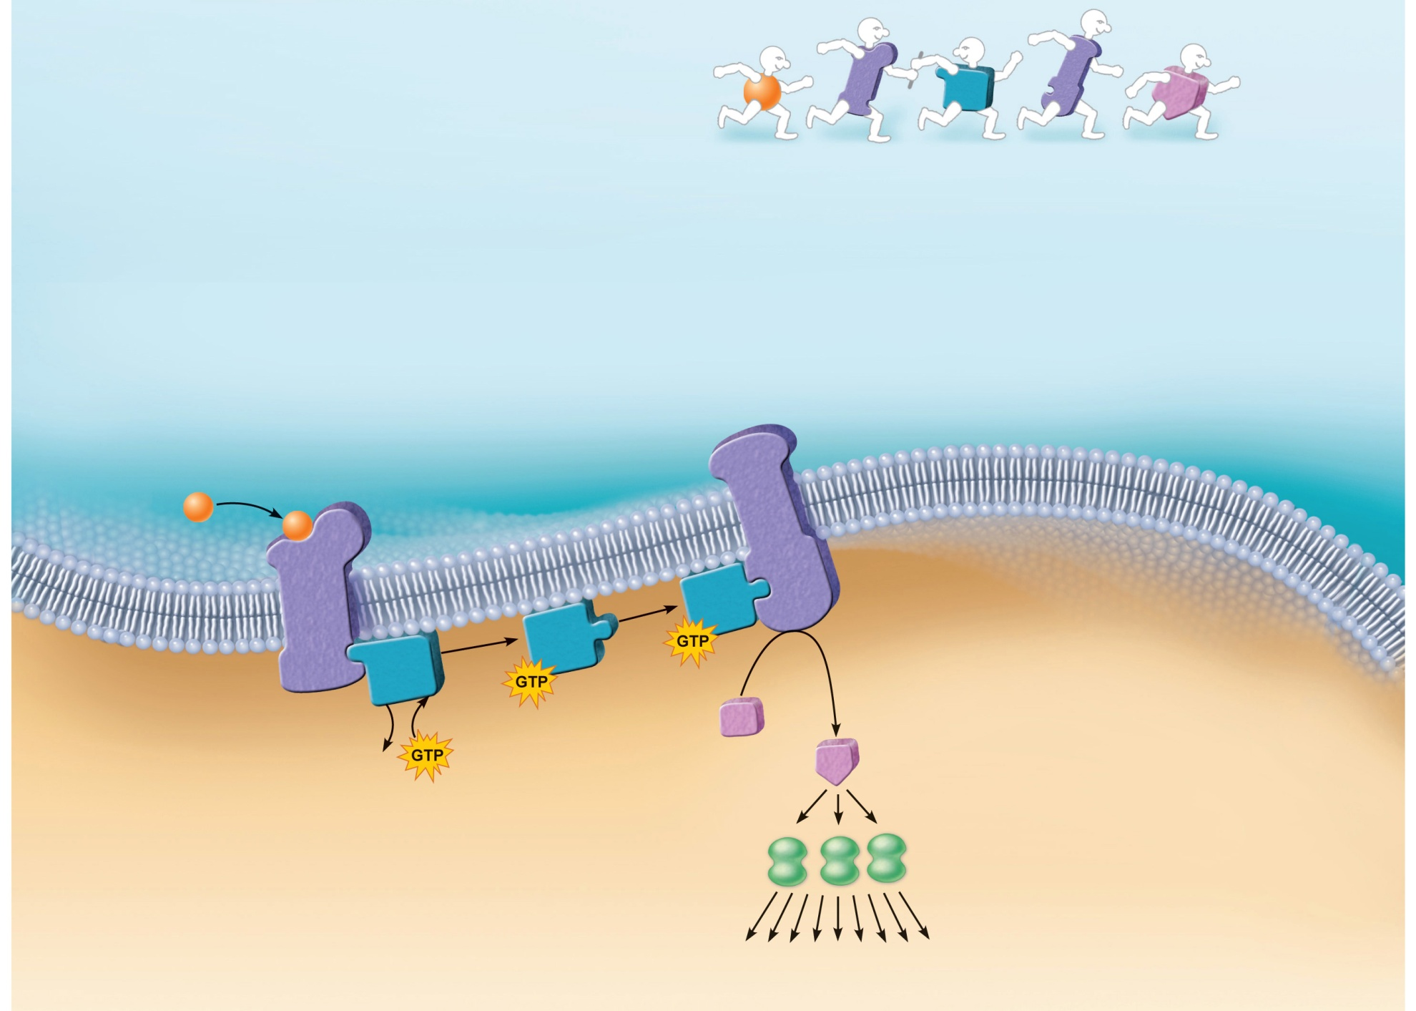
Figure 3.16 G Proteins
Ligand (1st
messenger)
Receptor
G protein
Enzyme
2nd
messenger
1
2
3
Ligand (1st
messenger) binds
to the receptor.
The activated receptor
binds to a G protein and
activates it.
Activated G protein activates
(or inactivates) effector protein
(e.g., an enzyme) by causing its
shape to change.
Extracellular fluid
Effector protein
(e.g., an enzyme)
Ligand
Receptor
4
Activated effector
enzymes catalyze reactions
that produce 2nd
messengers in the cell.
Inactive 2nd
messenger
G protein
5
GDP
Active 2nd
messenger
Second messengers
activate other enzymes
or ion channels.
6
Activated
kinase
enzymes
Kinase enzymes transfer
phosphate groups from ATP to
specific proteins and activate a
series of other enzymes that
trigger various cell responses.
Cascade of cellular responses
(metabolic and structural changes)
Intracellular fluid

Slide 84
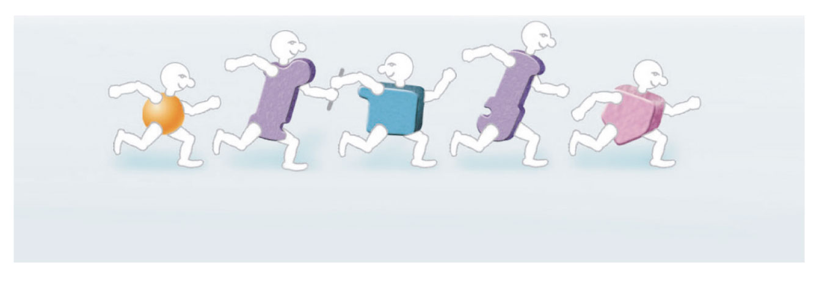
Figure 3.16 G Proteins (1 of 2)
Ligand
(1st
messenger)
Receptor
G
protein
Enzyme
2nd
messenger

Slide 85

Ligand (1st
messenger) binds
to the receptor.
2
3
1
The activated receptor
binds to a G protein and
activates it.
Activated G protein activates
(or inactivates) effector protein
(e.g., an enzyme) by causing its
shape to change.
Extracellular fluid
Effector protein
(e.g., an enzyme)
Ligand
Receptor
4
Activated effector
enzymes catalyze reactions
that produce 2nd
messengers in the cell
Inactive 2nd
messenger
G protein
5
GDP
Active 2nd
messenger
Second messengers
activate other enzymes
or ion channels
6
Activated
kinase
enzymes
Kinase enzymes transfer
phosphate groups from ATP to
specific proteins and activate a
series of other enzymes that
trigger various cell responses.
Cascade of cellular responses
(metabolic and structural changes)
Intracellular fluid
Figure 3.16

Slide 86

Ligand (1st
messenger) binds
to the receptor.
1
Extracellular fluid
Ligand
Receptor
Intracellular fluid
Figure 3.16 step 1

Slide 87

Ligand (1st
messenger) binds
to the receptor.
2
1
The activated receptor
binds to a G protein and
activates it.
Extracellular fluid
Ligand
Receptor
G protein
GDP
Intracellular fluid
Figure 3.16 step 2

Slide 88

Ligand (1st
messenger) binds
to the receptor.
2
3
1
The activated receptor
binds to a G protein and
activates it.
Activated G protein activates
(or inactivates) effector protein
(e.g., an enzyme) by causing its
shape to change.
Extracellular fluid
Effector protein
(e.g., an enzyme)
Ligand
Receptor
G protein
GDP
Intracellular fluid
Figure 3.16 step 3

Slide 89

Ligand (1st
messenger) binds
to the receptor.
2
3
1
The activated receptor
binds to a G protein and
activates it.
Activated G protein activates
(or inactivates) effector protein
(e.g., an enzyme) by causing its
shape to change.
Extracellular fluid
Effector protein
(e.g., an enzyme)
Ligand
Receptor
4
Activated effector
enzymes catalyze reactions
that produce 2nd
messengers in the cell
Inactive 2nd
messenger
G protein
GDP
Active 2nd
messenger
Intracellular fluid
Figure 3.16 step 4

Slide 90

Ligand (1st
messenger) binds
to the receptor.
2
3
1
The activated receptor
binds to a G protein and
activates it.
Activated G protein activates
(or inactivates) effector protein
(e.g., an enzyme) by causing its
shape to change.
Extracellular fluid
Effector protein
(e.g., an enzyme)
Ligand
Receptor
4
Activated effector
enzymes catalyze reactions
that produce 2nd
messengers in the cell
Inactive 2nd
messenger
G protein
5
GDP
Active 2nd
messenger
Second messengers
activate other enzymes
or ion channels
Activated
kinase
enzymes
Intracellular fluid
Figure 3.16 step 5

Slide 91
Ligand (1st
messenger) binds
to the receptor.
2
3
1
The activated receptor
binds to a G protein and
activates it.
Activated G protein activates
(or inactivates) effector protein
(e.g., an enzyme) by causing its
shape to change.
Extracellular fluid
Effector protein
(e.g., an enzyme)
Ligand
Receptor
4
Activated effector
enzymes catalyze reactions
that produce 2nd
messengers in the cell
Inactive 2nd
messenger
G protein
5
GDP
Active 2nd
messenger
Second messengers
activate other enzymes
or ion channels
6
Activated
kinase
enzymes
Kinase enzymes transfer
phosphate groups from ATP to
specific proteins and activate a
series of other enzymes that
trigger various cell responses.
Cascade of cellular responses
(metabolic and structural changes)
Intracellular fluid
Figure 3.16 step 6

Slide 92
Cytoplasm
Located between plasma membrane and nucleus
Cytosol
  Water with solutes (protein, salts, sugars, etc.)
Cytoplasmic organelles
  Metabolic machinery of cell
Inclusions
  Granules of glycogen or pigments, lipid droplets, vacuoles, and crystals

Slide 93
Cytoplasmic Organelles
Membranous
  1. Nucleus
  3. Endoplasmic reticulum
  4. Golgi apparatus
  5. Lysosomes
  6. Peroxisomes
  7. Mitochondria
Non-membranous
  2. Ribosomes
  8. Cytoskeleton
  9. Centrioles

Slide 94
The Cell Nucleus

Slide 95
Nucleus
Genetic library with blueprints for nearly all cellular proteins
Responds to signals and dictates kinds and amounts of proteins to be synthesized
Most cells are uninucleate
Red blood cells are anucleate
Skeletal muscle cells, bone destruction cells, and some liver cells are multinucleate

Slide 96
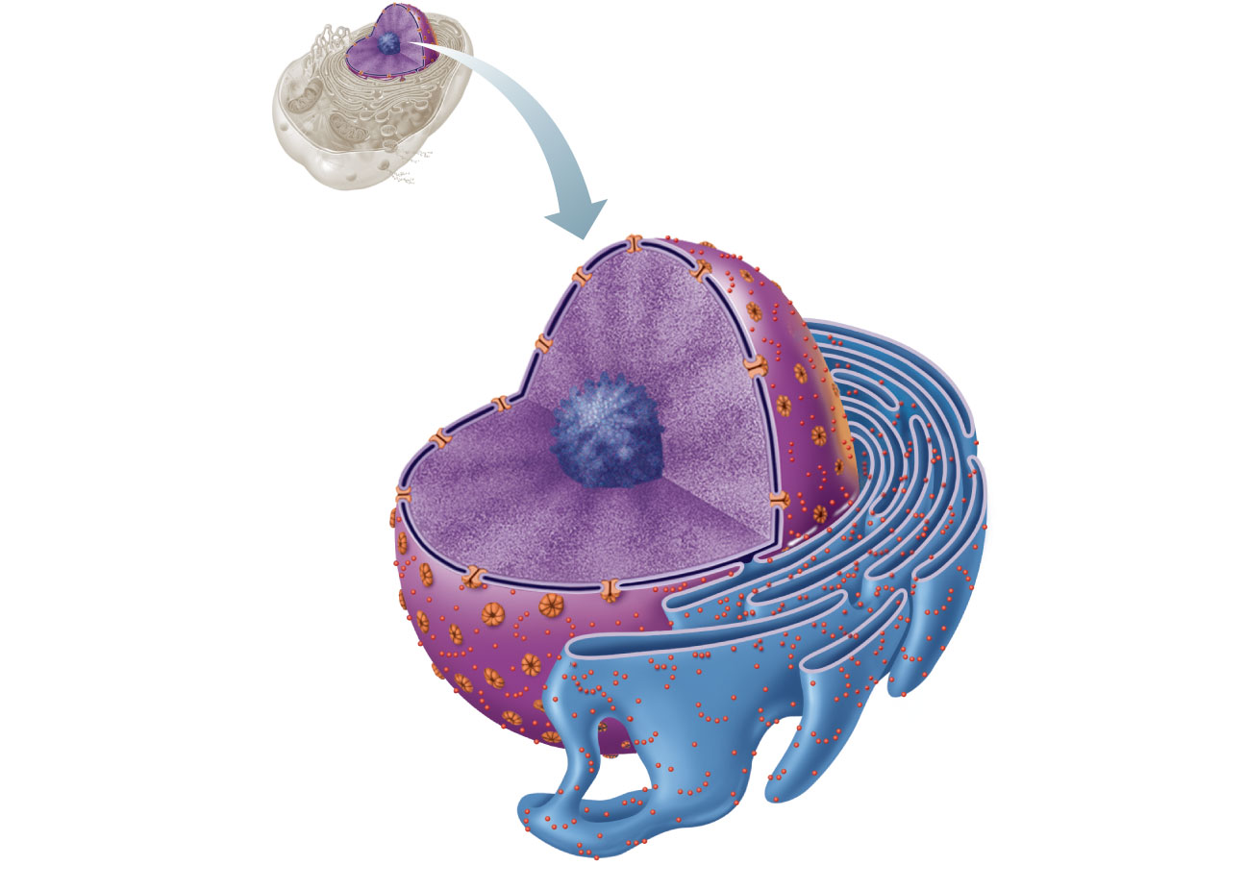
Nuclear pores
Nuclear envelope
Nucleus
Chromatin (condensed)
Nucleolus
Cisternae of rough ER
(a)
Figure 3.29a

Slide 97
Nuclear Envelope
Double-membrane barrier containing pores
Outer layer is continuous with rough ER and bears ribosomes
Inner lining (nuclear lamina) maintains shape of nucleus
Pore complex regulates transport of large molecules into and out of nucleus

Slide 98
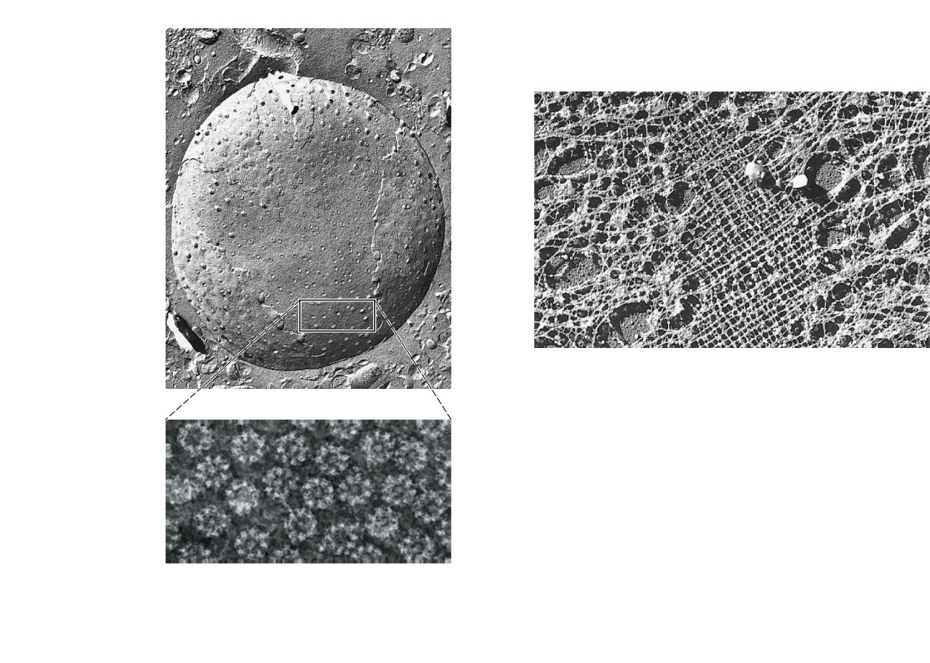
Surface of nuclear envelope.
Fracture
line of outer
membrane
Nuclear
pores
Nucleus
Nuclear lamina. The netlike
lamina composed of inter-
mediate filaments formed by
lamins lines the inner surface
of the nuclear envelope.
Nuclear pore complexes.
Each pore is ringed by
protein particles.
(b)
Figure 3.29b

Slide 99

Nuclear Pore

Slide 100
Nucleoli
Dark-staining spherical bodies within nucleus
Involved in rRNA synthesis and ribosome subunit assembly

Slide 101
DNA Folding in a Cell
The average human cell nucleus has a diameter of approximately 5 micrometers (5 x 10 ⁻⁶ meter or 5 millionths of a meter)
If we stretch out the DNA in a somatic cell in the human – it is approximately 2 meters in length – so you can see we need a heck of a good folding system for the DNA. The DNA must be folded good so it can be read properly.
The first action is to cut the 2 meters of DNA in a somatic cell into 46 pieces of genetic material – each about 4cm. – approximately 1.5 inches
A Gamete (sex cell) has 23 pieces of genetic material

Slide 102
DNA Folding
Next step is to fold all the 46 pieces
1. Make Nucleosome- take a couple of loops of double stranded DNA and wrap it around some 8 globular proteins called histones. The DNA gets thicker (10-nm) and somewhat shorter. It looks like thread wrapped around 8 marbles.
2. Unfolded Chromatin Fiber (10nm) – the line up of all of the nucleosomes
3. Folded Chromatin Fiber (30nm) – Coil the unfolded chromatin fiber around

Slide 103
DNA Folding
The 30nm Folded Chromatin fiber is then coiled into Loop Domains (300nm)
During mitosis or meiosis – the DNA coils into a Chromosome fold (700nm)
The DNA gets shorter but thicker
Most of the time the DNA stays in the Loop Domain fold which is beyond good resolution of the light microscope (.2micrometer)

Slide 104
Chromatin is a complex of DNA and protein, and is found in the nucleus of eukaryotic cells
Histones are proteins that are responsible for the first level of DNA packing in chromatin
Copyright © 2008 Pearson Education Inc., publishing as Pearson Benjamin Cummings
Notes:
For the Cell Biology Video Cartoon and Stick Model of a Nucleosomal Particle, go to Animation and Video Files.

Slide 105
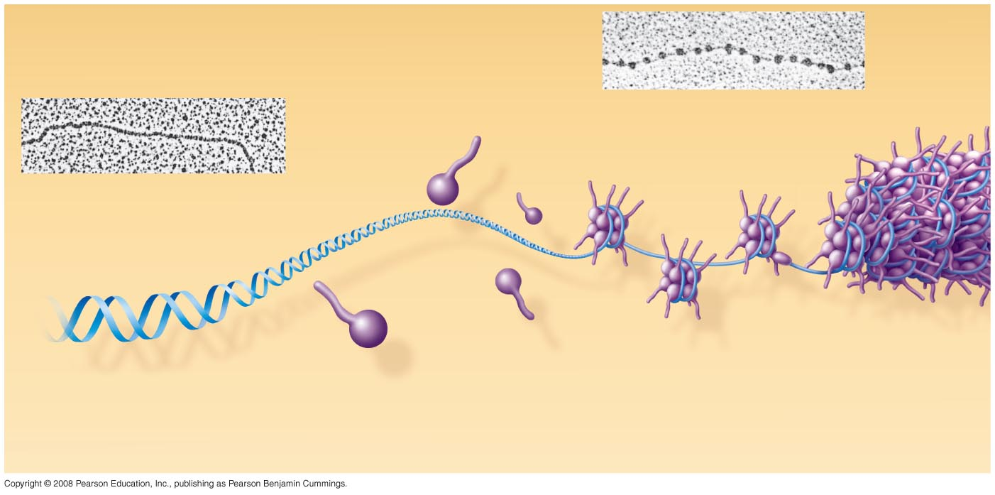
Fig. 16-21a
Nucleosome
(10 nm in diameter)
DNA double helix (2 nm in diameter)
H1
Histone tail
Histones
DNA, the double helix
Histones
Nucleosomes, or “beads on a string” (10-nm fiber)
Notes:
Figure 16.21a Chromatin packing in a eukaryotic chromosome

Slide 106
Chromatin is organized into fibers
10-nm fiber
  DNA winds around histones to form nucleosome “beads”
  Nucleosomes are strung together like beads on a string by linker DNA
30-nm fiber
  Interactions between nucleosomes cause the thin fiber to coil or fold into this thicker fiber
Copyright © 2008 Pearson Education Inc., publishing as Pearson Benjamin Cummings

Slide 107
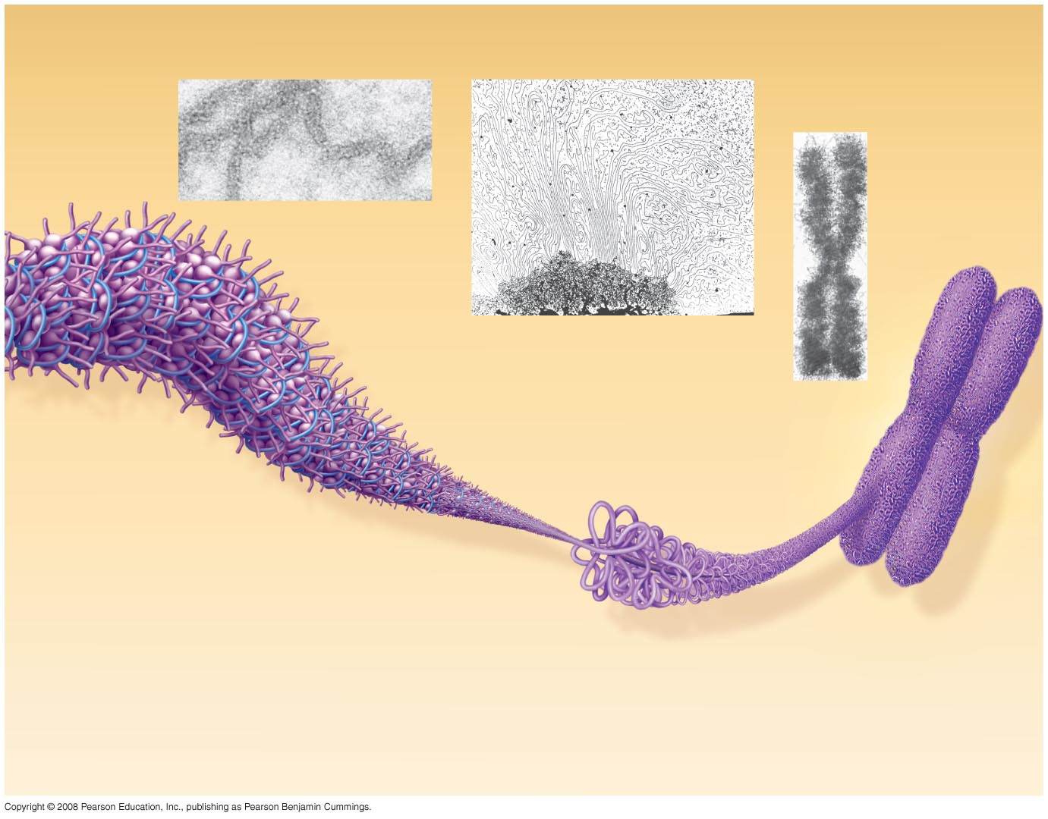
Fig. 16-21b
Chromatid
(700 nm)
30-nm fiber
Loops
Scaffold
300-nm fiber
Replicated chromosome (1,400 nm)
30-nm fiber
Looped domains (300-nm fiber)
Metaphase chromosome
Notes:
Figure 16.21b Chromatin packing in a eukaryotic chromosome

Slide 108
300-nm fiber
  The 30-nm fiber forms looped domains that attach to proteins
Metaphase chromosome
  The looped domains coil further
  The width of a chromatid is 700 nm
Copyright © 2008 Pearson Education Inc., publishing as Pearson Benjamin Cummings

Slide 109
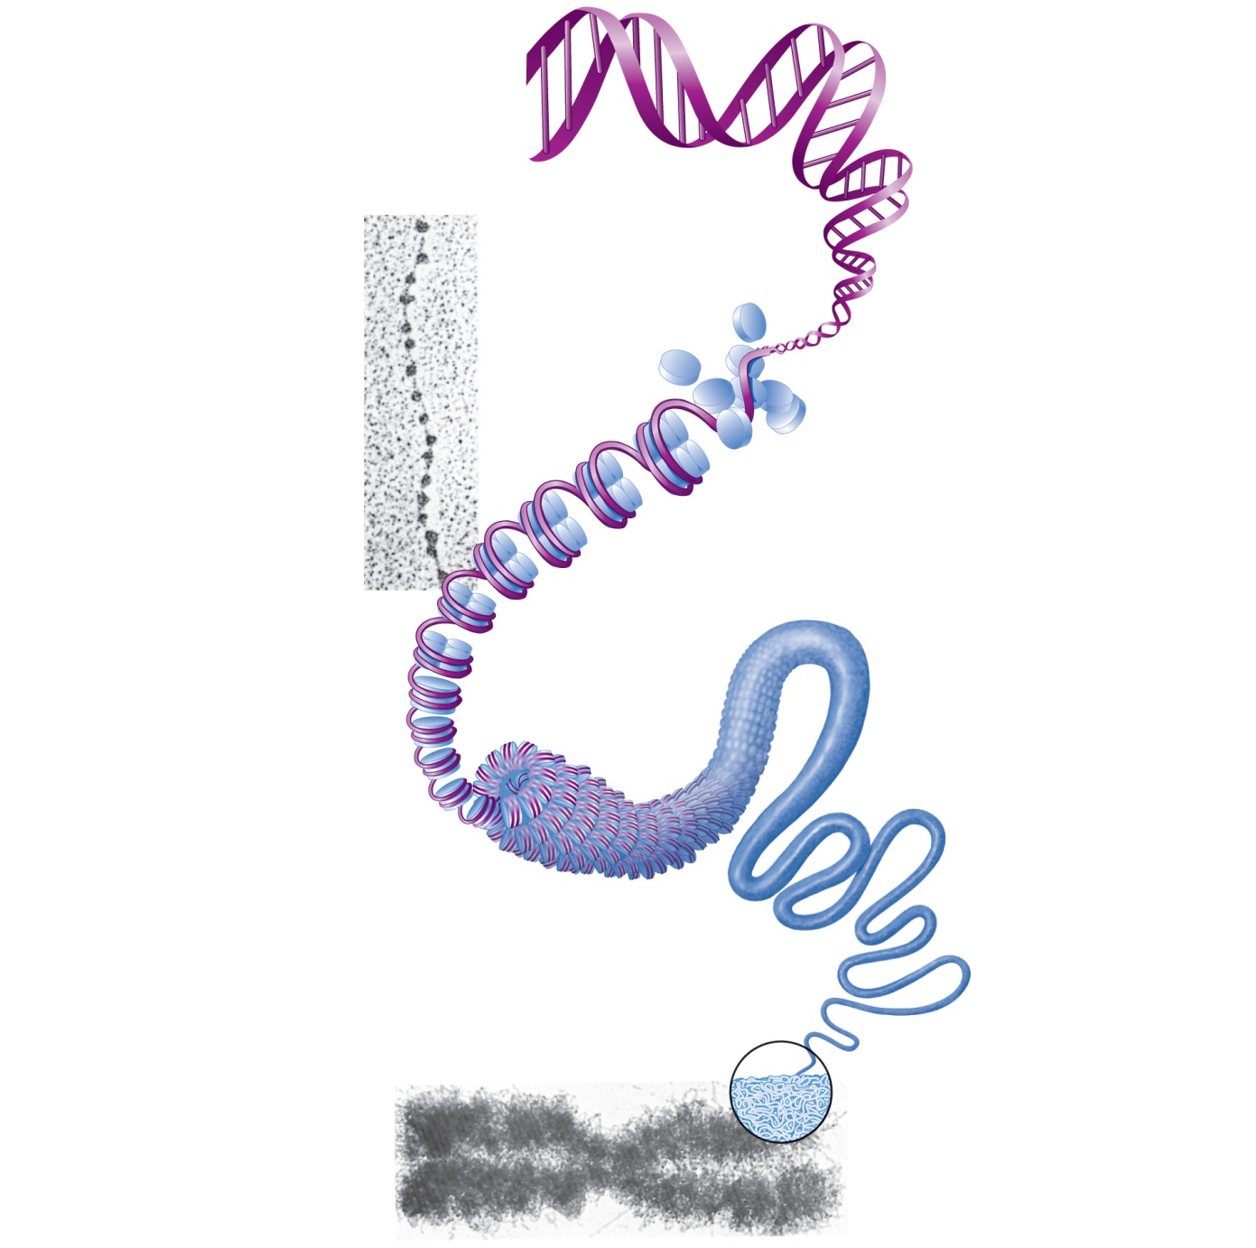
1
DNA double
helix (2-nm diameter)
2
Histones
Chromatin
(“beads on a
string”) structure
with nucleosomes
Linker DNA
Nucleosome (10-nm diameter; eight
histone proteins wrapped by two
winds of the DNA double helix)
(a)
3
Tight helical fiber
(30-nm diameter)
4
Looped domain
structure (300-nm
diameter)
5
Chromatid
(700-nm diameter)
Metaphase
chromosome
(at midpoint
of cell division)
(b)
Figure 3.30

Slide 110
Most chromatin is loosely packed in the nucleus during interphase and condenses prior to mitosis
Loosely packed chromatin is called euchromatin
During interphase a few regions of chromatin (centromeres and telomeres) are highly condensed into heterochromatin
Dense packing of the heterochromatin makes it difficult for the cell to express genetic information coded in these regions
Copyright © 2008 Pearson Education Inc., publishing as Pearson Benjamin Cummings

Slide 111
Histones can undergo chemical modifications that result in changes in chromatin organization
Methyl groups on histone proteins shuts down the nearby DNA
Attachment of phosphate group to a particular histone protein may indicate that the cell is about to commit suicide (Apoptosis)
Attachment to acetyl groups to histone exposes different DNA segments, or genes, so that they can dictate the specifications for protein synthesis or for various small RNA species.
Copyright © 2008 Pearson Education Inc., publishing as Pearson Benjamin Cummings

Slide 112
Differentiation of Cells
Differentiation is cell specialization
All cells have genomic equivalence – have the same genes
The key to differentiation is making some genes readable and some not
A kidney cell would have some genes readable that a liver cell would not and vice versa

Slide 113
Euchromatin – readable genes (DNA segments)
Heterochromatin – non-readable genes
Methyl groups on histone proteins shuts down the nearby DNA
Attachment of phosphate group to a particular histone protein may indicate that the cell is about to commit suicide (Apoptosis)
Attachment to acetyl groups to histone exposes different DNA segments, or genes, so that they can dictate the specifications for protein synthesis or for various small RNA species.

Slide 114
Ribosomes

Slide 115
Ribosomes
Granules containing protein and rRNA
Site of protein synthesis
Ribosomes are made in the cell nucleolus
Free ribosomes synthesize soluble proteins
Membrane-bound ribosomes (on rough ER) synthesize proteins to be incorporated into membranes or exported from the cell

Slide 116
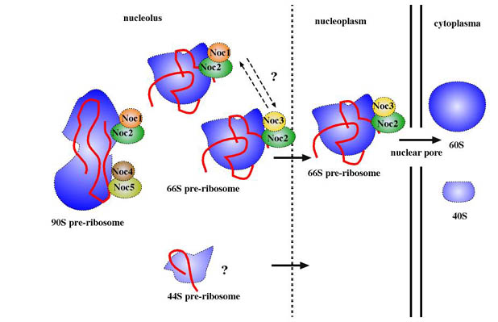
Ribosome Action

Slide 117
Ribosomes: Protein Factories
Ribosomes are particles made of ribosomal RNA and protein
Ribosomes carry out protein synthesis in two locations:
  In the cytosol (free ribosomes)
  On the outside of the endoplasmic reticulum or the nuclear envelope (bound ribosomes)
  Proteins made on free ribosomes are used inside the cell that made them
  Proteins made on bound ribosomes are used outside the cell that made them
Copyright © 2008 Pearson Education, Inc., publishing as Pearson Benjamin Cummings
Notes:
For the Cell Biology Video Staining of Endoplasmic Reticulum, go to Animation and Video Files.

Slide 118
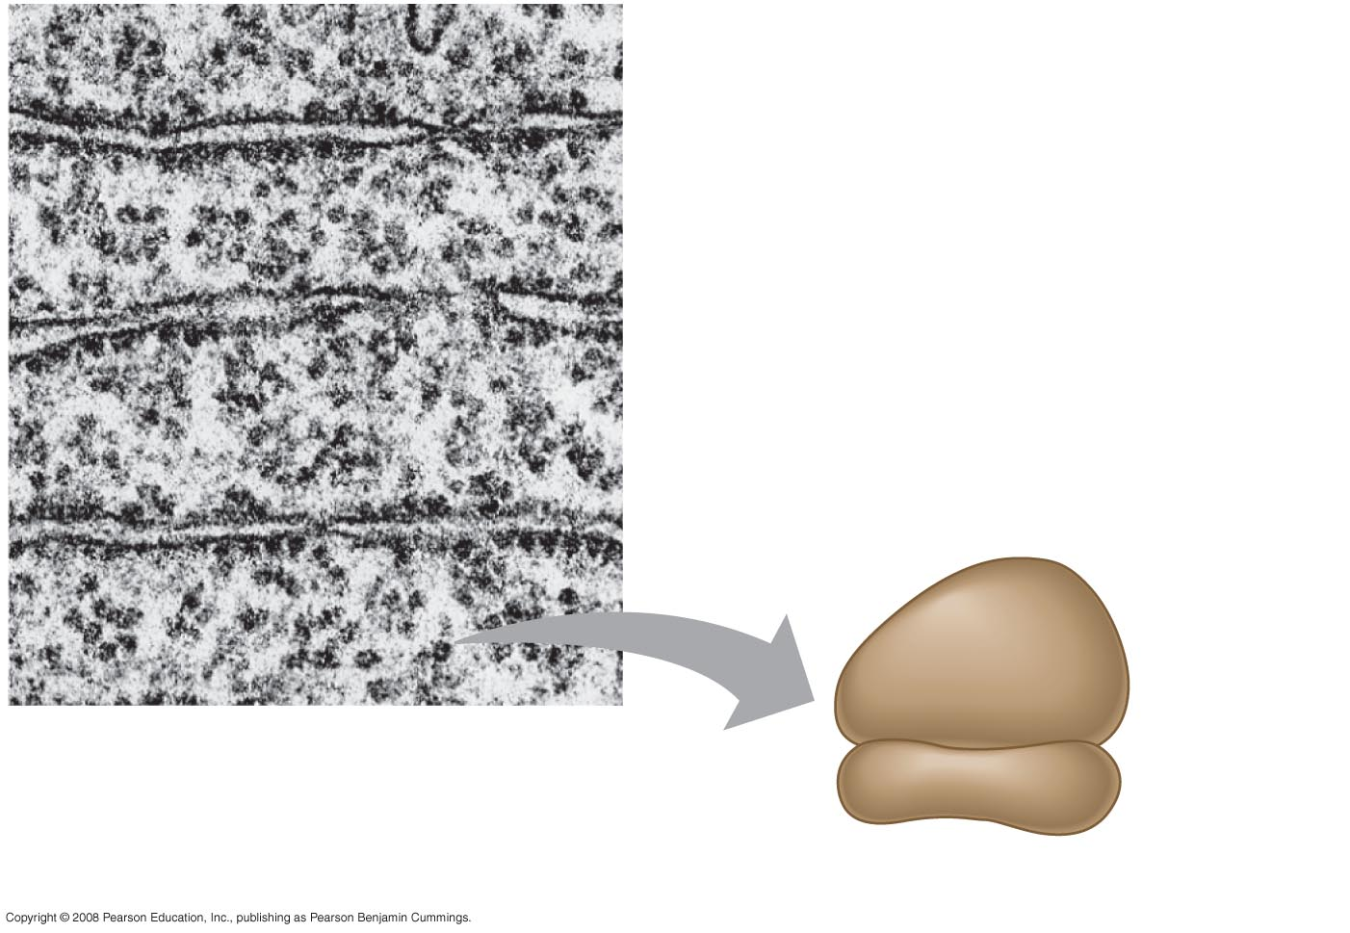
Fig. 6-11
Cytosol
Endoplasmic reticulum (ER)
Free ribosomes
Bound ribosomes
Large subunit
Small subunit
0.5 µm
TEM showing ER and ribosomes
Diagram of a ribosome
Notes:
Figure 6.11 Ribosomes

Slide 119
Endoplasmic Reticulum

Slide 120
The Endoplasmic Reticulum: Biosynthetic Factory
The endoplasmic reticulum (ER) accounts for more than half of the total membrane in many eukaryotic cells
The ER membrane is continuous with the nuclear envelope
There are two distinct regions of ER:
  Smooth ER, which lacks ribosomes
  Rough ER, with ribosomes studding its surface
Copyright © 2008 Pearson Education, Inc., publishing as Pearson Benjamin Cummings
Notes:
For the Cell Biology Video ER and Mitochondria in Leaf Cells, go to Animation and Video Files.

Slide 121
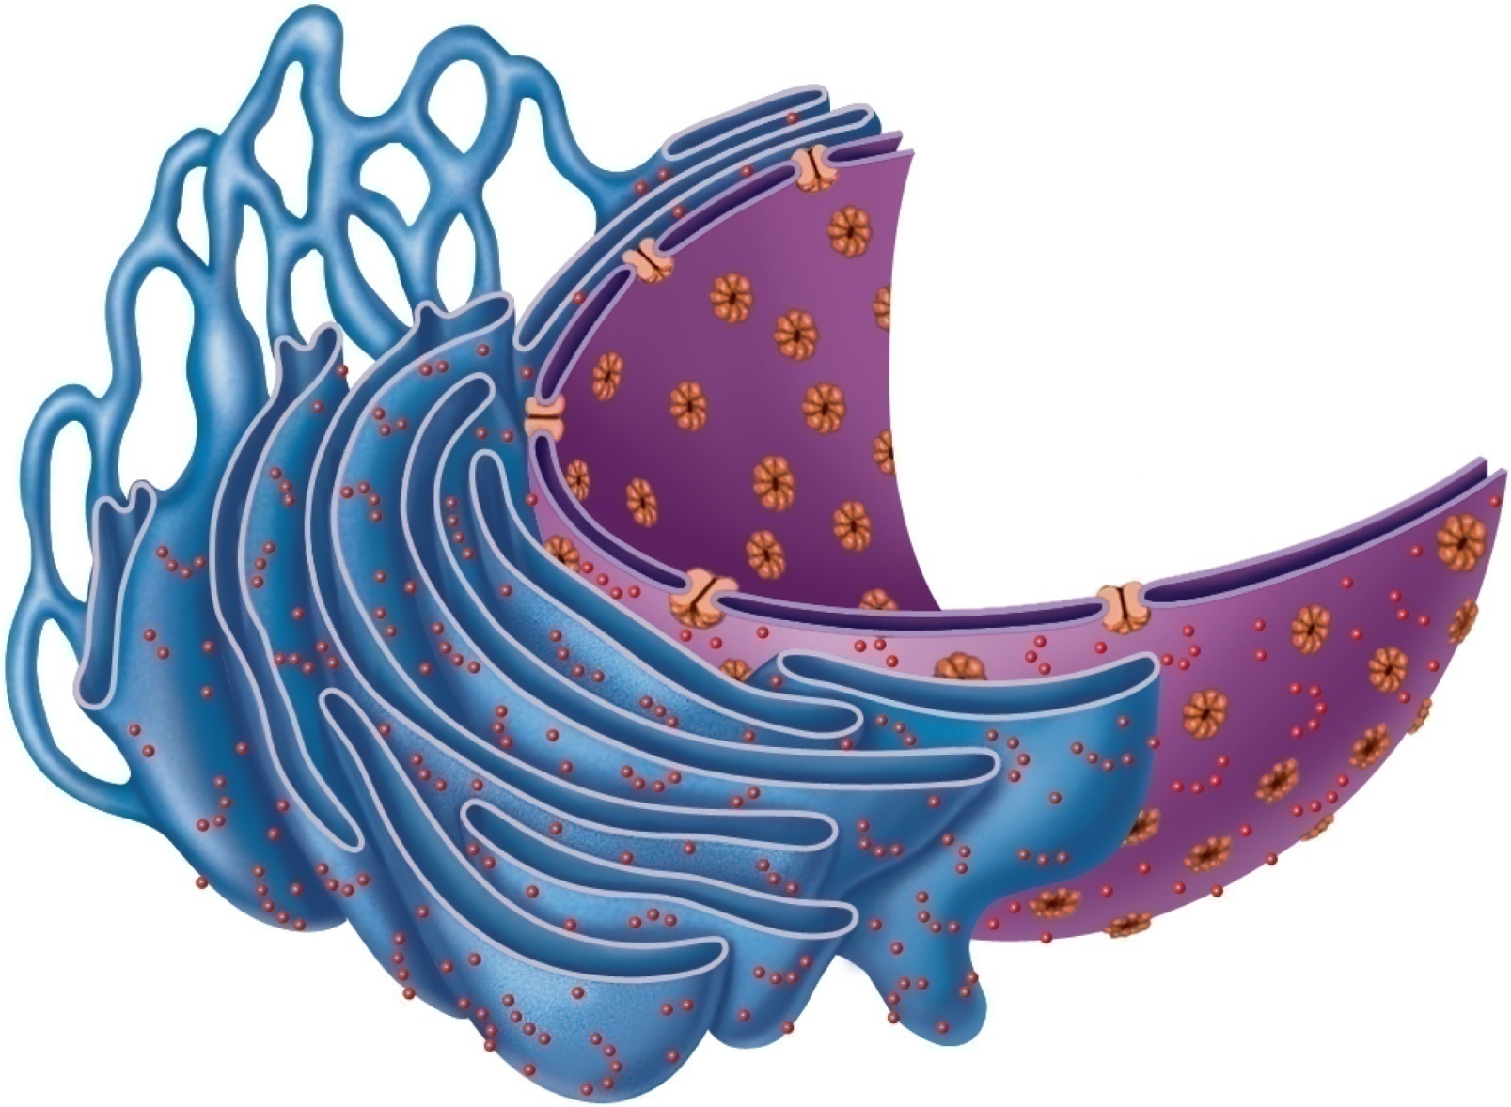
Smooth ER
Nuclear
envelope
Rough ER
Ribosomes
(a) Diagrammatic view of smooth and rough ER
Figure 3.18a

Slide 122
Functions of Rough ER
The rough ER
  Has bound ribosomes, which secrete glycoproteins (proteins covalently bonded to carbohydrates)
  Distributes transport vesicles, proteins surrounded by membranes
  Is a membrane factory for the cell
Copyright © 2008 Pearson Education, Inc., publishing as Pearson Benjamin Cummings

Slide 123
Smooth ER
Tubules arranged in a looping network
Enzyme (integral protein) functions:
  In the liver—lipid and cholesterol metabolism, breakdown of glycogen, and, along with kidneys, detoxification of drugs, pesticides, and carcinogens
  Synthesis of steroid-based hormones
  In intestinal cells—absorption, synthesis, and transport of fats
  In skeletal and cardiac muscle—storage and release of calcium (known as the Sarcoplasmic Reticulum)

Slide 124
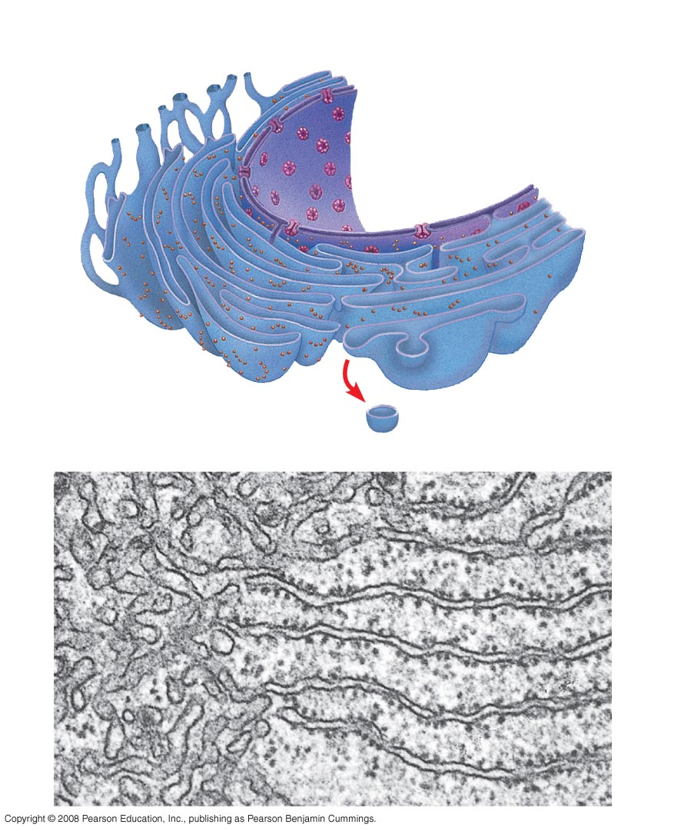
Fig. 6-12
Smooth ER
Rough ER
Nuclear envelope
ER lumen
Cisternae
Transitional ER
Ribosomes
Transport vesicle
Smooth ER
Rough ER
200 nm

Slide 125
The Golgi

Slide 126
The Golgi Apparatus: Shipping and
Receiving Center
The Golgi apparatus consists of flattened membranous sacs called cisternae
The Golgi modifies, concentrates, and packages proteins and lipids made in the rough ER
Transport vessels (Transitional ER) from ER fuse with convex cis face of Golgi apparatus
Proteins then pass through Golgi apparatus to trans face
Secretory vesicles leave trans face of Golgi stack and move to designated parts of cell
  Manufactures certain macromolecules – like Hyaluronic Acid
Copyright © 2008 Pearson Education, Inc., publishing as Pearson Benjamin Cummings

Slide 127

Fig. 6-13
cis face
(“receiving” side of Golgi apparatus)
0.1 µm
Cisternae
trans face
(“shipping” side of Golgi apparatus)
TEM of Golgi apparatus

Slide 128

1
Protein-
containing
vesicles pinch
off rough ER
and migrate to
fuse with
membranes of
Golgi
apparatus.
Rough ER
ER
membrane
Phagosome
Plasma
mem-
brane
Proteins in
cisterna
Pathway C:
Lysosome containing
acid hydrolase
enzymes
2
Proteins are
modified within
the Golgi
compartments.
Vesicle becomes
lysosome
3
Proteins are
then packaged
within different
vesicle types,
depending on
their ultimate
destination.
Secretory
vesicle
Golgi
apparatus
Pathway B:
Vesicle membrane
to be incorporated
into plasma
membrane
Pathway A:
Vesicle contents
destined for exocytosis
Secretion by
exocytosis
Extracellular fluid
Figure 3.20

Slide 129
The Lysosomes

Slide 130
Lysosomes: Destruction Body of Cell
Made from rough ER and Golgi
A lysosome is a membranous sac of hydrolytic enzymes (acid hydrolases) that can digest macromolecules
Lysosomal enzymes can hydrolyze proteins, fats, polysaccharides, and nucleic acids
Digest ingested bacteria, viruses, and toxins
Degrade nonfunctional organelles
Break down and release glycogen
Break down bone to release Ca2⁺
Destroy cells in injured or non-useful tissue (autolysis)
Copyright © 2008 Pearson Education, Inc., publishing as Pearson Benjamin Cummings

Slide 131
Lysosomes – the process
Some types of cells can engulf another cell by phagocytosis; this forms a vacuole
A lysosome fuses with the food vacuole and digests the molecules
Lysosomes also use enzymes to recycle the cell’s own organelles and macromolecules, a process called autophagy
Copyright © 2008 Pearson Education, Inc., publishing as Pearson Benjamin Cummings
Notes:
For the Cell Biology Video Phagocytosis in Action, go to Animation and Video Files.

Slide 132

Fig. 6-14
Nucleus
1 µm
Vesicle containing
two damaged organelles
1 µm
Mitochondrion
fragment
Peroxisome
fragment
Lysosome
Digestive
enzymes
Lysosome
Lysosome
Plasma
membrane
Peroxisome
Digestion
Food vacuole
Mitochondrion
Digestion
Vesicle
(a) Phagocytosis
(b) Autophagy
Notes:
Figure 6.14a Lysosomes

Slide 133

Fig. 6-14a
1 µm
Nucleus
Lysosome
Digestive enzymes
Lysosome
Plasma membrane
Digestion
Food vacuole
(a) Phagocytosis
Notes:
Figure 6.14a Lysosome—phagocytosis

Slide 134
Vesicles and Vacuoles
A vesicle is a small, intracellular, membrane-enclosed sac that stores or transports substances within a cell. Vesicles form naturally because of the properties of lipid membranes. Most vesicles have specialized functions depending on what materials they contain – like the lysosomes.
Vacuoles are vesicles which contain mostly water.
Food vacuoles are used in phagocytosis and other forms of endocytosis. The vesicles used in endocytosis are sometimes called endosomes.

Slide 135
Terms of Cell Destruction
Autophagy
Heterophagy
Apoptosis
Necrosis
Autolysis

Slide 136
Autophagy- is a catabolic process involving the degradation of a cell's own components through the lysosomal machinery. It is a tightly-regulated process that plays a normal part in cell growth, development, and homeostasis, helping to maintain a balance between the synthesis, degradation, and subsequent recycling of cellular products. It is a major mechanism by which a starving cell reallocates nutrients from unnecessary processes to more-essential processes.
Heterophagy - the taking into a cell of exogenous material by phagocytosis or pinocytosis and the digestion of the ingested material after fusion of the newly formed vacuole with a lysosome.

Slide 137
Cytosolic Protein Degradation
Nonfunctional organelle proteins are degraded by lysosomes
Ubiquitin tags damaged or unneeded soluble proteins in cytosol; they are digested by enzymes of proteasomes

Slide 138
Apoptosis is the process of programmed cell death (PCD) that may occur in multicellular organisms. Programmed cell death involves a series of biochemical events leading to a characteristic cell morphology and death; in more specific terms, a series of biochemical events that lead to a variety of morphological changes, including blebbing, changes to the cell membrane such as loss of membrane asymmetry and attachment, cell shrinkage, nuclear fragmentation, chromatin condensation, and chromosomal DNA fragmentation. Processes of disposal of cellular debris whose results do not damage the organism differentiate apoptosis from necrosis.
In contrast to necrosis, which is a form of traumatic cell death that results from acute cellular injury, apoptosis, in general, confers advantages during an organism's life cycle. For example, the differentiation of fingers and toes in a developing human embryo occurs because cells between the fingers apoptose; the result is that the digits are separate.

Slide 139
Necrosis (from the Greek νεκρός, "dead") is the premature death of cells and living tissue. Necrosis is caused by external factors, such as infection, toxins, or trauma. These external factors initiate Autolysis. This is in contrast to apoptosis, which is a naturally occurring cause of cellular death. While apoptosis often provides beneficial effects to the organism, necrosis is almost always detrimental, and can be fatal.
Cells which die due to necrosis do not usually send the same chemical signals to the immune system that cells undergoing apoptosis do. This prevents nearby phagocytes from locating and engulfing the dead cells, leading to a build up of dead tissue and cell debris at or near the site of the cell death. For this reason, it is often necessary to remove necrotic tissue surgically.

Slide 140
Autolysis - more commonly known as self digestion refers to the destruction of a cell through the action of its own enzymes. It may also refer to the digestion of an enzyme by another molecule of the same enzyme. Autolytic cell destruction is uncommon in adult organisms and usually occurs in injured cells or dying tissue. Autolysis is initiated by the cells' lysosomes releasing the digestive enzymes they contain out into the cytoplasm. The cell then, in effect, starts to digest itself. Autolysis of individual cell organelles can be lessened if the organelle is stored in ice-cold isotonic buffer after cell fractionation.

Slide 141
The Peroxisome

Slide 142
Peroxisomes: Oxidation
Peroxisomes are specialized membranous sacs containing powerful oxidases and catalases bounded by a single membrane
Peroxisomes produce hydrogen peroxide and convert it to water
Oxygen is used to break down different types of molecules
Detoxify harmful or toxic substances
Neutralize dangerous free radicals (highly reactive chemicals with unpaired electrons)
Copyright © 2008 Pearson Education, Inc., publishing as Pearson Benjamin Cummings

Slide 143

Fig. 6-19
Chloroplast
Peroxisome
Mitochondrion
1 µm
Notes:
Figure 6.19 A peroxisome

Slide 144
Peroxisomes contain oxidative enzymes, such as catalase, D-amino acid oxidase, and uric acid oxidase. However the last enzyme is absent in humans, explaining the accumulation of uric acid known as gout. Certain enzymes within the peroxisome, by using molecular oxygen, remove hydrogen atoms from specific organic substrates, in an oxidative reaction, producing hydrogen peroxide (H₂O₂, itself is slightly toxic):
Catalase, another enzyme in the peroxisome, in turn uses this H₂O₂ to oxidize other substrates, including phenols, formic acid, formaldehyde, and alcohol, by means of the peroxidation reaction:
This eliminates the slightly toxic hydrogen peroxide in the process. This reaction is important in liver and kidney cells, where the peroxisomes detoxify various toxic substances that enter the blood. About 25% of the ethanol we drink is oxidized to acetaldehyde in this way. In addition, when excess H₂O₂ accumulates in the cell, catalase converts it to H₂O through this reaction:

Slide 145
A major function of the peroxisome is the breakdown of fatty acid molecules, in a process called beta-oxidation. In this process, the fatty acids are broken down two carbons at a time, converted to Acetyl-CoA, which is then transported back to the cytosol for further use. In animal cells, beta-oxidation can also occur in the mitochondria. In yeast and plant cells, this process is exclusive for the peroxisome.

Slide 146
The Mitochondrion

Slide 147
Mitochondrion (pleural Mitochondria)
In cell biology, a mitochondrion (plural mitochondria) is a membrane-enclosed organelle found in most eukaryotic cells. These organelles range from 0.5–10 micrometers (μm) in diameter. Mitochondria are sometimes described as "cellular power plants" because they generate most of the cell's supply of adenosine triphosphate (ATP), used as a source of chemical energy. In addition to supplying cellular energy, mitochondria are involved in a range of other processes, such as signaling, cellular differentiation, cell death, as well as the control of the cell cycle and cell growth. Mitochondria have been implicated in several human diseases, including mitochondrial disorders and cardiac dysfunction, and may play a role in the aging process. The word mitochondrion comes from the Greek μίτος or mitos, thread + χονδρίον or khondrion, granule.

Slide 148
Mitochondria: Powerhouse of the Cell
Chemical Energy Conversion
Mitochondria are in nearly all eukaryotic cells
They have a smooth outer membrane and an inner membrane folded into cristae
The inner membrane creates two compartments: intermembrane space and mitochondrial matrix
Some metabolic steps of cellular respiration are catalyzed in the mitochondrial matrix
Cristae present a large surface area for enzymes that synthesize ATP It provides most of cell’s ATP via aerobic cellular respiration
Copyright © 2008 Pearson Education, Inc., publishing as Pearson Benjamin Cummings

Slide 149

Outer
mitochondrial
membrane
Ribosome
Mitochondrial
DNA
Inner
mitochondrial
membrane
(a)
Cristae
Matrix
(c)
Enzymes
(b)
Figure 3.17

Slide 150
Mitochondrion
Contain its own DNA and RNA
Since the mitochondrion contains a type of DNA similar to bacterial DNA - it appears that the mitochondrion evolved from the bacteria and once was on the lineage to become a type of cell of its own rather than a component of another cell

Slide 151
The Mitochondria and Its Genetic Material
The human mitochondrial DNA is a circular like bacteria rather than linear as in the human cell nucleus. The mitochondria also have their own RNA.
Not all proteins necessary for mitochondrial function are encoded by the mitochondrial DNA many are coded by genes in the cell nucleus and the corresponding proteins imported into the mitochondrion.
Mitochondria divide by binary fission similar to bacterial cell division; unlike bacteria, however, mitochondria can also fuse with other mitochondria...

Slide 152
Mitochondrial chromosomes have far fewer genes than the bacteria from which they are thought to be descended. Although some have been lost altogether, many have been transferred to the nucleus, such as the respiratory complex II protein subunits. This is thought to be relatively common over evolutionary time.
In most cases mitochondria divide mainly in response to the energy needs of the cell, rather than in phase with the cell cycle. When the energy needs of a cell are high, mitochondria grow and divide. When the energy use is low, mitochondria are destroyed or become inactive.
An individual's mitochondrial genes are not inherited by the same mechanism as nuclear genes – the human mitochondria come from the mother – thus mitochondrial DNA is maternal.

Slide 153

Fig. 6-17
Intermembrane space
Outer membrane
Free ribosomes
in the mitochondrial matrix
Inner membrane
Cristae
Matrix
0.1 µm
Notes:
Figure 6.17 The mitochondrion, site of cellular respiration

Slide 154

Stage 1 Digestion in
GI tract lumen to
absorbable forms.
Transport via blood to
tissue cells.
PROTEINS
CARBOHYDRATES
FATS
Amino acids
Glucose and other sugars
Glycerol
Fatty acids
Stage 2 Anabolism
(incorporation into
molecules) and
catabolism of nutrients
to form intermediates
within tissue cells.
Proteins
Glucose
Glycogen
Fats
NH₃
Pyruvic acid
Acetyl CoA
Stage 3 Oxidative breakdown
of products of stage 2 in
mitochondria of tissue cells.
CO₂ is liberated, and H atoms
removed are ultimately delivered
to molecular oxygen, forming
water. Some energy released is
used to form ATP.
Krebs
cycle
Infrequent
CO₂
O₂
Oxidative
phosphorylation
(in electron
transport chain)
H
H₂O
Catabolic reactions
Anabolic reactions
Figure 24.3

Slide 155

Chemical energy (high-energy electrons)
Chemical energy
Electron transport
chain and oxidative
phosphorylation
Glycolysis
Pyruvic
acid
Krebs
cycle
Glucose
Mitochondrial
cristae
Mitochondrion
Cytosol
Via oxidative
phosphorylation
Via substrate-level
phosphorylation
1
2
3
During glycolysis,
each glucose
molecule is broken
down into two
molecules of pyruvic
acid in the cytosol.
The pyruvic acid then enters
the mitochondrial matrix, where
the Krebs cycle decomposes it
to CO₂. During glycolysis and
the Krebs cycle, small amounts
of ATP are formed by substrate-
level phosphorylation.
Energy-rich electrons picked up by
coenzymes are transferred to the elec-
tron transport chain, built into the cristae
membrane. The electron transport chain
carries out oxidative phosphorylation,
which accounts for most of the ATP
generated by cellular respiration.
Figure 24.5

Slide 156
Glycolysis
Glucose
Glucose -6-Phosphate (Use an ATP)
Fructose – 6- Phosphate
Fructose 1,6 Bi (Di)phosphate (Use an ATP)
Dihydroxyacetone PO4 Glyceraldehyde 3-PO4
10 steps of conversions 1,3 Biphosphoglycerate
Make 4 ATPs but use 2 ATPs 3-Phosphoglycerate
thus net production of 2 ATPs Phosphglycerate
for 10 steps of work Phosphoenolpyruvate
poor energy efficiency Pyruvate

Slide 157

Fig. 9-10
If O2 is present – then Pyruvate can enter the mitochondrion and form Acetyl CoA
CYTOSOL
MITOCHONDRION
NAD⁺
NADH
+ H⁺
2
1
3
Acetyl CoA
Pyruvate
CO₂
Coenzyme A
Transport protein
If O2 is not available then Pyruvate cannot enter mitochondrion and then forms Lactate- a substance that gives your muscles discomfort.
Notes:
Figure 9.10 Conversion of pyruvate to acetyl CoA, the junction between glycolysis and the citric acid cycle

Slide 158

Fig. 9-19
Glucose
Glycolysis
CYTOSOL
Pyruvate
No O₂ present:
Fermentation
O₂ present:
Aerobic cellular
respiration
MITOCHONDRION
Ethanol
or
lactate
Acetyl CoA
Citric
acid
cycle
Painful acid
Notes:
Figure 9.19 Pyruvate as a key juncture in catabolism

Slide 159

Fig. 9-12-8
Acetyl CoA can enter the
Krebs cycle located in the
Mitochondrion-
Acetyl CoA
CoA—SH
NADH
+H⁺
1
H₂O
NAD⁺
Oxaloacetate
8
2
Malate
Citrate
Isocitrate
NAD⁺
Citric
acid
cycle
3
NADH
7
+ H⁺
H₂O
CO₂
Fumarate
CoA—SH
α-Keto-
glutarate
6
CoA—SH
4
FADH₂
5
CO₂
The result is your
Carbohydrate is broken
down into water and
Carbon dioxide
NAD⁺
FAD
Succinate
P
i
NADH
GTP
GDP
Succinyl
CoA
+ H⁺
ADP
ATP
Notes:
Figure 9.12 A closer look at the citric acid cycle

Slide 160
Carbohydrate Metabolism
Oxidation of glucose
  C₆H₁₂O₆ + 6O₂ → 6H₂O + 6CO₂ + 36 ATP + heat
Glucose is catabolized in three pathways
  Glycolysis
  Krebs cycle
  Electron transport chain and oxidative phosphorylation

Slide 161
Other biochemicals (proteins and fats) also use the Kreb cycle
Stage 1 Digestion in
GI tract lumen to
absorbable forms.
Transport via blood to
tissue cells.
PROTEINS
CARBOHYDRATES
FATS
Amino acids
Glucose and other sugars
Glycerol
Fatty acids
Stage 2 Anabolism
(incorporation into
molecules) and
catabolism of nutrients
to form intermediates
within tissue cells.
Proteins
Glucose
Glycogen
Fats
NH₃
Pyruvic acid
Acetyl CoA
Stage 3 Oxidative breakdown
of products of stage 2 in
mitochondria of tissue cells.
CO₂ is liberated, and H atoms
removed are ultimately delivered
to molecular oxygen, forming
water. Some energy released is
used to form ATP.
Krebs
cycle
Infrequent
CO₂
O₂
Oxidative
phosphorylation
(in electron
transport chain)
H
H₂O
Catabolic reactions
Anabolic reactions
but the preliminary steps before entering the Kreb are different
Figure 24.3

Slide 162
Electron Transport Chain (1)
During the processes of Glycolysis and the Krebs Cycle – electrons and hydrogen atoms are being collected from the converted biochemicals.
Inside the mitochondrion is a chain of linked molecules composing the “Electron Transport Chain”. Each member in line in the chain has a higher electronegativity than the member before – thus each member literally pulls the electrons along the chain. Oxygen is the most electronegative of all in the chain- thus it is the terminal acceptor of electrons in the chain. It is for this reason that we breath oxygen (respiration).

Slide 163
Electron Transport Chain (2)
When the electrons move along the chain energy is liberated and the chain collects the energy. Remember from earlier discussions – when something moves there is energy.
This collected energies are later used to make ATPs. It is like you are cashing in your electrons and hydrogens to make ATPs.
Thus the Krebs Cycle and the Electron Transport Chain are coupled – electrons from the Krebs and even Glycolysis are handed over to the Transport Chain to extract the energies

Slide 164
Electron Transport Chain (3)
Certain drugs and chemicals can uncouple the chain- for example cyanide.
Different drugs or poisons block action at different sites in the Electron Transport Chain
Cyanide disrupts the process by binding to cytochrome oxidase – thus blocking electron flow from complex IV to oxygen

Slide 165

Fig. 9-16
H⁺
H⁺
H⁺
H⁺
Protein complex
of electron
carriers
Cyt c
Q
ΙV
Ι
ΙΙΙ
ATP synthase
ΙΙ
H₂O
FADH₂
2 H⁺ + ¹/₂O₂
FAD
NADH
NAD⁺
ADP +
P
ATP
(carrying electrons
from food)
i
H⁺
1
Electron transport chain
2
Chemiosmosis
Oxidative phosphorylation
Notes:
Figure 9.16 Chemiosmosis couples the electron transport chain to ATP synthesis

Slide 166

Fig. 9-17
CYTOSOL
Electron shuttles
span membrane
MITOCHONDRION
2 NADH
or
2 FADH₂
2 NADH
2 NADH
6 NADH
2 FADH₂
Glycolysis
2
Acetyl
CoA
Citric
acid
cycle
Oxidative
phosphorylation:
electron transport
and
chemiosmosis
2
Pyruvate
Glucose
+ 2 ATP
+ 2 ATP
+ about 32 or 34 ATP
Maximum per glucose:
About
36 or 38 ATP
Notes:
Figure 9.17 ATP yield per molecule of glucose at each stage of cellular respiration

Slide 167
The Cytoskeleton

Slide 168
The cytoskeleton is a network of protein fibers extending throughout the cytoplasm
It organizes the cell’s structures and activities, anchoring many organelles
It is composed of three types of molecular structures:
  Microtubules
  Microfilaments
  Intermediate filaments
Copyright © 2008 Pearson Education, Inc., publishing as Pearson Benjamin Cummings
Notes:
For the Cell Biology Video The Cytoskeleton in a Neuron Growth Cone, go to Animation and Video Files
For the Cell Biology Video Cytoskeletal Protein Dynamics, go to Animation and Video Files.

Slide 169

Fig. 6-20
Microtubule
0.25 µm
Microfilaments
Notes:
Figure 6.20 The cytoskeleton

Slide 170
Roles of the Cytoskeleton: Support, Motility, and Regulation
The cytoskeleton helps to support the cell and maintain its shape
It interacts with motor proteins to produce motility
Inside the cell, vesicles can travel along “monorails” provided by the cytoskeleton
Recent evidence suggests that the cytoskeleton may help regulate biochemical activities
Copyright © 2008 Pearson Education, Inc., publishing as Pearson Benjamin Cummings

Slide 171
Components of the Cytoskeleton
Three main types of fibers make up the cytoskeleton:
  Microtubules are the thickest of the three components of the cytoskeleton (25 nm)
  Microfilaments, also called actin filaments, are the thinnest components (7 nm)
  Intermediate filaments are fibers with diameters in a middle range (8 nm – 12 nm)
Copyright © 2008 Pearson Education, Inc., publishing as Pearson Benjamin Cummings
Notes:
For the Cell Biology Video Actin Network in Crawling Cells, go to Animation and Video Files.
For the Cell Biology Video Actin Visualization in Dendrites, go to Animation and Video Files.

Slide 172

Table 6-1
10 µm
10 µm
10 µm
Column of tubulin dimers
Keratin proteins
Actin subunit
Fibrous subunit (keratins coiled together)
25 nm
7 nm
8–12 nm
α
β
Tubulin dimer
Notes:
Table 6-1

Slide 173
Microfilaments
Dynamic actin strands attached to cytoplasmic side of plasma membrane
Involved in cell motility, change in shape, endocytosis and exocytosis

Slide 174
Microfilaments (Actin Filaments)
Microfilaments are solid rods about 7 nm in diameter, built as a twisted double chain of actin subunits
The structural role of microfilaments is to bear tension, resisting pulling forces within the cell
They form a 3-D network called the cortex just inside the plasma membrane to help support the cell’s shape
Bundles of microfilaments make up the core of microvilli of intestinal cells
Copyright © 2008 Pearson Education, Inc., publishing as Pearson Benjamin Cummings

Slide 175

(a) Microfilaments
Strands made of spherical
protein subunits called actins
Actin subunit
7 nm
Microfilaments form the blue network
surrounding the pink nucleus in this
photo.
Figure 3.23a

Slide 176

Table 6-1b
10 µm
Actin subunit
7 nm
Notes:
Table 6-1b

Slide 177
Microfilaments that function in cellular motility contain the protein myosin in addition to actin
In muscle cells, thousands of actin filaments are arranged parallel to one another
Thicker filaments composed of myosin interdigitate with the thinner actin fibers
Copyright © 2008 Pearson Education, Inc., publishing as Pearson Benjamin Cummings

Slide 178

Fig, 6-27a
Muscle cell
Actin filament
Myosin filament
Myosin arm
(a) Myosin motors in muscle cell contraction
Notes:
Figure 6.27a Microfilaments and motility

Slide 179
Intermediate Filaments
Intermediate filaments range in diameter from 8–12 nanometers, larger than microfilaments but smaller than microtubules
They support cell shape and fix organelles in place
Intermediate filaments are more permanent cytoskeleton fixtures than the other two classes
Copyright © 2008 Pearson Education, Inc., publishing as Pearson Benjamin Cummings
Notes:
For the Cell Biology Video Interphase Microtubule Dynamics, go to Animation and Video Files.
For the Cell Biology Video Microtubule Sliding in Flagellum Movement, go to Animation and Video Files.
For the Cell Biology Video Microtubule Dynamics, go to Animation and Video Files.

Slide 180
Intermediate Filaments
Tough, insoluble ropelike protein fibers
Resist pulling forces on the cell and attach to desmosomes

Slide 181

Table 6-1c
5 µm
Keratin proteins
Fibrous subunit (keratins
coiled together)
8–12 nm
Notes:
Table 6-1c

Slide 182

(b) Intermediate filaments
Tough, insoluble protein fibers
constructed like woven ropes
Fibrous subunits
10 nm
Intermediate filaments form the purple
batlike network in this photo.
Figure 3.23b

Slide 183
Table 6-1c
5 µm
Keratin proteins
Fibrous subunit (keratins
coiled together)
8–12 nm
Notes:
Table 6-1c

Slide 184
Microtubules
Microtubules are hollow rods about 25 nm in diameter and about 200 nm to 25 microns long
Functions of microtubules:
  Shaping the cell
  Guiding movement of organelles
  Separating chromosomes during cell division
Copyright © 2008 Pearson Education, Inc., publishing as Pearson Benjamin Cummings
Notes:
For the Cell Biology Video Transport Along Microtubules, go to Animation and Video Files.
For the Cell Biology Video Movement of Organelles in Vivo, go to Animation and Video Files.
For the Cell Biology Video Movement of Organelles in Vitro, go to Animation and Video Files.

Slide 185
Microtubules
Dynamic hollow tubes
Most radiate from centrosome
Determine overall shape of cell and distribution of organelles

Slide 186

(c) Microtubules
Hollow tubes of spherical protein
subunits called tubulins
Tubulin subunits
25 nm
Microtubules appear as gold networks
surrounding the cells’ pink nuclei in
this photo.
Figure 3.23c

Slide 187

Table 6-1a
10 µm
Column of tubulin dimers
25 nm
α
β
Tubulin dimer
Notes:
Table 6-1a

Slide 188
Special Usages of the Cytoskeleton
Centrioles – cell structures composed of microtubules and used in the processes of mitosis and meiosis
Basal Body – a cell structure composed of microtubules and located at the base of each cilium and flagellum
Cell Appendages
Microvilli (also termed a Brush Border) –core
made of microfilaments
Flagellum – cell appendage that propels a cell –
core is made of microtubules
Cilium- cell appendage that moves material over
the top of a cell – core made of microtubules

Slide 189
Centrosome
“Cell center” near nucleus
Generates microtubules; organizes mitotic spindle
Contains centrioles: Small tube formed by microtubules

Slide 190
Centrosomes and Centrioles
In many cells, microtubules grow out from a centrosome near the nucleus
The centrosome is a “microtubule-organizing center”
In animal cells, the centrosome has a pair of centrioles, each with nine triplets of microtubules arranged in a ring
Copyright © 2008 Pearson Education, Inc., publishing as Pearson Benjamin Cummings

Slide 191

Fig. 6-22
Centrosome
Microtubule
Centrioles
0.25 µm
Longitudinal section of one centriole
Microtubules
Cross section
of the other centriole
Notes:
Figure 6.22 Centrosome containing a pair of centrioles

Slide 192
Cellular Extensions
Microvilli
  Fingerlike extensions of plasma membrane
  Increase surface area for absorption
  Core of actin filaments for stiffening

Slide 193

Microvillus
Actin
filaments
Terminal
web
Figure 3.28

Slide 194

Fig. 6-26
Microvillus
Plasma membrane
Microfilaments (actin filaments)
Intermediate filaments
0.25 µm
Notes:
Figure 6.26 A structural role of microfilaments

Slide 195
Cilia and flagella share a common ultrastructure:
  A core of microtubules sheathed by the plasma membrane
  A basal body that anchors the cilium or flagellum
  A motor protein called dynein, which drives the bending movements of a cilium or flagellum
Copyright © 2008 Pearson Education, Inc., publishing as Pearson Benjamin Cummings

Slide 196

Fig. 6-24
Outer microtubule doublet
Plasma membrane
0.1 µm
Dynein proteins
Central microtubule
Radial spoke
Microtubules
Protein cross-linking outer doublets
(b)
Cross section of cilium
Plasma membrane
Basal body
0.5 µm
(a)
Longitudinal section of cilium
0.1 µm
Triplet
(c) Cross section of basal body
Notes:
Figure 6.24 Ultrastructure of a eukaryotic flagellum or motile cilium

Slide 197

Outer microtubule
doublet
Dynein arms
The doublets
also have
attached motor
proteins, the
dynein arms.
Central
microtubule
Cross-linking
proteins inside
outer doublets
Radial spoke
The outer
microtubule
doublets and
the two central
microtubules
are held
together by
cross-linking
proteins and
radial spokes.
TEM
A cross section through the
cilium shows the “9 + 2”
arrangement of microtubules.
Microtubules
Cross-linking
proteins inside
outer doublets
Radial spoke
Plasma
membrane
Plasma
membrane
Cilium
Basal body
Triplet
TEM
TEM
A longitudinal section of a
cilium shows microtubules
running the length of the
structure.
A cross section through the
basal body. The nine outer
doublets of a cilium extend into
a basal body where each doublet
joins another microtubule to
form a ring of nine triplets.
Basal body
(centriole)
Figure 3.26

Slide 198
Cilia and Flagella
Microtubules control the beating of cilia and flagella, locomotor appendages of some cells
Cilia and flagella differ in their beating patterns
Copyright © 2008 Pearson Education, Inc., publishing as Pearson Benjamin Cummings

Slide 199

Fig. 6-23
Direction of swimming
(a) Motion of flagella
Flagella cause movement of a cell – only the sperm cell have flagella in the human
5 µm
Direction of organism’s movement
Power stroke
Recovery stroke
(b) Motion of cilia
15 µm
Cilia move substances over the top of a cell
Notes:
Figure 6.23a A comparison of the beating of flagella and cilia—motion of flagella

Slide 200

Power, or
propulsive,
stroke
Recovery stroke, when
cilium is returning to its
initial position
1
2
3
4
5
6
7
(a) Phases of ciliary motion.
Layer of mucus
Cell surface
(b) Traveling wave created by the activity of
many cilia acting together propels mucus
across cell surfaces.
Figure 3.27

Slide 201
Motor Molecules cause movement of the microtubules
Protein complexes that function in motility (e.g., movement of organelles and contraction)
Powered by ATP

Slide 202
Cilia and Flagella move through the use of some proteins termed dynein proteins
How dynein (motor molecule) “walking” moves flagella and cilia:
  Dynein arms alternately grab, move, and release the outer microtubules
  Protein cross-links limit sliding
  Forces exerted by dynein arms cause doublets to curve, bending the cilium or flagellum
Copyright © 2008 Pearson Education, Inc., publishing as Pearson Benjamin Cummings
Notes:
For the Cell Biology Video Motion of Isolated Flagellum, go to Animation and Video Files.
For the Cell Biology Video Flagellum Movement in Swimming Sperm, go to Animation and Video Files.

Slide 203

Vesicle
ATP
Receptor for motor molecule
Motor molecule (ATP powered)
Microtubule of cytoskeleton
(a) Motor molecules can attach to receptors on
vesicles or organelles, and “walk” the organelles
along the microtubules of the cytoskeleton.
ATP
Motor molecule (ATP powered)
Cytoskeletal elements
(microtubules or microfilaments)
(b) In some types of cell motility, motor molecules attached to one
element of the cytoskeleton can cause it to slide over another
element, as in muscle contraction and cilia movement.
Figure 3.24

Slide 204

Fig. 6-25
Microtubule
doublets
ATP
Dynein
protein
(a) Effect of unrestrained dynein movement
Cross-linking proteins
inside outer doublets
ATP
Anchorage
in cell
(b) Effect of cross-linking proteins
1
3
2
(c) Wavelike motion
Notes:
Figure 6.25 How dynein “walking” moves flagella and cilia

Slide 205

Fig. 6-25a
Microtubule doublets
ATP
Dynein protein
(a) Effect of unrestrained dynein movement
Notes:
Figure 6.25a How dynein “walking” moves flagella and cilia

Slide 206
Other Actions of the Cytoskeleton
The cytoskeleton ‘s localized contraction brought about by actin and myosin also drives amoeboid movement
The cytoskeleton is responsible for changing cell shape as exemplified in phagocytosis when the pseudopodia is formed
Pseudopodia (cellular extensions) extend and contract through the reversible assembly and contraction of actin subunits into microfilaments
Copyright © 2008 Pearson Education, Inc., publishing as Pearson Benjamin Cummings

Slide 207
Cytosolic Protein Degradation
Nonfunctional organelle proteins are degraded by lysosomes (Autophagy)
How does the cell know which organelles to destroy? Ubiquitin tags damaged or unneeded soluble proteins in cytosol; they are digested by enzymes of proteasomes

Slide 208
Extracellular Materials
Everything extracellular is a secretory product of the cell
Body fluids (interstitial fluid, blood plasma, and cerebrospinal fluid)
Cellular secretions (intestinal and gastric fluids, saliva, mucus, and serous fluids)
Extracellular matrix (abundant jellylike mesh containing proteins and polysaccharides in contact with cells)

Slide 209
Developmental Aspects of Cells
All cells of the body contain the same DNA but are not identical (termed Genomic Equivalence)
Chemical signals in the embryo channel cells into specific developmental pathways (the process of differentiation) by turning some genes off (converting Euchromatin into Heterochromatin)
Development of specific and distinctive features in cells is called cell differentiation
Elimination of excess, injured, or aged cells occurs through programmed rapid cell death (apoptosis) followed by phagocytosis

Slide 210
Theories of Cell Aging
Wear and tear theory: Little chemical insults and free radicals have cumulative effects
Immune system disorders: Autoimmune responses and progressive weakening of the immune response
Genetic theory: Cessation of mitosis and cell aging are programmed into genes. Telomeres (strings of nucleotides on the ends of chromosomes) may determine the number of times a cell can divide.

