Slide 1
Cell Divisional Cycle
Mike Clark, M.D.

Slide 2
The cell cycle, or cell-divisional cycle, is the series of events that take place in a cell leading to its division and duplication (replication).
In cells without a nucleus (prokaryotes), the cell cycle occurs via a process termed binary fission.
In cells with a nucleus (eukaryotes), the cell cycle can be divided in two brief periods: interphase—during which the cell grows, accumulating nutrients needed for mitosis and duplicating its DNA—and the mitosis (M) phase, during which the cell splits itself into two distinct cells, often called "daughter cells".
The cell-division cycle is a vital process by which a single-celled fertilized egg develops into a mature organism, as well as the process by which hair, skin, blood cells, and some internal organs are renewed.

Slide 3
The original cell prior to cell division, termed the mother cell. The term is generic and has nothing to do with male or female.
Mother Cell
After the cell divides it splits into 2 daughter cells. Each newly
Formed daughter cell enters the G1 period of the cell division
Cycle.
Daughter Cells

Slide 4
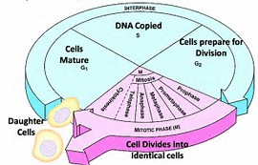
Cell Division Cycle
This is where the
Two daughter cells begin
Their respective cell division cycle.

Slide 5
Cell Divisional Cycle
The cell divisional cycle is an identifiably named series of events (termed stages and periods) that describes what a newly developed cell (daughter cell) goes through until it itself divides. The defined stages are
Interphase – this stage is subsumed into 3 periods
  The G1 period – termed Gap 1 (a growth phase)
  The S period – termed synthesis – DNA is synthesized in this stage (duplicated)
  The G2 period – termed Gap 2 period (a preparedness period for imminent cell duplication (cell splitting)
  The M period (Mitosis or Meiosis) – when the nucleus of a cell divides- and in most cases also the cytoplasm- but not necessarily

Slide 6
Interphase
Interphase – a period in the cell cycle – that for years was felt to be a resting phase due to the fact that the genetic material was in the loop domain fold or thinner – thus beyond the resolution (viewing ability) of the light microscope
Now we know that most of the important activities involving cell division occur during that period
Interphase is divided into three periods a G1, S, and G2 period

Slide 7
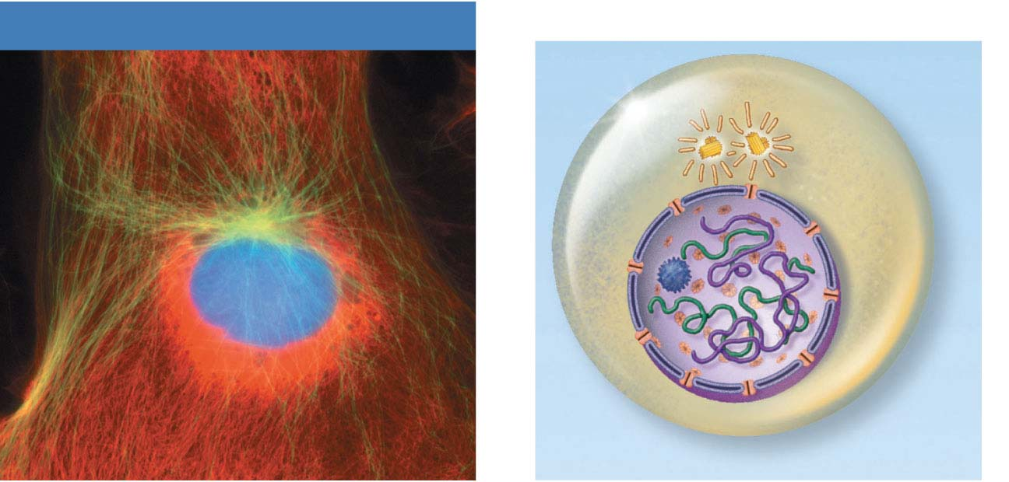
Genetic material is in too thin of a fold (Loop Domain or Thinner) to be seen under the light microscope.
Centrosomes
(each has 2
centrioles)
Interphase
Plasma
membrane
Nucleolus
Chromatin
Nuclear
envelope
Interphase
Figure 3.33

Slide 8
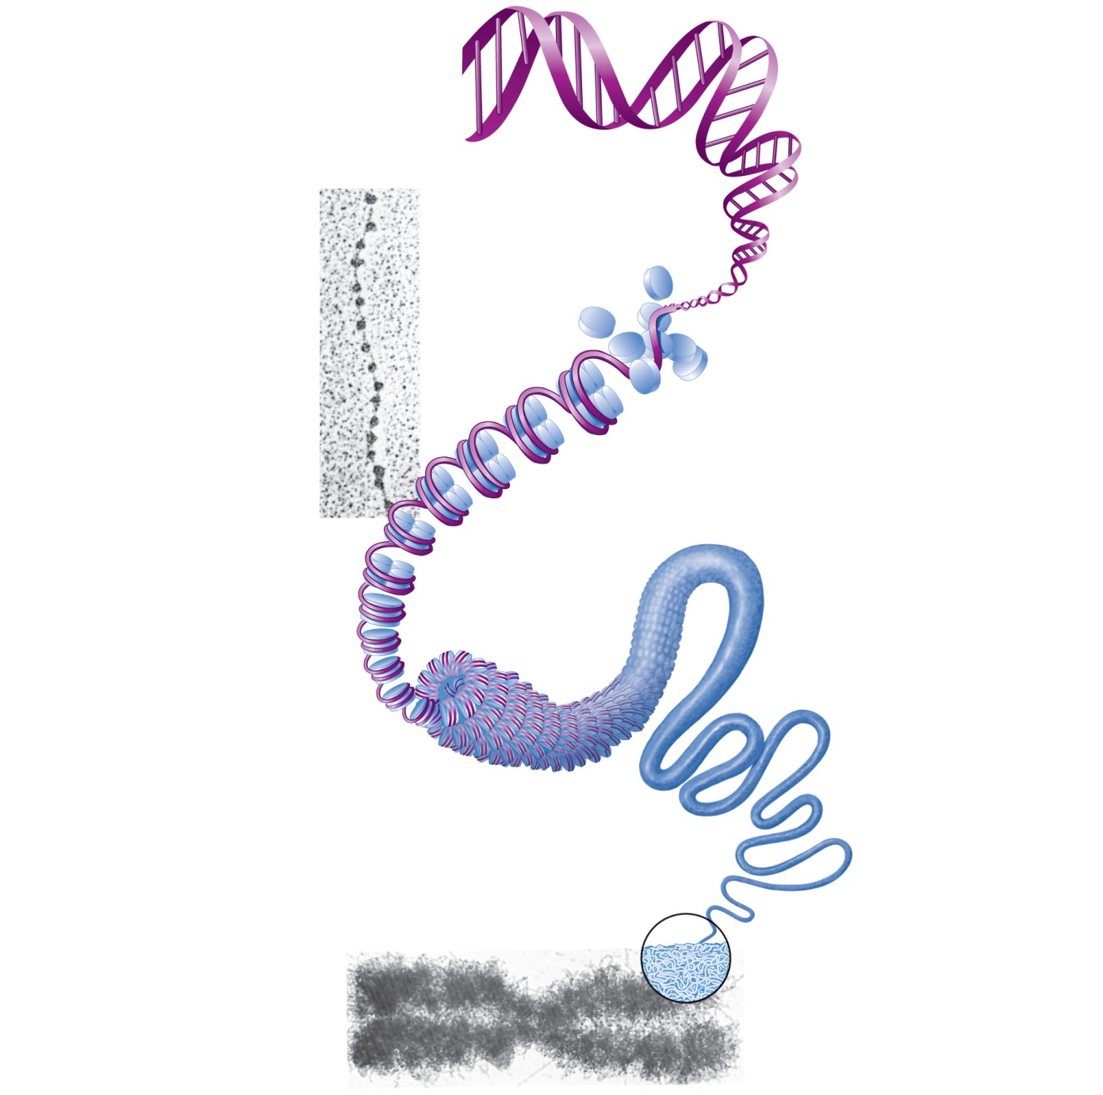
1
DNA double
helix (2-nm diameter)
2
Histones
Chromatin
(“beads on a
string”) structure
with nucleosomes
Linker DNA
Nucleosome (10-nm diameter; eight
histone proteins wrapped by two
winds of the DNA double helix)
(a)
3
Tight helical fiber
(30-nm diameter)
4
Looped domain
structure (300-nm
diameter)
5
Chromatid
(700-nm diameter)
Metaphase
chromosome
(at midpoint
of cell division)
(b)
Figure 3.30

Slide 9
Interphase (about 90% of the cell cycle) can be divided into sub-phases:
  G₁ phase (“first gap”)
  S phase (“synthesis”)
  G₂ phase (“second gap”)
The cell grows during all three phases, but genetic material (DNA) is duplicated only during the S phase
Copyright © 2008 Pearson Education, Inc., publishing as Pearson Benjamin Cummings

Slide 10
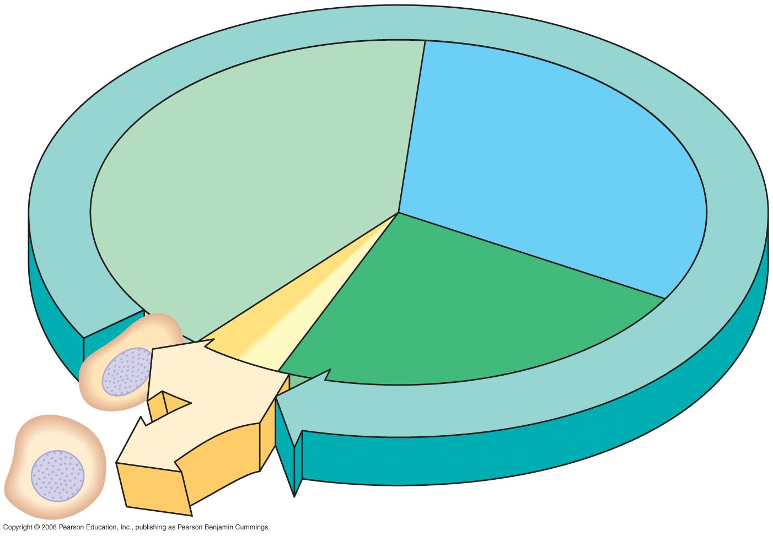
Fig. 12-5
INTERPHASE
G₁
S
(DNA synthesis)
Cytokinesis
G₂
Mitosis
MITOTIC
(M) PHASE
Notes:
Figure 12.5 The cell cycle

Slide 11
G1 Phase (Gap 1)
G1 is the variable time period in the cell divisional cycle – its length depends on the activities of the newly created cell
G1 begins the cell cycle for two newly created (daughter) cells – if the process of mitosis (or meiosis I) just concluded and created these two cells.
G1 is a growth period in which the newly created daughter cells enlarge and grow back to the size of the parent cell. Thus additional cytoplasm and organelles must be formed.
G1, as previously stated, begins immediately after the end of the M phase in the cell cycle. The G1 phase continues until the S phase if the cell is immediately going to divide again – however if the cell will not immediately divide again – the cell will exit the cell divisional cycle and enter a G0 phase, a non-dividing phase.
If the newly created cell is going to divide again immediately then the cell has two biosynthetic activities it must complete (1) synthesize new cytoplasm chemicals and produce additional organelles allowing the cell to start enlarging to the size of the parent cell and (2) synthesize various enzymes that are required in S phase, mainly those needed for DNA replication.

Slide 12
If a cell is not anticipating dividing immediately – the cell exits the Cell Divisional Cycle at the end of G1 and goes into a G0 phase. G0 is a non-dividing phase.
G0
Exit
G₁
S
(DNA synthesis)
G₂
Cytokinesis
Mitosis
MITOTIC
(M) PHASE
Notes:
Figure 12.5 The cell cycle

Slide 13
G0 phase
The G0 phase is a non-dividing phase – thus if one uses common sense – it cannot be a part of a cell divisional cycle – because the cell is not planning to divide at that point (at least not immediately).
What goes on in a cell during G0? The cell does the intended work of the cell – it performs its proper functioning. If it is a liver cell it does liver work – kidney cell – kidney work.
As long as a cell is running the cell divisional cycle time clock – its attention is turned totally to division – thus
A liver cell while running the CDC clock is not doing liver work – the same for a kidney cell and any other cells.

Slide 14
S-Phase (DNA Synthesis)
Duration 10 – 12 hours
The ensuing S phase starts when DNA synthesis commences; when it is complete, all of the genetic material (DNA) has been replicated.
Thus, during this phase, the amount of DNA in the cell has effectively doubled.
Rates of RNA transcription and protein synthesis are very low during this phase. An exception to this is histone production, most of which occurs during the S phase.

Slide 15
DNA Replication
DNA helices begin unwinding from the nucleosomes
Helicase untwists the double helix and exposes complementary chains
The Y-shaped site of replication is the replication fork
Each nucleotide strand serves as a template for building a new complementary strand

Slide 16
DNA Replication
DNA polymerase only works in one direction
  Continuous leading strand is synthesized
  Discontinuous lagging strand is synthesized in segments
  DNA ligase splices together short segments of discontinuous strand

Slide 17
DNA Replication
End result: two DNA molecules formed from the original
This process is called semiconservative replication

Slide 18
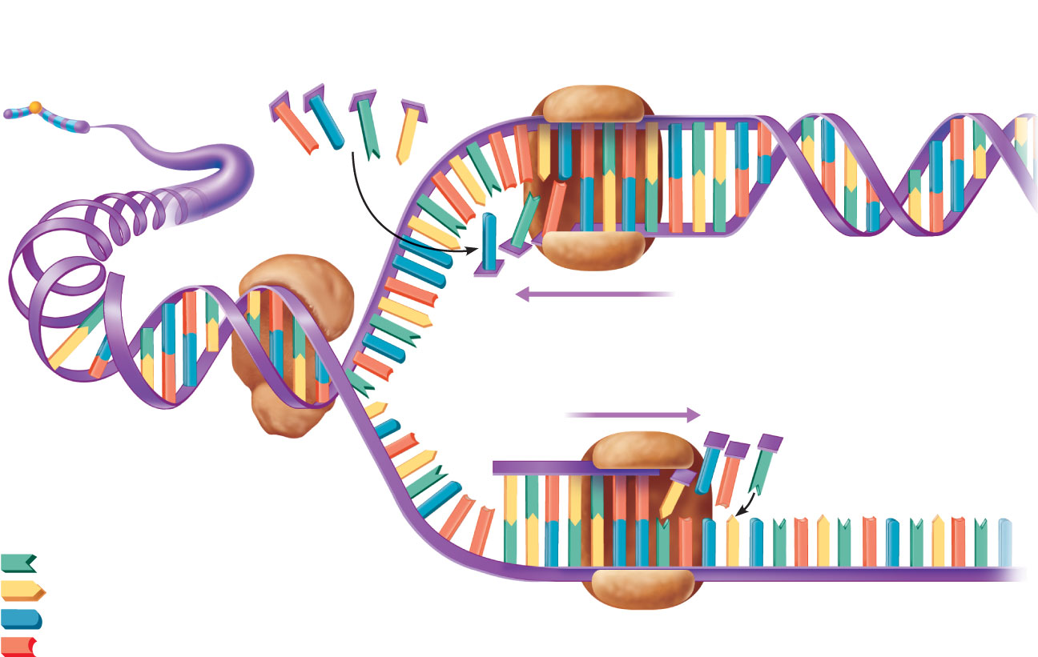
Old strand acts as a
template for synthesis
of new strand
Free nucleotides
DNA polymerase
Chromosome
Leading strand
Two new strands (leading and lagging)
synthesized in opposite directions
Old DNA
Lagging
strand
Helicase unwinds
the double helix and
exposes the bases
Replication
fork
Adenine
Thymine
Cytosine
DNA polymerase
Old (template) strand
Guanine
Figure 3.32

Slide 19
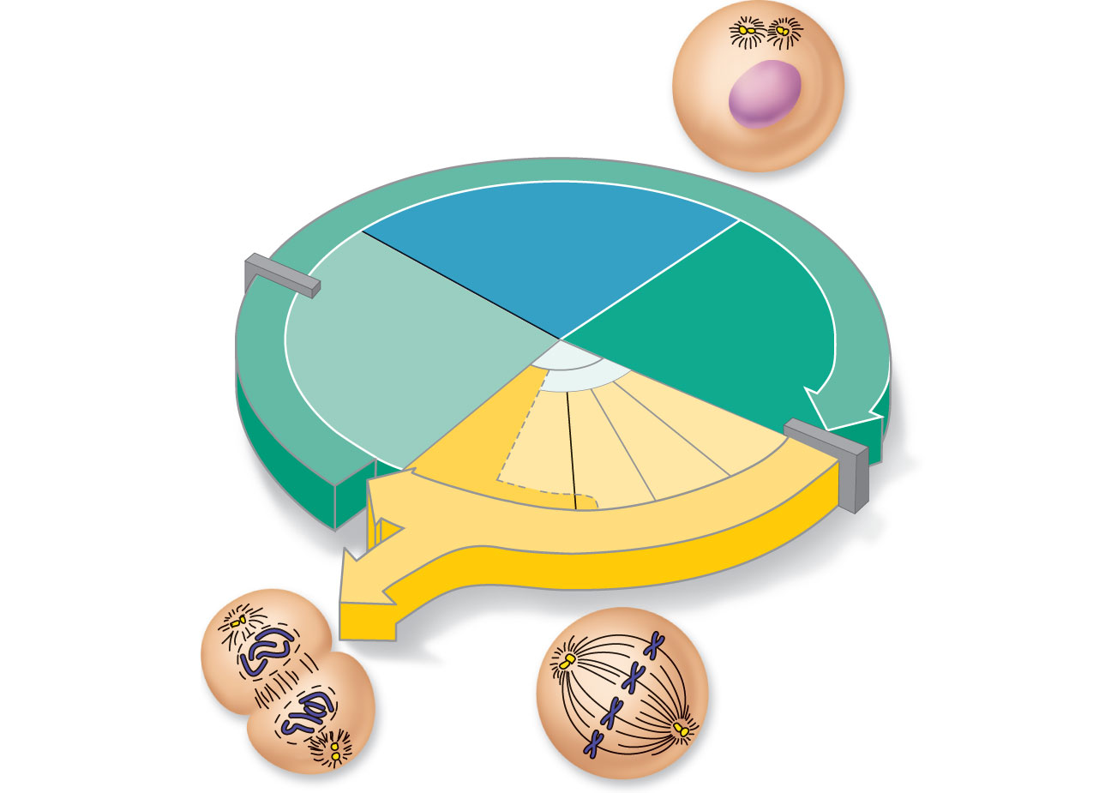
G₁ checkpoint
(restriction point)
S
Growth and DNA
synthesis
G₂
Growth and final
preparations for
division
G₁
Growth
M
G₂ checkpoint
Figure 3.31

Slide 20
Centrosomes
(each has 2
centrioles)
Interphase
Plasma
membrane
Nucleolus
Chromatin
Nuclear
envelope
Interphase
Figure 3.33

Slide 21
G2 (Gap 2) Phase
Duration 4 – 6 hours
This stage is a preparedness stage for the events of the M-phase. All the proteins needed in mitosis should be produced during this phase.
The cell then enters the G₂ phase, which lasts until the cell enters mitosis. Again, significant protein synthesis occurs during this phase, mainly involving the production of microtubules, which are required during the process of mitosis.
Inhibition of protein synthesis during G₂ phase prevents the cell from undergoing mitosis.

Slide 22
M-Phase (Mitosis or Meiosis)
Duration – 1 hour
Phase after Interphase
The genetic material folds into the thicker chromatid/chromosome fold in this phase- thus the genetic material can be seen under the light microscope
The relatively brief M phase consists of nuclear division (karyokinesis) and cytoplasmic division (cytokinesis). In plants and algae, cytokinesis is accompanied by the formation of a new cell wall. The M phase has been broken down into several distinct phases, sequentially known as prophase, Prometaphase, metaphase, anaphase and telophase leading to cytokinesis.

Slide 23
Let’s discuss the Checkpoints
G₁ checkpoint
(restriction point)
S
Growth and DNA
synthesis
G₂
Growth and final
preparations for
division
G₁
Growth
M
G₂ checkpoint
Figure 3.31

Slide 24
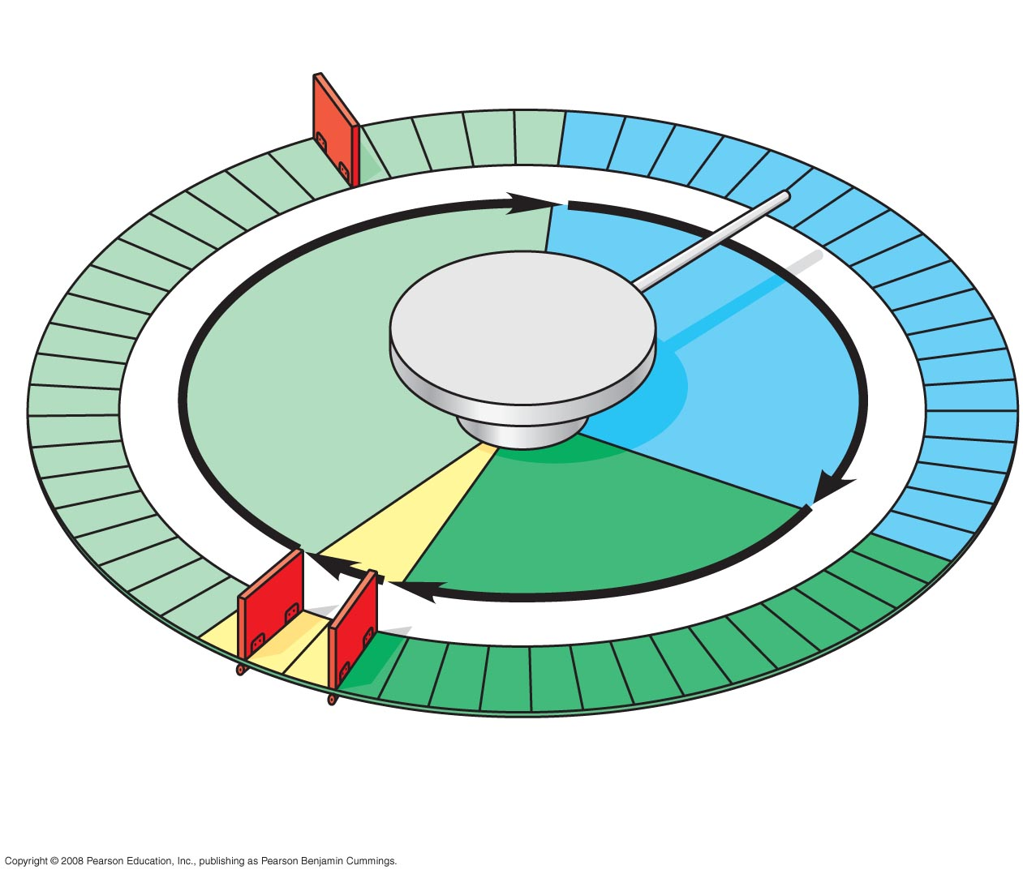
Fig. 12-14
G₁ checkpoint
Control
system
S
G₁
M
G₂
M checkpoint
G₂ checkpoint
Notes:
Figure 12.14 Mechanical analogy for the cell cycle control system

Slide 25
Check Points
As with any multistep complicated process – the process needs to have checks and balances to ensure it proceeds properly and does not get out of control.
What do these controls ensure in the cell divisional cycle?
(1) Make sure each phase occurs and is in the proper order.
(2) Make sure the actions of each phase are properly completed before the cell moves to the next phase. The activities of each phase are in preparedness for the next phase.
(3) Make sure that cell duplication only occurs when needed – if it occurs when not needed – then this is the start of tumors (benign or malignant).

Slide 26
G1 Checkpoint (Restriction Point)
The first checkpoint is located at the end of the cell cycle's G₁ phase, just before entry into S phase, making the key decision of whether the cell should divide, delay division, or enter a resting stage. Many cells stop at this stage and enter a resting state called G₀. Liver cells, for instance, only enter mitosis around once or twice a year. Nerve cells and some muscle cells stop dividing at a person’s young age. The G₁ checkpoint is where eukaryotes typically arrest the cell cycle if environmental conditions make cell division impossible or if the cell passes into G₀ for an extended period. In animal cells, the G₁ phase checkpoint is called the restriction point.

Slide 27
The G1 checkpoint (termed the restriction point)is the major checkpoint. It is a decision point deciding whether the cell will go into the G0 (non-dividing ) phase or not.
G₁ checkpoint
S
G₁
Control
system
G₂
M
M checkpoint
G₂ checkpoint
Notes:
Figure 12.14 Mechanical analogy for the cell cycle control system

Slide 28
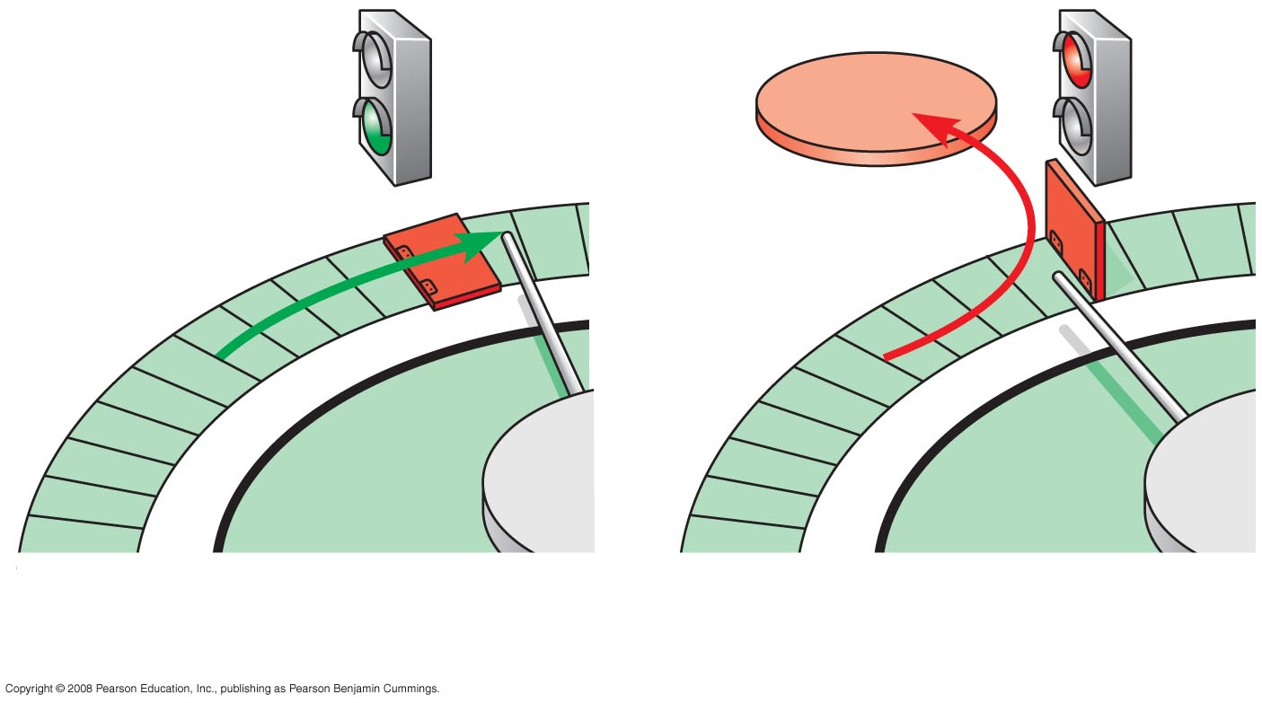
Fig. 12-15
G₀
G₁ checkpoint
G₁
G₁
Cell receives a go-ahead
signal
(b) Cell does not receive a
go-ahead signal
Notes:
Figure 12.15 The G₁ checkpoint

Slide 29
G2 Checkpoint
The second checkpoint is located at the end of G₂ phase, triggering the start of the M phase (mitosis).
In order for this checkpoint to be passed, the cell has to check a number of factors to ensure the cell is ready for mitosis. If this checkpoint is passed, the cell initiates the many molecular processes that signal the beginning of mitosis.

Slide 30
Fig. 12-14
G₁ checkpoint
Control
system
S
G₁
G₂
M
M checkpoint
G₂ checkpoint
The second checkpoint (G2 checkpoint) is located at the end of the G₂ phase, triggering the start of the M phase (mitosis).
Notes:
Figure 12.14 Mechanical analogy for the cell cycle control system

Slide 31
M-Phase Checkpoint
The M-phase checkpoint is a checkpoint located within the process of mitosis. It allows one internal stage of mitosis to proceed to another phase within mitosis. We will discuss this again when we discuss mitosis and discuss cell division control.

Slide 32
Fig. 12-14
G₁ checkpoint
Control
system
S
G₁
M
G₂
G₂ checkpoint
M checkpoint
The M-phase checkpoint is a checkpoint located within the process of mitosis.
Notes:
Figure 12.14 Mechanical analogy for the cell cycle control system

