Slide 1
Tumors
Cell Division Gone Wrong
Mike Clark, M.D.

Slide 2
Causes of Tumors
All tumors are ultimately the result of a genetic aberration.
The causes for the genetic problems are numerous
A growth factor that over-secretes
A cell becomes able to self-activate itself without its stimulation by its growth factor
A protooncogene becomes mutated to an oncogene
A tumor suppressor gene fails to work

Slide 3
The genes that code for the proteins that control cell division
Proto-oncogenes code for proteins that help to regulate cell growth and differentiation. Proto-oncogenes are often involved in signal transduction and execution of mitogenic signals, usually through their protein products.
A tumor suppressor gene, or antioncogene, is a gene that protects a cell from one step on the path to cancer.

Slide 4
Mutations of the Genes
A proto-oncogene is a normal gene that can become an oncogene due to mutations or increased expression.
An oncogene is a gene that, when expressed at high levels, helps turn a normal cell into a tumor cell
When a tumor suppressor gene is mutated to cause a loss or reduction in its function, the cell can progress to cancer, usually in combination with other genetic changes.

Slide 5
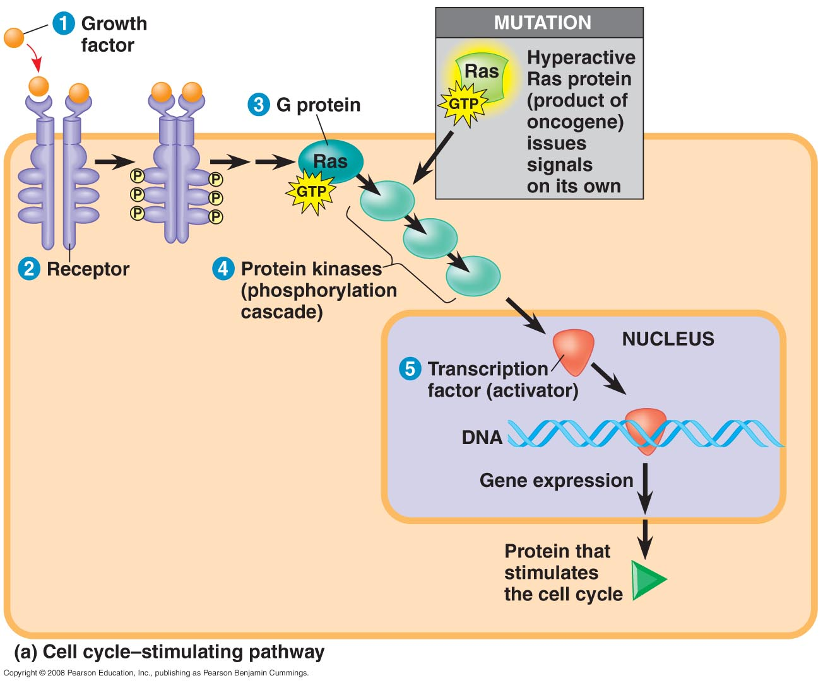
Proto-oncogene

Slide 6
Proto-oncogenes can be converted to oncogenes by
  Movement of DNA within the genome: if it ends up near an active promoter, transcription may increase
  Amplification of a proto-oncogene: increases the number of copies of the gene
  Point mutations in the proto-oncogene or its control elements: causes an increase in gene expression

Slide 7
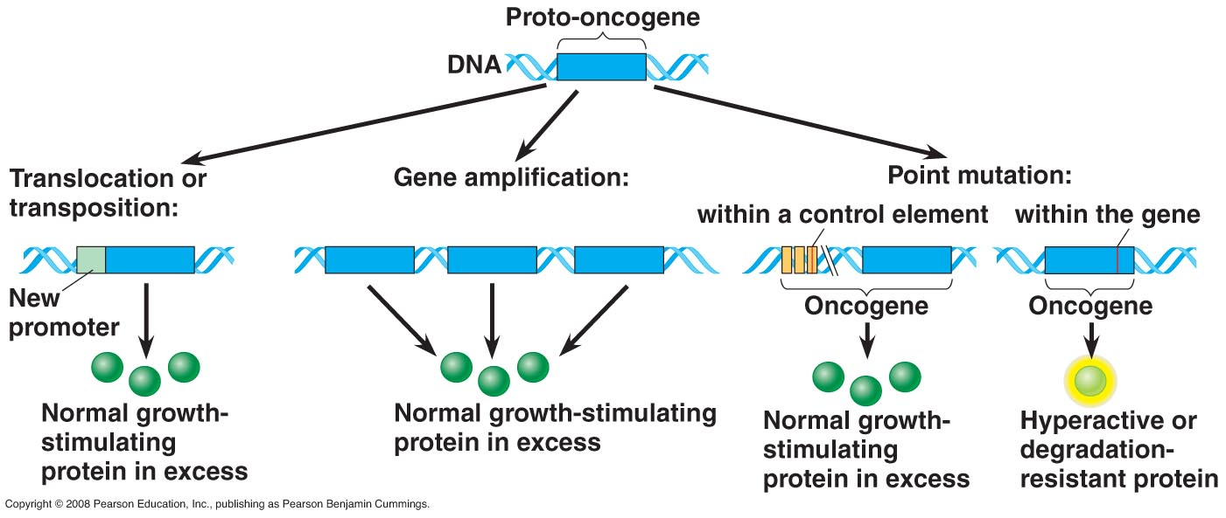
Mutating a Proto-oncogene

Slide 8
Proto-oncogenes
A proto-oncogene is a normal gene that can become an oncogene due to mutations or increased expression. Examples of proto-oncogenes include RAS, WNT, MYC, ERK, and TRK.

Slide 9
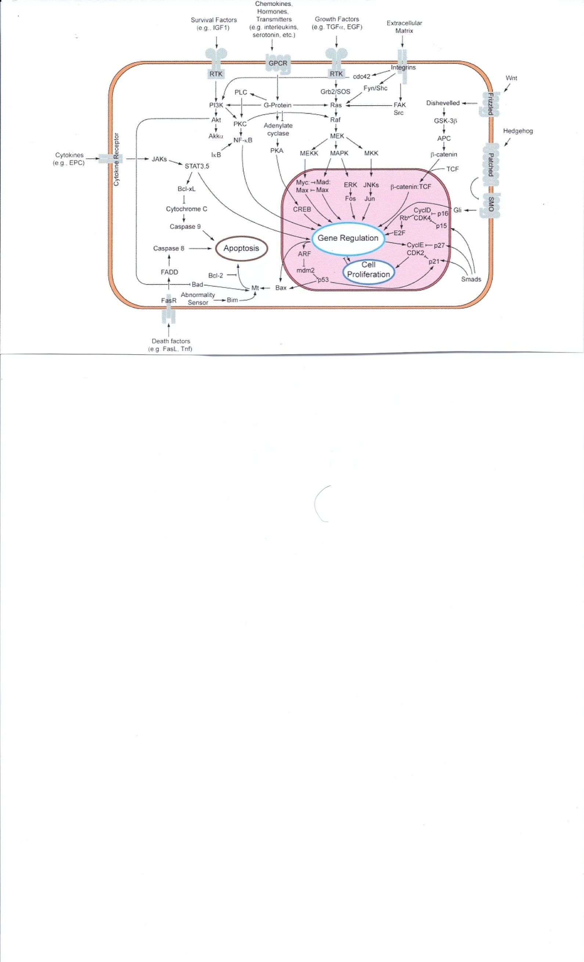
Proto-oncogenes are the blueprints for growth factors, and cell internal transduction chemicals.
Epidermal growth factor (EGF)
Erythropoietin (EPO) Example of Growth Factors
Fibroblast growth factor (FGF)
Internal Cell
Transduction

Slide 10
The proto-oncogene can become an oncogene by a relatively small modification of its original function. There are three basic activation types:
A mutation within a proto-oncogene can cause a change in the protein structure, causing
  an increase in protein (enzyme) activity
  a loss of regulation
An increase in protein concentration, caused by
  an increase of protein expression (through mis-regulation)
  an increase of protein stability, prolonging its existence and thus its activity in the cell
  a gene duplication (one type of chromosome abnormality), resulting in an increased amount of protein in the cell
A chromosomal translocation (another type of chromosome abnormality), causing
  an increased gene expression in the wrong cell type or at wrong times
  the expression of a constitutively active hybrid protein. This type of aberration in a dividing stem cell in the bone marrow leads to adult leukemia

Slide 11
Tumor Suppressor Genes
Functions
Tumor-suppressor genes, or more precisely, the proteins for which they code, either have a dampening or repressive effect on the regulation of the cell cycle or promote apoptosis, and sometimes do both. The functions of tumor-suppressor proteins fall into several categories including the following:
Repression of genes that are essential for the continuing of the cell cycle. If these genes are not expressed, the cell cycle will not continue, effectively inhibiting cell division.
Coupling the cell cycle to DNA damage. As long as there is damaged DNA in the cell, it should not divide. If the damage can be repaired, the cell cycle can continue.
If the damage cannot be repaired, the cell should initiate apoptosis (programmed cell death) to remove the threat it poses for the greater good of the organism.
Some proteins involved in cell adhesion prevent tumor cells from dispersing, block loss of contact inhibition, and inhibit metastasis. These proteins are known as metastasis suppressors

Slide 12
Tumor-Suppressor Genes
Tumor-suppressor genes help prevent uncontrolled cell growth
Mutations that decrease protein products of tumor-suppressor genes may contribute to cancer onset
Tumor-suppressor proteins
  Repair damaged DNA
  Control cell adhesion
  Inhibit the cell cycle in the cell-signaling pathway
  Can cause apoptosis

Slide 13
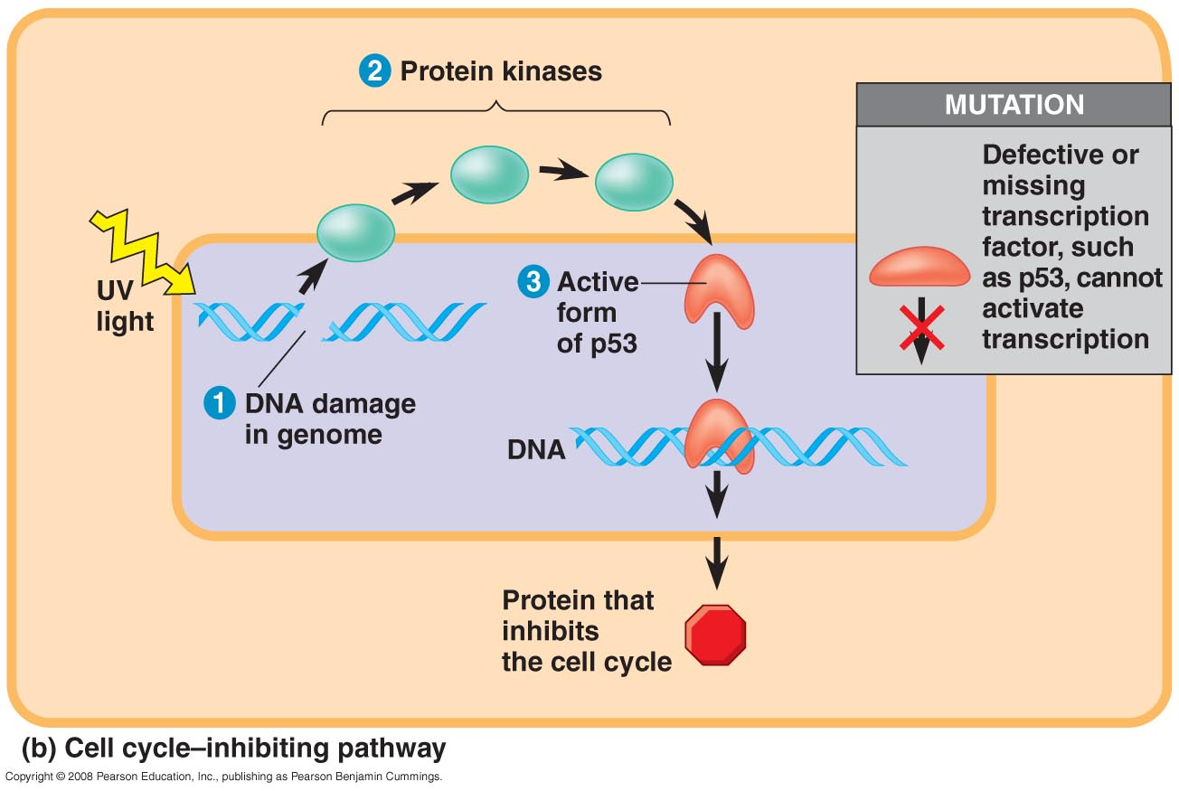
Tumor Suppressor Genes

Slide 14
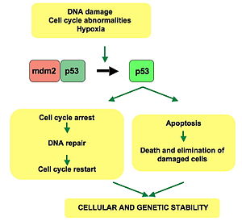

Slide 15
Examples of Tumor Suppressor Genes
The first tumor-suppressor protein discovered was the Retinoblastoma protein (pRb) in human retinoblastoma; however, recent evidence has also implicated pRb as a tumor-survival factor.
Another important tumor suppressor is the p53 tumor-suppressor protein encoded by the TP53 gene. Homozygous loss of p53 is found in 70% of colon cancers, 30–50% of breast cancers, and 50% of lung cancers. Mutated p53 is also involved in the pathophysiology of leukemias, lymphomas, sarcomas, and neurogenic tumors. Abnormalities of the p53 gene can be inherited in Li-Fraumeni syndrome (LFS), which increases the risk of developing various types of cancers.

Slide 16
One possible genetic cause for tumors
Two-hit hypothesis
Unlike oncogenes, tumor suppressor genes generally follow the 'two-hit hypothesis', which implies that both alleles that code for a particular gene must be affected before an effect is manifested. This is due to the fact that if only one allele for the gene is damaged, the second can still produce the correct protein. In other words, mutant tumor suppressors alleles are usually recessive whereas mutant oncogene alleles are typically dominant.

Slide 17
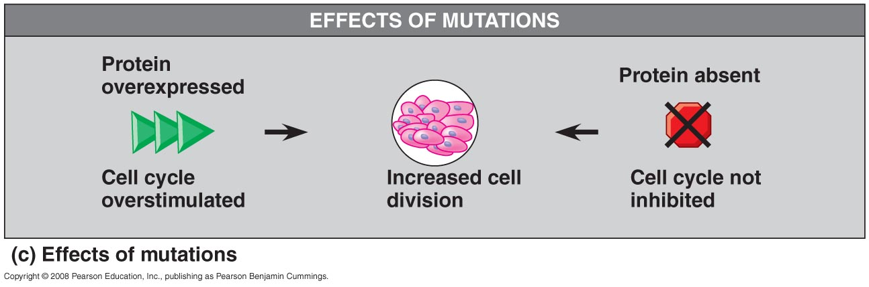
Tumor Formation

Slide 18
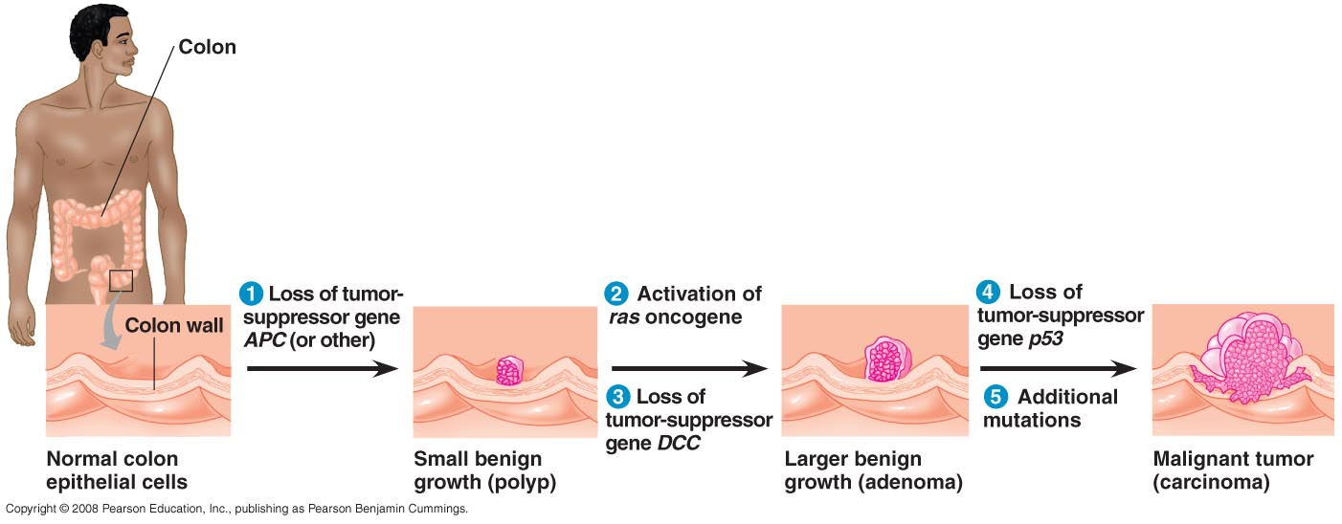
Progression of Cancer

Slide 19
Tumor
The word tumor has several meanings. In accordance with Stedman's Medical Dictionary, a tumor is any swelling.
Tumor 1. Any swelling or tumefaction. 2. neoplasm.
This discussion will focus on the word tumor as it is defined as a neoplasm. Stedman defines a neoplasm as:
Neoplasm (new growth) (1) a tumor (2) an abnormal tissue that grows by cellular proliferation more rapidly than normal and continues to grow after the stimuli that initiated the new growth cease. Neoplasms show partial or complete lack of structural organization and functional coordination with the normal tissue, and usually form a distinct mass of tissue which may be either benign (benign tumor) or malignant (cancer).

Slide 20
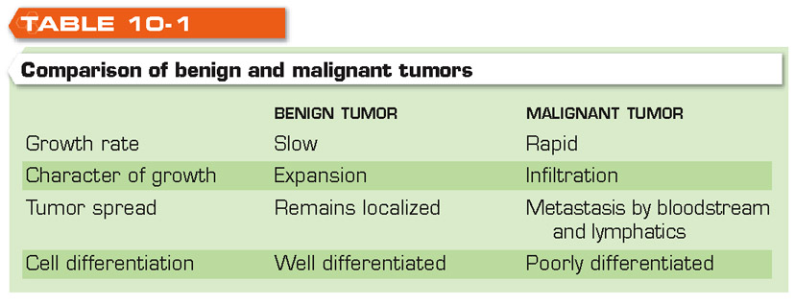
Comparison of Benign and
Malignant Tumors

Slide 21
Benign Tumor
A benign tumor is one that grows in a confined local area and rarely is life threatening. Some benign tumors occur in surgically inaccessible locations, such as the brain thus making them potentially life threatening.
The major problems with benign neoplasms are (1) space occupation - crowding out good functioning tissue (2) pain (3) pressure (4) bleeding and (5) inflammation secondary to necrosis. The sigh of relief factor is the inability of the benign tumor cells to spread over long distances (metastasis). Unfortunately some benign tumors do transform to malignancy. This fortunately is a very rare occurrence.

Slide 22
Cancer
The word cancer, which means "crab" in Latin was coined by Hippocrates in the fifth century B.C. to describe diseases in which tissues grow and spread unrestrained throughout the body, eventually choking off life. Cancers can originate in almost any tissue of the body. Depending on the cell type involved, they are grouped into three main categories. (1) Carcinomas, which are most common type of cancer, arise in epithelial cells. (2) Sarcomas arise in connective tissues. (3) Lymphomas and leukemias arise from blood cells and lymphatic origin.

Slide 23
Metastasis
Malignant tumors are capable of spreading by invasion and metastasis.
Cancer cells invade surrounding tissues and vessels (Local Spread)
A. Decrease in cell to cell adhesiveness
B. Increased cell mobility
C. Secretion of proteases that digest a path through the extracellular matrix
Cancer cells are transported to distant sites (Distant Spread) by the blood vessels and/or lymphatics
Cancer cells have a predilection for the sites they desire to invade, grow and multiply.

Slide 24
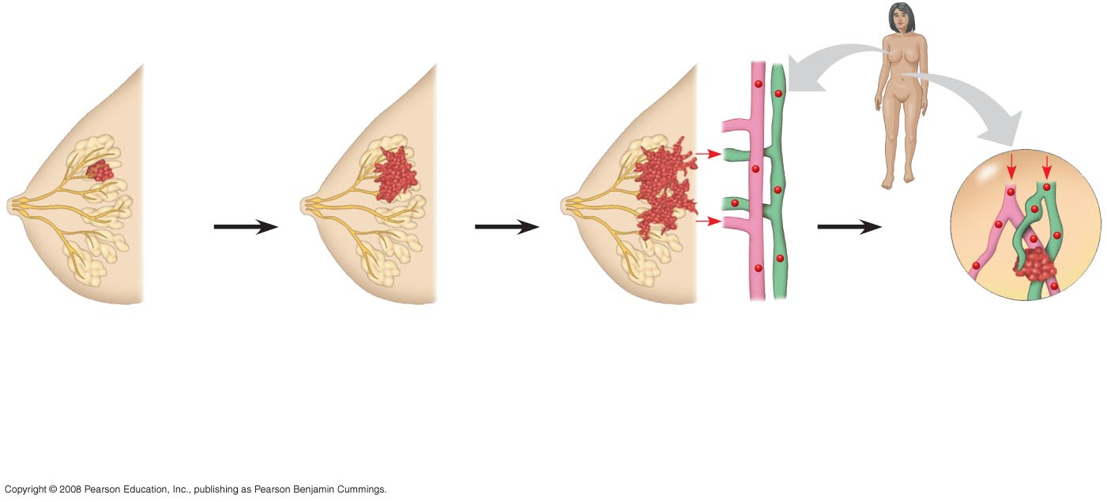
Fig. 12-20
Secondary (Metastatic) Site
Primary Site
Lymph
vessel
Tumor
Blood
vessel
Glandular
tissue
Cancer
cell
Metastatic
tumor
1
A tumor grows
from a single
cancer cell.
2
Cancer cells
invade neigh-
boring tissue.
3
Cancer cells spread
to other parts of
the body.
4
Cancer cells may
survive and
establish a new
tumor in another
part of the body.
Notes:
Figure 12.20 The growth and metastasis of a malignant breast tumor

Slide 25
Characteristic traits shared by cancer cells
Cancer cells have a distinctive appearance – they exhibit
Anaplasia - a process involving the loss of cell differentiation and the disruption of the proper orientation of cells of one another. Cancer cells also tend to exhibit large, irregularly shaped nuclei, prominent nucleoli, and a cell surface covered with microvilli and lamellipodia.
Cancer cells are immortal in culture.
Cancer cells lose contact inhibition
Cancer cells secrete a Transforming Growth Factor -a class of growth factors secreted by cancer cells that cause normal cells to acquire some of the growth characteristics of cancer cells.

Slide 26
Cancer cells lack normal cell cycle controls
Cancer cells exhibit cell surface alterations
(a) Decreased adhesiveness of cancer cells- due to decreased fibronectin
(b)Exhibition of tumor specific cell surface antigens
Many cancer cells and some benign tumor cells secrete tumor markers

Slide 27
Tumor Markers
Tumor markers are substances produced by tumor cells or by other cells of the body in response to cancer or certain benign (noncancerous) conditions. These substances can be found in the blood, in the urine, in the tumor tissue, or in other tissues. Different tumor markers are found in different types of cancer, and levels of the same tumor marker can be altered in more than one type of cancer. In addition, tumor marker levels are not altered in all people with cancer, especially if the cancer is early stage. Some tumor marker levels can also be altered in patients with noncancerous conditions.
To date, researchers have identified more than a dozen substances that seem to be expressed abnormally when some types of cancer are present. Some of these substances are also found in other conditions and diseases. Scientists have not found markers for every type of cancer.

Slide 28
Tumor Markers
Prostate-specific antigen (PSA) is a protein produced by the cells of the prostate gland. PSA is present in small quantities in the serum of normal men, and is often elevated in the presence of prostate cancer and in other prostate disorders. A blood test to measure PSA is considered the most effective test currently available for the early detection of prostate cancer, but this effectiveness has also been questioned
Carcinoma Embryonic Antigen (CEA) is used mainly to monitor the treatment of cancer patients, especially those with colon cancer. Following surgery, CEA values are helpful in monitoring the response to therapy and in determining whether the disease has recurred. CEA is also used as a marker for other forms of cancer, including cancers of the rectum, lung, breast, liver, pancreas, stomach, and ovary. Not all cancers produce CEA, and a positive CEA test is not always due to cancer. Therefore, CEA is not used for screening the general population.

Slide 29
Tumor Markers
Alpha-fetoprotein is a protein which in humans is encoded by the AFP gene.
This gene encodes alpha-fetoprotein, a major plasma protein produced by the yolk sac and the liver during fetal life. The protein is thought to be the fetal counterpart of serum albumin
In humans, AFP levels decrease gradually after birth, reaching adult levels by 8 to 12 months. Normal adult AFP levels are low, but detectable; however, AFP has no known function in healthy adults. In normal fetuses, AFP binds the hormone estradiol. AFP is measured in pregnant women, using maternal blood or amniotic fluid, as a screening test for a subset developmental abnormalities, principally increased in open neural tube defects and omphalocele & decreased in Down syndrome. It is also measured in pregnant women, other adults, and children, serving as a biomarker to detect a subset of tumors, principally hepatocellular carcinoma and endodermal sinus tumors.

Slide 30
Risk Markers
Some people have a greater chance of developing certain types of cancer because of a change, known as a mutation or alteration, in specific genes. The presence of such a change is sometimes called a risk marker. Tests for risk markers can help the doctor to estimate a person’s chance of developing a certain cancer. Risk markers can indicate that cancer is more likely to occur, whereas tumor markers can indicate the presence of cancer

Slide 31
BRCA1
BRCA1 (breast cancer 1, early onset) is a human gene, some mutations of which are associated with a significant increase in the risk of breast cancer, as well as other cancers. BRCA1 belongs to a class of genes known as tumor suppressors, which maintains genomic integrity to prevent dangerous genetic changes. The multifactorial BRCA1 protein product is involved in DNA damage repair especially error-free repair of DNA double strand breaks, ubiquitination, transcriptional regulation as well as other functions

Slide 32
BRAC
Inheritance of mutant breast cancer susceptibility genes
Mutant BRCA1 gene
  Increases breast and ovarian carcinoma risk
  Breast cancer risk at 80%
  Ovarian cancer risk is at 20–40%
  Large gene with many different mutations
Mutant BRCA2 gene
  Breast cancer risk at 80%
  Lower ovarian carcinoma risk at 10–20%

Slide 33
Causes of Cancer
The four presently accepted causes of cancer are:
Chemicals known as "carcinogens"
Radiation as a carcinogen
Viruses
Heredity i.e., genetic causes

Slide 34
Carcinogens
The term carcinogen refers to any substance, radionuclide or radiation that is an agent directly involved in the promotion of cancer or in the increase of its propagation. This may be due to the ability to damage the genome or to the disruption of cellular metabolic processes. Several radioactive substances are considered carcinogens, but their carcinogenic activity is attributed to the radiation, for example gamma rays and alpha particles, which they emit. Common examples of carcinogens are inhaled asbestos, certain dioxins, and tobacco smoke.

Slide 35
Carcinogens
Food -Cooking food at high temperatures, for example grilling or barbecuing meats, can lead to the formation of minute quantities of many potent carcinogens that are comparable to those found in cigarette smoke (i.e., benzo[a]pyrene)
Tobacco smoke contains over 4000 chemical compounds, many of which are carcinogenic or otherwise toxic
Circadian disruption
"Shift-work that involves circadian disruption" was listed, in 2007, as a probable carcinogen by the World Health Organization's International Agency for Research on Cancer. (IARC Press release No. 180. Multiple studies have documented a link between night shift work and the increased incidence of breast cancer. Circadian disruption by exposure to light at night suppresses the production of the hormone melatonin which leads to reduction in cellular immune defense and surveillance necessary for protection from development of cancers. Melatonin also seems to have a direct protective effect against cancer possibly in part because of its strong anti oxidant properties.

Slide 36
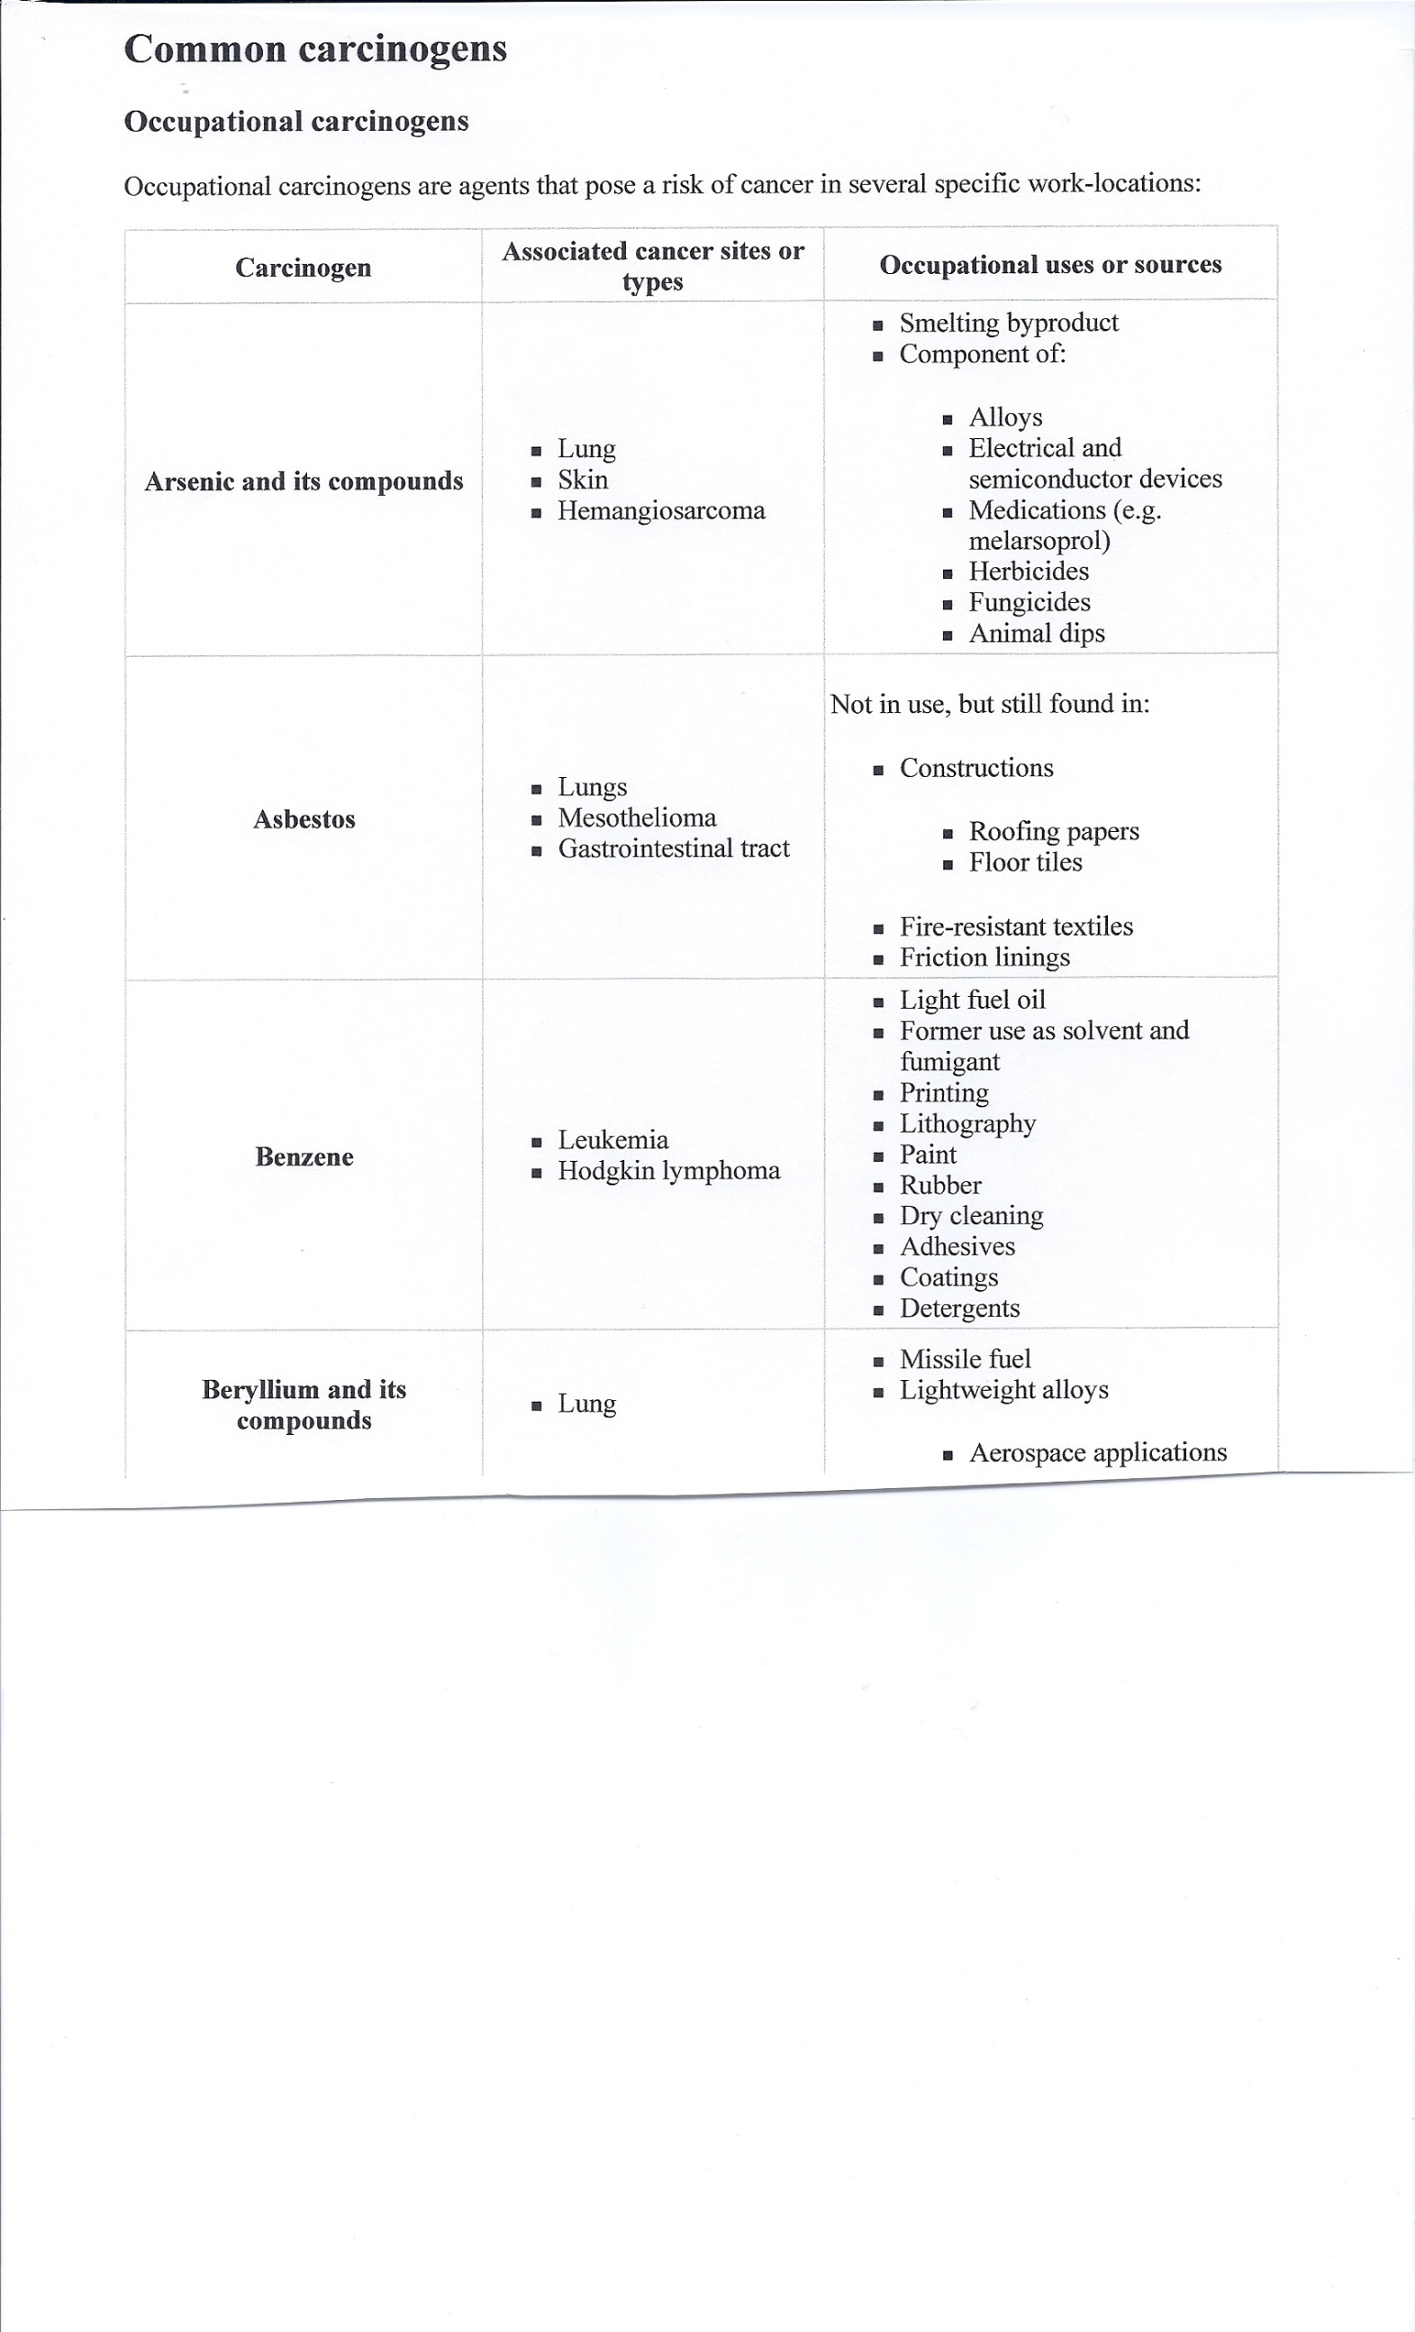

Slide 37
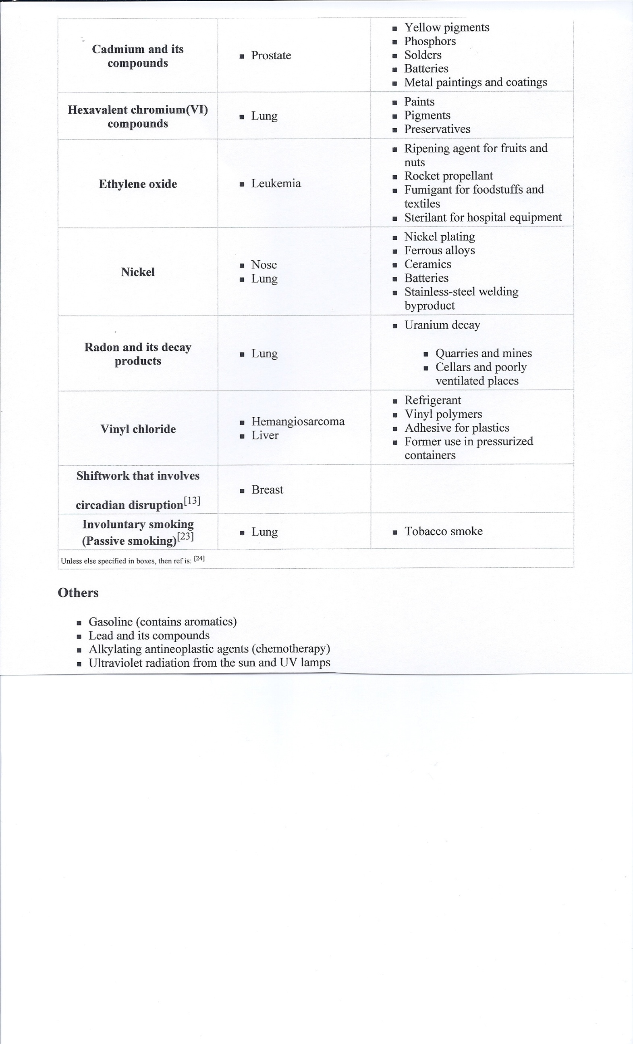

Slide 38
Viruses as causes of Cancer
Human papilloma viruses (HPVs) are a group of over 100 related viruses that can cause warts on the skin, mouth, genital organs, and larynx. Certain types of HPV are the main cause of cervical cancer, which is the second most common cancer among women worldwide.
Epstein-Barr virus (EBV) is a type of herpes virus. It is probably best known for causing infectious mononucleosis, also known as "mono" or the "kissing disease. Infection with EBV increases a person's risk of getting nasopharyngeal cancer (cancer of the area in the back of the nose) and certain types of fast-growing lymphomas such as Burkitt lymphoma. It may also be linked to Hodgkin disease and some cases of stomach cancer.

Slide 39
Hepatitis B virus (HBV) and hepatitis C virus (HCV) cause viral hepatitis, a type of liver infection. While other viruses can also cause hepatitis (hepatitis A virus, for example), only HBV and HCV can cause chronic (long-term) infections that increase a person’s chance of developing liver cancer. In the United States, about 30% of liver cancers are related to HBV or HCV infection. This number is much higher in certain other countries, where both the infections and liver cancer are much more common.
Human immunodeficiency virus (HIV) is the virus that causes acquired immune deficiency syndrome (AIDS), does not appear to cause cancers directly. But HIV infection increases a person's risk of getting several types of cancer, especially some linked to other viruses such as HHV-8 (see section below) and HPV.
HIV infection has been linked to a higher risk of developing of Kaposi sarcoma, invasive cervical cancer, and certain kinds of lymphoma, especially non-Hodgkin lymphoma and central nervous system lymphoma. Anti-HIV drugs may be used to reduce the risk of Kaposi sarcoma and cervical cancer.
Other forms of cancer that may be more likely to develop in people with HIV infection include: invasive anal cancer , Hodgkin disease , lung cancer , cancer of the mouth and throat , cancer of the testicles , skin cancers, including basal cell, squamous cell, and even malignant melanomas

Slide 40
Etiologic Factors in
Neoplastic Disease
Heredity and Tumors
There is no strong hereditary predisposition to most common malignant tumors
Hereditary factors do play a role in some common tumors
The predisposition is apparently the result of multifactorial inheritance pattern in which the individual at risk has inherited set of genes that influence some hormonal- or enzyme-regulated biochemical process within the body that slightly increases the susceptibility to a specific cancer

Slide 41
Heredity Cancers
Many types of cancer are linked to a family history of that cancer. Breast, ovarian, prostate, and colon are some of these cancers.
Breast Cancer - A woman who has a first-degree relative (such as a mother, sister, or daughter) with breast cancer is about twice as likely to develop breast cancer as a woman without a family history of this cancer.
Colon cancer - An important cause of hereditary colon cancer among adults is a disease called familial adenomatous polyposis (FAP). People with this disease start getting colon polyps by their teen years, and over time may have hundreds of polyps in their colon. If left alone, at least one of these polyps will become cancer. The gene for this syndrome is called APC, and testing for mutations in this gene is available. If FAP is diagnosed early in life, surgery to remove the colon can keep the cancer from developing.

Slide 42
Hereditary Cancers
Childhood cancers
Retinoblastoma: This is a childhood cancer that starts in the eye. It can be caused by an inherited mutation in the tumor suppressor gene Rb.
Li-Fraumeni syndrome: This syndrome occurs when a person inherits a mutation in the p53 gene (a tumor suppressor gene). A normal p53 gene stops the growth of abnormal cells. People with a p53 gene abnormality have a higher risk of childhood sarcoma, leukemia, and brain (central nervous system) cancers. Li-Fraumeni syndrome can also cause cancers of the breast and adrenal glands

Slide 43
SOME CANCER PREVENTIVES
Minimize exposure to carcinogens
Use of dietary antioxidants (vitamins A, C, and E)
Medical check-ups

Slide 44
Cancer Workup
Obtain a biopsy, if possible
From the biopsy determine (1) and (2)
(1) Cell Type – determine the cell type of the cancer out of the 210 human cell types
(2) Grade – once the cell type is determined find out if the cell looks normal for its type or does the cell look bizarre (atypical). The real question is does the cell look properly differentiated?
(3) Stage – how far has the cancer spread?

Slide 45
Grading of a Tumor
Pathology grading systems are used to classify neoplasms in terms of how abnormal the cells appear microscopically and what may be the outcome in terms of rate of growth, invasiveness, and dissemination. Cancer is a disorder of excessive cell growth, hence cancer cells often are poorly differentiated. The grade reflects the degree of cellular differentiation and refers to how much the tumor cells resemble or differ from the normal cells of the same tissue type.
An important part of evaluating a cancer is to determine its histologic grade. Grade is a marker of how differentiated a cell is. Grade is rated numerically (Grade 1-4) or descriptively (e.g., "low grade" or "high grade"). The higher the numeric grade, the more "poorly differentiated" is the cell, and it is called "high grade". A low grade cancer has a low number and is "well-differentiated.”
The tumor grade, along with the staging, is used to develop an individual treatment plan and to predict the patient's prognosis.

Slide 46
Grading
The most commonly used system of grading is as per the guidelines of the American Joint Commission on Cancer. As per their standards, the following are the grading categories.
GX Grade cannot be assessed
G1 Well differentiated (Low grade)
G2 Moderately differentiated (Intermediate grade)
G3 Poorly differentiated (High grade)
G4 Undifferentiated (High grade) Anaplastic

Slide 47
Staging
The stage of a cancer is a descriptor (usually numbers I to IV) of how much the cancer has spread. The stage often takes into account the size of a tumor, how deeply it has penetrated, whether it has invaded adjacent organs, how many lymph nodes it has metastasized to (if any), and whether it has spread to distant organs. Staging of cancer is important because the stage at diagnosis is the most powerful predictor of survival, and treatments are often changed based on the stage.

Slide 48
Cancer staging can be divided into a clinical stage and a pathologic stage. In the TNM (Tumor, Node, Metastasis) system, clinical stage and pathologic stage are denoted by a small "c" or "p" before the stage (e.g., cT3N1M0 or pT2N0).
Clinical stage is based on all of the available information obtained before a surgery to remove the tumor. Thus, it may include information about the tumor obtained by physical examination, radiologic examination, and endoscopy.
Pathologic stage adds additional information gained by examination of the tumor microscopically by a pathologist.
Because they use different information, clinical stage and pathologic stage are often different. Pathologic staging is usually considered the "better" or "truer" stage because it allows direct examination of the tumor and its spread, contrasted with clinical staging which is limited by the fact that the information is obtained by making indirect observations at a tumor which is still in the body. However, clinical staging and pathologic staging should complement each other. Not every tumor is treated surgically, so sometimes pathologic staging is not available. Also, sometimes surgery is preceded by other treatments such as chemotherapy and radiation therapy which shrink the tumor, so the pathologic stage may underestimate the true stage

Slide 49
Overall stage grouping
Overall Stage Grouping is also referred to as Roman Numeral Staging. This system uses numerals I, II, III, and IV (plus the 0) to describe the progression of cancer.
Stage 0 carcinoma in situ.
Stage I cancers are localized to one part of the body.
Stage II cancers are locally advanced.
Stage III cancers are also locally advanced. Whether a cancer is designated as Stage II or Stage III can depend on the specific type of cancer; for example, in Hodgkin's Disease, Stage II indicates affected lymph nodes on only one side of the diaphragm, whereas Stage III indicates affected lymph nodes above and below the diaphragm. The specific criteria for Stages II and III therefore differ according to diagnosis.
Stage IV cancers have often metastasized, or spread to other organs or throughout the body.
Within the TNM system, a cancer may also be designated as recurrent, meaning that it has appeared again after being in remission or after all visible tumor has been eliminated. Recurrence can either be local, meaning that it appears in the same location as the original, or distant, meaning that it appears in a different part of the body.

Slide 50
Cancer Treatments
Surgery
Chemotherapy
Radiation Therapy
Hormonal Therapy
Immunotherapy
Bone Marrow Transplantation
Hyperthermia
Gene Therapy
Pain Management
Palliative Treatments
Alternative Treatments
Hospice
A multi-modality approach is the use of one or more of the above weapons to fight cancer. For example, a patient with breast cancer initially will undergo surgery to remove the tumor, followed by chemotherapy and radiation therapy.

Slide 51
Surgery
Total Excision – remove all of the tumor – not always possible particularly if the tumor has metastasized or the organ that the tumor is in will not function with all the necessary tissue removed.
Partial Excision – take some of the tumor for palliative (comfort) purposes
Debulking – remove as much tumor as possible – treating the rest with a different form of treatment
Vascular Ablation – surgically cut the blood supply to the tumor area

Slide 52
Surgery Methods
Sharp Scalpel Dissection- the most common method used.
Cryosurgery- During this type of surgery, your doctor uses very cold material, such as liquid nitrogen spray or a cold probe, to freeze and destroy cancer cells or cells that may become cancerous, such as irregular cells in a woman's cervix that could become cervical cancer.
Electrosurgery- By applying high-frequency electrical currents, your doctor can kill cancer cells, for example, in your mouth or on your skin.

Slide 53
Surgical Methods
Laser surgery- Laser surgery, used to treat many types of cancer, uses beams of high-intensity light to shrink or vaporize cancer cells. In some cases, the heat of the laser accomplishes this. In other cases, the laser is used to activate a previously administered chemical that cancer cells absorb. When stimulated by light, the chemical kills the cancer cells.
Mohs' surgery- Useful for removing cancer from sensitive areas of the skin, such as near the eye, and for assessing how deep a cancer goes, this method of surgery involves carefully removing cancer layer by layer with a scalpel. After removing a layer, your doctor evaluates it under a microscope, continuing in this manner until all the abnormal cells have been removed and the surrounding tissue shows no evidence of cancer.

Slide 54
Surgical Methods
Laparoscopic surgery- A surgeon uses a laparoscope to see inside your body without making large incisions. Instead, several small incisions are made and a tiny camera and surgical tools are inserted into your body. The surgeon watches a monitor that projects what the camera sees inside your body. The smaller incisions mean faster recovery and a reduced risk of complications. Laparoscopic surgery is used in cancer diagnosis, staging, treatment and symptom relief.
Robotic surgery- In robotic surgery, the surgeon sits away from the operating table and watches a screen that projects a 3-D image of the area being operated on. The surgeon uses hand controls that tell a robot how to maneuver surgical tools to perform the operation. Robotic surgery helps the surgeon operate in hard-to-reach areas. But robotic surgical systems are expensive and require specialized training, so robotic surgery is usually available only in specialized medical centers.

Slide 55
Surgical Methods
Natural orifice surgery- Natural orifice surgery is currently being studied as a way to operate on organs in the abdomen without cutting through the skin. Instead, surgeons pass surgical tools through a natural orifice, such as your mouth, rectum or vagina. As an example, a surgeon might pass surgical tools down your throat and into your stomach during natural orifice surgery. A small incision is made in the wall of the stomach and surgical tools pass into the abdominal cavity in order to take a sample of liver tissue or remove your gallbladder. Natural orifice surgery is experimental, and few operations have been performed this way. Doctors hope it can reduce the risk of infection, pain and other complications of surgery.

Slide 56
Chemotherapy
Chemotherapy, in its most general sense, refers to treatment of disease by chemicals that kill cells. In popular usage, it refers to antineoplastic drugs used to treat cancer or the combination of these drugs into a cytotoxic standardized treatment regimen. In its non-oncological use, the term may also refer to antibiotics (antibacterial chemotherapy).
Most commonly, chemotherapy acts by killing cells that divide rapidly, one of the main properties of cancer cells. This means that it also harms cells that divide rapidly under normal circumstances: cells in the bone marrow, digestive tract and hair follicles; this results in the most common side effects of chemotherapy—myelosuppression (decreased production of blood cells), mucositis (inflammation of the lining of the digestive tract) and alopecia (hair loss).

Slide 57
Chemotherapy
The majority of chemotherapeutic drugs can be divided in to alkylating agents, antimetabolites, anthracyclines, plant alkaloids, topoisomerase inhibitors, and other antitumor agents. All of these drugs affect cell division or DNA synthesis and function in some way.
Some newer agents do not directly interfere with DNA. These include monoclonal antibodies and the new tyrosine kinase inhibitors e.g. imatinib mesylate (Gleevec or Glivec), which directly targets a molecular abnormality in certain types of cancer (chronic myelogenous leukemia, gastrointestinal stromal tumors). These are examples of targeted therapies.

Slide 58
New Chemotherapeutic Techniques on the Horizon
Targeted delivery mechanisms
Specially targeted delivery vehicles aim to increase effective levels of chemotherapy for tumor cells while reducing effective levels for other cells. This should result in an increased tumor kill and/or reduced toxicity.
Specially targeted delivery vehicles have a differentially higher affinity for tumor cells by interacting with tumor-specific or tumour-associated antigens.
In addition to their targeting component, they also carry a payload - whether this is a traditional chemotherapeutic agent, or a radioisotope or an immune stimulating factor. Reduced systemic toxicity means that they can also be used in sicker patients, and that they can carry new chemotherapeutic agents that would have been far too toxic to deliver via traditional systemic approaches.

Slide 59
New Chemotherapeutic Techniques on the Horizon
Nano-particles
These have emerged as a useful vehicle for poorly-soluble agents such as paclitaxel a drug used to treat refractory breast cancer. Nano-particles made of magnetic material can also be used to concentrate agents at tumor sites using an externally applied magnetic field.

Slide 60
Radiation Therapy
Radiation therapy (also called radiotherapy, x-ray therapy, or irradiation) is the use of a certain type of energy (called ionizing radiation) to kill cancer cells and shrink tumors. Radiation therapy injures or destroys cells in the area being treated (the “target tissue”) by damaging their genetic material, making it impossible for these cells to continue to grow and divide. Although radiation damages both cancer cells and normal cells, most normal cells can recover from the effects of radiation and function properly. The goal of radiation therapy is to damage as many cancer cells as possible, while limiting harm to nearby healthy tissue.
There are different types of radiation and different ways to deliver the radiation. For example, certain types of radiation can penetrate more deeply into the body than can others. In addition, some types of radiation can be very finely controlled to treat only a small area (an inch of tissue, for example) without damaging nearby tissues and organs. Other types of radiation are better for treating larger areas.

Slide 61
Radiation Therapy
In some cases, the goal of radiation treatment is the complete destruction of an entire tumor. In other cases, the aim is to shrink a tumor and relieve symptoms. In either case, doctors plan treatment to spare as much healthy tissue as possible.
About half of all cancer patients receive some type of radiation therapy. Radiation therapy may be used alone or in combination with other cancer treatments, such as chemotherapy or surgery. In some cases, a patient may receive more than one type of radiation therapy.

Slide 62
Radiation Therapy
External radiation therapy usually is given on an outpatient basis; most patients do not need to stay in the hospital. External radiation therapy is used to treat most types of cancer, including cancer of the bladder, brain, breast, cervix, larynx, lung, prostate, and vagina. In addition, external radiation may be used to relieve pain or ease other problems when cancer spreads to other parts of the body from the primary site.
Internal radiation therapy (also called brachytherapy) uses radiation that is placed very close to or inside the tumor. The radiation source is usually sealed in a small holder called an implant. Implants may be in the form of thin wires, plastic tubes called catheters, ribbons, capsules, or seeds. The implant is put directly into the body. Internal radiation therapy may require a hospital stay.

Slide 63
Hormone Treatment
Tumors in organs that are sensitive to certain hormone – like the prostate to androgens (male hormones) or the breast for estrogens can sometimes be treated by giving the opposing hormones or giving drugs to decrease the production of the stimulating hormones.
Example: Tamoxifen or aromatase inhibitors used in breast cancer
Tamoxifen is an antagonist of the estrogen receptor in breast tissue.
Aromatase is the enzyme that produces estrogen in postmenopausal women. Interfering with the production of estrogen triggered by aromatase reduces the amount of estrogen in the body, helping to starve breast cancer cells by depriving them of estrogen.

Slide 64

Aromatase
Use an enzyme inhibitor (inhibition was discussed in our enzyme lectures) against the aromatase enzyme – thus less estrogen is produced.

Slide 65
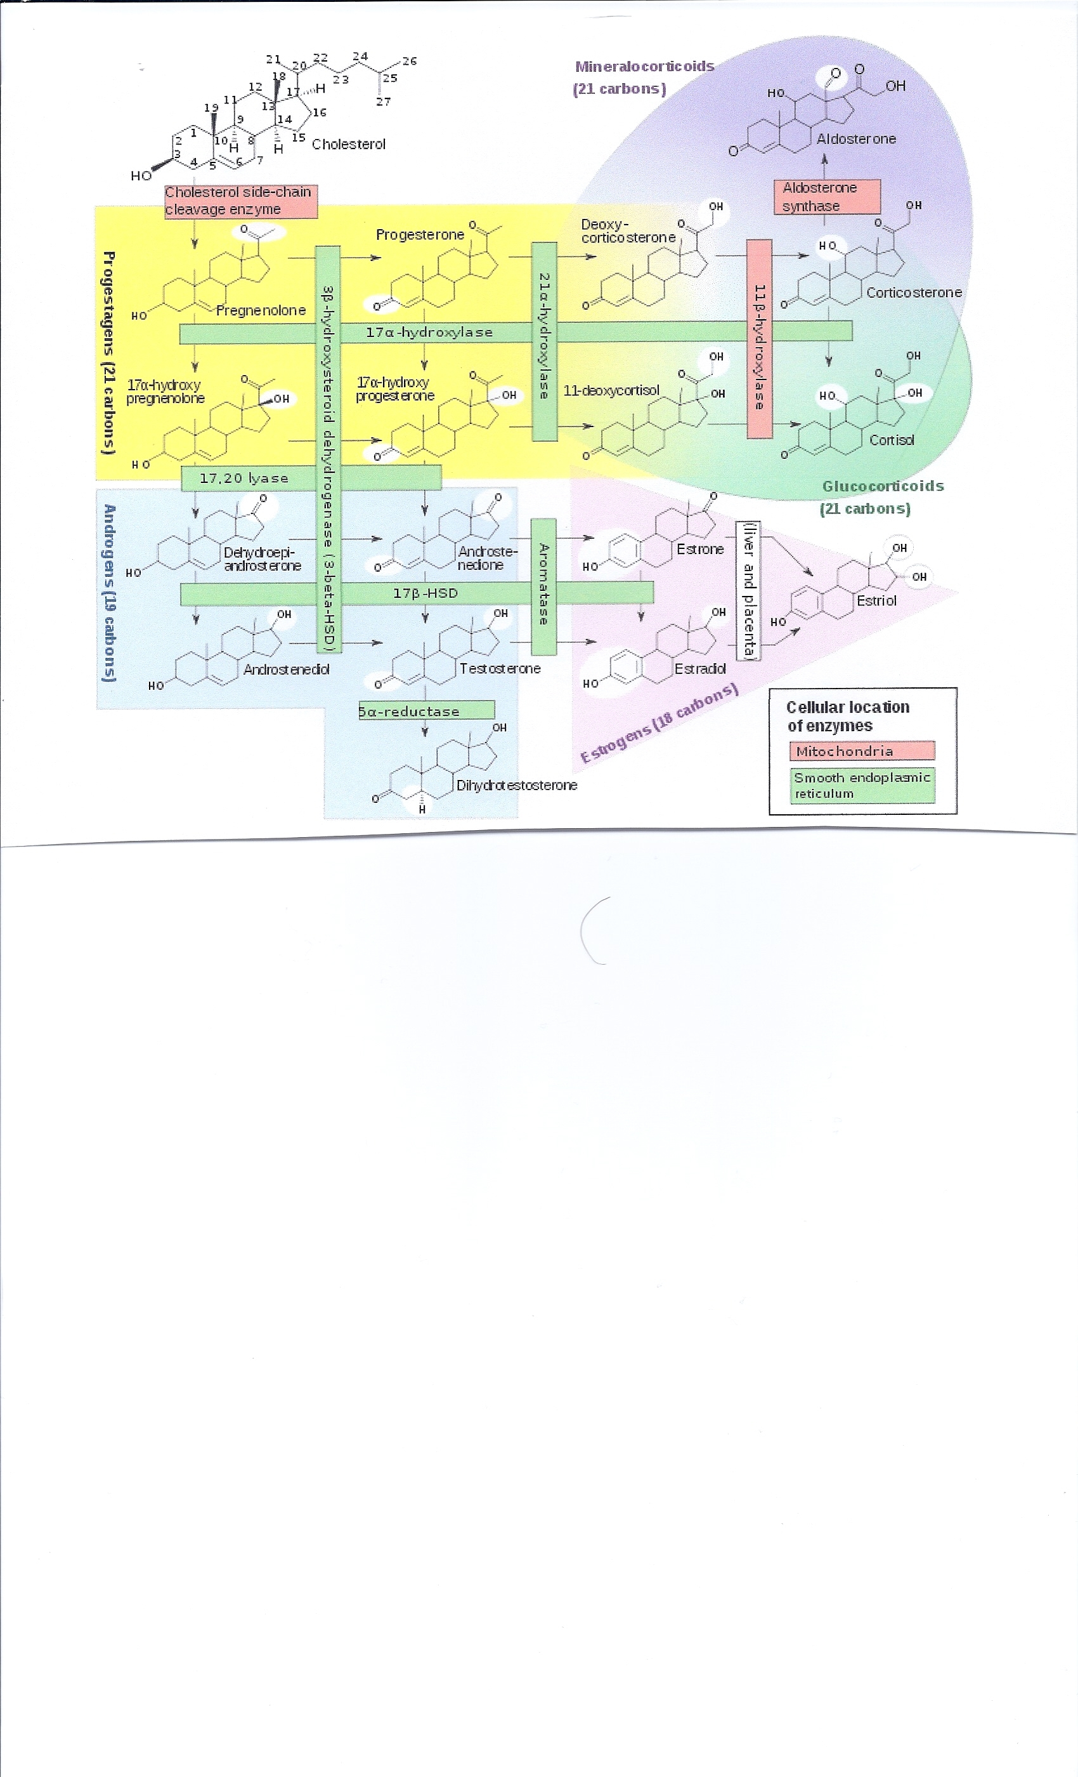
Aromatase

Slide 66
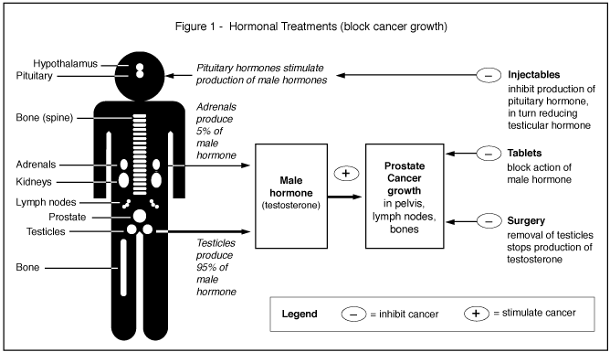
Hormone Treatment in Prostate Cancer

Slide 67
Immunotherapy for Cancer
Cancer immunotherapy is the use of the immune system to reject cancer. The main premise is stimulating the patient's immune system to attack the malignant tumor cells that are responsible for the disease. This can be either through immunization of the patient, in which case the patient's own immune system is trained to recognize tumor cells as targets to be destroyed, or through the administration of therapeutic antibodies as drugs, in which case the patient's immune system is recruited to destroy tumor cells by the therapeutic antibodies.

Slide 68
Bone Marrow Transplant in Cancer Treatment
Bone marrow transplants have been used to treat patients with certain forms of cancer, such as leukemia, lymphoma, and breast cancer. The goal of such a transplant in women with breast cancer was to allow them to undergo high-dose chemotherapy -- which aggressively attacks the cancer cells, but also damages normal blood cells. Bone marrow transplant then replaces the damaged cells with healthy ones.
Where Does the Transplanted Bone Marrow Come From? Bone marrow given during a transplant either comes from you or from a donor whose bone marrow "matches" yours.

Slide 69
Hyperthermia in Cancer Treatment
Hyperthermia (also called thermal therapy or thermotherapy) is a type of cancer treatment in which body tissue is exposed to high temperatures (up to 113°F). Research has shown that high temperatures can damage and kill cancer cells, usually with minimal injury to normal tissues (1). By killing cancer cells and damaging proteins and structures within cells (2), hyperthermia may shrink tumors.
How is hyperthermia used to treat cancer? Hyperthermia is almost always used with other forms of cancer therapy, such as radiation therapy and chemotherapy. Hyperthermia may make some cancer cells more sensitive to radiation or harm other cancer cells that radiation cannot damage. When hyperthermia and radiation therapy are combined, they are often given within an hour of each other. Hyperthermia can also enhance the effects of certain anticancer drugs.

Slide 70
Pembrolizumab (Keytruda)
It blocks a protective mechanism on cancer cells, and allows the immune system to destroy those cancer cells. It targets the programmed cell death 1 (PD-1) receptor.

Slide 71
PD- 1
PD-1 and CD279 279, is a cell surface receptor that plays an important role in down-regulating the immune system and promoting self tolerance by suppressing T cell inflammatory activity. PD-1 is an immune checkpoint and guards against autoimmunity through a dual mechanism of promoting apoptosis (programmed cell death) in antigen specific T-cells in lymph nodes while simultaneously reducing apoptosis in regulatory T cells (anti-inflammatory, suppressive T cells

Slide 72
Gene Therapy in Cancer Treatment
Advances in understanding and manipulating genes have set the stage for scientists to alter a person's genetic material to fight or prevent disease. Gene therapy is an experimental treatment that involves introducing genetic material (DNA or RNA) into a person's cells to fight disease. Gene therapy is being studied in clinical trials (research studies with people) for many different types of cancer and for other diseases. It is not currently available outside a clinical trial.

Slide 73
How is gene therapy being studied in the treatment of cancer? Researchers are studying several ways to treat cancer using gene therapy. Some approaches target healthy cells to enhance their ability to fight cancer. Other approaches target cancer cells, to destroy them or prevent their growth. Some gene therapy techniques under study are described below.
  In one approach, researchers replace missing or altered genes with healthy genes. Because some missing or altered genes (e.g., p53) may cause cancer, substituting “working” copies of these genes may be used to treat cancer.
  Researchers are also studying ways to improve a patient's immune response to cancer.
  Scientists are investigating the insertion of genes into cancer cells to make them more sensitive to chemotherapy, radiation therapy, or other treatments. In other studies, researchers remove healthy blood-forming stem cells from the body, insert a gene that makes these cells more resistant to the side effects of high doses of anticancer drugs, and then inject the cells back into the patient.

Slide 74
Pain Management
Palliative Treatments
Alternative Treatments
Hospice

Slide 75
Other Treatments
Pain Management – simply relieve pain
Palliative Treatments – do what it takes to decrease symptoms
Alternate Treatments – nutraceuticals and experimental natural treatments
Hospice – long term care

Slide 76
How is the Treatment Regimen Determined
Physical and medical Condition of Patient
Cultural Factors
Cell Type
Grade of Tumor
Stage

Slide 77
Survival of Neoplastic Disease
The curability of the various types of cancer can be assessed in terms of five-year survival rates
Survival rates vary from 4% to more than 95%
Cancer is second only to heart disease as a cause of death in the US
One in every 4 people will eventually develop cancer
Lung cancer is the most common cancer affecting males
Breast cancer is the most common cancer affecting women

Slide 78
Survival of Neoplastic Disease
Early diagnosis and treatment may enhance survival
The chances for survival are significantly reduced if the tumor has metastasized to the regional lymph nodes or to distant sites
Five-year survival does not necessarily mean that the patient is cured
Some types of malignant tumors may recur and may prove fatal many years after initial treatment, such as breast carcinoma and malignant melanomas

