Slide 1
7
The Skeleton: Part C

Slide 2
Appendicular Skeleton
Bones of the limbs and their girdles
  Pectoral girdle attaches the upper limbs to the body trunk
  Pelvic girdle secures the lower limbs

Slide 3
Pectoral Girdle (Shoulder Girdle)
Clavicles and the scapulae
  Attach the upper limbs to the axial skeleton
  Provide attachment sites for muscles that move the upper limbs
PLAY
A&P Flix™: Bones of the pectoral girdle

Slide 4
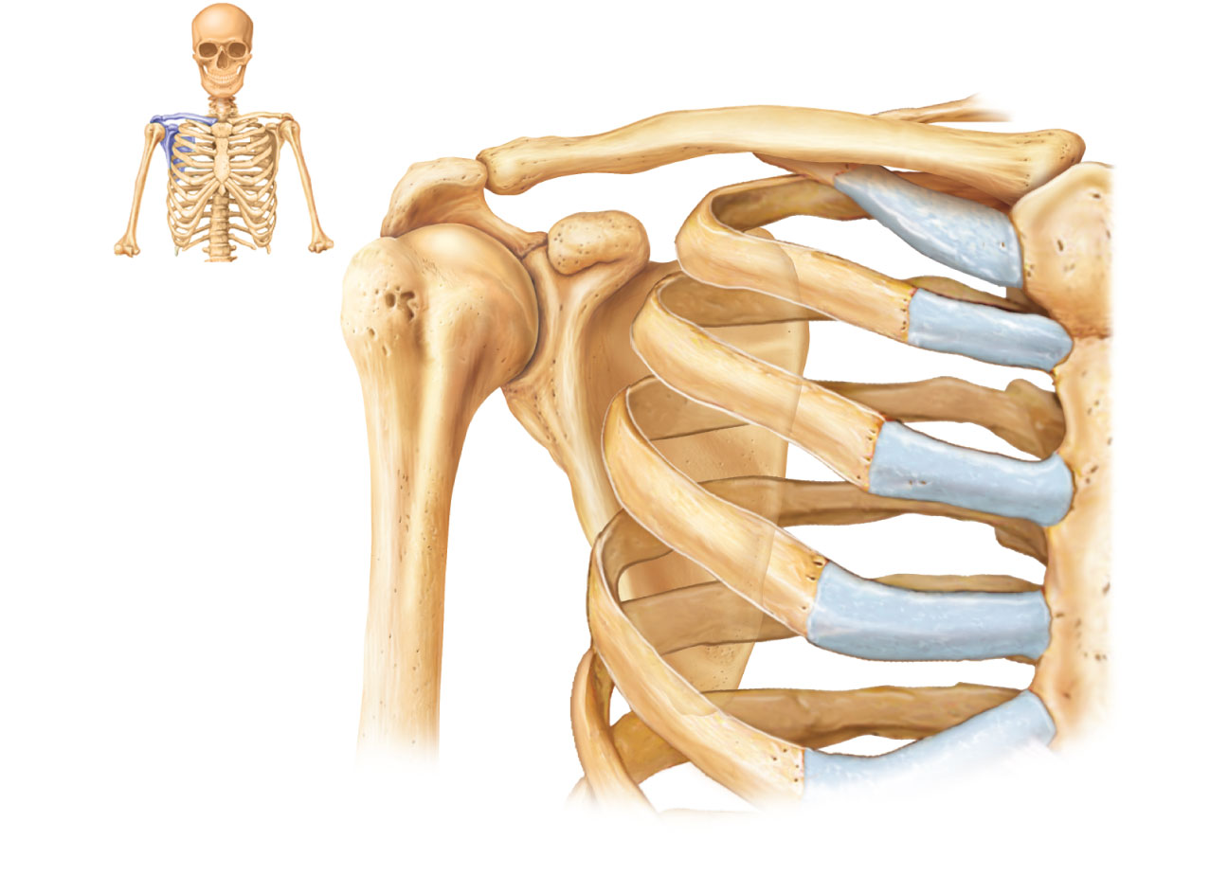
Acromio-
clavicular
joint
Clavicle
Scapula
(a)
Articulated pectoral girdle
Figure 7.24a

Slide 5
Clavicles (Collarbones)
Flattened acromial (lateral) end articulates with the scapula
Cone-shaped sternal (medial) end articulates with the sternum
Act as braces to hold the scapulae and arms out laterally

Slide 6
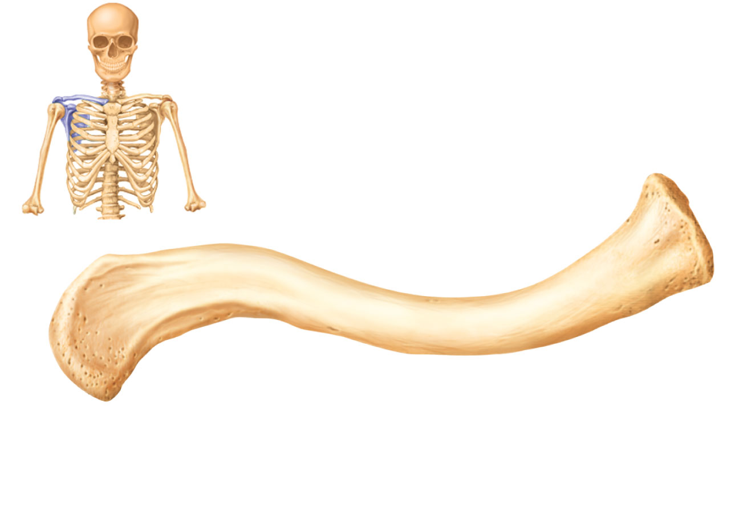
Sternal (medial)
end
Posterior
Anterior
Acromial (lateral)
end
(b)
Right clavicle, superior view
Figure 7.24b

Slide 7
Scapulae (Shoulder Blades)
Situated on the dorsal surface of rib cage, between ribs 2 and 7
Flat and triangular, with three borders and three angles
Seven large fossae, named according to location

Slide 8
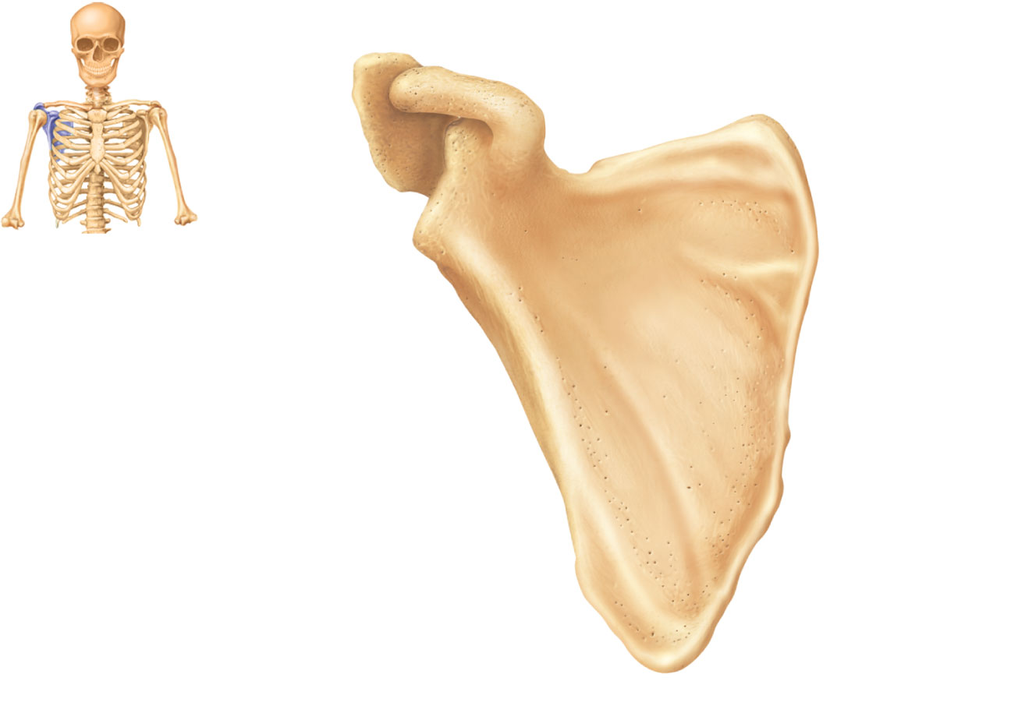
Acromion
Suprascapular notch
Superior border
Coracoid
process
Superior
angle
Glenoid
cavity
Subscapular
fossa
Lateral border
Medial border
Inferior angle
(a) Right scapula, anterior aspect
Figure 7.25a

Slide 9
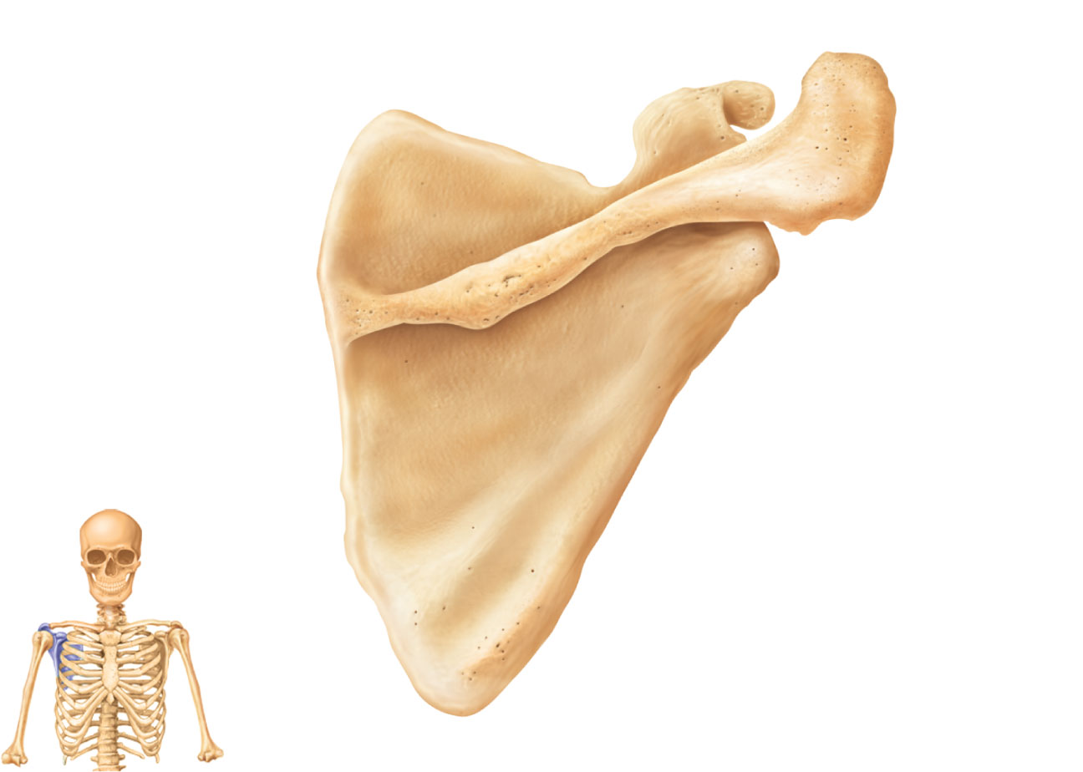
Suprascapular notch
Coracoid process
Superior
angle
Acromion
Supraspinous
fossa
Glenoid
cavity
at lateral
angle
Spine
Infraspinous
fossa
Medial border
Lateral border
(b) Right scapula, posterior aspect
Figure 7.25b

Slide 10
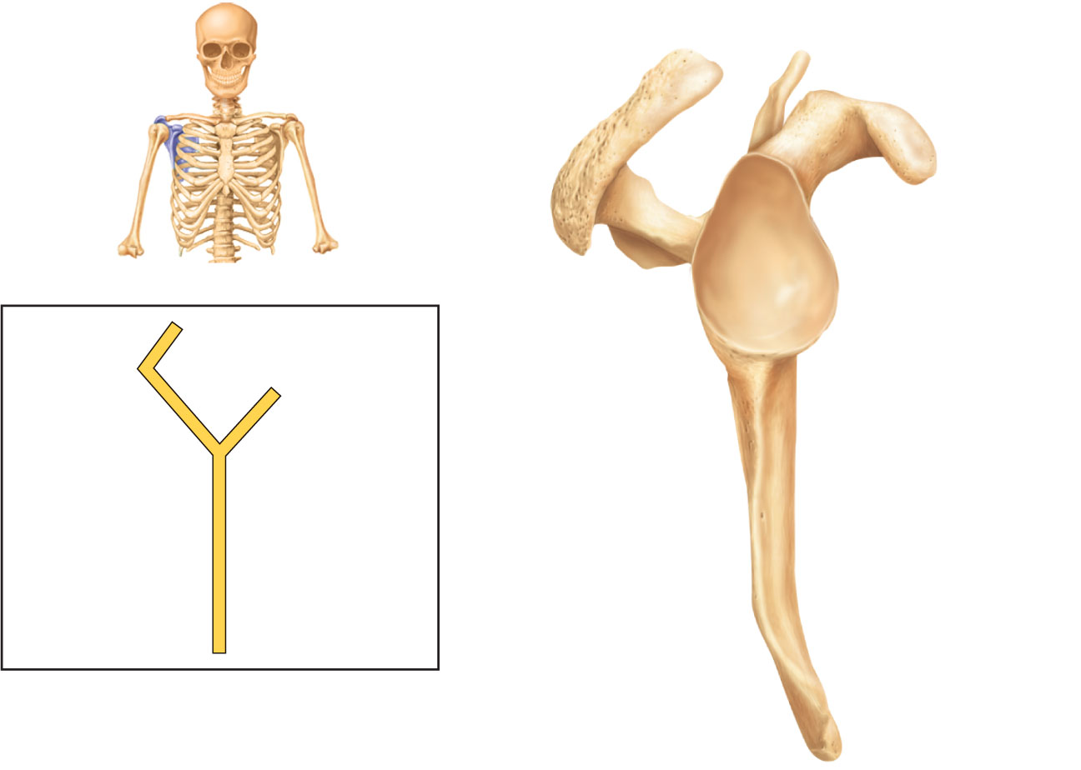
Supraspinous fossa
Acromion
Supraglenoid
tubercle
Coracoid
process
Spine
Glenoid
cavity
Supraspinous
fossa
Infraspinous
fossa
Infraglenoid
tubercle
Infraspinous
fossa
Subscapular
fossa
Subscapular
fossa
Posterior
Anterior
(c) Right scapula, lateral aspect
Inferior angle
Figure 7.25c

Slide 11
The Upper Limb
30 bones form the skeletal framework of each upper limb
  Arm
    Humerus
  Forearm
    Radius and ulna
  Hand
    8 carpal bones in the wrist
    5 metacarpal bones in the palm
    14 phalanges in the fingers

Slide 12
Humerus
Largest, longest bone of upper limb
Articulates superiorly with glenoid cavity of scapula
Articulates inferiorly with radius and ulna

Slide 13
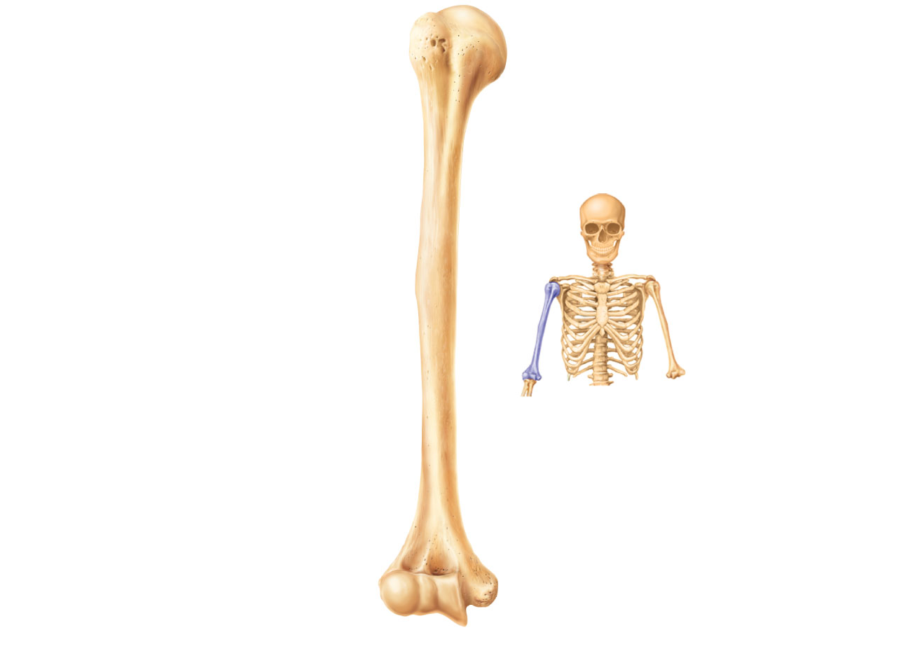
Greater
tubercle
Head of
humerus
Lesser
tubercle
Anatomical
neck
Inter-
tubercular
sulcus
Deltoid
tuberosity
Lateral
supracondylar
ridge
Coronoid
fossa
Radial
fossa
Medial
epicondyle
Capitulum
Trochlea
(a) Anterior view
Figure 7.26a

Slide 14
Bones of the Forearm
Ulna
  Medial bone in forearm
  Forms the major portion of the elbow joint with the humerus
Radius
  Lateral bone in forearm
  Head articulates with capitulum of humerus and with radial notch of ulna
  Interosseous membrane connects the radius and ulna along their entire length

Slide 15
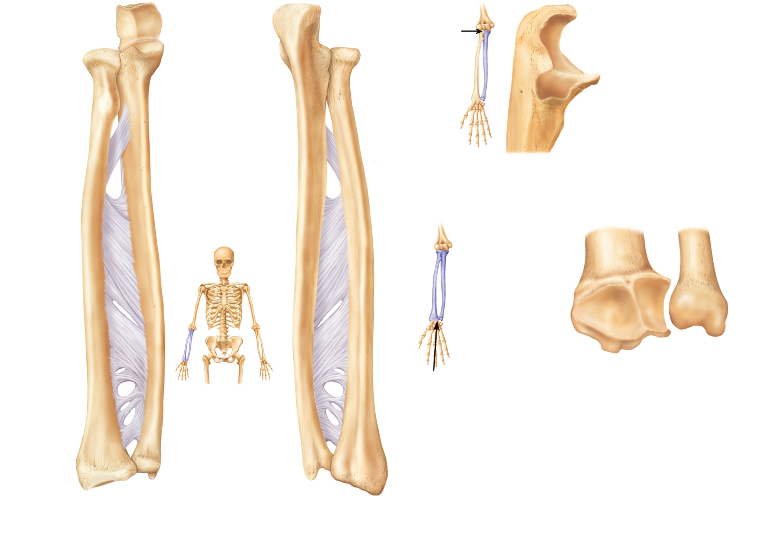
Radial
notch of
the ulna
Olecranon
process
Trochlear
notch
Head
Neck
Coronoid
process
Head of
radius
Radial
tuberosity
Proximal
radioulnar
joint
Neck of
radius
Interosseous
membrane
Ulna
Radius
Ulnar notch
of the radius
Radius
Head of ulna
Styloid
process
of radius
Styloid
process of ulna
Distal radioulnar
joint
Styloid process
of radius
(a) Anterior view
(b) Posterior view
Figure 7.27a-b

Slide 16
Olecranon process
View
Trochlear notch
Coronoid process
Radial notch
(c) Proximal portion of ulna,
lateral view
Ulnar notch of radius
Articulation
for lunate
Articulation
for scaphoid
Styloid
process
View
Head
of ulna
Styloid
process
(d) Distal ends of the radius and
ulna at the wrist
Figure 7.27c-d

Slide 17
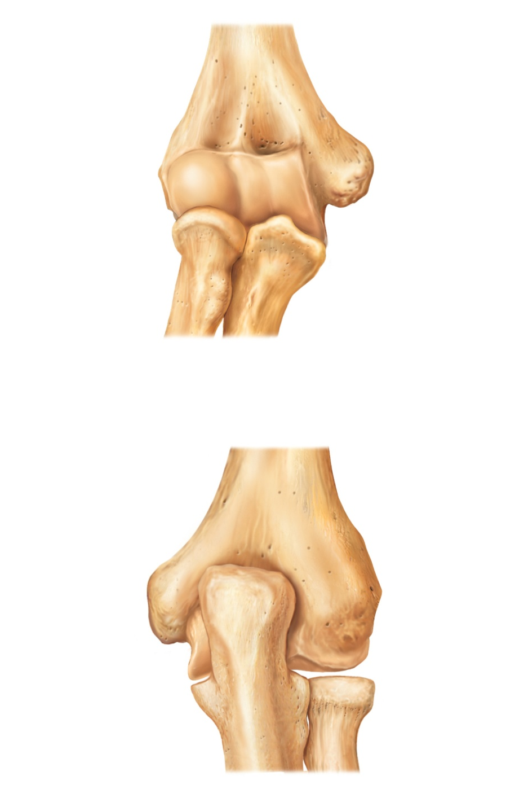
Humerus
Coronoid
fossa
Capitulum
Medial
epicondyle
Head of
radius
Trochlea
Coronoid
process of
ulna
Radial
tuberosity
Radius
Radial notch
Ulna
(c) Anterior view at the elbow region
Humerus
Olecranon
fossa
Olecranon
process
Lateral
epicondyle
Medial
epicondyle
Head
Ulna
Neck
Radius
(d) Posterior view of extended elbow
Figure 7.26c-d

Slide 18
Hand: Carpus
Eight bones in two rows
  Proximal row
    Scaphoid, lunate, triquetrum, and pisiform proximally
  Distal row
    Trapezium, trapezoid, capitate, and hamate distally
Only scaphoid and lunate articulate with radius to form wrist joint

Slide 19
Hand: Metacarpus and Phalanges
Metacarpus
  Five metacarpal bones (#1 to #5) form the palm
Phalanges
  Each finger (digit), except the thumb, has three phalanges—distal, middle, and proximal
  Fingers are numbered 1–5, beginning with the thumb (pollex)
  Thumb has no middle phalanx

Slide 20
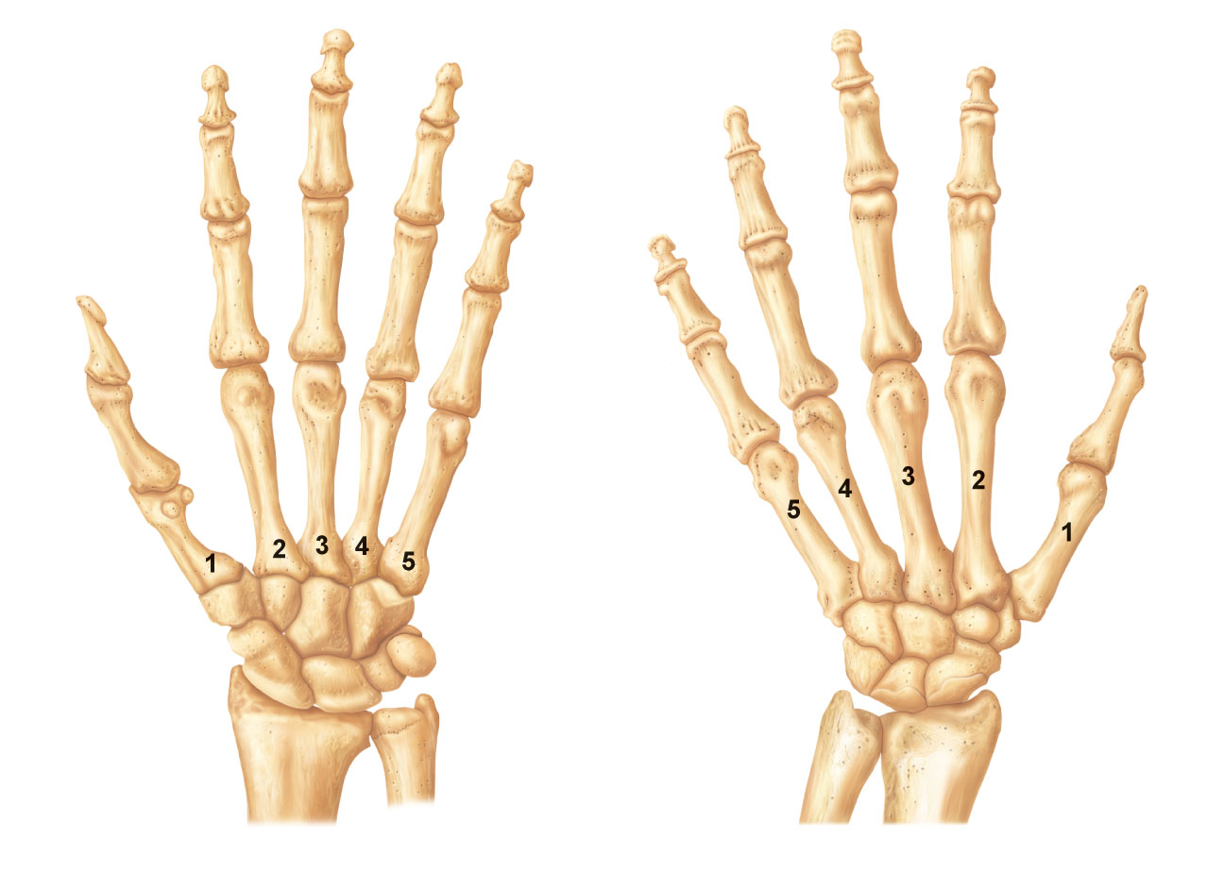
Phalanges
• Distal
• Middle
• Proximal
Metacarpals
• Head
• Shaft
Sesamoid
bones
• Base
Carpals
Carpals
Carpals
• Trapezium
• Trapezium
• Hamate
• Capitate
• Trapezoid
• Trapezoid
• Scaphoid
• Scaphoid
• Pisiform
• Triquetrum
Radius
• Lunate
Ulna
Radius
(a) Anterior view of left hand
(b) Posterior view of left hand
Figure 7.28a-b

Slide 21
Pelvic (Hip) Girdle
Two hip bones (each also called coxal bone or os coxae)
  Attach the lower limbs to the axial skeleton with strong ligaments
  Transmit weight of upper body to lower limbs
  Support pelvic organs
Each hip bone consists of three fused bones: ilium, ischium, and pubis
Together with the sacrum and the coccyx, these bones form the bony pelvis

Slide 22
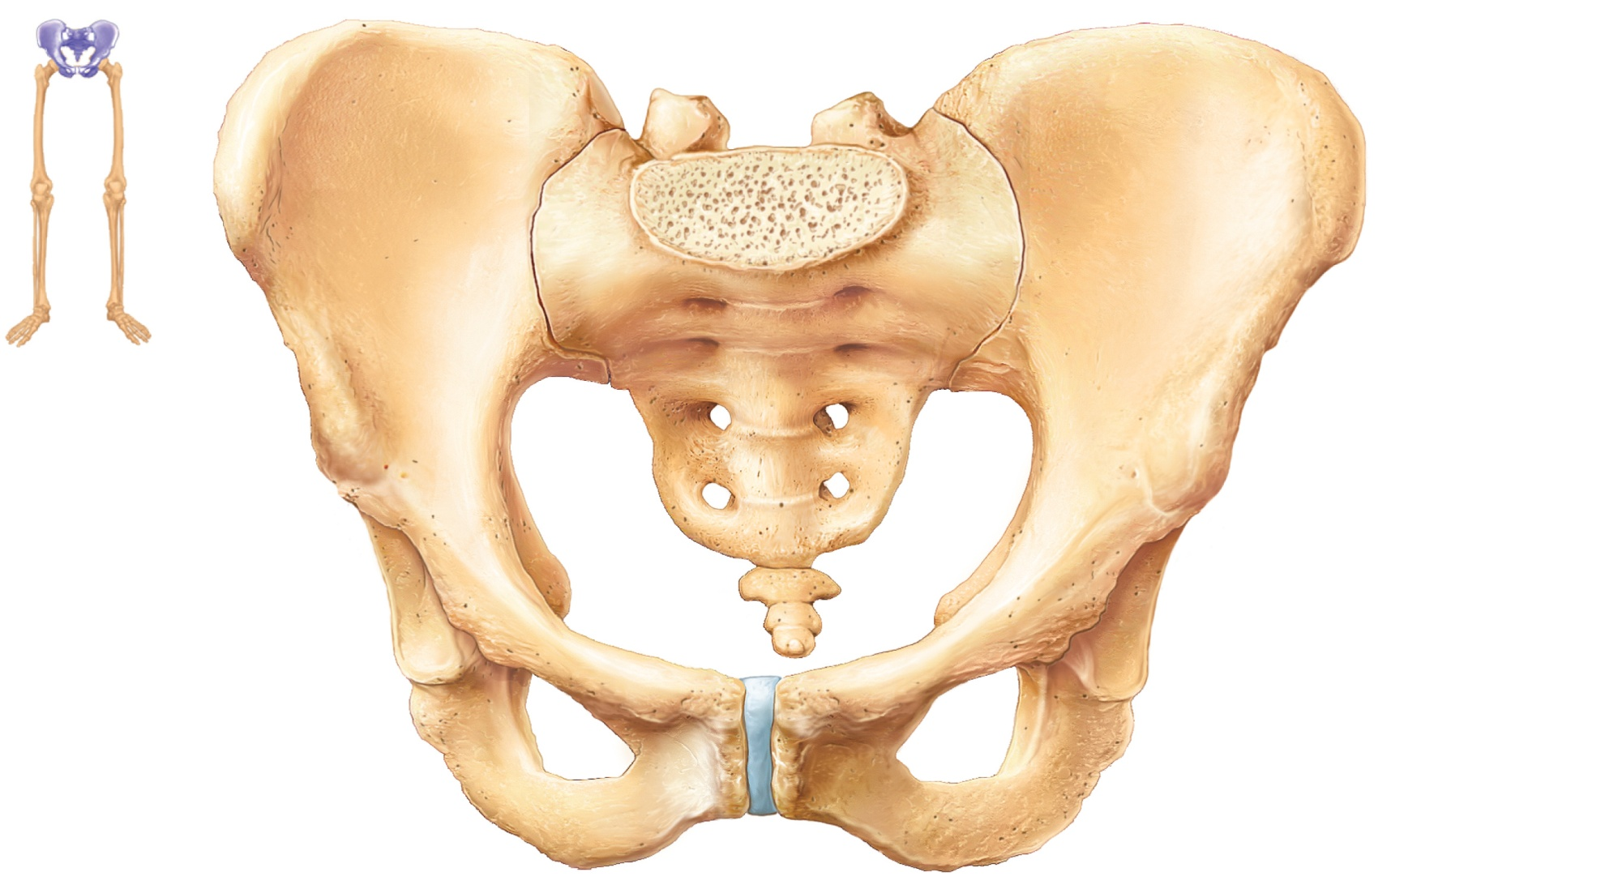
Base of sacrum
Iliac crest
Sacroiliac
joint
Iliac fossa
Anterior
superior
iliac spine
Sacral
promontory
Coxal
bone
(os coxae
or hip
bone)
llium
Anterior inferior
iliac spine
Pubic
bone
Sacrum
Pelvic brim
Coccyx
Acetabulum
Ischium
Pubic tubercle
Pubic crest
Pubic symphysis
Pubic arch
PLAY
Animation: Rotatable pelvis
Figure 7.29

Slide 23
Hip Bone
Three regions
  Ilium
    Superior region of the coxal bone
    Auricular surface articulates with the sacrum (sacroiliac joint)
  Ischium
    Posteroinferior part of hip bone
  Pubis
    Anterior portion of hip bone
    Midline pubic symphysis joint

Slide 24
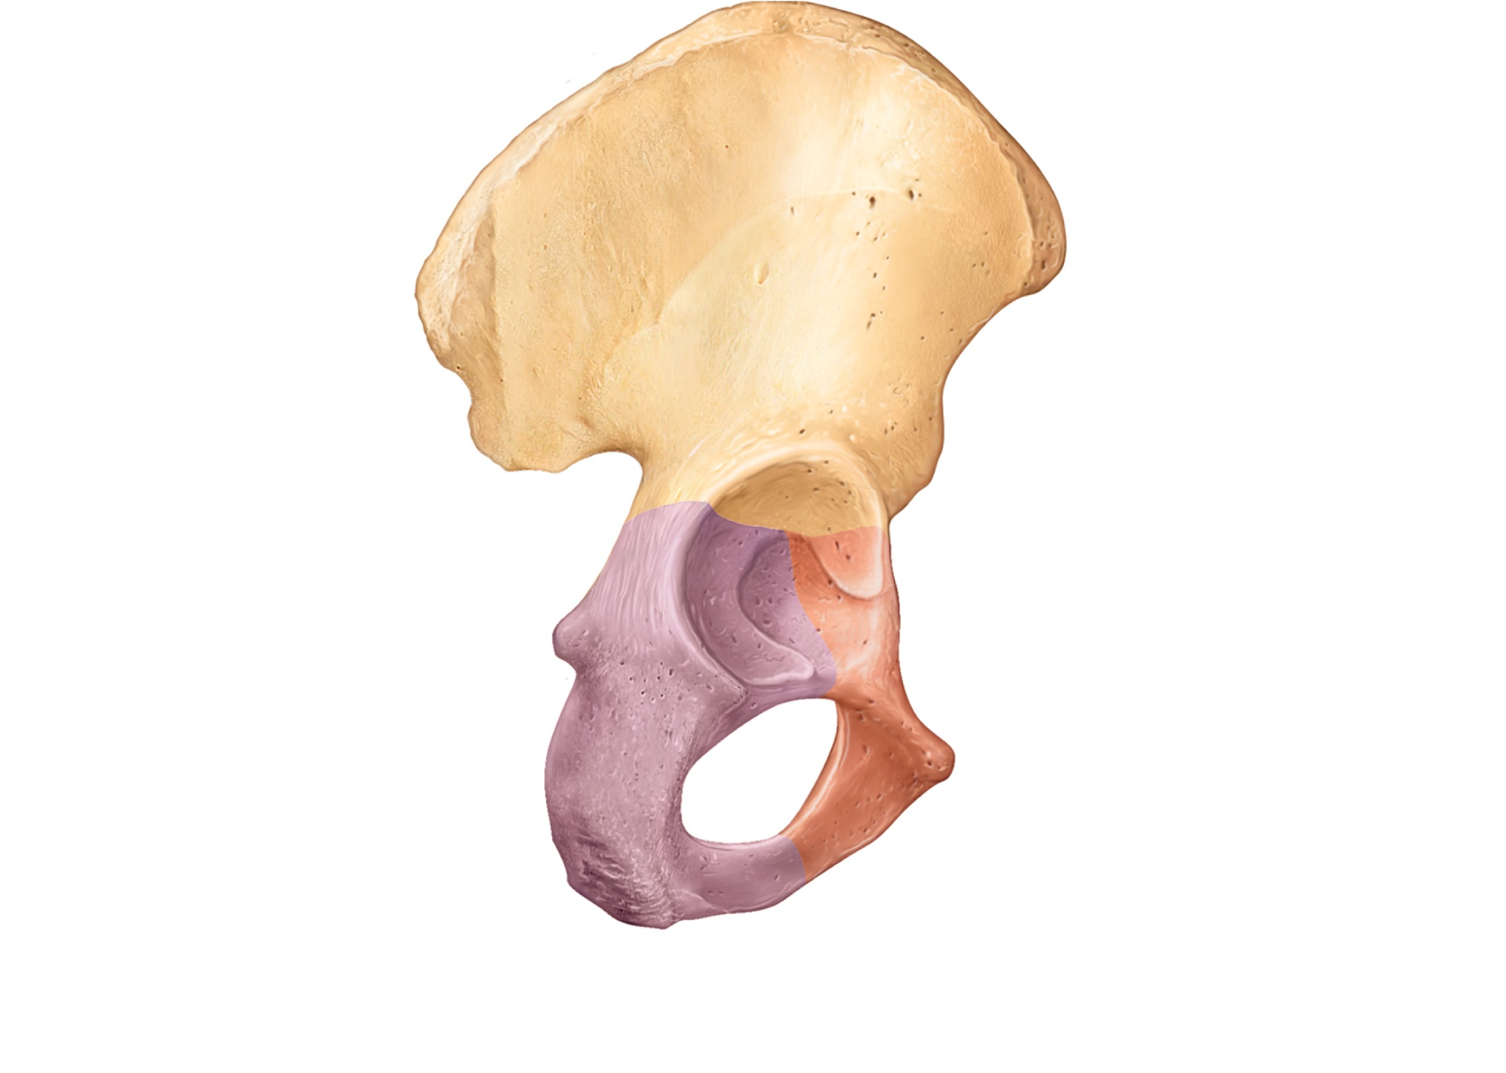
Anterior gluteal
line
Ilium
Ala
Posterior
gluteal line
Iliac crest
Posterior
superior
iIiac spine
Anterior
superior
iliac spine
Posterior inferior
iliac spine
Inferior
gluteal line
Greater sciatic
notch
Anterior inferior
iliac spine
Ischial body
Ischial spine
Acetabulum
Lesser sciatic
notch
Pubic body
Pubis
Ischium
Ischial
tuberosity
Inferior ramus
of pubis
Ischial ramus
Obturator foramen
(a) Lateral view, right hip bone
Figure 7.30a

Slide 25
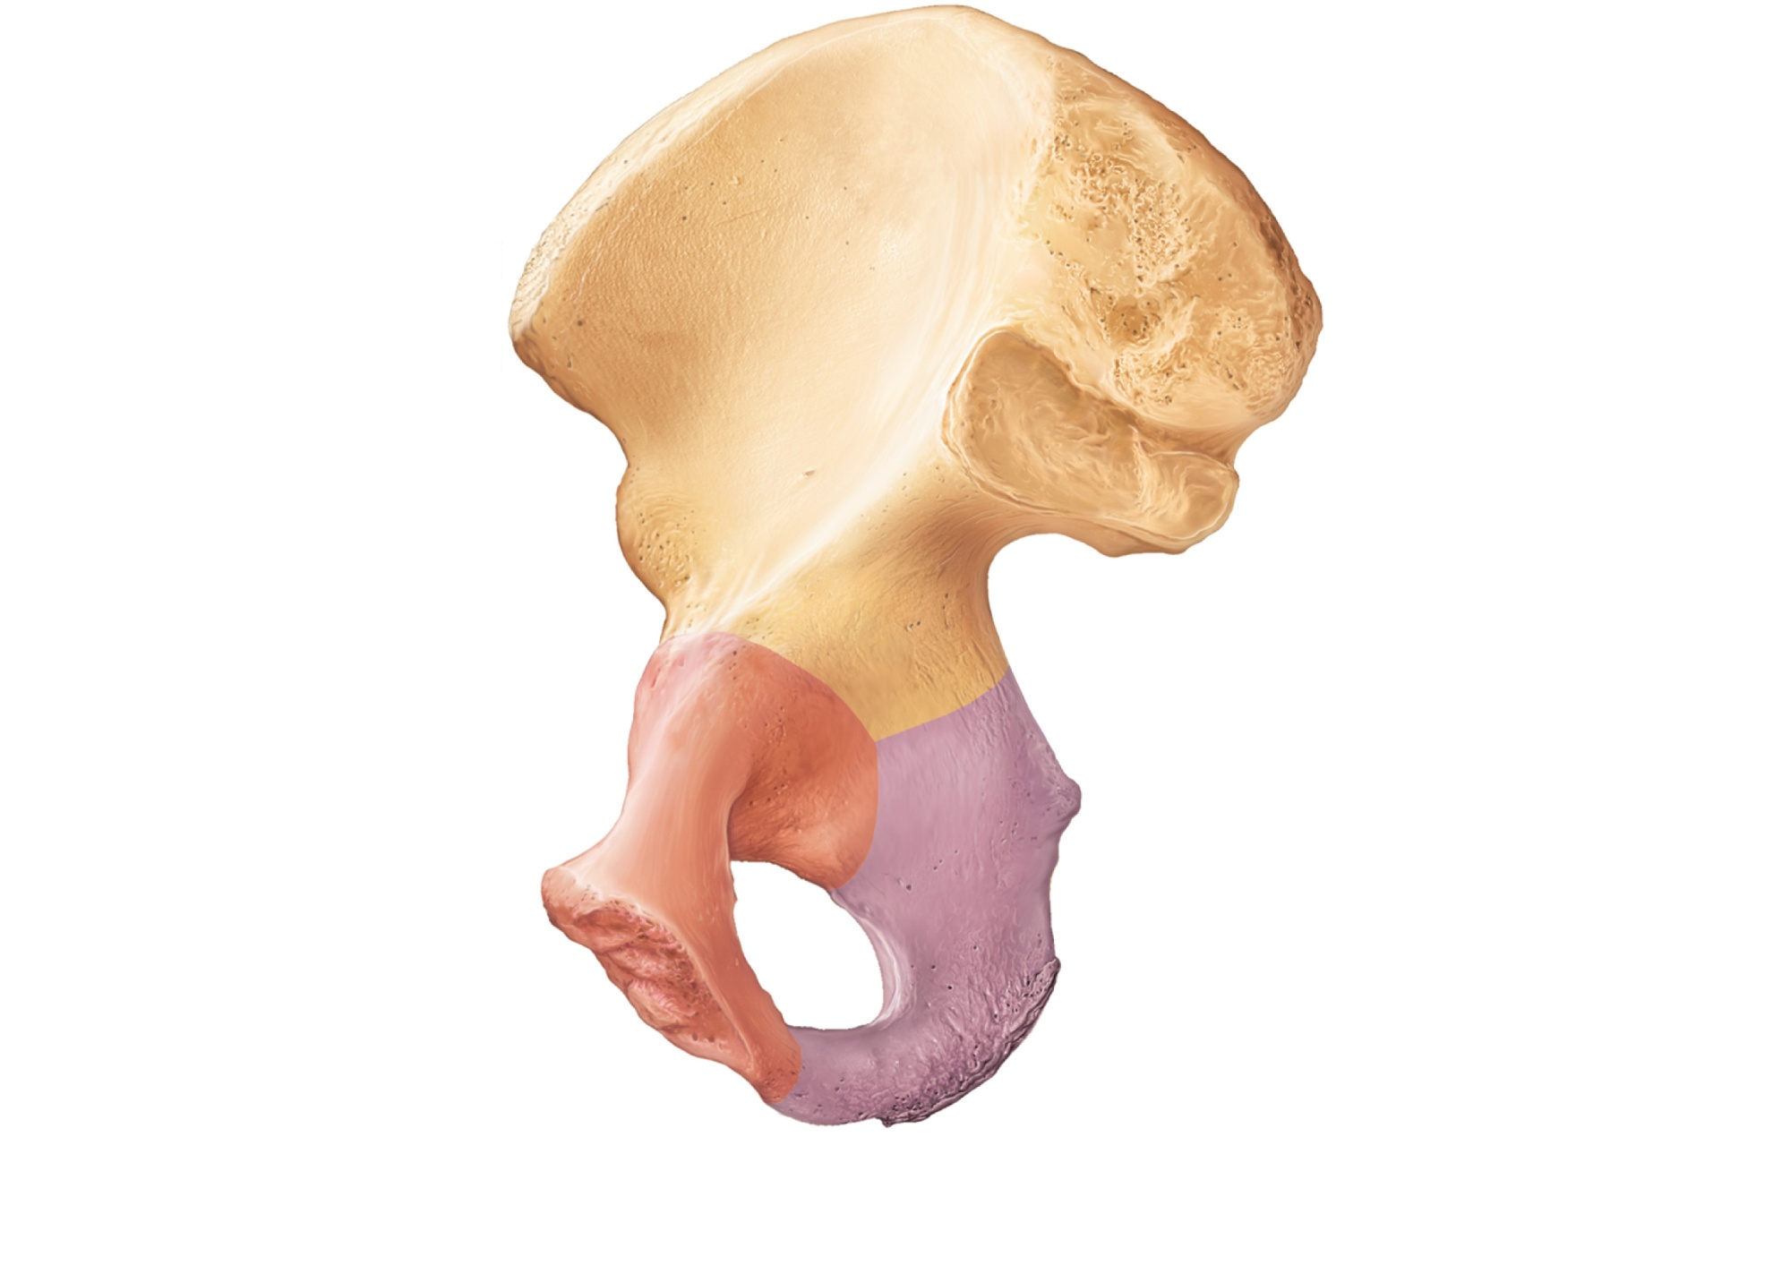
Ilium
Iliac fossa
Iliac crest
Posterior
superior
iliac spine
Anterior
superior
iliac spine
Posterior
inferior
iliac spine
Anterior inferior
iliac spine
Body of
the ilium
Auricular
surface
Arcuate line
Greater sciatic notch
Superior ramus
of pubis
Ischial spine
Pubic tubercle
Lesser sciatic notch
Articular surface
of pubis (at pubic
symphysis)
Obturator
foramen
Ischium
Inferior ramus
of pubis
Ischial ramus
(b) Medial view, right hip bone
Figure 7.30b

Slide 26
Comparison of Male and Female Pelves
Female pelvis
  Adapted for childbearing
  True pelvis (inferior to pelvic brim) defines birth canal
  Cavity of the true pelvis is broad, shallow, and has greater capacity

Slide 27
Comparison of Male and Female Pelves
Male pelvis
  Tilted less forward
  Adapted for support of male’s heavier build and stronger muscles
  Cavity of true pelvis is narrow and deep

Slide 28
Comparison of Male and Female Pelves
Characteristic | Female | Male
Bone thickness | Lighter, thinner, and smoother | Heavier, thicker, and more prominent markings
Pubic arch/angle | 80˚– 90˚ | 50˚– 60˚
Acetabula | Small; farther apart | Large; closer together
Sacrum | Wider, shorter; sacral curvature is accentuated | Narrow, longer; sacral promontory more ventral
Coccyx | More movable; straighter | Less movable; curves ventrally

Slide 29
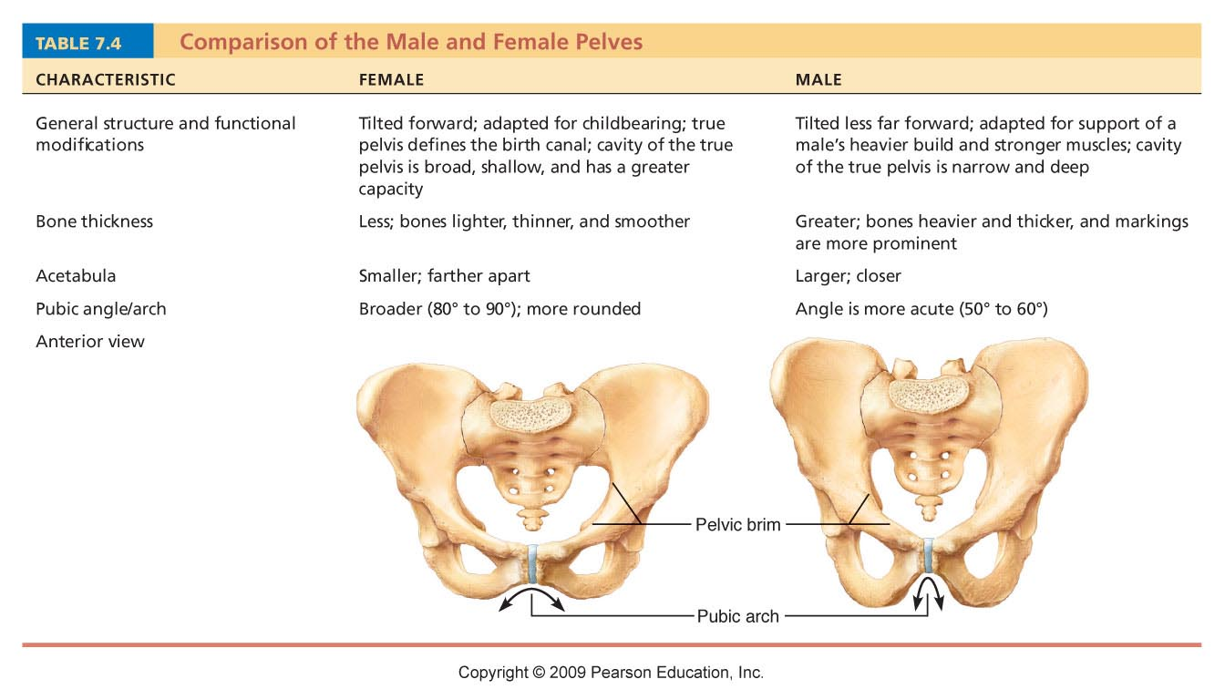
Table 7.4

Slide 30
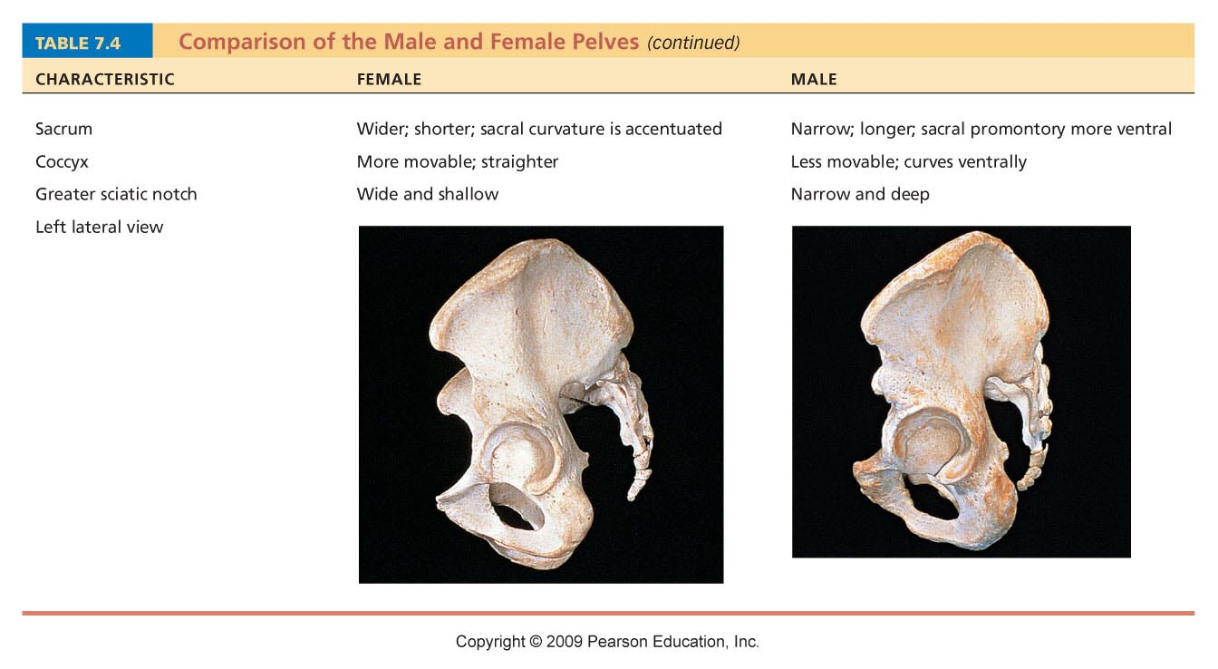
Table 7.4

Slide 31
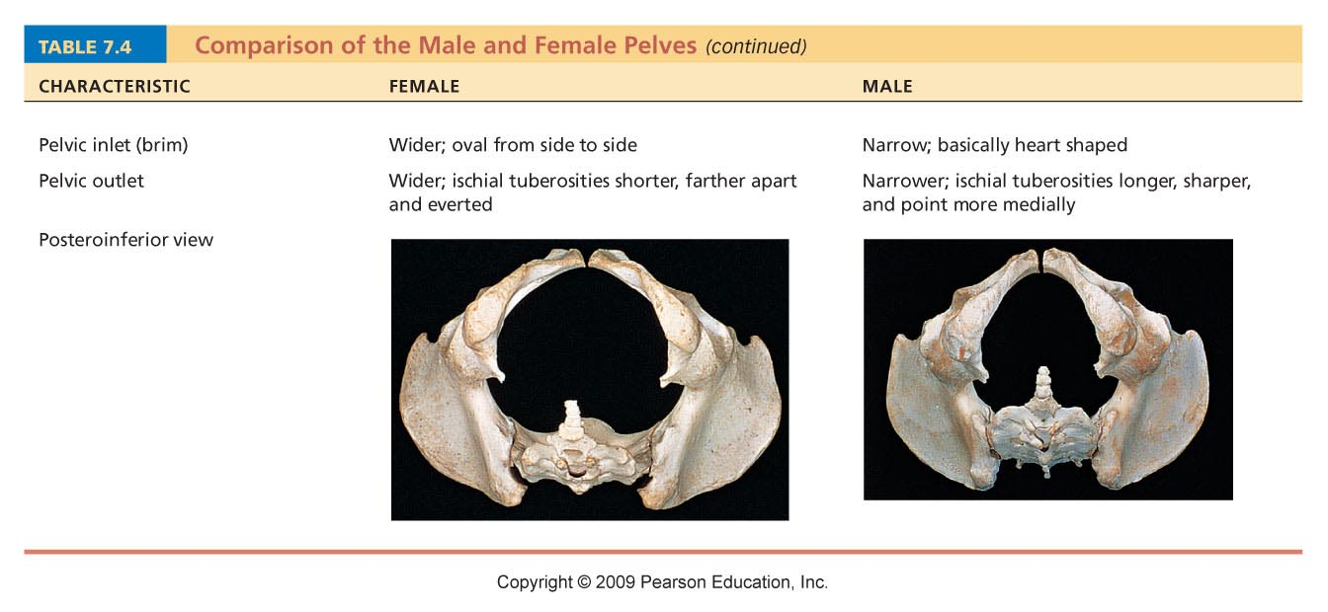
Table 7.4

Slide 32
The Lower Limb
Carries the weight of the body
Subjected to exceptional forces
Three segments of the lower limb
  Thigh: femur
  Leg: tibia and fibula
  Foot: 7 tarsal bones in the ankle, 5 metatarsal bones in the metatarsus, and 14 phalanges in the toes

Slide 33
Femur
Largest and strongest bone in the body
Articulates proximally with the acetabulum of the hip and distally with the tibia and patella

Slide 34
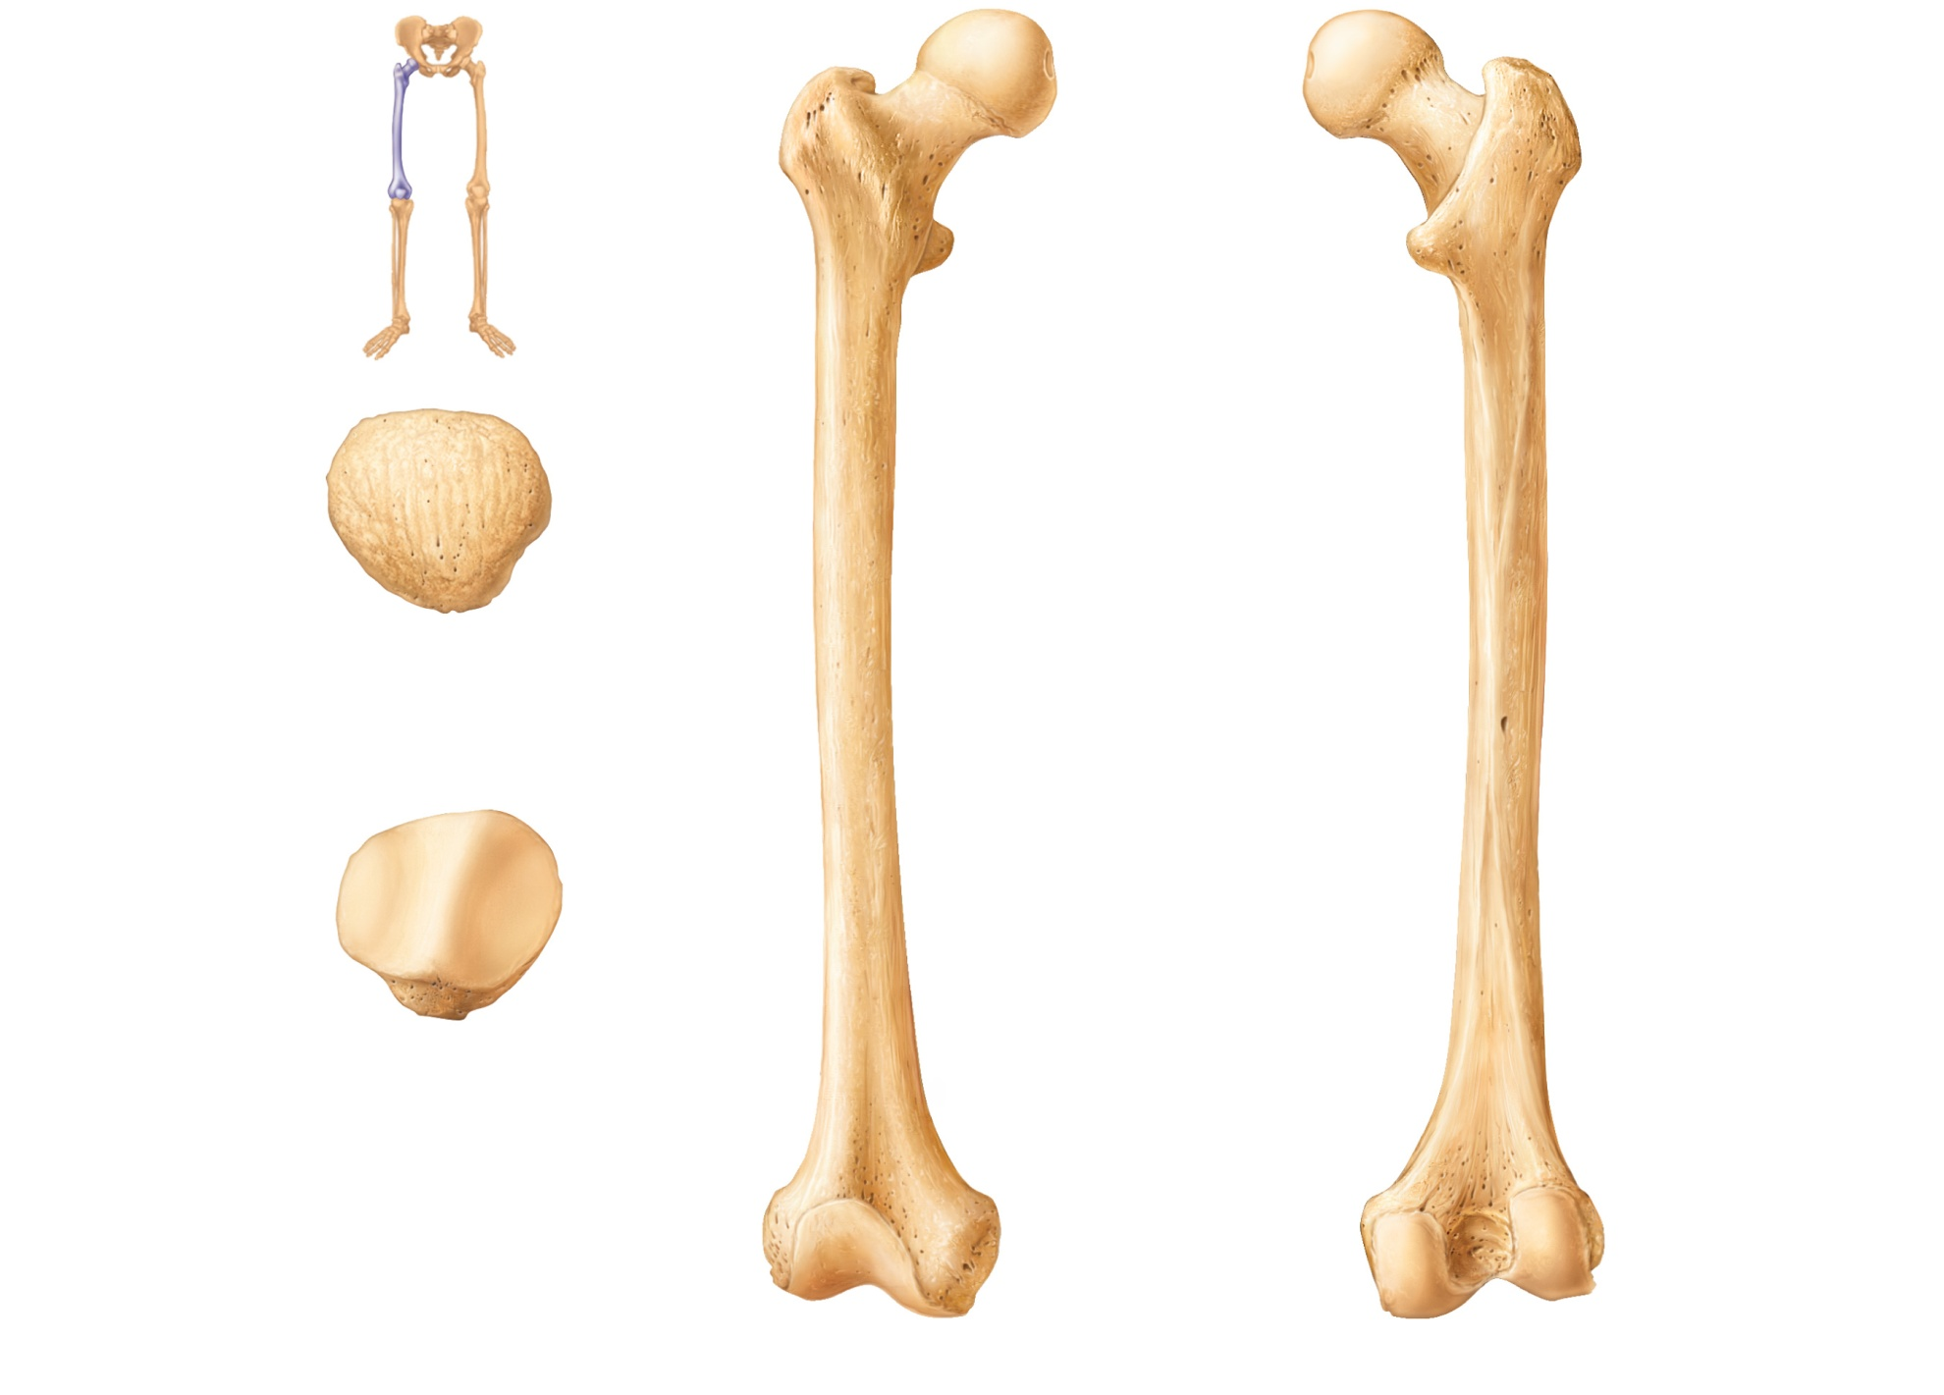
Neck
Fovea
capitis
Greater
trochanter
Head
Lesser trochanter
Inter-
trochanteric
crest
Intertrochanteric
line
Gluteal tuberosity
Apex
Linea aspera
Anterior
Facet for
medial
condyle
of femur
Facet for lateral
condyle of femur
Medial and
lateral supra-
condylar lines
Lateral
condyle
Lateral
epicondyle
Surface for
patellar
ligament
Intercondylar fossa
Posterior
Medial condyle
(a) Patella (kneecap)
Adductor
tubercle
Lateral epicondyle
Medial
epicondyle
Patellar surface
Anterior view
(b) Femur (thigh bone)
Posterior view
Figure 7.31

Slide 35
Bones of the Leg
Tibia
  Medial leg bone
  Receives the weight of the body from the femur and transmits it to the foot
Fibula
  Not weight bearing; no articulation with femur
  Site of muscle attachment
  Connected to tibia by interosseous membrane
  Articulates with tibia via proximal and distal tibiofibular joints

Slide 36
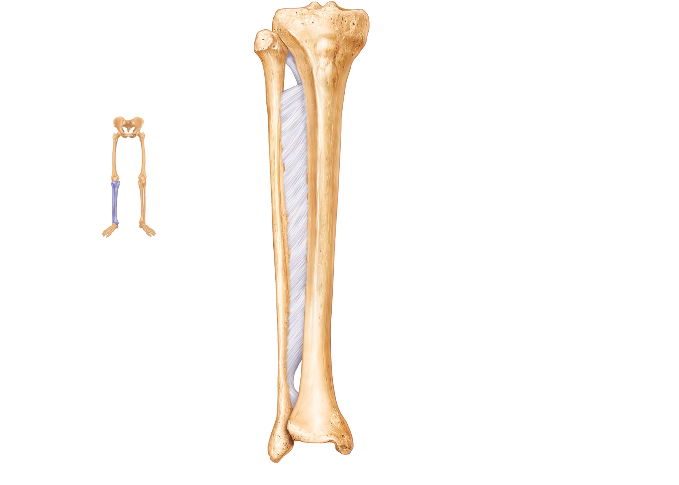
Lateral condyle
Intercondylar eminence
Head
Medial condyle
Proximal tibiofibular
joint
Tibial tuberosity
Interosseous membrane
Anterior border
Fibula
Tibia
Distal tibiofibular
joint
Articular surface
Lateral malleolus
Medial malleolus
(a) Anterior view
Figure 7.32a

Slide 37
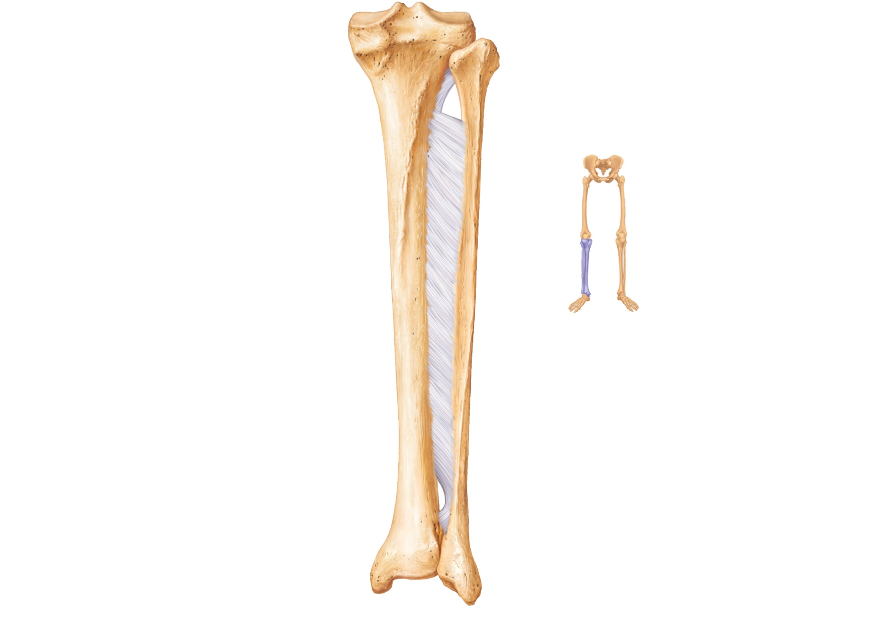
Articular surface
of medial condyle
Articular surface of
lateral condyle
Medial condyle
Head of fibula
Interosseous
membrane
Tibia
Fibula
Articular surface
Medial malleolus
Lateral malleolus
(b) Posterior view
Figure 7.32b

Slide 38
Foot: Tarsals
Seven tarsal bones form the posterior half of the foot
Talus transfers most of the weight from the tibia to the calcaneus
Other tarsal bones: cuboid, navicular, and the medial, intermediate, and lateral cuneiforms

Slide 39
Foot: Metatarsals and Phalanges
Metatarsals:
  Five metatarsal bones (#1 to #5)
  Enlarged head of metatarsal 1 forms the “ball of the foot”
Phalanges
  The 14 bones of the toes
  Each digit (except the hallux) has three phalanges
  Hallux has no middle phalanx

Slide 40
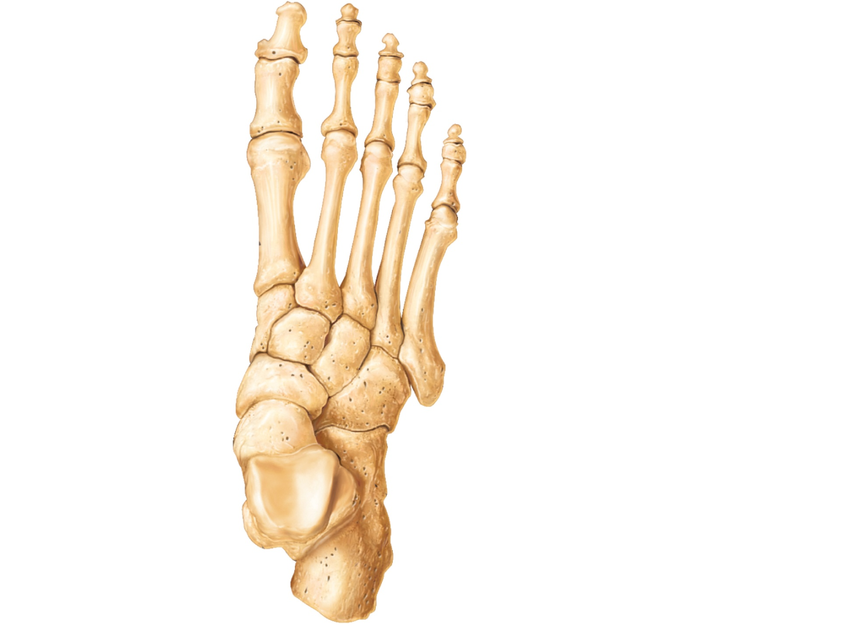
Phalanges
Distal
Middle
Proximal
1
2
3
4
5
Metatarsals
Medial
cuneiform
Intermediate
cuneiform
Lateral
cuneiform
Navicular
Cuboid
Tarsals
Talus
Trochlea
of talus
Calcaneus
(a) Superior view
Figure 7.33a

Slide 41
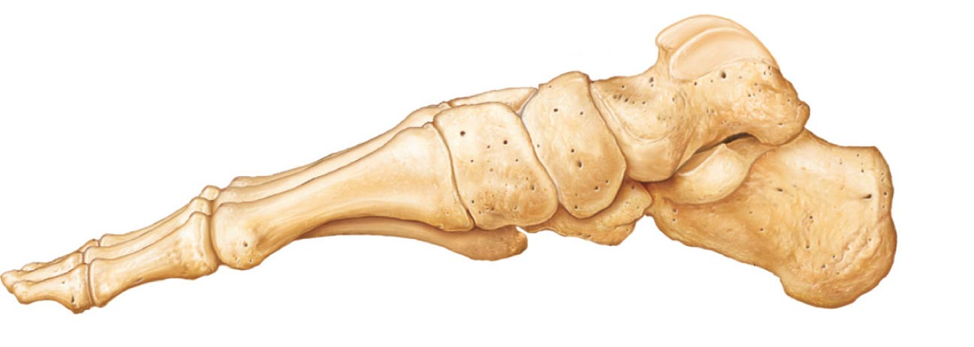
Talus
Facet for
medial
malleolus
Intermediate
cuneiform
Navicular
Sustentac-
ulum tali
(talar shelf)
First metatarsal
Medial
cuneiform
Calcaneus
Calcaneal
tuberosity
(b) Medial view
PLAY
Animation: Rotatable bones of the foot
Figure 7.33b

Slide 42
Arches of the Foot
Arches are maintained by interlocking foot bones, ligaments, and tendons
Arches allow the foot to bear weight
Three arches
  Lateral longitudinal
  Medial longitudinal
  Transverse

Slide 43
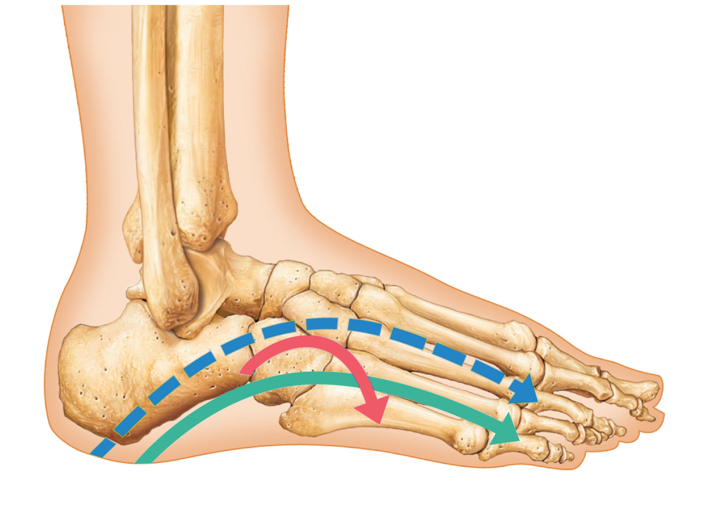
Medial longitudinal
arch
Transverse arch
Lateral
longitudinal arch
(a) Lateral aspect of right foot
Figure 7.34a

Slide 44
Developmental Aspects: Fetal Skull
Infant skull has more bones than the adult skull
Skull bones such as the mandible and frontal bones are unfused
At birth, skull bones are connected by fontanelles
  Fontanelles
    Unossified remnants of fibrous membranes between fetal skull bones
    Four fontanelles
      Anterior, posterior, mastoid, and sphenoid

Slide 45
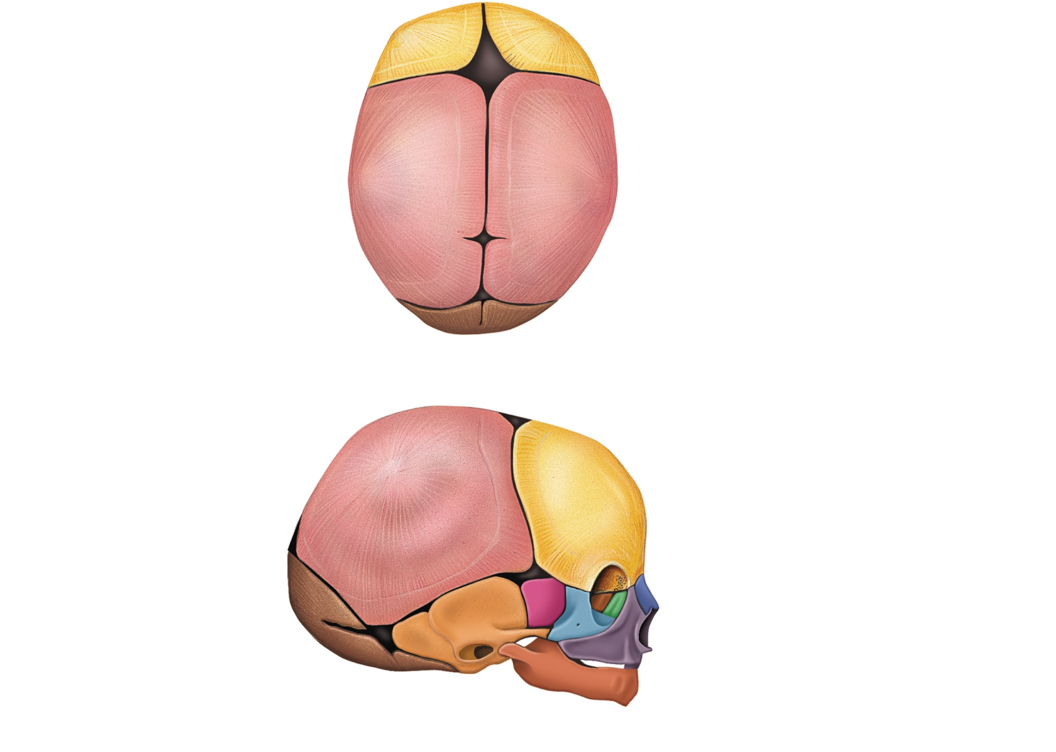
Frontal suture
Frontal bone
Anterior
fontanelle
Ossification
center
Parietal bone
Posterior fontanelle
Occipital bone
(a) Superior view
Parietal bone
Frontal bone
Ossification
center
Sphenoidal
fontanelle
Posterior
fontanelle
Temporal bone
(squamous portion)
Mastoid
fontanelle
Occipital bone
(b) Lateral view
Figure 7.35

Slide 46
Developmental Aspects: Growth Rates
At birth, the cranium is huge relative to the face
At 9 months of age, cranium is ½ adult size
Mandible and maxilla are foreshortened but lengthen with age
The arms and legs grow at a faster rate than the head and trunk, leading to adult proportions

Slide 47
Developmental Aspects: Spinal Curvature
Thoracic and sacral curvatures are obvious at birth
  These primary curvatures give the spine a C shape
  Convex posteriorly

Slide 48
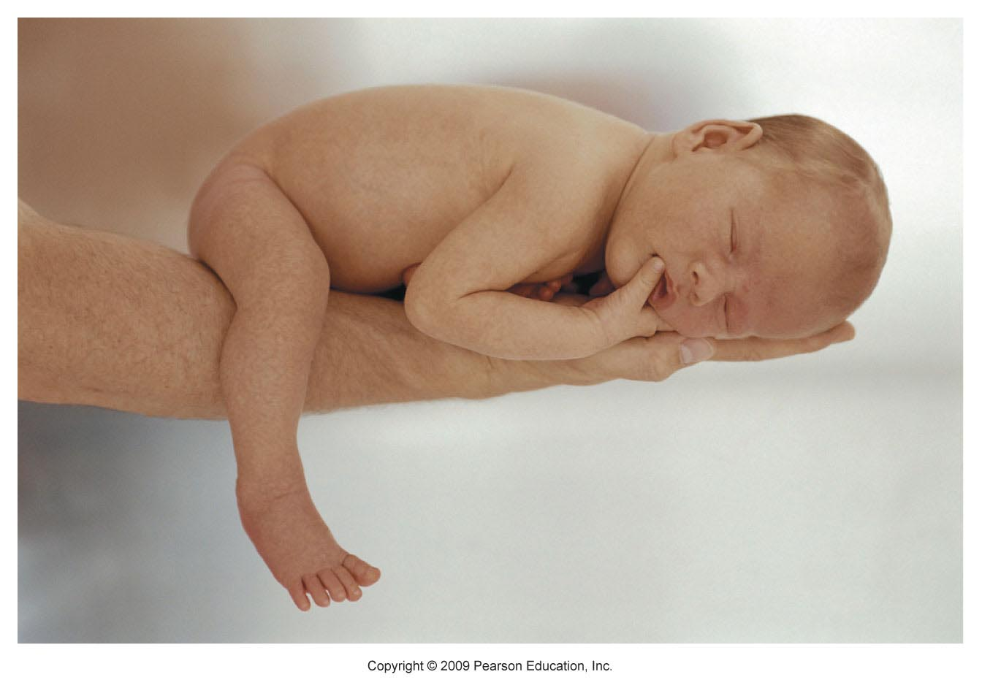
Figure 7.37

Slide 49
Developmental Aspects: Spinal Curvature
Secondary curvatures
  Cervical and lumbar—convex anteriorly
  Appear as child develops (e.g., lifts head, learns to walk)

Slide 50
Developmental Aspects: Old Age
Intervertebral discs become thin, less hydrated, and less elastic
Risk of disc herniation increases
Loss of stature by several centimeters is common by age 55
Costal cartilages ossify, causing the thorax to become rigid
All bones lose mass

