Slide 1
8
Joints: Part B

Slide 2
Classification of Synovial Joints
Six types, based on shape of articular surfaces:
  Plane
  Hinge
  Pivot
  Condyloid
  Saddle
  Ball and socket

Slide 3
Plane Joints
Nonaxial joints
Flat articular surfaces
Short gliding movements

Slide 4
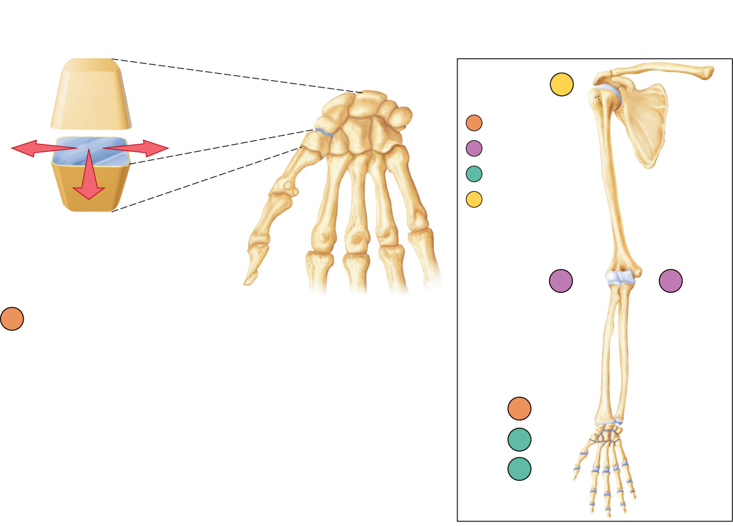
f
Nonaxial
Uniaxial
Biaxial
Multiaxial
c
b
a
Plane joint (intercarpal joint)
a
e
d
Figure 8.7a

Slide 5
Hinge Joints
Uniaxial joints
Motion along a single plane
Flexion and extension only

Slide 6
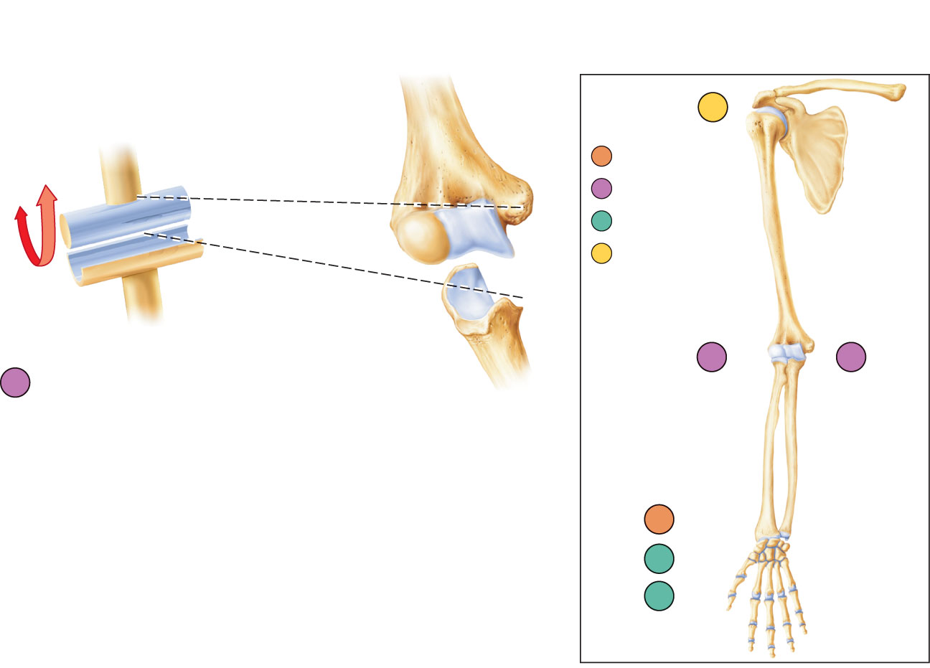
f
Nonaxial
Uniaxial
Biaxial
Multiaxial
c
b
b
Hinge joint (elbow joint)
a
e
d
Figure 8.7b

Slide 7
Pivot Joints
Rounded end of one bone conforms to a “sleeve,” or ring of another bone
Uniaxial movement only

Slide 8
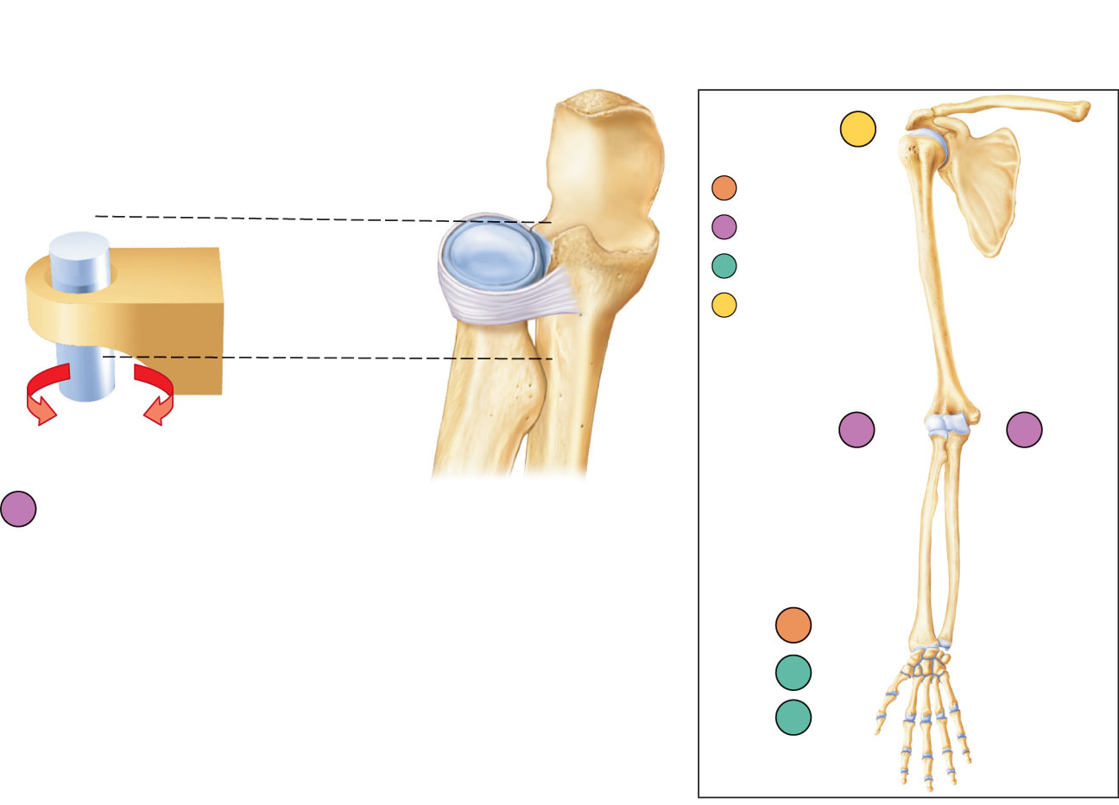
f
Nonaxial
Uniaxial
Biaxial
Multiaxial
c
b
c
Pivot joint (proximal radioulnar joint)
a
e
d
Figure 8.7c

Slide 9
Condyloid (Ellipsoidal) Joints
Biaxial joints
Both articular surfaces are oval
Permit all angular movements

Slide 10
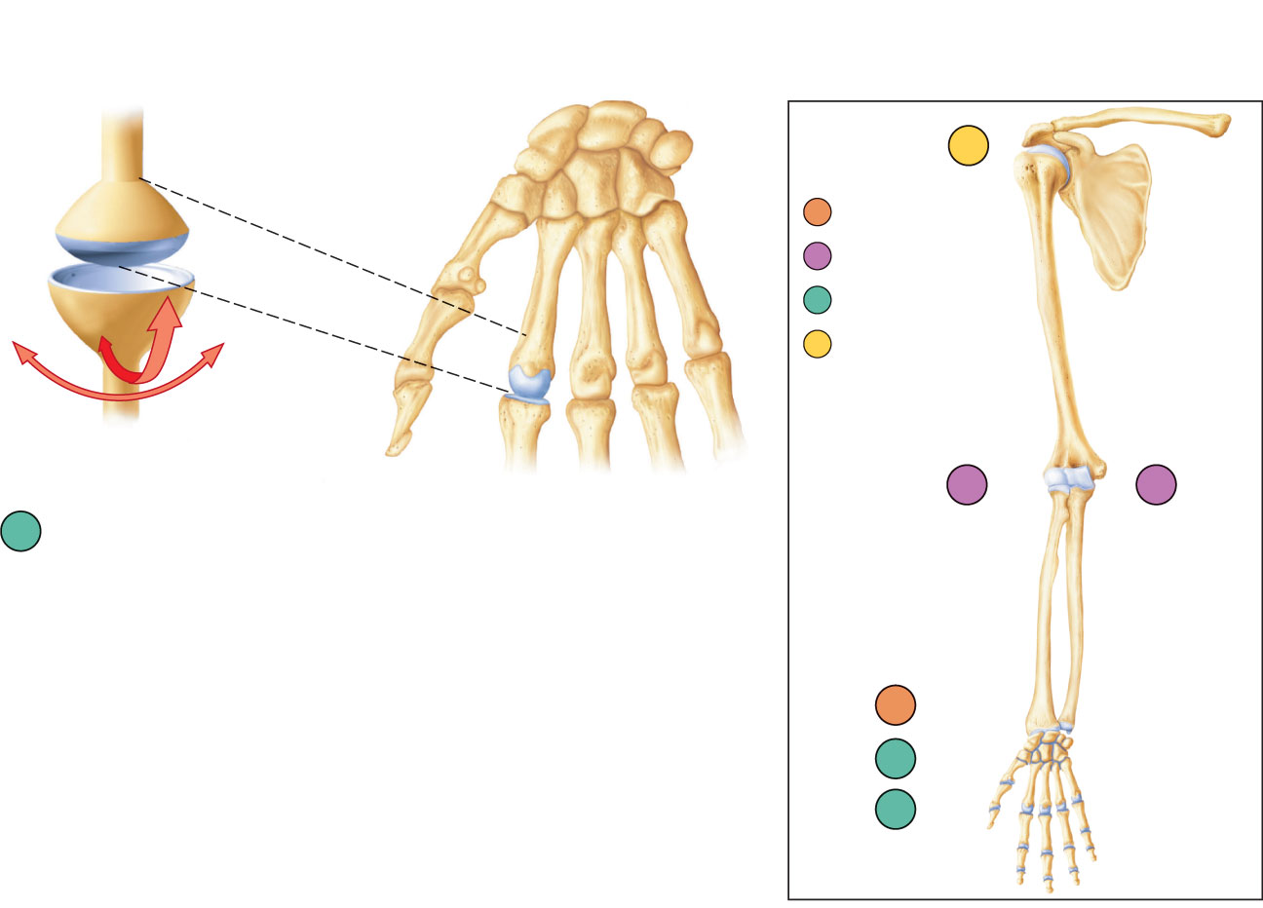
f
Nonaxial
Uniaxial
Biaxial
Multiaxial
c
b
d
Condyloid joint
(metacarpophalangeal joint)
a
e
d
Figure 8.7d

Slide 11
Saddle Joints
Biaxial
Allow greater freedom of movement than condyloid joints
Each articular surface has both concave and convex areas

Slide 12
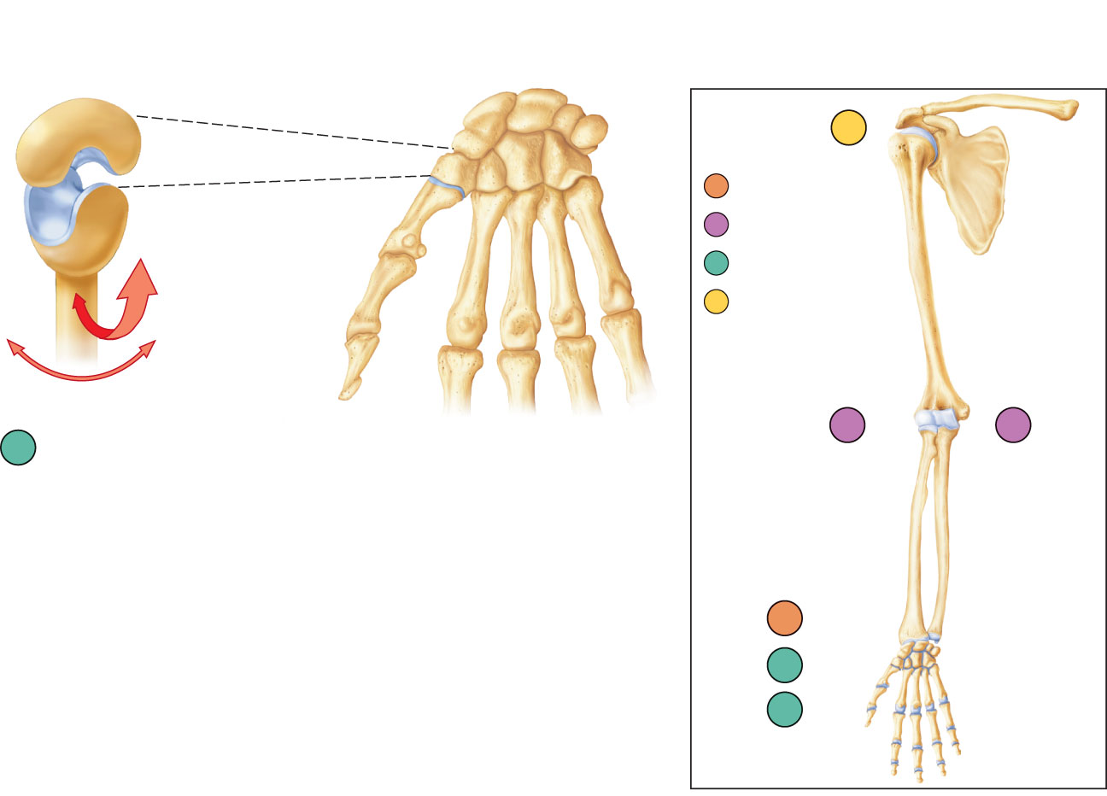
f
Nonaxial
Uniaxial
Biaxial
Multiaxial
c
b
e
Saddle joint (carpometacarpal joint
of thumb)
a
e
d
Figure 8.7e

Slide 13
Ball-and-Socket Joints
Multiaxial joints
The most freely moving synovial joints

Slide 14
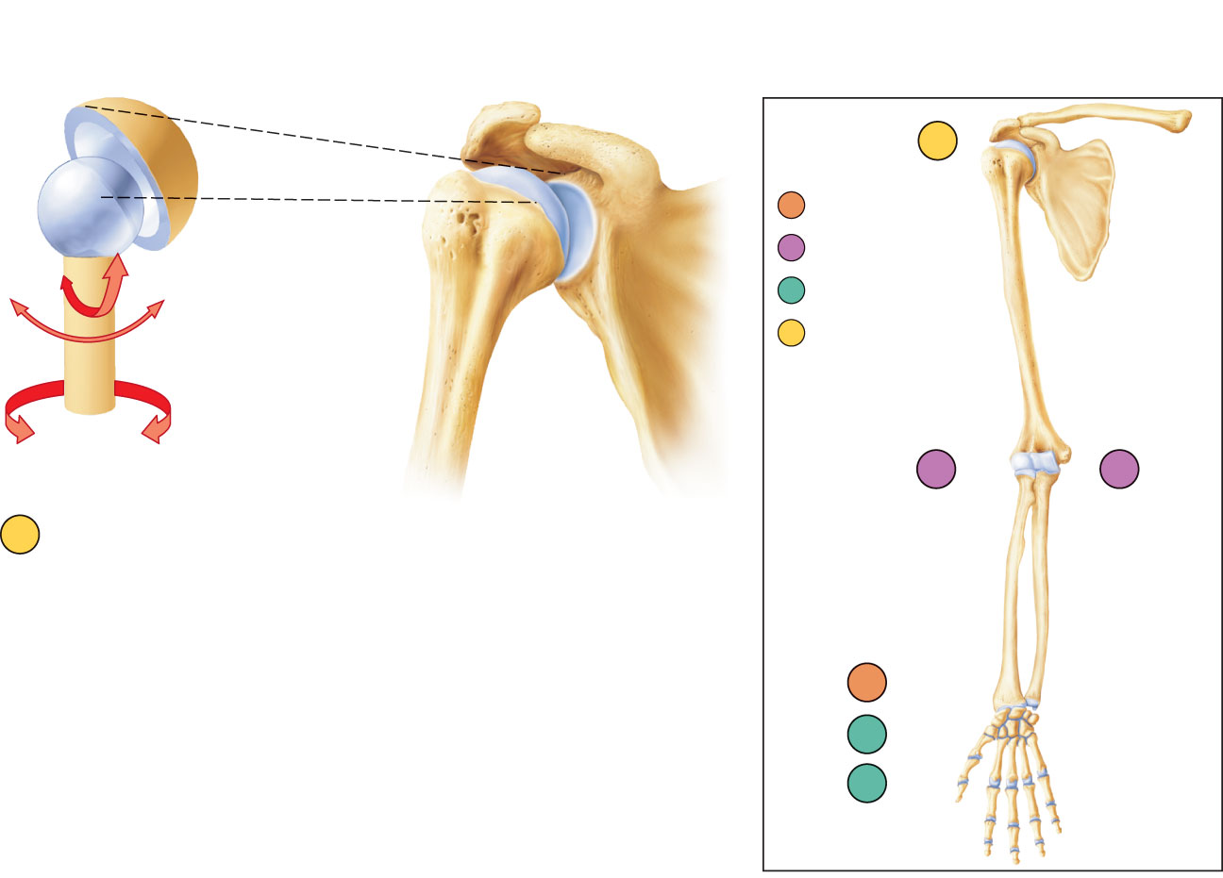
f
Nonaxial
Uniaxial
Biaxial
Multiaxial
c
b
f
Ball-and-socket joint (shoulder joint)
a
e
d
Figure 8.7f

Slide 15
Knee Joint
Largest, most complex joint of body
Three joints surrounded by a single joint cavity:
  Femoropatellar joint:
    Plane joint
    Allows gliding motion during knee flexion
  Lateral and medial tibiofemoral joints between the femoral condyles and the C-shaped lateral and medial menisci (semilunar cartilages) of the tibia
    Allow flexion, extension, and some rotation when knee is partly flexed
PLAY
A&P Flix™: Movement at the knee joint

Slide 16
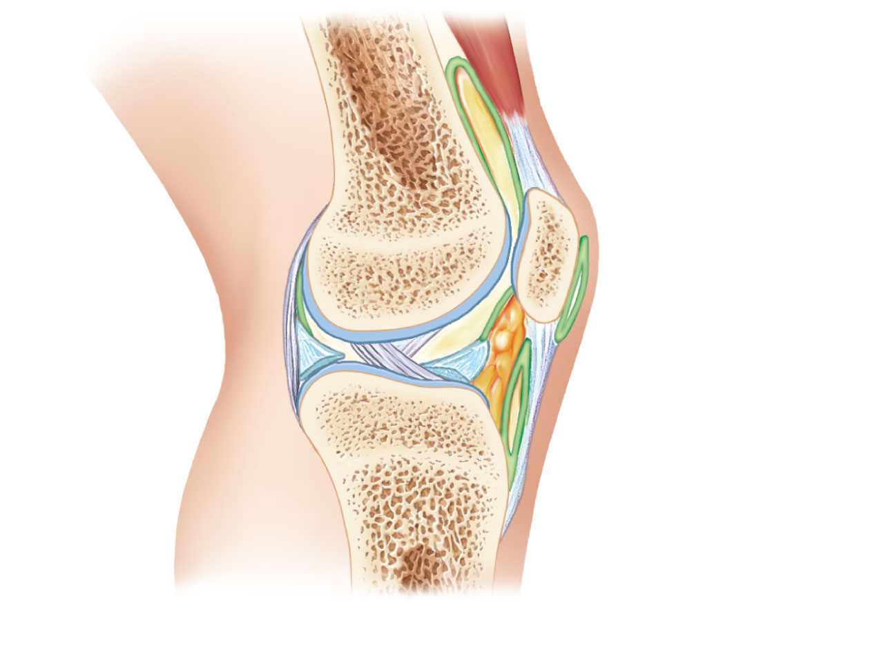
Tendon of
quadriceps
femoris
Femur
Articular
capsule
Suprapatellar
bursa
Patella
Posterior
cruciate
ligament
Subcutaneous
prepatellar bursa
Synovial cavity
Lateral
meniscus
Lateral meniscus
Infrapatellar
fat pad
Anterior
cruciate
ligament
Deep infrapatellar
bursa
Tibia
Patellar ligament
(a) Sagittal section through the right knee joint
Figure 8.8a

Slide 17
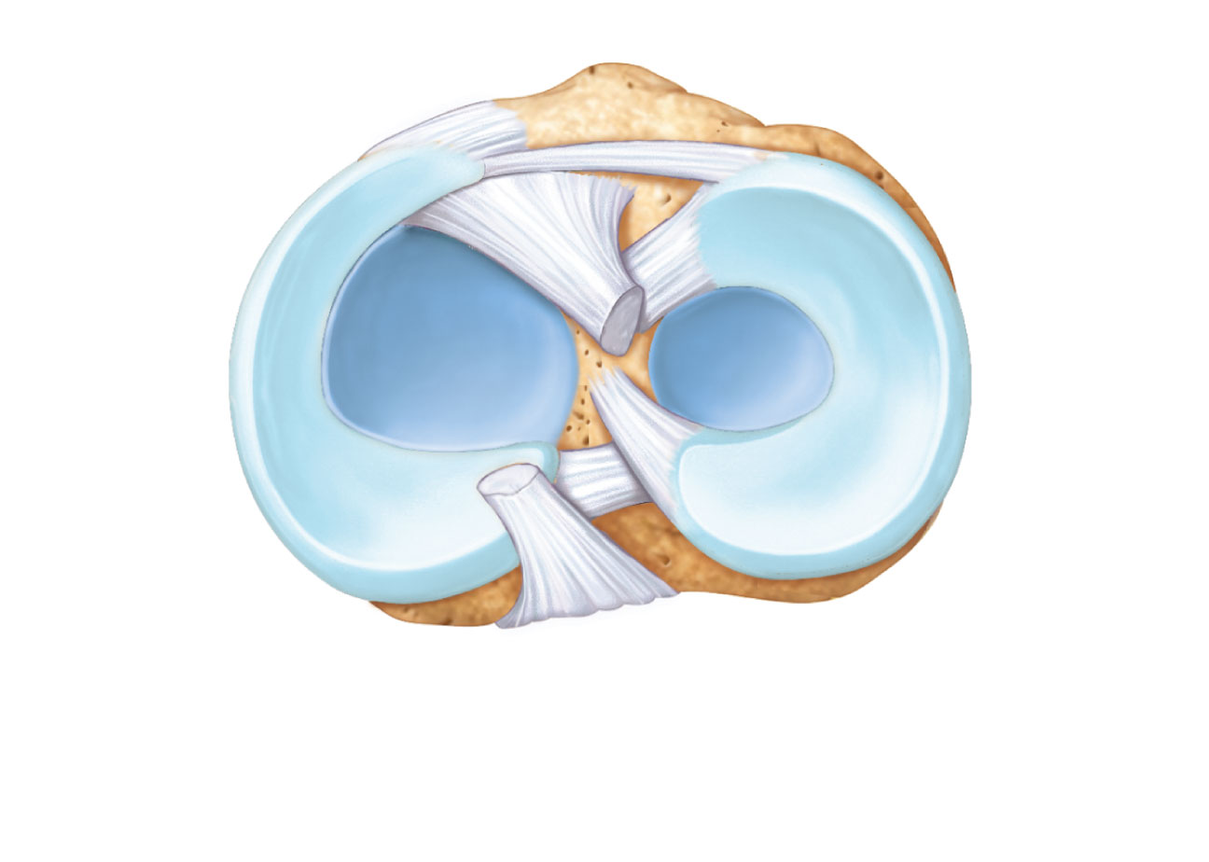
Anterior
Anterior
cruciate
ligament
Articular
cartilage on
lateral tibial
condyle
Articular
cartilage
on medial
tibial
condyle
Medial
meniscus
Lateral
meniscus
Posterior
cruciate
ligament
(b) Superior view of the right tibia in the knee joint, showing
the menisci and cruciate ligaments
Figure 8.8b

Slide 18
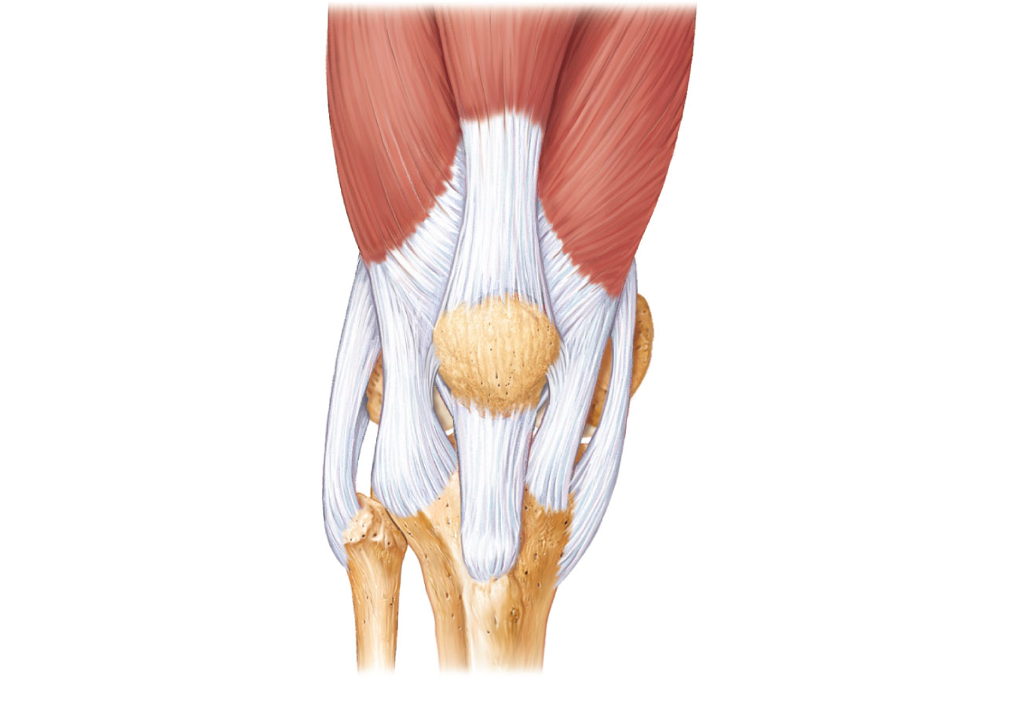
Quadriceps
femoris muscle
Tendon of
quadriceps
femoris muscle
Patella
Medial patellar
retinaculum
Lateral patellar
retinaculum
Tibial collateral
ligament
Fibular
collateral
ligament
Patellar ligament
Fibula
Tibia
(c) Anterior view of right knee
Figure 8.8c

Slide 19
Knee Joint
Capsular and extracapsular ligaments
  Help prevent hyperextension
Intracapsular ligaments:
  Anterior and posterior cruciate ligaments
  Prevent anterior-posterior displacement
  Reside outside the synovial cavity

Slide 20
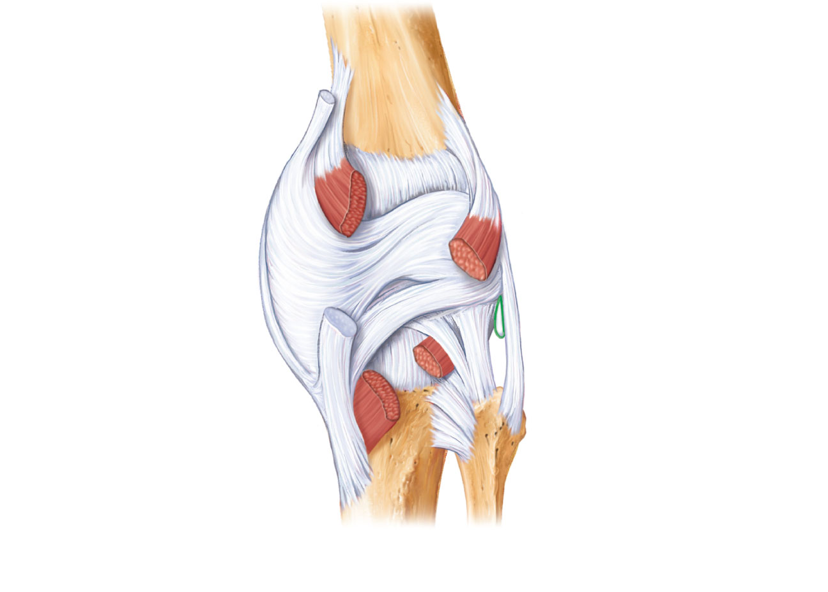
Femur
Tendon of
adductor magnus
Articular capsule
Oblique popliteal
ligament
Medial head of
gastrocnemius
muscle
Lateral head of
gastrocnemius
muscle
Popliteus
muscle (cut)
Bursa
Tibial collateral
ligament
Fibular collateral
ligament
Tendon of
semimembranosus
muscle
Arcuate popliteal
ligament
Tibia
(d) Posterior view of the joint capsule,
including ligaments
Figure 8.8d

Slide 21
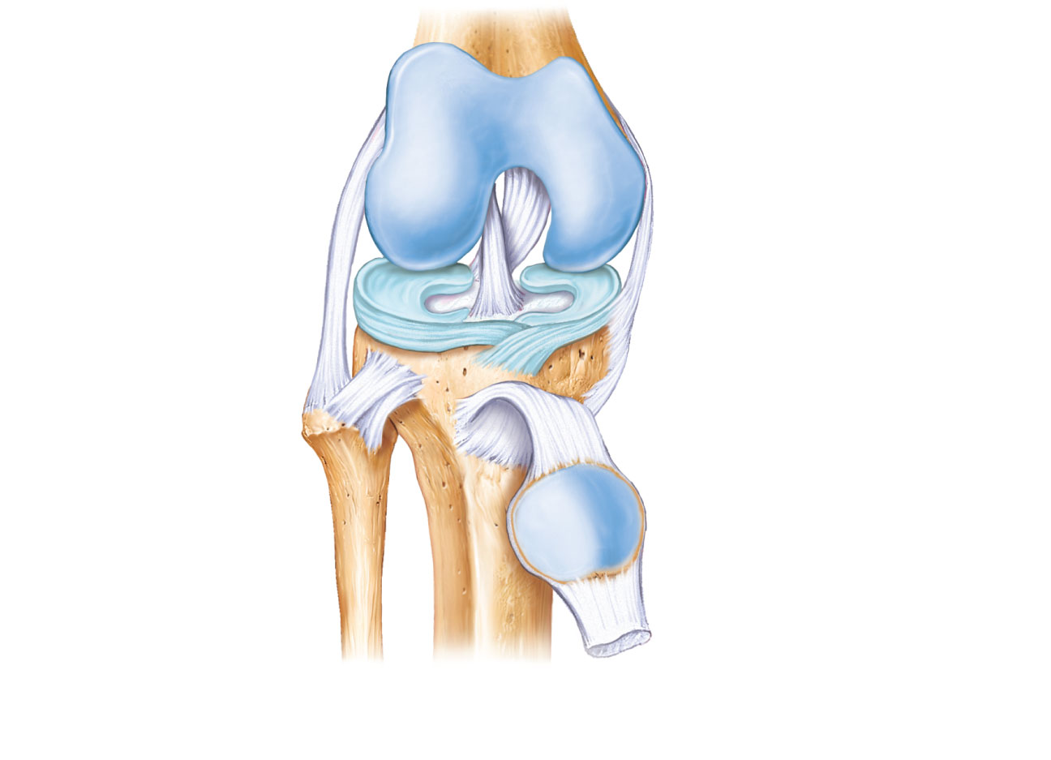
Posterior cruciate
ligament
Fibular
collateral
ligament
Medial condyle
Lateral condyle
of femur
Tibial collateral
ligament
Lateral
meniscus
Anterior cruciate
ligament
Tibia
Medial meniscus
Patellar ligament
Fibula
Patella
Quadriceps tendon
(e) Anterior view of flexed knee, showing the cruciate
ligaments (articular capsule removed, and quadriceps
tendon cut and reflected distally)
PLAY
Animation: Rotatable knee
Figure 8.8e

Slide 22
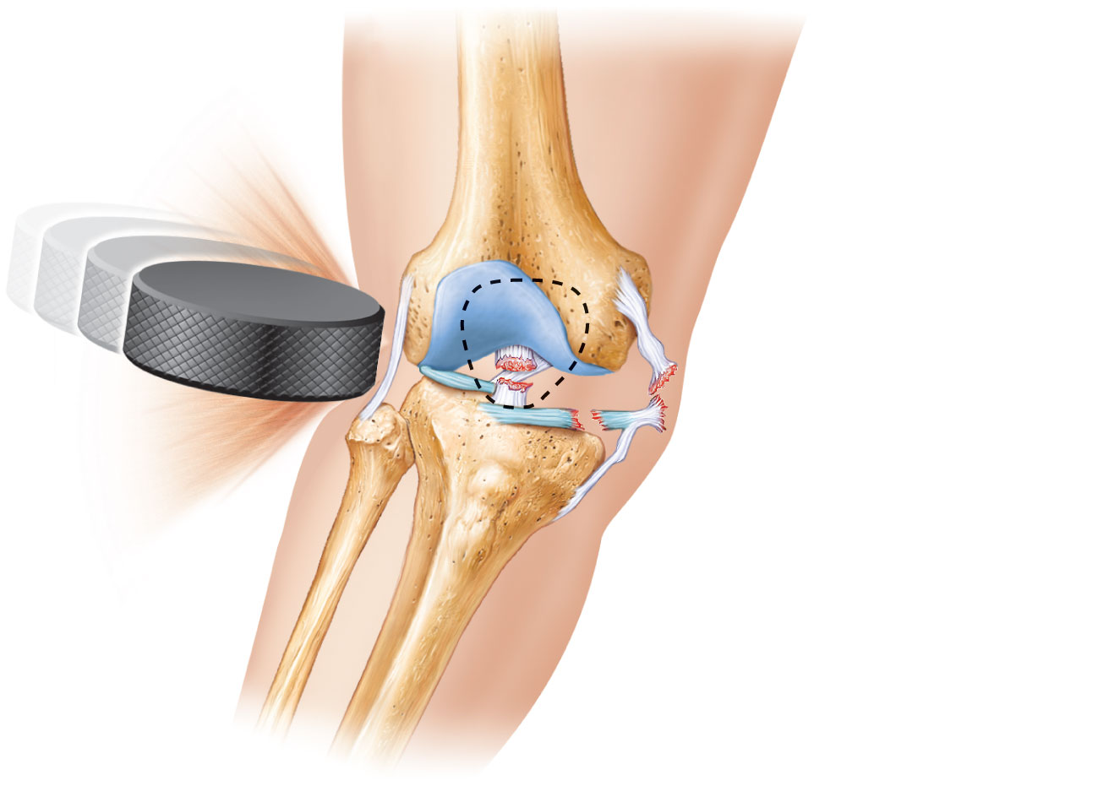
Lateral
Medial
Patella
(outline)
Hockey puck
Tibial collateral
ligament
(torn)
Medial
meniscus (torn)
Anterior
cruciate
ligament (torn)
Figure 8.9

Slide 23
Shoulder (Glenohumeral) Joint
Ball-and-socket joint: head of humerus and glenoid fossa of the scapula
Stability is sacrificed for greater freedom of movement

Slide 24
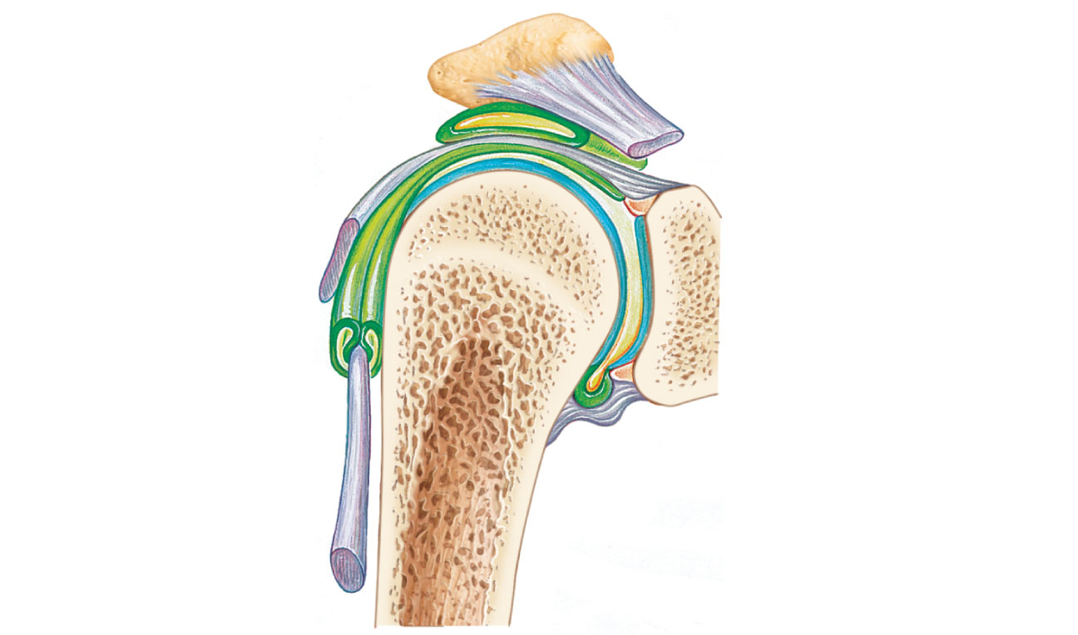
Acromion
of scapula
Coracoacromial
ligament
Synovial cavity
of the glenoid
cavity containing
synovial fluid
Subacromial
bursa
Fibrous
articular capsule
Hyaline
cartilage
Tendon
sheath
Synovial membrane
Fibrous capsule
Tendon of
long head
of biceps
brachii muscle
Humerus
(a) Frontal section through right shoulder joint
PLAY
Animation: Rotatable shoulder
Figure 8.10a

Slide 25
Shoulder Joint
Reinforcing ligaments:
  Coracohumeral ligament—helps support the weight of the upper limb
  Three glenohumeral ligaments—somewhat weak anterior reinforcements

Slide 26
Shoulder joint
Reinforcing muscle tendons:
  Tendon of the long head of biceps:
    Travels through the intertubercular groove
    Secures the humerus to the glenoid cavity
  Four rotator cuff tendons encircle the shoulder joint:
    Subscapularis
    Supraspinatus
    Infraspinatus
    Teres minor
PLAY
A&P Flix™: Rotator cuff muscles: An overview (a)
PLAY
A&P Flix™: Rotator cuff muscles: An overview (b)

Slide 27
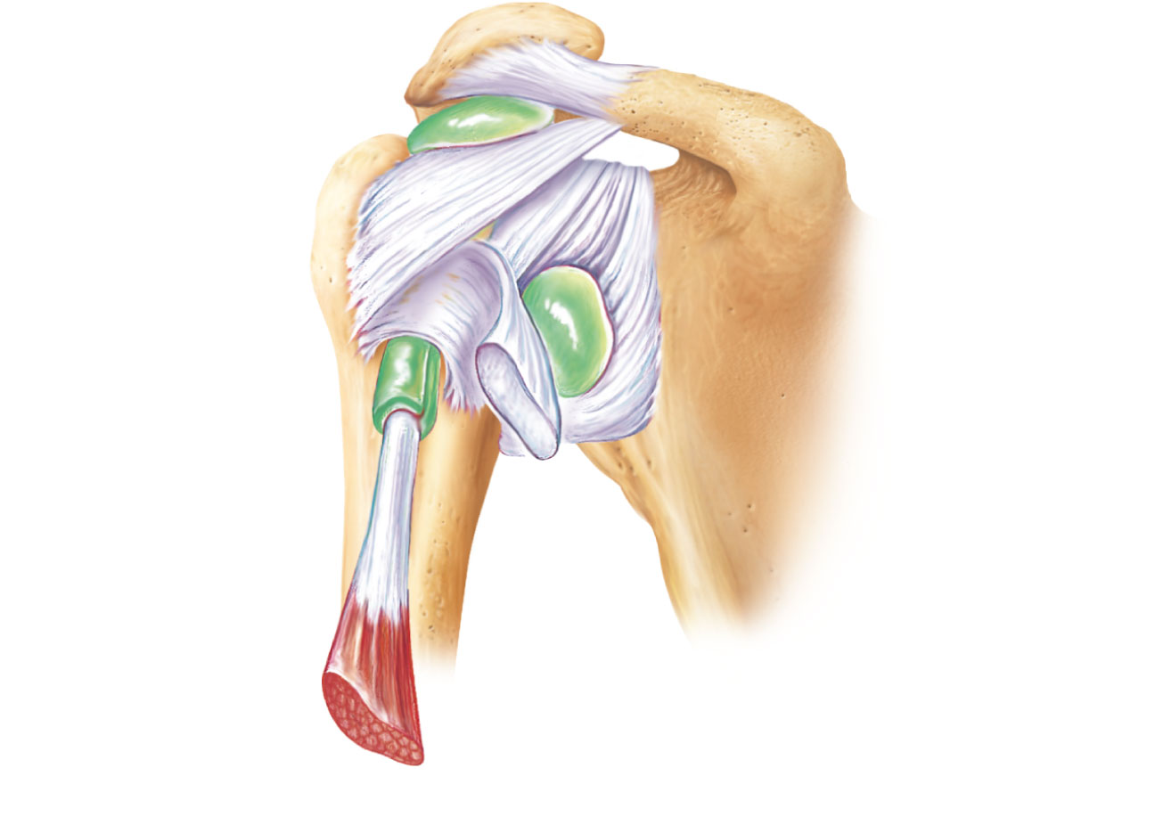
Acromion
Coracoid
process
Coracoacromial
ligament
Articular
capsule
reinforced by
glenohumeral
ligaments
Subacromial
bursa
Coracohumeral
ligament
Greater
tubercle
of humerus
Subscapular
bursa
Tendon of the
subscapularis
muscle
Transverse
humeral
ligament
Scapula
Tendon sheath
Tendon of long
head of biceps
brachii muscle
(c) Anterior view of right shoulder joint capsule
Figure 8.10c

Slide 28
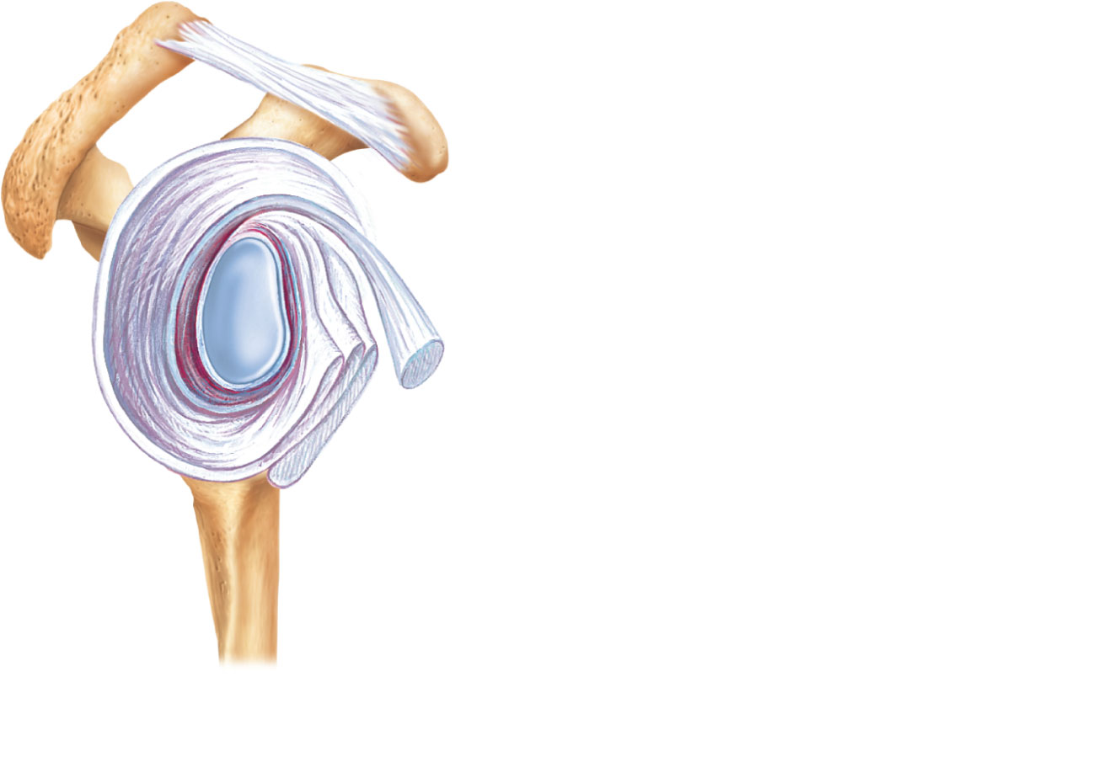
Acromion
Coracoid process
Articular capsule
Glenoid cavity
Glenoid labrum
Tendon of long head
of biceps brachii muscle
Glenohumeral ligaments
Tendon of the
subscapularis muscle
Scapula
Posterior
Anterior
(d) Lateral view of socket of right shoulder joint,
humerus removed
Figure 8.10d

Slide 29
Elbow Joint
Radius and ulna articulate with the humerus
Hinge joint formed mainly by trochlear notch of ulna and trochlea of humerus
Flexion and extension only
PLAY
A&P Flix™: Movement at the elbow joint

Slide 30
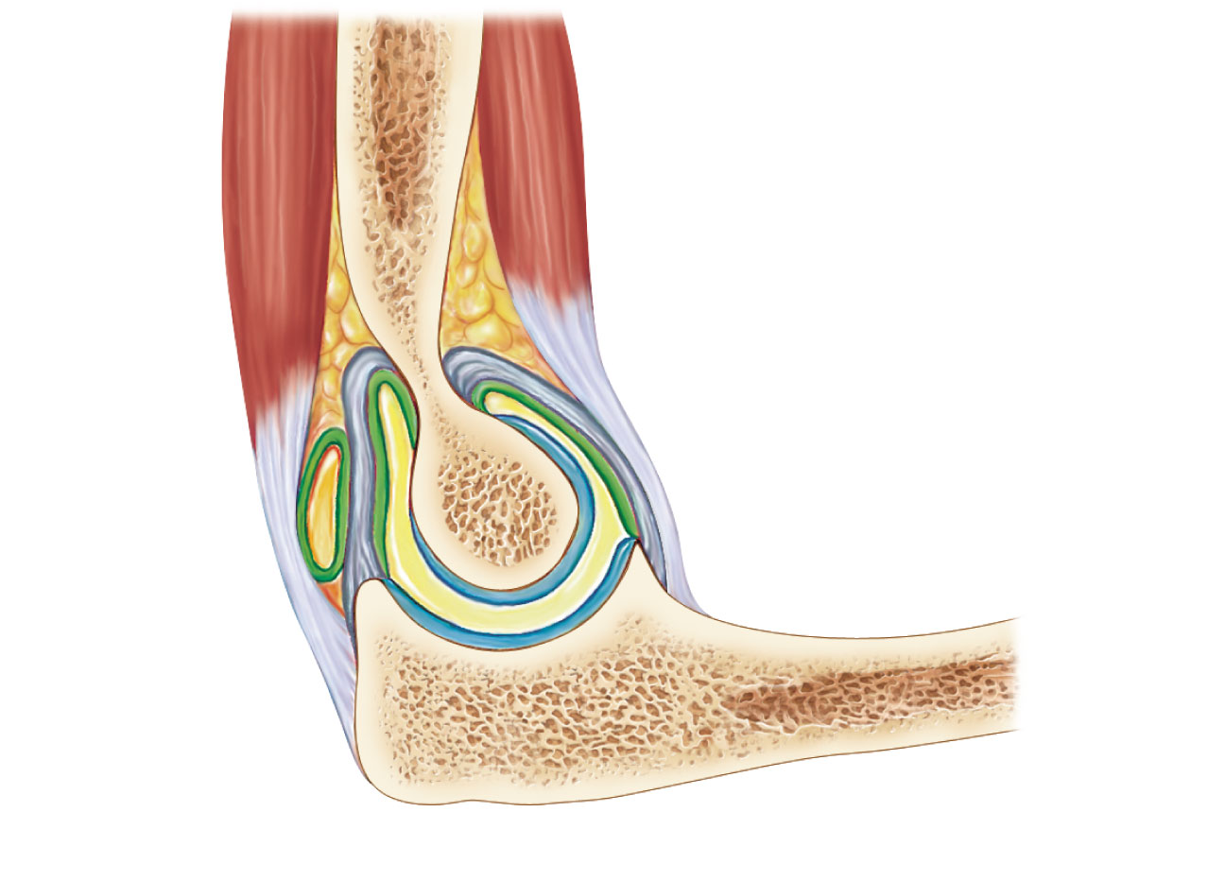
Articular
capsule
Synovial
membrane
Humerus
Synovial cavity
Articular cartilage
Fat pad
Coronoid process
Tendon of
triceps
muscle
Tendon of
brachialis muscle
Ulna
Bursa
Trochlea
Articular cartilage
of the trochlear
notch
(a) Median sagittal section through right elbow (lateral view)
Figure 8.11a

Slide 31
Elbow Joint
Anular ligament—surrounds head of radius
Two capsular ligaments restrict side-to-side movement:
  Ulnar collateral ligament
  Radial collateral ligament

Slide 32
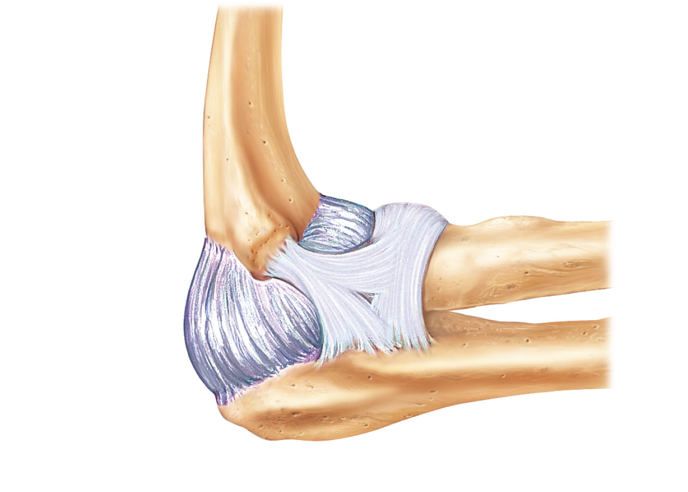
Humerus
Anular
ligament
Radius
Lateral
epicondyle
Articular
capsule
Radial
collateral
ligament
Olecranon
process
Ulna
(b) Lateral view of right elbow joint
Figure 8.11b

Slide 33
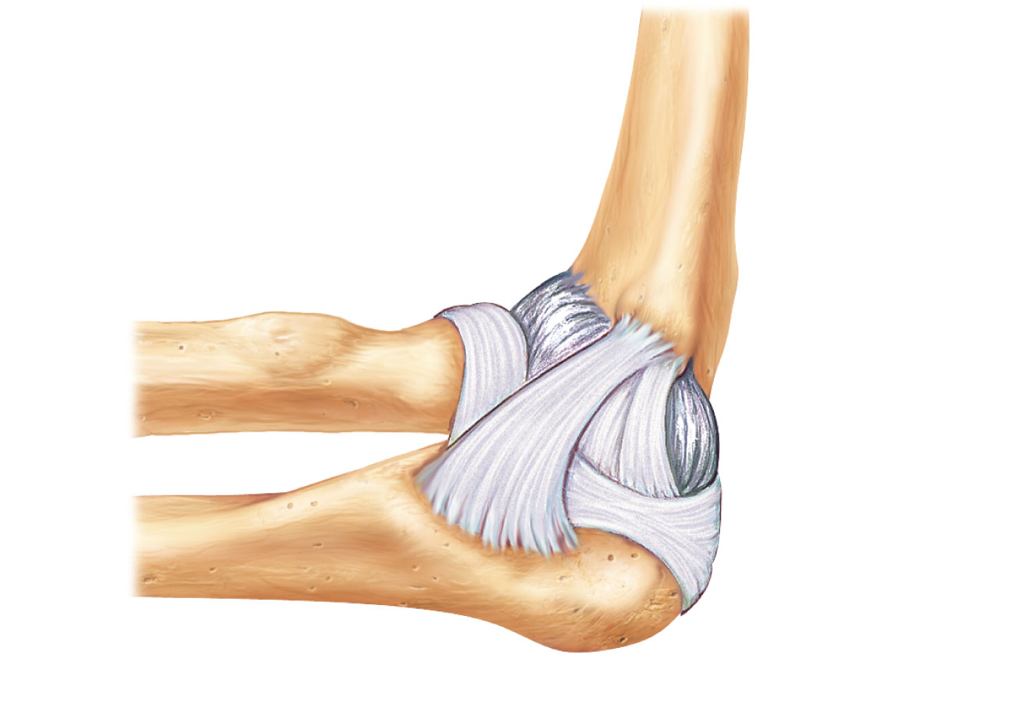
Articular
capsule
Anular
ligament
Humerus
Coronoid
process
Medial
epicondyle
Ulnar
collateral
ligament
Radius
Ulna
(d) Medial view of right elbow
PLAY
Animation: Rotatable elbow
Figure 8.11d

Slide 34
Hip (Coxal) Joint
Ball-and-socket joint
Head of the femur articulates with the acetabulum
Good range of motion, but limited by the deep socket
Acetabular labrum—enhances depth of socket
PLAY
A&P Flix™: Movement at the hip joint: An overview

Slide 35
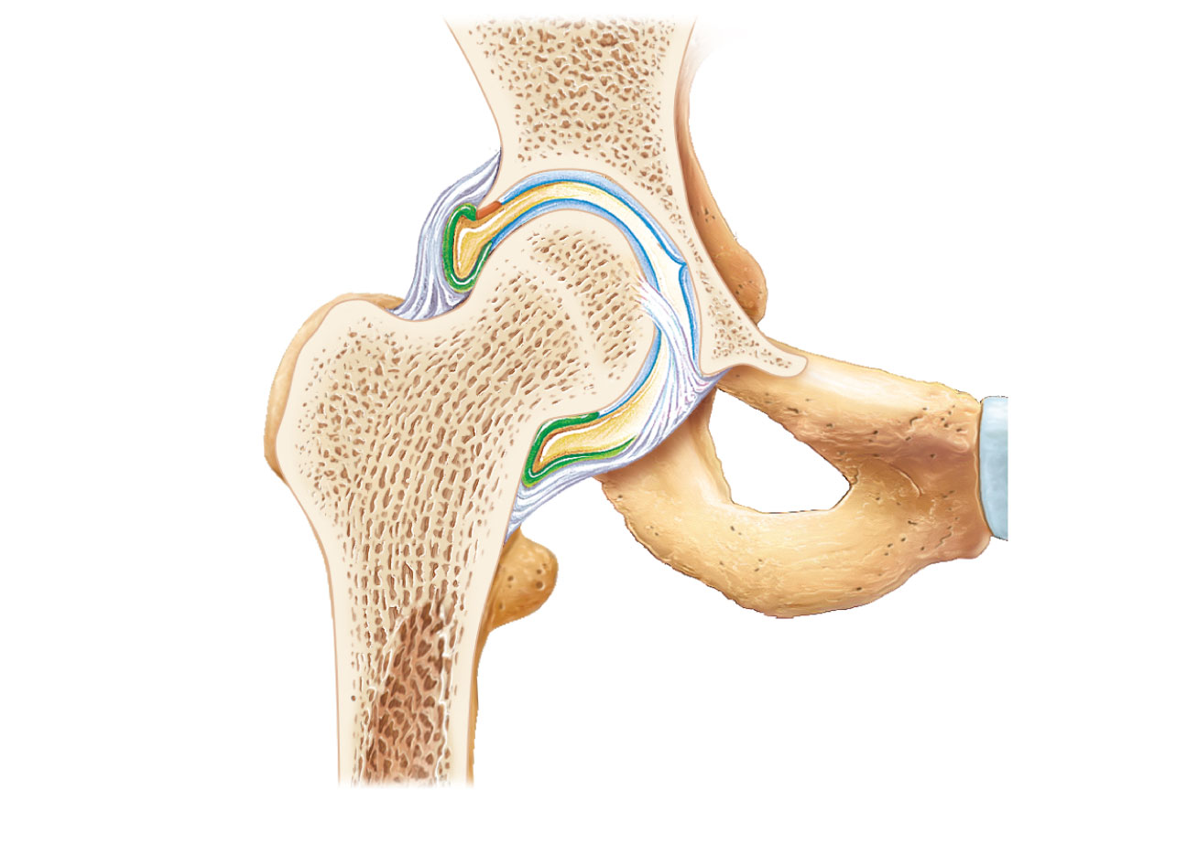
Coxal (hip) bone
Articular cartilage
Ligament of
the head of
the femur
(ligamentum
teres)
Acetabular
labrum
Femur
Synovial cavity
Articular capsule
(a) Frontal section through the right hip joint
Figure 8.12a

Slide 36
Hip Joint
Reinforcing ligaments:
Iliofemoral ligament
Pubofemoral ligament
Ischiofemoral ligament
Ligamentum teres

Slide 37
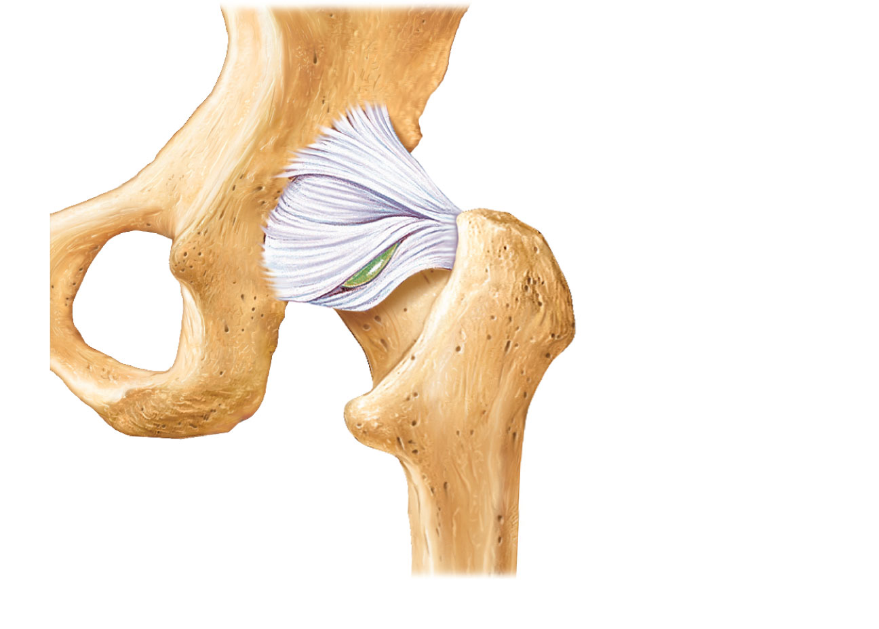
Iliofemoral
ligament
Ischium
Ischiofemoral
ligament
Greater
trochanter
of femur
(c) Posterior view of right hip joint, capsule in place
PLAY
Animation: Rotatable hip
Figure 8.12c

Slide 38
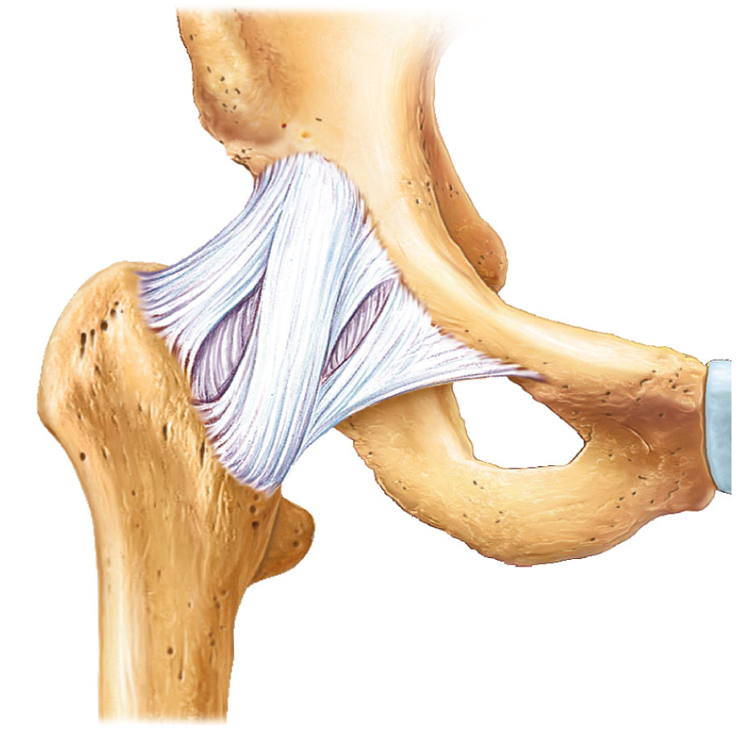
Anterior inferior
iliac spine
Iliofemoral
ligament
Pubofemoral
ligament
Greater
trochanter
(d) Anterior view of right hip joint, capsule in place
Figure 8.12d

Slide 39
Temporomandibular Joint (TMJ)
Mandibular condyle articulates with the temporal bone
Two types of movement
  Hinge—depression and elevation of mandible
  Gliding—e.g. side-to-side (lateral excursion) grinding of teeth
Most easily dislocated joint in the body

Slide 40
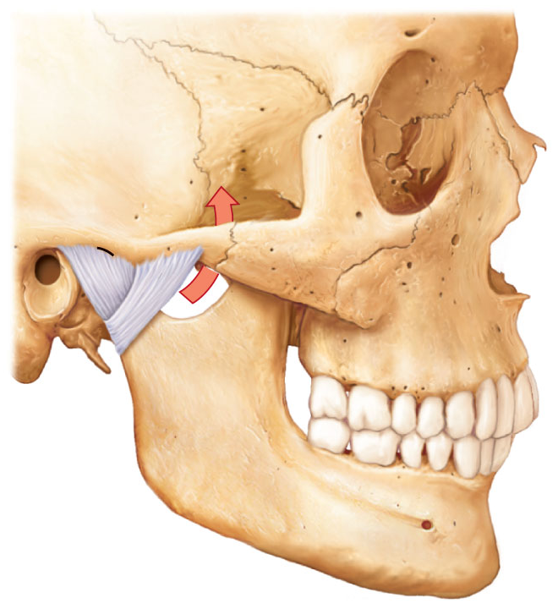
Mandibular fossa
Articular tubercle
Zygomatic process
Infratemporal fossa
External
acoustic
meatus
Lateral
ligament
Articular
capsule
Ramus of
mandible
(a) Location of the joint in the skull
Figure 8.13a

Slide 41
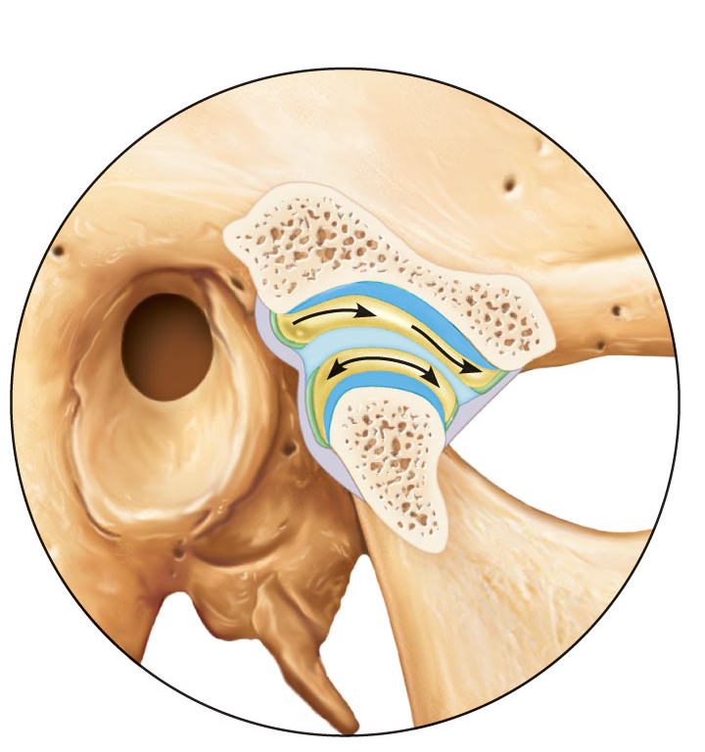
Articular disc
Articular
tubercle
Mandibular
fossa
Superior
joint
cavity
Articular
capsule
Synovial
membranes
Mandibular
condyle
Ramus of
mandible
Inferior joint
cavity
(b) Enlargement of a sagittal section through the joint
Figure 8.13b

Slide 42
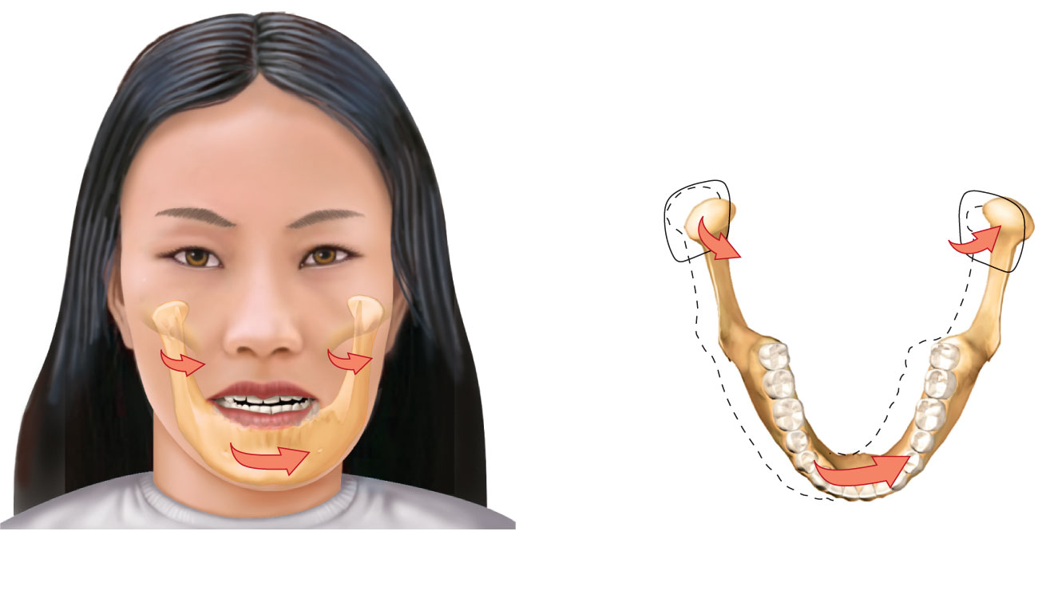
Superior view
Outline of
the mandibular
fossa
Lateral excursion: lateral (side-to-side) movements of the
mandible
Figure 8.13c

Slide 43
Common Joint Injuries
Sprains
  The ligaments are stretched or torn
  Partial tears slowly repair themselves
  Complete ruptures require prompt surgical repair
Cartilage tears
  Due to compression and shear stress
  Fragments may cause joint to lock or bind
  Cartilage rarely repairs itself
  Repaired with arthroscopic surgery

Slide 44
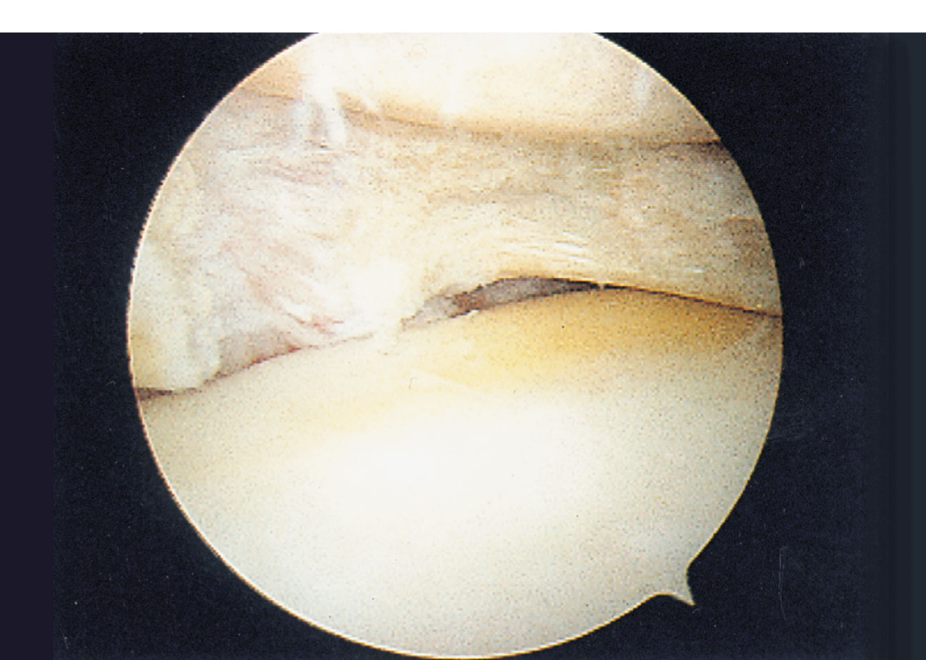
Torn
meniscus
Figure 8.14

Slide 45
Common Joint Injuries
Dislocations (luxations)
  Occur when bones are forced out of alignment
  Accompanied by sprains, inflammation, and joint immobilization
  Caused by serious falls or playing sports
Subluxation—partial dislocation of a joint

Slide 46
Inflammatory and Degenerative Conditions
Bursitis
  An inflammation of a bursa, usually caused by a blow or friction
  Treated with rest and ice and, if severe, anti-inflammatory drugs
Tendonitis
  Inflammation of tendon sheaths typically caused by overuse
  Symptoms and treatment similar to bursitis

Slide 47
Arthritis
>100 different types of inflammatory or degenerative diseases that damage joints
Most widespread crippling disease in the U.S.
Symptoms; pain, stiffness, and swelling of a joint
Acute forms: caused by bacteria, treated with antibiotics
Chronic forms: osteoarthritis, rheumatoid arthritis, and gouty arthritis

Slide 48
Osteoarthritis (OA)
Common, irreversible, degenerative (“wear-and-tear”) arthritis
85% of all Americans develop OA, more women than men
Probably related to the normal aging process

Slide 49
Osteoarthritis (OA)
More cartilage is destroyed than replaced in badly aligned or overworked joints
Exposed bone ends thicken, enlarge, form bone spurs, and restrict movement
Treatment: moderate activity, mild pain relievers, capsaicin creams, glucosamine and chondroitin sulfate

Slide 50
Rheumatoid Arthritis (RA)
Chronic, inflammatory, autoimmune disease of unknown cause
Usually arises between age 40 and 50, but may occur at any age; affects 3 times as many women as men
Signs and symptoms include joint pain and swelling (usually bilateral), anemia, osteoporosis, muscle weakness, and cardiovascular problems

Slide 51
Rheumatoid Arthritis
RA begins with synovitis of the affected joint
Inflammatory blood cells migrate to the joint, release inflammatory chemicals
Inflamed synovial membrane thickens into a pannus
Pannus erodes cartilage, scar tissue forms, articulating bone ends connect (ankylosis)

Slide 52
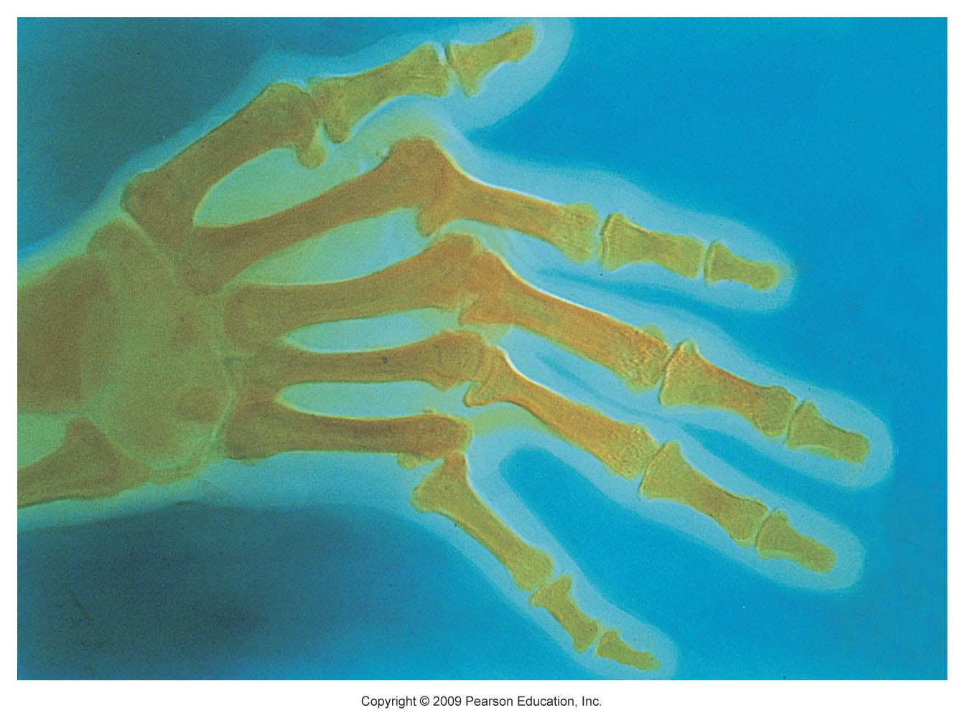
Figure 8.15

Slide 53
Rheumatoid Arthritis: Treatment
Conservative therapy: aspirin, long-term use of antibiotics, and physical therapy
Progressive treatment: anti-inflammatory drugs or immunosuppressants
New biological response modifier drugs neutralize inflammatory chemicals

Slide 54
Gouty Arthritis
Deposition of uric acid crystals in joints and soft tissues, followed by inflammation
More common in men
Typically affects the joint at the base of the great toe
In untreated gouty arthritis, the bone ends fuse and immobilize the joint
Treatment: drugs, plenty of water, avoidance of alcohol

Slide 55
Lyme Disease
Caused by bacteria transmitted by the bites of ticks
Symptoms: skin rash, flu-like symptoms, and foggy thinking
May lead to joint pain and arthritis
Treatment: antibiotics

Slide 56
Developmental Aspects of Joints
By embryonic week 8, synovial joints resemble adult joints
A joint’s size, shape, and flexibility are modified by use
Advancing years take their toll on joints:
  Ligaments and tendons shorten and weaken
  Intervertebral discs become more likely to herniate
  Most people in their 70s have some degree of OA
Exercise that coaxes joints through their full range of motion is key to postponing joint problems

