Slide 1
7
The Skeleton: Part A

Slide 2
The Axial Skeleton
Consists of 80 bones
Three major regions
  Skull
  Vertebral column
  Thoracic cage

Slide 3
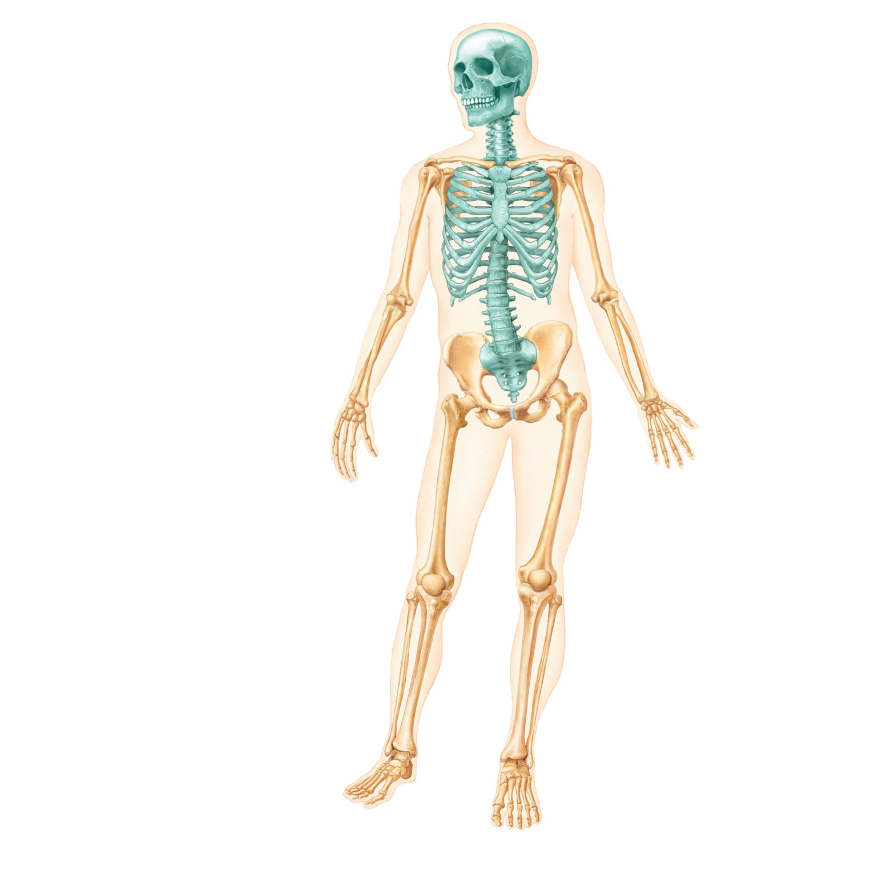
Skull
Cranium
Facial bones
Clavicle
Thoracic cage
(ribs and
sternum)
Scapula
Sternum
Rib
Humerus
Vertebral
column
Vertebra
Radius
Sacrum
Ulna
Carpals
Phalanges
Metacarpals
Femur
Patella
Tibia
Fibula
Tarsals
Metatarsals
(a) Anterior view
Phalanges
Figure 7.1a

Slide 4
The Skull
Two sets of bones
  Cranial bones
    Enclose the brain in the cranial cavity
      Cranial vault (calvaria)
      Cranial base: anterior, middle, and posterior cranial fossae
    Provide sites of attachment for head and neck muscles

Slide 5
The Skull
  Facial bones
    Framework of face
    Cavities for special sense organs for sight, taste, and smell
    Openings for air and food passage
    Sties of attachment for teeth and muscles of facial expression

Slide 6
Bone Markings: Depressions and Openings
Meatus
  Canal-like passageway
Sinus
  Cavity within a bone
Fossa
  Shallow, basinlike depression
Groove
  Furrow
Fissure
  Narrow, slitlike opening
Foramen
  Round or oval opening through a bone

Slide 7
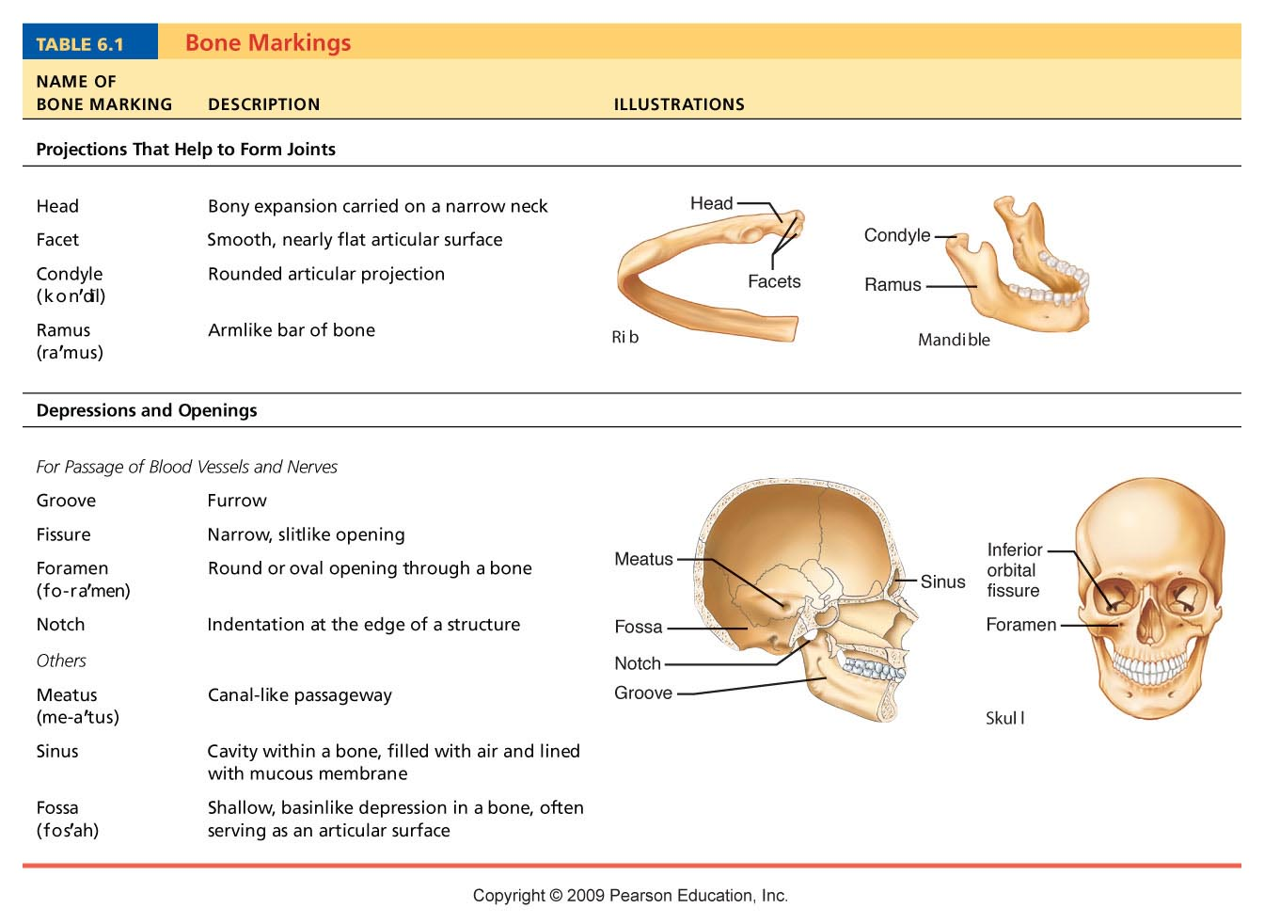
Table 6.1

Slide 8
Fontanels (soft spots) & Sutures
Cartilage and mesenchyme regions in the skull that will eventually ossify by intramembranous bone formation
Physiologic Purposes
1. Allows rapid growth of the brain
2. Allows overlap of the skull bones during delivery
Medical Usages
1. Allows determination of fetal head during delivery
2. Allows determination of the superior sagittal sinus during surgery for hydrocephalus
3. Assists in the determination of fetal age

Slide 9
Fontanels
Anterior Fontanel – Largest Fontanel – closes 18 – 24 months after birth
Posterior Fontanel – Closes 2 months after birth
Anterolateral Fontanel – Closes 3 months after birth
Posterolateral Fontanel – begins to close 1 – 2 months after birth and finishes closure at 12 months

Slide 10
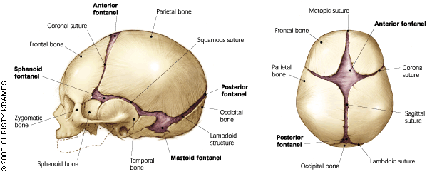

Slide 11
Sutures
A suture is a type of fibrous joint which only occurs in the skull (or "cranium"). They are bound together by Sharpey's fibers. A tiny amount of movement is permitted at sutures, which contributes to the compliance and elasticity of the skull.
Frontal Suture – completely closes – if it persists it is termed the metopic suture
  Coronal suture—between parietal bones and frontal bone
  Sagittal suture—between right and left parietal bones
  Lambdoid suture—between parietal bones and occipital bone
  Squamous (squamosal) sutures—between parietal and temporal bones on each side of skull

Slide 12
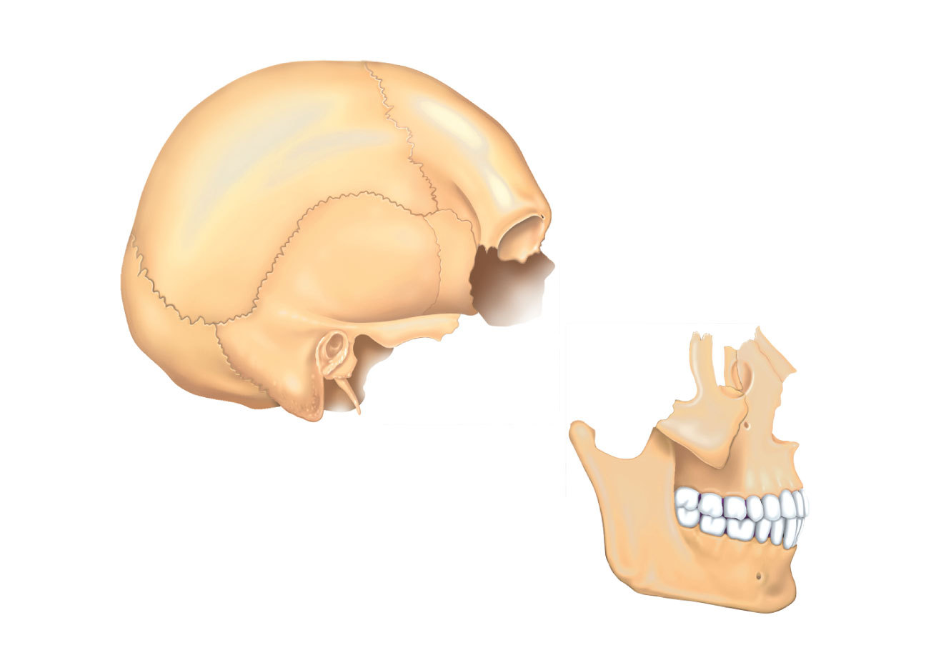
Bones of cranium (cranial vault)
Coronal
suture
Squamous
suture
Lambdoid
suture
Facial
bones
(a) Cranial and facial divisions of the skull
Figure 7.2a

Slide 13
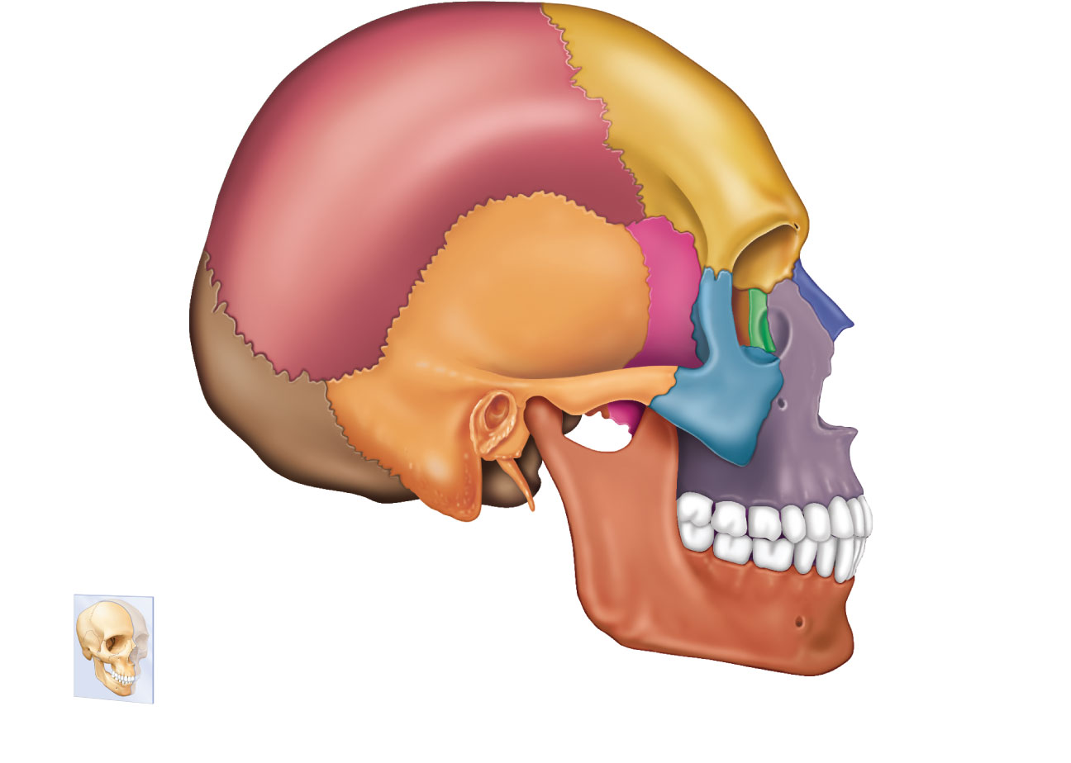
Coronal suture
Frontal bone
Sphenoid bone
(greater wing)
Parietal bone
Ethmoid bone
Temporal bone
Lacrimal bone
Lambdoid
suture
Lacrimal fossa
Squamous
suture
Occipital
bone
Nasal bone
Zygomatic
bone
Zygomatic
process
Occipitomastoid
suture
Maxilla
External acoustic
meatus
Mastoid process
Alveolar
margins
Styloid process
Mandibular condyle
Mandible
Mandibular notch
Mental foramen
Mandibular ramus
Mandibular angle
Coronoid process
(a) External anatomy of the right side of the skull
Figure 7.5a

Slide 14
Cranial Bones
Frontal bone
Parietal bones (2)
Occipital bone
Temporal bones (2)
Sphenoid bone
Ethmoid bone

Slide 15
Frontal Bone
Anterior portion of cranium
Most of anterior cranial fossa
Superior wall of orbits
Contains air-filled frontal sinus

Slide 16
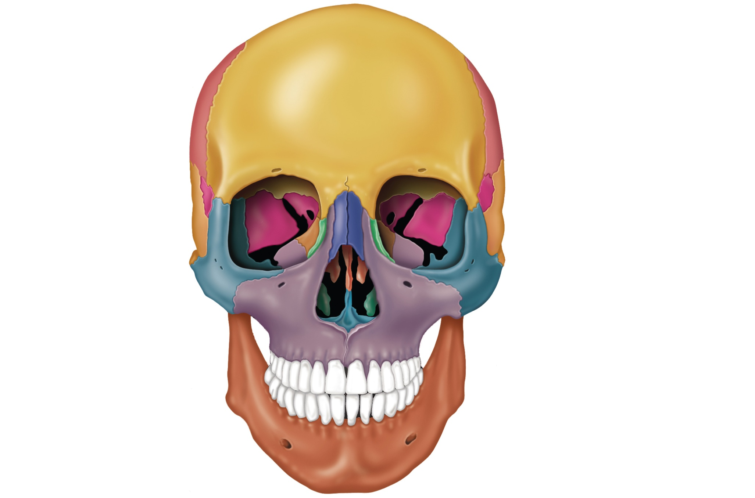
Frontal bone
Glabella
Parietal bone
Frontonasal suture
Supraorbital foramen
(notch)
Squamous part
of frontal bone
Nasal bone
Supraorbital margin
Sphenoid bone
(greater wing)
Superior orbital
fissure
Temporal bone
Optic canal
Ethmoid bone
Inferior orbital
fissure
Lacrimal bone
Middle nasal
concha
Zygomatic bone
Ethmoid
bone
Infraorbital foramen
Perpendicular
plate
Maxilla
Mandible
Inferior nasal concha
Vomer
Mental
foramen
(a) Anterior view
Mandibular symphysis
Figure 7.4a

Slide 17
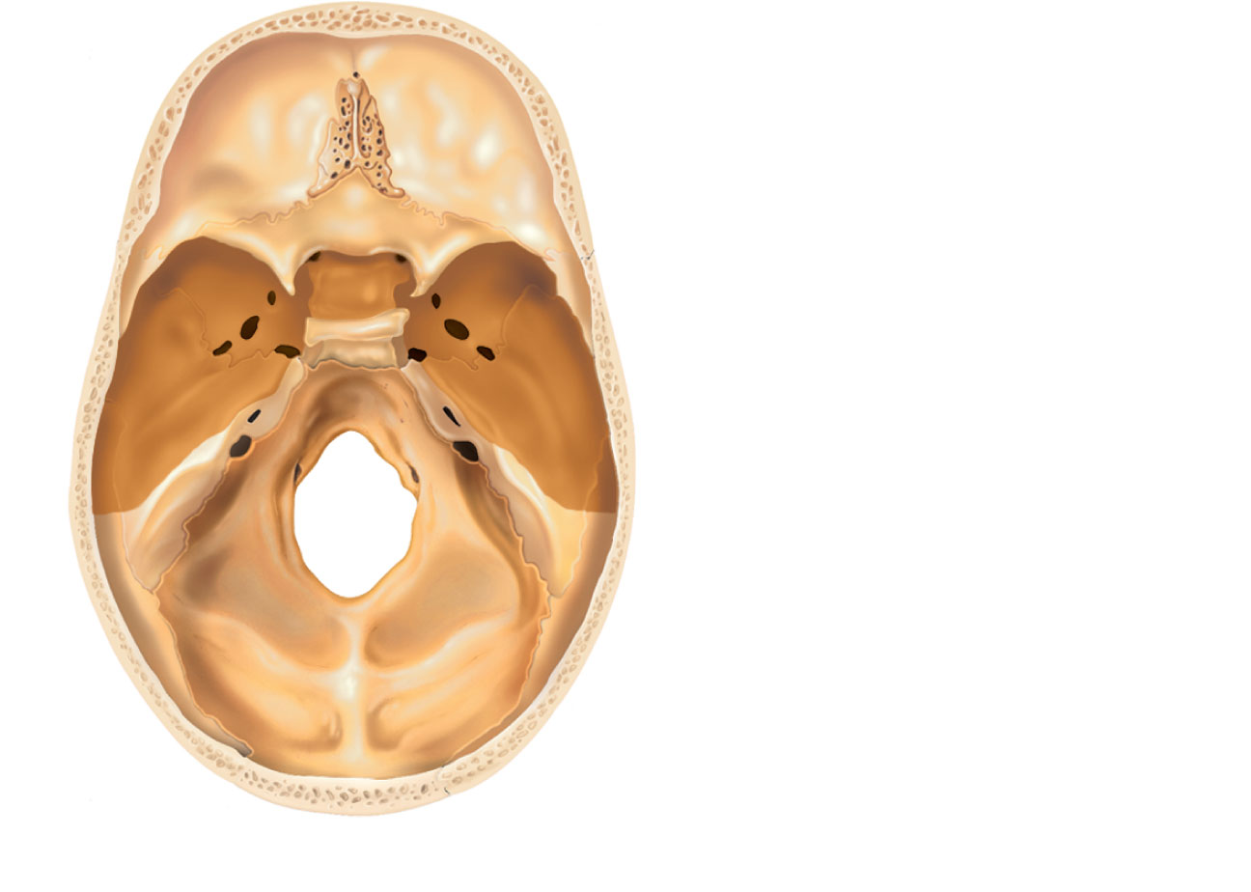
Anterior cranial
fossa
Middle cranial
fossa
Posterior cranial
fossa
(b) Superior view of the cranial fossae
Figure 7.2b

Slide 18
Parietal Bones
Superior and lateral aspects of cranial vault

Slide 19
Coronal suture
Frontal bone
Sphenoid bone
(greater wing)
Parietal bone
Ethmoid bone
Temporal bone
Lacrimal bone
Lambdoid
suture
Lacrimal fossa
Squamous
suture
Occipital
bone
Nasal bone
Zygomatic
bone
Zygomatic
process
Occipitomastoid
suture
Maxilla
External acoustic
meatus
Mastoid process
Alveolar
margins
Styloid process
Mandibular condyle
Mandible
Mandibular notch
Mental foramen
Mandibular ramus
Mandibular angle
Coronoid process
(a) External anatomy of the right side of the skull
Figure 7.5a

Slide 20
Anterior cranial
fossa
Middle cranial
fossa
Posterior cranial
fossa
(b) Superior view of the cranial fossae
Figure 7.2b

Slide 21
Ethmoid Bone
Deepest skull bone
Superior part of nasal septum, roof of nasal cavities
Contributes to medial wall of orbits

Slide 22
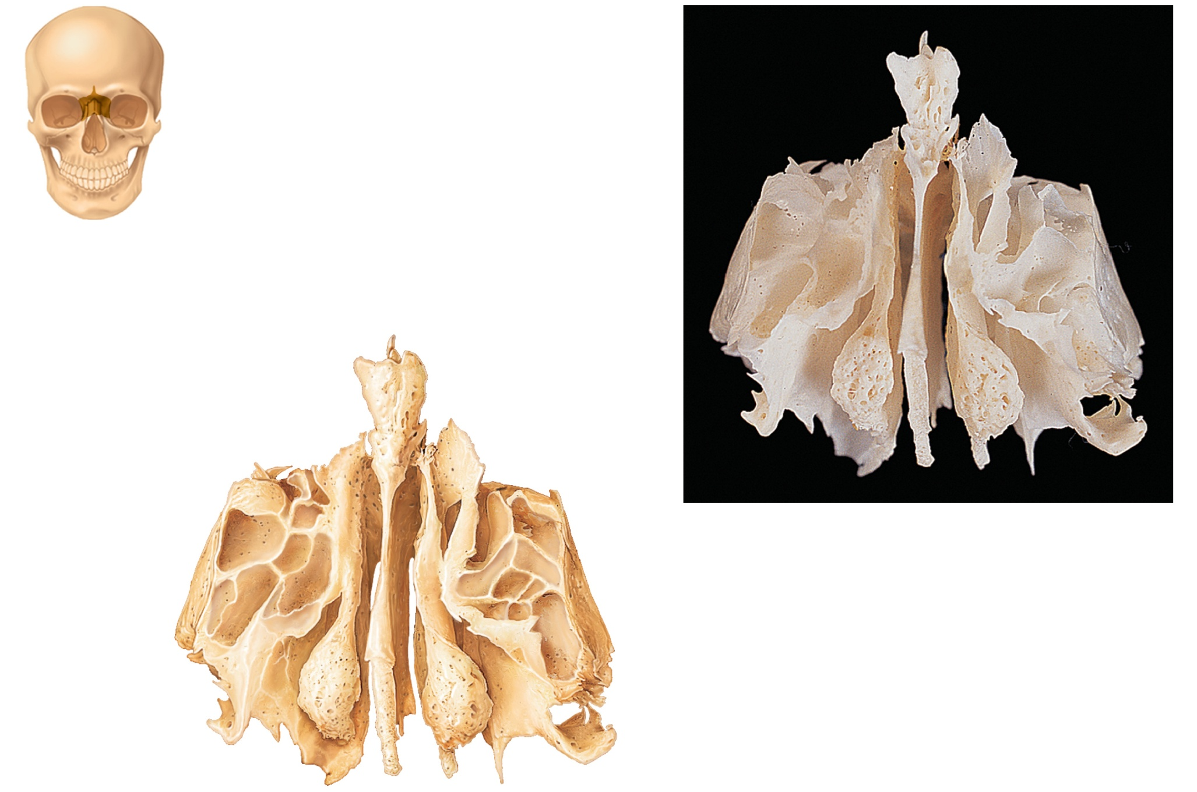
Olfactory
foramina
Crista galli
Cribriform
plate
Orbital
plate
Left lateral mass
Ethmoidal
air cells
Perpendicular
plate
Middle nasal concha
Figure 7.10

Slide 23
Frontal bone
Glabella
Parietal bone
Frontonasal suture
Supraorbital foramen
(notch)
Squamous part
of frontal bone
Nasal bone
Supraorbital margin
Sphenoid bone
(greater wing)
Superior orbital
fissure
Temporal bone
Optic canal
Ethmoid bone
Inferior orbital
fissure
Lacrimal bone
Middle nasal
concha
Zygomatic bone
Ethmoid
bone
Infraorbital foramen
Perpendicular
plate
Maxilla
Mandible
Inferior nasal concha
Vomer
Mental
foramen
(a) Anterior view
Mandibular symphysis
Figure 7.4a

Slide 24
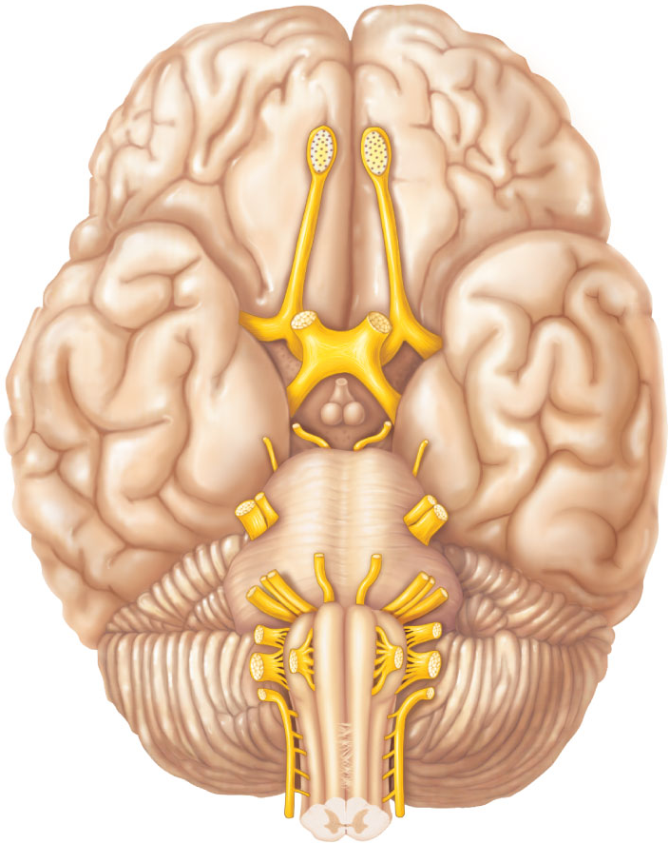
Figure 13.5a Location and function of cranial nerves.
Filaments of
olfactory
nerve (I)
Frontal lobe
Olfactory bulb
Olfactory tract
Temporal lobe
Optic nerve
(II)
Infundibulum
Optic chiasma
Optic tract
Facial
nerve (VII)
Oculomotor
nerve (III)
Vestibulo-
cochlear
nerve (VIII)
Trochlear
nerve (IV)
Trigeminal
nerve (V)
Glossopharyngeal
nerve (IX)
Abducens
nerve (VI)
Vagus nerve (X)
Accessory nerve (XI)
Cerebellum
Medulla
oblongata
Hypoglossal nerve (XII)
(a)

Slide 25
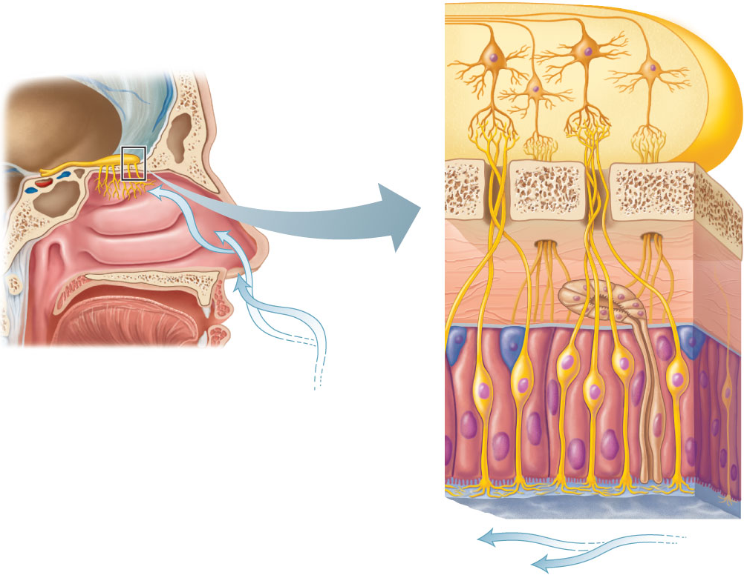
Figure 15.21 Olfactory receptors.
Mitral cell
(output cell)
Olfactory
epithelium
Glomeruli
Olfactory
tract
Olfactory bulb
Cribriform plate
of ethmoid bone
Olfactory tract
Olfactory bulb
Filaments of
olfactory nerve
Lamina propria
connective tissue
Nasal
conchae
Axon
Olfactory
gland
Basal cell
Olfactory
receptor cell
Route of
inhaled air
(a)
Olfactory
epithelium
Supporting cell
Dendrite
Olfactory cilia
Mucus
Route of inhaled air
containing odor molecules
(b)

Slide 26
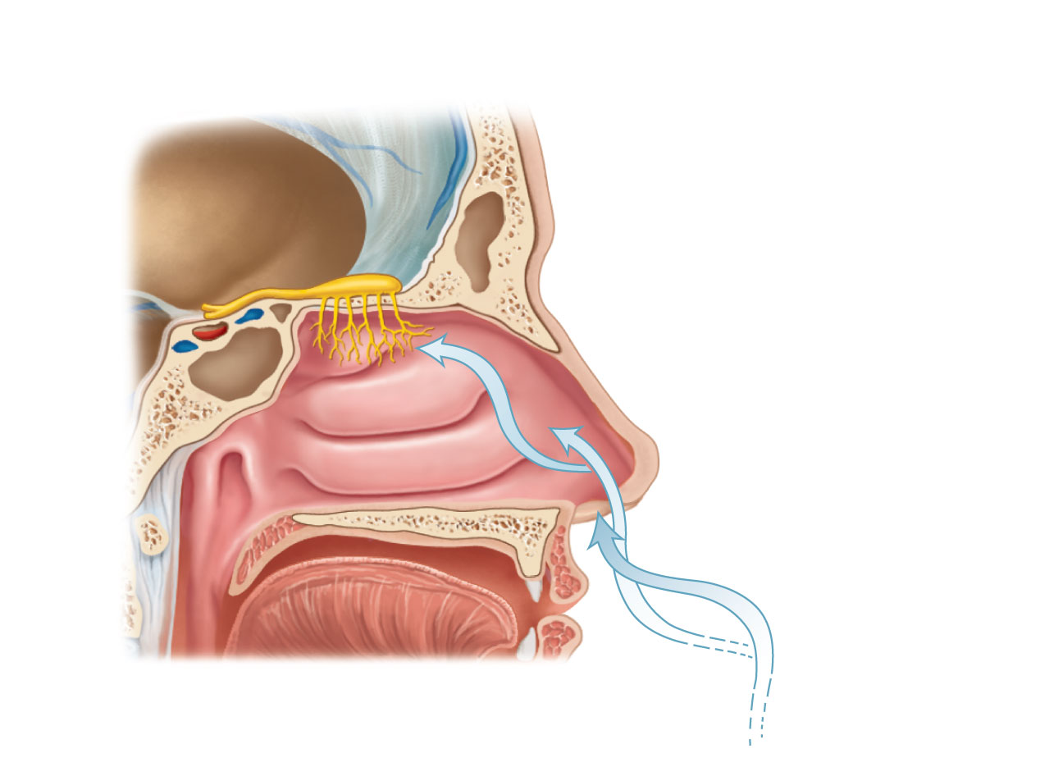
Figure 15.21a Olfactory receptors.
Olfactory
epithelium
Olfactory tract
Olfactory bulb
Nasal
conchae
Route of
inhaled air
(a)

Slide 27
Sphenoid Bone
Complex, bat-shaped bone
Keystone bone
  Articulates with all other cranial bones
Three pairs of processes
  Greater wings
  Lesser wings
  Pterygoid processes

Slide 28
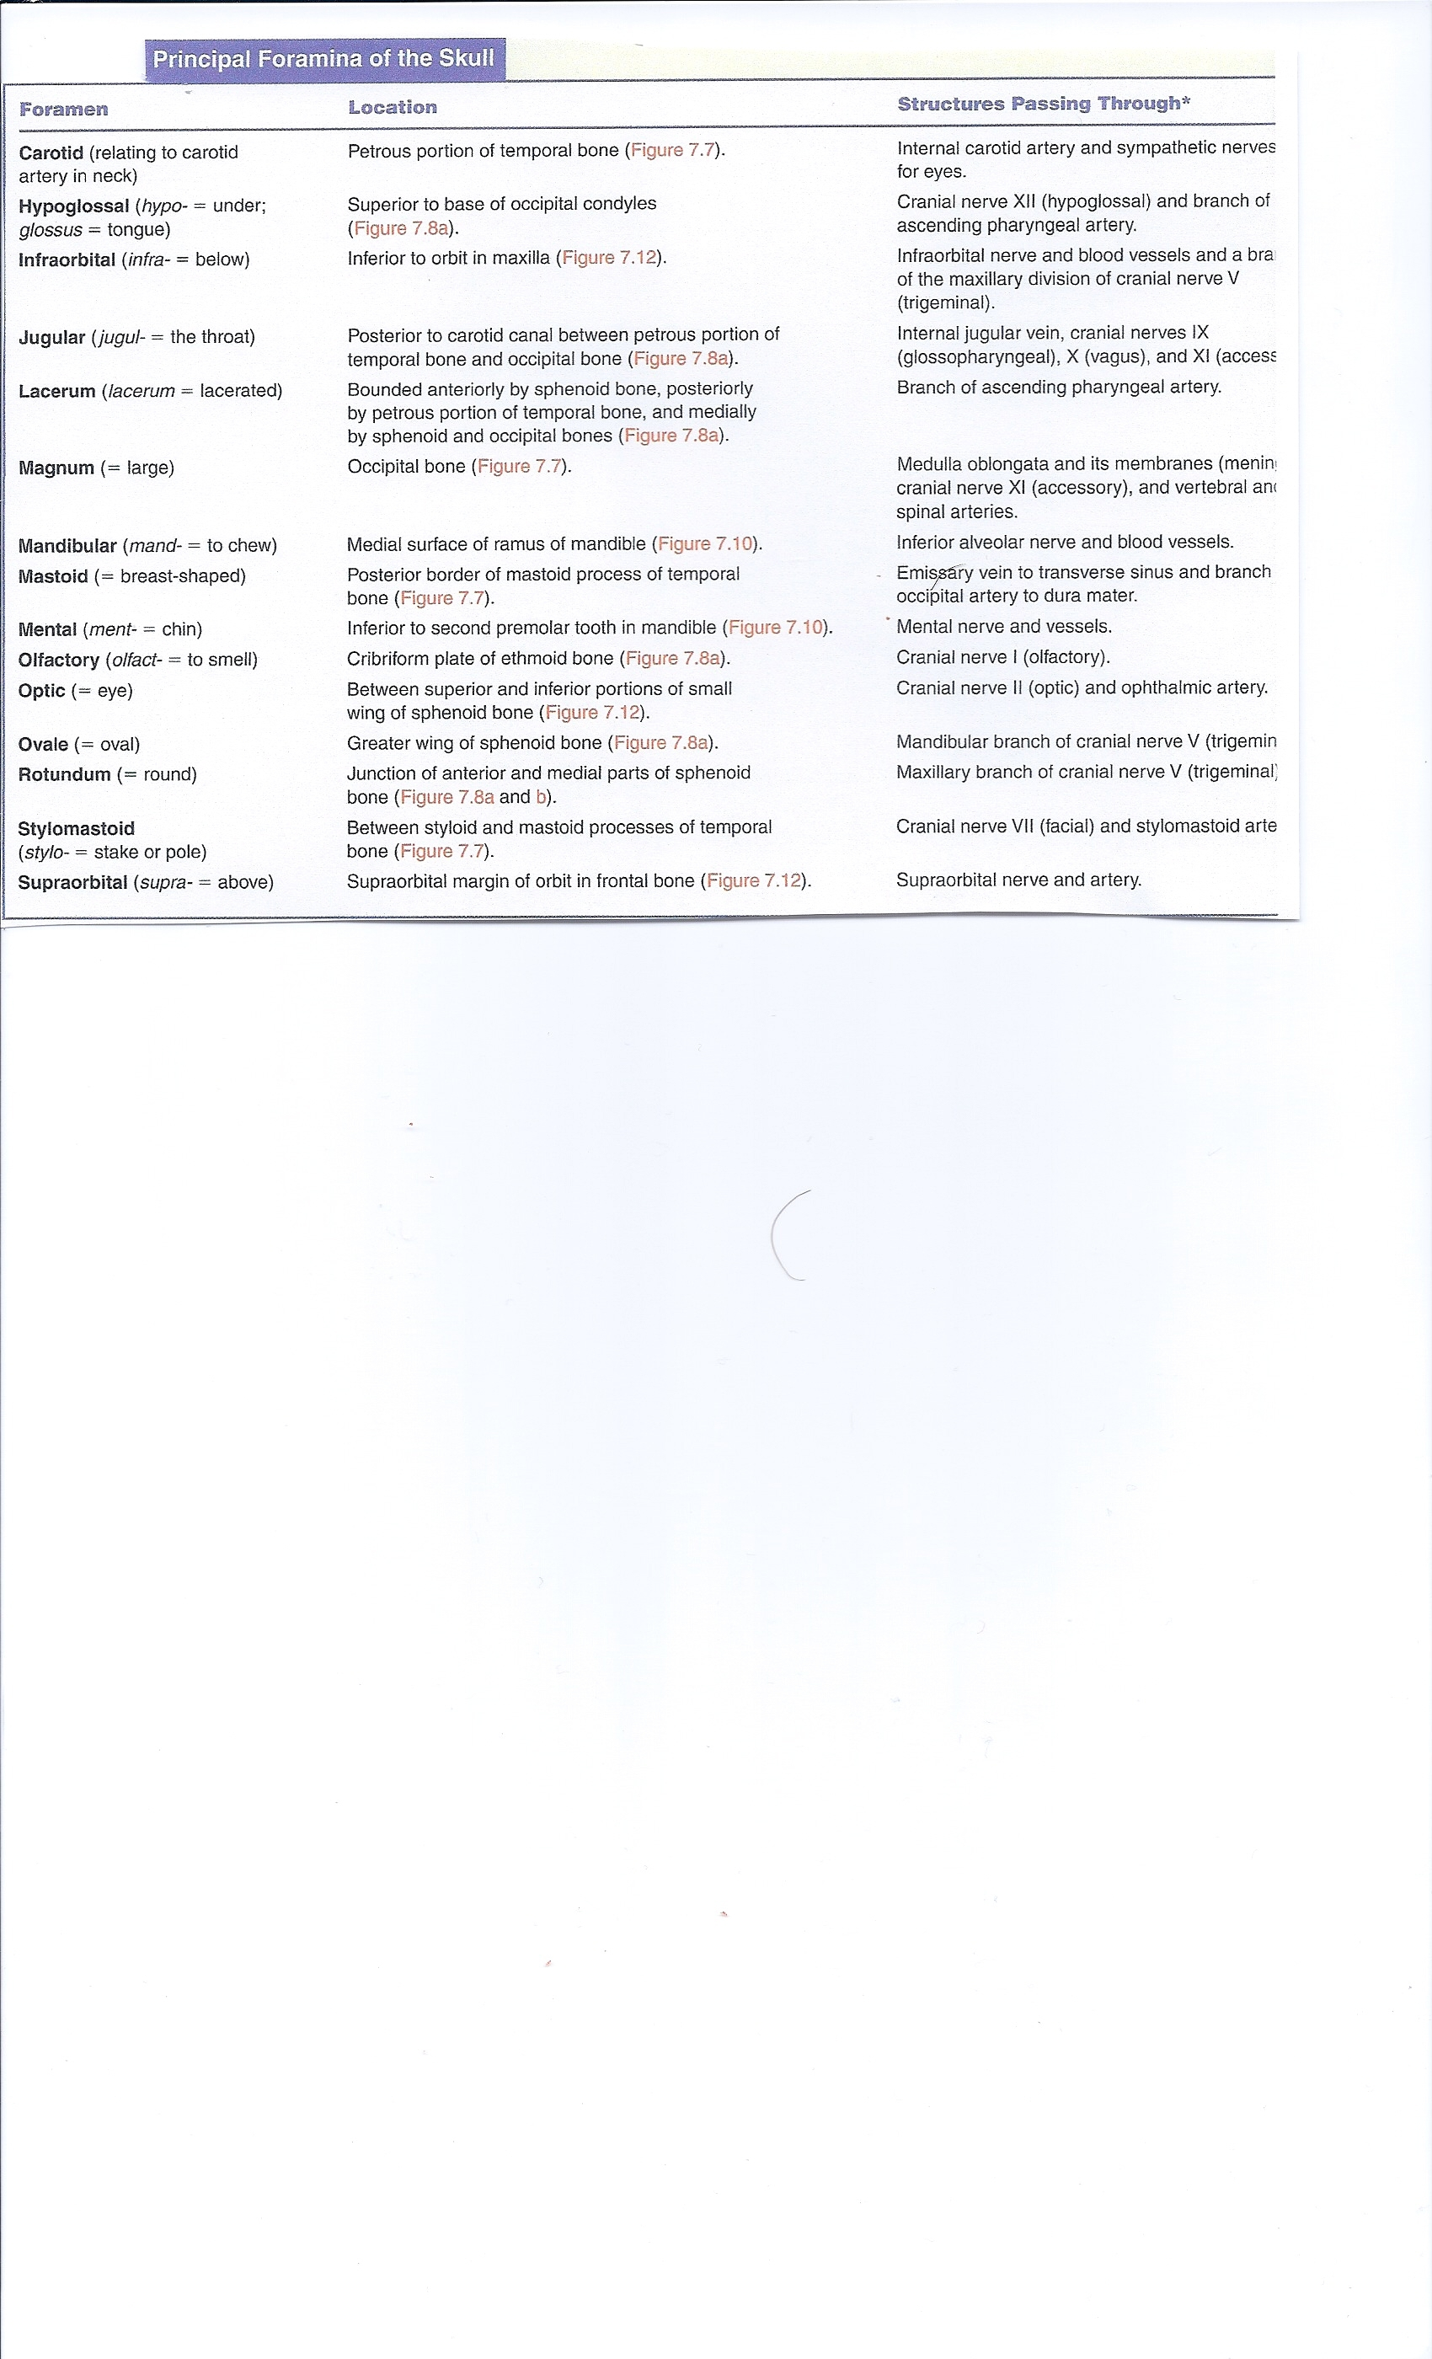

Slide 29
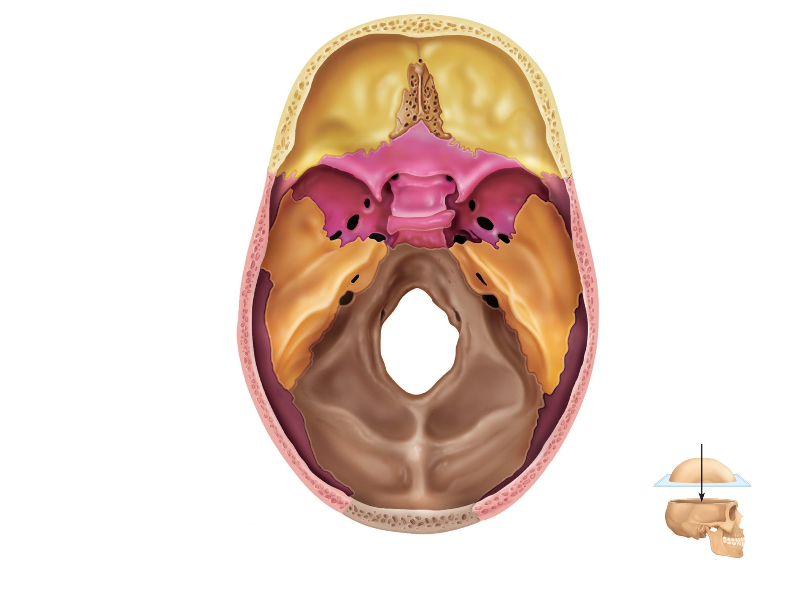
Ethmoid
bone
Cribriform plate
Frontal bone
Crista galli
Olfactory foramina
Anterior cranial fossa
Optic canal
Sphenoid
Lesser wing
Greater wing
Foramen rotundum
Foramen ovale
Hypophyseal fossa
of sella turcica
Foramen spinosum
Middle cranial
fossa
Foramen lacerum
Internal acoustic
meatus
Temporal bone
(petrous part)
Jugular foramen
Hypoglossal canal
Posterior
cranial fossa
Foramen magnum
View
Parietal bone
Occipital bone
(a) Superior view of the skull, calvaria removed
Figure 7.7a

Slide 30
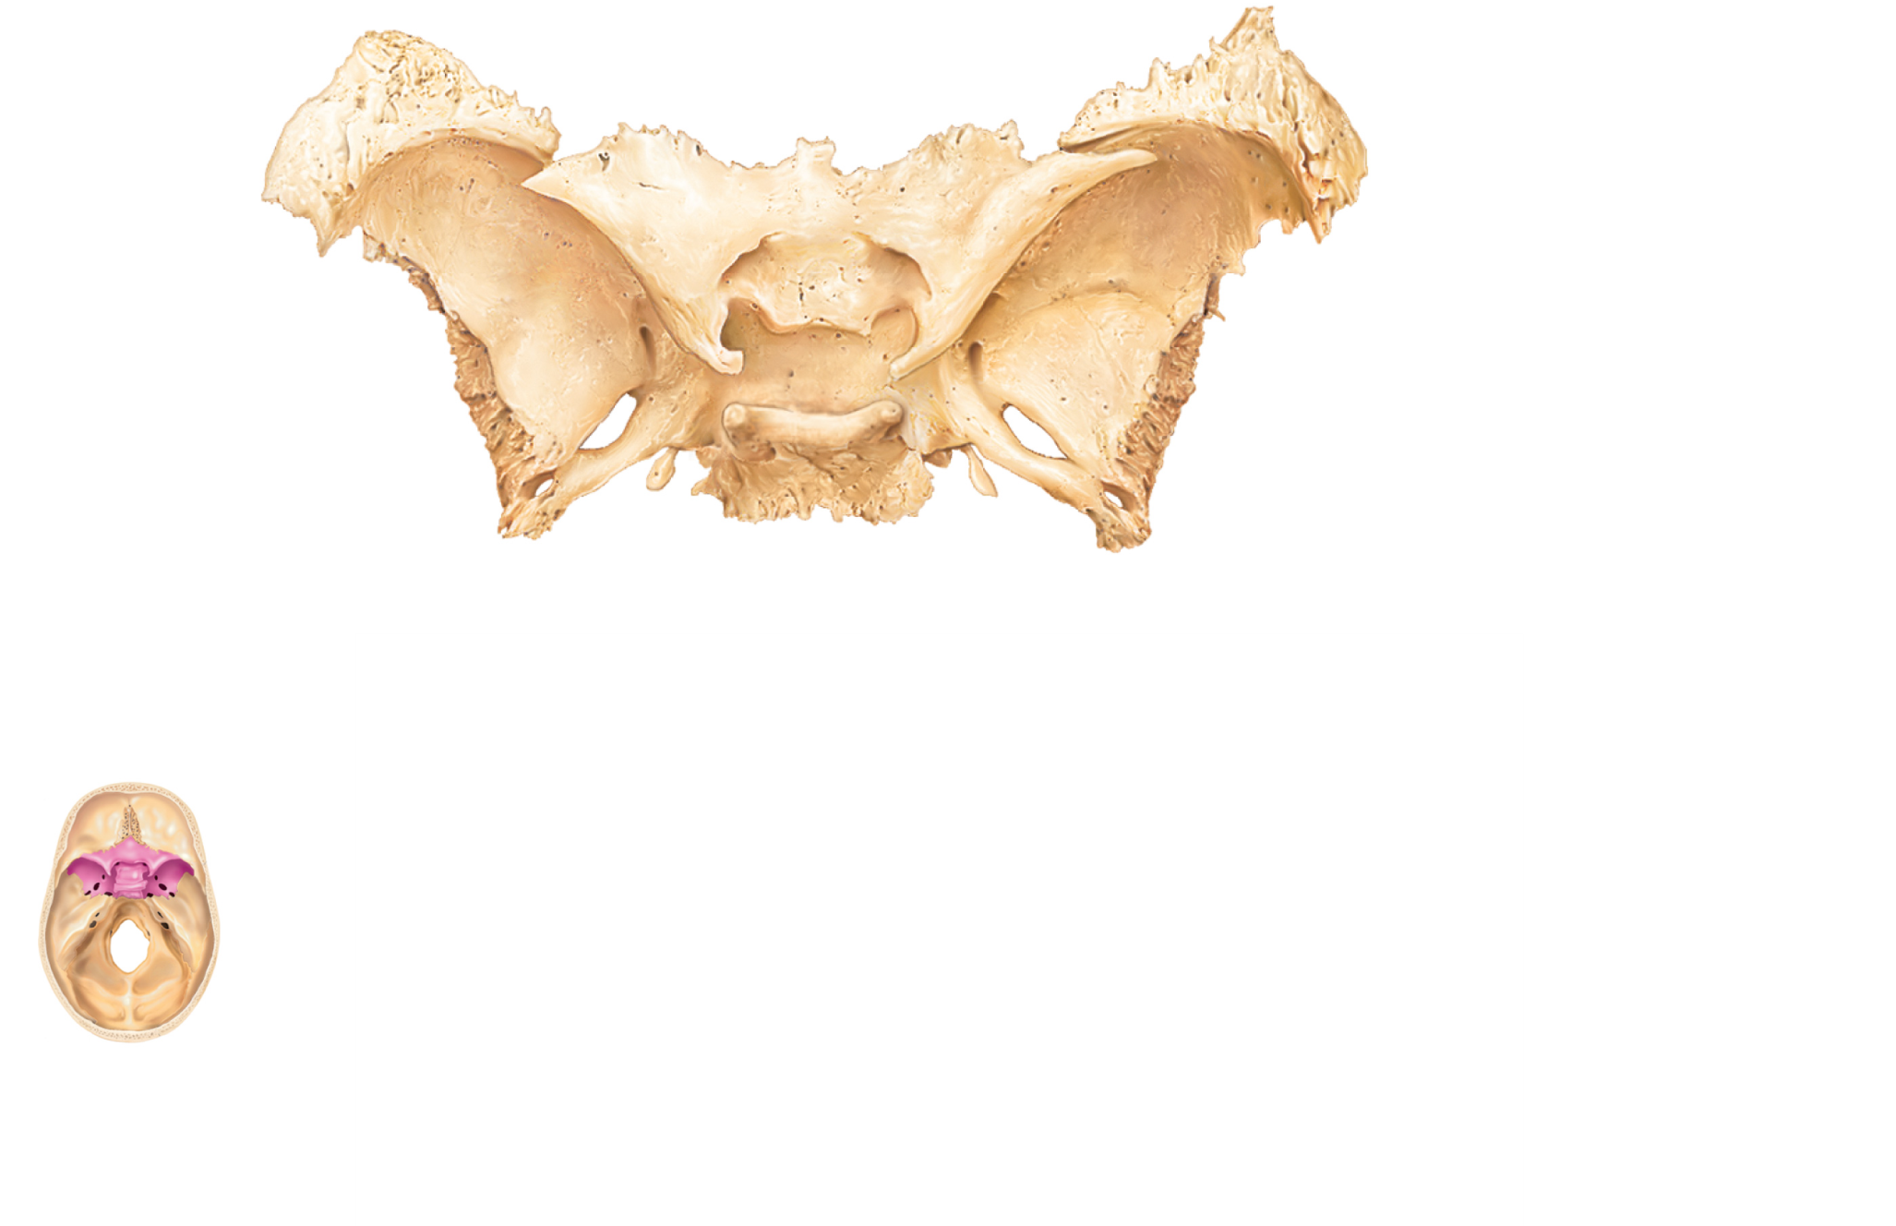
Lesser wing
Optic canal
Superior
orbital fissure
Greater
wing
Foramen
rotundum
Foramen
ovale
Hypophyseal
fossa of
sella turcica
Foramen
spinosum
Body of sphenoid
(a) Superior view
Figure 7.9a

Slide 31
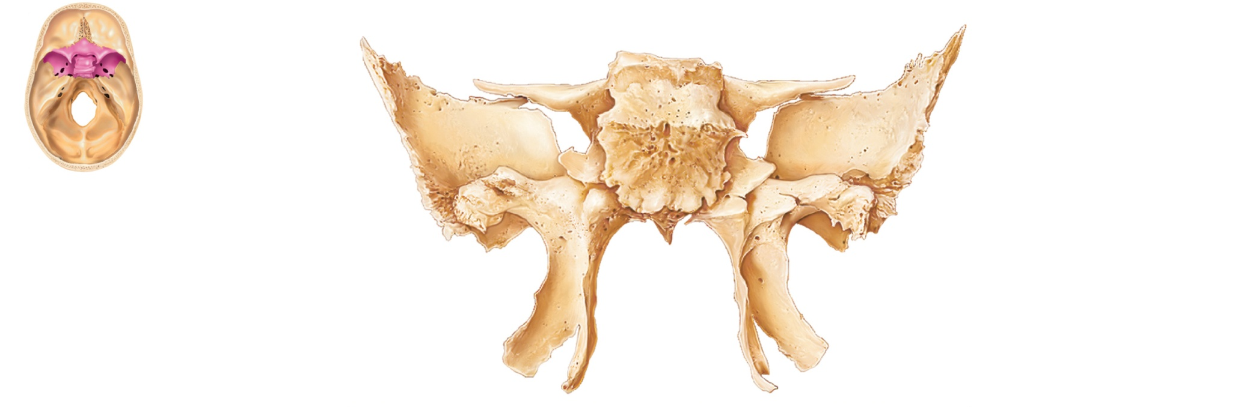
Body of sphenoid
Lesser
wing
Greater
wing
Superior
orbital
fissure
Pterygoid
process
(b) Posterior view
Figure 7.9b

Slide 32
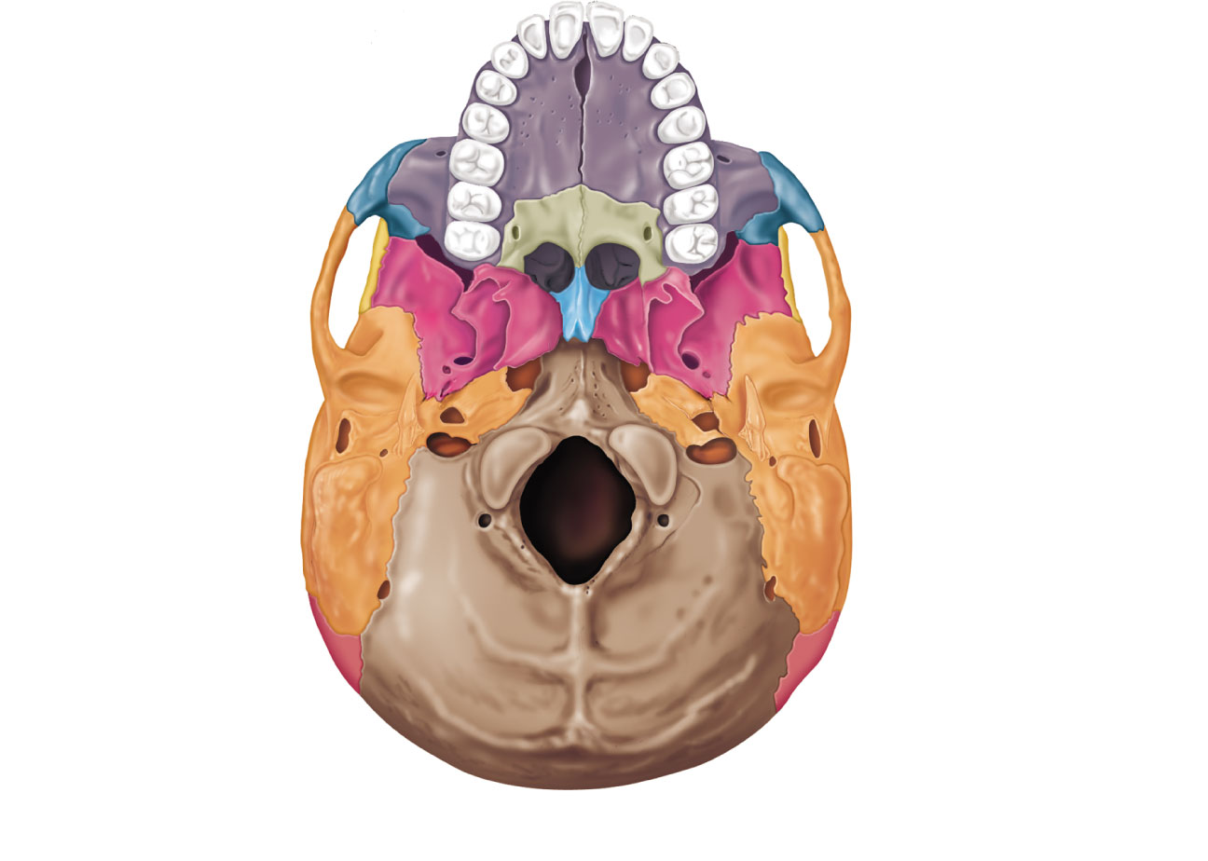
Maxilla
(palatine process)
Incisive fossa
Hard
palate
Intermaxillary suture
Palatine bone
(horizontal plate)
Median palatine suture
Infraorbital foramen
Maxilla
Zygomatic bone
Sphenoid bone
(greater wing)
Temporal bone
(zygomatic process)
Foramen ovale
Vomer
Foramen spinosum
Foramen lacerum
Mandibular
fossa
Carotid canal
Styloid process
External acoustic meatus
Stylomastoid
foramen
Mastoid process
Temporal bone
(petrous part)
Jugular foramen
Pharyngeal tubercle
of basilar region of
the occipital bone
Occipital condyle
Inferior nuchal line
Parietal bone
Superior nuchal line
External occipital crest
External occipital
protuberance
Foramen magnum
(a) Inferior view of the skull (mandible removed)
Figure 7.6a

Slide 33
Temporal Bones
Inferolateral aspects of skull and parts of cranial floor
Four major regions
  Squamous
  Tympanic
  Mastoid
  Petrous

Slide 34
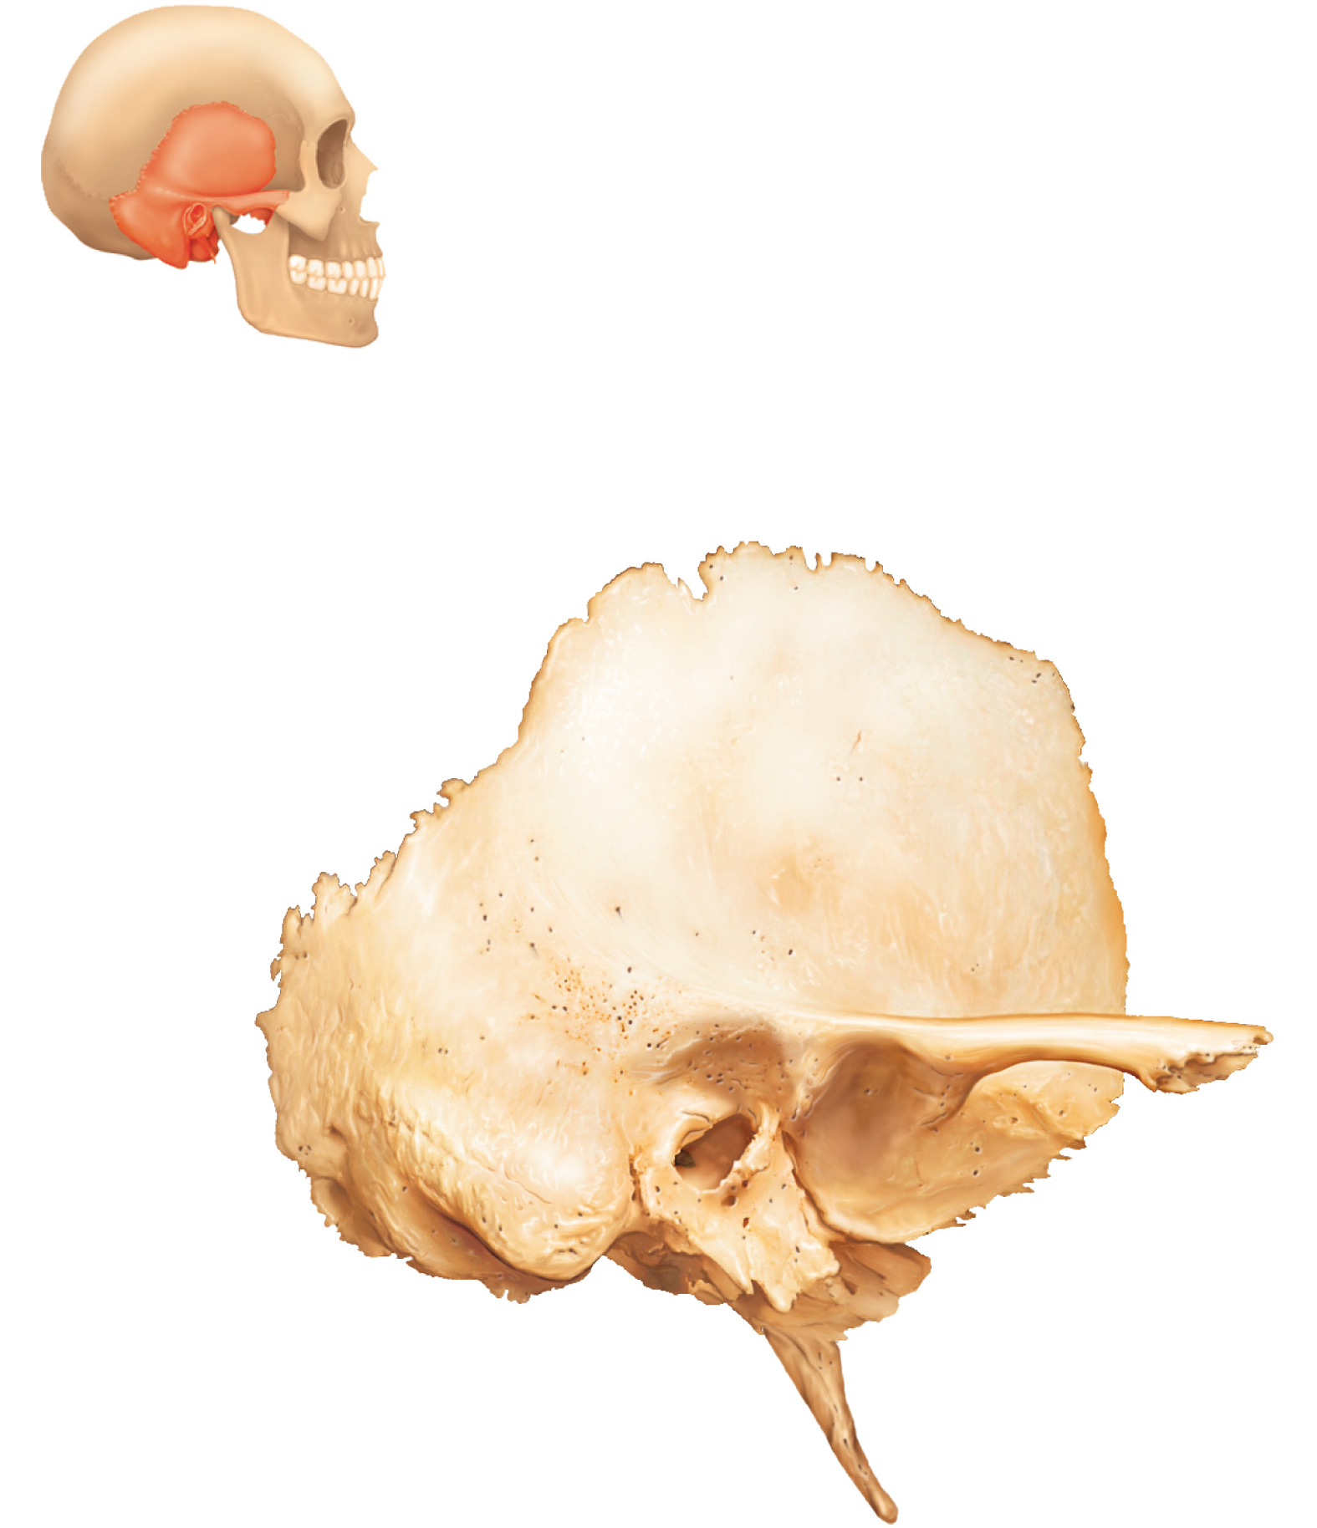
Squamous
region
External
acoustic
meatus
Mastoid
region
Zygomatic process
Mandibular fossa
Mastoid
process
Tympanic region
Styloid process
Figure 7.8

Slide 35
Maxilla
(palatine process)
Incisive fossa
Hard
palate
Intermaxillary suture
Palatine bone
(horizontal plate)
Median palatine suture
Infraorbital foramen
Maxilla
Zygomatic bone
Sphenoid bone
(greater wing)
Temporal bone
(zygomatic process)
Foramen ovale
Vomer
Foramen spinosum
Foramen lacerum
Mandibular
fossa
Carotid canal
Styloid process
External acoustic meatus
Stylomastoid
foramen
Mastoid process
Temporal bone
(petrous part)
Jugular foramen
Pharyngeal tubercle
of basilar region of
the occipital bone
Occipital condyle
Inferior nuchal line
Parietal bone
Superior nuchal line
External occipital crest
External occipital
protuberance
Foramen magnum
(a) Inferior view of the skull (mandible removed)
Figure 7.6a

Slide 36
Ethmoid
bone
Cribriform plate
Frontal bone
Crista galli
Olfactory foramina
Anterior cranial fossa
Optic canal
Sphenoid
Lesser wing
Greater wing
Foramen rotundum
Foramen ovale
Hypophyseal fossa
of sella turcica
Foramen spinosum
Middle cranial
fossa
Foramen lacerum
Internal acoustic
meatus
Temporal bone
(petrous part)
Jugular foramen
Hypoglossal canal
Posterior
cranial fossa
Foramen magnum
View
Parietal bone
Occipital bone
(a) Superior view of the skull, calvaria removed
Figure 7.7a

Slide 37
Occipital Bone
Most of skull’s posterior wall and posterior cranial fossa
Articulates with 1st vertebra
Sites of attachment for the ligamentum nuchae and many neck and back muscles

Slide 38
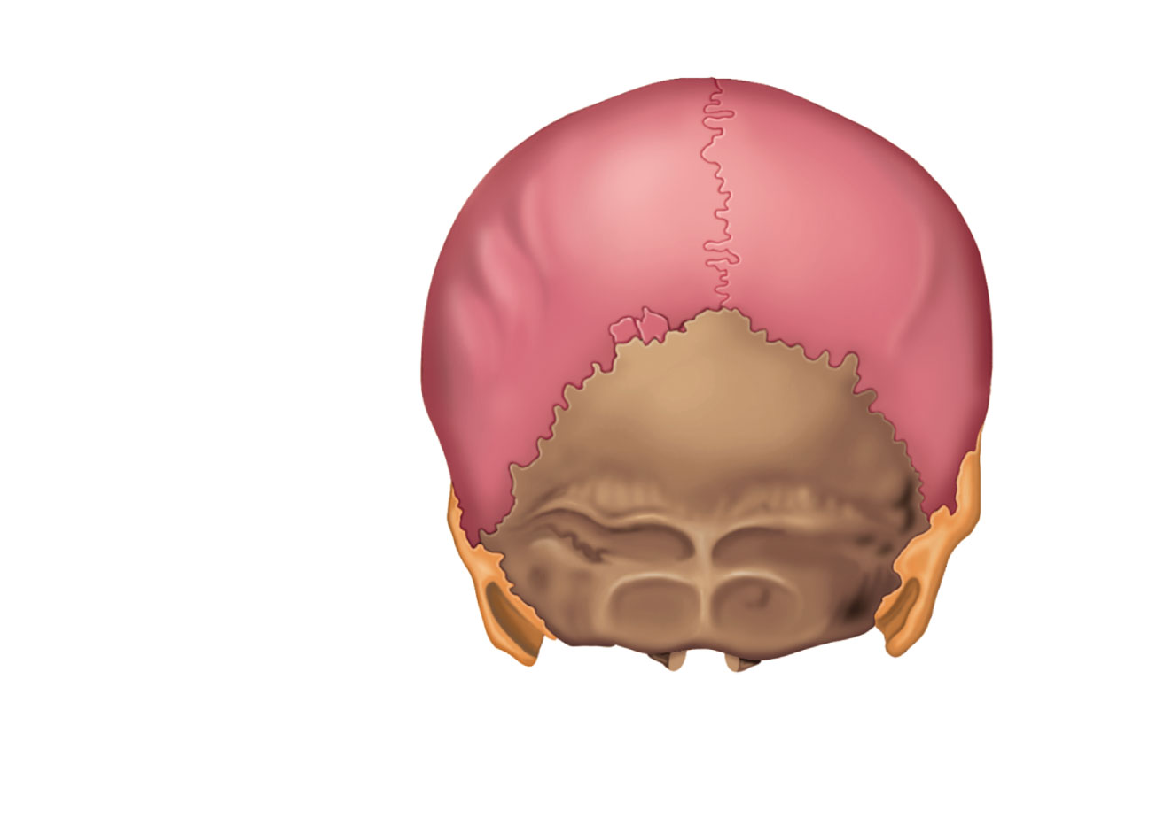
Sagittal suture
Parietal
bone
Sutural
bone
Lambdoid
suture
Occipital bone
Superior nuchal line
External
occipital
protuberance
Mastoid
process
Inferior
nuchal
line
Occipitomastoid
suture
External
occipital
crest
Occipital
condyle
(b) Posterior view
Figure 7.4b

Slide 39
Maxilla
(palatine process)
Incisive fossa
Hard
palate
Intermaxillary suture
Palatine bone
(horizontal plate)
Median palatine suture
Infraorbital foramen
Maxilla
Zygomatic bone
Sphenoid bone
(greater wing)
Temporal bone
(zygomatic process)
Foramen ovale
Vomer
Foramen spinosum
Foramen lacerum
Mandibular
fossa
Carotid canal
Styloid process
External acoustic meatus
Stylomastoid
foramen
Mastoid process
Temporal bone
(petrous part)
Jugular foramen
Pharyngeal tubercle
of basilar region of
the occipital bone
Occipital condyle
Inferior nuchal line
Parietal bone
Superior nuchal line
External occipital crest
External occipital
protuberance
Foramen magnum
(a) Inferior view of the skull (mandible removed)
Figure 7.6a

Slide 40
Sutural Bones
Tiny irregularly shaped bones that appear within sutures

Slide 41
Sagittal suture
Parietal
bone
Sutural
bone
Lambdoid
suture
Occipital bone
Superior nuchal line
External
occipital
protuberance
Mastoid
process
Inferior
nuchal
line
Occipitomastoid
suture
External
occipital
crest
Occipital
condyle
(b) Posterior view
Figure 7.4b

Slide 42
Facial Bones
Mandible
Maxillary bones (maxillae) (2)
Zygomatic bones (2)
Nasal bones (2)
Lacrimal bones (2)
Palatine bones (2)
Vomer
Inferior nasal conchae (2)

Slide 43
Mandible
Lower jaw
Largest, strongest bone of face
Temporomandibular joint: only freely movable joint in skull

Slide 44
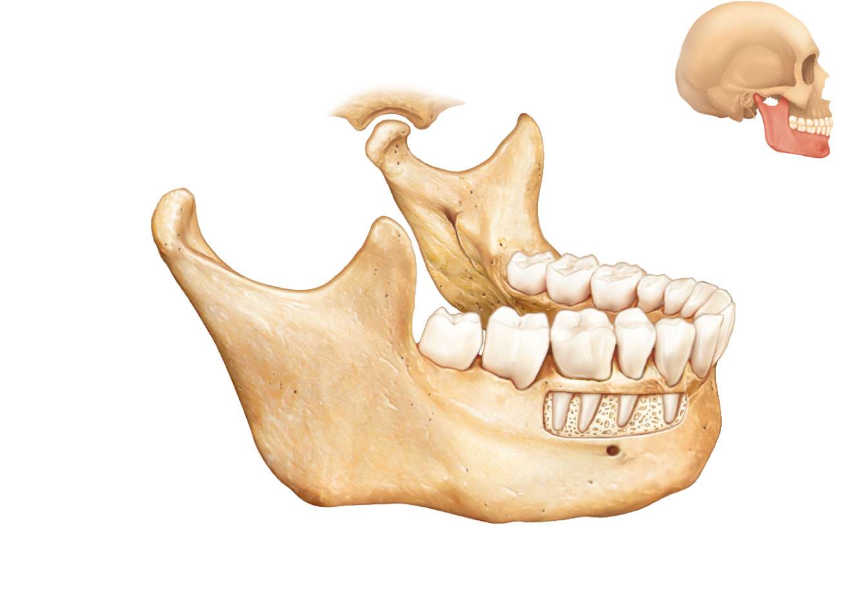
Temporomandibular
joint
Mandibular fossa
of temporal bone
Mandibular notch
Mandibular
condyle
Coronoid
process
Mandibular foramen
Alveolar
margin
Ramus
of
mandible
Mental
foramen
Mandibular
angle
Body of mandible
(a) Mandible, right lateral view
Figure 7.11a

Slide 45
Maxillary Bones
Medially fused to form upper jaw and central portion of facial skeleton
Keystone bones
  Articulate with all other facial bones except mandible

Slide 46
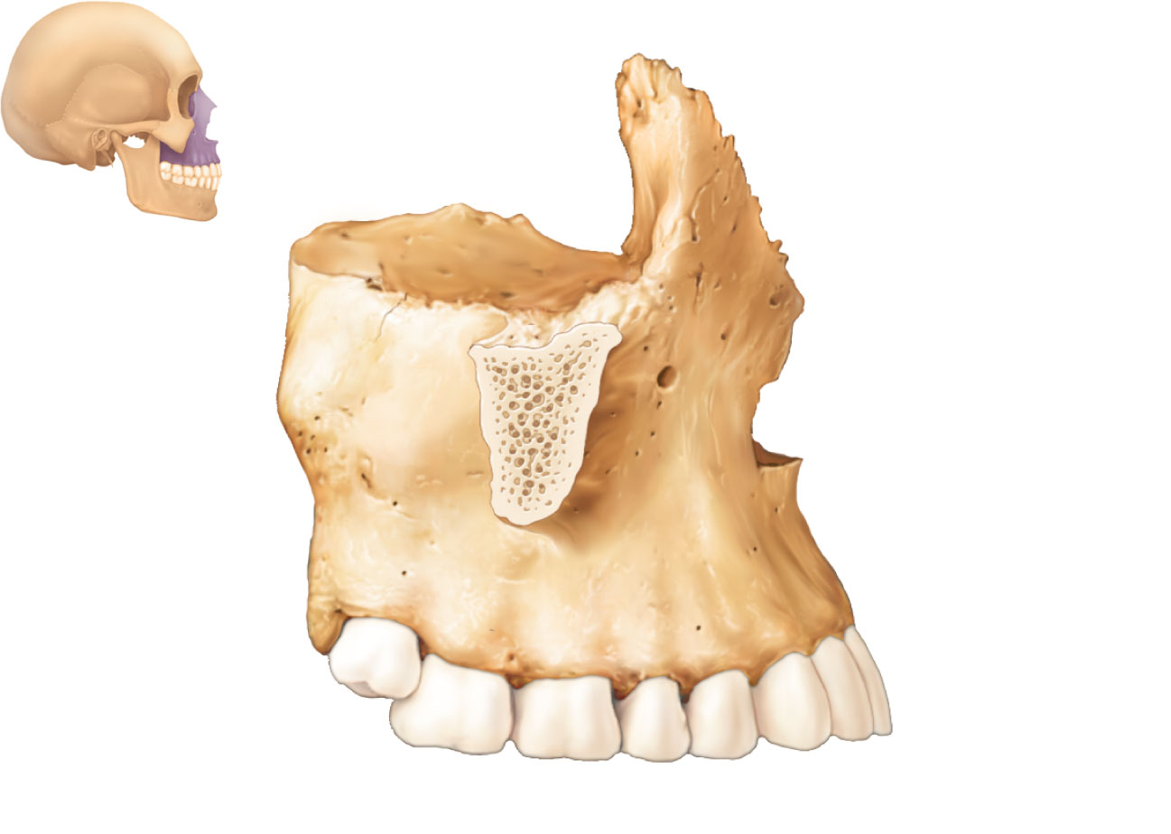
Articulates with
frontal bone
Frontal process
Orbital
surface
Zygomatic
process
(cut)
Infraorbital
foramen
Anterior nasal
spine
Alveolar
margin
(b) Maxilla, right lateral view
Figure 7.11b

Slide 47
Frontal bone
Glabella
Parietal bone
Frontonasal suture
Supraorbital foramen
(notch)
Squamous part
of frontal bone
Nasal bone
Supraorbital margin
Sphenoid bone
(greater wing)
Superior orbital
fissure
Temporal bone
Optic canal
Ethmoid bone
Inferior orbital
fissure
Lacrimal bone
Middle nasal
concha
Zygomatic bone
Ethmoid
bone
Infraorbital foramen
Perpendicular
plate
Maxilla
Mandible
Inferior nasal concha
Vomer
Mental
foramen
(a) Anterior view
Mandibular symphysis
Figure 7.4a

Slide 48
Maxilla
(palatine process)
Incisive fossa
Hard
palate
Intermaxillary suture
Palatine bone
(horizontal plate)
Median palatine suture
Infraorbital foramen
Maxilla
Zygomatic bone
Sphenoid bone
(greater wing)
Temporal bone
(zygomatic process)
Foramen ovale
Vomer
Foramen spinosum
Foramen lacerum
Mandibular
fossa
Carotid canal
Styloid process
External acoustic meatus
Stylomastoid
foramen
Mastoid process
Temporal bone
(petrous part)
Jugular foramen
Pharyngeal tubercle
of basilar region of
the occipital bone
Occipital condyle
Inferior nuchal line
Parietal bone
Superior nuchal line
External occipital crest
External occipital
protuberance
Foramen magnum
(a) Inferior view of the skull (mandible removed)
Figure 7.6a

Slide 49
Zygomatic Bones
Cheekbones
Inferolateral margins of orbits

Slide 50
Frontal bone
Glabella
Parietal bone
Frontonasal suture
Supraorbital foramen
(notch)
Squamous part
of frontal bone
Nasal bone
Supraorbital margin
Sphenoid bone
(greater wing)
Superior orbital
fissure
Temporal bone
Optic canal
Ethmoid bone
Inferior orbital
fissure
Lacrimal bone
Middle nasal
concha
Zygomatic bone
Ethmoid
bone
Infraorbital foramen
Perpendicular
plate
Maxilla
Mandible
Inferior nasal concha
Vomer
Mental
foramen
(a) Anterior view
Mandibular symphysis
Figure 7.4a

Slide 51
Nasal Bones and Lacrimal Bones
Nasal bones
  Form bridge of nose
Lacrimal bones
  In medial walls of orbits
  Lacrimal fossa houses lacrimal sac

Slide 52
Coronal suture
Frontal bone
Parietal bone
Sphenoid bone
(greater wing)
Ethmoid bone
Temporal bone
Lacrimal bone
Lambdoid
suture
Lacrimal fossa
Squamous
suture
Occipital
bone
Nasal bone
Zygomatic
bone
Zygomatic
process
Occipitomastoid
suture
Maxilla
External acoustic
meatus
Mastoid process
Alveolar
margins
Styloid process
Mandibular condyle
Mandible
Mandibular notch
Mental foramen
Mandibular ramus
Mandibular angle
Coronoid process
(a) External anatomy of the right side of the skull
Figure 7.5a

Slide 53
Palatine Bones and Vomer
Palatine bones
  Posterior one-third of hard palate
  Posterolateral walls of the nasal cavity
  Small part of the orbits
Vomer
  Plow shaped
  Lower part of nasal septum

Slide 54
Maxilla
(palatine process)
Incisive fossa
Hard
palate
Intermaxillary suture
Palatine bone
(horizontal plate)
Median palatine suture
Infraorbital foramen
Maxilla
Zygomatic bone
Sphenoid bone
(greater wing)
Temporal bone
(zygomatic process)
Foramen ovale
Vomer
Foramen spinosum
Foramen lacerum
Mandibular
fossa
Carotid canal
Styloid process
External acoustic meatus
Stylomastoid
foramen
Mastoid process
Temporal bone
(petrous part)
Jugular foramen
Pharyngeal tubercle
of basilar region of
the occipital bone
Occipital condyle
Inferior nuchal line
Parietal bone
Superior nuchal line
External occipital crest
External occipital
protuberance
Foramen magnum
(a) Inferior view of the skull (mandible removed)
Figure 7.6a

Slide 55
Inferior Nasal Conchae
Form part of lateral walls of nasal cavity

Slide 56
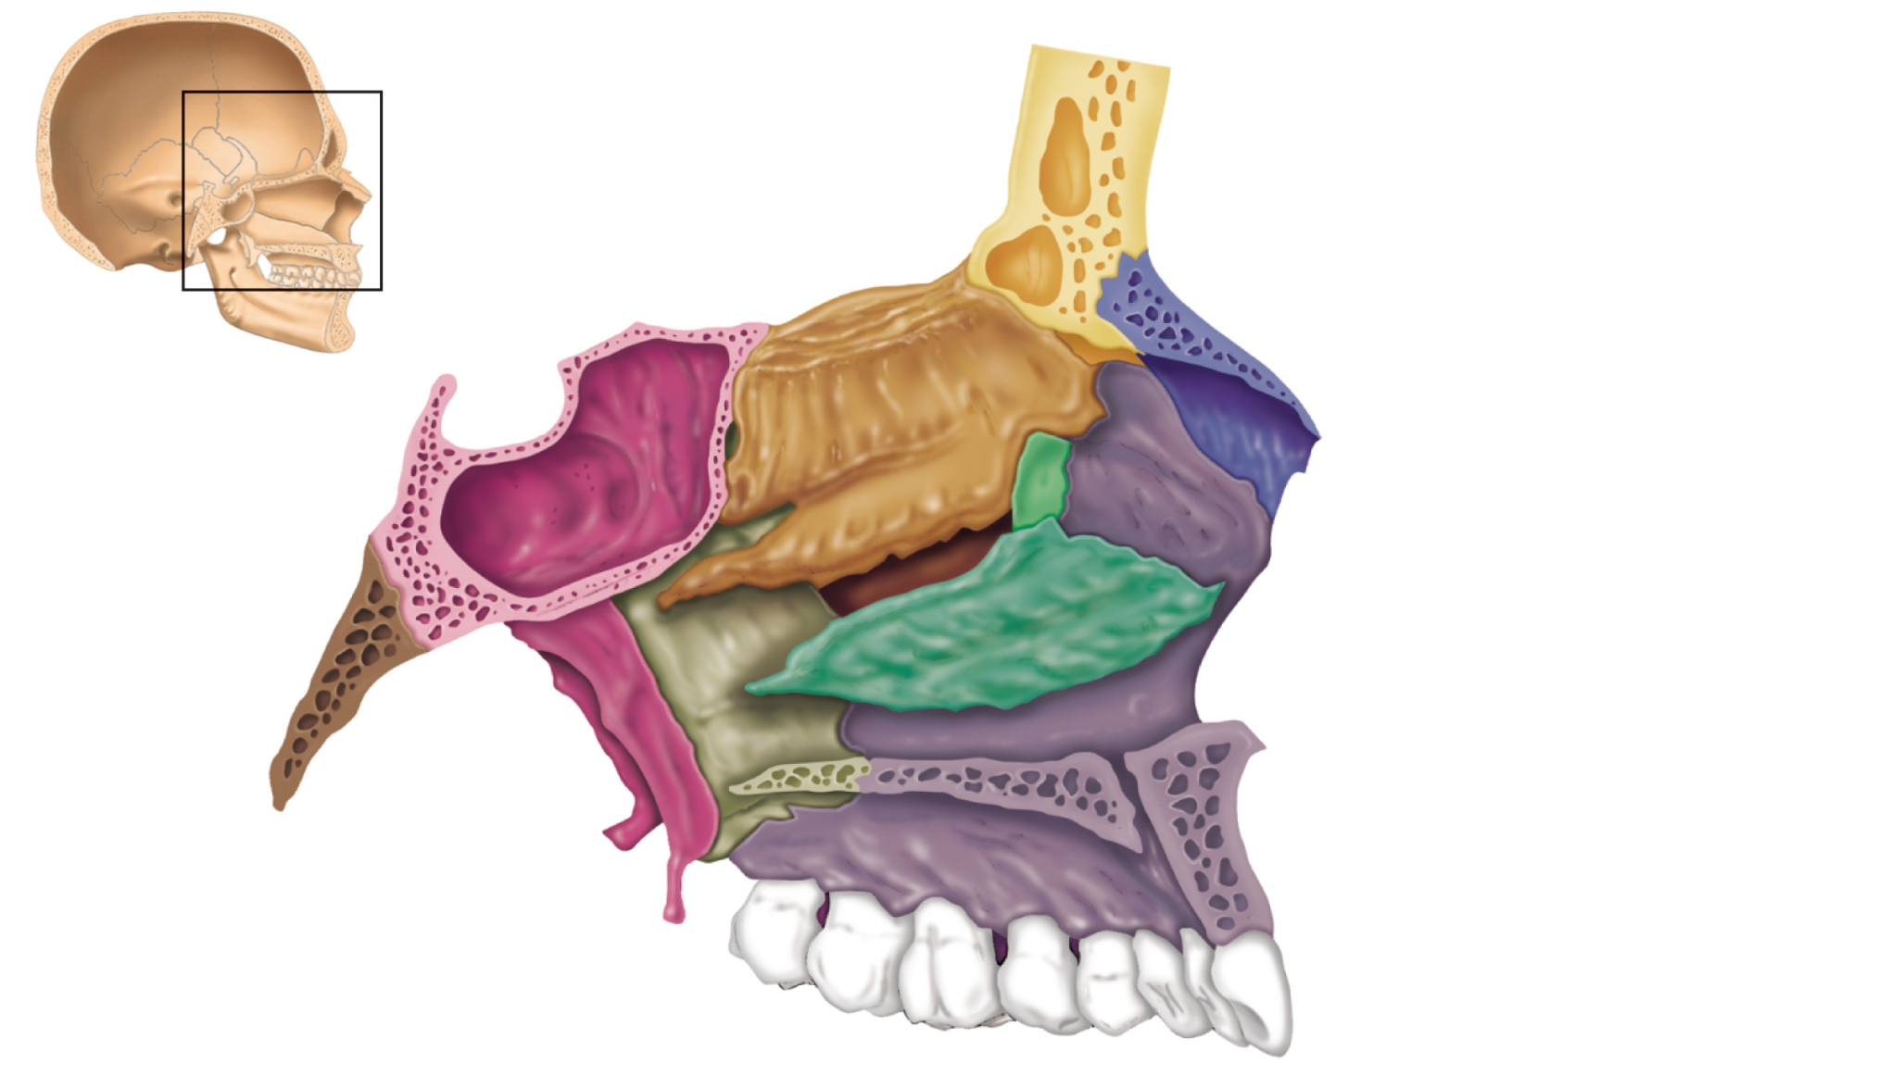
Frontal sinus
Superior, middle, and
inferior meatus
Superior
nasal concha
Ethmoid
bone
Middle
nasal concha
Inferior nasal
concha
Nasal bone
Anterior nasal spine
Sphenoid
sinus
Maxillary bone
(palatine process)
Sphenoid
bone
Pterygoid
process
Palatine bone
(perpendicular plate)
Palatine bone
(horizontal plate)
(a) Bones forming the left lateral wall of the nasal cavity
(nasal septum removed)
Figure 7.14a

Slide 57
Orbits
Encase eyes and lacrimal glands
Sites of attachment for eye muscles
Formed by parts of seven bones (next slide)

Slide 58
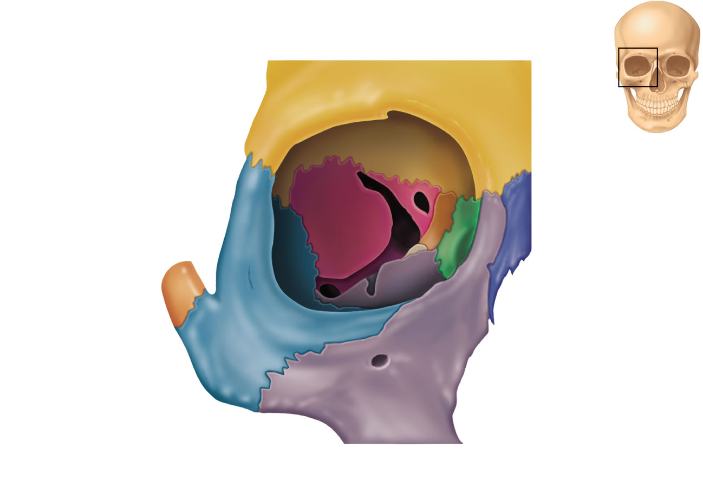
Superior
orbital fissure
Roof of orbit
Supraorbital notch
Optic canal
• Lesser wing of
sphenoid bone
• Orbital plate of
frontal bone
Medial wall
• Sphenoid body
Lateral wall of orbit
• Orbital plate
of ethmoid bone
• Zygomatic process
of frontal bone
• Frontal process
of maxilla
• Greater wing of
sphenoid bone
• Lacrimal bone
• Orbital surface of
zygomatic bone
Nasal bone
Inferior orbital fissure
Floor of orbit
Infraorbital groove
• Orbital process of
palatine bone
Zygomatic bone
• Orbital surface of
maxillary bone
Infraorbital foramen
• Zygomatic bone
(b) Contribution of each of the seven bones forming the right orbit
Figure 7.13a

Slide 59
Nasal Cavity
Roof, lateral walls, and floor formed by parts of four bones
  Ethmoid
  Palatine bones
  Maxillary bones
  Inferior nasal conchae
Nasal septum of bone and hyaline cartilage
  Ethmoid
  Vomer
  Anterior septal cartilage

Slide 60
Frontal sinus
Superior, middle, and
inferior meatus
Superior
nasal concha
Ethmoid
bone
Middle
nasal concha
Inferior nasal
concha
Nasal bone
Anterior nasal spine
Sphenoid
sinus
Maxillary bone
(palatine process)
Sphenoid
bone
Pterygoid
process
Palatine bone
(perpendicular plate)
Palatine bone
(horizontal plate)
(a) Bones forming the left lateral wall of the nasal cavity
(nasal septum removed)
Figure 7.14a

Slide 61
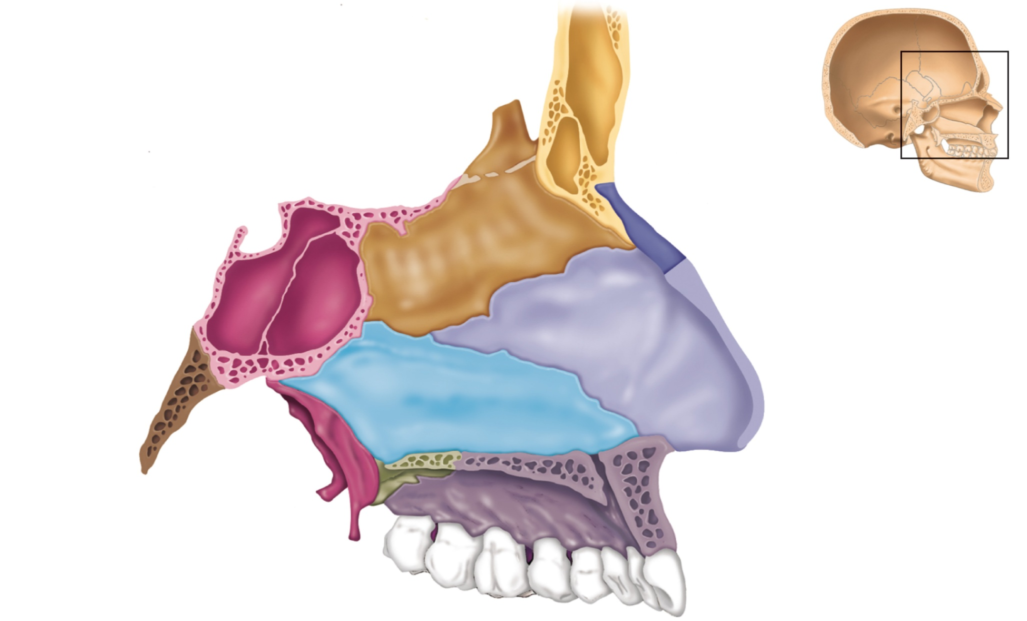
Crista galli
Ethmoid
bone
Cribriform
plate
Frontal
sinus
Sella turcica
Nasal bone
Perpendicular
plate of
ethmoid bone
Sphenoid
sinus
Septal cartilage
Palatine
bone
Vomer
Alveolar margin
of maxilla
Hard
palate
Palatine process
of maxilla
(b) Nasal cavity with septum in place showing the contributions
of the ethmoid bone, the vomer, and septal cartilage
Figure 7.14b

Slide 62
Paranasal Sinuses
Mucosa-lined, air-filled spaces
Lighten the skull
Enhance resonance of voice
Found in frontal, sphenoid, ethmoid, and maxillary bones

Slide 63
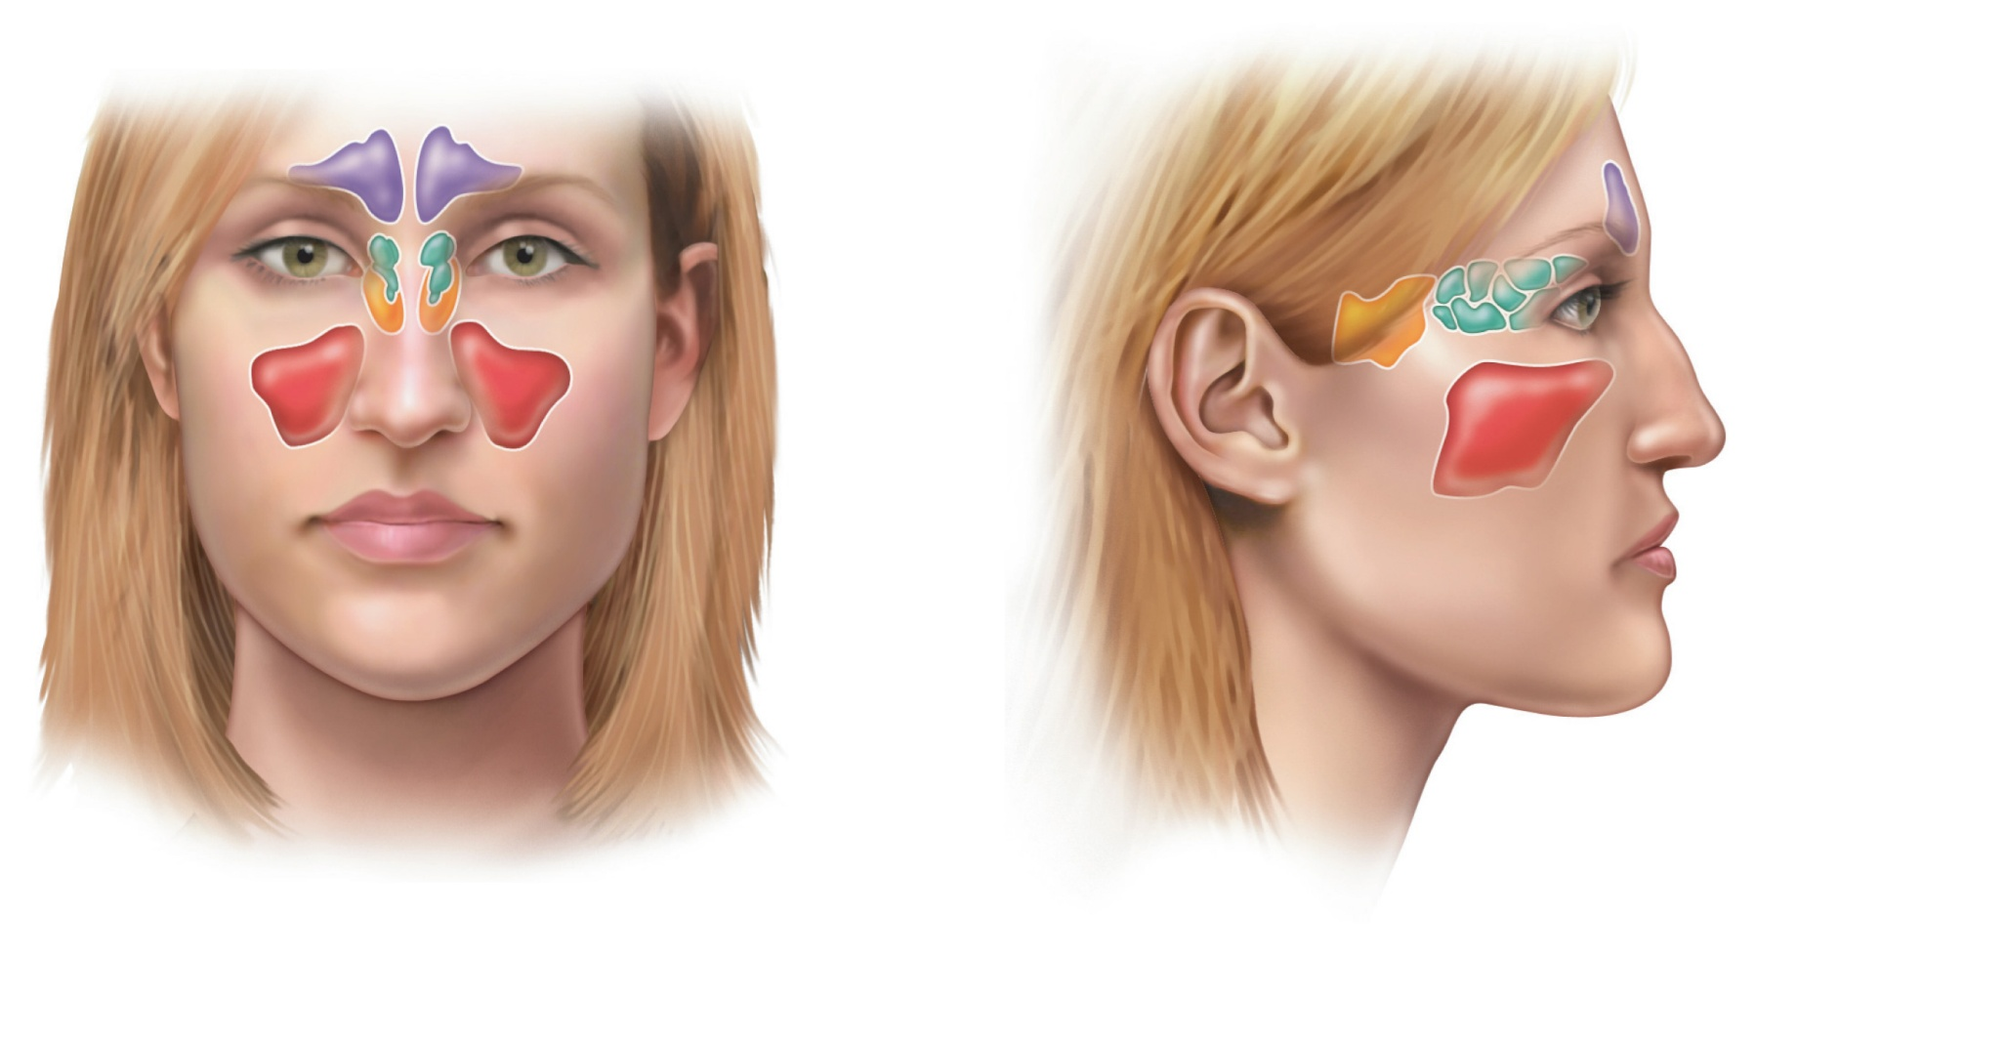
Frontal
sinus
Frontal
sinus
Ethmoidal
air cells
(sinus)
Ethmoidal
air cells
Sphenoid
sinus
Sphenoid
sinus
Maxillary
sinus
Maxillary
sinus
(a) Anterior aspect
(b) Medial aspect
Figure 7.15

Slide 64
Hyoid Bone
Not a bone of the skull
Does not articulate directly with another bone
Site of attachment for muscles of swallowing and speech

Slide 65
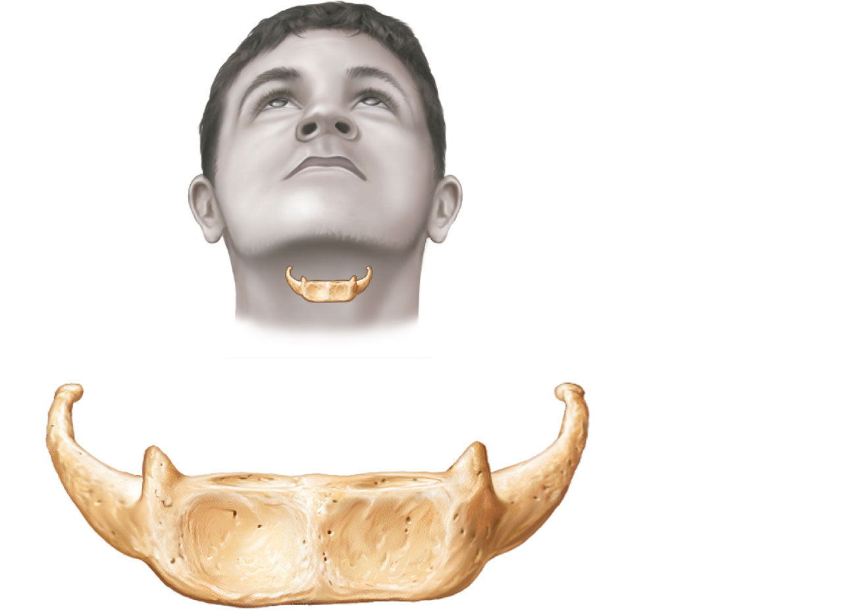
Greater horn
Lesser horn
Body
Figure 7.12

