Slide 1
9
Muscle 2
Mike Clark, M.D.

Slide 2
Review Principles of Muscle Mechanics
Same principles apply to contraction of a single fiber and a whole muscle
Contraction produces tension, the force exerted on the load or object to be moved

Slide 3
Review Principles of Muscle Mechanics
Contraction does not always shorten a muscle:
  Isometric contraction: no shortening; muscle tension increases but does not exceed the load
  Isotonic contraction: muscle shortens because muscle tension exceeds the load

Slide 4
Review Principles of Muscle Mechanics
Force and duration of contraction vary in response to stimuli of different frequencies and intensities

Slide 5
Motor Unit: The Nerve-Muscle Functional Unit
Motor unit = a somatic motor neuron and all (four to several hundred) muscle fibers it supplies (innervates)
A motor unit contracts in an all-or-none manner (if turned on all muscles will contract equally; if not turned on none will contract)

Slide 6
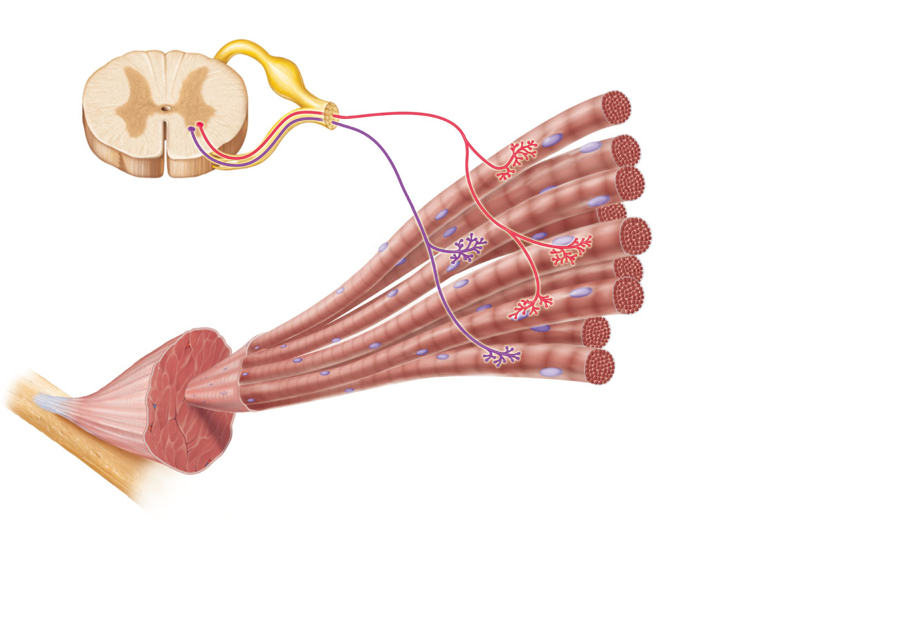
Spinal cord
Axon terminals at
neuromuscular junctions
Motor
unit 1
Motor
unit 2
Nerve
Motor neuron
cell body
Motor
neuron
axon
Muscle
Muscle
fibers
Axons of motor neurons extend from the spinal cord to the
muscle. There each axon divides into a number of axon
terminals that form neuromuscular junctions with muscle
fibers scattered throughout the muscle.
Figure 9.13a

Slide 7
Motor Unit
Small motor units in muscles that control fine movements (fingers, eyes)
Large motor units in large weight-bearing muscles (thighs, hips)

Slide 8
Hypothetical
Let’s say that one muscle cell could lift ¼ pound (definitely not true, just for example)
Let’s say that large motor units have 20 muscle cells. Since a motor unit contracts in an all-or-none manner (if turned on all muscles will contract equally; if not turned on none will contract) So this motor unit will lift 5 pounds, no more and no less.
Lets say a small motor unit is 4 muscle cells; one pound lifted, no more and no less
Let’s say an entire muscle has 10 motor units. So the maximum that muscle could lift if it is made up of large motor units is 50 pounds (200 muscle cells X ¼ pound)
Small motor units would max at 10 pounds.

Slide 9
Motor Unit
Muscle fibers from a motor unit are spread throughout the muscle so that a single motor unit causes weak contraction of entire muscle
Motor units in a muscle usually contract asynchronously; helps prevent fatigue

Slide 10
Muscle Twitch
Response of a muscle to a single, brief threshold stimulus
Simplest contraction observable in the lab (recorded as a myogram)

Slide 11
Muscle Twitch
Three phases of a twitch:
  Latent period: events of excitation-contraction coupling
  Period of contraction: cross bridge formation; tension increases
  Period of relaxation: Ca²⁺ reentry into the SR; tension declines to zero

Slide 12
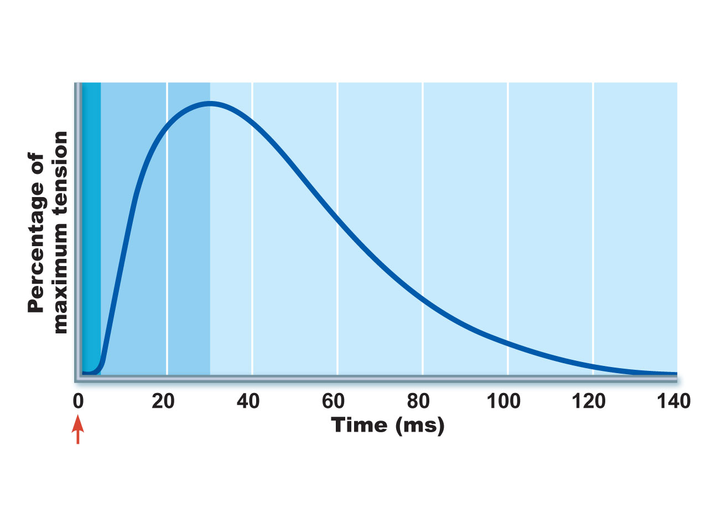
Latent
period
Period of
contraction
Period of
relaxation
Single
stimulus
(a) Myogram showing the three phases of an isometric twitch
Figure 9.14a

Slide 13
Muscle Twitch Comparisons
Different strength and duration of twitches are due to variations in metabolic properties and enzymes between muscles

Slide 14
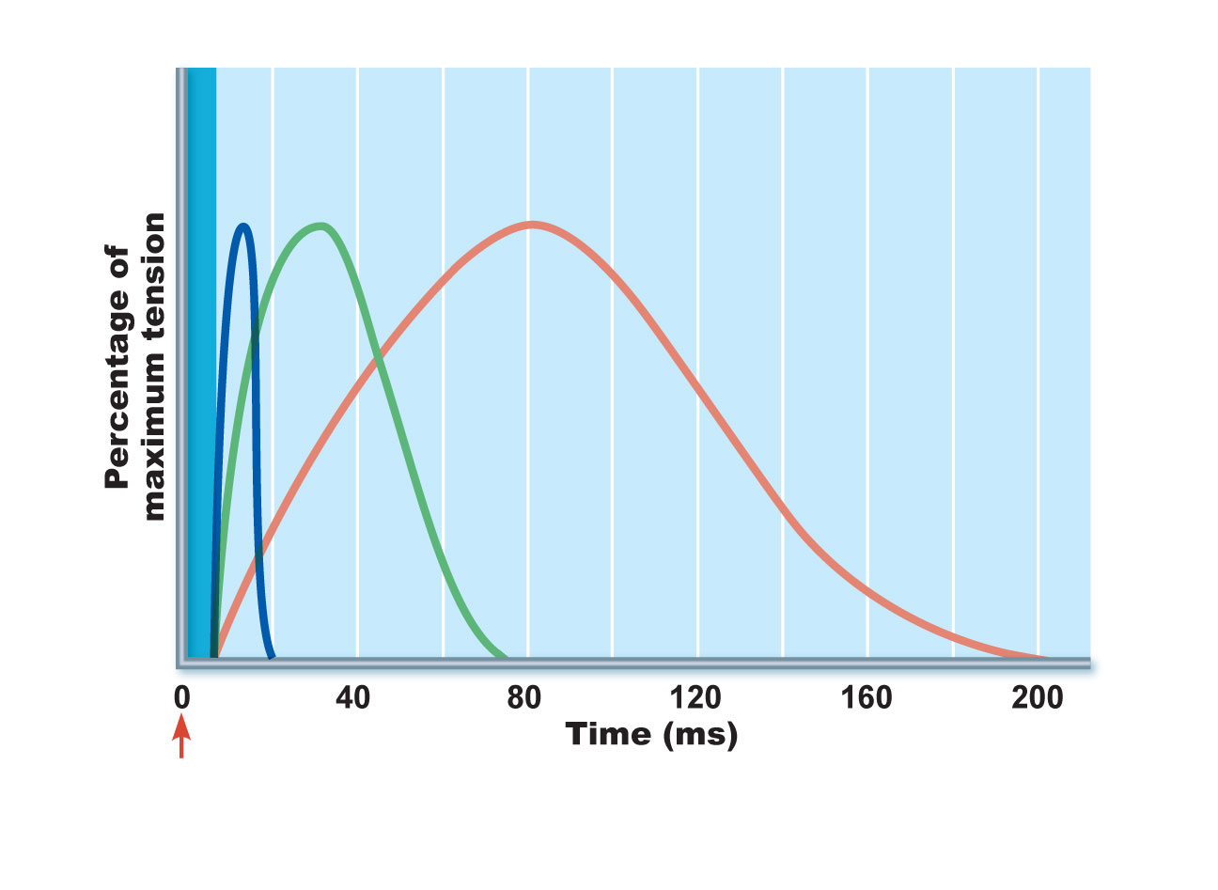
Latent period
Extraocular muscle (lateral rectus)
Gastrocnemius
Soleus
Single
stimulus
(b) Comparison of the relative duration of twitch responses of
three muscles
Figure 9.14b

Slide 15
Graded Muscle Responses
Variations in the degree of muscle contraction
Required for proper control of skeletal movement
Responses are graded by:
  Changing the frequency of stimulation (Temporal Summation)
  Changing the strength of the stimulus (Spatial Summation)

Slide 16
Response to Change in Stimulus Frequency
A single stimulus results in a single contractile response—a muscle twitch

Slide 17
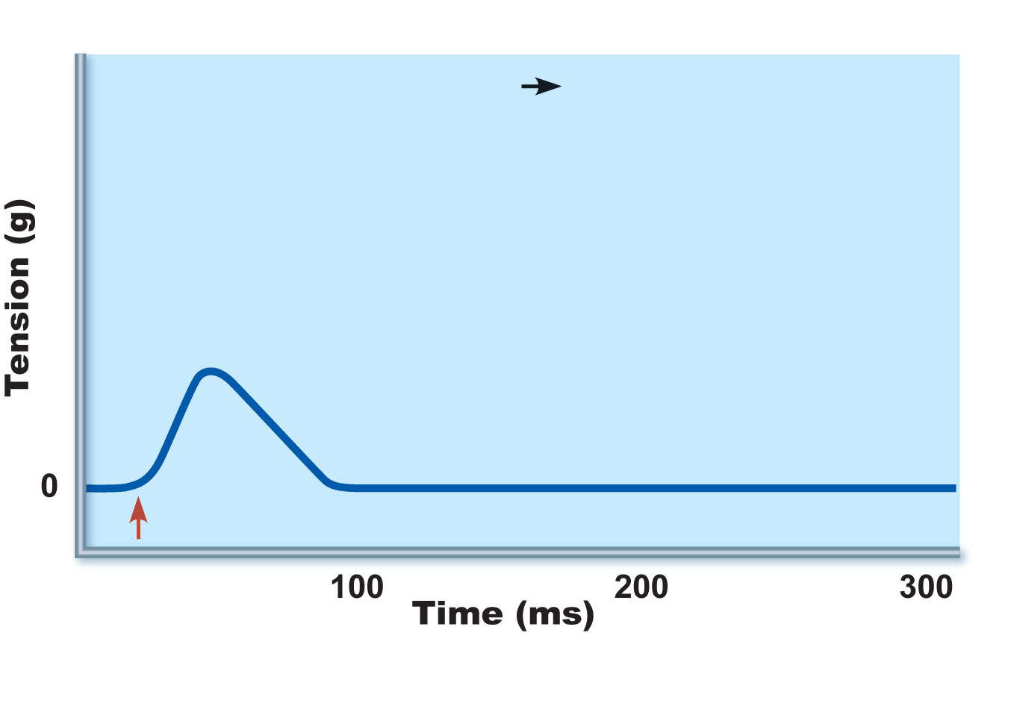
Single stimulus
single twitch
Contraction
Relaxation
Stimulus
A single stimulus is delivered. The muscle
contracts and relaxes
Figure 9.15a

Slide 18
Latent period
Extraocular muscle (lateral rectus)
Gastrocnemius
Soleus
Single
stimulus
(b) Comparison of the relative duration of twitch responses of
three muscles
Figure 9.14b

Slide 19
Response to Change in Stimulus Frequency
Increase frequency of stimulus (muscle does not have time to completely relax between stimuli)
Ca²⁺ release stimulates further contraction → temporal (wave) summation
Further increase in stimulus frequency → unfused (incomplete) tetanus

Slide 20
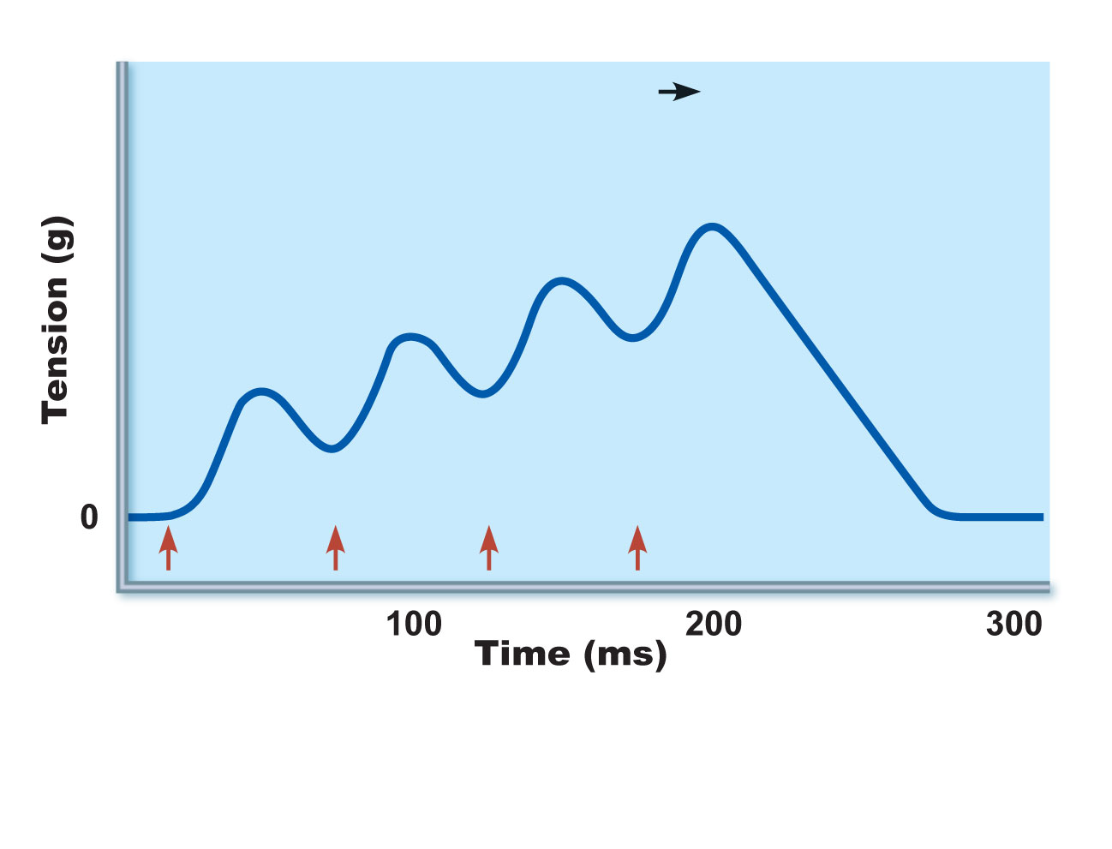
Low stimulation frequency
unfused (incomplete) tetanus
Treppe
Partial relaxation
Stimuli
(b) If another stimulus is applied before the muscle
relaxes completely, then more tension results.
This is temporal (or wave) summation and results
in unfused (or incomplete) tetanus.
Figure 9.15b

Slide 21
Response to Change in Stimulus Frequency
If stimuli are given quickly enough, fused (complete) tetany results

Slide 22
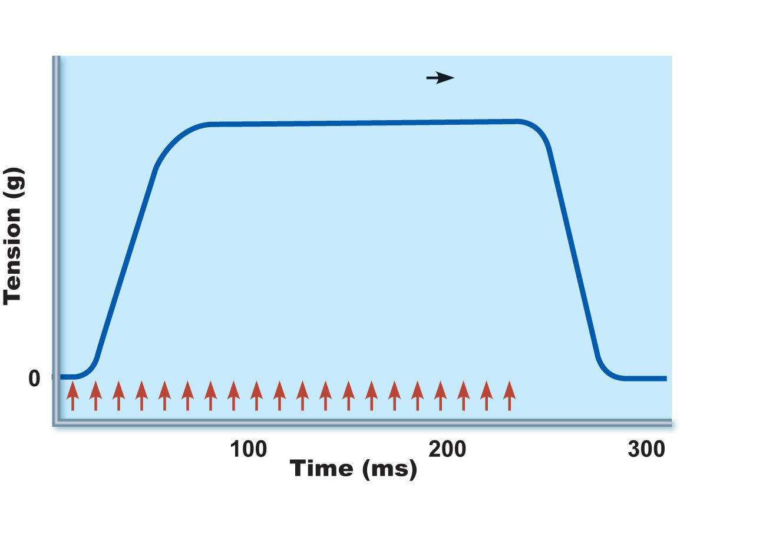
High stimulation frequency
fused (complete) tetanus
Stimuli
(c) At higher stimulus frequencies, there is no relaxation
at all between stimuli. This is fused (complete) tetanus.
Figure 9.15c

Slide 23
Response to Change in Stimulus Strength
Threshold stimulus: stimulus strength at which the first observable muscle contraction occurs
Muscle contracts more vigorously as stimulus strength is increased above threshold
Contraction force is precisely controlled by recruitment (multiple motor unit summation), which brings more and more muscle fibers into action

Slide 24
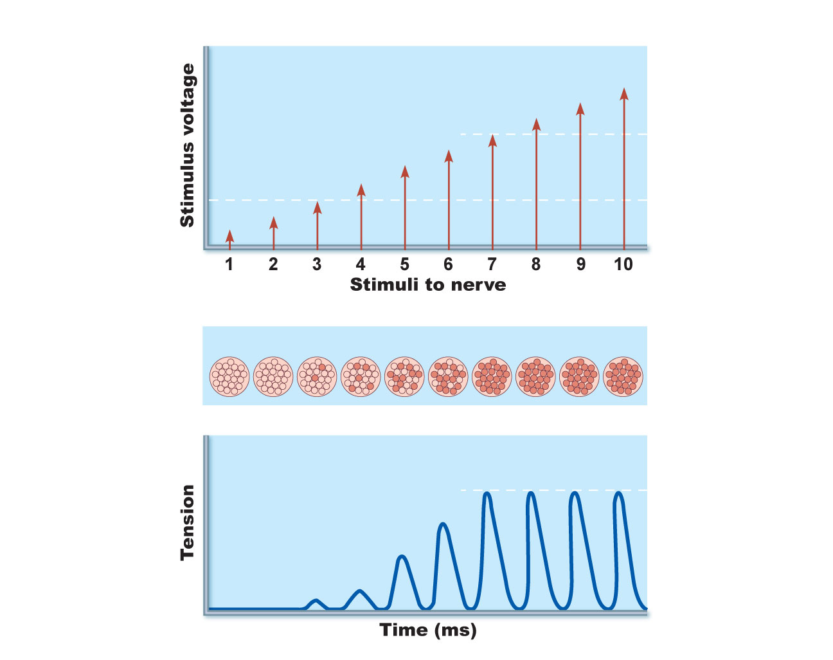
Stimulus strength
Maximal
stimulus
Recruitment
Threshold
stimulus
Proportion of motor units excited
Strength of muscle contraction
Maximal contraction
Figure 9.16

Slide 25
Response to Change in Stimulus Strength
Size principle: motor units with larger and larger fibers are recruited as stimulus intensity increases

Slide 26
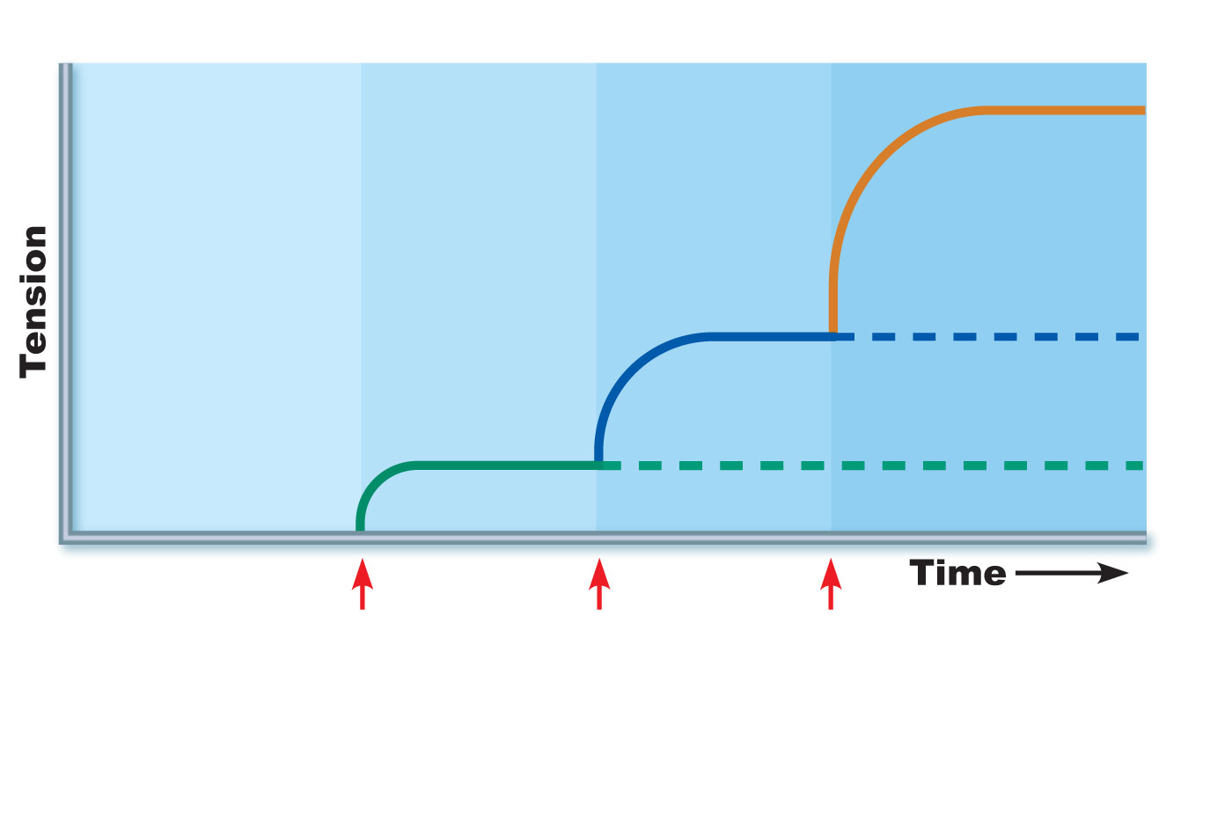
Motor
unit 1
Recruited
(small
fibers)
Motor
unit 2
recruited
(medium
fibers)
Motor
unit 3
recruited
(large
fibers)
Figure 9.17

Slide 27
Muscle Tone (Tonus)
Constant, slightly contracted state of all muscles
Due to spinal reflexes that activate groups of motor units alternately in response to input from stretch receptors in muscles
Keeps muscles firm, healthy, and ready to respond
If no tonus, the muscle if flaccid.

Slide 28
Spinal cord
Axon terminals at
neuromuscular junctions
Motor
unit 1
Motor
unit 2
Nerve
Motor neuron
cell body
Motor
neuron
axon
Muscle
Muscle
fibers
Axons of motor neurons extend from the spinal cord to the
muscle. There each axon divides into a number of axon
terminals that form neuromuscular junctions with muscle
fibers scattered throughout the muscle.
Figure 9.13a

Slide 29
Motor
unit 1
Recruited
(small
fibers)
Motor
unit 2
recruited
(medium
fibers)
Motor
unit 3
recruited
(large
fibers)
Figure 9.17

Slide 30
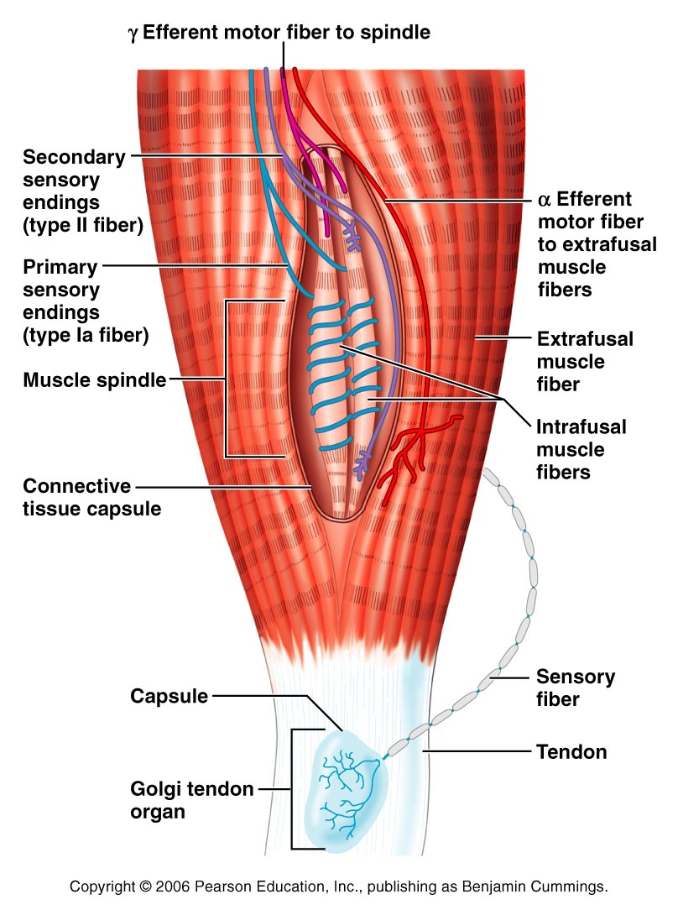
Figure 13.15

Slide 31
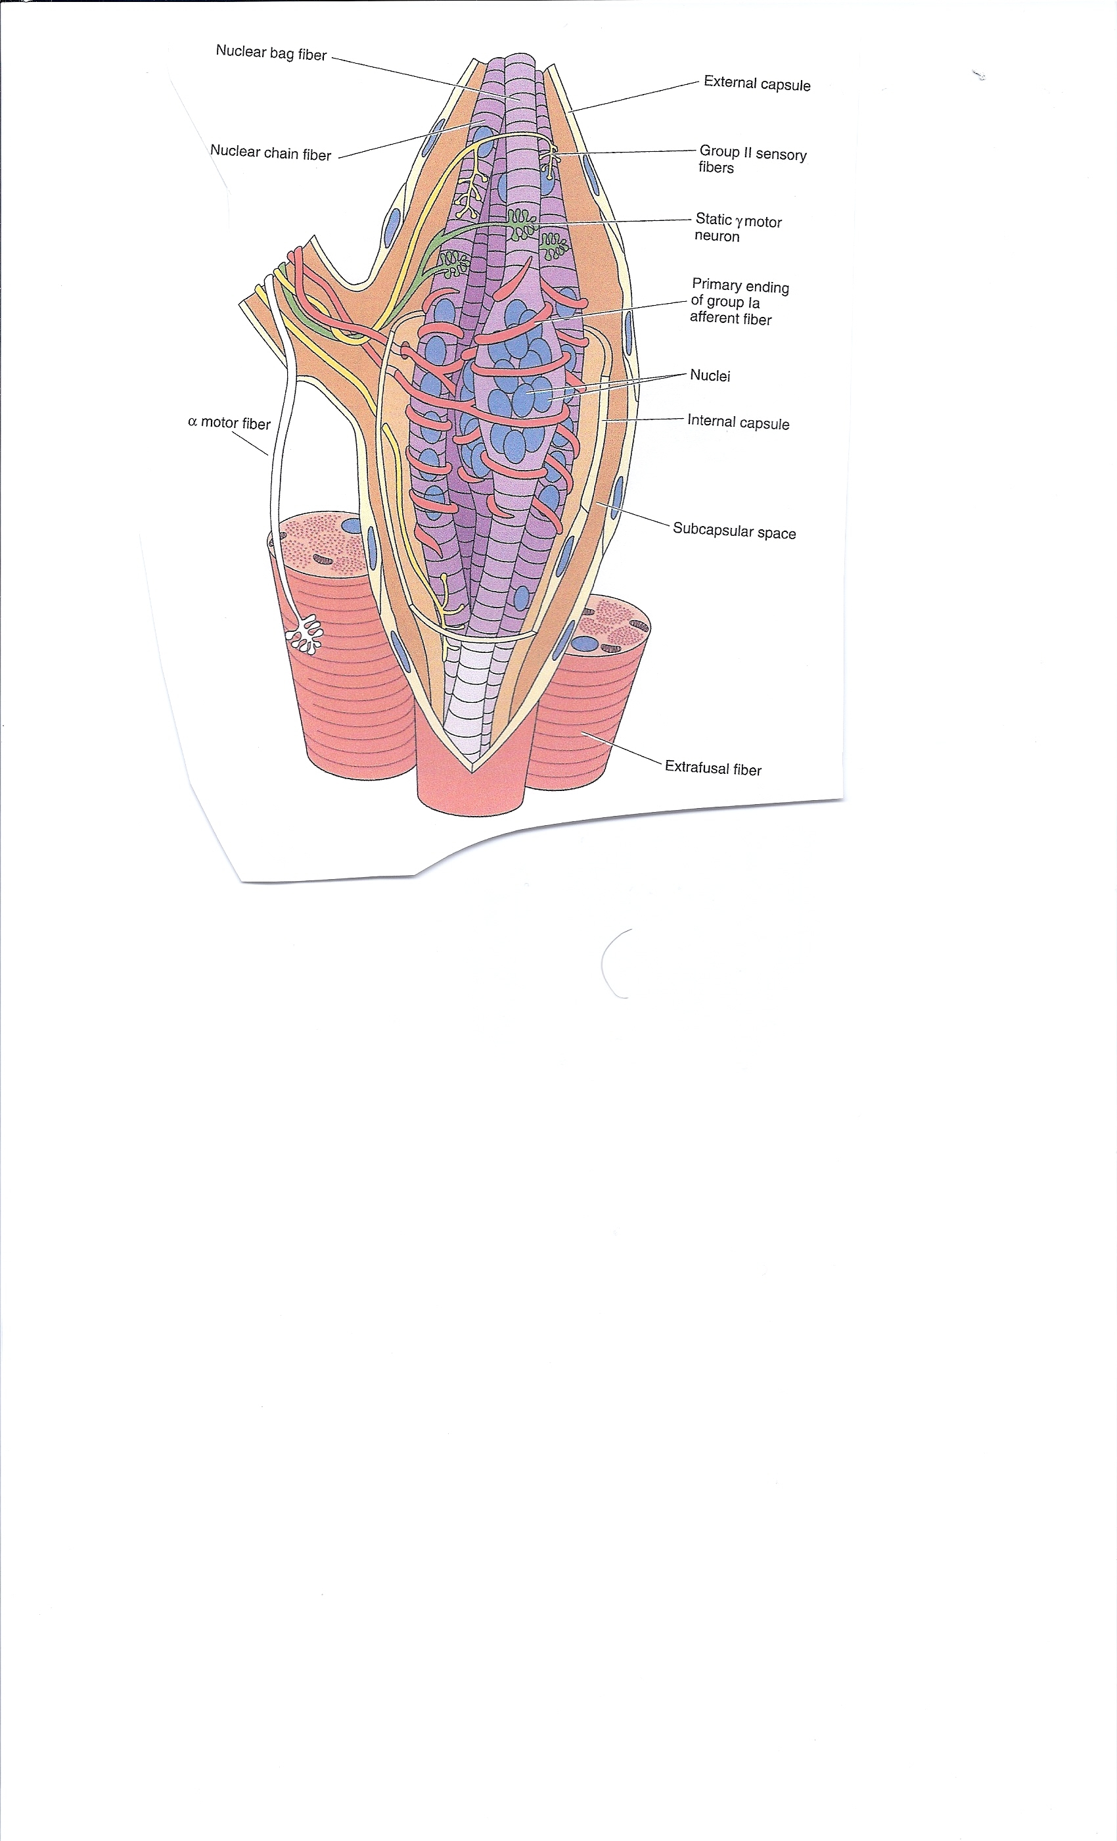
Muscle Spindle

Slide 32
Isotonic Contractions
Muscle changes in length and moves the load
Isotonic contractions are either concentric or eccentric:
  Concentric contractions—the muscle shortens and does work
  Eccentric contractions—the muscle contracts as it lengthens

Slide 33
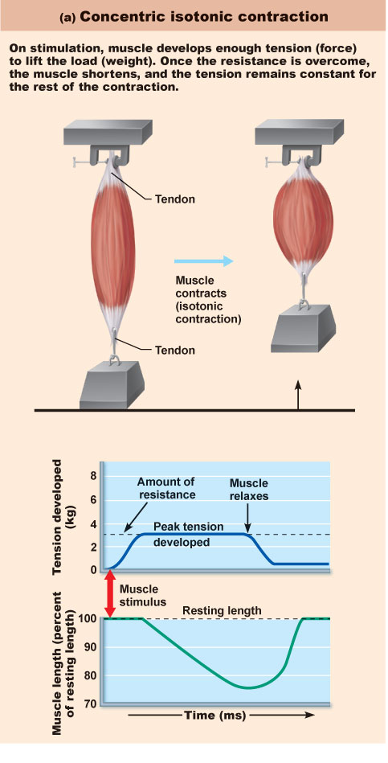
Figure 9.18a

Slide 34
Isometric Contractions
The load is greater than the tension the muscle is able to develop
Tension increases to the muscle’s capacity, but the muscle neither shortens nor lengthens

Slide 35
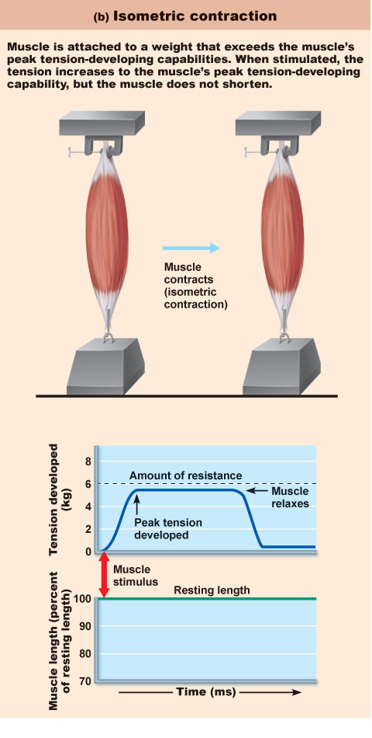
Figure 9.18b

Slide 36
Muscle Metabolism: Energy for Contraction
ATP is the only source used directly for contractile activities
Available stores of ATP are depleted in 4–6 seconds

Slide 37
Muscle Metabolism: Energy for Contraction
ATP is regenerated by:
  Direct phosphorylation of ADP by creatine phosphate (CP)
  Anaerobic pathway (glycolysis)
  Aerobic respiration

Slide 38
Creatine and Creatinine
In humans and animals, approximately half of stored creatine originates from food (mainly from fresh meat). Since vegetables do not contain creatine, vegetarians show lower levels of muscle creatine which, upon creatine supplementation, rise to a level higher than in meat-eaters.
In humans, about half of the daily creatine is biosynthesized from three different amino acids - arginine, glycine, and methionine in the kidneys, pancreas and liver. The rest is taken in by alimentary sources. Ninety-five percent of creatine is later stored in the skeletal muscles (must be transported there).
Creatinine is a break-down product of creatine phosphate in muscle, and is usually produced at a fairly constant rate by the body (depending on muscle mass).

Slide 39
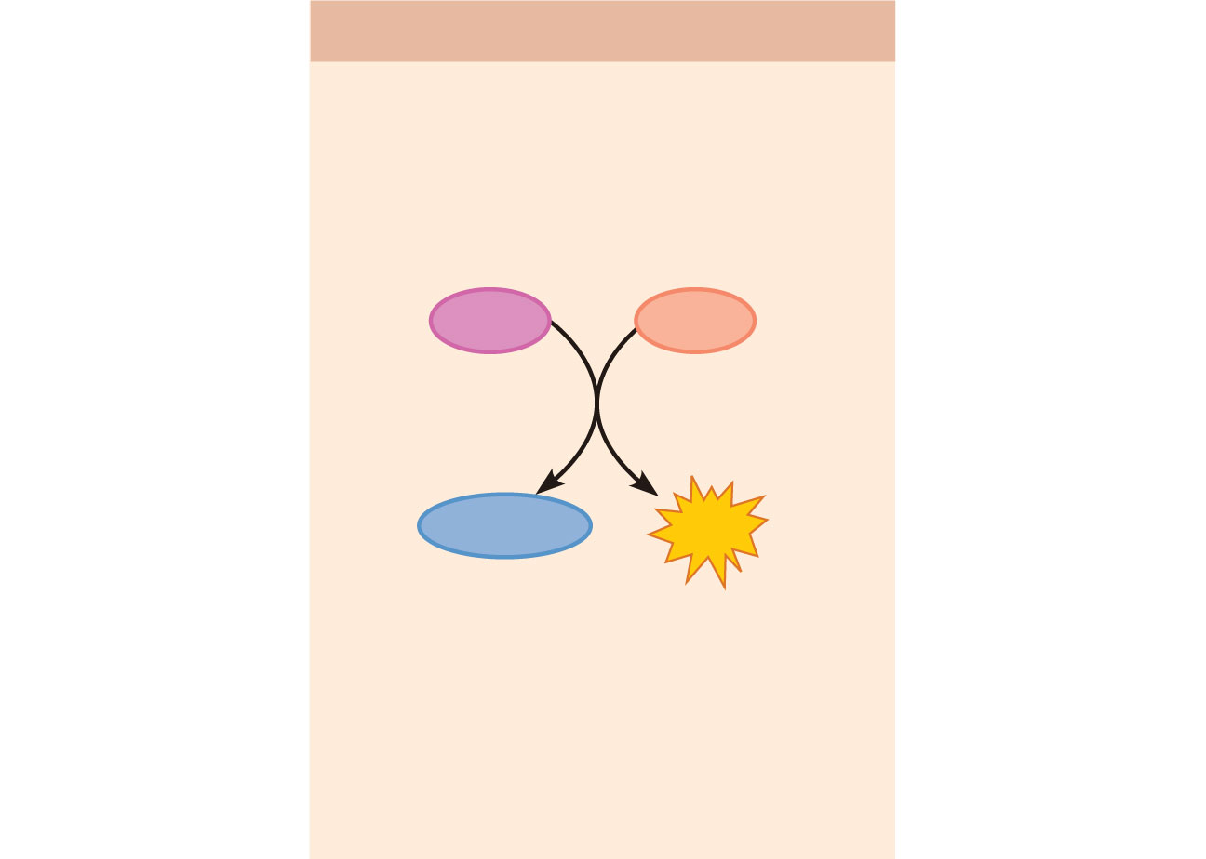
(a) Direct phosphorylation
Coupled reaction of creatine
phosphate (CP) and ADP
Energy source: CP
CP
ADP
Creatine
kinase
Creatine
ATP
Oxygen use: None
Products: 1 ATP per CP, creatine
Duration of energy provision:
15 seconds
Figure 9.19a

Slide 40
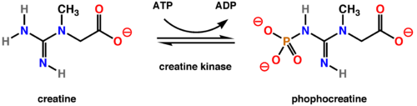

Slide 41
Creatine kinase (CK), also known as creatine phosphokinase (CPK) or phosphocreatine kinase, is an enzyme expressed by various tissue types. It catalyses the conversion of creatine and consumes adenosine triphosphate (ATP) to create phosphocreatine and adenosine diphosphate (ADP).
In tissues that consume ATP rapidly, especially skeletal muscle, but also brain and smooth muscle, phosphocreatine serves as an energy reservoir for the rapid regeneration of ATP. Thus creatine kinase is an important enzyme in such tissues.

Slide 42
Anaerobic Pathway
At 70% of maximum contractile activity:
  Bulging muscles compress blood vessels
  Oxygen delivery is impaired
  Pyruvic acid is converted into lactic acid

Slide 43
Anaerobic Pathway
Lactic acid:
  Diffuses into the bloodstream
  Used as fuel by the liver, kidneys, and heart
  Converted back into pyruvic acid by the liver

Slide 44
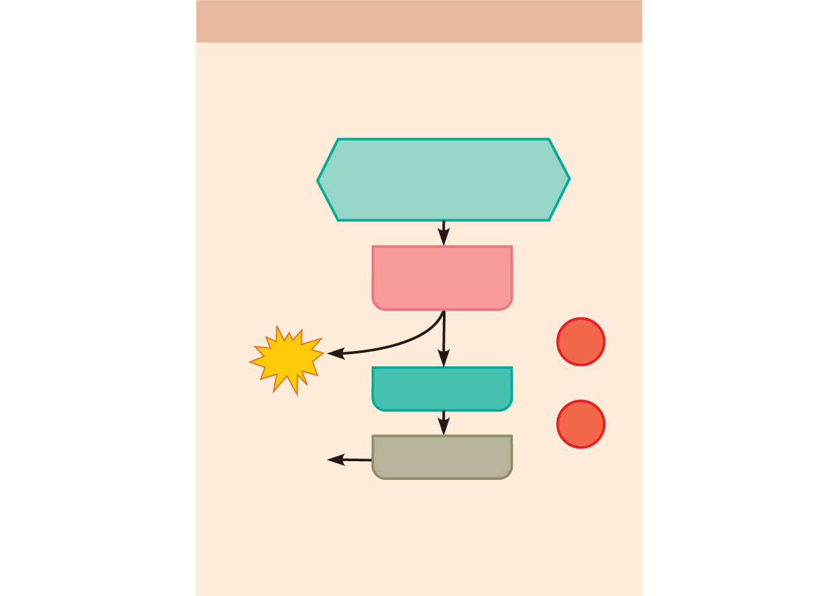
(b) Anaerobic pathway
Glycolysis and lactic acid formation
Energy source: glucose
Glucose (from
glycogen breakdown or
delivered from blood)
Glycolysis
in cytosol
O₂
2
ATP
Pyruvic acid
net gain
O₂
Released
to blood
Lactic acid
Oxygen use: None
Products: 2 ATP per glucose, lactic acid
Duration of energy provision:
60 seconds, or slightly more
Figure 9.19b

Slide 45
Aerobic Pathway
Produces 95% of ATP during rest and light to moderate exercise
Fuels: stored glycogen, then bloodborne glucose, pyruvic acid from glycolysis, and free fatty acids

Slide 46
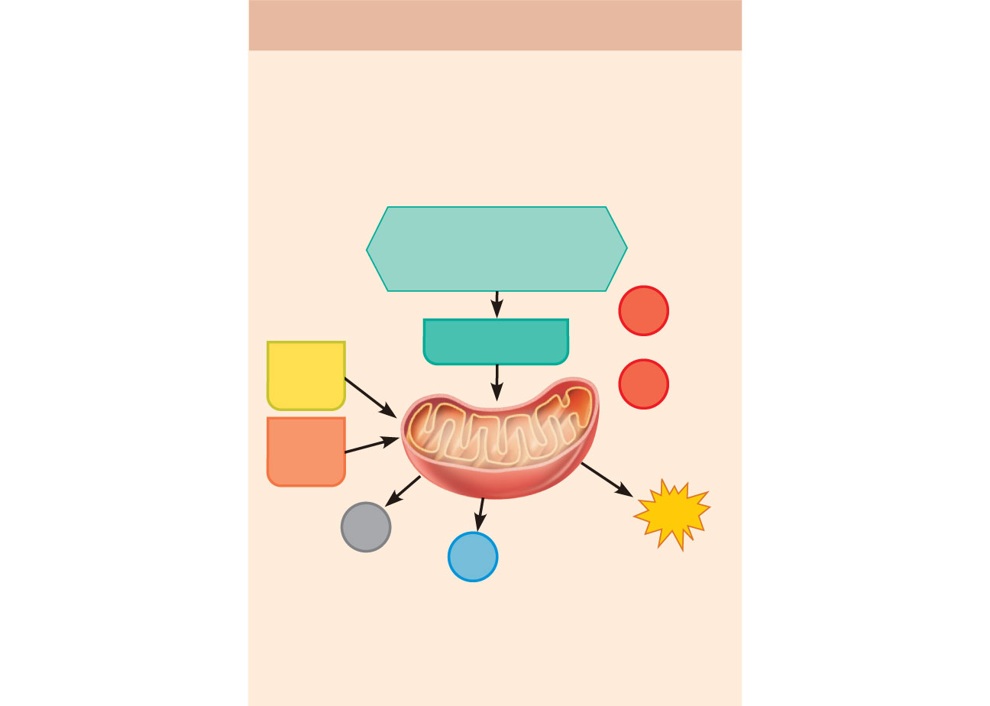
(c) Aerobic pathway
Aerobic cellular respiration
Energy source: glucose; pyruvic acid;
free fatty acids from adipose tissue;
amino acids from protein catabolism
Glucose (from
glycogen breakdown or
delivered from blood)
O₂
Pyruvic acid
Fatty
acids
O₂
Aerobic respiration
in mitochondria
Amino
acids
Aerobic respiration
in mitochondria
CO₂
32
ATP
H₂O
net gain per
glucose
Oxygen use: Required
Products: 32 ATP per glucose, CO₂, H₂O
Duration of energy provision: Hours
Figure 9.19c

Slide 47
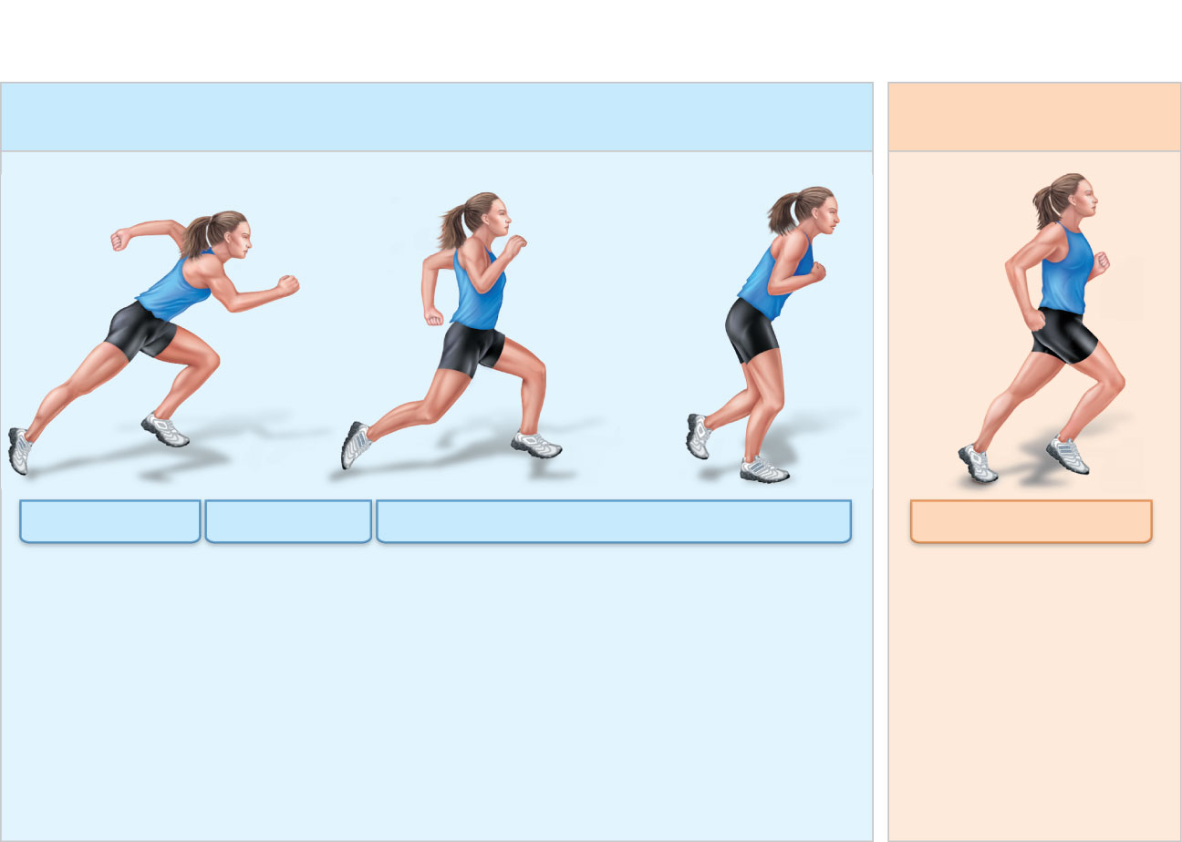
Short-duration exercise
Prolonged-duration
exercise
ATP stored in
muscles is
used first.
ATP is formed
from creatine
Phosphate
and ADP.
Glycogen stored in muscles is broken
down to glucose, which is oxidized to
generate ATP.
ATP is generated by
breakdown of several
nutrient energy fuels by
aerobic pathway. This
pathway uses oxygen
released from myoglobin
or delivered in the blood
by hemoglobin. When it
ends, the oxygen deficit is
paid back.
Figure 9.20

Slide 48

Muscle Fatigue
Physiological inability to contract
Occurs when:
  Ionic imbalances (K⁺, Ca²⁺, P_{i}) interfere with E-C coupling
  Prolonged exercise damages the SR and interferes with Ca²⁺ regulation and release
Total lack of ATP occurs rarely, during states of continuous contraction, and causes contractures (continuous contractions)

Slide 49
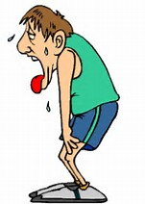
Oxygen Deficit
Extra O₂ needed after exercise for:
Replenishment of
  Oxygen reserves
  Glycogen stores
  ATP and CP reserves
Conversion of lactic acid to pyruvic acid, glucose, and glycogen

Slide 50
Heat Production During Muscle Activity
~ 40% of the energy released in muscle activity is useful as work
Remaining energy (60%) given off as heat
Dangerous heat levels are prevented by radiation of heat from the skin and sweating

