Slide 1
11
Muscle Synapses
Mike Clark, M.D.

Slide 2
The Synapse
A junction that mediates information transfer from one neuron:
  To another neuron, or to a gland or muscle cell

Slide 3
The Synapse
Presynaptic neuron—conducts impulses toward the synapse
Postsynaptic neuron—transmits impulses away from the synapse
PLAY
Animation: Synapses

Slide 4
Muscle Synapses
Neuromuscular junction

Slide 5
Chemical Synapses
Specialized for the release and reception of neurotransmitters
Typically composed of two parts
  Axon terminal of the presynaptic neuron, which contains synaptic vesicles
  Receptor region on the postsynaptic membrane which in this case is a skeletal muscle cell

Slide 6
Events at the Neuromuscular Junction
Skeletal muscles are stimulated by somatic motor neurons
Axons of motor neurons travel from the central nervous system via nerves to skeletal muscles
Each axon forms several branches as it enters a muscle
Each axon ending forms a neuromuscular junction with a single muscle fiber

Slide 7
Synaptic Cleft
Fluid-filled space separating the presynaptic and postsynaptic neurons
Prevents nerve impulses from directly passing from one neuron to the next

Slide 8
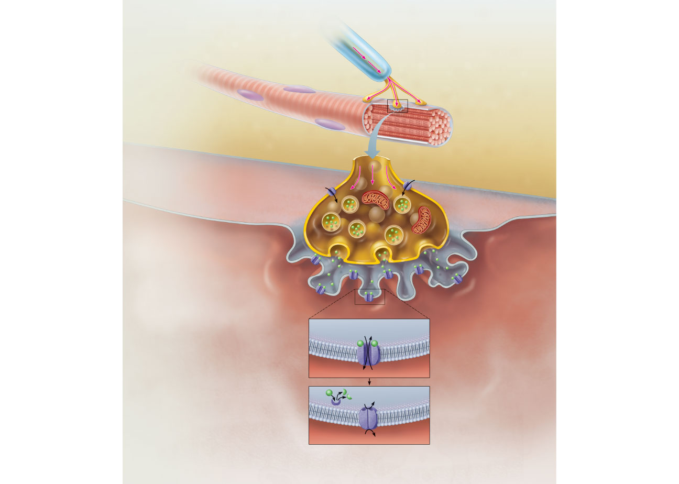
Action
potential (AP)
Myelinated axon
of motor neuron
Nucleus
Axon terminal of
neuromuscular
junction
Sarcolemma of
the muscle fiber
1
Action potential arrives at
axon terminal of motor neuron.
Ca²⁺
Ca²⁺
Synaptic vesicle
containing ACh
2
Voltage-gated Ca²⁺ channels
open and Ca²⁺ enters the axon
terminal.
Mitochondrion
Synaptic
cleft
Axon terminal
of motor neuron
Fusing synaptic
vesicles
Figure 9.8
Figure 9.8

Slide 9
Neuromuscular Junction
Situated midway along the length of a muscle fiber
Axon terminal and muscle fiber are separated by a gel-filled space called the synaptic cleft
Synaptic vesicles of axon terminal contain the neurotransmitter acetylcholine (ACh)
Junctional folds of the sarcolemma contain ACh receptors

Slide 10
Action
potential (AP)
Myelinated axon
of motor neuron
Nucleus
Axon terminal of
neuromuscular
junction
Sarcolemma of
the muscle fiber
1
Action potential arrives at
axon terminal of motor neuron.
Ca²⁺
Ca²⁺
Synaptic vesicle
containing ACh
2
Voltage-gated Ca²⁺ channels
open and Ca²⁺ enters the axon
terminal.
Mitochondrion
Synaptic
cleft
Axon terminal
of motor neuron
Fusing synaptic
vesicles
Figure 9.8
Figure 9.8

Slide 11
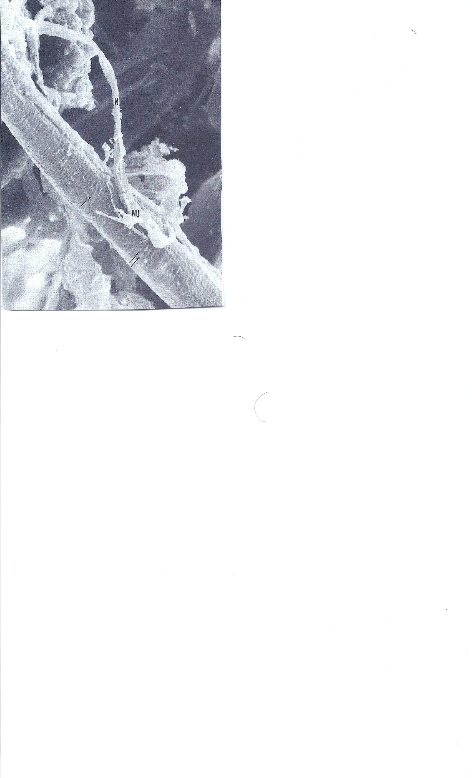

Slide 12
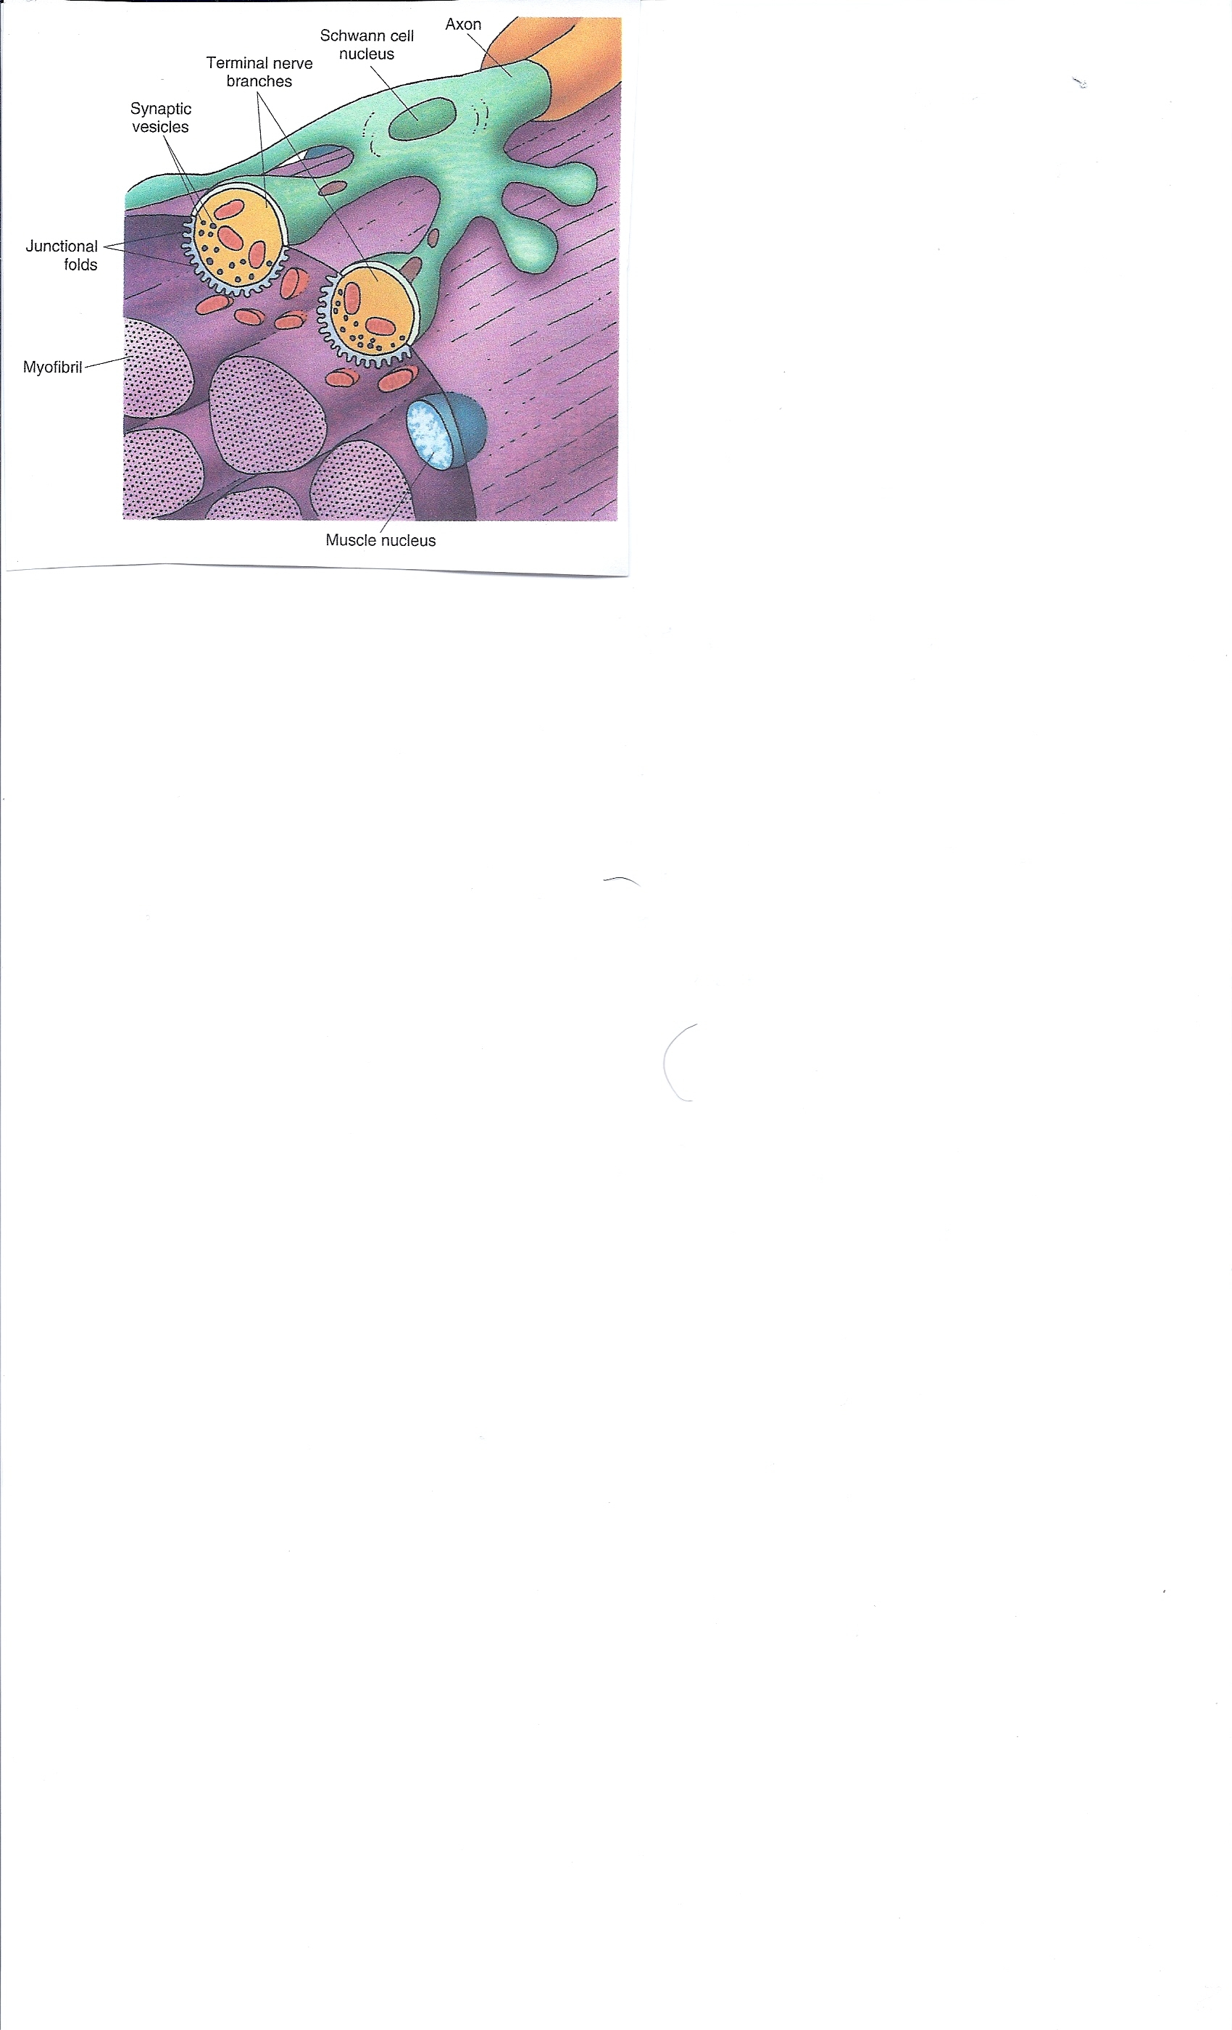

Slide 13
Synaptic Cleft
Transmission across the synaptic cleft:
  Is a chemical event (as opposed to an electrical one)
  Involves release, diffusion, and binding of neurotransmitters
  Ensures unidirectional communication between neurons
PLAY
Animation: Neurotransmitters

Slide 14
Information Transfer
AP arrives at axon terminal of the presynaptic neuron and opens voltage-gated Ca²⁺ channels
Synaptotagmin protein binds Ca²⁺ and promotes fusion of synaptic vesicles with axon membrane
Exocytosis of neurotransmitter occurs

Slide 15
Events at the Neuromuscular Junction
Nerve impulse arrives at axon terminal
ACh is released and binds with receptors on the sarcolemma
Electrical events lead to the generation of an action potential

Slide 16
Information Transfer
Neurotransmitter diffuses and binds to receptors (often chemically gated ion channels) on the postsynaptic membrane
Ion channels are opened, causing a motor end plate potential on the skeletal muscle cell membrane

Slide 17
Synaptic Delay
Neurotransmitter must be released, diffuse across the synapse, and bind to receptors
Synaptic delay—time needed to do this (0.3–5.0 ms)
Synaptic delay is the rate-limiting step of neural transmission

Slide 18
Motor End Plate Potentials
Neurotransmitter binds to and opens chemically gated channels that allow simultaneous flow of Na⁺ and K⁺ in opposite directions (Calcium ions also move into the Cell membrane) but Chloride does not exit in that the membrane blocks it.
Na⁺ influx is greater that K⁺ efflux, causing a net depolarization

Slide 19
Chemical Classes of Neurotransmitters
Acetylcholine (Ach)
  Released at neuromuscular junctions and some ANS neurons
  Synthesized by enzyme choline acetyltransferase
  Degraded by the enzyme acetylcholinesterase (AChE)

Slide 20
Destruction of Acetylcholine
ACh effects are quickly terminated by the enzyme acetylcholinesterase
Prevents continued muscle fiber contraction in the absence of additional stimulation

Slide 21
Action
potential (AP)
Myelinated axon
of motor neuron
Nucleus
Axon terminal of
neuromuscular
junction
Sarcolemma of
the muscle fiber
1
Action potential arrives at
axon terminal of motor neuron.
Ca²⁺
Ca²⁺
Synaptic vesicle
containing ACh
2
Voltage-gated Ca²⁺ channels
open and Ca²⁺ enters the axon
terminal.
Mitochondrion
Synaptic
cleft
Axon terminal
of motor neuron
3
Ca²⁺ entry causes some
synaptic vesicles to release
their contents (acetylcholine)
by exocytosis.
Fusing synaptic
vesicles
Junctional
folds of
sarcolemma
ACh
4
Acetylcholine, a
neurotransmitter, diffuses across
the synaptic cleft and binds to
receptors in the sarcolemma.
Sarcoplasm of
muscle fiber
5
Postsynaptic membrane
ion channel opens;
ions pass.
ACh binding opens ion
channels that allow simultaneous
passage of Na⁺ into the muscle
fiber and K⁺ out of the muscle
fiber.
Na⁺
K⁺
6
Degraded ACh
ACh effects are terminated
by its enzymatic breakdown in
the synaptic cleft by
acetylcholinesterase.
Ach–
Na⁺
Postsynaptic membrane
ion channel closed;
ions cannot pass.
Acetyl-
cholinesterase
K⁺
Figure 9.8

Slide 22
Events in Generation of an Action Potential
Local depolarization (end plate potential):
  ACh binding opens chemically (ligand) gated ion channels
  Simultaneous diffusion of Na⁺ (inward) and K⁺ (outward)
  More Na⁺ diffuses, so the interior of the sarcolemma becomes less negative
  Local depolarization – end plate potential

Slide 23
Events in Generation of an Action Potential
Generation and propagation of an action potential:
  End plate potential spreads to adjacent membrane areas
  Voltage-gated Na⁺ channels open
  Na⁺ influx decreases the membrane voltage toward a critical threshold
  If threshold is reached, an action potential is generated

Slide 24
Events in Generation of an Action Potential
Local depolarization wave continues to spread, changing the permeability of the sarcolemma
Voltage-regulated Na⁺ channels open in the adjacent patch, causing it to depolarize to threshold

Slide 25
Events in Generation of an Action Potential
Repolarization:
Na⁺ channels close and voltage-gated K⁺ channels open
K⁺ efflux rapidly restores the resting polarity
Fiber cannot be stimulated and is in a refractory period until repolarization is complete
Ionic conditions of the resting state are restored by the Na⁺-K⁺ pump

Slide 26
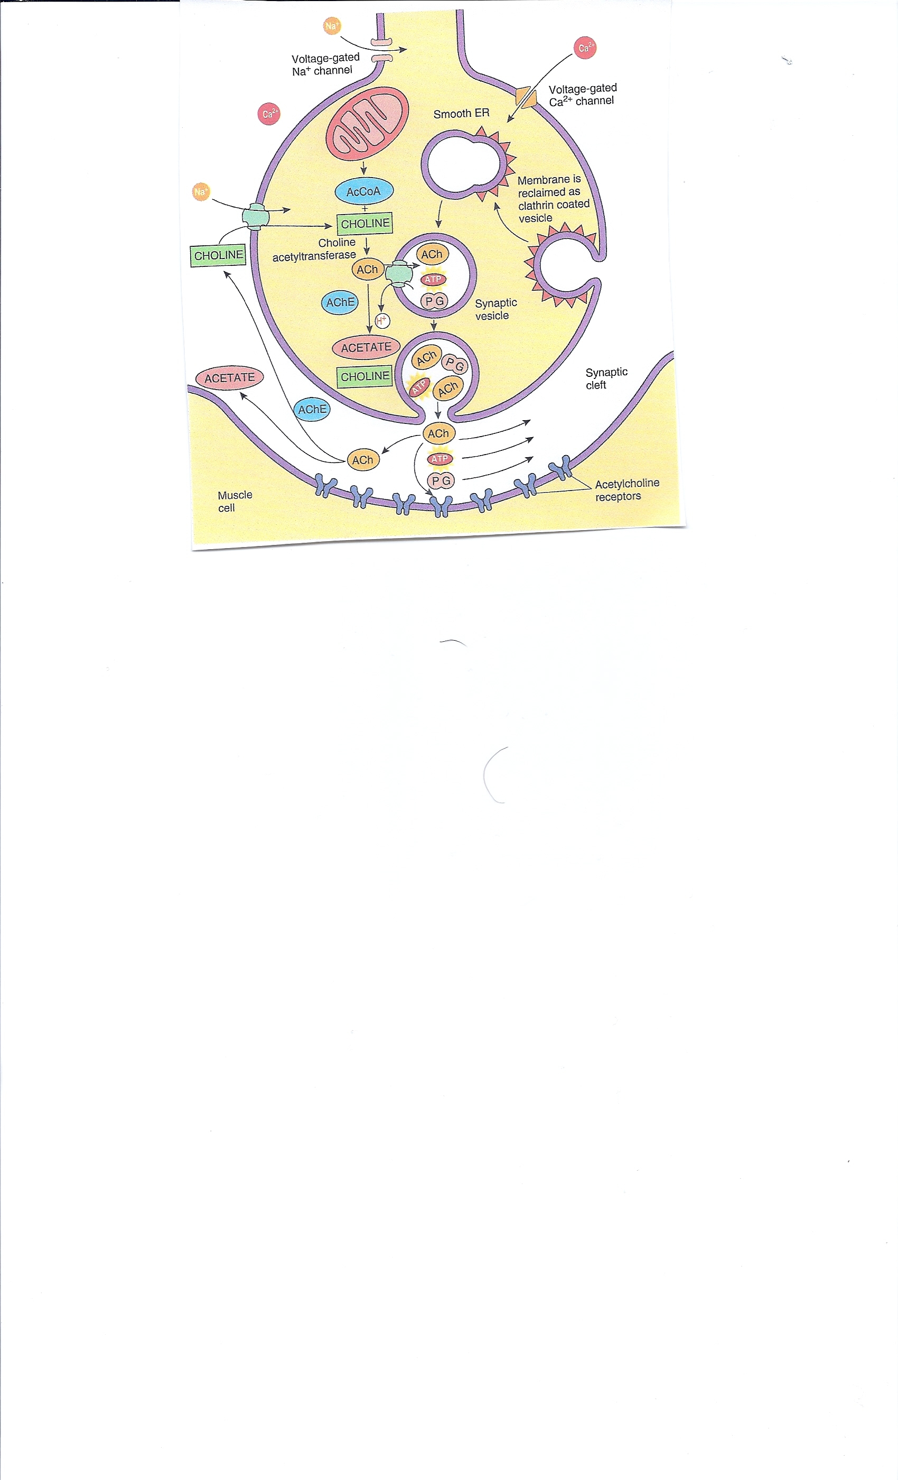

Slide 27
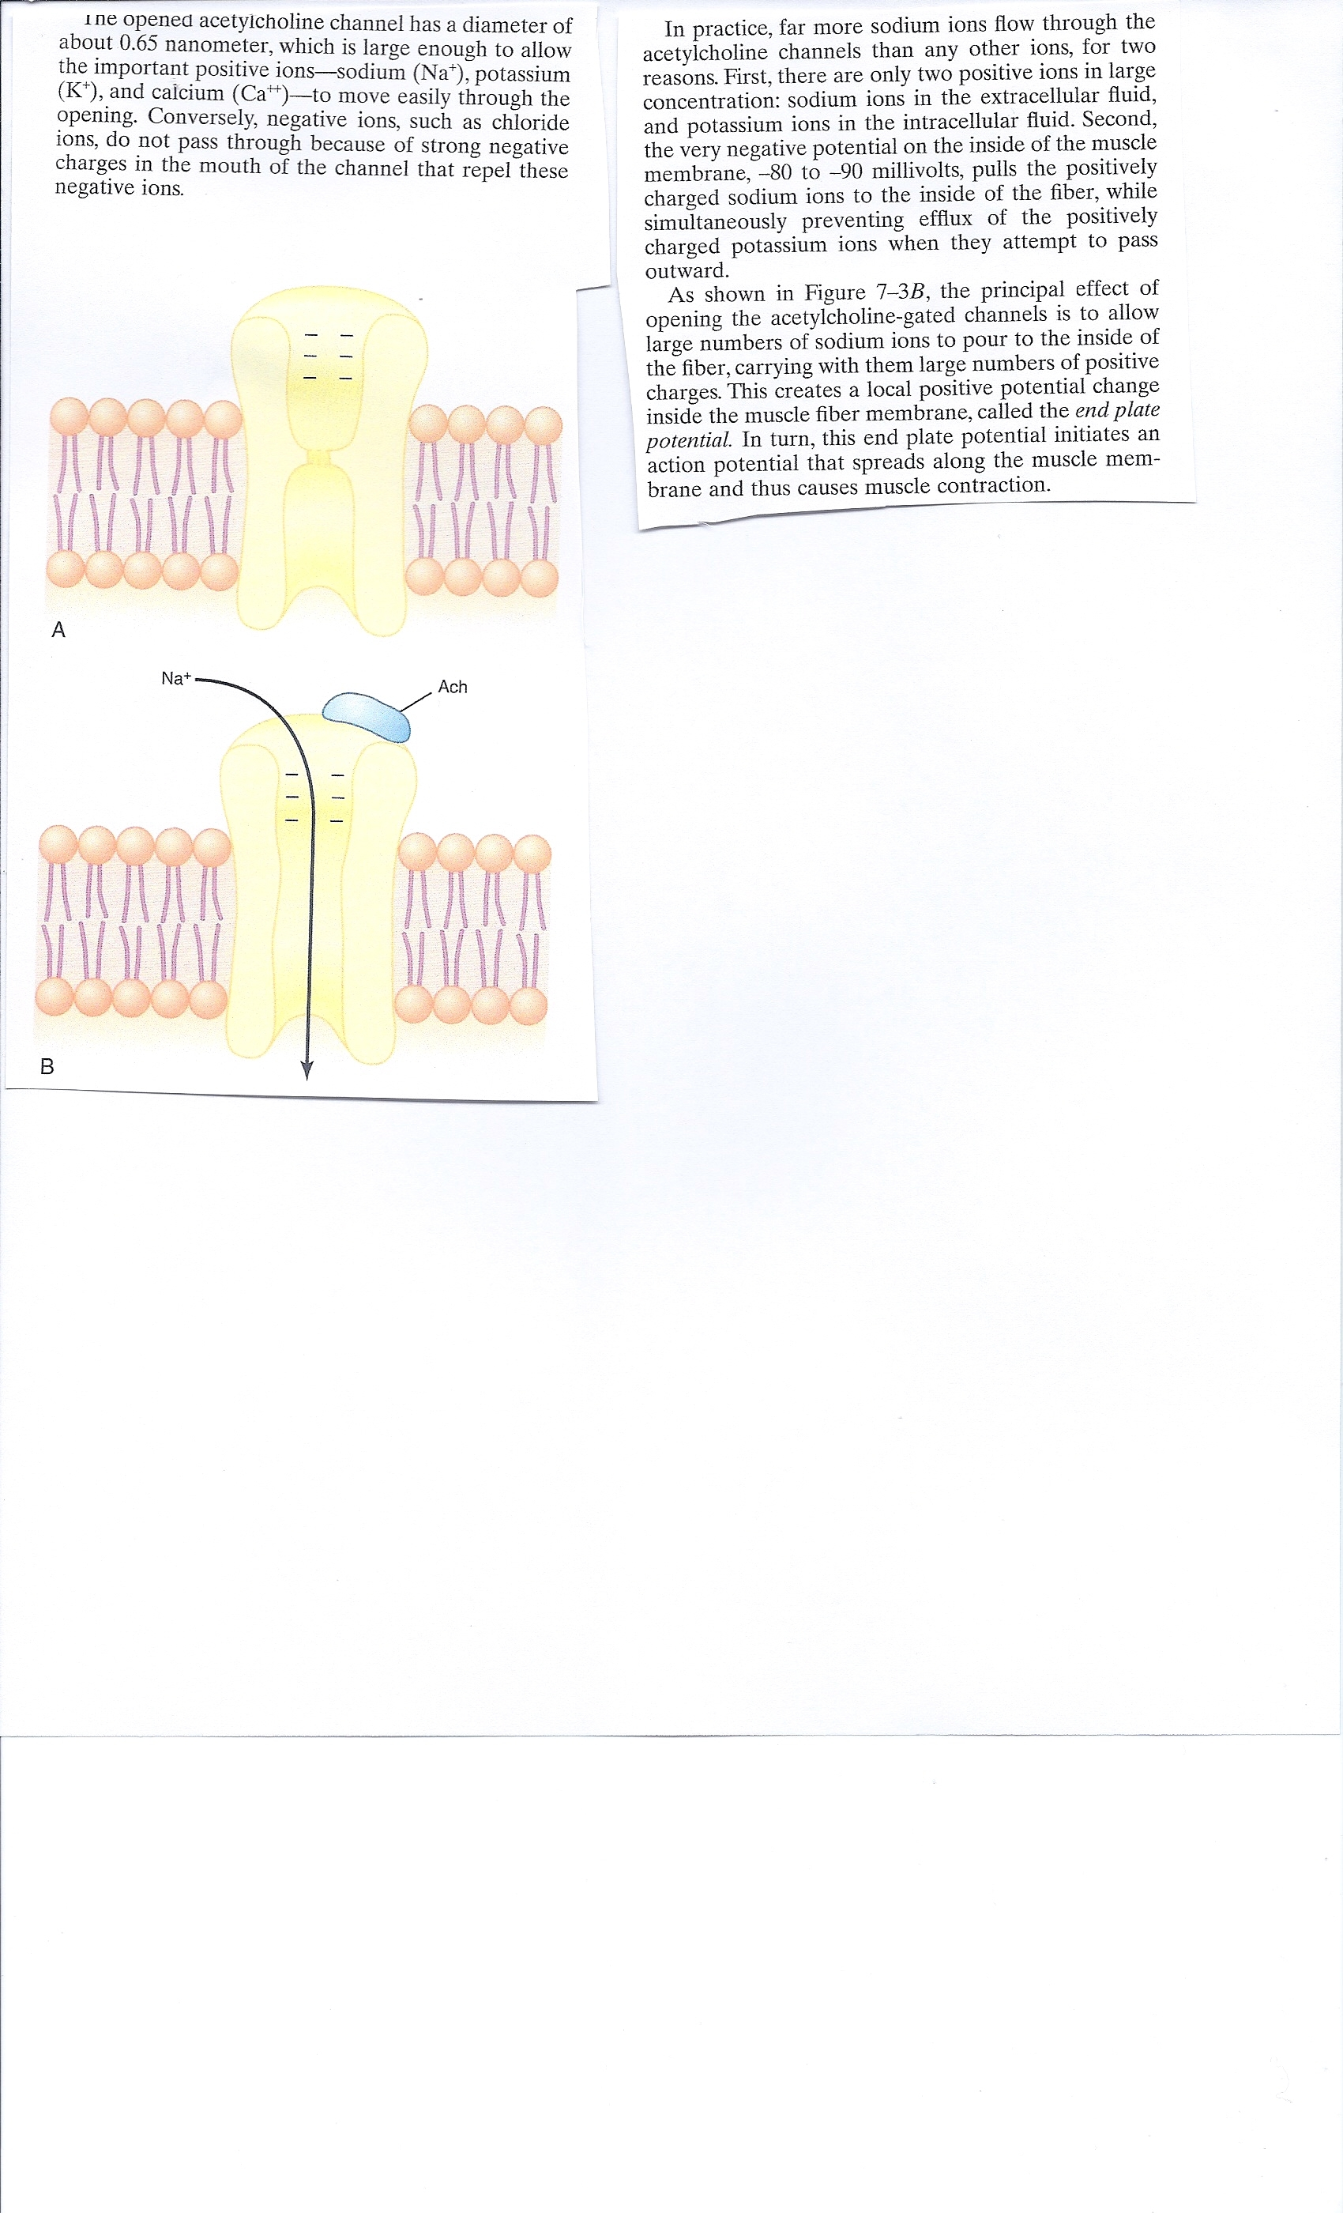

Slide 28
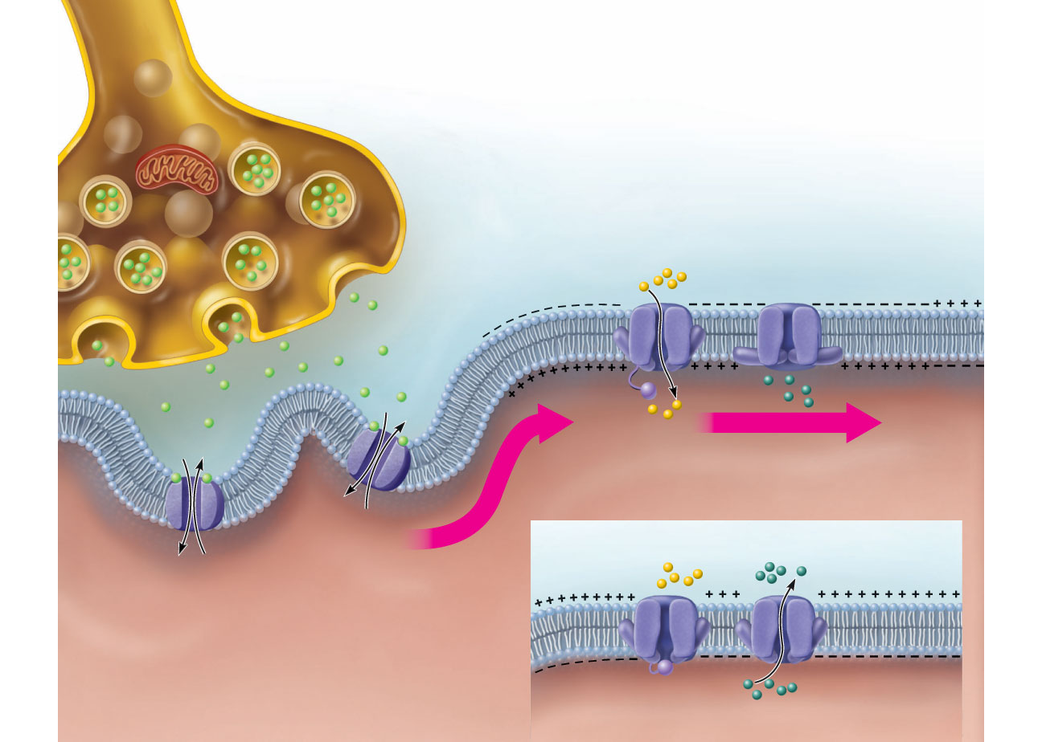
Axon terminal
Open Na⁺
Channel
Closed K⁺
Channel
Synaptic
cleft
Na⁺
ACh
Na⁺
K⁺
K⁺
ACh
+
+
+
+
+
n
+
+
+
Action potential
+
+
o
+
+
Na⁺
K⁺
a
t
i
2
z
Generation and propagation of
the action potential (AP)
i
r
a
l
o
p
e
o
f
d
W
a
v
e
Closed Na⁺
Channel
Open K⁺
Channel
1
Local depolarization:
generation of the end
plate potential on the
sarcolemma
Na⁺
3
K⁺
Sarcoplasm of muscle fiber
Repolarization
Figure 9.9

Slide 29
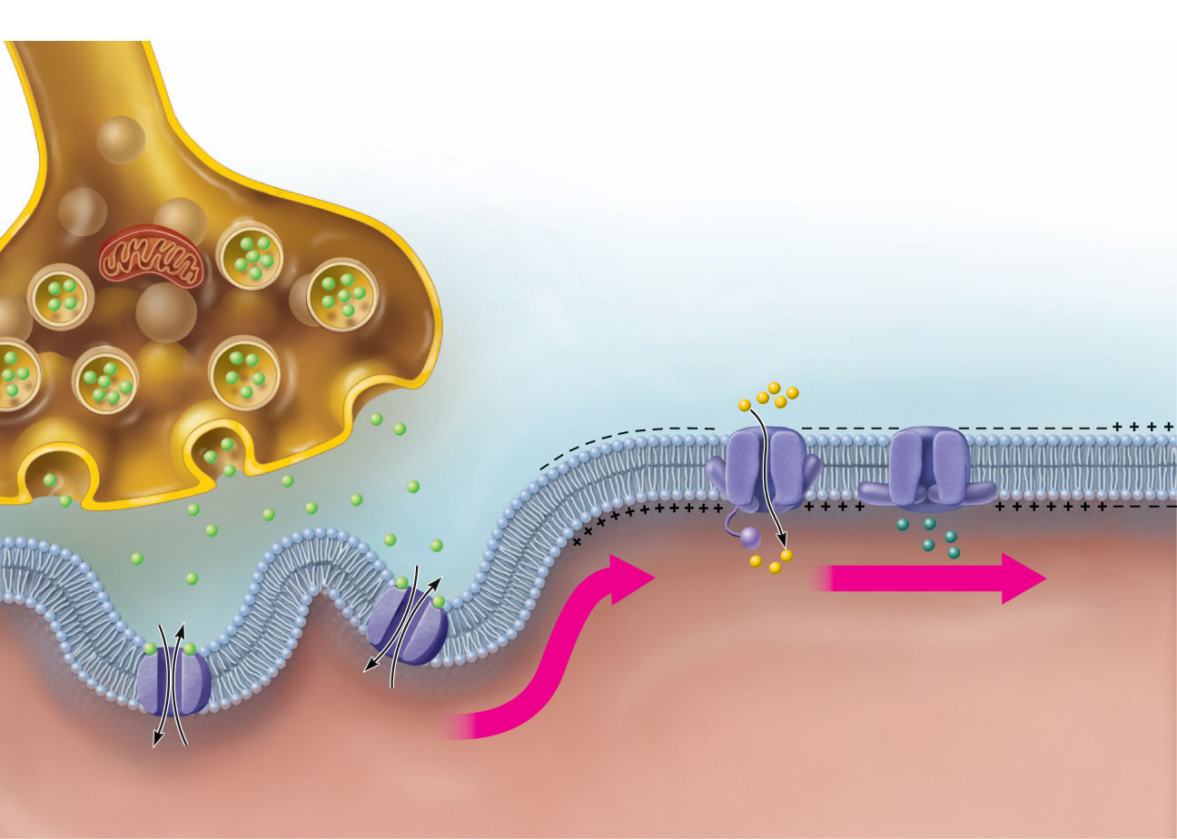
Axon terminal
Open Na⁺
Channel
Closed K⁺
Channel
Synaptic
cleft
Na⁺
ACh
K⁺
ACh
Na⁺
K⁺
+
+
+
+
+
+
+
n
+
+
Action potential
+
Na⁺
K⁺
t
i
o
+
+
z
a
i
r
a
l
o
p
e
f
d
a
v
e
o
W
1
1
Local depolarization: generation of the
end plate potential on the sarcolemma
Sarcoplasm of muscle fiber
Figure 9.9, step 1

Slide 30
Axon terminal
Open Na⁺
Channel
Closed K⁺
Channel
Synaptic
cleft
Na⁺
ACh
K⁺
ACh
Na⁺
K⁺
+
+
+
+
+
+
+
n
+
+
Action potential
+
Na⁺
K⁺
t
i
o
+
+
z
a
2
i
r
Generation and propagation of the
action potential (AP)
a
l
o
p
e
f
d
a
v
e
o
W
1
1
Local depolarization: generation of the
end plate potential on the sarcolemma
Sarcoplasm of muscle fiber
Figure 9.9, step 2

Slide 31
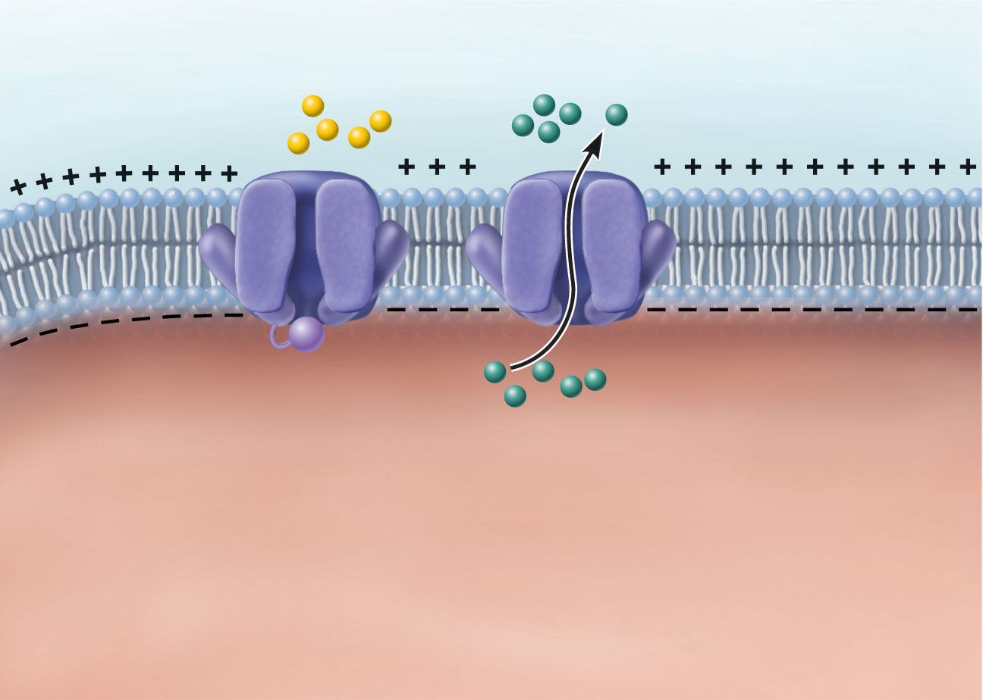
Closed Na⁺
Channel
Open K⁺
Channel
Na⁺
K⁺
3
Repolarization
Figure 9.9, step 3

Slide 32
Axon terminal
Open Na⁺
Channel
Closed K⁺
Channel
Synaptic
cleft
Na⁺
ACh
Na⁺
K⁺
K⁺
ACh
+
+
+
+
+
n
+
+
+
Action potential
+
+
o
+
+
Na⁺
K⁺
a
t
i
2
z
Generation and propagation of
the action potential (AP)
i
r
a
l
o
p
e
o
f
d
W
a
v
e
Closed Na⁺
Channel
Open K⁺
Channel
1
Local depolarization:
generation of the end
plate potential on the
sarcolemma
Na⁺
3
K⁺
Sarcoplasm of muscle fiber
Repolarization
Figure 9.9

Slide 33
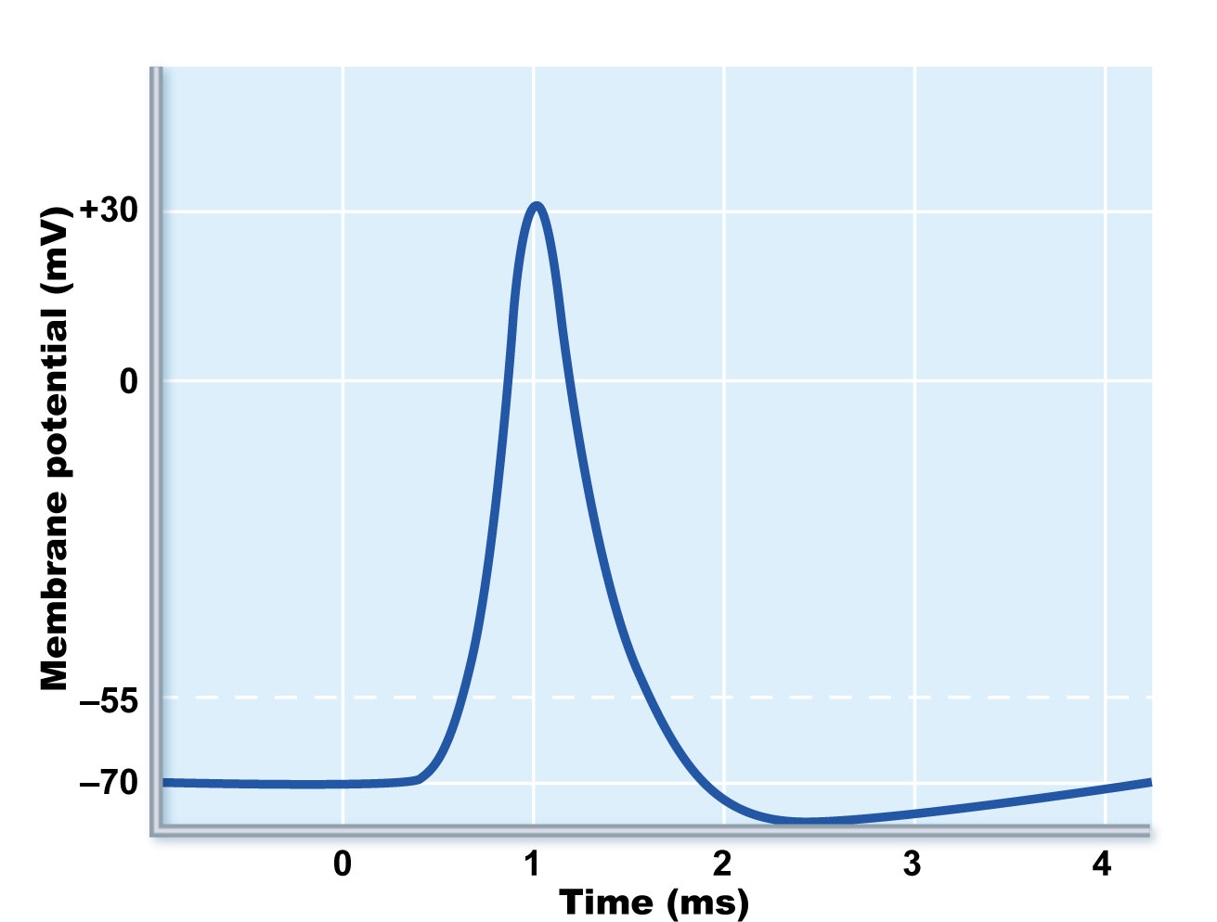
Na⁺ channels
close, K⁺ channels
open
Depolarization
due to Na+ entry
Repolarization
due to K⁺ exit
Na⁺
channels
open
Threshold
K⁺ channels
close
Figure 9.10

Slide 34
Excitation-Contraction (E-C) Coupling
Sequence of events by which transmission of an AP along the sarcolemma leads to sliding of the myofilaments
Latent period:
  Time when E-C coupling events occur
  Time between AP initiation and the beginning of contraction

Slide 35
Blockade – Muscle Relaxants
Neuromuscular-blocking drugs block neuromuscular transmission at the neuromuscular junction,causing paralysis of the affected skeletal muscles. This is accomplished either by acting presynaptically via the inhibition of acetylcholine (ACh) synthesis or release, or by acting postsynaptically at the acetylcholine receptor. While there are drugs that act presynaptically (such as botulin toxin and tetrodotoxin), the clinically-relevant drugs work postsynaptically.

Slide 36
Clinically, neuromuscular block is used as an adjunct to anesthesia to induce paralysis, so that surgery, especially intra-abdominal and intra-thoracic surgeries, can be carried out with fewer complications. Because neuromuscular block may paralyze muscles required for breathing, mechanical ventilation should be available to maintain adequate respiration.

Slide 37
These drugs fall into two groups:
Non-depolarizing blocking agents: These agents constitute the majority of the clinically-relevant neuromuscular blockers. They act by blocking the binding of ACh to its receptors, and in some cases, they also directly block the ionotropic activity of the ACh receptors.^{[2]}
Depolarizing blocking agents: These agents act by depolarizing the plasma membrane of the skeletal muscle fiber. This persistent depolarization makes the muscle fiber resistant to further stimulation by ACh.

Slide 38
Non-depolarizing blocking agents
Below are some of the more common agents that act as competitive antagonists against acetylcholine at the site of postsynaptic acetylcholine receptors.
Tubocurarine, found in curare of the South American plant genus Strychnos, is the prototypical non-depolarizing neuromuscular blocker. It has a slow onset (>5 min) and a long duration of action (1–2 hours). Side effects include hypotension, which is partially explained by its effect of increasing histamine release, a vasodilator,^{[3]} as well as its effect of blocking autonomic ganglia.^{[4]} It is excreted in the urine.

Slide 39
Depolarizing blocking agents
Depolarizing blocking agents work by depolarizing the plasma membrane of the muscle fiber, similar to acetylcholine. However, these agents are more resistant to degradation by acetylcholinesterase, the enzyme responsible for degrading acetylcholine, and can thus more persistently depolarize the muscle fibers. This differs from acetylcholine, which is rapidly degraded and only transiently depolarizes the muscle.

Slide 40
The prototypical depolarizing blocking drug is succinylcholine (suxamethonium). It is the only such drug used clinically. It has a rapid onset (30 seconds) but very short duration of action (5–10 minutes) because of hydrolysis by various cholinesterases (such as butyrylcholinesterase in the blood). Succinylcholine was originally known as diacetylcholine because structurally it is composed of two acetylcholine molecules joined with a methyl group. Decamethonium is sometimes, but rarely, used in clinical practice.
Inhibition of acetylcholinesterase may be used to cause the same effect as a depolarizing neuromuscular block.

Slide 41
Comparison of drugs
The main difference is in the reversal of these two types of neuromuscular-blocking drugs.
Non-depolarizing blockers are reversed by acetylcholinesterase inhibitor drugs since they are competitive antagonists at the ACh receptor so can be reversed by increases in ACh.
The depolarizing blockers already have ACh-like actions, so these agents will have prolonged effect under the influence of acetylcholinesterase inhibitors. The administration of depolarizing blockers will initially exhibit fasciculations (a sudden twitch just before paralysis occurs). This is due to the depolarization of the muscle. Also, post-operative pain is associated with depolarizing blockers.
The tetanic fade is the failure of muscles to maintain a fused tetany at sufficiently-high frequencies of electrical stimulation.
Non-depolarizing blockers will have this effect on patients.
Depolarizing blockers will not.

