Slide 1
Protein Synthesis
Mike Clark, M.D.

Slide 2
Protein Synthesis
DNA is the master blueprint for protein synthesis
Gene: Segment of DNA with blueprint for one polypeptide
Triplets of nucleotide bases form genetic library
Each triplet specifies coding for an amino acid

Slide 3
DNA
Somatic Body Cells are all the cells of the body except the sex cells (sperm and egg)
Somatic cells has 23 pairs of genetic material (46 pieces) – one member of the pair came from your mother and the other from your father –– thus you need all the pieces each piece of genetic material carries different codes
Gametes (sperm and egg) only have 23 pieces – but need a representative genetic piece from each pair Why? So during fertilization – (sperm fertilizes egg) the 46 number is reestablished

Slide 4
Human Genome
The human genome is stored on 23 chromosome pairs. Twenty-two of these are autosomal chromosome pairs, while the remaining pair is sex-determining. The haploid human genome occupies a total of just over 3 billion DNA base pairs. The Human Genome Project (HGP) produced a reference sequence of the euchromatic human genome, which is used worldwide in biomedical sciences.

Slide 5
Human Genome
The haploid human genome contains an estimated 20,000–25,000 protein-coding genes, far fewer than had been expected before its sequencing. In fact, only about 1.5% of the genome codes for proteins, while the rest consists of RNA genes, regulatory sequences, introns and (controversially) "junk" DNA

Slide 6
Definitions and Terms in Protein Synthesis
DNA – Deoxyribonucleic Acid
RNA – Ribonucleic Acid
Three types of RNA
mRNA – messenger RNA
rRNA – ribosomal RNA
tRNA – transfer RNA

Slide 7
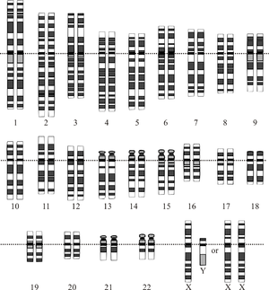
Human Karyotype

Slide 8
Ribosome Review
The ribosome has two subunits the small and the large
There are free ribosomes and fixed ribosomes
Free ribosomes float in the cytoplasm making proteins. Proteins made on free ribosomes are used inside the cell that made them
Fixed ribosomes are attached to the rough endoplasmic reticulum. Proteins made on fixed ribosomes are used outside the cell that made them.

Slide 9
More Terms
Gene – a region of DNA that codes for one polypeptide
DNA Reading frame - regions within a gene that code for one amino acid
A DNA Reading frame contains three nucleotides (nitrogenous base component) in sequence from the 3’ to 5’ direction on DNA
Thus if the polypeptide had 100 amino acids- the DNA would need minimally 100 reading frames and each reading frame has 3 nucleotides – so need 300 nucleotides minimally on the DNA

Slide 10
RNA codes
mRNA Codons (messenger RNA)– contains three nucleotides (nitrogenous base component) in sequence from the 5’ to 3’ direction on mRNA
tRNA Anticodons (transfer RNA)– three nucleotides that can attach to the mRNA codons

Slide 11
Genetic Code
Each three-base sequence on DNA is represented by a codon
  Codon—complementary three-base sequence on mRNA

Slide 12
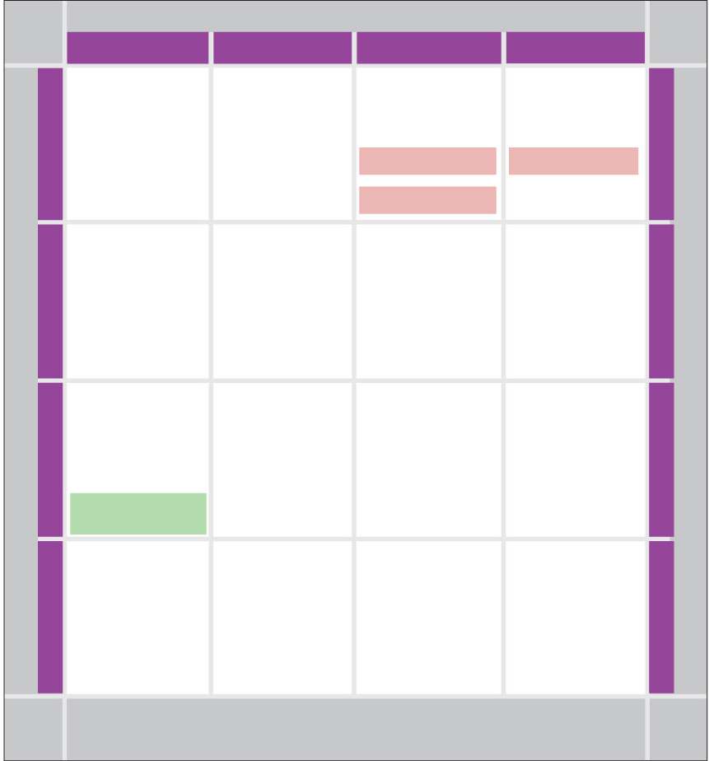
SECOND BASE
U
C
A
G
UUU
UCU
UAU
UGU
U
Phe
Tyr
Cys
C
U
UUC
UCC
UAC
UGC
Ser
A
UUA
UCA
UAA
Stop
UGA
Stop
Leu
G
UUG
UCG
UAG
Stop
UGG
Trp
CUU
CCU
CAU
CGU
U
His
C
C
CUC
CCC
CAC
CGC
Leu
Pro
Arg
A
CUA
CCA
CAA
CGA
Gln
G
CUG
CCG
CAG
CGG
AUU
ACU
AAU
AGU
U
Asn
Ser
C
A
AUC
Ile
ACC
AAC
AGC
Thr
A
AUA
ACA
AAA
AGA
Met or
Lys
Arg
G
AUG
Start
ACG
AAG
AGG
GUU
GCU
GAU
GGU
U
Asp
C
G
GUC
GCC
GAC
GGC
Val
Ala
Gly
A
GUA
GCA
GAA
GGA
Glu
G
GUG
GCG
GAG
GGG
Figure 3.36

Slide 13
Main Steps of Protein Synthesis
1. Find the proper gene for the proper polypeptide among the 23 pairs of genetic material on DNA (action occurring in the cell nucleus)
2. Read the gene’s (DNA) reading frame using the enzyme RNA polymerase – thus making an RNA (mRNA) copy of the DNA – since the action is one nucleotide language (DNA) being copied to another nucleotide language (it is transcription) – like recopying your class notes
(this action is also occurring in the cell nucleus)

Slide 14
Main Steps of Protein Synthesis
3. RNA modifications – the newly formed RNA is termed pre-mRNA in that it must be modified in two ways (1) certain regions in the RNA must be cut out (splicing) and (2) some capping nucleotides must be enzymatically attached to the end of the mRNA message.

Slide 15
Splicing
Splicing - The newly formed mRNA has some intentionally added nucleotides over and above those needed. These nucleotides are in the middle of the mRNA message. These extra nucleotides are called introns (intervening regions). The needed nucleotides are called exons (expressible regions). The introns must be cut out (spliced) and the exons rejoined together. This action happens in the cell nucleus. The messenger RNA cannot normally exit the cell nucleus unless it has been properly spliced

Slide 16
Capping
Each end of a pre-mRNA molecule is modified in a particular way:
  The 5′ end receives a modified nucleotide 5′ cap
  The 3′ end gets a poly-A tail
These modifications share several functions:
  They seem to facilitate the export of mRNA from the nucleus
  They protect mRNA from hydrolytic enzymes in the cytoplasm when it transports there
  They help ribosomes attach to the 5′ end of the properly modified mRNA in the cytoplasm after export from the nucleus

Slide 17
Main Steps of Protein Synthesis
4. Once the modifications of the mRNA are completed the mRNA can exit the nucleus and enter the cytoplasm. Chaperone proteins help take the mRNA to the small subunit of a ribosome. The 5’ cap assists the mRNA to attach to the small subunit of the ribosome.
5. The small subunit of the ribosome acts as a construction table for the newly forming polypeptide to be made.

Slide 18
Main Steps of Protein Synthesis
6. The small subunit of the ribosome slides underneath the m-RNA from the 5’ to 3’ direction. This small subunit is acting like a reader – moving underneath the various nitrogenous bases in an orderly manner. Eventually it will reach codons – regions that code for amino acids.

Slide 19
Main Steps of Protein Synthesis
Translation step – converting nucleotide language into protein/amino acid language
7. Eventually the small subunit will slide underneath a codon known as the start codon (AUG). This codon says begin making the polypeptide (translation). It codes for the amino acid Methionine. Thus methionine is placed at the beginning of every polypeptide – but it is removed later if the particular polypeptide does not desire methionine as the first amino acid.

Slide 20
Methionine Placement
The job of bringing amino acids (like methionine) to the mRNA and ribosome is the responsibility of tRNA – known as transfer RNA. It is called that because it transfers amino acids to the construction site (mRNA and ribosome).
Molecules of tRNA are not identical:
  Each carries a specific amino acid on one end (20 different naturally occurring amino acids)
  Each has an anticodon on the other end; the anticodon base-pairs with a complementary codon on mRNA

Slide 21
Main Steps of Protein Synthesis
8. Immediately after the first amino acid (methionine) is attached to the mRNA which is attached to the small subunit of the ribosome. The large subunit attaches to the small subunit. Thus now there is a ribosome complex attached to the messenger RNA.
9. The large unit has three sites (grooves) in it. A new amino acid entrance site – termed the A site. A site for the polypeptide that is be assembled – termed a P site and a site for the exit of the tRNA that brought in the last amino acid before the recent one.

Slide 22
Main Steps of Protein Synthesis
10. The new tRNA brings in a new amino acid dictated by the next mRNA codon. It sits in the A site (site for new tRNA entrants). Enzymes in the large subunit of the ribosome cause the new amino acid to join to the already existing polypeptide (which was in the P site). The new tRNA that brought in the new amino acid now holds the entire polypeptide. Since it now holds the entire polypeptide it sits now occupies the P (polypeptide) site. The old t-RNA that occupied the P site is now holding on to nothing and moves to the E site to be ejected (it exits).

Slide 23
Main Steps of Protein Synthesis
11. This process continues elongating the newly forming polypeptide – until the ribosome complex slides underneath codons known as termination codons. These codons cause a release factor to be introduced – freeing up the polypeptide.
12. Instead of one polypeptide being made at one time – several are made. How? Once a ribosome has attached to mRNA and started its process of polypeptide synthesis- another ribosome jumps on behind that one and does the same thing – then another and another. This is termed a polysome.

Slide 24
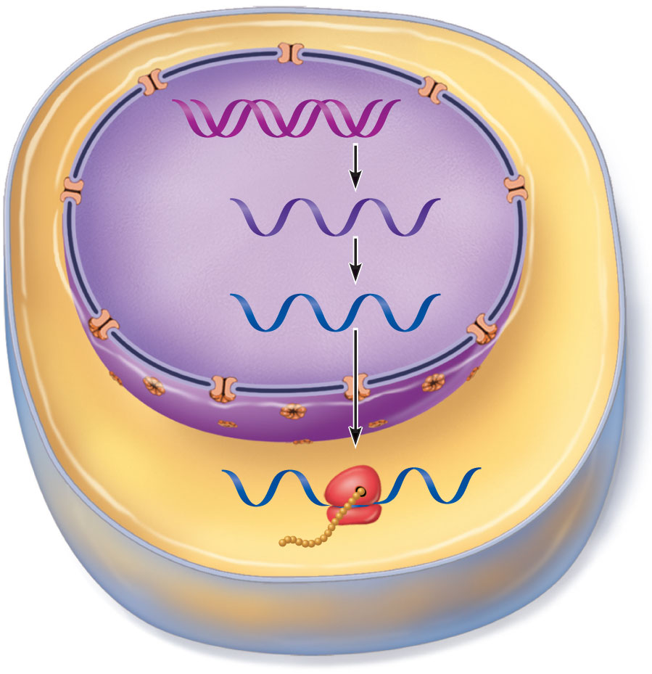
Nuclear
envelope
Transcription
DNA
RNA Processing
Pre-mRNA
mRNA
Nuclear
pores
Ribosome
Translation
Polypeptide
Figure 3.34

Slide 25
Step 1
Find the proper gene for the proper polypeptide among the 23 pairs of genetic material on DNA (action occurring in the cell nucleus)

Slide 26
Let’s say that insulin (a protein) is low in concentration and more needs to be made (homeostasis). The reading enzyme (RNA Polymerase) must find the proper piece of genetic material among the 23 pairs- go to the right member of the pair (mom vs.dad) for the gene if one is better than the other (recessive vs. dominant). Find the proper gene location (gene loci) on the DNA. Since the reading enzyme creates mRNA from the 5’ to 3’ end – the DNA is read from 3’ to 5’. Since DNA is antiparallel in the same gene region are two sides – the reading enzyme must choose the right side – right side “sense strand” wrong side ”non-sense” strand

Slide 27
Step 2
Read the gene’s (DNA) reading frame using the enzyme RNA polymerase – thus making an RNA (mRNA) copy of the DNA – since the action is one nucleotide language (DNA) being copied to another nucleotide language (it is transcription) – like recopying your class notes

Slide 28
Transcription
Transfers DNA gene base sequence to a complementary base sequence of an mRNA
Transcription factor
  Loosens histones from DNA in area to be transcribed
  Binds to promoter, a DNA sequence specifying start site of gene to be transcribed
  Mediates the binding of RNA polymerase to promoter

Slide 29
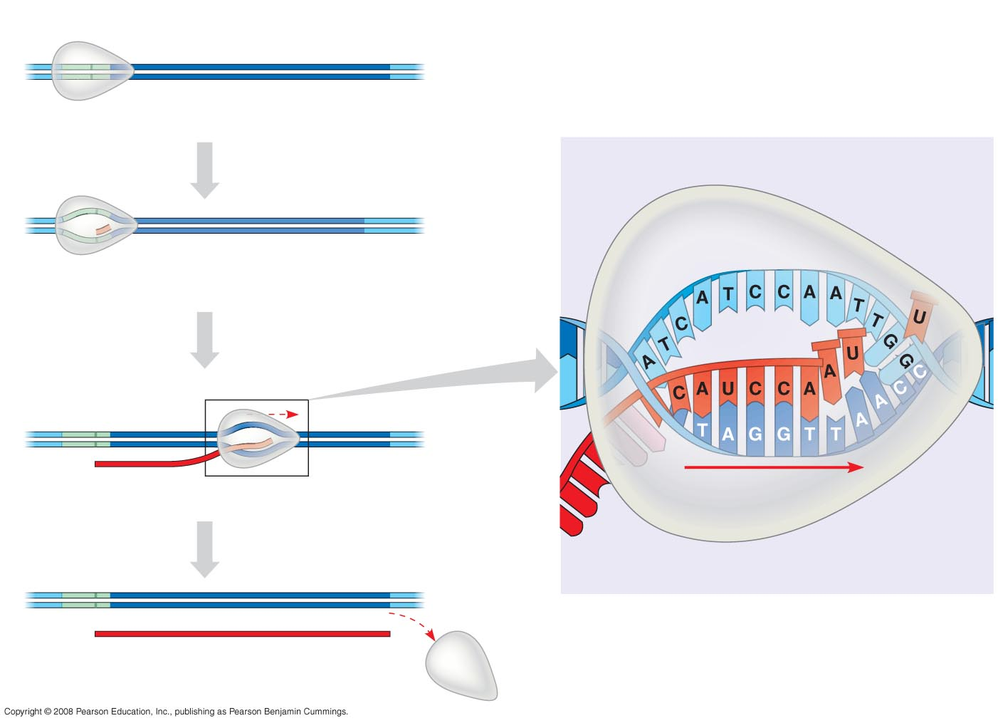
Fig. 17-7
Promoter
Transcription unit
5
3
3
DNA
5
Start point
RNA polymerase
1
Initiation
Elongation
Nontemplate
strand of DNA
5
3
RNA nucleotides
3
5
RNA
polymerase
RNA
transcript
Template strand
of DNA
Unwound
DNA
2
Elongation
3
3 end
Rewound
DNA
5
5
3
3
3
5
5
RNA
transcript
5
Direction of
transcription
(“downstream”)
Template
strand of DNA
3
Termination
Newly made
RNA
5
3
3
5
5
Completed RNA transcript
3
Notes:
Figure 17.7 The stages of transcription: initiation, elongation, and termination

Slide 30
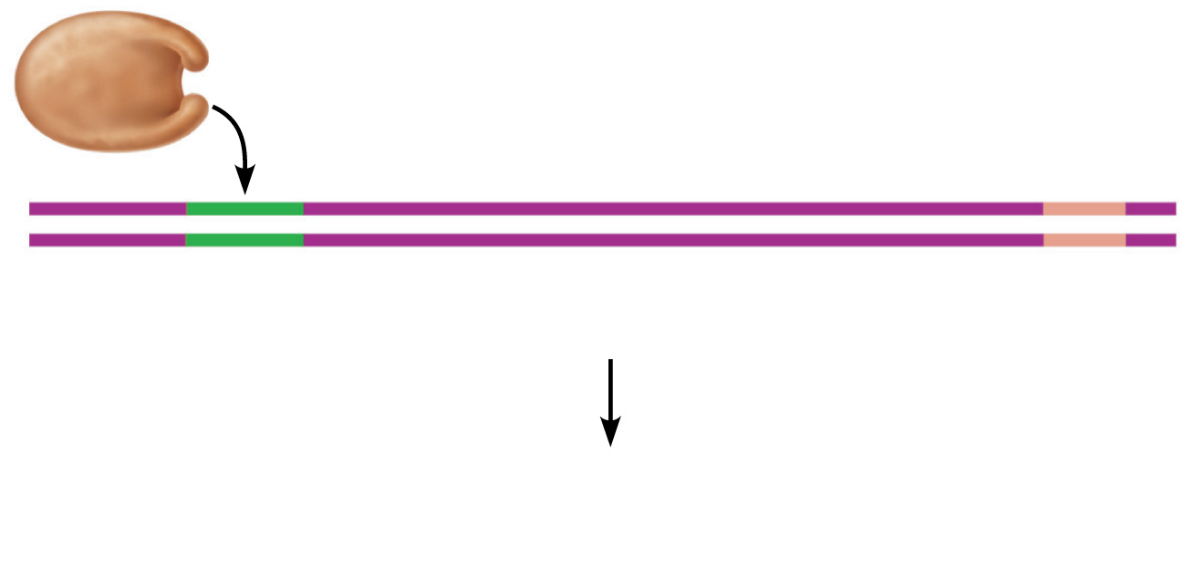
RNA polymerase
Coding strand
DNA
Promoter
region
Template strand
Termination
signal
1
Initiation: With the help of transcription factors, RNA
polymerase binds to the promoter, pries apart the two DNA strands,
and initiates mRNA synthesis at the start point on the template strand.
Figure 3.35 step 1

Slide 31
Transcription
RNA polymerase
  Enzyme that oversees synthesis of mRNA
  Unwinds DNA template
  Adds complementary RNA nucleotides on DNA template and joins them together
  Stops when it reaches termination signal
  mRNA pulls off the DNA template, is further processed by enzymes, and enters cytosol

Slide 32
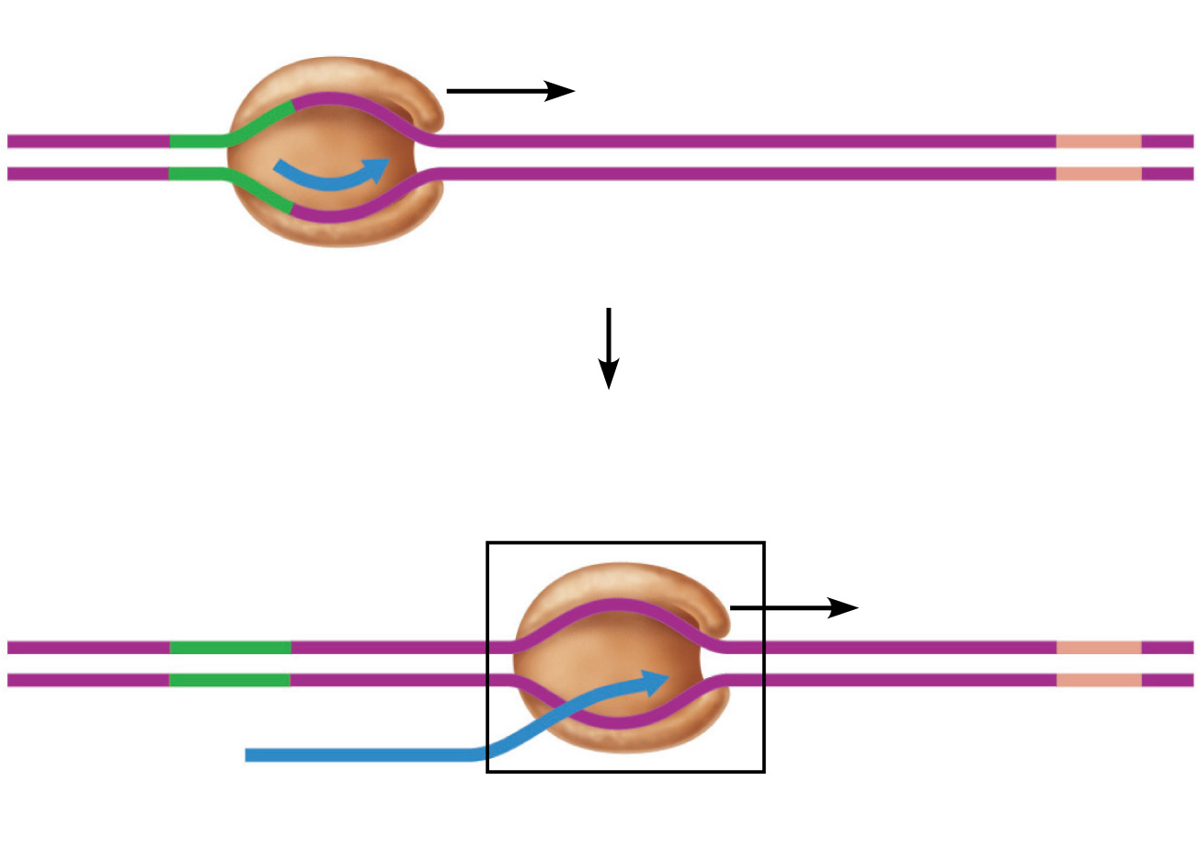
mRNA
Template strand
2
Elongation: As the RNA polymerase moves along the template
strand, elongating the mRNA transcript one base at a time, it unwinds
the DNA double helix before it and rewinds the double helix behind it.
mRNA transcript
Figure 3.35 step 2

Slide 33
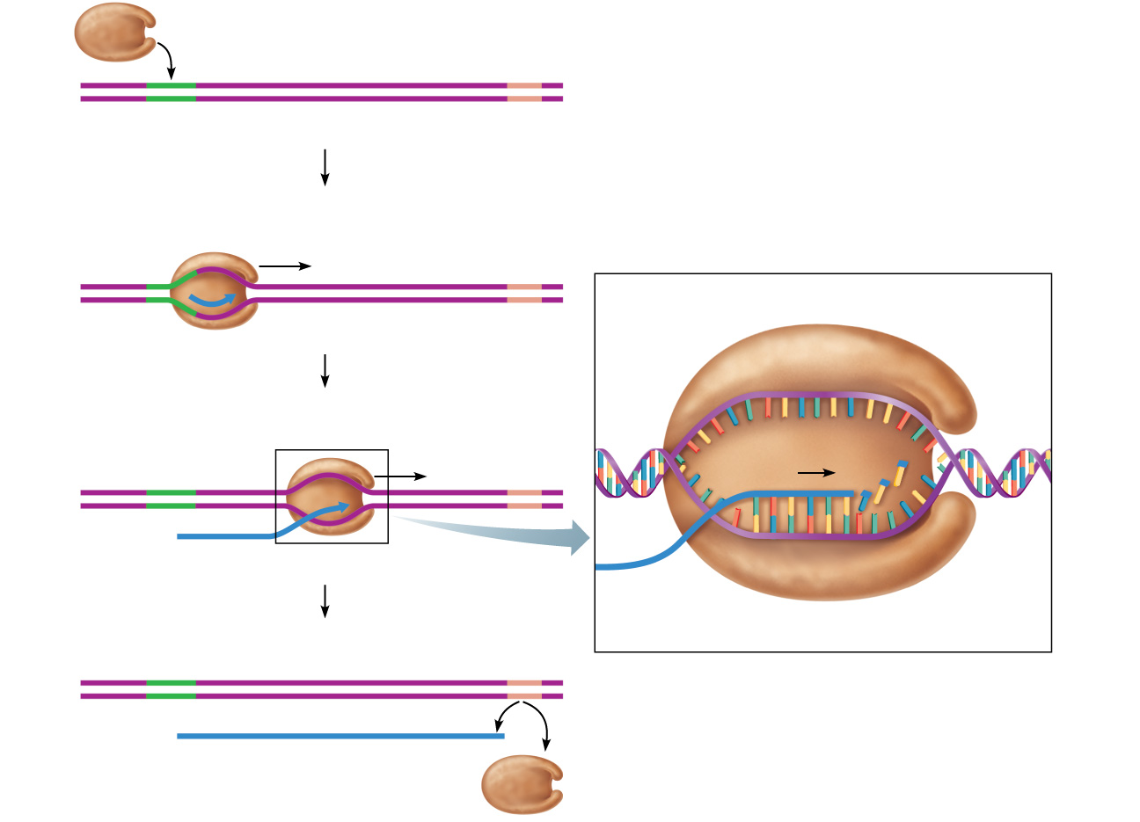
RNA polymerase
Coding strand
DNA
Promoter
region
Template strand
Termination
signal
1
Initiation: With the help of transcription factors, RNA
polymerase binds to the promoter, pries apart the two DNA strands,
and initiates mRNA synthesis at the start point on the template strand.
mRNA
Template strand
Coding strand of DNA
2
Rewinding
of DNA
Unwinding
of DNA
Elongation: As the RNA polymerase moves along the template
strand, elongating the mRNA transcript one base at a time, it unwinds
the DNA double helix before it and rewinds the double helix behind it.
RNA nucleotides
Direction of
transcription
mRNA transcript
mRNA
DNA-RNA hybrid region
Template
strand
3
RNA
polymerase
Termination: mRNA synthesis ends when the termination signal
is reached. RNA polymerase and the completed mRNA transcript are
released.
The DNA-RNA hybrid: At any given moment, 16–18 base pairs of
DNA are unwound and the most recently made RNA is still bound to
DNA. This small region is called the DNA-RNA hybrid.
Completed mRNA transcript
RNA polymerase
Figure 3.35

Slide 34
RNA polymerase
Coding strand
DNA
Promoter
region
Template strand
Termination
signal
1
Initiation: With the help of transcription factors, RNA
polymerase binds to the promoter, pries apart the two DNA strands,
and initiates mRNA synthesis at the start point on the template strand.
Figure 3.35 step 1

Slide 35
mRNA
Template strand
2
Elongation: As the RNA polymerase moves along the template
strand, elongating the mRNA transcript one base at a time, it unwinds
the DNA double helix before it and rewinds the double helix behind it.
mRNA transcript
Figure 3.35 step 2

Slide 36
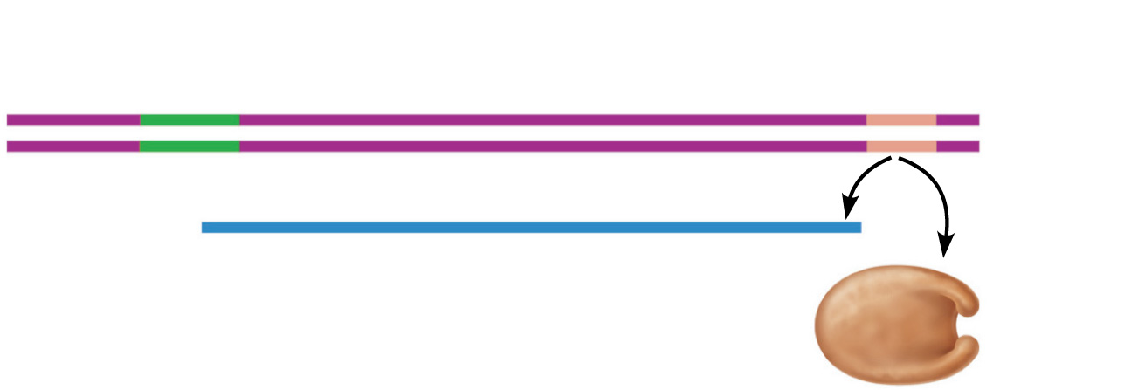
3
Termination: mRNA synthesis ends when the termination signal
is reached. RNA polymerase and the completed mRNA transcript are
released.
RNA
polymerase
Completed mRNA transcript
Figure 3.35 step 3

Slide 37
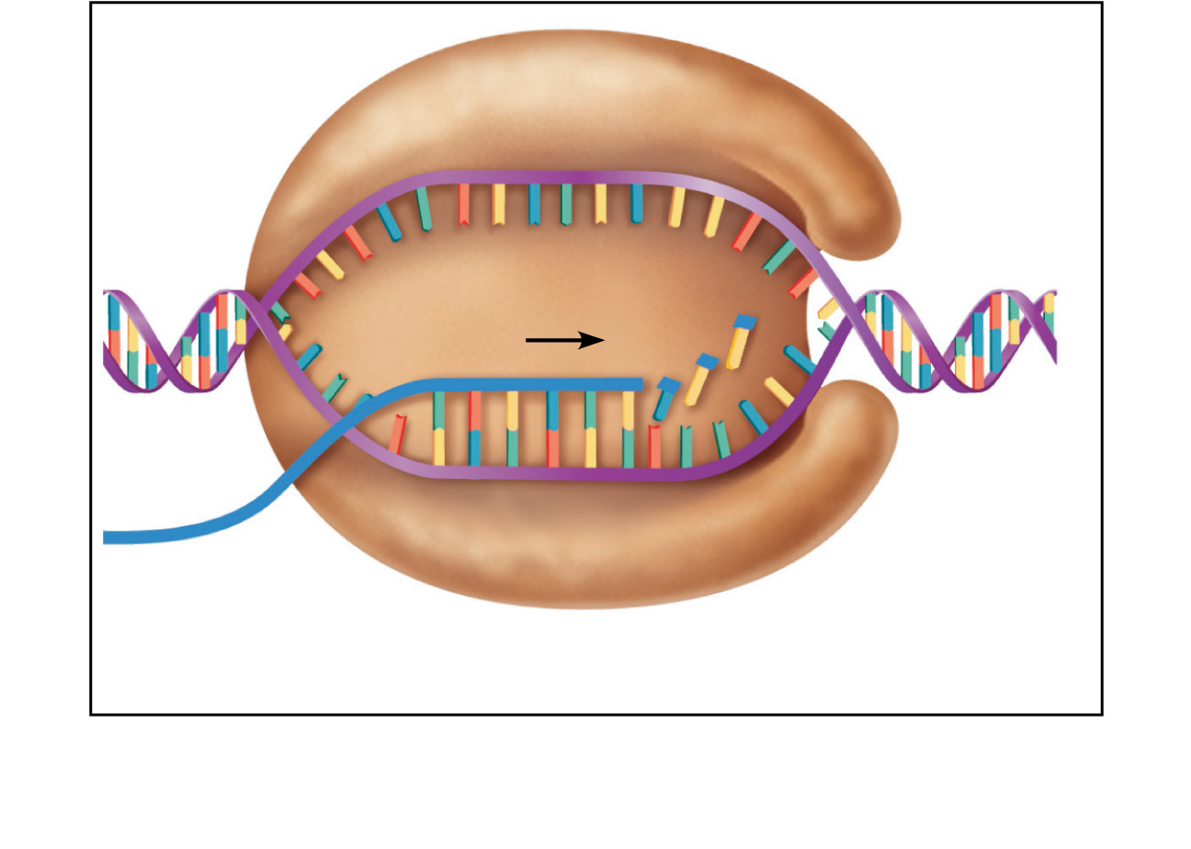
Coding strand of DNA
Rewinding
of DNA
Unwinding
of DNA
RNA nucleotides
Direction of
transcription
Template
strand
DNA-RNA hybrid region
mRNA
RNA
polymerase
The DNA-RNA hybrid: At any given moment, 16–18 base pairs
of DNA are unwound and the most recently made RNA is still
bound to DNA. This small region is called the DNA-RNA hybrid.
Figure 3.35 step 4

Slide 38
Step 3
RNA modifications – the newly formed RNA is termed pre-mRNA in that it must be modified in two ways (1) certain regions in the RNA must be cut out (splicing) and (2) some capping nucleotides must be enzymatically attached to the end of the mRNA message.

Slide 39
Splicing
Splicing - The newly formed mRNA has some intentionally added nucleotides over and above those needed. These nucleotides are in the middle of the mRNA message. These extra nucleotides are called introns (intervening regions). The needed nucleotides are called exons (expressible regions). The introns must be cut out (spliced) and the exons rejoined together. This action happens in the cell nucleus. The messenger RNA cannot normally exit the cell nucleus unless it has been properly spliced

Slide 40
In some cases, RNA splicing is carried out by spliceosomes
Spliceosomes consist of a variety of proteins and several small nuclear ribonucleoproteins (snRNPs) that recognize the splice sites
Copyright © 2008 Pearson Education Inc., publishing as Pearson Benjamin Cummings

Slide 41
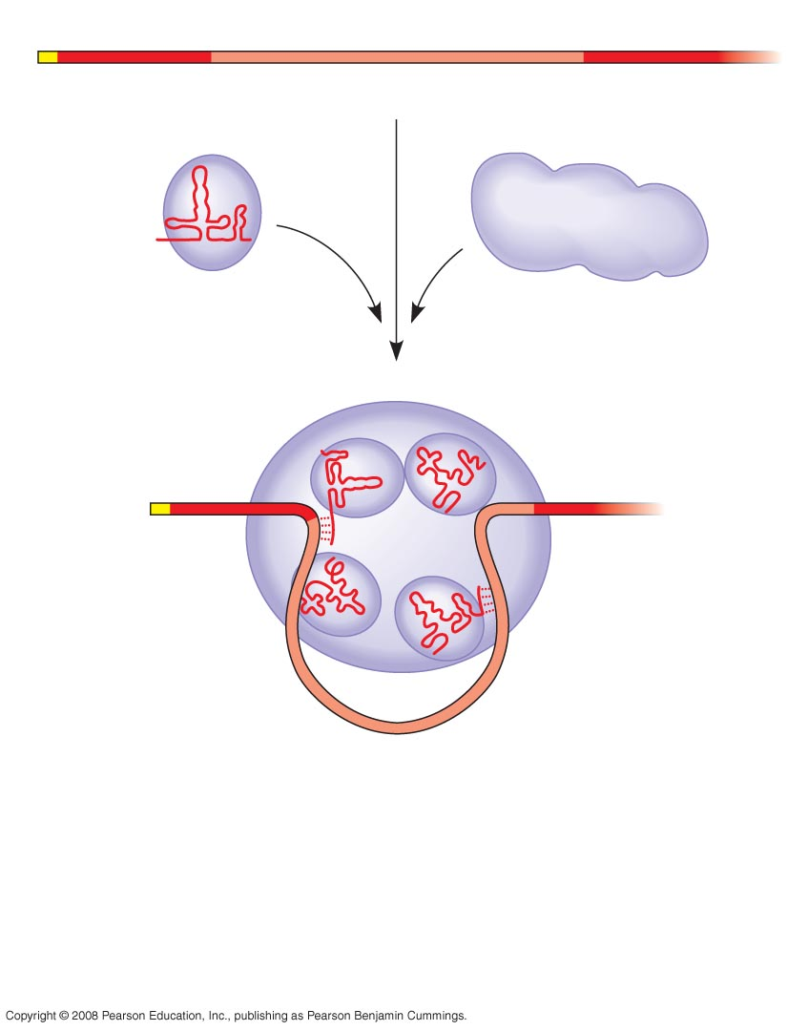
Fig. 17-11-2
RNA transcript (pre-mRNA)
5
Exon 1
Intron
Exon 2
Protein
snRNA
Other
proteins
snRNPs
Spliceosome
5
Notes:
Figure 17.11 The roles of snRNPs and spliceosomes in pre-mRNA splicing

Slide 42
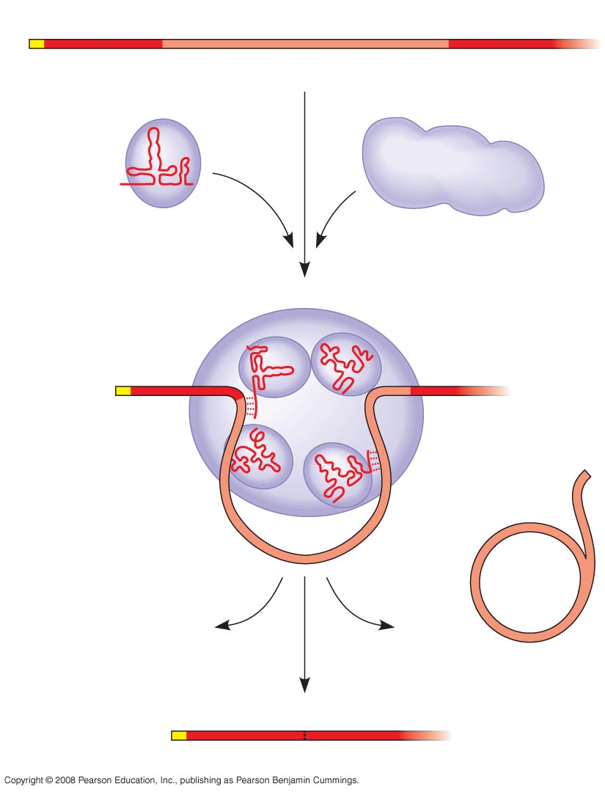
Fig. 17-11-3
RNA transcript (pre-mRNA)
5
Exon 1
Intron
Exon 2
Protein
snRNA
Other
proteins
snRNPs
Spliceosome
5
Spliceosome
components
Cut-out
intron
mRNA
5
Exon 1
Exon 2
Notes:
Figure 17.11 The roles of snRNPs and spliceosomes in pre-mRNA splicing

Slide 43
Capping
Each end of a pre-mRNA molecule is modified in a particular way:
  The 5′ end receives a modified nucleotide 5′ cap
  The 3′ end gets a poly-A tail
These modifications share several functions:
  They seem to facilitate the export of mRNA from the nucleus
  They protect mRNA from hydrolytic enzymes in the cytoplasm when it transports there
  They help ribosomes attach to the 5′ end of the properly modified mRNA in the cytoplasm after export from the nucleus

Slide 44
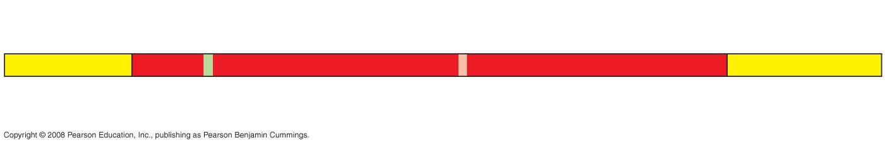
Fig. 17-9
Protein-coding segment
Polyadenylation signal
5
3
G
P
P
P
AAUAAA
AAA
…
AAA
5 Cap
5 UTR
Start codon
Stop codon
3 UTR
Poly-A tail
Notes:
Figure 17.9 RNA processing: addition of the 5′ cap and poly-A tail

Slide 45
Main Steps of Protein Synthesis
4. Once modifications of the mRNA are completed the mRNA can exit the nucleus and enter the cytoplasm. Chaperone proteins help take the mRNA to the small subunit of a ribosome. The 5’ cap assists the mRNA to attach to the small subunit of the ribosome.
5. The small subunit of the ribosome acts as a construction table for the newly forming protein to be made.

Slide 46
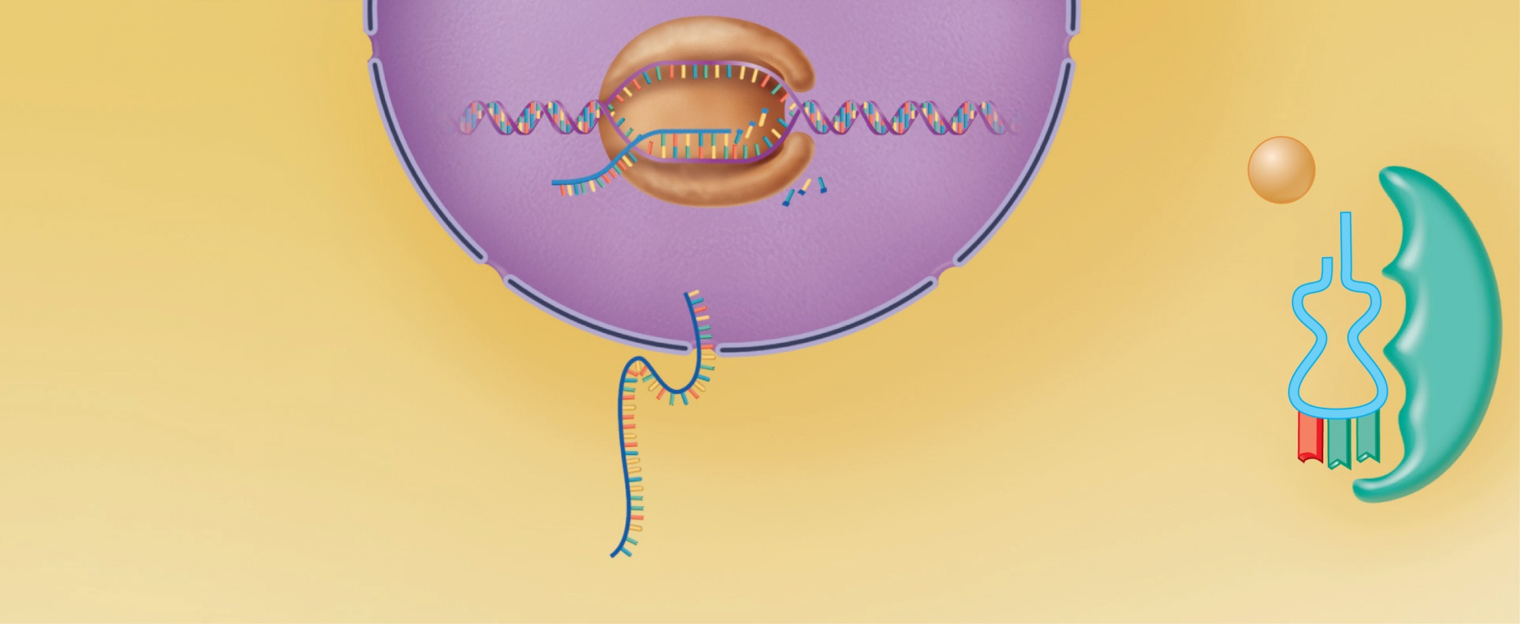
Nucleus
Energized by ATP, the correct
amino acid is attached to each
species of tRNA by aminoacyl-
tRNA synthetase enzyme.
RNA polymerase
mRNA
Template
strand of
DNA
Leu
Amino acid
1
After mRNA synthesis in
the nucleus, mRNA leaves the
nucleus and attaches to a
ribosome.
Nuclear pore
tRNA
Nuclear
membrane
G
A
A
Released mRNA
Aminoacyl-tRNA
synthetase
Figure 3.37 step 1

Slide 47
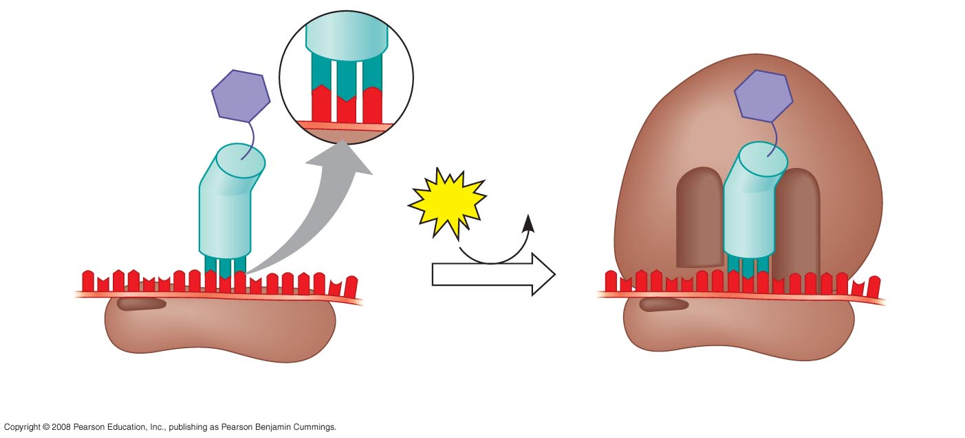
Fig. 17-17
Large
ribosomal
subunit
3
U
A
C
5
P site
Met
5
A
U
G
3
Met
Initiator
tRNA
GTP
GDP
E
A
mRNA
5
3
5
3
Start codon
Small
ribosomal
subunit
mRNA binding site
Translation initiation complex
Notes:
Figure 17.17 The initiation of translation

Slide 48
Main Steps of Protein Synthesis
6. The small subunit of the ribosome slides underneath the m-RNA from the 5’ to 3’ direction. This small subunit is acting like a reader – moving underneath the various nitrogenous bases in an orderly manner. Eventually it will reach codons – regions that code for amino acids.

Slide 49
Fig. 17-17
Large
ribosomal
subunit
3
U
A
C
5
P site
Met
5
A
U
G
3
Met
Initiator
tRNA
GTP
GDP
E
A
mRNA
5
3
5
3
Start codon
Small
ribosomal
subunit
mRNA binding site
Translation initiation complex
Notes:
Figure 17.17 The initiation of translation

Slide 50
Main Steps of Protein Synthesis
Translation step – converting nucleotide language into protein/amino acid language
7. Eventually the small subunit will slide underneath a codon known as the start codon (AUG). This codon says begin making the polypeptide (translation). It codes for the amino acid Methionine. Thus methionine is placed at the beginning of every polypeptide – but it is removed later if the particular polypeptide does not desire methionine as the first amino acid.

Slide 51
Translation
mRNA attaches to a small ribosomal subunit that moves along the mRNA to the start codon
Large ribosomal unit attaches, forming a functional ribosome
Anticodon of a tRNA binds to its complementary codon and adds its amino acid to the forming protein chain
New amino acids are added by other tRNAs as ribosome moves along rRNA, until stop codon is reached

Slide 52
Fig. 17-17
Large
ribosomal
subunit
3
U
A
C
5
P site
Met
5
A
U
G
3
Met
Initiator
tRNA
GTP
GDP
E
A
mRNA
5
3
5
3
Start codon
Small
ribosomal
subunit
mRNA binding site
Translation initiation complex
Notes:
Figure 17.17 The initiation of translation

Slide 53
Methionine Placement
The job of bringing amino acids (like methionine) to the mRNA and ribosome is the responsibility of tRNA – known as transfer RNA. It is called that because it transfers amino acids to the construction site (mRNA and ribosome).
Molecules of tRNA are not identical:
  Each carries a specific amino acid on one end (20 different naturally occurring amino acids)
  Each has an anticodon on the other end; the anticodon base-pairs with a complementary codon on mRNA

Slide 54
Fig. 17-17
Large
ribosomal
subunit
3
U
A
C
5
P site
Met
5
A
U
G
3
Met
Initiator
tRNA
GTP
GDP
E
A
mRNA
5
3
5
3
Start codon
Small
ribosomal
subunit
mRNA binding site
Translation initiation complex
Notes:
Figure 17.17 The initiation of translation

Slide 55
Main Steps of Protein Synthesis
8. Immediately after the first amino acid (methionine) is attached to the mRNA which is attached to the small subunit of the ribosome. The large subunit attaches to the small subunit. Thus now there is a ribosome complex attached to the messenger RNA.
9. The large unit has three sites (grooves) in it. A new amino acid entrance site – termed the A site. A site for the polypeptide that is be assembled – termed a P site and a site for the exit of the tRNA that brought in the last amino acid before the recent one.

Slide 56
Fig. 17-17
Large
ribosomal
subunit
3
U
A
C
5
P site
Met
5
A
U
G
3
Met
Initiator
tRNA
GTP
GDP
E
A
mRNA
5
3
5
3
Start codon
Small
ribosomal
subunit
mRNA binding site
Translation initiation complex
Notes:
Figure 17.17 The initiation of translation

Slide 57
9. The large unit has three sites (grooves) in it. A new amino acid entrance site – termed the A site. A site for the polypeptide that is be assembled – termed a P site and a site for the exit of the tRNA that brought in the last amino acid before the recent one.

Slide 58
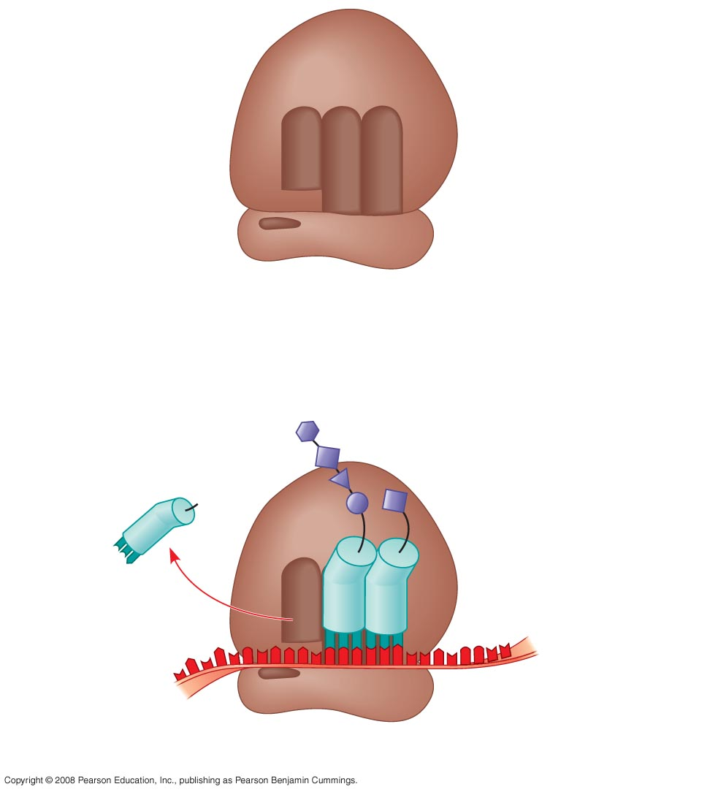
Fig. 17-16b
P site (Peptidyl-tRNA
binding site)
A site (Aminoacyl-
tRNA binding site)
E site
(Exit site)
E
P
A
Large
subunit
mRNA
binding site
Small
subunit
(b) Schematic model showing binding sites
Amino end
Growing polypeptide
Next amino acid
to be added to
polypeptide chain
E
tRNA
mRNA
3
5
Codons
(c) Schematic model with mRNA and tRNA
Notes:
Figure 17.16 The anatomy of a functioning ribosome

Slide 59
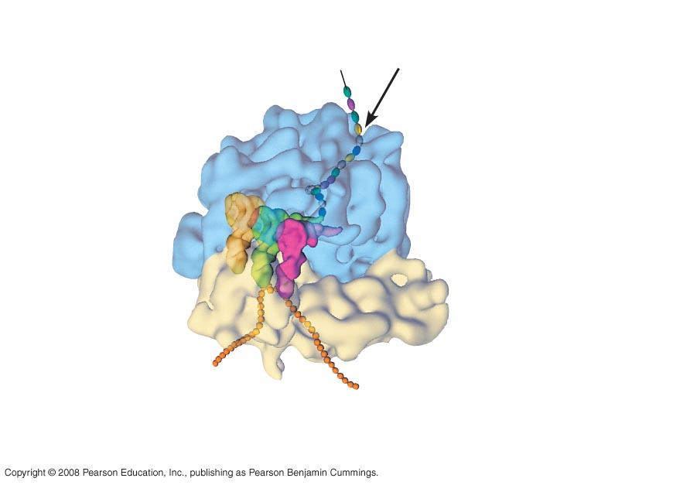
Fig. 17-16a
Growing
polypeptide
Exit tunnel
tRNA
molecules
Large
subunit
E
P
A
Small
subunit
5
3
mRNA
(a) Computer model of functioning ribosome
Notes:
Figure 17.16 The anatomy of a functioning ribosome

Slide 60
Main Steps of Protein Synthesis
10. The new tRNA brings in a new amino acid dictated by the next mRNA codon. It sits in the A site (site for new tRNA entrants). Enzymes in the large subunit of the ribosome cause the new amino acid to join to the already existing polypeptide (which was in the P site). The new tRNA that brought in the new amino acid now holds the entire polypeptide. Since it now holds the entire polypeptide it sits now occupies the P (polypeptide) site. The old t-RNA that occupied the P site is now holding on to nothing and moves to the E site to be ejected (it exits).

Slide 61
Nucleus
Energized by ATP, the correct
amino acid is attached to each
species of tRNA by aminoacyl-
tRNA synthetase enzyme.
RNA polymerase
mRNA
Template
strand of
DNA
Leu
Amino acid
1
After mRNA synthesis in
the nucleus, mRNA leaves the
nucleus and attaches to a
ribosome.
Nuclear pore
tRNA
Nuclear
membrane
G
A
A
Released mRNA
Aminoacyl-tRNA
synthetase
Figure 3.37 step 1

Slide 62
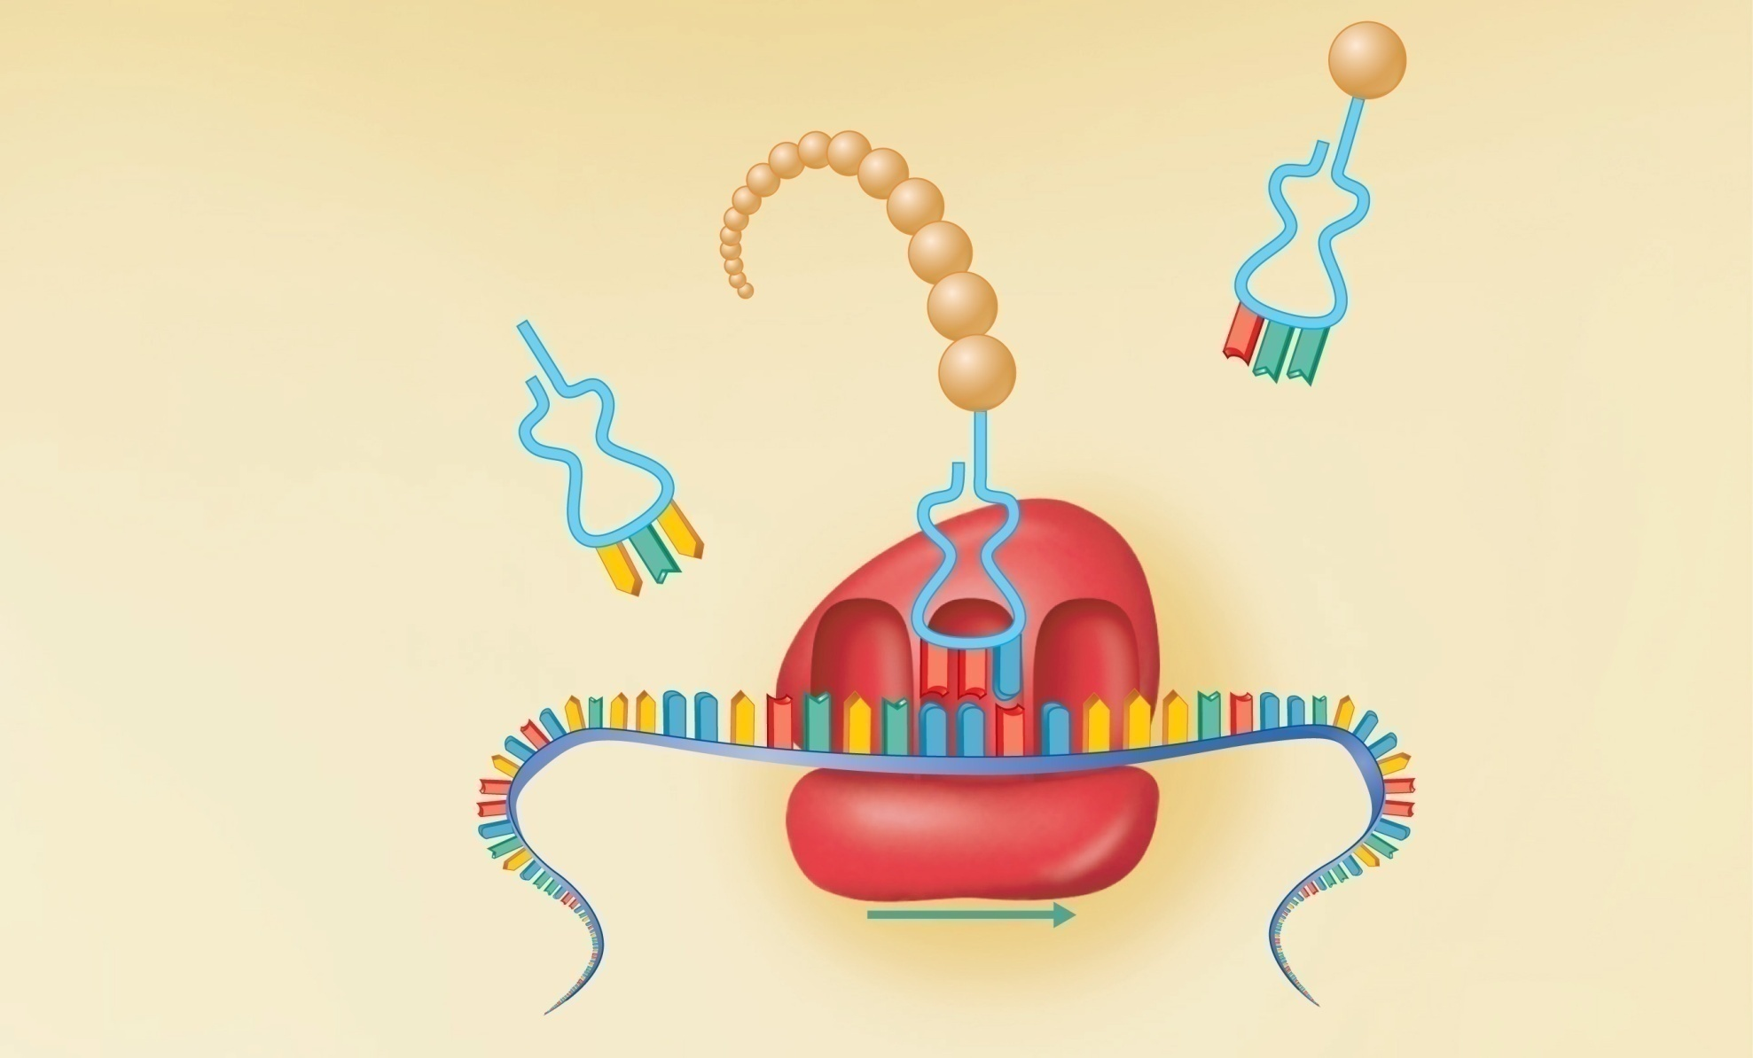
Leu
2
Translation begins as
incoming aminoacyl-tRNA
recognizes the
complementary codon
calling for it at the A site
on the ribosome. It
hydrogen-bonds to the
codon via its anticodon.
tRNA “head”
bearing
anticodon
Ile
G
A
A
Pro
A
U
U
P
site
Large
ribosomal
subunit
E
site
A
site
G
G
C
A
U
A
C
C
G
C
U
U
Small
ribosomal
subunit
Codon
15
Codon
16
Codon
17
Portion of
mRNA already
translated
Direction of
ribosome advance
Figure 3.37 step 2

Slide 63
Leu
3
As the ribosome moves
along the mRNA, and each
codon is read in sequence, a
new amino acid is added to
the growing protein chain and
the tRNA in the A site is
translocated to the P site.
2
Translation begins as
incoming aminoacyl-tRNA
recognizes the
complementary codon
calling for it at the A site
on the ribosome. It
hydrogen-bonds to the
codon via its anticodon.
tRNA “head”
bearing
anticodon
Ile
G
A
A
Pro
A
U
U
P
site
Large
ribosomal
subunit
E
site
A
site
G
G
C
A
U
A
C
C
G
C
U
U
Small
ribosomal
subunit
Codon
15
Codon
16
Codon
17
Portion of
mRNA already
translated
Direction of
ribosome advance
Figure 3.37 step 3

Slide 64
Leu
3
As the ribosome moves
along the mRNA, and each
codon is read in sequence, a
new amino acid is added to
the growing protein chain and
the tRNA in the A site is
translocated to the P site.
2
Translation begins as
incoming aminoacyl-tRNA
recognizes the
complementary codon
calling for it at the A site
on the ribosome. It
hydrogen-bonds to the
codon via its anticodon.
tRNA “head”
bearing
anticodon
Ile
G
A
A
Pro
4
Once its amino acid is
released from the P site, tRNA
is ratcheted to the E site and
then released to reenter the
cytoplasmic pool, ready to be
recharged with a new amino
acid. The polypeptide is
released when the stop
codon is read.
A
U
U
P
site
Large
ribosomal
subunit
E
site
A
site
G
G
C
A
U
A
C
C
G
C
U
U
Small
ribosomal
subunit
Codon
15
Codon
16
Codon
17
Portion of
mRNA already
translated
Direction of
ribosome advance
Figure 3.37 step 4

Slide 65
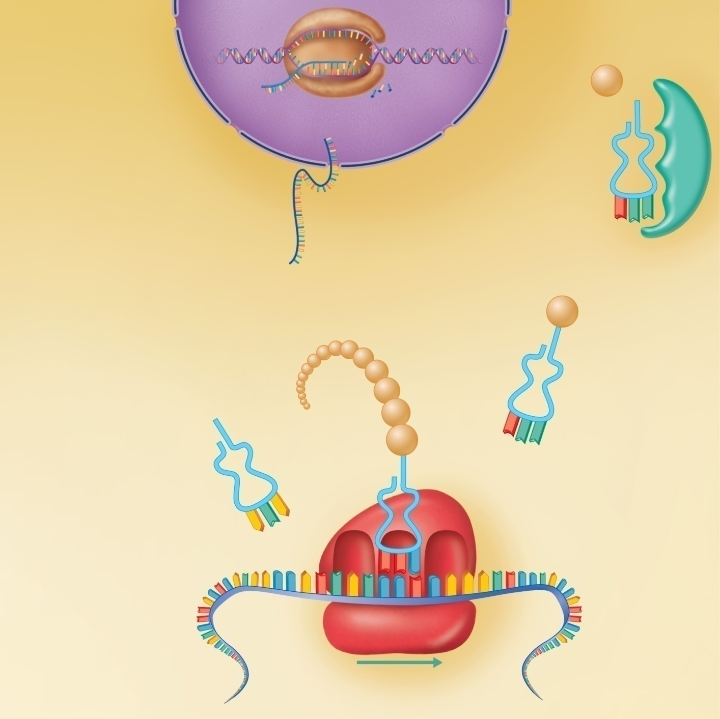
Nucleus
RNA polymerase
Energized by ATP, the correct amino
acid is attached to each species of
tRNA by aminoacyl-tRNA synthetase
enzyme.
mRNA
Template
strand of
DNA
Leu
Amino acid
1
After mRNA synthesis in the
nucleus, mRNA leaves the nucleus
and attaches to a ribosome.
Nuclear pore
Nuclear
membrane
tRNA
G
A
A
2
Translation begins as incoming
aminoacyl-tRNA recognizes the
complementary codon calling for
it at the A site on the ribosome. It
hydrogen-bonds to the codon via
its anticodon.
Released mRNA
Aminoacyl-tRNA
synthetase
Leu
3
As the ribosome moves along
the mRNA, and each codon is
read in sequence, a new amino
acid is added to the growing
protein chain and the tRNA in
the A site is translocated to the
P site.
Ile
G
A
tRNA “head”
bearing
anticodon
Pro
A
4
Once its amino acid is released
from the P site, tRNA is ratcheted
to the E site and then released to
reenter the cytoplasmic pool,
ready to be recharged with a new
amino acid. The polypeptide is
released when the stop codon is
read.
U
U
A
P
site
E
site
A
site
Large
ribosomal
subunit
G
G
C
A
U
A
C
C
G
C
U
U
Small
ribosomal
subunit
Codon
15
Codon
16
Codon
17
Portion of mRNA
already translated
Direction of
ribosome advance
Figure 3.37

Slide 66
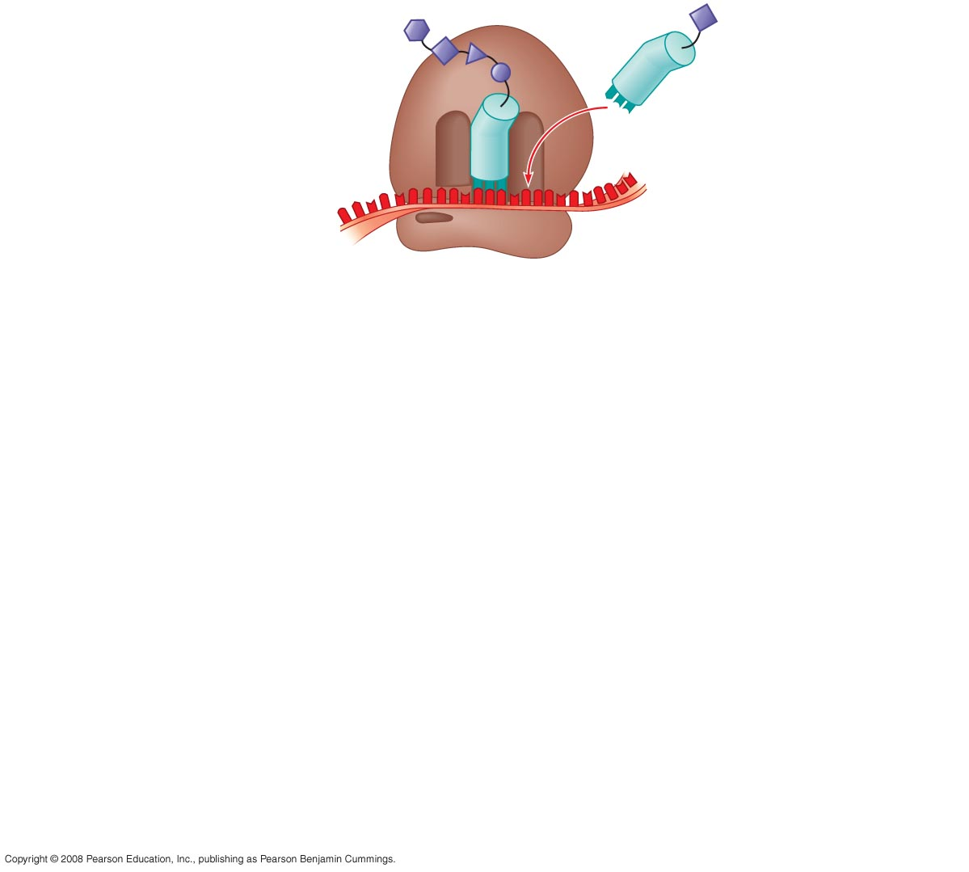
Fig. 17-18-1
Amino end
of polypeptide
E
3
mRNA
5
P
site
A
site
Notes:
Figure 17.18 The elongation cycle of translation

Slide 67
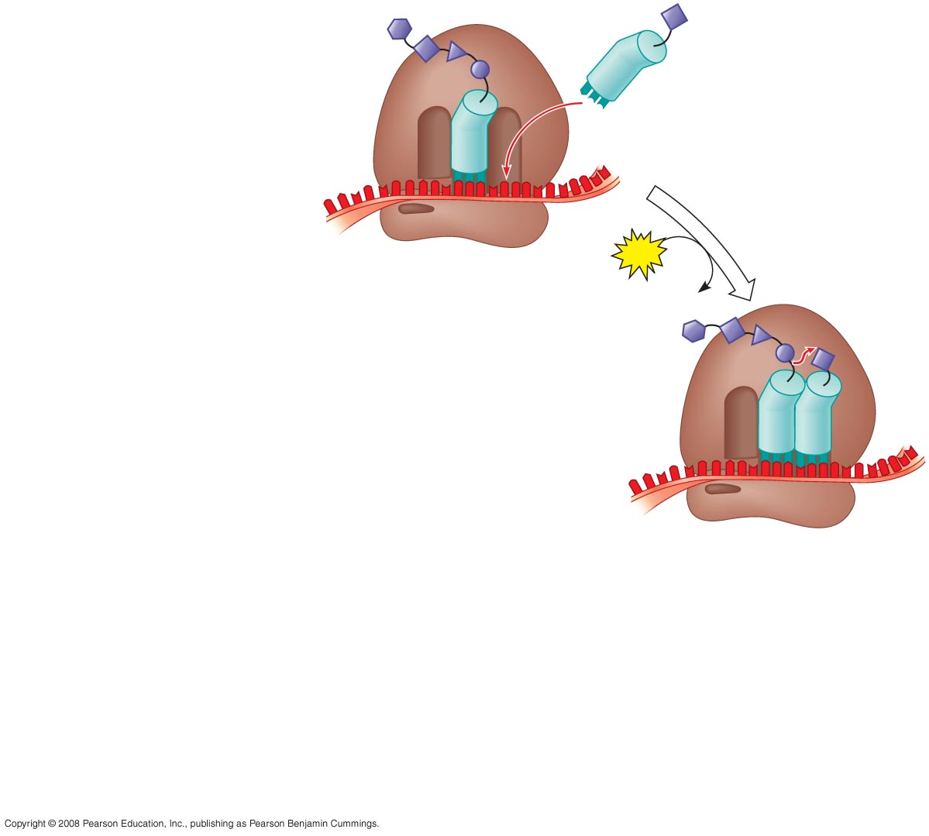
Fig. 17-18-2
Amino end
of polypeptide
E
3
mRNA
5
P
site
A
site
GTP
GDP
E
P
A
Notes:
Figure 17.18 The elongation cycle of translation

Slide 68
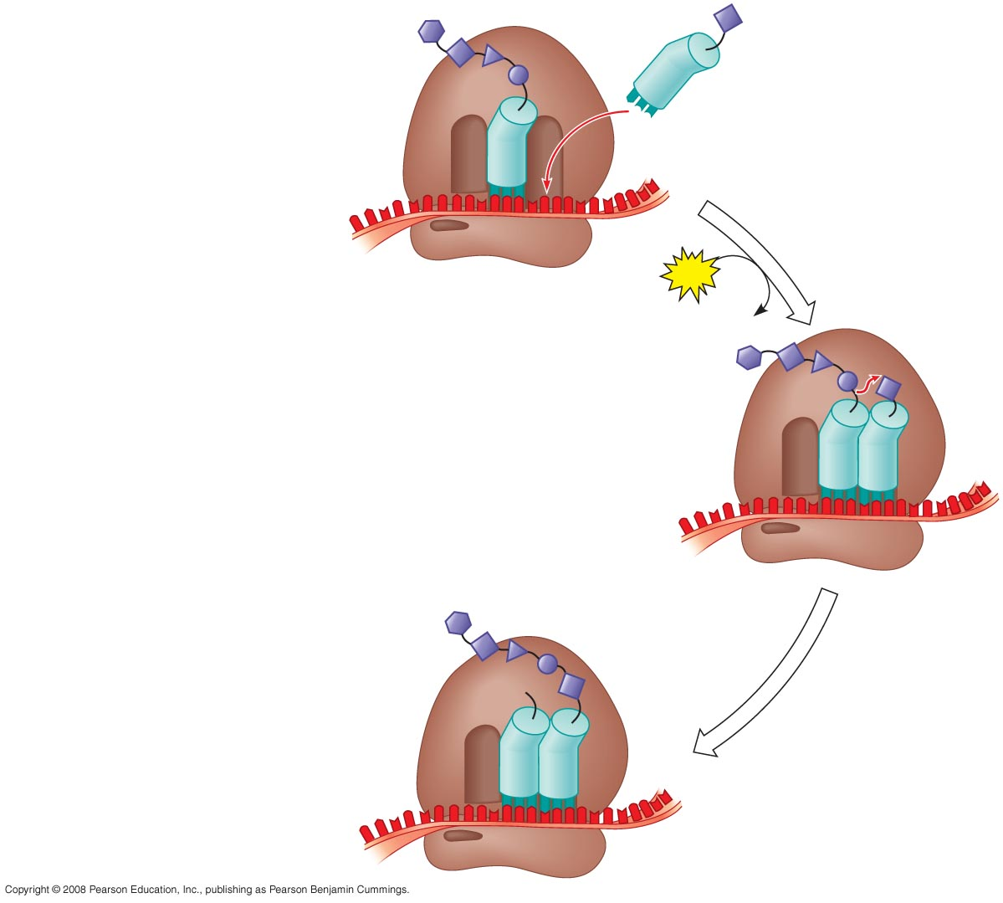
Fig. 17-18-3
Amino end
of polypeptide
E
3
mRNA
5
P
site
A
site
GTP
GDP
E
P
A
E
P
A
Notes:
Figure 17.18 The elongation cycle of translation

Slide 69
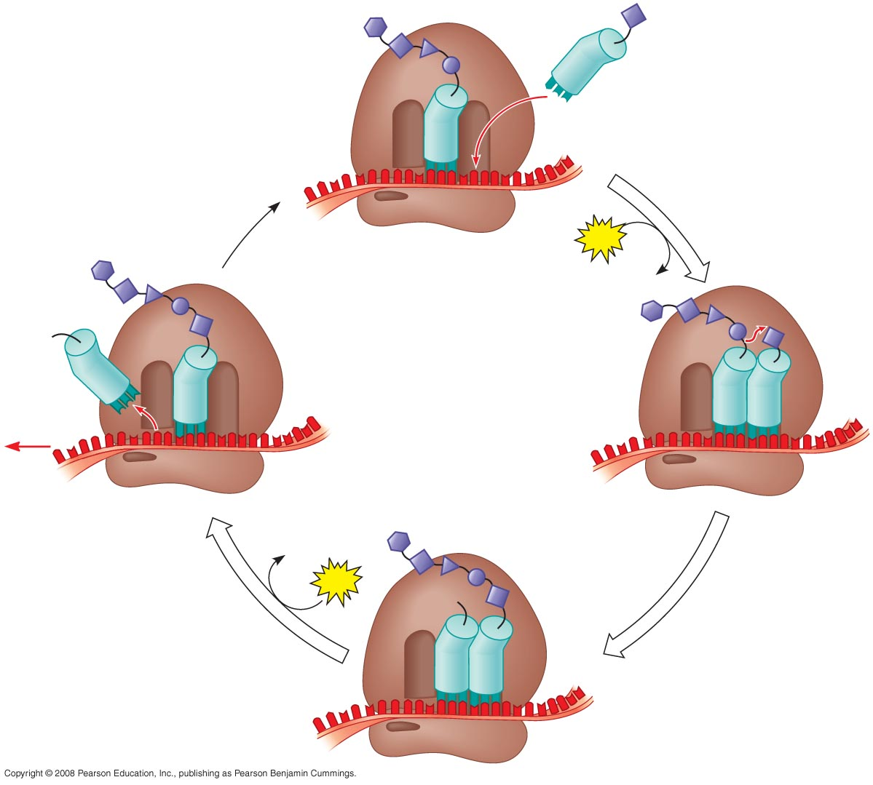
Fig. 17-18-4
Amino end
of polypeptide
E
3
mRNA
Ribosome ready for
next aminoacyl tRNA
5
P
site
A
site
GTP
GDP
E
E
P
A
P
A
GDP
GTP
E
P
A
Notes:
Figure 17.18 The elongation cycle of translation

Slide 70
Main Steps of Protein Synthesis
11. This process continues elongating the newly forming polypeptide – until the ribosome complex slides underneath codons known as the termination codons. These codons cause a release factor to be introduced – freeing up the polypeptide.

Slide 71
Termination of Translation
Termination occurs when a stop codon in the mRNA reaches the A site of the ribosome
The A site accepts a protein called a release factor
The release factor causes the addition of a water molecule instead of an amino acid
This reaction releases the polypeptide, and the translation assembly then comes apart
Copyright © 2008 Pearson Education Inc., publishing as Pearson Benjamin Cummings

Slide 72
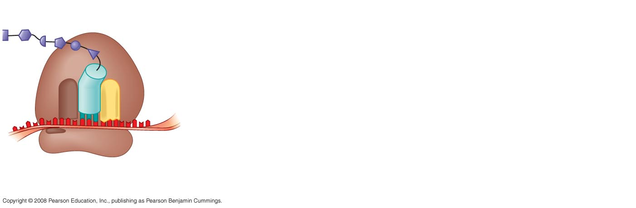
Fig. 17-19-1
Release
factor
3
5
Stop codon
(UAG, UAA, or UGA)
Notes:
Figure 17.19 The termination of translation

Slide 73
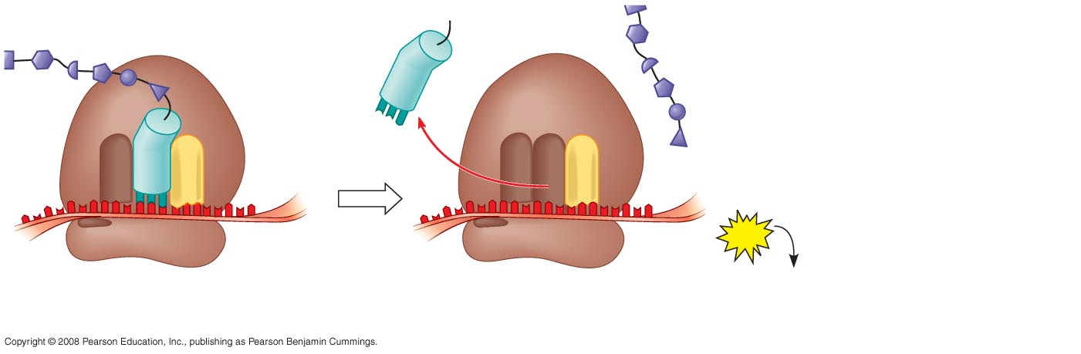
Fig. 17-19-2
Release
factor
Free
polypeptide
3
3
5
5
2
GTP
Stop codon
(UAG, UAA, or UGA)
2 GDP
Notes:
Figure 17.19 The termination of translation

Slide 74
Main Steps of Protein Synthesis
12. Instead of one polypeptide being made at one time – several are made. How? Once a ribosome has attached to mRNA and started its process of polypeptide synthesis- another ribosome jumps on behind that one and does the same thing – then another and another. This is termed a polyribosome or polysome.

Slide 75
Polyribosomes
A number of ribosomes can translate a single mRNA simultaneously, forming a polyribosome (or polysome)
Polyribosomes enable a cell to make many copies of a polypeptide very quickly
Copyright © 2008 Pearson Education Inc., publishing as Pearson Benjamin Cummings

Slide 76
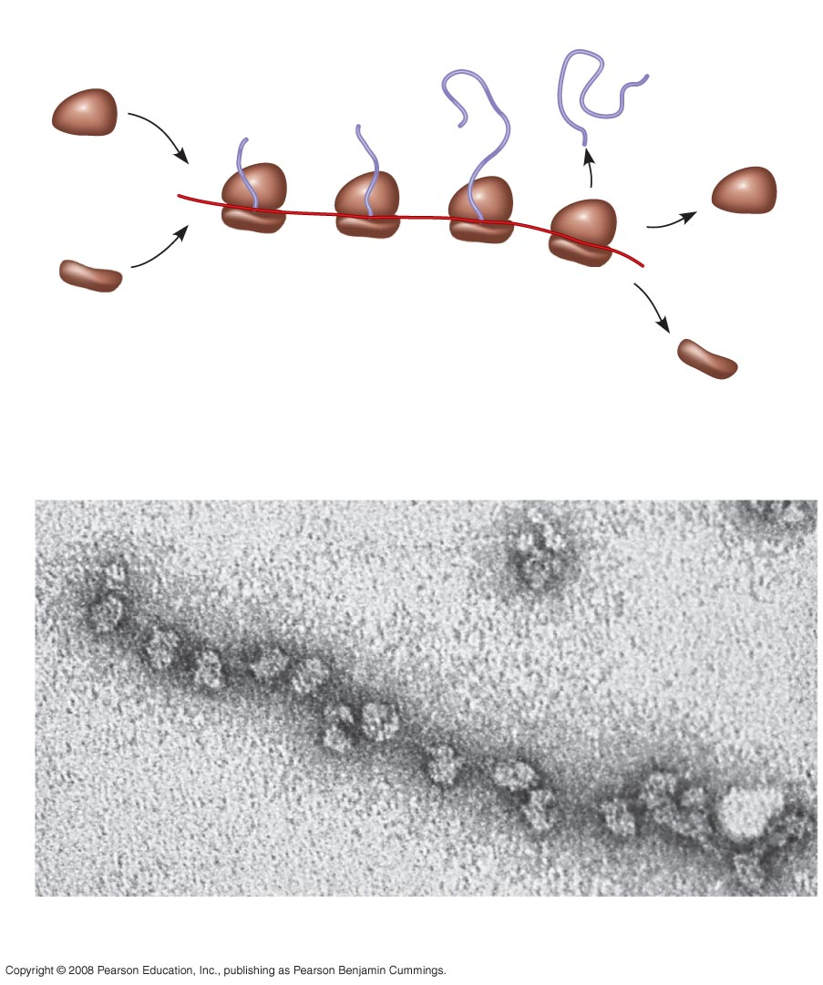
Fig. 17-20
Completed
polypeptide
Growing
polypeptides
Incoming
ribosomal
subunits
Polyribosome
Start of
mRNA
(5 end)
End of
mRNA
(3 end)
(a)
Ribosomes
mRNA
(b)
0.1 µm
Notes:
Figure 17.20 Polyribosomes

Slide 77
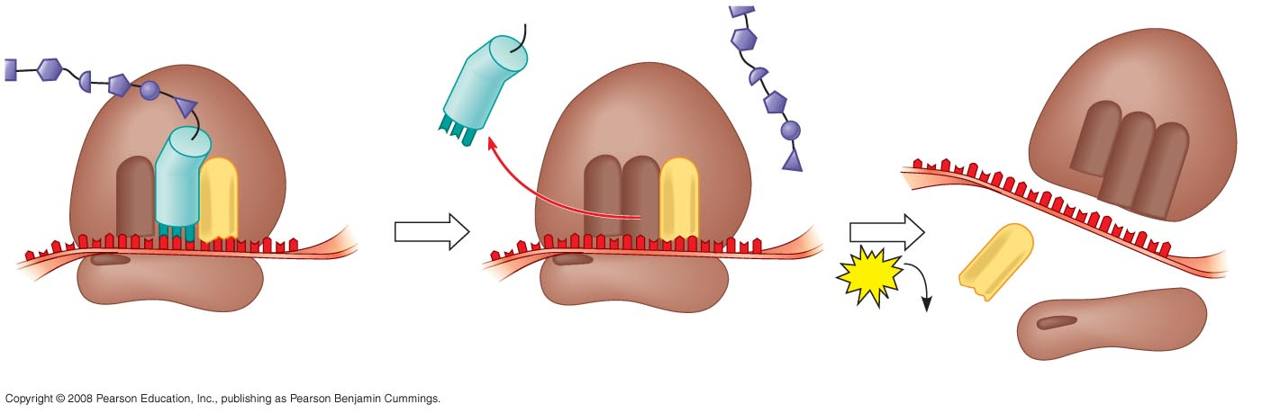
Fig. 17-19-3
Once the last ribosome has moved to the termination
codon thus having completed making the last polypeptide on the mRNA – the entire complex disassembles.
Release
factor
Free
polypeptide
5
3
3
3
5
5
2
GTP
Stop codon
(UAG, UAA, or UGA)
2 GDP
Notes:
Figure 17.19 The termination of translation

Slide 78
Ribosomes on the Endoplasmic Reticulum
Some ribosomes attach to the rough endoplasmic reticulum as the polypeptide is being made
The developing polypeptide pulls the mRNA and ribosome to the ER in the region that is to be rough. It is the first few amino acids of the developing polypeptide (termed the signal sequence) that pulls the ribosome to the ER
So all ribosomes are the same – there is no ribosome dedicated to be fixed – the polypeptide being produced determines where the ribosome will perform its protein synthesis function

Slide 79
Role of Rough ER in Protein Synthesis
mRNA–ribosome complex is directed to rough ER by a signal-recognition particle (SRP)
Forming protein enters the ER
Sugar groups may be added to the protein, and its shape may be altered
Protein is enclosed in a vesicle for transport to Golgi apparatus

Slide 80
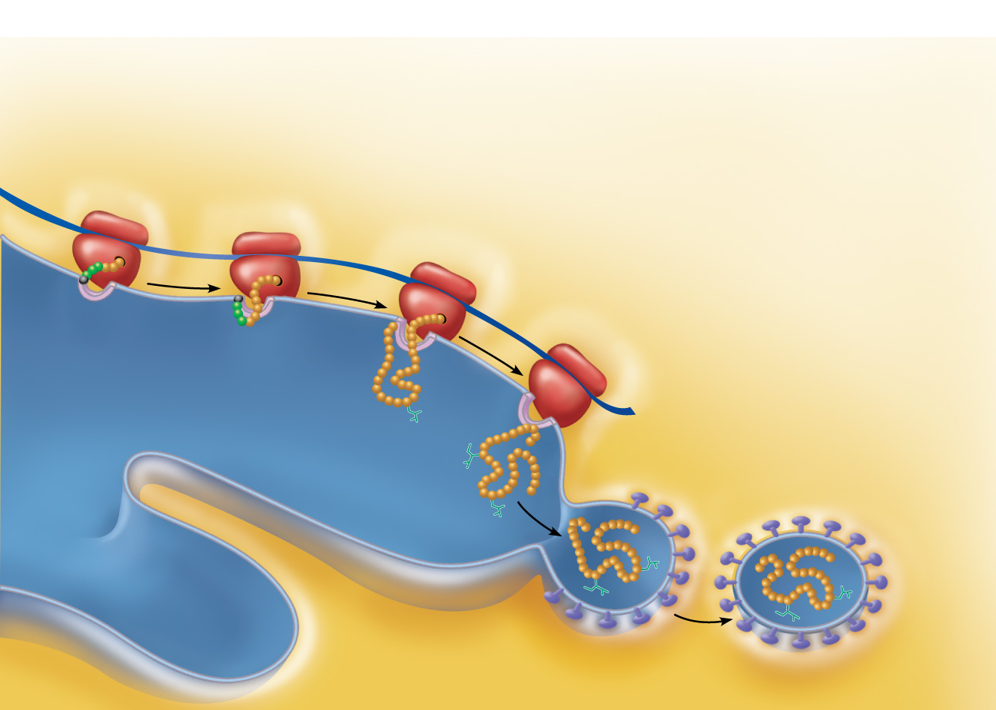
1
2
The mRNA-ribosome complex is
directed to the rough ER by the SRP.
There the SRP binds to a receptor site.
Once attached to the ER, the SRP is released
and the growing polypeptide snakes through the
ER membrane pore into the cisterna.
ER signal
sequence
3
The signal sequence is clipped off by an
enzyme. As protein synthesis continues, sugar
groups may be added to the protein.
Ribosome
mRNA
4
In this example, the completed
protein is released from the ribosome
and folds into its 3-D conformation,
a process aided by molecular chaperones.
Signal
recognition
particle
(SRP)
Signal
sequence
removed
Receptor site
5
The protein is enclosed within a
protein (coatomer)-coated transport
vesicle. The transport vesicles make
their way to the Golgi apparatus,
where further processing of the
proteins occurs (see Figure 3.19).
Growing
polypeptide
Sugar
group
Released
protein
Rough ER cisterna
Transport vesicle
pinching off
Coatomer-coated
transport vesicle
Cytoplasm
Figure 3.39

Slide 81
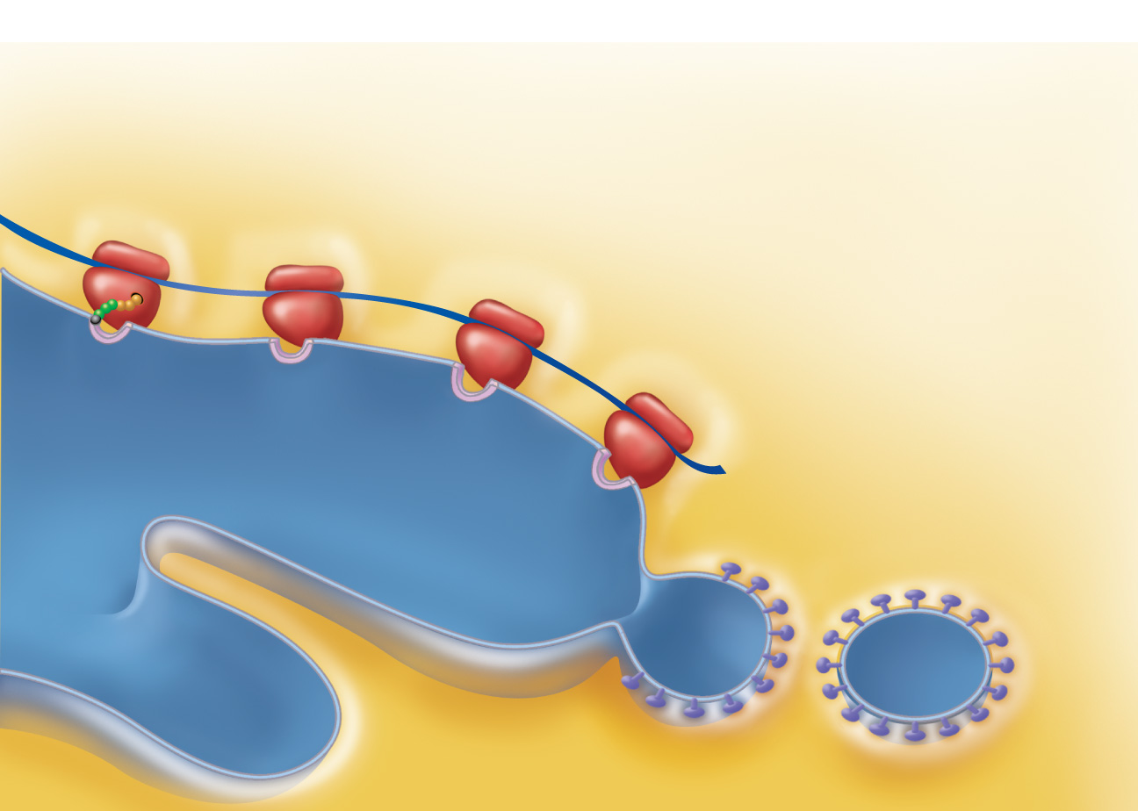
1
The mRNA-ribosome complex is
directed to the rough ER by the SRP.
There the SRP binds to a receptor site.
ER signal
sequence
Ribosome
mRNA
Signal
recognition
particle
(SRP)
Receptor site
Rough ER cisterna
Cytoplasm
Figure 3.39 step 1

Slide 82

1
2
The mRNA-ribosome complex is
directed to the rough ER by the SRP.
There the SRP binds to a receptor site.
Once attached to the ER, the SRP is released
and the growing polypeptide snakes through the
ER membrane pore into the cisterna.
ER signal
sequence
Ribosome
mRNA
Signal
recognition
particle
(SRP)
Receptor site
Growing
polypeptide
Rough ER cisterna
Cytoplasm
Figure 3.39 step 2

Slide 83

1
2
The mRNA-ribosome complex is
directed to the rough ER by the SRP.
There the SRP binds to a receptor site.
Once attached to the ER, the SRP is released
and the growing polypeptide snakes through the
ER membrane pore into the cisterna.
ER signal
sequence
3
The signal sequence is clipped off by an
enzyme. As protein synthesis continues, sugar
groups may be added to the protein.
Ribosome
mRNA
Signal
recognition
particle
(SRP)
Signal
sequence
removed
Receptor site
Growing
polypeptide
Sugar
group
Rough ER cisterna
Cytoplasm
Figure 3.39 step 3

Slide 84

1
2
The mRNA-ribosome complex is
directed to the rough ER by the SRP.
There the SRP binds to a receptor site.
Once attached to the ER, the SRP is released
and the growing polypeptide snakes through the
ER membrane pore into the cisterna.
ER signal
sequence
3
The signal sequence is clipped off by an
enzyme. As protein synthesis continues, sugar
groups may be added to the protein.
Ribosome
mRNA
4
In this example, the completed
protein is released from the ribosome
and folds into its 3-D conformation,
a process aided by molecular chaperones.
Signal
recognition
particle
(SRP)
Signal
sequence
removed
Receptor site
Growing
polypeptide
Sugar
group
Released
protein
Rough ER cisterna
Cytoplasm
Figure 3.39 step 4

Slide 85
1
2
The mRNA-ribosome complex is
directed to the rough ER by the SRP.
There the SRP binds to a receptor site.
Once attached to the ER, the SRP is released
and the growing polypeptide snakes through the
ER membrane pore into the cisterna.
ER signal
sequence
3
The signal sequence is clipped off by an
enzyme. As protein synthesis continues, sugar
groups may be added to the protein.
Ribosome
mRNA
4
In this example, the completed
protein is released from the ribosome
and folds into its 3-D conformation,
a process aided by molecular chaperones.
Signal
recognition
particle
(SRP)
Signal
sequence
removed
Receptor site
5
The protein is enclosed within a
protein (coatomer)-coated transport
vesicle. The transport vesicles make
their way to the Golgi apparatus,
where further processing of the
proteins occurs (see Figure 3.19).
Growing
polypeptide
Sugar
group
Released
protein
Rough ER cisterna
Transport vesicle
pinching off
Coatomer-coated
transport vesicle
Cytoplasm
Figure 3.39 step 5

Slide 86
Other Roles of DNA
Intron (“junk”) regions of DNA code for other types of RNA:
  Antisense RNA
    Prevents protein-coding RNA from being translated
  MicroRNA
    Small RNAs that interfere with mRNAs made by certain exons
  Riboswitches
    Folded RNAs that act as switches regulating protein synthesis in response to environmental conditions

