Slide 1
12
P A R T B
  The Central Nervous System

Slide 2
Posterior Association Area
Takes up most of temporal, occipital and parietal cortex
Involved in 1) recognition of patterns and faces
2) localizing us and our surroundings
in space
3) building different inputs into a
complete picture

Slide 3
Limbic Association Cortex
Located in the Cingulate Gyrus, Hippocampus, Parahippocampal gyrus
Provides emotional sense to what inputs we have

Slide 4
Putting it together
Drop a bottle of acid on chemistry lab floor and it splashes on you
See it – visual cortex – then to visual association
Hear it – auditory cortex – then to auditory association
Feel it – primary sensory cortex – then to sensory association cortex
Then to multimodal association cortices

Slide 5
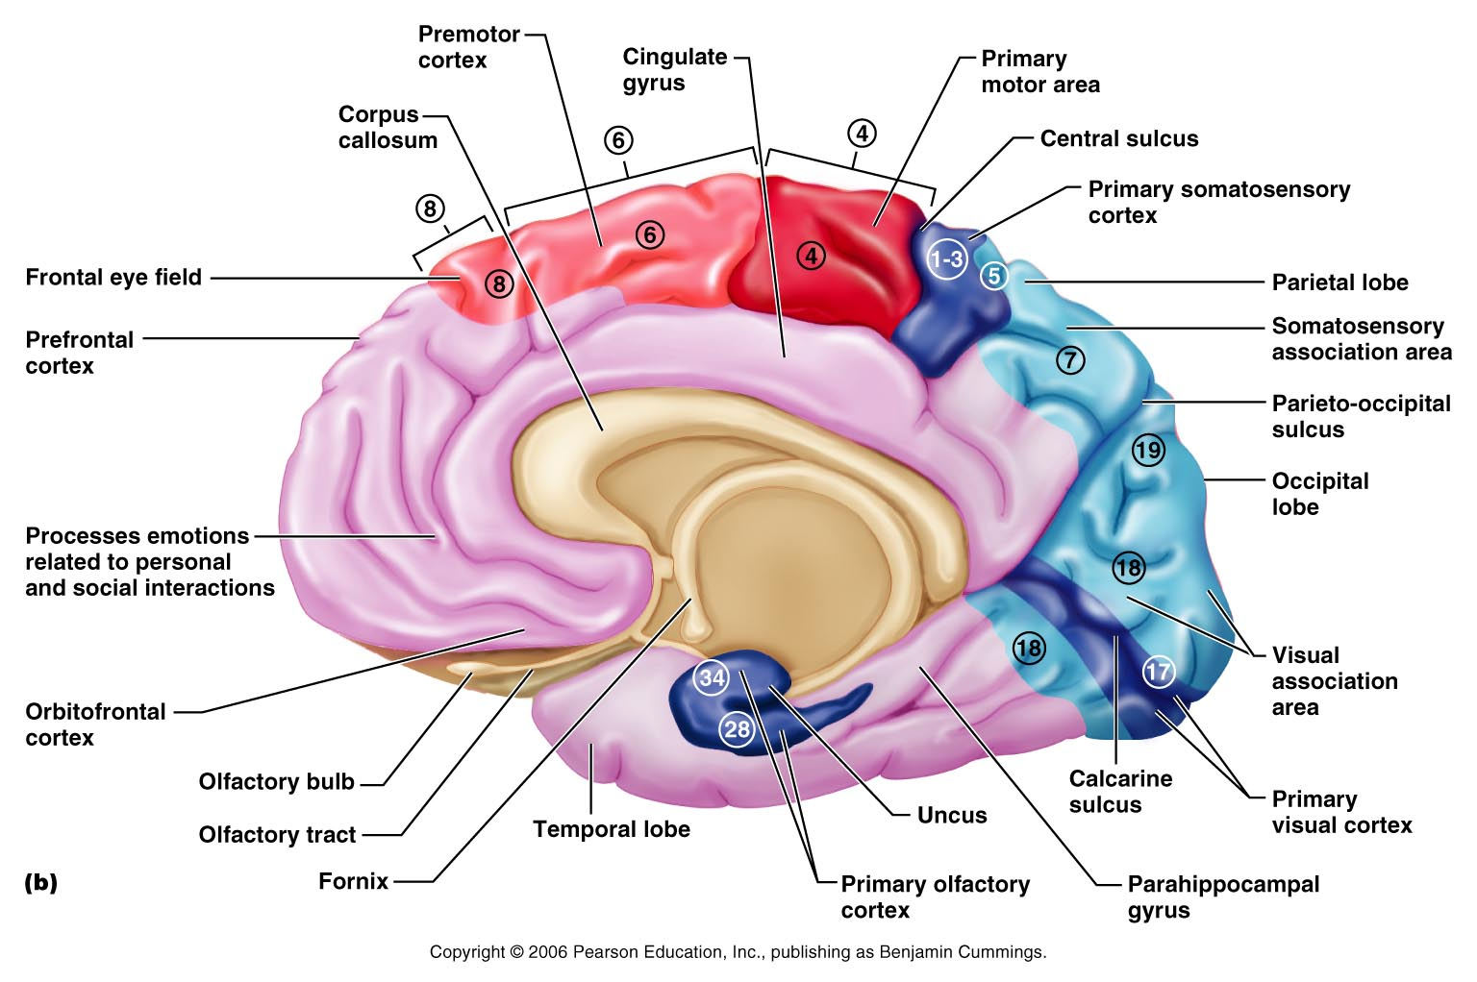

Slide 6
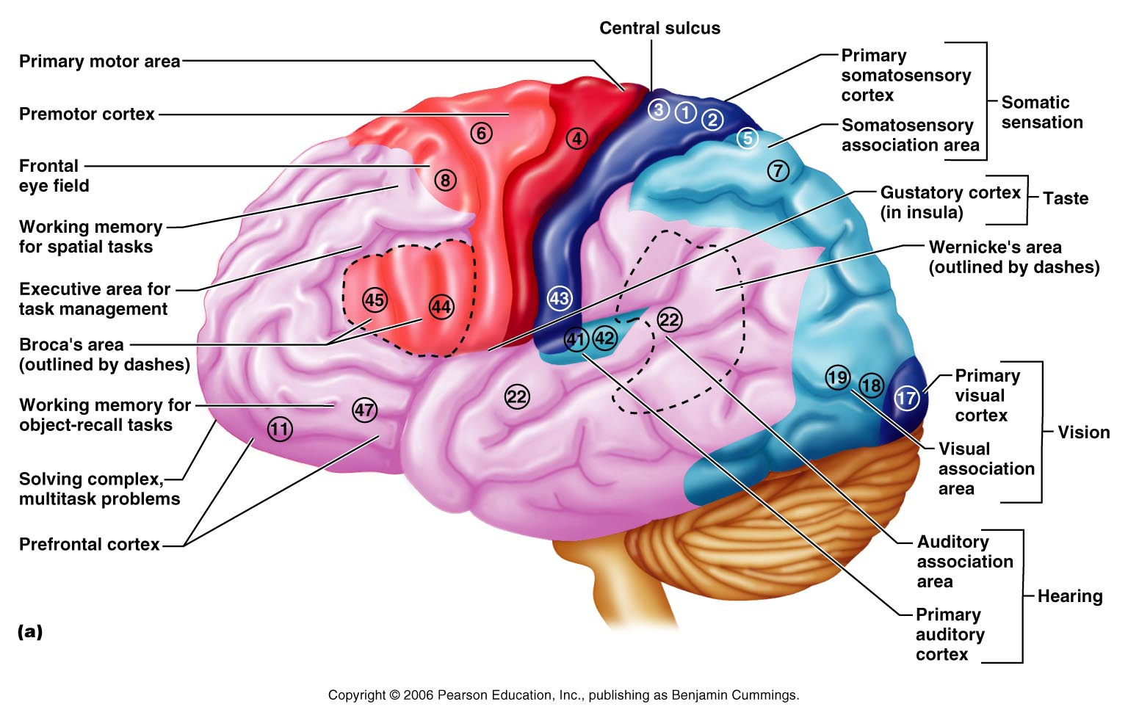

Slide 7
Language Areas
Located in a large area surrounding the left (or language-dominant) lateral sulcus – Right hemisphere for body language
  Wernicke’s area –sounding out unfamiliar words
  Problem with Wernicke’s area – can speak language but produce a word salad speech incoherent type speech (Aphasia)
  Broca’s area – speech preparation and production
  Problem with Broca’s area – can speak language but not understand language (Aphasia)
  Left Lateral prefrontal cortex – language comprehension and word analysis
  Lateral and ventral temporal lobe – coordinate auditory and visual aspects of language

Slide 8
Lateralization of Cortical Function
Lateralization – each hemisphere has abilities not shared with its partner
Cerebral dominance – designates the hemisphere dominant for language
Left hemisphere – controls language, math, and logic
Right hemisphere – controls visual-spatial skills, emotion, and artistic skills
10% have sides reversed or use both sides equally

Slide 9
Cerebral White Matter
Consists of deep myelinated fibers and their tracts
It is responsible for communication between:
  The cerebral cortex and lower CNS center, and areas of the cerebrum

Slide 10
Cerebral White Matter
Types include:
  Commissures – connect corresponding gray areas of the two hemispheres
  Association fibers – connect different parts of the same hemisphere
  Projection fibers – enter the hemispheres from lower brain or cord centers

Slide 11
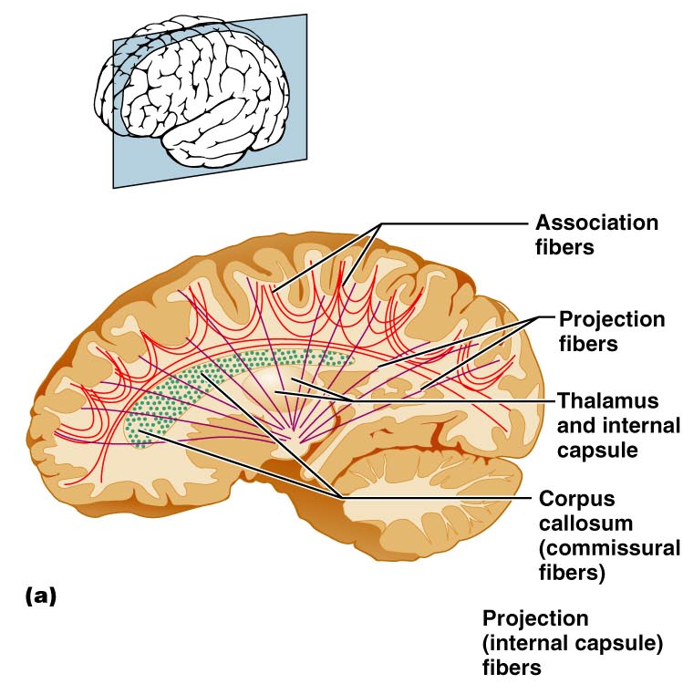
Fiber Tracts in White Matter
Figure 12.10a

Slide 12
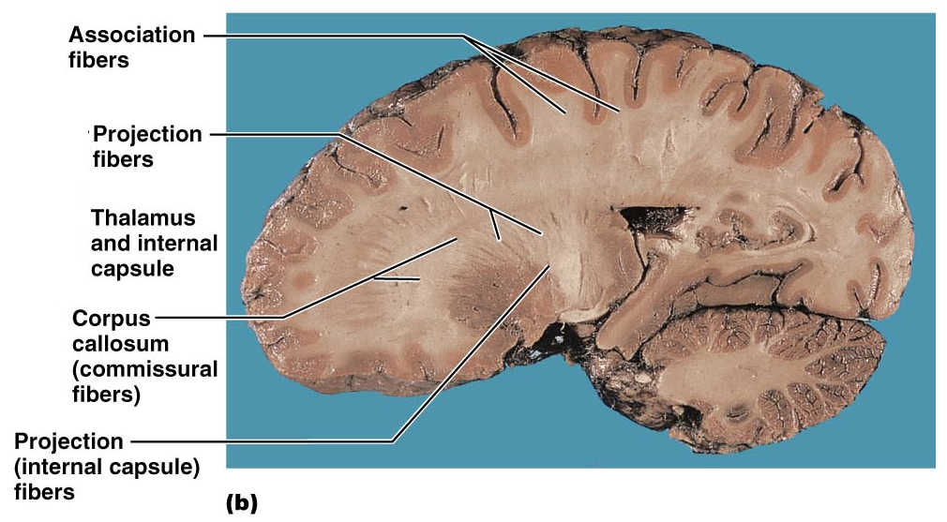
Fiber Tracts in White Matter
Figure 12.10b

Slide 13
Basal Nuclei (Old name Basal Ganglia)
Masses of gray matter found deep within the cortical white matter
The corpus striatum is composed of three parts
  Caudate nucleus
  Lentiform nucleus – composed of the putamen and the globus pallidus
  Fibers of internal capsule running between and through caudate and lentiform nuclei
  Functionally associated with sub-thalamic nucleus and the Substantia Nigra

Slide 14
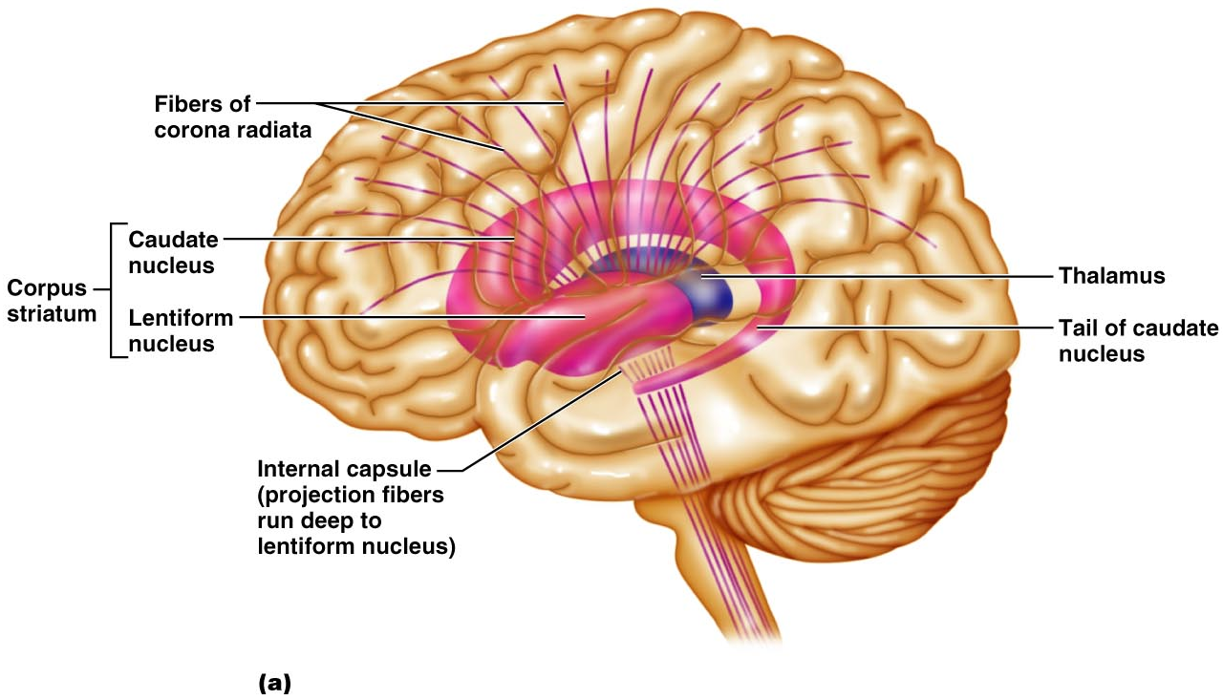
Basal Nuclei
Figure 12.11a

Slide 15
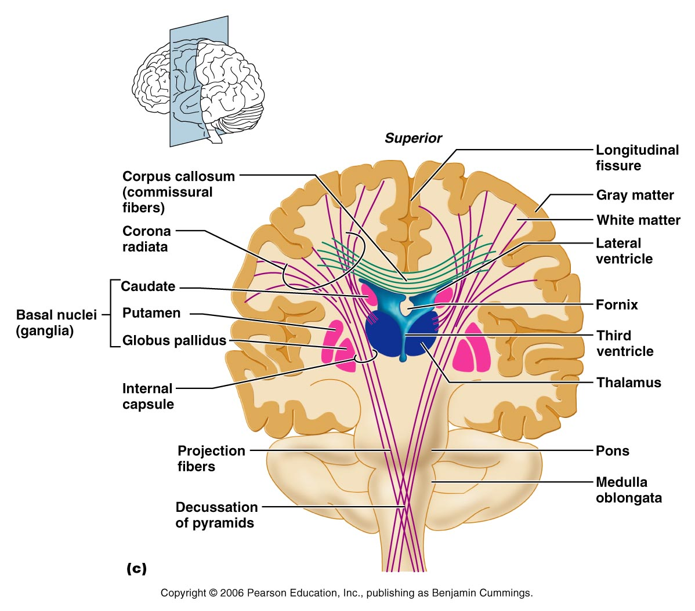
Figure 12.10c

Slide 16
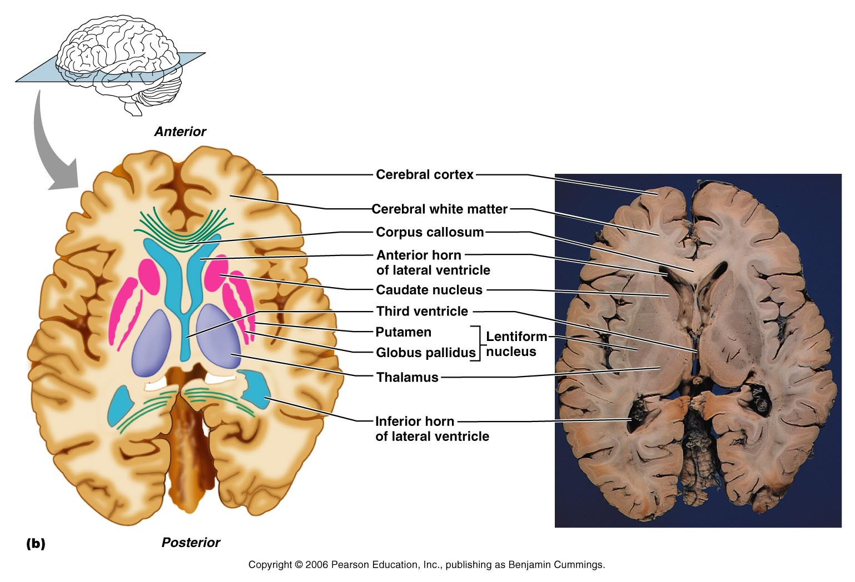
Basal Nuclei
Figure 12.11b

Slide 17
Input: The Basal Nuclei receive inputs from all areas of cerebral cortex (above Basal Nuclei) and from subcortical nuclei and from each other nuclei within the Basal Nuclei
Output: Via relays through Thalamus, Globus Pallidus and Substantia Nigra – they project to the Premotor cortex and prefrontal cortices to affect motor movements of the primary motor cortex. The Basal Nuclei have no direct access to motor pathways

Slide 18
Functions of Basal Nuclei
Though somewhat elusive, the following are thought to be functions of basal nuclei – some functions regarding movement are shared with the Cerebellum
  Influence muscular activity – particularly starting and stopping movements and regulating the intensity of these movements particularly those that are slow and stereotyped like arm swinging while walking
  Regulate attention and cognition
  Inhibit antagonistic and unnecessary movement

Slide 19
Problems with the Basal Nuclei could give too much involuntary movement as in Huntington’s Chorea or too little motion as in Parkinson’s Disease.

Slide 20
Huntington's disease (also known as Huntington's chorea), is a genetic neurological disorder characterized after onset by uncoordinated, jerky body movements and a decline in some mental abilities. HD affects specific areas of the brain; mainly the striatum, which is composed of the caudate nucleus and putamen

Slide 21
Parkinson's disease (also known as Parkinson disease or PD) is a degenerative disease of the brain (central nervous system) that often impairs motor skills, speech, and other possible functions.^{[1]}
Parkinson's disease belongs to a group of conditions called movement disorders. It is characterized by muscle rigidity, tremor, a slowing of physical movement (bradykinesia) and, in extreme cases, a loss of physical movement (akinesia). The primary symptoms are the results of decreased stimulation of the motor cortex by the basal ganglia, normally caused by the insufficient formation and action of dopamine, which is produced in the dopaminergic neurons of the brain. Secondary symptoms may include high level cognitive dysfunction and subtle language problems. PD is both chronic and progressive.

Slide 22
Diencephalon
Central core of the forebrain
Consists of three paired structures – thalamus, hypothalamus, and epithalamus
Encloses the third ventricle

Slide 23
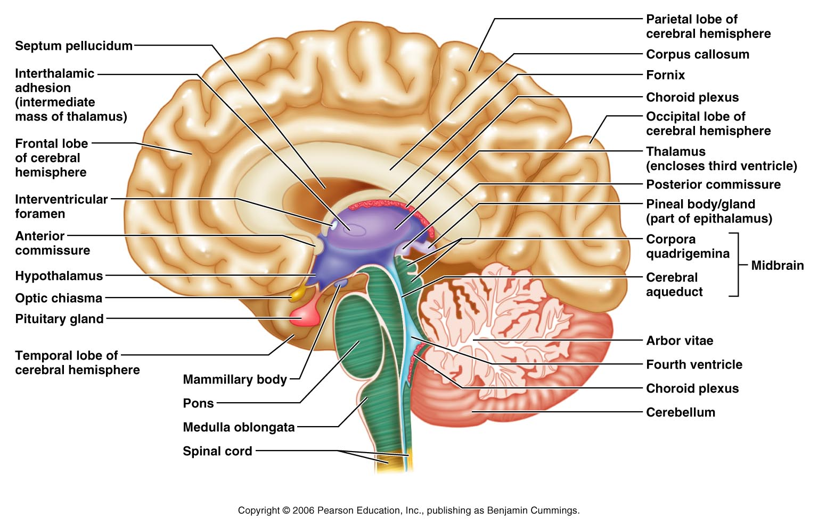
Diencephalon
Figure 12.12

Slide 24
Thalamus – the inner room
(80% of Diencephalon)
Paired, egg-shaped masses that form the superolateral walls of the third ventricle
Connected at the midline by the intermediate mass
Contains four groups of nuclei – anterior, ventral, dorsal, and posterior
Nuclei project and receive fibers from the cerebral cortex
Nuclei also receive input from sensory projections below the Thalamus and nuclei within Thalamus

Slide 25
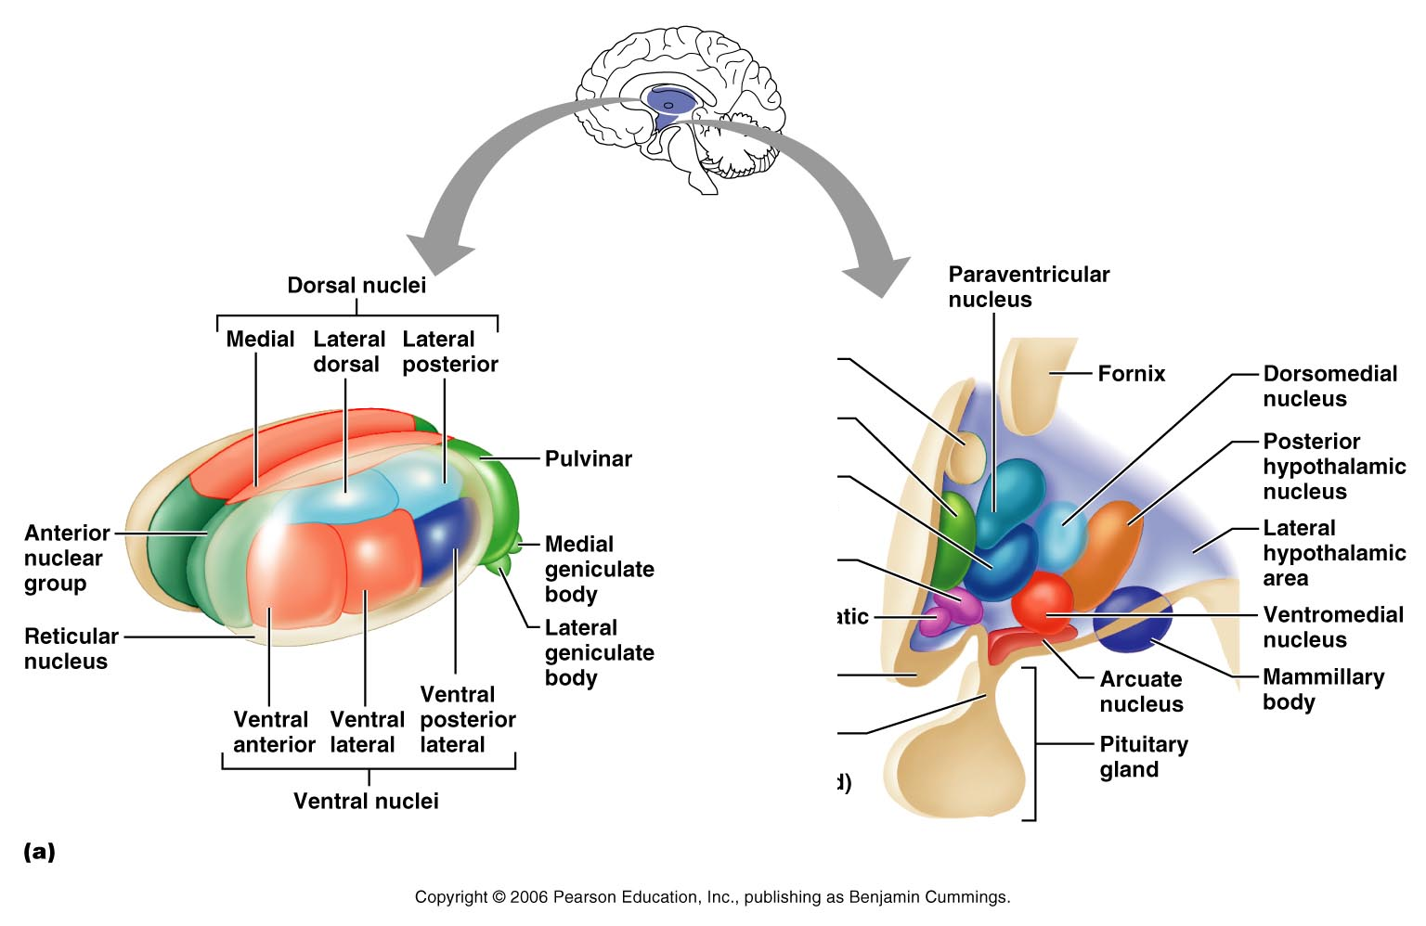
Thalamus
Since there are so many nuclei – approximately 26 – clustered in a small area neuroanatomists had to name the nuclei primarily by there relative locations to one another using the directional terms – anterior, posterior, dorsal, ventral, medial and lateral. Use the four legged animal as your landmarks.
Figure 12.13a

Slide 26
Thalamus
Medial geniculate body gets input from Auditory
Lateral geniculate input from visual
Ventral Posterior Lateral gets input from pain, temperature and pressure of skin
Figure 12.13a

Slide 27
Thalamus
The Pulvinar is divided into sub-nuclei (oral, inferior, lateral and medial. The lateral and inferior have connections to the visual cortex. The oral has connections to the somatosensory cortical association areas. The medial is connected to the prefrontal cortical areas.
Figure 12.13a

Slide 28
Thalamus
The thalamic reticular nucleus receives input from the cerebral cortex and dorsal thalamic nuclei. Primary thalamic reticular nucleus efferent fibers project to dorsal thalamic nuclei, but never to the cerebral cortex. This is the only thalamic nucleus that does not project to the cerebral cortex. The function of the thalamic reticular nucleus is not understood, although it has some role in absence seizures
Figure 12.13a

Slide 29
Thalamic Function
Sensory afferent impulses converge and synapse in the thalamus (all sensory to cortex must go through Thalamus)
Gives a crude sense of pleasant versus unpleasant
Impulses of similar function are sorted out, edited, and relayed as a group
All inputs ascending to the cerebral cortex pass through the thalamus
Mediates sensation, motor activities, cortical arousal, learning, and memory

Slide 30
Hypothalamus
Located below the thalamus, it caps the brainstem and forms the inferolateral walls of the third ventricle
Mammillary bodies
  Small, paired nuclei bulging anteriorly from the hypothalamus
  Relay station for olfactory pathways
Infundibulum – stalk of the hypothalamus; connects to the pituitary gland
  Main visceral control center of the body

Slide 31
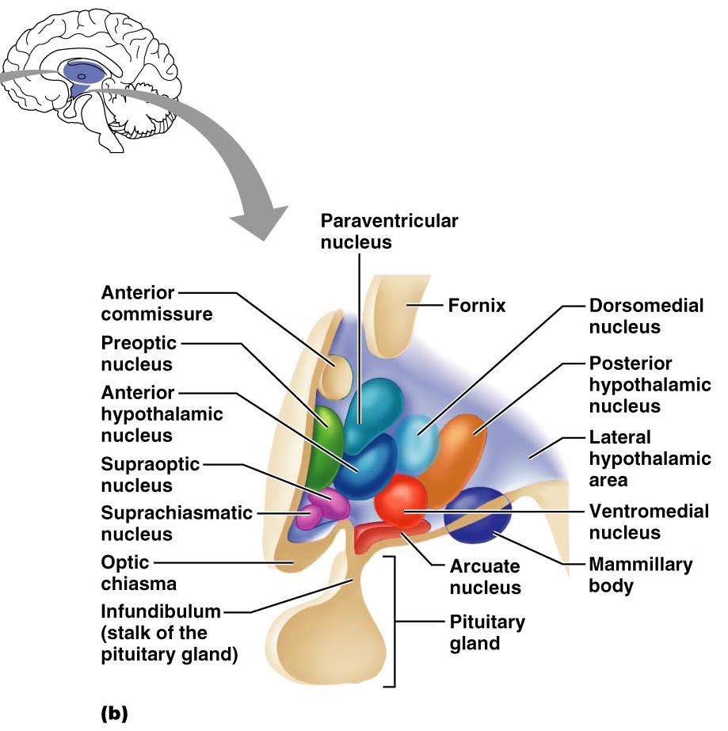
Hypothalamic Nuclei
Figure 12.13b

Slide 32
Hypothalamic Function
Regulates Autonomic Nervous system – thus assists in regulation of blood pressure, rate and force of heartbeat, digestive tract motility, rate and depth of breathing, and many other visceral activities
Regulates Anterior Pituitary Gland secretions via its releasing and inhibiting factors
Perception of pleasure, fear, and rage (major part of Limbic System)
Maintains normal body temperature
Regulates feelings of hunger and satiety
Regulates sleep and the sleep cycle
Senses Osmotic Pressure – thus regulating fluid and electrolyte balance

Slide 33
Endocrine Functions of the Hypothalamus
Releasing hormones control secretion of hormones by the anterior pituitary
The supraoptic and paraventricular nuclei produce ADH and oxytocin

Slide 34
Epithalamus
Most dorsal portion of the diencephalon; forms roof of the third ventricle
Pineal gland – extends from the posterior border and secretes melatonin
  Melatonin – a hormone involved with sleep regulation, sleep-wake cycles, and mood

Slide 35
Melatonin
Secreted primarily from the pineal gland
Controlled by the suprachiasmatic nucleus of the Hypothalamus
Secretion of melatonin occurs in darkness
It is inhibited by light – particularly blue light
Causes drowsiness and lowered body temperature
Antioxidant role
Immune System action
Dreaming

Slide 36
Epithalamus
Figure 12.12

Slide 37
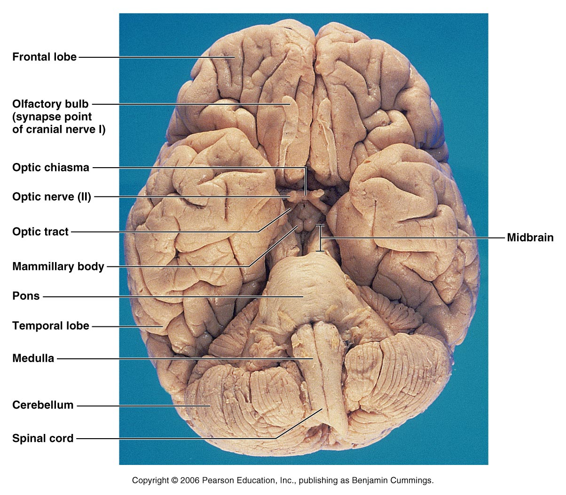
Human Brain: Ventral Aspect
Figure 12.14

Slide 38
Brain Stem
Consists of three regions – midbrain, pons, and medulla oblongata
Similar to spinal cord but contains embedded nuclei
Controls automatic behaviors necessary for survival
Provides the pathway for tracts between higher and lower brain centers
Associated with 10 of the 12 pairs of cranial nerves

Slide 39
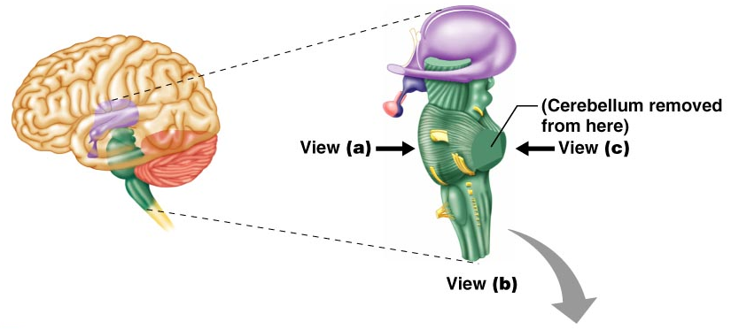
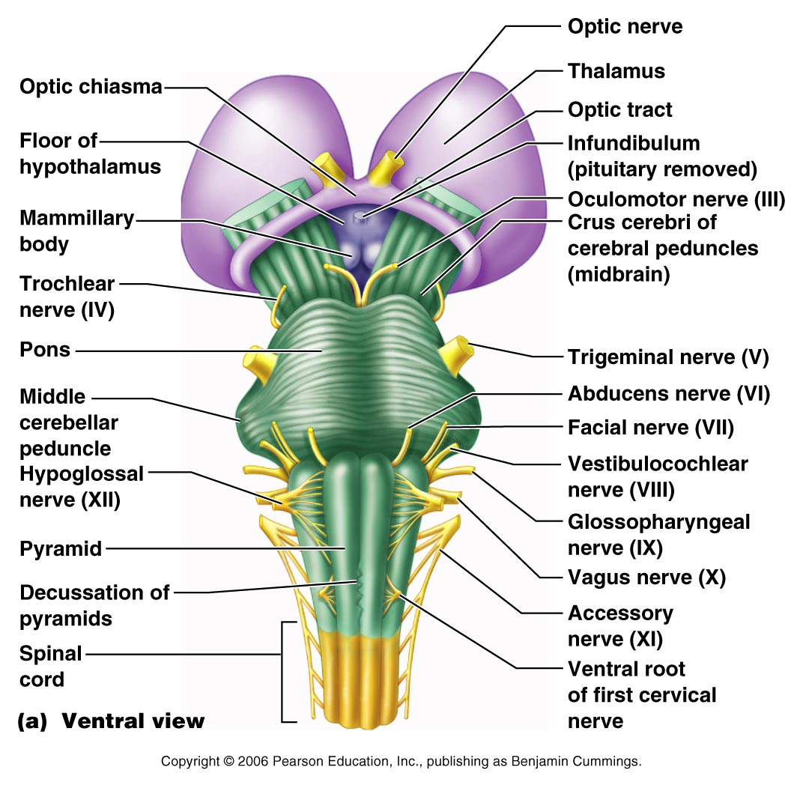
Brain Stem
Figure 12.15a

Slide 40
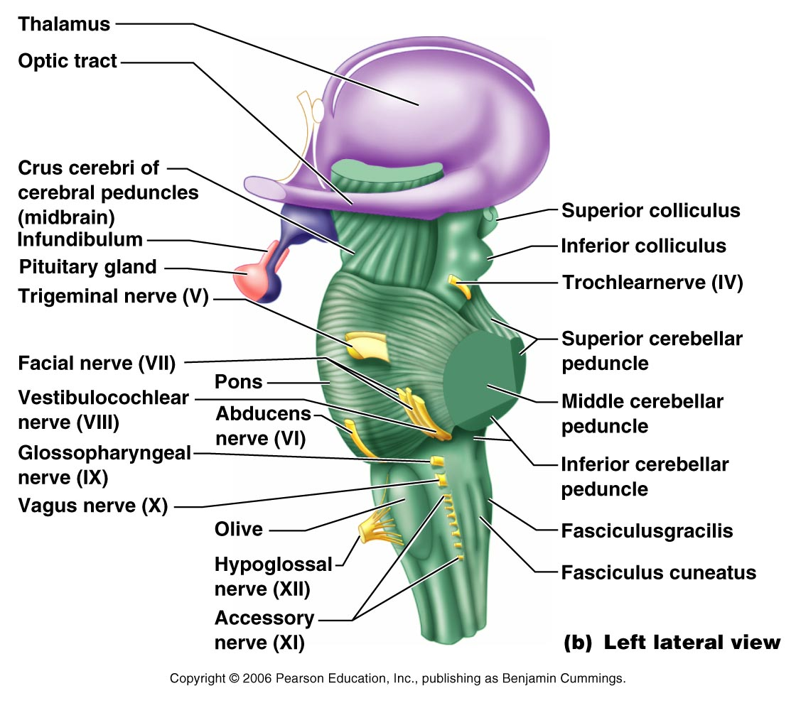
Brain Stem
Figure 12.15b

Slide 41
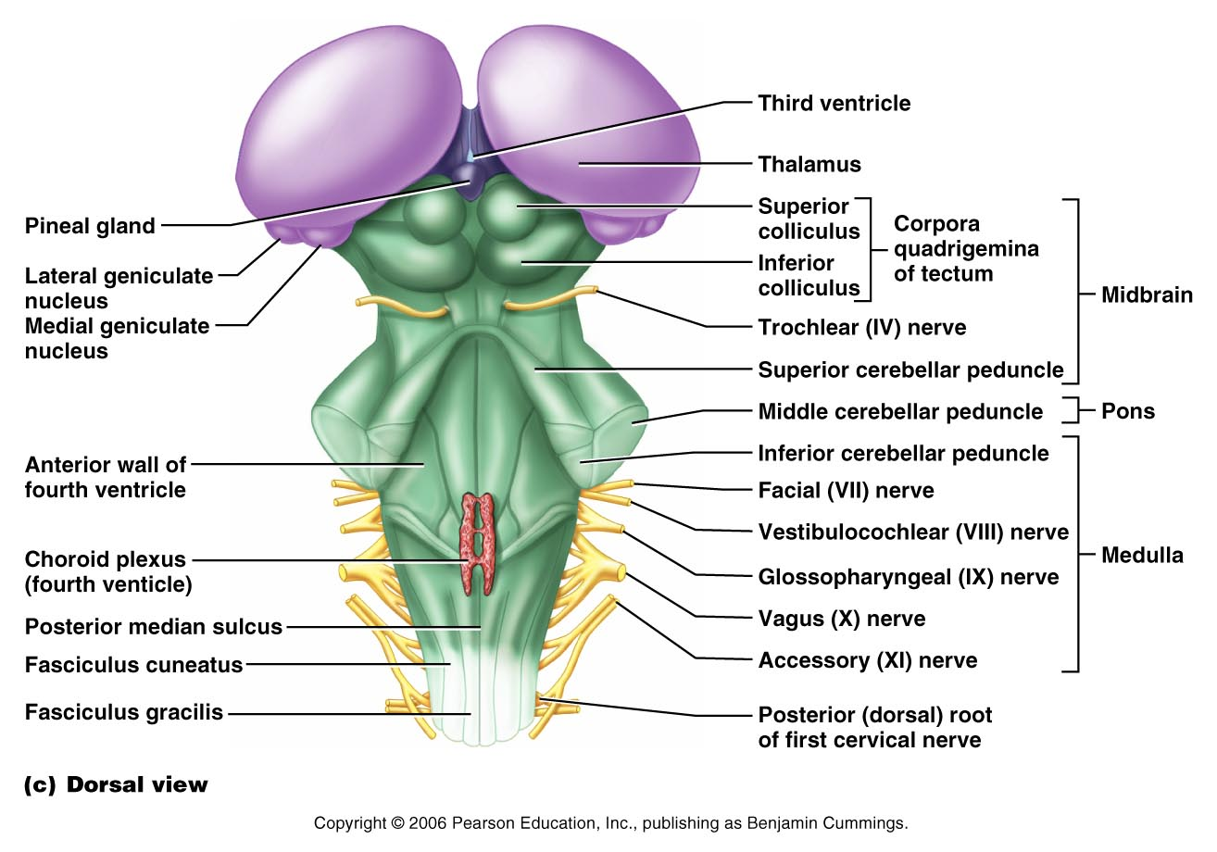
Brain Stem
Figure 12.15c

Slide 42
Midbrain
Located between the diencephalon and the pons
Midbrain structures include:
  Cerebral peduncles – two bulging structures that contain descending pyramidal motor tracts
  Cerebral aqueduct – hollow tube that connects the third and fourth ventricles
  Various nuclei

Slide 43
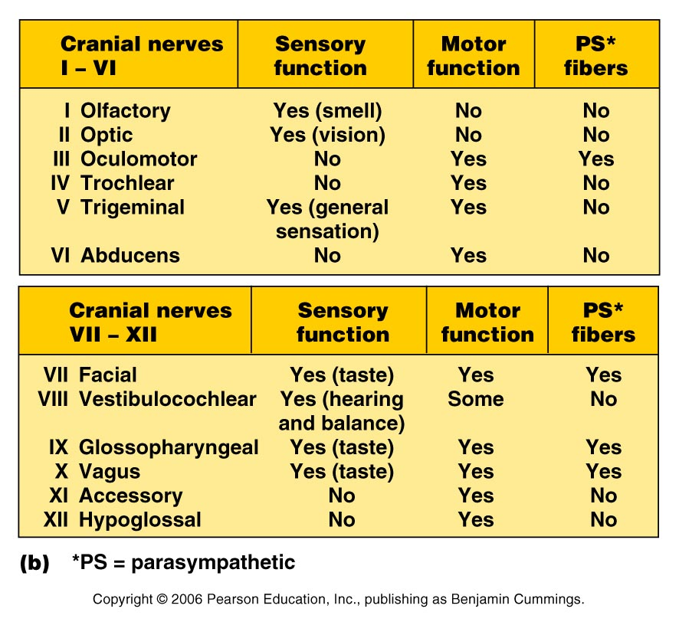

Slide 44
CN I – smell
CN II – vision
CN III –(Midbrain) Controls 4 of 6 eye muscles and Levator Palpebrae superioris - has cillary ganglion – for pupil – Sensory for same eye muscles
CN IV – (Midbrain) Controls Superior Oblique eye muscle and sensory proprioception from that muscle

Slide 45
CN V – Trigeminal (Pons) - 3 branches ophthalmic, maxillary and mandibular – Motor to muscles of mastication NOTE – sensory of anterior tongue but not taste
CN VI – (Pons) Motor to Lateral Rectus of eye and sensory proprioception from that muscle

Slide 46
CN VII – (Pons) Motor to muscles of facial expression (five branches – temporal, zygomatic, buccal, mandibular and cervical) Autonomic (pterygopalatine ganglion – goes to lacrimal glands and nasal mucosae and submandibular ganglion- goes to submandibular and sublingual salivary glands) – Sensory – taste from anterior 2/3 of tongue

Slide 47
CN VIII – Hearing and balance – mainly sensory – Motor to outer hair cells of cochlea
CN IX – Sensory from pharynx and posterior 1/3 of tongue – also from baroreceptors and chemoreceptors Motor- to some pharyngeal muscles that elevate pharynx in swallowing Autonomic – Otic ganglion which goes to Parotid gland

Slide 48
CN X – only cranial nerve to extend below head- most motor fibers are parasympathetic Sensory from viscera and some sensory from baroreceptors and chemoreceptors
CN XI – Formed by union of cranial root and spinal roots (C1 – C5) – Mainly motor cranial root gives motor to larynx, pharynx, and soft palate. Spinal root supplies the trapezius and sternocleidomastoid Sensory – proprioception from those muscles

Slide 49
CN XII – carries fibers to extrinsic and intrinsic tongue muscles.

Slide 50
Midbrain Nuclei
Nuclei that control cranial nerves III (oculomotor) and IV (trochlear)
Corpora quadrigemina – four domelike protrusions of the dorsal midbrain
Superior colliculi – visual reflex centers

Slide 51
Midbrain Nuclei
Inferior colliculi – auditory relay centers
Substantia nigra – functionally linked to basal nuclei
Red nucleus – largest nucleus of the reticular formation; red nuclei are relay nuclei for some descending motor pathways

Slide 52
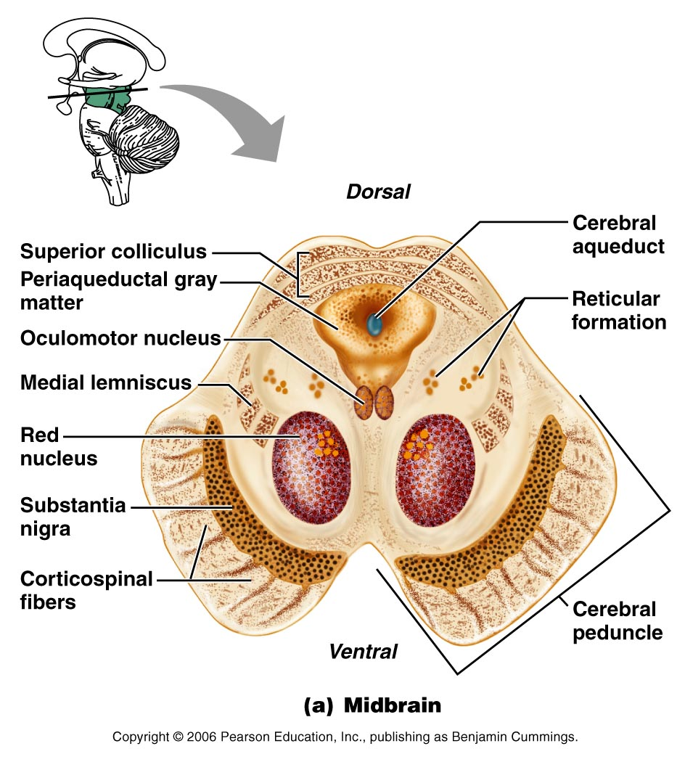
Midbrain Nuclei
Figure 12.16a

Slide 53
Pons
Bulging brainstem region between the midbrain and the medulla oblongata
Forms part of the anterior wall of the fourth ventricle
Fibers of the pons:
  Connect higher brain centers and the spinal cord
  Relay impulses between the motor cortex and the cerebellum

Slide 54
Pons
Origin of cranial nerves V (trigeminal), VI (abducens), and VII (facial)
Contains nuclei of the reticular formation

Slide 55
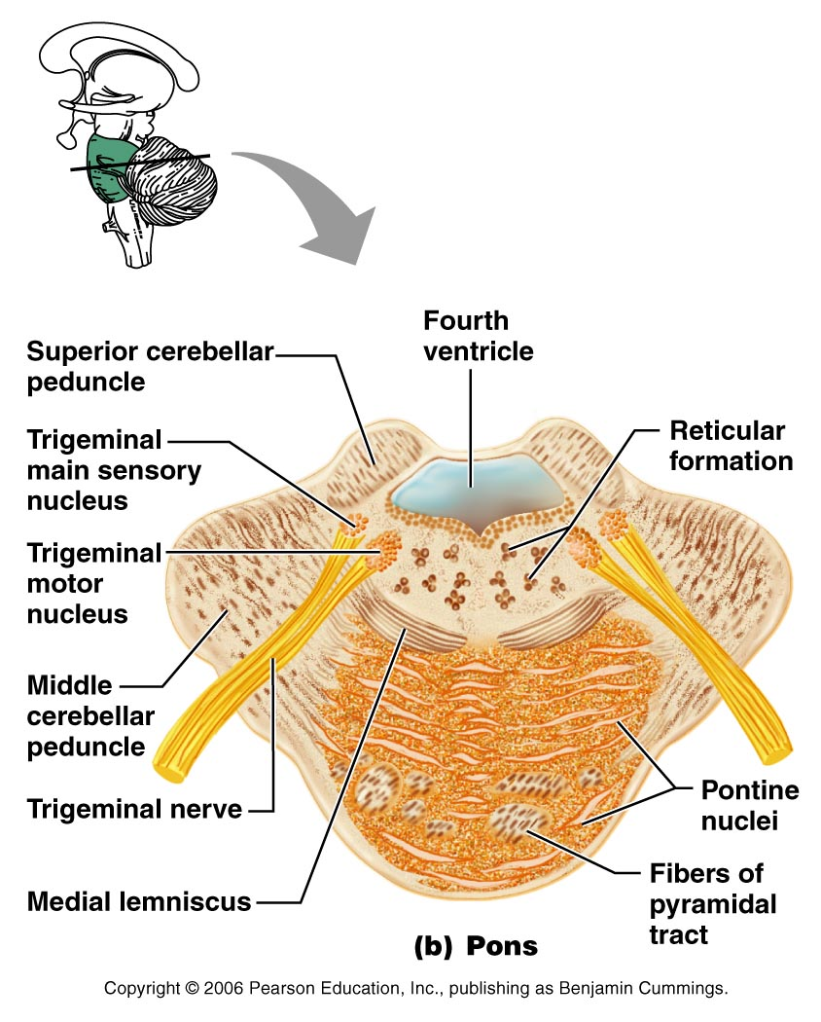
Pons
Figure 12.16b

Slide 56
Medulla Oblongata
Most inferior part of the brain stem
Along with the pons, forms the ventral wall of the fourth ventricle
Contains a choroid plexus of the fourth ventricle
Pyramids – two longitudinal ridges formed by corticospinal tracts
Decussation of the pyramids – crossover points of the corticospinal tracts

Slide 57
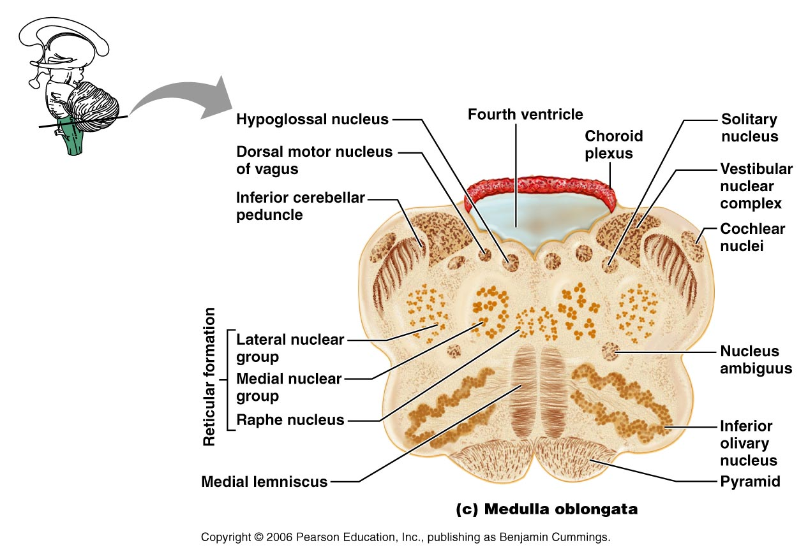
Medulla Oblongata
Figure 12.16c

Slide 58
Medulla Nuclei
Inferior olivary nuclei – gray matter that relays sensory information
Cranial nerves X, XI, and XII are associated with the medulla
Vestibular nuclear complex – synapses that mediate and maintain equilibrium
Ascending sensory tract nuclei, including nucleus cuneatus and nucleus gracilis

Slide 59
Medulla Nuclei
Cardiovascular control center – adjusts force and rate of heart contraction
Respiratory centers – control rate and depth of breathing
Additional centers – regulate vomiting, hiccuping, swallowing, coughing, and sneezing

Slide 60
The Cerebellum
Located dorsal to the pons and medulla
Protrudes under the occipital lobes of the cerebrum
Makes up 11% of the brain’s mass
Provides precise timing and appropriate patterns of skeletal muscle contraction
Cerebellar activity occurs subconsciously

Slide 61
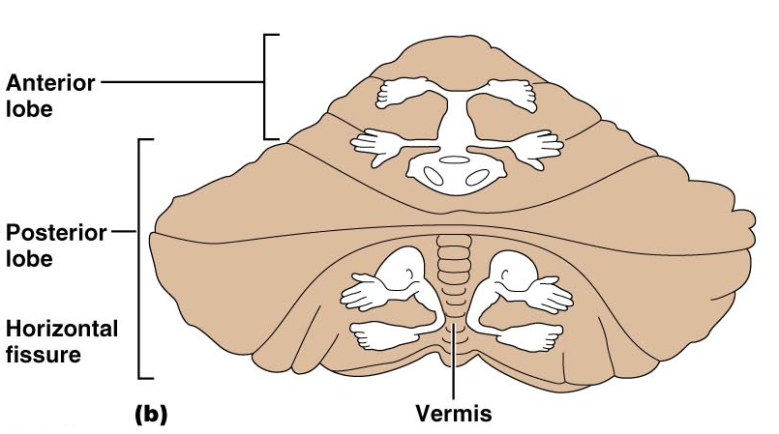
The Cerebellum
Figure 12.17b

Slide 62
Anatomy of the Cerebellum
Two bilaterally symmetrical hemispheres connected medially by the vermis
Folia – transversely oriented gyri
Each hemisphere has three lobes – anterior, posterior, and flocculonodular
Neural arrangement – gray matter cortex, internal white matter, scattered nuclei
Arbor vitae – distinctive treelike pattern of the cerebellar white matter

Slide 63
Cerebellar Peduncles
Three paired fiber tracts that connect the cerebellum to the brain stem
All fibers in the cerebellum are ipsilateral
Superior peduncles connect the cerebellum to the midbrain
Middle peduncles connect the pons to the cerebellum
Inferior peduncles connect the medulla to the cerebellum

Slide 64
Cerebellar Processing
Cerebellum receives impulses of the intent to initiate voluntary muscle contraction
Proprioceptors and visual signals “inform” the cerebellum of the body’s condition
Cerebellar cortex calculates the best way to perform a movement
A “blueprint” of coordinated movement is sent to the cerebral motor cortex

Slide 65
Cerebellar Cognitive Function
Plays a role in language and problem solving
Recognizes and predicts sequences of events

Slide 66
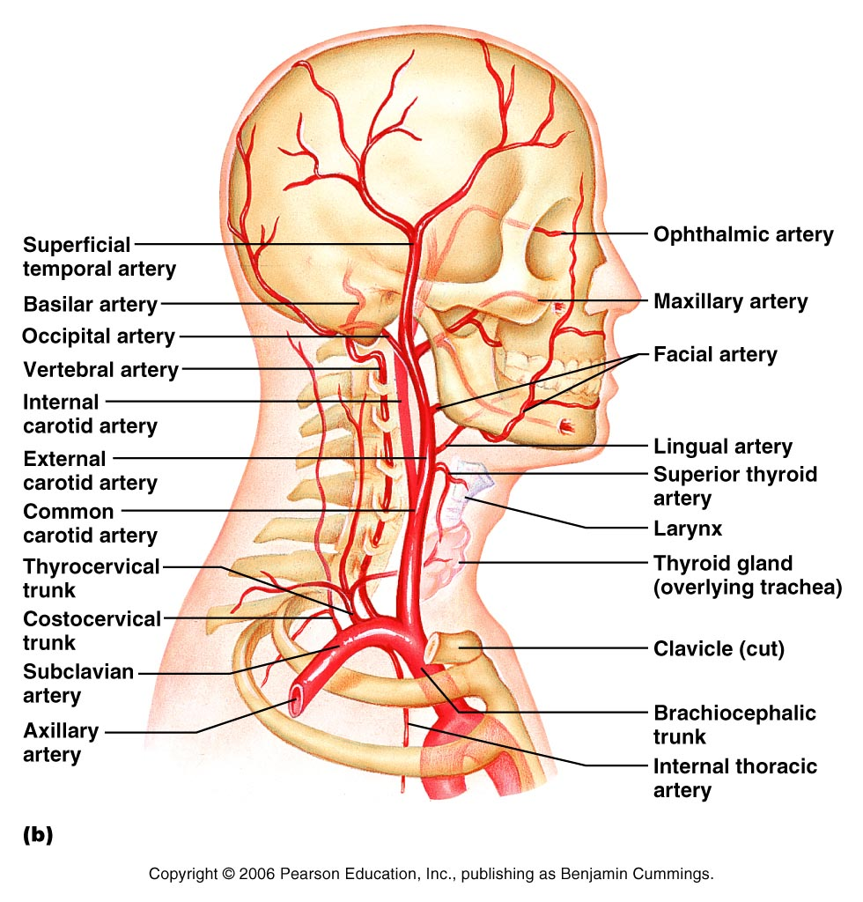

Slide 67
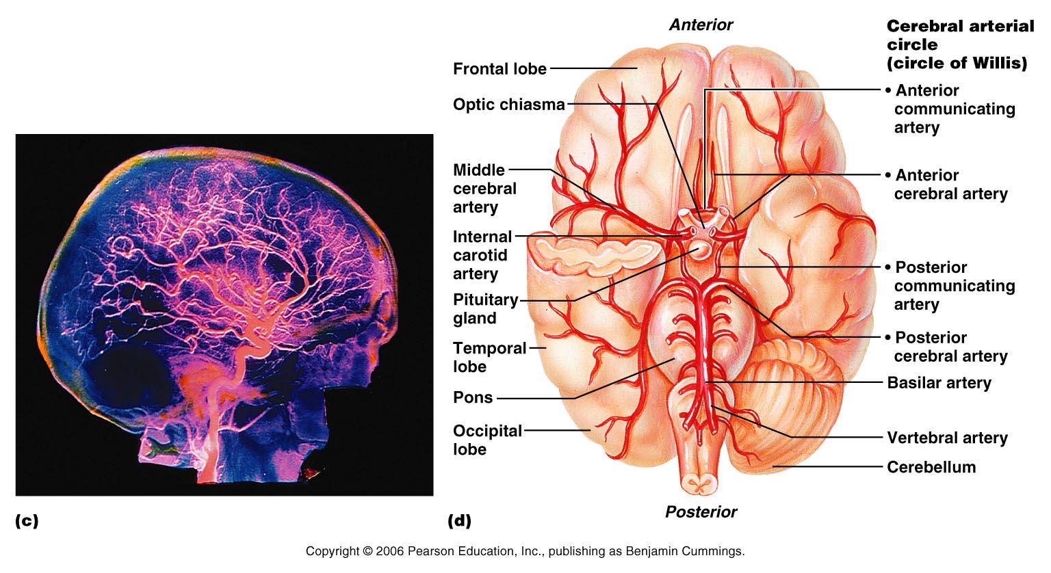

Slide 68
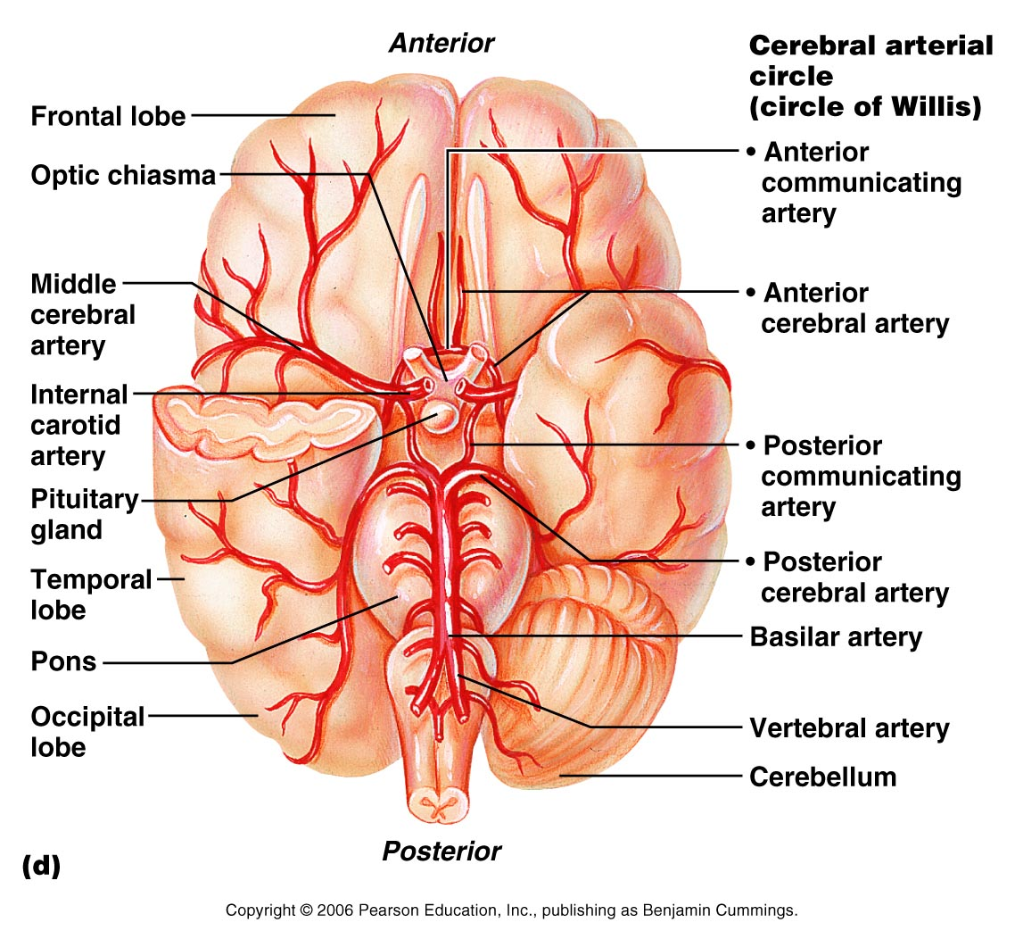
Figure 19.21d

