Slide 1
12
P A R T C
  The Central Nervous System

Slide 2
Functional Brain System
Networks of neurons working together and spanning wide areas of the brain
The two systems are:
  Limbic system
  Reticular formation

Slide 3
Limbic System
Structures located on the medial aspects of cerebral hemispheres and diencephalon
Includes the rhinencephalon, amygdala, hypothalamus, and anterior nucleus of the thalamus

Slide 4
Limbic System
Parts especially important in emotions:
  Amygdala – deals with anger, danger, and fear responses
  Cingulate gyrus – plays a role in expressing emotions via gestures, and resolves mental conflict
Puts emotional responses to odors – e.g., skunks smell bad

Slide 5
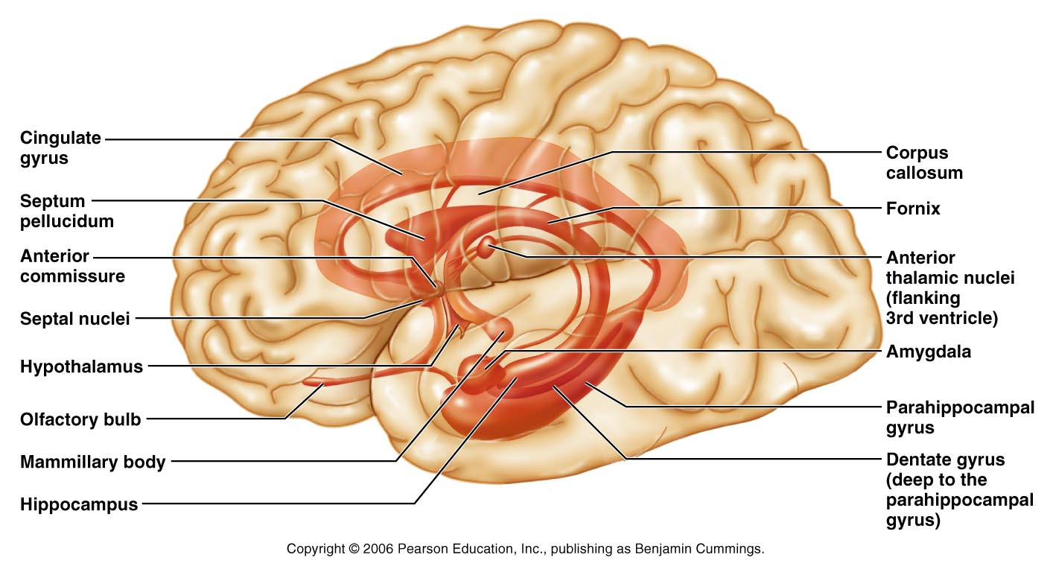
Limbic System
Figure 12.18

Slide 6
Limbic System: Emotion and Cognition
The limbic system interacts with the prefrontal lobes, therefore:
  One can react emotionally to conscious understandings
  One is consciously aware of emotion in one’s life
Hippocampal structures – convert new information into long-term memories

Slide 7
Reticular Formation
Composed of three broad columns along the length of the brain stem
  Raphe nuclei
  Medial (large cell) group
  Lateral (small cell) group
Has far-flung axonal connections with hypothalamus, thalamus, cerebellum, and spinal cord

Slide 8
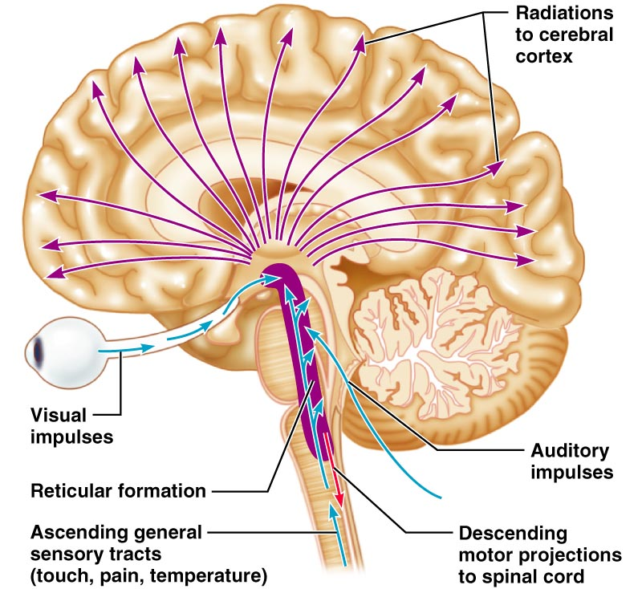
Reticular Formation
Figure 12.19

Slide 9
Reticular Formation: RAS and Motor Function
RAS – Reticular Activating System
  Sends impulses to the cerebral cortex to keep it conscious and alert
  Filters out repetitive and weak stimuli
Motor function
  Helps control coarse motor movements
  Autonomic centers regulate visceral motor
  functions – e.g., vasomotor, cardiac, and respiratory centers

Slide 10
Brain Waves
Normal brain function involves continuous electrical activity
An electroencephalogram (EEG) records this activity
Patterns of neuronal electrical activity recorded are called brain waves
Each person’s brain waves are unique
Continuous train of peaks and troughs
Wave frequency is expressed in Hertz (Hz)

Slide 11
Types of Brain Waves
Alpha waves – regular and rhythmic, low-amplitude, slow, synchronous waves indicating an “idling” brain
Beta waves – rhythmic, more irregular waves occurring during the awake and mentally alert state
Theta waves – more irregular than alpha waves; common in children but abnormal in adults
Delta waves – high-amplitude waves seen in deep sleep and when reticular activating system is damped

Slide 12
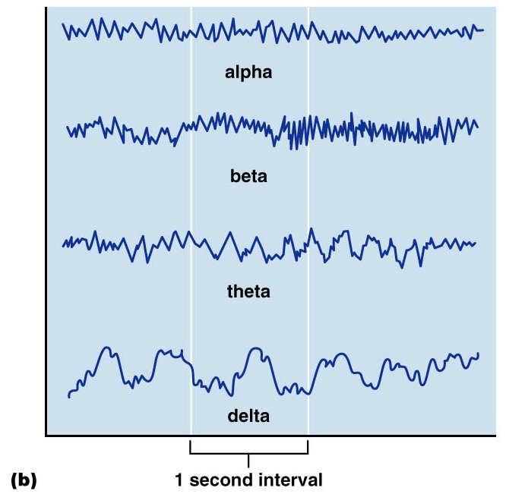
Types of Brain Waves
Figure 12.20b

Slide 13
Brain Waves: State of the Brain
Change with age, sensory stimuli, brain disease, and the chemical state of the body
EEGs used to diagnose and localize brain lesions, tumors, infarcts, infections, abscesses, and epileptic lesions
A flat EEG (no electrical activity) is clinical evidence of death

Slide 14
Epilepsy
A victim of epilepsy may lose consciousness, fall stiffly, and have uncontrollable jerking, characteristic of epileptic seizure
Epilepsy is not associated with, nor does it cause, intellectual impairments
Epilepsy occurs in 1% of the population

Slide 15
Epileptic Seizures
Absence seizures, or petit mal – mild seizures seen in young children where the expression goes blank
Grand mal seizures – victim loses consciousness, bones are often broken due to intense convulsions, loss of bowel and bladder control, and severe biting of the tongue

Slide 16
Control of Epilepsy
Epilepsy can usually be controlled with anticonvulsive drugs
Valproic acid, a nonsedating drug, enhances GABA and is a drug of choice
Vagus nerve stimulators can be implanted under the skin of the chest and can keep electrical activity of the brain from becoming chaotic

Slide 17
Consciousness
Encompasses perception of sensation, voluntary initiation and control of movement, and capabilities associated with higher mental processing
Involves simultaneous activity of large areas of the cerebral cortex
Is superimposed on other types of neural activity

Slide 18
Consciousness
Is holistic and totally interconnected
Clinical consciousness is defined on a continuum that grades levels of behavior – alertness, drowsiness, stupor, coma

Slide 19
Types of Sleep
There are two major types of sleep:
  Non-rapid eye movement (NREM)
  Rapid eye movement (REM)
One passes through four stages of NREM during the first 30-45 minutes of sleep
REM sleep occurs after the fourth NREM stage has been achieved

Slide 20
Types and Stages of Sleep: NREM
NREM stages include:
  Stage 1 – eyes are closed and relaxation begins; the EEG shows alpha waves; one can be easily aroused
  Stage 2 – EEG pattern is irregular with sleep spindles (high-voltage wave bursts); arousal is more difficult
  Stage 3 – sleep deepens; theta and delta waves appear; vital signs decline; dreaming is common
  Stage 4 – EEG pattern is dominated by delta waves; skeletal muscles are relaxed; arousal is difficult

Slide 21
Types and Stages of Sleep: REM
Characteristics of REM sleep
  EEG pattern reverts through the NREM stages to the stage 1 pattern
  Vital signs increase
  Skeletal muscles (except ocular muscles) are inhibited
  Most dreaming takes place

Slide 22
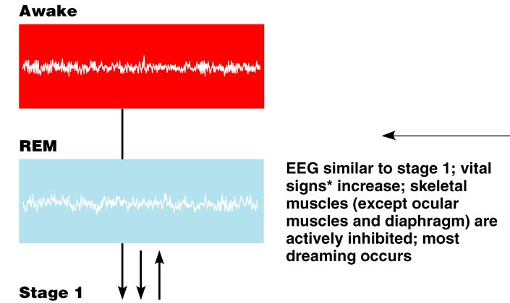
Sleep
Figure 12.21a.1

Slide 23
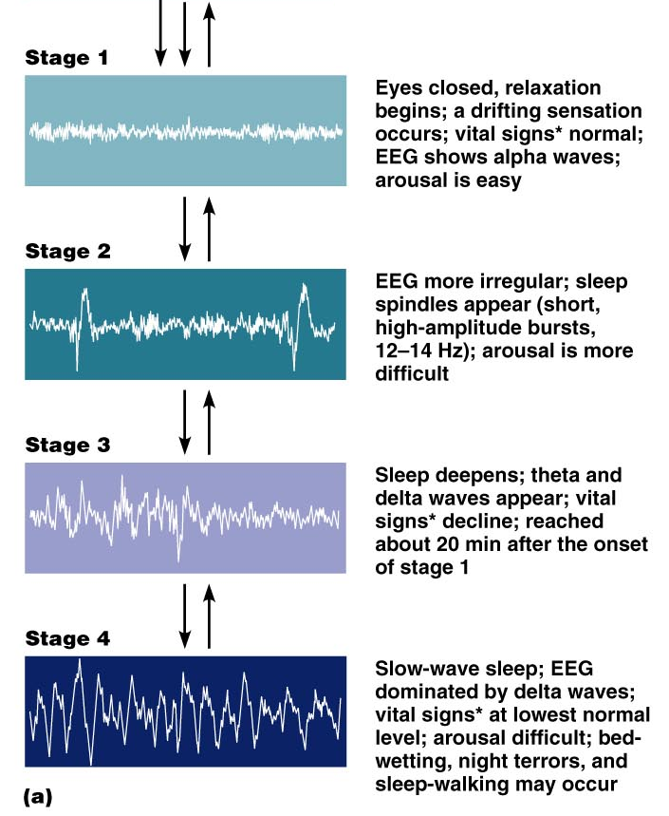
Sleep
Figure 12.21a.2

Slide 24
Sleep Patterns
Alternating cycles of sleep and wakefulness reflect a natural circadian rhythm
Although RAS activity declines in sleep, sleep is more than turning off RAS
The brain is actively guided into sleep
The suprachiasmatic and preoptic nuclei of the hypothalamus regulate the sleep cycle
A typical sleep pattern alternates between REM and NREM sleep

Slide 25
Importance of Sleep
Slow-wave sleep is presumed to be the restorative stage
Those deprived of REM sleep become moody and depressed
REM sleep may be a reverse learning process where superfluous information is purged from the brain
Daily sleep requirements decline with age

Slide 26
Sleep Disorders
Narcolepsy – lapsing abruptly into sleep from the awake state
Insomnia – chronic inability to obtain the amount or quality of sleep needed
Sleep apnea – temporary cessation of breathing during sleep

Slide 27
Memory
Memory is the storage and retrieval of information
The three principles of memory are:
  Storage – occurs in stages and is continually changing
  Processing – accomplished by the hippocampus and surrounding structures
  Memory traces – chemical or structural changes that encode memory

Slide 28
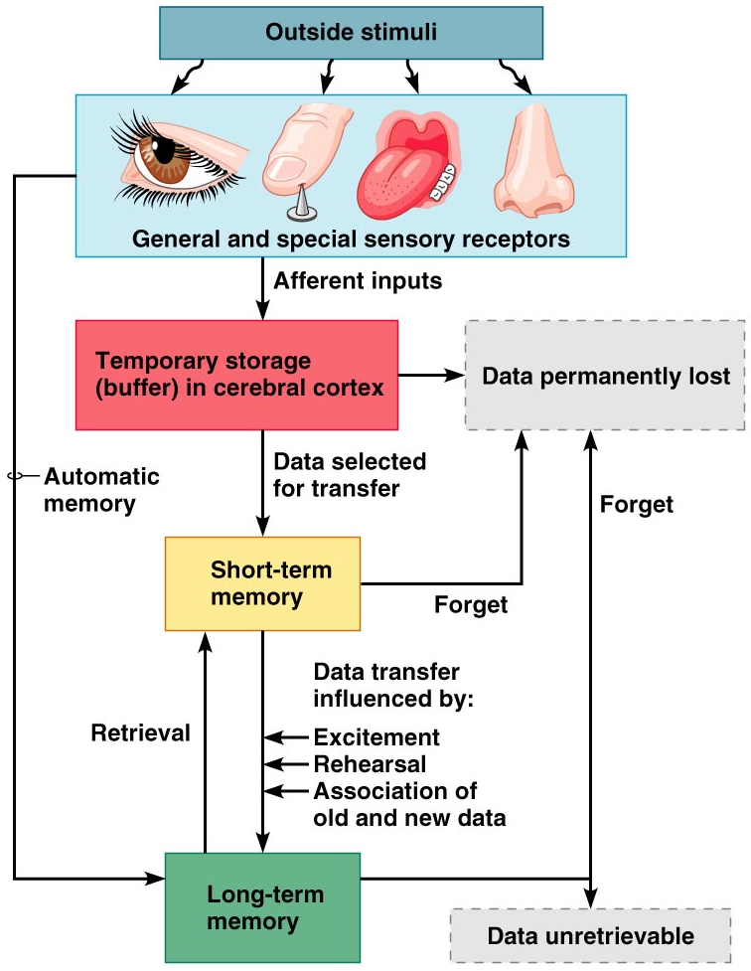
Memory Processing
Figure 12.22

Slide 29
Stages of Memory
The two stages of memory are short-term memory and long-term memory
Short-term memory (STM, or working memory) – a fleeting memory of the events that continually happen
STM lasts seconds to hours and is limited to 7 or 8 pieces of information
Long-term memory (LTM) has limitless capacity

Slide 30
Transfer from STM to LTM
Factors that effect transfer of memory from STM to LTM include:
  Emotional state – we learn best when we are alert, motivated, and aroused
  Rehearsal – repeating or rehearsing material enhances memory
  Association – associating new information with old memories in LTM enhances memory
  Automatic memory – subconscious information stored in LTM

Slide 31
Categories of Memory
The two categories of memory are fact memory and skill memory
Fact (declarative) memory:
  Entails learning explicit information
  Is related to our conscious thoughts and our language ability
  Is stored with the context in which it was learned

Slide 32
Skill Memory
Skill memory is less conscious than fact memory and involves motor activity
It is acquired through practice
Skill memories do not retain the context in which they were learned

Slide 33
Structures Involved in Fact Memory
Fact memory involves the following brain areas:
  Hippocampus and the amygdala, both limbic system structures
  Specific areas of the thalamus and hypothalamus of the diencephalon
  Ventromedial prefrontal cortex and the basal forebrain

Slide 34
Structures Involved in Skill Memory
Skill memory involves:
  Corpus striatum – mediates the automatic connections between a stimulus and a motor response
  Portion of the brain receiving the stimulus
  Premotor and motor cortex

Slide 35
Mechanisms of Memory
Neuronal RNA content is altered
Dendritic spines change shape
Extracellular proteins are deposited at synapses involved in LTM
Number and size of presynaptic terminals may increase
More neurotransmitter is released by presynaptic neurons
New hippocampal neurons appear

Slide 36
Mechanisms of Memory
Long-term potentiation (LTP) is involved and is mediated by NMDA receptors
Synaptic events involve the binding of brain-derived neurotropic factor (BDNF)
BDNF is involved with Na⁺, Ca²⁺, and Mg²⁺ influence at synapses

Slide 37
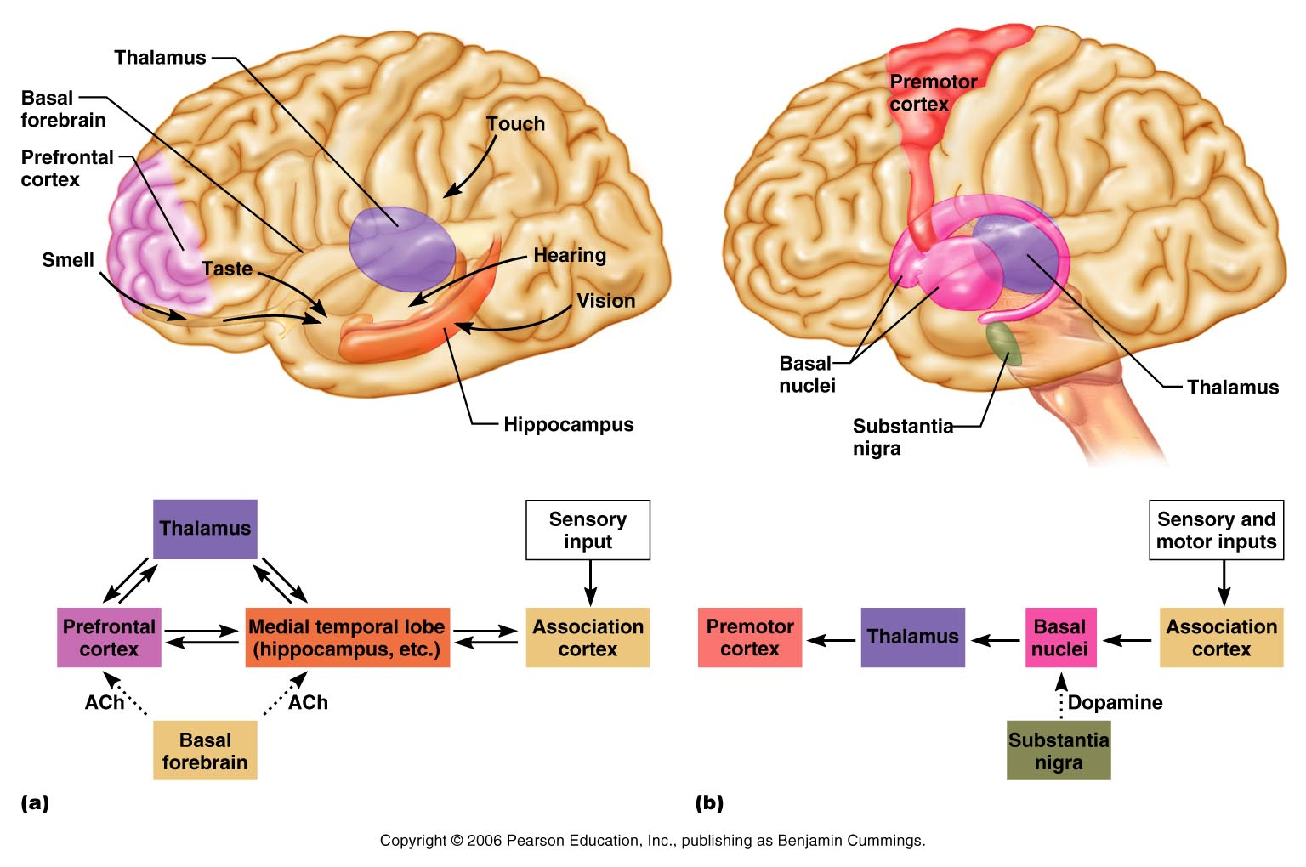
Proposed Memory Circuits
Figure 12.23

Slide 38
Protection of the Brain
The brain is protected by bone, meninges, and cerebrospinal fluid
Harmful substances are shielded from the brain by the blood-brain barrier

Slide 39
Meninges
Three connective tissue membranes lie external to the CNS – dura mater, arachnoid mater, and pia mater
Functions of the meninges
  Cover and protect the CNS
  Protect blood vessels and enclose venous sinuses
  Contain cerebrospinal fluid (CSF)
  Form partitions within the skull

Slide 40
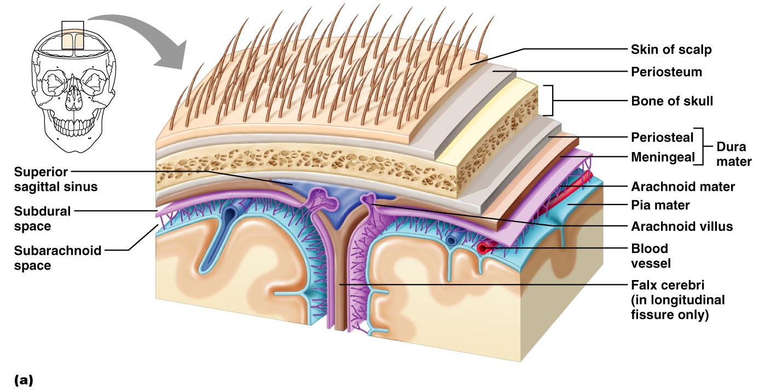
Meninges
Figure 12.24a

Slide 41
Dura Mater
Leathery, strong meninx composed of two fibrous connective tissue layers
The two layers separate in certain areas and form dural sinuses

Slide 42
Dura Mater
Three dural septa extend inward and limit excessive movement of the brain
  Falx cerebri – fold that dips into the longitudinal fissure
  Falx cerebelli – runs along the vermis of the cerebellum
  Tentorium cerebelli – horizontal dural fold extends into the transverse fissure

Slide 43
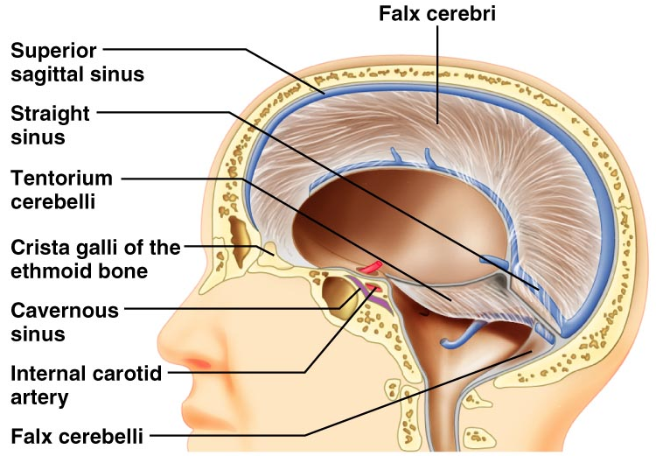
Dura Mater
Figure 12.25

Slide 44
Arachnoid Mater
The middle meninx, which forms a loose brain covering
It is separated from the dura mater by the subdural space
Beneath the arachnoid is a wide subarachnoid space filled with CSF and large blood vessels
Arachnoid villi protrude superiorly and permit CSF to be absorbed into venous blood

Slide 45
Arachnoid Mater
Figure 12.24a

Slide 46
Pia Mater
Deep meninx composed of delicate connective tissue that clings tightly to the brain

Slide 47
Cerebrospinal Fluid (CSF)
Watery solution similar in composition to blood plasma
Contains less protein and different ion concentrations than plasma
Forms a liquid cushion that gives buoyancy to the CNS organs

Slide 48
Cerebrospinal Fluid (CSF)
Prevents the brain from crushing under its own weight
Protects the CNS from blows and other trauma
Nourishes the brain and carries chemical signals throughout it

Slide 49
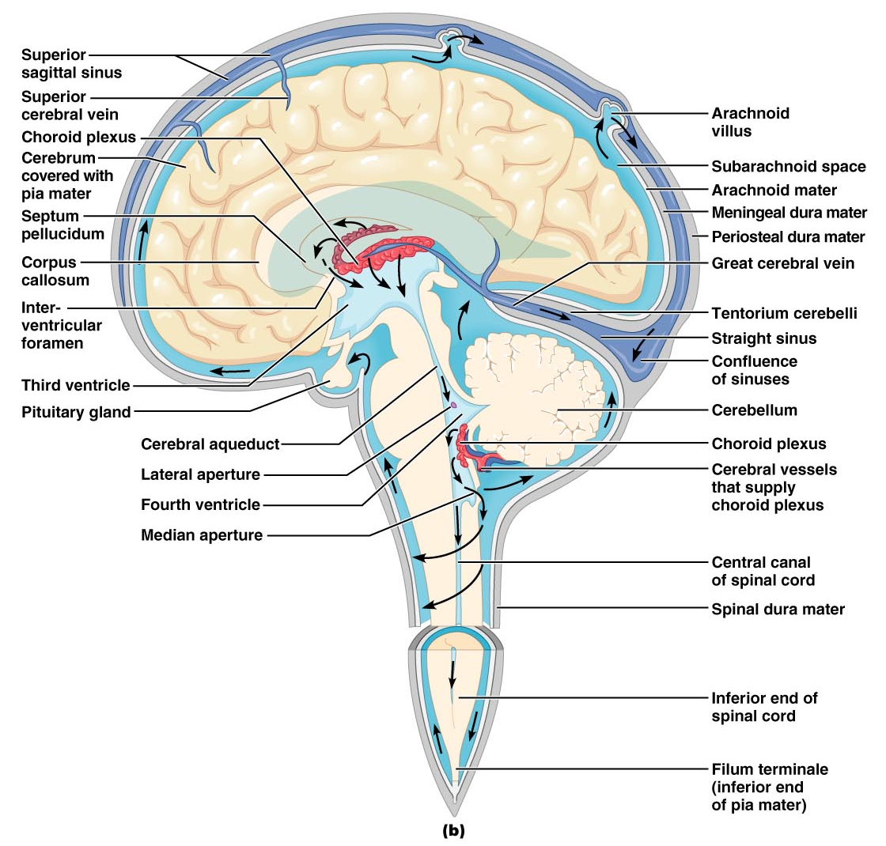
Circulation of CSF
Figure 12.26b

Slide 50
Choroid Plexuses
Clusters of capillaries that form tissue fluid filters, which hang from the roof of each ventricle
Have ion pumps that allow them to alter ion concentrations of the CSF
Help cleanse CSF by removing wastes

Slide 51
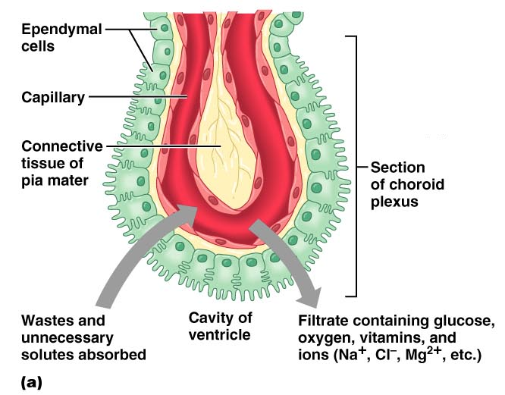
Choroid Plexuses
Figure 12.26a

Slide 52
Blood-Brain Barrier
Protective mechanism that helps maintain a stable environment for the brain
Bloodborne substances are separated from neurons by:
  Continuous endothelium of capillary walls
  Relatively thick basal lamina
  Bulbous feet of astrocytes

Slide 53
Blood-Brain Barrier: Functions
Selective barrier that allows nutrients to pass freely
Is ineffective against substances that can diffuse through plasma membranes
Absent in some areas (vomiting center and the hypothalamus), allowing these areas to monitor the chemical composition of the blood
Stress increases the ability of chemicals to pass through the blood-brain barrier

Slide 54
Cerebrovascular Accidents (Strokes)
Caused when blood circulation to the brain is blocked and brain tissue dies
Most commonly caused by blockage of a cerebral artery
Other causes include compression of the brain by hemorrhage or edema, and atherosclerosis
Transient ischemic attacks (TIAs) – temporary episodes of reversible cerebral ischemia
Tissue plasminogen activator (TPA) is the only approved treatment for stroke

Slide 55
Degenerative Brain Disorders
Alzheimer’s disease – a progressive degenerative disease of the brain that results in dementia
Parkinson’s disease – degeneration of the dopamine-releasing neurons of the substantia nigra
Huntington’s disease – a fatal hereditary disorder caused by accumulation of the protein huntingtin that leads to degeneration of the basal nuclei

Slide 56
Embryonic Development of the Spinal Cord
Develops from caudal portion of neural tube
By week 6, there are two clusters of neuroblasts:
  Alar plate – will become interneurons
  Basal plate – will become motor neurons
Neural crest cells form the dorsal root ganglia

Slide 57
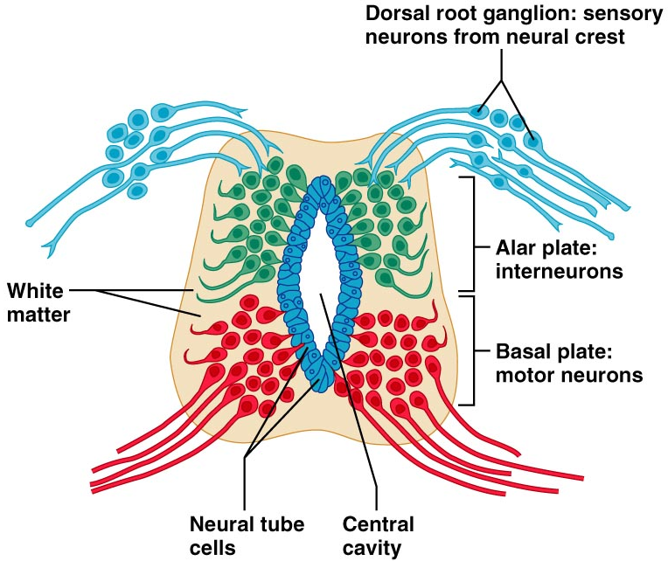
Embryonic Development of the Spinal Cord
Figure 12.28

