Slide 1
12
P A R T A
  The Central Nervous System

Slide 2
Central Nervous System (CNS)
CNS – composed of the brain and spinal cord
Cephalization
  Elaboration of the anterior portion of the CNS
  Increase in number of neurons in the head
  Highest level is reached in the human brain

Slide 3
The Brain
Composed of wrinkled, pinkish gray tissue
Surface anatomy includes cerebral hemispheres, cerebellum, and brain stem

Slide 4
Embryonic Development
During the first 26 days of development:
  Ectoderm thickens forming the neural plate
  The neural plate invaginates, forming the neural groove
  The neural groove fuses dorsally and forms the neural tube

Slide 5
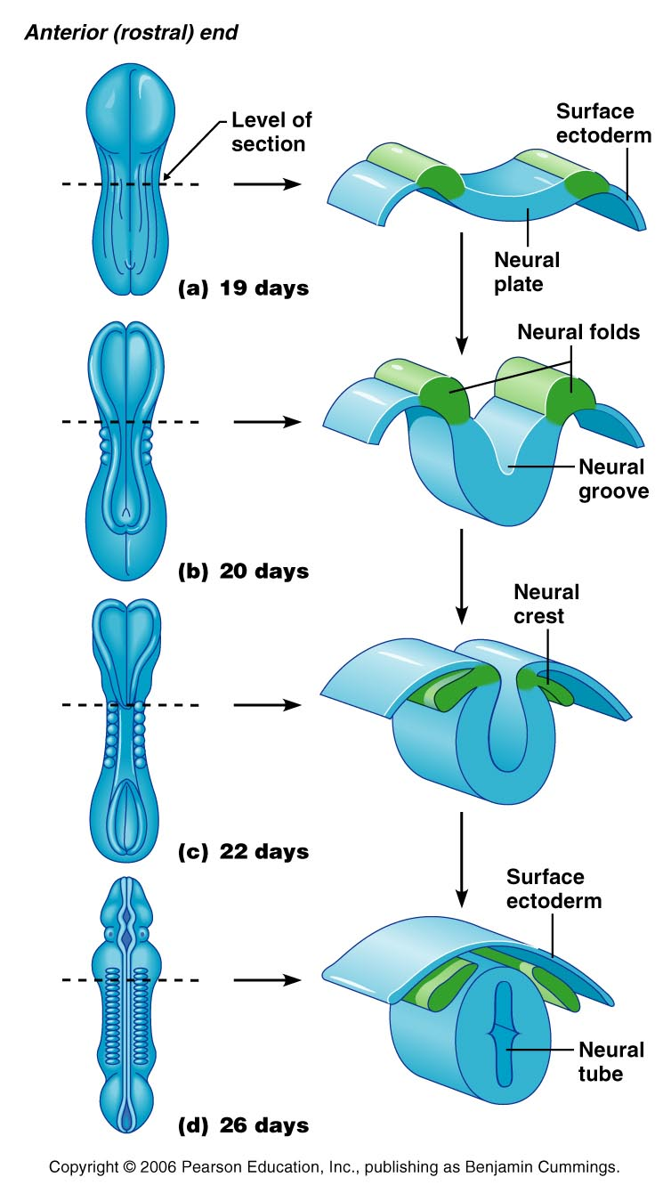
Embryonic Development
Figure 12.1

Slide 6
Primary Brain Vesicles
The anterior end of the neural tube expands and constricts to form the three primary brain vesicles
  Prosencephalon – the forebrain
  Mesencephalon – the midbrain
  Rhombencephalon – hindbrain

Slide 7
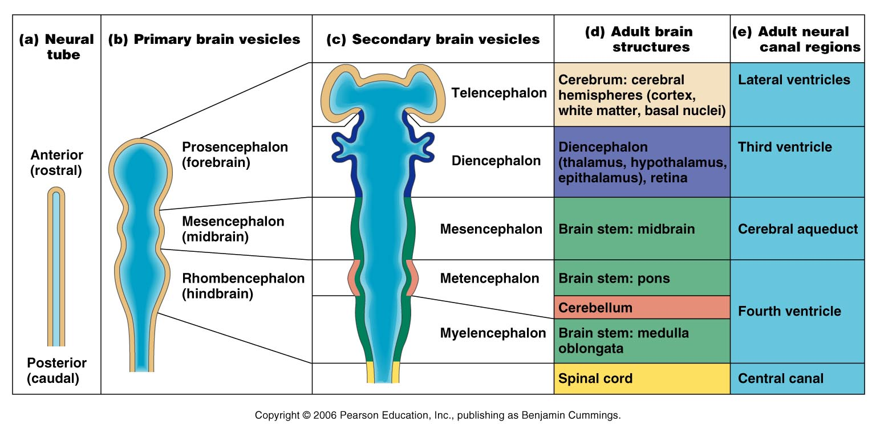
Neural Tube and Primary Brain Vesicles
Figure 12.2a, b

Slide 8
Secondary Brain Vesicles
In week 5 of embryonic development, secondary brain vesicles form
  Telencephalon and diencephalon arise from the forebrain
  Mesencephalon remains undivided
  Metencephalon and myelencephalon arise from the hindbrain

Slide 9
Secondary Brain Vesicles
Figure 12.2c

Slide 10
Adult Brain Structures
Fates of the secondary brain vesicles:
  Telencephalon – cerebrum: cortex, white matter, and basal nuclei
  Diencephalon – thalamus, hypothalamus, and epithalamus
  Mesencephalon – brain stem: midbrain
  Metencephalon – brain stem: pons
  Myelencephalon – brain stem: medulla oblongata

Slide 11
Adult Neural Canal Regions
Figure 12.2c, d

Slide 12
Adult Neural Canal Regions
Adult structures derived from the neural canal
  Telencephalon – lateral ventricles
  Diencephalon – third ventricle
  Mesencephalon – cerebral aqueduct
  Metencephalon and myelencephalon – fourth ventricle

Slide 13
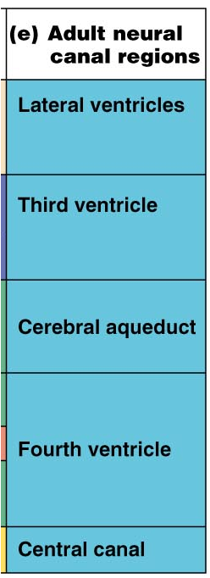
Adult Neural Canal Regions
Figure 12.2c, e

Slide 14
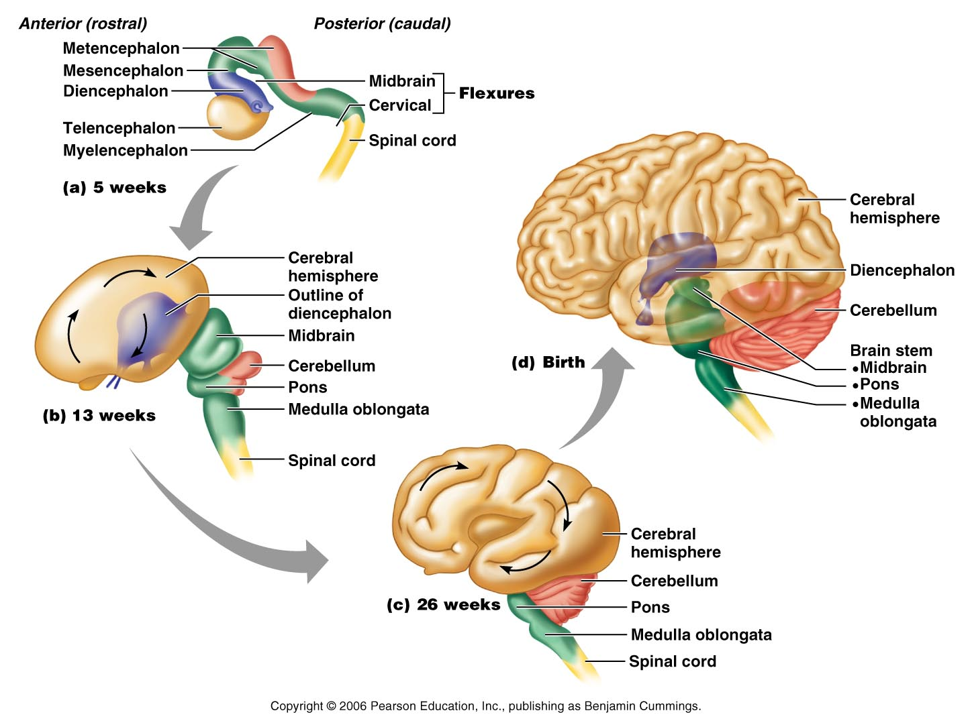
Space Restriction and Brain Development
Figure 12.3

Slide 15
Basic Pattern of the Central Nervous System
Spinal Cord
  Central cavity surrounded by a gray matter core
  External to which is white matter composed of myelinated fiber tracts
Brain
  Similar to spinal cord but with additional areas of gray matter
  Cerebellum has gray matter in nuclei
  Cerebrum has nuclei and additional gray matter in the cortex

Slide 16
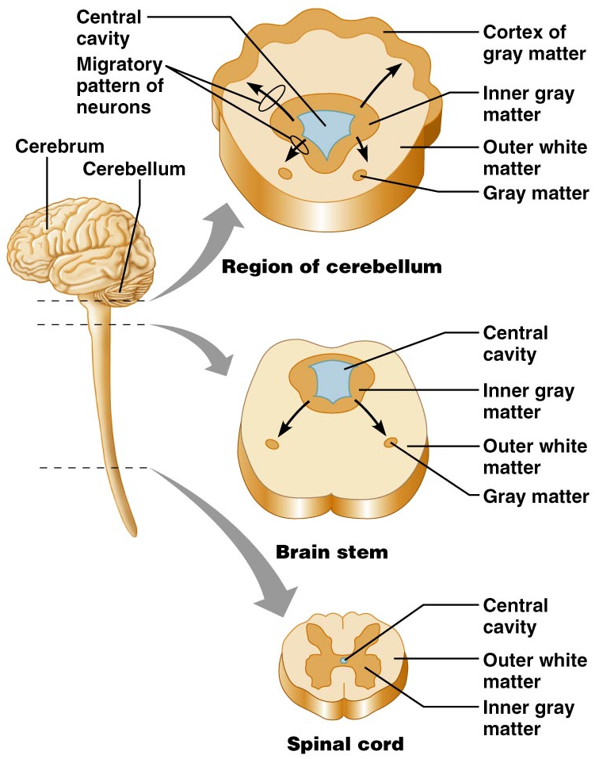
Basic Pattern of the Central Nervous System
Figure 12.4

Slide 17
Ventricles of the Brain
Arise from expansion of the lumen of the neural tube
The ventricles are:
  The paired C-shaped lateral ventricles
  The third ventricle found in the diencephalon
  The fourth ventricle found in the hindbrain dorsal to the pons

Slide 18
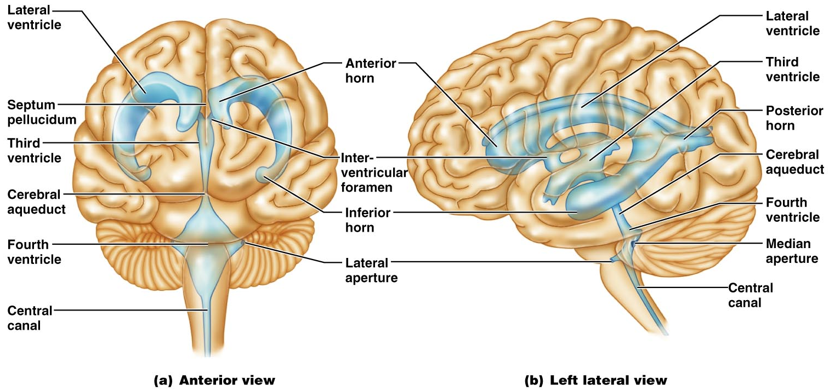
Ventricles of the Brain
Figure 12.5

Slide 19
Cerebral Hemispheres
Form the superior part of the brain and make up 83% of its mass
Contain ridges (gyri) and shallow grooves (sulci)
Contain deep grooves called fissures
Are separated by the longitudinal fissure
Have three basic regions: cortex, white matter, and basal nuclei

Slide 20
Major Lobes, Gyri, and Sulci of the Cerebral Hemisphere
Deep sulci divide the hemispheres into five lobes:
  Frontal, parietal, temporal, occipital, and insula
Central sulcus – separates the frontal and parietal lobes

Slide 21
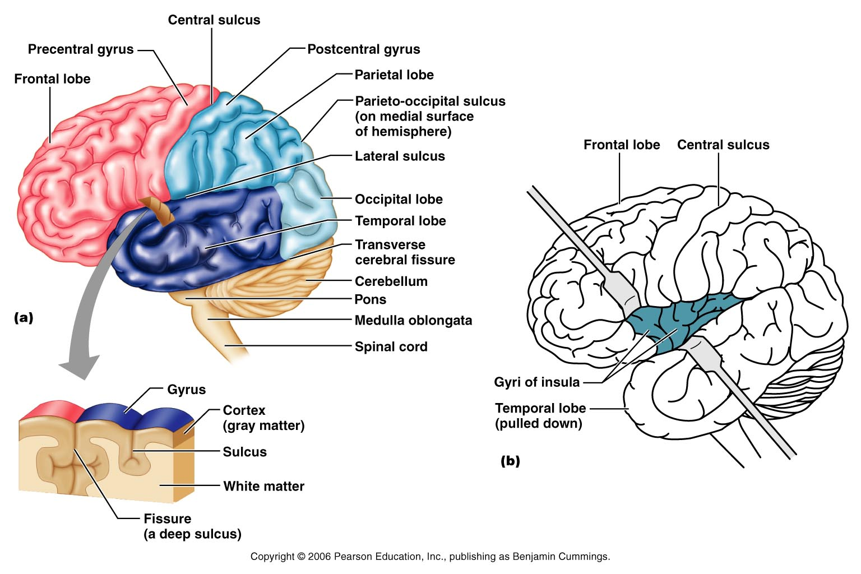
Brain Lobes
Figure 12.6a–b

Slide 22
Major Lobes, Gyri, and Sulci of the Cerebral Hemisphere
Parieto-occipital sulcus – separates the parietal and occipital lobes
Lateral sulcus – separates the parietal and temporal lobes
The precentral and postcentral gyri border the central sulcus

Slide 23
Cerebral Cortex
The cortex – superficial gray matter; accounts for 40% of the mass of the brain
It enables sensation, communication, memory, understanding, and voluntary movements
Each hemisphere acts contralaterally (controls the opposite side of the body)
Hemispheres are not equal in function
No functional area acts alone; conscious behavior involves the entire cortex

Slide 24
Functional Areas of the Cerebral Cortex
The three types of functional areas are:
  Motor areas – control voluntary movement
  Sensory areas – conscious awareness of sensation
  Association areas – integrate diverse information

Slide 25
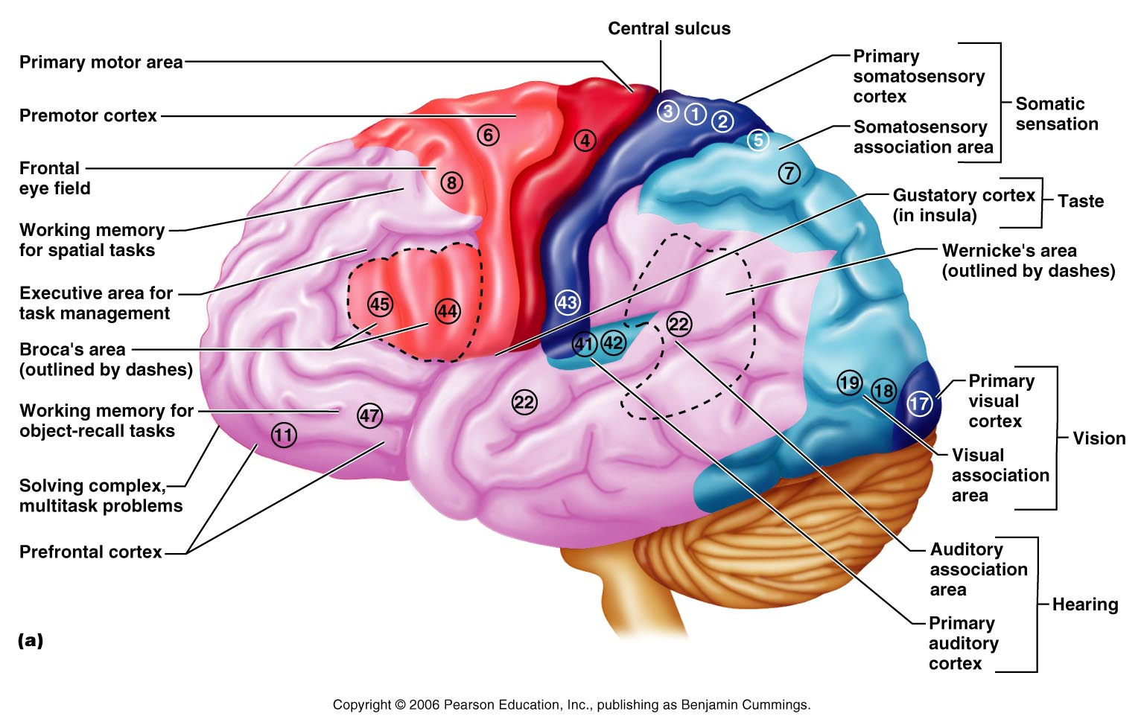
Functional Areas of the Cerebral Cortex
Figure 12.8a

Slide 26
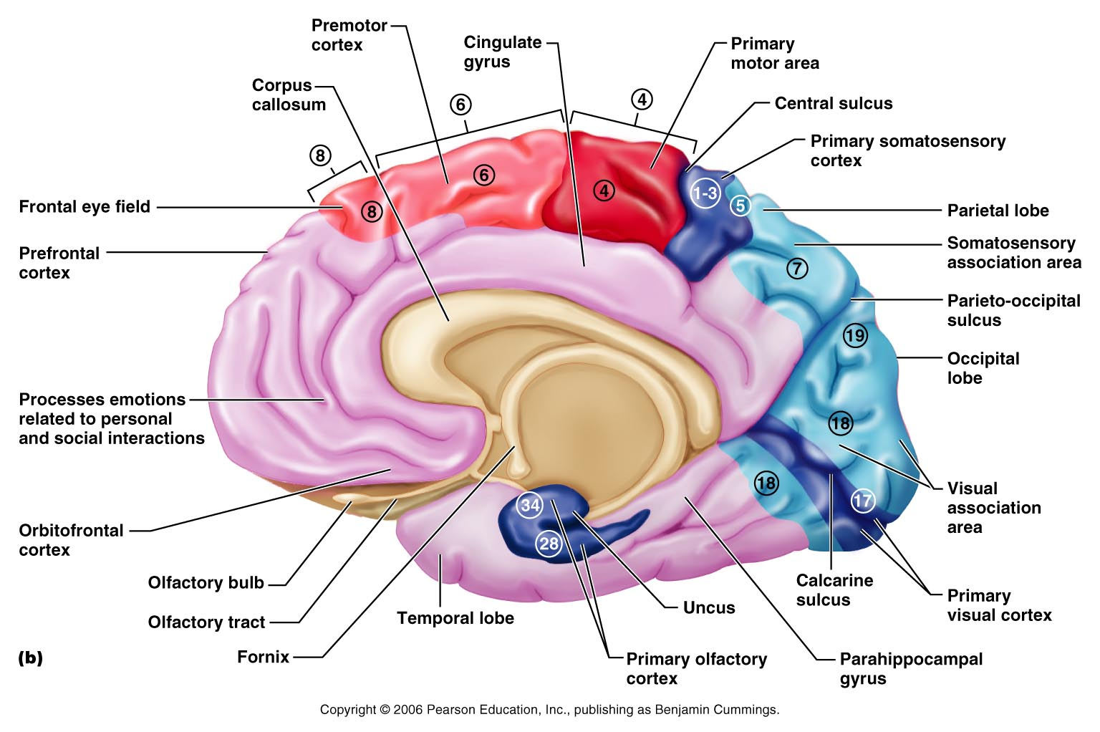
Functional Areas of the Cerebral Cortex
Figure 12.8b

Slide 27
Cerebral Cortex: Motor Areas
Primary (somatic) motor cortex
Premotor cortex
Broca’s area
Frontal eye field

Slide 28
Primary Motor Cortex
Located in the precentral gyrus
Pyramidal cells whose axons make up the corticospinal tracts
Allows conscious control of precise, skilled, voluntary movements

Slide 29
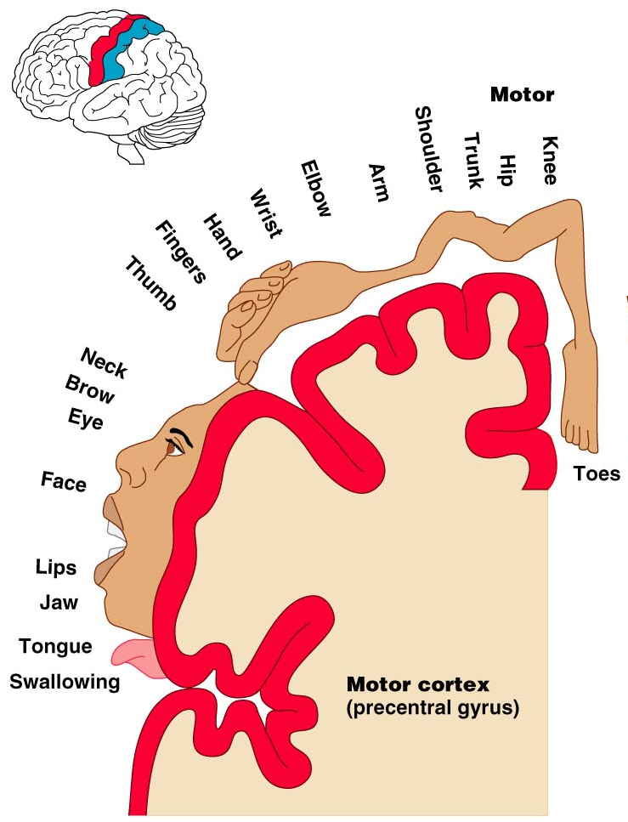
Primary Motor Cortex Homunculus
Figure 12.9.1

Slide 30
Premotor Cortex
Located anterior to the precentral gyrus
Controls learned, repetitious, or patterned motor skills
Coordinates simultaneous or sequential actions
Involved in the planning of movements

Slide 31
Broca’s Area
Broca’s area
  Located anterior to the inferior region of the premotor area
  Present in one hemisphere (usually the left)
  A motor speech area that directs muscles of the tongue
  Is active as one prepares to speak

Slide 32
Frontal Eye Field
Frontal eye field
  Located anterior to the premotor cortex and superior to Broca’s area
  Controls voluntary eye movement

Slide 33
Sensory Areas
Primary somatosensory cortex
Somatosensory association cortex
Visual and auditory areas
Olfactory Cortex
Gustatory Cortex
Visceral Cortex
Vestibular Cortex

Slide 34
Sensory Areas
Figure 12.8a

Slide 35
PrImary Somatosensory Cortex
Located in the postcentral gyrus, this area:
  Receives information from the skin and skeletal muscles
  Exhibits spatial discrimination

Slide 36
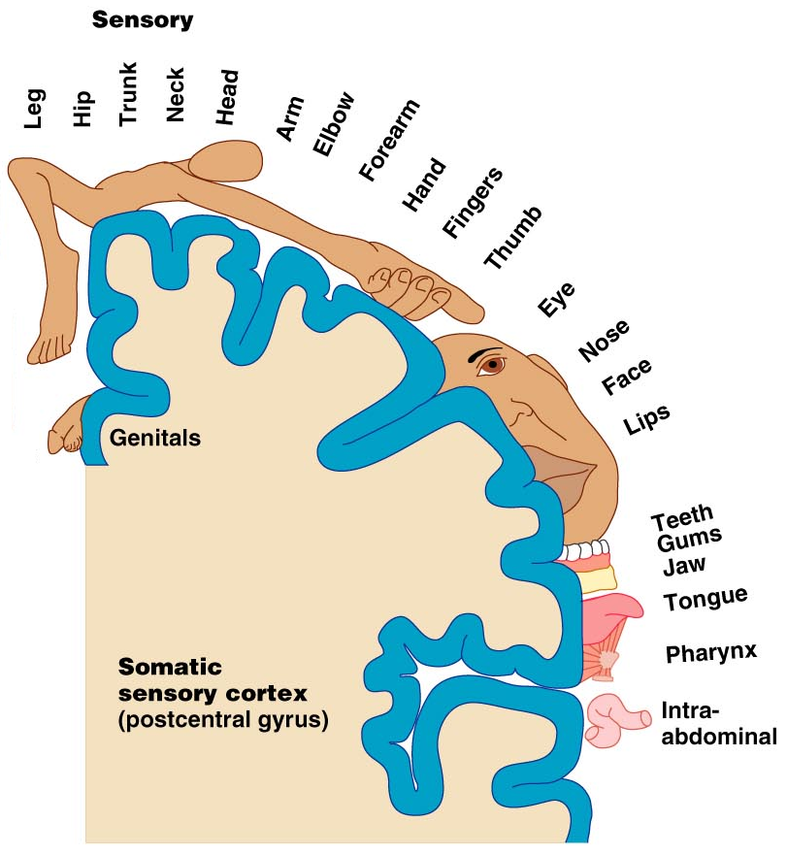
Primary Somatosensory Cortex Homunculus
Figure 12.9.2

Slide 37
Somatosensory Association Cortex
Located posterior to the primary somatosensory cortex
Integrates sensory information
Forms comprehensive understanding of the stimulus
Determines size, texture, and relationship of parts

Slide 38
Visual Areas
Primary visual (striate) cortex
  Seen on the extreme posterior tip of the occipital lobe
  Most of it is buried in the calcarine sulcus
  Receives visual information from the retinas
Visual association area
  Surrounds the primary visual cortex
  Interprets visual stimuli (e.g., color, form, and movement)

Slide 39
Auditory Areas
Primary auditory cortex
  Located at the superior margin of the temporal lobe
  Receives information related to pitch, rhythm, and loudness
Auditory association area
  Located posterior to the primary auditory cortex
  Stores memories of sounds and permits perception of sounds
  Wernicke’s area

Slide 40
Olfactory Cortex
Located on medial aspect of temporal lobe in an area termed the piriform lobe – which is dominated by the hooklike uncus
The olfactory cortex is part of the rhinencephalon
The rhinencephalon includes the orbitofrontal cortex, the uncus and associated regions of the temporal lobe, and the protruding olfactory tracts and bulbs that extend into the nose
Most of the rhinencephalon as a result of evolution has become associated with the Limbic system

Slide 41
The Insula Cortices
Gustatory Cortex is located in the insula
Visceral Sensory Area – Located in the Insula – this cortex is involved in conscious awareness of a full bladder or upset stomach, etc.
Vestibular Cortex – difficult to pin down its location – quite diffuse location but appears to be in posterior part to the insula – involved in conscious awareness of balance – head in space location

Slide 42
Multimodal Association Areas
The pure motor or pure sensory cortices and their sub-divisions are concerned with only one sensory modality (input) – but how do we put multiple inputs together to get a meaning – by sending the messages to the Multimodal Association Areas – which consist of:
Prefrontal cortex (Anterior Association Area)
Posterior Association Area
Limbic Association area

Slide 43
Association Areas
Figure 12.8a

Slide 44
Prefrontal Cortex (Anterior Association Area)
Located in the anterior portion of the frontal lobe
Involved with intellect, cognition, recall, and personality
Necessary for judgment, reasoning, persistence, and conscience
Closely linked to the limbic system (emotional part of the brain)

