Slide 1
8
Joints: Part A

Slide 2
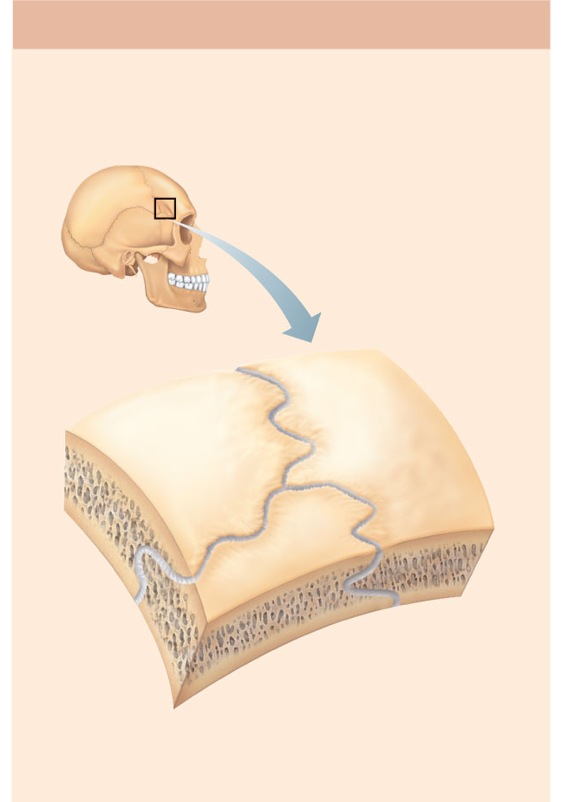
(a) Suture
Joint held together with very short,
interconnecting fibers, and bone edges
interlock. Found only in the skull.
Suture
line
Dense
fibrous
connective
tissue
Figure 8.1a

Slide 3
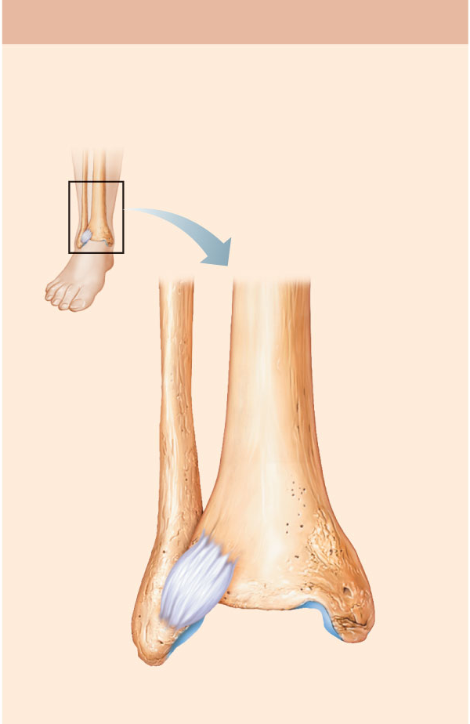
(b) Syndesmosis
Joint held together by a ligament.
Fibrous tissue can vary in length, but
is longer than in sutures.
Fibula
Tibia
Ligament
Figure 8.1b

Slide 4
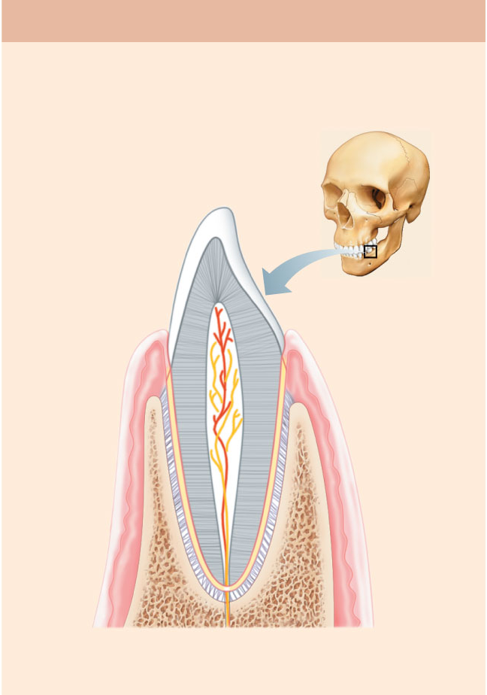
(c) Gomphosis
“Peg in socket” fibrous joint. Periodontal
ligament holds tooth in socket.
Socket of
alveolar
process
Root of
tooth
Periodontal
ligament
Figure 8.1c

Slide 5
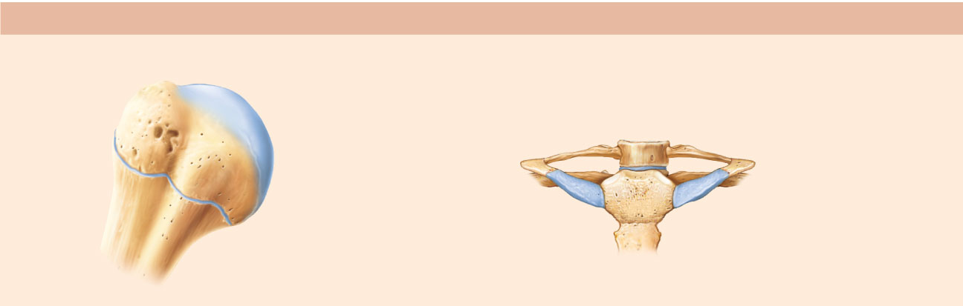
(a) Synchondroses
Bones united by hyaline cartilage
Sternum
(manubrium)
Epiphyseal
plate (temporary
hyaline cartilage
joint)
Joint between
first rib and
sternum
(immovable)
Figure 8.2a

Slide 6
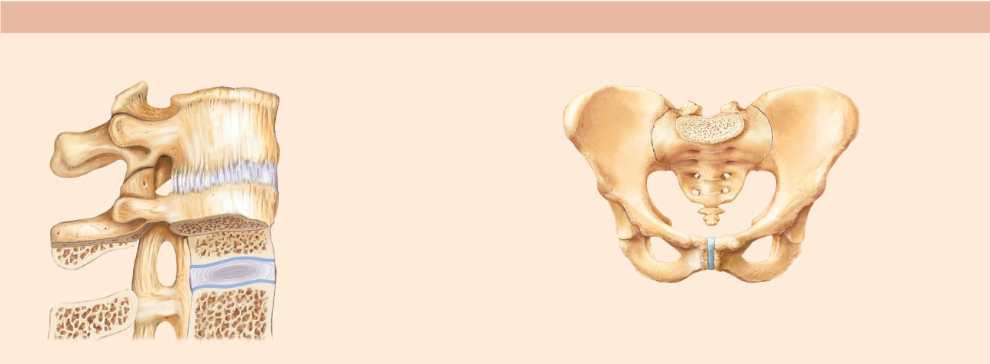
(b) Symphyses
Bones united by fibrocartilage
Body of vertebra
Fibrocartilaginous
intervertebral
disc
Hyaline cartilage
Pubic symphysis
Figure 8.2b

Slide 7
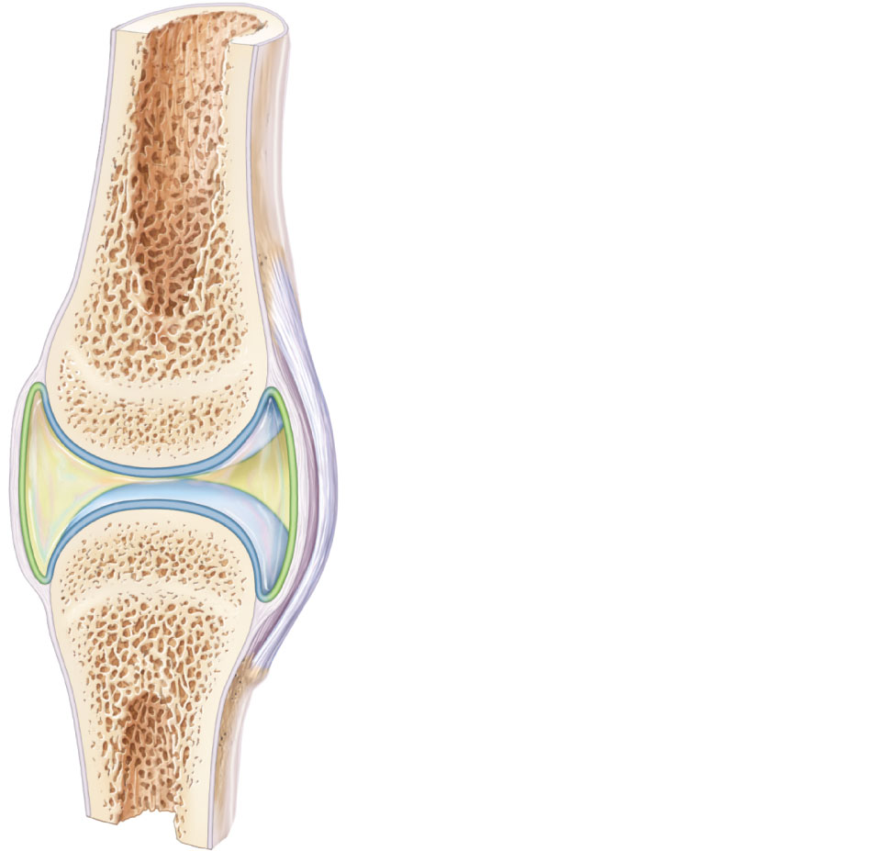
Ligament
Joint cavity
(contains
synovial fluid)
Articular (hyaline)
cartilage
Fibrous
capsule
Articular
capsule
Synovial
membrane
Periosteum
Figure 8.3

Slide 8
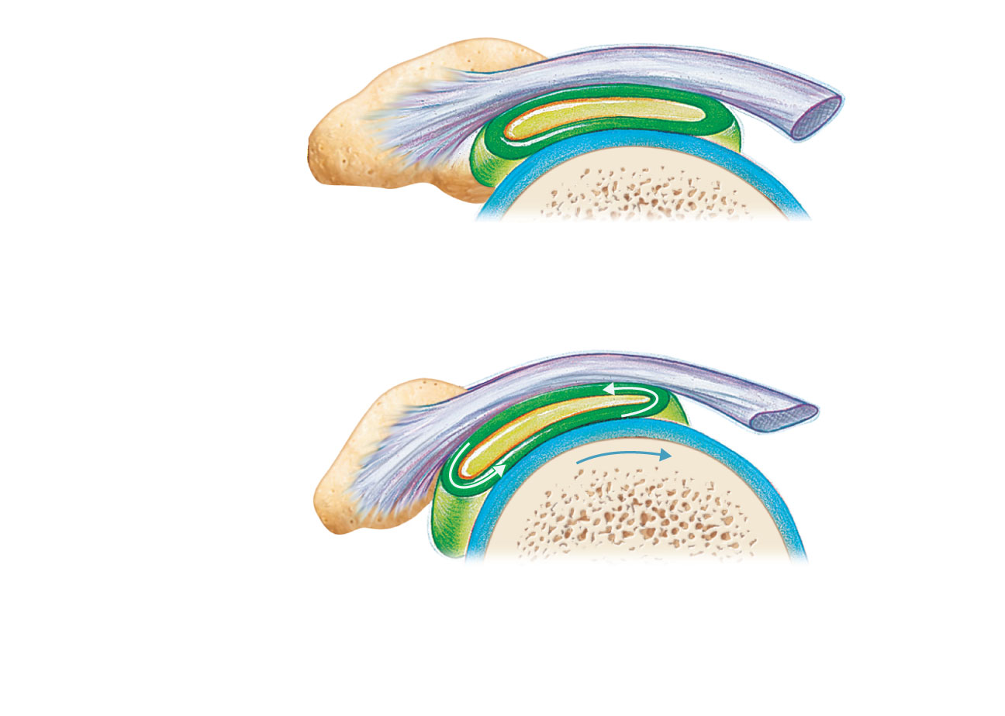
Coracoacromial
ligament
Subacromial
bursa
Humerus
resting
Cavity in
bursa containing
synovial fluid
Bursa rolls
and lessens
friction.
Humerus head
rolls medially as
arm abducts.
Humerus
moving
(b) Enlargement of (a), showing how a bursa
eliminates friction where a ligament (or other
structure) would rub against a bone
Figure 8.4b

Slide 9
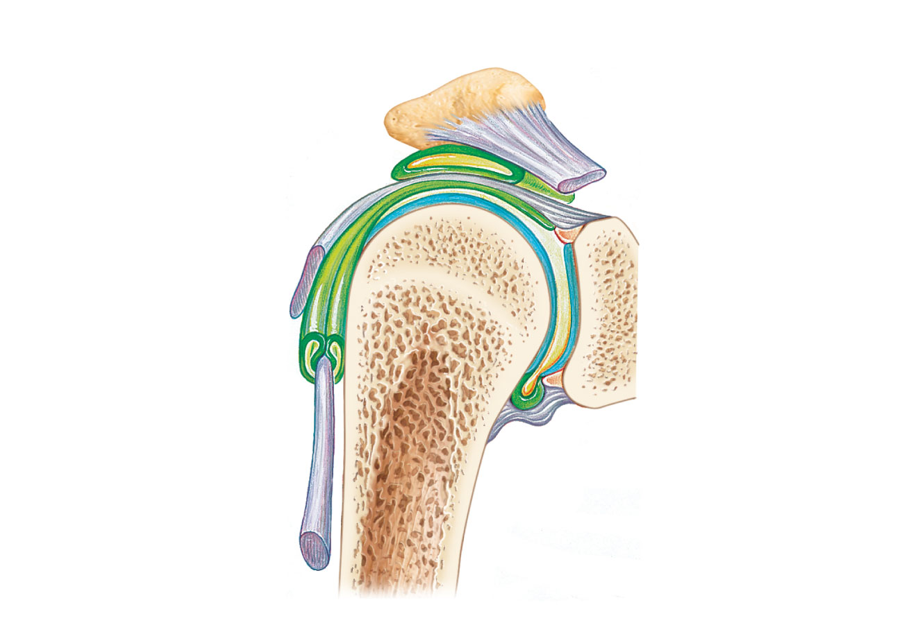
Acromion
of scapula
Coracoacromial
ligament
Joint cavity
containing
synovial fluid
Subacromial
bursa
Fibrous
articular capsule
Hyaline
cartilage
Tendon
sheath
Synovial
membrane
Tendon of
long head
of biceps
brachii muscle
Fibrous
capsule
Humerus
(a) Frontal section through the right shoulder joint
Figure 8.4a

Slide 10
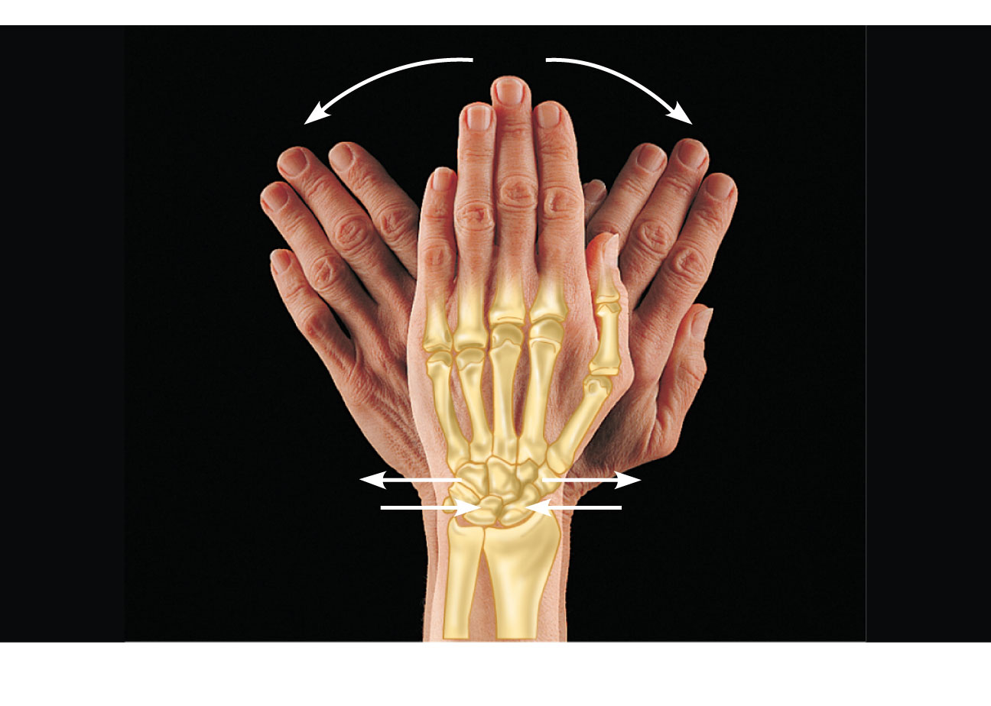
Gliding
(a) Gliding movements at the wrist
Figure 8.5a

Slide 11
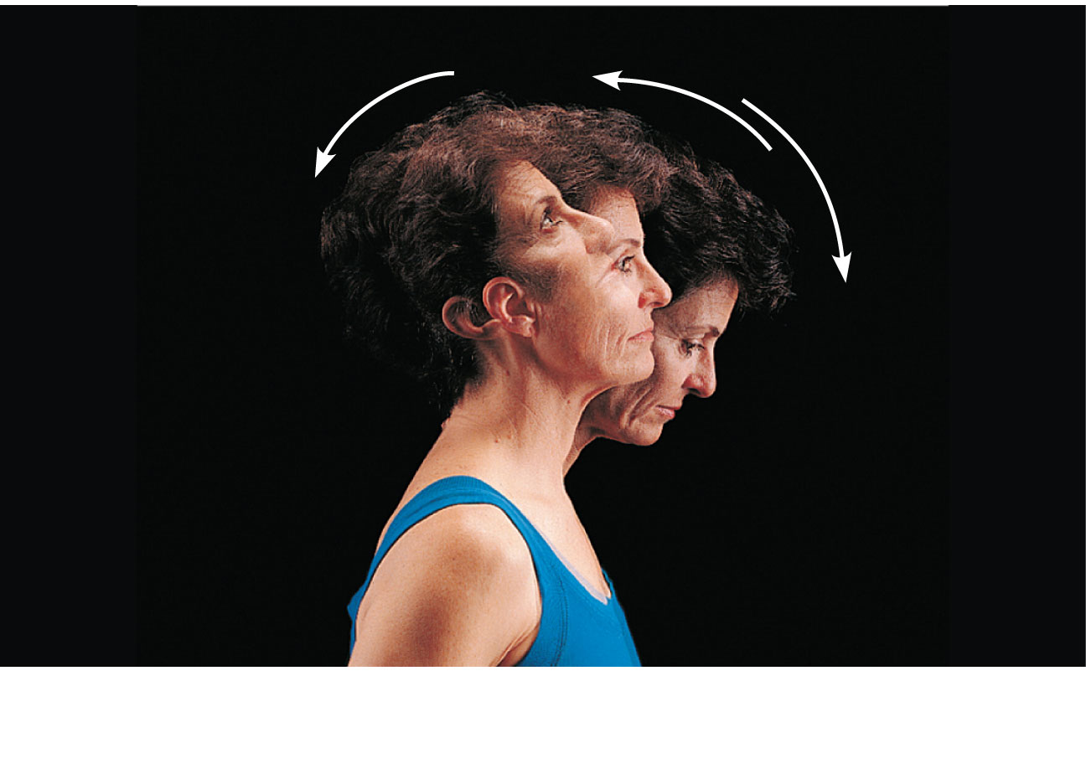
Hyperextension
Extension
Flexion
(b) Angular movements: flexion, extension, and
hyperextension of the neck
Figure 8.5b

Slide 12
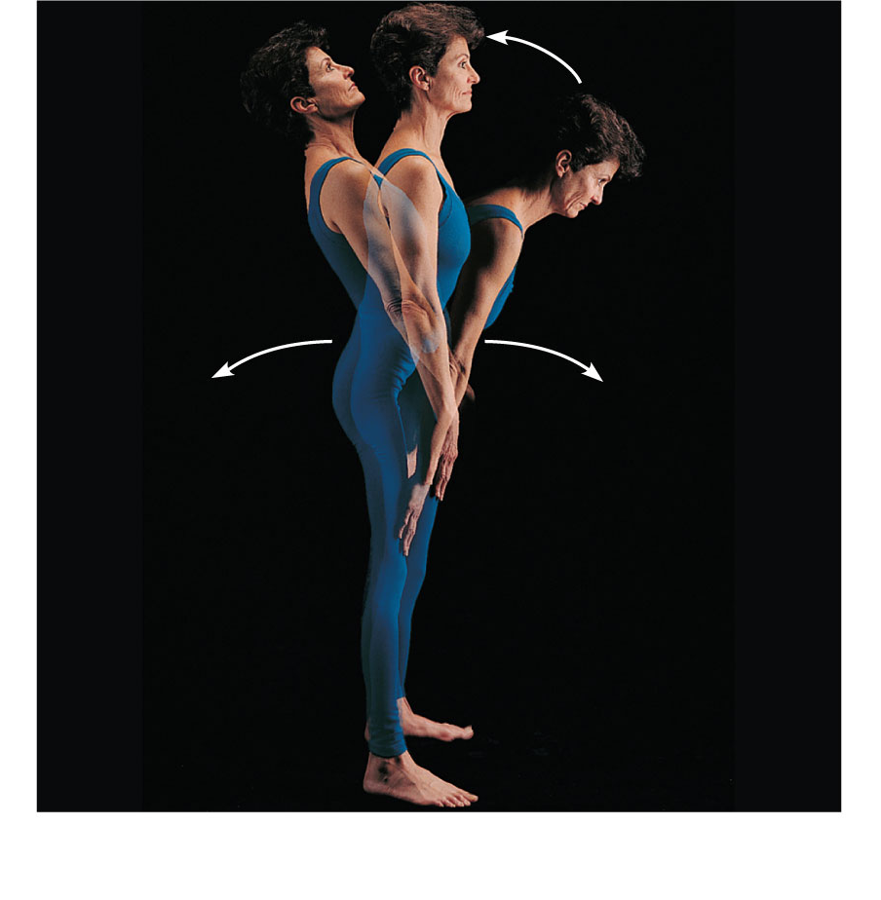
Extension
Hyperextension
Flexion
(c) Angular movements: flexion, extension, and
hyperextension of the vertebral column
Figure 8.5c

Slide 13
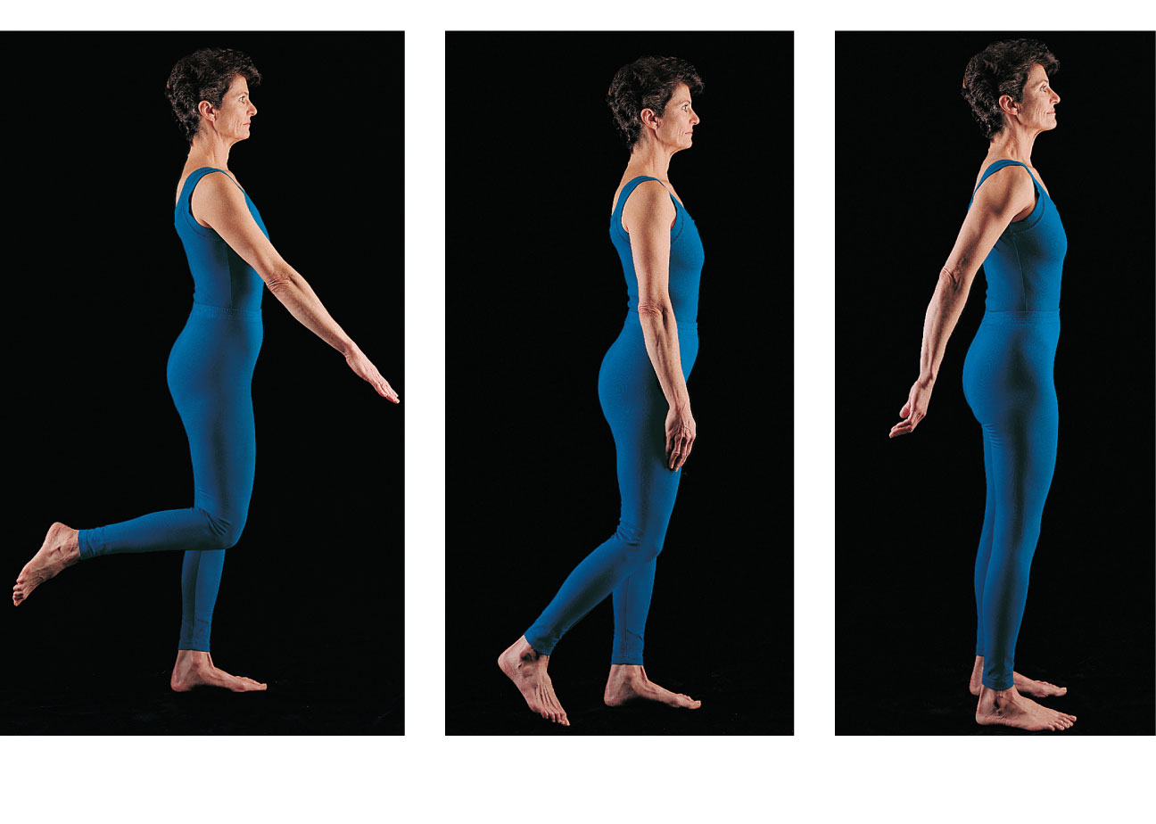
Flexion
Extension
Flexion
Extension
(d) Angular movements: flexion and extension at the
shoulder and knee
Figure 8.5d

Slide 14
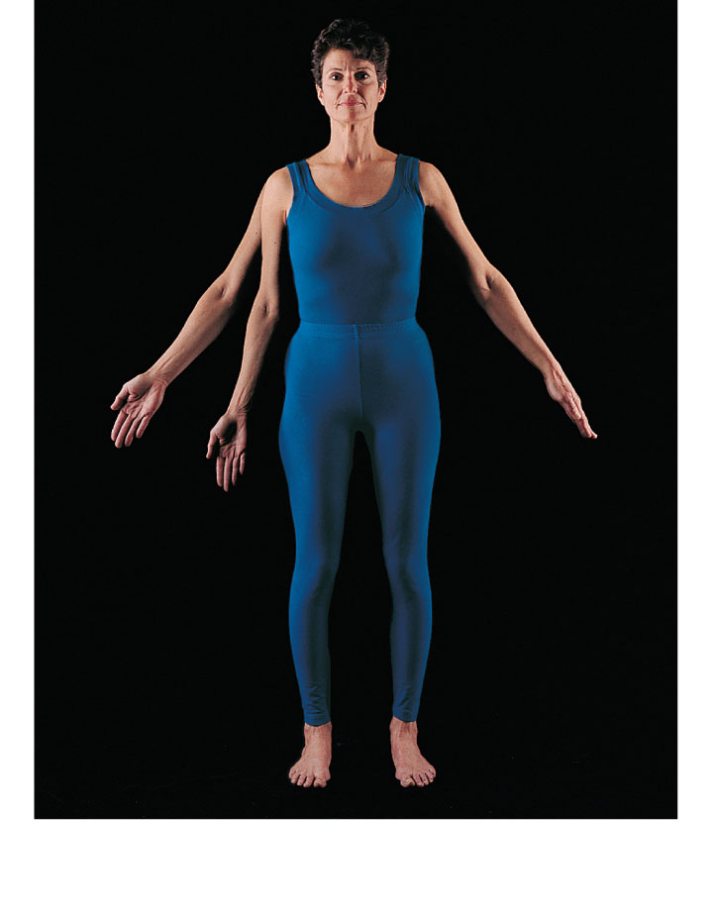
Abduction
Adduction
Circumduction
(e) Angular movements: abduction, adduction, and
circumduction of the upper limb at the shoulder
Figure 8.5e

Slide 15
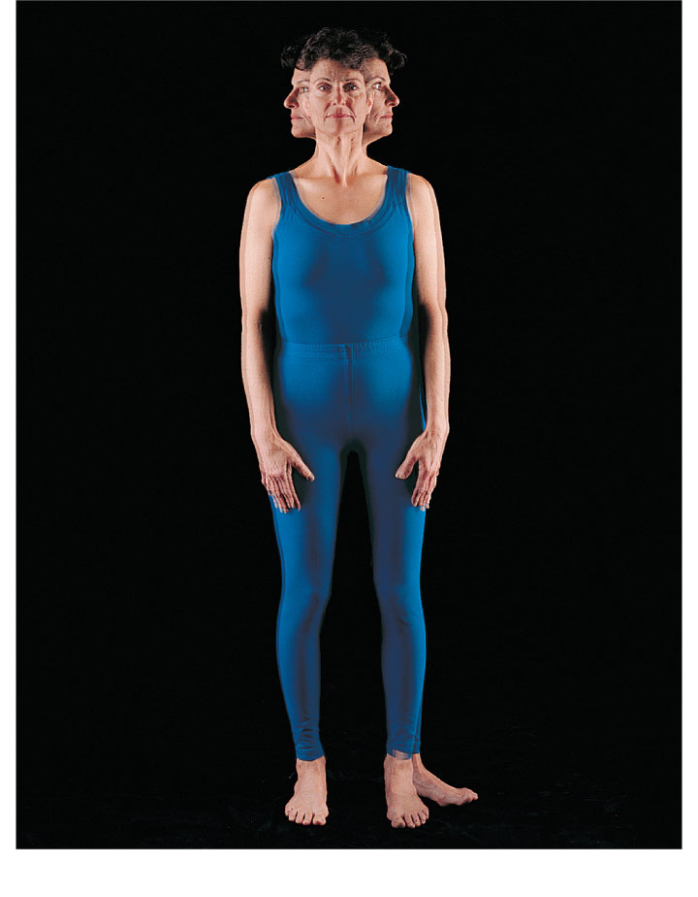
Rotation
Lateral
rotation
Medial
rotation
(f) Rotation of the head, neck, and lower limb
Figure 8.5f

Slide 16
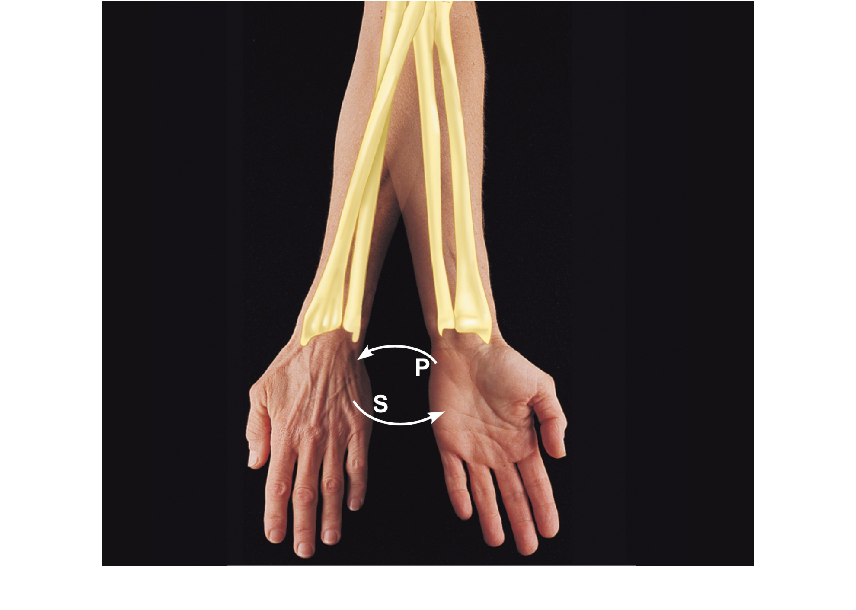
Pronation
(radius
rotates
over ulna)
Supination
(radius and
ulna are
parallel)
(a) Pronation (P) and supination (S)
Figure 8.6a

Slide 17
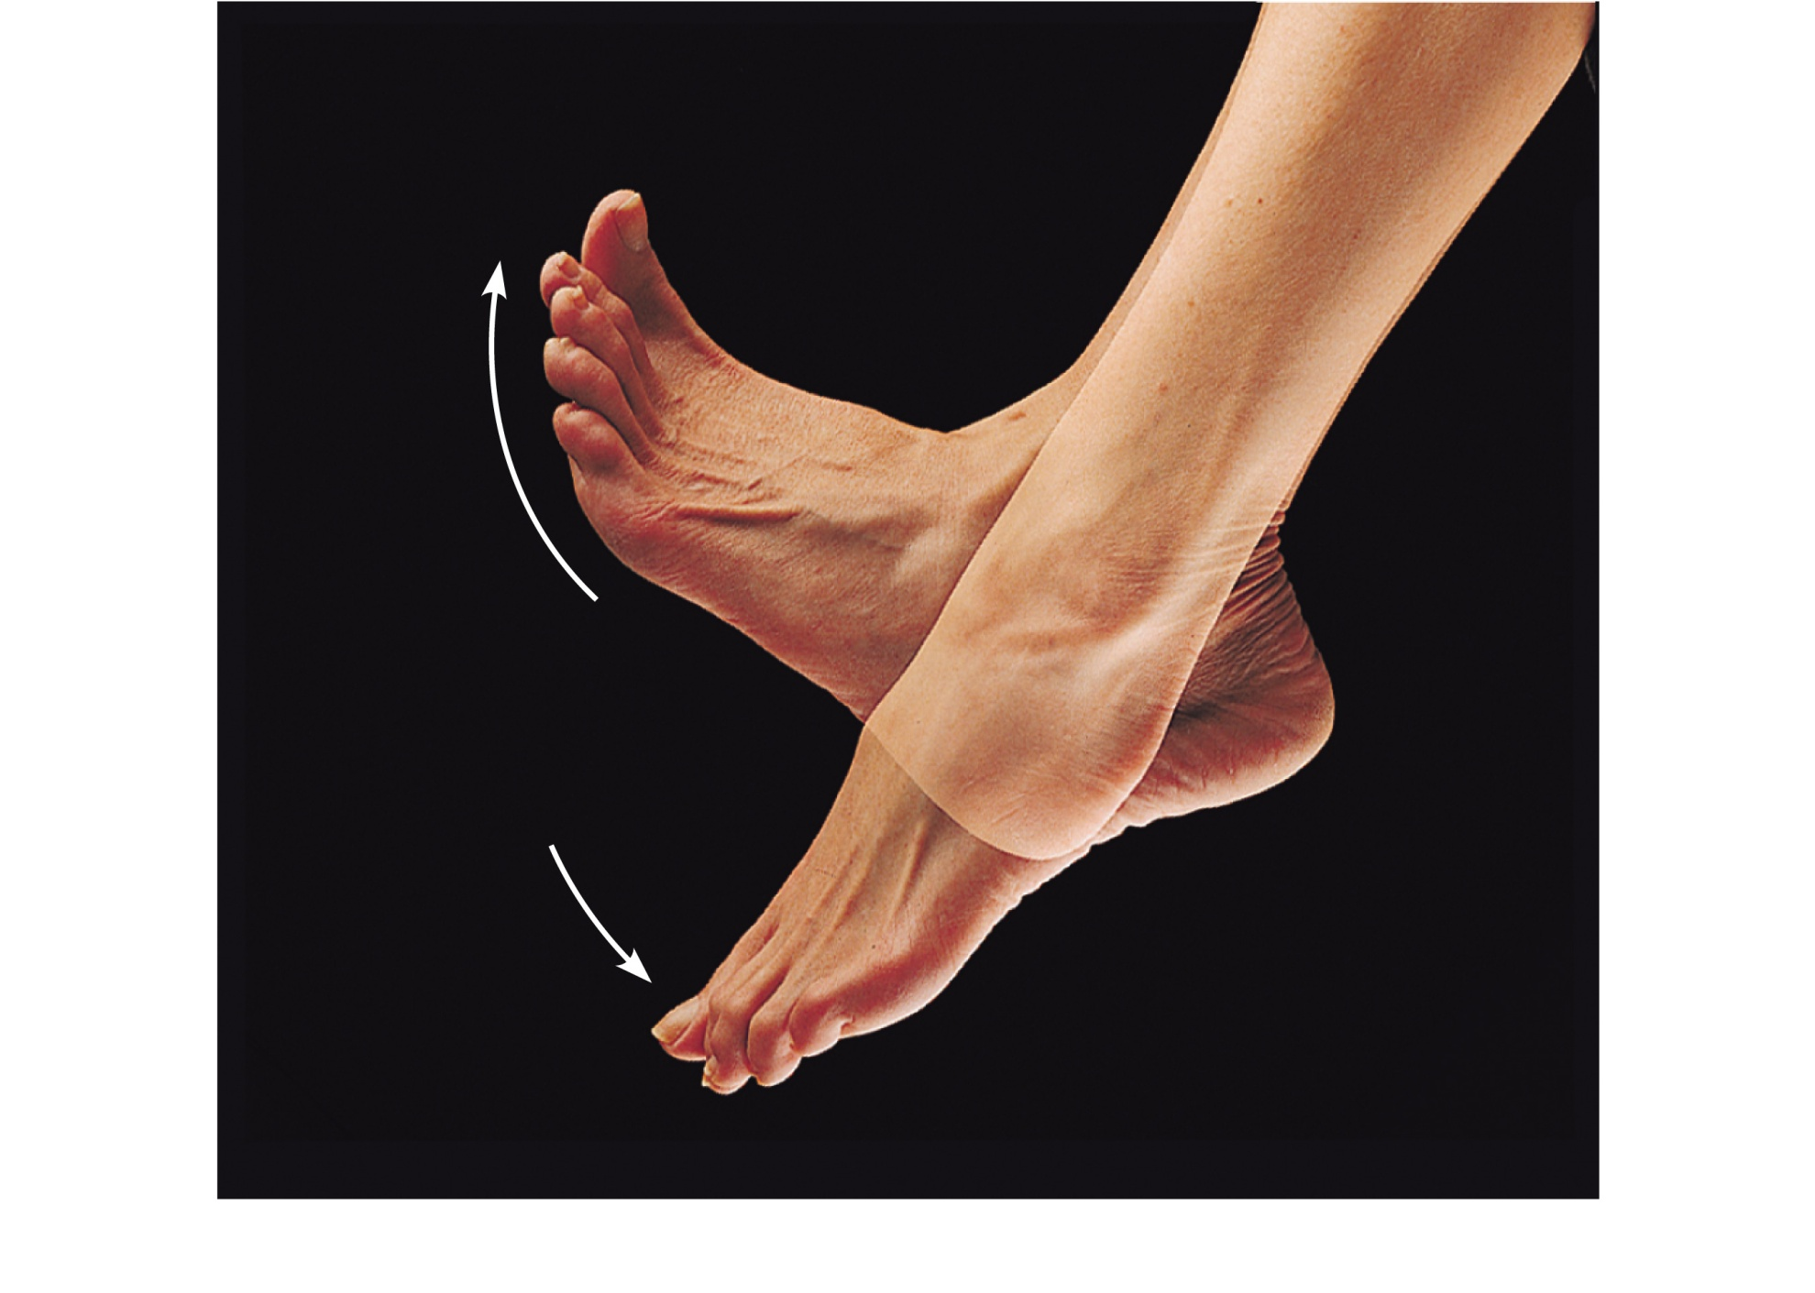
Dorsiflexion
Dorsiflexion
Plantar flexion
Plantar flexion
(b) Dorsiflexion and plantar flexion
Figure 8.6b

Slide 18
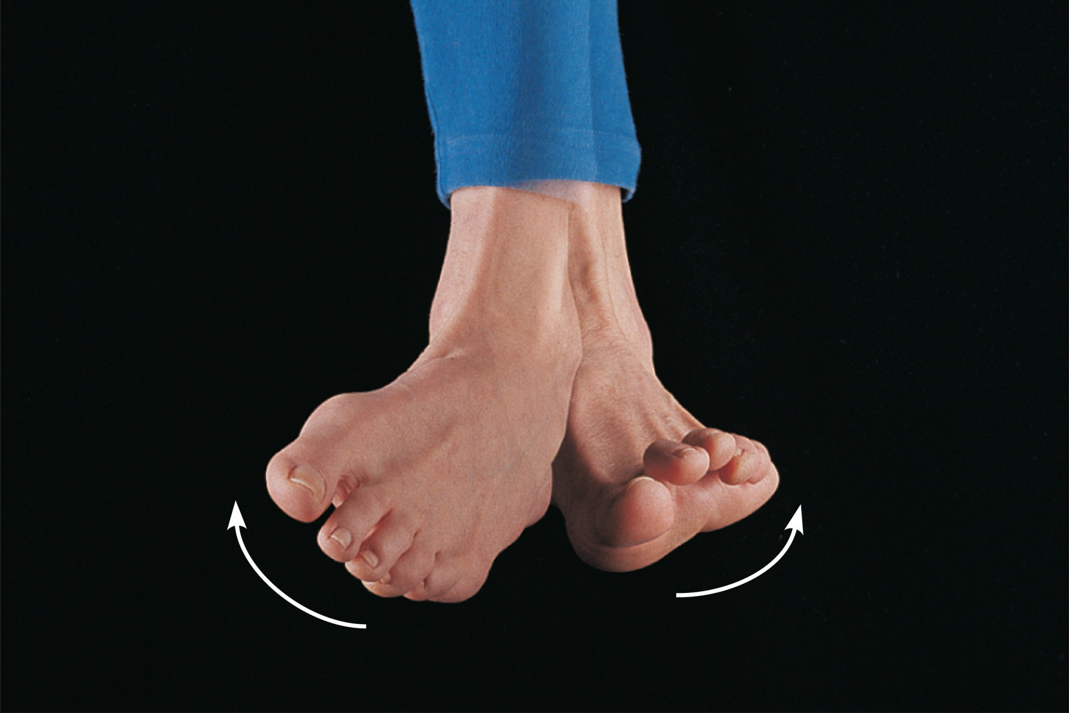
Inversion
Eversion
(c) Inversion and eversion
Figure 8.6c

Slide 19
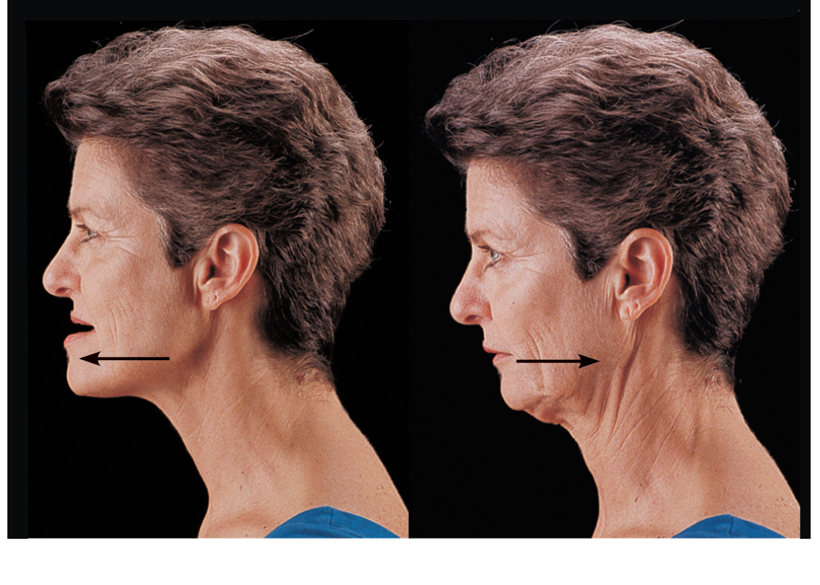
Protraction
of mandible
Retraction
of mandible
(d) Protraction and retraction
Figure 8.6d

Slide 20
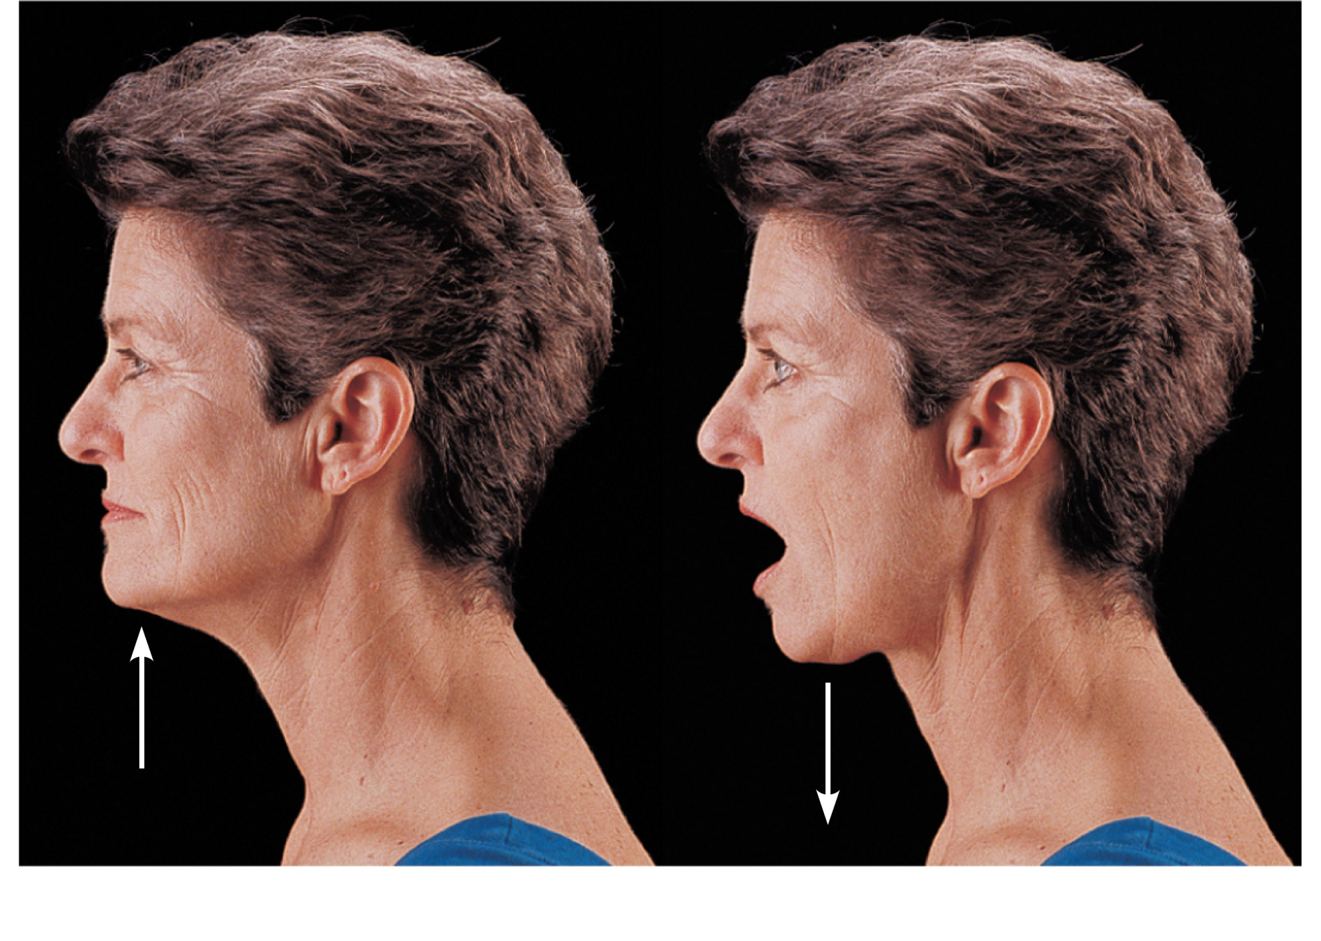
Elevation
of mandible
Depression
of mandible
(e) Elevation and depression
Figure 8.6e

Slide 21
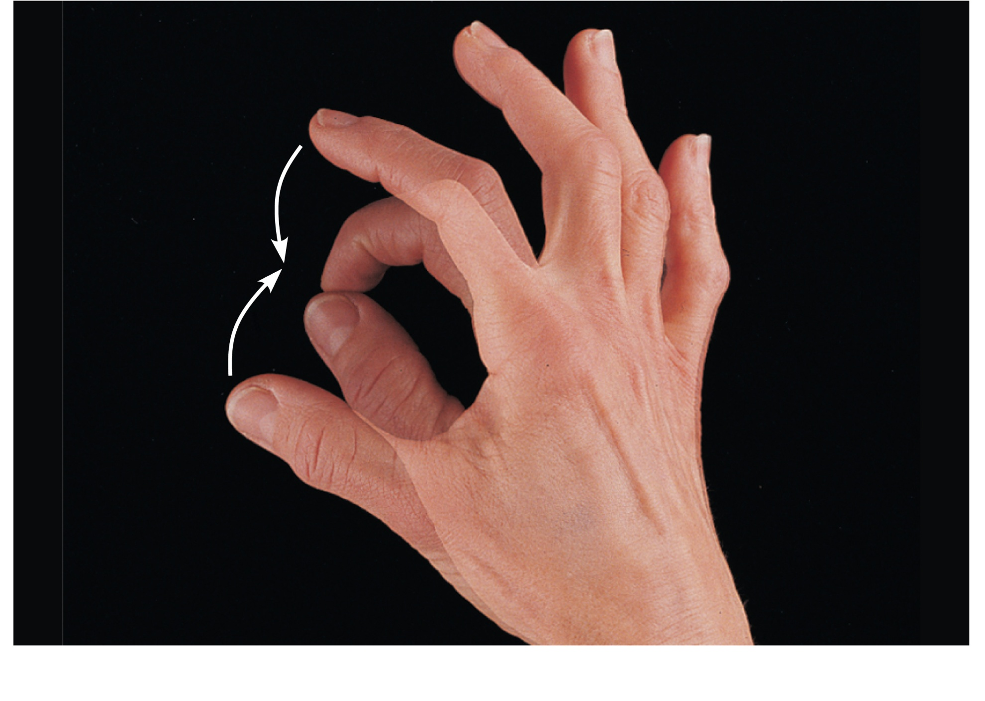
Opposition
(f) Opposition
Figure 8.6f

Slide 22
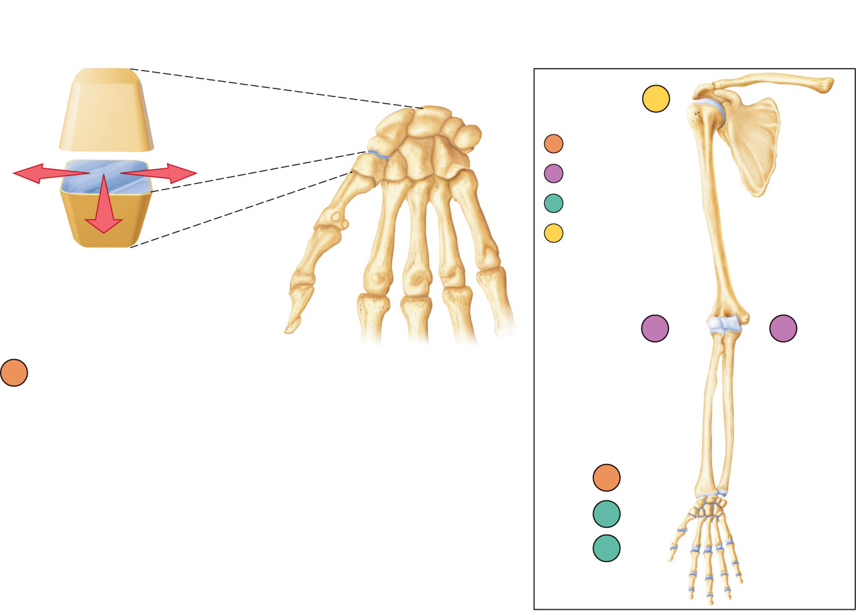
f
Nonaxial
Uniaxial
Biaxial
Multiaxial
c
b
a
Plane joint (intercarpal joint)
a
e
d
Figure 8.7a

Slide 23
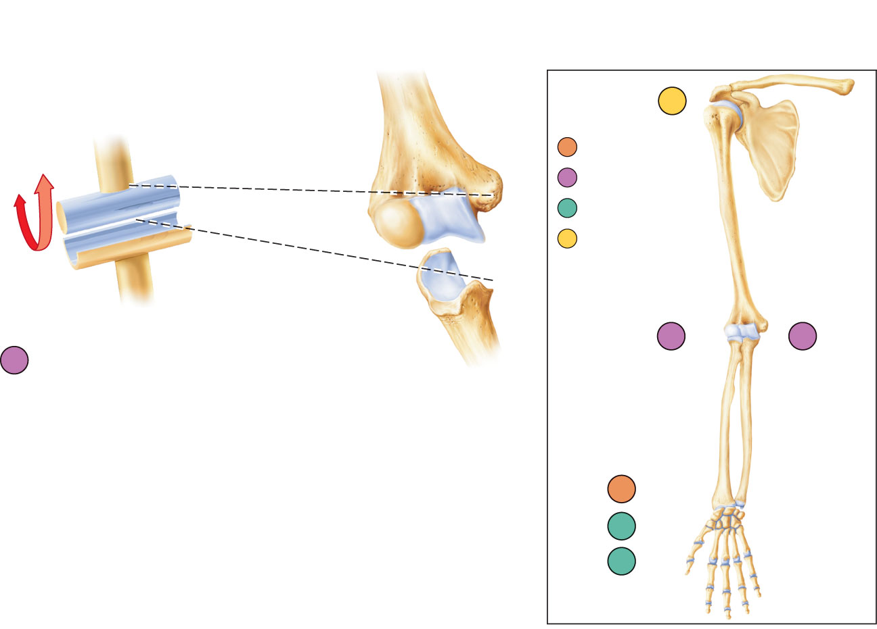
f
Nonaxial
Uniaxial
Biaxial
Multiaxial
c
b
b
Hinge joint (elbow joint)
a
e
d
Figure 8.7b

Slide 24
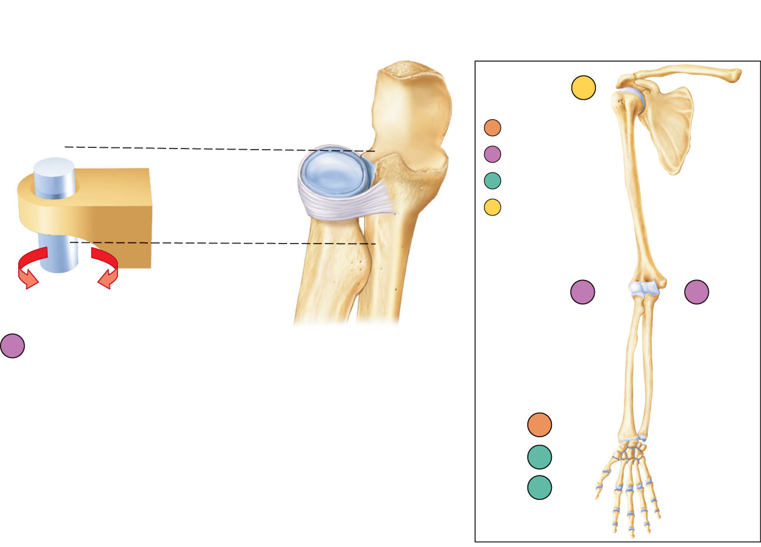
f
Nonaxial
Uniaxial
Biaxial
Multiaxial
c
b
c
Pivot joint (proximal radioulnar joint)
a
e
d
Figure 8.7c

Slide 25
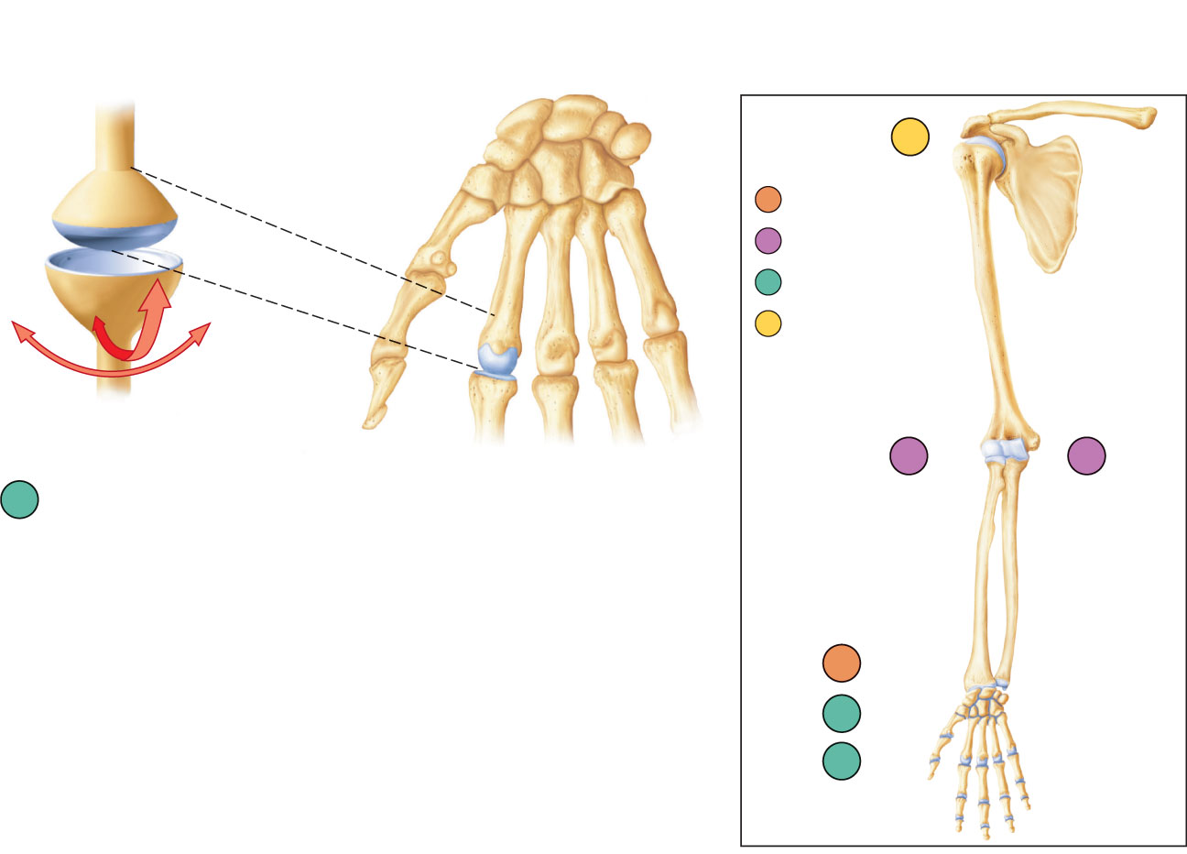
f
Nonaxial
Uniaxial
Biaxial
Multiaxial
c
b
d
Condyloid joint
(metacarpophalangeal joint)
a
e
d
Figure 8.7d

Slide 26
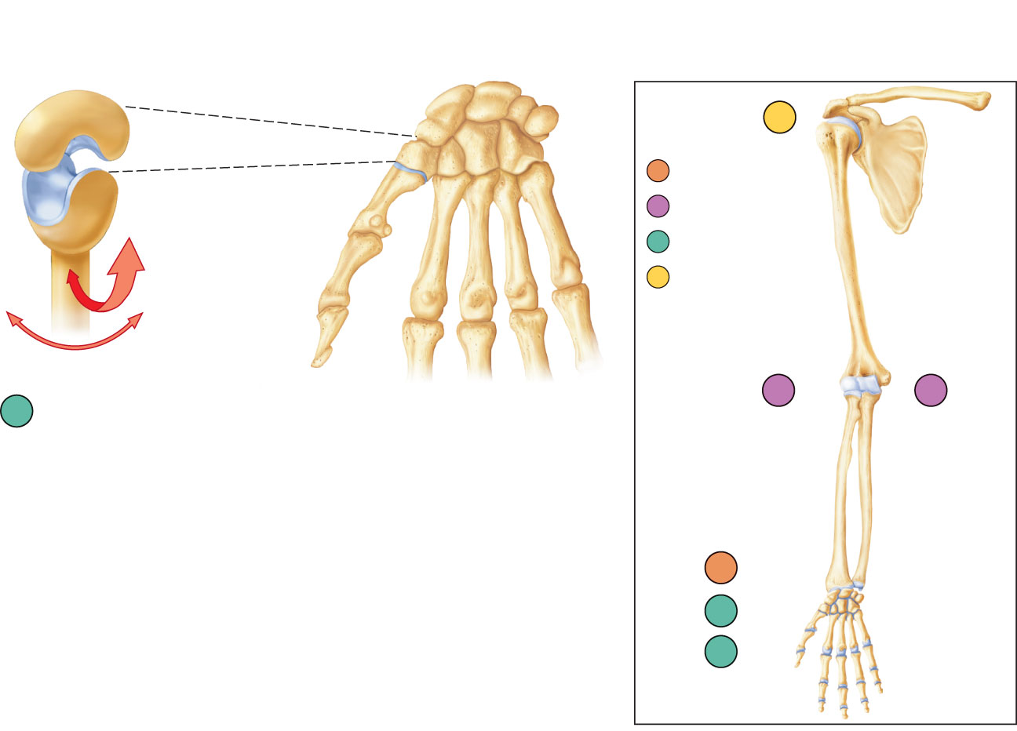
f
Nonaxial
Uniaxial
Biaxial
Multiaxial
c
b
e
Saddle joint (carpometacarpal joint
of thumb)
a
e
d
Figure 8.7e

Slide 27
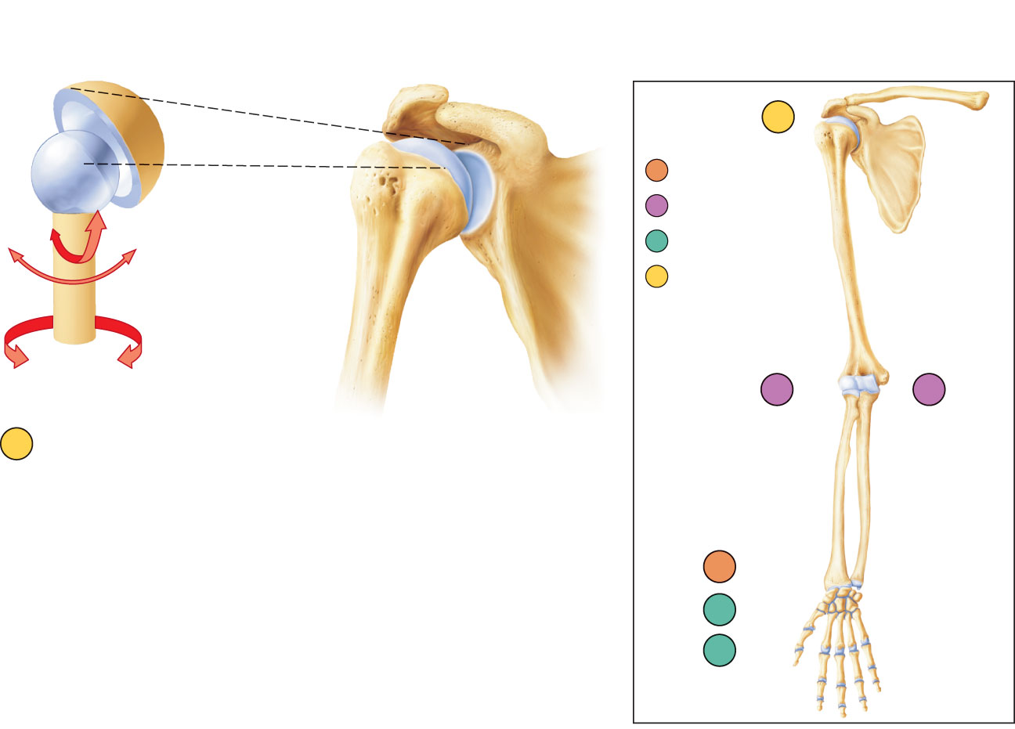
f
Nonaxial
Uniaxial
Biaxial
Multiaxial
c
b
f
Ball-and-socket joint (shoulder joint)
a
e
d
Figure 8.7f

Slide 28
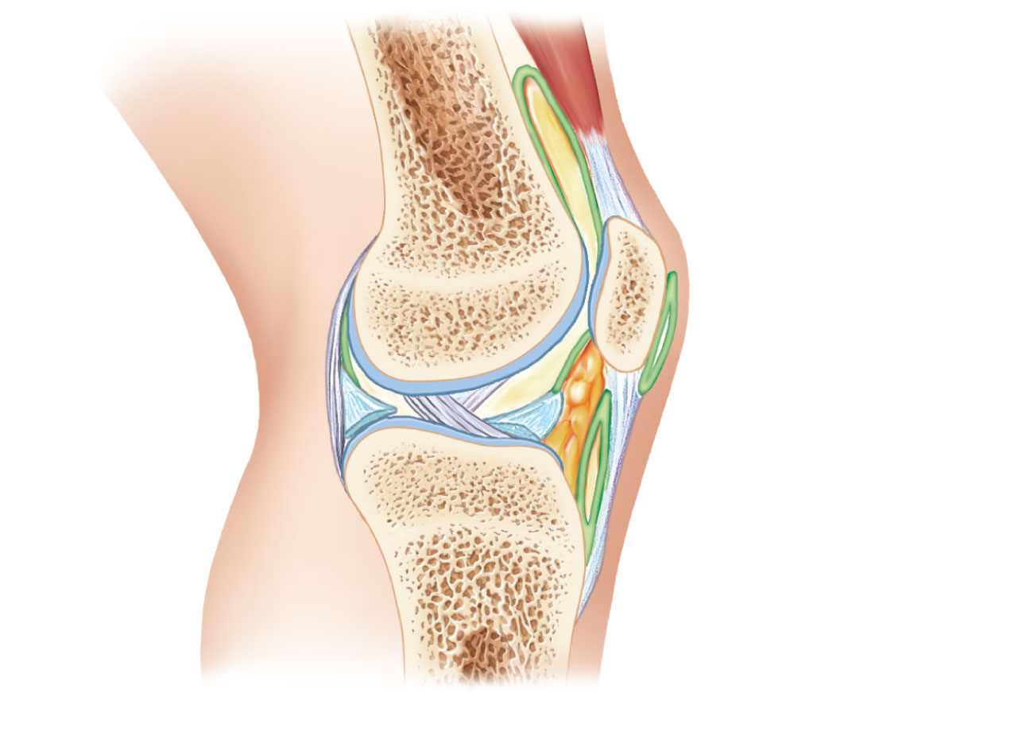
Tendon of
quadriceps
femoris
Femur
Articular
capsule
Suprapatellar
bursa
Patella
Posterior
cruciate
ligament
Subcutaneous
prepatellar bursa
Synovial cavity
Lateral
meniscus
Lateral meniscus
Infrapatellar
fat pad
Anterior
cruciate
ligament
Deep infrapatellar
bursa
Tibia
Patellar ligament
(a) Sagittal section through the right knee joint
Figure 8.8a

Slide 29
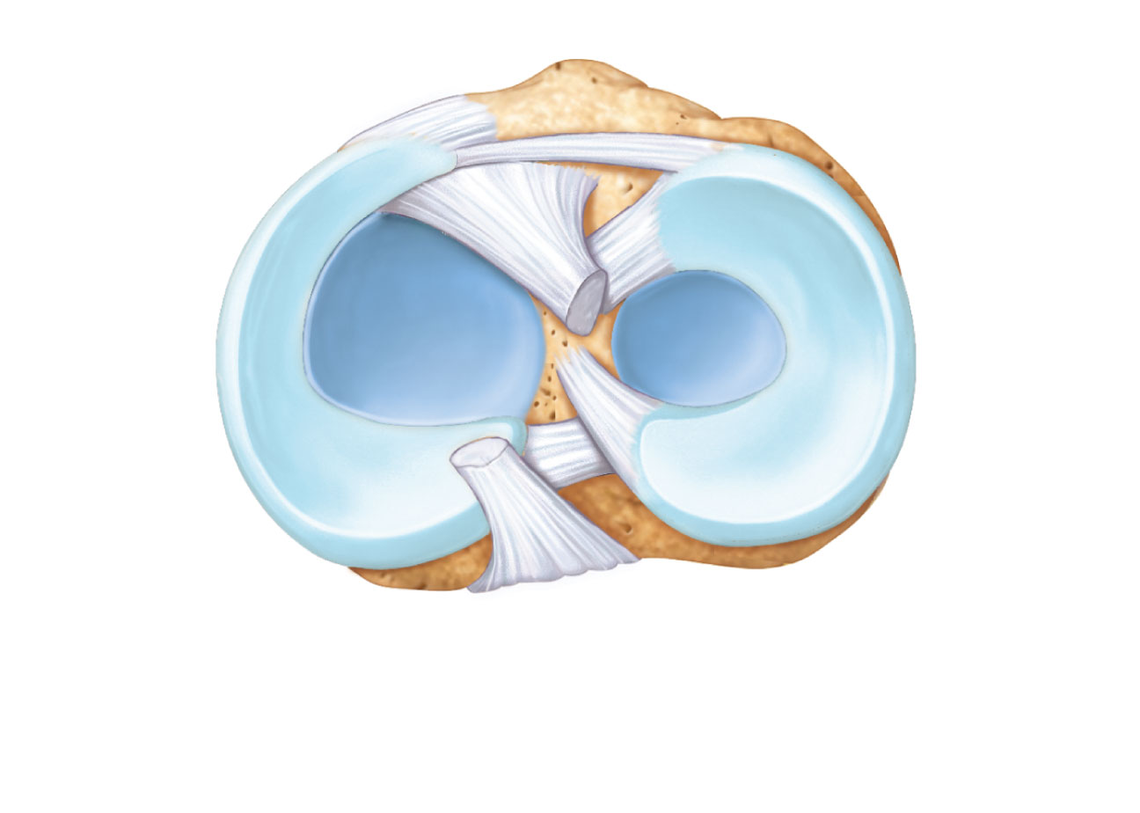
Anterior
Anterior
cruciate
ligament
Articular
cartilage on
lateral tibial
condyle
Articular
cartilage
on medial
tibial
condyle
Medial
meniscus
Lateral
meniscus
Posterior
cruciate
ligament
(b) Superior view of the right tibia in the knee joint, showing
the menisci and cruciate ligaments
Figure 8.8b

Slide 30
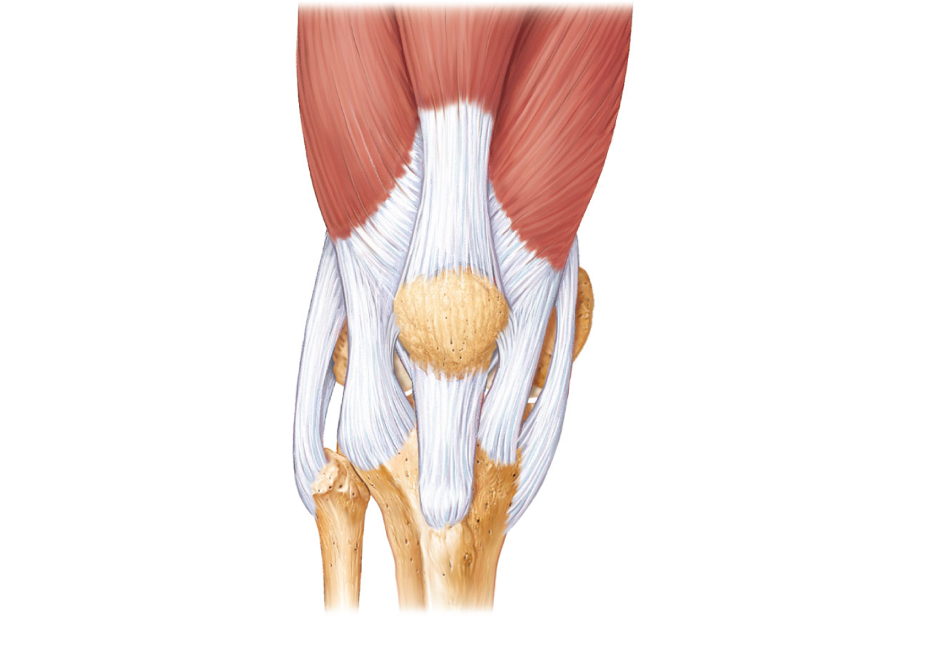
Quadriceps
femoris muscle
Tendon of
quadriceps
femoris muscle
Patella
Medial patellar
retinaculum
Lateral patellar
retinaculum
Tibial collateral
ligament
Fibular
collateral
ligament
Patellar ligament
Fibula
Tibia
(c) Anterior view of right knee
Figure 8.8c

Slide 31
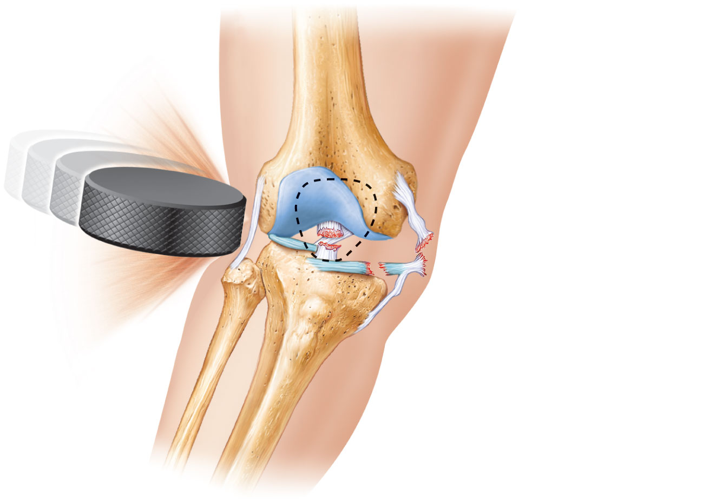
Lateral
Medial
Patella
(outline)
Hockey puck
Tibial collateral
ligament
(torn)
Medial
meniscus (torn)
Anterior
cruciate
ligament (torn)
Figure 8.9

Slide 32
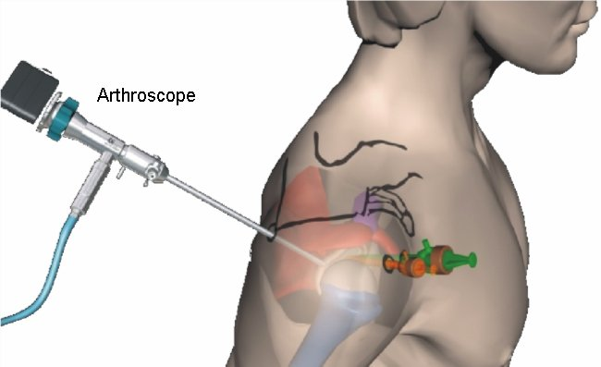
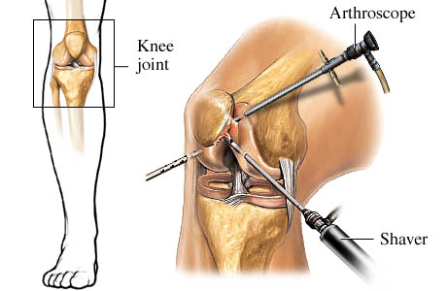

Slide 33
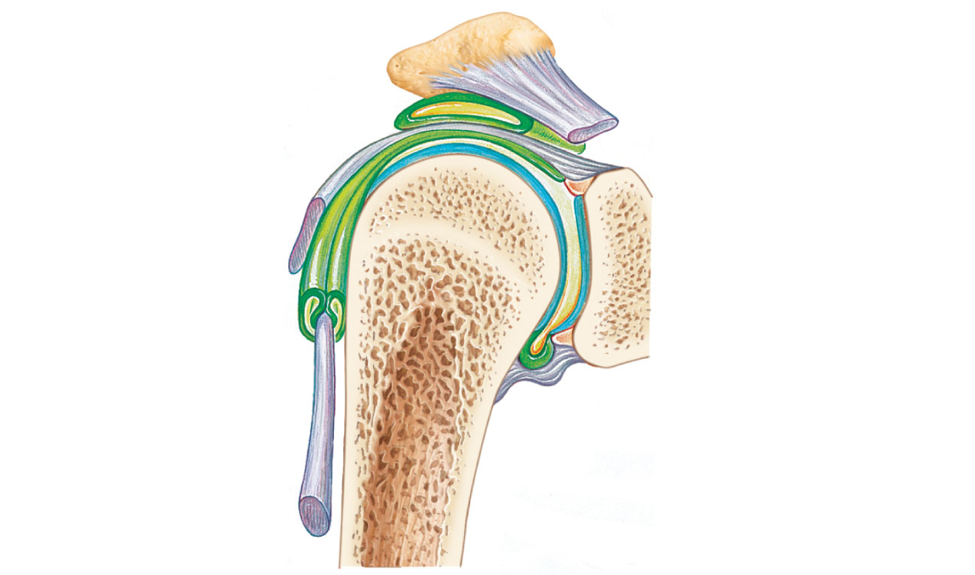
Acromion
of scapula
Coracoacromial
ligament
Synovial cavity
of the glenoid
cavity containing
synovial fluid
Subacromial
bursa
Fibrous
articular capsule
Hyaline
cartilage
Tendon
sheath
Synovial membrane
Fibrous capsule
Tendon of
long head
of biceps
brachii muscle
Humerus
(a) Frontal section through right shoulder joint
PLAY
Animation: Rotatable shoulder
Figure 8.10a

Slide 34
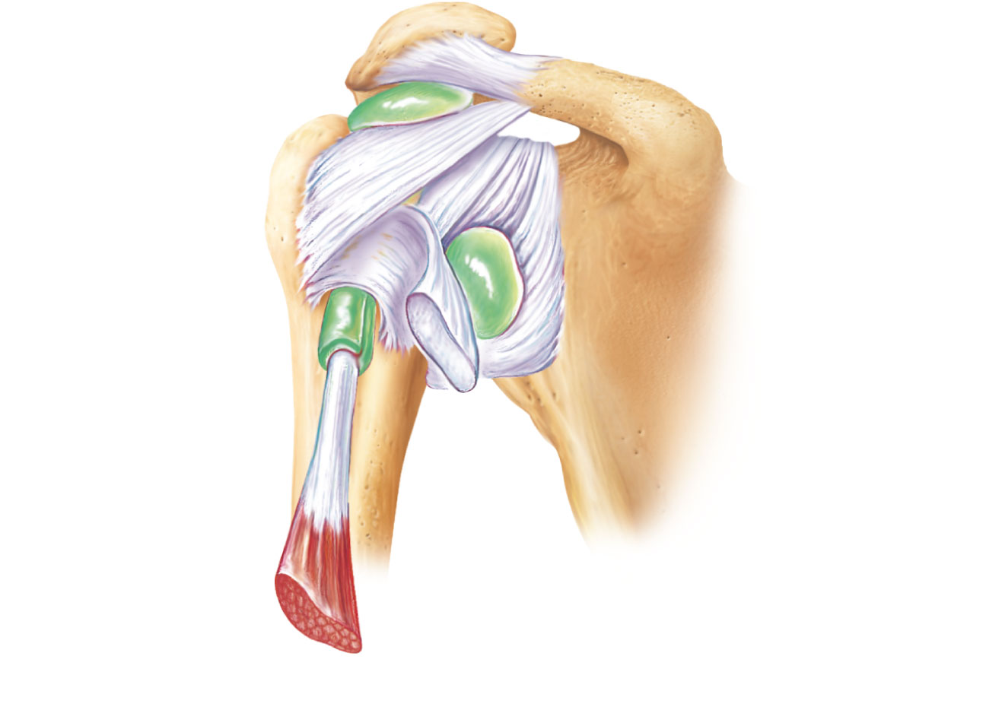
Acromion
Coracoid
process
Coracoacromial
ligament
Articular
capsule
reinforced by
glenohumeral
ligaments
Subacromial
bursa
Coracohumeral
ligament
Greater
tubercle
of humerus
Subscapular
bursa
Tendon of the
subscapularis
muscle
Transverse
humeral
ligament
Scapula
Tendon sheath
Tendon of long
head of biceps
brachii muscle
(c) Anterior view of right shoulder joint capsule
Figure 8.10c

Slide 35
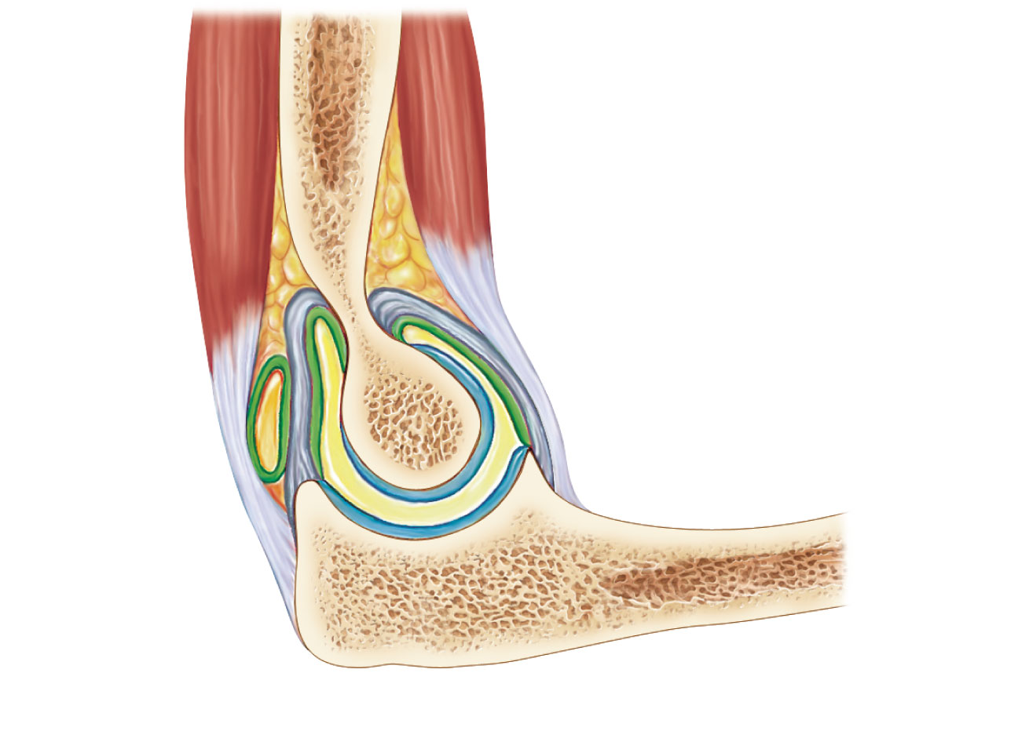
Articular
capsule
Synovial
membrane
Humerus
Synovial cavity
Articular cartilage
Fat pad
Coronoid process
Tendon of
triceps
muscle
Tendon of
brachialis muscle
Ulna
Bursa
Trochlea
Articular cartilage
of the trochlear
notch
(a) Median sagittal section through right elbow (lateral view)
Figure 8.11a

Slide 36
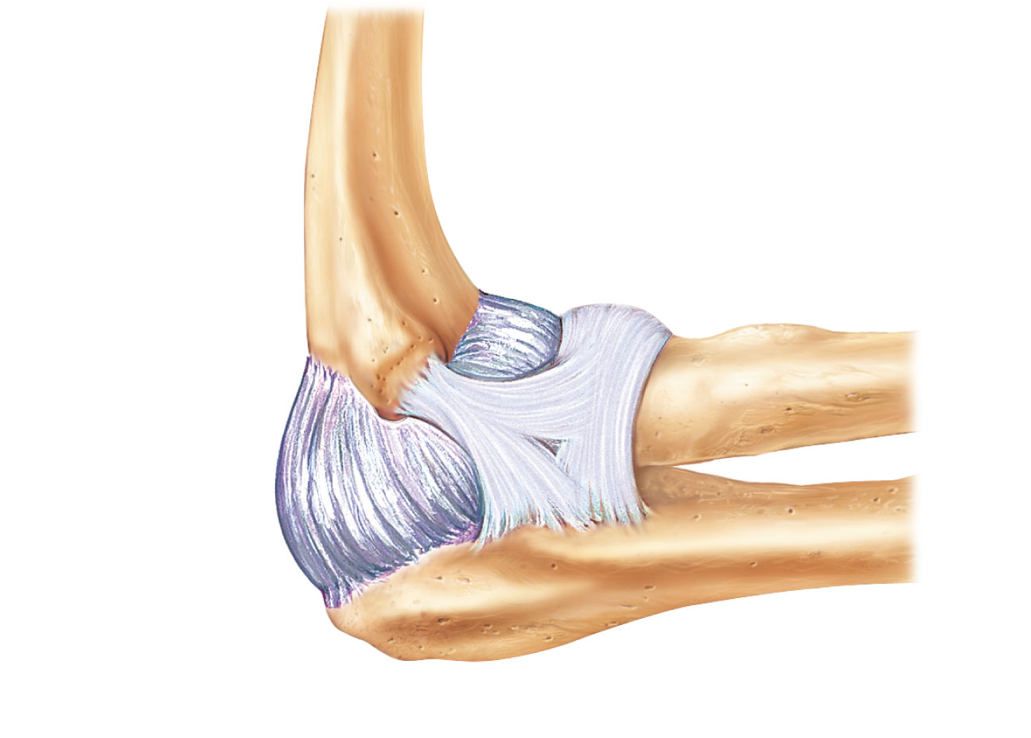
Humerus
Anular
ligament
Radius
Lateral
epicondyle
Articular
capsule
Radial
collateral
ligament
Olecranon
process
Ulna
(b) Lateral view of right elbow joint
Figure 8.11b

Slide 37
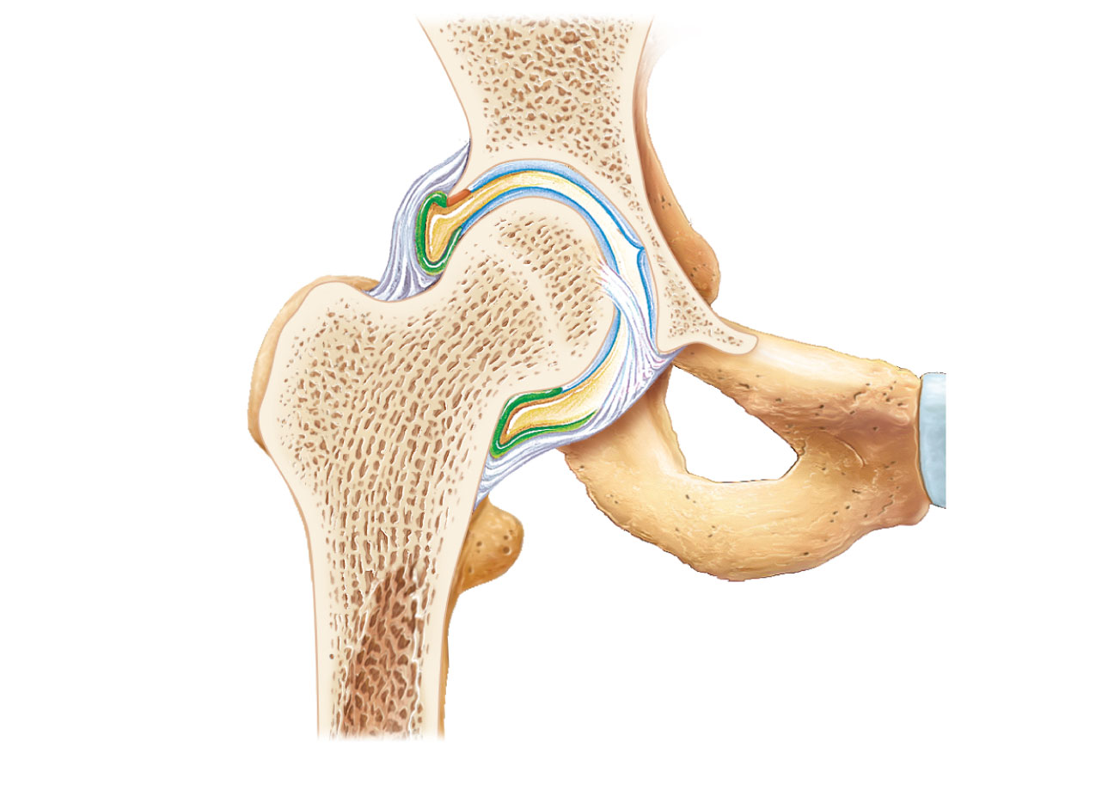
Coxal (hip) bone
Articular cartilage
Ligament of
the head of
the femur
(ligamentum
teres)
Acetabular
labrum
Femur
Synovial cavity
Articular capsule
(a) Frontal section through the right hip joint
Figure 8.12a

Slide 38
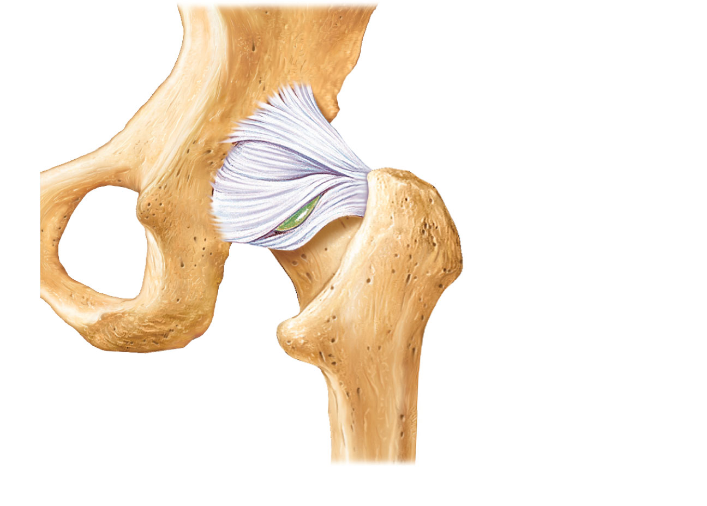
Iliofemoral
ligament
Ischium
Ischiofemoral
ligament
Greater
trochanter
of femur
(c) Posterior view of right hip joint, capsule in place
PLAY
Animation: Rotatable hip
Figure 8.12c

Slide 39
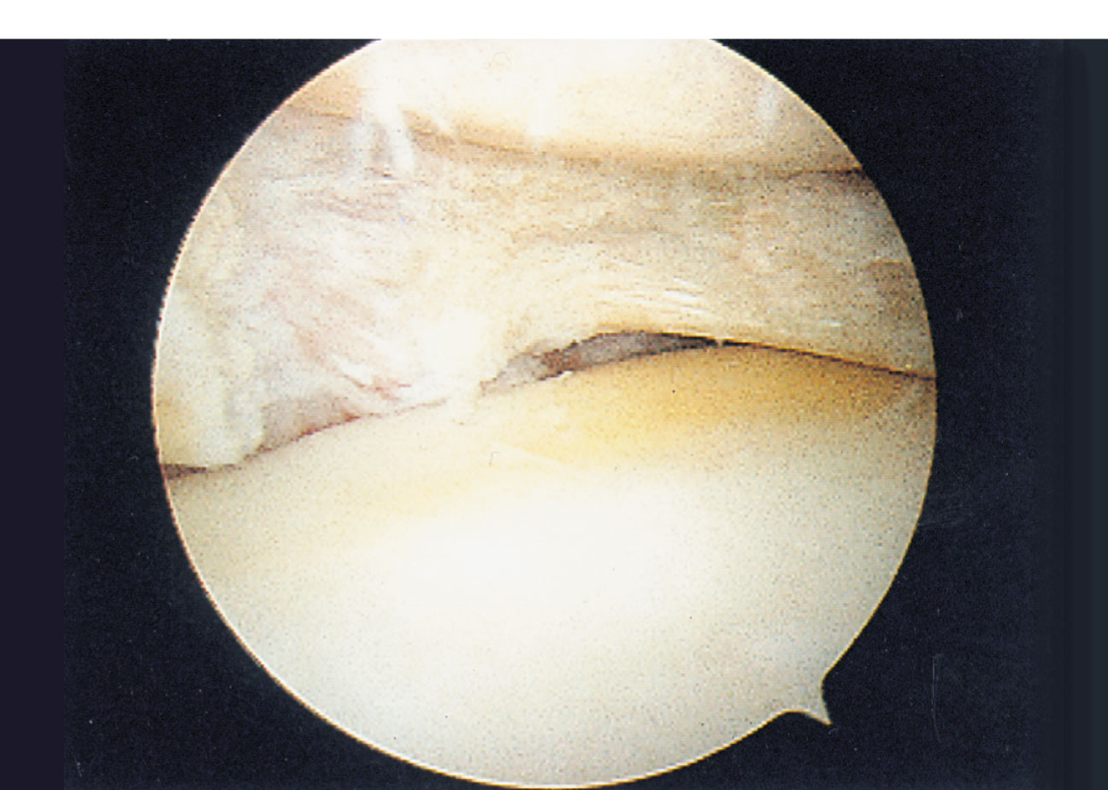
Torn
meniscus
Figure 8.14

