Slide 1
Microscopic Identification Lab
Clark, M.D.

Slide 2
IMPORTANT
When doing a lab test, always look exactly where the arrow is pointing to for identification.
The entire picture (micrograph) does not have all the same tissue. Look at the pointer!!!

Slide 3
Mitosis Identification
Interphase
Prophase
Metaphase
Anaphase
Telophase
Cytokinesis

Slide 4
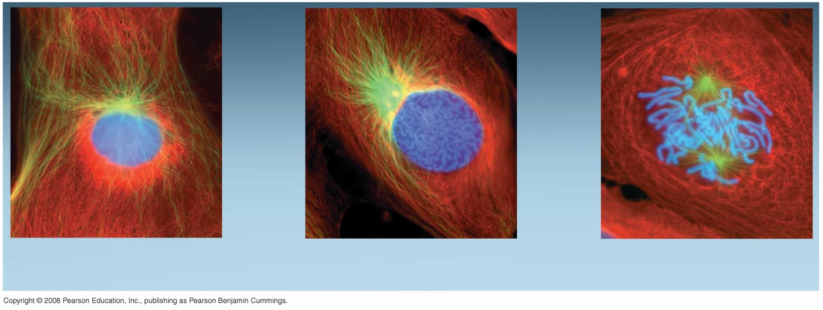
In Interphase cannot
see the genetic material using the light microscope.
During early prophase the
genetic material starts coiling
Into the light microscope visible
form (chromatid/chromosome)
G₂ of Interphase
Early Prophase
Late Prophase
During late prophase the genetic
material is coiled into the worm looking light microscope visible chromatid/chromosomes.
Notes:
Figure 12.6 The mitotic division of an animal cell

Slide 5
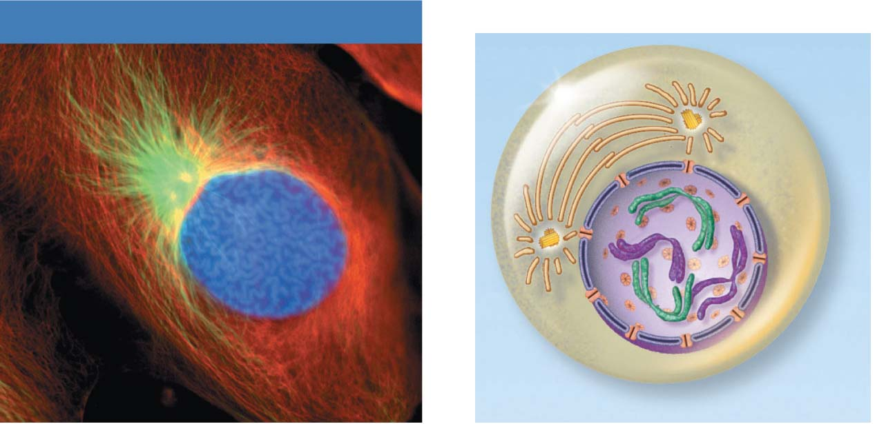
Mitotic Apparatus forming
Early mitotic
spindle
Early Prophase
Aster
Chromosome
consisting of two
sister chromatids
Centromere
Early Prophase
Figure 3.33

Slide 6
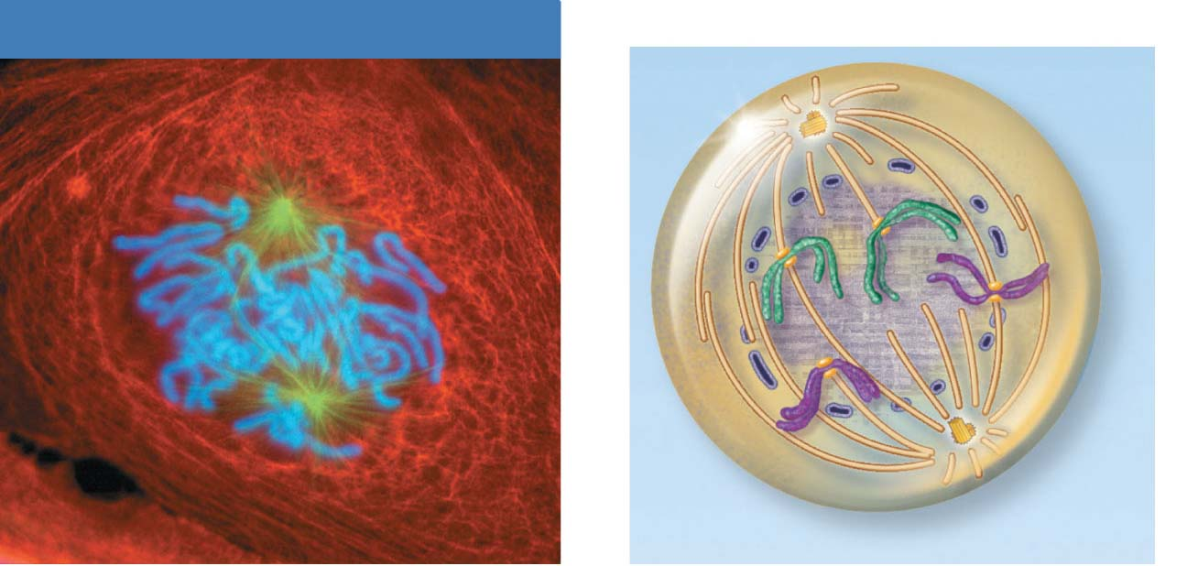
Nuclear membrane has dissolved – see only fragments. Once
the nuclear membrane dissolves the entire cell becomes the
nucleus.
Polar microtubule
Late Prophase
Spindle pole
Fragments
of nuclear
envelope
Kinetochore
Kinetochore
microtubule
Late Prophase
Figure 3.33

Slide 7
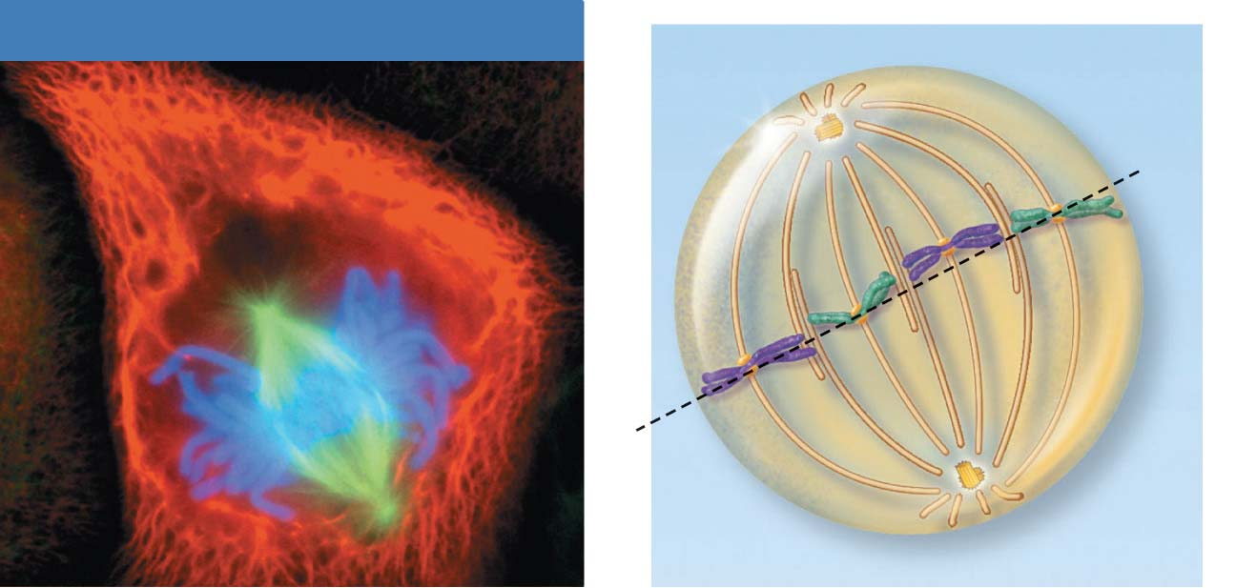
Metaphase
Spindle
Metaphase
plate
Metaphase
Figure 3.33

Slide 8
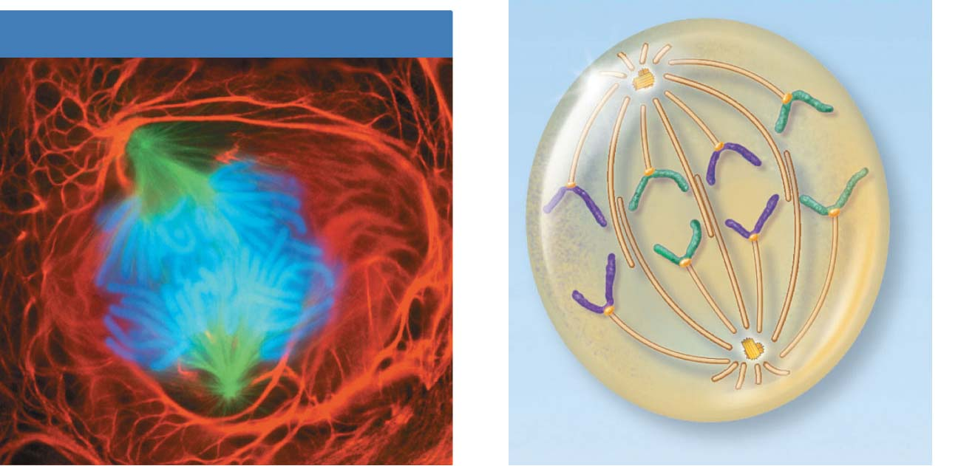
Polar (non-kinetochore) fibers are elongating the cell.
Anaphase
Daughter
chromosomes
Anaphase
Kinetochore fibers are pulling the recently
split chromosomes towards their respective
poles.
Figure 3.33

Slide 9
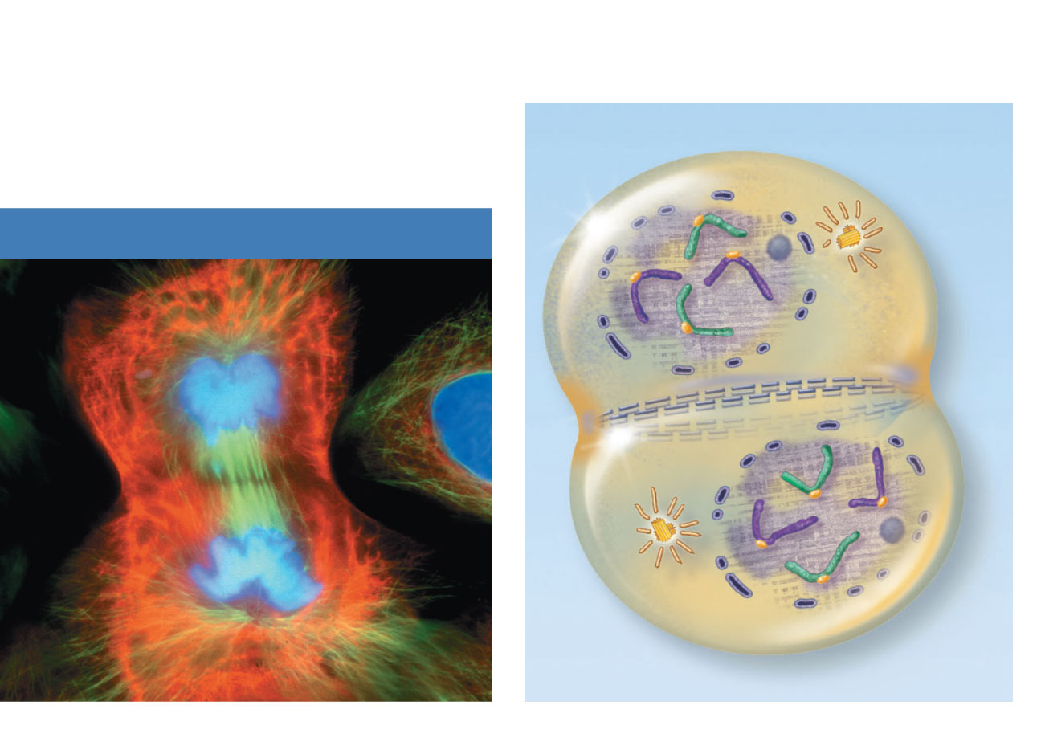
Nuclear
envelope
forming
Nucleolus
forming
Contractile
ring at
cleavage
furrow
Telophase and Cytokinesis
Telophase
Figure 3.33

Slide 10
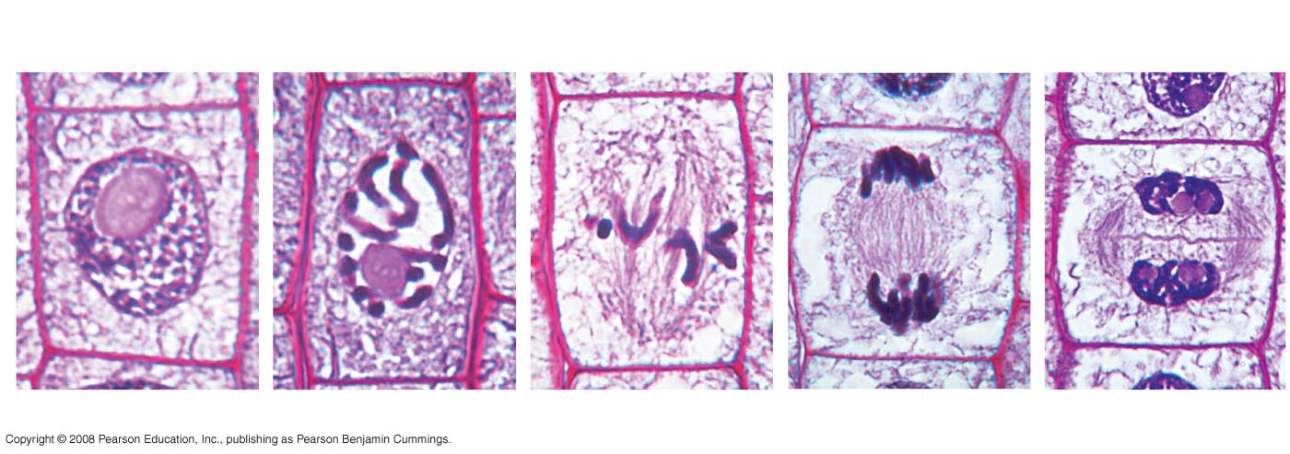
Fig. 12-10
Nucleus
Chromatin
condensing
10 µm
Nucleolus
Chromosomes
Cell plate
1
Prophase
2
Late Prophase
3
Metaphase
4
Anaphase
5
Telophase
Notes:
Figure 12.10 Mitosis in a plant cell

Slide 11
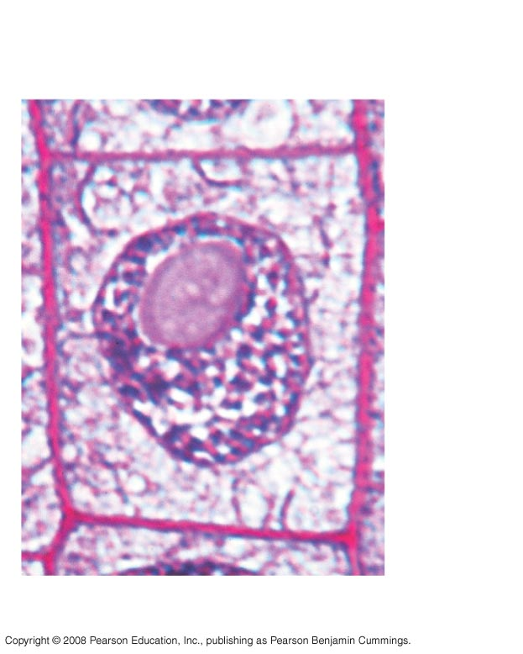
Fig. 12-10a
Nucleus
Chromatin
condensing
Nucleolus
1
Prophase
Notes:
Figure 12.10 Mitosis in a plant cell

Slide 12
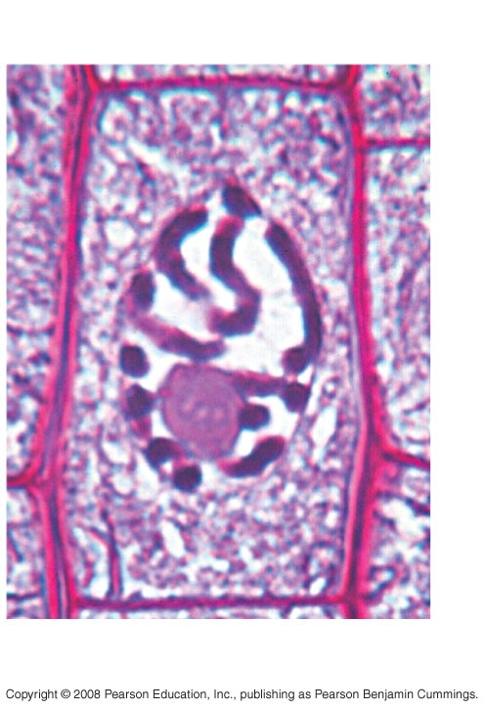
Fig. 12-10b
Chromosomes
2
Late Prophase
Notes:
Figure 12.10 Mitosis in a plant cell

Slide 13
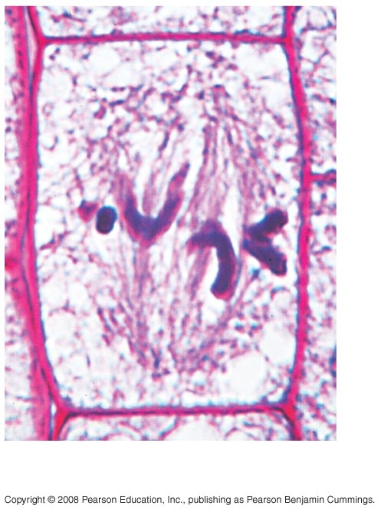
Fig. 12-10c
3
Metaphase
Notes:
Figure 12.10 Mitosis in a plant cell

Slide 14
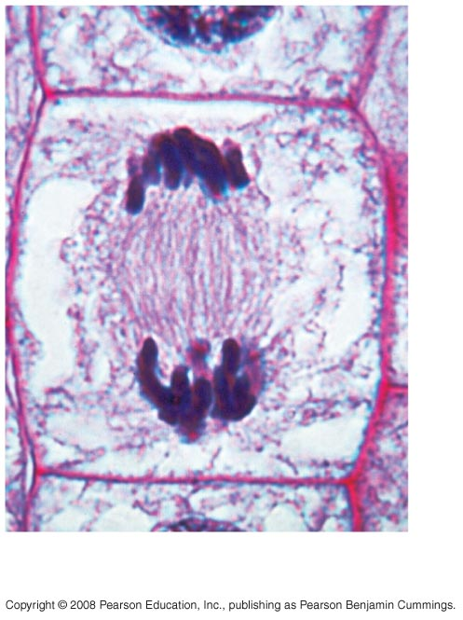
Fig. 12-10d
4
Anaphase
Notes:
Figure 12.10 Mitosis in a plant cell

Slide 15
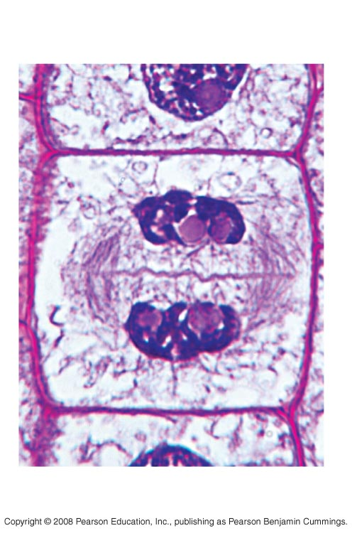
Fig. 12-10e
10 µm
Cell plate
5
Telophase
Notes:
Figure 12.10 Mitosis in a plant cell

Slide 16
Tissues (Histology)
Epithelia
Simple Squamous
Simple Cuboidal
Simple Columnar
Pseudostratified Columnar
Transitional

Slide 17
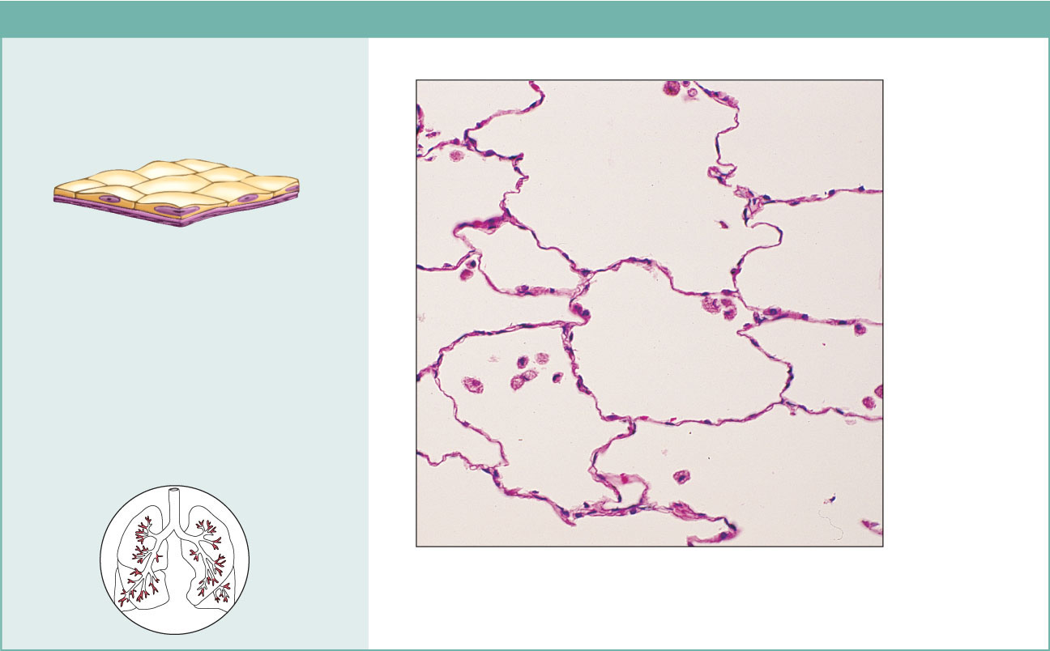
Simple Squamous Epithelium
(a) Simple squamous epithelium
Description: Single layer of flattened
cells with disc-shaped central nuclei
and sparse cytoplasm; the simplest
of the epithelia.
Air sacs of
lung tissue
Function: Allows passage of
materials by diffusion and filtration
in sites where protection is not
important; secretes lubricating
substances in serosae.
Nuclei of
squamous
epithelial
cells
Location: Kidney glomeruli; air sacs
of lungs; lining of heart, blood
vessels, and lymphatic vessels; lining
of ventral body cavity (serosae).
Photomicrograph: Simple squamous epithelium
forming part of the alveolar (air sac) walls (125x).
Figure 4.3a

Slide 18
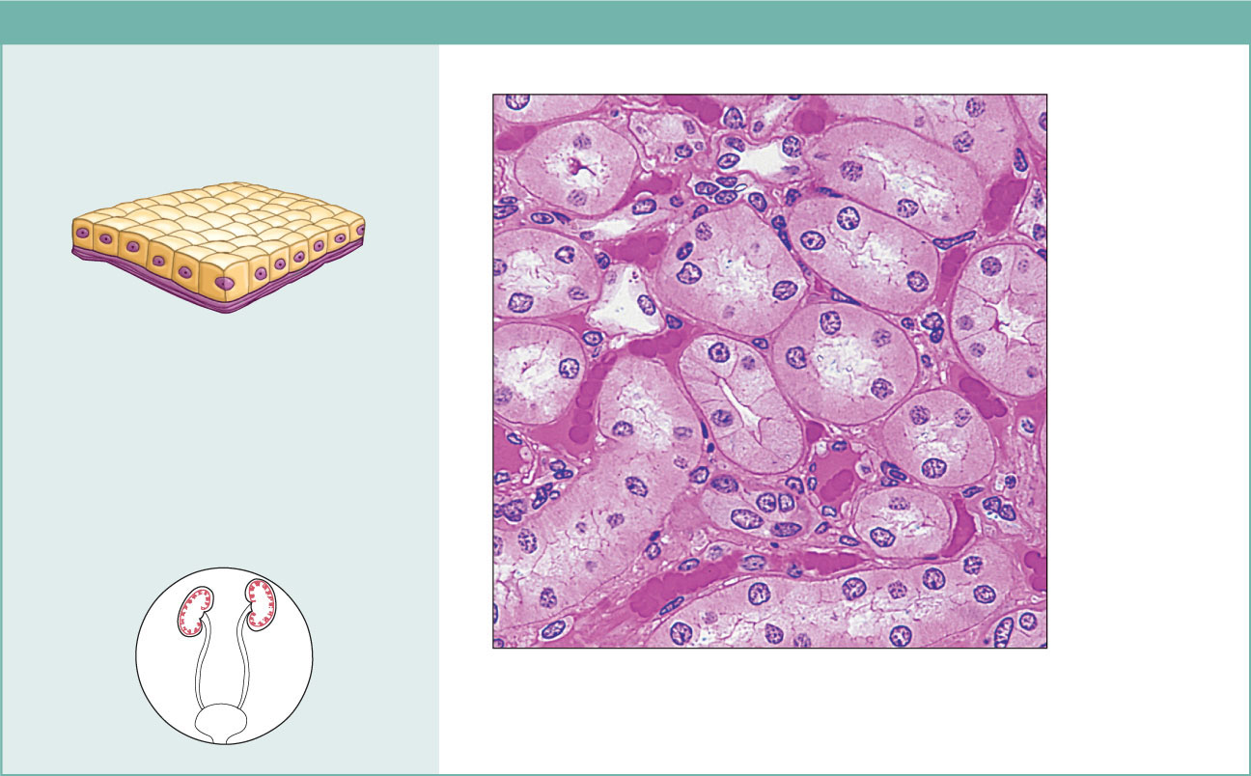
Simple Cuboidal
(b) Simple cuboidal epithelium
Description: Single layer of
cubelike cells with large,
spherical central nuclei.
Simple
cuboidal
epithelial
cells
Function: Secretion and
absorption.
Basement
membrane
Location: Kidney tubules;
ducts and secretory portions
of small glands; ovary surface.
Connective
tissue
Photomicrograph: Simple cuboidal
epithelium in kidney tubules (430x).
Figure 4.3b

Slide 19
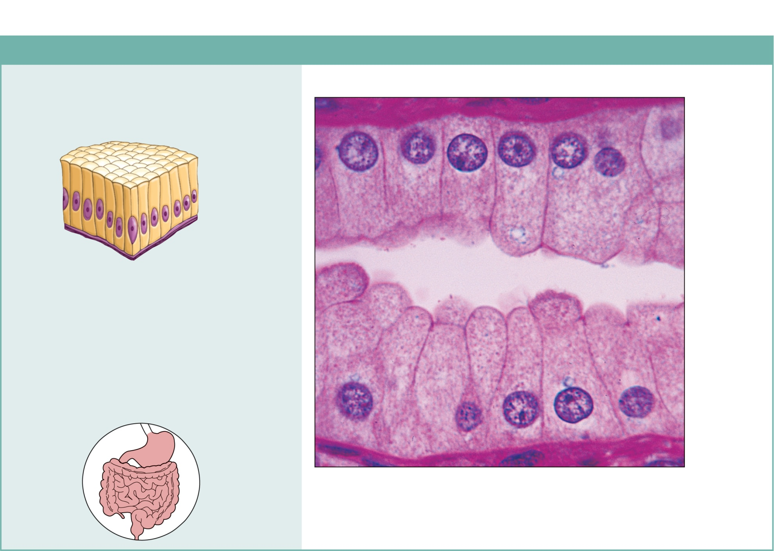
Simple Columnar
(c) Simple columnar epithelium
Description: Single layer of tall cells
with round to oval nuclei; some cells
bear cilia; layer may contain mucus-
secreting unicellular glands (goblet cells).
Simple
columnar
epithelial
cell
Function: Absorption; secretion of
mucus, enzymes, and other substances;
ciliated type propels mucus (or
reproductive cells) by ciliary action.
Location: Nonciliated type lines most of
the digestive tract (stomach to anal canal),
gallbladder, and excretory ducts of some
glands; ciliated variety lines small
bronchi, uterine tubes, and some regions
of the uterus.
Basement
membrane
Photomicrograph: Simple columnar epithelium
of the stomach mucosa (860X).
Figure 4.3c

Slide 20
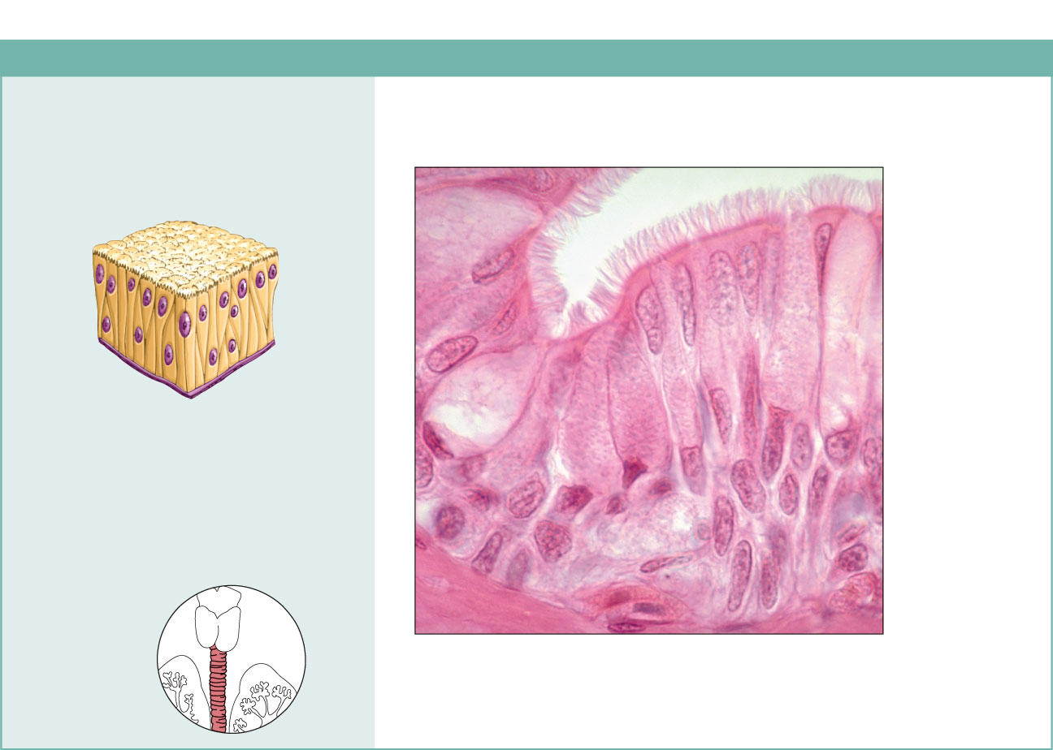
Pseudostratified Columnar
(d) Pseudostratified columnar epithelium
Description: Single layer of cells of
differing heights, some not reaching
the free surface; nuclei seen at
different levels; may contain mucus-
secreting cells and bear cilia.
Cilia
Mucus of
mucous cell
Pseudo-
stratified
epithelial
layer
Function: Secretion, particularly of
mucus; propulsion of mucus by
ciliary action.
Location: Nonciliated type in male’s
sperm-carrying ducts and ducts of
large glands; ciliated variety lines
the trachea, most of the upper
respiratory tract.
Basement
membrane
Trachea
Photomicrograph: Pseudostratified ciliated
columnar epithelium lining the human trachea (570x).
Figure 4.3d

Slide 21
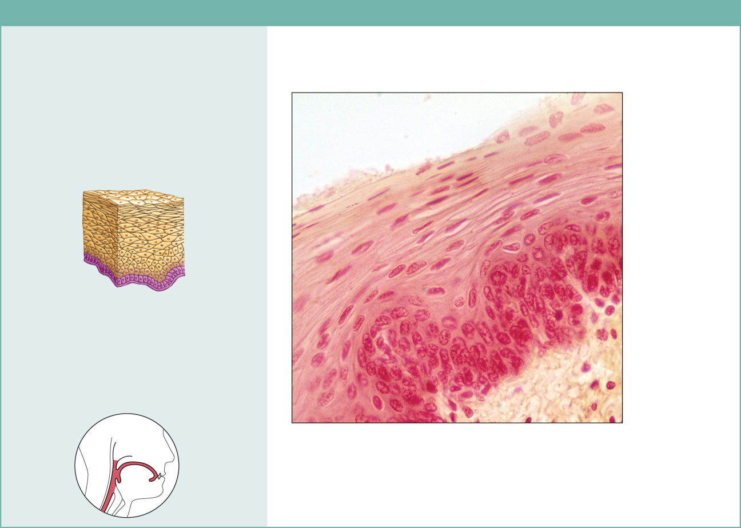
Stratified Squamous
(e) Stratified squamous epithelium
Description: Thick membrane
composed of several cell layers;
basal cells are cuboidal or columnar
and metabolically active; surface
cells are flattened (squamous); in the
keratinized type, the surface cells are
full of keratin and dead; basal cells
are active in mitosis and produce the
cells of the more superficial layers.
Stratified
squamous
epithelium
Function: Protects underlying
tissues in areas subjected to abrasion.
Nuclei
Location: Nonkeratinized type forms
the moist linings of the esophagus,
mouth, and vagina; keratinized variety
forms the epidermis of the skin, a dry
membrane.
Basement
membrane
Connective
tissue
Photomicrograph: Stratified squamous epithelium
lining the esophagus (285x).
Figure 4.3e

Slide 22
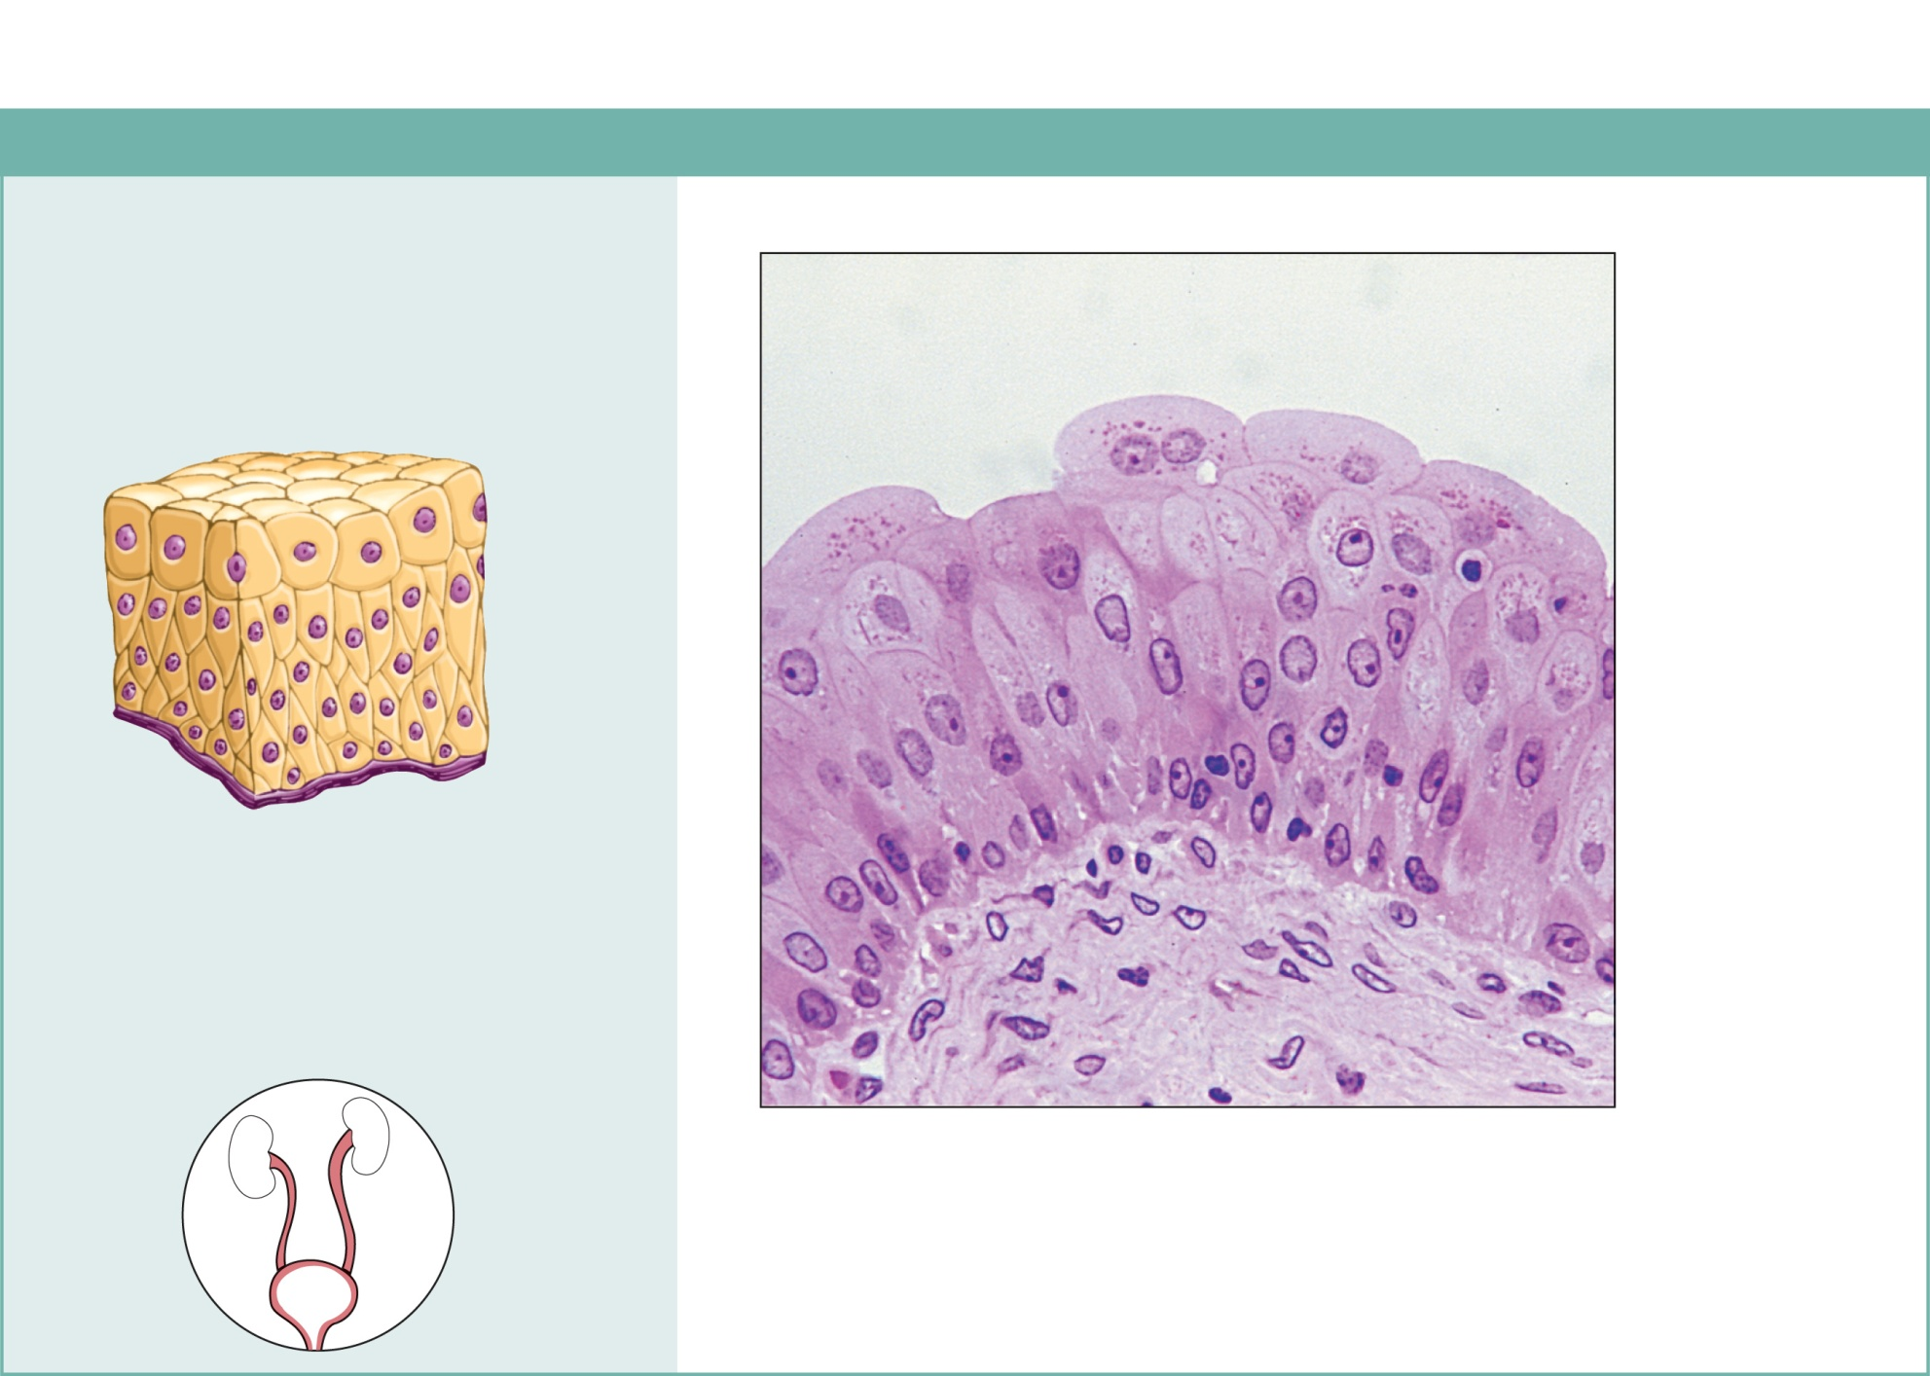
Transitional
(f) Transitional epithelium
Description: Resembles both
stratified squamous and stratified
cuboidal; basal cells cuboidal or
columnar; surface cells dome
shaped or squamouslike, depending
on degree of organ stretch.
Transitional
epithelium
Function: Stretches readily and
permits distension of urinary organ
by contained urine.
Location: Lines the ureters, urinary
bladder, and part of the urethra.
Basement
membrane
Connective
tissue
Photomicrograph: Transitional epithelium lining the urinary
bladder, relaxed state (360X); note the bulbous, or rounded,
appearance of the cells at the surface; these cells flatten and
become elongated when the bladder is filled with urine.
Figure 4.3f

Slide 23
Connective Tissues
Loose Connective Tissue
Adipose Tissue
Reticular Loose Connective Tissue
Dense Regular
Dense Irregular
Elastic Connective Tissue
Hyalin Cartilage
Fibrocartilage
Elastic Cartilage

Slide 24
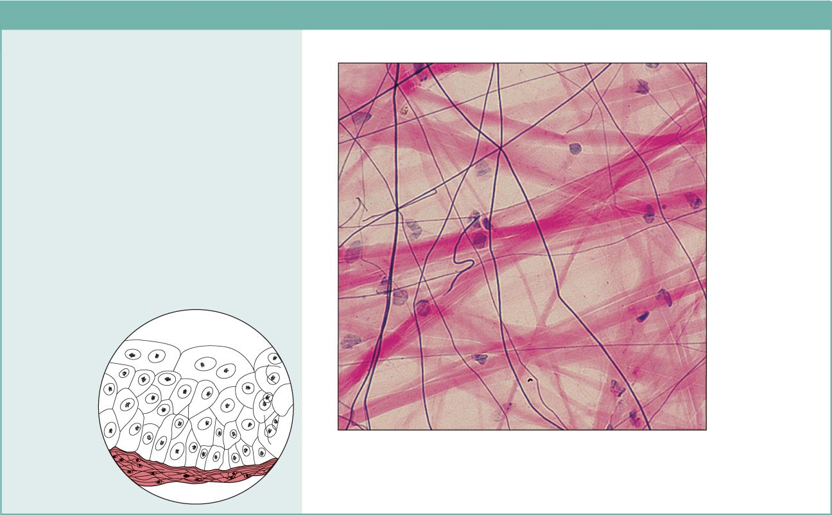
(a) Connective tissue proper: loose connective tissue, areolar
Description: Gel-like matrix with all
three fiber types; cells: fibroblasts,
macrophages, mast cells, and some
white blood cells.
Elastic
fibers
Function: Wraps and cushions
organs; its macrophages phagocytize
bacteria; plays important role in
inflammation; holds and conveys
tissue fluid.
Collagen
fibers
Location: Widely distributed under
epithelia of body, e.g., forms lamina
propria of mucous membranes;
packages organs; surrounds
capillaries.
Fibroblast
nuclei
Epithelium
Photomicrograph: Areolar connective tissue, a
soft packaging tissue of the body (300x).
Lamina
propria
Figure 4.8a

Slide 25
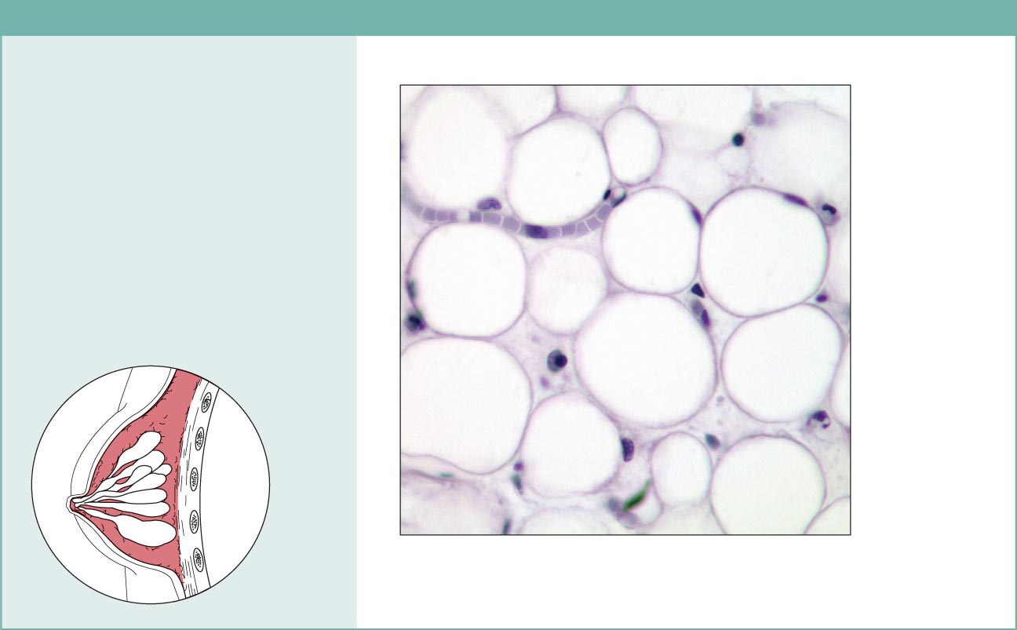
(b) Connective tissue proper: loose connective tissue, adipose
Description: Matrix as in areolar,
but very sparse; closely packed
adipocytes, or fat cells, have
nucleus pushed to the side by large
fat droplet.
Function: Provides reserve food
fuel; insulates against heat loss;
supports and protects organs.
Nucleus of
fat cell
Location: Under skin in the
hypodermis; around kidneys and
eyeballs; within abdomen; in breasts.
Adipose
tissue
Vacuole
containing
fat droplet
Photomicrograph: Adipose tissue from the
subcutaneous layer under the skin (350x).
Mammary
glands
Figure 4.8b

Slide 26
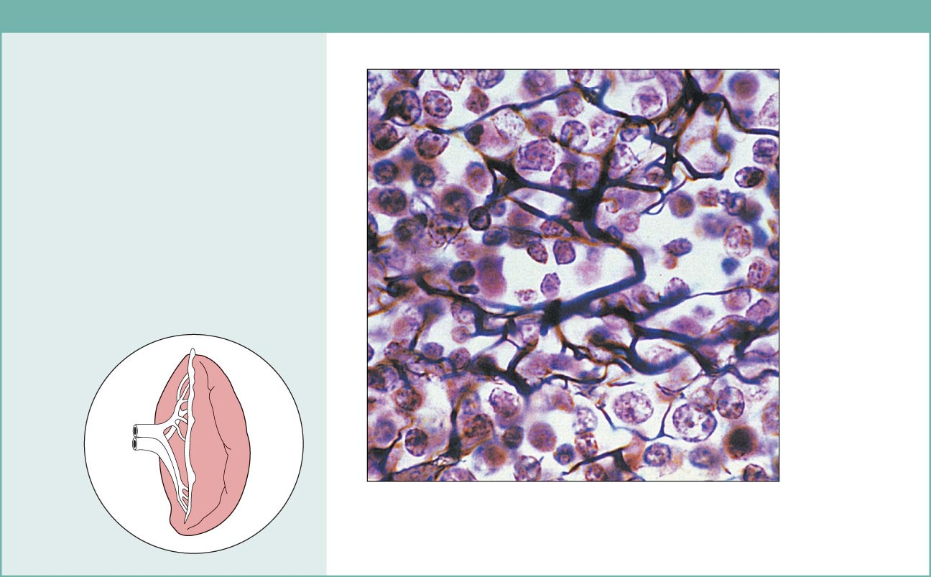
(c) Connective tissue proper: loose connective tissue, reticular
Description: Network of reticular
fibers in a typical loose ground
substance; reticular cells lie on the
network.
Function: Fibers form a soft internal
skeleton (stroma) that supports other
cell types including white blood cells,
mast cells, and macrophages.
White blood
cell
(lymphocyte)
Location: Lymphoid organs (lymph
nodes, bone marrow, and spleen).
Reticular
fibers
Spleen
Photomicrograph: Dark-staining network of reticular
connective tissue fibers forming the internal skeleton
of the spleen (350x).
Figure 4.8c

Slide 27
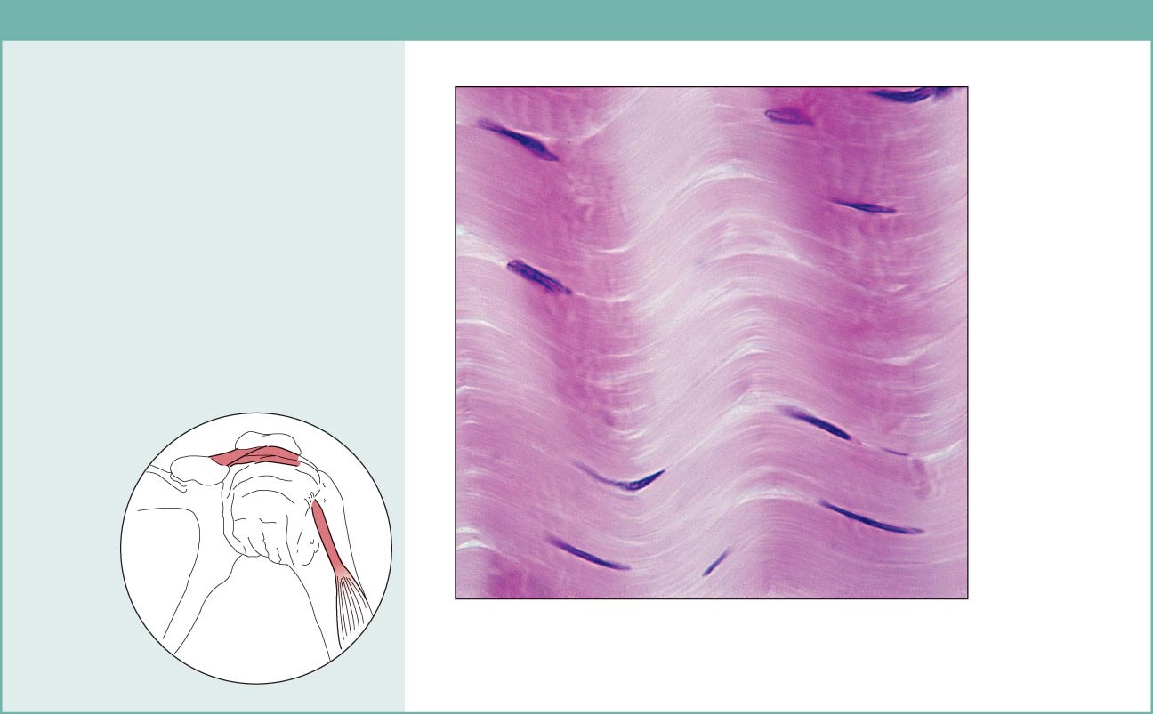
(d) Connective tissue proper: dense connective tissue, dense regular
Description: Primarily parallel
collagen fibers; a few elastic fibers;
major cell type is the fibroblast.
Collagen
fibers
Function: Attaches muscles to
bones or to muscles; attaches bones
to bones; withstands great tensile
stress when pulling force is applied
in one direction.
Location: Tendons, most
ligaments, aponeuroses.
Nuclei of
fibroblasts
Shoulder
joint
Ligament
Photomicrograph: Dense regular connective
tissue from a tendon (500x).
Tendon
Figure 4.8d

Slide 28
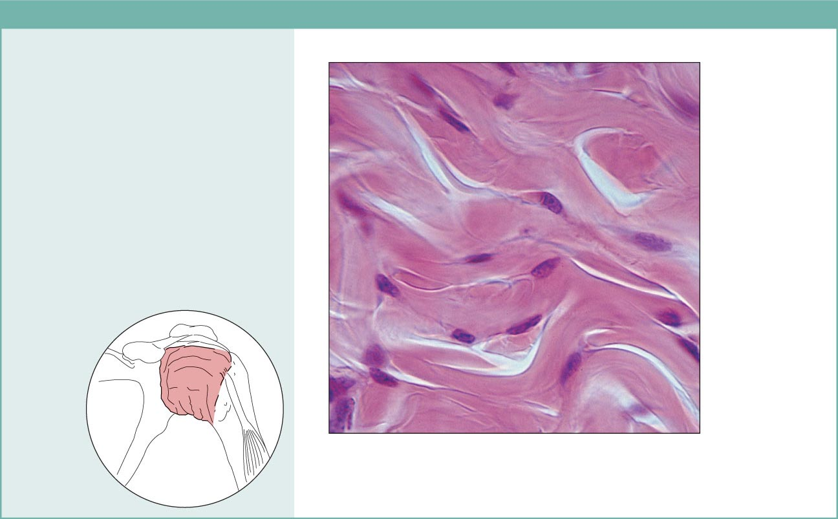
(e) Connective tissue proper: dense connective tissue, dense irregular
Description: Primarily
irregularly arranged collagen
fibers; some elastic fibers;
major cell type is the fibroblast.
Nuclei of
fibroblasts
Function: Able to withstand
tension exerted in many
directions; provides structural
strength.
Location: Fibrous capsules of
organs and of joints; dermis of
the skin; submucosa of
digestive tract.
Collagen
fibers
Fibrous
joint
capsule
Photomicrograph: Dense irregular
connective tissue from the dermis of the
skin (400x).
Figure 4.8e

Slide 29
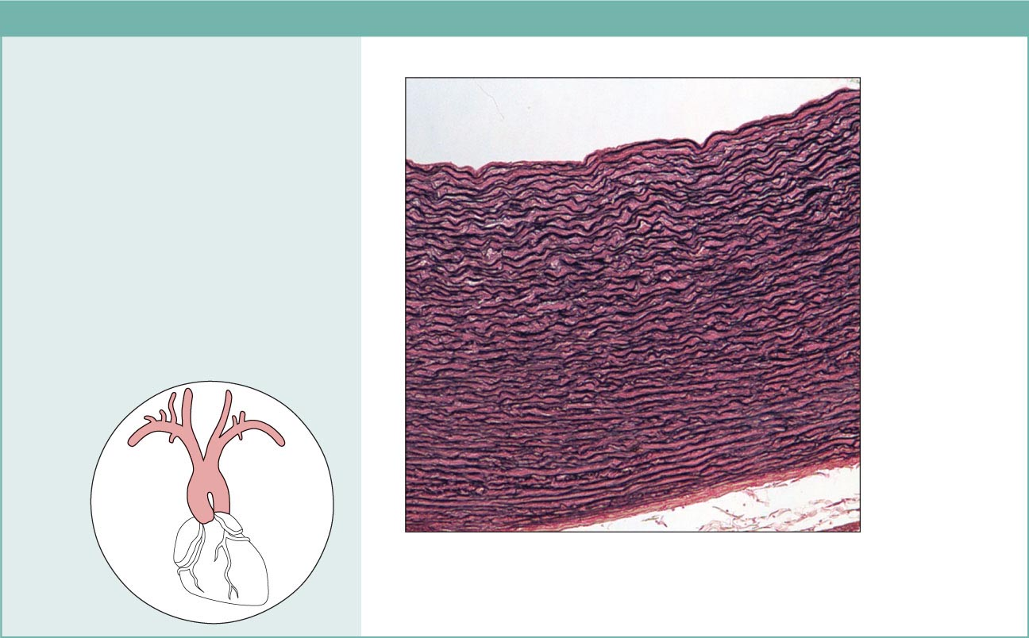
(f) Connective tissue proper: dense connective tissue, elastic
Description: Dense regular
connective tissue containing a high
proportion of elastic fibers.
Function: Allows recoil of tissue
following stretching; maintains
pulsatile flow of blood through
arteries; aids passive recoil of lungs
following inspiration.
Location: Walls of large arteries;
within certain ligaments associated
with the vertebral column; within the
walls of the bronchial tubes.
Elastic fibers
Aorta
Heart
Photomicrograph: Elastic connective tissue in
the wall of the aorta (250x).
Figure 4.8f

Slide 30
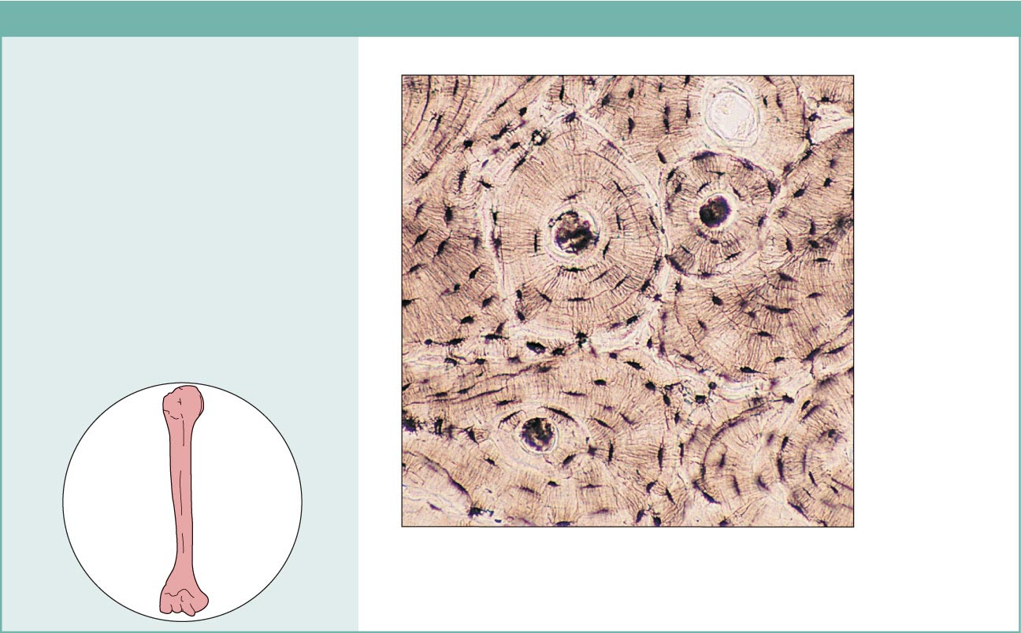
(j) Others: bone (osseous tissue)
Description: Hard, calcified
matrix containing many collagen
fibers; osteocytes lie in lacunae.
Very well vascularized.
Function: Bone supports and
protects (by enclosing);
provides levers for the muscles
to act on; stores calcium and
other minerals and fat; marrow
inside bones is the site for blood
cell formation (hematopoiesis).
Central
canal
Lacunae
Lamella
Location: Bones
Photomicrograph: Cross-sectional view
of bone (125x).
Figure 4.8j

Slide 31
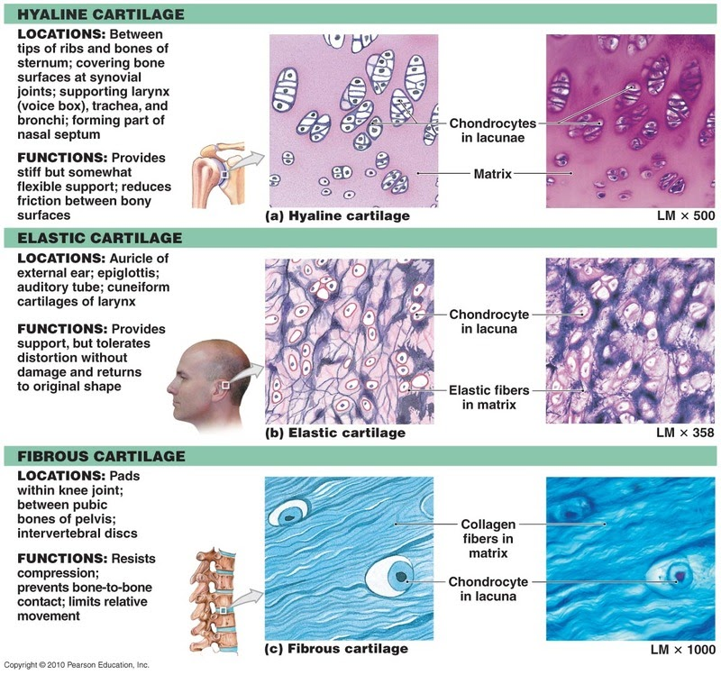
Cartilage Types

Slide 32
Muscle Types
Skeletal
Cardiac
Smooth

Slide 33
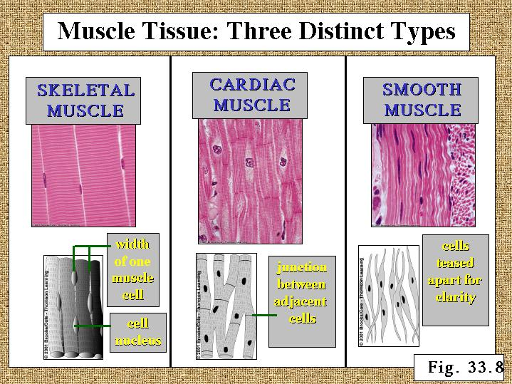

Slide 34
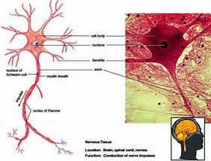
Neuron

