Slide 1
10
The Muscular System:
Mike Clark,MD

Slide 2
Skeletal Muscles: Functional Groups
Prime movers
  Provide the major force for producing a specific movement
Antagonists
  Oppose or reverse a particular movement

Slide 3
Skeletal Muscles: Functional Groups
Synergists
  Add force to a movement
  Reduce undesirable or unnecessary movement
Fixators
  Synergists that immobilize a bone or muscle’s origin

Slide 4
Naming Skeletal Muscles
Location—bone or body region associated with the muscle
Shape—e.g., deltoid muscle (deltoid = triangle)
Relative size—e.g., maximus (largest), minimus (smallest), longus (long)
Direction of fibers or fascicles—e.g., rectus (fibers run straight), transversus, and oblique (fibers run at angles to an imaginary defined axis)

Slide 5
Naming Skeletal Muscles
Number of origins—e.g., biceps (2 origins) and triceps (3 origins)
Location of attachments—named according to point of origin or insertion
Action—e.g., flexor or extensor, muscles that flex or extend, respectively

Slide 6
Muscle Mechanics: Arrangement of Fascicles
Circular
  Fascicles arranged in concentric rings (e.g., orbicularis oris)
Convergent
  Fascicles converge toward a single tendon insertion (e.g., pectoralis major)

Slide 7
Muscle Mechanics: Arrangement of Fascicles
Parallel
  Fascicles parallel to the long axis of a straplike muscle (e.g., sartorius)
Fusiform
  Spindle-shaped muscles with parallel fibers (e.g., biceps brachii)

Slide 8
Muscle Mechanics: Arrangement of Fascicles
Pennate
  Short fascicles attach obliquely to a central tendon running the length of the muscle (e.g., rectus femoris)

Slide 9
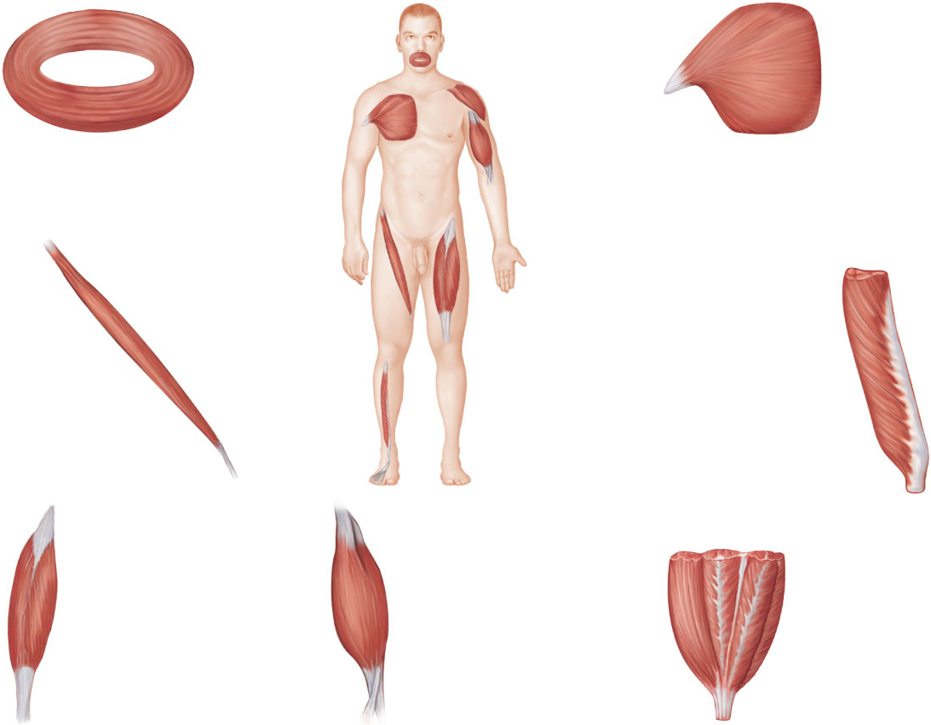
(a)
(b)
(g)
Circular
(orbicularis oris)
(f)
(b) Convergent
(pectoralis major)
(c)
(e)
(c) Parallel
(sartorius)
(d) Unipennate
(extensor
digitorum
longus)
(d)
(e) Bipennate
(rectus femoris)
(f) Fusiform
(biceps brachii)
(g) Multipennate
(deltoid)
Figure 10.1

Slide 10
Muscle Mechanics: Lever Systems
Components of a lever system
  Lever—rigid bar (bone) that moves on a fixed point or fulcrum (joint)
  Effort—force (supplied by muscle contraction) applied to a lever to move a resistance (load)
  Load—resistance (bone + tissues + any added weight) moved by the effort

Slide 11
Mechanical Advantage
1. Measure distance from fulcrum to effort.
2. Measure distance from fulcrum to load.
3. Divide the distance of fulcrum to effort by distance of fulcrum to load.
The longer the distance of fulcrum to effort compared to fulcrum to load the more mechanical advantage.

Slide 12
Speed Advantage
The closer the effort is to the load – the faster the movement and more distance of the movement.

Slide 13
Classes of Lever Systems
First class
  Fulcrum between load and effort

Slide 14
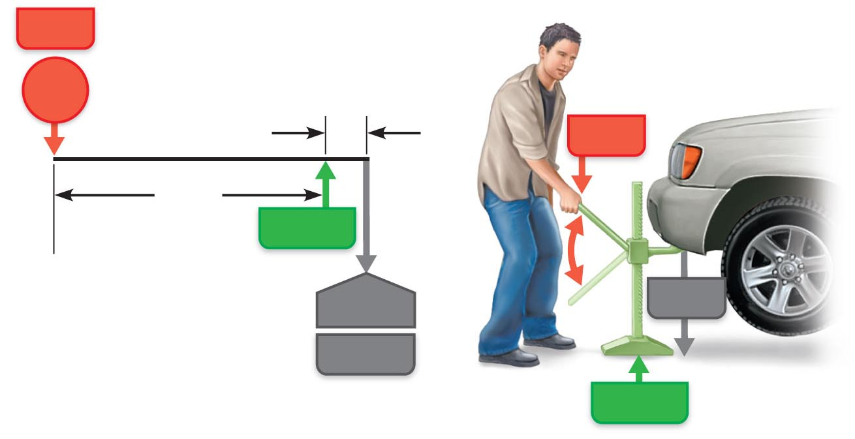
Effort x length of effort arm = load x length of load arm
(force x distance) = (resistance x distance)
Effort
10
kg
0.25 cm
Effort
25 cm
Fulcrum
10 x 25 = 1000 x 0.25
250 = 250
1000 kg
Load
Load
Fulcrum
(a) Mechanical advantage with a power lever
Figure 10.2a

Slide 15
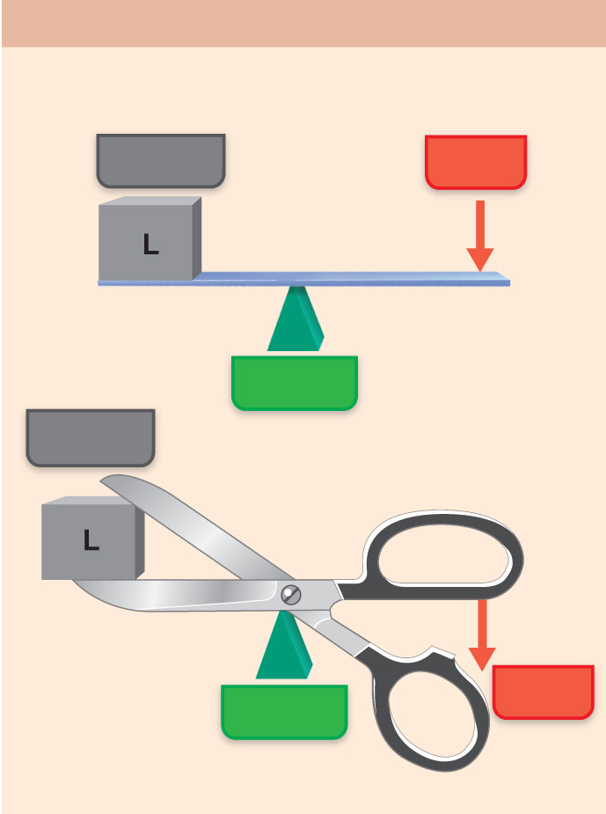
The See-Saw
(a) First-class lever
Arrangement of the elements is
load-fulcrum-effort
Load
Effort
Mechanical
Advantage but
Low speed
Fulcrum
Load
Effort
Fulcrum
Example: scissors
Figure 10.3a (1 of 2)

Slide 16
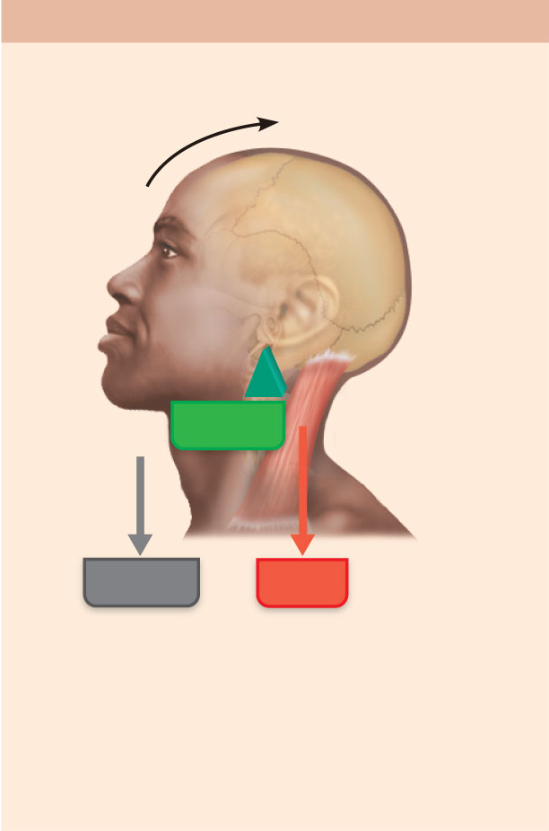
(a) First-class lever
Arrangement of the elements is
load-fulcrum-effort
Fulcrum
Load
Effort
In the body: A first-class lever system
raises your head off your chest. The
posterior neck muscles provide the effort,
the atlanto-occipital joint is the fulcrum,
and the weight to be lifted is the facial
skeleton.
Figure 10.3a (2 of 2)

Slide 17
Classes of Lever Systems
Second class
  Load between fulcrum and effort

Slide 18
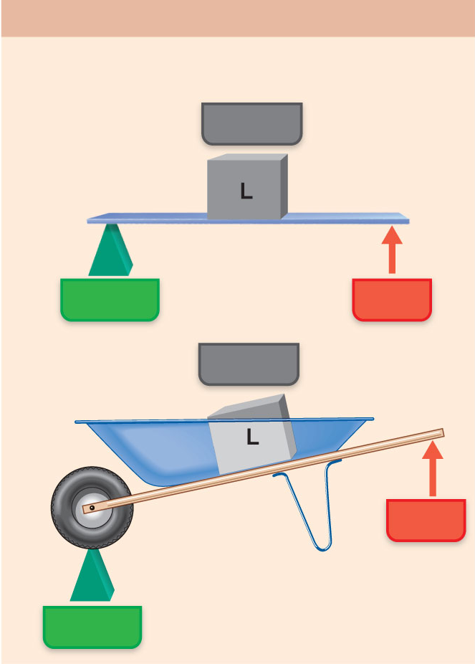
(b) Second-class lever
Arrangement of the elements is
fulcrum-load-effort
Load
Speed but no
Mechanical
Advantage
Fulcrum
Effort
Load
Effort
Example: wheelbarrow
Fulcrum
Figure 10.3b (1 of 2)

Slide 19
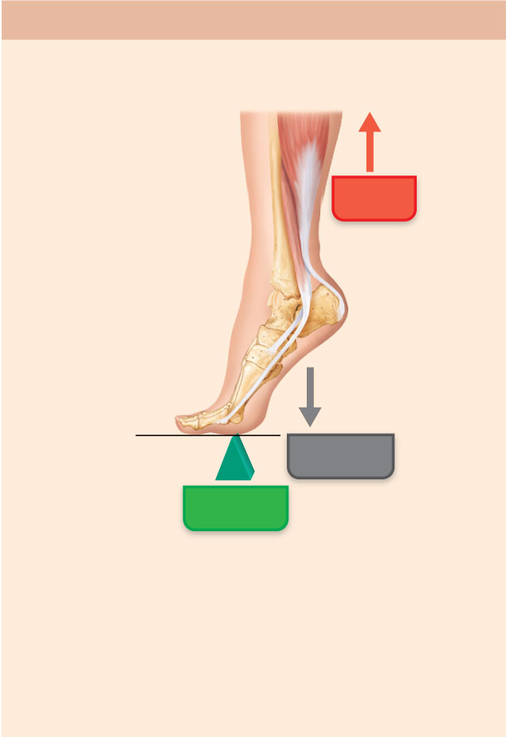
(b) Second-class lever
Arrangement of the elements is
fulcrum-load-effort
Effort
Load
Fulcrum
In the body: Second-class leverage is
exerted when you stand on tip-toe. The
effort is exerted by the calf muscles
pulling upward on the heel; the joints of
the ball of the foot are the fulcrum; and
the weight of the body is the load.
Figure 10.3b (2 of 2)

Slide 20
Third Class Lever
Load – Effort -- Fulcrum

Slide 21
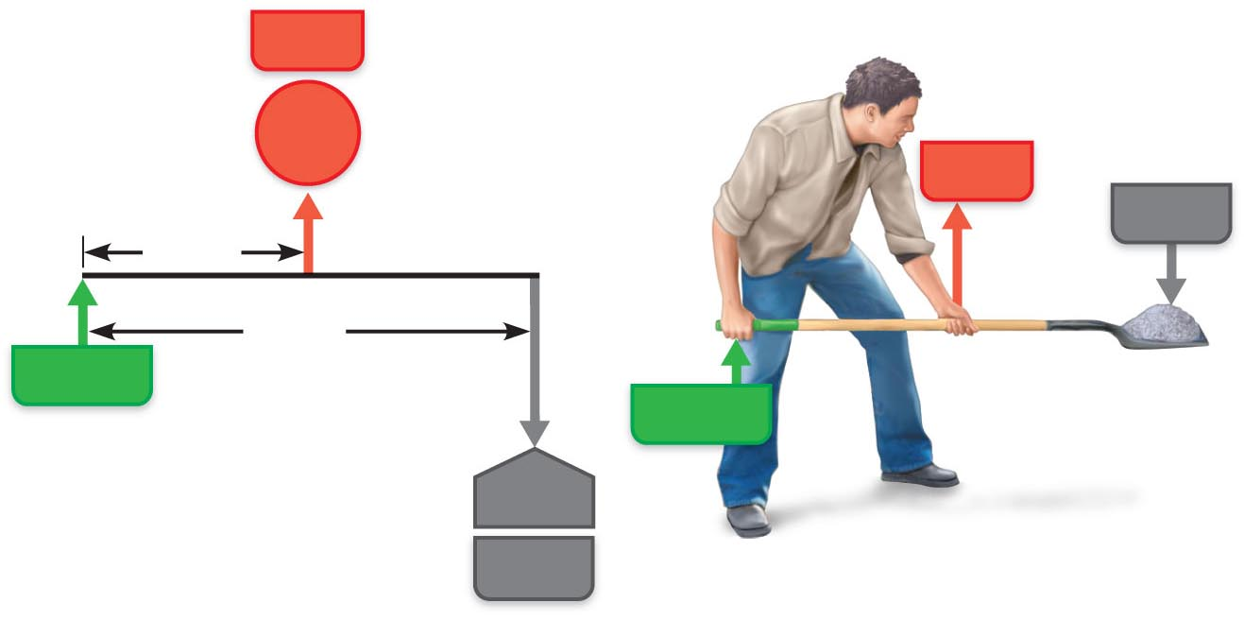
Effort
100 kg
Effort
Load
25 cm
50 cm
Fulcrum
Fulcrum
100 x 25 = 50 x 50
2500 = 2500
50 kg
Load
(b) Mechanical disadvantage with a speed lever
Figure 10.2b

Slide 22
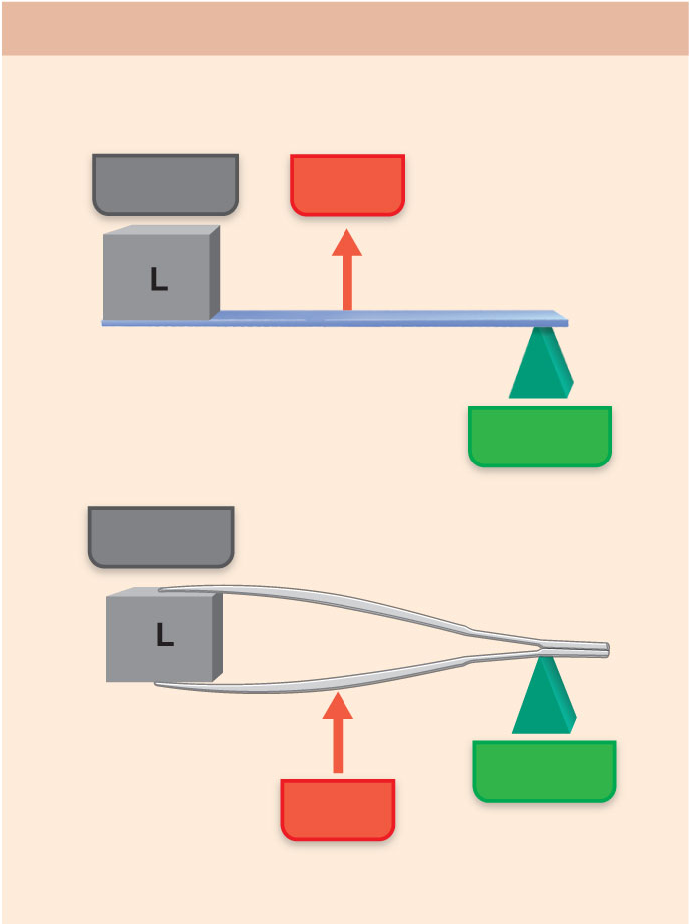
(c) Third-class lever
Arrangement of the elements is
load-effort-fulcrum
Load
Effort
Fulcrum
Load
Fulcrum
Effort
Example: tweezers or forceps
Figure 10.3c (1 of 2)

Slide 23
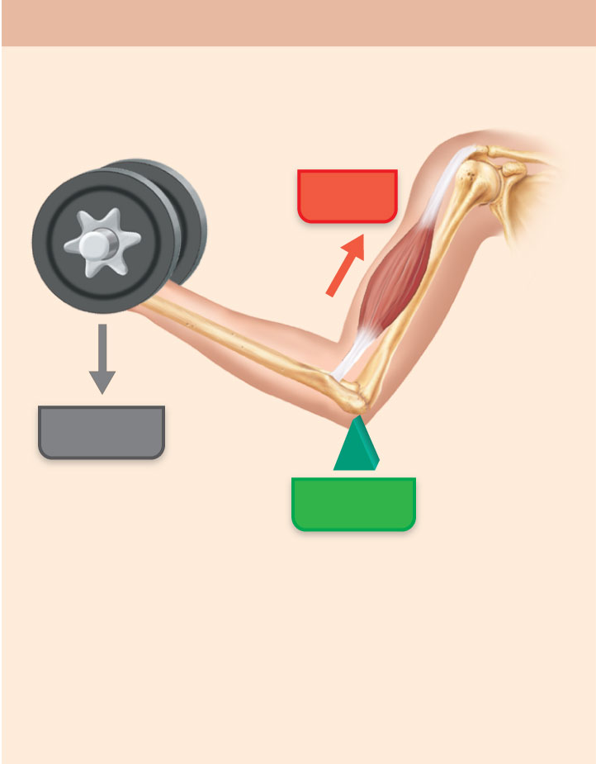
(c) Third-class lever
Arrangement of the elements is
load-effort-fulcrum
Effort
Load
Fulcrum
In the body: Flexing the forearm by the
biceps brachii muscle exemplifies
third-class leverage. The effort is exerted
on the proximal radius of the forearm, the
fulcrum is the elbow joint, and the load is
the hand and distal end of the forearm.
Figure 10.3c (2 of 2)

Slide 24
Major Skeletal Muscles of the Body
Grouped by function and location
Information for each muscle
  Name and description—note information in the name
  Origin and insertion—there is usually a joint between the origin and the insertion
  Action—insertion moves toward origin; best learned by acting out muscle movement on one’s own body
  Innervation—name of major nerve that supplies the muscle

Slide 25
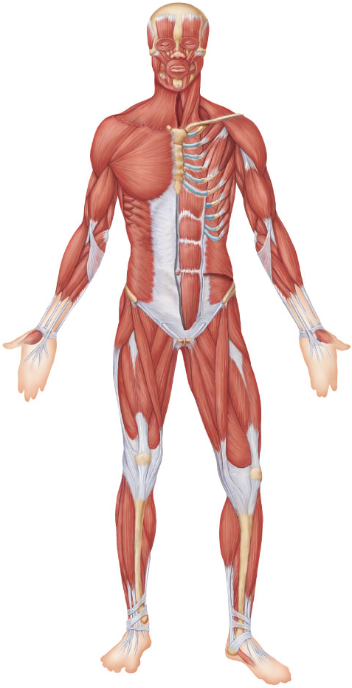
Head
Facial
Temporalis
Epicranius, frontal belly
Masseter
Orbicularis oculi
Shoulder
Zygomaticus
Trapezius
Orbicularis oris
Deltoid
Neck
Arm
Sternohyoid
Triceps brachii
Platysma
Biceps brachii
Sternocleidomastoid
Brachialis
Thorax
Forearm
Pectoralis minor
Pronator teres
Serratus anterior
Brachioradialis
Pectoralis major
Flexor carpi radialis
Intercostals
Palmaris longus
Abdomen
Pelvis/thigh
Rectus abdominis
Iliopsoas
Internal oblique
Pectineus
Transversus abdominis
Thigh
External oblique
Rectus femoris
Thigh
Vastus lateralis
Tensor fasciae latae
Vastus medialis
Sartorius
Leg
Adductor longus
Gracilis
Fibularis longus
Leg
Extensor digitorum longus
Gastrocnemius
Tibialis anterior
Soleus
Figure 10.4

Slide 26
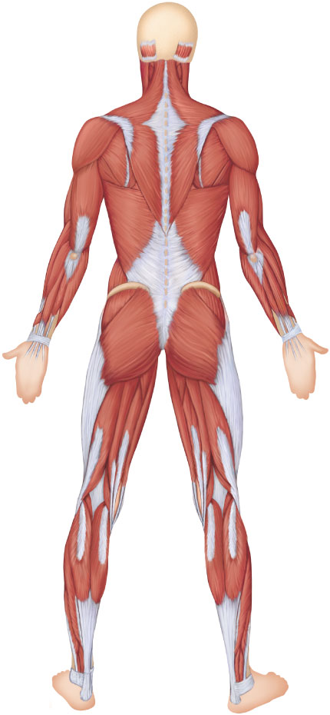
Neck
Epicranius, occipital belly
Arm
Sternocleidomastoid
Trapezius
Triceps brachii
Shoulder
Brachialis
Deltoid
Forearm
Infraspinatus
Brachioradialis
Teres major
Extensor carpi
radialis longus
Rhomboid major
Latissimus dorsi
Flexor carpi ulnaris
Hip
Extensor carpi
ulnaris
Gluteus medius
Extensor digitorum
Gluteus maximus
Iliotibial tract
Thigh
Adductor magnus
Hamstrings:
Leg
Biceps femoris
Gastrocnemius
Semitendinosus
Soleus
Semimembranosus
Fibularis longus
Calcaneal
(Achilles) tendon
Figure 10.5

Slide 27
Muscles of the Head
Two groups
  Muscles of facial expression
  Muscles of mastication and tongue movement

Slide 28
Muscles of Facial Expression
Insert into the skin
Important in nonverbal communication
All innervated by cranial nerve VII (facial nerve)

Slide 29
Muscles of Facial Expression
Epicranius (occipitofrontalis)
  Bipartite muscle consisting of the
    Frontalis
    Occipitalis
    Galea aponeurotica—cranial aponeurosis connecting above muscles
The two muscles have alternate actions of pulling the scalp forward and backward

Slide 30
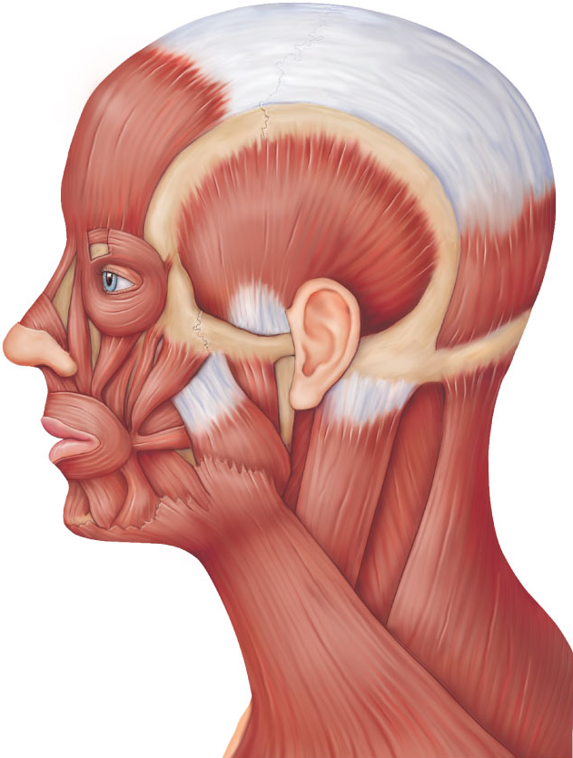
Epicranius
Galea
aponeurotica
Corrugator
supercilii
Frontal belly
Orbicularis oculi
Occipital
belly
Levator labii
superioris
Zygomaticus
minor and major
Temporalis
Buccinator
Masseter
Risorius
Sternocleidomastoid
Orbicularis oris
Trapezius
Mentalis
Depressor
labii inferioris
Splenius capitis
Depressor anguli oris
Platysma
Figure 10.6

Slide 31
Muscles of Mastication and Tongue Movement
Four pairs involved in mastication
  Prime movers of jaw closure
    Temporalis and masseter
  Grinding movements
    Medial and lateral pterygoids

Slide 32
Muscles of Mastication and Tongue Movement
All are innervated by cranial nerve V (trigeminal nerve)
Buccinator muscles (of facial expression group) also help by holding food between the teeth
Three muscles anchor and move the tongue
All are innervated by cranial nerve XII (hypoglossal nerve)

Slide 33
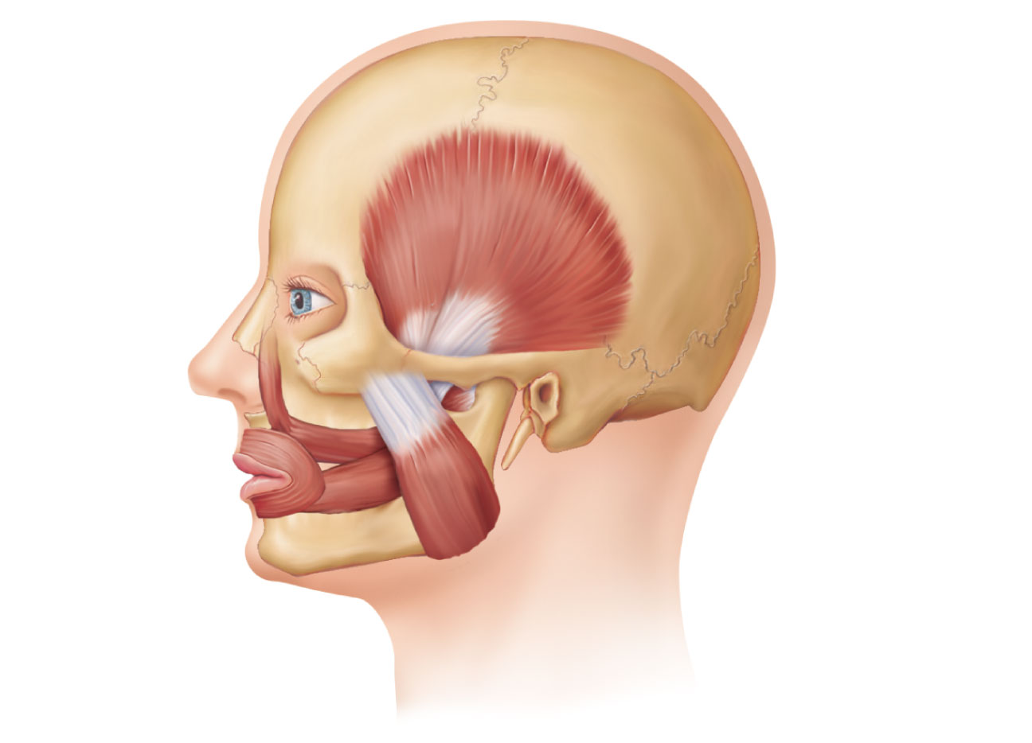
Temporalis
Orbicularis
oris
Masseter
Buccinator
(a)
Figure 10.7a

Slide 34
Muscles of Mastication and Tongue Movement
PLAY
A&P Flix™: Temporalis
PLAY
A&P Flix™: Masseter
PLAY
A&P Flix™: Buccinator

Slide 35
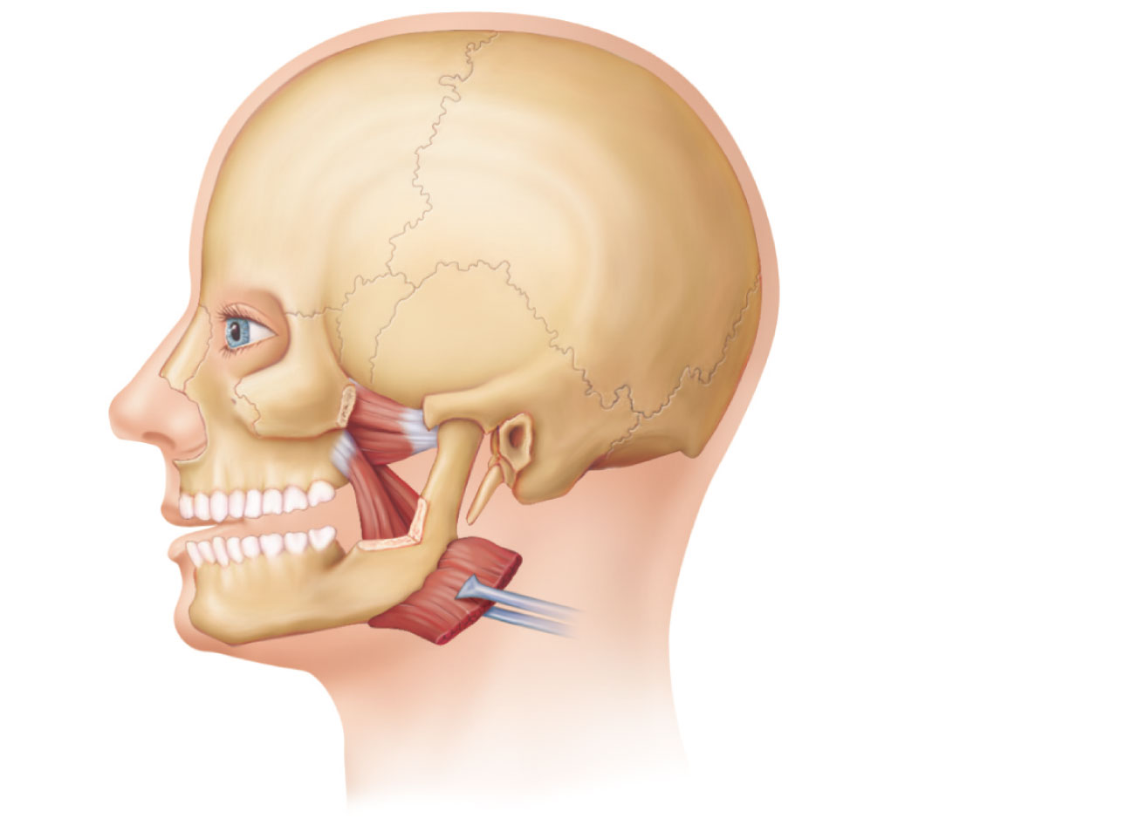
Lateral
pterygoid
Medial
pterygoid
Masseter
pulled away
(b)
Figure 10.7b

Slide 36
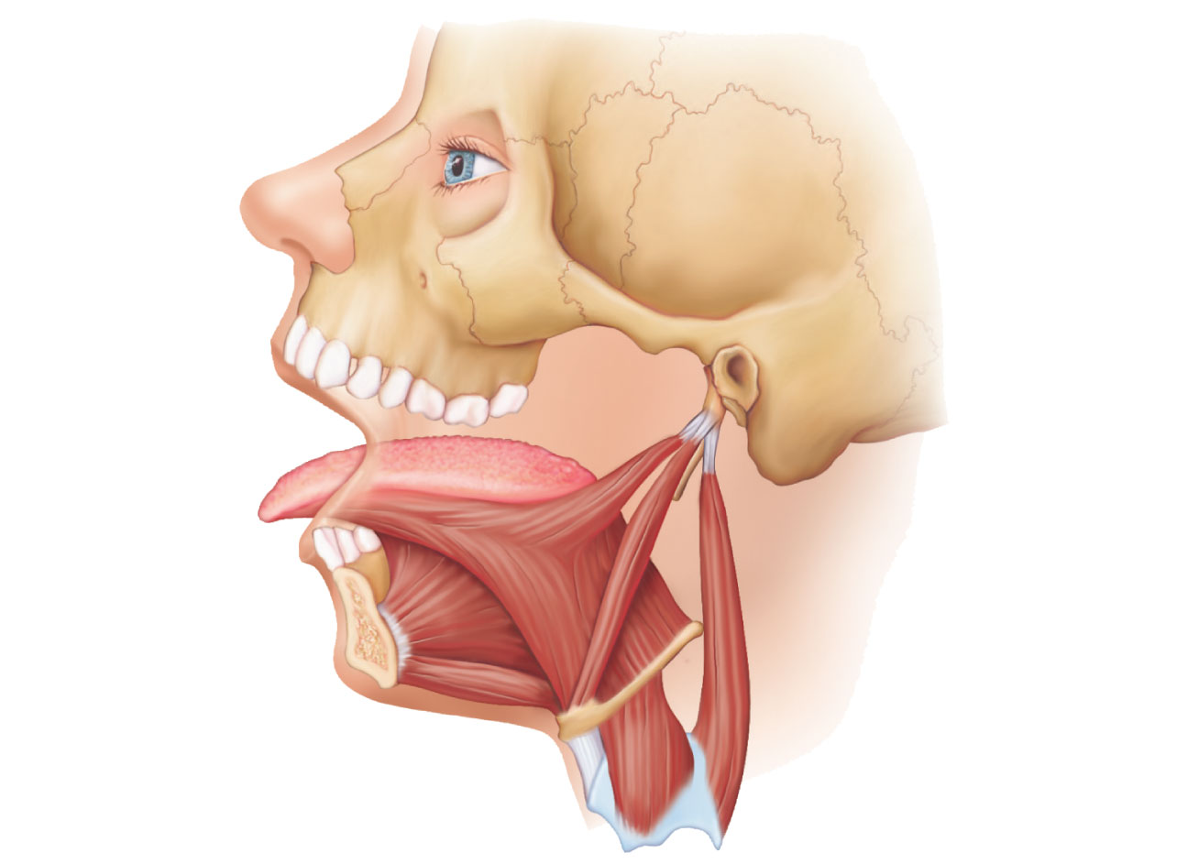
Tongue
Styloid process
Styloglossus
Genioglossus
Hyoglossus
Mandibular
symphysis
Stylohyoid
Hyoid bone
Geniohyoid
Thyrohyoid
Thyroid cartilage
(c)
Figure 10.7c

Slide 37
Muscles of the Anterior Neck and Throat
Most are involved in swallowing
Two groups
  Suprahyoid
  Infrahyoid

Slide 38
Suprahyoid Muscles of the Anterior Neck and Throat
Four deep muscles are involved in swallowing (they move the hyoid bone and larynx)
  Form the floor of the oral cavity
  Anchor the tongue
  Move the hyoid bone and the larynx

Slide 39
Infrahyoid Muscles of the Anterior Neck and Throat
Straplike muscles that depress the hyoid and larynx as swallowing ends and during speaking

Slide 40
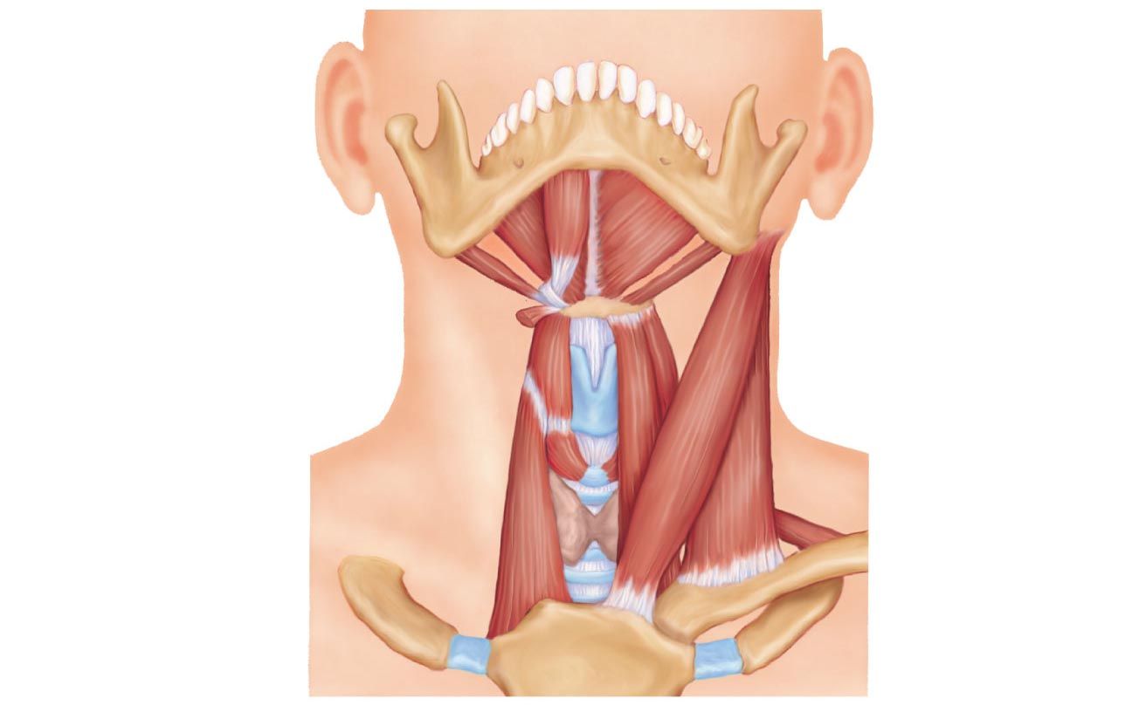
Median raphe
Anterior
belly
Mylohyoid
Digastric
Stylohyoid
Posterior
belly
Hyoid bone
Omohyoid
(superior belly)
Stylohyoid (cut)
Thyrohyoid
Sternohyoid
Thyroid cartilage
of the larynx
Sternocleido-
mastoid
Thyroid gland
Sternothyroid
Omohyoid
(inferior belly)
(a)
Figure 10.8a

Slide 41
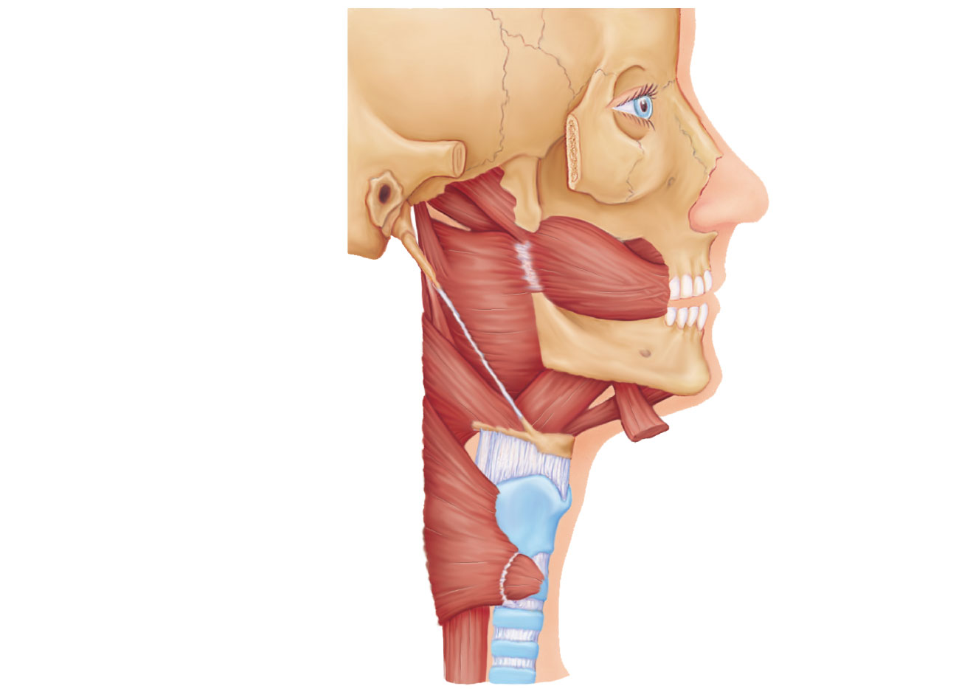
Tensor veli palatini
Levator veli palatini
Styloid process
Buccinator
Superior pharyngeal
constrictor
Middle pharyngeal
constrictor
Mandible
Mylohyoid
(cut)
Hyoid bone
Thyrohyoid
membrane
Geniohyoid
Hyoglossus
Inferior
pharyngeal
constrictor
Thyroid
cartilage
of larynx
Esophagus
(c)
Trachea
Figure 10.8c

Slide 42
Infrahyoid Muscles of the Anterior Neck and Throat
PLAY
Animation: Rotatable head
PLAY
Animation: Rotatable face

Slide 43
Muscles of the Neck and Vertebral Column
Two functional groups
  Muscles that move the head
  Muscles that extend the trunk and maintain posture

Slide 44
Muscles of the Neck and Vertebral Column: Head Movement
Sternocleidomastoid—major head flexor
Suprahyoid and infrahyoid—synergists to head flexion
Sternocleidomastoid and scalenes—lateral head movements
Semispinalis capitis—synergist with sternocleidomastoid
Splenius (capitis and cervicis portions): head extension, rotation, and lateral bending

Slide 45
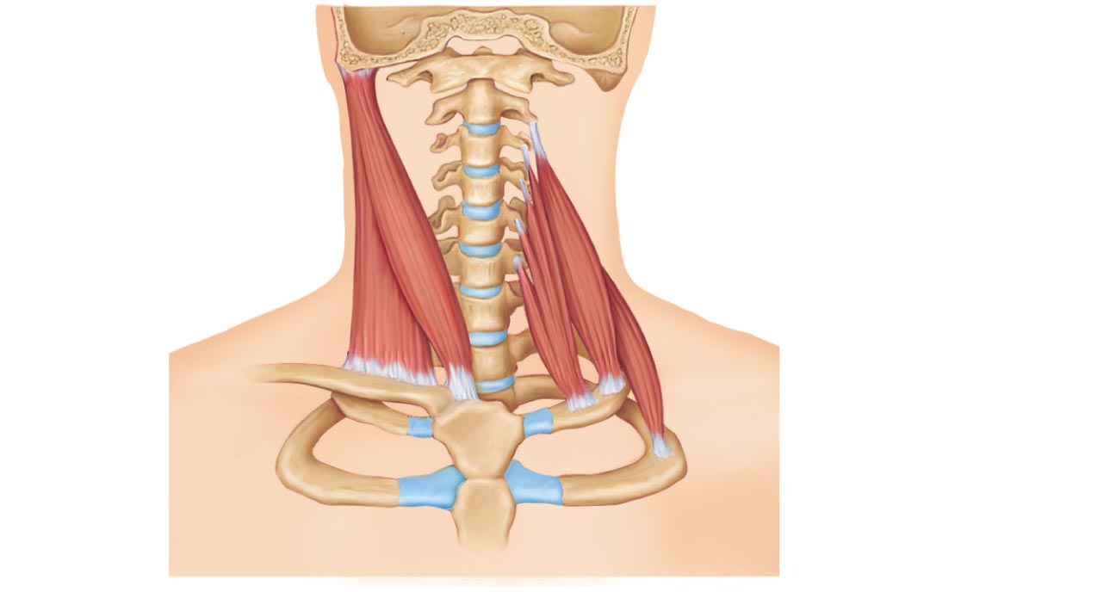
Base of
occipital bone
1st cervical
vertebra
Mastoid
process
Middle
scalene
Sternocleido-
mastoid
Anterior
scalene
Posterior
scalene
(a) Anterior
Figure 10.9a

Slide 46
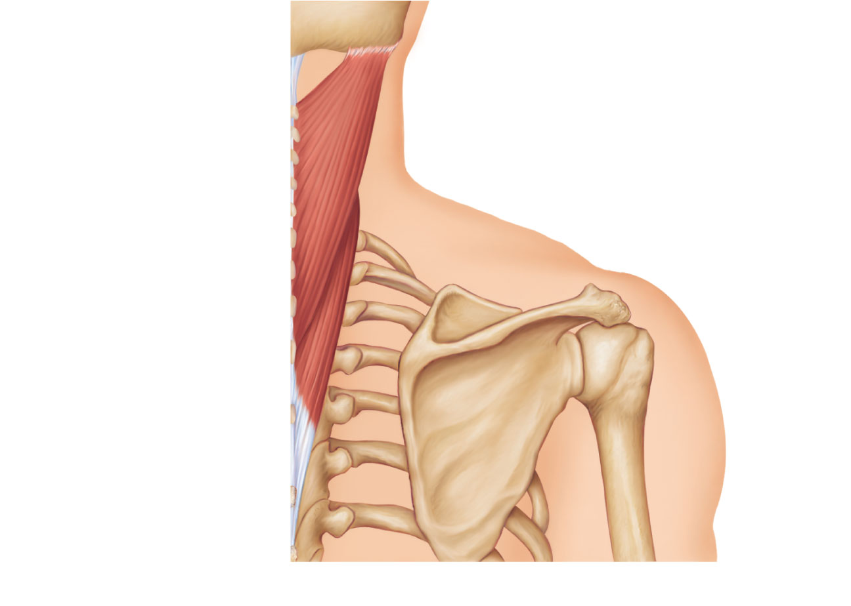
Mastoid process
Splenius
capitis
Spinous
processes
of the
vertebrae
Splenius
cervicis
(b) Posterior
Figure 10.9b

Slide 47
Muscles of the Neck and Vertebral Column: Head Movement
PLAY
A&P Flix™: Splenius capitis
PLAY
A&P Flix™: Semispinalis capitis

Slide 48
Muscles of the Neck and Vertebral Column: Trunk Extension
Deep (intrinsic) back muscles
  Erector spinae (sacrospinalis) group—prime movers of back extension and lateral bending
    Iliocostalis
    Longissimus
    Spinalis
  Semispinalis and quadratus lumborum—synergists in extension and rotation

Slide 49
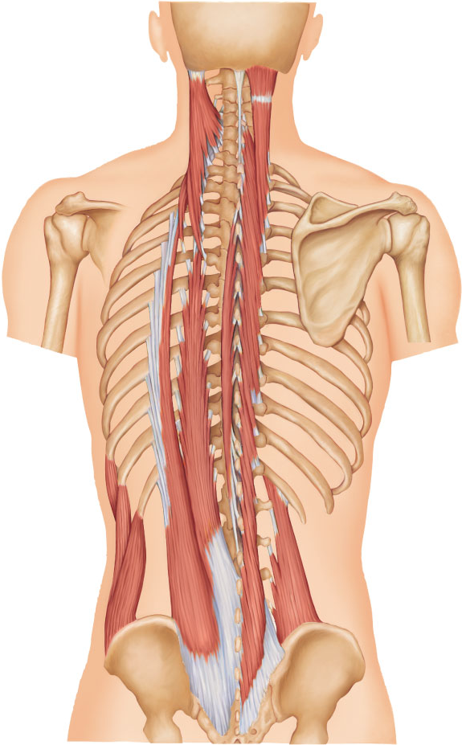
Ligamentum
nuchae
Mastoid process
of temporal bone
Semispinalis
capitis
Longissimus capitis
Iliocostalis cervicis
Semispinalis
cervicis
Longissimus
cervicis
Iliocostalis
thoracis
Semispinalis
thoracis
Longissimus thoracis
Spinalis thoracis
Iliocostalis
Erector
spinae
Longissimus
Spinalis
Multifidus
Iliocostalis
lumborum
Quadratus
lumborum
External oblique
(d)
Figure 10.9d

Slide 50
Muscles of the Neck and Vertebral Column: Trunk Extension
PLAY
A&P Flix™: Iliocostalis
PLAY
A&P Flix™: Longissimus
PLAY
A&P Flix™: Spinalis

