Slide 1
Blood Pressure Control
Mike Clark, M.D.

Slide 2
MAP = CO x SVR
CO = HR x SV
SV = EDV – ESV
(EDV concerned with blood volume and ESV concerned more with inotropic effect)
SVR = ∑R₁ + R₂ + 1/R₃ + 1/R₄ …..
R = 8ŋL/∏r⁴
In order to live – the body compensates by increasing the actions of the organs not affected (homeostasis – negative feedback)

Slide 3
How to Calculate Blood Pressure
The formula MAP = CO x SVR cannot be actually calculated because SVR cannot accurately determined for almost 60,000 miles of blood vessels – thus another formula must be used
MAP is an average blood pressure – thus an averaging method must be determined

Slide 4
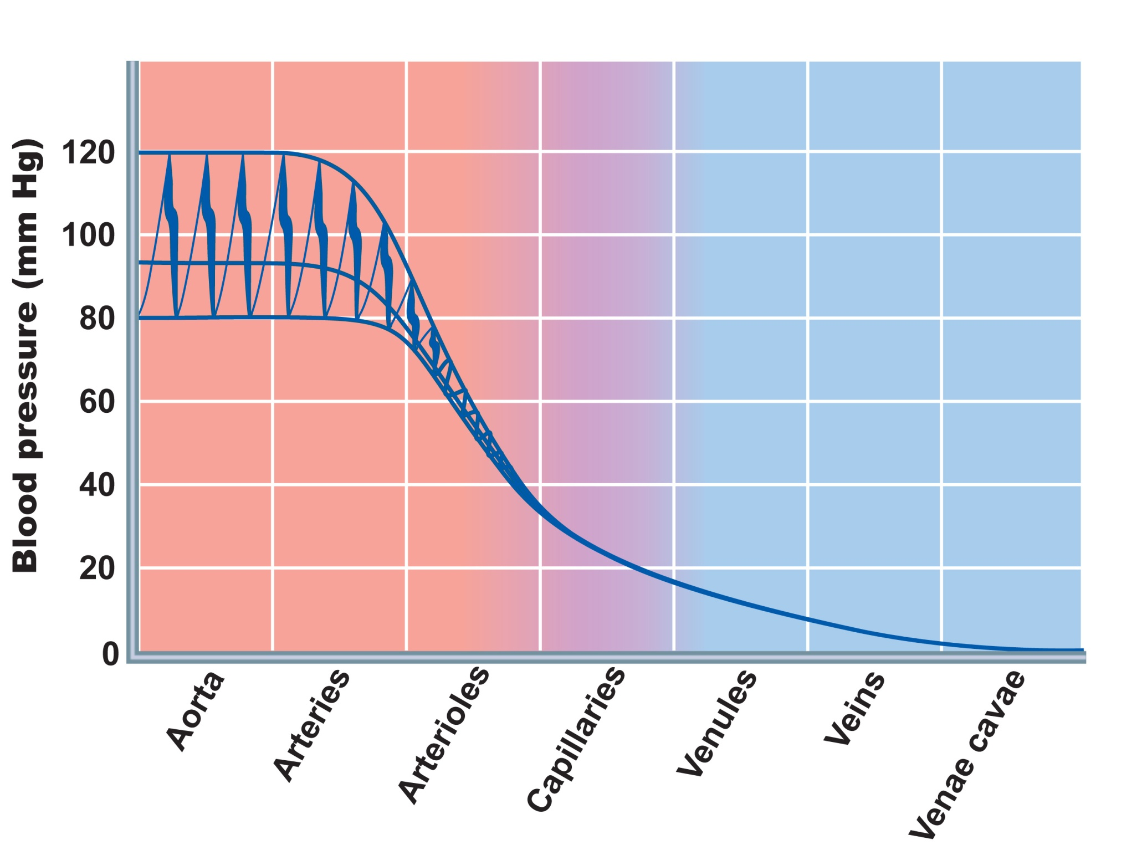
Systolic pressure
Mean pressure
Diastolic
pressure
Pressure in
Arteries forms a
Wave
Figure 19.6

Slide 5
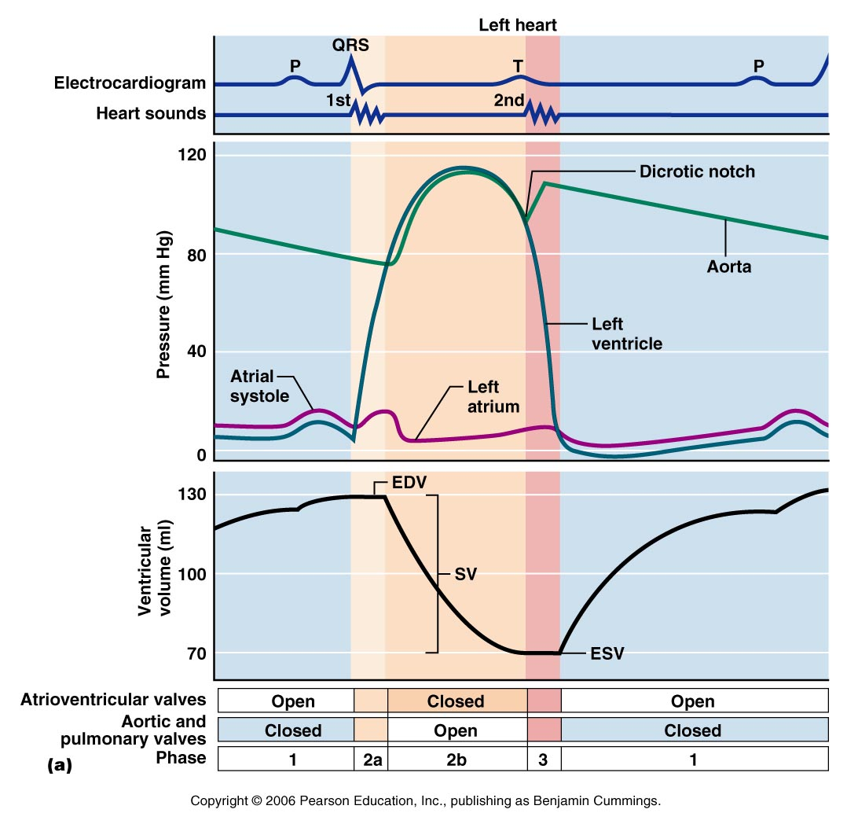
Highest Pressure in
Arteries during
Ejection contraction
Lowest Pressure in
Arteries immediately
Prior to next Ejection
contraction
Figure 18.20a

Slide 6
MAP (SYSTEMIC) = CO X TPR (SVR)
This formula is an excellent one to use to understand pressures in the blood vessels. It can explain hypertensive pressures, normotensive pressures and hypotensive pressures. However, it cannot be actually calculated in that the TPR cannot be calculated. TPR in involves calculating the radius of the blood vessels at each millimeter along the circulation – the human body has approximately 60,000 miles of blood vessels – thus this is impossible to calculate.
The algebraic formula used to calculate MAP is
MAP = DBP + 1/3 (SBP – DBP)
DBP is the Diastolic Blood Pressure, and SBP is the Systolic Blood Pressure
SBP – DBP is the Pulse Pressure

Slide 7
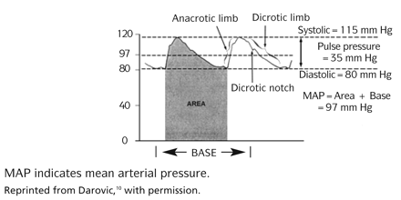
MAP = DBP + 1/3 (SBP – DBP)
Systolic Blood Pressure – occurs during Ejection Contraction Time
The Diastolic Blood Pressure has more weight (significance) in this formula – because during one cardiac cycle there is more time spent in diastole in the blood vessels than is systole. The actual way MAP is calculated by the computer (arterial line) is using differential Calculus. Differential calculus exactly calculates the area under a curve.

Slide 8
Pulse Pressure
Formally it is the systolic pressure minus the diastolic pressure.
Theoretically, the systemic pulse pressure can be conceptualized as being proportional to stroke volume and inversely proportional to the compliance of the aorta.
Systemic pulse pressure = P_{systolic} - P_{diastolic} = 120mmHg - 80mmHg = 40mmHg
Pulmonary pulse pressure = P_{systolic} - P_{diastolic} = 25mmHg - 10mmHg = 15mmHg
Low values
In trauma a low or narrow pulse pressure suggests significant blood loss. In an otherwise healthy person a difference of less than 40 mmHg is usually an error of measurement. If the pulse pressure is genuinely low, e.g. 25 mmHg or less, the cause may be low stroke volume, as in Congestive Heart Failure and/or shock, a serious issue.

Slide 9
Low values of Pulse Pressure
In trauma a low or narrow pulse pressure suggests significant blood loss. In an otherwise healthy person a difference of less than 40 mmHg is usually an error of measurement. If the pulse pressure is genuinely low, e.g. 25 mmHg or less, the cause may be low stroke volume, as in Congestive Heart Failure and/or shock, a serious issue.
High values during or shortly after exercise
Usually, the resting pulse pressure in healthy adults, sitting position, is about 40 mmHg. The pulse pressure increases with exercise due to increased stroke volume], healthy values being up to pulse pressures of about 100 mmHg, simultaneously as total peripheral resistance drops during exercise. In healthy individuals the pulse pressure will typically return to normal within about 10 minutes.
Consistently high values
If the usual resting pulse pressure is consistently greater than 40 mmHg, e.g. 60 or 80 mmHg, the most likely basis is stiffness of the major arteries, aortic regurgitation (a leak in the aortic valve), arteriovenous malformation (an extra path for blood to travel from a high pressure artery to a low pressure vein without the gradient of a capillary bed), hyperthyroidism or some combination. (A chronically increased stroke volume is also a technical possibility,

Slide 10
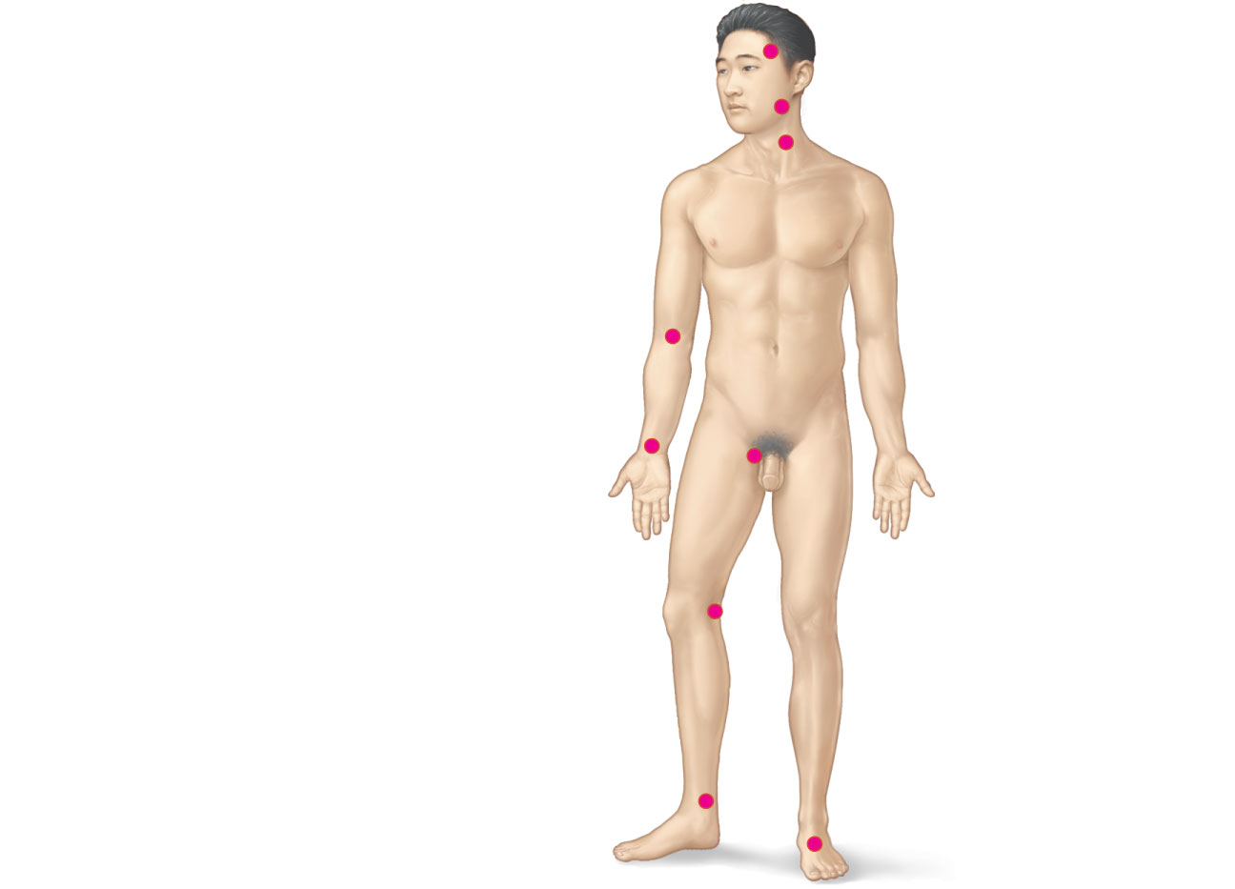
Location where pulses can be taken
Superficial temporal
artery
Facial artery
Common carotid
artery
Brachial artery
Radial artery
Femoral artery
Popliteal artery
Posterior tibial
artery
Dorsalis pedis
artery
Figure 19.12

Slide 11
MAP = CO x SVR
CO = HR x SV
SV = EDV – ESV
(EDV concerned with blood volume and ESV concerned more with inotropic effect)
SVR = ∑R₁ + R₂ + 1/R₃ + 1/R₄ …..
R = 8ŋL/∏r⁴
In order to live – the body compensates by increasing the actions of the organs not affected (homeostasis – negative feedback)

Slide 12
Widespread versus Local Control
Widespread control affects Mean Arterial Pressure (MAP) in the entire Systemic Circulation- this control is mediated through the Nervous and Hormonal Systems
Local Control affects MAP in localized tissues and organs – it generally does not affect overall blood pressure – organs possessing good local control mechanisms are the brain, heart, skin, lungs, skeletal muscles

Slide 13
Reticular System in CNS
The reticular formation is a part of the brain that is involved in actions such as awaking/sleeping cycle, and filtering incoming stimuli to discriminate irrelevant background stimuli. It is essential for governing some of the basic functions of higher organisms, and is one of the phylogenetically oldest portions of the brain.
The reticular formation is a poorly-differentiated area of the brain stem, centered roughly in the pons. The reticular formation is the core of the brainstem running through the mid-brain, pons and medulla. The ascending reticular activating system connects to areas in the thalamus, hypothalamus, and cortex, while the descending reticular activating system connects to the cerebellum and sensory nerves. The reticular activating system is a portion of the reticular formation – concerned with sleep/wake, arousal and alertness.

Slide 14
Reticular System (Functions)
1. Somatic motor control - Some motor neurons send their axons to the reticular formation nuclei, giving rise to the reticulospinal tracts of the spinal cord. These tracts function in maintaining tone, balance, and posture--especially during body movements.
Other motor nuclei include gaze centers, which enable the eyes to track and fixate objects, and central pattern generators, which produce rhythmic signals to the muscles of breathing and swallowing

Slide 15
Reticular System (Functions)
2. Cardiovascular control - The reticular formation includes the cardiac and vasomotor centers of the medulla oblongata.
3. Pain modulation - The reticular formation is one means by which pain signals from the lower body reach the cerebral cortex. It is also the origin of the descending analgesic pathways. The nerve fibers in these pathways act in the spinal cord to block the transmission of some pain signals to the brain.
4. Sleep and consciousness - The reticular formation has projections to the thalamus and cerebral cortex that allow it to exert some control over which sensory signals reach the cerebrum and come to our conscious attention. It plays a central role in states of consciousness like alertness and sleep. Injury to the reticular formation can result in irreversible coma.

Slide 16
Reticular System (Functions)
5. Habituation - This is a process in which the brain learns to ignore repetitive, meaningless stimuli while remaining sensitive to others. A good example of this is when a person can sleep through loud traffic in a large city, but is awakened promptly due to the sound of an alarm or crying baby. Reticular formation nuclei that modulate activity of the cerebral cortex are called the reticular activating system or extrathalamic control modulatory system.

Slide 17
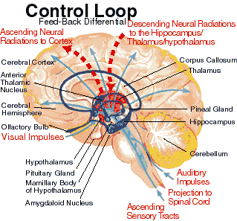
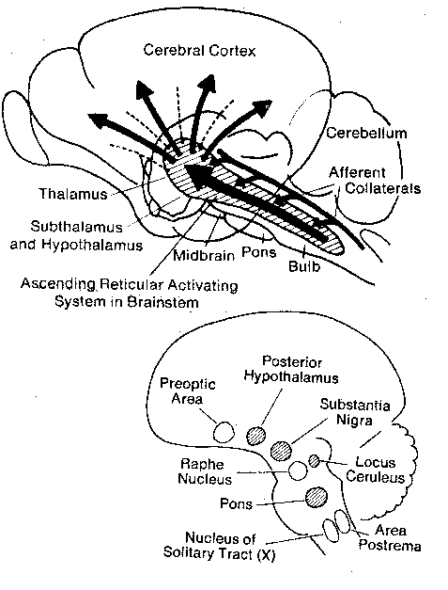
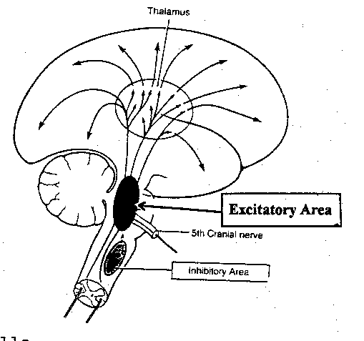

Slide 18
Neural Control
Homeostasis (Feedback Loop)
Control Center – Vasomotor Center in Medulla
Sensory Receptors – mainly by the baroreceptors the Carotid Sinus and Aortic Sinus – with some inputs from the chemoreceptors which are the Carotid bodies and Aortic Body
Sensory nerves – Cranial nerves IX (Glossopharyngeal assoc. with Herrings) from Carotid sinus and X (Vagus) from Aortic Sinus
Motor – via the sympathetic nervous system

Slide 19
The Vasomotor Center
A cluster of sympathetic neurons in the medulla that oversee changes in blood vessel diameter
Part of the cardiovascular center, along with the cardiac centers
Maintains vasomotor tone (moderate constriction of arterioles)
Receives inputs from baroreceptors, chemoreceptors, and higher brain centers

Slide 20
Short-Term Mechanisms: Baroreceptor-Initiated Reflexes
Baroreceptors are located in
  Carotid sinuses
  Aortic arch
  Walls of large arteries of the neck and thorax

Slide 21
Short-Term Mechanisms:
Baroreceptor-Initiated Reflexes
Baroreceptors taking part in the carotid sinus reflex protect the blood supply to the brain
Baroreceptors taking part in the aortic reflex help maintain adequate blood pressure in the systemic circuit

Slide 22

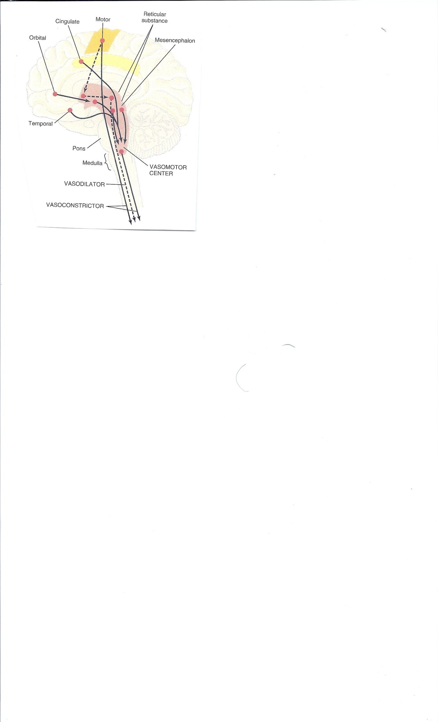
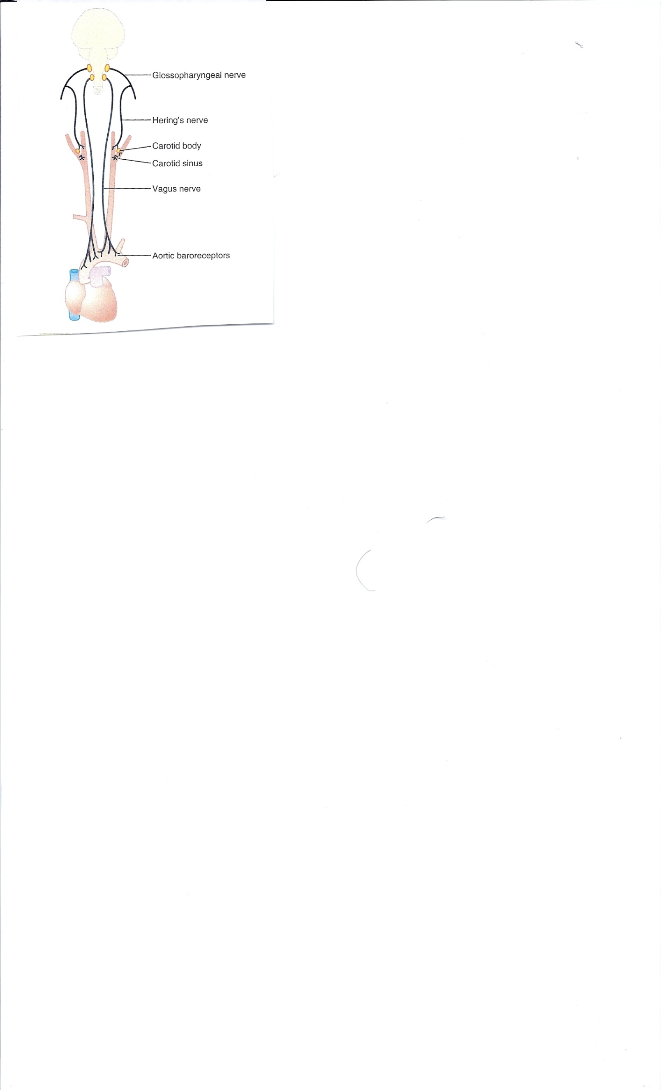

Slide 23
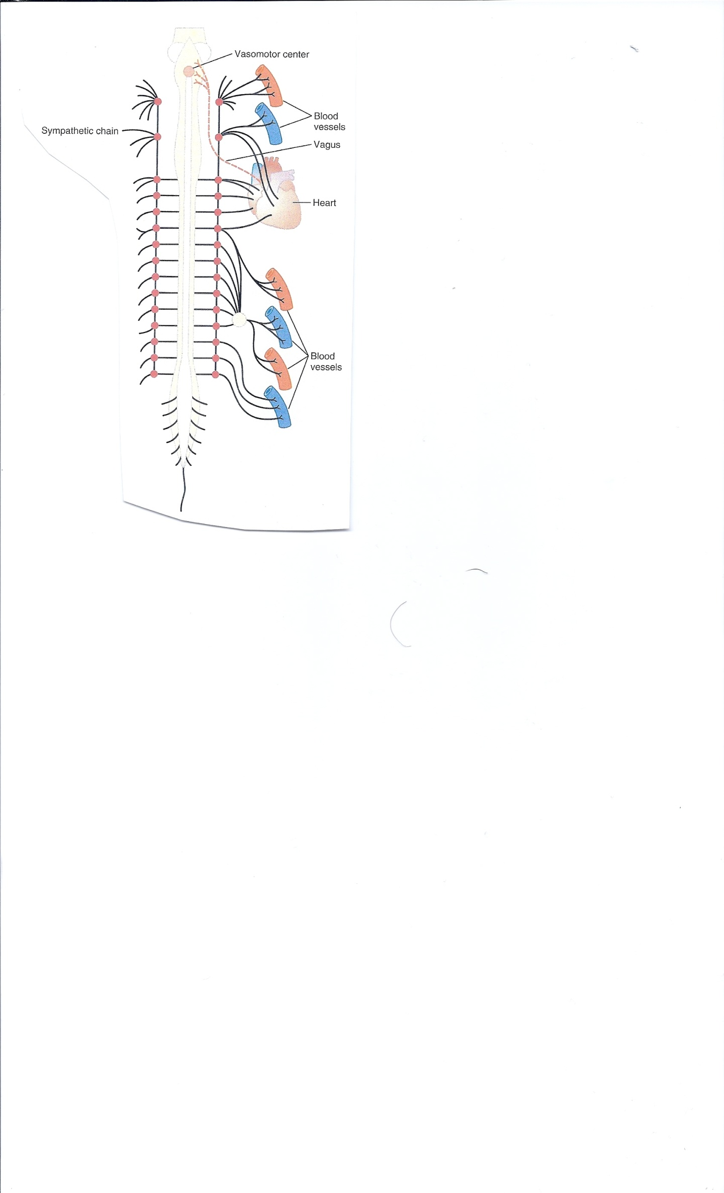
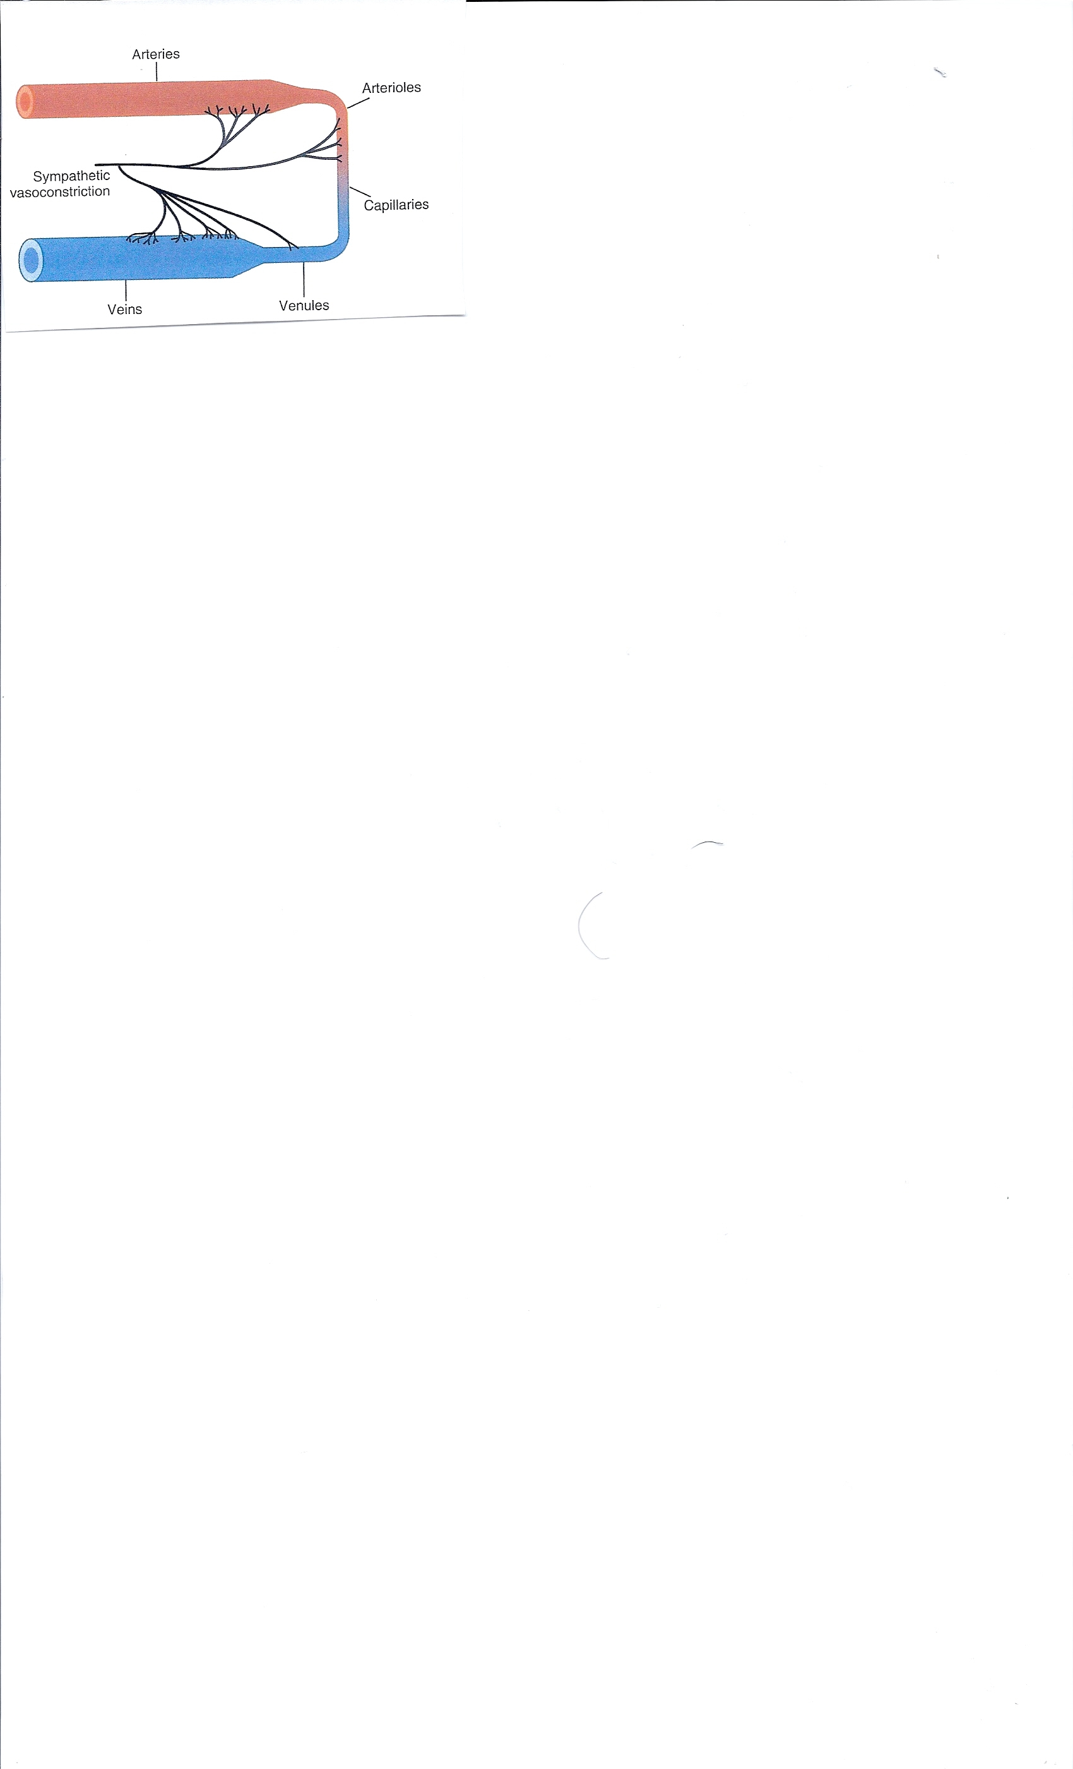

Slide 24
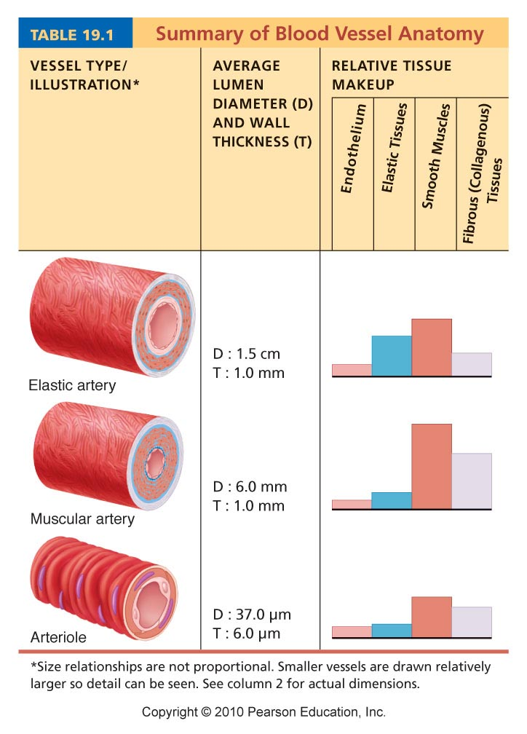
Table 19.1 (1 of 2)

Slide 25
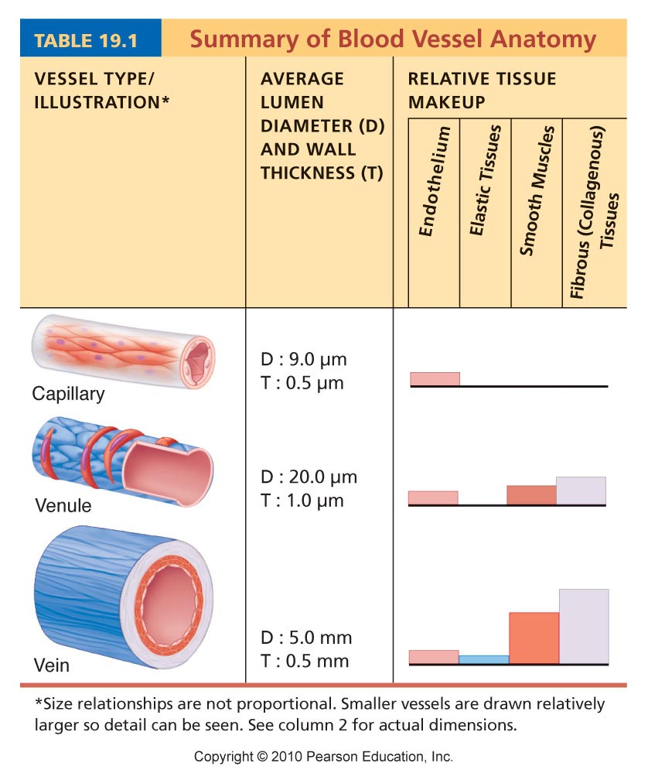
Table 19.1 (2 of 2)

Slide 26
Adrenergic Receptor Actions
Alpha Receptor
Beta Receptor
Vasoconstriction
Iris Dilation
Intestinal Relaxation
Intestinal Sphincter Contraction
Pilomotor contraction
Bladder Sphincter Contraction
Vasodilation (Beta 2)
Cardioacceleration (Beta 1)
+ Inotropic (Beta 1)
Intestinal Relaxation (Beta 2)
Uterus Relaxation (Beta 2)
Bronchodilation (Beta 2)
Calorigenesis ( Beta 2)
Glycogenolysis (Beta 2)
Lipolysis (Beta 1)
Bladder Wall Relaxation (Beta 2)

Slide 27
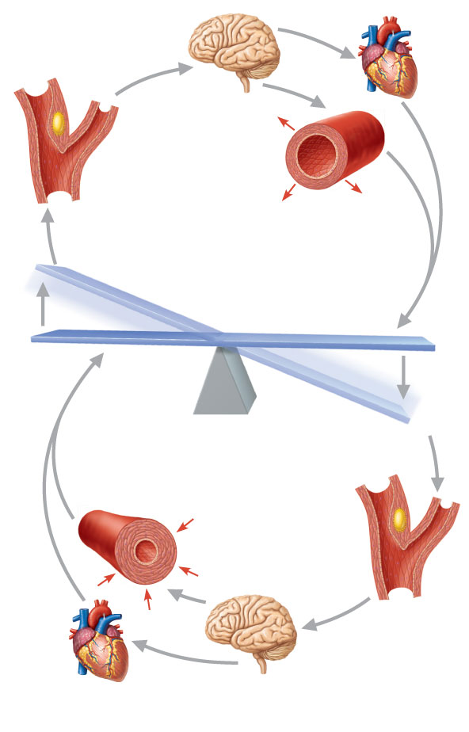
3
Impulses from baroreceptors
stimulate cardioinhibitory center
(and inhibit cardioacceleratory
center) and inhibit vasomotor
center.
4a
Sympathetic
impulses to heart
cause HR,
contractility, and
CO.
2
Baroreceptors
in carotid sinuses
and aortic arch
are stimulated.
4b
Rate of
vasomotor impulses
allows vasodilation,
causing R
5
1
CO and R
return blood
pressure to
homeostatic range.
Stimulus:
Blood pressure
(arterial blood
pressure rises above
normal range).
Homeostasis: Blood pressure in normal range
1
Stimulus:
Blood pressure
(arterial blood
pressure falls below
normal range).
5
CO and R
return blood pressure
to homeostatic range.
4b
Vasomotor
fibers stimulate
vasoconstriction,
causing R
2
Baroreceptors
in carotid sinuses
and aortic arch
are inhibited.
4a
Sympathetic
impulses to heart
cause HR,
contractility, and
CO.
3
Impulses from baroreceptors stimulate
cardioacceleratory center (and inhibit cardioinhibitory
center) and stimulate vasomotor center.
Figure 19.9

Slide 28
Short-Term Mechanisms: Baroreceptor-Initiated Reflexes
Increased blood pressure stimulates baroreceptors to increase input to the vasomotor center
  Inhibits the vasomotor center, causing arteriole dilation and venodilation
  Stimulates the cardioinhibitory center

Slide 29
Short-Term Mechanisms:
Chemoreceptor-Initiated Reflexes
Chemoreceptors are located in the
  Carotid sinus
  Aortic arch
  Large arteries of the neck
  Chemoreceptors measure the concentrations of O2, CO2 and H+ (Acid)
  Though they play a role they are far more important in respiratory control

Slide 30
Influence of Higher Brain Centers
Reflexes that regulate BP are integrated in the medulla
Higher brain centers (cortex and hypothalamus) can modify BP via relays to medullary centers

Slide 31
Short-Term Mechanisms: Hormonal Controls
Adrenal medulla hormones norepinephrine (NE) and epinephrine cause generalized vasoconstriction and increase cardiac output
Angiotensin II, generated by kidney release of renin, causes vasoconstriction

Slide 32
Indirect Mechanism
The renin-angiotensin mechanism
  ↓ Arterial blood pressure → release of renin
  Renin→ production of angiotensin II
  Angiotensin II is a potent vasoconstrictor
  Angiotensin II → aldosterone secretion
    Aldosterone → renal reabsorption of Na⁺ and ↓ urine formation
  Angiotensin II stimulates ADH release

Slide 33
Renin
Secretion
The peptide hormone is secreted by the kidney from specialized cells called granular cells of the juxtaglomerular apparatus in response to:
A decrease in arterial blood pressure (that could be related to a decrease in blood volume) as detected by baroreceptors (pressure sensitive cells). This is the most causal link between blood pressure and renin secretion (the other two methods operate via longer pathways).
A decrease in sodium chloride levels in the ultra-filtrate of the nephron. This flow is measured by the macula densa of the juxtaglomerular apparatus.
Sympathetic nervous system activity, that also controls blood pressure, acting through the β₁ adrenergic receptors.

Slide 34
Renin
Function
Renin activates the renin-angiotensin system by cleaving angiotensinogen, produced by the liver, to yield angiotensin I, which is further converted into angiotensin II by ACE, the angiotensin-converting enzyme primarily within the capillaries of the lungs. Angiotensin II then constricts blood vessels, increases the secretion of ADH and aldosterone, and stimulates the hypothalamus to activate the thirst reflex, each leading to an increase in blood pressure.

Slide 35
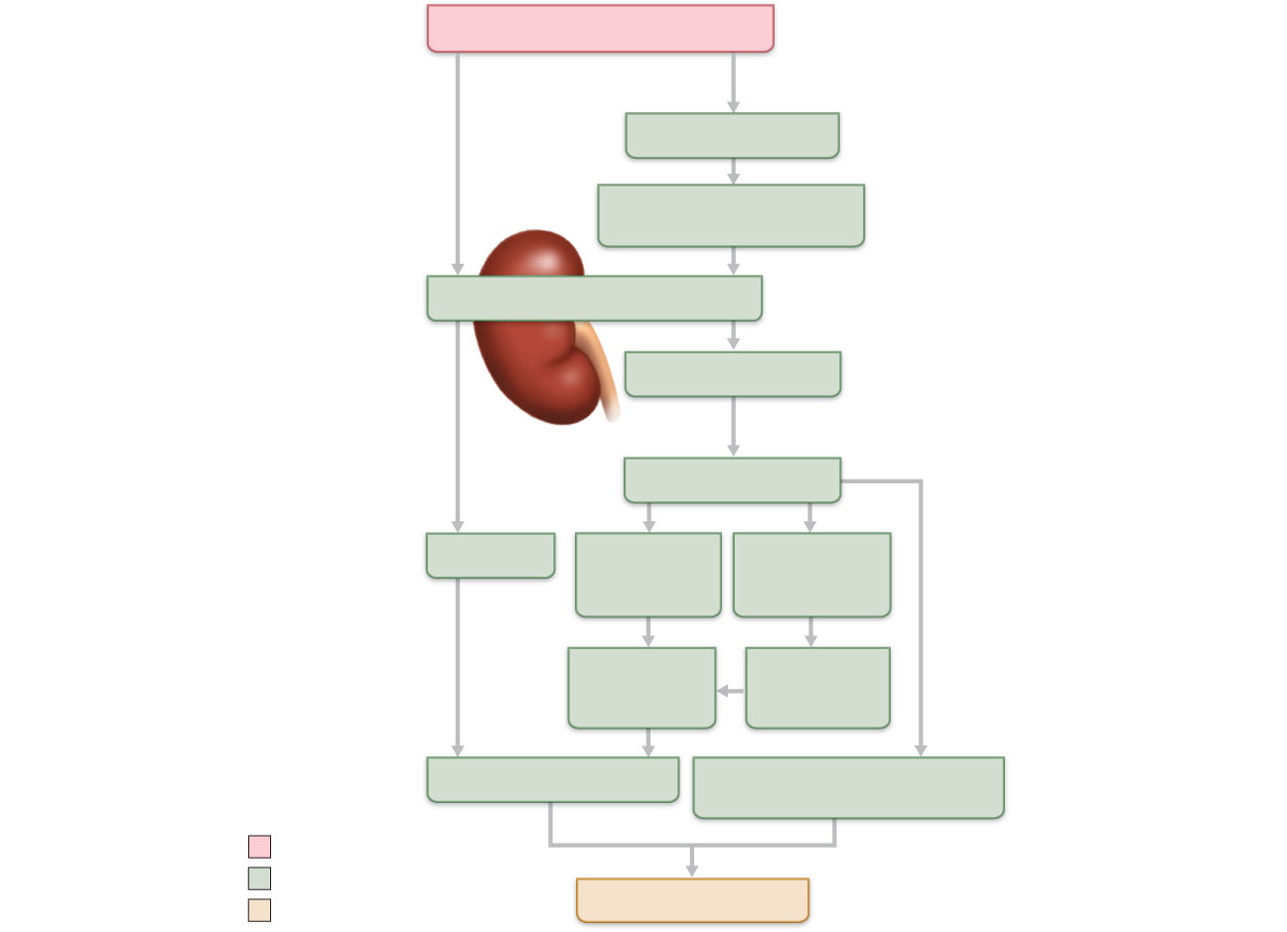
Arterial pressure
Direct renal
mechanism
Indirect renal
mechanism (hormonal)
Baroreceptors
Sympathetic stimulation
promotes renin release
Kidney
Renin release
catalyzes cascade,
resulting in formation of
Angiotensin II
Filtration
ADH release
by posterior
pituitary
Aldosterone
secretion by
adrenal cortex
Water
reabsorption
by kidneys
Sodium
reabsorption
by kidneys
Blood volume
Vasoconstriction
( diameter of blood vessels)
Initial stimulus
Physiological response
Arterial pressure
Result
Figure 19.10

Slide 36
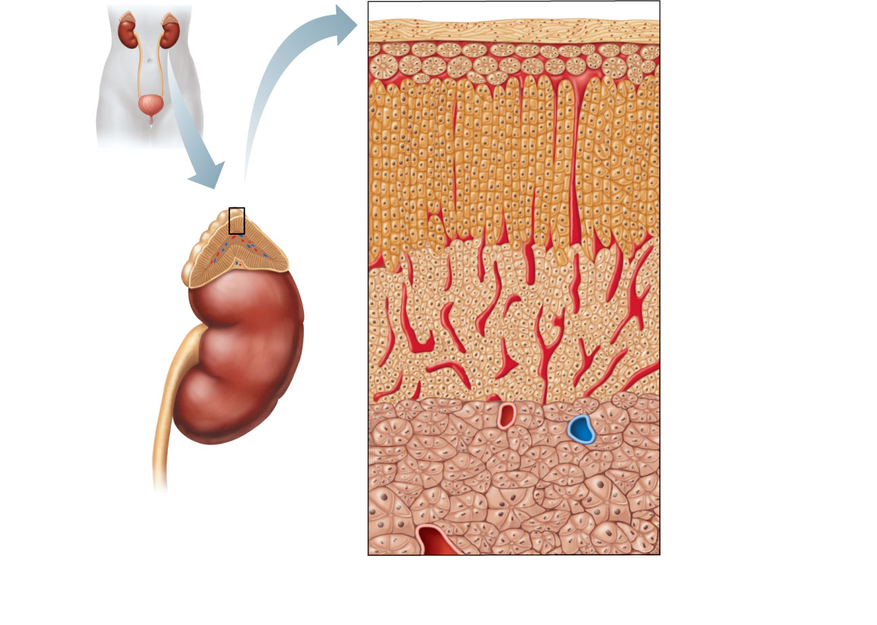
Capsule
Zona
glomerulosa
Zona
fasciculata
Adrenal gland
Cortex
• Medulla
• Cortex
Zona
reticularis
Kidney
Medulla
Adrenal
medulla
(a) Drawing of the histology of the
adrenal cortex and a portion of
the adrenal medulla
Figure 16.13a

Slide 37
Aldosterone
Regulate electrolytes (primarily Na⁺ and K⁺) in ECF
  Importance of Na⁺: affects ECF volume, blood volume, blood pressure, levels of other ions
  Importance of K⁺: sets RMP of cells
Aldosterone is the most potent mineralocorticoid
  Stimulates Na⁺ reabsorption and water retention by the kidneys

Slide 38
Mechanisms of Aldosterone Secretion
Renin-angiotensin mechanism: decreased blood pressure stimulates kidneys to release renin, triggers formation of angiotensin II, a potent stimulator of aldosterone release
Plasma concentration of K⁺: Increased K⁺ directly influences the zona glomerulosa cells to release aldosterone
ACTH: causes small increases of aldosterone during stress
Atrial natriuretic peptide (ANP): blocks renin and aldosterone secretion, to decrease blood pressure

Slide 39
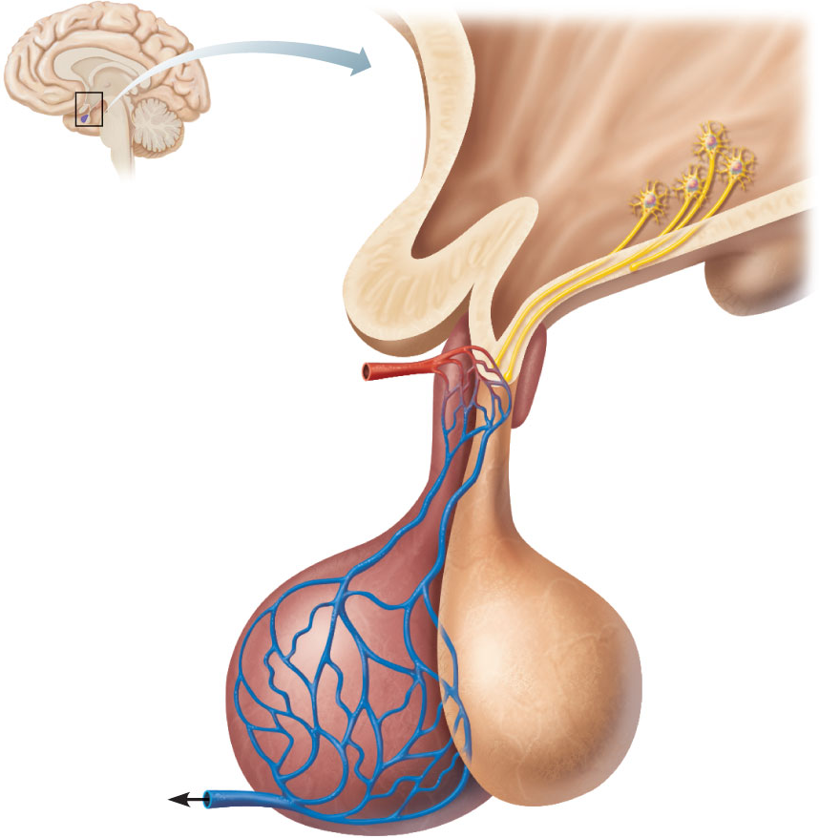
1
Hypothalamus
When appropriately
stimulated,
hypothalamic neurons
secrete releasing and
inhibiting hormones
into the primary
capillary plexus.
Hypothalamic neuron
cell bodies
Superior
hypophyseal artery
Hypophyseal
portal system
2
Hypothalamic hormones
travel through the portal
veins to the anterior pituitary
where they stimulate or
inhibit release of hormones
from the anterior pituitary.
• Primary capillary
plexus
• Hypophyseal
portal veins
• Secondary
capillary
plexus
Anterior lobe
of pituitary
3
Anterior pituitary
hormones are secreted
into the secondary
capillary plexus.
TSH, FSH,
LH, ACTH,
GH, PRL
(b) Relationship between the anterior pituitary and the hypothalamus
Figure 16.5b

Slide 40
Short-Term Mechanisms: Hormonal Controls
Atrial natriuretic peptide causes blood volume and blood pressure to decline, causes generalized vasodilation
Antidiuretic hormone (ADH)(vasopressin) causes intense vasoconstriction in cases of extremely low BP

Slide 41
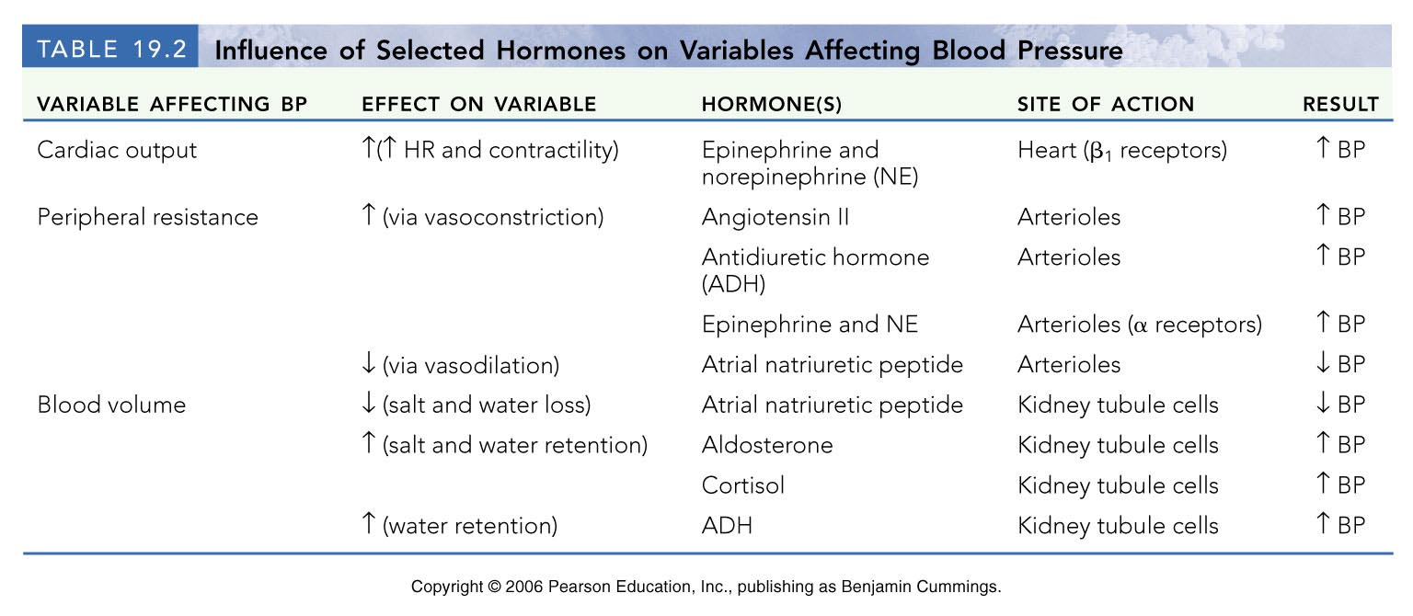
Table 19.2

Slide 42
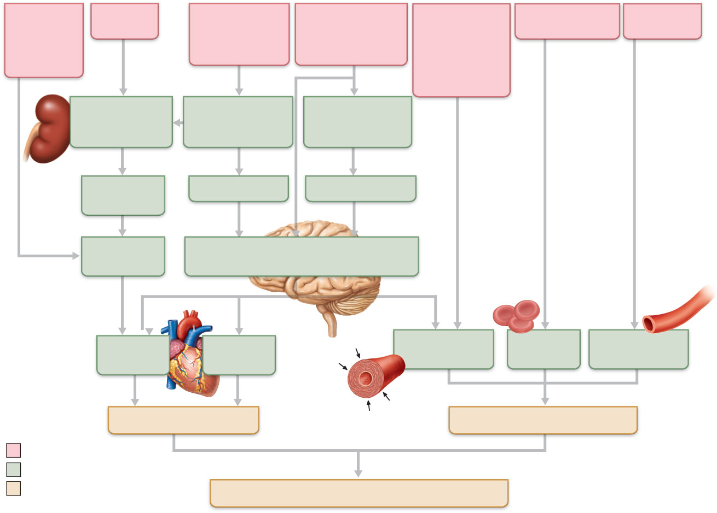
Activity of
muscular
pump and
respiratory
pump
Release
of ANP
Fluid loss from
hemorrhage,
excessive
sweating
Crisis stressors:
exercise, trauma,
body
temperature
Bloodborne
chemicals:
epinephrine,
NE, ADH,
angiotensin II;
ANP release
Dehydration,
high hematocrit
Body size
Conservation
of Na⁺ and
water by kidney
Blood volume
Blood pressure
Blood pH, O₂,
CO₂
Blood
volume
Baroreceptors
Chemoreceptors
Venous
return
Activation of vasomotor and cardiac
acceleration centers in brain stem
Stroke
volume
Heart
rate
Diameter of
blood vessels
Blood
viscosity
Blood vessel
length
Cardiac output
Peripheral resistance
Initial stimulus
Physiological response
Result
Mean systemic arterial blood pressure
Figure 19.11

Slide 43
Local Control
Autoregulation
Mechanisms of autoregulation
  Metabolic
  Myogenic
  Paracrine/Autocrine

Slide 44
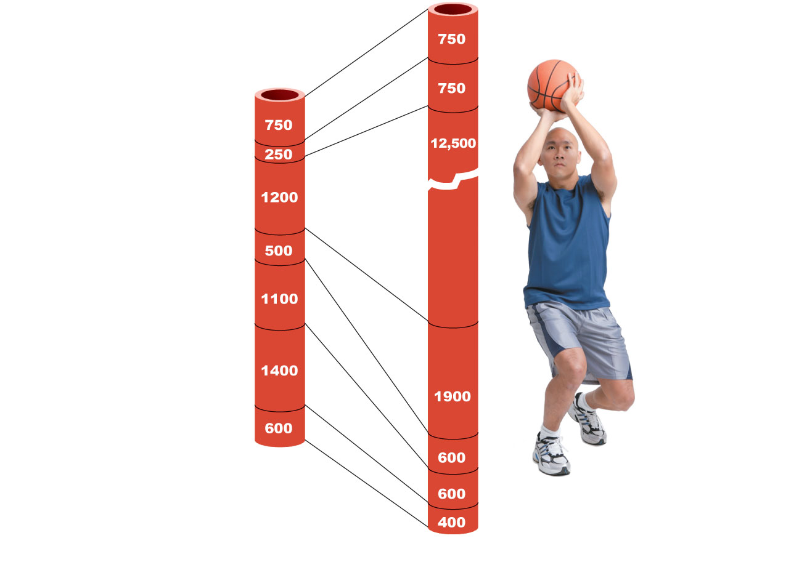
Brain
Heart
Skeletal
muscles
Skin
Kidney
Abdomen
Other
Total blood
flow at rest
5800 ml/min
Total blood flow during strenuous
exercise 17,500 ml/min
Figure 19.13

Slide 45
Autoregulation
Automatic adjustment of blood flow to each tissue in proportion to its requirements at any given point in time
Is controlled intrinsically by modifying the diameter of local arterioles feeding the capillaries
Is independent of MAP, which is controlled as needed to maintain constant pressure

Slide 46
Blood Flow Through Body Tissues
Blood flow (tissue perfusion) is involved in
  Delivery of O₂ and nutrients to, and removal of wastes from, tissue cells
  Gas exchange (lungs)
  Absorption of nutrients (digestive tract)
  Urine formation (kidneys)
Rate of flow is precisely the right amount to provide for proper function

Slide 47
Active versus Reactive Hyperemia
Functional hyperemia, or active hyperemia, is the increased blood flow that occurs when tissue is active.
When cells within the body are active in one way or another, they use more oxygen and fuel, such as glucose or fatty acids, than when they are not. The blood vessels compensate for this metabolism by dilatation, allowing more blood to reach the tissue. This prevents deprivation of the tissue.
Since most of the common nutrients in the body are converted to carbon dioxide when they are metabolized, smooth muscle around blood vessels relax in response to increased concentrations of carbon dioxide within the blood and surrounding interstitial fluid. The relaxation of this smooth muscle results in vascular dilation and increased blood flow.
Reactive hyperemia is the transient increase in organ blood flow that occurs following a brief period of ischemia . Following Ischemia there will be a shortage of oxygen and a build-up of metabolic waste.

Slide 48
Myogenic Controls
Myogenic responses of vascular smooth muscle keep tissue perfusion constant despite most fluctuations in systemic pressure
Passive stretch (increased intravascular pressure) promotes increased tone and vasoconstriction
Reduced stretch promotes vasodilation and increases blood flow to the tissue

Slide 49
Autocrine/Paracrine
Vasodilation – Endothelial Derived Relaxing Factor (Nitric Oxide), Prostaglandins, Kinins Histamine
Vasoconstriction - Endothelin

Slide 50
Metabolites
H+, CO2, Adenosine, K+

Slide 51
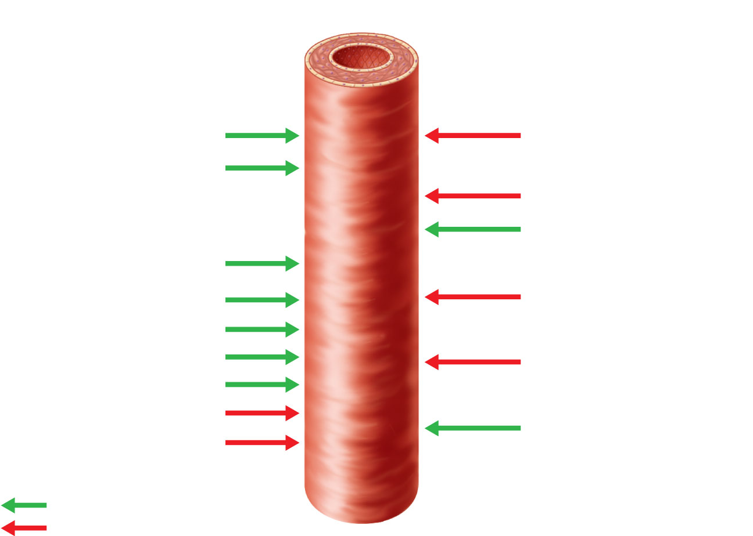
Intrinsic mechanisms
(autoregulation)
Extrinsic mechanisms
• Maintain mean arterial pressure (MAP)
• Redistribute blood during exercise and
thermoregulation
• Distribute blood flow to individual
organs and tissues as needed
Amounts of:
pH
Sympathetic
Nerves
O₂
α Receptors
Metabolic
controls
β Receptors
Epinephrine,
norepinephrine
Amounts of:
CO₂
K⁺
Angiotensin II
Hormones
Prostaglandins
Adenosine
Antidiuretic
hormone (ADH)
Nitric oxide
Endothelins
Atrial
natriuretic
peptide (ANP)
Myogenic
controls
Stretch
Dilates
Constricts
Figure 19.15

Slide 52
Long-Term Autoregulation
Angiogenesis
  Occurs when short-term autoregulation cannot meet tissue nutrient requirements
  The number of vessels to a region increases and existing vessels enlarge
  Common in the heart when a coronary vessel is occluded, or throughout the body in people in high-altitude areas

Slide 53
Blood Flow: Skeletal Muscles
At rest, myogenic and general neural mechanisms predominate
During muscle activity
  Blood flow increases in direct proportion to the metabolic activity (active or exercise hyperemia)
  Local controls override sympathetic vasoconstriction
Muscle blood flow can increase 10× or more during physical activity

Slide 54
Blood Flow: Brain
Blood flow to the brain is constant, as neurons are intolerant of ischemia
Metabolic controls
  Declines in pH, and increased carbon dioxide cause marked vasodilation
Myogenic controls
  Decreases in MAP cause cerebral vessels to dilate
  Increases in MAP cause cerebral vessels to constrict

Slide 55
Blood Flow: Brain
The brain is vulnerable under extreme systemic pressure changes
  MAP below 60 mm Hg can cause syncope (fainting)
  MAP above 160 can result in cerebral edema

Slide 56
Blood Flow: Skin
Blood flow through the skin
  Supplies nutrients to cells (autoregulation in response to O₂ need)
  Helps maintain body temperature (neurally controlled)
  Provides a blood reservoir (neurally controlled)

Slide 57
Blood Flow: Skin
Blood flow to venous plexuses below the skin surface
  Varies from 50 ml/min to 2500 ml/min, depending on body temperature
  Is controlled by sympathetic nervous system reflexes initiated by temperature receptors and the central nervous system

Slide 58
Temperature Regulation
As temperature rises (e.g., heat exposure, fever, vigorous exercise)
  Hypothalamic signals reduce vasomotor stimulation of the skin vessels
  Heat radiates from the skin

Slide 59
Temperature Regulation
Sweat also causes vasodilation via bradykinin in perspiration
  Bradykinin stimulates the release of NO
As temperature decreases, blood is shunted to deeper, more vital organs

Slide 60
Blood Flow: Lungs
Pulmonary circuit is unusual in that
  The pathway is short
  Arteries/arterioles are more like veins/venules (thin walled, with large lumens)
  Arterial resistance and pressure are low (24/8 mm Hg)

Slide 61
Blood Flow: Lungs
Autoregulatory mechanism is opposite of that in most tissues
  Low O₂ levels cause vasoconstriction; high levels promote vasodilation
  Allows for proper O₂ loading in the lungs

Slide 62
Blood Flow: Heart
During ventricular systole
  Coronary vessels are compressed
  Myocardial blood flow ceases
  Stored myoglobin supplies sufficient oxygen
At rest, control is probably myogenic

Slide 63
Blood Flow: Heart
During strenuous exercise
  Coronary vessels dilate in response to local accumulation of vasodilators
  Blood flow may increase three to four times

