Slide 1
Blood Vessel Formulas

Slide 2
Mathematical Analysis of the Circulatory System
Discussion of Pressure
Discussion of Pressure in a pipe without an external compression device (pressure in the blood vessels without the heart) known as “Mean Circulatory Filling Pressure”. Discuss unstressed and stressed blood volume
Discuss pressure in blood vessels with heart compression
Discuss Flow – velocity of flow versus rate of flow
Discuss Resistance –
resistance in pipes arranged in series versus those arranged in parallel
Total Peripheral Resistance
Examine Diffusion Formula
Examine Capacitance (Compliance) Formula
Examine the Mean Arterial Pressure Formulas
Wall Tension

Slide 3
Pressure
Pulling or pushing force
Volume of gas or liquid
Density of gas or liquid
Pressure = Volume/1 X particles/volume X force/particle
Pressure = force
Mercury is 13.6 times more dense than water, so the same volume of mercury can exert far more pressure than water.

Slide 4
Mean Circulatory Filling Pressure
The pressure in your blood vessels without a heart.
The pressure depends on (1) volume of blood in your blood vessels and (2) the amount of vasodilation or constriction.
The average value is 7 mmHg
The volume and/or vasoconstriction – the pressure goes up and vice versa.

Slide 5
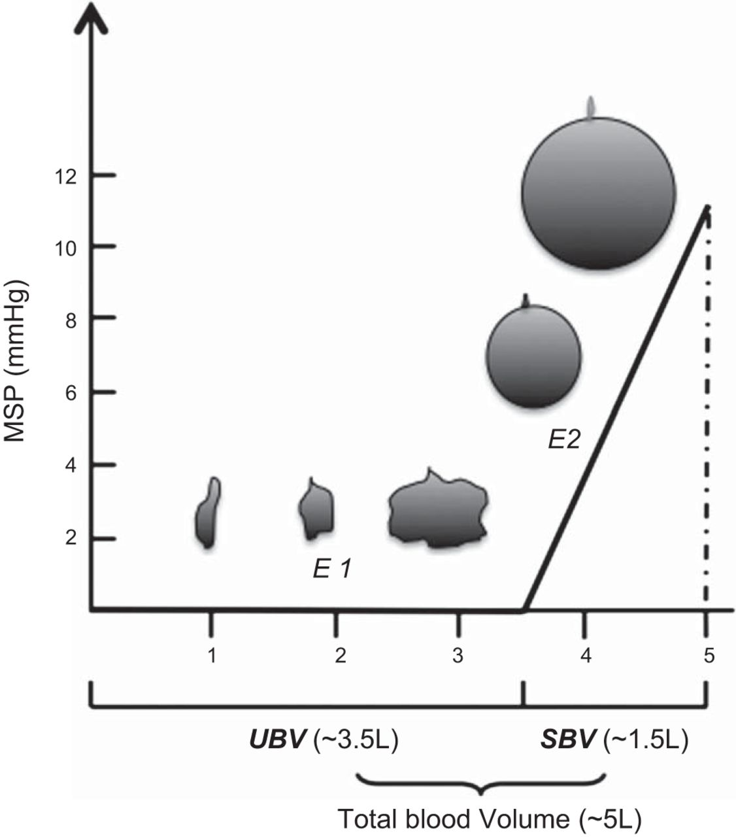
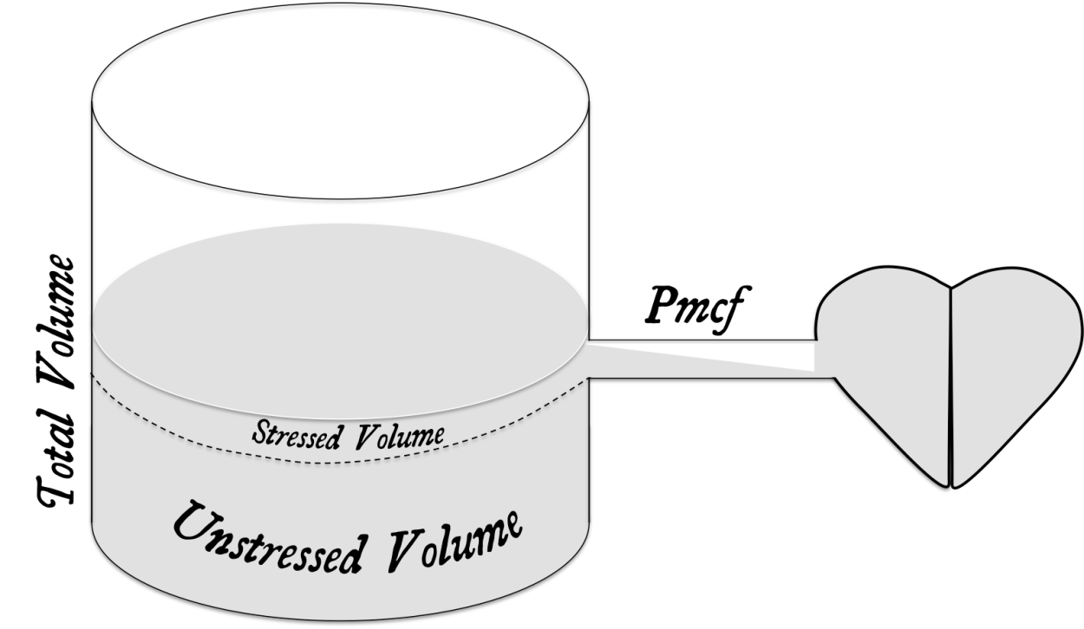
Stressed and Unstressed Blood Volume
Unstressed Blood Volume is the volume in the blood vessels before there is enough to
stretch out the blood vessels walls. When there begins to be enough in the blood vessels
to stretch out the blood vessels walls, that amount of blood that does that is the stressed blood volume.

Slide 6
Adding the Heart
Pressure Total = Compression Pressure of the Heart + MCFP
In order to stand up, you need a 60mmHg pressure, if the MCFP is even 12 mmHg, you still need a working heart.
Assume this container to be The blood vessels.
The pressure in this
Container is the
“Mean Circulatory
Filling Pressure.”
It has an average
Pressure of 7mmHg,
But can raise or lower
Based on how much fluid you put in or how much to enlarge the tank diameter or decrease it; that would symbolize vasodilation and vasoconstriction.
When you add the pressure
Of the heart it would be the
Mean circulatory filling pressure
Plus the heart compression
Pressure.

Slide 7
Formulas of importance
Flow = ∆P/ R, ∆P is the change in pressure from one area to another (P1 – P2) – in the direction of flow, R is the resistance (Note: pressure drops off as a fluid or gas passes further down the pipe – thus the pressure in proximal area 1 (P1) is higher than the pressure is distal area 2. The more pressure drop off the more the flow. Also, the less the resistance the better the flow.
Rate of Flow = amount of gas or liquid/time (example ml/min)
Velocity of flow = amount of gas or liquid/time/cross sectional area (another way of looking at it is Vf = rate of flow/cross sectional area)
example of velocity of flow ml. /min per cm²
Note: Area of a circle (like the inside of a vessel ) = equals pi (π) times the radius squared (π⋅r²), example ml. /min per cm²
^{Flow formula derived Ohm’s Law}

Slide 8
Rate of Flow versus Velocity of Flow
The rate of flow is how much per some unit time, for example ml./minute.
The velocity of flow is how much per some unit time per cross sectional area.

Slide 9
Let’s think of it this way
Let’s compare a solid object to continuous substances like gases and liquids. A solid object has a discrete structure like a car; it has a definite beginning and end. Gases and liquids have a more fuzzy begin and end.
A car traveling 25 miles/hour. It says how much distance (area), the time and how many – one car.
A liquid flows at 25 ml./minute. It says how much (25 ml.), time, but no area. This is the rate of flow.
If I said the liquid flows at 25 ml./minute/meter squared, that would be the velocity of flow.
So gases and liquids have two measurements of flow: rate of flow and velocity of flow.

Slide 10
Formulas of Importance
Resistance –a force of impedance (holding back) R = 8ηL/πR⁴ , η is viscosity of the gas or liquid, L is the length of the vessel, and R is the radius raised to the 4th power
Summation (∑) of Resistances – adding up the resistors in flow arrangement a series arrange
Resistors in series – one resistor in front of another ∑ = R1 + R2 + R3 + ……
Resistors in parallel – a pipe leads into a branching set of pipes ∑ = 1/R1 + 1/R2 + 1/R3 +..
Note: resistors in parallel give less total resistance than those in series (think of the capillary arrangement)

Slide 11
Resistance
Resistance –a force of impedance (holding back) R = 8ηL/πR⁴ ,
η is viscosity of the gas or liquid
L is the length of the vessel
R is the radius raised to the 4th power
π – a constant

Slide 12
Adding up Resistances
Summation (∑) of resistances depends on are the resistors in series or parallel.
Resistors in series – one resistor in front of another ∑ = R1 + R2 + R3 + ……
Resistors in parallel – a pipe leads into a branching set of pipes ∑ = 1/R1 + 1/R2 + 1/R3 +..
Note: resistors in parallel give less total resistance than those in series (think of the capillary arrangement)

Slide 13
Total Peripheral Resistance (Systemic Vascular Resistance)
The TPR (SVR) is the summation (∑ ) of all the resistors in the systemic (Left Ventricle – to Right Atrium) circulation. Some of the blood vessel resistors are in series (R1 + R2 + R3 + ……) and some are in parallel (1/R1 + 1/R2 + 1/R3 )– thus the two different formulas must be used.
Since R is raised to 4th power it numerically is the most significant contributor to Total Peripheral Resistance – thus vasoconstriction and vasodilation are the most important contributors to TPR.
Alternate calculations are Total Pulmonary Resistance which is resistance in the pulmonary circulation – as well as other organ and circulatory resistances can be calculated

Slide 14
Formulas of Importance
Diffusion – net movement of certain particles from a region of high concentration of those certain particles to region of low concentration of those certain particles
D = A x Dc /t (Co – Ci)
A is the area of the membrane being diffused through, Dc is the diffusion coefficient, t- is the thickness of the membrane being diffused through, Co – Ci is the concentration difference between the o (outside) and I (inside) of the container
The diffusion coefficient = solubility coefficient divided by the square root of the molecular weight of the substance diffusing (this applies more to gases)
Analysis- the greater the area and/or diffusion coefficient – the faster the rate of diffusion. The more the concentration difference the faster the rate of diffusion. However, the thicker the membrane to diffuse through the slower the rate of diffusion.

Slide 15
Formulas of Importance
Capacitance (Compliance) C – is the ease at which a container can stretch to accommodate increased volumes of gases or liquids.
C = ∆V/∆P,
∆P is change in pressure, and ∆V is change in volume
The more volume change without a change in pressure (due to compression of atoms and molecules in a minimally stretchable container) the greater the capacitance (compliance)
Thus a balloon would have greater capacitance (compliance) that a leather container.

Slide 16
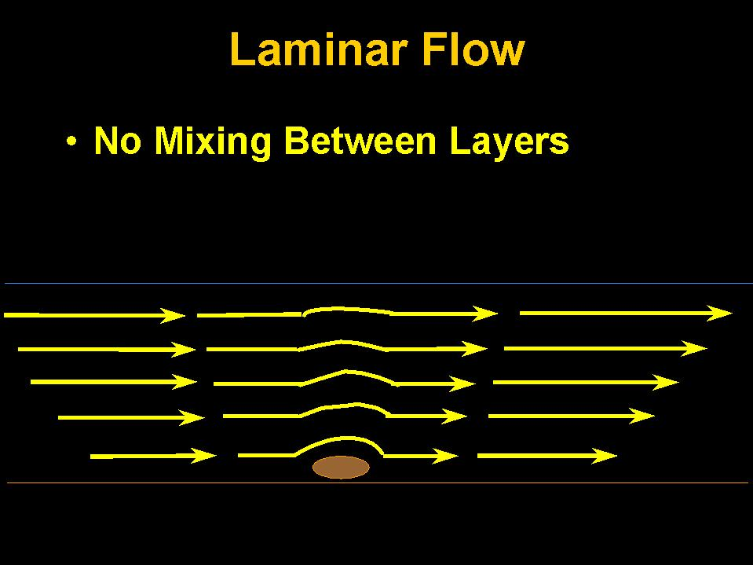
Laminar Flow Versus Turbulent Flow
Laminar flow, sometimes known as streamline flow, occurs when a fluid flows in parallel layers, with no disruption between the layers. It is the opposite of turbulent flow. In nonscientific terms laminar flow is "smooth," while turbulent flow is "rough."

Slide 17
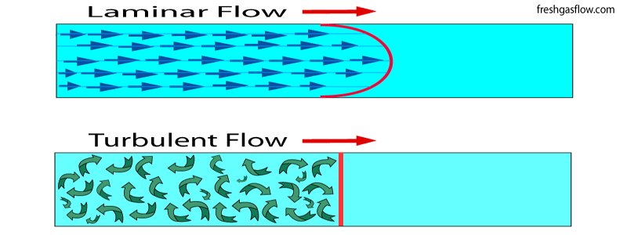
Laminar Flow is a quiet smooth flow through blood vessels – whereas turbulent flow makes a noise as it flows – the more turbulent the flow the louder the noise.
Turbulent flow produces murmur like sounds in the heart.
A Bruit is the unusual sound that blood makes when it rushes past an obstruction (called turbulent flow) in an artery when the sound is auscultated with the bell portion of a stethoscope. A related term is "vascular murmur", which should not be confused with a heart murmur.

Slide 18
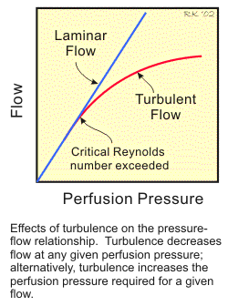
Determining if flow is Laminar versus Turbulent
The Reynolds number is used to determine whether a flow will be laminar or turbulent. Reynolds number (Re) is the ratio of inertial forces to viscous forces and is given by the formula:
Re = ρVD/μ
where ρ = density of the fluid, V = velocity, D = pipe diameter, and μ = fluid viscosity.
If Re is high (>2100), inertial forces dominate viscous forces and the flow is turbulent; if Re number is low (<1100), viscous forces dominate and the flow is laminar.

Slide 19
Mean Arterial Pressure
It is defined as the average arterial pressure during a single cardiac cycle.
MAP (SYSTEMIC) = CO X TPR (SVR)
MAP (SYSTEMIC) is the average pressure in the systemic circulation (Left Ventricle to Right Atrium). Thus MAP (pulmonic) can be calculated also as well as other circulations.
CO is the cardiac output = heart rate x stroke volume (stroke volume is End Diastolic Volume – End Systolic Volume)
TPR (SVR) is the total resistance in the systemic circulation

Slide 20
MAP (SYSTEMIC) = CO X TPR (SVR)
This formula is an excellent one to use to understand pressures in the blood vessels. It can explain hypertensive pressures, normotensive pressures and hypotensive pressures. However, it cannot be actually calculated in that the TPR cannot be calculated. TPR in involves calculating the radius of the blood vessels at each millimeter along the circulation – the human body has approximately 60,000 miles of blood vessels – thus this is impossible to calculate.
The algebraic formula used to calculate MAP is
MAP = DBP + 1/3 (SBP – DBP)
DBP is the Diastolic Blood Pressure, and SBP is the Systolic Blood Pressure
SBP – DBP is the Pulse Pressure

Slide 21
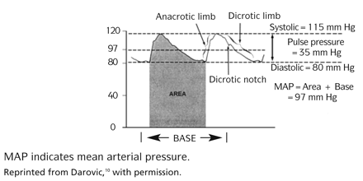
MAP = DBP + 1/3 (SBP – DBP)
Systolic Blood Pressure – occurs during Ejection Contraction Time
The Diastolic Blood Pressure has more weight (significance) in this formula – because during one cardiac cycle there is more time spent in diastole in the blood vessels than is systole. The actual way MAP is calculated by the computer (arterial line) is using differential Calculus. Differential calculus exactly calculates the area under a curve.

Slide 22
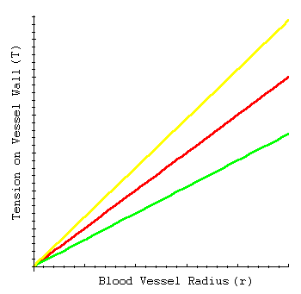
Blood Vessel Wall Tension
Tension = Pressure inside vessel x r/ 2
r is radius of the vessel
Interpretation: For a given blood pressure, increasing the radius of the blood vessel leads to a linear increase in tension. This implies that large arteries must have thicker walls than small arteries in order to withstand the level of tension.

