Slide 1

GALLANT BUSINESS SOLUTIONS
Expert Consultants | Smart A.I Solutions
Innovative solutions, exceptional talent - transforming businesses

Slide 2





WHO WE ARE
DC Metro Headquarters
Innovative consulting and staffing firm
20+ Years Experience
Management consulting and agile project expertise
Client-Focused Collaboration
Delivering superior solutions through partnerships
Innovative Approach
Result-based solutions for sustainable success

Slide 3





OUR SERVICES
AI Powered Staffing
Process Automation
Workforce Development
Innovative recruitment for all professional levels
Low-code solutions improving automation and business efficiency
AI and low-code upskilling programs
Agile Project Management
Intelligent tools for project execution

Slide 4





STAFFING EXPERTISE
Senior Management
Professional Services
Technologists & PM Pros
Top-level executives driving success
Finance, legal, consulting experts
Technical specialists and project leaders
Medical & Support Staff
Logistics & General Labor
Healthcare and administrative personnel
Warehouse and entry-level workers

Slide 5
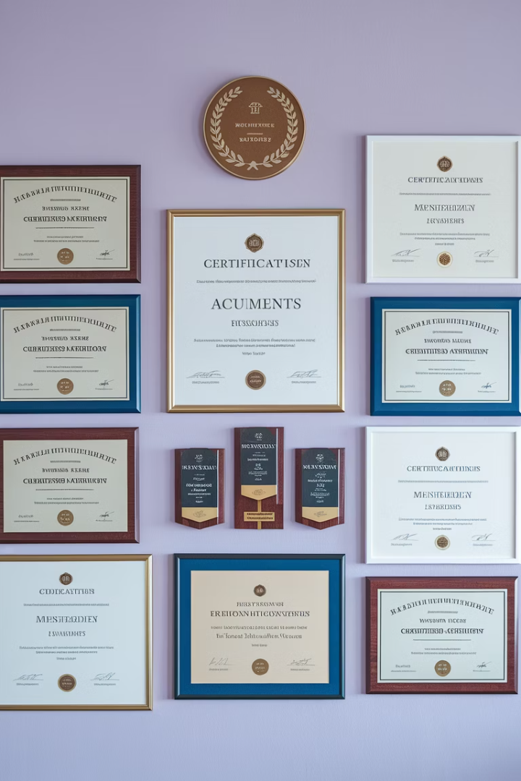




CERTIFICATIONS
MDOT MBE/DBE/SBE
Certified with Maryland Department of Transportation
Small Business Reserve
Eligible for set-aside contracts with Maryland
Prince George's County MBE
Recognized for diversity and inclusion
Excellence Commitment
Quality service delivery and expertise

Slide 6
LEADERSHIP & VALUE
Leadership Excellence
Client Value Proposition
26 years combined experience
Evolve your business operations with A.I
Expertise in consulting and staffing
Drive operational efficiency
Technology and project management focus
Enhance workforce capabilities
Delivering measurable outcomes
Proactive problem-solving approach
Aligned with mission-critical goals

Slide 7


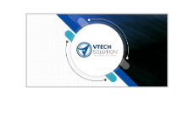


VALUED CUSTOMERS
Trusted by leading organizations across multiple industries
Building lasting partnerships through exceptional service delivery

Slide 8

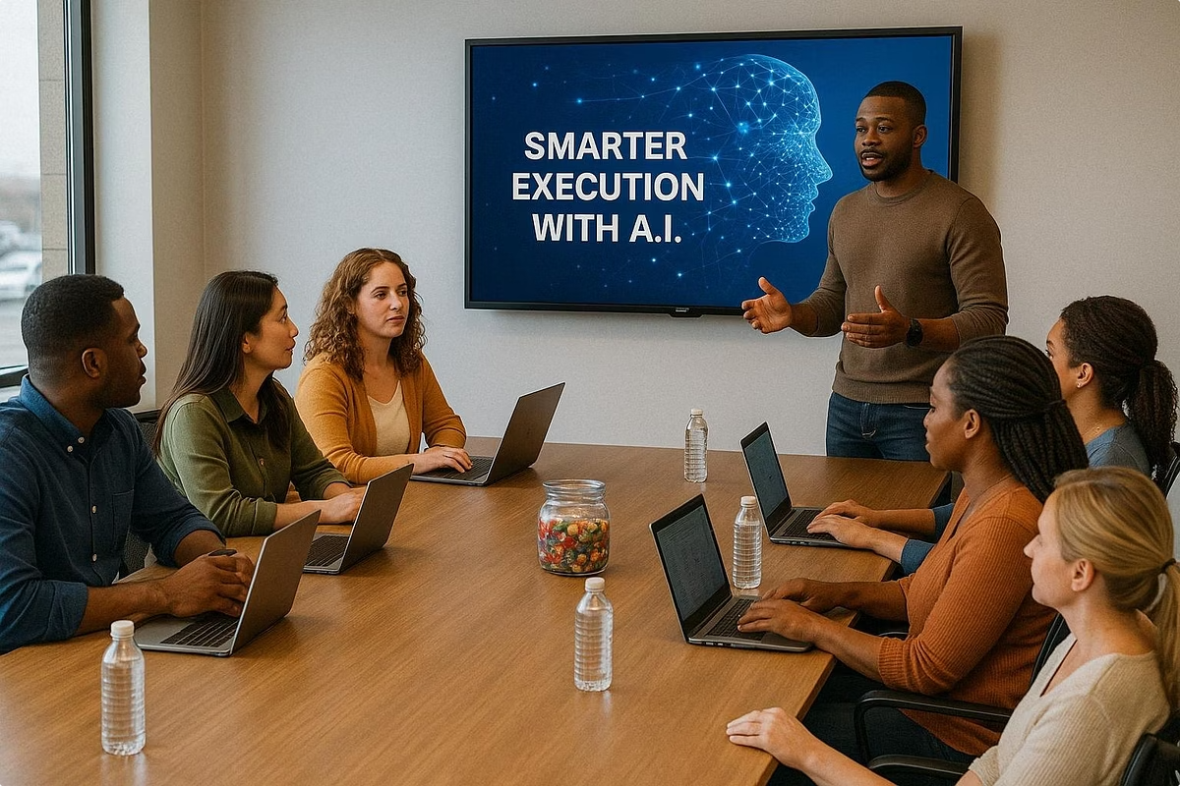

WHY CHOOSE GALLANT
Proven Results
Track record of high-quality impact
Client-First Approach
Your objectives drive our solutions
Innovation Focus
Creative solutions to complex challenges
Contact Us
Info@GallantbusinessSolutions.com

