Slide 1
PPT on Line, Surface and Volume Integral
(For BSc.-I)
CHAPTER 5 & 6
Amarpreet Kaur

Slide 2
Vector integrals
Line integrals
Surface integrals
Volume integrals
Integral theorems
The gauss divergence theorem
Green’s theorem in the plane
Stoke’s theorem

Slide 3
VECTOR INTEGRALS

Slide 4
Line integral
Also called path integral, curve integral is an integral where the function is integrated along a curve r(t) instead of along a straight line.
The function to be integrated can be either a scalar of a vector field
If we want to integrate a scalar field f along a curve r(t), the line integral is simply

Slide 5
Line integral of vector fields: Simple integration of a vector

Slide 6
Line integral of a vector field
Line integral of a vector field

Slide 7
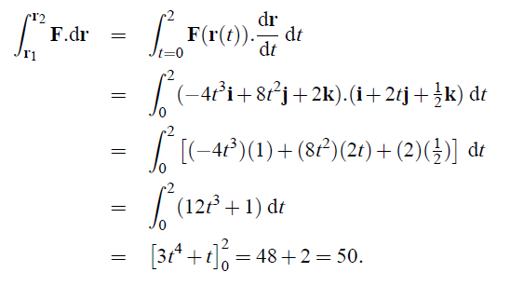
The curve r(t)

Slide 9
Interpretation of line integrals of vector fields: work / flow
In general the work is said to be ‘path dependent’ because the result of the integral depends on the shape of r.

Slide 10
Surface integrals
The surface integral is a definite integral taken over a surface.
It can be thought of as the double integral analog of the line integral.
Given a surface, one may integrate over its scalar fields, and vector fields
are surface integrals of scalar
fields over plane surfaces
Therefore, we need to generalize this concept:
For curved surfaces
For vector fields

Slide 11
Curved surfaces: area elements

Slide 12
Surface integrals of vector fields
( These can be thought as integration of scalar field $f$ over a surface: $\int{f|dS|}$ )

Slide 13
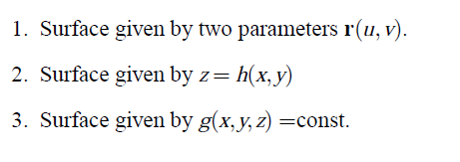
Surface integrals of vector fields: a general approach
Recall that in general, a surface can be described in three ways
We will therefore develop three different ways of calculating the surface integral, depending on the specific description of the surface
(parametric form)
(explicit form)
(implicit form)

Slide 14
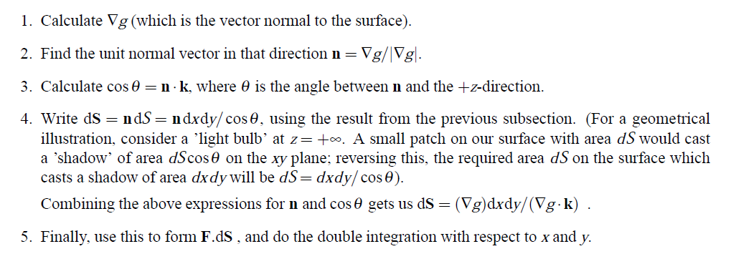
Surface integrals of vector fields Surface described in implicit form

Slide 15
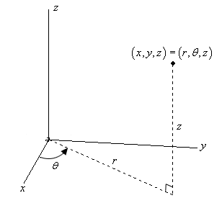
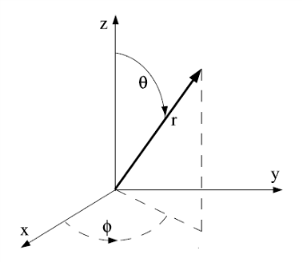
Volume integrals
In this section we will only consider integrals of scalar or vector fields over volumes defined in $ℝ^{3}$ , either in cartesian or in generic curvilinear coordinates.
Where we recall that the volument element for canonical curvilinear coordinates
CYLINDRICAL $dV=rdrdθdz$
SPHERICAL $dV= r^{2}sinθ drdθdφ$

Slide 16
INTEGRAL THEOREMS

Slide 17
In the preceding sections we have studied how to calculate the integrals of vector fields over curves (line integrals), surfaces, and volumes.
It turns out that there exist relations between these kind of integrals in some circumstances.
These relations are generically gathered under the label integral theorems.

Slide 18
The divergence theorem
Statement
This theorem relates the surface integral of a vector field with the volume integral of a scalar field constructed as the divergence of the vector field:
The surface S over which the integration is performed is indeed the boundary of the volume V
Intuitively, it states that the sum of all sources minus the sum of all sinks gives the net flow out of a region.

Slide 19
The divergence theorem
Statement
This theorem also requires some mathematical conditions: - the volume V must be compact and its boundary surface must be piecewise smooth - the vector field F must be continuously differentiable on the neighborhood of V

Slide 21
The divergence theorem
Statement
This theorem is stated in $ℝ^{3}$. It has other versions in lower dimensions:
$ℝ$ : the 1-dimensional version reduces to the fundamental theorem of calculus, that links the concepts of derivative and integral of a scalar field
$ℝ^{2}$: the 2-dimensional version is called the Green’s theorem, that links the line integral of a vector field over a curve with the surface integral over a plane region. Let’s see this theorem in more detail.

Slide 22
Green’s theorem
Green's theorem is also special case of the Stokes theorem that we will explain in the next section, when applied to a region in the xy-plane

Slide 24
Stoke’s theorem
This theorem relates the line integral of a vector field with the surface integral of another vector field, constructed as the curl of the former:

Slide 26
Some important applications of divergence, Green and Stoke’s theorems
Electromagnetism: Maxwell laws

